Slide 1
Local Coupling Knobs and Reverse Polarity Optics
Félix Soubelet
2025-02-26 OMC Meeting

Slide 2
Some Reminders
Local Coupling and RP Optics

Slide 3
Reminder – Local Coupling Correctors
IR local coupling is handled with the MQSX skew quadrupole correctors.
Expected coupling sources:
  Mostly the triplets (via tilts)
  Potentially other magnets in the IR
Powering acted via:
  Individual trims (RQSX circuits)
  Colinearity knob for a local bump

Slide 4
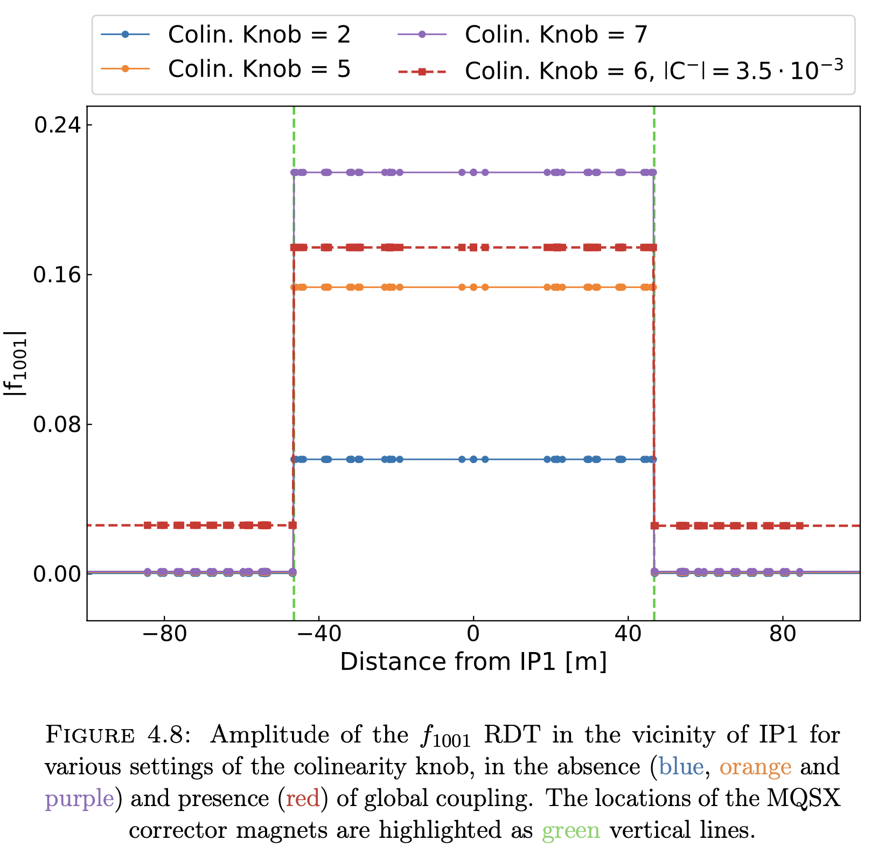
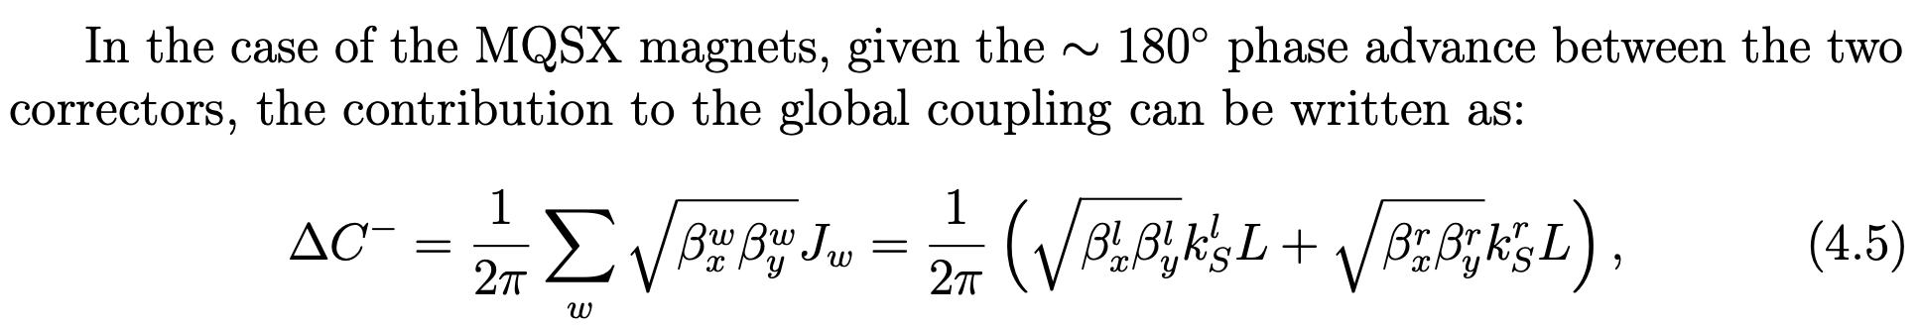
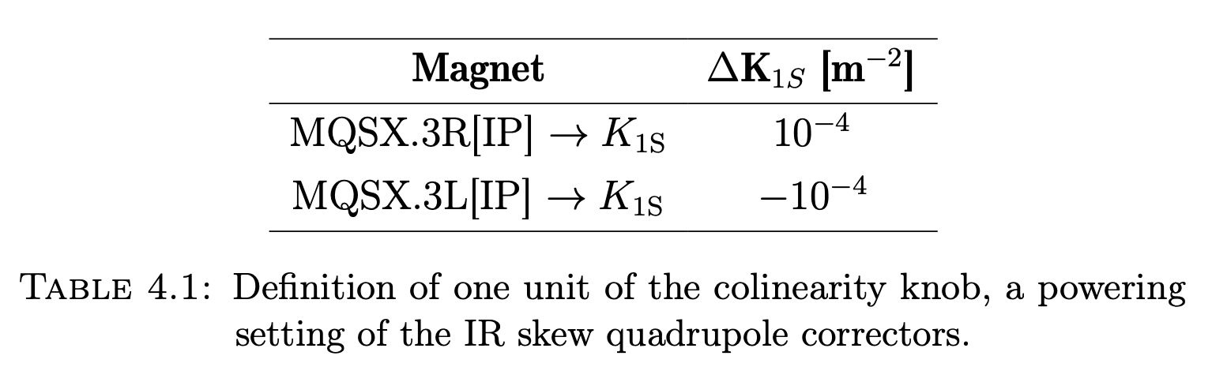
Reminder – Local Coupling Correctors
IR local coupling is handled with the MQSX skew quadrupole correctors
Corrections determined with:
  Segment-by-Segment (via f1001)
  The RWS (round beams only)
Powering acted via:
  Individual trims (RQSX circuits)
  Colinearity knob for a local bump

Slide 5
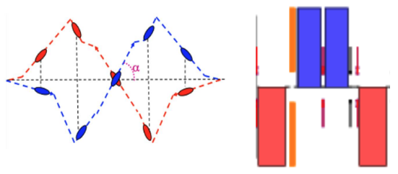
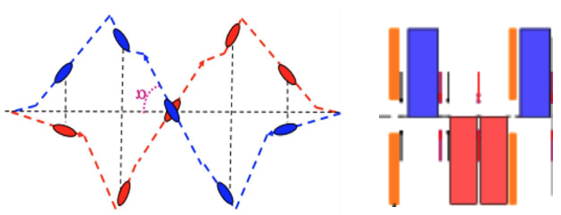
Reminder – Reverse Polarity Optics
Due to radiation dose deposition concerns, the polarity of the triplets is reversed.
Dose deposition done differently.
Done in 2024 for IP1:
  Triplet polarity reversed, Q4 off
  Crossing angle changed from
  positive to negative
IR1 2023
IR1 2024
See Tobias Presentation

Slide 6
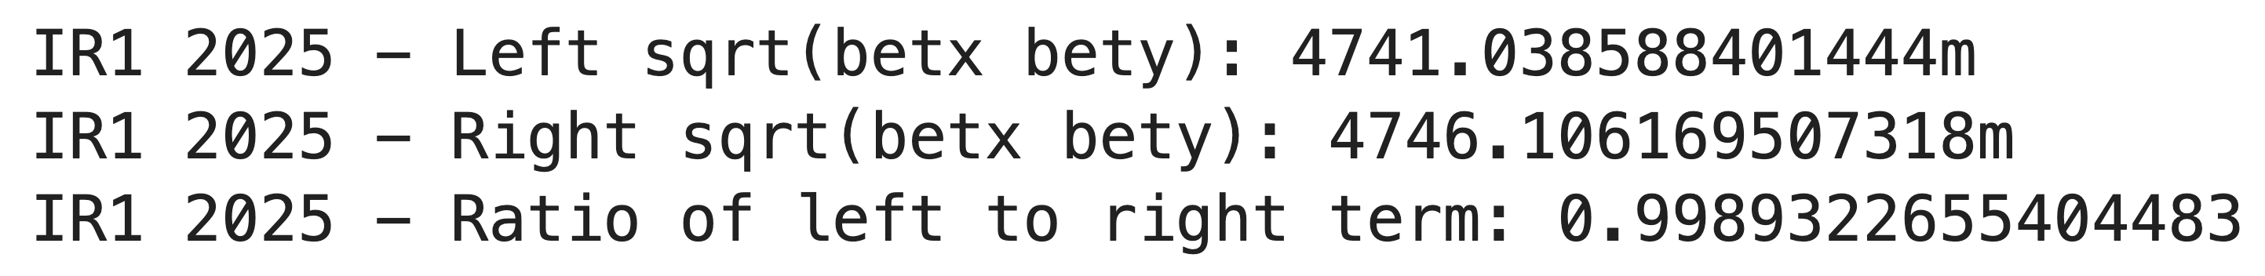
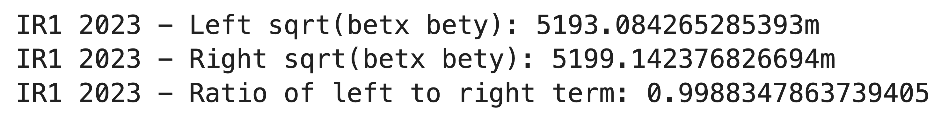
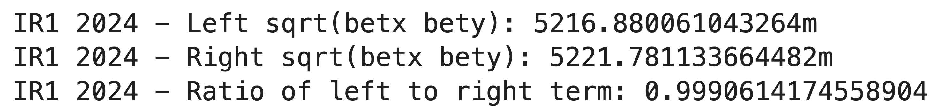
IR1 Reverse Polarity Optics – 2023 vs 2024
Local coupling corrections were basically an inversion of the sign (see Tobias presentation).
Caveat for 2025: IR1 re-reverses optics polarity & switches crossing plane (and we have flat optics).

Slide 7
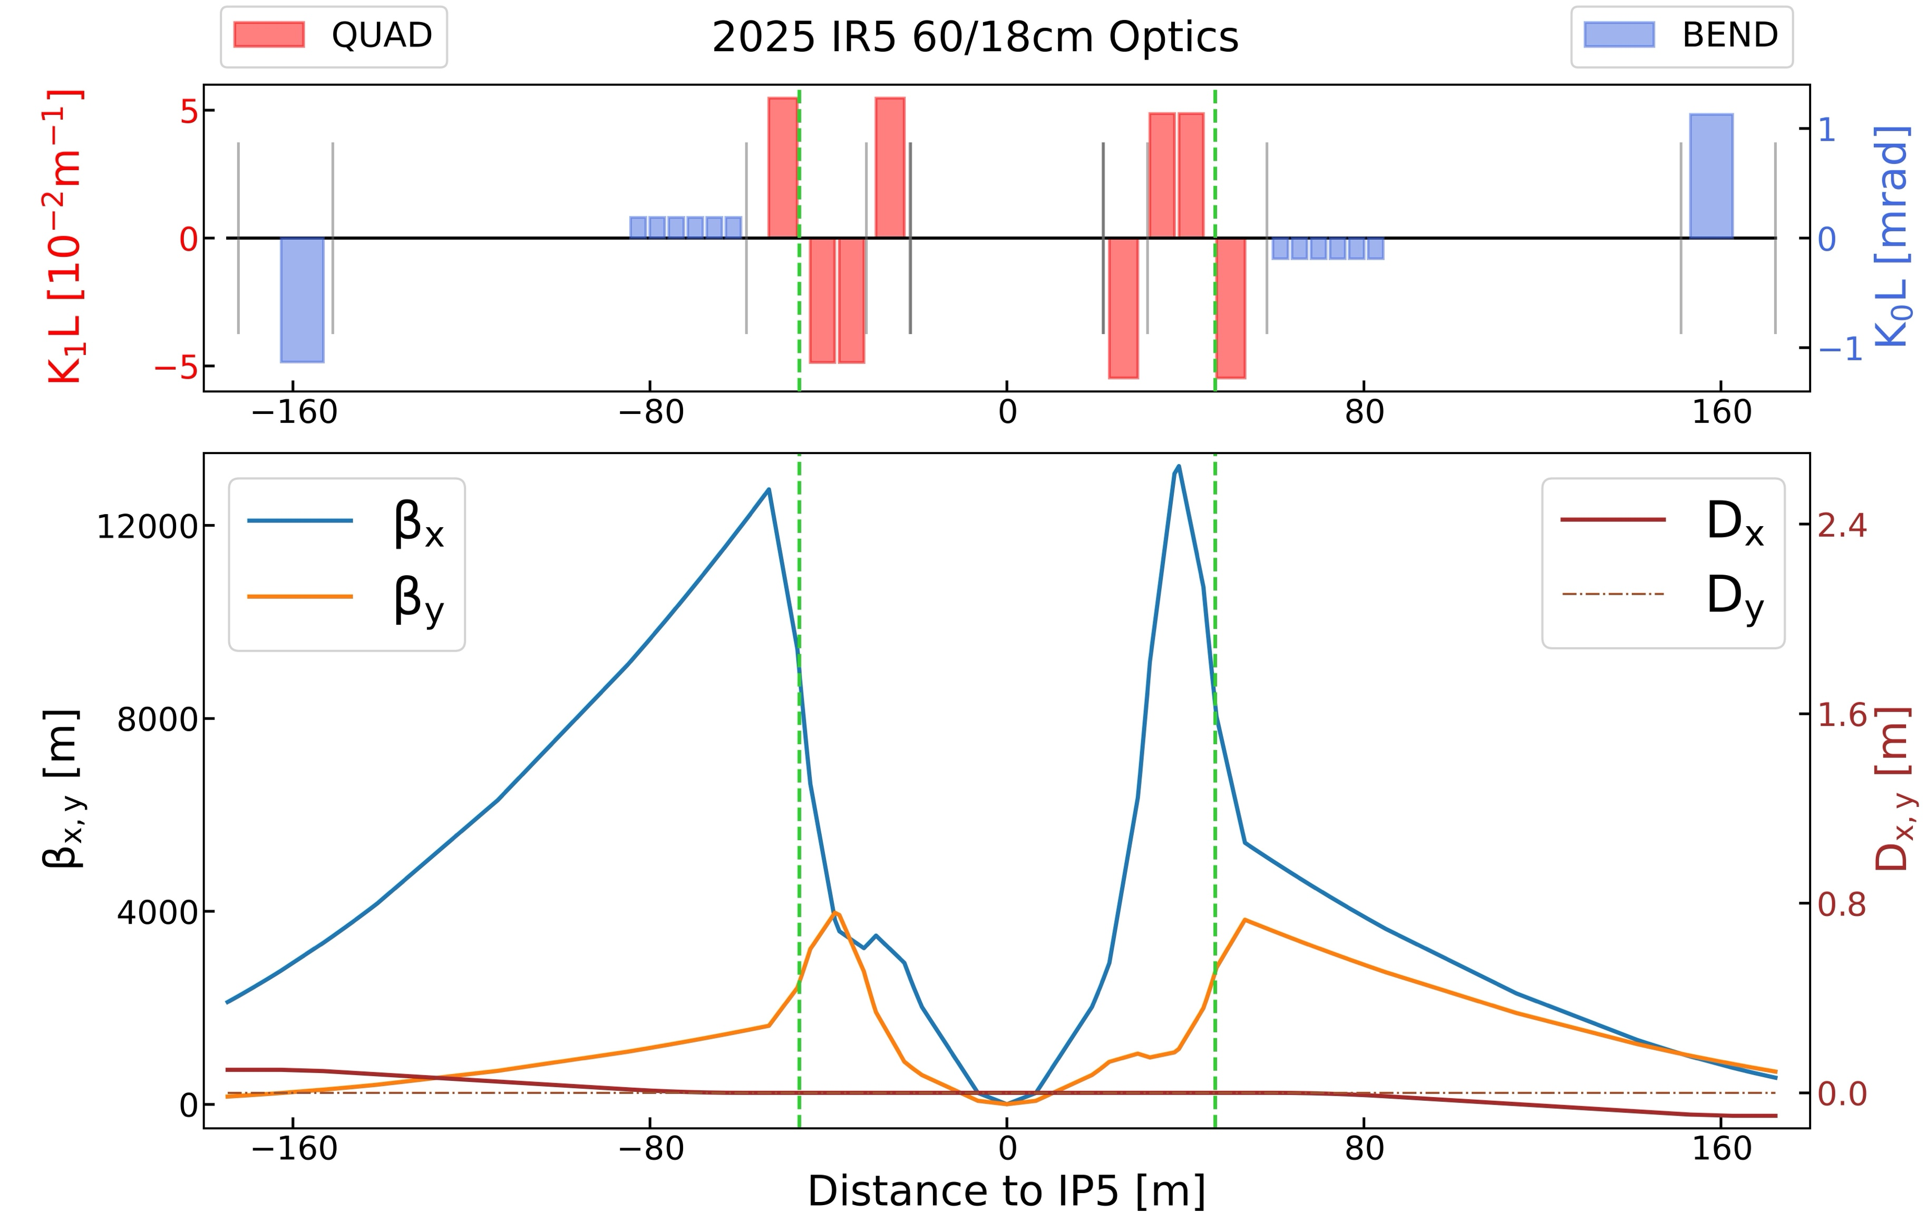
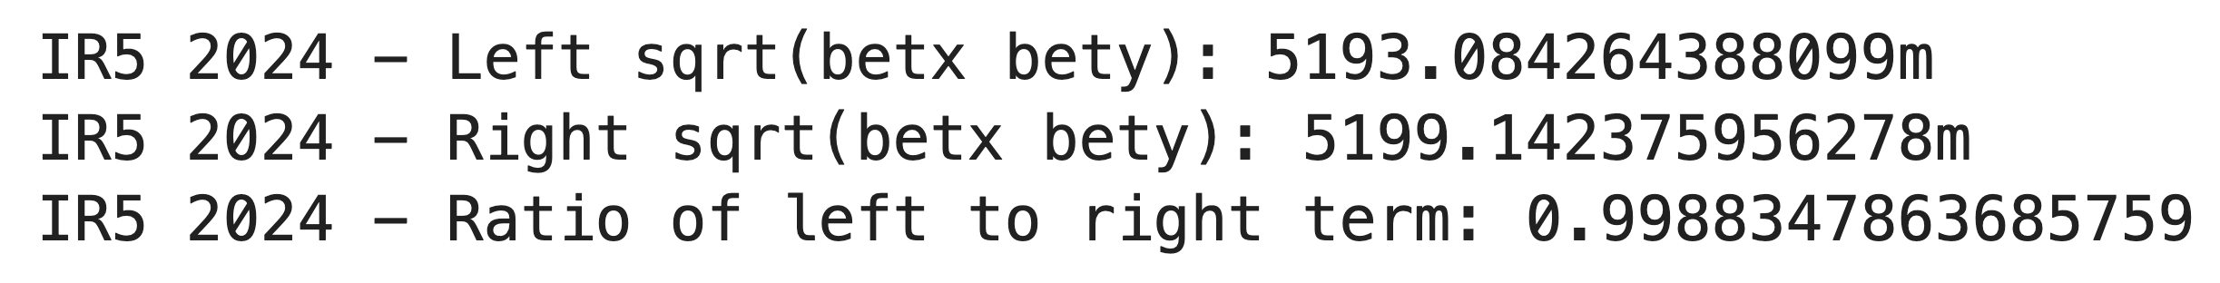
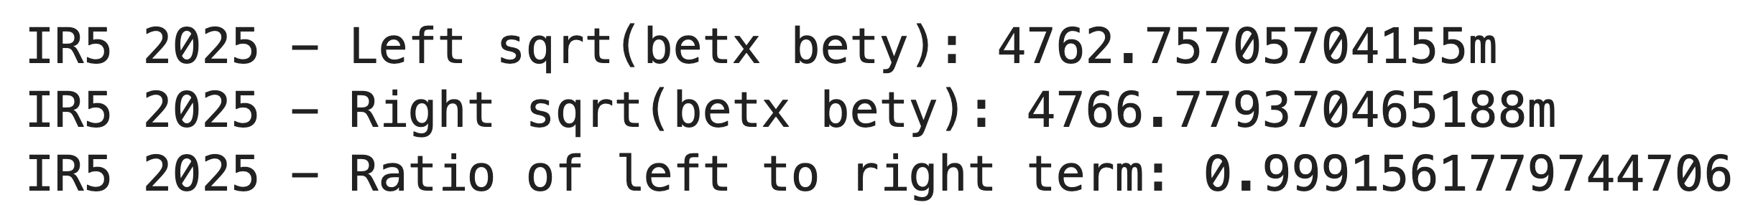
IR5 Reverse Polarity Optics – 2024 vs 2025
Left and right MQSX will have the same effect, and we should be able to use the colinearity knob ☺
Reminder: in IR5 polarity is reversed and crossing plane switched.

Slide 8
Guess Corrections
What to start with at IP1 / IP5 in 2025

Slide 9
IR1 2025 Guess Corrections
IR1 2023 corrections (from BetaStarLevelling-SQUEEZE-6.8TeV-1.2m-30cm-2023_V1@696_[END]) (also IPAC24 paper):
  RQSX3.L1/K1S = 11.5E-4
  RQSX3.R1/K1S = 3.5E-4
IR1 2024 corrections (from BetaStarLevelling-SQUEEZE-6.8TeV-1.2m-30cm-2024_V1@696_[END]) (also IPAC24 paper):
  RQSX3.L1/K1S = -10.5E-4
  RQSX3.R1/K1S = -4.5E-4
  Corresponds to sign switch from 2023 then an adjustment of 1 unit of the colinearity knob
IR1 2025 corrections suggestions:
Go back to 2023 corrections?
RQSX3.L1/K1S = 11.5E-4
RQSX3.R1/K1S = 3.5E-4
Switch sign from 2024 corrections
RQSX3.L1/K1S = 10.5E-4
RQSX3.R1/K1S = 4.5E-4

Slide 10
IR5 2025 Guess Corrections
IR5 2023 corrections (from BetaStarLevelling-SQUEEZE-6.8TeV-1.2m-30cm-2023_V1@696_[END]):
  RQSX3.L5/K1S = 4.0E-4
  RQSX3.R5/K1S = 8.0E-4
IR5 2024 corrections (from BetaStarLevelling-SQUEEZE-6.8TeV-1.2m-30cm-2024_V1@696_[END]):
  RQSX3.L5/K1S = 4.0E-4
  RQSX3.R5/K1S = 8.0E-4
  Corresponds to settings from 2023, unchanged
IR5 2025 corrections suggestions:
Switch sign from 2023/2024 corrections
RQSX3.L5/K1S = -4.0E-4
RQSX3.R5/K1S = -8.0E-4
Checks with SbS & potential colinearity knob trim

Slide 11
IR2 / IR8 2025 Guess Corrections
There is no change in the optics to suggest we need to change the corrections.
We should carry over the corrections from 2024.
Use IR2 Corrections from 2024
RQSX3.L2/K1S = -14.0E-4
RQSX3.R2/K1S = -14.0E-4
Checks with SbS & potential colinearity knob trim
Use IR8 Corrections from 2024
RQSX3.L8/K1S = -5.0E-4
RQSX3.R8/K1S = -5.0E-4
Checks with SbS & potential colinearity knob trim

Slide 12
Settings and Knobs
Caveats, what to change, where to click ☺

Slide 13
2024 Colinearity Knob Caveats
Ewen noticed the colinearity knob setting was only trimmed in during the squeeze (2m – 1.2m) in 2024.
This is because it was figured out later in commissioning and they wanted to make minimal changes to the cycle (c.f. Tobias).
  It means it was not present in the process at injection.
  It means it was not present for any MD at injection.
There is no harm in having the colinearity knob adjustment at injection, and no reason not to have it there.
  We should remember to include it in the whole process!

Slide 14
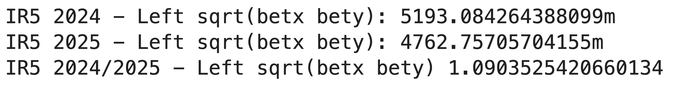
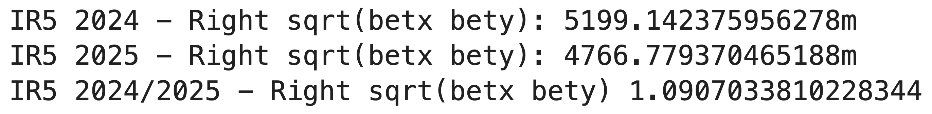
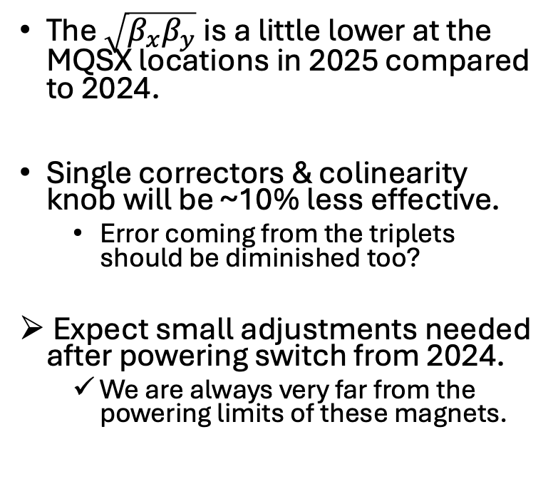
2025 Colinearity Knob Caveats
The $\sqrt{β_{x}β_{y}}$ is a little lower at the MQSX locations in 2025 compared to 2024.
Single correctors & colinearity knob will be ~10% less effective.
  Error coming from the triplets should be diminished too?
Expect small adjustments needed after powering switch from 2024.
  We are always very far from the powering limits of these magnets.

Slide 15
Local Coupling Corrections and Knobs
Any adjustment found with SbS should be trimmed individually on the corrector K1S values.
  The setting can be found in LSA App Suite
  Select the Beam Process → ALL MAGNETS → K and search for “RQSX”
  Trim the relevant magnet strength (i.e. RQSX3.L1/K1S)
Any adjustment with the colinearity knob should be trimmed through the knob itself.
  The knob setting can be found in LSA App Suite
  Select the Beam Process → BETA-BEATING → KNOB → search for “colinearity”
  Trim the relevant knob (i.e. LHCBEAM/ATS_2022_05_10_colinearityIP1)
We should create a single knob with all local coupling corrections once determined, to be included in the Beam Process.
  Done in LSA Optics Application
  Akin to LHCBEAM/ATSR_2025_XX_XX_localCouplingIP1258 with RQSX3.[LR][1258]/K1S settings
  Propagate it to all the proton optics for relevant BPs → active from injection to collisions

Slide 16
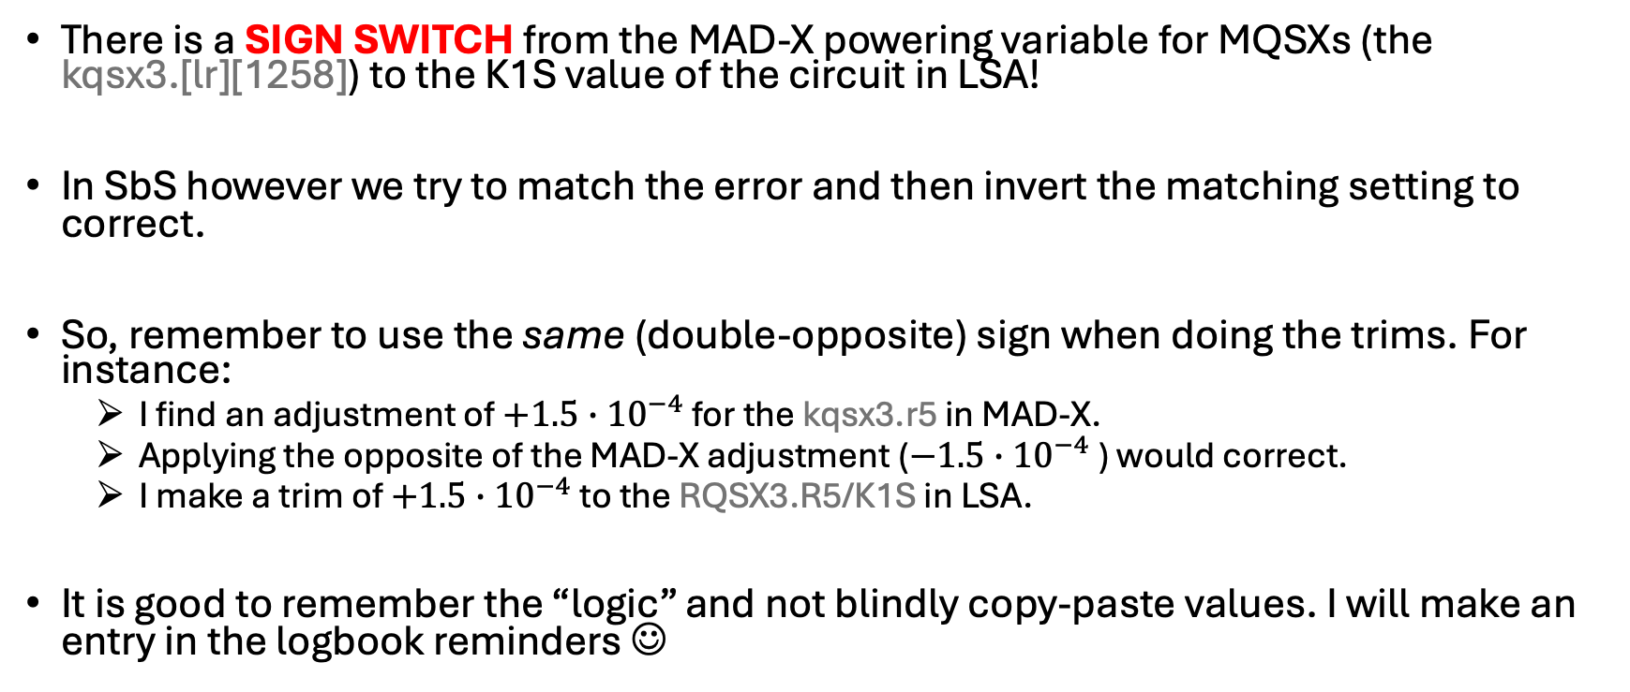
Reminder - Powering Caveats
There is a SIGN SWITCH from the MAD-X powering variable for MQSXs (the kqsx3.[lr][1258]) to the K1S value of the circuit in LSA!
In SbS however we try to match the error and then invert the matching setting to correct.
So, remember to use the same (double-opposite) sign when doing the trims. For instance:
  I find an adjustment of $+1.5∙{10}^{−4}$ for the kqsx3.r5 in MAD-X.
  Applying the opposite of the MAD-X adjustment ($−1.5∙{10}^{−4}$) would correct.
  I make a trim of $+1.5∙{10}^{−4}$ to the RQSX3.R5/K1S in LSA.
It is good to remember the “logic” and not blindly copy-paste values. I will make an entry in the logbook reminders ☺

Slide 17
Backups

Slide 18
Colinearity Knob Effect in IR5 2025
Colinearity knob still gives a nice closed coupling bump.
Colinearity knob will be a tad less effective there (~10%)
  No worries, we are always very far from the powering limits of these magnets.

