Slide 1

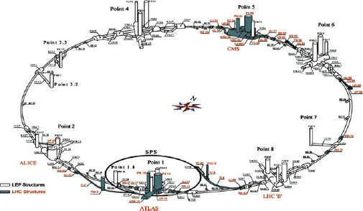


Injection/RAMP Knob recap

Slide 2
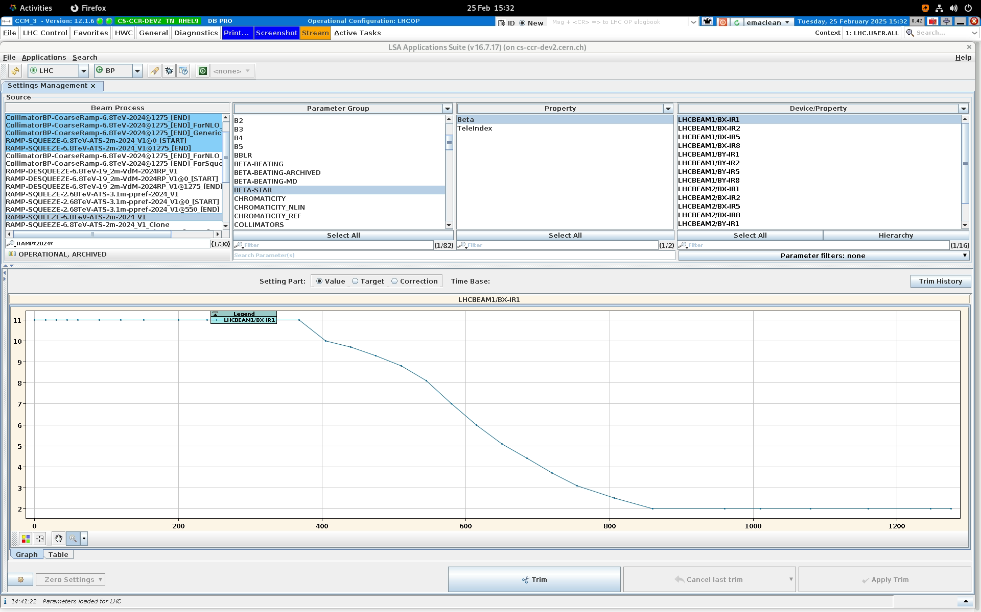
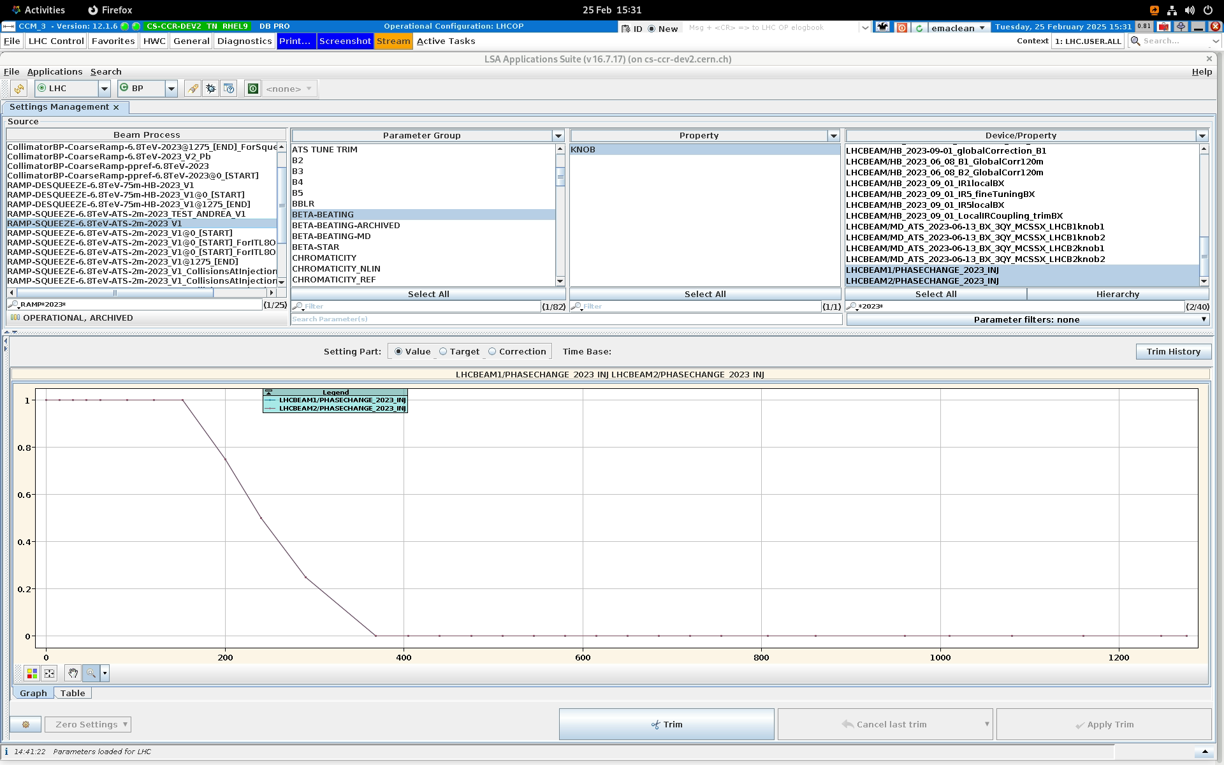
2024 RAMP/SQUEEZE knob incorporation - overview
Ramp from 450GeV to 6.8TeV at 1270s
Beta* constant @ 11m to 368s. Squeezed to 2m@820s
(2023) phase knob constant to 152s, then trimmed out to 0 at 368s

Slide 3
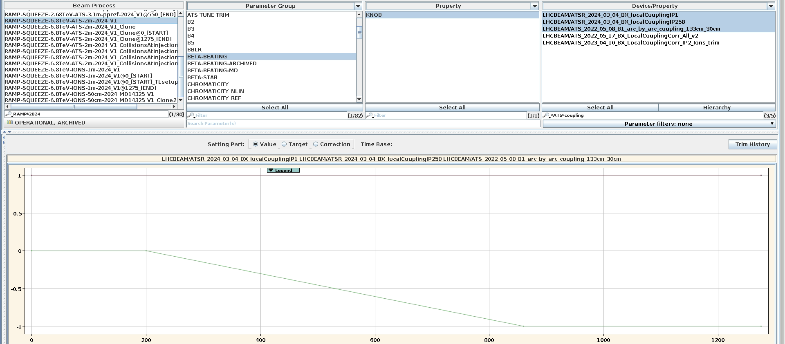
2024 RAMP/SQUEEZE knob incorporation - coupling
LOCAL [constant through cycle]
LHCBEAM/ATSR_2024_03_04_BX_localCouplingIP1
LHCBEAM/ATSR_2024_03_04_BX_localCouplingIP258
Arc-by-Arc [0 > 0@200s > -1@860s]
LHCBEAM/ATS_2022_05_08_B1_arc_by_arc_coupling_133cm_30cm
Why no arc-by-arc at injection? 200s trim just historical?
local
Arc-by-arc

Slide 4
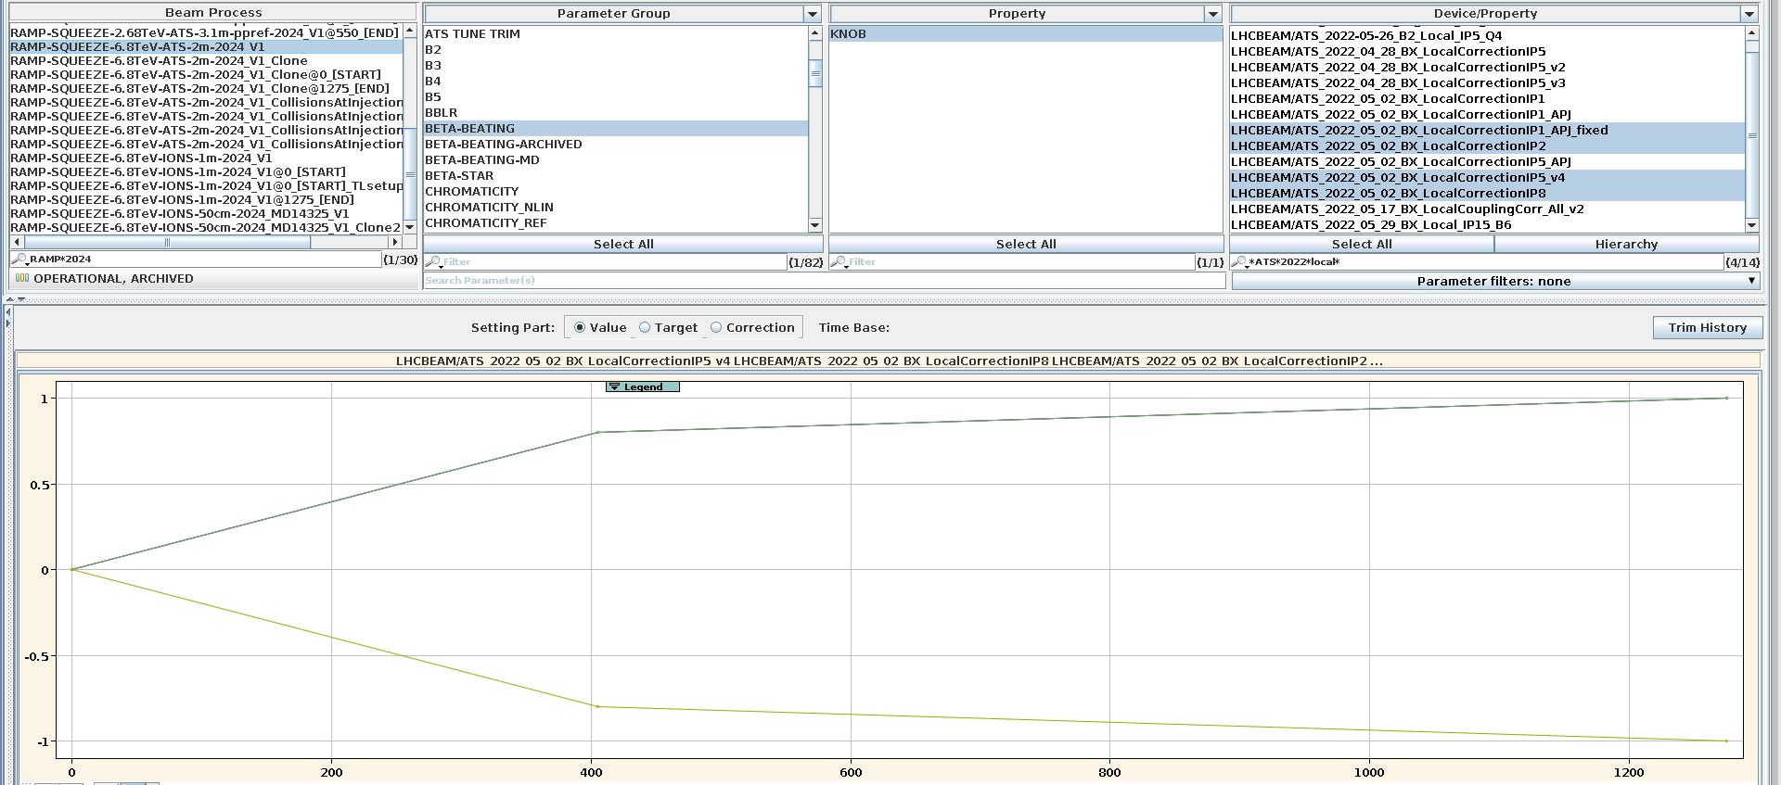
2024 RAMP/SQUEEZE knob incorporation - local
LHCBEAM/ATS_2022_05_02_BX_LocalCorrectionIP1_APJ_fixed
LHCBEAM/ATS_2022_05_02_BX_LocalCorrectionIP2
LHCBEAM/ATS_2022_05_02_BX_LocalCorrectionIP5_v4
LHCBEAM/ATS_2022_05_02_BX_LocalCorrectionIP8
IP1 inverted sign w.r.t. 2022/23
Trimmed in to +/-0.8 @405s then fully at EoR
For 2025: just trim IP5_v4 to -1 and IP1_APJ_fixed to +1
IP2,5,8
IP1

Slide 5
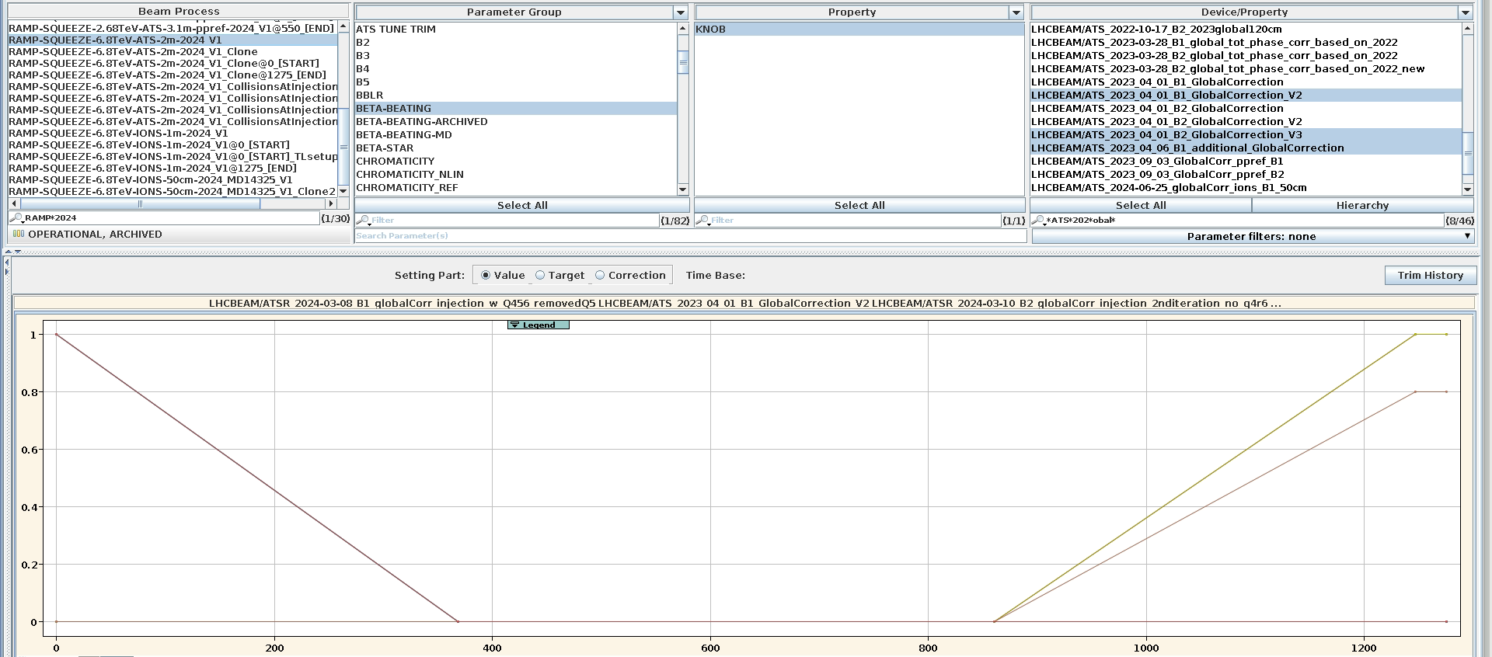
2024 RAMP/SQUEEZE knob incorporation - global
INJ:
LHCBEAM/ATSR_2024-03-08_B1_globalCorr_injection_w_Q456_removedQ5
LHCBEAM/ATSR_2024-03-10_globalCorr_injection_2nditeration
LHCBEAM/ATSR_2024-03-13_B1_globalCorr_injection_after_q5removal
LHCBEAM/ATSR_2024-03-08_B2_globalCorr_injection_w_Q456
LHCBEAM/ATSR_2024-03-10_globalCorr_injection_2nditeration
LHCBEAM/ATSR_2024-03-10_B2_globalCorr_injection_2nditeration_no_q4r6
TOP:
LHCBEAM/ATS_2023_04_01_B1_GlobalCorrection_V2
LHCBEAM/ATS_2023_04_06_B1_additional_GlobalCorrection
[+0.8 instead of +1]
LHCBEAM/ATS_2023_04_01_B2_GlobalCorrection_V3
INJ GLOBAL trimmed out for start of squeeze segment @368s
TOP GLOBAL trimmed in from end of squeeze in ramp
@860s

Slide 6
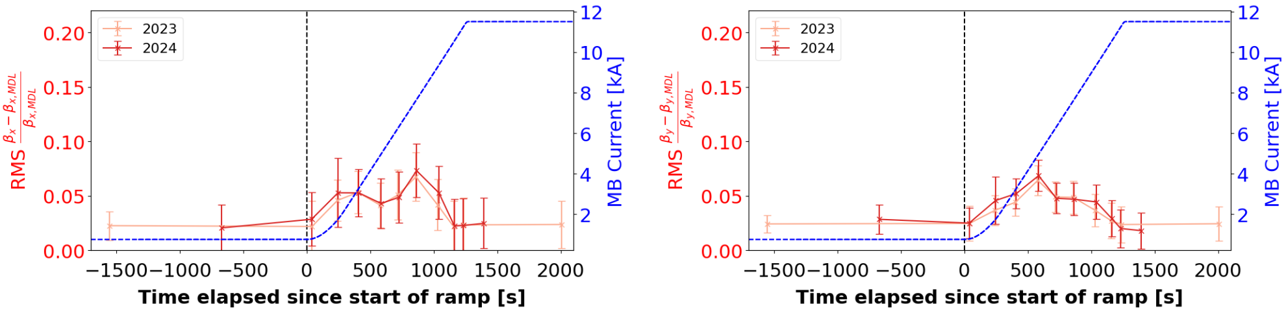
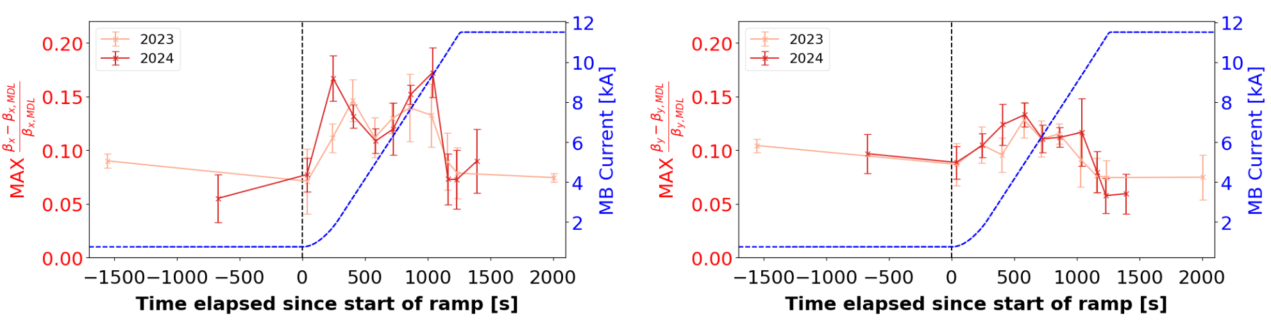
2024 RAMP/SQUEEZE knob incorporation - global
S.Horney LNO 24/05/24 https://indico.cern.ch/event/1419803/contributions/5970048/attachments/2863342/5010298/LNO%20meeting%2024%20May%202024.pdf

Slide 7
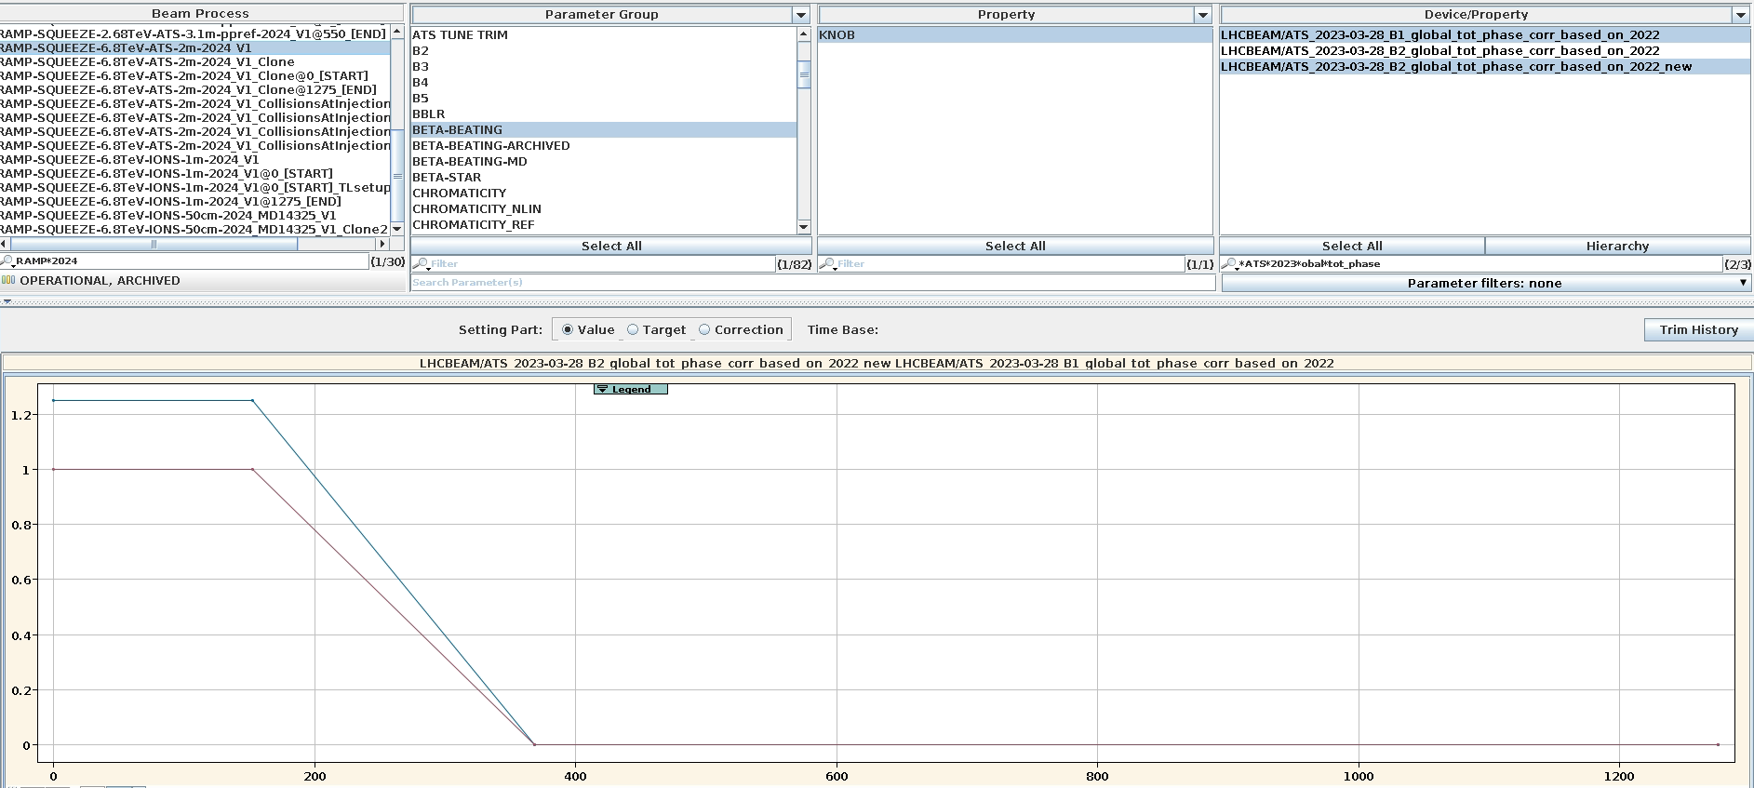
2024 RAMP/SQUEEZE knob incorporation – total phase
LHCBEAM/ATS_2023-03-28_B1_global_tot_phase_corr_based_on_2022
LHCBEAM/ATS_2023-03-28_B2_global_tot_phase_corr_based_on_2022_new
LHCB2 tot phase knob starts at 1.25
LHCB1 tot phase
TOTAL PHASE knobs trimmed out along with MO phase knob [152s → 368s]

Slide 8
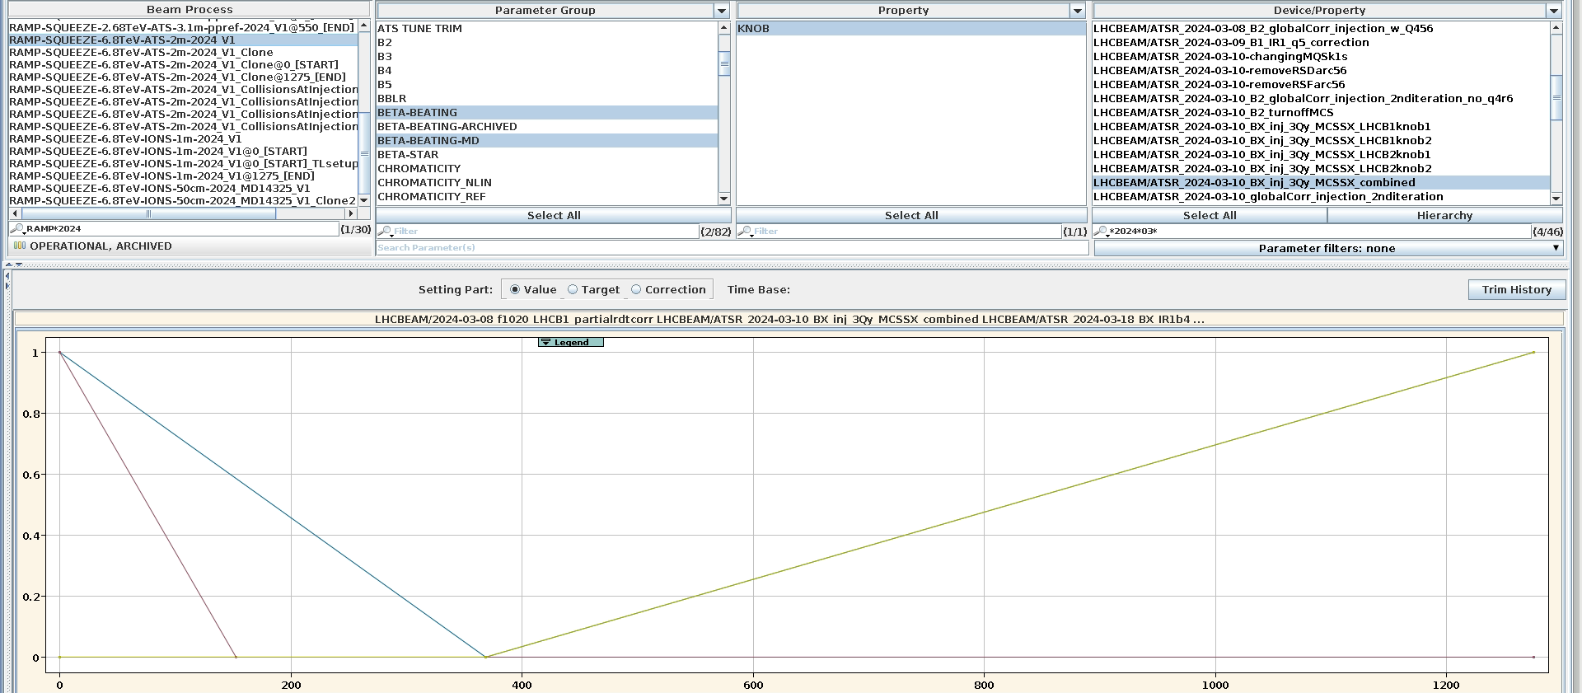
2024 RAMP/SQUEEZE knob incorporation – NL main process
3Qy: LHCBEAM/ATSR_2024-03-10_BX_inj_3Qy_MCSSX_combined
Lattice b3: LHCBEAM/2024-03-08_f1020_LHCB1_partialrdtcorr
IRb4: LHCBEAM/ATSR_2024-03-18_BX_IR1b4 / LHCBEAM/ATSR_2024-03-18_BX_b4_IP5
B3 trimmed out @ start of squeeze segment
3Qy → 0
for 152s
(phaseknob)
IRb4 trimmed in from start of squeeze to end of ramp

Slide 9
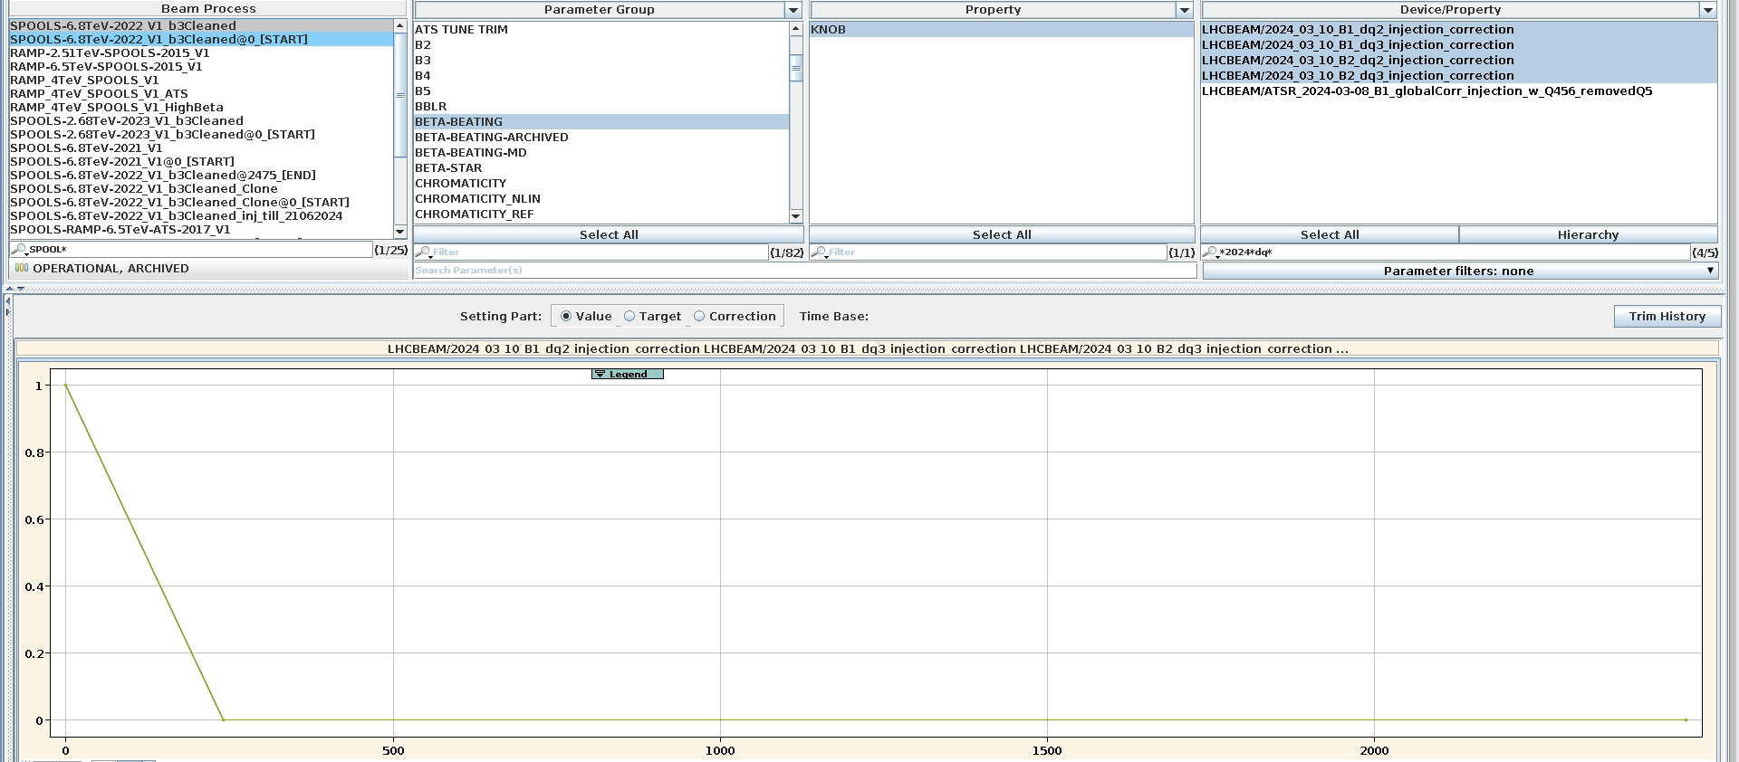
2024 RAMP/SQUEEZE knob incorporation – NL spool process
Recall that Q’’ and Q’’’ knobs are incorporated on the longer spools process, not ramp-squeeze
Q`` : LHCBEAM/2024_03_10_B1_dq2_injection_correction / LHCBEAM/2024_03_10_B2_dq2_injection_correction
Q```: LHCBEAM/2024_03_10_B1_dq3_injection_correction / LHCBEAM/2024_03_10_B2_dq3_injection_correction
Spools 6.8TeV
NL chroma knobs trimmed to 0 at 240s (??? Just historical? Ramp rates?)

Slide 10
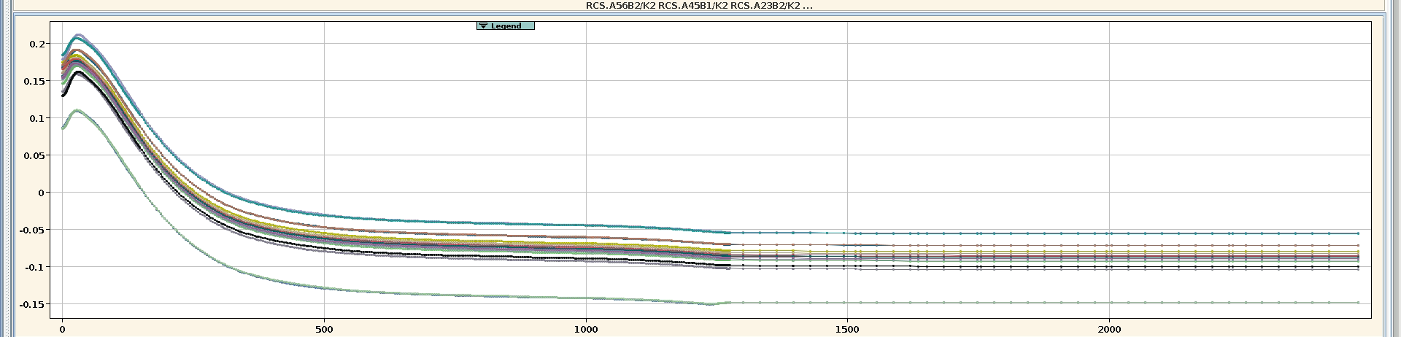
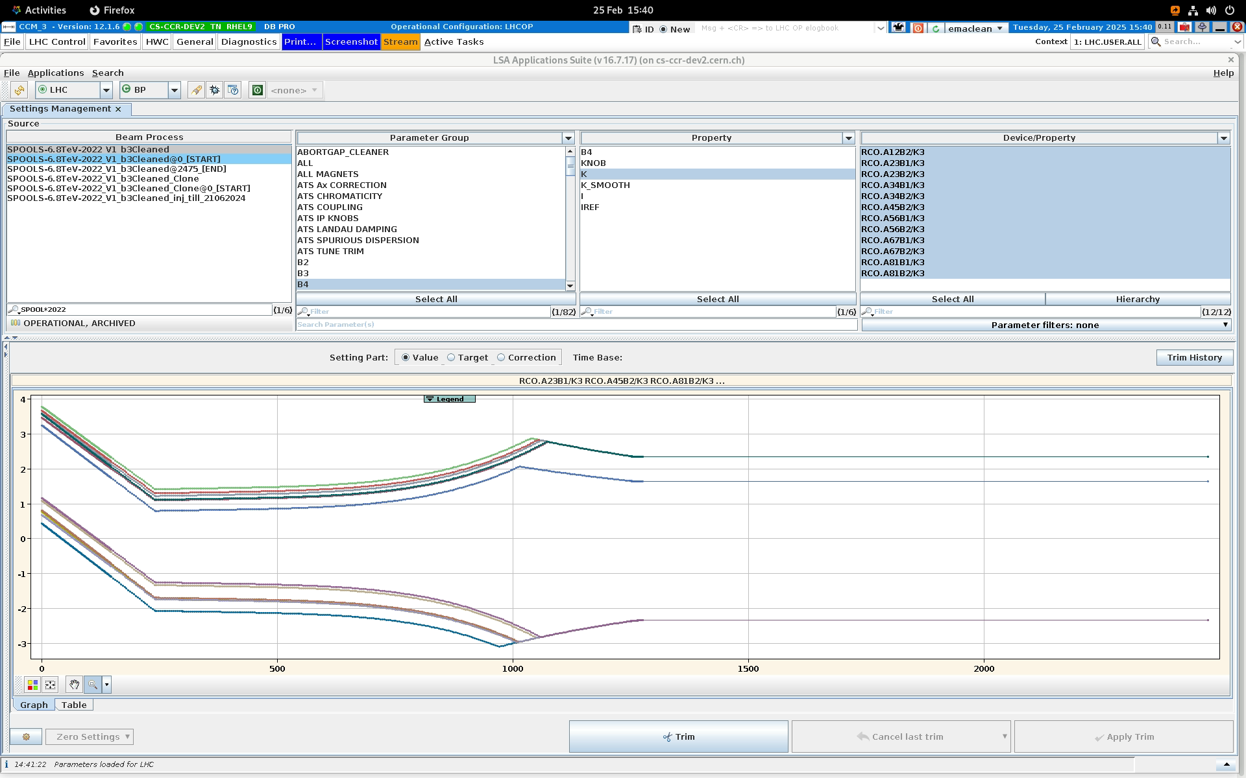
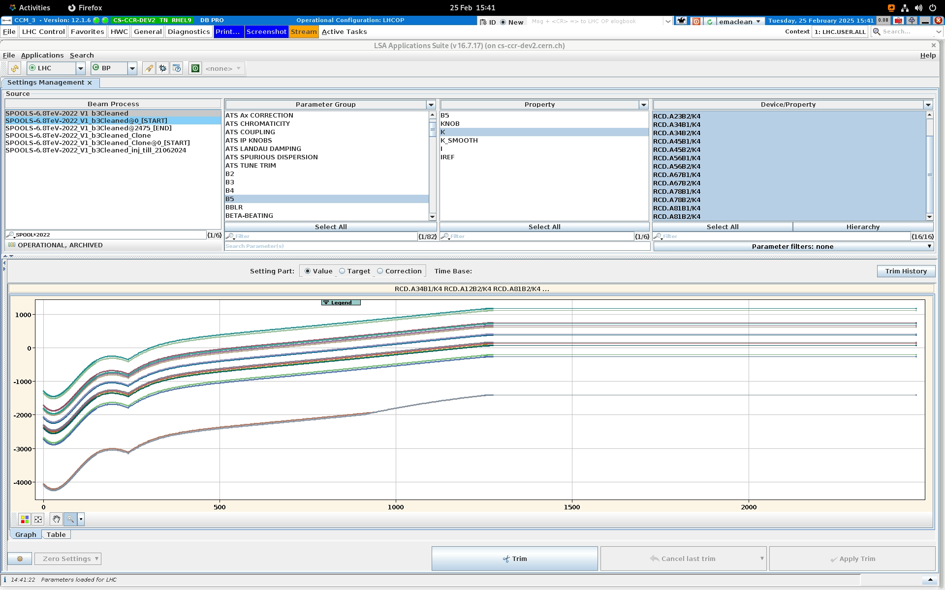
2024 RAMP/SQUEEZE knob incorporation – NL spool process
RCS
RC0
RCD

Slide 11
2024 RAMP/SQUEEZE knob incorporation
Coupling:
Start with old/predicted local coupling knobs
No arc-by-arc coupling correction? Why not? Needed? Still valid?
Local:
Start with old/predicted local optics knobs: IP1_APJ_fixed trimmed in to +1, IP5_v4 trimmed in to -1
Global:
New corrs needed at injection. Start with all old global corrections removed
Test 2023 global corrs at end-of-ramp after local iterations done.
Same incorporation strategy as 2024?
Tot phase:
Test 2022 knobs at end of first shift after global sorted (as 2023/24)? Or incorporate from start?
NL:
Leave Q`` and Q``` corrections incorporated as 2024 (little impact on Nlchroma observed from RP)
3Qy – complete redo
B3? To be checked.
Start with IR-b4 removed. Incorporated as in past once new IRb4 knobs found at 6.8TeV

Slide 12
2024 SQUEEZE knobs

Slide 13
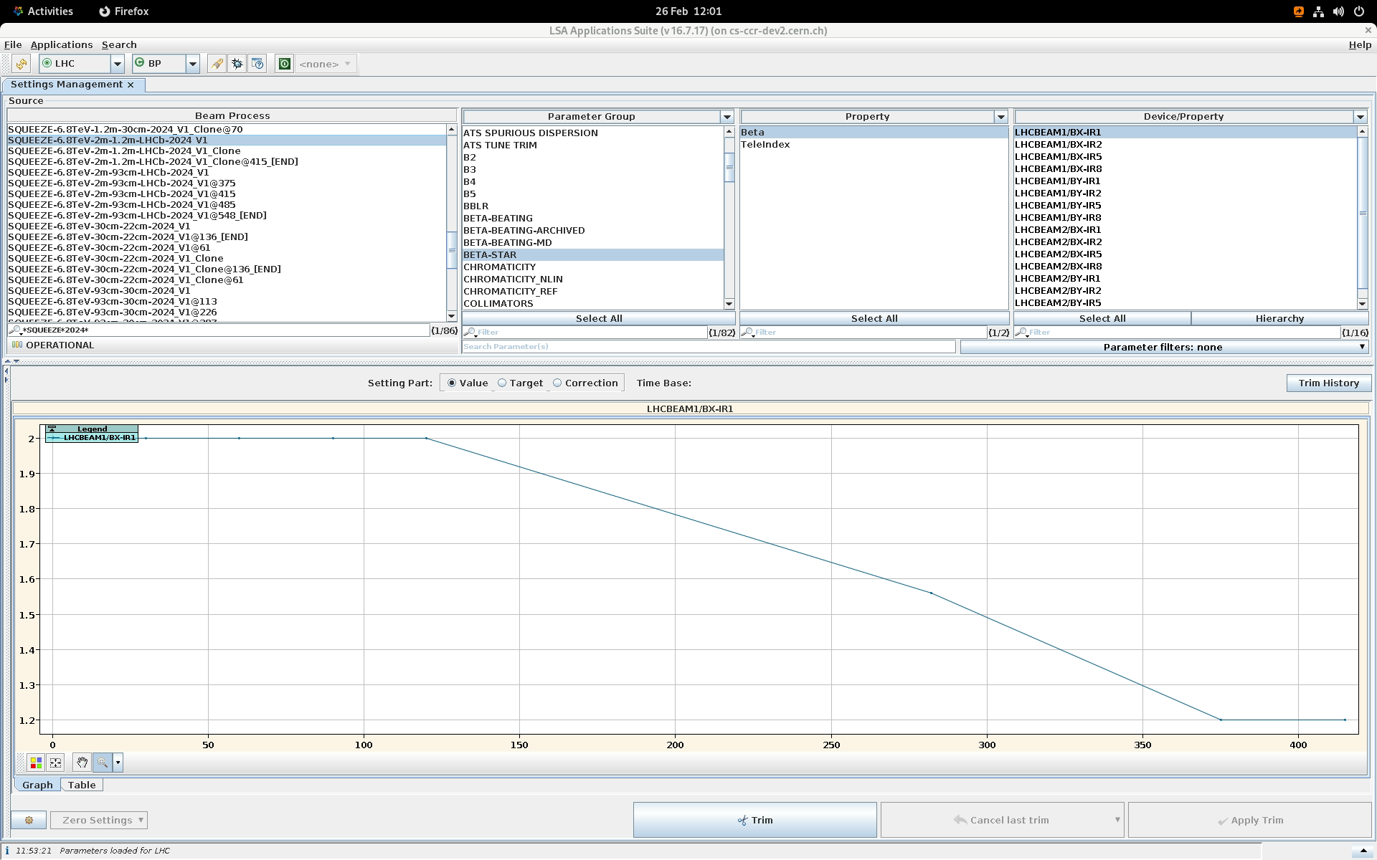
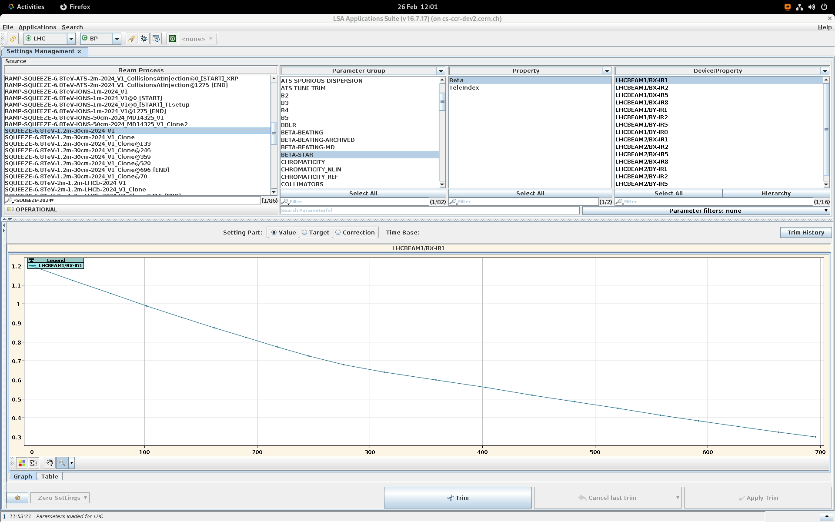
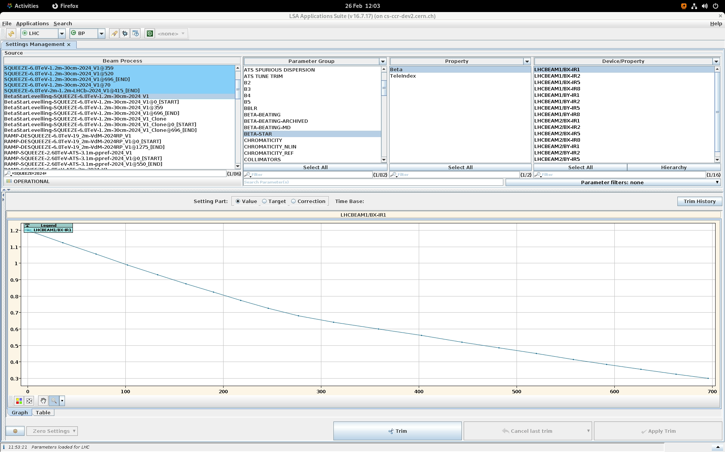
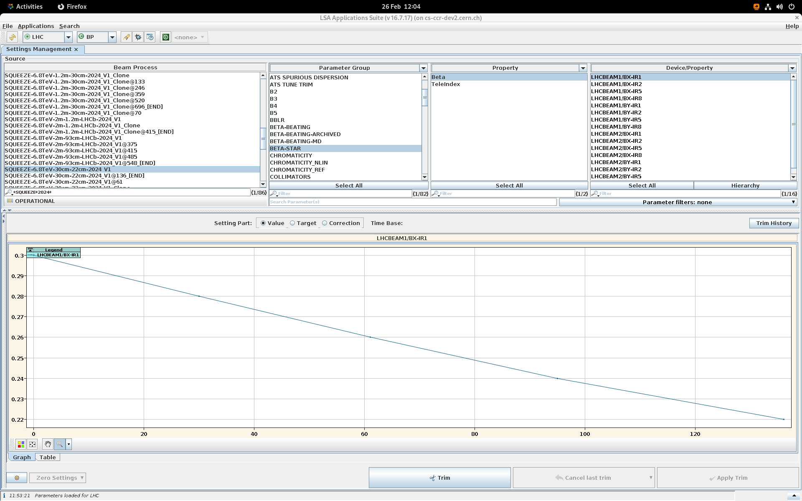
2024 SQUEEZE knob incorporation - overview
SQUEEZE-6.8TeV-2m-1.2m-LHCb-2024_V1
SQUEEZE-6.8TeV-1.2m-30cm-2024_V1
BetaStarLevelling-SQUEEZE-6.8TeV-1.2m-30cm-2024_V1
SQUEEZE-6.8TeV-30cm-22cm-2024_V1

Slide 14
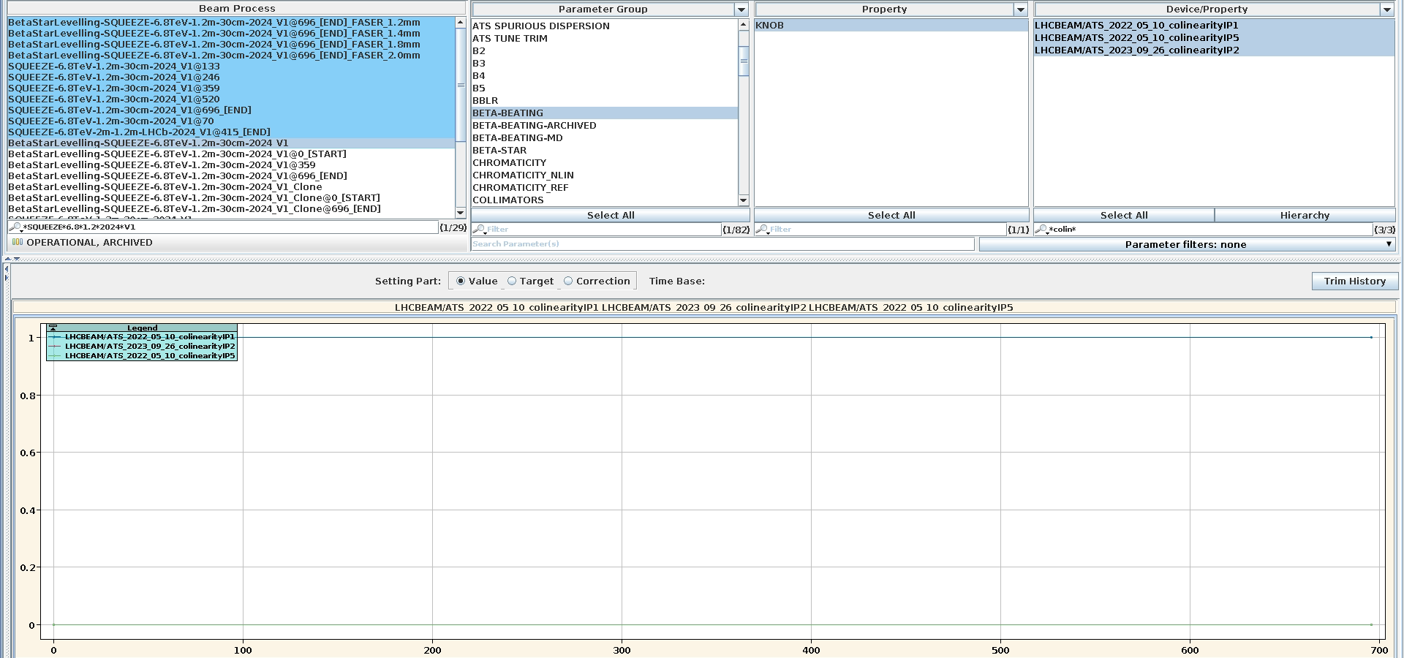
2024 SQUEEZE knob incorporation - coupling
Colinearity
LHCBEAM/ATS_2022_05_10_collinearity_IP1
+1 constant in beta* levelling process. No settings in squeeze processes? No settings in injection? No collinearity in IP2/5?
IP1 off in special FASER beta* levelling process?
LOCAL Coupling knobs
[constant through squeeze – same settings as injection]
LHCBEAM/ATSR_2024_03_04_BX_localCouplingIP1
LHCBEAM/ATSR_2024_03_04_BX_localCouplingIP258
IP1=1
IP2,IP5=no settings

Slide 15
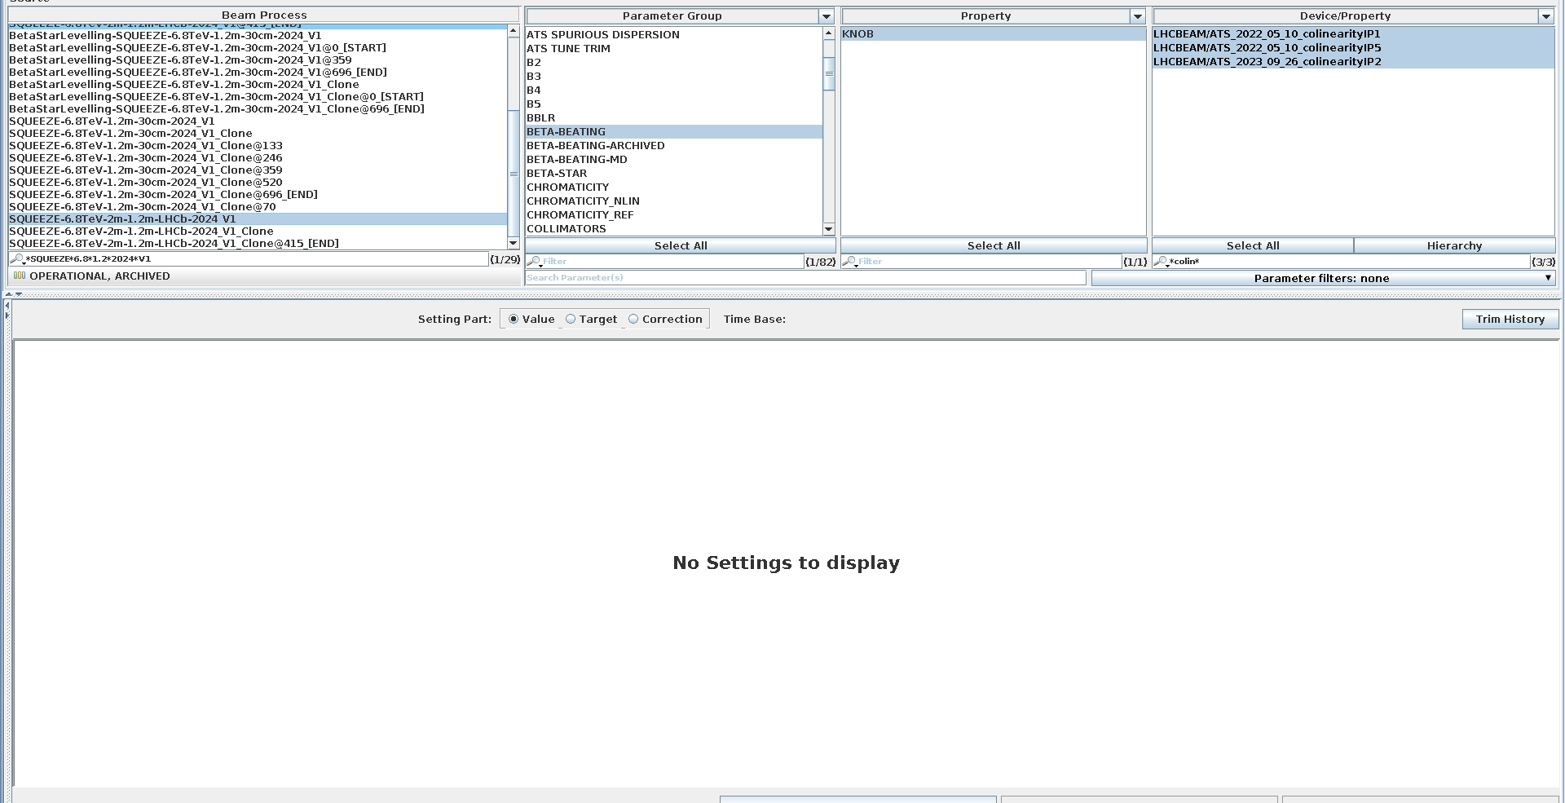
2024 SQUEEZE knob incorporation - coupling
Colinearity
LHCBEAM/ATS_2022_05_10_collinearity_IP1
+1 constant in beta* levelling process. No settings in squeeze processes? No settings in injection? No collinearity in IP2/5?
IP1 off in special FASER beta* levelling process?
LOCAL Coupling knobs
[constant through squeeze – same settings as injection]
LHCBEAM/ATSR_2024_03_04_BX_localCouplingIP1
LHCBEAM/ATSR_2024_03_04_BX_localCouplingIP258

Slide 16
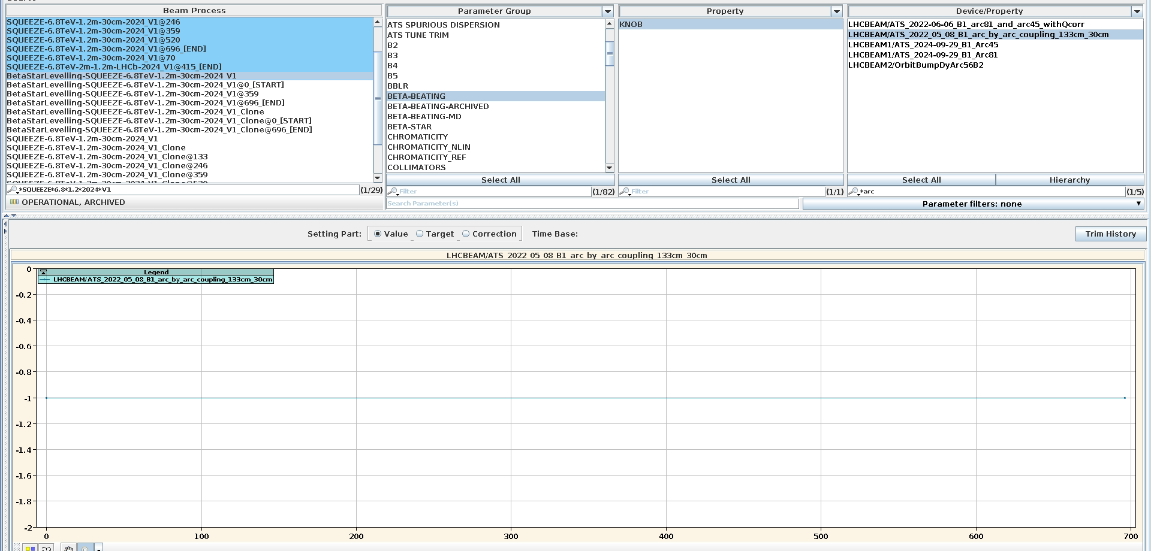
2024 SQUEEZE knob incorporation - coupling
Arc-by-Arc [constant at -1 through all squeeze processes]
LHCBEAM/ATS_2022_05_08_B1_arc_by_arc_coupling_133cm_30cm

Slide 17
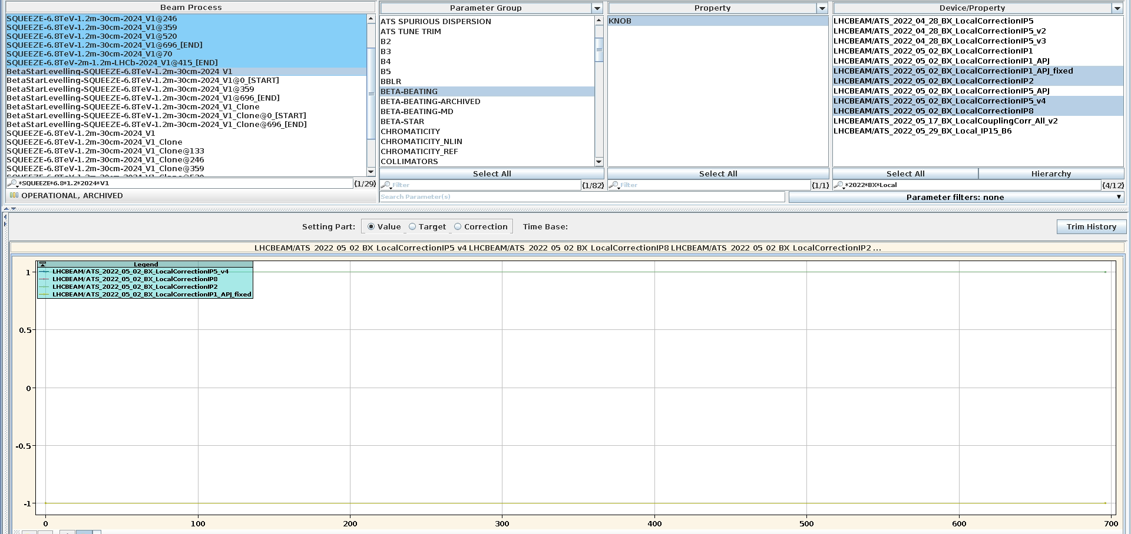
2024 SQUEEZE knob incorporation – local IP
LHCBEAM/ATS_2022_05_02_BX_LocalCorrectionIP1_APJ_fixed
LHCBEAM/ATS_2022_05_02_BX_LocalCorrectionIP2
LHCBEAM/ATS_2022_05_02_BX_LocalCorrectionIP5_v4
LHCBEAM/ATS_2022_05_02_BX_LocalCorrectionIP8
[constant at +/-1 through all squeeze processes]
[for 2025 swap signs of IP1 and IP5]
IP2,5,8 = +1
IP1 = -1

Slide 18
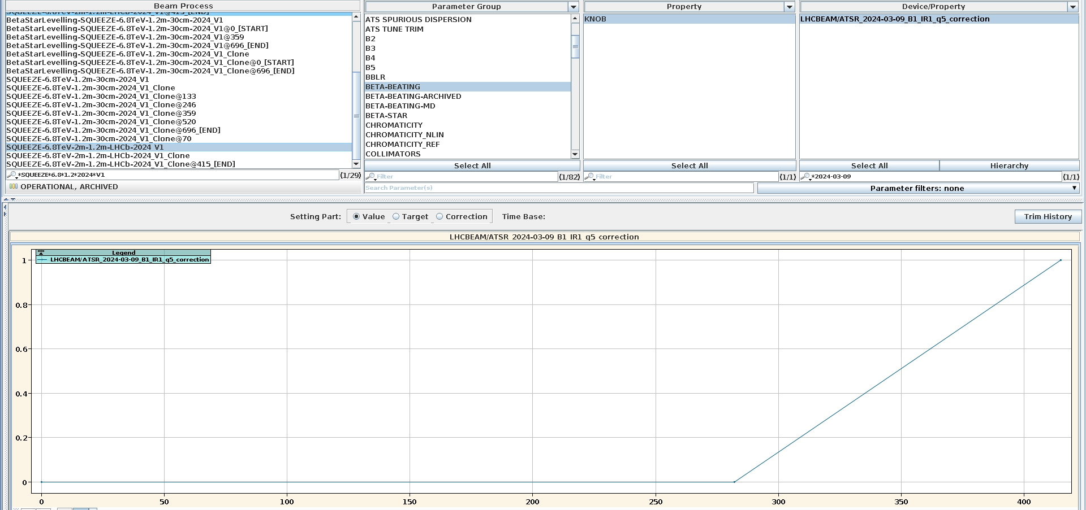
2024 SQUEEZE knob incorporation – local IP
Extra 2024 iteration:
LHCBEAM/2024-03-09_B1_IR1_q5_correction
Trimmed in during squeeze from 2m-1.2m (actually starts about 1.65m) → remove for 2025

Slide 19
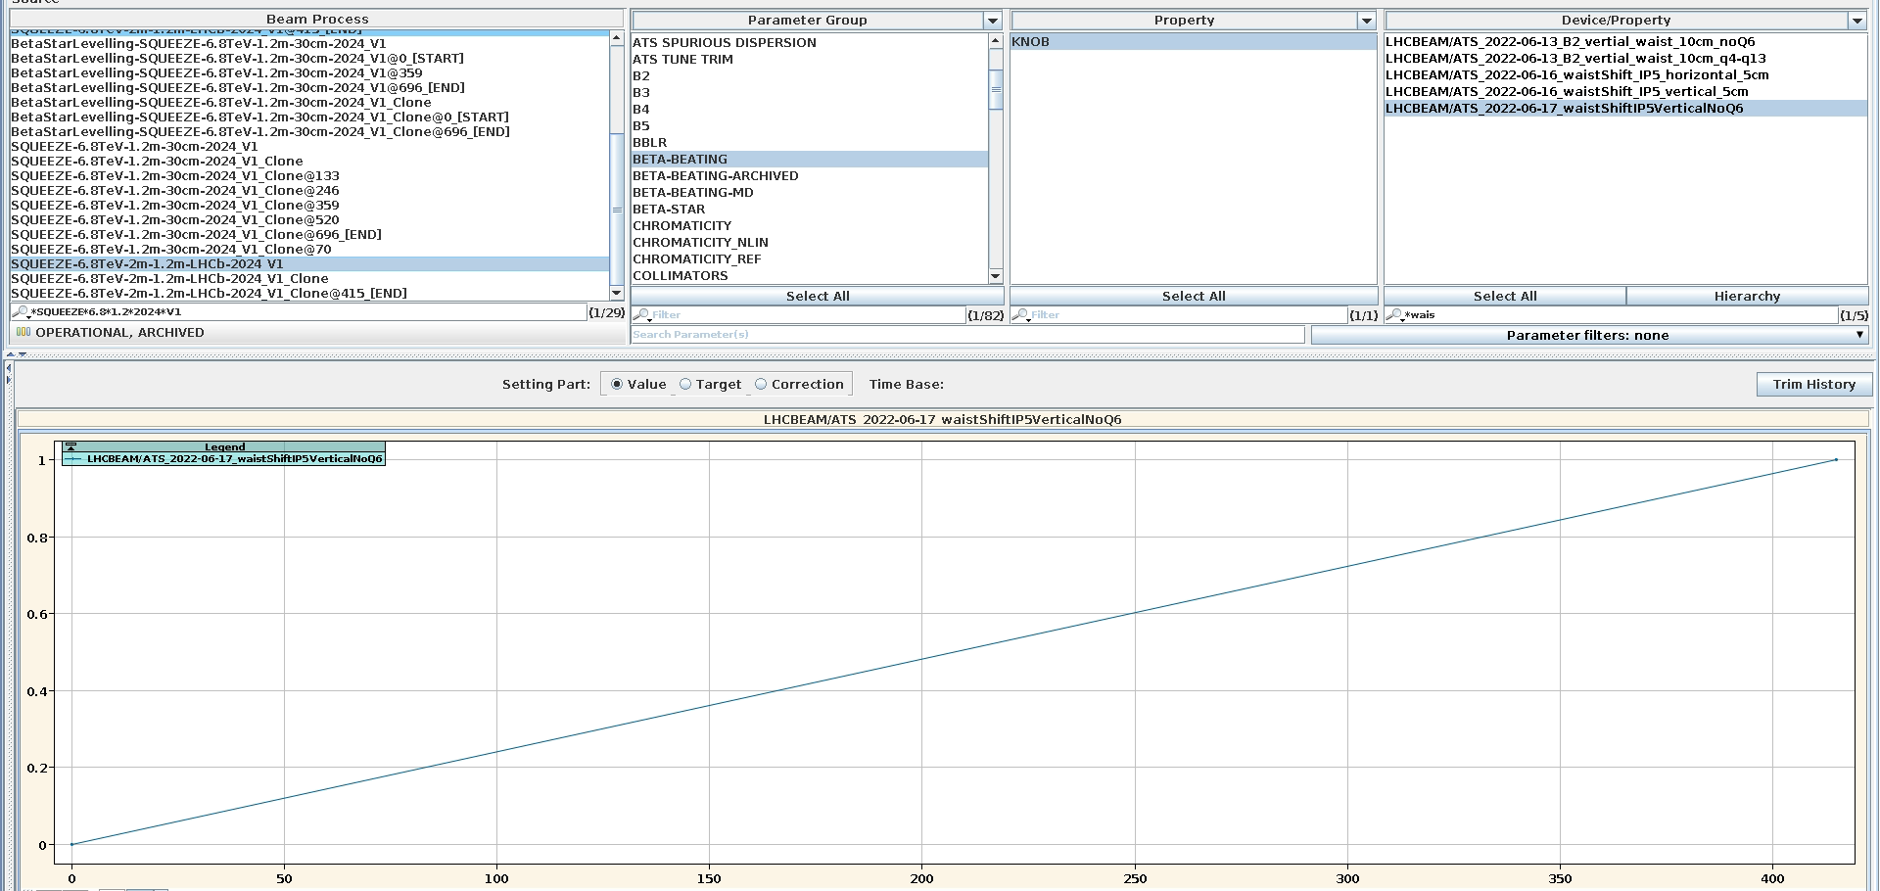
2024 SQUEEZE knob incorporation – local IP
Extra 2024 iteration:
LHCBEAM/ATS_2022-06-17_waistShiftIP5VerticalNoQ6
Trimmed in during squeeze through 2m-1.2m seq
Then constant through rest of squeeze
Remove for 2025? Or invert sign?
I thought we had more waist shift knobs – but this is all I see? Were they edited directly in the local?

Slide 20
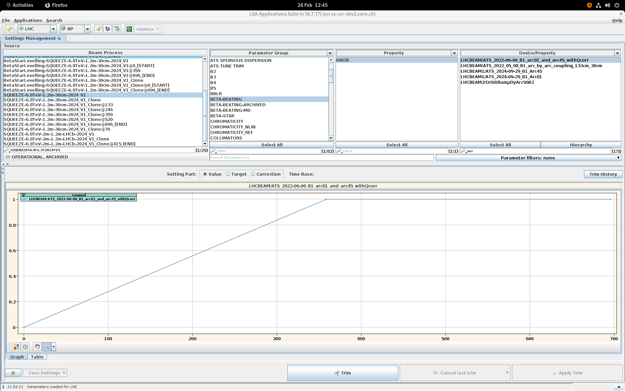
2024 SQUEEZE knob incorporation – local arc
LHCBEAM/2022-06-06_B1_arc81_and_arc45_withQcorr
Off during 2m-1.2m squeeze, then trimmed in from 1.2m to 60cm
From last meeting:
Arc81 still okay in 2025 MD
Arc45 bump should be doubled or check shifting by 1 MS
Arc56 large error – to be checked also with back propagation

Slide 21
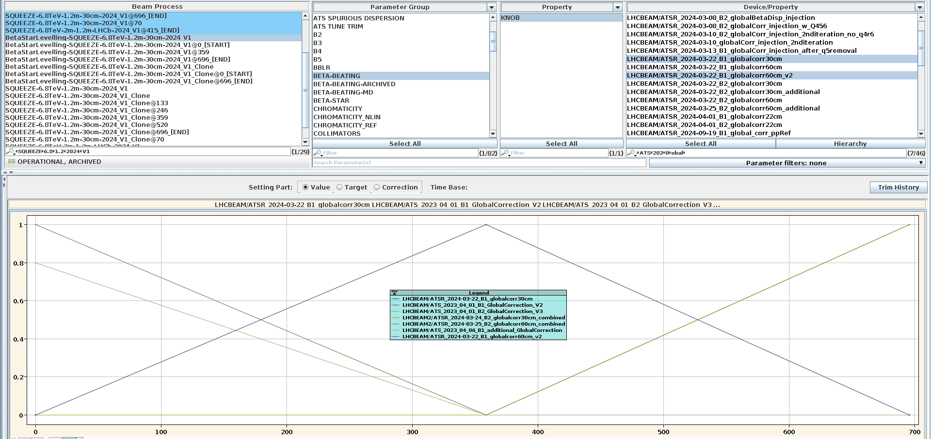
2024 SQUEEZE knob incorporation – global
[+1@1.2m → 0@60cm → 0@30cm]
[0@1.2m → +1@60cm → 0@30cm]
[0@1.2m → 0@60cm → +1@30cm]
LHCBEAM/ATS_2023_04_01_B1_GlobalCorrection_V2
LHCBEAM/ATS_2023_04_06_B1_additional_GlobalCorrection [+0.8]
LHCBEAM/ATS_2023_04_01_B2_GlobalCorrection_V3
LHCBEAM /ATSR_2024-03-22_B1_globalcorr60cm_v2
LHCBEAM2/ATSR_2024-03-25_B2_globalcorr60cm_combined
LHCBEAM /ATSR_2024-03-22_B1_globalcorr30cm
LHCBEAM2/ATSR_2024-03-24_B2_globalcorr30cm_combined
Remove for 2025
Test 2023 correction at 1.2m after new local established
30cm global knobs were removed for the 2025 MD

Slide 22
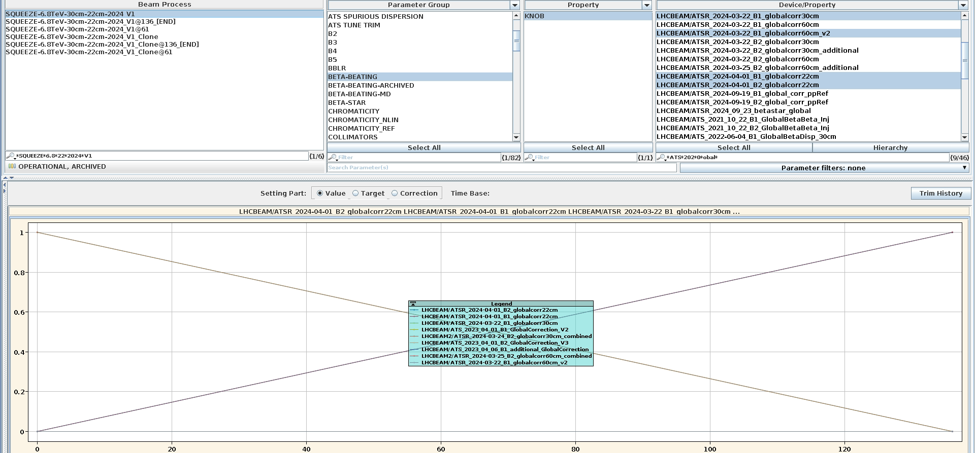
2024 SQUEEZE knob incorporation – global to 22cm
[0@1.2m → 0@60cm → +1@30cm → 0@22cm]
[0@1.2m → 0@60cm → 0@30cm → +1@22cm]
LHCBEAM /ATSR_2024-03-22_B1_globalcorr30cm
LHCBEAM2/ATSR_2024-03-24_B2_globalcorr30cm_combined
LHCBEAM/ATSR_2024-04-01_B1_globalcorr22cm
LHCBEAM/ATSR_2024-04-01_B2_globalcorr22cm
For 2025 expect global corrections at: 2m-1.2m → 60/60cm → 60/30cm → 60/18cm with validations at intermediate steps

Slide 23
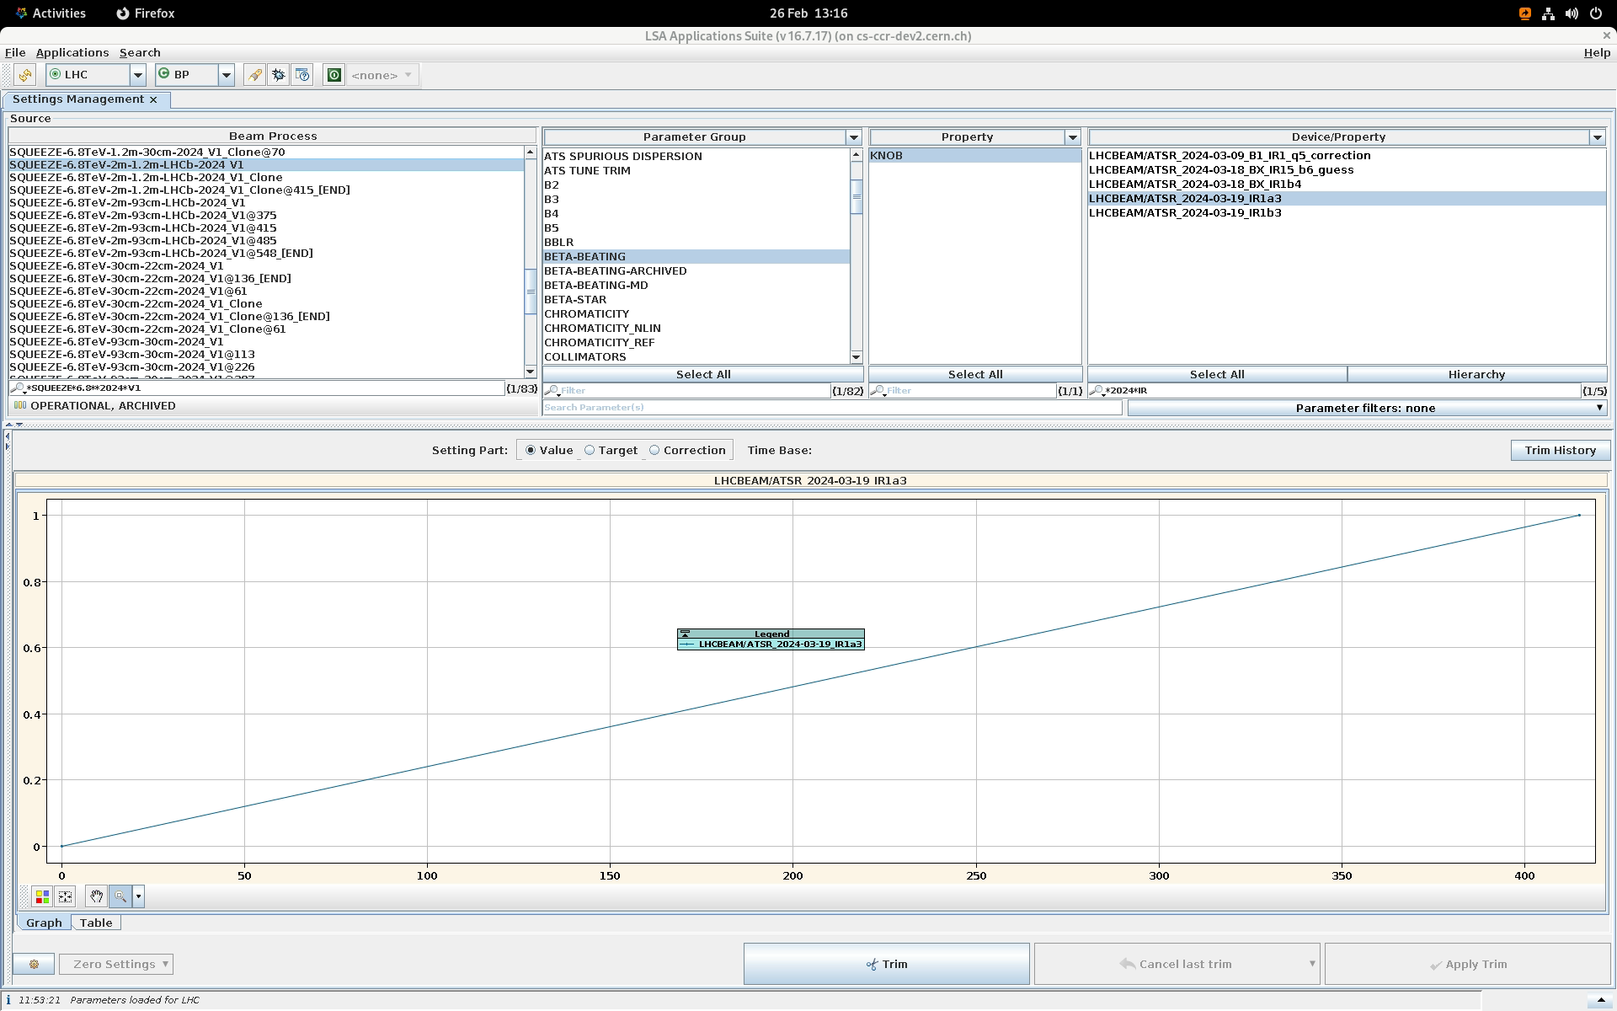
2024 SQUEEZE knob incorporation – IRNL
IRb4: LHCBEAM/ATSR_2024-03-18_BX_IR1b4 / LHCBEAM/ATSR_2024-03-18_BX_b4_IP5 [constant through whole squeeze]
IRsextupole: LHCBEAM/ATSR_2024-03-19_IR1a3 etc [trimmed in from 2m→1.2m]
Remove for 2025
Expect completely new sextupole and skew-octupole corrections.
IRb4 extrapolation didn’t work in 2024 so just make new virgin correction? Otherwise can make approximate guess and iterate
LRBB?

