Slide 1


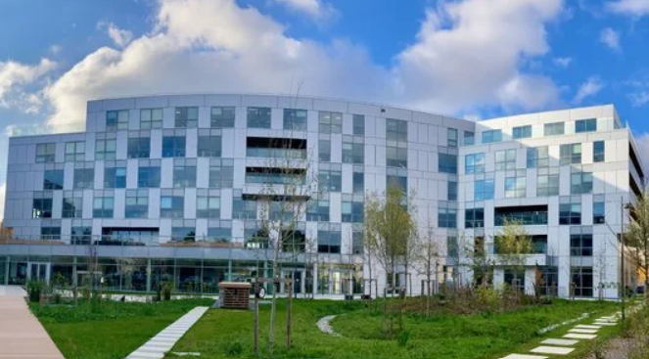
France Lab
Paris-Saclay, France
Fields of Activity
Research
Doc & Vision with AI
Quantum Computing
    Technology
    Biz & DevOps Automation
Decisioning AI (reasoning, fraud detection etc)
Cooperation sought:
Anomaly detection applied to particle physics and fraud detection.
Agent-based simulations for real-time decisions.
Company representative
Pierre Feillet

Slide 2


Dortmund, Germany
Fields of Activity
Data-driven business models
Digital transformation
Data engineering
Data science
Applied AI
Cooperation sought:
Academic and industrial partners for R&D collaboration
Near real-time decision making
Company representative
Jesko Merkel

Slide 3

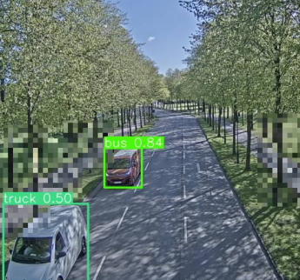
Onsala, Sweden
Fields of Activity
Machine Learning traffic predictions
Congestion Mitigation
Dynamic route guidance for fleets and individual drivers
Cooperation sought:
Strategic partnerships with smart-city operators, vehicle OEMs, infrastructure managers and research institutions.
Co-develop and pilot spatio-temporal predictive-analytics platform.
Company representative
Alexandros Sopasakis

Slide 4


Geneva, Switzerland
Fields of Activity
Financial Market Predications
High Performance Architectures
Advanced Algorithms
Cooperation sought:
Scalable Analytics
Simulation Environments
AI-driven Automation for Industry/Science
Company representative
Stefano Torre

Slide 5

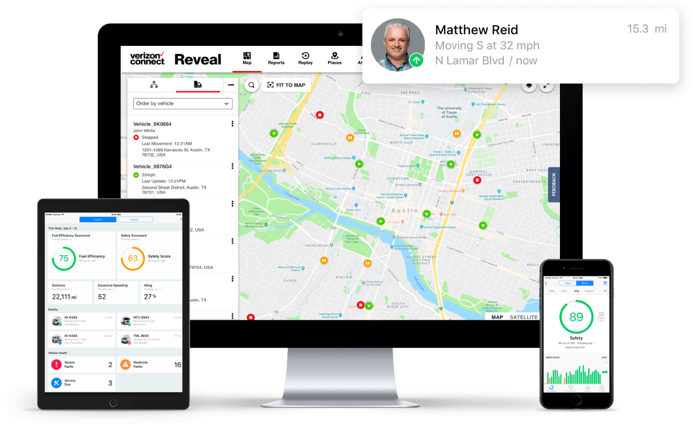
Florence,
Italy (R&D centre)
Fields of Activity
SaaS for Road Vehicle Fleet Management
Connected Vehicles
Machine Learning
Cooperation sought:
R&D and networking opportunities
Company representative
Henrique Piñeiro Monteagudo

