Slide 1


FCC-ee Pre-Injector Complex:
Linac Studies
Andrea Latina

Slide 2
FCC-ee Injector Study Group
10
CHART collaboration. I am referring to the work of three work-packages WP1, WP2, and WP3
Electron Source, Electron and Positron Linacs (WP1, WP2, A. Grudiev)
Positron Source: Target and Capture System (WP3, I. Chaikovska)
Damping Ring and Transfer Lines (WP4, C. Milardi)
The work so far: CERN closely followed the effort
A. Latina¹, (Y. Zhao¹), H. Bartosik¹, A. Grudiev¹, A. Kurtulus¹, S. Doebert¹, Z. Vostrel¹,
S. Bettoni², P. Craievich², J.-Y. Raguin², R. Zennaro², I. Chaikovska³, F. Alharthi³, Y. Wang³
¹ CERN, Geneva (Switzerland)
² Paul Scherrer Institut, Villigen (Switzerland)
³ IJCLab, Orsay (France)

Slide 3
Status of CHART
10
CHART I and CHART II - finished
Mid-term Review end of 2023 → Report in Feb 2024
  “Focus on cost-effectiveness, reduced power consumption, and beam stability”
  Substantial design changes:
    RF frequency
    DR energy (1.54 -> 2.86 GeV)
    Rep. rate
    Overall Layout
    Train structure
Feasibility Report end of 2024
  Completed by the end of 2024
    Simplified layout
    Improved efficiency
    Improved beam stability
    It’s the current baseline
    More work to do.
CHART III – Starting soon (?)

Slide 4
Status of the studies
Electron gun (S. Doebert)
  Design and performance simulation
Positron capture section
  Design and performance simulation
e-Linac and p-Linac
  Design and performance simulation
  Static and dynamic effects
  Beam-based alignment
High-Energy Linac
  Design and performance simulation
  Static and dynamic effects
  Beam-based alignment
Energy Compressor before BR
  Preliminary design
All this was done in RF-Track: elements overlap, multi-species, multi-bunch, beam loading, realistic RF structures, collective effects.

Slide 5
FCC-ee Pre-Injector Complex
100 Hz rep-rate; 4 bunches per train; bunch charge from few pC to 5 nC for top-up injection.
Technical Challenges:
Bunch generation for top-up injection: arbitrary charge from 0 to 5 nC
Emittance versus bunch compression at nC charge
Transverse jitter amplification and damping
Energy compressor and impact

Slide 6
Emittance growth and bunch compressors
  Before EC

Slide 7
Jitter amplification and damping

Slide 8
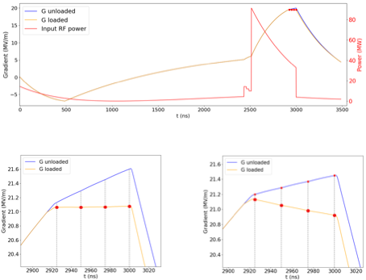
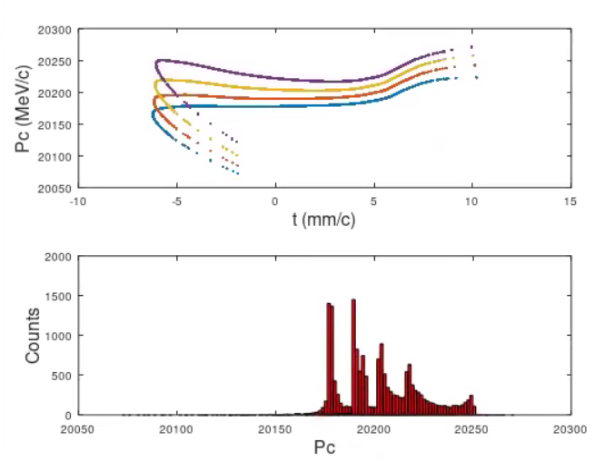
Energy Compressor
5-nC bunch charge. An incoming 0.7% energy chirp from the DR translates into a time-of-arrival delay.
The substantial bunch charge variations ranging from zero to few nC are converted into time delays and jitter.
Nominal charge
“Top-up” operation (5 nC)

Slide 9
Work to be done
1) Energy Compressors and the Bunch Compressor at the interface with the DR
- Design of EC at DR entrance
- Design of BC at HE-linac entrance
- Positron acceptance with the EC might lead to a reoptimisation of the positron linac
2) Start-to-end performance including ECs and BC: static and dynamic
- Impact of Coherent Synchrotron Radiation
- Impact of Intra-Beam Scattering
- Impact of Beam Loading on energy spread / beam stability in top-up mode
3) Complete the design: e.g., insert diagnostics
4) Code development: (RF-Track)
- Coherent Synchrotron Radiation
- Polarization ?
5) Integrate polarization in the pre-Injector design ?
6) Integrate lattices in Lattice repository in appropriate format
7) Experimental verifications
Additional design work: There’s a push to move from 2.8 GHz to 3 GHz, and use of 1.5 GHz for the capture linac. Redesign needed.

Slide 10
Experimental verifications
Experimental programme being discussed with
- FACET-II (B. O’Shea, SLAC) – Experiment approved. Some resources from SLAC.
- SuperKEKB
- CLEAR
Emittance versus bunch compression at nC charge (FACET-II)
Transverse jitter amplification and damping (FACET-II, SuperKEKB)
Bunch generation for top-up injection: charge scan from 0 to 5 nC (FACET-II ?)
Energy compressor (FACET-II ?)

Slide 11
Available and required resources
Code development:
Implementation of CSR (I am to implement it)
Lattice file format: to be discussed with Xsuite colleagues
Beam dynamics: (help needed)
Design and integration of Bunch Compressor / Energy Compressors
Redesign at different frequencies
FACET-II setup: simulation and experimental verification
SuperKEKB linacs: simulation and experimental verification
Resources available:
A fraction of myself
Yongke Zhao, being re-hired as PJAS (but he’ll be shared with WP4 and with some obligations towards LNF-INFN)
Some help will come from CHART III ?

