Slide 2
BOND design status March 2025
BOND 14 T Dipole design meeting
Author: Juan Carlos Perez
Date: Tuesday March 4th

Slide 3
Table of contents
BOND design status
Tooling and Mock-ups for BOND fabrication

Slide 4
Scope of the Work Package
WP3.5: Nb₃Sn 14 T Block dipole BOND
Demonstrate Nb₃Sn performance in a 14 T block-type dipole at 1.9 K
Design and construction of a 14 T accelerator quality dipole model magnet
  The short model magnet should reach 15-15.5 T field
Explore alternatives and develop design and technology for Nb₃Sn accelerator dipoles

Slide 5
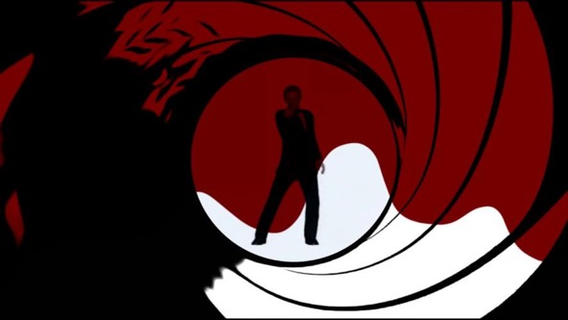
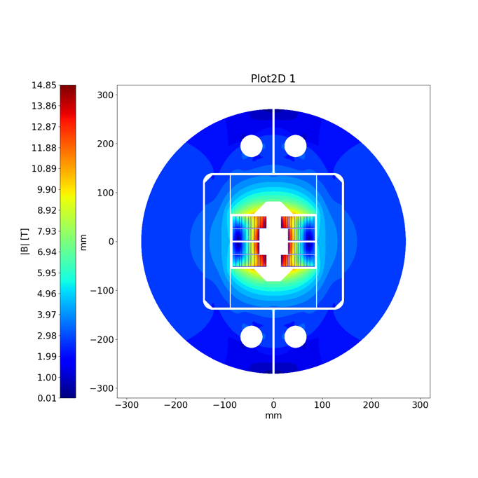
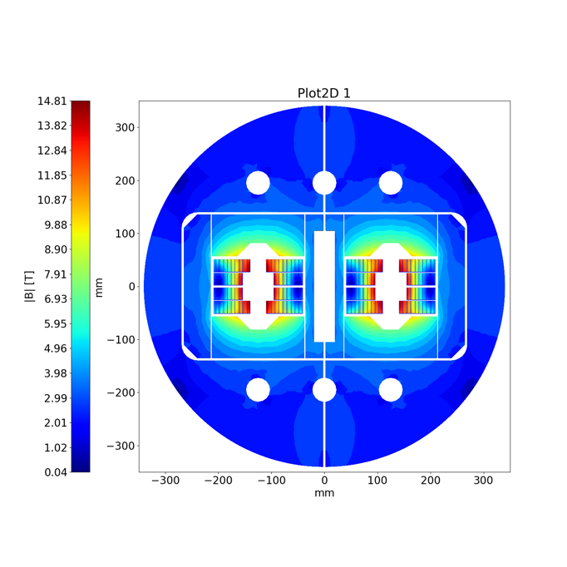
14 T Block dipole BOND
BOND
BOND stands for BlOck coil Nb₃Sn Dipole

Slide 6
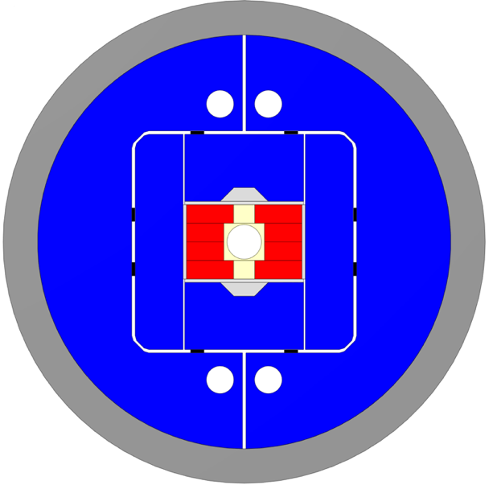
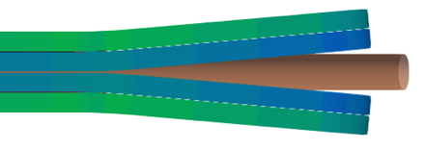
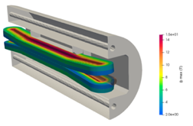
14 T Block dipole BOND
Design requirements:
14 T bore field with ≈ 20 % load line margin
(1.9 K using HFM specs).
Protection time margin*¹ > 40 ms.
Aperture = 50 mm.
Eq. coil width*² < 60 mm → “accelerator coil size”.
Field quality within 10 units at all current levels (excluding PC effects).
Magnet OD:
  Double aperture, inter-beam distance: 250 mm.
  Cold mass OD: 800 mm and Magnet OD: 760 mm.
  For the 1 in 1, we will scale down.
Coil
Vertical pad
Al shell
Horizontal pad
Key
Ti post
Iron yoke
Courtesy of A. Haziot, J. Ferradas & E. Fernandez

Slide 7

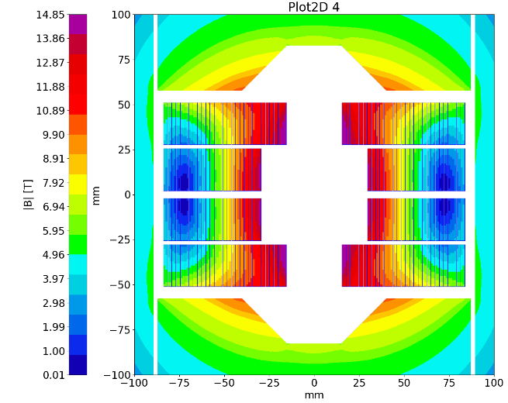
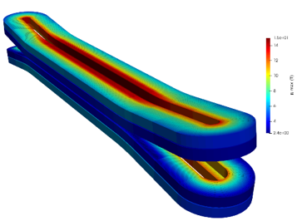
14 T Block Dipole BOND
A first BOND conceptual design (2024) was investigated accounting for the use of a large cable made of 44 strands of 1.1 mm diameter. The cable would be the same as the Test Facility Dipole (TFD), manufactured at LBNL since the strand number exceeds the current capability of CERN’s Rutherford cabling machine.
In parallel, a second design based on a 40 strands cable (which can be manufactured at CERN) was also considered and initially kept as an alternative.
BOND – 40 strands cable
In December 2024, a decision was made to change the baseline for BOND design and proceed with the 40 strands (1.1 mm diam.) option, allowing for the internalization of the cable production.

Slide 8
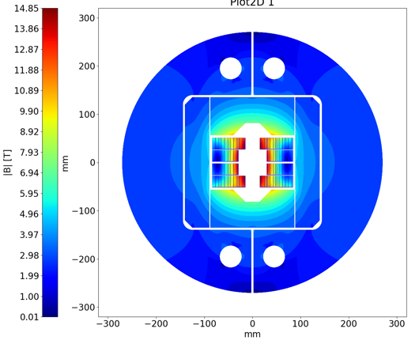
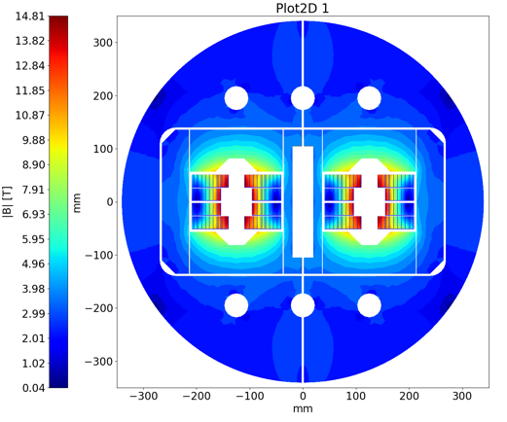
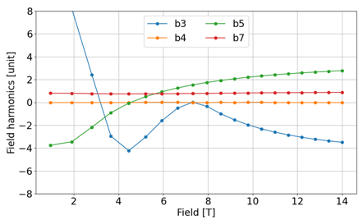
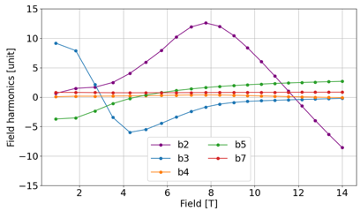
BOND Design Parameters
The 2D & 3D electromagnetic design for the single aperture configuration was completed in January 2025.
Magnet |  | Single | Double
Aperture | [mm] | 50 | 50
Intra-beam distance | [mm] | - | 250
Yoke diameter | [mm] | 540 | 680
Shell diameter | [mm] | 640 | 780
Nominal current | [kA] | 20.005 | 19.340
J overall | [A/mm2] | 360 | 348
J strand (eng.) | [A/mm2] | 526 | 509
Nominal field | [T] | 14.00 | 14.00
Peak field | [T] | 14.85 | 14.81
Ap. to peak field ratio | [%] | 6.0 | 5.7
Load line fraction @1.9 K | [%] | 82.7 | 81.7
Load line fraction @4.2 K | [%] | 92.6 | 91.2
Temperature margin | [K] | 3.99 | 4.11
Inductance | [mH/m] | 4.72 | 10.24
Stored energy | [MJ/m] | 1.031 | 2.064
Coil |  | Single | Double
No. of turns per pole |  | 52
Insulated cable surface | [mm²] | 11572
Equivalent coil width | [mm] | 53.4
Coil efficiency *¹ | [T.mm/A] | 0.00073 | 0.00075
Courtesy of A. Haziot

Slide 9
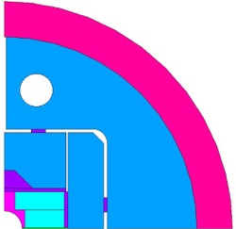
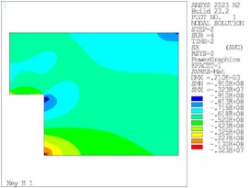
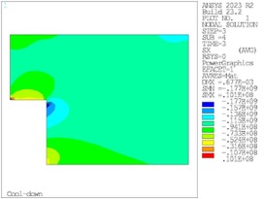
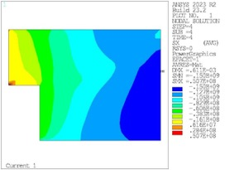
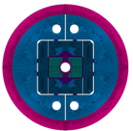
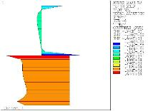
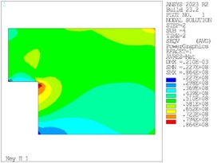
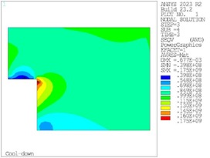
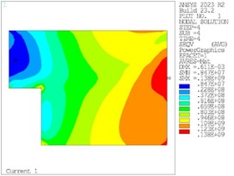
BOND Mechanical Design
Peak at RT = 91 MPa
Peak at CD = 177 MPa
Peak at 14 T = 150 MPa
X-component of stress (MPa) during assembly (left), cool down (centre), and at 14 T (right).
Coil to pole contact pressure at 14 T
Peak at RT = 86 MPa
Peak at CD = 175 MPa
Peak at 14 T = 140 MPa
Von Mises stresses (MPa) during assembly (left), cool down (centre), and at 14 T (right).
Courtesy of J. Ferradas

Slide 10
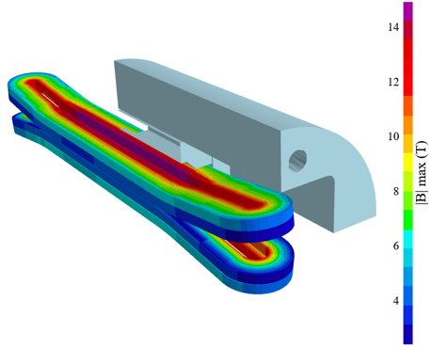
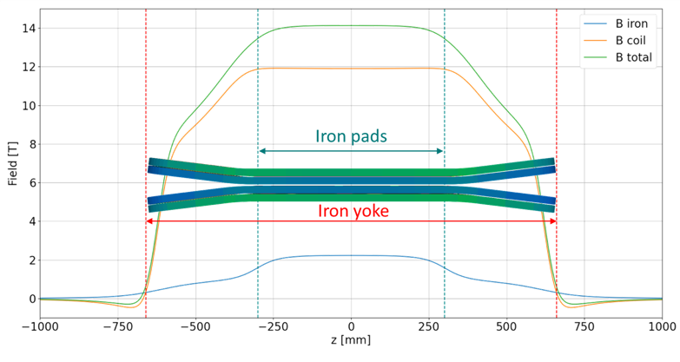
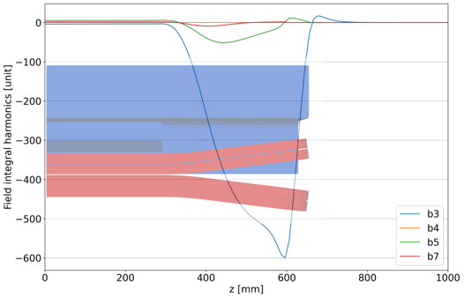
BOND Coils Configuration and Field Profile
Flared end curvature radius | mm | 750
Flared end angle | º | 7
Flared end straight section | mm | 178.4

Slide 11
Tooling & components design
Coil components and coil fabrication tooling design is well on track.
The 3D design will be completed by end of April.
First tooling delivered is expected by late summer 2025.
Impregnation
Winding
Reaction
Courtesy of N. Peray

Slide 12
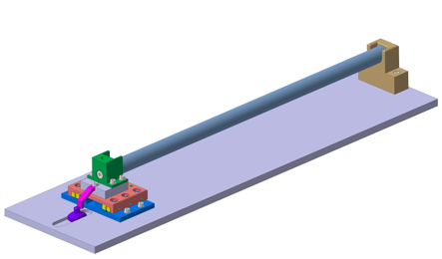
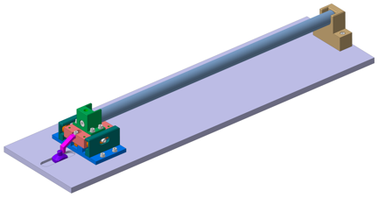
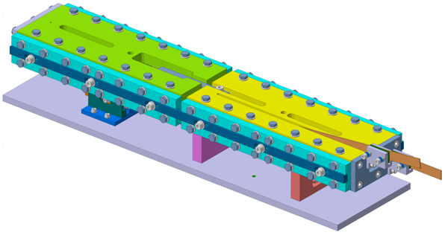
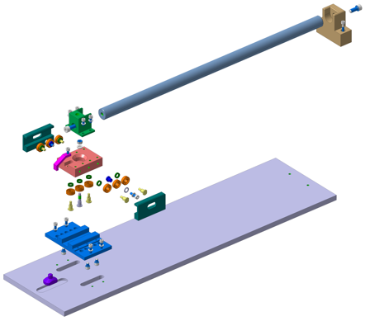
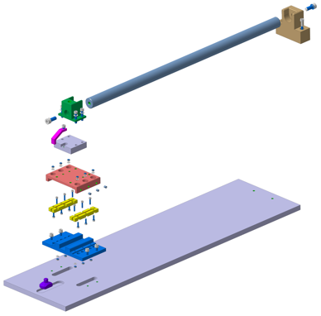
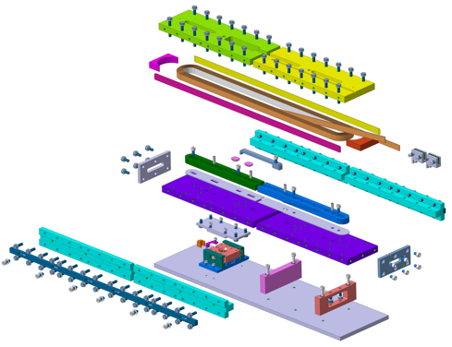
Mock-up design of sliding reaction tooling
Thanks to the experience gained during the construction of the Race-tracks, FRESCA2 and MQXF magnets, BOND tooling designed to compensate for dimensional variations during heat treatments is currently in the design phase.
Racetrack coil mock-up with integrated sliding system
Linear ceramic bearing
Circular ceramic bearing
The basic concepts will be validated using simplified mock-ups that replicate conditions close as possible to those that will be used during coil manufacturing.
Courtesy of N. Lusa, J. Ferradas & B. Pellet

Slide 13
BOND Magnet development plan
Analysis
Iterative engineering design
First Single Aperture Magnet #1 assembly
Trial Copper Coil
Powering tests Magnet #2
Today
1st Nb₃Sn Coil Winding
Double Aperture Magnet #1 assembly
Q1_2025
Q2_2025
Q3_2025
Q4_2025
Q1_2026
Q2_2026
Q3_2026
Q4_2026
Insulated Nb₃Sn Cable delivery
Double Aperture Magnet Magnet #1 powering tests
First dummy copper cable at CERN
Single Aperture Magnet #2 assembly
Coil 3D CAD Design
Cold Powering
Tests Magnet #1
3D CAD Winding, reaction & splicing tooling
Tests using Mock-ups

