Slide 1
BOND 14T
Ceramic coatings
Ariel Haziot
February 25th, 2025

Slide 2
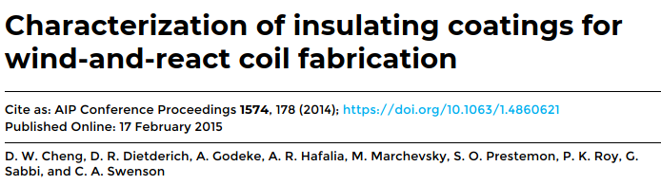
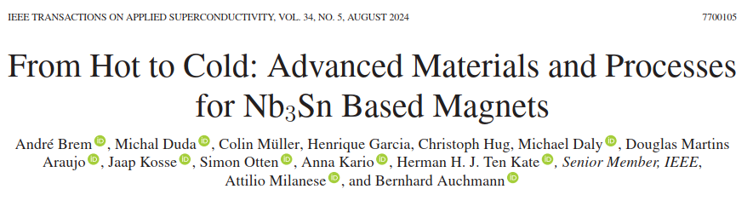
Outline
Alumina plasma spray coating
  Used in 11T for headspacers
  Used at LBNL
Ceramic coating Armeco
  Applied on magnet parts at PSI
  In development at LBNL

Slide 3
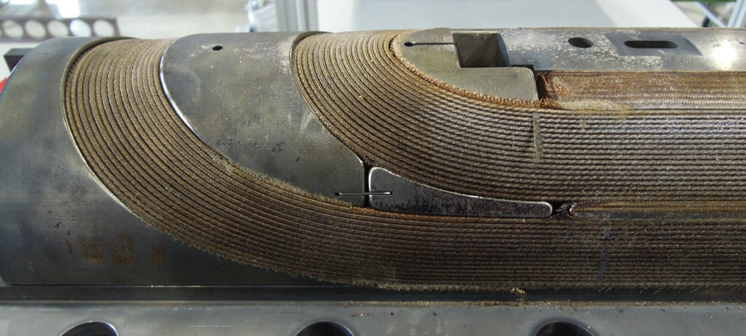
Plasma spray coating
From 11T review
Insulation of spacers for 11T:
  Al₂O₃ by plasma coating does not withstand the reaction (peels off)
  Vitreous Enamels: no R&D available
  Al₂O₃ by PVD coating gives promising results, currently under development with the Danish Technological Institute (DAI 7534740)
Did not go through at the end.
Explored again by C. Scheuerlein

Slide 4
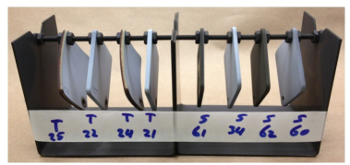
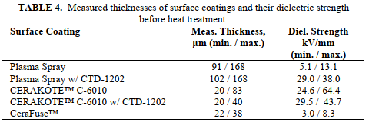
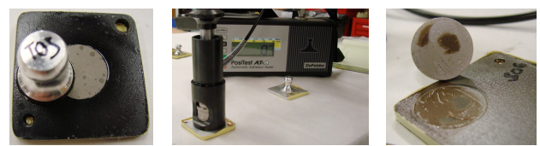
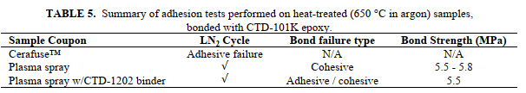
Plasma spray coating
Tests at LBNL:
Initial findings suggest that:
plasma sprayed surfaces have good potential when used in Nb3Sn coil fabrication
It has been shown to survive the heat treatment and cryogenic thermal cycles without detrimental effects.

Slide 5
Outline
Plasma spray coating
  Used in 11T for headspacers
  Used at LBNL
Ceramic coating Armeco
  Applied on magnet parts at PSI
  In development at LBNL

Slide 6
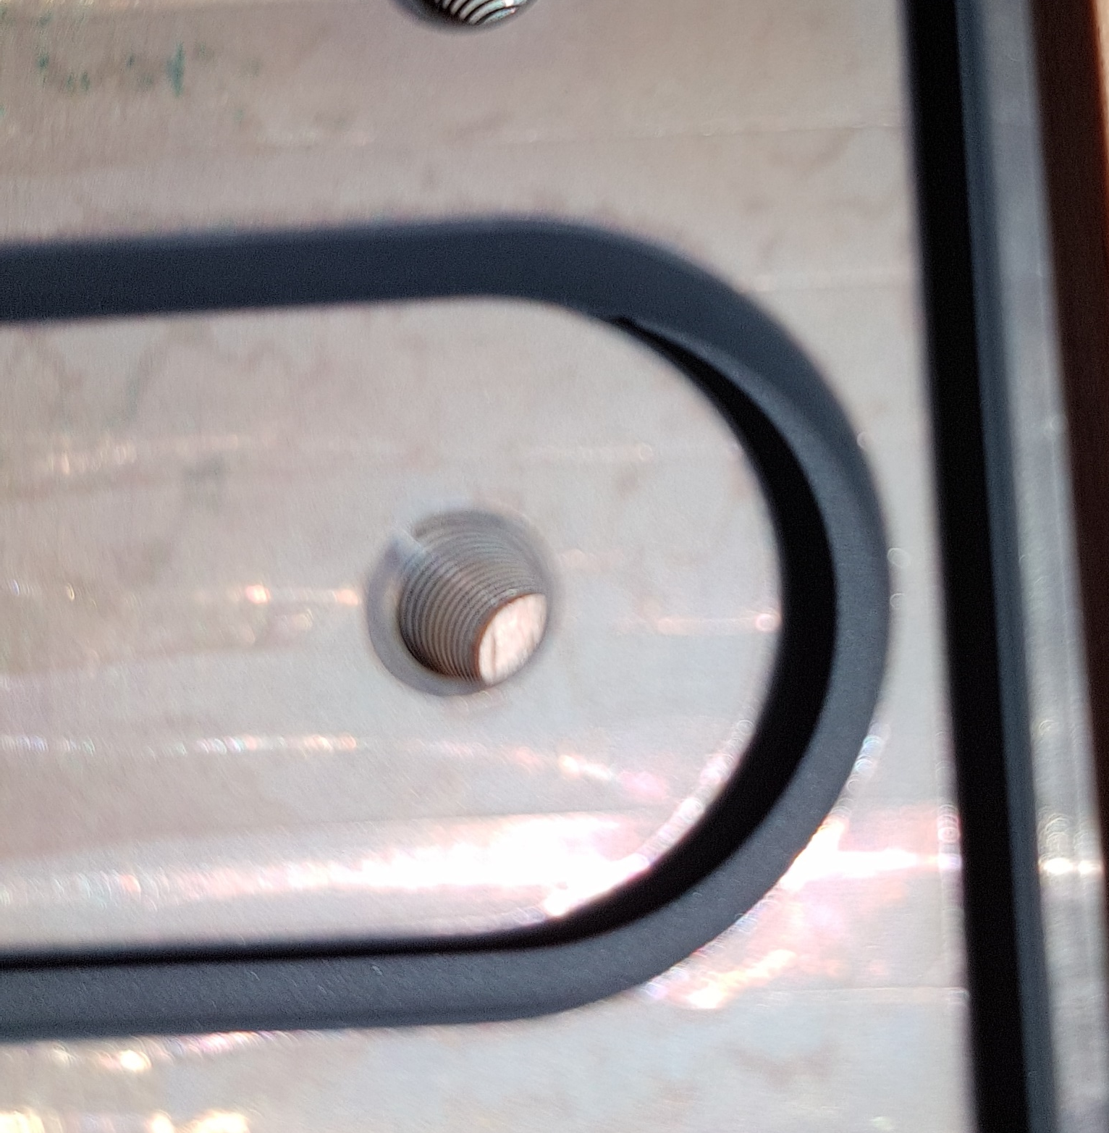
Ceramic coating - Armeco
Various commercial ceramic coatings were testedas an alternative to line of sight coating methods
Aremco SGC4000-HT was chosen as a suitable coating
  temperature resistance to 760 °C, requires glazing at 720 °C
  40 V/μm dielectric breakdown strength
  simple dilution with alcohol (adjustable viscosity)
  suitable for spraying (fine particles), dip-coating
  good adhesion to stainless steel
  survives the reaction cycle
coating
ceramic coating on box channel

Slide 7
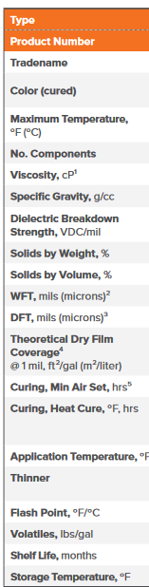

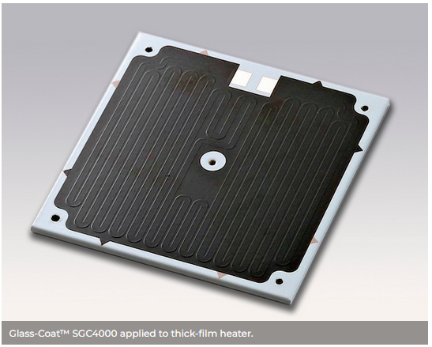
Ceramic coating - Armeco
https://www.aremco.com/wp-content/uploads/2018/05/A05_S1_18_Electrical.pdf

Slide 8
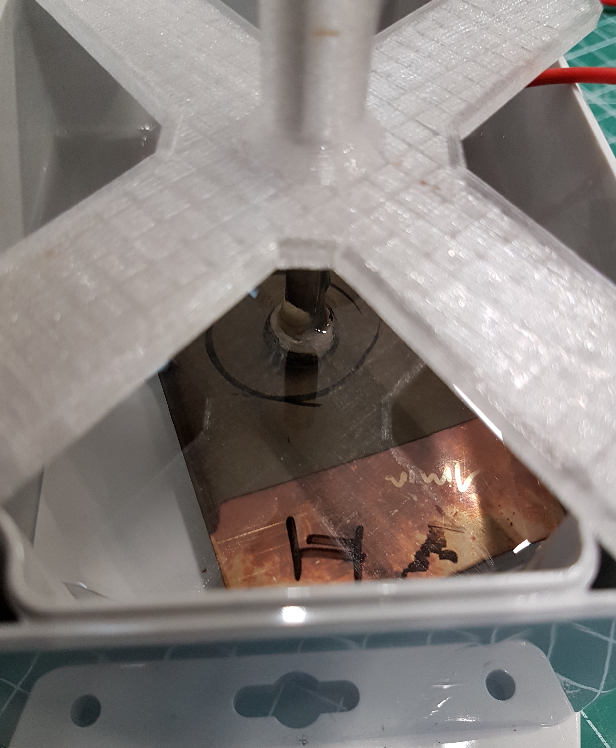
Ceramic coating - Armeco
electrode
paraffin oil
coating
stainless steel
electrode
Layer thickness measured with a Testboy 70
Voltage applied with a Megger MIT515 in steps

Slide 9
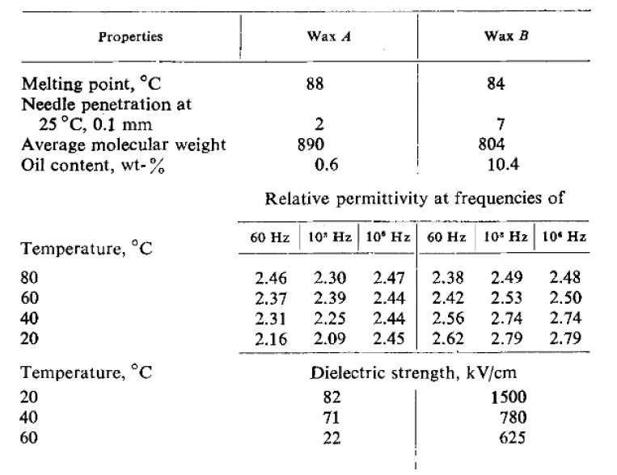


Ceramic coating - Armeco
Aremco SGC4000-HT in paraffin oil
layer thickness (μm) | breakdown voltage (V) | expected DBS value (V)
11 | 490 | 444
21 | 750 | 822
32 | 1160 | 1244
36-40 V/μm
(Freund 1982)
BOX wax in paraffin oil
layer thickness (μm) | breakdown voltage (V)
93 | >5000*
65 | >5000*
>76 V/μm
* 5kV is the limit of the Megger MT515
8.2 $V/μm$
150 $V/μm$

Slide 10
Ceramic coating - Armeco
Comparison with other materials
Material | DBS (V/μm)
S2-Glass, AGY, RT | 13*
Stycast 2850FT + 23LV, RT | 14.8*
MY750, RT | 27.5*
BOX wax immersed, RT | >76
Aremco SGC-4000HT, RT | 36
*values from datasheet

Slide 11
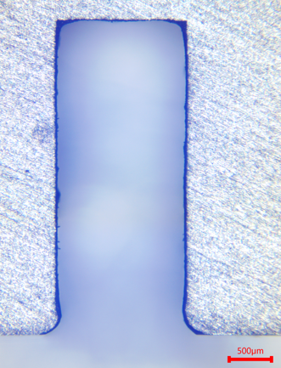
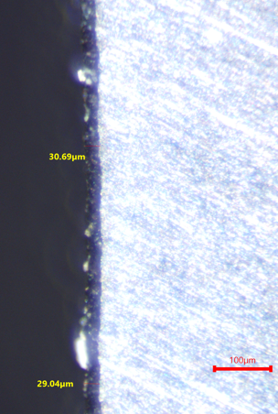
Ceramic coating - Armeco
deep channels, aspect ratio 1:2.5
even coating – controllable thickness
smooth finish possible with
additional water glass coat
used as secondary insulation in addition to the glass fiber

Slide 12
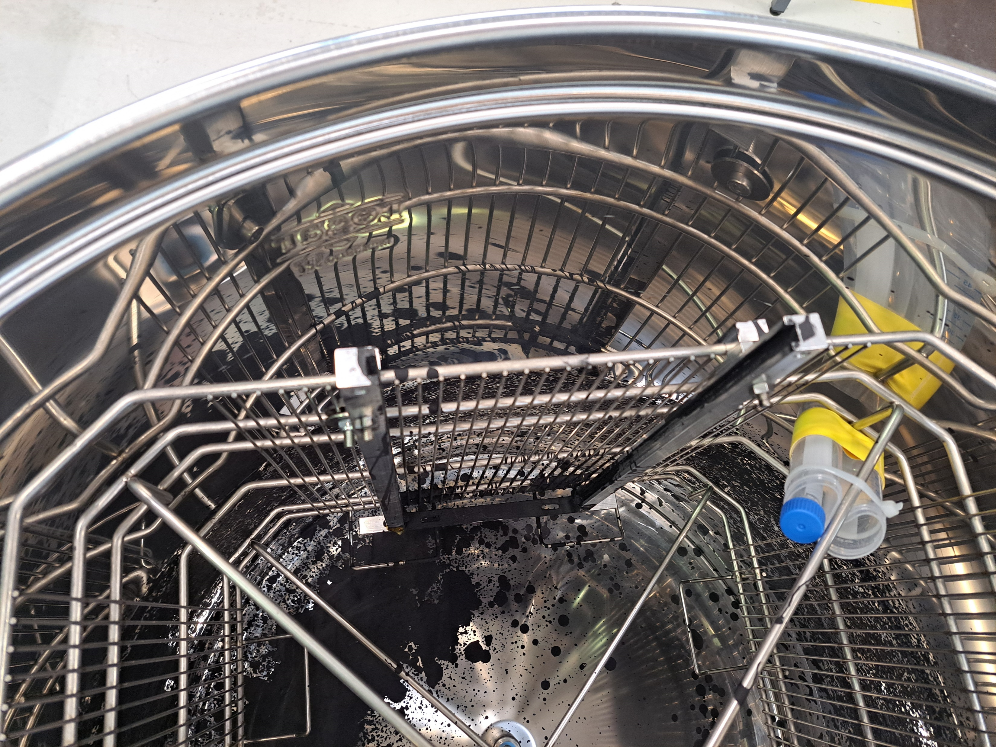
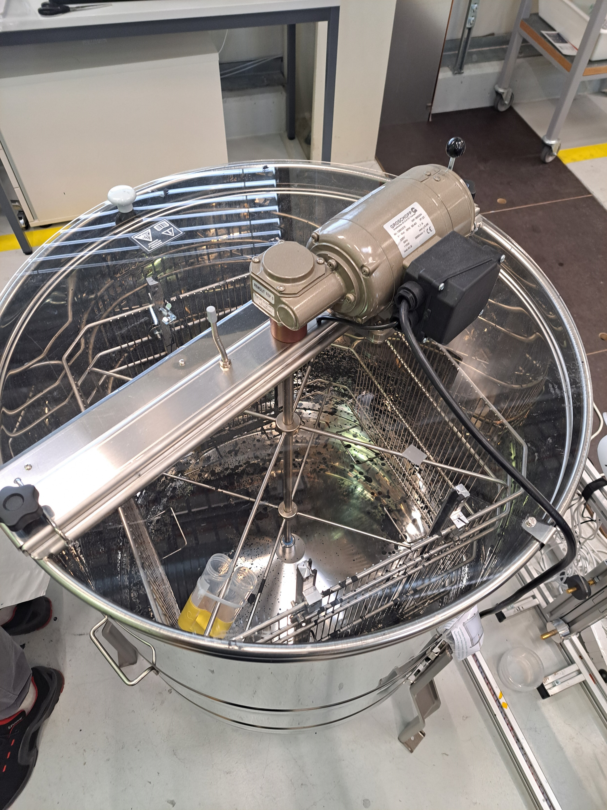
Ceramic coating - Armeco

Slide 13
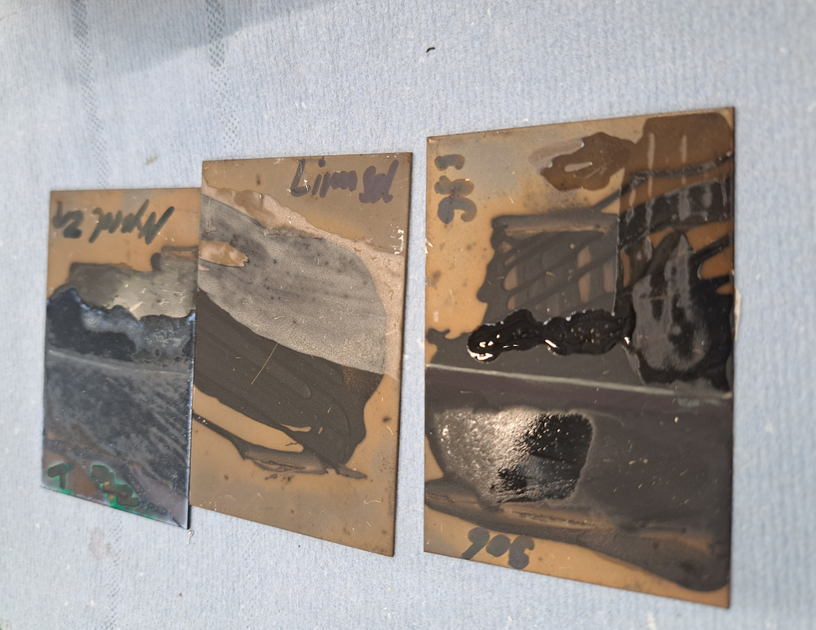
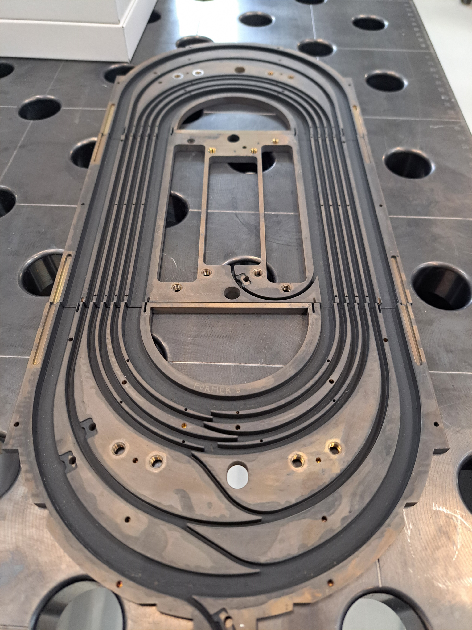
Ceramic coating - Armeco

