Slide 1
Bond
Mock-up design of sliding reaction tooling
N. Lusa and J. Ferradas Troitino
04/03/2025

Slide 2
Test set-up
Updates w.r.t. the last meeting (04/02/25)
  Linear/circular ceramic bearings test set-up
    Drawings signed
    All the material for manufacturing and assembly in-house
  Is the intermediate heat treatment needed? Here below what we observed
    The small components (CRNMHF0ST0049) did not change in shape after HT
    The titanium plate (CRNMHF0ST0039) experienced release of tension that changed its shape (details in the next slides)
      Based on that, we propose to repeat the same process only for the larger parts, i.e. for the titanium plate for the racetrack coil mock-up
      OPEN QUESTION: Are we sure the plate will not move anymore during the next heating cycles? Maybe some reinforcement could be needed to increase its stiffness…
  Displacement measurement based on high temperature capacitive sensors or other measurement device
    Meeting with EN-MME on 03/12/2024 to activate a collaboration aiming at finding the appropriate measuring device for our case
    We expect to have soon (within end of February) a tentative timeline for
      Feasibility study
      Purchasing of one or more measurement systems
      Calibration
      Implementation and integration of the measurement system in a dedicated mock-up
    In parallel mechanical system will be implemented to measure the maximum displacement during RHT, once the cycle is finished
EDMS 3227341

Slide 3
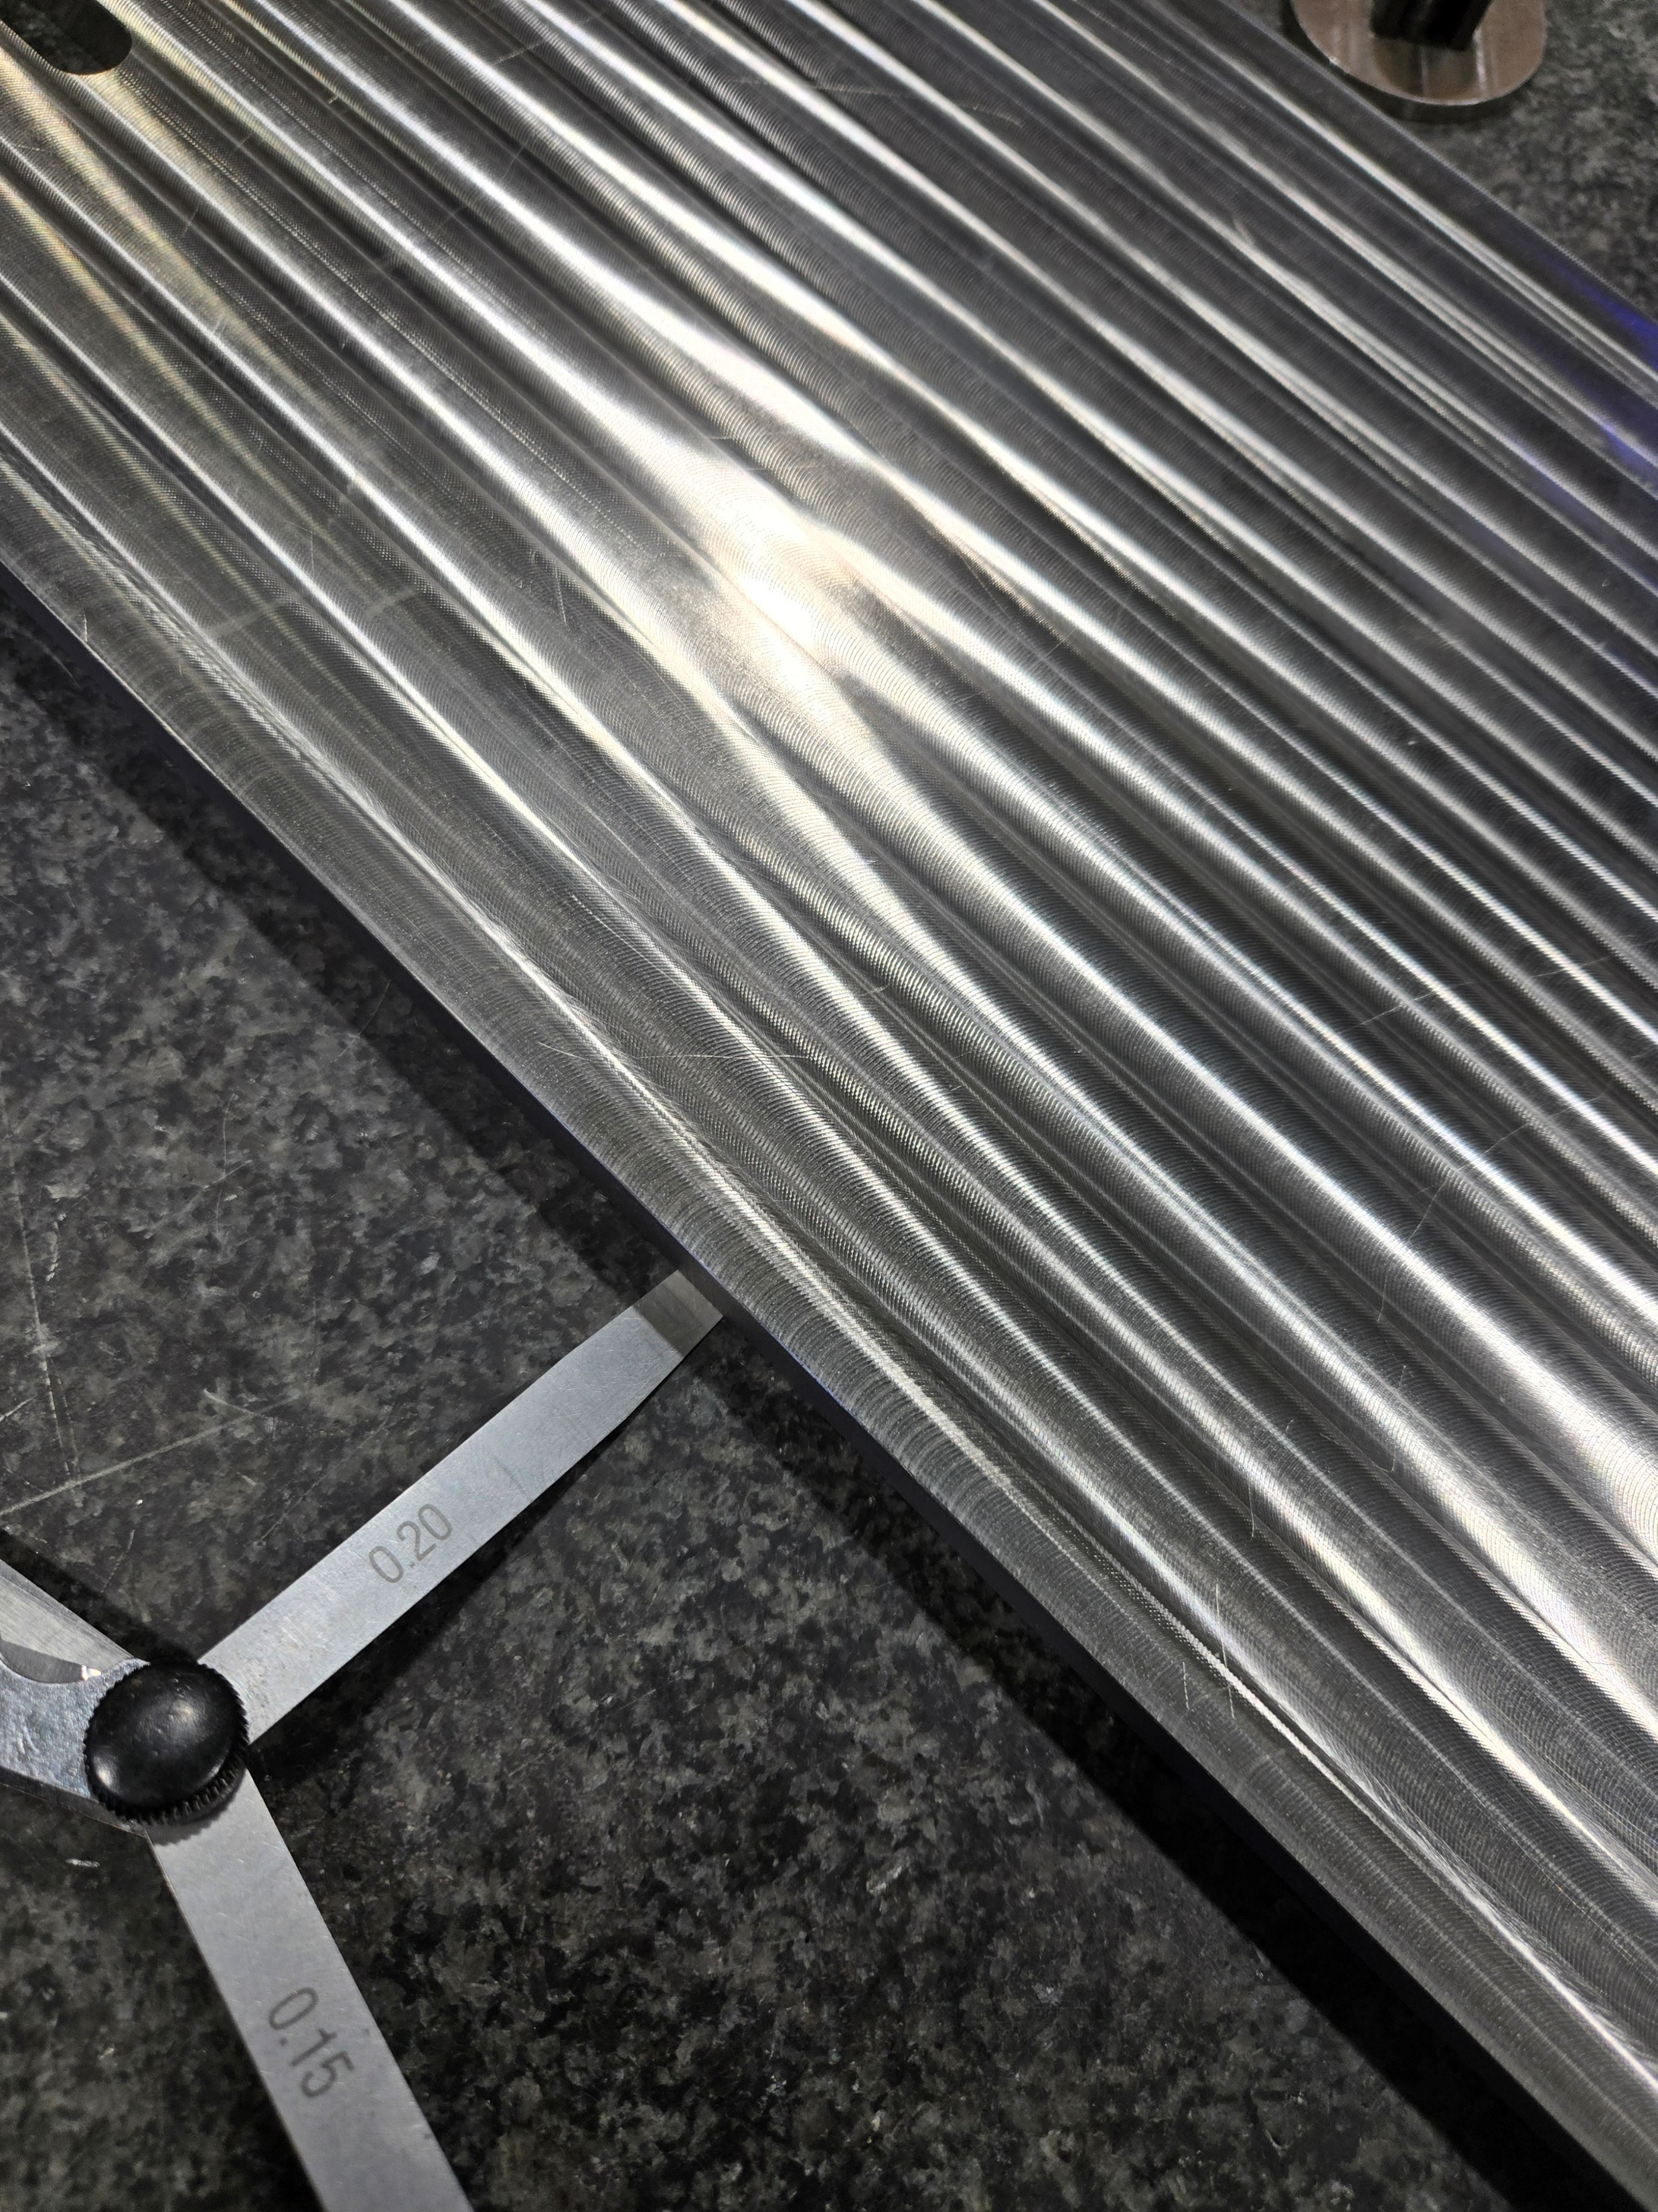
Metrology of the plate before/after HT
  The plate is checked with dial gauge
    Prior HT
      The plate has a belly shape with a maximum of about 0.280 mm towards the middle
      It is not something local, but the deformation is general
    After HT
      The plate deformed in the opposite direction due to release of internal tensions
      The HT cycle was effective and needed prior to perform the finishing
Courtesy of A. Vieitez Suarez
Prior HT

Slide 4
Manufacturing schedule

Slide 5
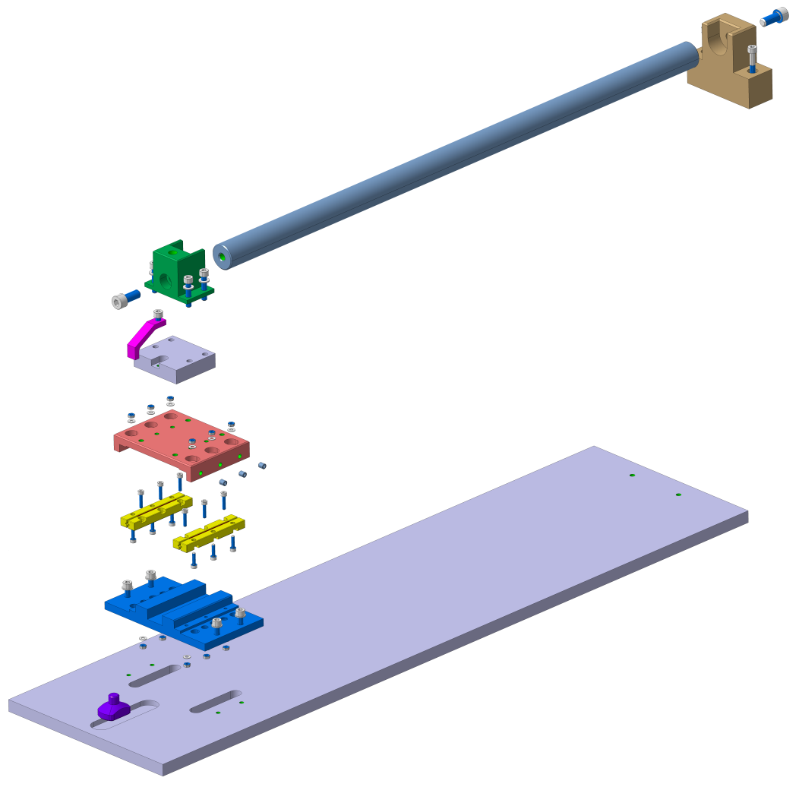
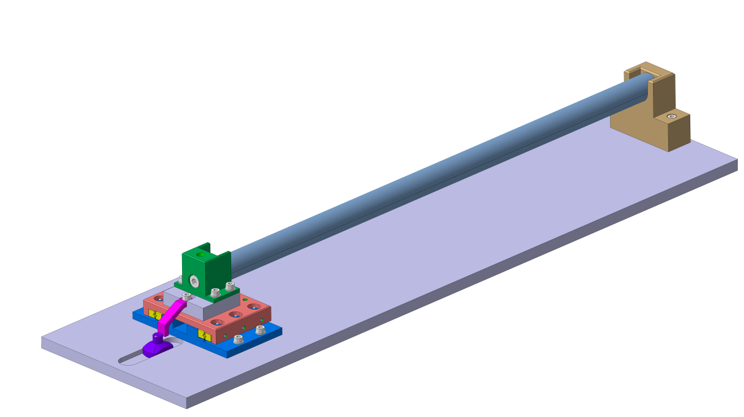
Test set-up:
Linear ceramic bearing
Courtesy of B. Pellet

Slide 6
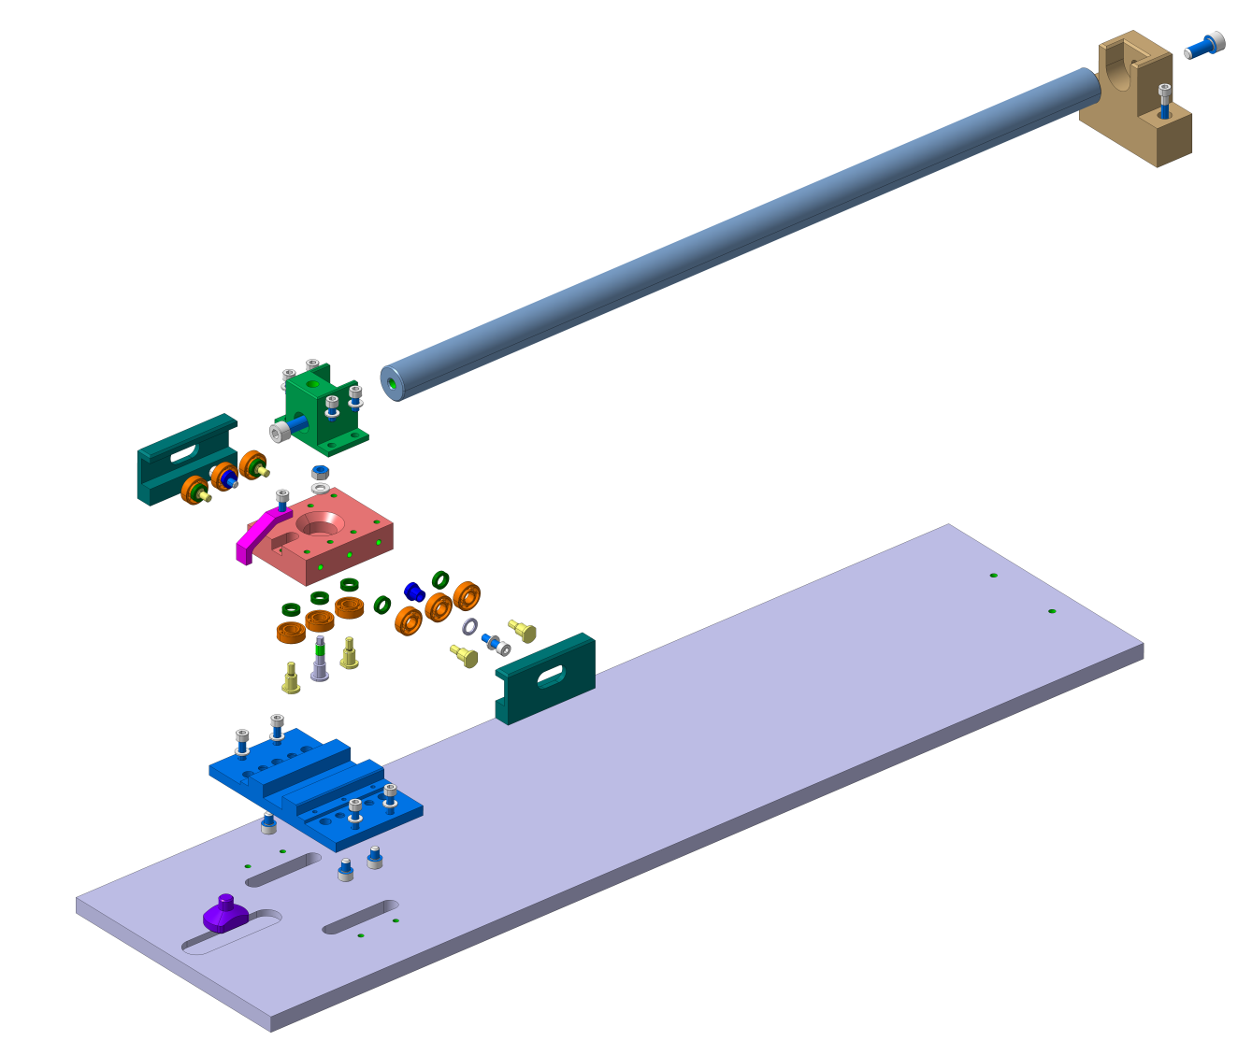
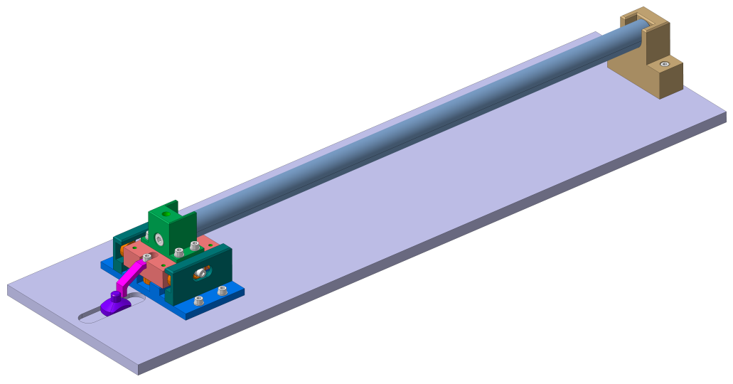
Test set-up:
Circular ceramic bearing
Courtesy of B. Pellet

Slide 7
Racetrack coil mock-up test set-up
Updates w.r.t. the last meeting (04/02/25)
    3D model completed
      Detail drawings of the mold completed
      Integration of the sliding system completed
      Drawings sent for signature
    Meeting with P. Moyret about the manufacturing of the components
      The parts will be manufactured in the main workshop with an intermediate heat treatment at 950°C for 2h for detensioning
      Announced delay: 05/2025
    MQXFB insulated cable leftovers for the winding, about 15m for the test
      Cable with keystone angle → suggestion of making lateral shims with a compensation angle
  Design of a test set-up with one flared end coil mock-up
    Next step, using N. Peray coil design as input for the coil end
    Take advantage as much as possible of the components manufactured for the racetrack coil mock-up
EDMS 3234739

Slide 8
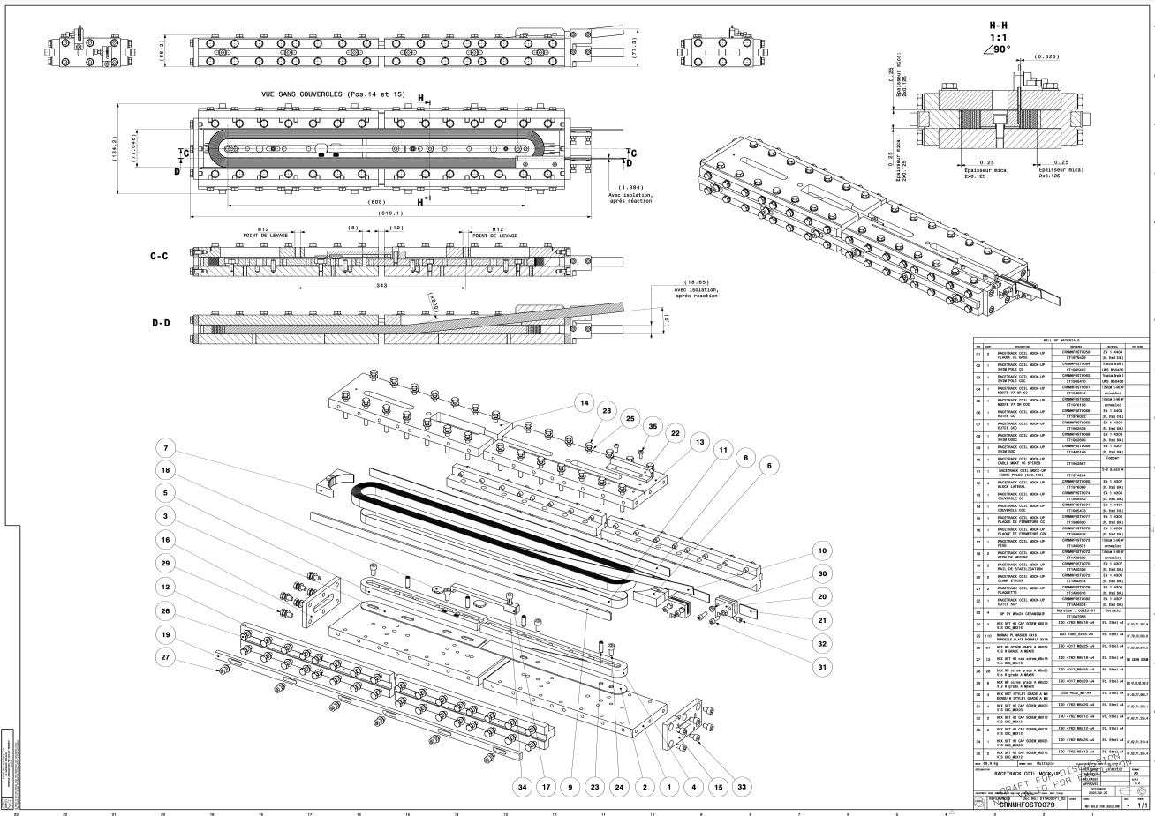
Racetrack coil mock-up
EDMS 3234739
Courtesy of B. Pellet

Slide 9
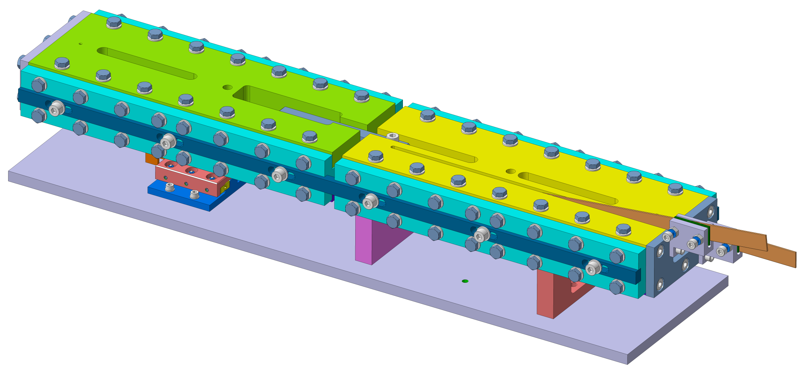
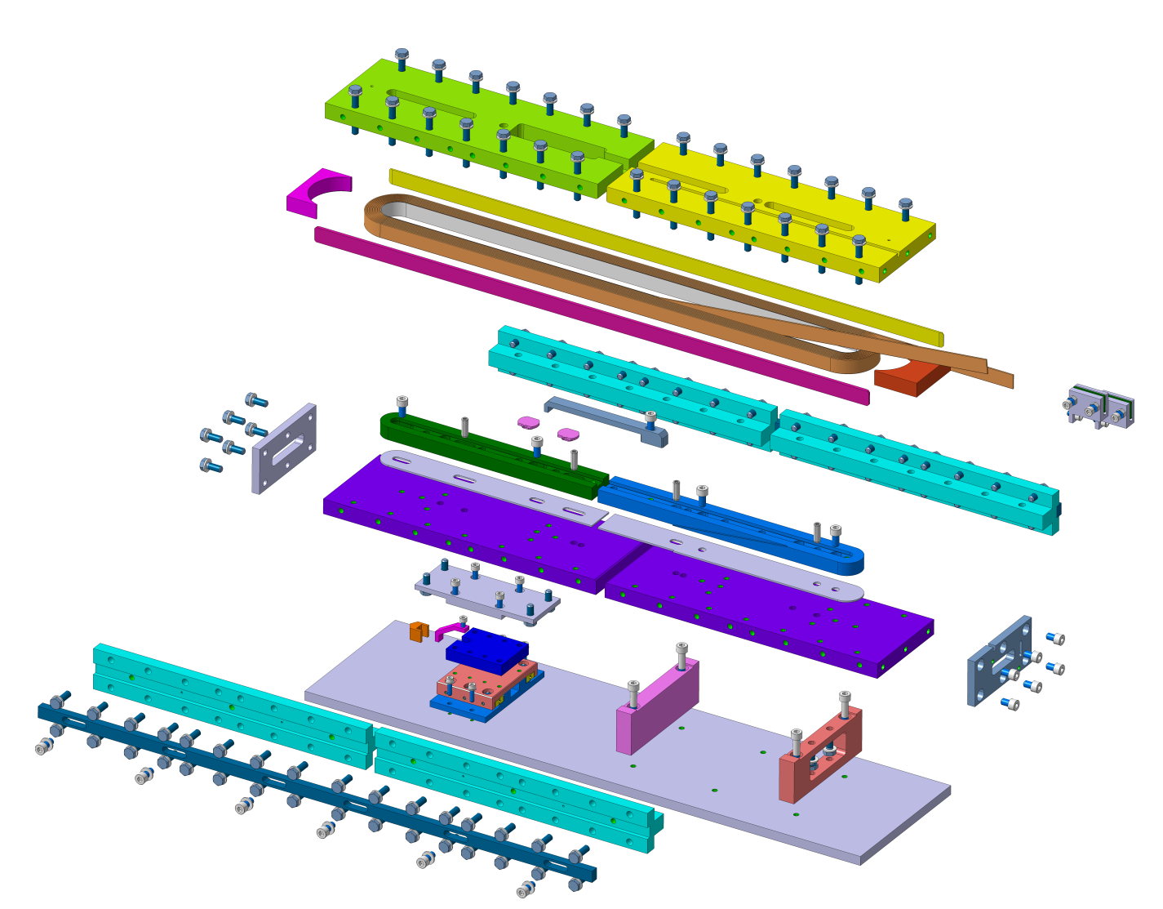
Racetrack coil mock-up
Set-up suitable for both sliding systems (linear and circular ceramic bearings)
Courtesy of B. Pellet

Slide 10
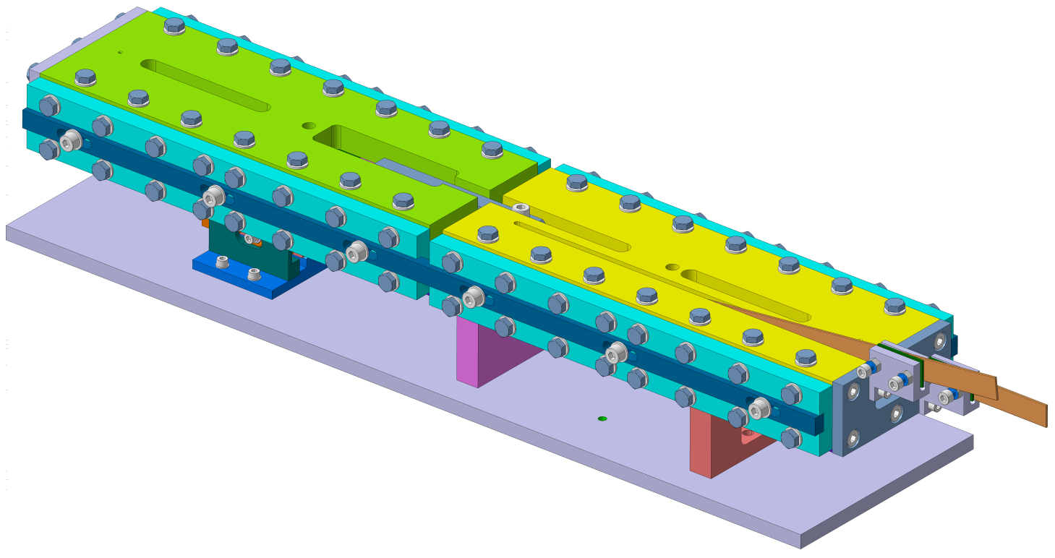
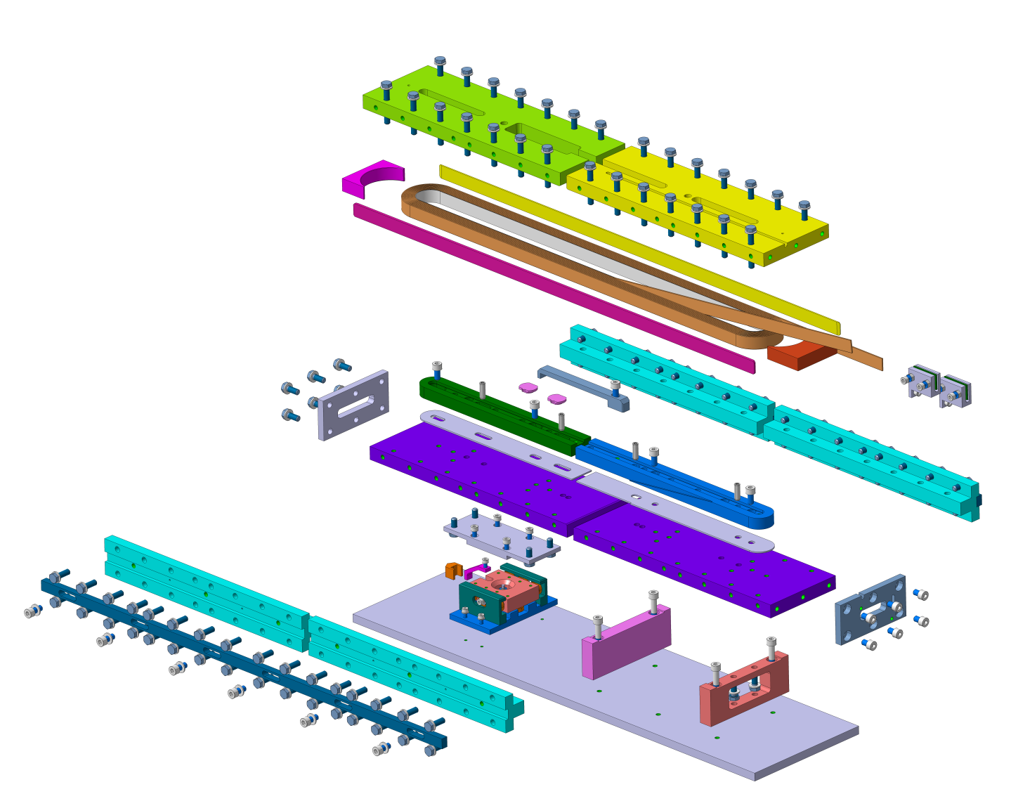
Racetrack coil mock-up
Set-up suitable for both sliding systems (linear and circular ceramic bearings)
Courtesy of B. Pellet

Slide 11
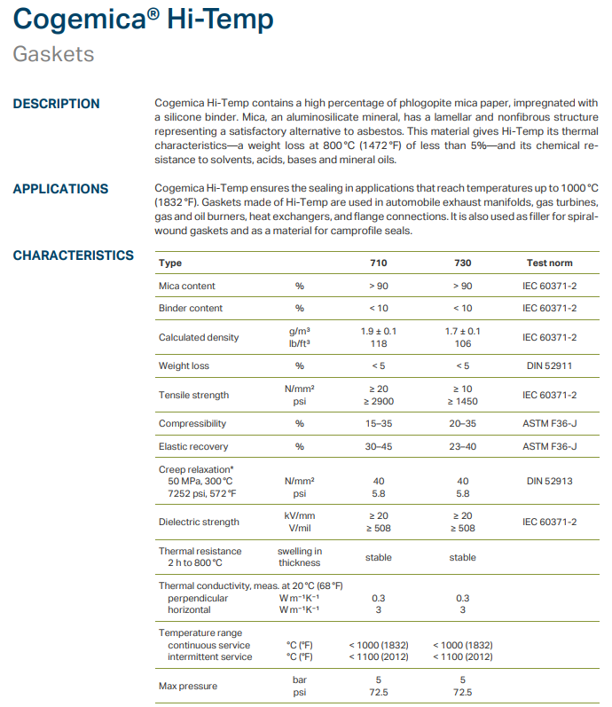
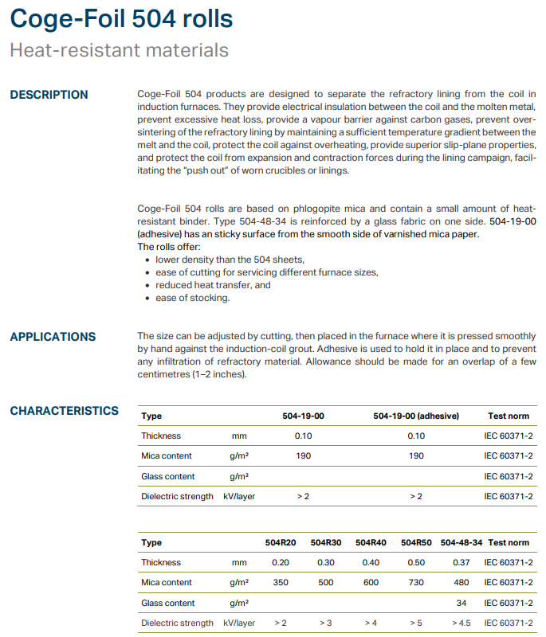
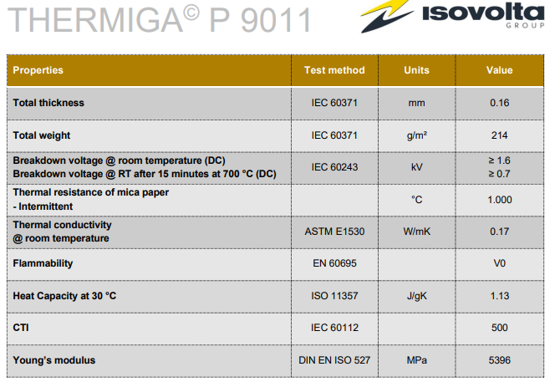
Parallel activities for BOND coil manufacturing
MICA
  In contact with different supplier to explore the possibility to have a mica with following specs
    Low content of resin
    High temperature resistance resin
    Procurable in custom sizes
  Only 2 companies replied, as of today
TGA + FTIR tests to be performed at the chemical lab to check for the mass loss at high temperature and the type of resin
  COGEBI
    Cogemica® Hi-Temp 730
      Already used in US for MQXFA coils
      Got samples for tests
    Coge-foil 504
  ISOVOLTA
    THERMIGA© P9011

Slide 12
Parallel activities for BOND coil manufacturing
FIBER INTERLAYER
  In contact with Final Advanced Materials to explore the possibility to have a different type of fiber for the interlayer manufacturing
    Ceramic fiber (72% Al₂O₃ and 28% SiO₂)
    Silicate fiber (94% SiO₂, 4% Al₂O₃ and others)
    Rescor 901A ceramic binder as hardener or rigidizer for insulation materials
    The Polymer Lab is joining the test campaign to characterize the materials
    Got samples to start performing tests
MICA INTERLAYER
  In contact with Cogebi to explore the possibility to have a 2mm thick mica laminate for the interlayer manufacturing
    Discussion ongoing to target the right product to test
CMC (Ceramic Matrix Composite) INTERLAYER
  In contact with Isovolta to explore the possibility to have use a Lightweight Ceramica Matrix Composite prepreg for the interlayer manufacturing
    Discussion ongoing to check whether CERAPREG® product could fit our need

Slide 13
Spare slides

Slide 14
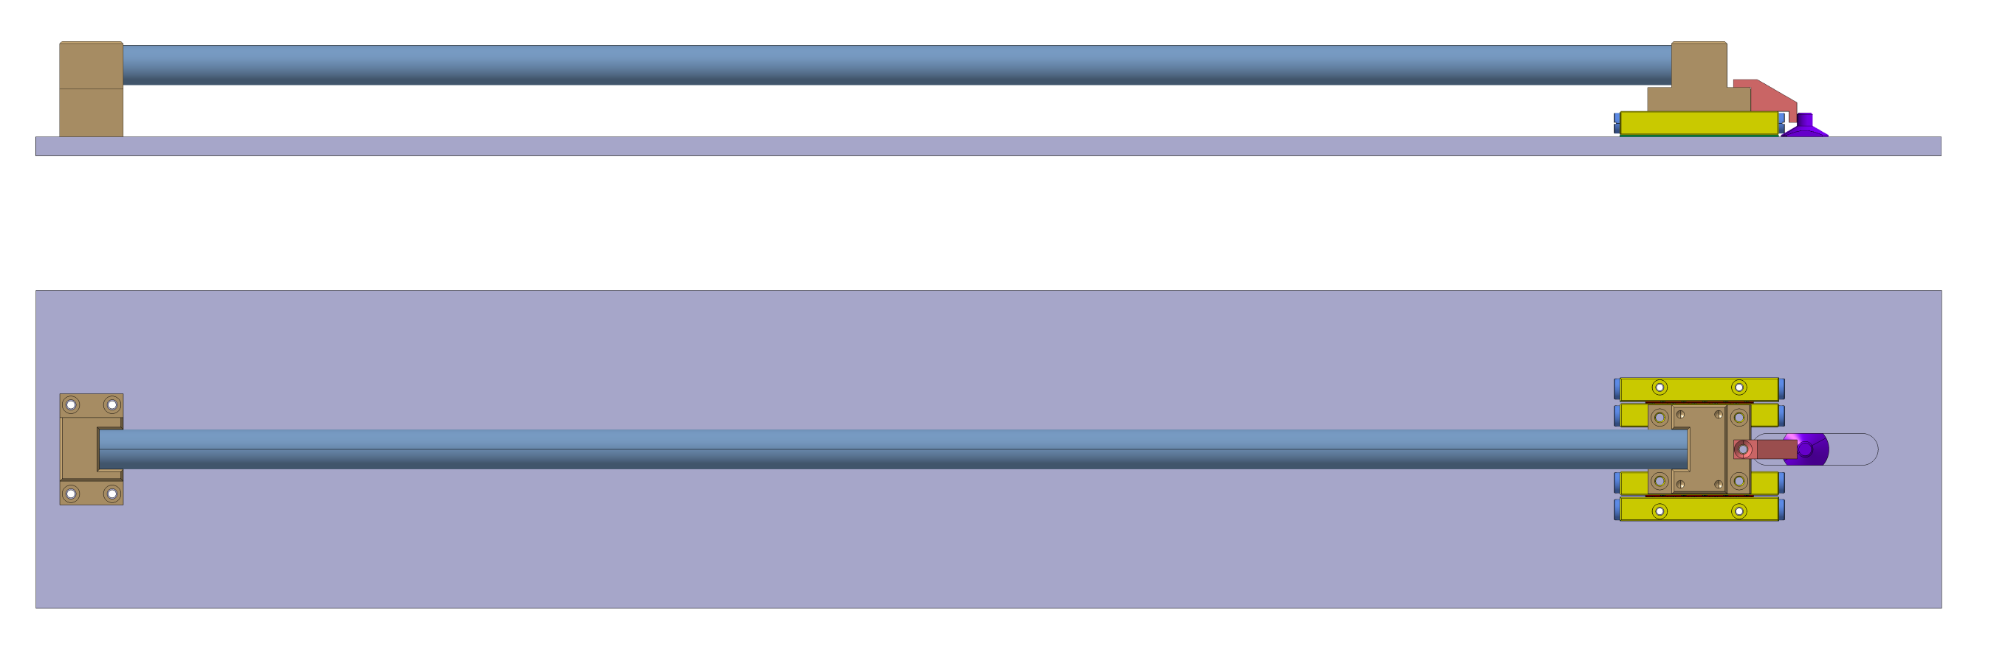
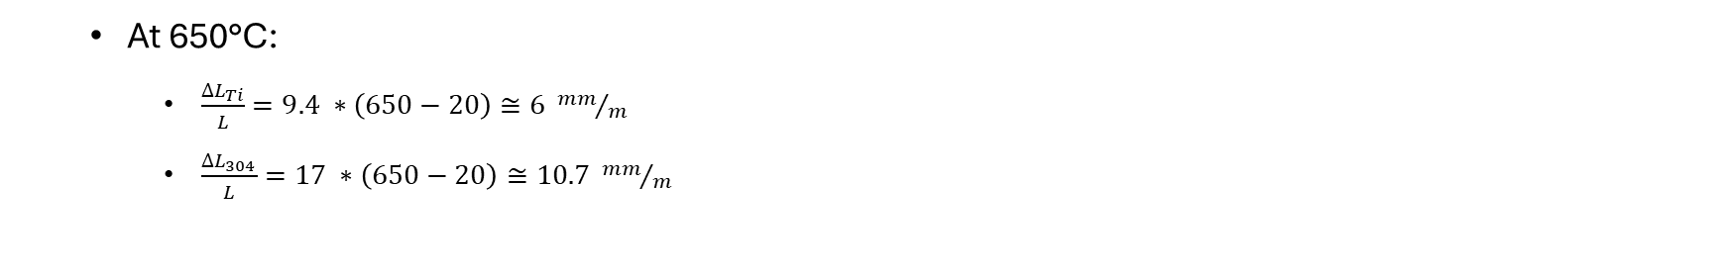
Test set-up
0.6m long bar
(SS 304)
  At 650°C:
    $\frac{{∆L}_{Ti}}{L}=9.4 ∗\left(650−20\right)≅6 {mm}/m$
    $\frac{{∆L}_{304}}{L}=17 ∗\left(650−20\right)≅10.7 {mm}/m$
A 0.6m long bar of SS 304 is enough to have a differential displacement of about 2.8 mm

Slide 15

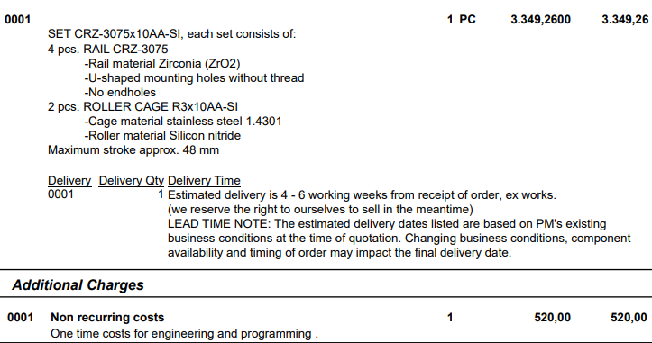
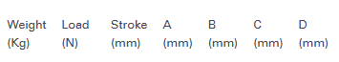
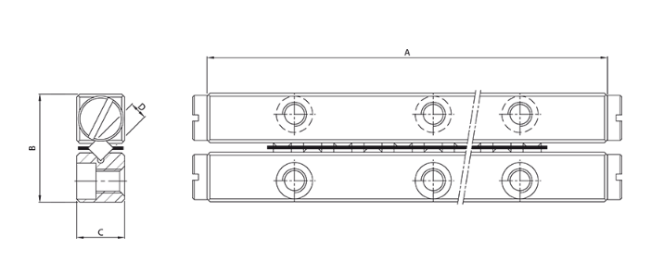
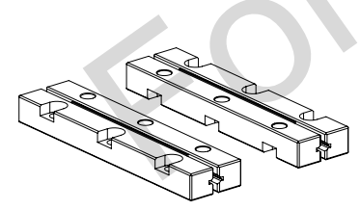
1st option
Linear ceramic bearing
Purchasing of 1 set CRZ-3075x10AA-SI:
  4 pcs ZrO₂ rails (Si₃N₄ rails available upon request and for a MOQ)
  2 pcs stainless steel roller cage and Si₃N₄ rollers

Slide 16
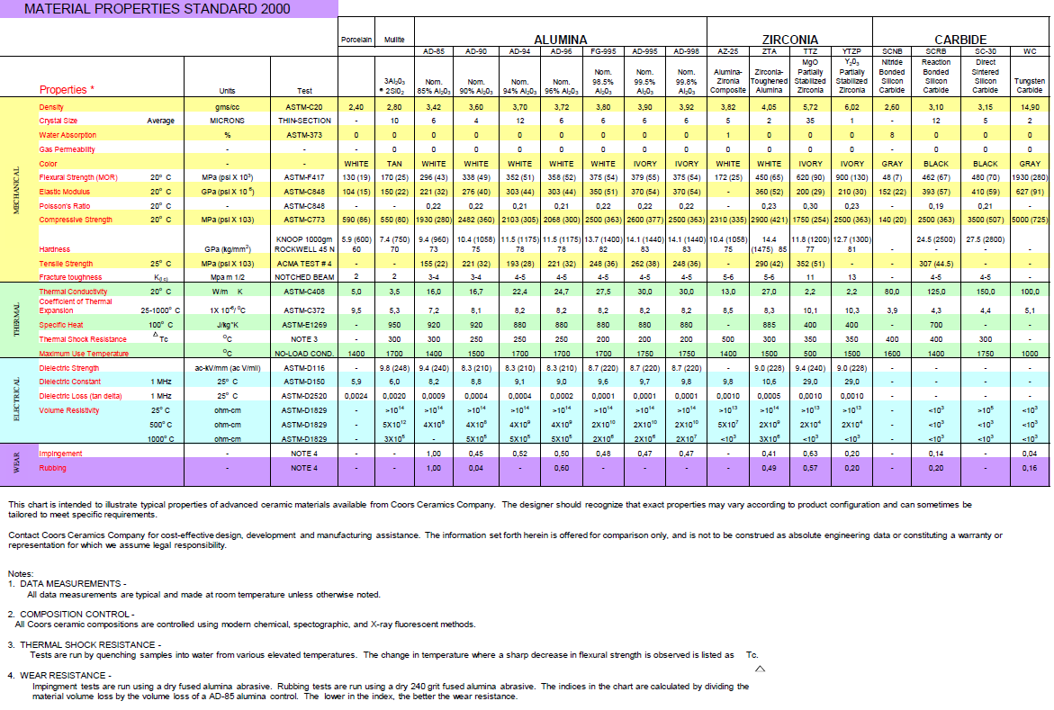
ZrO₂ properties (supplier datasheet)

Slide 17

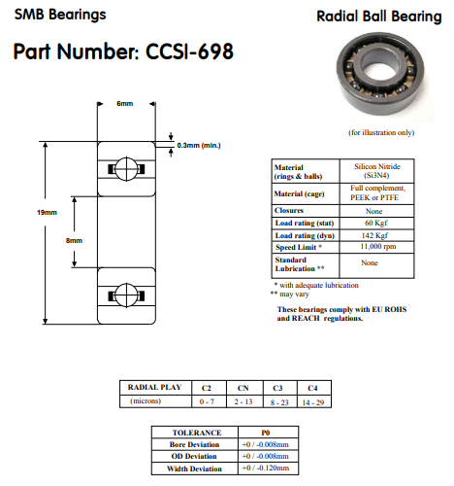
2nd option
Circular ceramic bearing
Based on actual full Si₃N₄ bearing stock, they can propose us only bearings without cage
  In principle for temperatures between 500-900°C a GH4099 nickel-based alloy cage could be used
Price for 6 bearings CCSI-698 (chosen randomly for the mock-up manufacturing)
  26.97 £/piece (30.48 CHF/piece)
  12 bearings in stock
COMMENT: The use of this type of bearing could be more challenging w.r.t. another system
  Fitting shaft/bearing must be careful check both at ambient and high temperatures to
    Ensure the alignment of the mold parts during the whole reaction cycle
    Make sure that interference fits due to differential thermal expansions do not reduce the radial play of the bearing to an unacceptable level (or shaft and housing fits should always accommodate differences in expansion coefficients)

Slide 18
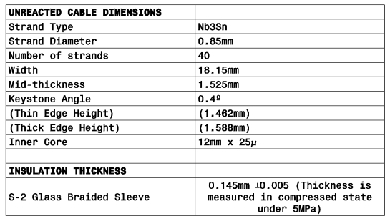
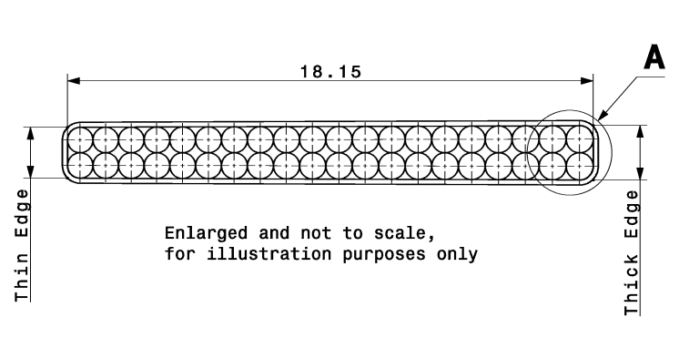
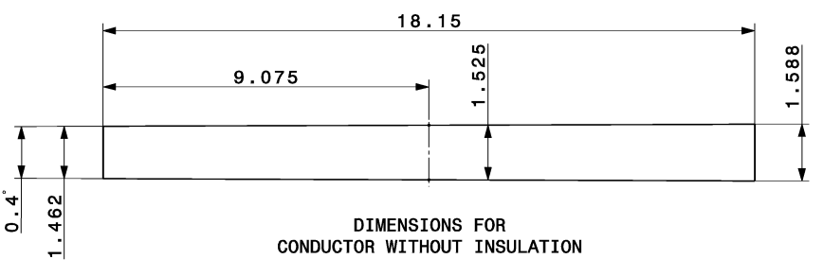
Racetrack coil mock-up
Insulated cable reference parameters in the table below from drawing LHCMQXFBC0057
Based on expansion coefficient assumptions:
  4.5% azimuthal
  1.2% radial
18.36mm (reacted bare cable)
18.65mm (insulated reacted cable)
1.594mm (reacted bare cable)
1.884mm (insulated reacted cable)

Slide 19
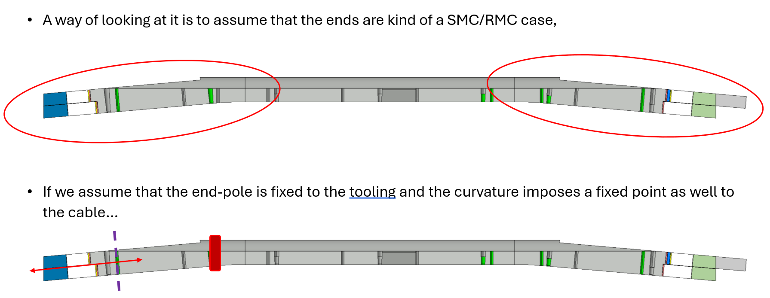
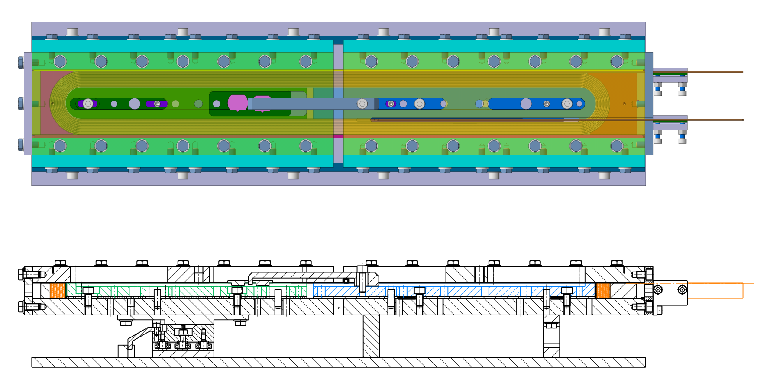
Racetrack coil mock-up
Tests can be done to validate/explore different scenarios
  1 pole fixed and 1 pole completely free (just pinned to the base plate to ensure alignment) with gap between poles and 2-parts mold
    Assuming free sliding of the coil inside the mold, the sliding system should not move
  Both poles fixed to the base plates (and pinned for alignment) with gap between poles and 2-parts mold
    Simulation of the fix point caused by the flared end, the sliding system should move accordingly to the cable expansion/contraction
Sez. A-A
A
A
Courtesy of B. Pellet

Slide 20
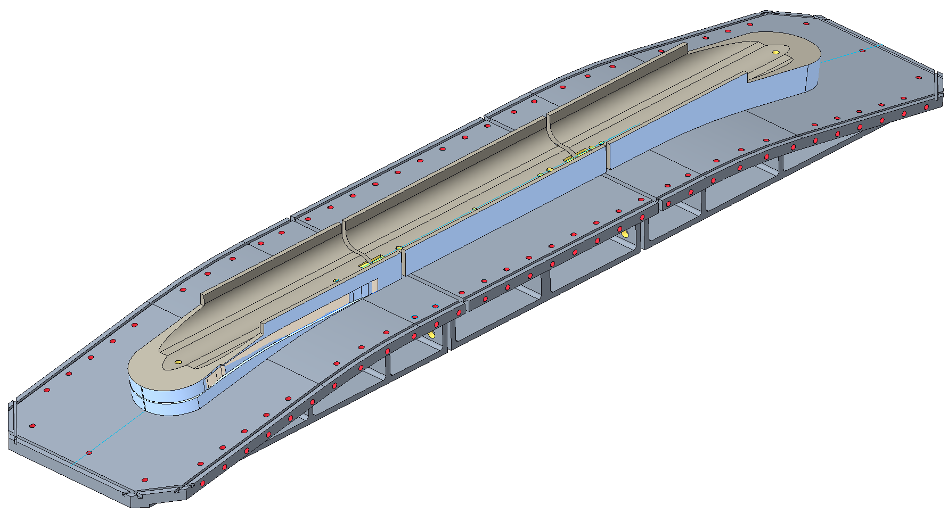




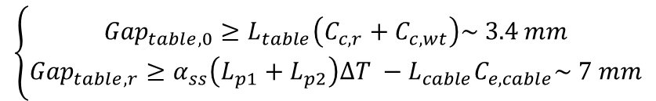
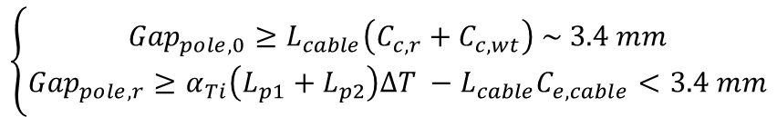

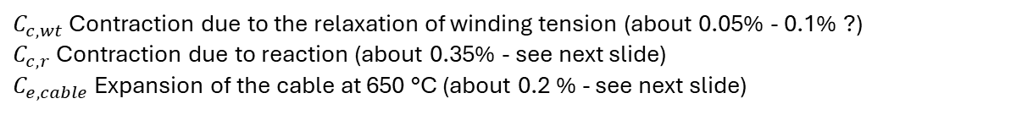


Some comments on gaps
For the first-order assessment of the required gaps, we follow a similar logic than for TFD (see J.L. Rudeiros presentation).
$$L_{p2}$$
$${Gap}_{pole}$$
$$L_{p1}$$
Central plane
Main parameters
Pole extremity
Pole center
$C_{c,wt}$ Contraction due to the relaxation of winding tension (about 0.05% - 0.1% ?)
$C_{c,r}$ Contraction due to reaction (about 0.35% - see next slide)
$C_{e,cable}$ Expansion of the cable at 650 °C (about 0.2 % - see next slide)
Cable
$$L_{cable}$$
Table extremity
Table center
$$L_{t2}$$
$${Gap}_{table}$$
$$L_{t1}$$
$$\left\{\begin{aligned}{Gap}_{pole,0}≥L_{cable}\left(C_{c,r}+C_{c,wt}\right) \sim 3.4 mm \\ {Gap}_{pole,r}≥α_{Ti}\left(L_{p1}+L_{p2}\right)∆T −L_{cable}C_{e,cable}<3.4 mm\end{aligned}\right.$$
Pole
Central plane
$$\left\{\begin{aligned}{Gap}_{table,0}≥L_{table}\left(C_{c,r}+C_{c,wt}\right)\sim 3.4 mm \\ {Gap}_{table,r}≥α_{ss}\left(L_{p1}+L_{p2}\right)∆T −L_{cable}C_{e,cable}\sim 7 mm\end{aligned}\right.$$
Table
Assuming SS 316
** Without considering the change in coil length after releasing winding tension
* Courtesy of Jose Luis Rudeiros

Slide 21
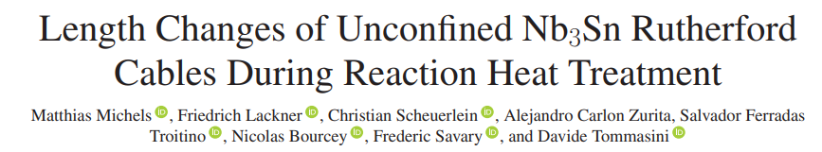
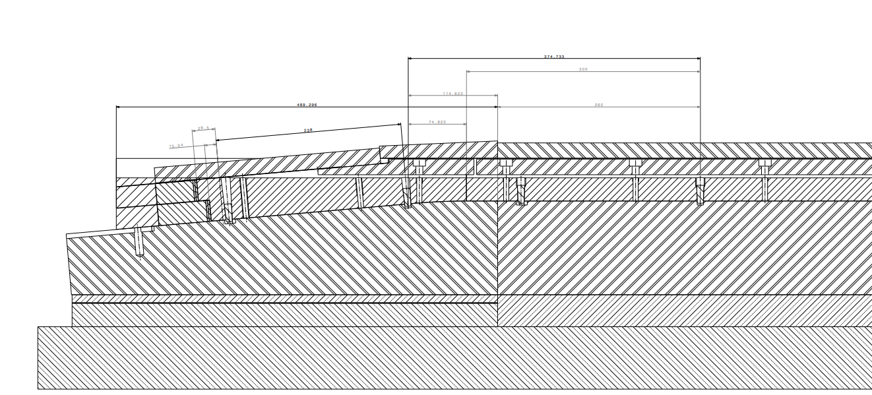
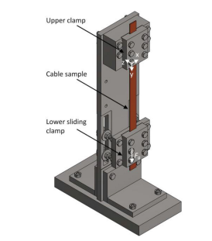
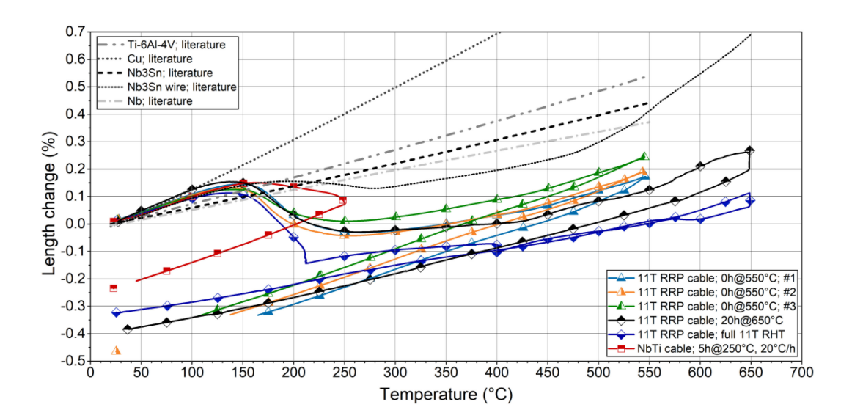
Some comments on gaps

Slide 22
Reaction mold – Motion during reaction cycle
Because of non homogenized material choice in coil/mold component, relative movement will occur during the reaction process.
For transverse dimension change, the mold will expand more than the pole and the conductor. And the cavity is design with the reacted cable dimension to anticipate its growth during reaction.
For the longitudinal direction it is a different story. The “angle” between the straight section and the head creates a kind of fixed point that restrain the straight section to live its life freely.
* Slide from N. Peray

Slide 23
Reaction mold – Central pole fixed point
Pins or part of it might be removed during reaction
Fixed point
Nice, but what happen with the layerjump ?
Screwed cap
Conical section
Pin interface in the mold
Cylindrical section
* Slide from N. Peray

Slide 24
Reaction mold – Motion during reaction cycle
A way of looking at it is to assume that the ends are kind of a SMC/RMC case,
If we assume that the end-pole is fixed to the tooling and the curvature imposes a fixed point as well to the cable…
All displacement is then happening in the head. Would we need to cut the end region to introduce a gap (magenta dashed line) as well?

