Slide 1


All About AXI
Oliver Bründler – Staff Engineer
oliver.bruendler@enclustra.com
Notes:
Mention Wording:
AXI: Master/Slave – Manager/Subordinate
- Mention that I noticed recently but the presentation still is Master/Slave
- So is AMD
- This is not political
AXI4-Stream: Transmitter/Receiver (use)

Slide 2
Agenda
Introduction
AXI Protocols
Pitfalls
Custom AXI Logic
04
07
33
53

Slide 3
Agenda
Introduction
AXI Protocols
Pitfalls
Custom AXI Logic
04
07
33
53

Slide 4
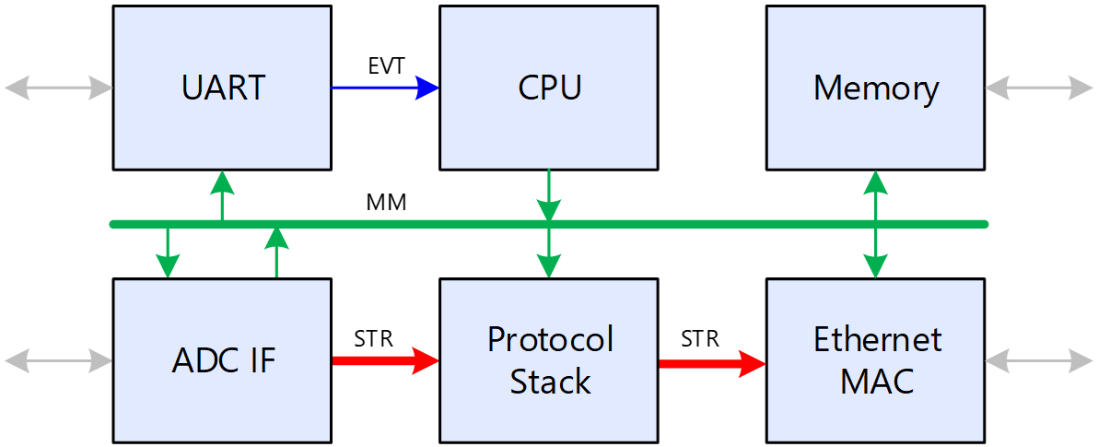
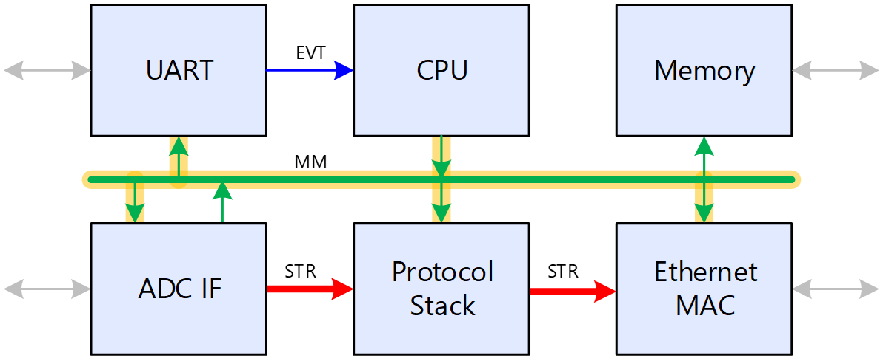
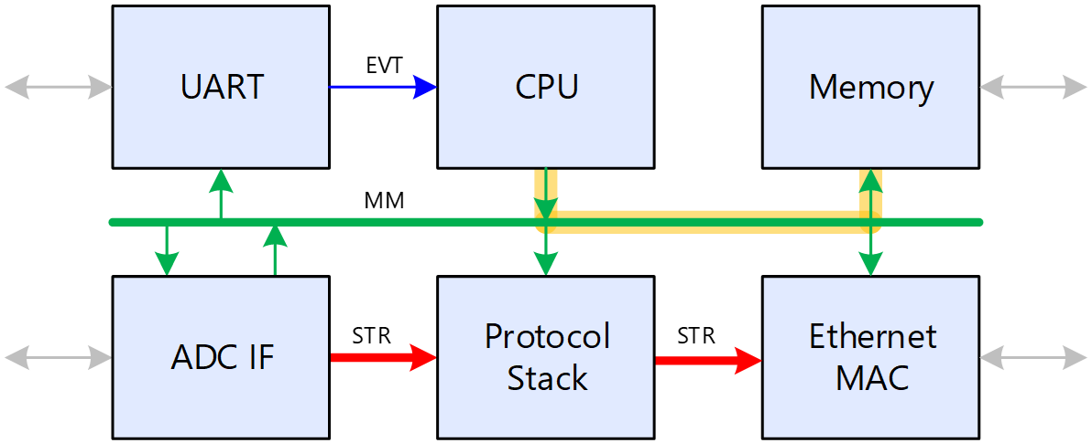
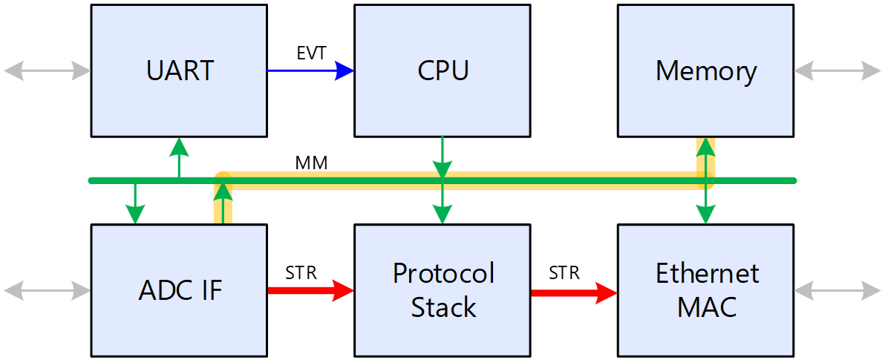
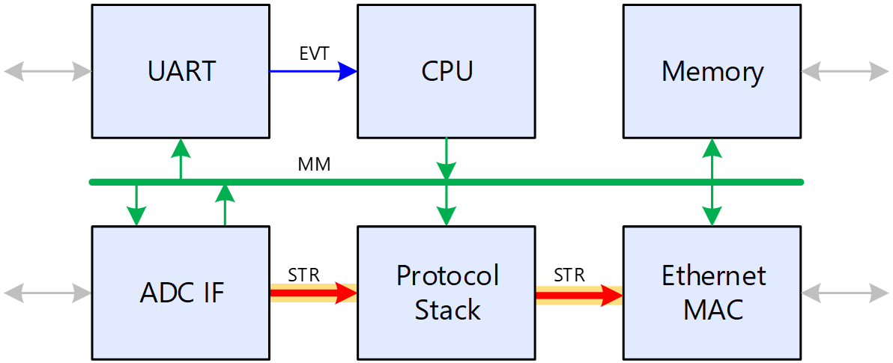
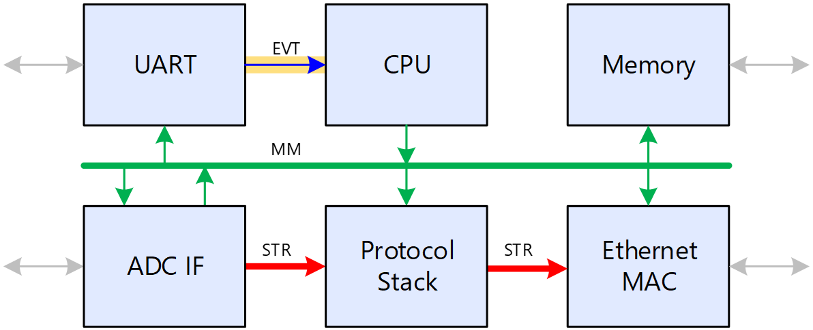
Introduction – Communication Needs
Memory Mapped
  Access to registers (slow)
  Access to memory (fast)
  AXI3/AXI4/AXI4-Lite
Streaming
  Point-to-point
  Decentral
  AXI4-Stream
Events
  E.g. IRQs
  Not covered by AXI
Notes:
2’
Total 3:30

Slide 5

Introduction – One for All
Before AXI
  Xilinx: PLB/LMB
  Altera: Avalon
  ARM: AHB
  Logic not portable!
AXI
  Driven by ARM
  SoCs made AXI an FPGA thing
  De-facto industry standard
  Used in FPGA, ASIC & uC (e.g. STM32)
Notes:
2’
Total 5:00

Slide 6
Agenda
Introduction
AXI Protocols
Pitfalls
Custom AXI Logic
04
07
33
53

Slide 7
AXI Protocols – Common Properties
Synchronous Protocols
  Specification on a per-clock-cycle basis
  No timing information like setup and hold times
Endianness
  Officially byte-invariant endianness
  WDATA[7:0] -> Addr+0, WDATA[15:8] -> Addr+1
  What usually is referred to as little endian
Point to Point Capability
  Masters and slaves can be connected directly
Notes:
2’

Slide 8
AXI Protocols – Common Properties
Interconnect Approach
  Logic (interconnect) required for connecting multiple endpoints
  Interconnect != Bus (there is logic)
  Multiple transactions possible simultaneously
Notes:
1’
Total 8:00

Slide 9
AXI Protocols – AXI4-Stream
Aim of the Protocol
  Transfer data between two endpoints - TDATA
  Flow-control – TVALID, TREADY
  Support packetized data – TLAST
  Dynamic selection of destination – TDEST
  Handling multiple logical streams through one physical link – TID
  Data alignment and dynamic bus sizing – TKEEP, TSTRB
  Handling of application specific side-band information - TUSER
Notes:
1’

Slide 10
AXI Protocols – AXI4-Stream
Signals
Sample text
Sample text
Signal | Optional | Direction | Description
ACLK | No | - | Clock, rising-edge active
ARESETn | Yes | - | Reset, low-active
TVALID | No | M → S | Indicates when the master has valid data
TREADY | Yes | S → M | Indicates when the slave is ready to receive data
TDATA | Yes | M → S | Data to be transferred
TSTRB | Yes | M → S | Indicates whether a byte contains data
TKEEP | Yes | M → S | Indicates whether a byte must be kept (not removed)
TLAST | Yes | M → S | Indicates the end of a packet
TID | Yes | M → S | Number of the logical stream
TDEST | Yes | M → S | Endpoint to route the packet to
TUSER | Yes | M → S | Use defined side-band signals
Notes:
30”
Total: 10:35

Slide 11
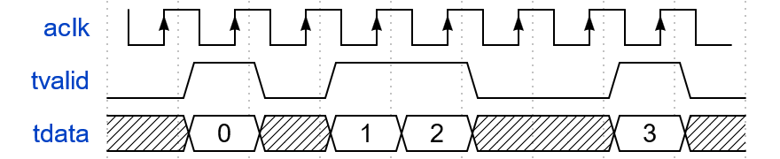
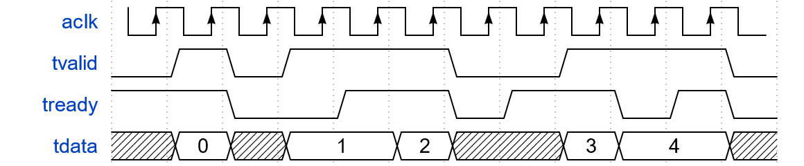
AXI Protocols – AXI4-Stream
Handshaking
  TREADY is optional
  Blocking the data-stream by TREADY=‘0’ is called back-pressure
Notes:
2’
Total: 12:00
Mention: Definition of a Data Beat

Slide 12
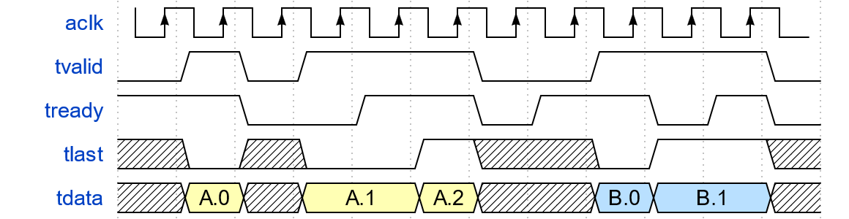
AXI Protocols – AXI4-Stream
Packet Handling (TLAST)
  Valid together with TDATA
  The same applies to all signals except TVALID, TREADY, ACLK and ARESETn
Notes:
1’
Total: 13:00

Slide 13

AXI Protocols – AXI4-Stream
Byte Types (TKEEP/TSTRB)
  Data byte (TKEEP=1, TSTRB=1)
    Byte contains information
    Do not remove, do not modify
  Position byte (TKEEP=1, TSTRB=0)
    Byte not interpreted at destination
    Do not remove – but may be modified
  Null byte (TKEEP=0, TSTRB=0)
    Byte not interpreted at destination
    May be added, removed or modified
  TKEEP=0, TSTRB=1 is illegal
Notes:
1’

Slide 14
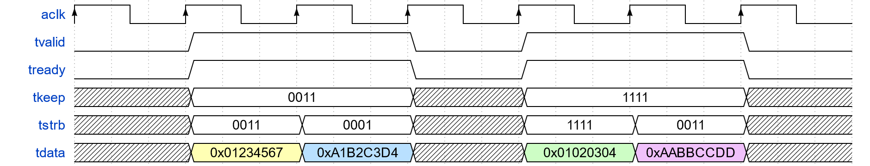
AXI Protocols – AXI4-Stream
Byte Types Example
Address | +3 | +2 | +1 | +0
0x00 | - | 0xD4 | 0x45 | 0x67
0x04 | 0x01 | 0x02 | 0x03 | 0x04
0x08 | - | - | 0xCC | 0xDD
Notes:
1’
Total: 16:30

Slide 15

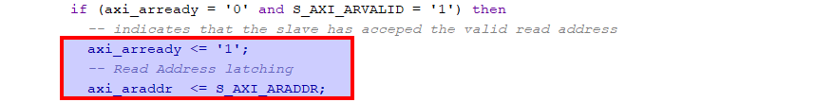
AXI Protocols – AXI4-Stream
Most Important Rules
  TVALID shall not depend on TREADY
    … but TREADY may depend on TVALID
    Required to avoid dead-locks
  TVALID must be kept until TREADY
    … but TREADY may be de-asserted
  Signals must not be changed between TVALID and TREADY assertion
Notes:
1’
Total 18:30

Slide 16

AXI Protocols – AXI4
Aim of the Protocol
  Memory mapped read and write
  Read/write independent
  and simultaneous
  Burst accesses of up to 256-beats
  Configurable data width up to 1024 bits
  Overlapping transfers
    Start one transfer before the last one is completed
  Taylored for
    Low latency
    High bandwidth
    NOT simplicity
Notes:
1’
Total: 20:00

Slide 17
AXI Protocols – AXI4
Concept
  5 Channels
  Each channel has xREADY/xVALID handshaking (analog to AXI4-Stream)
Notes:
1’
Total: 21:00

Slide 18
AXI Protocols – AXI4
Global Signals
Present in all Channels
Sample text
Sample text
Signal | Optional (M/S) | Description
ACLK | No / No | Clock, rising-edge active
ARESETn | No / No | Reset, low-active
Signal | Optional (M/S) | Description
xID | Yes / No | ID signal, identifies the master that requested a transaction
xValid | No / No | Handshaking signal (according to AXI4-Stream)
xReady | No / No | Handshaking signal (according to AXI4-Stream)
xUser | Yes / Yes | User defined side-band signals (according to AXI4-Stream)
Notes:
30”

Slide 19
AXI Protocols – AXI4
Read/Write Address Channel
Sample text
Sample text
Signal | Optional (M/S) | Description
xADDR | No / No | Address to access (for bursts: first address)
xLEN | Yes / No | Burst length minus 1 (e.g. 4 = burst of 5 beats)
xSIZE | Yes / No | Bytes per beat in 2^{x} bytes (e.g. 2 = 4 bytes) – If != data width -> Narrow Burst
xBURST | Yes / No | Burst type (incrementing, fixed or wrapping)
xLOCK | Yes / Yes | Atomic access control, out of scope for this presentation
xCACHE | Yes / Yes | Cache control, out of scope for this presentation
xPROT | No / Yes | Used for security control, out of scope for this presentation
xQOS | Yes / Yes | Quality of service, out of scope for this presentation
xREGION | Yes / Yes | For handling of multiple logical interfaces in one physical IF, out of scope for this presentation
Notes:
1.30’

Slide 20
AXI Protocols – AXI4
Write Data Channel
Read Data Channel
Write Response Channel
Sample text
Sample text
Signal | Optional (M/S) | Description
WSTRB | Yes / No | Byte-enable
WDATA | No / No | Write data
WLAST | No / Yes | One packet per AW command
Signal | Optional (M/S) | Description
RDATA | No / No | Read data
RRESP | Yes / Yes | Read response (signal errors if any)
RLAST | Yes / No | One packet per AR command
Signal | Optional (M/S) | Description
BRESP | Yes / Yes | Write response (signal errors if any)
Notes:
1’
Total: 24:00

Slide 21
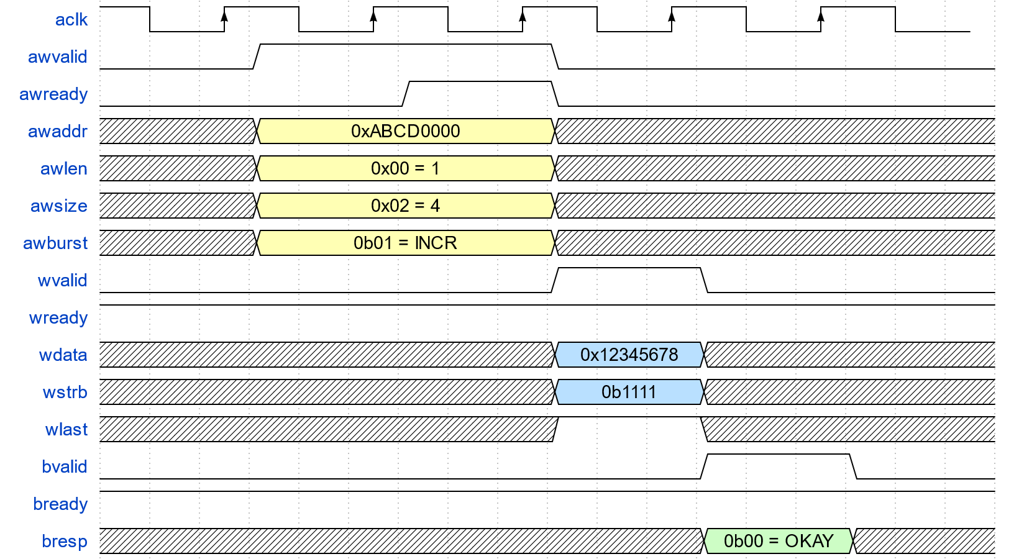
AXI Protocols – AXI4
Example Write Transaction
  32-bit access
  Write to 0xABCD0000
Notes:
1.30

Slide 22
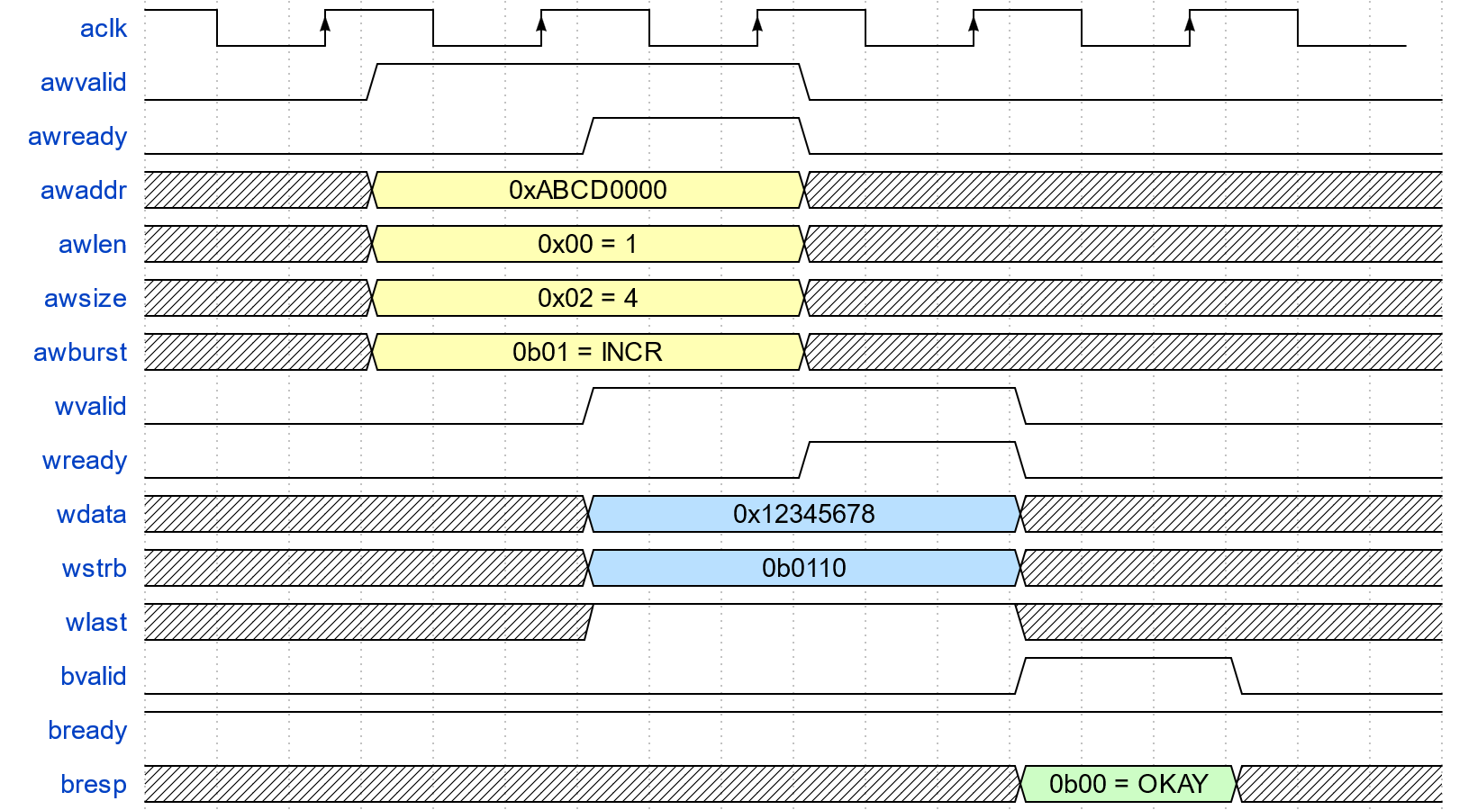
AXI Protocols – AXI4
Example Write Transaction
  16-bit access
  Write to 0xABCD0001
  Unaligned
Notes:
1.30

Slide 23
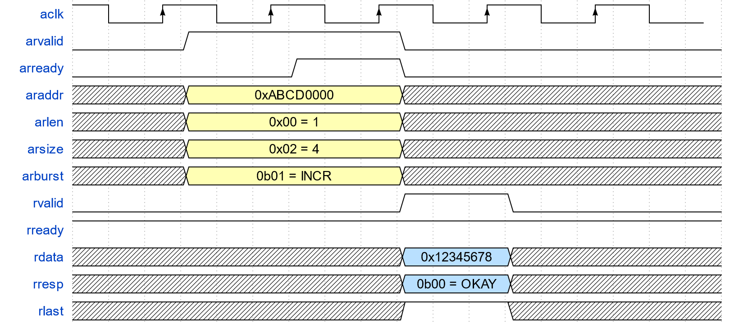
AXI Protocols – AXI4
Example Read Transaction
  Reads are always full-width
  Read from 0xABCD0000
Notes:
30’

Slide 24
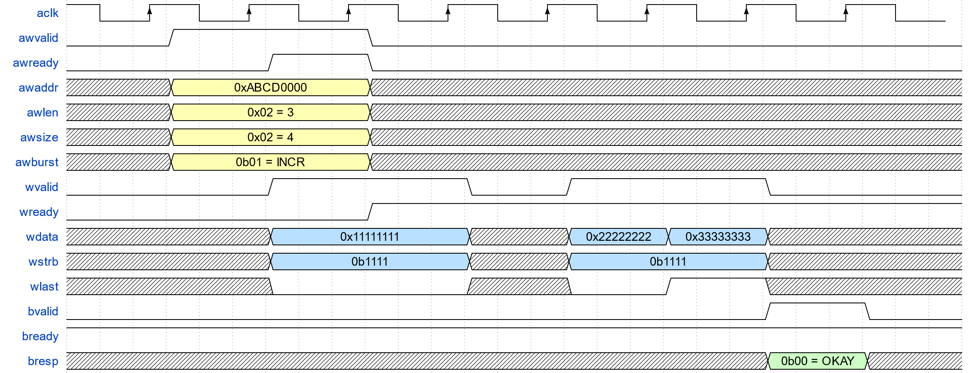
AXI Protocols – AXI4
Example Burst Write Transaction
  0x11111111 > 0xABCD0000
  0x22222222 > 0xABCD0004
  0x33333333 > 0xABCD0008
Notes:
1’

Slide 25
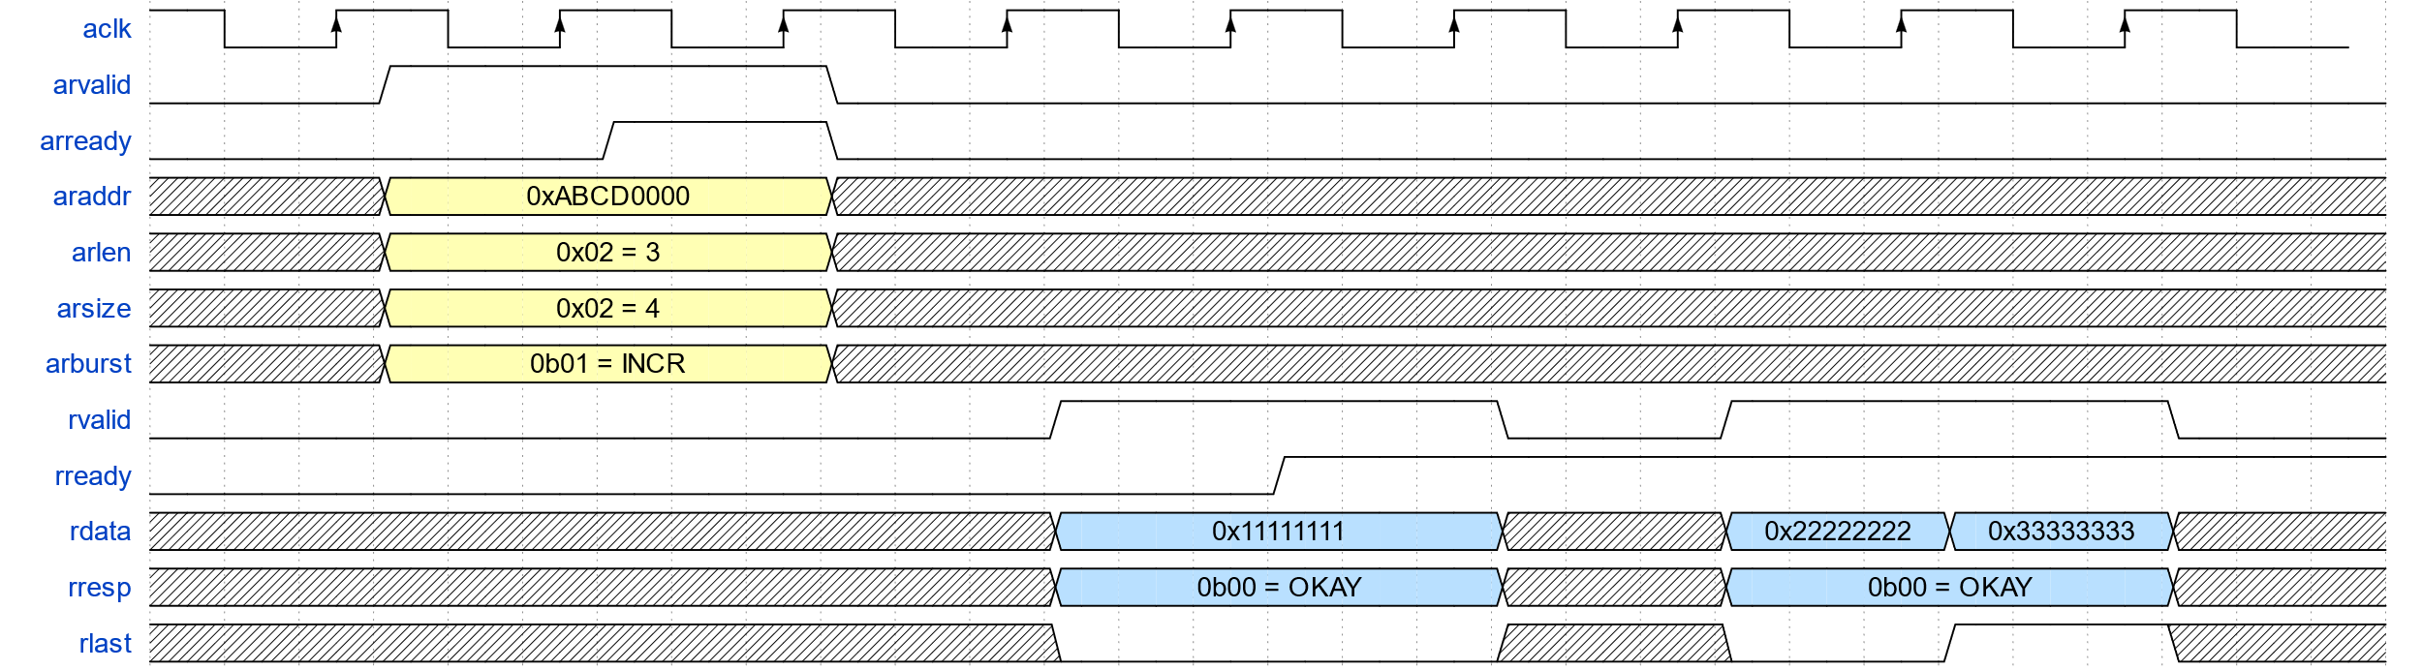
AXI Protocols – AXI4
Example Burst Read Transaction
  0x11111111 < 0xABCD0000
  0x22222222 < 0xABCD0004
  0x33333333 < 0xABCD0008
Notes:
1’
Total: 28:30

Slide 26
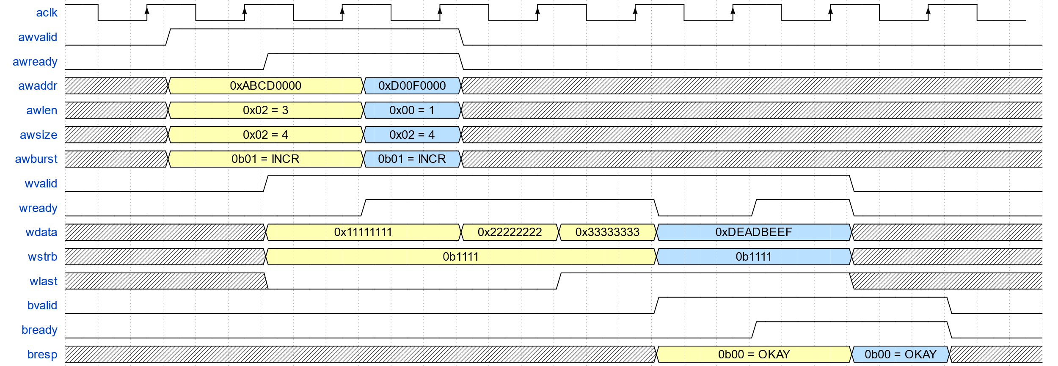
AXI Protocols – AXI4
Example Pipelined Transactions
Notes:
1’

Slide 27
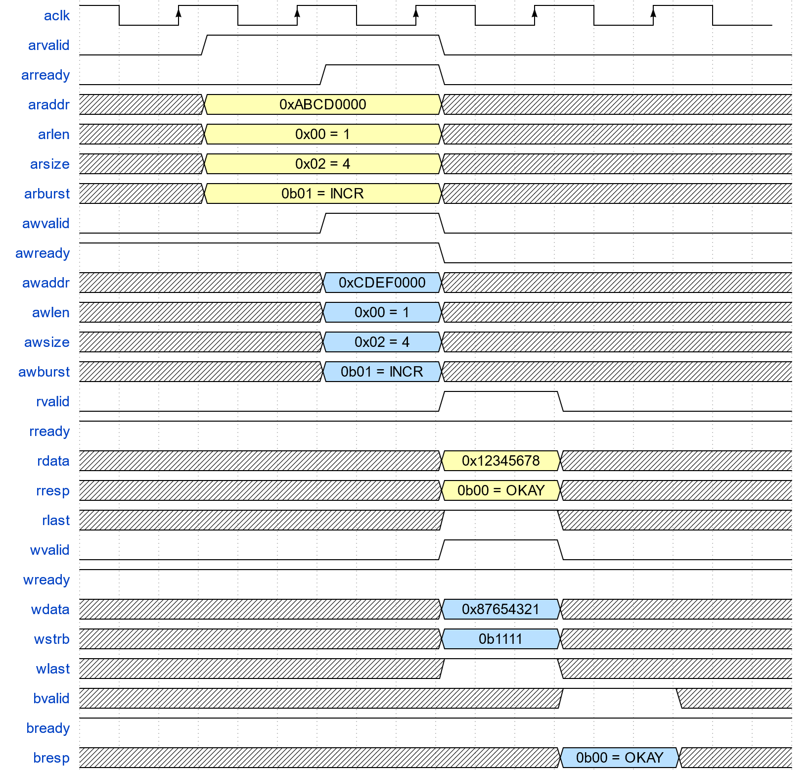
AXI Protocols – AXI4
Concurrent Read & Write
Notes:
30’
Total: 30:30

Slide 28
AXI Protocols – AXI4
Most Important Rules
  No bursts across 4kB boundaries
  R-packets must match ARSIZE
    Even in case of errors
    No possibility to abort
  W-packets must match AWSIZE
    No possibility to abort
  B/R required for every AW/AR command
Notes:
1’

Slide 29

AXI Protocols – AXI4
What is Skipped
  Cache control
  Exclusive/atomic access
  Transfer ordering scheme
  Access protection
  Narrow bursts
  Wrapping bursts
Notes:
30’
Total: 33:00

Slide 30
AXI Protocols – AXI4-Lite
AXI4 is Overkill for Simple Peripherals
  AXI4-Lite is simplified (e.g. no burst access)
  AXI4 signals below are omitted
Sample text
Sample text
Signal | Reason
xID | All transactions MUST happened in order
AxLEN | No bursts supported, only single word transactions
AxSIZE | All transactions have the same width as the data bus
AxBURST | No bursts supported, only single word transactions
AxLOCK | No atomic accesses supported
AxCACHE | No cache control
AxPROT | No access protection
AxQOS | No quality of service
AxREGION | Only one region per slave
xLAST | No bursts supported, only single word transactions
Notes:
1’
Total: 34:30

Slide 31

AXI Protocols – AXI3
Predecessor of AXI4
  Very similar to AXI4
  Burst size limited to 16 (instead of 256)
  Minor modifications like:
    Changed cache signaling
    Changed atomic/exclusive access signaling
    Region signaling not present in AXI3
    …
  AXI3 is still used in PS interconnects for
    Zynq-7000
    Zynq-UltraScale+ MPSoC
    Reduce burst size for accesses from PL to PS!
Notes:
1’
Total: 36:00
Note: There is also AXI5 (adding parity protection and the like) – just that nobody uses it in the FPGA context.

Slide 32
Agenda
Introduction
AXI Protocols
Pitfalls
Custom AXI Logic
04
07
33
53

Slide 33
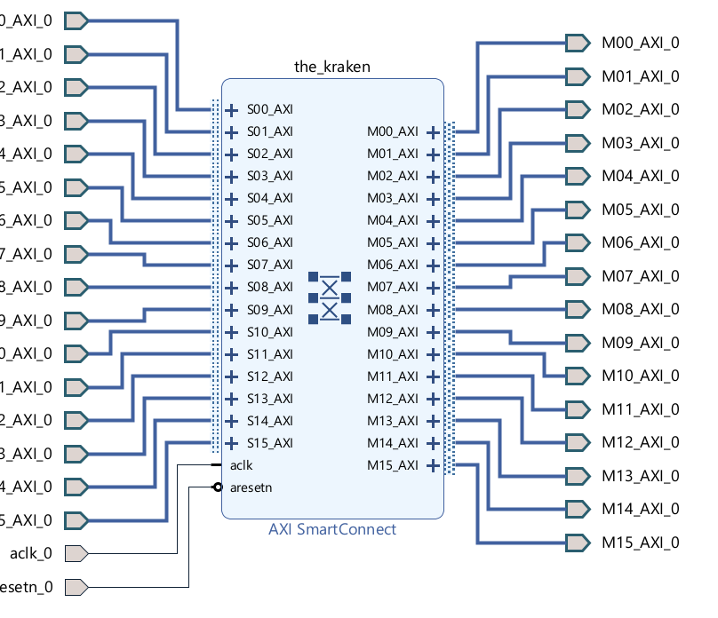
Pitfalls – One-for-All Interconnect
Single Interconnect Approach
  Is simple
  Matches table-based tools (EDK/PFD)
  Wastes either resources or bandwidth
    Resources waste being the default
  Causes timing problems and
  congestion hotspots
Multi Interconnect Approach
  Enhanced design structure
  Allows for optimization
NOC – Versal ACAP
Notes:
30’<
Total: 39:00

Slide 34
Pitfalls – One-for-All Interconnect
What’s Wrong with This?

Slide 35
Pitfalls – One-for-All Interconnect
10k LUT, 12.5k FF, 06:18
It Boils down to This!
  Wide Crossbar
  Does the Memory Tester really need access to I2C?
Notes:
1’
Mention: Systems are not separated – CPU needs DDR access

Slide 36
Pitfalls – One-for-All Interconnect
We can Split the Interconnect
  Tools usually maximize bus-widths
  In Vivado the width converter
  must be added manually
  Saves 55% LUT
4.5k LUT, 5.7k FF, 04:12
Notes:
1’

Slide 37
Pitfalls – One-for-All Interconnect
We can Optimize Converters
  Tools tend to full AXI4
  Saves 62% resp. 15% of LUT
3.8k LUT, 4.9k FF, 03:40
Notes:
1.30
Total: 45:30

Slide 38
Pitfalls – AMD Smart Connect
Interconnect
SmartConnect
Sample text
Sample text
Design | LUT | FF | Runtime | Comment
Design 1 | 10.0k | 12.5k | 06:18 | -
Design 2 | 4.5k | 4.9k | 04:12 | Separate 32- and 512-bit domain
Design 3 | 3.8k | 4.9k | 03:40 | Reduce AXI4-Lite converters
Design | LUT | FF | Runtime | Comment
Design 1 | 20.9k | 28.8k | 11:42 | 209% LUT usage
Design 2 | 21.9k | 28.9k | 13:04 | 487% LUT usage
Design 3 | 19.2k | 27.8k | 15:07 | 505% LUT usage
Notes:
1’
SmartConnect LUTs:
Design 1:
Main: 20.9k
Design 2:
32-bit: 5.1k
512-bit: 15.5k
Design 3:
Splitter: 2.4k
512-bit: 14.0k (???)
AxiLite: 0.45k
InterConnect LUTs
Design 1:
Main: 10.0k LUT
Design 2:
32-bit: 1.4k
512-bit: 1.4k
Design 3:
Splitter: 0.56k
512-bit: 1.4k
AxiLite: 0.12k

Slide 39

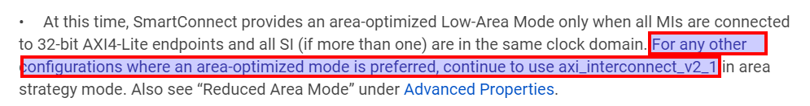
Pitfalls – AMD Smart Connect
More Resource Consumption
More Performance
  Especially in cases with lots of
  small transactions
  MAMD instead of SAMD
  Back-to-back arbitration
  …
Notes:
Mention: You can build interconnect manually!
1.30
Total: 49:30

Slide 40
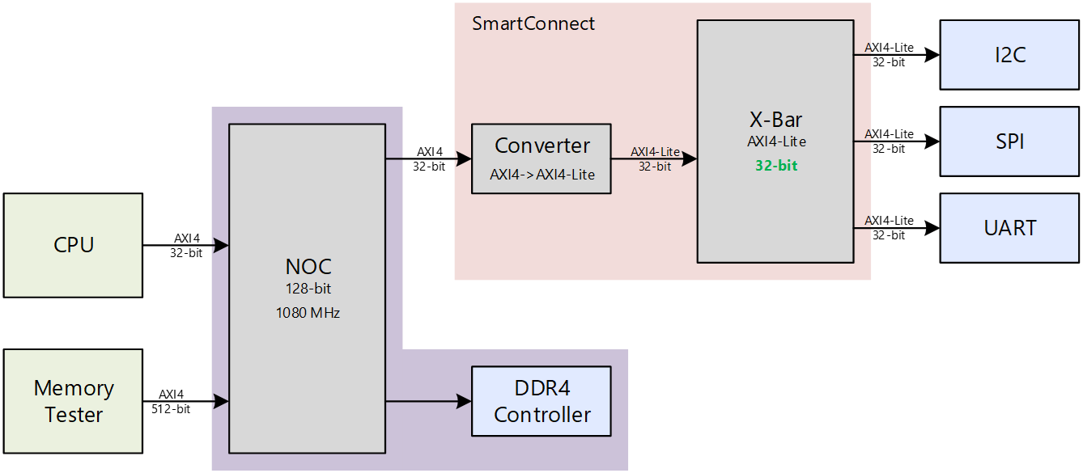
Pitfalls – The NOC Exception
The NOC is hardened
  Available on AMD Versal only
  “All-for-one” but super efficient
  Saves 94% resp. 85% of LUT
Versal and AXI
  Only SmartConnect
  No basic components
0.60k LUT, 0.85k FF, 11:04
Notes:
1’

Slide 41
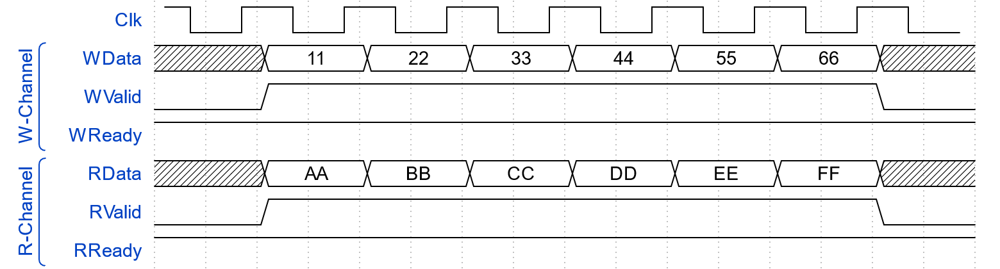
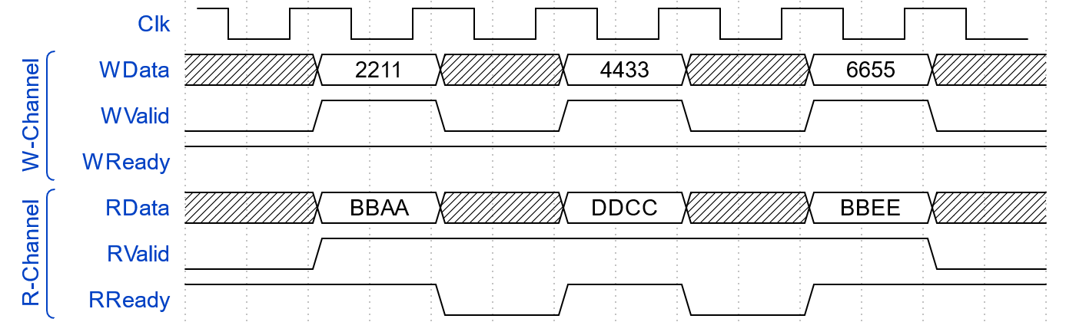
Pitfalls – Bandwidth Changes
Do not change AXI bandwidth without Packet buffers
  Gained bandwidth is wasted otherwise
Notes:
1’

Slide 42
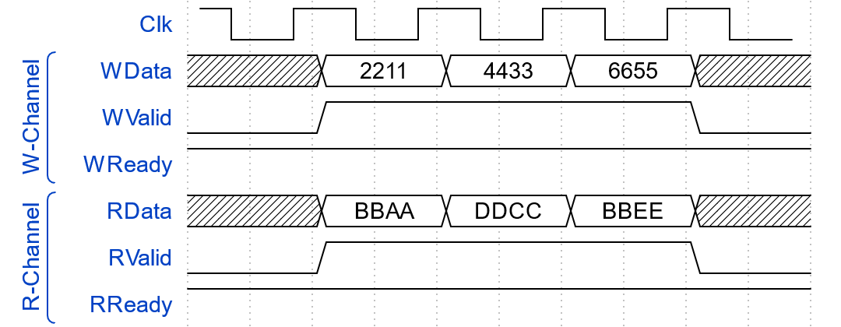
Pitfalls– Bandwidth Changes
Add Buffers on High-Bandwidth Side
  Compress transfers
  Free time for other transactions
Notes:
30”

Slide 43
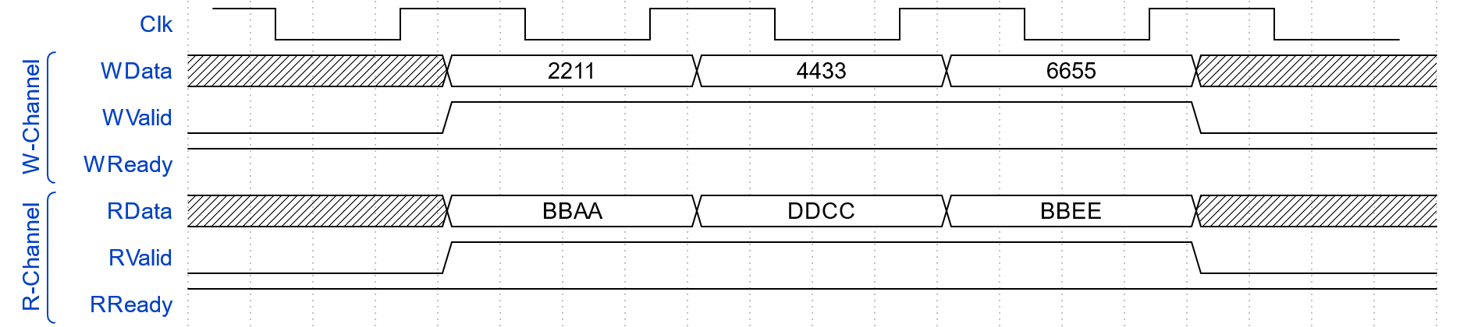
Pitfalls – Bandwidth Changes
Same for Clock Crossings
Notes:
30”

Slide 44
Pitfalls – Bandwidth Changes
Same for Clock Crossings
Notes:
30”
Total: 52:00

Slide 45
Pitfalls – Bandwidth Changes
Packet Buffers Add Latency
  It’s the common latency vs. bandwidth tradeoff
  More open transactions required
Packet Buffers May Require Resources
  Usually double-buffering
  2 x 4kB = 8kB = 64kb
Most Tools allow Configuring Buffers in AXI Infrastructure
  Clock crossings / with converters / interconnects
Does Only Apply to Interconnect Based Systems
  E.g. not for point-to-point AXI4-Stream
  Who else would use the freed up cycles?
Notes:
1’
Total: 55:00

Slide 46
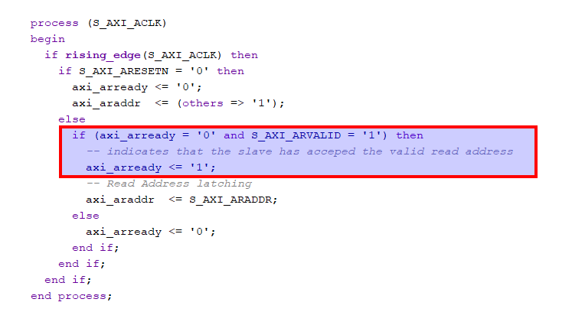
Pitfalls – Inter-Channel Dependencies
Backpressure on System Level
  R backpressure must be propagated to AR
  Same for B and AW
  Is it obvious?
Notes:
1’
Total: 57:00

Slide 47

Pitfalls – Stalling Others
During a Burst Write
  … no other master can access the same slave
During a Burst Read
  … a master can’t receive any other data

Slide 48
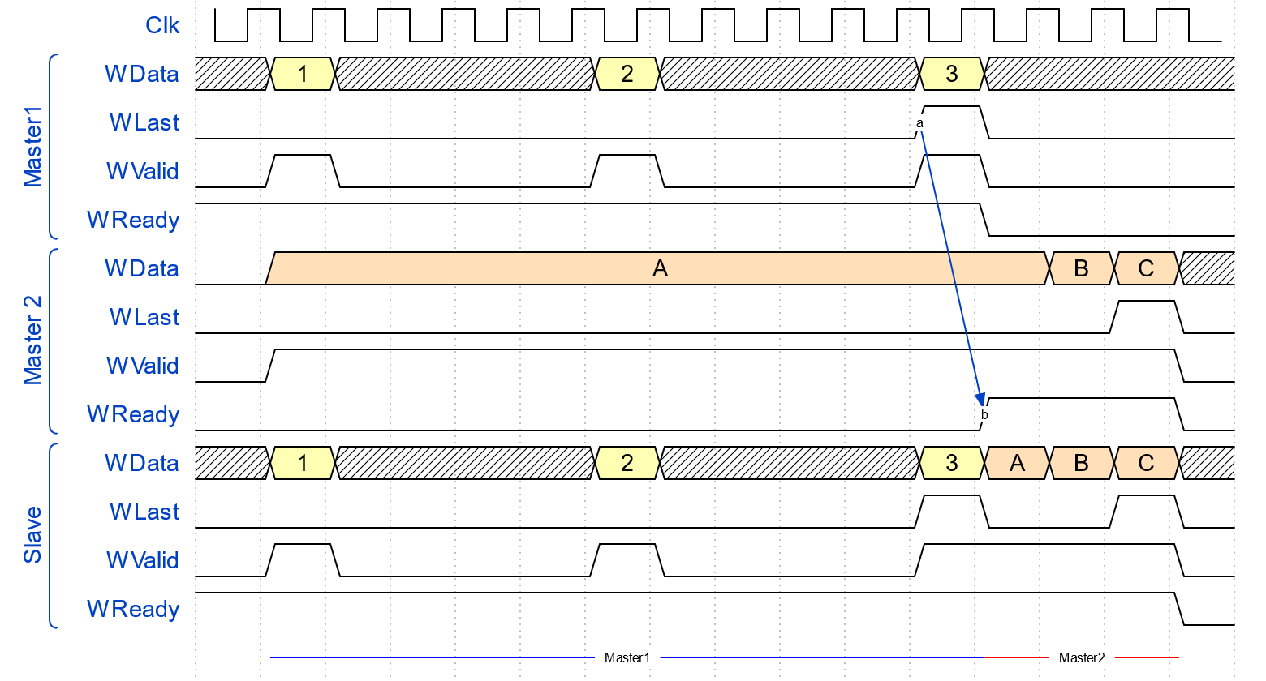
Pitfalls – Stalling Others
Problem

Slide 49
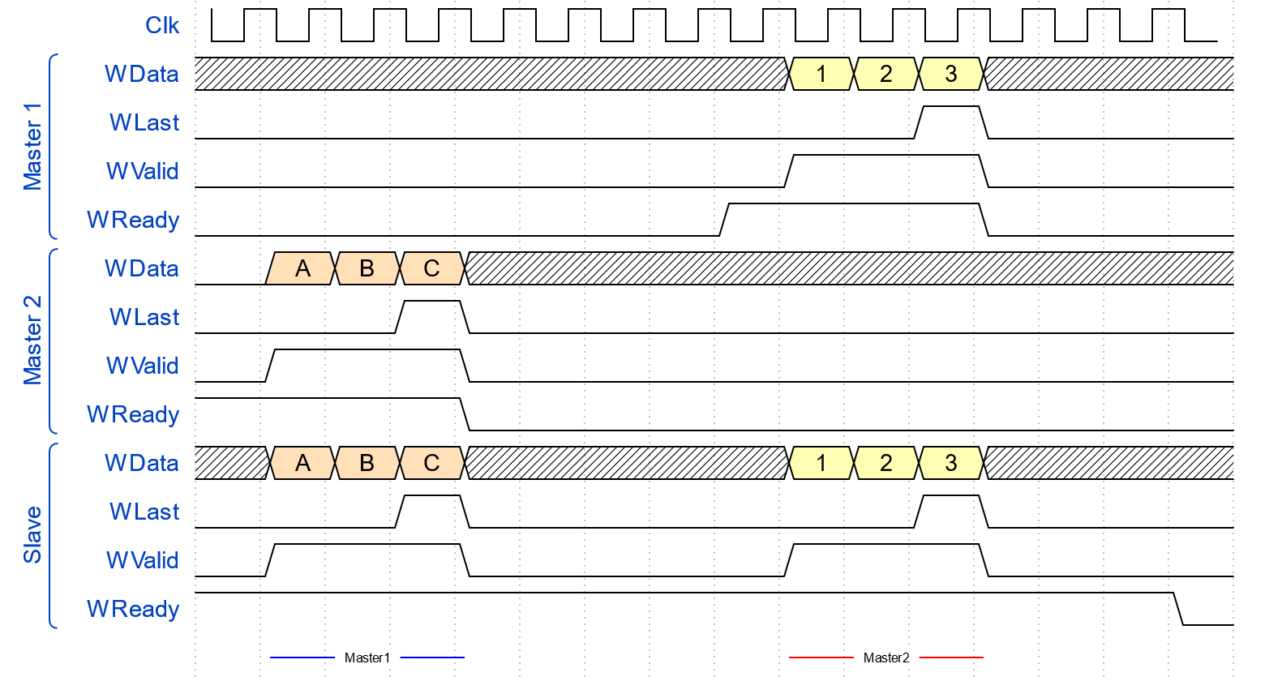
Pitfalls – Stalling Others
Solution
  Buffer data before initiating
  AXI Burst
  Applies to W and R channels
Low-Latency
  Exit strategy Dummy Data
  Exit strategy Error Response
No Fancy Concepts
  E.g. do not build a direct
  AXI/I2C bridge
Notes:
1:01:00

Slide 50

Pitfalls – Testing Shortcuts
Don’t Believe it Works only Because …
  … a simple testbench works
  … a test design works
  … the code was used before
Issues Often only Arise with …
  … heavy traffic load
  ... specific traffic shapes
Applies to …
  … AXI infrastructure
  … AXI endpoints
  NOT to fixed AXI4-Stream Pairs
Notes:
2’
Total: 1:04:00

Slide 51

Pitfalls – Blindly Believe the Spec
Most Implementations do not 100%
adhere to the AXI specification
Example:
  Spec defines narrow bursts
  This is complex (resources)
  … and seldom needed
  Most slaves do not support narrow bursts
  Nor do most interconnects
Check Limitations
  … don’t waste effort on unsupported things
Notes:
Other examples:
TKEEP containing zeros in AMD only allowed on last beat
Wrapping bursts

Slide 52
Agenda
Introduction
AXI Protocols
Pitfalls
Custom AXI Logic
04
07
33
53

Slide 53
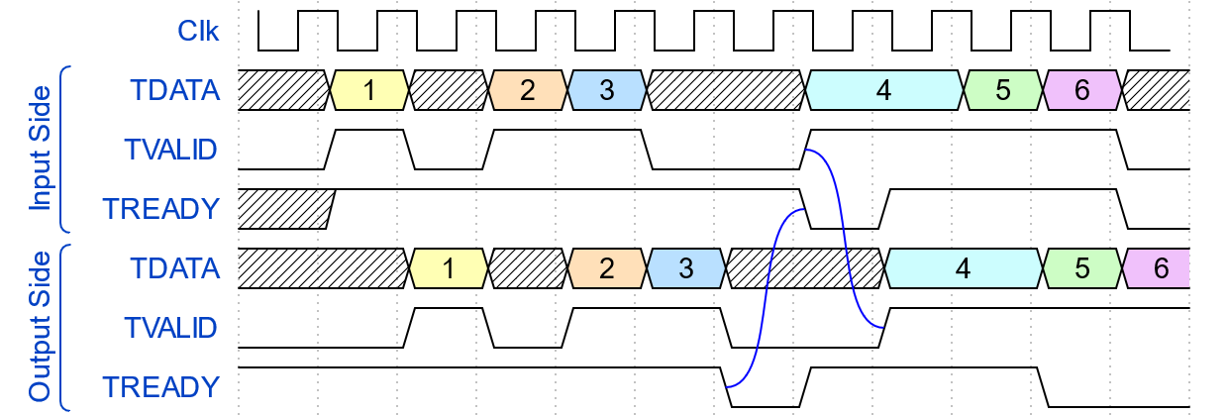
Custom AXI Logic – Backpressure
Problem
Notes:
2’

Slide 54
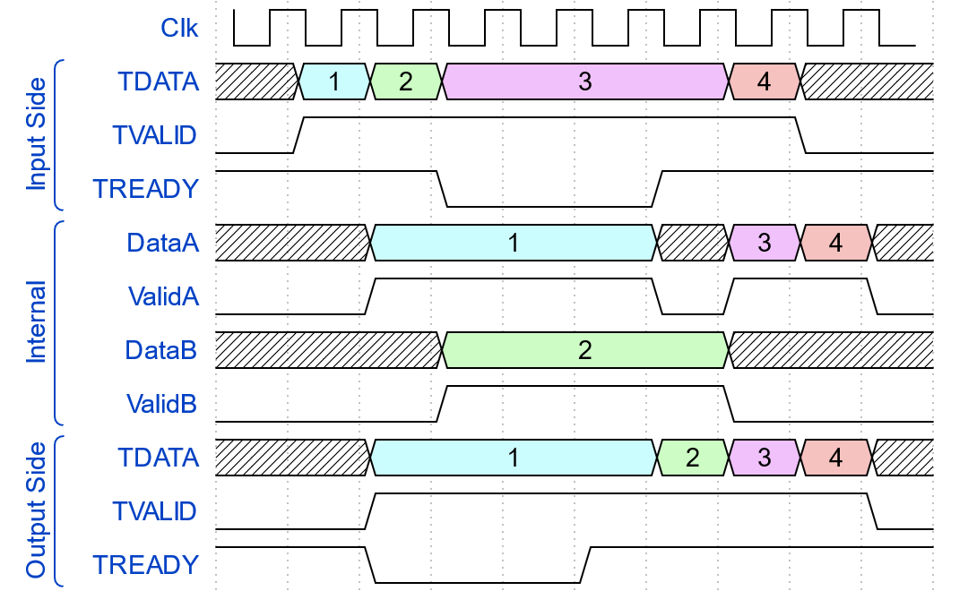
Custom AXI Logic – Backpressure
Solution 1
  Implement pipeline stages with two sets of registers
  “Two level FIFO” behavior
Notes:
2’

Slide 55
Custom AXI Logic – Backpressure
Solution 1
?
Notes:
-
Total: 1:08:00

Slide 56
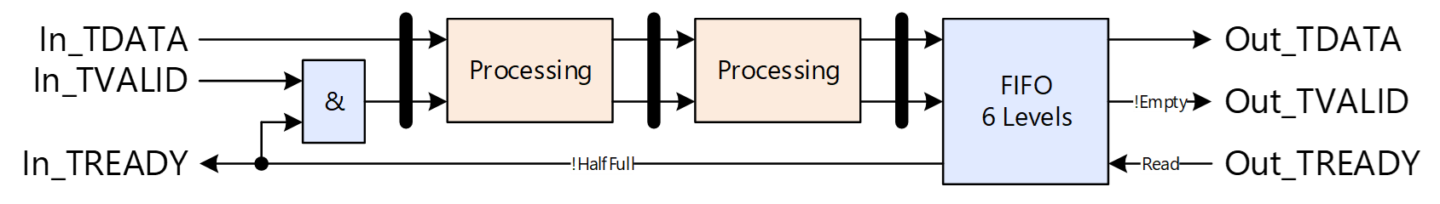
Custom AXI Logic – Backpressure
Solution
  Backpressure FIFO
  Stop sample injection when half full
  Compatible with legacy processing not support backpressure
  FIFO depth = 2 x N
Notes:
1’

Slide 57
Custom AXI Logic – Backpressure
Solution
  Why depth = 2 x N
  After Out_TREADY goes high, first N samples must come from FIFO
    … before first data from Processing arrives at FIFO
  After Out_TREADY goes low, last N samples in processing must fit into FIFO
    … before no more samples arrive
    … we can’t realy on samples arriving (processing could be empty)
Notes:
2’
1:12:0
Mention:
Actually 2 x N + FIFO latency
In reality usually FIFO=LUTRAM, no change in resources up to 32 levels which is > 2 x N in most cases. Just round up.

Slide 58

Custom AXI Logic – USE
Use Software Existingly
  AXI Master/Slave
    Use IP provided by vendor
    Use HLS
    Use open-source implementation
  Decide what you use
    Get used to it and use the same again
    Ensure proper verification
    Plausibility review
Notes:
Total: 1:15

Slide 59
Agenda
Introduction
AXI Protocols
Pitfalls
Custom AXI Logic
04
07
33
53

Slide 60

Questions?

Slide 61


Thank You!

