Slide 1

2025 AGM

Slide 2
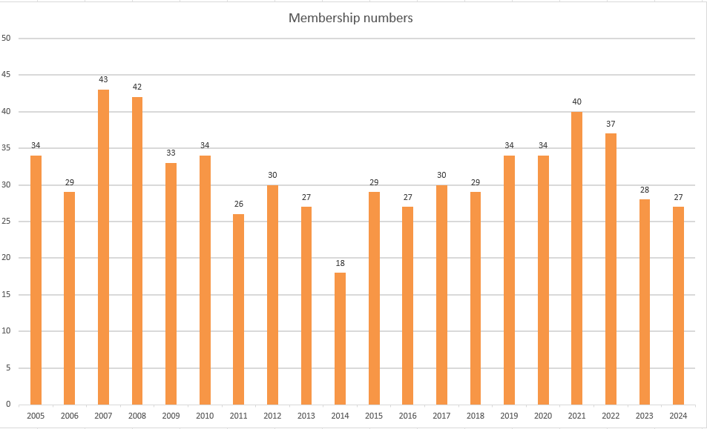
Membership
Numbers as at 9 April 2025 – Stable but still low
AGM 9/4/25
Notes:
2

Slide 3

Jardin des Particules
The figures don’t include the institutional membership of the Jardin des Particules, which joined in 2023 – about fifty children enjoy full benefit of our book rooms and ever-expanding children’s collection.
AGM 9/4/25

Slide 4
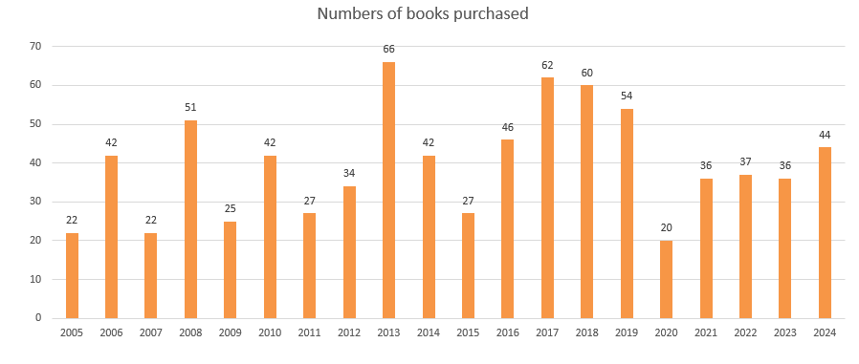
Book orders
Book orders since 2005
AGM 9/4/25
Notes:
4

Slide 5


Matters arising from 2024 AGM
Ad to be placed on CERN marketplace and ECHO
Sign-up sheet for promo events
Two book selections, one in April, one in October
Data privacy notice – still no action taken
Promotions table at R1 on 10 July and presence at two onboarding sessions, in April and October
No Promotions table in R2
No survey sent to club members re fees
No book culling this year, no bookmark developed
AGM 9/4/25

Slide 6
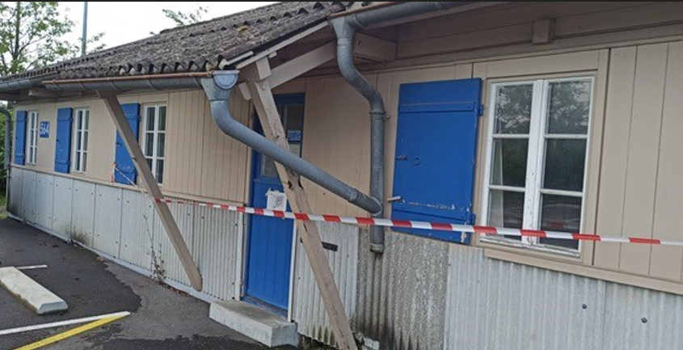
2024
Other things that came up
Access to the club rooms was prohibited from mid-May to mid-June
AGM 9/4/25

Slide 7

2024
Other things that came up
Access to the club rooms was prohibited from mid-May to mid-June - photo
Experiment with a « club social » at the end of November
Experiment with a « feedback hub »
Sergio collected books culled in 2023 and donated them to library in his home town
Reading to children of the JdP
Klaudia stepped down as web maintainer
AGM 9/4/25

Slide 8
Once again thanks
To the committee members:
  Kate (secretary)
  Sharon (treasurer)
  Eva (rooms)
  Klaudia (website and Mattermost, stepped down end 2024).
AGM 9/4/25

Slide 9
Any questions ?
AGM 9/4/25

Slide 10
Programme for 2025 – much to-do!
To-do list:
  Call for subscriptions to go out very soon, subject to decision on subscription rates
  Spring book selection
  Attract new members – promotions tables, onboarding,
  Data privacy notice (again…)
  Bookmarks, ads in ECHO and CERN marketplace
  Anything else…?
AGM 14/03/2024

