Slide 1


Coherent direct space charge: comparison of different analytical approaches
D. Amorim, E. Métral
Work Package 3 meeting, 9th May 2025
This work was performed under the auspices and with support from the Swiss Accelerator Research and Technology (CHART) program (www.chart.ch).

Slide 2
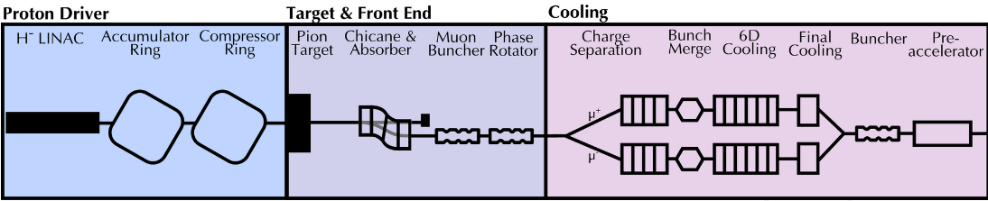
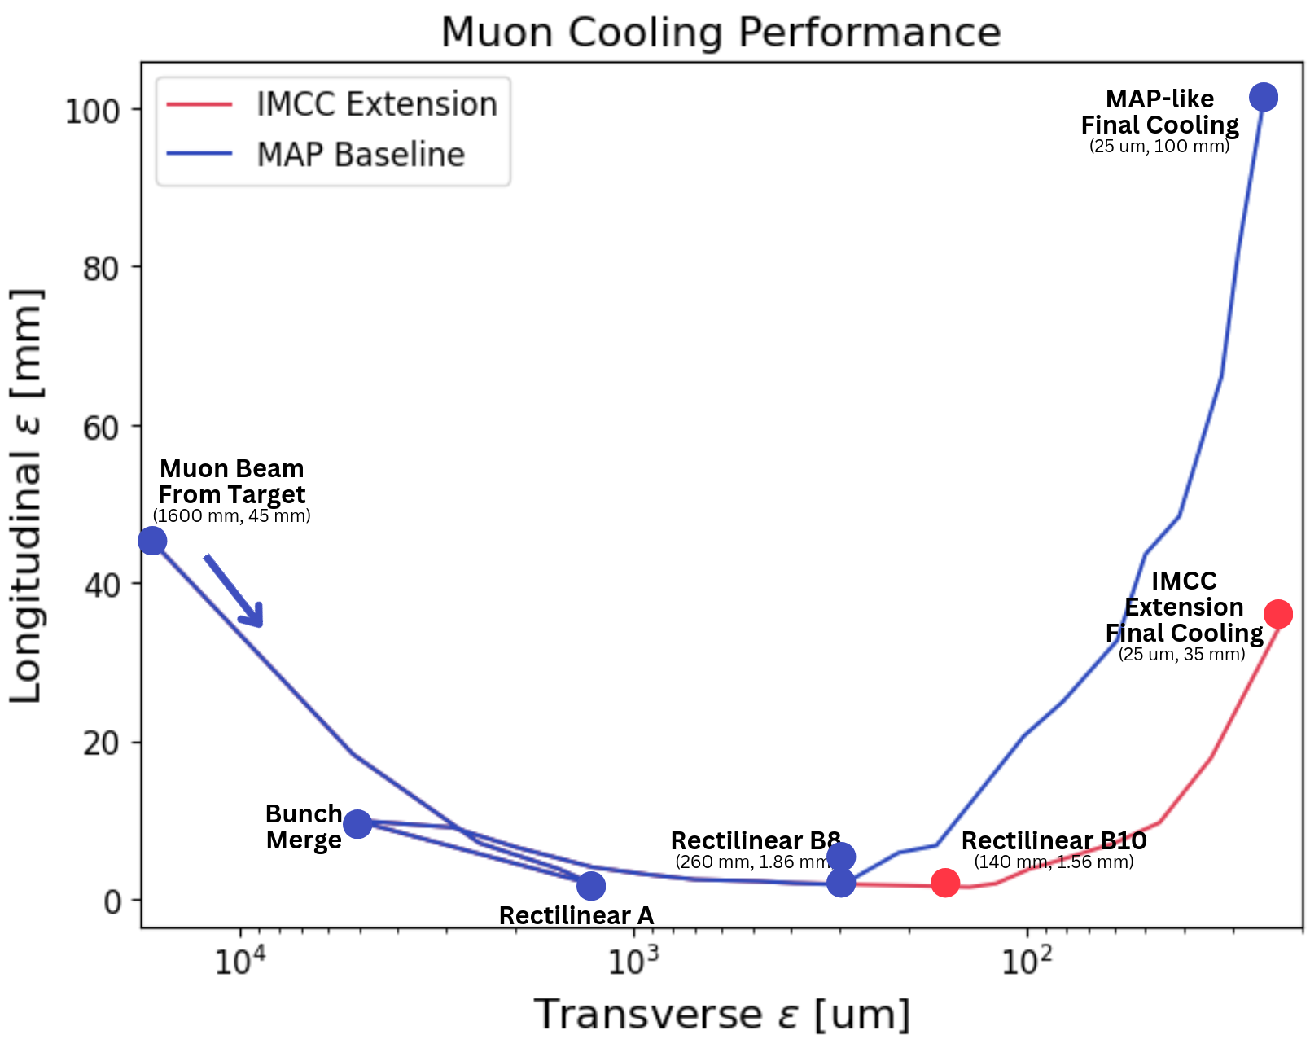
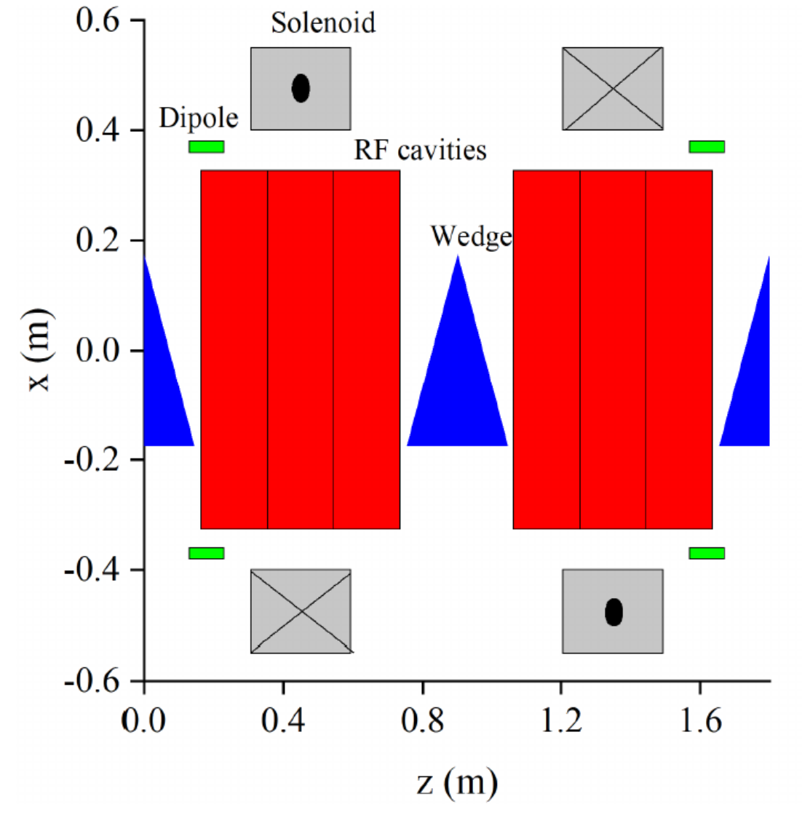
Space charge in the Muon Collider complex
Proton driver: high power proton beam, two options at 2 MW or 4 MW
  5 GeV or 10 GeV, 5⋅10¹⁴ protons on target, 2 ns bunch length, 5 Hz repetition rate
  Proton driver design is based on the CERN NuFact study
Muon Cooling: ionization cooling provided
by Liquid Hydrogen wedge absorbers
  Low energy muon and anti-muon
  beams p_{z}~200 MeV/c for cooling efficiency
  Small transverse emittance at the end
  of cooling: 25 µm
  Impedance and space-charge effect in matter: see
  E. Metral presentation at CEI meeting
Notes:
https://ieeexplore.ieee.org/document/10443443
https://indico.cern.ch/event/1325963/contributions/5792975/attachments/2818936/4922081/IMCC_March2024.pdf

Slide 3
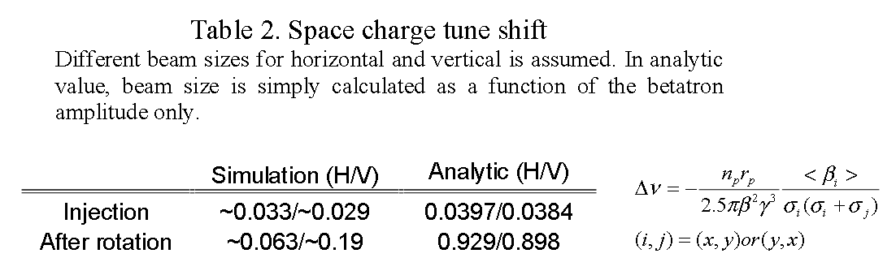
Space charge in the Muon Collider complex
5 GeV proton driver option design based
on NuFact. With ΔQ_{SC,y} ~ 0.1 and Q_{s}~ 1/100
→ ΔQ_{SC,y}/Q_{s} ~ 10
CERN SPS: ΔQ_{SC,y} ~ 0.2 and Q_{s}~ 1/66
→ ΔQ_{SC,y}/Q_{s} ~ 13
Combined effect of space charge and impedance have been discussed extensively for SPS
  See for example X. Buffat, “SPS TMCI withspace charge, an update”
This presentation will not show results specific to the Muon Collider, but can be a pointer to effects that will need to be investigated
From M. Aiba NUFACT note 151
Notes:
https://ieeexplore.ieee.org/document/10443443
https://indico.cern.ch/event/1325963/contributions/5792975/attachments/2818936/4922081/IMCC_March2024.pdf

Slide 4
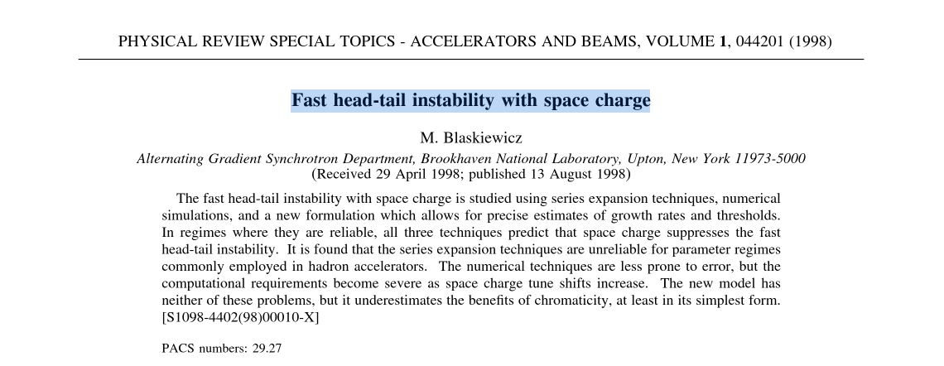
M. Blaskiewicz 1998 article
This presentation follows the same structure as the by E. Métral
at CEI meeting 03/04/2025
Notes:
https://ieeexplore.ieee.org/document/10443443
https://indico.cern.ch/event/1325963/contributions/5792975/attachments/2818936/4922081/IMCC_March2024.pdf

Slide 5
M. Blaskiewicz 1998 article
Mike Blaskiewicz in a 1998 article showed three methods to study fast head-tail instabilities with space-charge
Notes:
https://ieeexplore.ieee.org/document/10443443
https://indico.cern.ch/event/1325963/contributions/5792975/attachments/2818936/4922081/IMCC_March2024.pdf

Slide 6
M. Blaskiewicz 1998 article
Mike Blaskiewicz in a 1998 article showed three methods to study fast head-tail instabilities with space-charge
  Analytical, numerical and a simplified model
Air-bag in square well (ABS) model
Notes:
https://ieeexplore.ieee.org/document/10443443
https://indico.cern.ch/event/1325963/contributions/5792975/attachments/2818936/4922081/IMCC_March2024.pdf

Slide 7
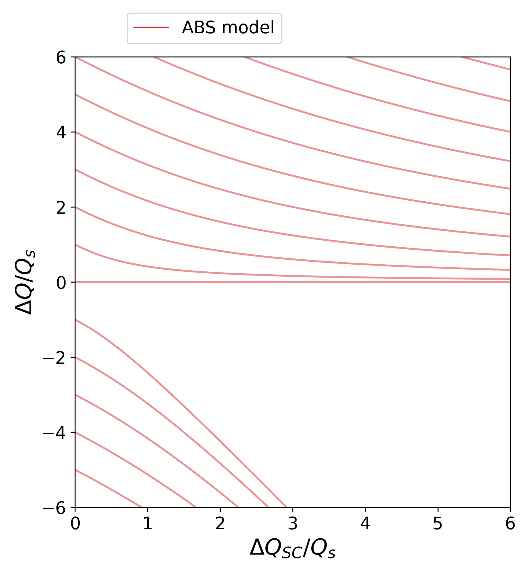
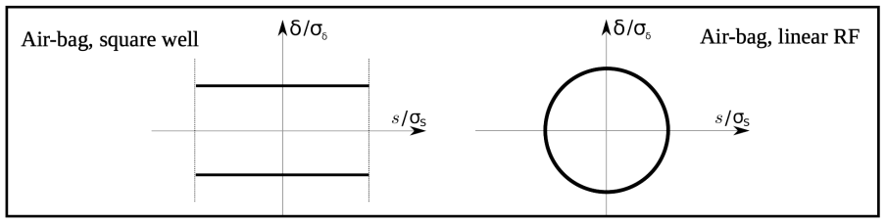
Airbag in square well
The simplified model introduced by M. Blaskiewicz has been used to combine space-charge and impedance effects
  See for example A. Burov “Transverse Instabilities of a Bunch with Space Charge, Wake and Feedback”
Notes:
https://ieeexplore.ieee.org/document/10443443
https://indico.cern.ch/event/1325963/contributions/5792975/attachments/2818936/4922081/IMCC_March2024.pdf

Slide 8
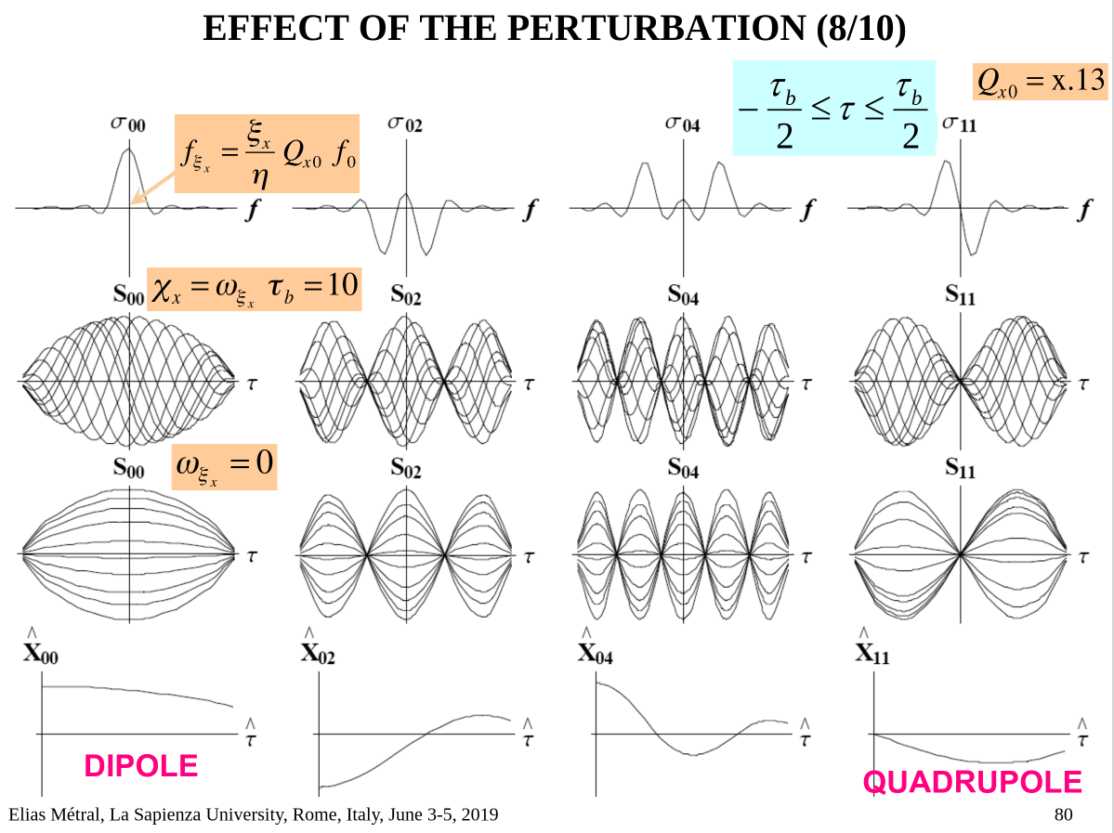
Airbag in square well
The bunch motion is described as a superposition of modes
Depending on the effect included in the model (space-charge, wakefield, damper), these modes can couple and/or become unstable
With space-charge only, the different modes remain stable and do not couple
From E. Metral course
Notes:
https://ieeexplore.ieee.org/document/10443443
https://indico.cern.ch/event/1325963/contributions/5792975/attachments/2818936/4922081/IMCC_March2024.pdf

Slide 9
Airbag in square well
The bunch motion is described as a superposition of modes
Depending on the effect included in the model (space-charge, wakefield, damper), these modes can couple and/or become unstable
With space-charge only, the different modes remain stable and do not couple
From E. Metral course
Notes:
https://ieeexplore.ieee.org/document/10443443
https://indico.cern.ch/event/1325963/contributions/5792975/attachments/2818936/4922081/IMCC_March2024.pdf

Slide 10
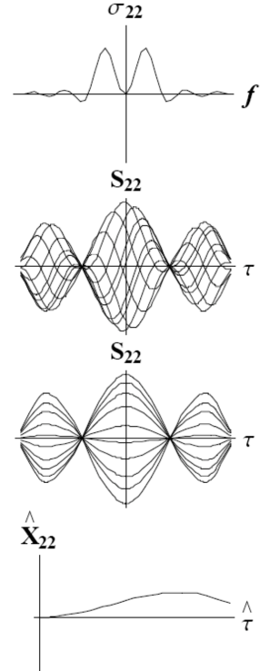
Airbag in square well
The bunch motion is described as a superposition of modes
Depending on the effect included in the model (space-charge, wakefield, damper), these modes can couple and/or become unstable
With space-charge only, the different modes remain stable and do not couple
From E. Metral course
Notes:
https://ieeexplore.ieee.org/document/10443443
https://indico.cern.ch/event/1325963/contributions/5792975/attachments/2818936/4922081/IMCC_March2024.pdf

Slide 11
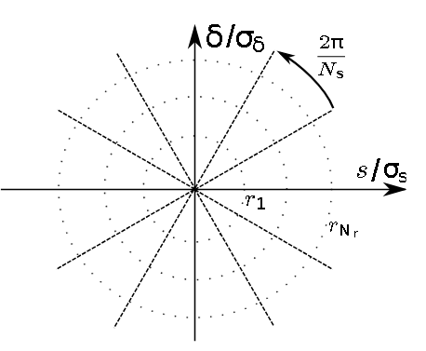
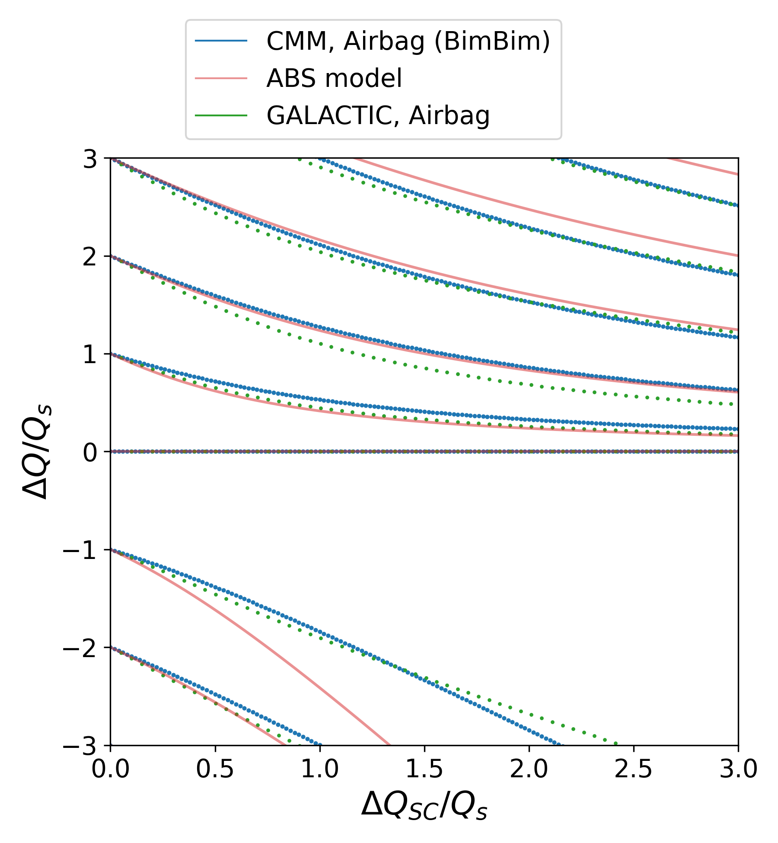
Airbag in square well
The ABS was compared to other models
The Circulant Matrix Model (CMM) with
the BimBim code
  Longitudinal phase space distribution is discretized in slices in the azimuthal direction and in rings in the radial direction
  Any longitudinal distributions featuring a polar symmetry can be modelled considering either a linear or a sinusoidal RF force.
The GALACTIC code for space-charge
  The linearized Vlasov equation is solved in two steps, first finding the eigenvalues and eigenvectors at low intensity, then using those as a basis for the high-intensity eigenvalue problem
  Any phase-space distribution can be implemented (waterbag or airbag or Gaussian) but it has been optimised for waterbag
X. Buffat
Notes:
https://ieeexplore.ieee.org/document/10443443
https://indico.cern.ch/event/1325963/contributions/5792975/attachments/2818936/4922081/IMCC_March2024.pdf

Slide 12
Airbag in square well
The ABS was compared to other models
The three models have similar behavior
  Mode 0 is not affected by space-charge
  Positive azimuthal modes (m ≥ +1) are shifted as ΔQ_{SC} increases, but remain positive
  Negative azimuthal modes (m ≤ -1) are also shifted.
The ABS model predicts stronger shifts for negative azimuthal modes than CMM and GALACTIC
Notes:
https://ieeexplore.ieee.org/document/10443443
https://indico.cern.ch/event/1325963/contributions/5792975/attachments/2818936/4922081/IMCC_March2024.pdf

Slide 13
M. Blaskiewicz 1998 article
Air-bag in square well (ABS) model
Notes:
https://ieeexplore.ieee.org/document/10443443
https://indico.cern.ch/event/1325963/contributions/5792975/attachments/2818936/4922081/IMCC_March2024.pdf

Slide 14
M. Blaskiewicz 1998 article
The equation of motion were solved for a Gaussian and a boxcar distribution, in a linear RF potential
The analytical way
Notes:
https://ieeexplore.ieee.org/document/10443443
https://indico.cern.ch/event/1325963/contributions/5792975/attachments/2818936/4922081/IMCC_March2024.pdf

Slide 15
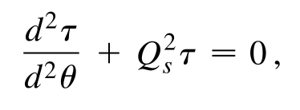
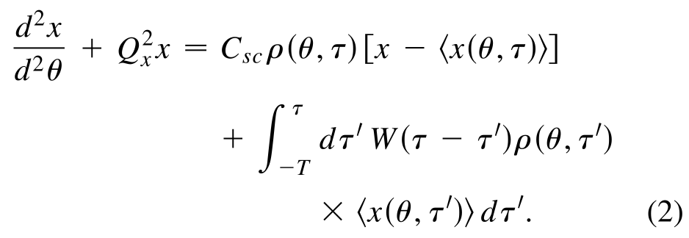
The analytical way
Longitudinal equation of motion
Transverse equation of motion
  Only consider space-charge term in our case
Space-charge
Wake-field
Notes:
https://ieeexplore.ieee.org/document/10443443
https://indico.cern.ch/event/1325963/contributions/5792975/attachments/2818936/4922081/IMCC_March2024.pdf

Slide 16
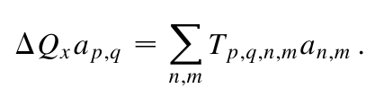


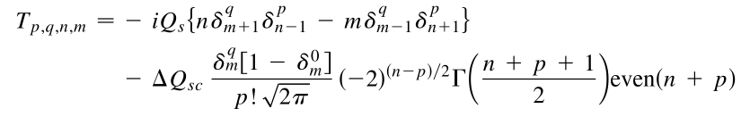

The analytical way
After some lengthy derivations, an eigenvalue system is reached
m, q: azimuthal mode numbers
n, p: radial mode numbers
The matrix terms T_{pqnm} depend on the longitudinal distribution ρ(τ) choice
ρ(τ) = Boxcar (constant line density)
$$\frac{1}{2}$$
A factor ½ is missing in the paper
ρ(τ) = Gaussian
Notes:
https://ieeexplore.ieee.org/document/10443443
https://indico.cern.ch/event/1325963/contributions/5792975/attachments/2818936/4922081/IMCC_March2024.pdf

Slide 17
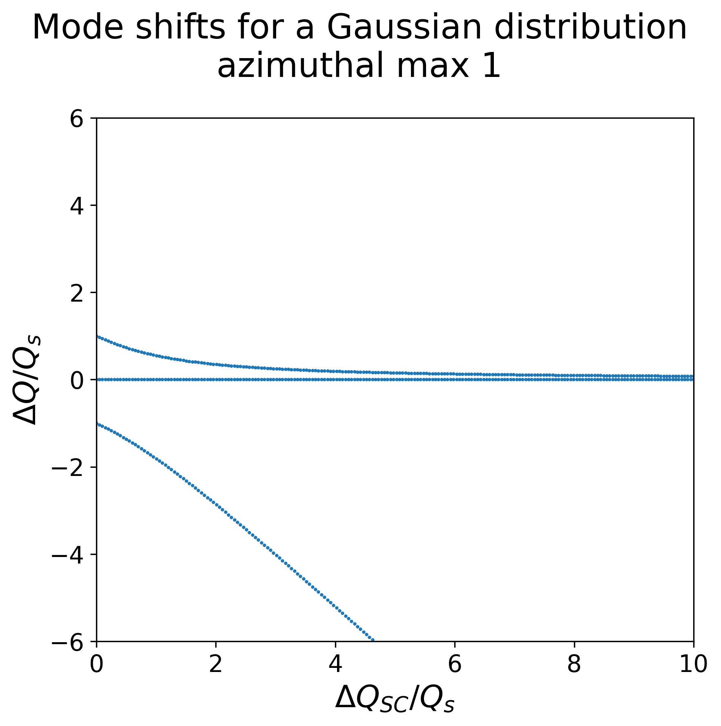
The analytical way
This model includes several radial modes n for each azimuthal mode m
Notes:
https://ieeexplore.ieee.org/document/10443443
https://indico.cern.ch/event/1325963/contributions/5792975/attachments/2818936/4922081/IMCC_March2024.pdf

Slide 18
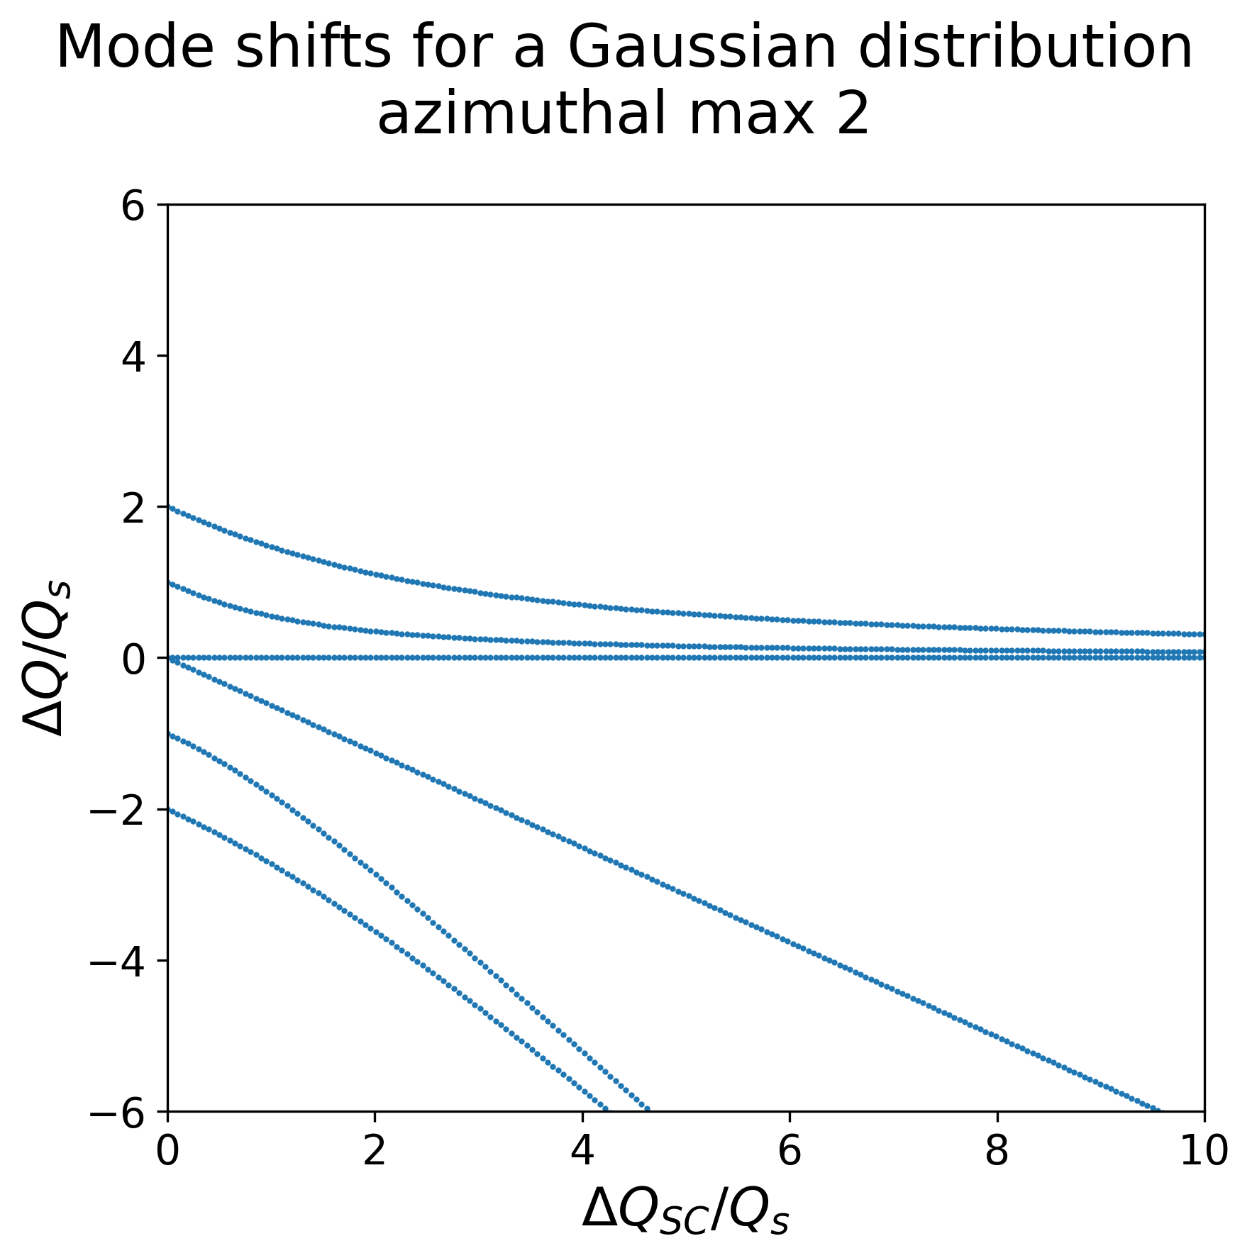
The analytical way
This model includes several radial modes n for each azimuthal mode m
Notes:
https://ieeexplore.ieee.org/document/10443443
https://indico.cern.ch/event/1325963/contributions/5792975/attachments/2818936/4922081/IMCC_March2024.pdf

Slide 19

The analytical way
This model includes several radial modes n for each azimuthal mode m
The main azimuthal mode have the same behavior as before with the ABS
For azimuthal modes m ≥ +1, the radial modes become negative
Notes:
https://ieeexplore.ieee.org/document/10443443
https://indico.cern.ch/event/1325963/contributions/5792975/attachments/2818936/4922081/IMCC_March2024.pdf

Slide 20
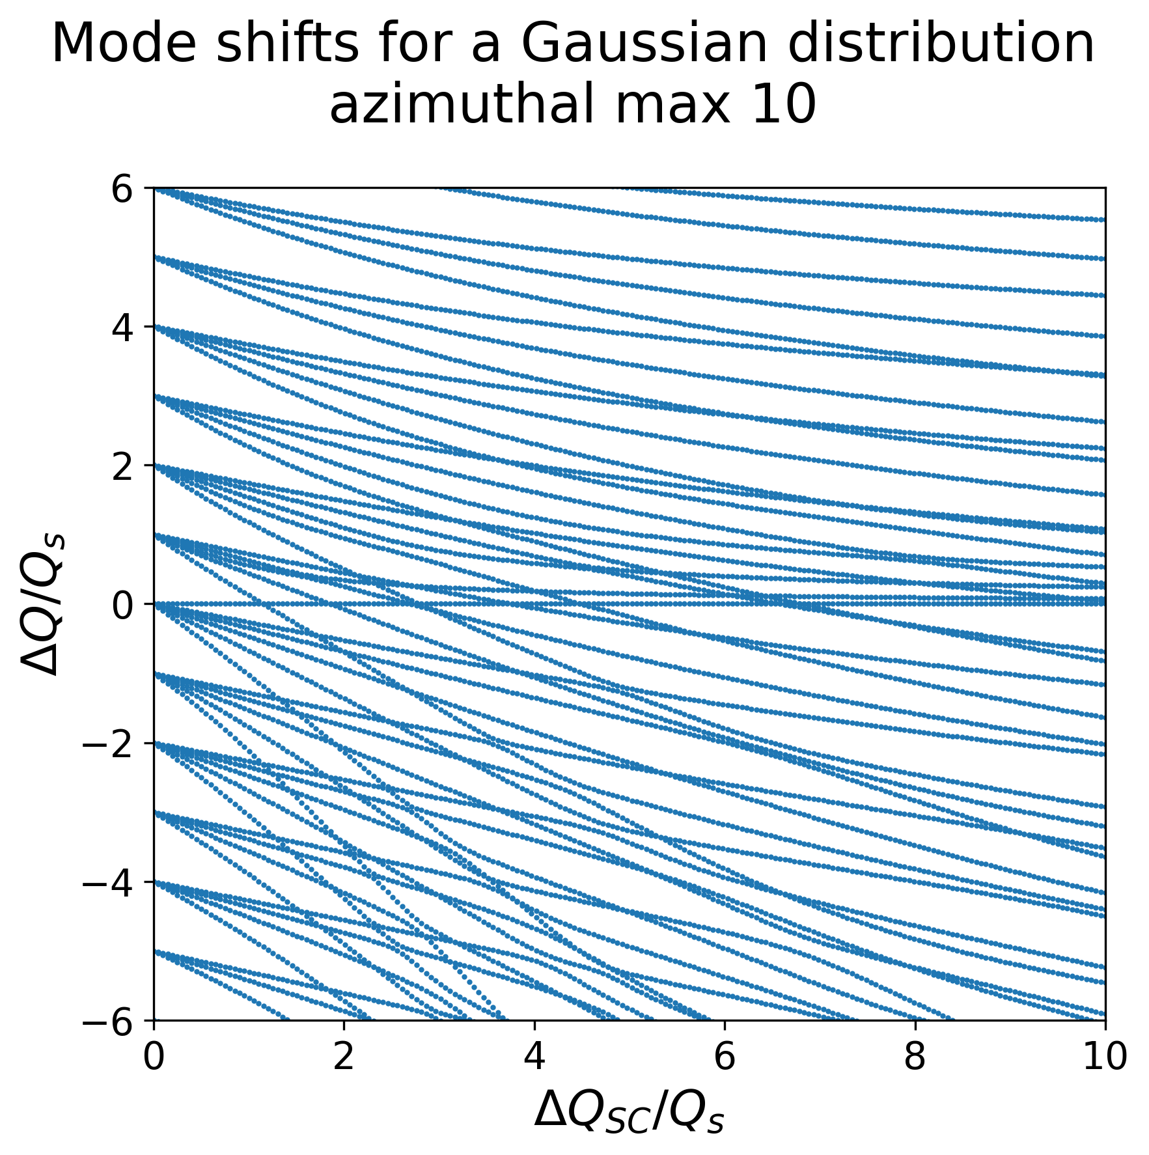
The analytical way
This model includes several radial modes n for each azimuthal mode m
The main azimuthal mode have the same behavior as before with the ABS
For azimuthal modes m ≥ +1, the radial modes become negative
Notes:
https://ieeexplore.ieee.org/document/10443443
https://indico.cern.ch/event/1325963/contributions/5792975/attachments/2818936/4922081/IMCC_March2024.pdf

Slide 21
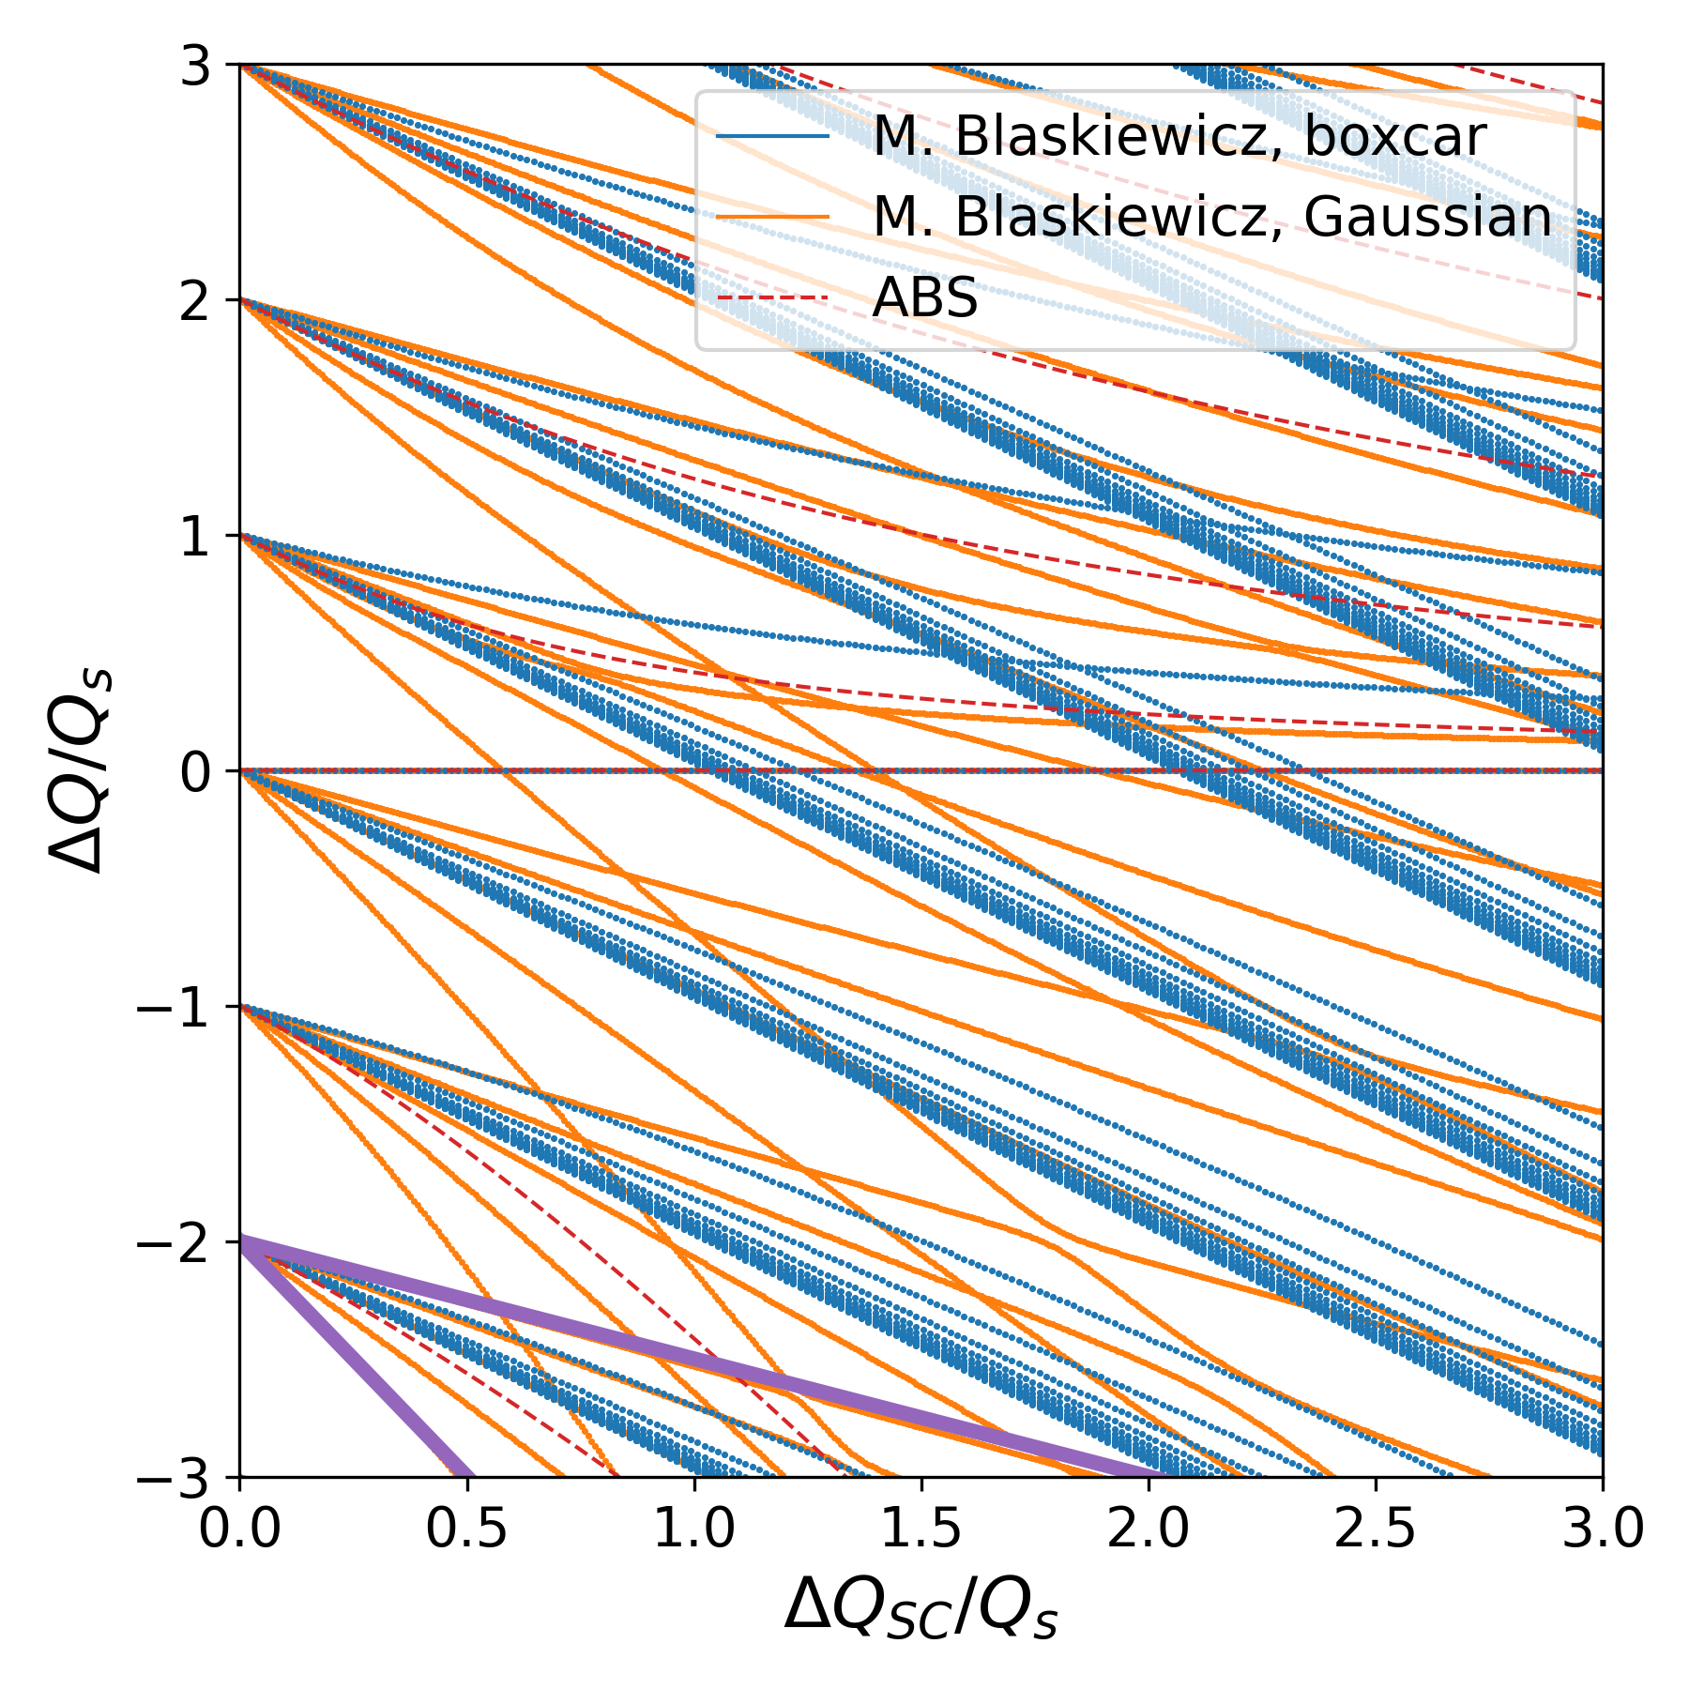
The analytical way
This model includes several radial modes n for each azimuthal mode m
For the boxcar distribution, include 10 azimuthal modes m and 10 radial modes n
With the Gaussian distribution, m and n are linked by a condition
  m+n ≤ m_{max} = 10 in this case
Notes:
https://ieeexplore.ieee.org/document/10443443
https://indico.cern.ch/event/1325963/contributions/5792975/attachments/2818936/4922081/IMCC_March2024.pdf

Slide 22
The analytical way
With the boxcar distribution, radial modes are grouped
  Because the line density ρ is constant, all particles experience the same shift from this term of the space-charge force:
With the Gaussian distribution, there is a spread in the radial mode shifts
  Particles at the edge of the distribution ρ experience a smaller shift from the space-charge force (upper slope)
  Particles in the center experience a stronger force and therefore a stronger shift (lower slope)
Notes:
https://ieeexplore.ieee.org/document/10443443
https://indico.cern.ch/event/1325963/contributions/5792975/attachments/2818936/4922081/IMCC_March2024.pdf

Slide 23
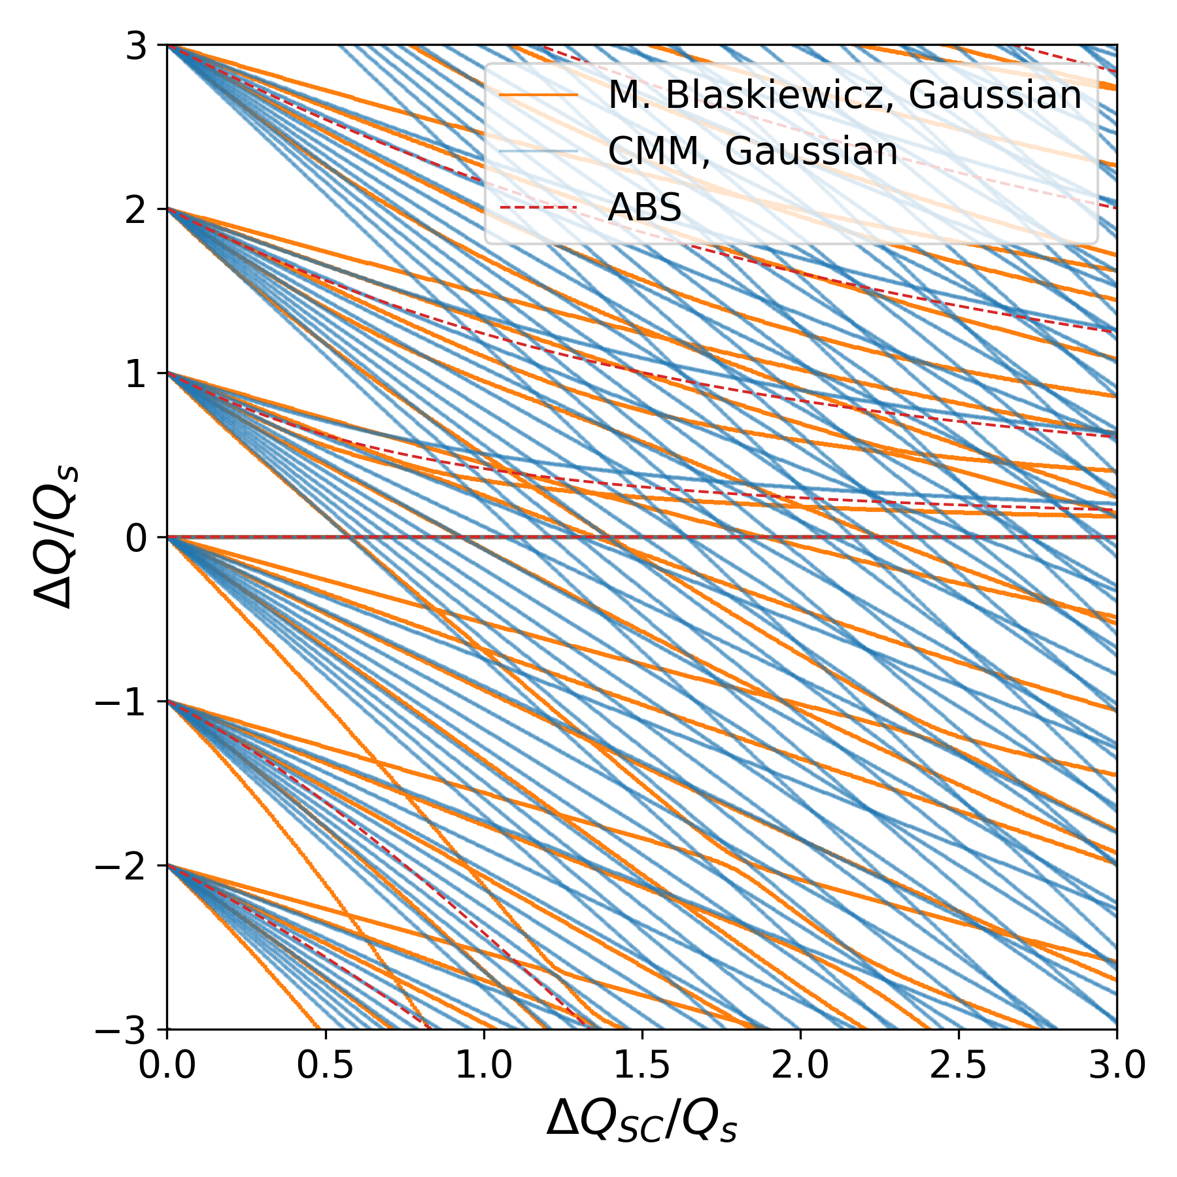
The analytical way
The behavior is like the CMM with a Gaussian distribution
There are however differences in the mode shifts magnitude
Notes:
https://ieeexplore.ieee.org/document/10443443
https://indico.cern.ch/event/1325963/contributions/5792975/attachments/2818936/4922081/IMCC_March2024.pdf

Slide 24
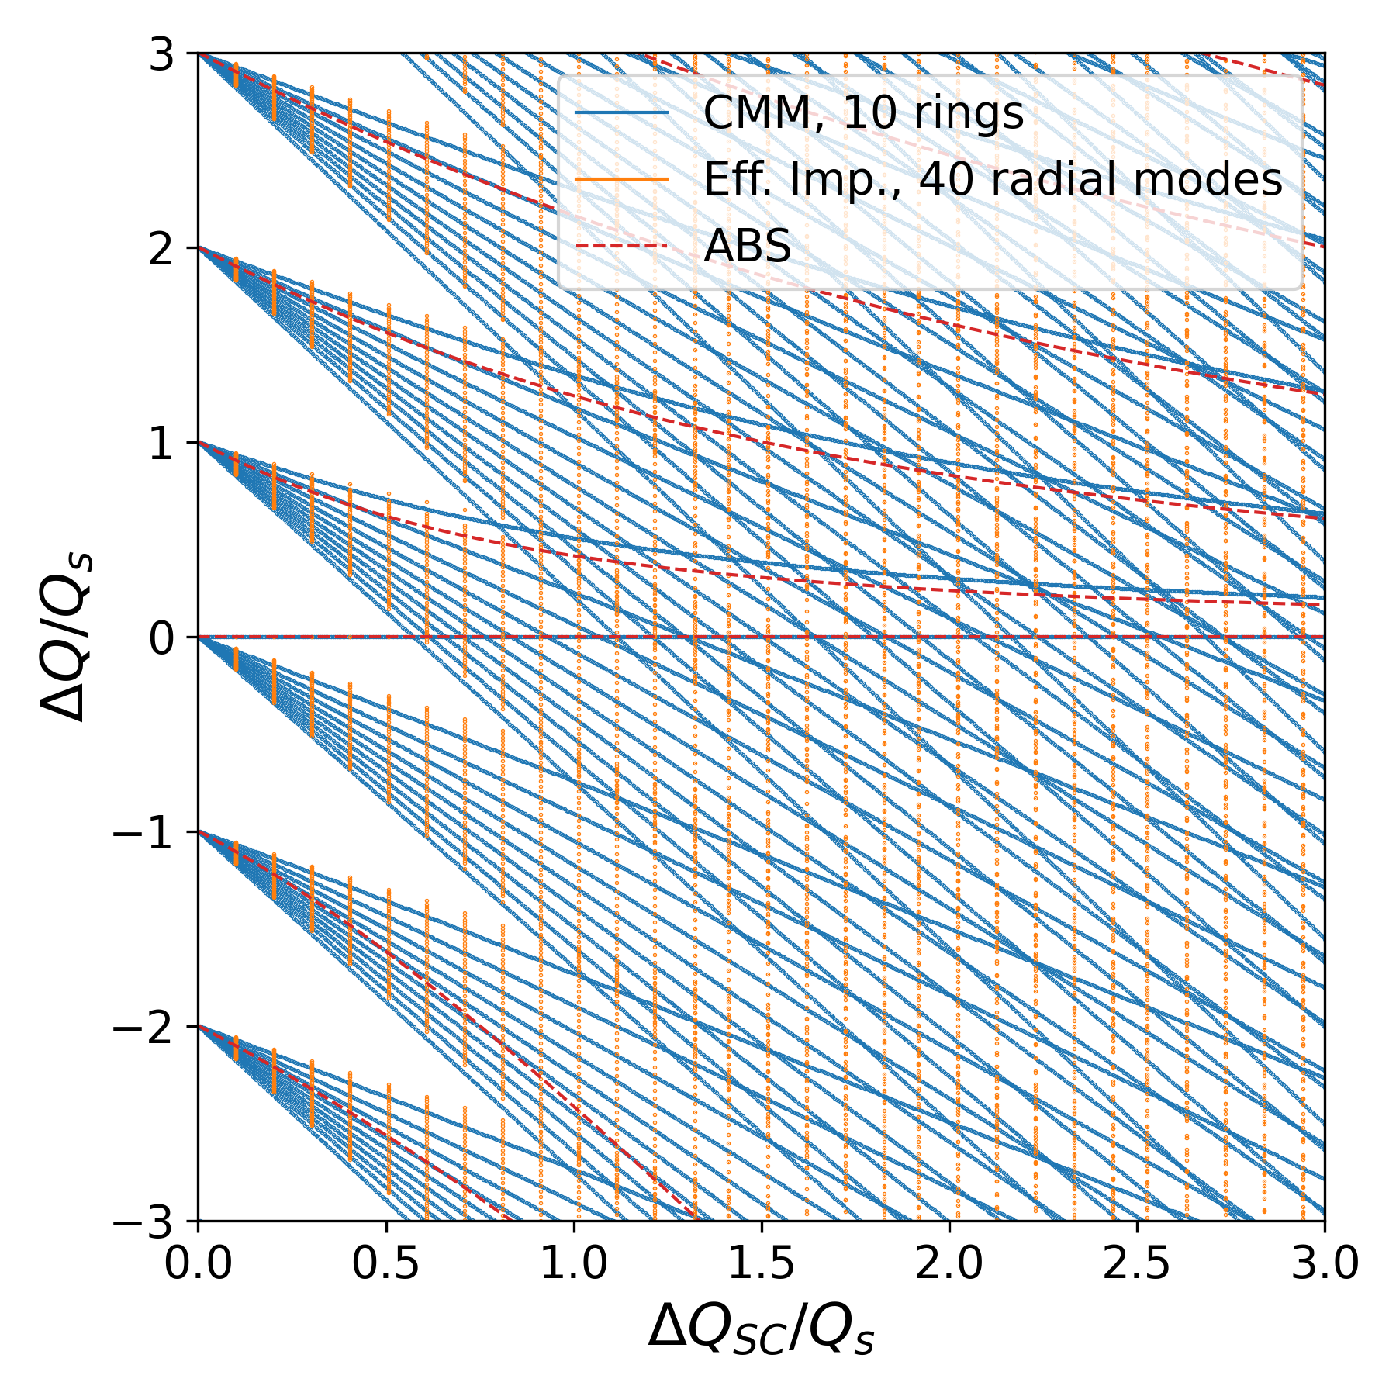
The analytical way
The CMM was also compared to the Effective Impedance method for space-charge
  Method developed by K. Ohmi et al.
  Space-charge forces acting on the beam are expressed as a wake function.
  Other effects such as impedance and beam-beam can be included, and the linearized Vlasov equation is then solved to find the coherent modes.
Same behaviour in the spread of radial modes as ΔQ_{SC} increases
Notes:
https://ieeexplore.ieee.org/document/10443443
https://indico.cern.ch/event/1325963/contributions/5792975/attachments/2818936/4922081/IMCC_March2024.pdf

Slide 25
Conclusion
Space-charge effects in the Muon Collider could affect the proton driver and the muon cooling lines
Coherent space-charge effects have been studied analytically in a variety of ways
  M. Blaskiewicz 1998 paper introduced both analytical models and the simplified ABS model
  The later has been commonly used, including impedance and damper effects as well
  The Circulant Matrix Model, GALACTIC and the Effective impedance model can also include coherent space-charge
  The different methods were compared and show similar behavior, more details
Details can be found in these two papers
  E. Metral, “Space charge in the GALACTIC Vlasov solver”, IPAC 2025
  D. Amorim, “Transverse coherent direct space charge: comparison between several approaches”, IPAC 2025
M. Blaskiewicz analytical derivations for the boxcar and Gaussian distribution can be found in a simple python implementation: gitlab.cern.ch/damorim/codispac

Slide 27
References
Transverse impedance and beam stability studies for the muon collider ring, IPAC 23
Transverse impedance and beam stability studies for the muon collider Rapid Cycling Synchrotrons, IPAC 23
Transverse Coherent Instability Studies for the High-Energy Part of the Muon Collider Complex, HB 2023
Transverse Collective Effects studies for a Muon Collider, ICHEP 2024
Coherent Beam-Beam effects in a Muon Collider, Beam Beam workshop 2024
IMCC and MuCol annual meeting 2024
IMCC annual meeting 2023
IMCC annual meeting 2022
Interim report for the International Muon Collider Collaboration (IMCC)
MuCol Milestone Report 5: Preliminary parameters

