Slide 1
Coherent Effects and Impedances section (CEI) – general information
BE-ABP-CEI
Coherent Effects and Impedance
Giovanni RUMOLO
David AMORIM
Chiara ANTUONO
Miltiadis BOZATZIS
Xavier BUFFAT
Elena DE LA FUENTE GARCIA
Dora GIBELLIERI
Fredrik GRØNVOLD
Peter KICSINY
Jintao LI
Elena MACCHIA
Lotta METHER
Elias MÉTRAL
Nicolas MOUNET
Luca SABATO
Daniel SCHULTE
Leonardo SITO
Roxana SOOS
R TAYLOR
Carlo ZANNINI
Giovanni Rumolo
CEI Section Meeting, 13/03/2025
Scientific secretary: Chiara Antuono
https://indico.cern.ch/event/1519352/

Slide 2
Some deadlines and events
CAS on Intensity Limitations
  Instructions distributed to the approved participants
  Please organize your travel as soon as possible and in any case no later than a month prior to the travel
Participation proposals for HB2025 in CEI
  Elias, Elena, anybody else?
Summer studentships:
  Two CEI projects were not selected as summer student projects, however we can ask for trainees – Xavier investigating the possibility for a Norwegian intern over summer, Carlo/Elena checking for a Danish intern in autumn.

Slide 3

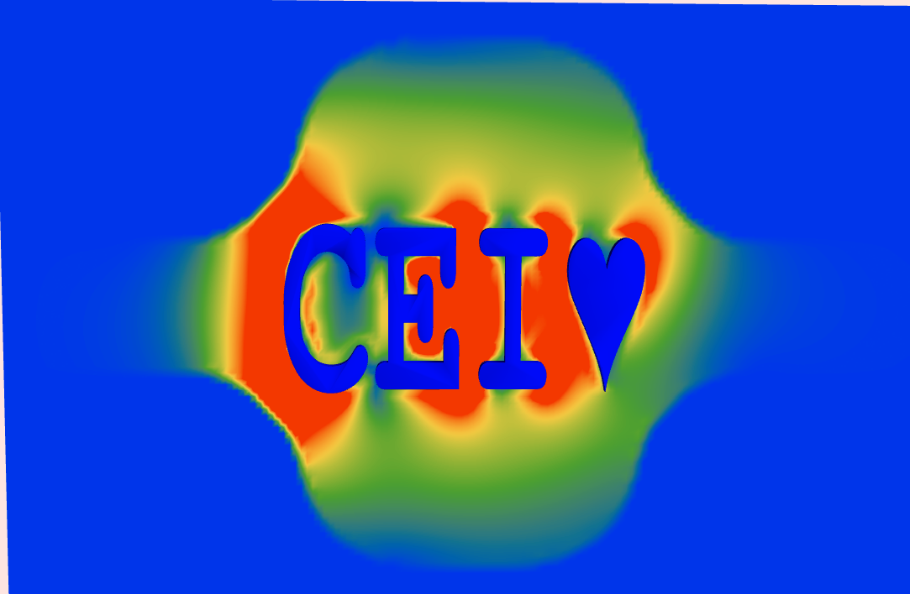
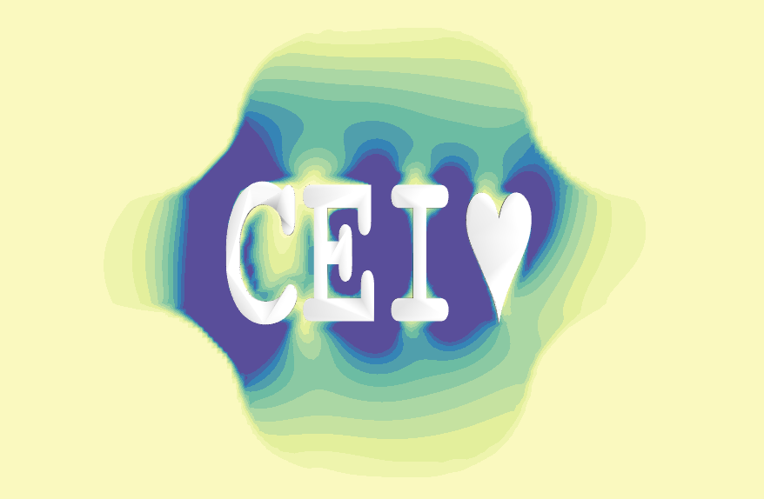

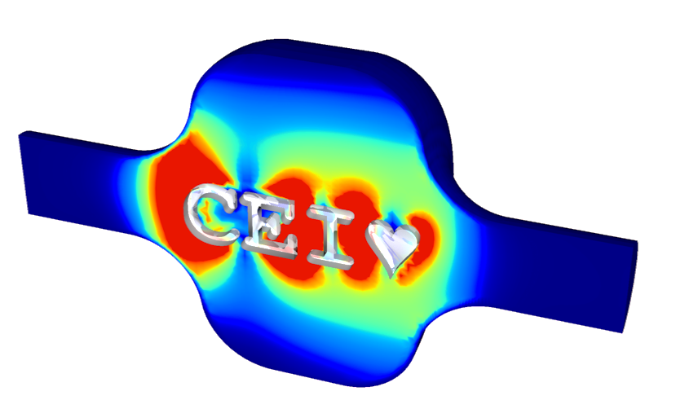

Some deadlines and events
New CEI logo? Based on Wakis, thanks Elena!

Slide 4
Injectors schedule
Beam to SPS is now expected tomorrow or Monday next week latest
By the end of next week
  Planned start of SPS scrubbing run, planning and studies detailed by Lotta & Ingrid at SPS MPC meeting last Tuesday
  Kevin has requested moving Friday’s dedicated MD block in W13 to the following week in order to be sure to have the SPS ready for scrubbing over the weekend

Slide 5
LHC schedule
Handover to operation tomorrow after DSO tests today
Progress as expected with HW commissioning, e.g.
  Cracks in flanges for RF cryomodules discovered earlier in YETS have been all fixed (modules exchanged)
  Warm transition modules exchanged by TE/VSC
  Polarities inverted in IP1 (back to nominal) and IP5 (reverse) + PSS roman pot tilt
Beam expected on 7 April

