Slide 1


LHCb QC Workshop 2025
Closing Remarks
Ahmed Abdelmotteleb
ahmed.abdelmotteleb@cern.ch
University of Warwick
2 July 2025

Slide 2


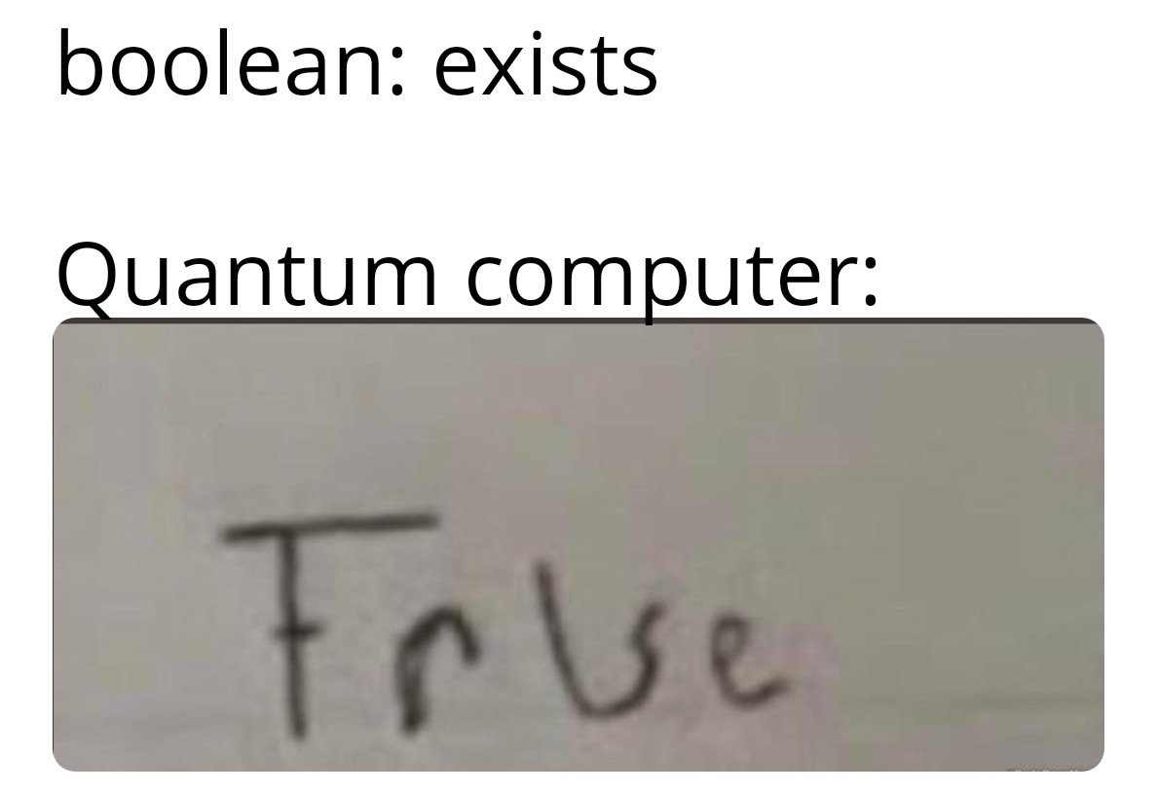
LHCb Quantum Computing workshop
Thank you for joining us!
It’s been a pleasure having you at the first-ever LHCb Quantum Computing Workshop
We hope you found it useful, inspiring, and fun!
Special thanks to Nicole Skidmore for making this possible
Presentations and recordings will be uploaded to the event webpage (indico)

Slide 3


Stay connected
LHCb DPA WP4 Quantum Computing webpage
Mattermost channel: LHCb Quantum Computing
Mattemost channel 2: DPA WP4 Novel Analysis Techniques
Join the mailing list: lhcb-dpa-wp4
Ahmed.Abdelmotteleb@cern.ch

Slide 4


Social event and dinner – Join us!
Social mixer with free snacks & drinks
An informal chance to chat with speakers and other participants!
Mathematical Sciences Building, Room MB0.07
Free beer! 🍺 (and other non-alcoholic drinks)
Immediately after this presentation
Free 3-Course Dinner (!)
Enjoy a full meal and good company at the end of the day
Radcliffe Restaurant, University of Warwick Campus
From 7 PM to 9 PM

Slide 5

Future plans
Considering making this a regular (maybe annual) meeting
Could maybe consider making this an LHC-wide event?
Try to bring more people from industry?
Catering for both beginners and experts of the field – both theory and application

Slide 6
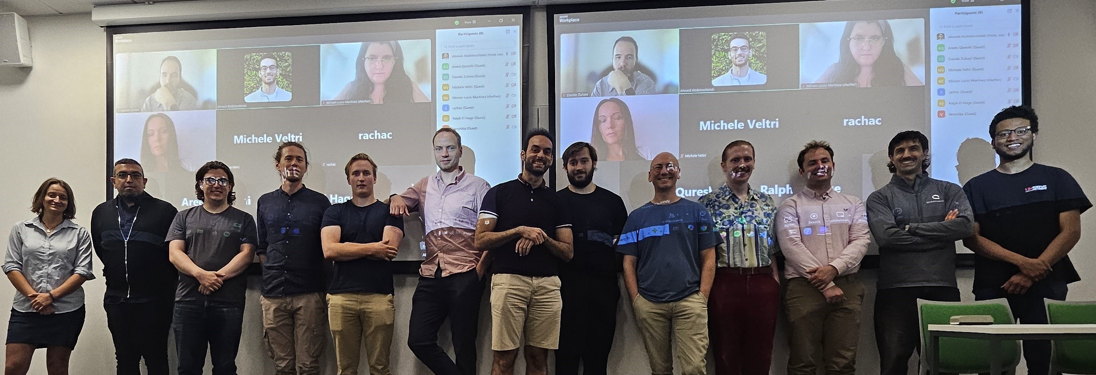
Entangled and observed – now we must collapse 📸

Slide 7

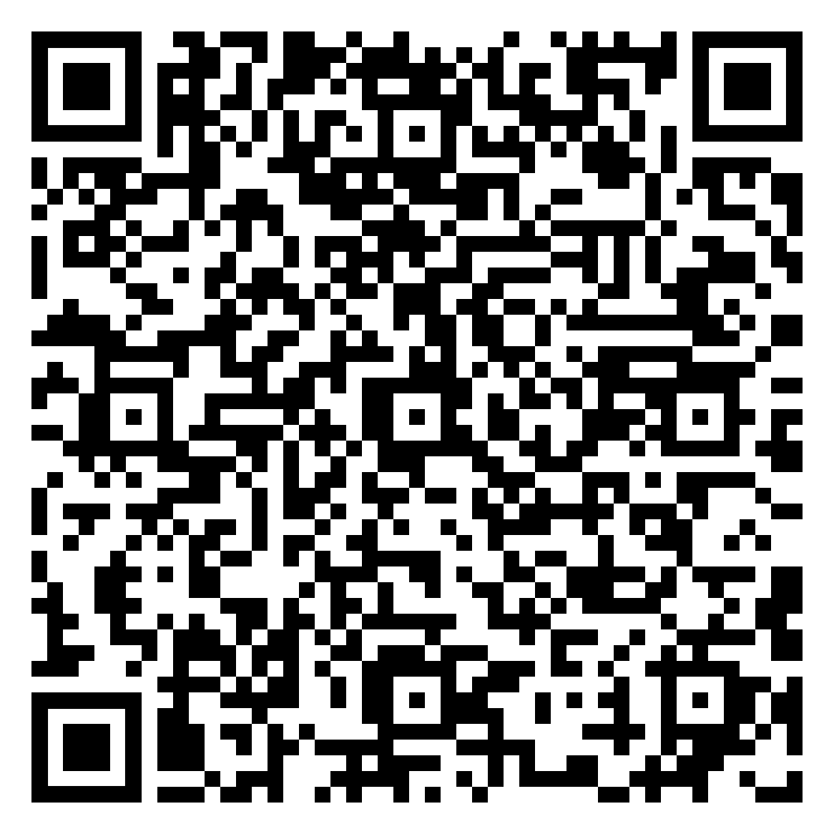
Feedback – only takes 2 minutes!
https://forms.gle/GcFki3yEuCGHmwuR8

