Slide 1


Introduction to Quantum Computing
Lecture 1
Ahmed Abdelmotteleb
University of Warwick
ahmed.abdelmotteleb@cern.ch
LHCb Quantum Computing Workshop
1st of July 2025

Slide 2
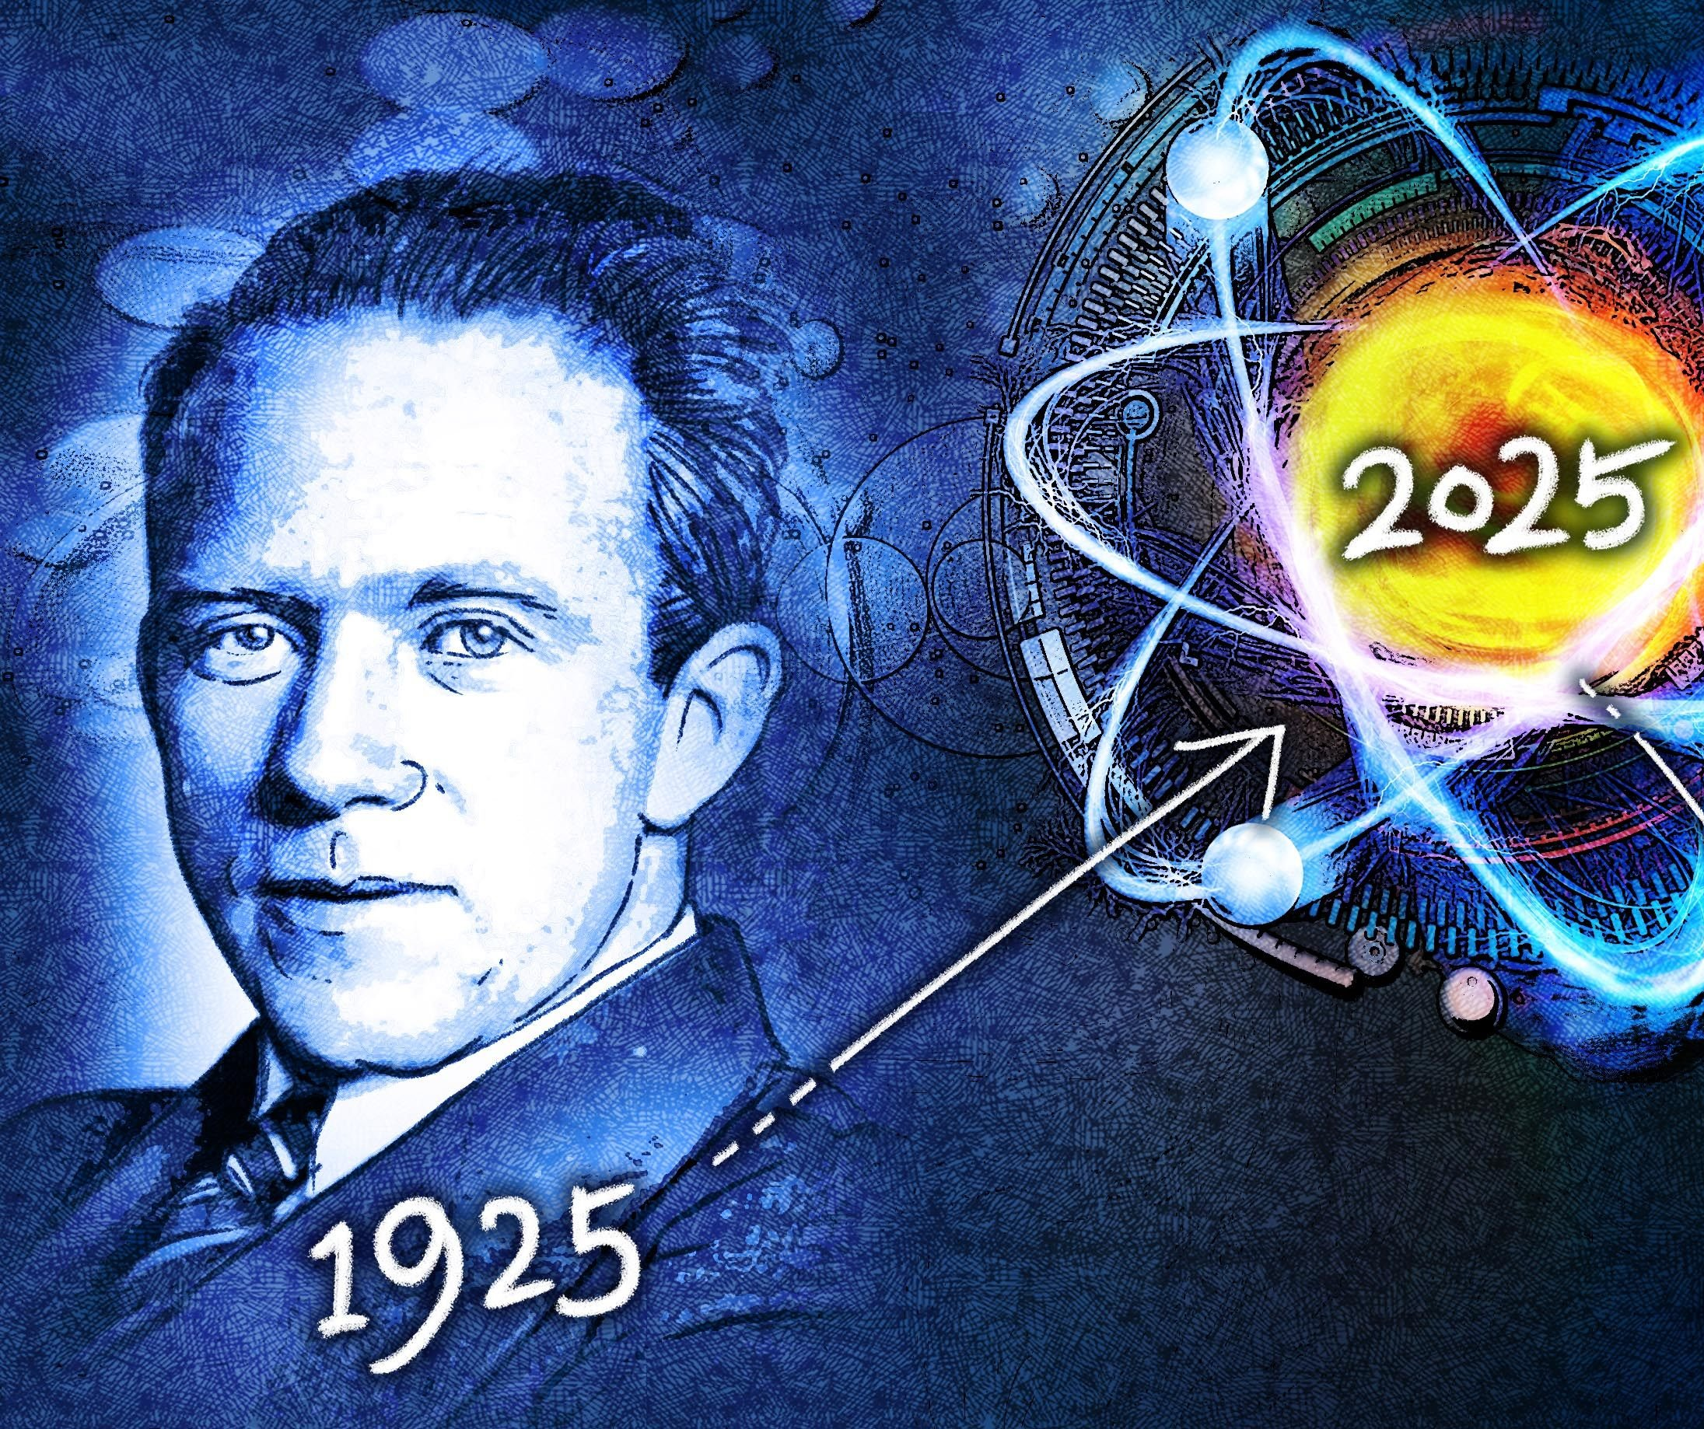
Happy Quantum Year! 🎉
The United Nations has declared 2025 as the International Year of Quantum Science and Technology, celebrating a century of research and innovation in the field.

Slide 3
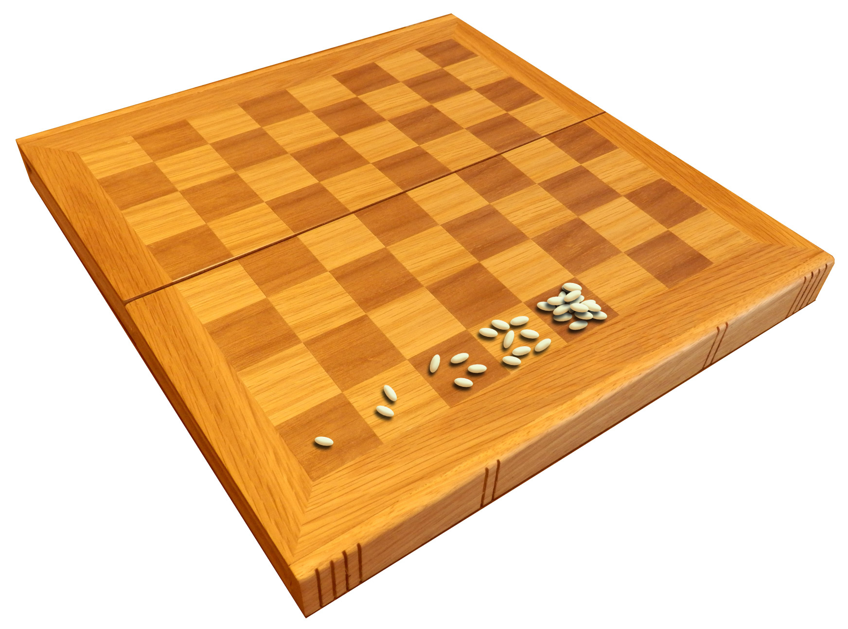

On the origins of chess
“Just one grain of wheat on the first square of a chessboard. Then put two on the second square, four on the next, then eight, and continue, doubling the number of grains on each successive square, until every square on the chessboard is reached.”
“Sure thing fam.” – famous last words
18,446,744,073,709,551,615 grains ($2^{64}$)
Over 2,000 times the annual world production of wheat!

Slide 4
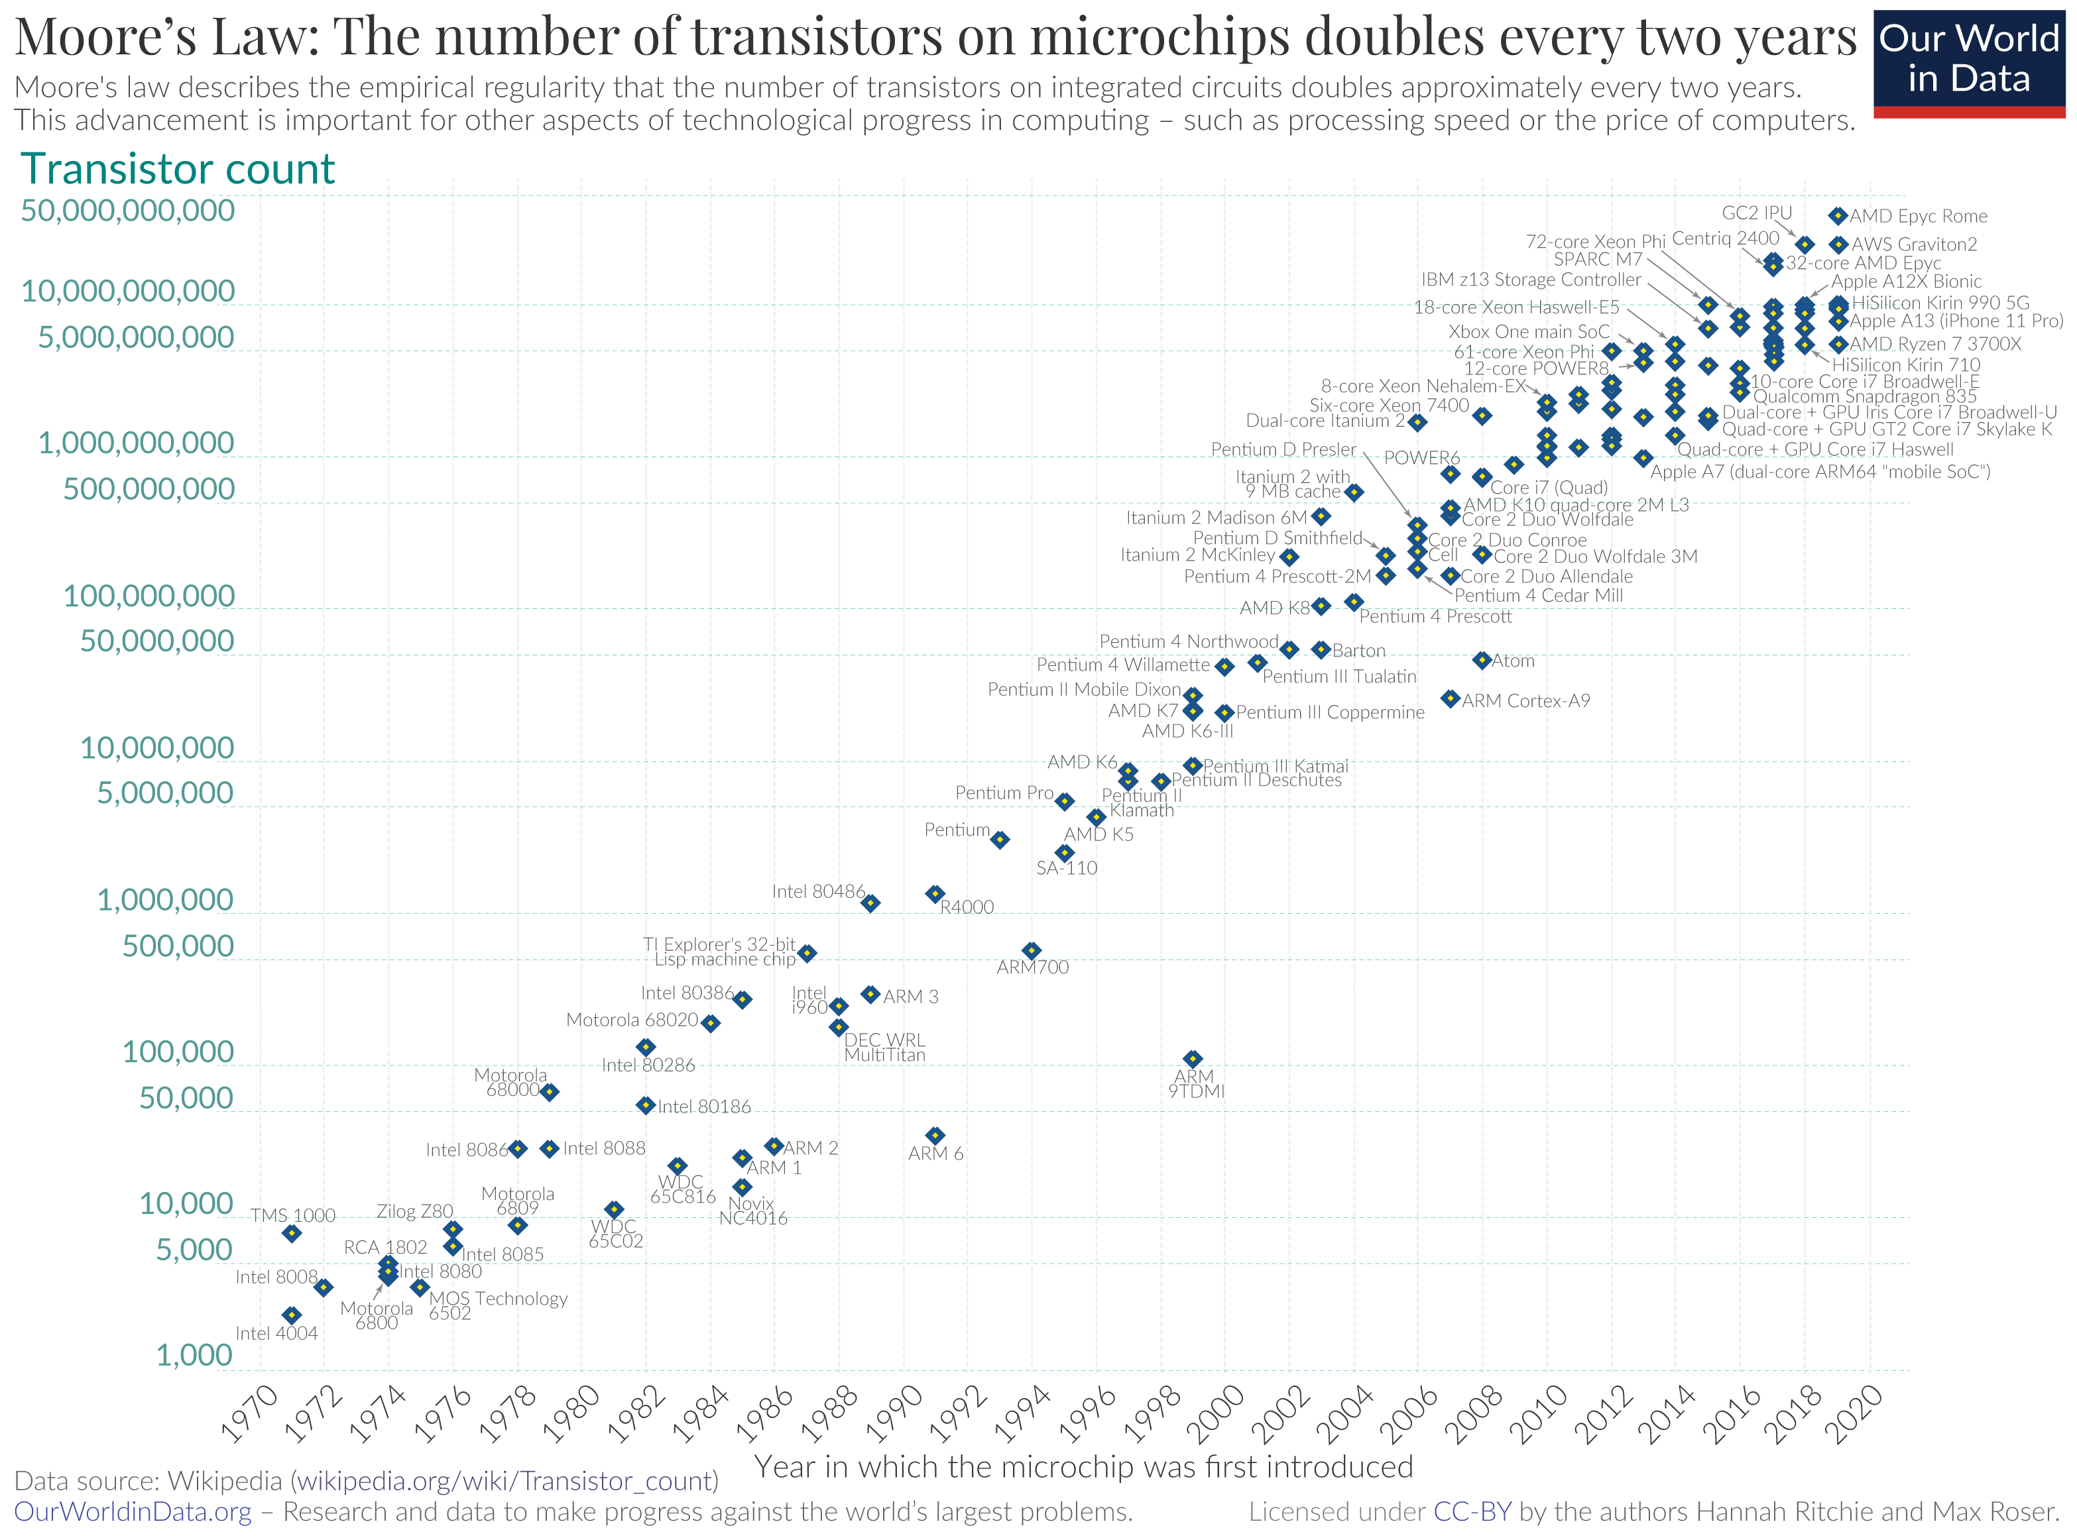
Moore’s “Law”
More of an observation by Gordon Moore of Intel
(in 1965)
Processing powers of (classical) computers double every 2 years
Production cost correspondingly halve
Number of transistors on a CPU chip double every two years (18 months)
Moore’s Law was estimated to end sometime in the 2020s. Many experts agree that Moore’s Law is right now no longer true
Transistors can’t go any smaller without adverse temperature and quantum effects
ourworldindata.org

Slide 5

What is a classical computer?
A classical computer uses processing chips
A chip uses transistors
A transistor is like a light switch (on or off)
First computer by Intel had around 2300 transistors (1971)
Apple’s M3 Ultra chip in the latest Macbook pro has 184 billion transistors
Cerebras WSE-3 supercomputing processor has 4 trillion transistors with 900,000 AI cores

Slide 6

What is a quantum computer?
Let’s discuss first what it is not:
It is not the end of classical, silicon-based computers
It is not the saviour of Moore’s law
It is not the destroyer of the world of finance, cryptography and world order as we know it
It cannot work without classical computers
Quantum computers will change the world!
We’ll address some more misconceptions in detail as we go along

Slide 7
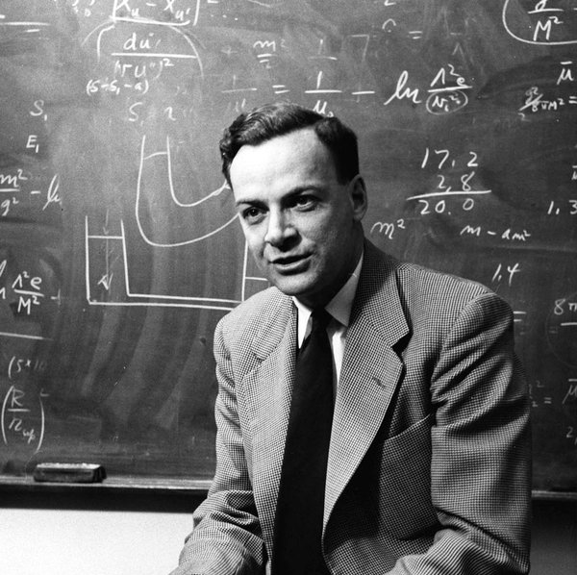
“Let the computer itself be built of quantum mechanical elements which obey quantum mechanical laws.”
-Richard Feynman

Slide 8
What is a quantum computer? - continued
A system that uses atomic or subatomic particles and quantum mechanics to do computations
In contrast to classical computing bits, which can be either 0 or 1, quantum bits or “qubits” can take an arbitrary combination of 0 and 1 (more on that in a bit)
Many types of qubits, including superconducting (IBM, Google), photonics (Xanadu, PsiQuantum), trapped ions (Quantinuum, IonQ), annealing (D-Wave), and many more
Makes use of 3 main principles of quantum mechanics: superposition, entanglement and interference

Slide 9
Classical bit vs quantum bit
Classical computers operate using strings of zeros and ones, such as 01100111 01101111 01110100 01100011 01101000 01100001
Each option (0 or 1) is distinguishable and represents a physical state (e.g. light switch on or off, magnet up or down)
Command issued by a certain string of “bits” that corresponds to specific physical states
→ leads to the triggering of the command
A quantum bit (qubit) can exist in either one of the two discrete
states (0 or 1), or it can exist in both states simultaneously
Thanks to the principles of superposition and entanglement,
we can represent and manipulate many possible states at once
- more on that shortly

Slide 10
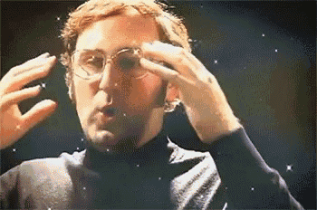
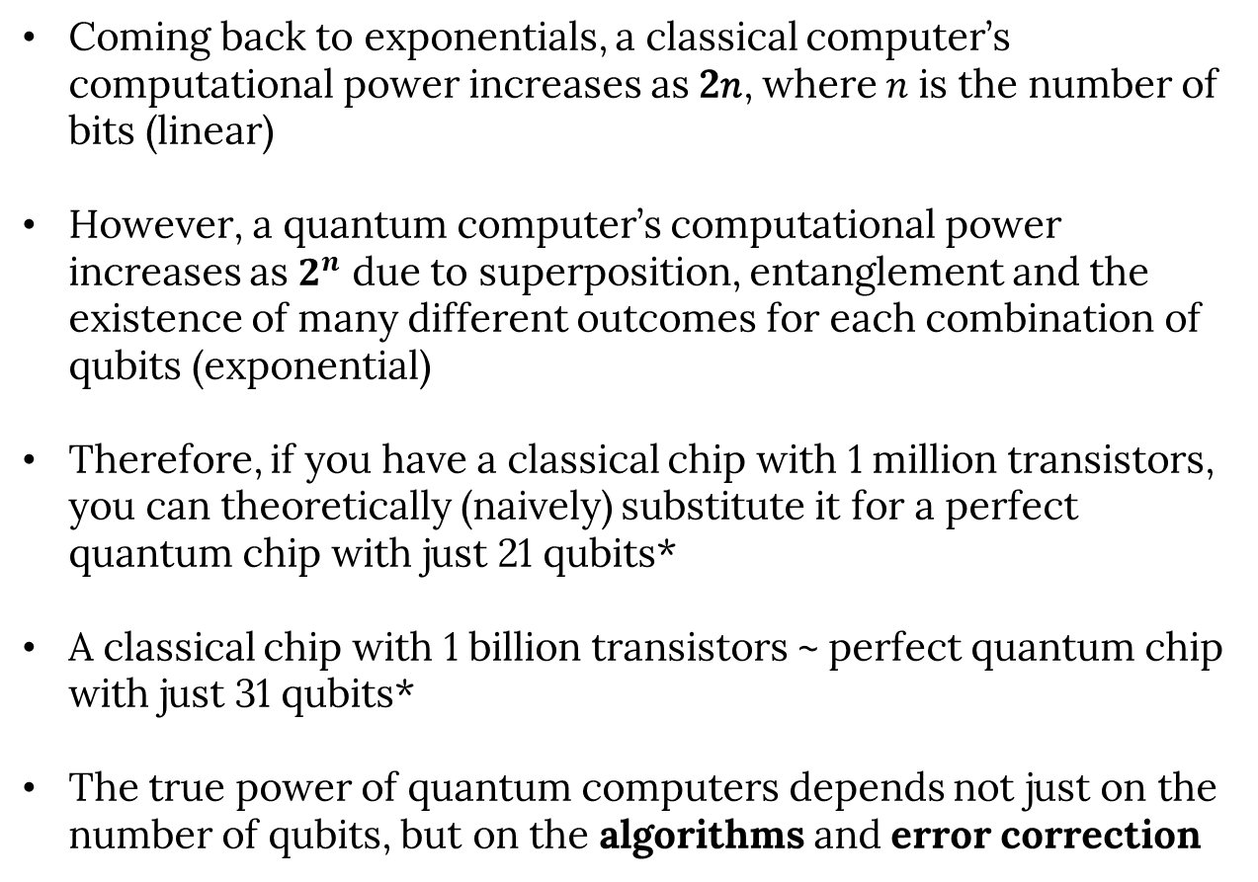
Classical bit vs quantum bit - continued
Coming back to exponentials, a classical computer’s computational power increases as 2𝑛, where 𝑛 is the number of bits (linear)
However, a quantum computer’s computational power increases as $2^{n}$ due to superposition, entanglement and the existence of many different outcomes for each combination of qubits (exponential)
Therefore, if you have a classical chip with 1 million transistors, you can theoretically (naively) substitute it for a perfect quantum chip with just 21 qubits*
A classical chip with 1 billion transistors ~ perfect quantum chip with just 31 qubits*
The true power of quantum computers depends not just on the number of qubits, but on the algorithms and error correction
*in real life, we should also consider noise effects

Slide 11
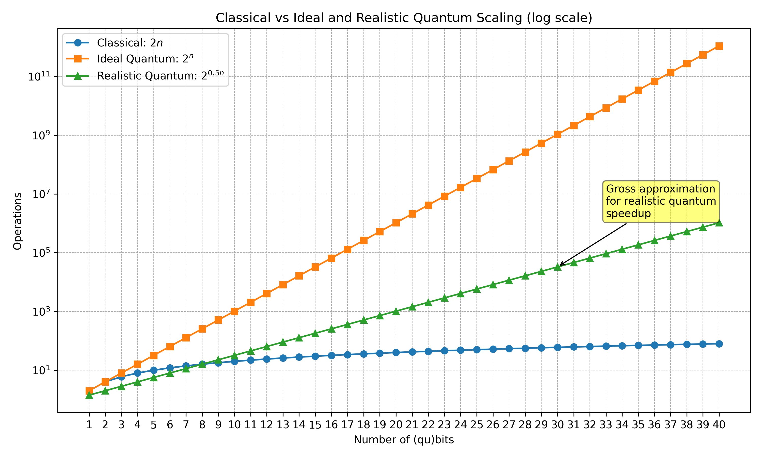
Classical bit vs quantum bit - continued
*in real life, we should also consider noise effects

Slide 12
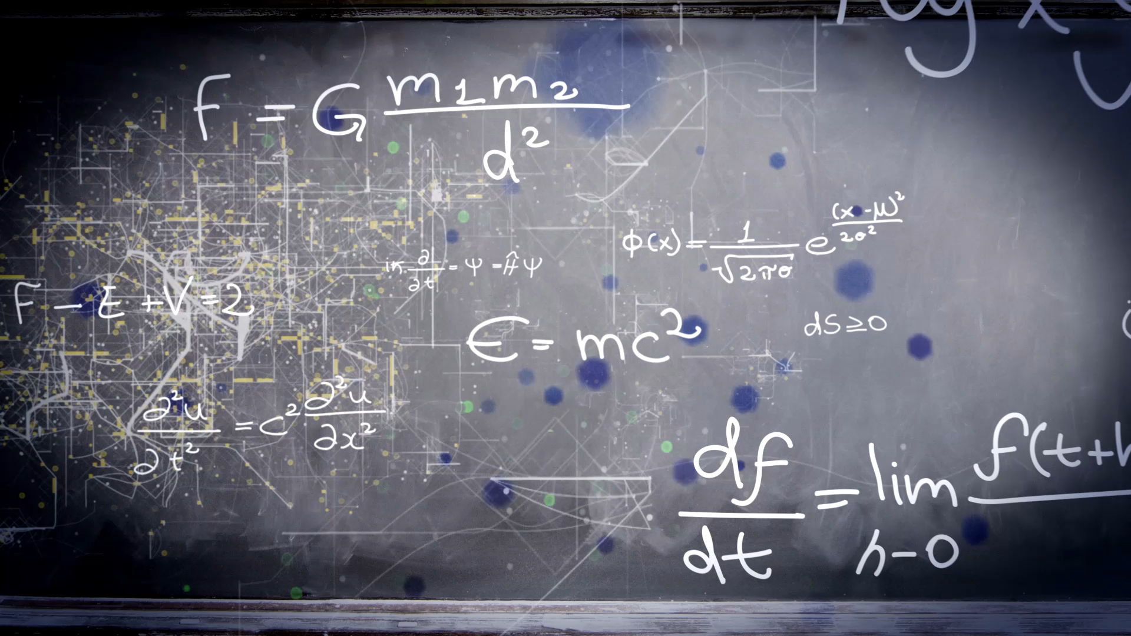

Slide 13
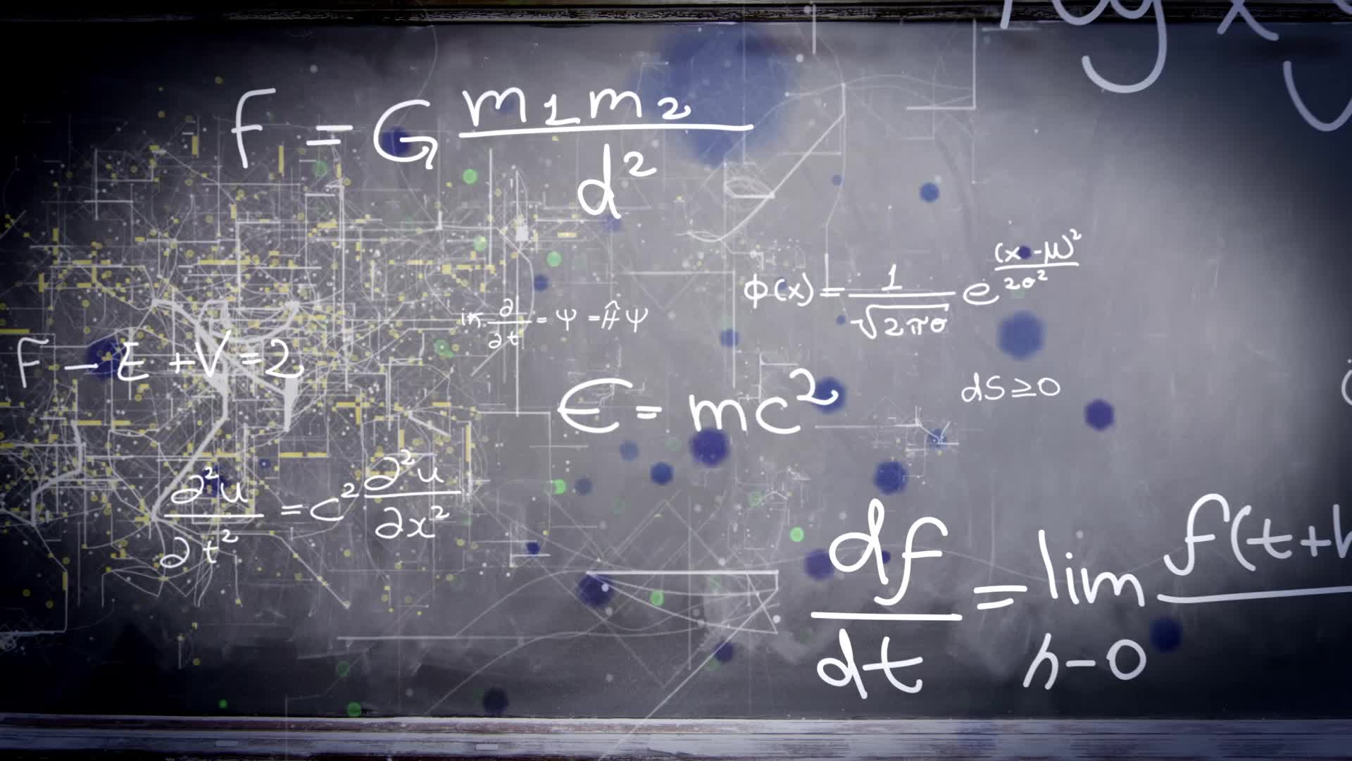
Understanding quantum computing is not scary, it’s just linear algebra

Slide 14
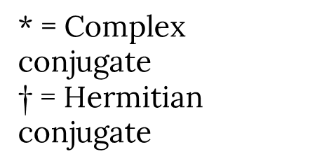
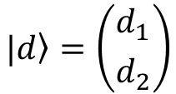
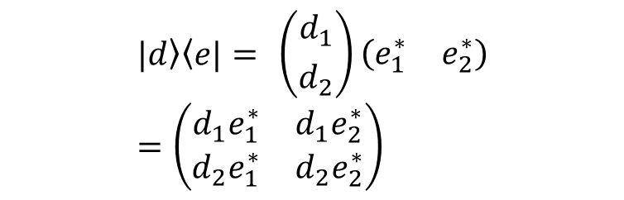
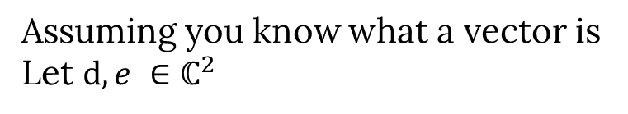
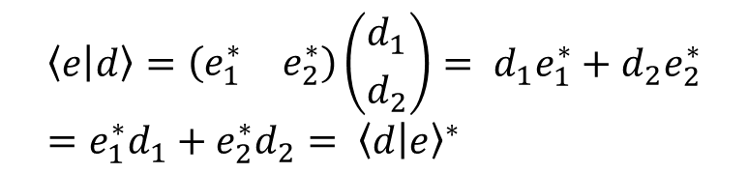
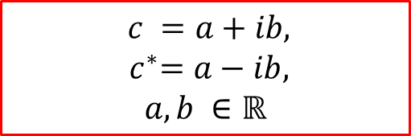
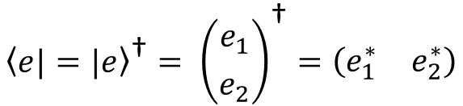
Mathematical aside 1 – Complex numbers and Dirac notation
$$c =a+ib,$$
$${ c}^{∗}=a−ib,$$
$$a, b ∈\text{ℝ}$$
* = Complex conjugate
$\text{†}$ = Hermitian conjugate
Assuming you know what a vector is
Let $d, e ∈{\text{ℂ}}^{2}$
ket is a column vector:
bra is a row vector:
$$\left.|d\right\rangle =\left({d_{1} \atop d_{2}}\right)$$
$$\left\langle e|\right.={\left.|e\right\rangle }^{\text{†}}= {\left({e_{1} \atop e_{2}}\right)}^{\text{†}}=\left(\begin{matrix}e_{1}^{∗} & e_{2}^{∗}\end{matrix}\right)$$
bra-ket is an inner product:
ket-bra is a matrix multiplication:
$$\left\langle e | d\right\rangle =\left(\begin{matrix}e_{1}^{∗} & e_{2}^{∗}\end{matrix}\right)\left({d_{1} \atop d_{2}}\right)= d_{1}e_{1}^{∗}+d_{2}e_{2}^{∗}=e_{1}^{∗}d_{1}+e_{2}^{∗}d_{2}= {\left\langle d | e\right\rangle }^{∗}$$
$$\left.|d\right\rangle \left\langle e|= \right.\left({d_{1} \atop d_{2}}\right)\left(\begin{matrix}e_{1}^{∗} & e_{2}^{∗}\end{matrix}\right)=\left(\begin{matrix}d_{1}e_{1}^{∗} & d_{1}e_{2}^{∗} \\ d_{2}e_{1}^{∗} & d_{2}e_{2}^{∗}\end{matrix}\right)$$

Slide 15
Properties of Quantum Systems
Superposition
Entanglement
Interference
Decoherence and noise

Slide 16
Properties of Quantum Systems
Superposition
Entanglement
Interference
Decoherence and noise

Slide 17


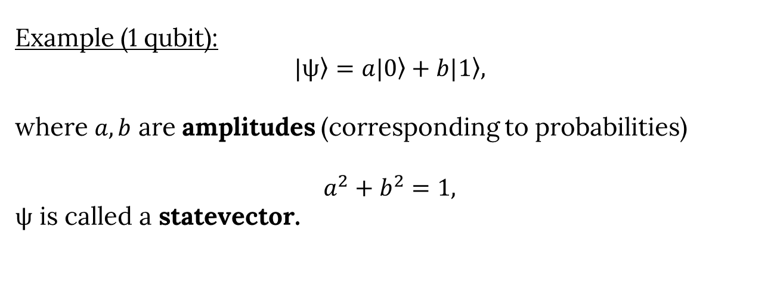

Quantum basis states
“.” notation is used to represent multiplying
$$\left.|0\right\rangle =\left({1 \atop 0}\right)$$
$$\left.|1\right\rangle =\left({0 \atop 1}\right)$$
Orthogonal states, i.e. $\left\langle 0 | 1\right\rangle =1.0+0.1=0$ and $\left\langle 1 | 0\right\rangle =0$ → $\left\langle ψ | ψ′\right\rangle$ = 0
Normalised states, i.e. $\left\langle 0 | 0\right\rangle$ = 1 and $\left\langle 1 | 1\right\rangle$ = 1 → $\left\langle ψ | ψ\right\rangle$ = 1
Example (1 qubit):
$$\left.|ψ\right\rangle =a\left.|0\right\rangle +\left.b|1\right\rangle ,$$
where $a,b$ are amplitudes (corresponding to probabilities)
$$a^{2}+b^{2}=1,$$
$ψ$ is called a statevector.

Slide 18
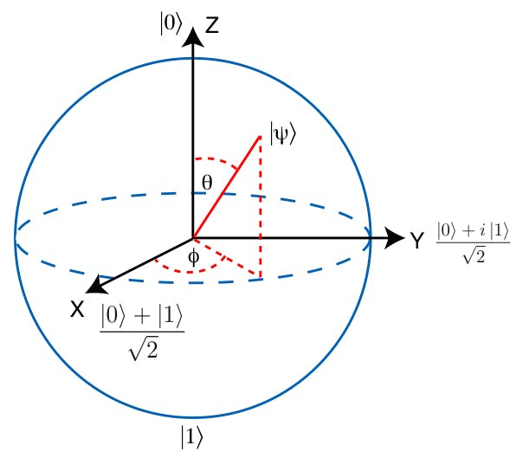


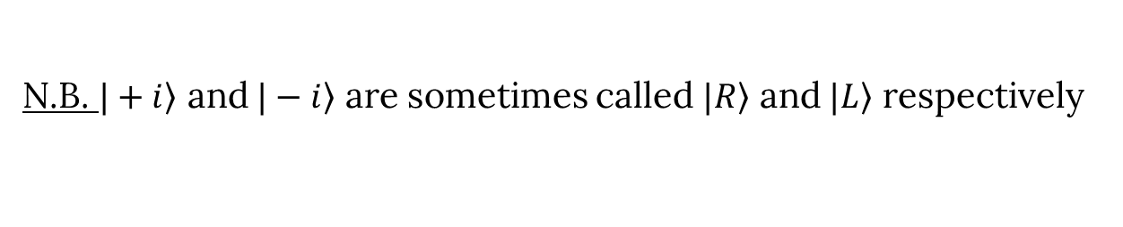
Quantum basis states - continued
$$\left.|0\right\rangle =\left({1 \atop 0}\right)$$
$$\left.|1\right\rangle =\left({0 \atop 1}\right)$$
z-basis states
$$\left.|+\right\rangle = \frac{1}{\sqrt{2}}\left(\left.|0\right\rangle +\left.|1\right\rangle \right)= \frac{1}{\sqrt{2}}\left({1 \atop 1}\right), \left.|−\right\rangle = \frac{1}{\sqrt{2}}\left(\left.|0\right\rangle −\left.|1\right\rangle \right)=\frac{1}{\sqrt{2}}\left({1 \atop −1}\right)$$
x-basis states
$$\left.|+i\right\rangle = \frac{1}{\sqrt{2}}\left(\left.|0\right\rangle +\left.i|1\right\rangle \right)=\frac{1}{\sqrt{2}}\left({1 \atop i}\right), \left.|−i\right\rangle = \frac{1}{\sqrt{2}}\left(\left.|0\right\rangle −\left.i|1\right\rangle \right)=\frac{1}{\sqrt{2}}\left({1 \atop −i}\right)$$
y-basis states
N.B. $\left.|+i\right\rangle$ and $\left.|−i\right\rangle$ are sometimes called $\left.|R\right\rangle$ and $\left.|L\right\rangle$ respectively
Will come back to these again when we discuss Bloch spheres

Slide 19

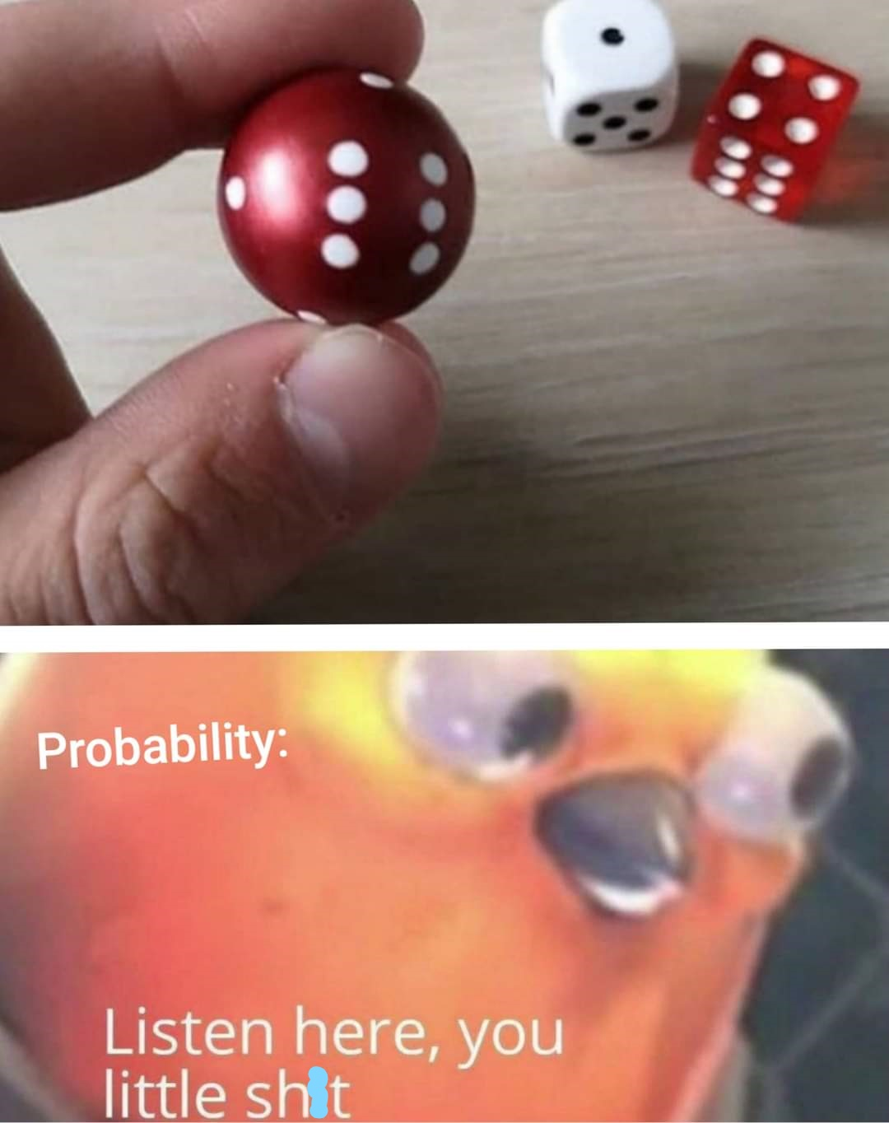
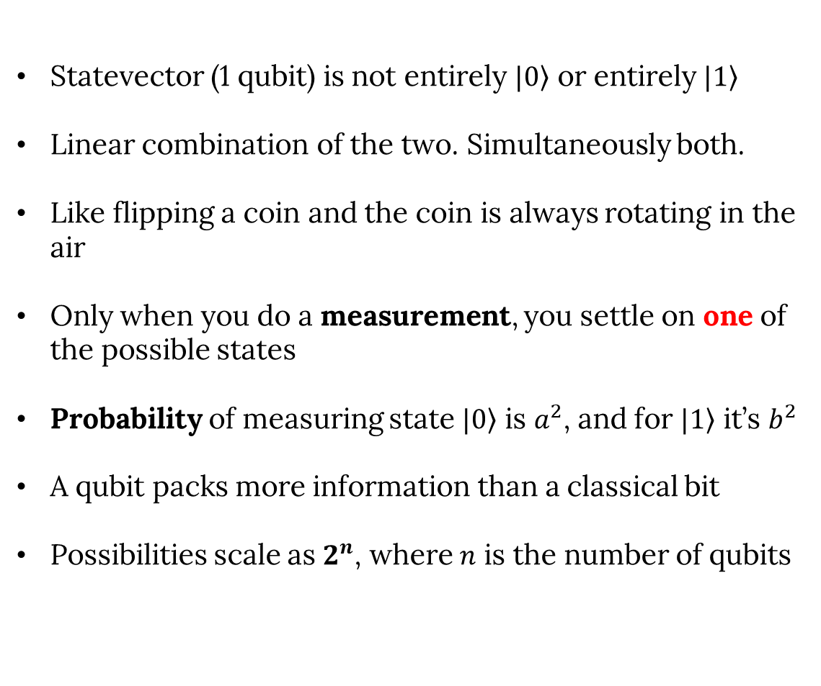
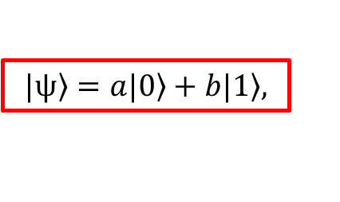
Superposition
$$\left.|ψ\right\rangle =a\left.|0\right\rangle +\left.b|1\right\rangle ,$$
Statevector (1 qubit) is not entirely $\left.|0\right\rangle$ or entirely $\left.|1\right\rangle$
Linear combination of the two. Simultaneously both.
Like flipping a coin and the coin is always rotating in the air
Only when you do a measurement, you settle on one of the possible states
Probability of measuring state $\left.|0\right\rangle$ is $a^{2}$, and for $\left.|1\right\rangle$ it’s $b^{2}$
A qubit packs more information than a classical bit
Possibilities scale as $2^{n}$, where $n$ is the number of qubits

Slide 20
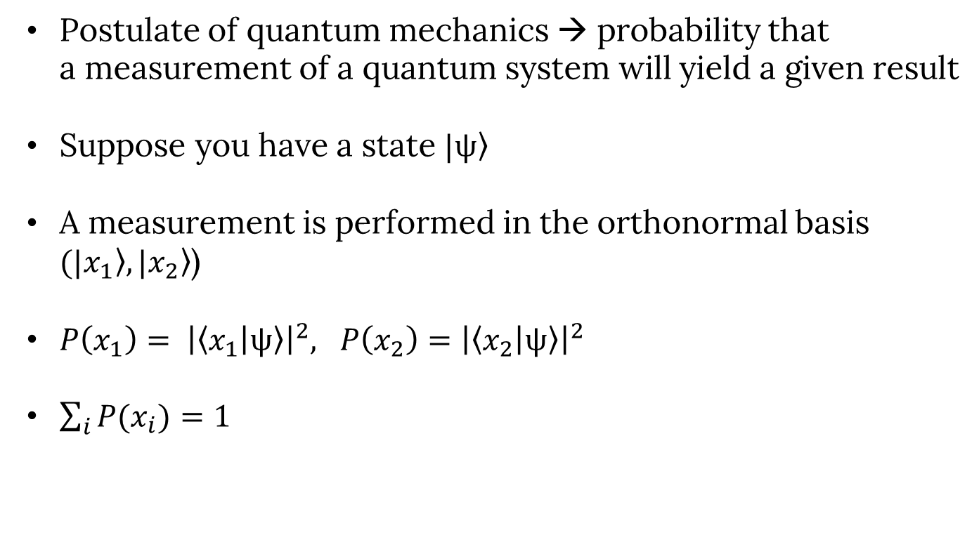
Born rule
Postulate of quantum mechanics → probability that a measurement of a quantum system will yield a given result
Suppose you have a state $\left.|ψ\right\rangle$
A measurement is performed in the orthonormal basis $(\left.|x_{1}\right\rangle ,\left.|x_{2}\right\rangle$)
$P\left(x_{1}\right)= {\left|\left\langle x_{1} | ψ\right\rangle \right|}^{2}, P\left(x_{2}\right)={\left|\left\langle x_{2} | ψ\right\rangle \right|}^{2}$
$\sum_{i}{P(x_{i})}=1$

Slide 21
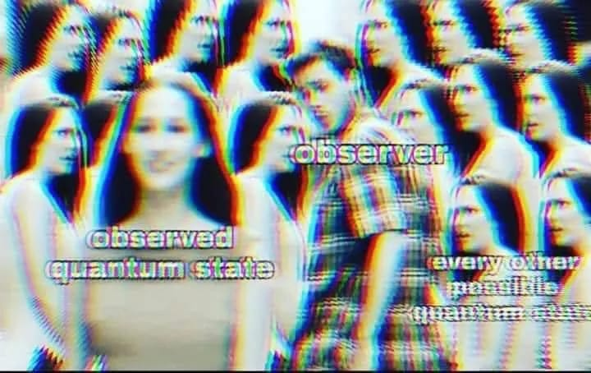

Born rule - continued
$P\left(x_{1}\right)= {\left|\left\langle x_{1} | ψ\right\rangle \right|}^{2}, P\left(x_{2}\right)={\left|\left\langle x_{2} | ψ\right\rangle \right|}^{2}$
$\sum_{i}{P(x_{i})}=1$
Example 1: state $\left.|ψ\right\rangle =\frac{1}{\sqrt{3}} \left(\left.|0\right\rangle +\sqrt{2}\left.|1\right\rangle \right)$ is measured in the orthonormal basis ($\left.|0\right\rangle ,\left.|1\right\rangle$) [z-basis]
$P\left(0\right)= {\left|\left\langle 0 | ψ\right\rangle \right|}^{2}=$ ${\left|\left\langle 0 | \frac{1}{\sqrt{3}} \left(\left.|0\right\rangle +\sqrt{2}\left.|1\right\rangle \right)\right\rangle \right|}^{2}={\left|\frac{1}{\sqrt{3}}\left\langle 0 | 0\right\rangle +\frac{√2}{\sqrt{3}}\left\langle 0 | 1\right\rangle \right|}^{2}=\frac{1}{3}$
Try to prove that $P\left(1\right)=\frac{2}{3}$ [$P\left(0\right)+P\left(1\right)=1$]
1
0

Slide 22
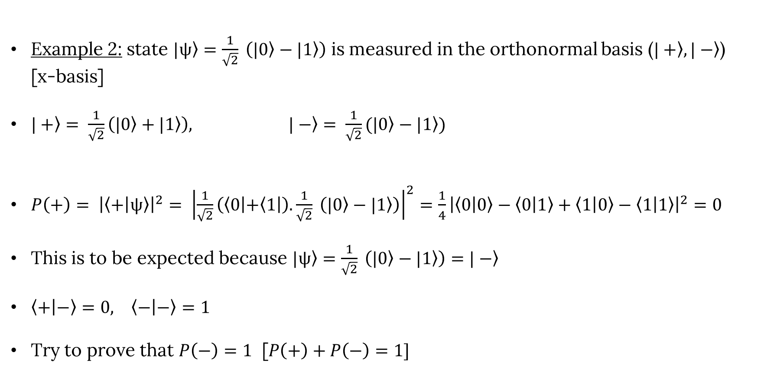
Born rule - continued
Example 2: state $\left.|ψ\right\rangle =\frac{1}{\sqrt{2}} \left(\left.|0\right\rangle −\left.|1\right\rangle \right)$ is measured in the orthonormal basis ($\left.|+\right\rangle ,\left.|−\right\rangle$) [x-basis]
$\left.|+\right\rangle = \frac{1}{\sqrt{2}}\left(\left.|0\right\rangle +\left.|1\right\rangle \right), \left.|−\right\rangle = \frac{1}{\sqrt{2}}(\left.|0\right\rangle −\left.|1\right\rangle )$
$P\left(+\right)= {\left|\left\langle + | ψ\right\rangle \right|}^{2}= {\left|\frac{1}{\sqrt{2}}\left(\left\langle 0\left|+\left\langle 1\right.\right|\right.\right).\frac{1}{\sqrt{2}} \left(\left.|0\right\rangle −\left.|1\right\rangle \right)\right|}^{2}=\frac{1}{4}{\left|\left\langle 0 | 0\right\rangle −\left\langle 0 | 1\right\rangle +\left\langle 1 | 0\right\rangle −\left\langle 1 | 1\right\rangle \right|}^{2}=0$
This is to be expected because $\left.|ψ\right\rangle =\frac{1}{\sqrt{2}} \left(\left.|0\right\rangle −\left.|1\right\rangle \right)=\left.|−\right\rangle$
$\left\langle + | −\right\rangle =0, \left\langle − | −\right\rangle =1$
Try to prove that $P\left(−\right)=1$ [$P\left(+\right)+P\left(−\right)=1]$
1
0
0
1

Slide 23
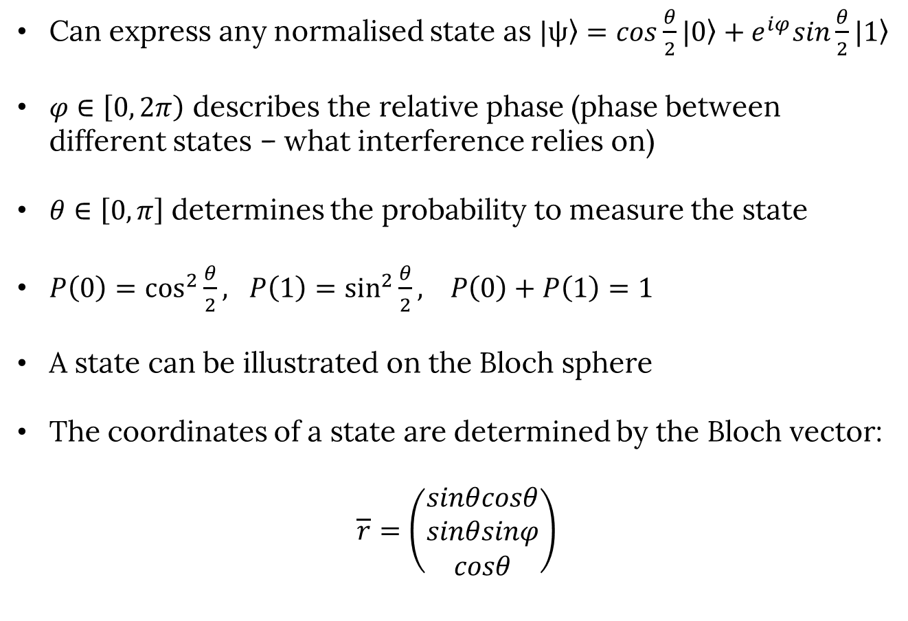
Bloch Sphere
Can express any normalised state as $\left.|ψ\right\rangle =cos\frac{θ}{2}\left.|0\right\rangle +e^{iφ}sin\frac{θ}{2}\left.|1\right\rangle$
$φ∈\left[0, 2π\right)$ describes the relative phase (phase between different states – what interference relies on)
$θ∈\left[0,π\right]$ determines the probability to measure the state
$P\left(0\right)=\cos^{2}{\frac{θ}{2}}, P\left(1\right)=\sin^{2}{\frac{θ}{2}}, P\left(0\right)+P\left(1\right)=1$
A state can be illustrated on the Bloch sphere
The coordinates of a state are determined by the Bloch vector:
$$\overline{r}=\left(\begin{matrix}sinθcosθ \\ sinθsinφ \\ cosθ\end{matrix}\right)$$

Slide 24
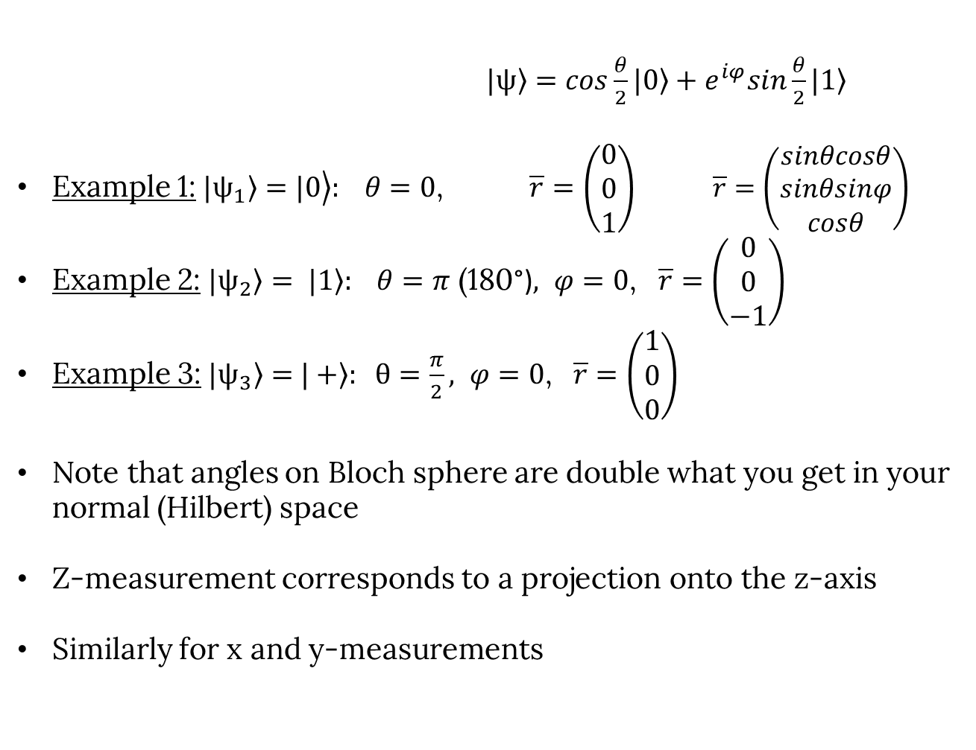
Bloch Sphere - continued
$\left.|ψ\right\rangle =cos\frac{θ}{2}\left.|0\right\rangle +e^{iφ}sin\frac{θ}{2}\left.|1\right\rangle$
Example 1: $\left.\left.|ψ_{1}\right\rangle =|0\right\rangle : θ=0$, $\overline{r}=\left(\begin{matrix}0 \\ 0 \\ 1\end{matrix}\right)$ $\overline{r}=\left(\begin{matrix}sinθcosθ \\ sinθsinφ \\ cosθ\end{matrix}\right)$
Example 2: $\left.|ψ_{2}\right\rangle = \left.|1\right\rangle : θ=π$ (180°)$, φ=0$, $\overline{r}=\left(\begin{matrix}0 \\ 0 \\ −1\end{matrix}\right)$
Example 3: $\left.|ψ_{3}\right\rangle =$ $\left.|+\right\rangle : θ=\frac{π}{2}, φ=0$, $\overline{r}=\left(\begin{matrix}1 \\ 0 \\ 0\end{matrix}\right)$
Note that angles on Bloch sphere are double what you get in your normal (Hilbert) space
Z-measurement corresponds to a projection onto the z-axis
Similarly for x and y-measurements

Slide 25
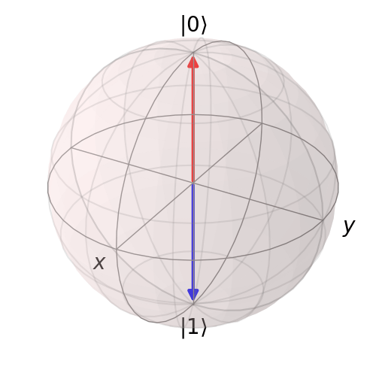
Bloch Sphere - continued
https://javafxpert.github.io/grok-bloch/

Slide 26
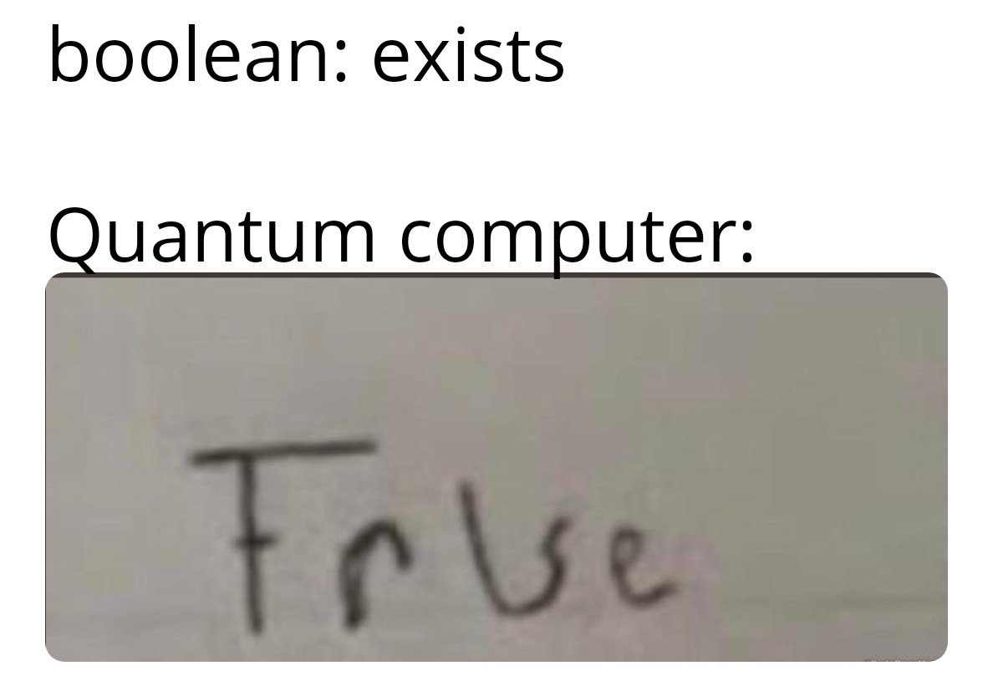
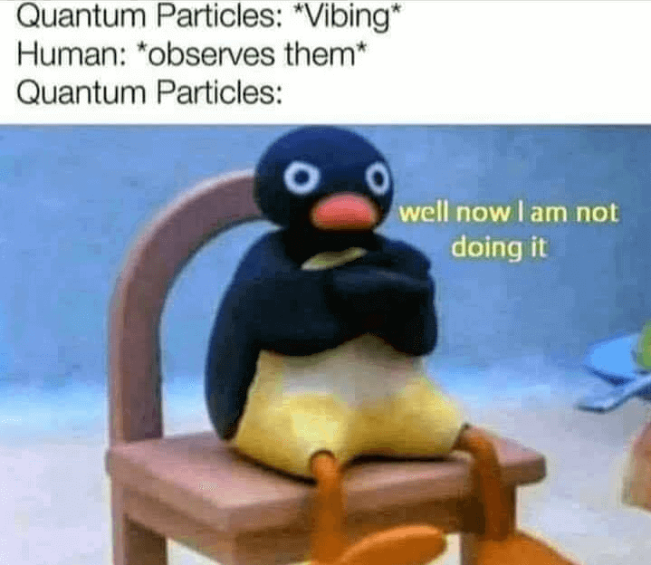
Superposition – takeaway points
A classical bit can only be in the state corresponding to 0 or the state corresponding to 1
Superposition is an ambiguous state in which a particle can be both a 0 and a 1 (until you measure it)
The probability of measuring 0 or 1 for a qubit is in general neither 0% nor 100%
The statevector collapses into one of the states when observed/an interaction with the environment occurs (like stopping a coin from flipping in the air)
A Bloch sphere can be used to illustrate a quantum state

Slide 27
Properties of Quantum Systems
Superposition
Entanglement
Interference
Decoherence and noise

Slide 28
Entanglement
A feature of quantum mechanics that is not present in classical mechanics (i.e. confusing)
Describes correlations between particles (on a quantum level)
A group of particles are generated, interact, or share spatial proximity in a certain way (more than 1 qubit)
Grouped particles are so intertwined that one constituent cannot be fully described without considering the other(s)
Quantum state of each particle of the group cannot be described independently of the state of the others, even if separated by huge distances
Described by Einstein as “spooky action at a distance”
Root of very deep and very fundamental disagreements on how we define quantum mechanics and how we interpret it

Slide 29
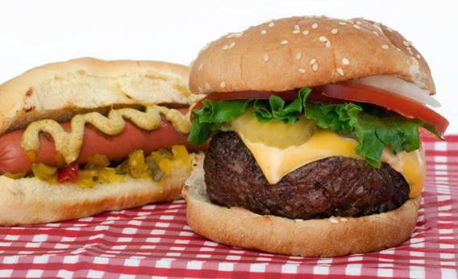
Entanglement - continued
Subject of the 2022 Nobel Prize in Physics
In November 2024, NASA launched a quantum entanglement experiment called SEAQUE to the International Space Station
Example 1:
You are hungry, so you order a burger and a hotdog from a local restaurant
You receive your order in 2 identical, unlabeled boxes
If you open one box, and discover it contains a burger, then, by definition, the other box contains a hotdog (assuming the restaurant didn’t mess up your order)
This is also true even if you travel with one of the boxes and leave the other one behind

Slide 30
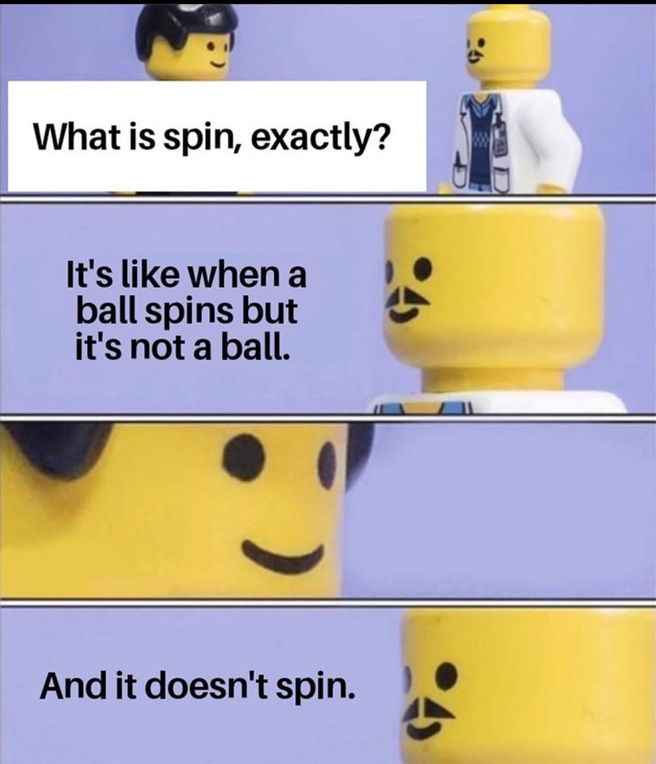
Entanglement - continued
Measurements of physical properties such as position, momentum, spin, and polarisation performed on entangled particles can, in some cases, be found to be perfectly correlated
Example 2:
Have 2 entangled electrons such that their total spin is known to be zero (but both are in a state of superposition)
If you measure one of them to be spin-up, then, by definition, the other one will have to be spin-down
Example 3:
Have 2 entangled photons such that their total polarisation is known to be zero (again, both are in a state of superposition)
If you measure one of them to be polarised 90 degrees clockwise, then, by definition, the other one will have to be 90 degrees anticlockwise

Slide 31
Entanglement – takeaway points
A special connection between two or more qubits
A feature of quantum mechanics is that some particles are connected and correlated to each other
Once you know a property of one of them, you can deduce the property of the other
Each particle cannot be described independently
This property does not change with distance

Slide 32
Properties of Quantum Systems
Superposition
Entanglement
Interference
Decoherence and noise

Slide 33
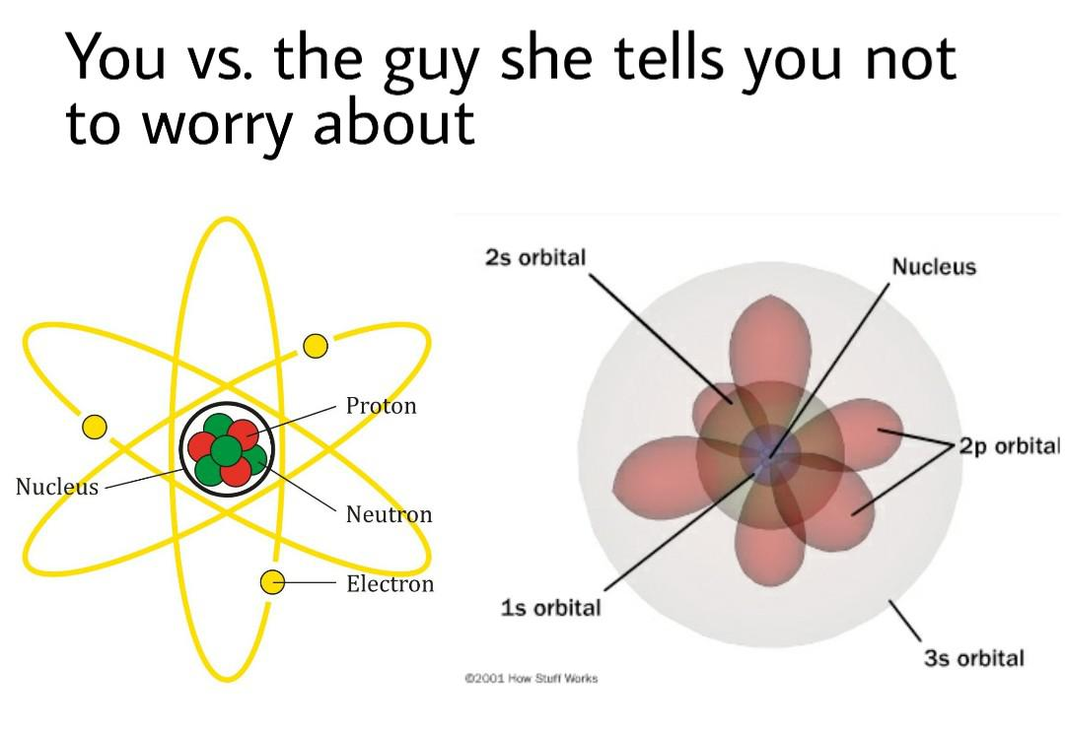
Interference
Due to “wave-particle duality”, at the subatomic (quantum) level, particles have wavelike properties
This is why electron orbitals are depicted as clouds of probability instead of as orbits like planets around the sun
In quantum computing, interference is used to affect probability amplitudes

Slide 34
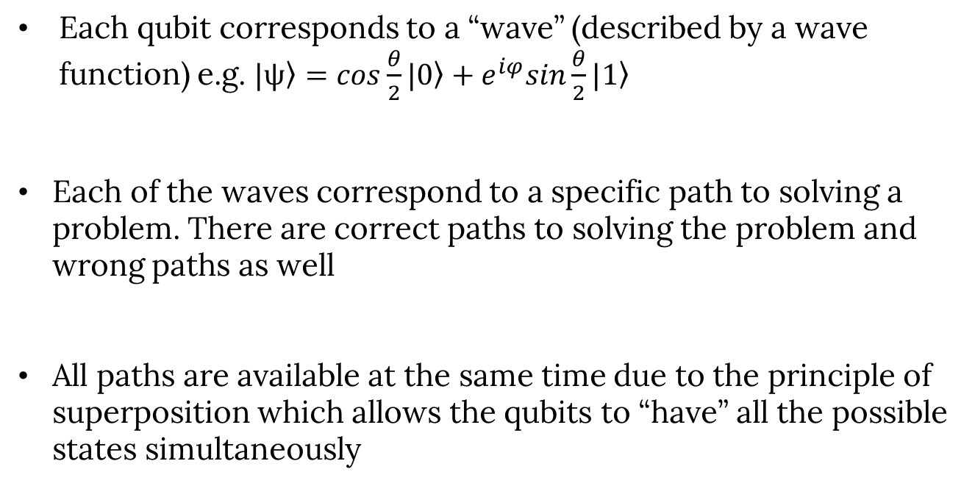
Interference - continued
Each qubit corresponds to a “wave” (described by a wave function) e.g. $\left.|ψ\right\rangle =cos\frac{θ}{2}\left.|0\right\rangle +e^{iφ}sin\frac{θ}{2}\left.|1\right\rangle$
Each of the waves correspond to a specific path to solving a problem. There are correct paths to solving the problem and wrong paths as well
All paths are available at the same time due to the principle of superposition which allows the qubits to “have” all the possible states simultaneously

Slide 35
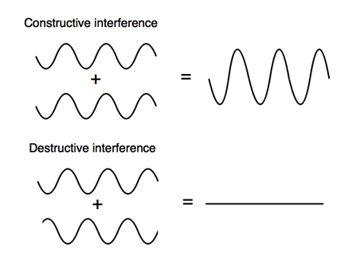
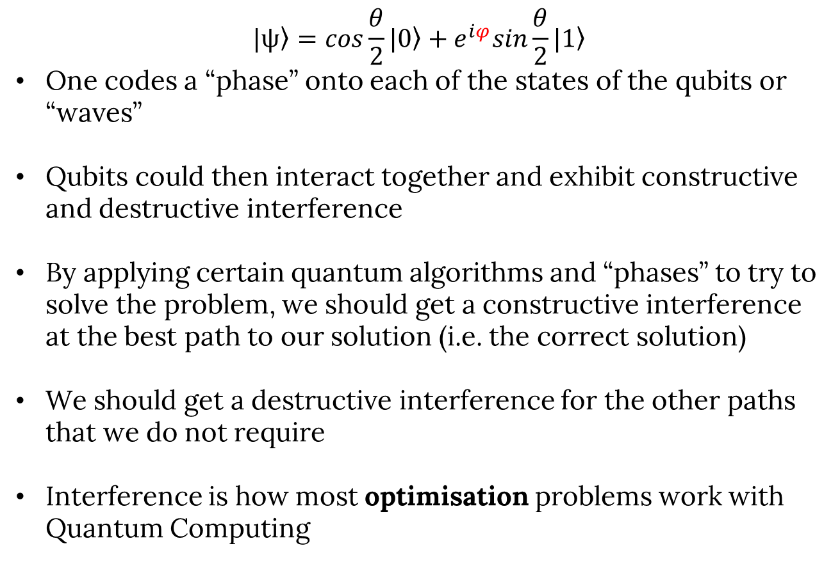
Interference - continued
$$\left.|ψ\right\rangle =cos\frac{θ}{2}\left.|0\right\rangle +e^{iφ}sin\frac{θ}{2}\left.|1\right\rangle$$
One codes a “phase” onto each of the states of the qubits or “waves”
Qubits could then interact together and exhibit constructive and destructive interference
By applying certain quantum algorithms and “phases” to try to solve the problem, we should get a constructive interference at the best path to our solution (i.e. the correct solution)
We should get a destructive interference for the other paths that we do not require
Interference is how most optimisation problems work with Quantum Computing

Slide 36
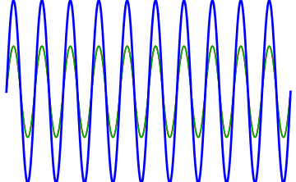
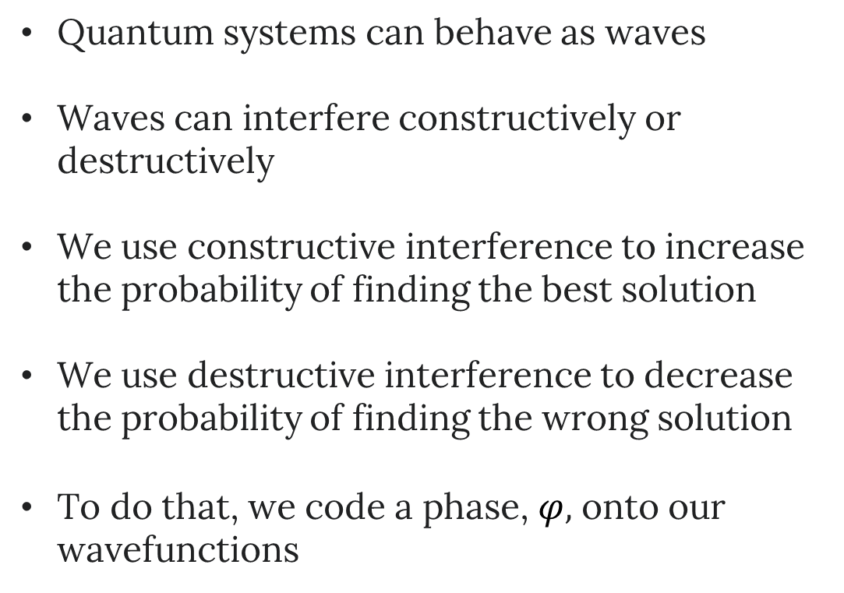
Interference – takeaway points
Quantum systems can behave as waves
Waves can interfere constructively or destructively
We use constructive interference to increase the probability of finding the best solution
We use destructive interference to decrease the probability of finding the wrong solution
To do that, we code a phase, $φ,$ onto our wavefunctions

Slide 37
Properties of Quantum Systems
Superposition
Entanglement
Interference
Decoherence and noise

Slide 38
Decoherence and noise
Quantum states are very sensitive and vulnerable to errors
These errors arise from decoherence, a process in which the environment interacts with the qubits, uncontrollably changing their quantum states and causing information stored by the quantum computer to be lost
Decoherence could come from many aspects of the environment:
changing magnetic and electric fields
radiation from warm objects nearby
cross talk between qubits
This causes “noise” and uncertainty when it comes to measurements coming out of a quantum computer
This “noise” needs to be mitigated

Slide 39
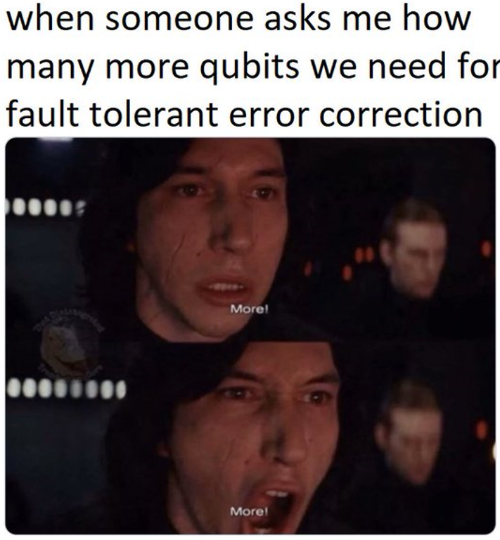
Decoherence and noise - continued
Physical isolation: e.g. cryogenic cooling, shielding the computer from EM radiation
Algorithmic improvements: algorithms that are more robust to errors, can tolerate a certain amount of noise
Hardware improvements: new materials, manufacturing techniques, or designs for quantum computers
Quantum error correction:
use redundancy to correct for noise errors
encode information in a quantum state into multiple qubits, and then using a set of rules to correct for errors when they occur
→ by encoding info across multiple physical qubits, you form a “logical qubit”

Slide 40

All done with theory! (for now…)

Slide 41
Quantum advantage (“supremacy”)
“Quantum advantage” is the demonstrated and measured ability of a quantum computer to solve a real-world problem faster than any classical computer
Some people say that “quantum supremacy” means the same thing and both terms can be used interchangeably
Some other people say “quantum supremacy” means that no classical computer can do the work of the quantum computer at all within a set of reasonable parameters
The term “quantum advantage” is now the more preferred term

Slide 42
Quantum advantage (“supremacy”) - continued
Google claimed they achieved a “quantum advantage” back in 2019 with a paper in Nature using a quantum computer with 54 qubits, with IBM presenting arguments against this before the paper even released
D-Wave (2025): Simulated magnetic materials using the Advantage2 processor in ~20 min — a task estimated to take classical supercomputers ~1 million years
Quantinuum (2025): Used a 56-qubit trapped-ion device to generate certified random numbers; validated by Frontier supercomputer
Can we expect more interesting examples in the future?

Slide 43
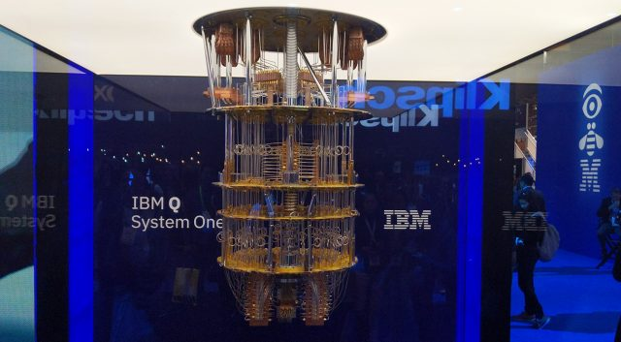
Types of quantum computing qubits
1. Superconducting quantum computers
Superconducting electrical circuits
No resistance to the flow of direct electrical current
Used by IBM, Google, Intel, Amazon, …
Computations can be performed faster than on other qubits
Take advantage of existing printable circuit processes that are efficient and available
Most straightforward approach to creating a quantum computer
Quickly experience decoherence
Demand error correction techniques
Only operate in very cold environments (below 100mK)
Each superconducting qubit is different from others and therefore requires continuous calibration for operations
IBM Q System One

Slide 44
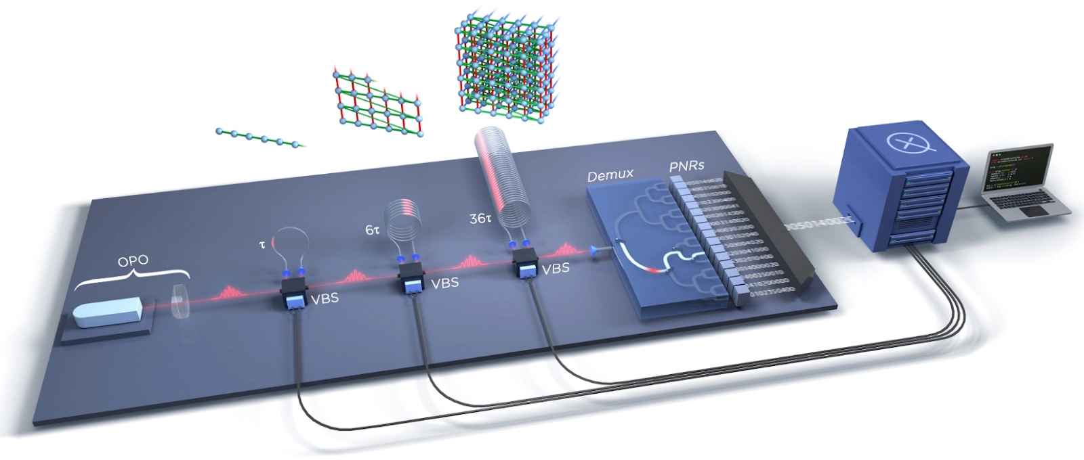
Types of quantum computing qubits - continued
2. Optical quantum computers
Use particles of light (photons) to carry and process information
Photons are manipulated with mirrors, beam splitters, and phase shifters
Used by Xanadu, PsiQuantum, UST of China, …
Photonic qubits can operate at room temperature
Photons have long coherence time
Photons are not highly affected by the environment
Can be easily integrated into existing optical–based infrastructures
Novel emerging technology (still maturing)
Can be bulky in size → integrated photonic chips are reducing size
Due to the interaction of several signals, computation is a complex process
Xanadu Borealis

Slide 45
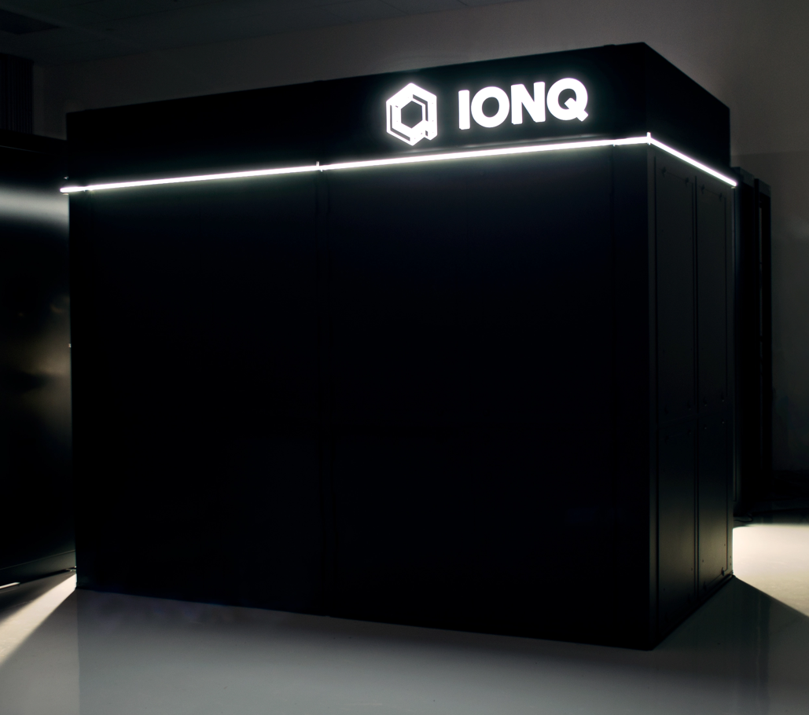
Types of quantum computing qubits - continued
3. Trapped ion quantum computers
Charged atoms (ions) trapped in place by lasers and magnetic fields
Quantum information is encoded in the electronic energy levels of ions as they are suspended in vacuum
Used by Quantinuum, IonQ, Oxford Ionics, …
Significantly longer time to decoherence
Excel in gate fidelity and coherence
An ion trap can operate at room temperature, but you get better performance if the ions are cooled to somewhere around 4K
Currently slower than their superconducting qubits
Vacuum required to hold, or trap, the ions
IonQ Harmony

Slide 46
Types of quantum computing qubits - continued
Other types of qubits include:
Diamond Nitrogen-Vacancy (NV) Center
Annealing
Quantum dot
Color center
Neutral atoms in optical tweezer array
Topological quantum computers (Majorana zero mode)
Electron-on-helium
Cold atom
Defect based
Nuclear magnetic resonance
…

Slide 47

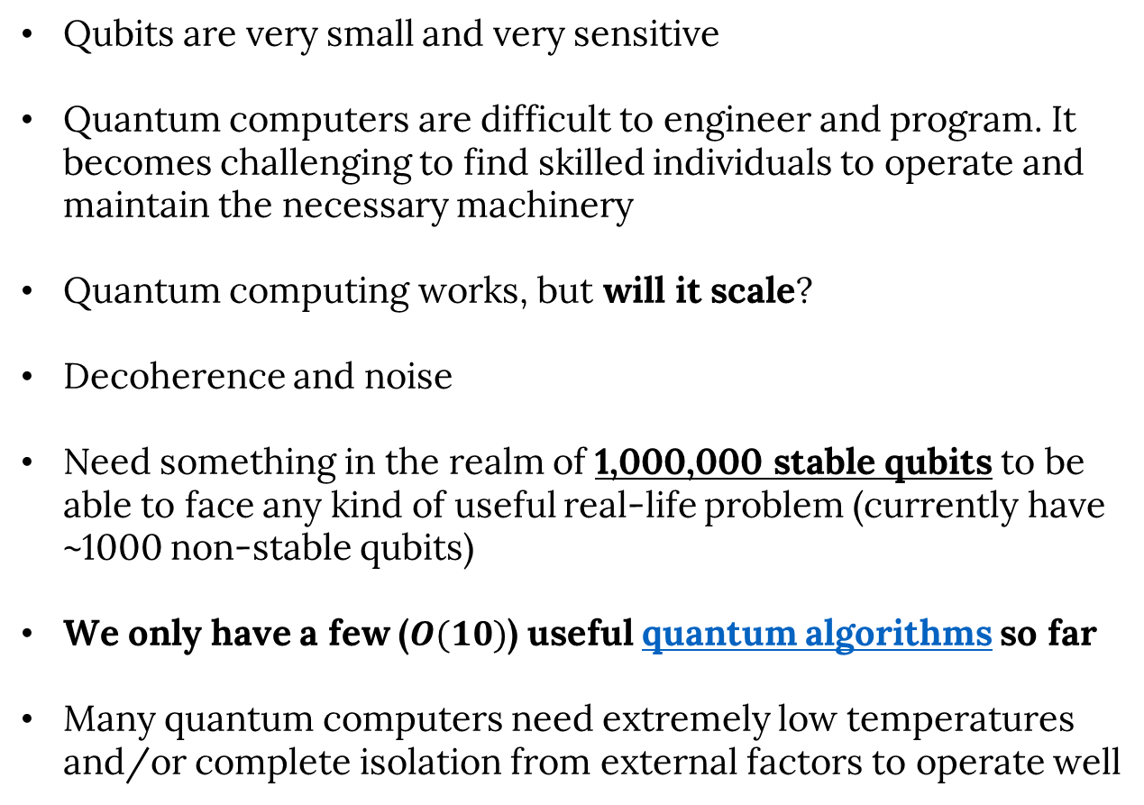
Shortcomings and difficulties (uncertain future)
Qubits are very small and very sensitive
Quantum computers are difficult to engineer and program. It becomes challenging to find skilled individuals to operate and maintain the necessary machinery
Quantum computing works, but will it scale?
Decoherence and noise
Need something in the realm of 1,000,000 stable qubits to be able to face any kind of useful real-life problem (currently have ~1000 non-stable qubits)
We only have a few ($O(10)$) useful quantum algorithms so far
Many quantum computers need extremely low temperatures and/or complete isolation from external factors to operate well

Slide 48
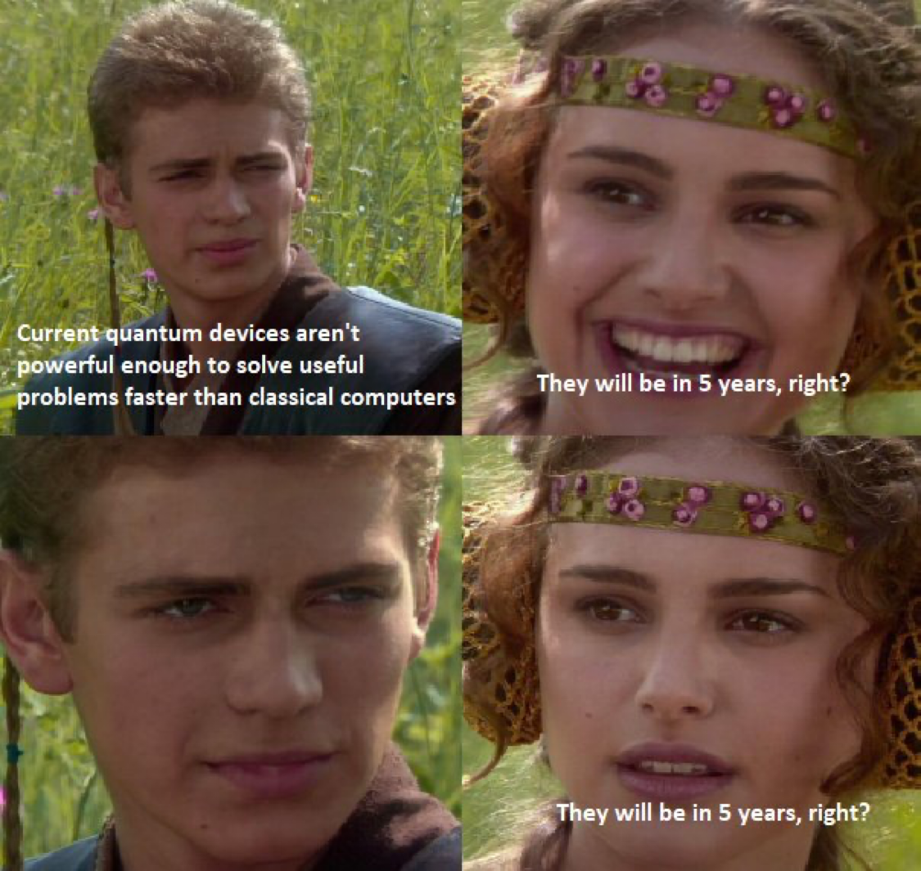
Summary
Quantum computers are an exciting prospect based on several quantum properties including superposition, entanglement, interference, and decoherence
Understanding quantum computing is not scary, it’s just linear algebra
Quantum advantage means a quantum computer doing one specific thing better than a classical computer
There are many types of quantum computers, all with advantages and disadvantages
It is still early days for quantum computing. The future is still uncertain

Slide 49
Congratulations, you are now familiar with the basics of quantum computing! 🥳

Slide 50

Blooket
https://play.blooket.com

Slide 51

Thank you for your attention!
https://forms.gle/NNcGhkqXsUaU5vxQ7

