Slide 1
DRD 8 WP1 kick-off meeting
C. Gargiulo (CERN)
F. Palla (INFN Pisa)
CERN, 27 March2025

Slide 2
Introduction - DRD8 Collaboration
The DRD8 Proposal on Mechanics & Cooling for Future Vertex and Tracking Systems has been approved by the CERN Research Board on December 4.
Following the approval, DRD8 is now appearing in the Greybook for the CERN Experimental Programme, which simplifies affiliation of collaborators to CERN: https://greybook.cern.ch/researchProgram/detail?id=R%26D.
An Indico category has been created: https://indico.cern.ch/category/19408/, in which we will have sub-categories for the different Work Packages of DRD8 etc., so that all the information is centrally available.
The web-page for DRD8 has as well been created: https://drd8.web.cern.ch/. Feedback is welcome! Write access will be given to the WP conveners to add information for their Work Package as desired.
The next major task is the preparation of the Memorandum of Understanding for DRD8.
Burkhard slides

Slide 3
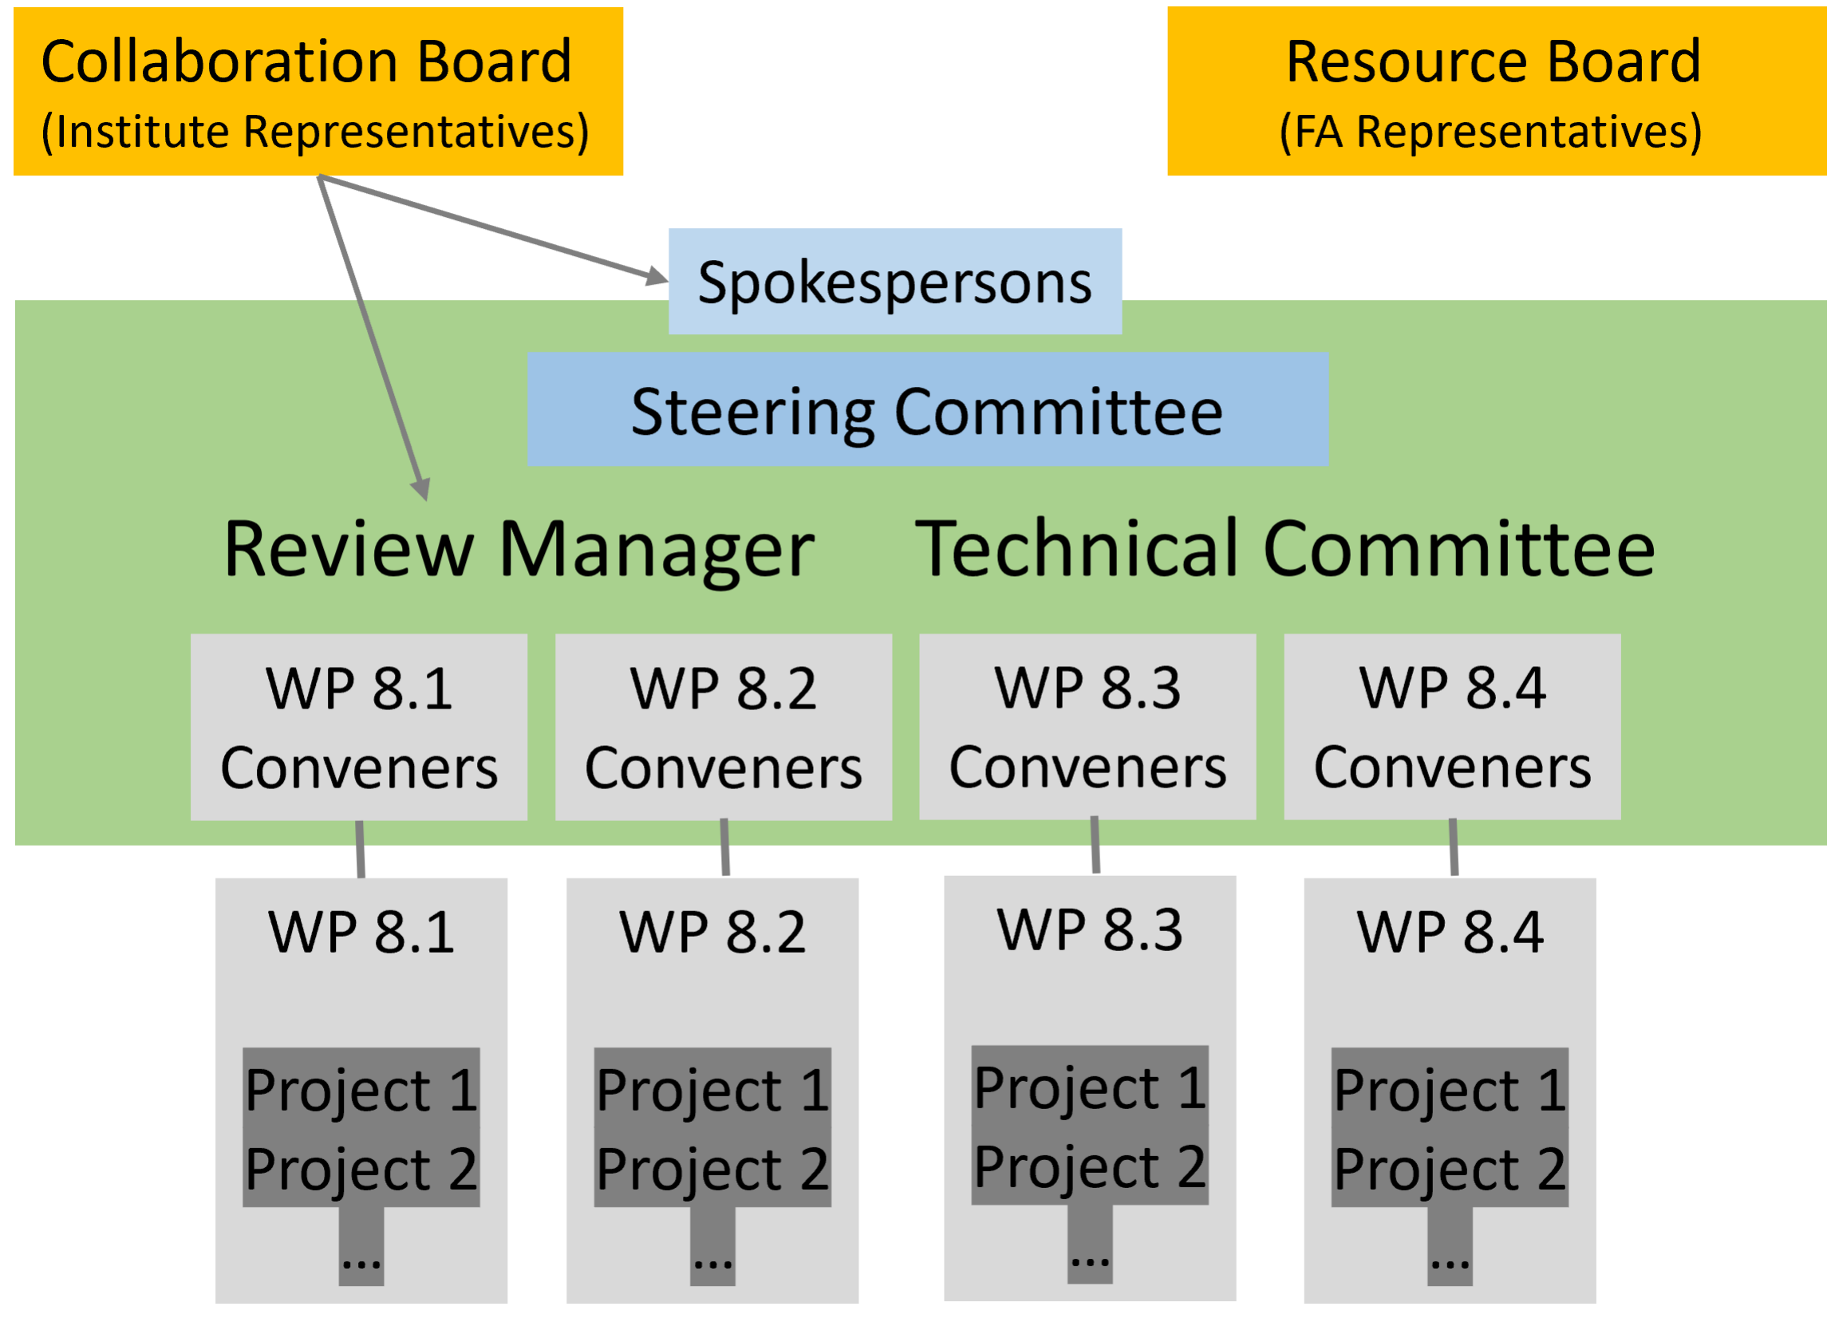
DRD8 Technical Committee
General Mailing list: DRD8
Endorsed Work Package Conveners:
WP1: Global system design and integration
Corrado Gargiulo (CERN)
Fabrizio Palla (Universita & INFN Pisa (IT))
WP2: Low-mass mechanics and thermal management
Adam Dominic Lowe (University of Oxford (GB))
Sushrut Karmarkar (Purdue University (US))
WP3: Detector cooling
Bart Verlaat (CERN)
Oscar Augusto De Aguiar Francisco (Manchester (GB))
WP4: Design and qualification tools
Diego Alvarez Feito (CERN)
Joao Batista Lopes (CERN)
Burkhard slides
Technical committee meetings on-going

Slide 4
DRD8 – WP1 projects
The Vertex Region of Future Particle Physics Experiments
Development of the next generation mechanics for advanced vertex layouts, including
Curved and tilted silicon sensors
Low radii vertex and retractable detectors
Ultra-light, high-vacuum leak tight beam pipes and vessels
Low mass hardware alignment systems for future vertex detectors
Machine Detector Interface and impact on Detector
Robots in the HEP Experimental Caverns
Development of robotic systems for future high energy physics experiments for inspection monitoring and first intervention for particle detectors even during the operation of beams
Legged ground robotic platform in experimental cavern
Aerial robotic platform in experimental cavern
Mini-robots swarm and mobile mesh network

Slide 5
Today’s focus
To initiate the development of the WP1 collaboration by discussing the ongoing or planned R&D activities in the different institutes that align with our two main projects.
Presentations focused on giving
- The current status of R&D activities
- Any planned activities for the next three years (if applicable)
- A brief overview of the institute's resources for DRD8 WP1
Today’s list is not exhaustive of the whole Institute interests. We plan to have a second session in April

Slide 6
AIDAxxx call
The preparation for a new AIDA proposal has started
This is a possibility to get some funding for DRD8 activities
Some funds will be available for a WP on Mechanics and cooling for the period of 4 years
More news in coming weeks

Slide 7
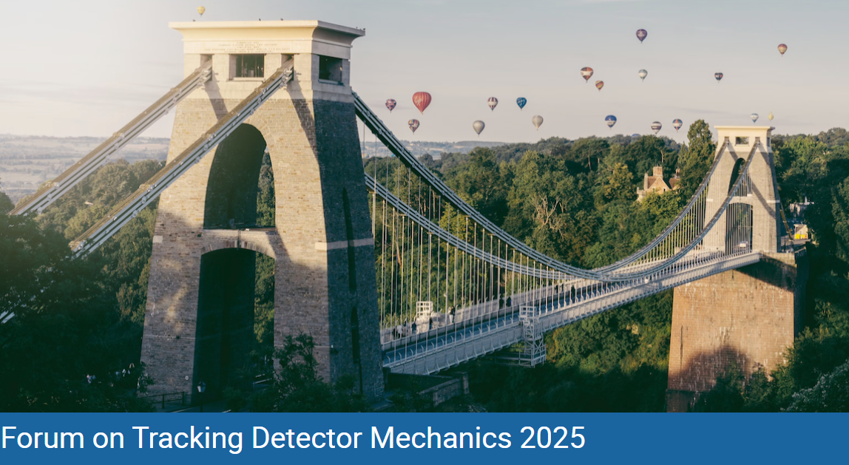
DRD8 Collaboration Week 2025
16-20 June 2025, University of Bristol
https://indico.cern.ch/event/1482847/
Burkhard slides

Slide 8
DRD8 Collaboration Week 2025
16-20 June 2025, University of Bristol
https://indico.cern.ch/event/1482847/
The week will start with the Forum on Tracking Detector Mechanics (Monday to Wednesday), including (composite) lab visits on Wednesday afternoon, followed by the DRD collaboration meeting (on Thursday and Friday).
We consider to have both Plenary and Parallel Sessions for the DRD8 meetings to give more time for discussion among the people active in each Work Package.
We plan to have a few invited speakers.

Slide 9
DRD8 WP1 Group meeting
A bi-monthly meeting will be hold to review the progress of the different groups and the synergies on common activities.
The meetings will also serve to share plans for the activities of the next two months
Each Institutes part of DRD8 WP1 are encouraged to send the conveners a bullet list of
the activities planned in the next two months April/ May
the activities where support from other Institutes could be needed
The conveners will share this regularly on the web pages of the WP1
Direct contacts across Institutes are encouraged
Next meeting in April (tbd)
9

