Slide 1
DRD8 WP1.2 Robots in the HEP Experimental Caverns WP1 Kick-off Meeting
Francesco Mazzei, Corrado Gargiulo
27/03/2025
https://indico.cern.ch/event/1507330/

Slide 2

Preamble
The DRD8 activity on Robotics presented here after are based on the CERN EP-R&D effort and on the Universities and Institutes network created within this frame.
DRD8 counts on enlarging this collaboration including new partners interested in the ongoing development or in new ones that fit DRD8 objectives

Slide 3
Contents
Introduction
Institute collaborations
Resources
Legged ground robotic platforms – Current Status & Future Works
Robotic airships – Current Status & Future Works
Mobile mesh network – Current Status & Future Works

Slide 4
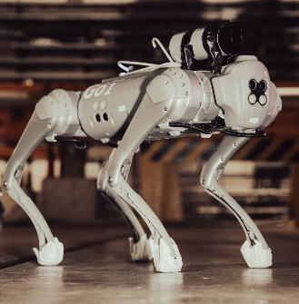
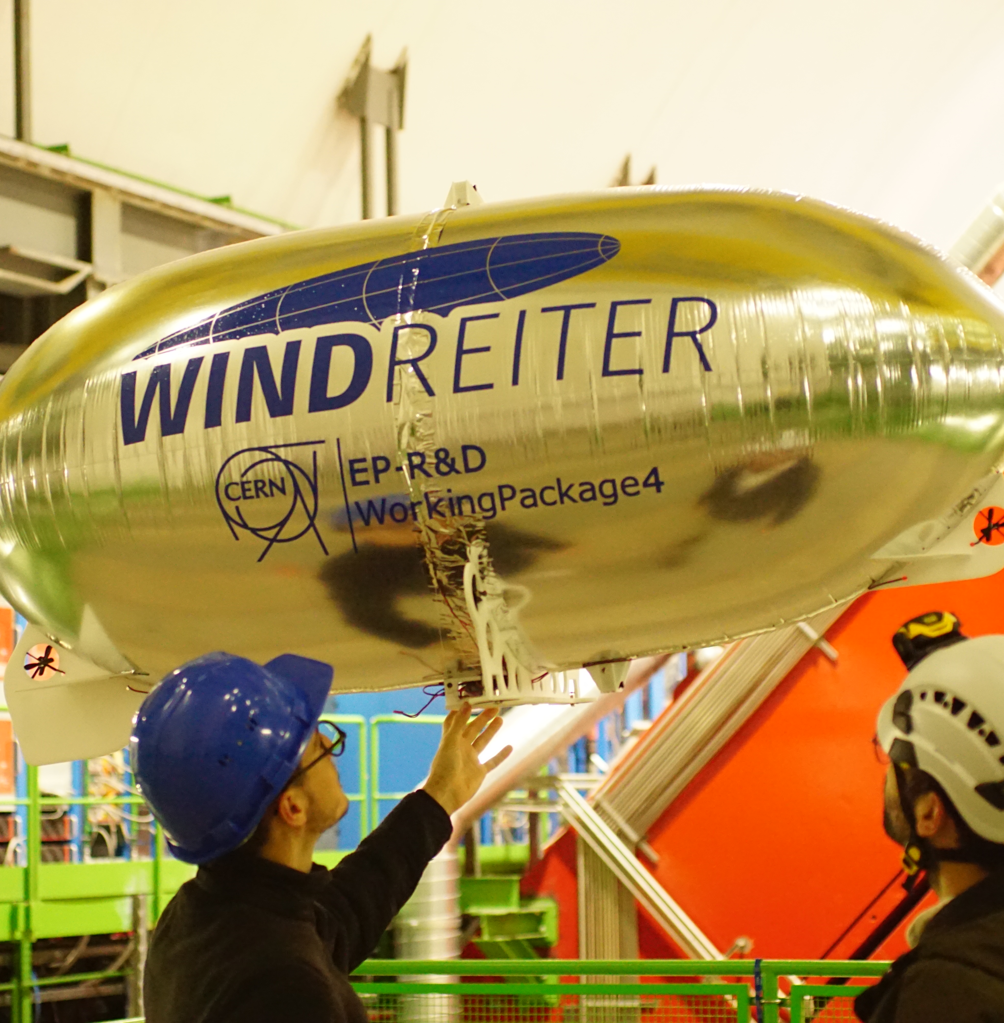
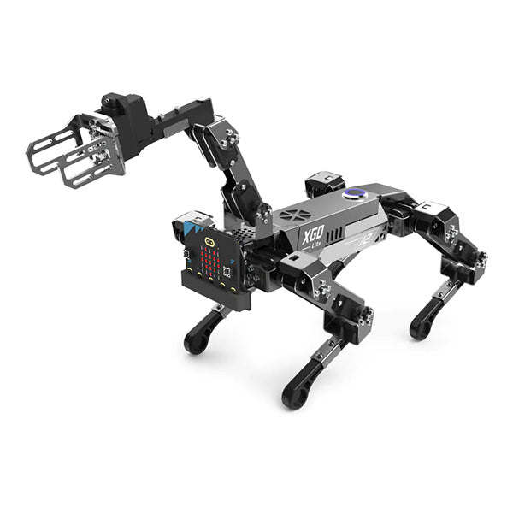
WP1.2 Robots in the HEP Experimental Caverns
Legged ground robotic platforms
Robotic airships
Mobile mesh network
Notes:
Develop legged robots equipped with advanced sensors for autonomous and on-demand inspection of walkable areas
Develop lightweight blimps for low-risk, low-power 3D mapping of magnetic fields and radiation in detector caverns.
Use a swarm of mini robots with a mobile mesh network to inspect confined spaces and relay anomaly data from deep inside the experiment to the main network.

Slide 5
Institute collaborations

Slide 6



Universities
Sapienza University of Rome
School of Aerospace Engineering
The University of Arizona
Department of Systems and Industrial Engineering
University of Rome Tor Vergata
Department of Physics
Framework Collaboration Agreement (Ref. KN2489/GEN) (Signed in 2022)
Established in 2022 to support student research on robotic systems for exploration in challenging environments, such as underground areas, and the development of robust control system strategies.
Memorandum of Understanding (MoU) KN5569/EP (Signed in 2023)
Robotic research activities of the department covers: Optical Navigation and obstacle avoidance; Guidance, Navigation and Control; AI applied to control design and path planning.
At Tor Vergata University, a PhD student in the Astronomy, Astrophysics, and Space Science 2024 program is conducting research at CERN focusing on robotic airship systems.

Slide 7


Institutes and companies (resources)
CERN
EP-R&D
CERN
BE-MRO
Windreiter UG
Established in 2020, the EP-R&D WP4.2 focuses on the development of robotic systems to operate in future HEP experiments, with the aim to automate the maintenance and installation of particle detectors and to enable autonomous inspection and monitoring of underground experimental caverns, even during beam operations.
With the BE department, an Accelerator & Technology Sector MTP Request was made, establishing a collaboration.
With this collaboration, the section cover the software development for legged robots and robotic assistance for particle accelerators.
A Demande D’achat Interne (DAI) [Ref. 9499061] has been established with Windreiter UG for the construction of a prototype blimp capable of demonstrating autonomous flight inside the ALICE cavern at CERN.

Slide 8



Institutes and companies (materials)
LuwuDynamics XGO
Unitree
Petoi
LuwuDynamics is a STEM education technology company founded by a team from the Harbin Institute of Technology (HIT), China. The company develops the XGO robot platform, which includes both quadruped and wheel-legged robots.
We are currently testing these platforms as part of our mobile mesh network system.
Unitree Robotics is a Chinese company specializing in quadruped robots for consumer and research applications.
We are using the Go1, Go2, and B1 platforms for legged robot testing in cavern inspection scenarios.
Petoi is a robotics company focused on educational and affordable bio-inspired robots.
We are using the Petoi Bittle, a compact quadruped robot dog, for testing low-cost legged mobility and communication algorithms in cluttered environments.

Slide 9
Resources

Slide 10
Resources for EP-R&D & DRD 8
Institute | Effort [FTE/year] |  | Material Budget [kCHF]
 | Available | Required | Available | Required
CERN | 2 (fell) | 2 (fell) | 100 | 100
Uni. Sapienza | 0 | 1 (stud) | 10 | 10
Tor Vergata | 1 | 1 (PhD) | 10 | 10
Uni. Arizona | 0 | 1 (stud) | 10 | 10
Available Resources: We currently have the following resources available to complete the project.
Required Resources: To meet the project milestones, we need additional resources. These requirements have already been communicated to the involved institutions. However, new partners could provide the opportunity to secure the project milestons and enhance the quality of the project.
For more information or specifics, please refer to Corrado Gargiulo.

Slide 11
Legged ground robotic platforms
Current Status

Slide 12
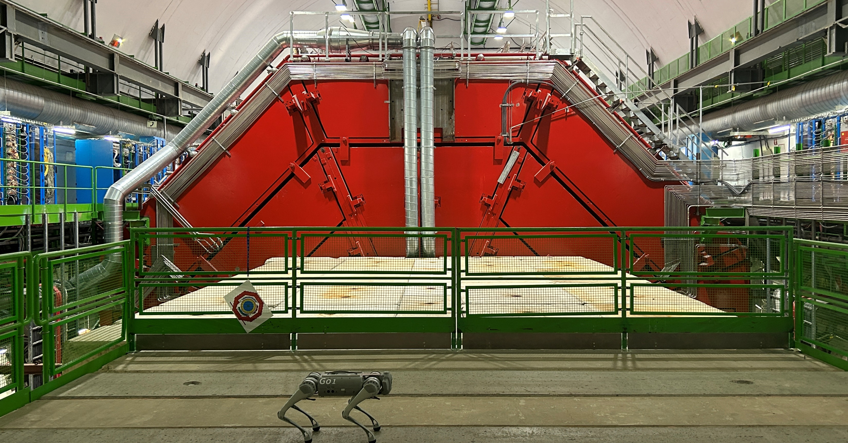
Deploy legged robots equipped with advanced sensors for autonomous and on-demand inspection of walkable areas

Slide 13
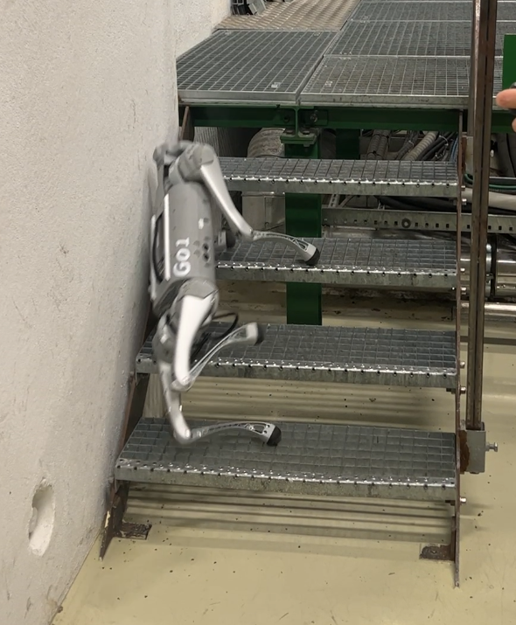
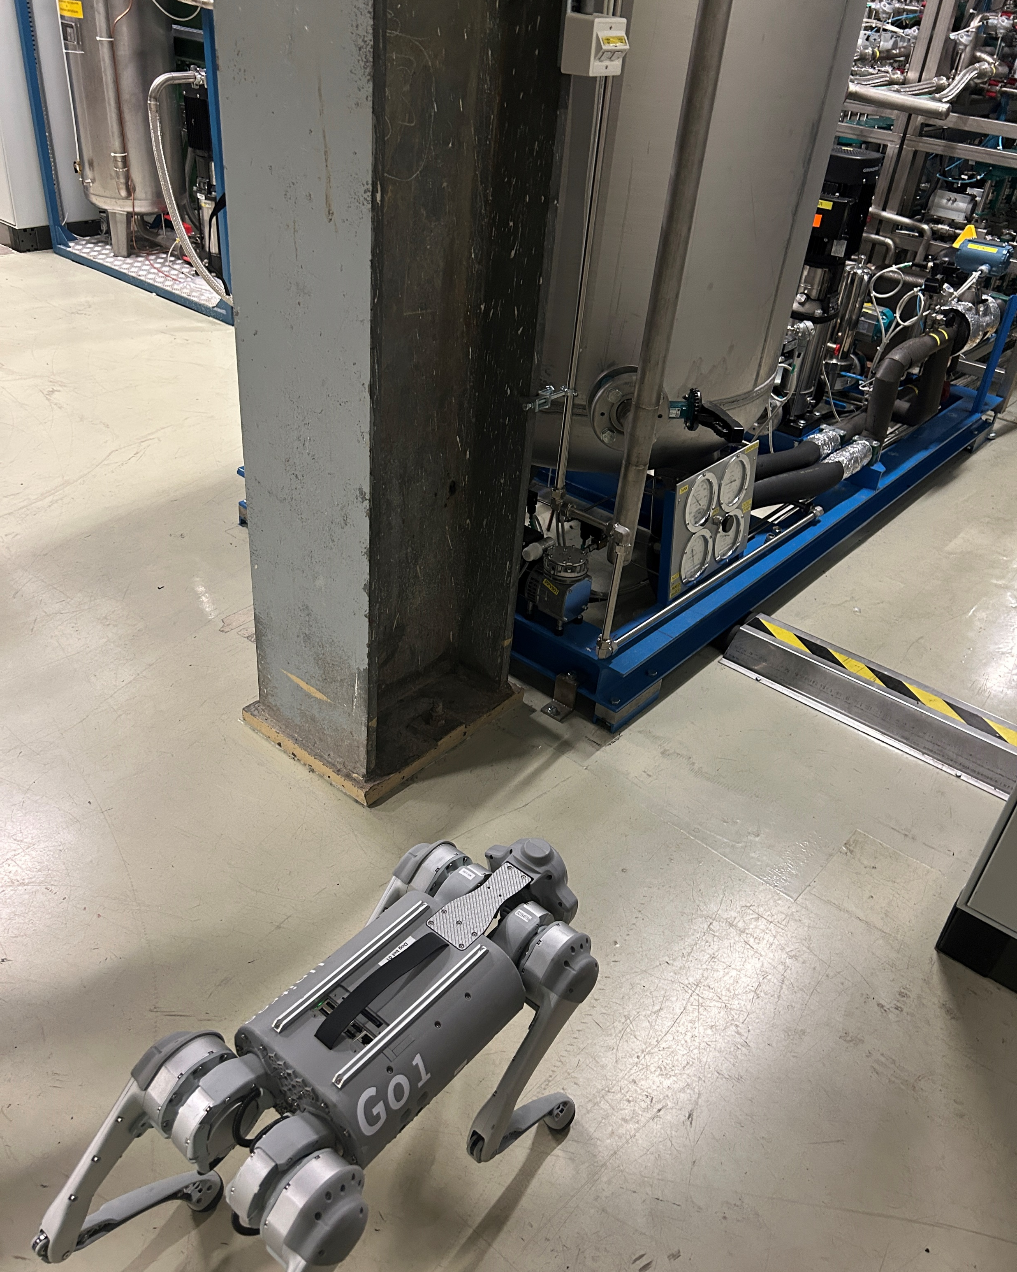
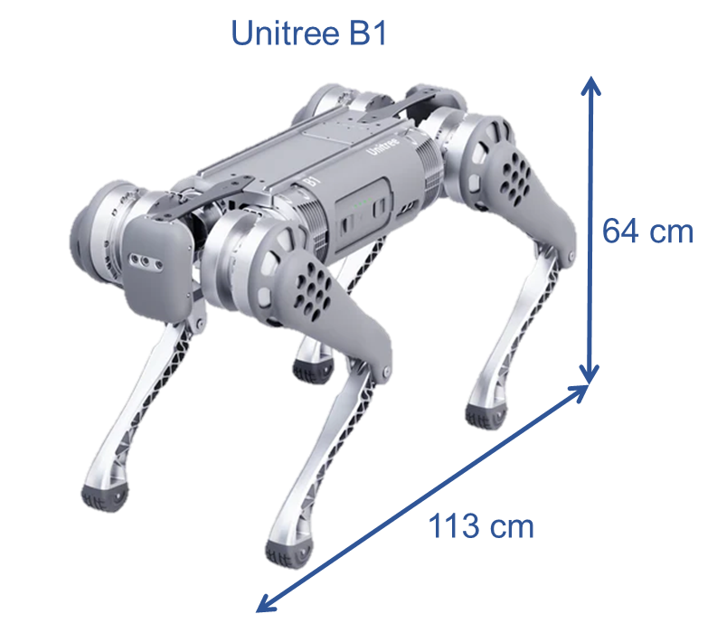
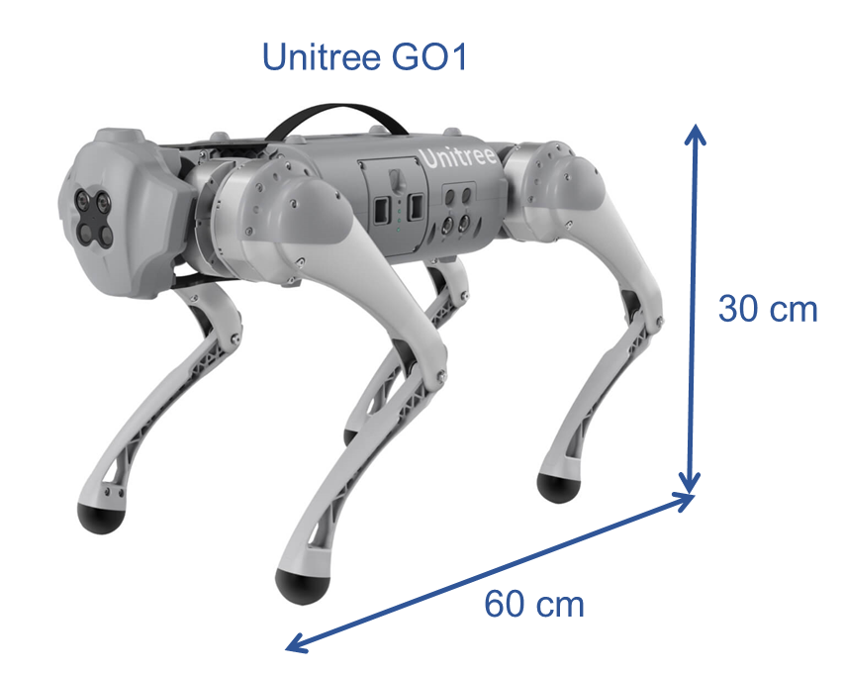
Mobility test
Testing the agility of legged robots in a cluttered cavern environment without a magnetic field.
The Unitree GO1 failed to climb stairs, so a new platform, the Unitree B2, was purchased to overcome the GO1's limitations (higher payload capacity, stair-climbing ability, and stronger motors).

Slide 14
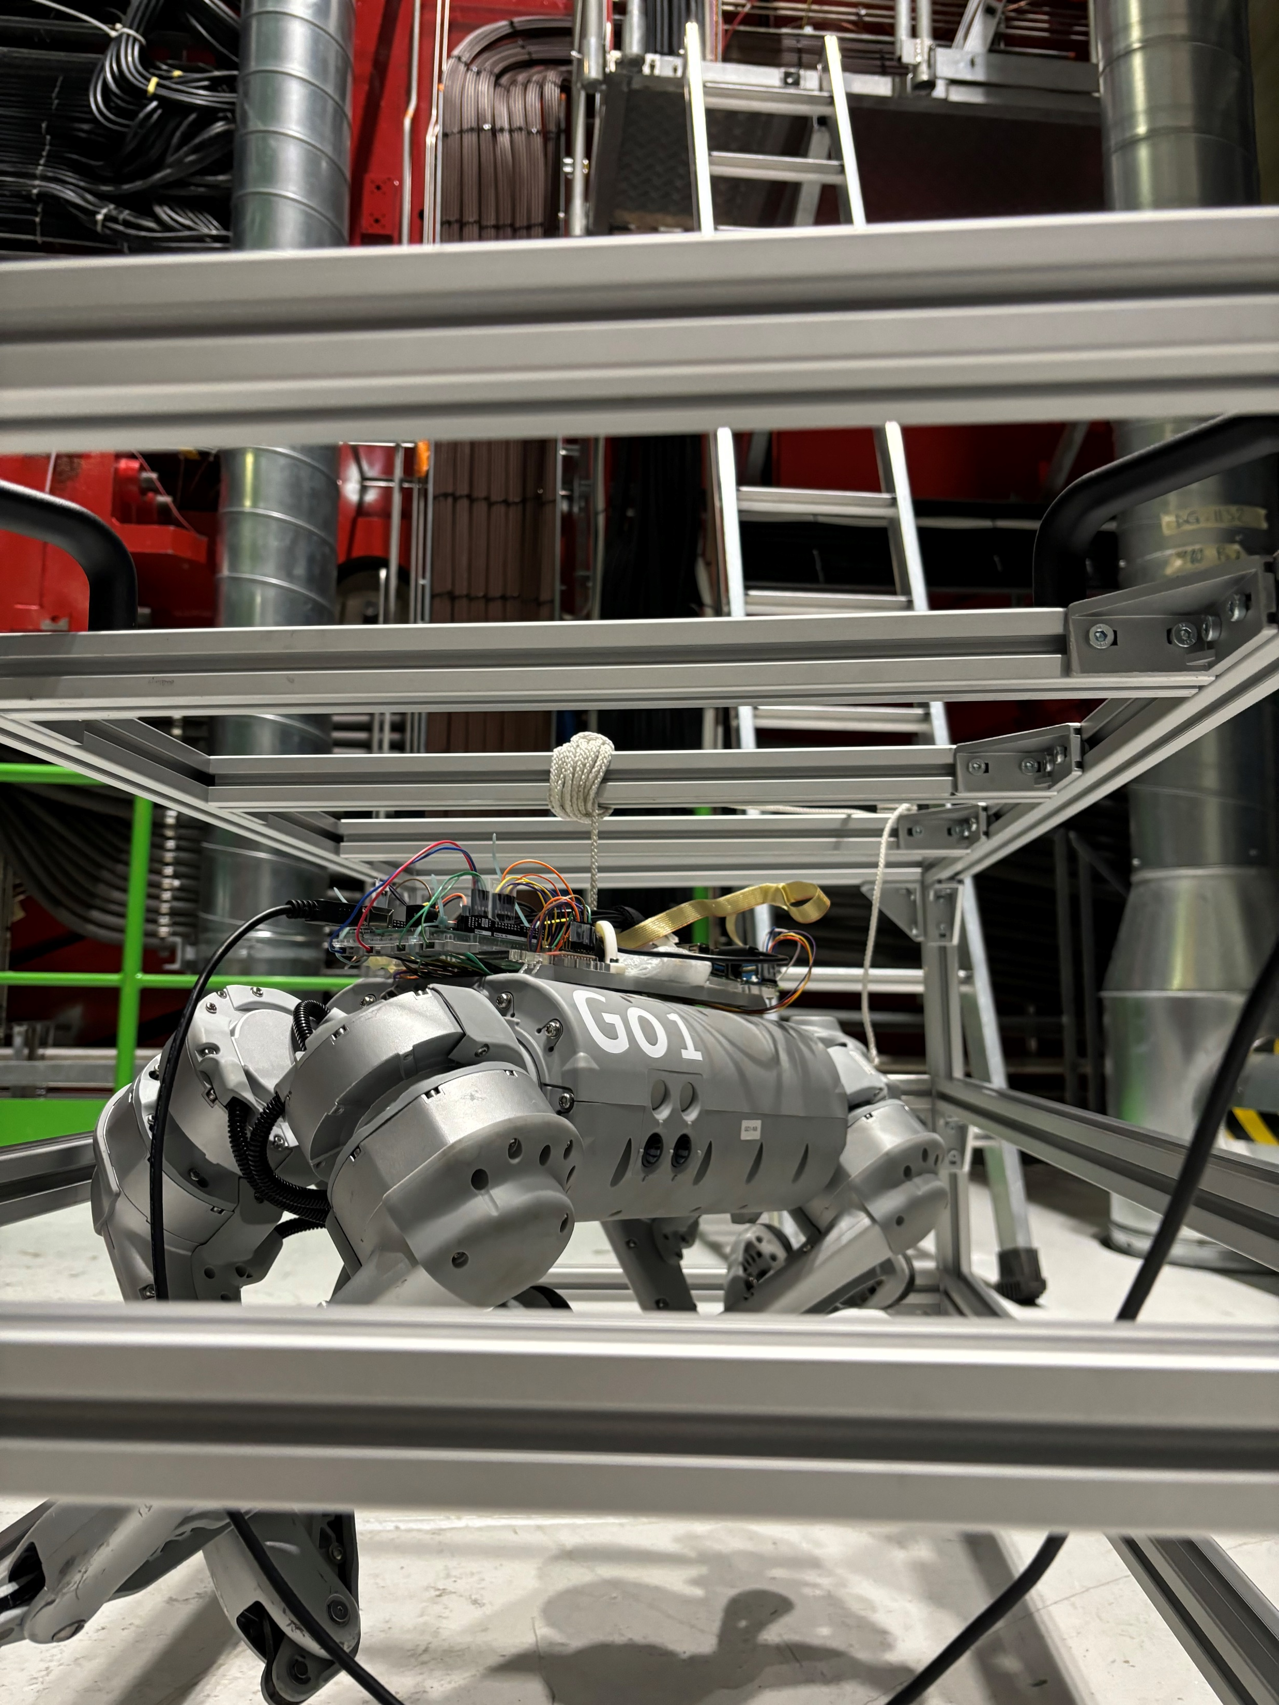
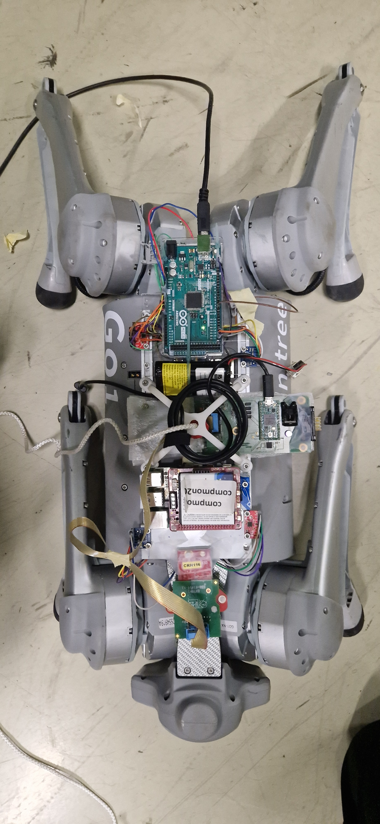
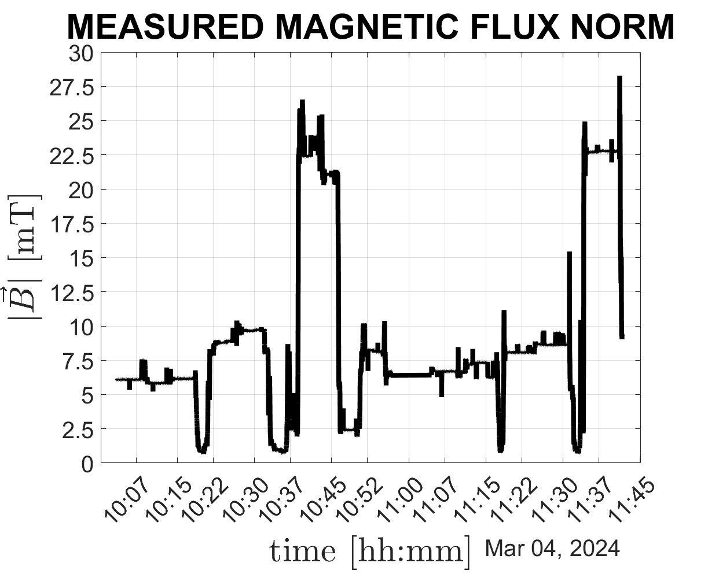
Magnetic field test
Stable operation up to ~10 mT; failures observed at 24 mT due to motor encoder issues. Magnetic torque disturbances up to 0.3 Nm; can be mitigated with robust control and motor design adjustments.
Equipped with MEMS IMU and 3D Hall probe (EP R&D WP-8) for motion tracking and magnetic field measurement.
Unitree Go1 quadruped tested in collaboration with BE-CEM-MRO section.

Slide 15
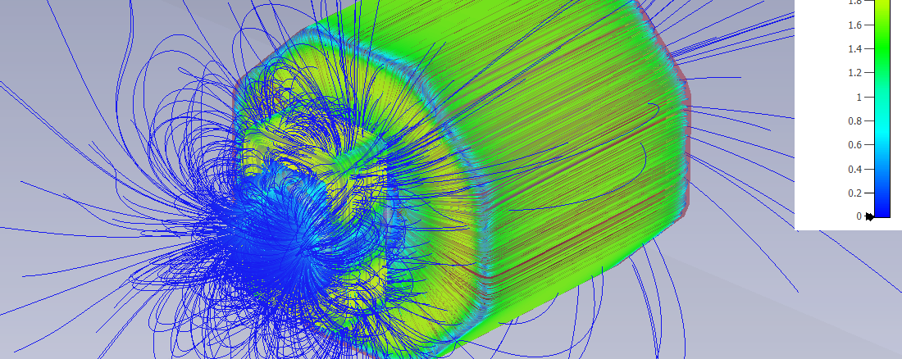
Magnetic field interactions
Motor simulation:
Analytical and numerical models developed to estimate motor magnetization and predict disturbances in real time.
Detector simulation:
Electromagnetic field simulations (based on ALICE) used to generate realistic background field maps.

Slide 16
Legged ground robotic platforms
Future Work & Milestones

Slide 17
Legged Robots – Roadmap
Final Goal
Milestones
Achieve full autonomy for cavern inspection missions with optimal path planning, ensuring robustness against magnetic disturbances.
Motor improvements:
Design and test magnetic shielding to reduce encoder failures.
Evaluate sensorless motors and alternative encoder technologies (e.g., optical encoders).
Magnetization modeling:
Develop and validate numerical models for disturbance estimation based on motor orientation.
Apply to both quadruped and blimp actuators; integrate into control systems and mission planning.
Payload & sensor integration:
Design a robotic arm-mounted sensor suite with custom mechanical and electrical interfaces.

Slide 18
Robotics Airships
Current status

Slide 19
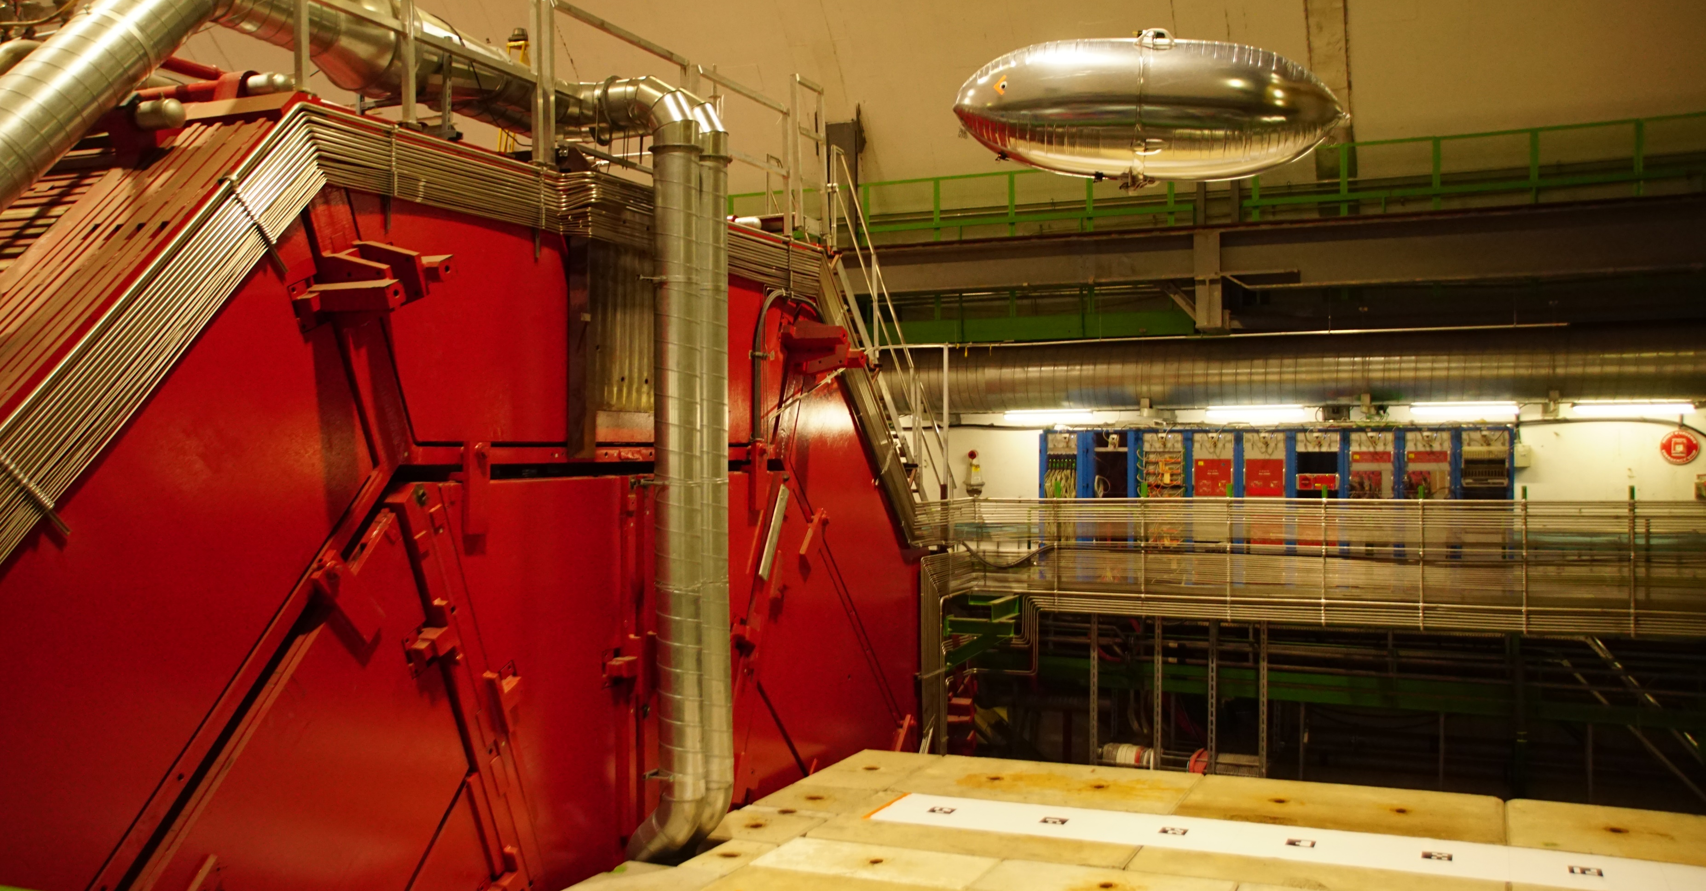
Develop lightweight blimps for low-risk, low-power environmental mapping of magnetic fields and radiation in detector caverns.

Slide 20
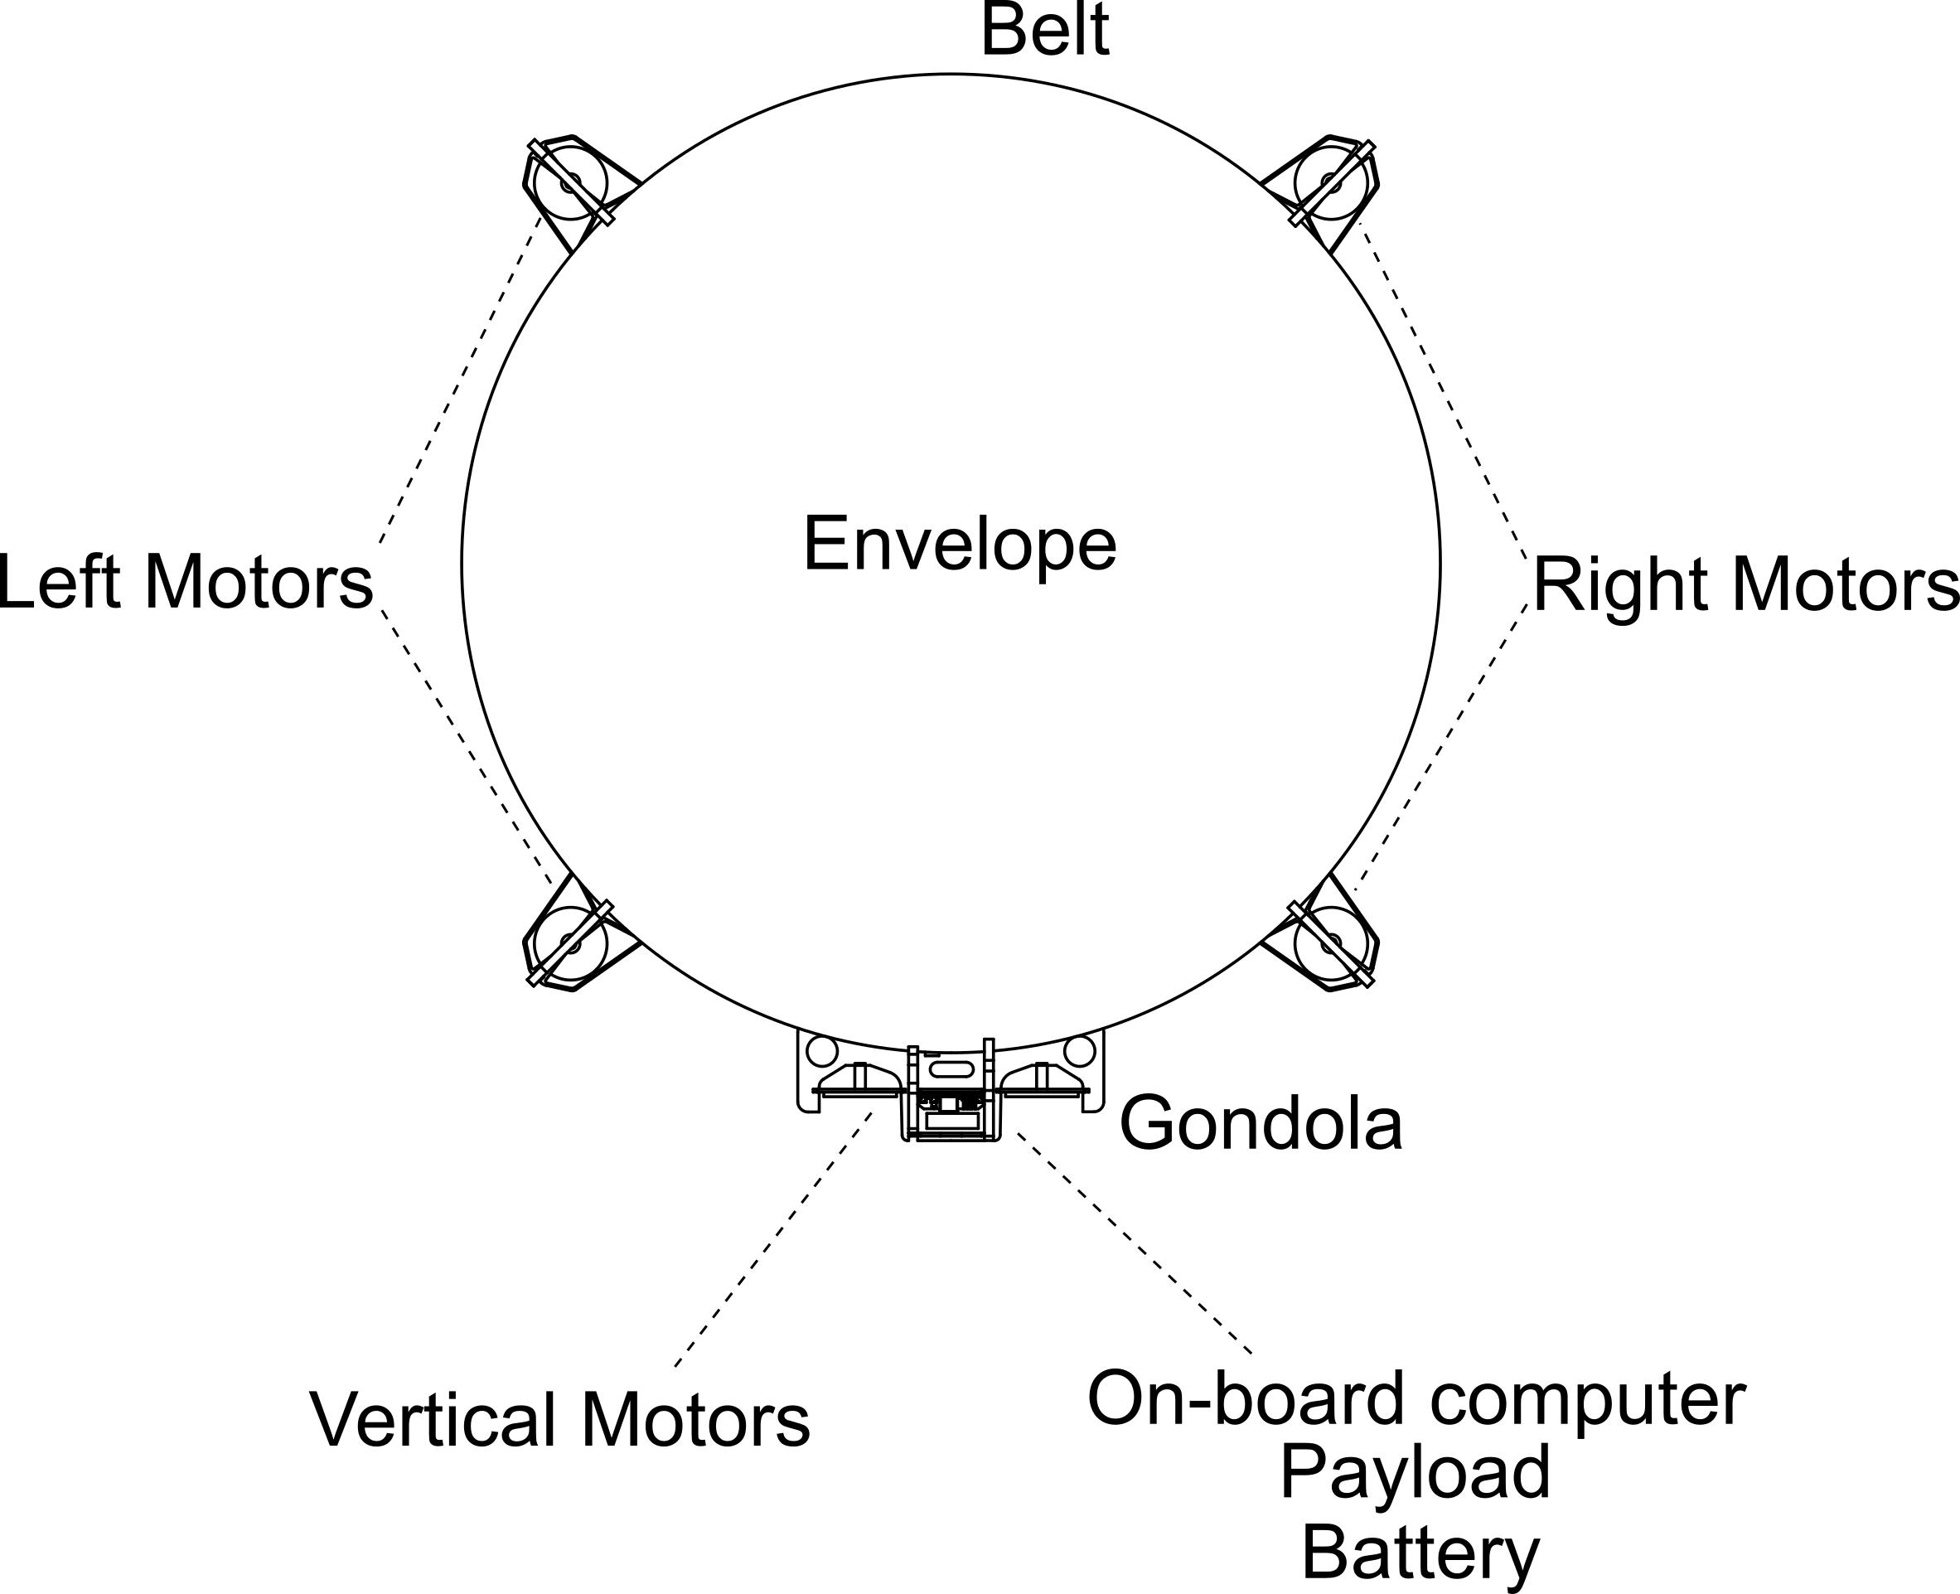
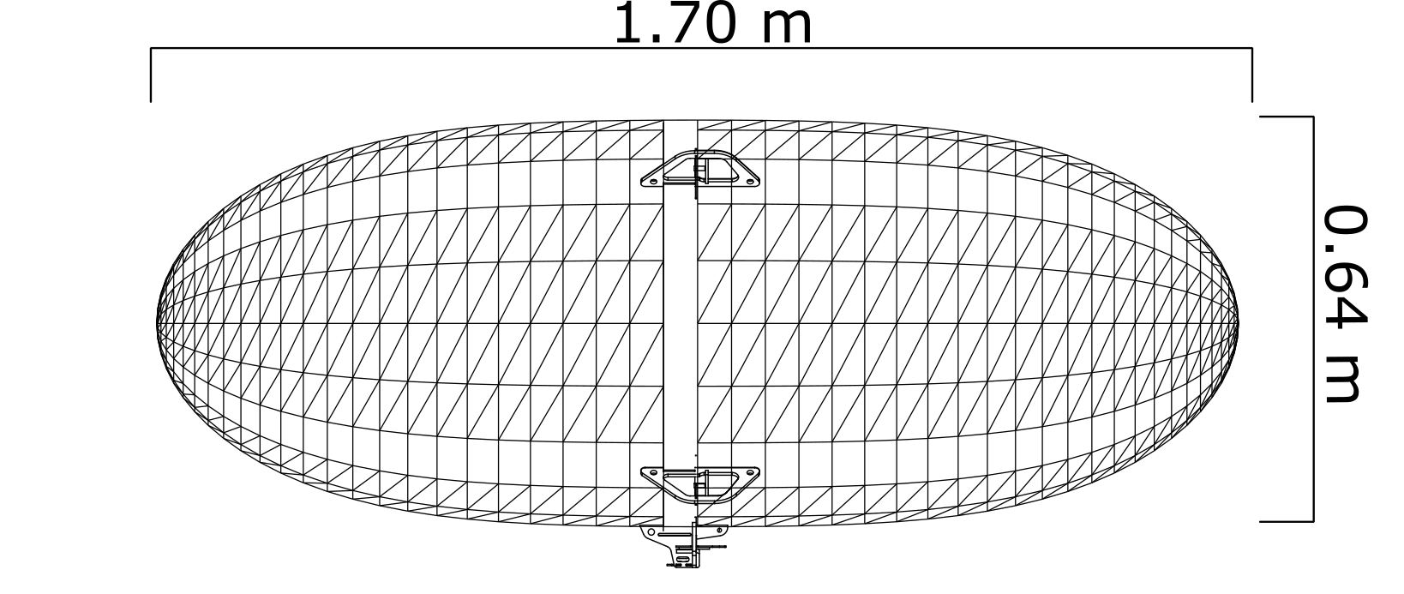
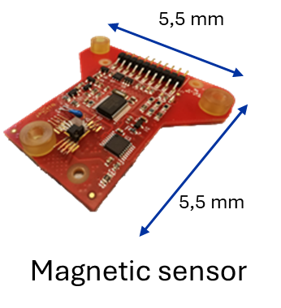
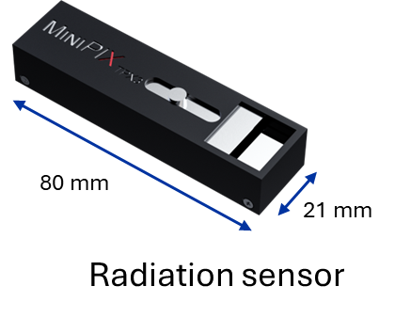
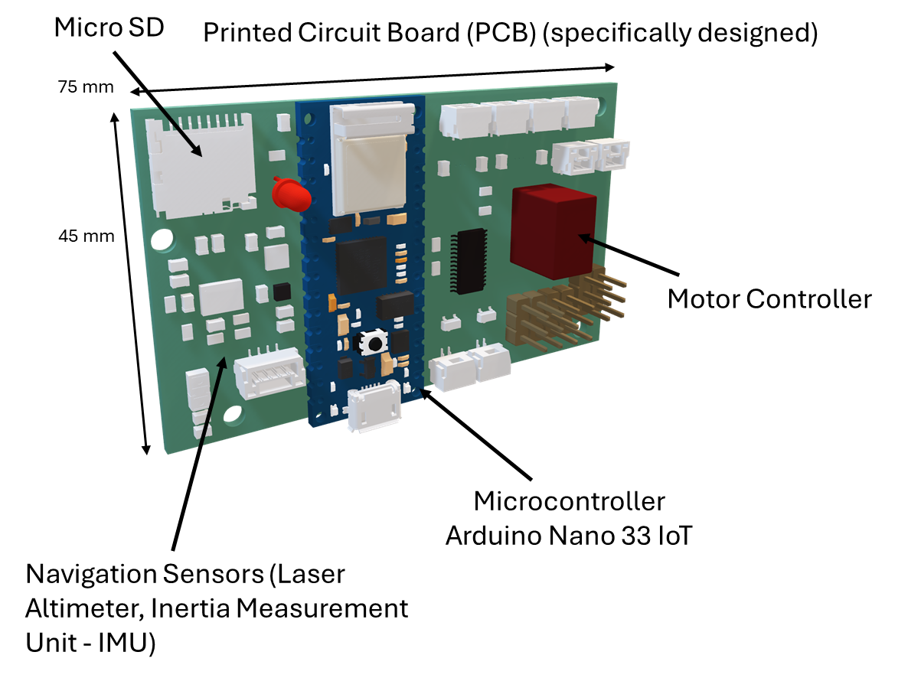
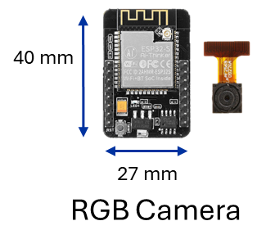
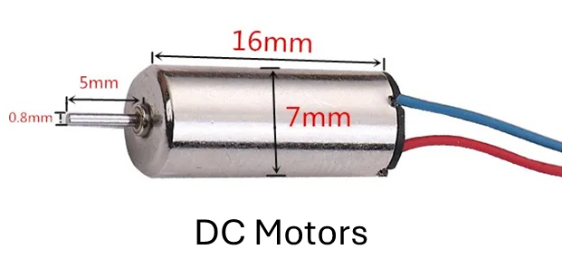
System Design
Structure: Helium-filled blimp with gondola housing electronics.
Propulsion: Lightweight system with multiple motors, custom PCB, microcontroller, LiPo battery.
Navigation Sensors: IMU, infrared altimeter, camera for pose estimation.
Payload: Sensors for magnetic fields, radiation, optical inspection, and environmental data.
Communication: Wi-Fi link between blimp & ground station.

Slide 21
Software development
Guidance, Navigation & Control (GNC)
Simulation & Modeling
Path Planning & Trajectory Optimization
Computes optimal paths for cavern exploration, minimizing energy consumption or time based on mission and system constraints.
Kalman Filter: Sensor Fusion & State Estimation
Integrates onboard sensors and ground-based data for accurate state estimation.
Robust Control
Implements Model Predictive Control (MPC) or Sliding Mode Control to counteract external disturbances and model uncertainties, ensuring stable autonomous flight.
Physical Parameters:
Mass & inertia from CAD models.
Aerodynamic coefficients via CFD simulations.
Motor thrust curves from experimental tests.
Flight Simulator & Virtual Reality
Simulation of the system model and its GNC framework to perform virtual test flights.
Validation of software using MATLAB/Simulink + Unreal Engine.

Slide 22
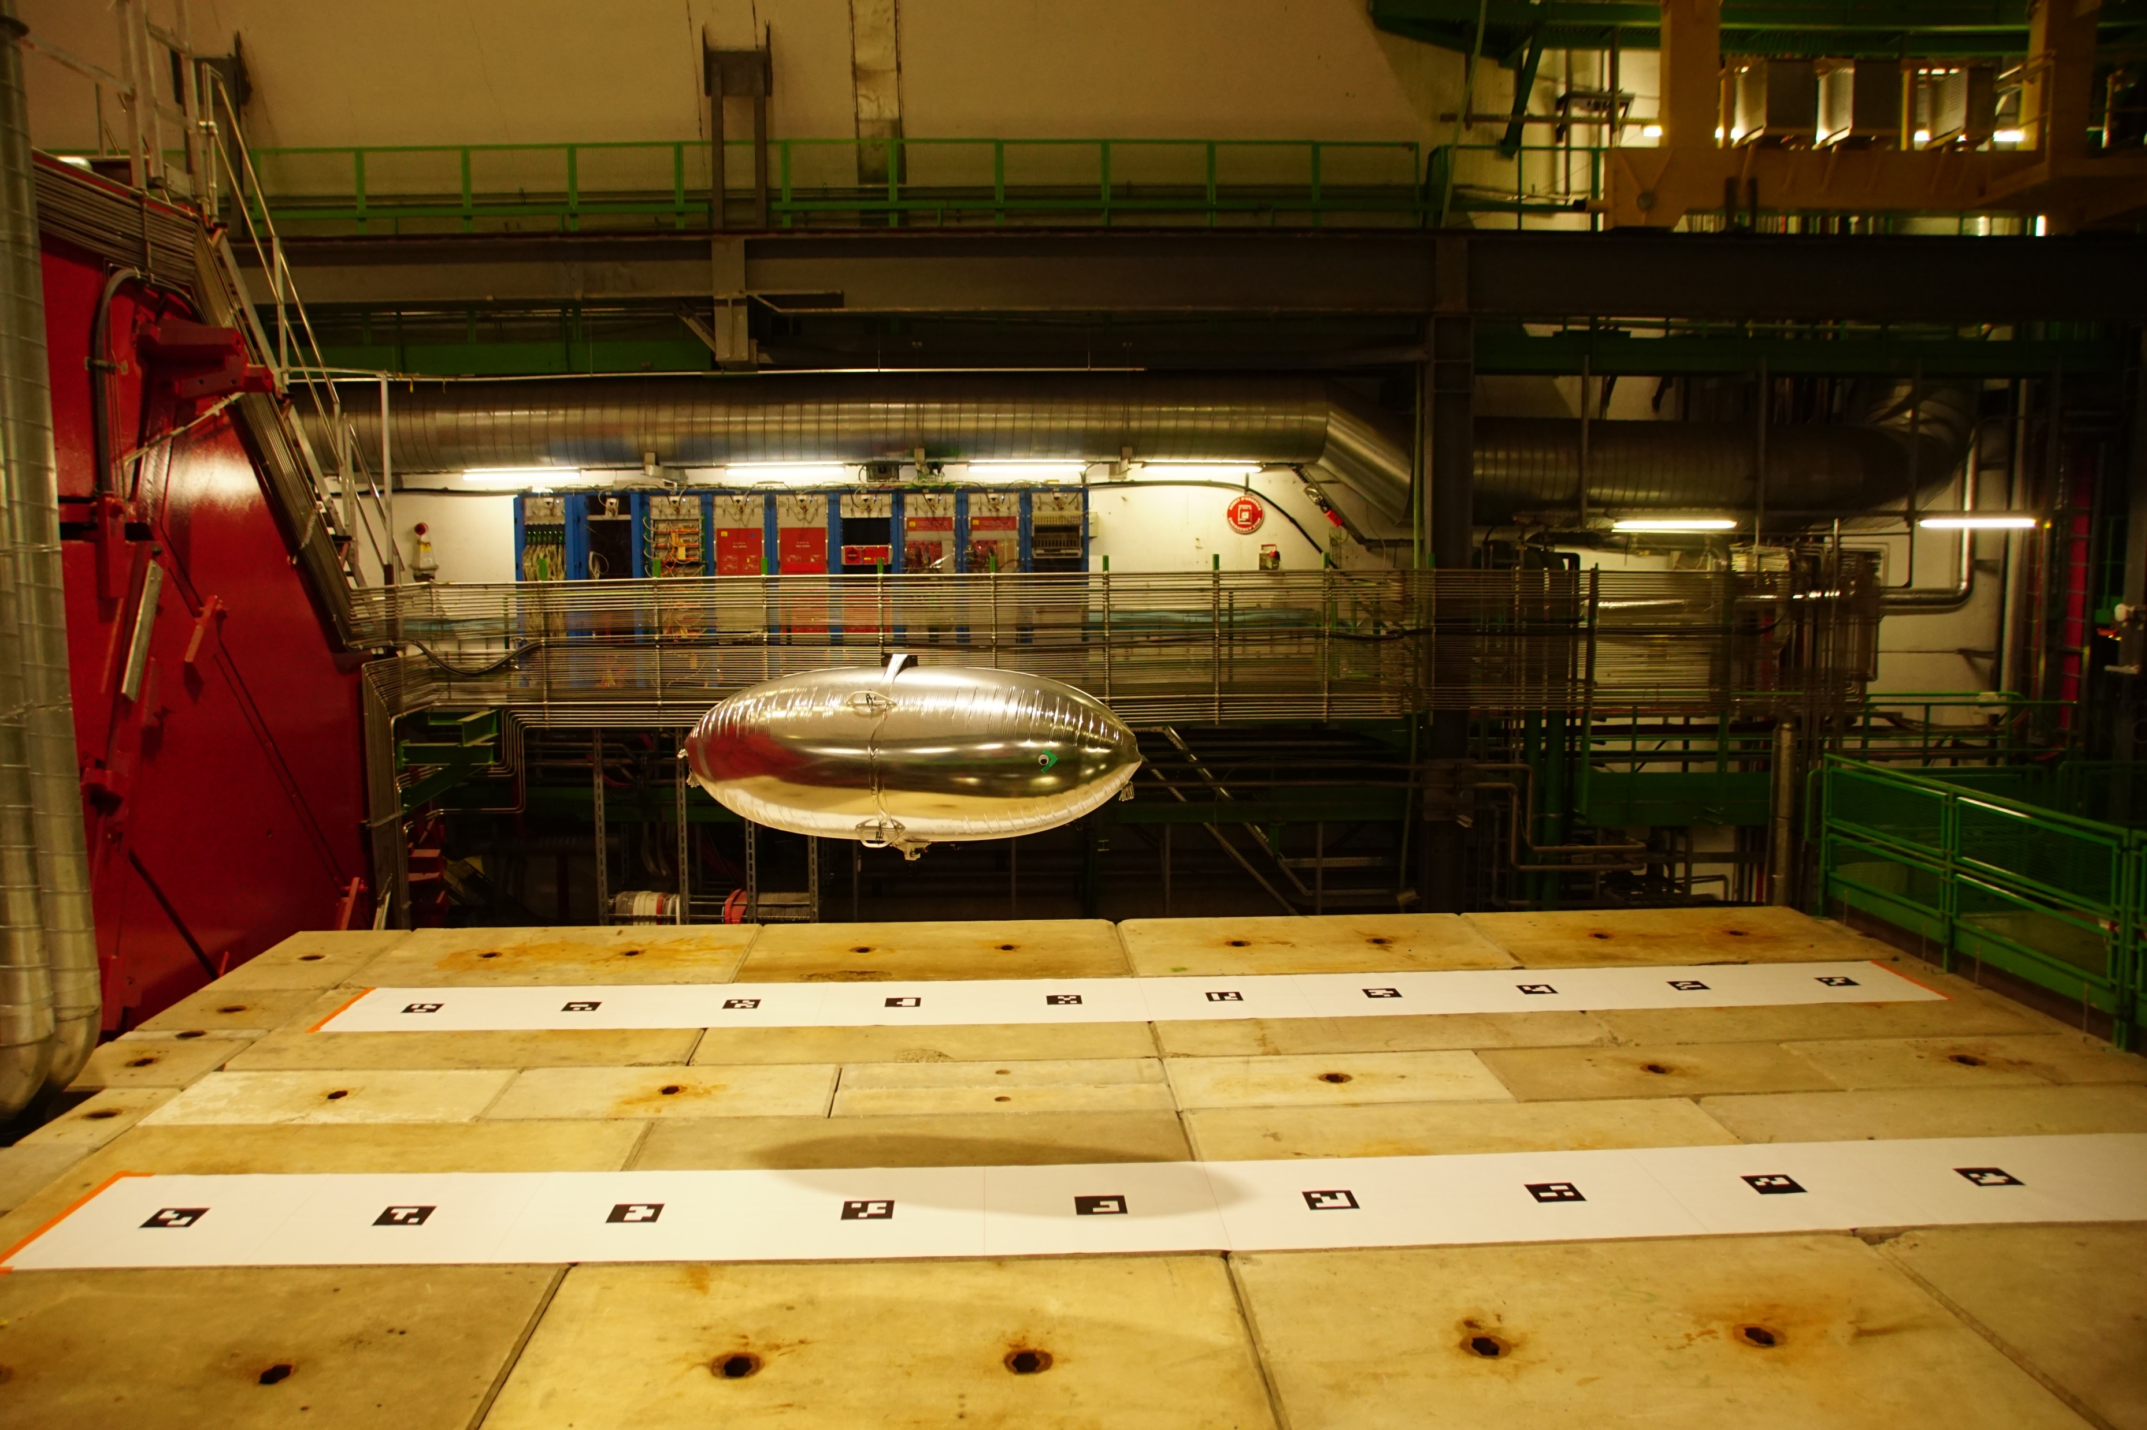
Ground System Development
Indoor Positioning System (IPS)
Computer vision and fiducial markers improving localization
Ground Station
GUI Real-time system monitoring and data sensing & reception

Slide 23
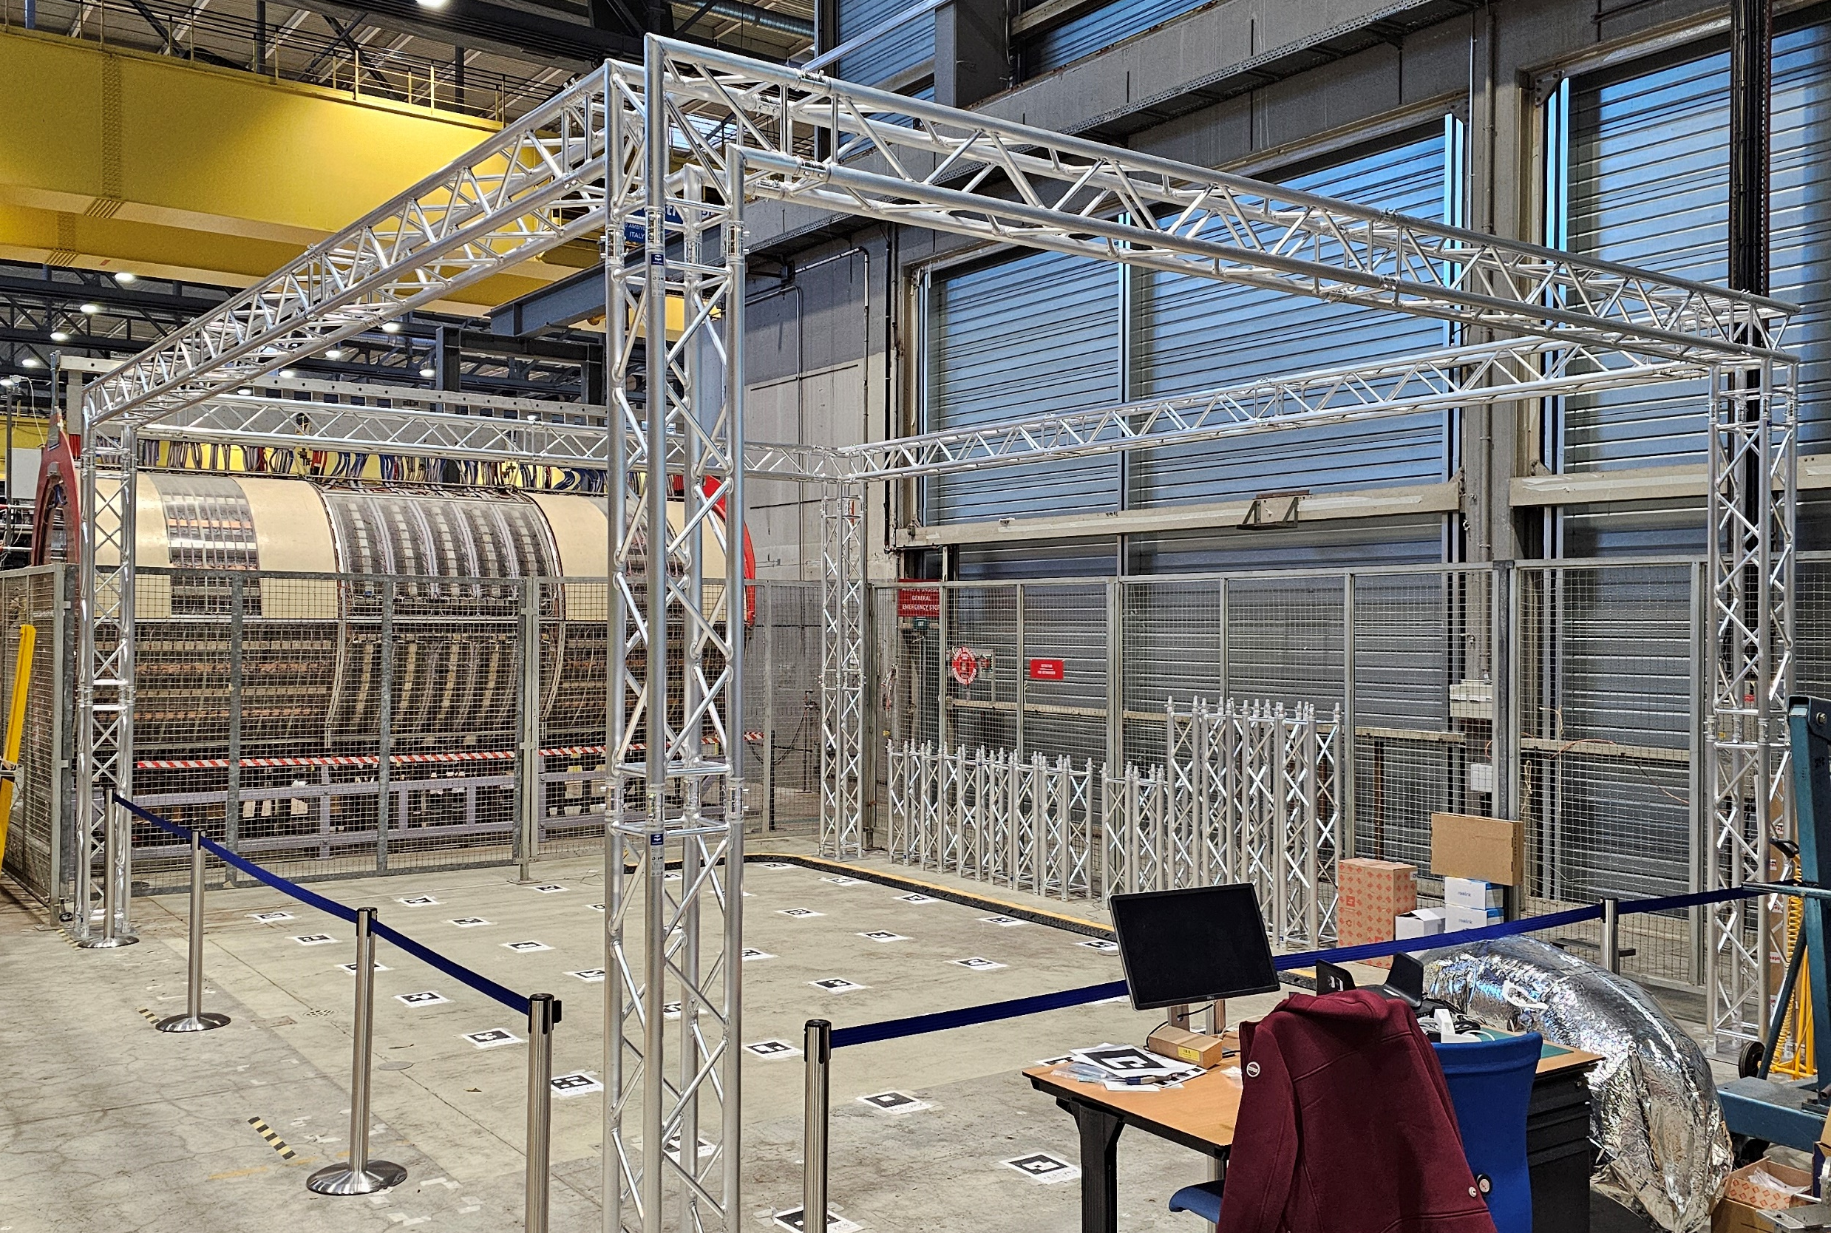
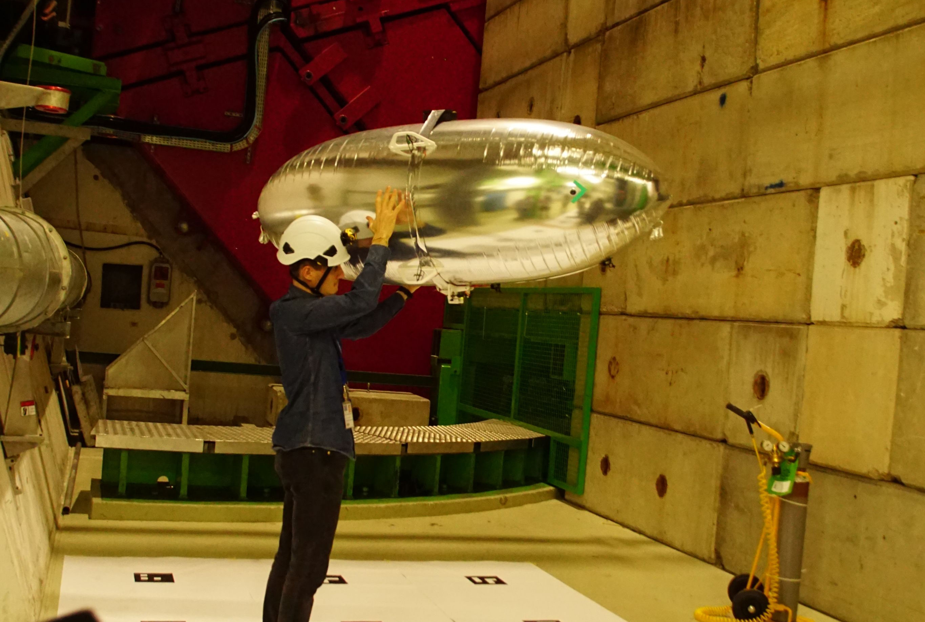
Testing and Validation
Controlled environment
Test environment for validating the algorithms
Field Test
Test campaign in a cavern to evaluate the system in a real environment

Slide 24
Robotics Airships
Future Work & Milestones

Slide 25
Blimp Platform – Roadmap
Final Goal
Milestones
Achieve full autonomy for long lasting cavern missions, including magnetic field and radiation mapping, as well as on-demand inspection of equipment in need
System Design Refinement
Optimize sensor and actuator selection for improved performance.
Design an automatic recharging and refilling system.
Enhanced control
Replace the current control system with a more robust strategy.
Enhanced positioning
Shift position estimation onboard instead of relying on ground processing.
Fuse fiducial marker data with other sensors for accurate localization.

Slide 26
Mobile mesh network
Current status

Slide 27
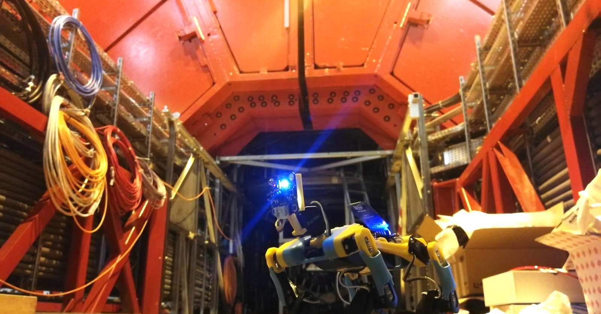
Use a swarm of mini robots with a mobile mesh network to inspect confined spaces and relay anomaly data from deep inside the experiment to the main network.

Slide 28
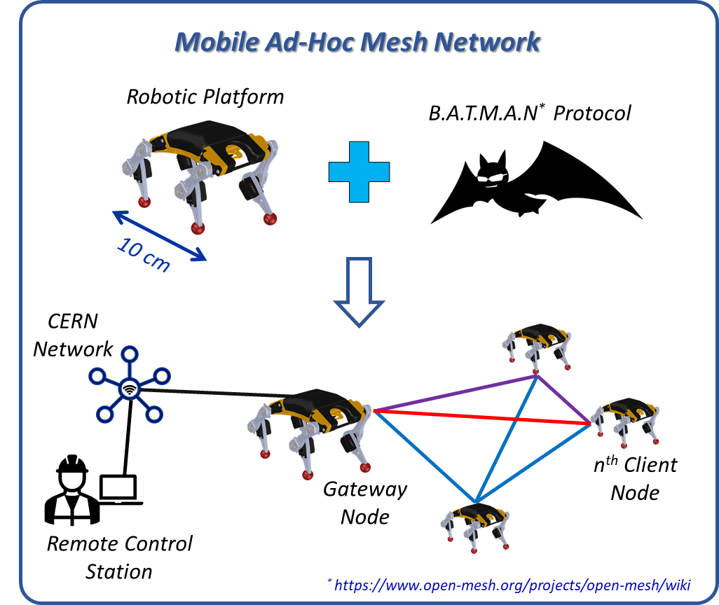
Mobile Communication Network for Remote Robot Operation
Challenges with CERN Wi-Fi:
Signal attenuation in confined areas or far from access points
Risk of communication blackouts during missions
Mobile robot network solution:
Gateway robot connects to CERN Wi-Fi
Client robots form an internal robot-to-robot network
Ensures continuous two-way communication with remote operator
Miniaturized legged robots:
Chosen for their ability to access confined spaces
Initially used Petoi Bittle, now upgraded to XGO mini2+
Network topology evolution:
Transition from ring to mesh topology to avoid single points of failure
Adoption of B.A.T.M.A.N. protocol for efficient multi-hop routing
Successful preliminary test:
3-node mesh network (1 gateway + 2 clients)
Enabled real-time remote control and video streaming

Slide 29
Mobile mesh network
Future Work & Milestones

Slide 30
Mobile mesh network – Roadmap
Final Goal
Milestones
Develop a multi-agent system where mini-robots collaborate as a swarm, enabling adaptive communication and mission execution in complex environments.
Gateway Failover implementations:
A safety feature to automatically redirect traffic to a backup gateway in case of failure.
Ensures uninterrupted communication with the operator.
Automatic Network Reconfiguration:
Enables client nodes to take over as gateway if the main gateway fails.
Ensures continuous data flow between robots and the remote operator.
Extensive Testing & Performance Evaluation :
Simulate mission scenarios with a large number of nodes.
Test gateway failure recovery and system resilience.
Optimize communication strategies for tunnels and cable trays.
Strategically position robots to relay signals effectively.

Slide 31
THANK YOU FOR THE ATTENTION

