Slide 1


Activities and plans at INFN Perugia
DRD8 - WP1 kick-off meeting
27 March 2025
Giorgio Baldinelli ⁽¹⁾ ⁽²⁾ and Cristiano Turrioni ⁽²⁾ for the Perugia group
Università degli Studi di Perugia
Istituto Nazionale di Fisica Nucleare – INFN - Sezione di Perugia

Slide 2
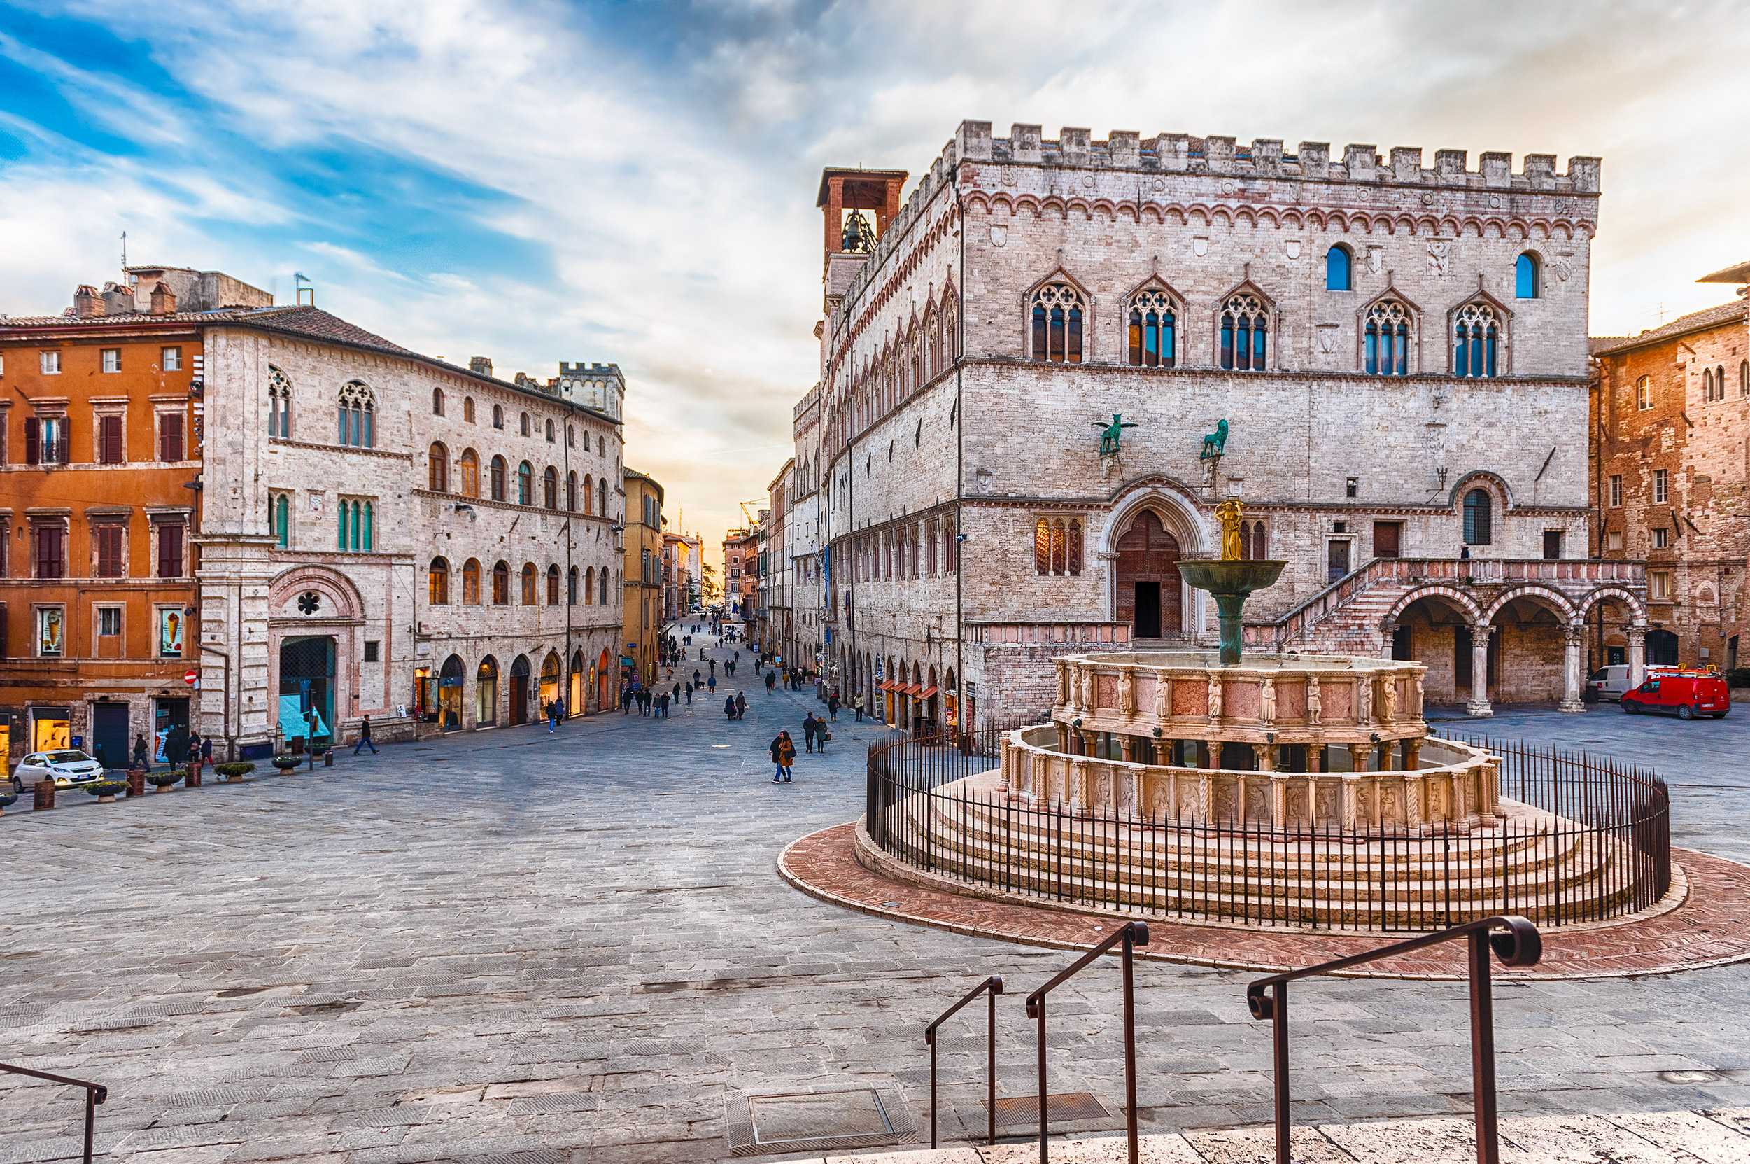
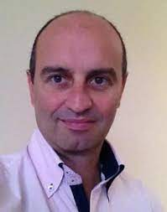
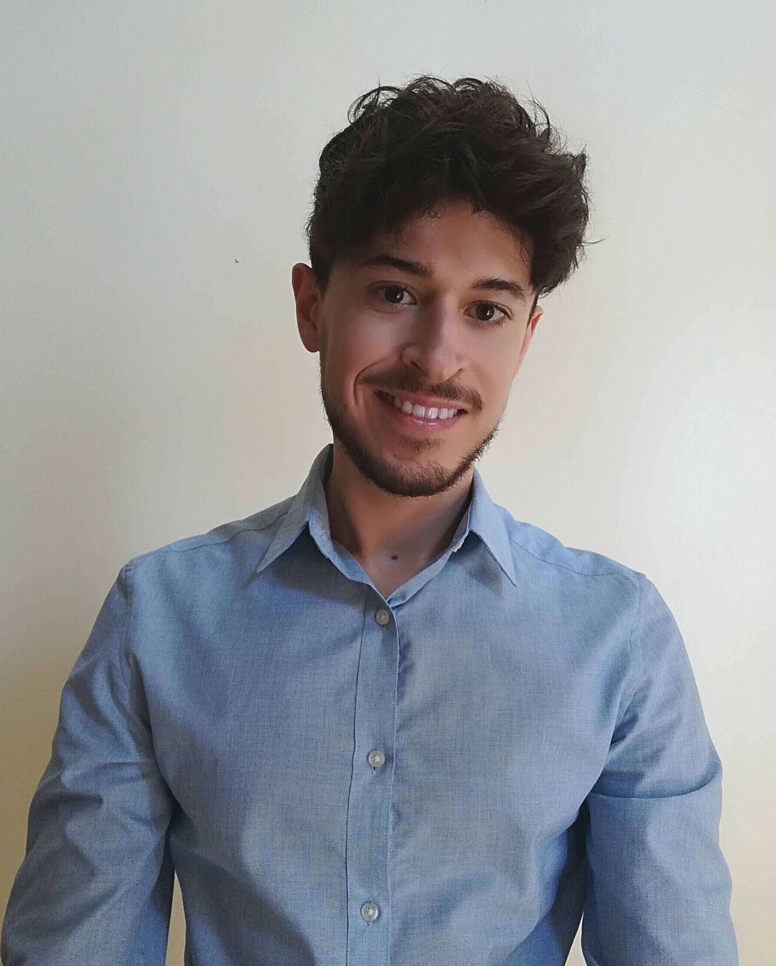
PERUGIA GROUP FOR DRD8
Contacts:
Sensors & Radiation damage
Powering
Mechanics, Cooling & Thermal
studies
Module construction
Prof. Giorgio Baldinelli
Dr. Cristiano Turrioni
giorgio.baldinelli@unipg.it
giorgio.baldinelli@cern.ch
cristiano.turrioni@pg.infn.it
cristiano.turrioni@cern.ch
Topics of interest for our group
Many years of expertise on heat transfer and numerical simulations.
Relative young group for the topics of detector mechanics (since 2018), mainly born around the HL-LHC detectors upgrade.
Already plenty of experience in simulating thermal performance of Modules and structures for detectors Upgrade.
Still heavy involvment of the people in the construction of Modules for the CMS Upgrade.
But lot of interest for DRD8 studies, to lay the foundations for the near future.

Slide 3
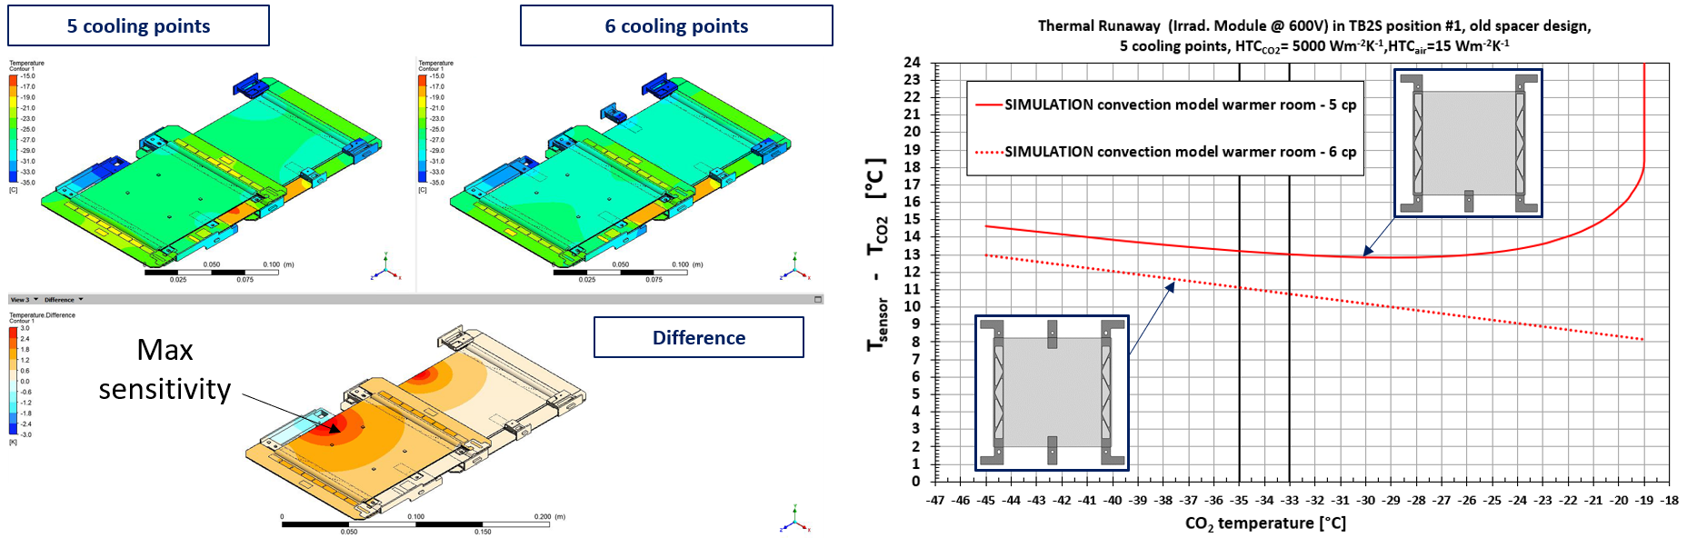
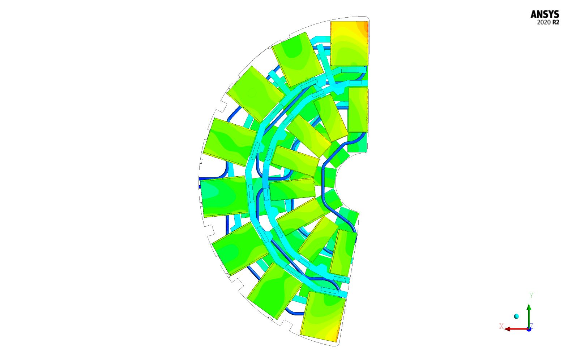
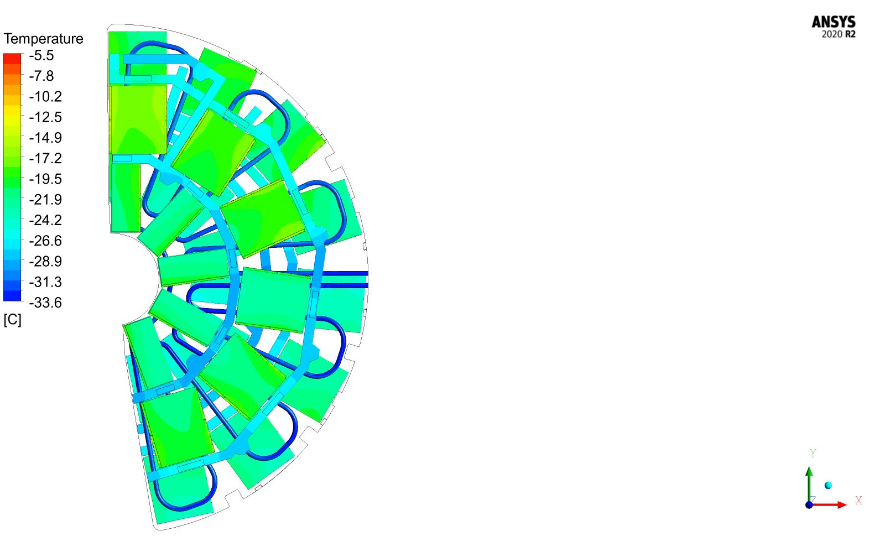
PAST & CURRENT WORK
Prediction of thermal runaway on sensors through Finite Volume Simulations (FVM) for CMS Phase-2 Tracker (Two-Phase CO₂ cooling)
Design optimization for Modules and Mechanics.
Calculation of pressure drops and sizing of cooling loops.
TFPX
Entire dee cooling path optimisation

Slide 4
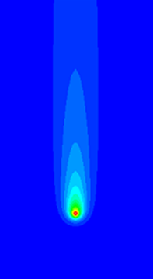
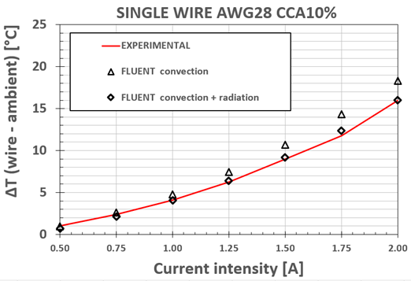
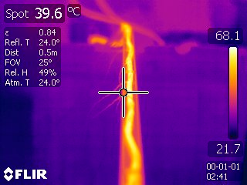
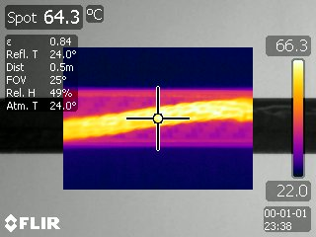
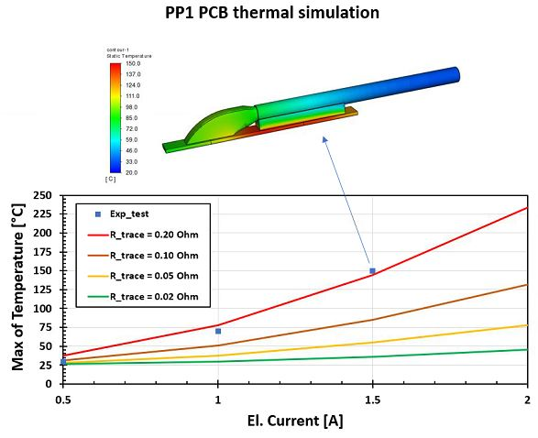
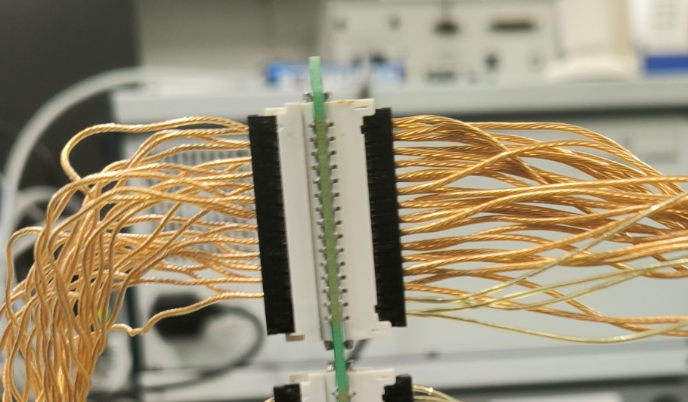
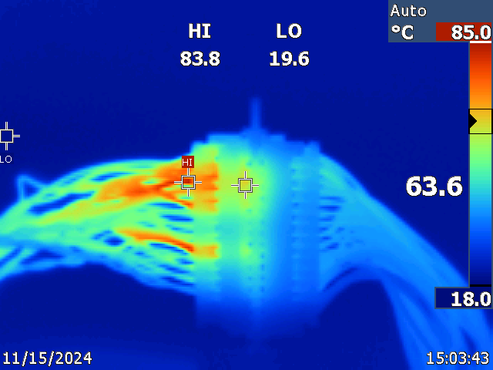
PAST & CURRENT WORK
Simulation and testing of heat dissipation of power cables and patch panels for CMS Phase-2 Tracker (mainly passive cooling, natural convection).

Slide 5
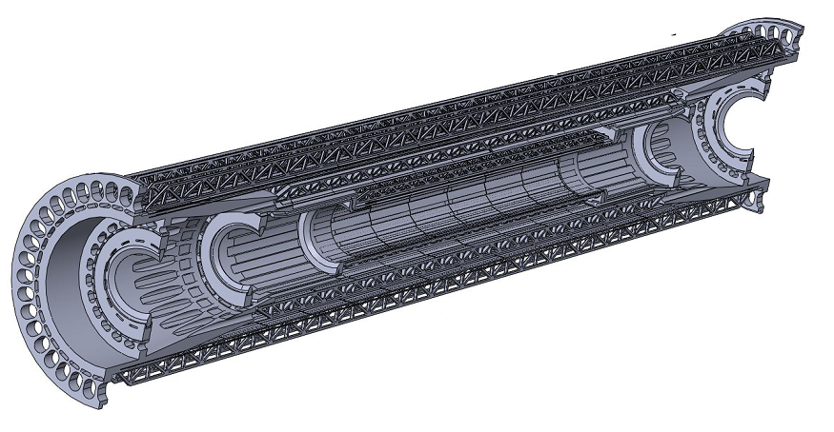
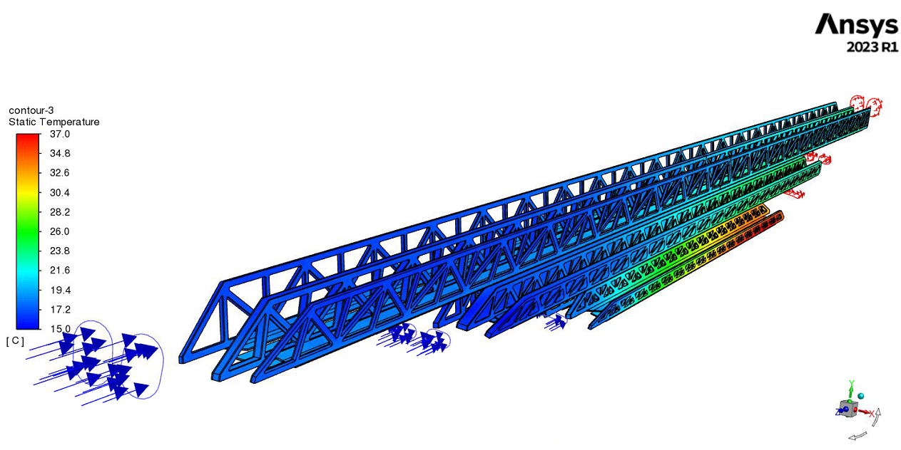
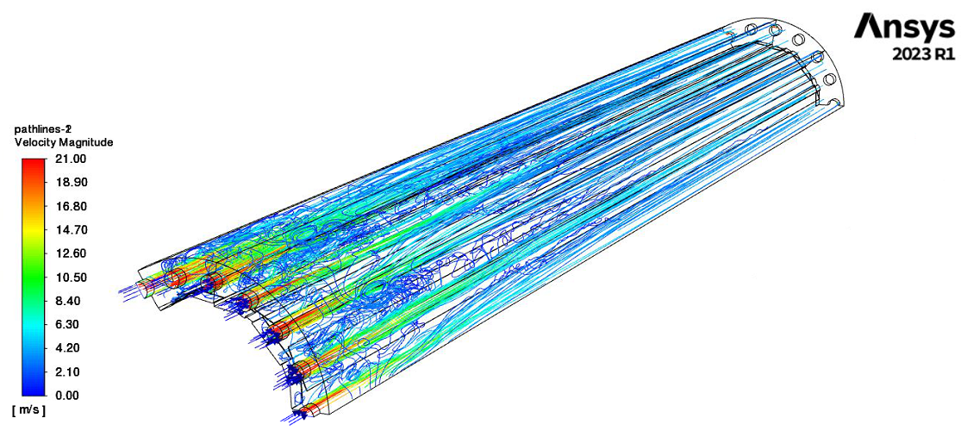
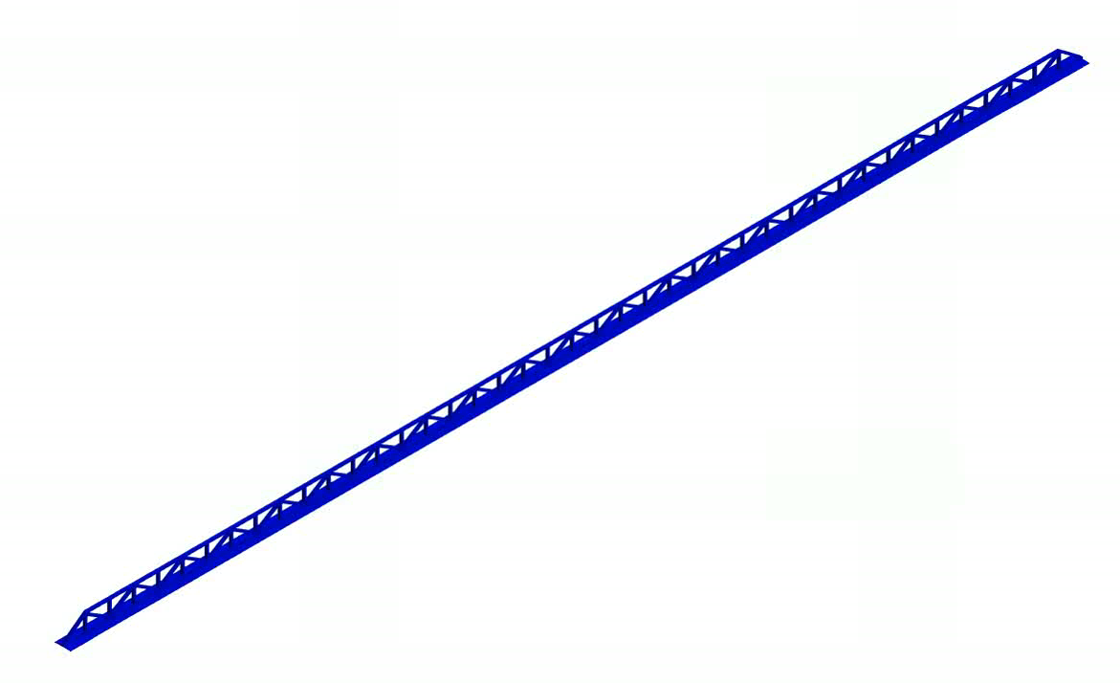
PAST & CURRENT WORK
Geometry
Temperature
Velocity
Multiphysics simulation on the IDEA concept inner vertex detector (forced air cooling)
Thermal performance.
Fluid flow parameters.
Fluid induced vibrations
Displacement

Slide 6
CONTRIBUTION TO DRD8 - WG1.1
We make available our expertise in numerical simulations for supporting WG1.1 studies.
This is in strong sinergy with the work on WG1.1 of other INFN Sections (Refer to other INFN presentations in this meeting).
Plan to make models of the Mockups under development to study their thermal and mechanical performance.
Take advantage of DRD8 also to understand how to improve the modeling of some critical aspects (for simulation) related to the mechanics of detector (see next slide).

Slide 7
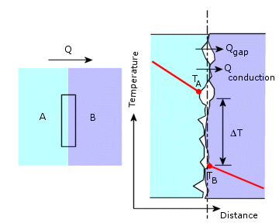
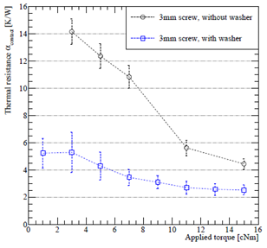
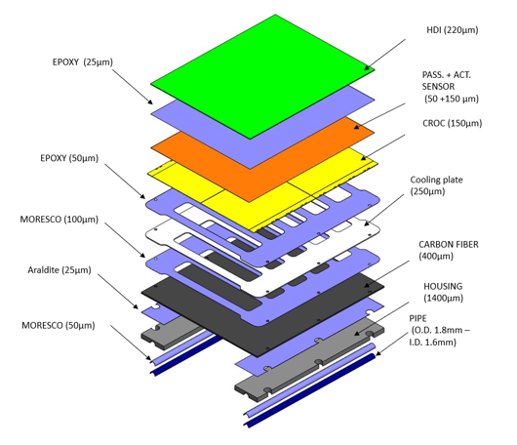
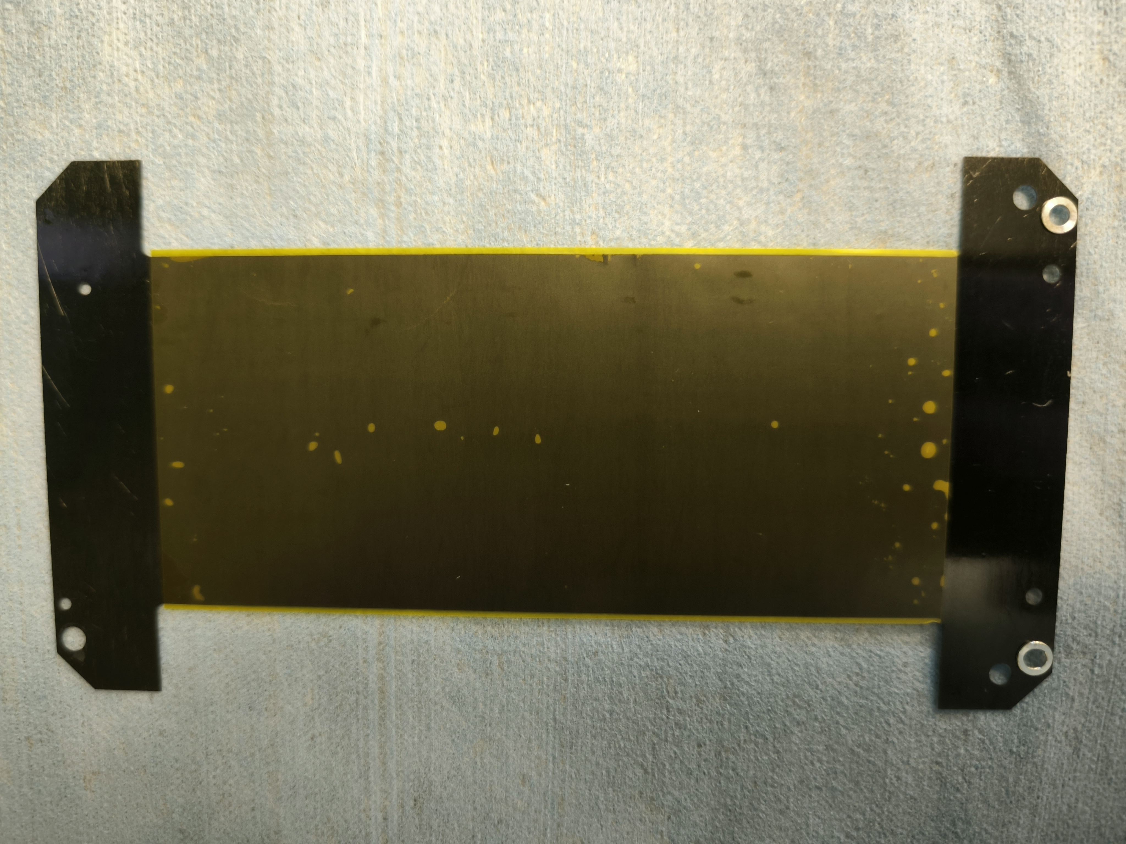
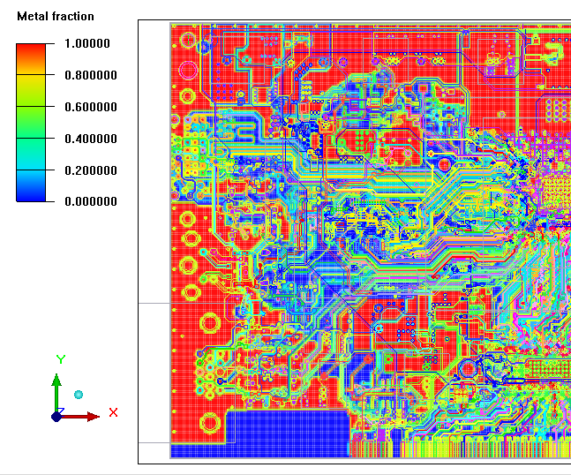
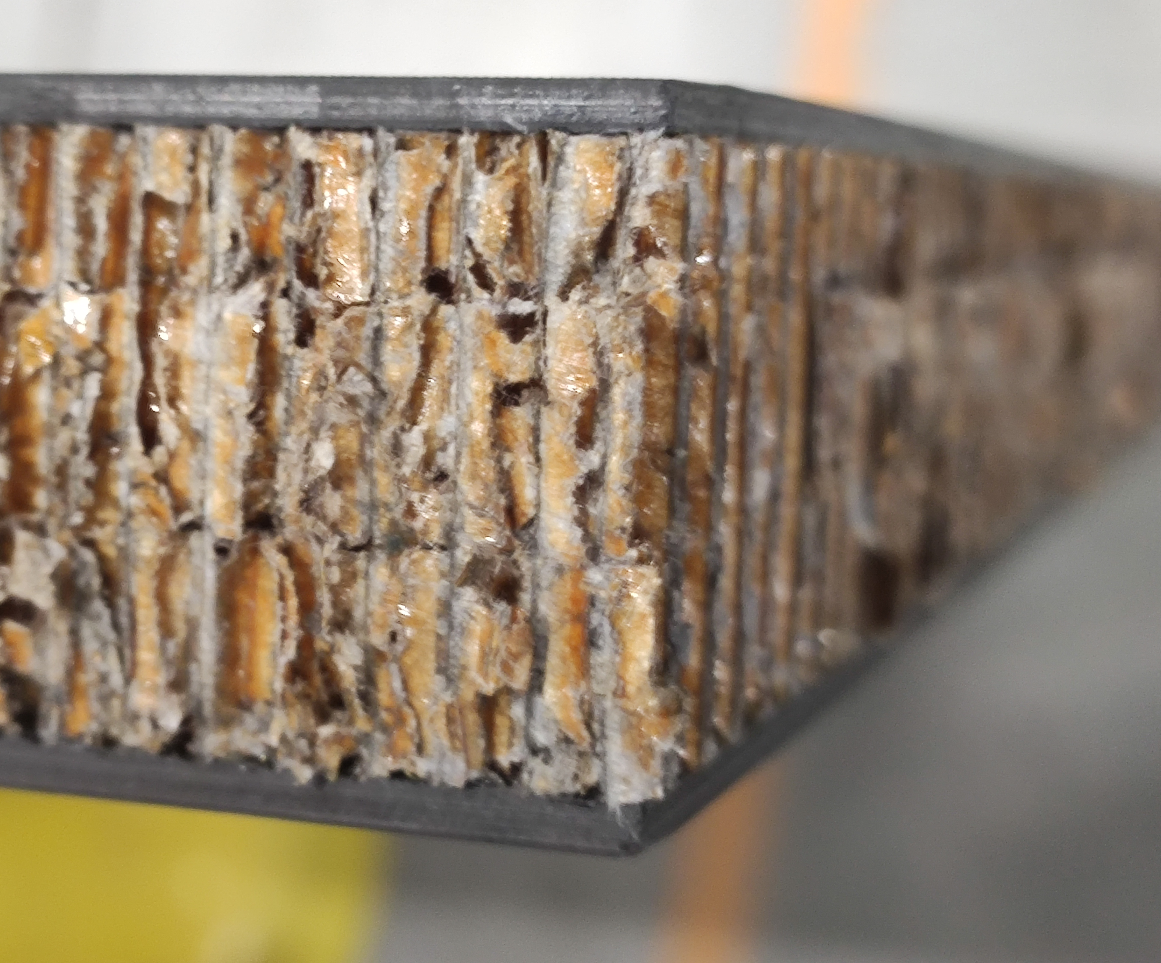
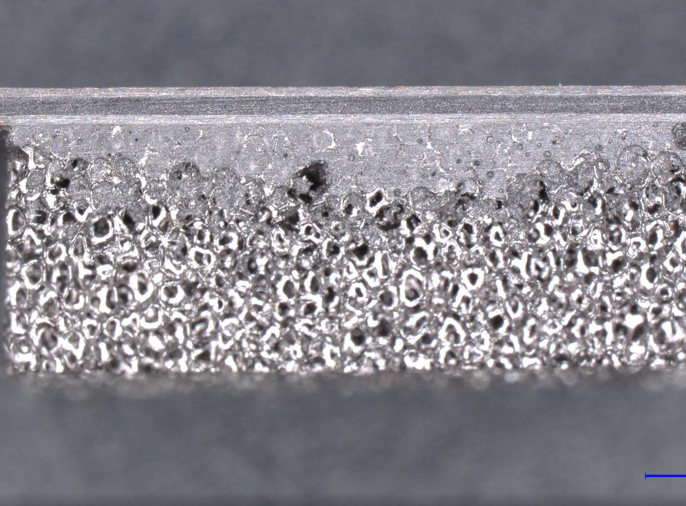
(SOME) CRITICAL ASPECTS TO DEAL WITH IN NUMERICAL SIMULATIONS
We selected some topics from our past experince in simulating Modules and structures for the Phase-2 Upgrade of the CMS experiment:
Thermal contact resistance
Thin glue layers
Threatment of very thin glue layers.
Modeling of trapped air bubbles and fillers.
Model delamination
Relating screw torque to Heat Transfer Coefficient.
Thermal paste thickness vs dry contact.
M. Rauch thesis
Composite & porous materials
PCBs composition and bonds
Different methods for simulating PCB traces.
Threatment of wirebondings and bump-bonding.
Anisotropic modeling.
Glue penetrating on carbon foam
Strong relation with DRD 8.2 for what concerns material properties measurements.

Slide 8
OUR VIEW
Usually a common approach is to do rough simplifications for the previous aspects. But going small with the size of the system, they become more and more relevant for the overall performance, so a detailed modeling of them become needed.
Also, when implementing a simulation for a Prototype or a Mockup, many of the previous aspects coexist simultaneously, and it is very difficoult to evaluate the contribution of each one of them from the overall model.
To study how accurate is the modeling of each one, it is useful to create a dedicated test setup, where the single criticality is tested alone.
This is difficult to manage in detail when the focus of work is the validation of a prototype or a detector upgrade.
Try to do in the DRD8 context.
We would like to study and validate in Perugia the simulation techniques which are more suitable for «best» modelling previous topics.
Validation through dedicated measurements in- house → find for each case a set of measurement that are sufficient to provide comprehensive inputs for the simulation model (New instrumentation and small lab setups).
The amount of possible topics to be studied will depend on the feedback of our funding agency for DRD8 (Now main part of resorces are coming from the Upgrade of CMS Tracker).

Slide 9
Thanks for your attention

