Slide 1

Upgrades and results from CIRCUS, the autonomous control system for complex experiments
Marco Volponi, Jakub Zielinski (the AEgIS Collaboration)

Slide 2
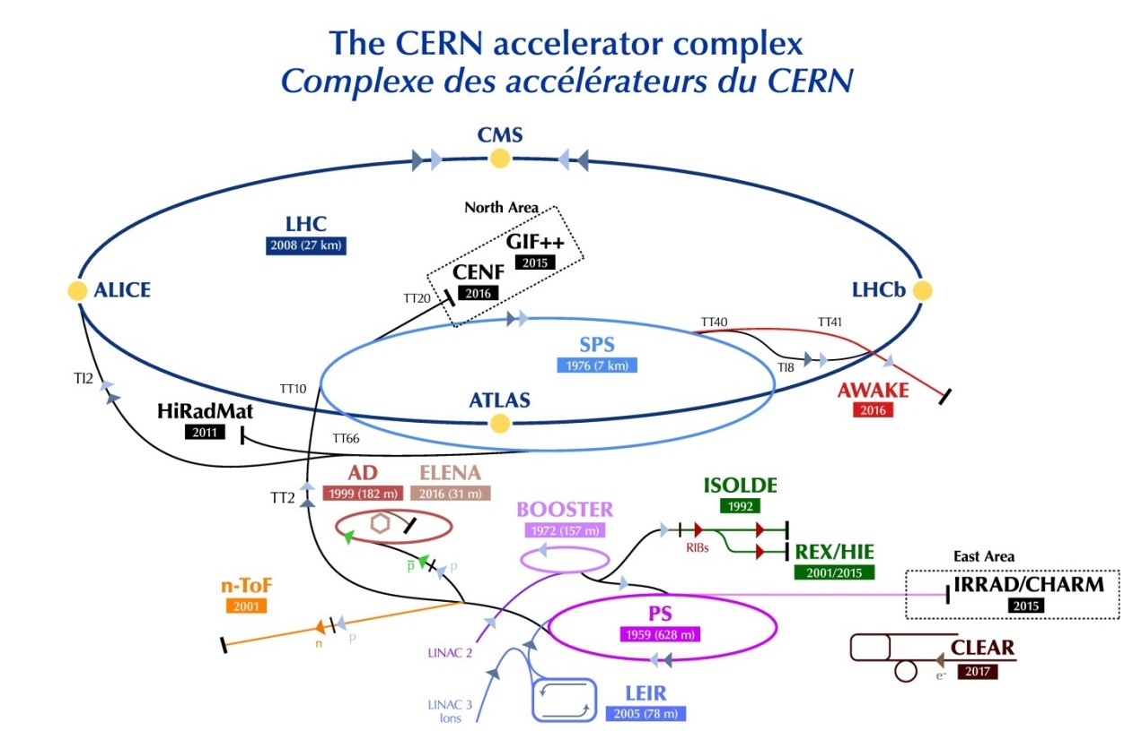
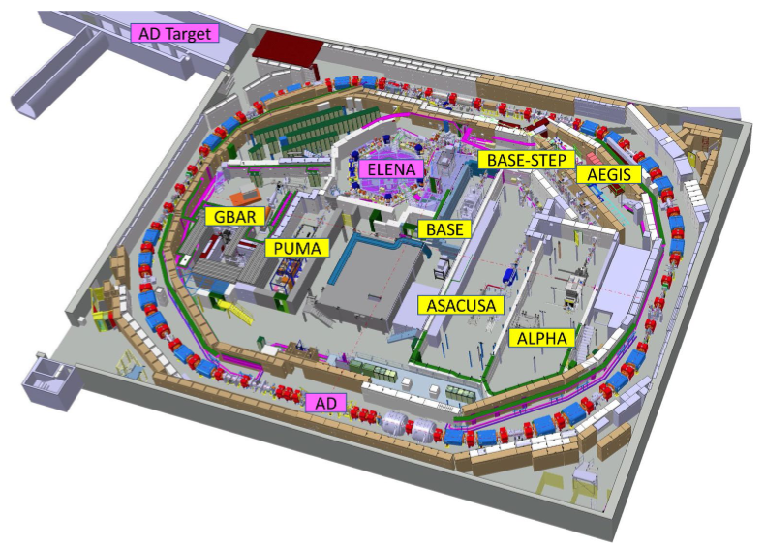

The Aegis experiment
The Antimatter Experiment: Gravity, Interferometry, Spectroscopy (AEgIS) collaboration aims at performing spectroscopic studies and direct experimental tests of the Weak Equivalence Principle (WEP) using antimatter-containing neutral systems (anti-hydrogen, positronium atom, antiprotonic ions).

Slide 3
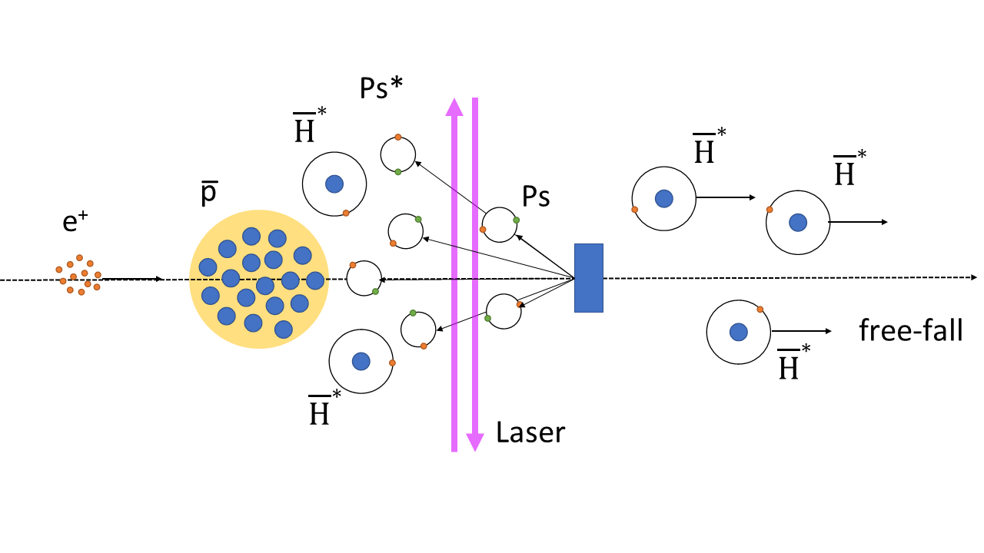
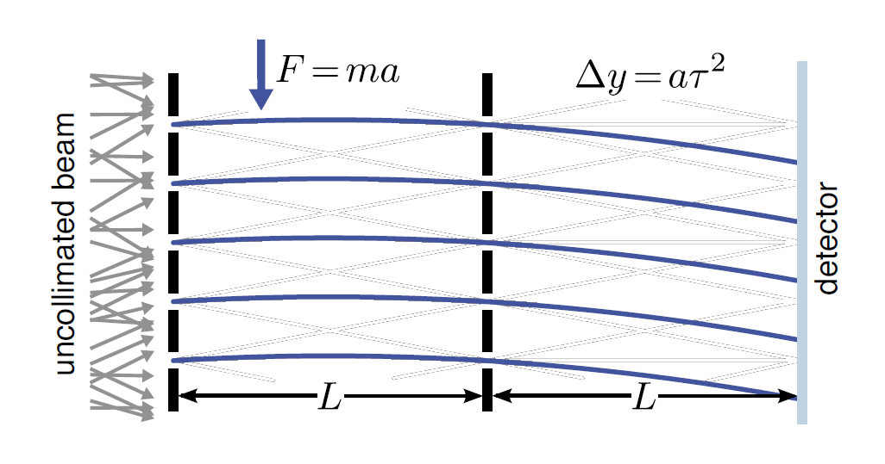
Gravity on antihydrogen
Beam of antihydrogen
via charge-exchange
Gravity detector:
measure free-fall

Slide 4

The CIRCUS:
Computer Interface for Reliably Controlling, in an Unsupervised manner, Scientific experiments

Slide 5
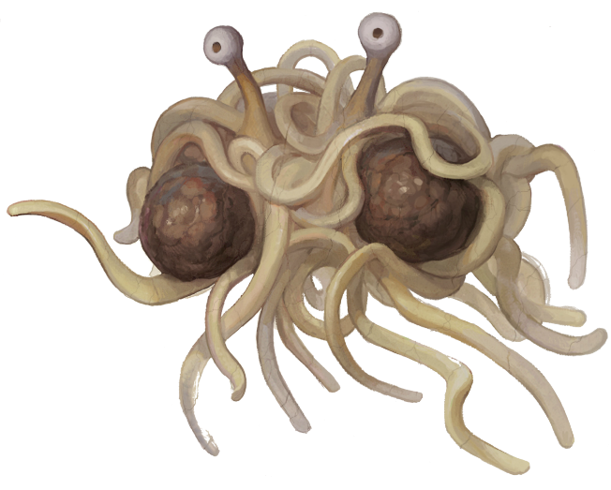
Two Founding Pillars
Distributed System
  Unifies all the single machines in a coordinated system
  Enhance reproducibility, stability and safety
  Enable possibility of smart automation
“Everything is a MicroService”
  Defined, clear scope and tasks
  Modularity
  Asynchronicity
  Code uniformation and standardisation

Slide 6
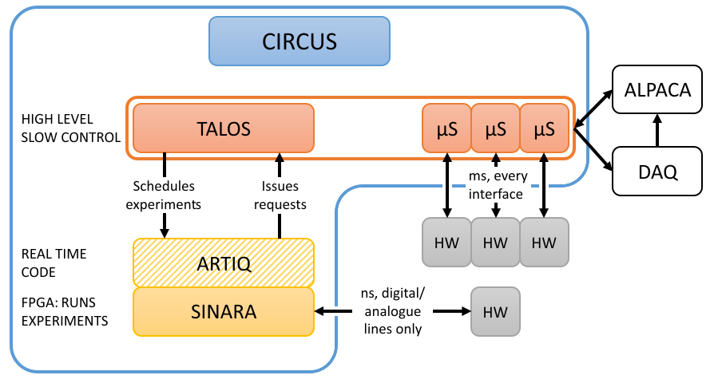
CIRCUS Structure
ANALYSIS
ENGINE

Slide 7

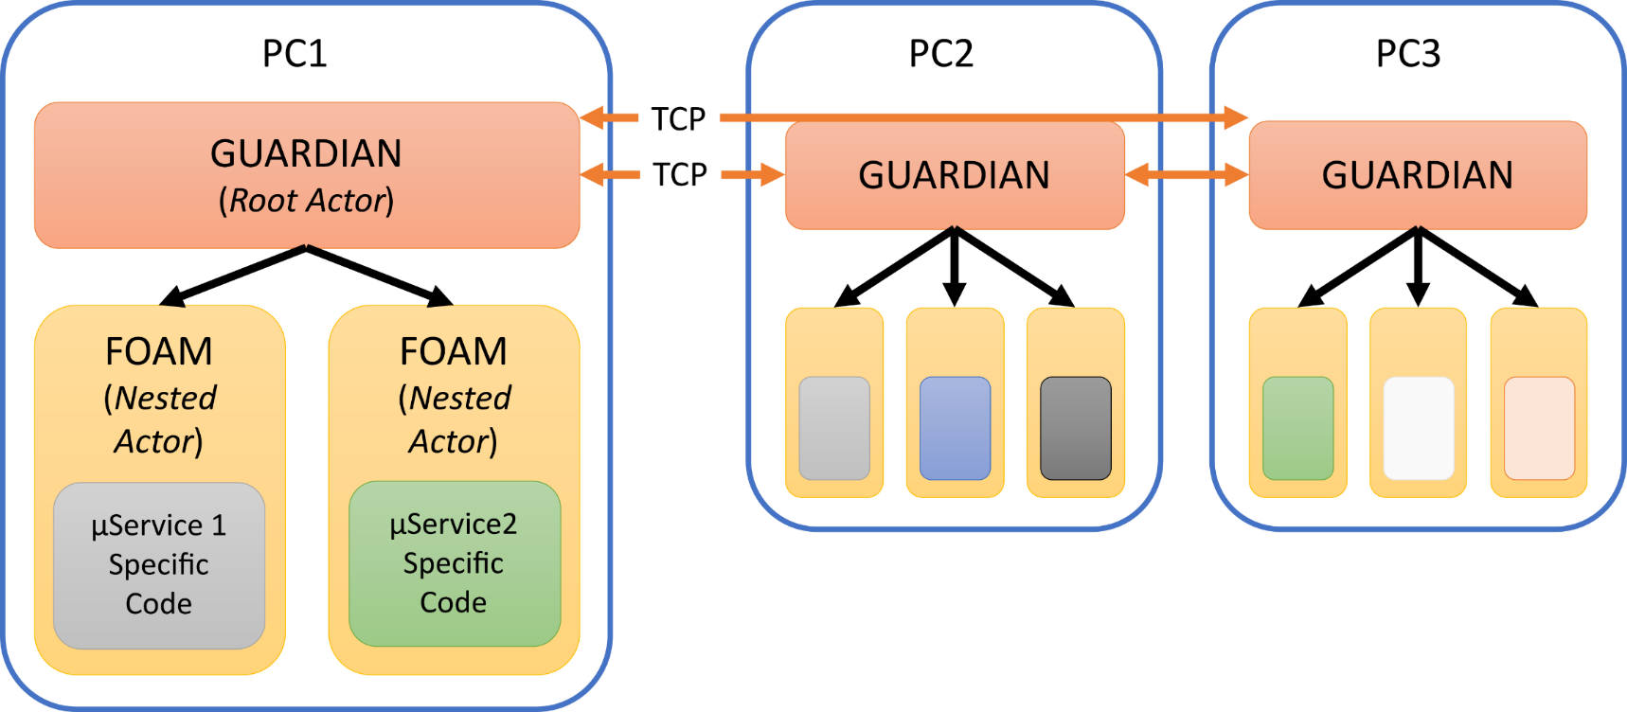
Talos: total automation of labview operations for science
Actor Framework
Guardian = Root Actor
Flat Hierarchy
Power of class inheritance

Slide 8



Main CIRCUS $μ$services
Error Manager: distributed system error concentrator
Scheduler: to create schedules of experiments (i.e. scripts + parameters)
Kasli Wrapper: encapsulate shell interaction with Kasli (FPGA)
Monkey: core of automation, execute experiments
Tamer: for multi-Kasli operation

Slide 9
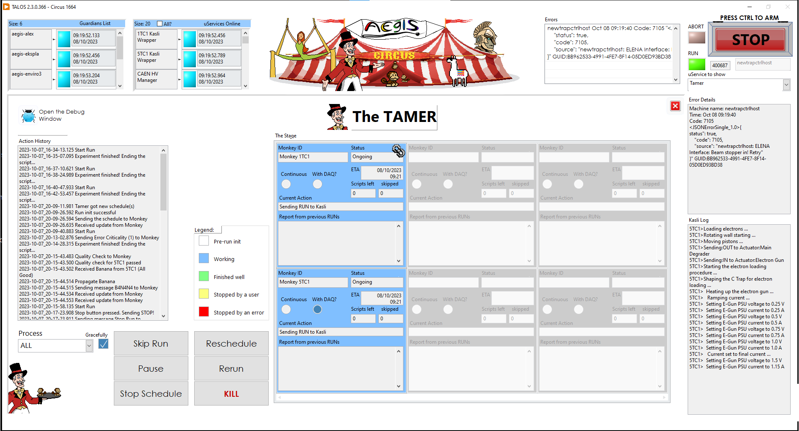

Slide 10
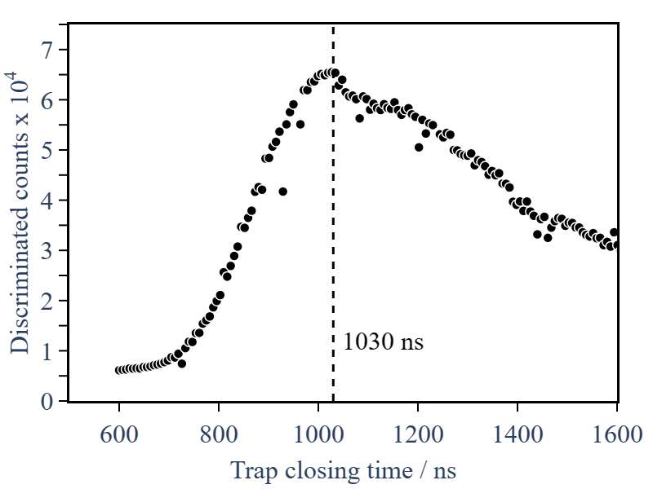
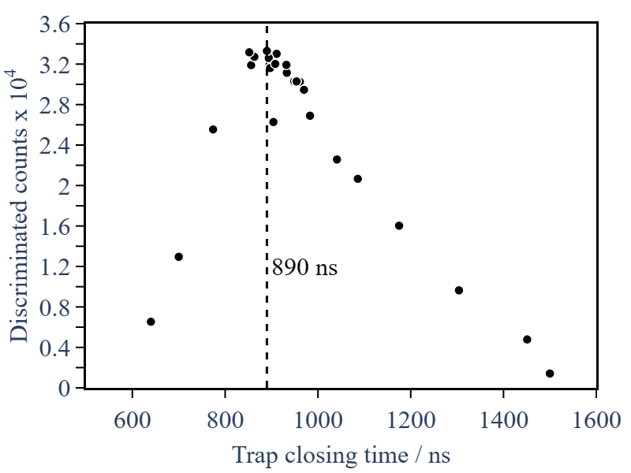
Autonomous parameter optimisation via live data feedback
Interface of Monkey with ALPACA (Data Analysis Engine) enabled autonomous parameter exploration to optimise pre-defined observable

Slide 11
Upgrades

Slide 12
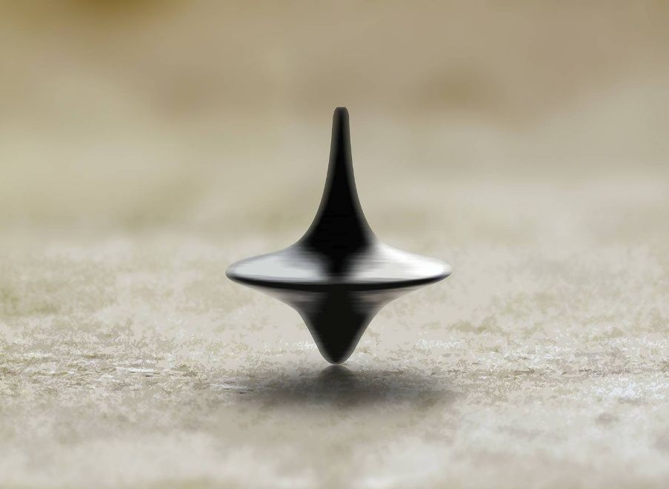

Extraction of Circus $μ$services from Talos
Inserting them was a good idea, but underperforming
Extraction was a game changer for the development of TALOS
  Now it compiles in < 1 min instead of > 10 mins !
Loading from CIRCUS is also much faster
Best would be to make another separate PPL
  But a PPL with a PPL inside with a PPL inside doesn’t compile…

Slide 13
Removal of TALOS Internal Shared Variables
Error Queue: now simply a message to Error Manager
  A ‘local Error Manager’ is needed, otherwise if the Distributed Error Manager is off, the error is lost
  Future: direct TCP connection between Error Managers could ensure hardening against congestions of general TALOS connection
Initial Guardian connection: a ‘send and hope’ message to TCP Server of that machine
  Message from the m-th starting machine will correctly arrive to the (N-m-1)-th machines already started

Slide 14
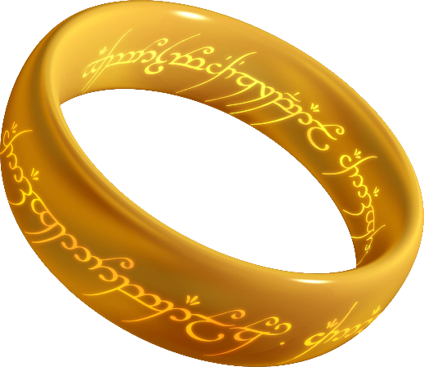
Removal of TALOS Internal Shared Variables
(part 2)
Abort: replaced the nomad singleton SV with a Guardian private data boolean, and added the Bearer flag
  Only the value of Abort of the “Bearer” Guardian is the valid one: the others Abort are used as “local copies”
  Only one Bearer in the network, propagated with the periodic Pat
  In case the Bearer disappears from the network, someone else take the burden
  In case of multiple Bearers, who’s after in alphabetical order resigns

Slide 15
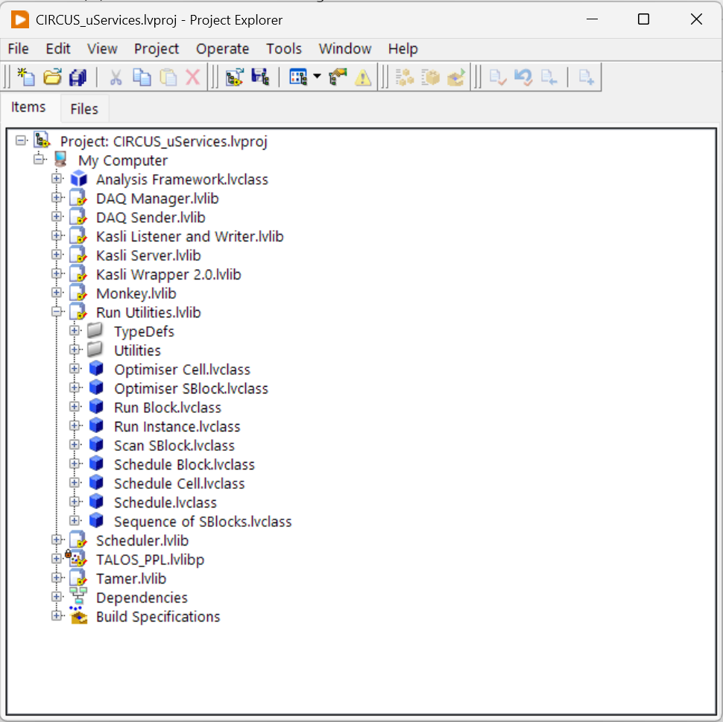
Huge code refactoring
More classes!

Slide 16
results

Slide 17
Boot up speed
 | CIRCUS 3.0 | CIRCUS 4.0 | Improvement
Single PC startup | 147±3 s | 43.6±0.5 s | ~330 %
AEgIS’ CIRCUS restart | 262±17 s | 107±2 s | ~250 %
No SVs
  → no Datalogging and Supervisoy Control (DSC) module to load
  → no SVs to deploy and to clean up
  → TCP communication way faster than SVEngine
CIRCUS uServices not needed to be loaded on slower machines

Slide 18
Abort is faster
Abort=True propagated as before, O(10 ms)
Abort=False now propagated (even if multiple Bearer) in O(10 ms) instead of O(s)!
Now multiple Bearer cleaning takes O(10 ms) and happen every second instead of 30 s → “singleton” recovered in seconds instead of minute(s)!

Slide 19

64 bit unlocked
DSC no more a dependency → now TALOS supports LV 64 bits!
Tested on LV 2024 Q3 64 bits
Finally we are back to the future!

Slide 20
Physics improvements
Removing and shrinking delays in Python and in LabVIEW made possible to form antihydrogen every 2 ELENA shot instead of 3-4 →
> 33% higher efficiency
Full 10-dimensional optimisation of beam steering inside the apparatus → ~ 2x antiprotons captured per ELENA shot wrt 4D optimisation

Slide 21
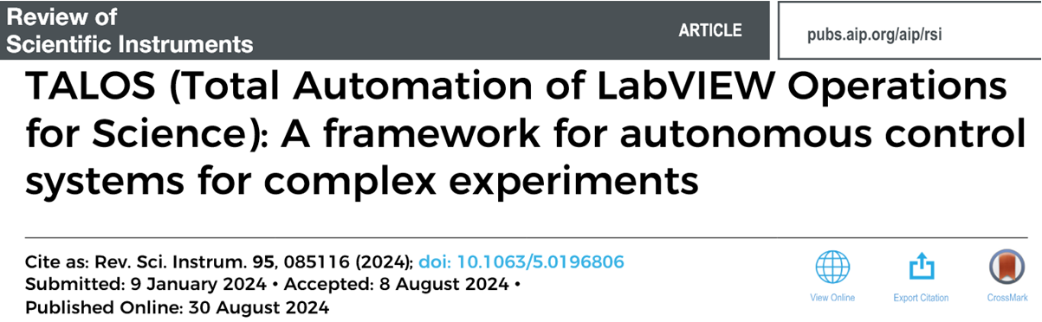
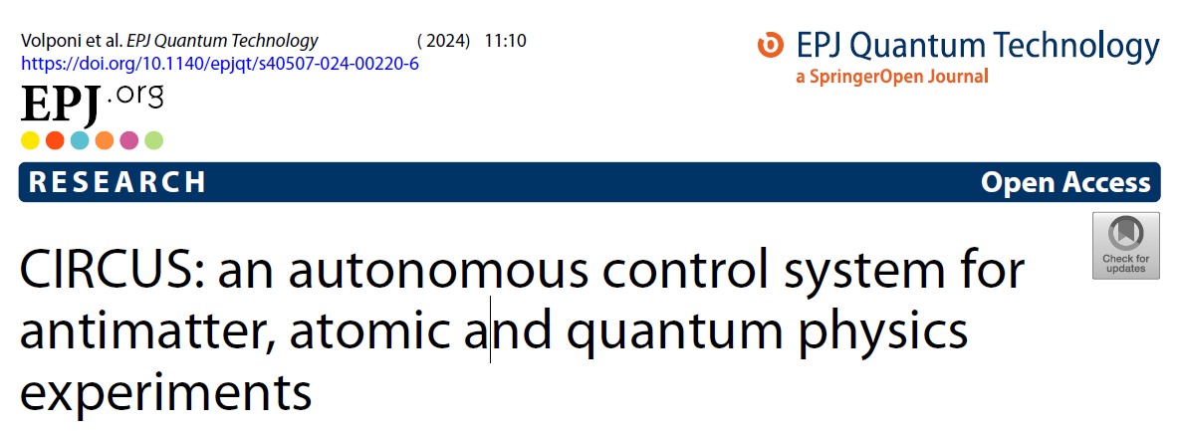
two publications

Slide 22
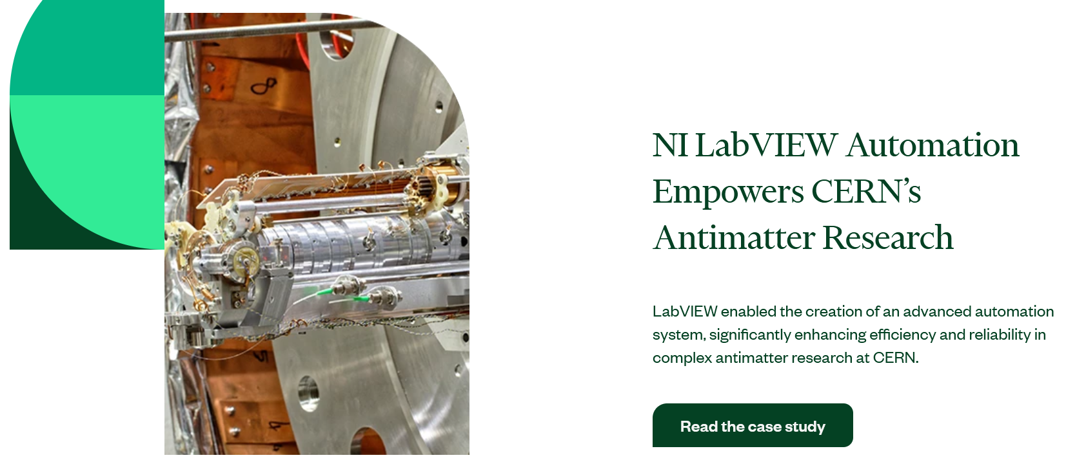
NI Case study for academic and research solutions

Slide 23
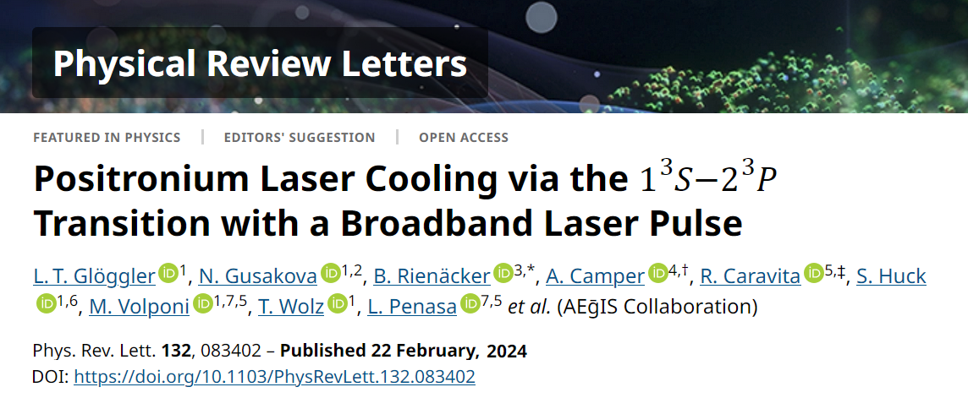


Important physics results
APS and CERN Press Release
In the top 5% of all research outputs scored by Altmetric
Huge media impact (social, TV, journals, …)

Slide 24
The most important metric
 | Version 3.0 |  | Version 4.0
 | VIs | Wires length | VIs | Wires length
TALOS | 939 | 1.51 km | 529 | 920 m
AEgIS CIRCUS | 801 | 1.48 km | 1396 | 2.97 km
Total | 1740 | 2.99 km | 1925 | 3.89 km
Using a corrected version of Piotr Demski’s Wirelength Calculator and a 24” full HD screen.

Slide 25
Conclusions
TALOS is “finished” (as much as such a piece of code can be finished…)
Automation is opening new physics doors
  More to come!
Open source release
  CIRCUS: 10.5281/zenodo.10371799
  TALOS: 10.5281/zenodo.10371404
Deployment in other experiments (PSICO, Univ. Of Trento)

Slide 26







Thank you!
Disclaimer: no animals have been mistreated for the creation of this project.
Just some scientists.

Slide 27
Backup slides

Slide 28
Aegis System Size
 | PCs | uServices instances | uServices coded
Current | 6 | 130 | 49
Forecast end 2025 | 9 | ~210 | ~58
‘They grow so fast!’

Slide 29
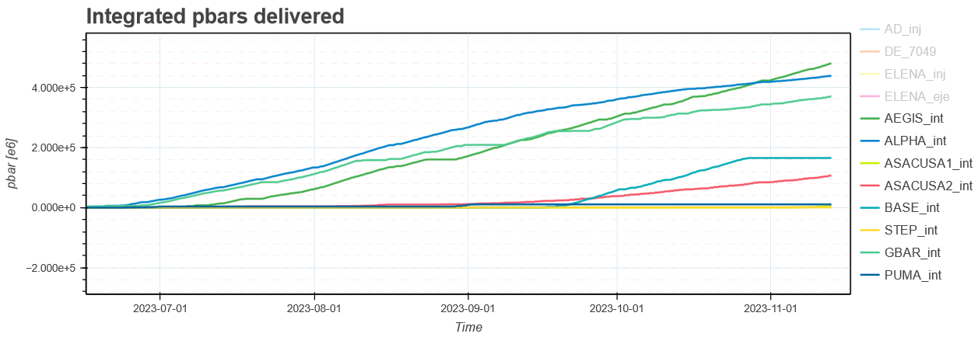
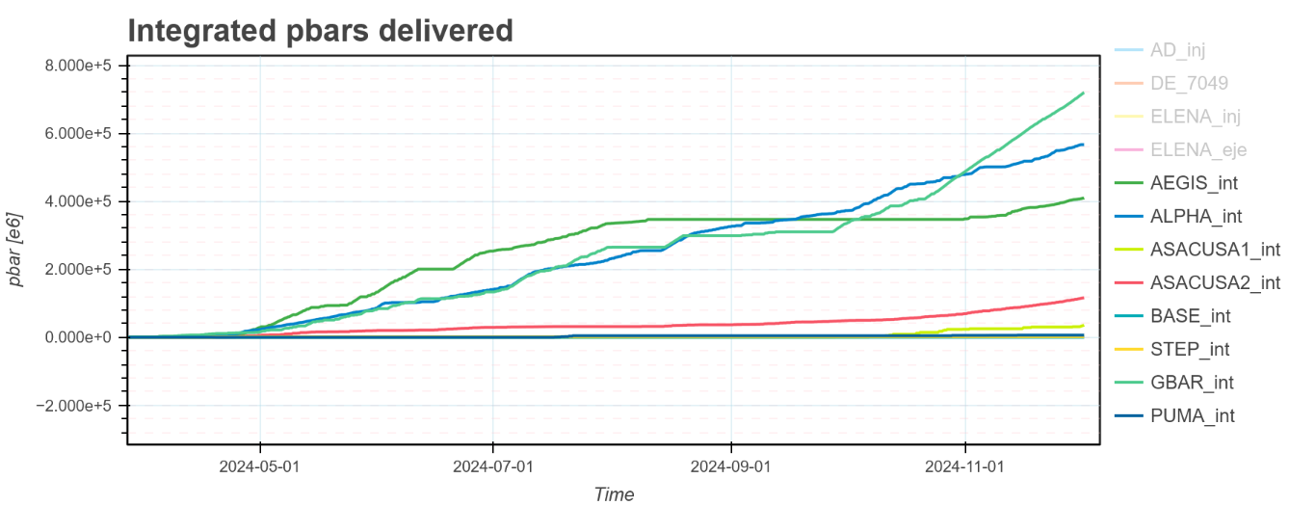
Consistent performance

Slide 30
Why autonomous?
ELENA works 24/7 😱
More beamtime
Unmanned system
Less shifters workload
More time for data analyses & physics 🚀

Slide 31
A Boat with two captains
TALOS does overall coordination, but it’s “slow” (~ms)
Sinara is used to control the fast operations (~ns)
High integration:
  TALOS controls Sinara, so no humans need to feed it experiments scripts
  Sinara can ask TALOS to perform operations on hardware
  In case of any error, TALOS guarantees their handling
The helm is periodically switched between the two!

Slide 32
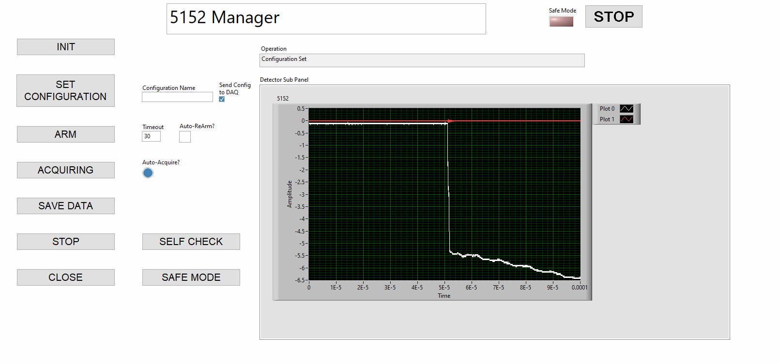
Single uService testing

Slide 33
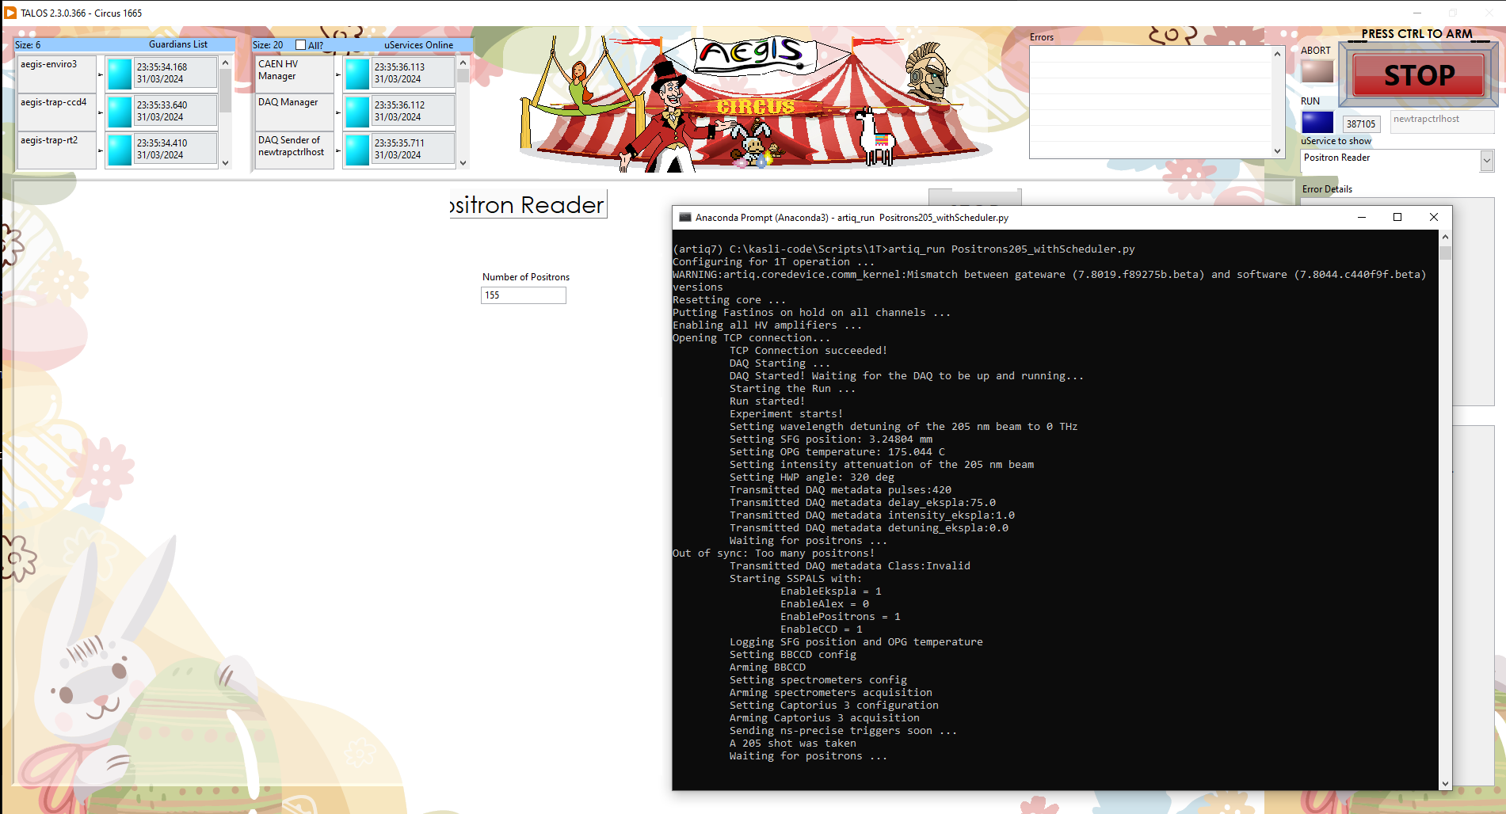
Running in Hybrid (Debug) mode
Picture of TALOS with an anaconda shell opened with a script running?

Slide 34
Running in autonomous mode: operations
Via the Scheduler, a list of scripts to be executed can be prepared (each with different parameters)
Then the Monkey takes over and executes the scripts one by one
In case an error is generated by a µService or the Kasli, the Monkey can:
  Continue
  Retry – run again the same script
  Skip – go to the next script in the schedule
  Stop – stop the execution of the scripts and idle
  Abort – stop the execution and put the entire system in Safe Mode

Slide 35
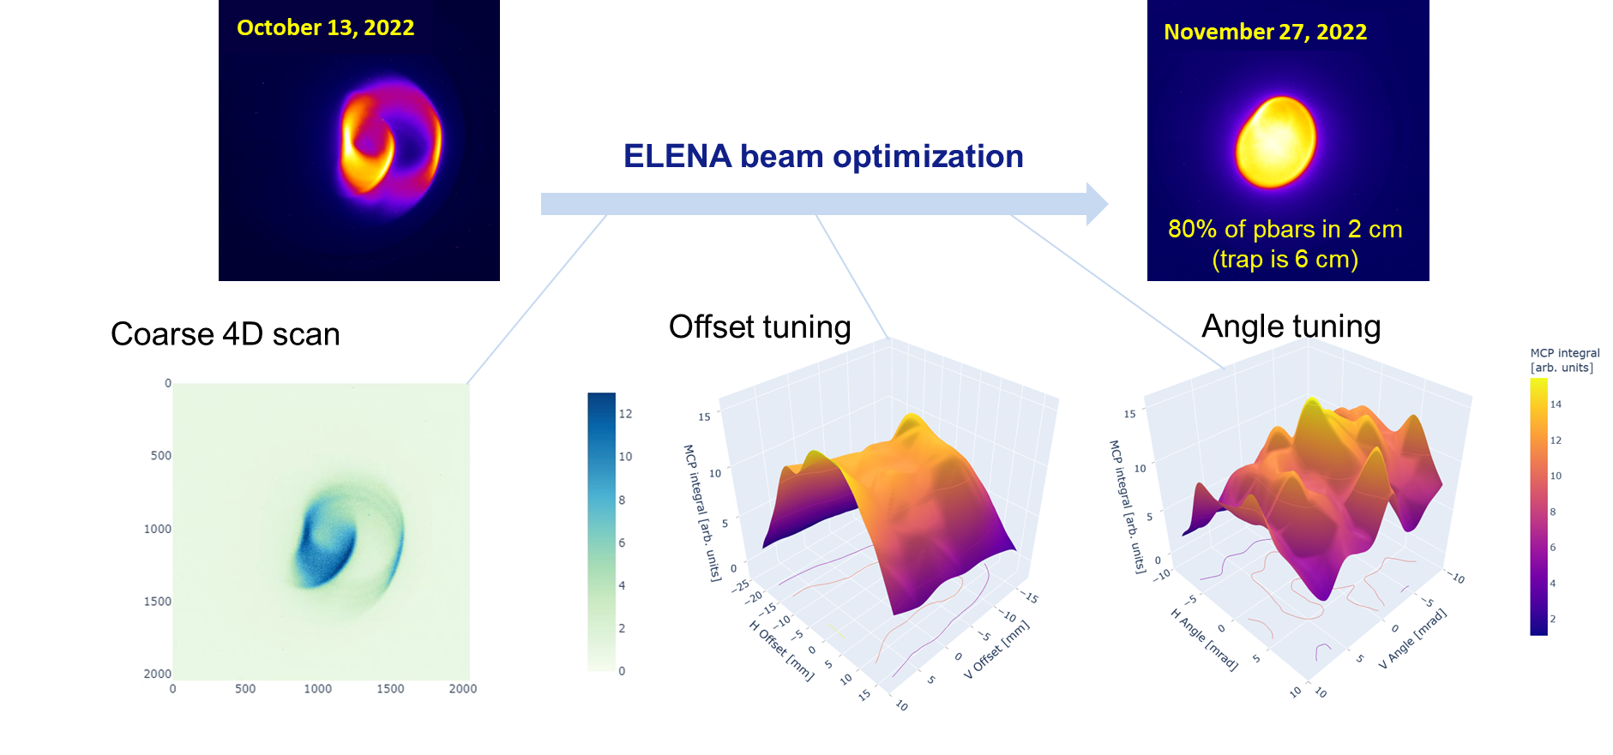
ELENA automated beam Steering

Slide 36
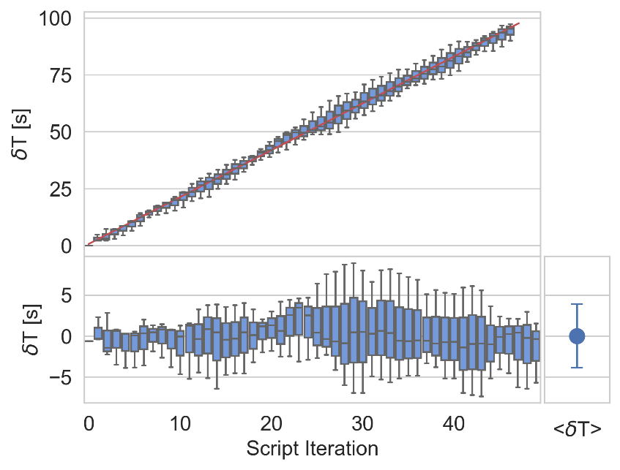
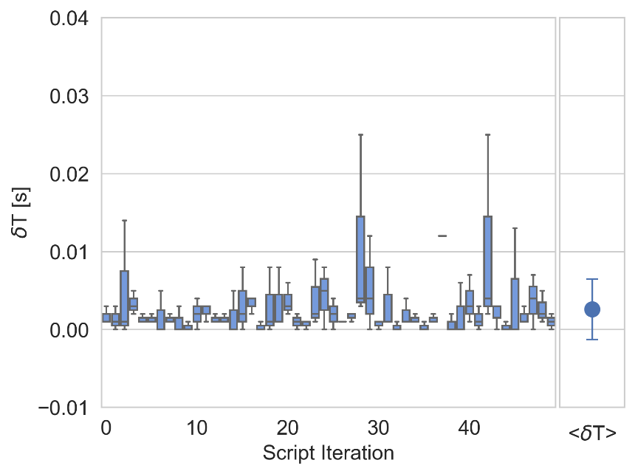
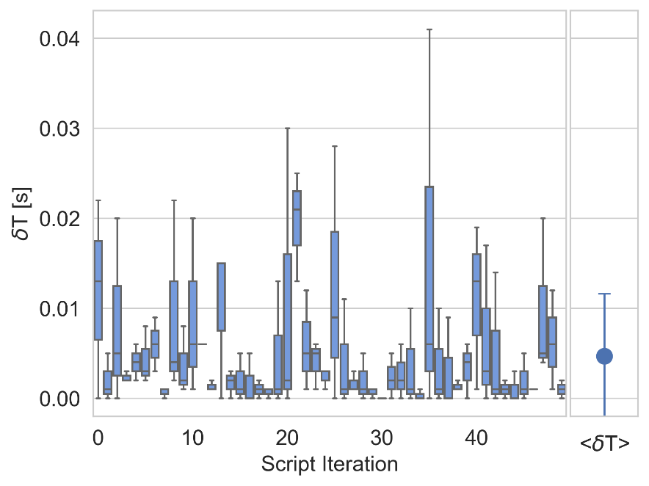
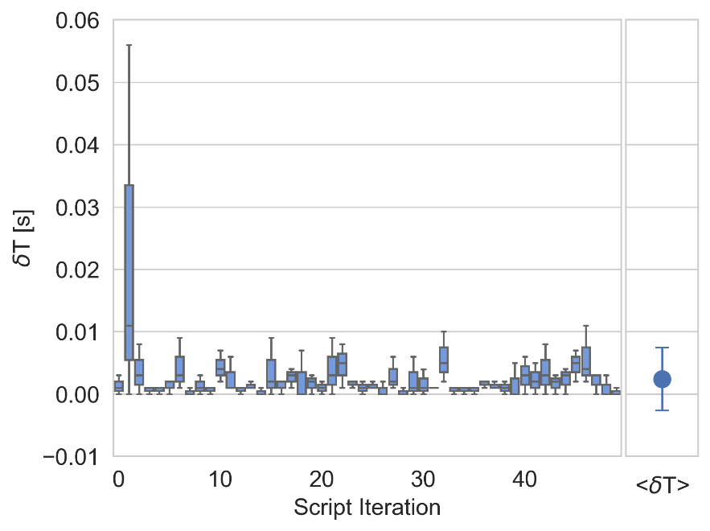
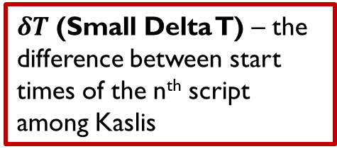
Performance tests
Different duration - async
Different duration - sync
Same duration - async
Same duration - sync
$δT$ (Small Delta T) – the difference between start times of the n^{th} script among Kaslis
36

Slide 37
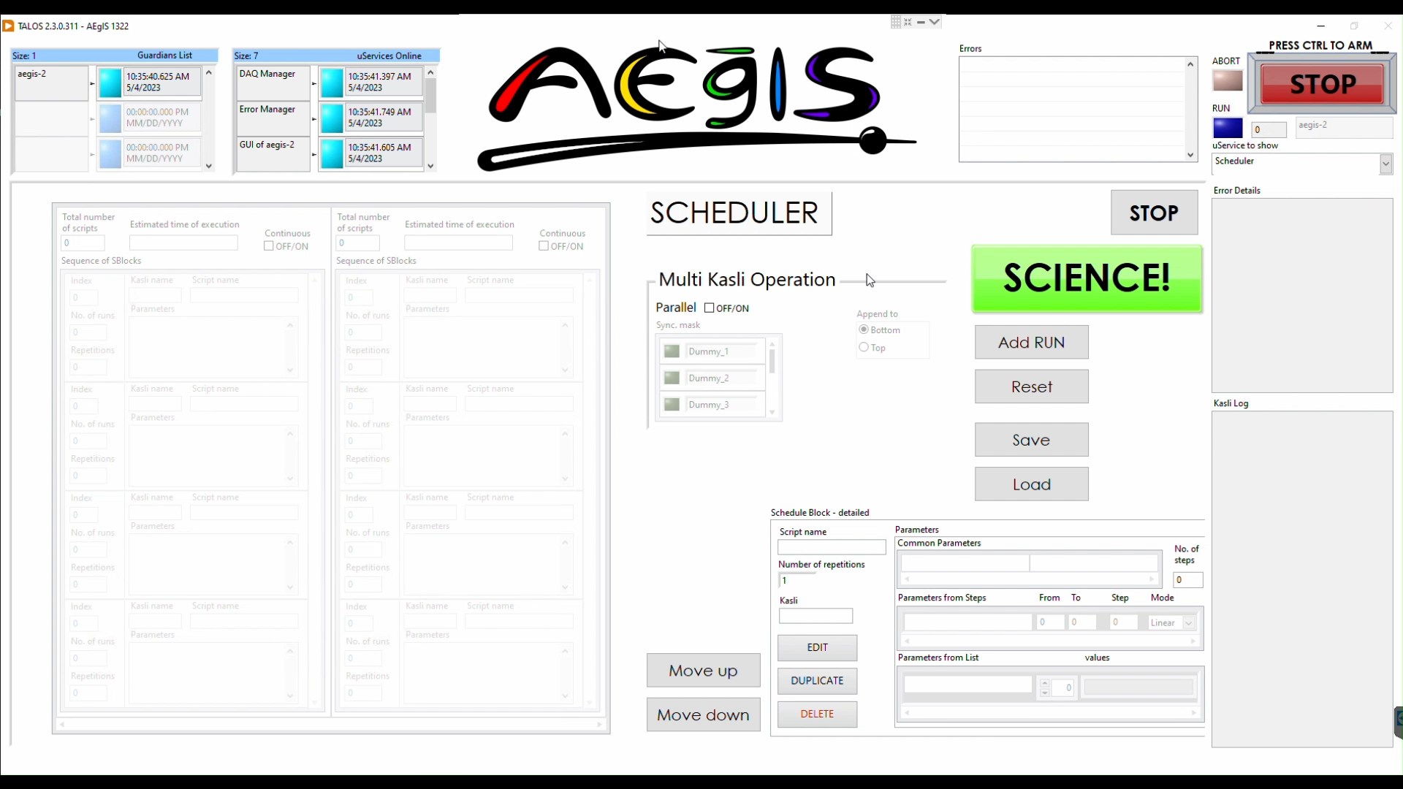

Add sblock - demo
Notes:
Add sblock - demo

Slide 38
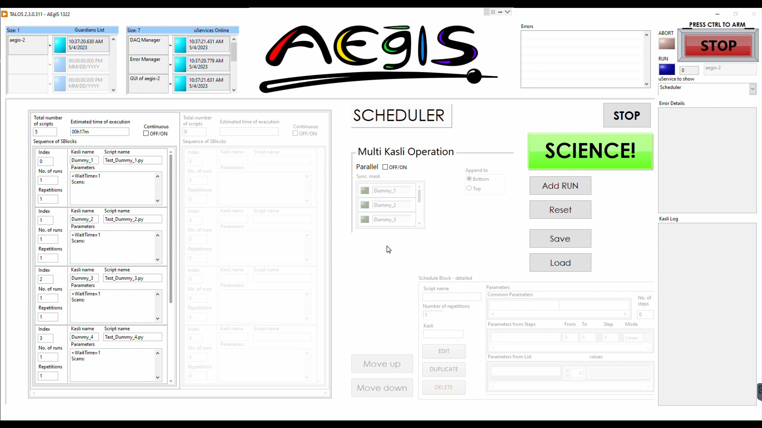
Standard operation – demo
Notes:
Standard operation - demo

Slide 39
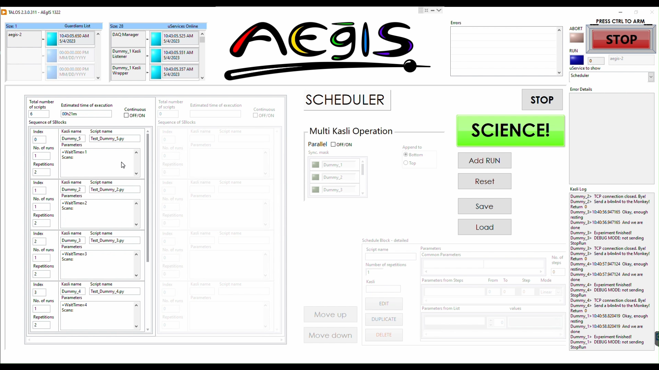
Parallel mode – demo
Notes:
Parallel mode - demo

Slide 40
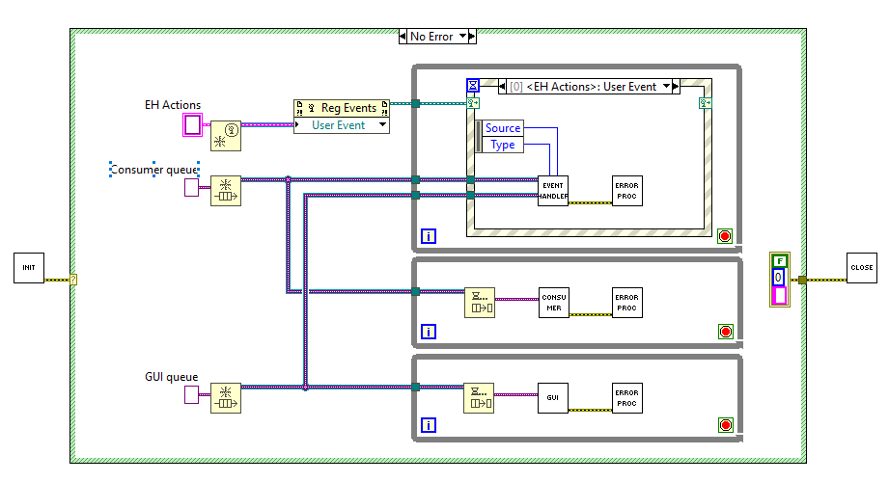
uService = QMH

Slide 41
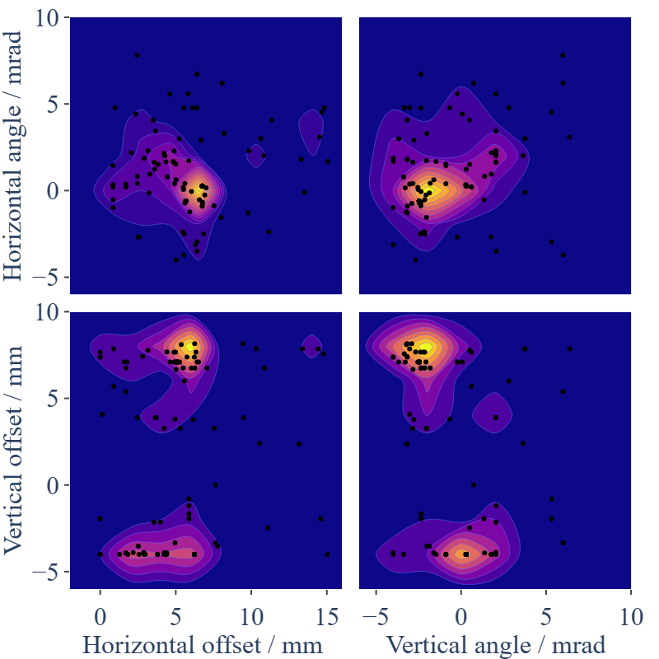
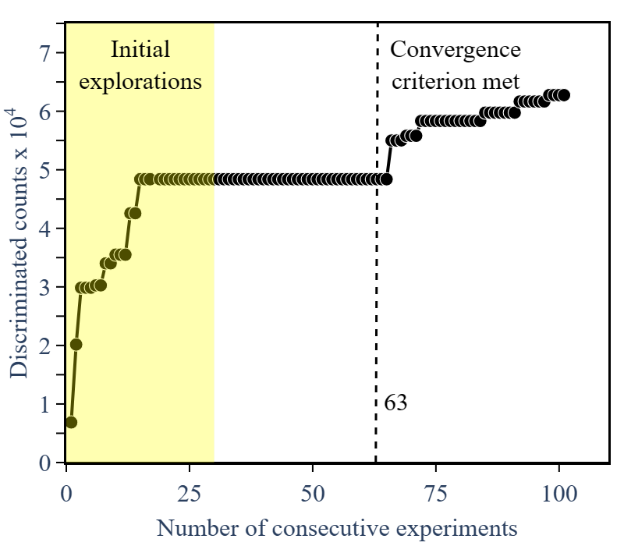
ELENA automated beam Steering

Slide 42
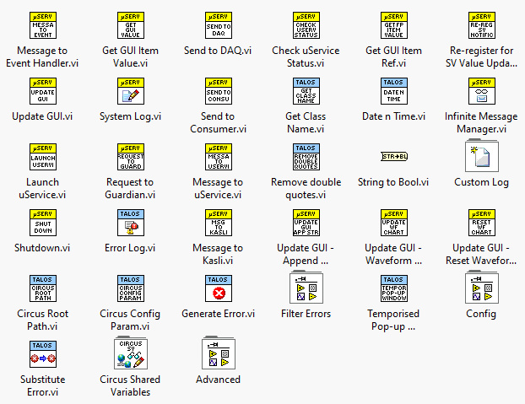
... With dedicated palette!

Slide 43
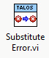
Criticality code
Each error is substituted with a custom defined error with associated criticality code:
0: Continue
1: Retry
2: Skip
3: Stop
4: ABORT

Slide 44

SOLUTION – Introducing the tamer
Scheduler
Tamer
HW
Standard operation
Monkey
Kasli 1 Wrapper
Kasli 1
Kasli 2 Wrapper
Kasli 2
NOTE: only ONE Kasli at a time is operated!
Kasli 3 Wrapper
Kasli 3
Dynamically spawned as schedule requires

Slide 45
SOLUTION – Introducing the tamer
Scheduler
Tamer
HW
Parallel operation
Monkey Kasli 1
Kasli 1 Wrapper
Kasli 1
Monkey Kasli 2
Kasli 2 Wrapper
Kasli 2
Monkey Kasli 3
Kasli 3 Wrapper
Kasli 3
Dynamically spawned as schedule requires

Slide 46
operation
Scheduler
Tamer
Monkey
Monkey
Prepare schedule(s)
Init Run
(Spawn Monkeys, Check Guardians,
Check uServices)
Failed
Passed

Slide 47
operation
Standard operation
Tamer
Monkey
Monkey Kasli 2
Send schedule
Check script
Script execution
Submit script
Kasli 1
Banana arrived
Kasli
Kasli
Finish script
Update
Report to Tamer

Slide 48
operation
Parallel operation - asynchronous
Tamer
Monkey Kasli 1
Monkey Kasli 2
Send schedules
Check script
Check script
Script execution
Submit script
Submit script
Kasli 1
Banana arrived
Kasli
Kasli
Finish script
Finish script
Update
Report to Tamer
Report to Tamer

Slide 49
operation
Parallel operation - synchronous
Tamer
Monkey Kasli 1
Monkey Kasli 2
Send schedule
Check script
Check script
Collect checks
Script execution
Submit script
Submit script
Kasli 1
Banana arrived
Kasli
Kasli
Collect bananas
Finish script
Finish script
Update
Report to Tamer
Report to Tamer

Slide 50
Double TCP Tunnel
Communication via shell breaks realtime operation
Solution: two monodirectional TCP tunnels between Kasli and TALOS
  No realtime breaking
  Faster than shell processing for TALOS (~ ms), immediate* for Kasli
  Being each tunnel monodirectional, no message delay
  Kasli can reach all uServices, with no wire drawn!
(*) The communication takes place between TALOS and the Kasli Host, so if Kasli schedules it well it literally takes no time

Slide 51
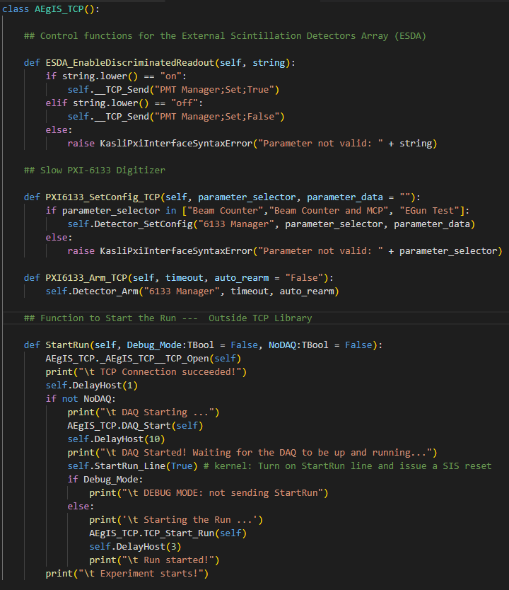
TCP Library
All communication functions are immediately available by importing this library
Each function triggers a specific action from a specific uService
The entire bridge is created by simply encasing the experiment code inside two function, StartRun() and StopRun()

Slide 52
What about the daq?
Operation mode | DAQ operator
Standard | Monkey (in the script, as before)
Parallel (Asynchronous) | Only dedicated ports supported (no run-specific DAQ)
Parallel (Synchronous) | Tamer (starts when the script checker is passed, stops when all bananas arrive)

Slide 53
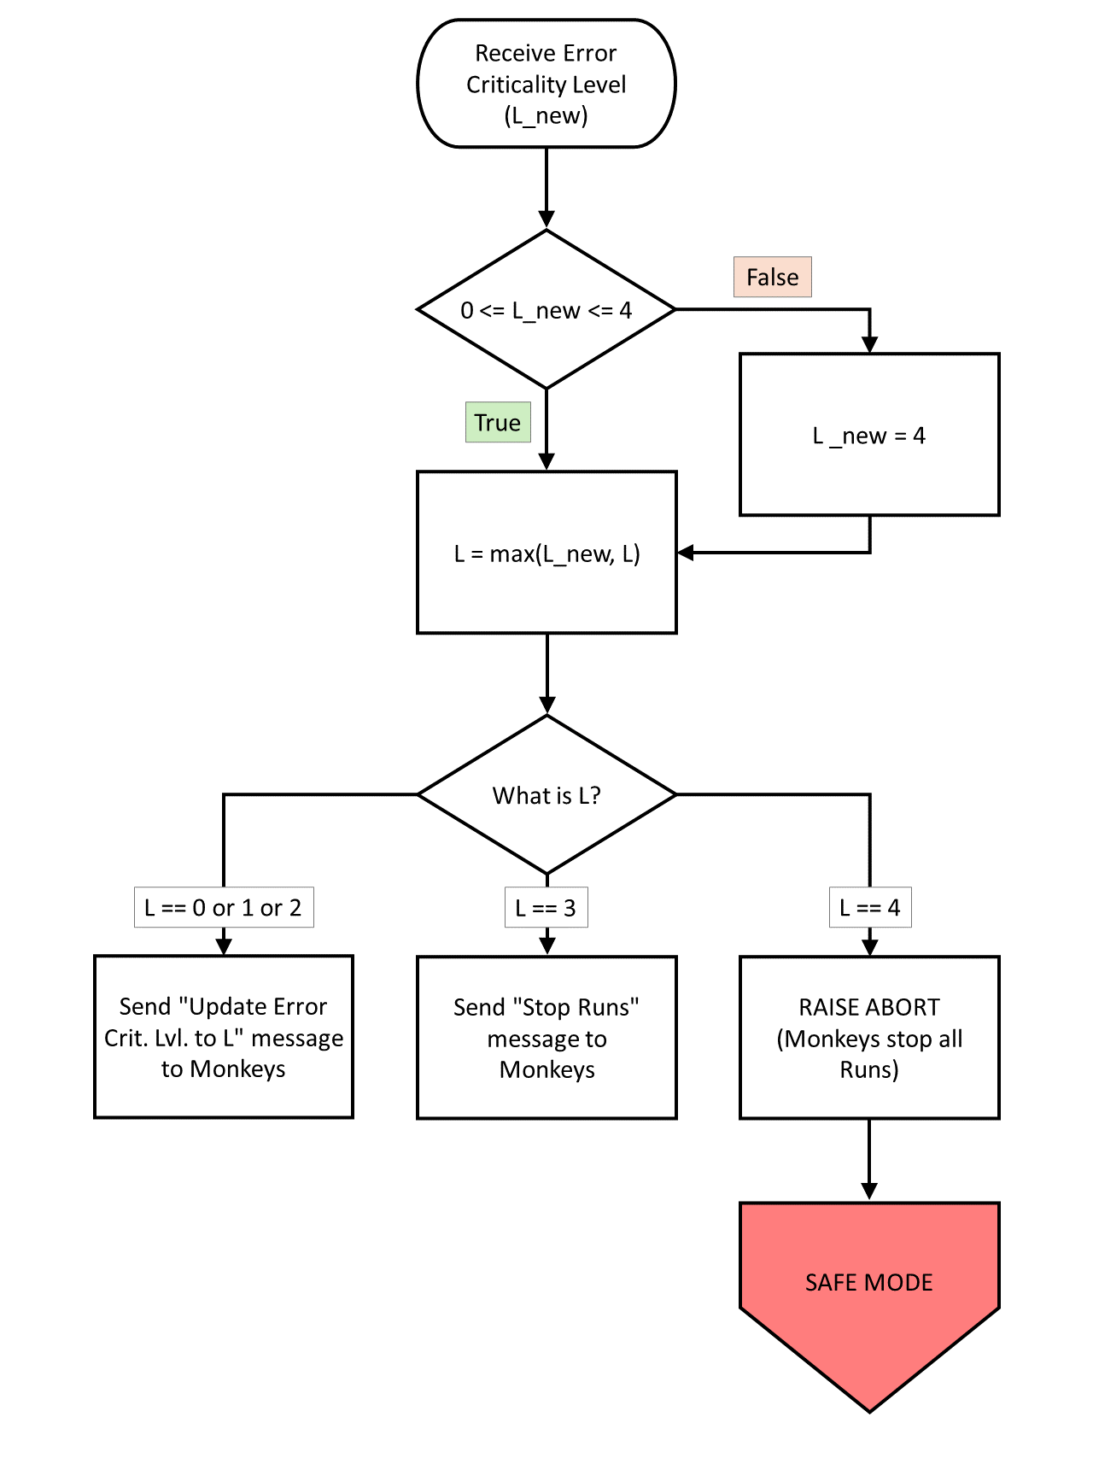
Tamer Flowchart

Slide 54
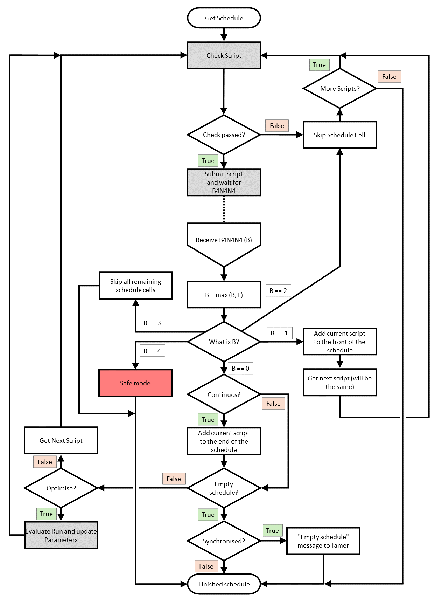
Monkey Flowchart

Slide 55

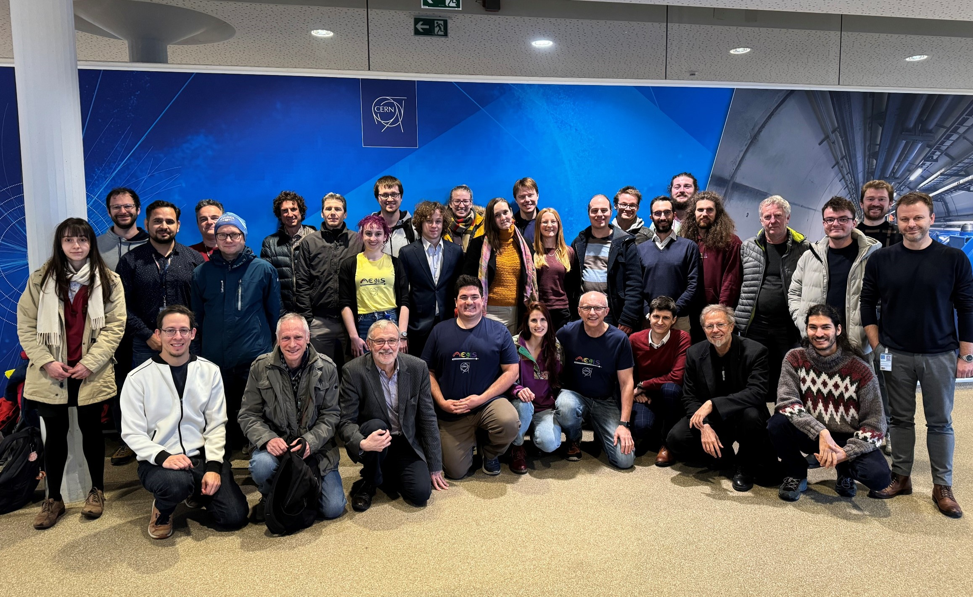
AEgIS Collaboration

