Slide 1

ATOM plateform kick off
Optimisation and standardisation of work processes
Camille Sortambosc – Project Leader

Slide 2



INTRODUCTION
Definition
Applicative Tool for Operationnal Management
Objectives
Vision
Provide a common platform that unifies the processes of the group.
Customisable and upgradable tool, useful for individuals, for the group and for the organisation
ATOM
ATOM

Slide 3
LONG-TERM VISION
Standardisation & Uniformisation
Automation & Time Saver
ATOM PLATEFORM
Improved maintenance
Collaboration & Communication
Performance monitoring & Evolution
Strategic pillar for the future
ATOM

Slide 4


STRUCTURE & USERS
ATOM
Management
Project Contributors
Everybody
Department Head (DH)
Group Leaders (GL)
Section Leaders (SL)
Project managers SAM/PPM
Managers IRP
Consultants BE
ATOM Portal
Atom TV
ATOM ELEC
ATOM HVAC
ATOM SURFACE CE
Vision
Operational part
Technicians
Contract Managers
Team Referee
Contractors
ATOM DESIGN OFFICE
ATOM
ATOM

Slide 5



IMPLEMENTATION
01
02
Governance & Collaboration
01
02
Development & Validation
Collaboration
Workshops
Test phases
EN/PPM/SMS
10
1
Bi-monthly reviews
3
04
03
Continous improvement and development
04
03
Training & Support
Adaptability
Evolution
10
Trainings
Feedbacks
Weekly
6
ATOM
Notes:
QUI GOURNERNE, QUI EXECUTE, QUI INTERVIENT POUR DES STADES D’EVÔLUTION ET POUR LES ETAPES DE DEVELOPPEMENT
l’imnplementation s’articule surtout entre la partie gouvernance decisionnelle, et la partie exécution. Tout ce on arrive a la mettre en œuvre grâce au dispatch suivant :

Slide 6

PROJECT MANAGEMENT : ATOM STEERING COMMITEE (ASC)
Project Leader
ATOM Support
Standards
Camille Sortambosc
Antoine Didier Degenève
DH SCE
Samuel Adam (CE)
Paul Gendron (Elec)
Grégoire Guillot (Hvac)
Ludovic Barthélémy (Calculs/Dessins)
Mar Capeans Garrido
ATOM CE
Alejandro Martinez Selles
GL SCE-SAM
Pierre Cardon
ATOM Elec
SL SCE-SAM-CE
Project Leader
Camille Sortambosc
Contributors
STEER
ING
COMMI
TEE
Antoine Didier Degenève
Alejandro Martinez Selles
Admin Hub
PPM
SMS
TR SCE-SAM-TG
ATOM HVAC
Ludovic Barthélémy
Grégoire Guillot
TR SCE-SAM-IN
Grégoire Guillot
ATOM Design Office
Ludovic Barthélémy
ATOM Support
Antoine Didier Degenève
ATOM Portal
Camille SORTAMBOSC
ATOM

Slide 7
COST OVERVIEW 2024/2025
  CONCEPTION
IT EQUIPMENT
Technical standards: external architect mandates 30KCHF in 2024 and 60 KCHF expected in 2025
Potential future trainee: CHF 10K
Long-term maintenance: to be estimated
STAFF 0.5 FTE/year GRAD 0.7 FTE/year
Screen/TV: CHF 1,000
PC + Mouse + Keyboard : 800 CHF
~100K CHF +
1.2 FTE
~2000K
CHF
ATOM
Notes:
On a privilegie un développement onterne pour contenir les coups, on a simplemment eu recours a un consultant externe pour la concetion des standards techniques , pour le maintîent dans la continuité, on est sur UN COUT EXTREMEMENT LIMITé AUX SIMPLES ACHATS DE MATERIEL DE BUREAU

Slide 8
ATOM CONTENT MANAGEMENT
2025
2026
2027
ATOM Portal 15% 5% 5%
Camille Sortambosc
ATOM ELEC 15% 5% 5%
SAM-IN
ATOM CE 20% 5% 5%
SAM-CE
ATOM HVAC 30% 5% 5%
SAM-IN
ATOM Design Office 30% 5% 5%
SAM-TG & SAM-IN
Standards Genie Civil 20% 5% 5%
SAM-CE & SAM-TG
Standards Elec 15 % 5% 5%
SAM-IN Elec
Standards HVAC 20% 5% 5%
SAM-IN HVAC
Standards Architecturaux 20% 5% 5%
Araceli Alvarez Escobar
Standards Calculs/Dessins 30% 5% 5%
SAM-CE & SAM-TG
ATOM
Notes:
FTE
séparer la technique et l’apport d’information
contenu users
PETIT EFFORT AU DEBUT ET APRES CA VA SE FAIRE TOUT SEUL

Slide 9
DEVELOPMENT
IMPLEMENTATION
SITUATION AT THE END OF 2024
ATOM Elec
95%
15%
ATOM Design Office
In use for more than 1 year
ATOM
60%
Setting up tickets in progress for SAM-TG
Automation and BIM integration
100%
0%
80%
75%
ATOM CE
ATOM Portal
Training for contractors/contracts in progress
Definition of standards in progress
Implementation of standards/procedures
40%
40%
45%
80%
80%
ATOM HVAC
ATOM TV
Pending contract renewal
Definition of standards in progress
0%
100%
50%
Setting the display
ATOM HOME
Help via videos
A few figures
ATOM
Notes:
DONE / ONGOING

Slide 10
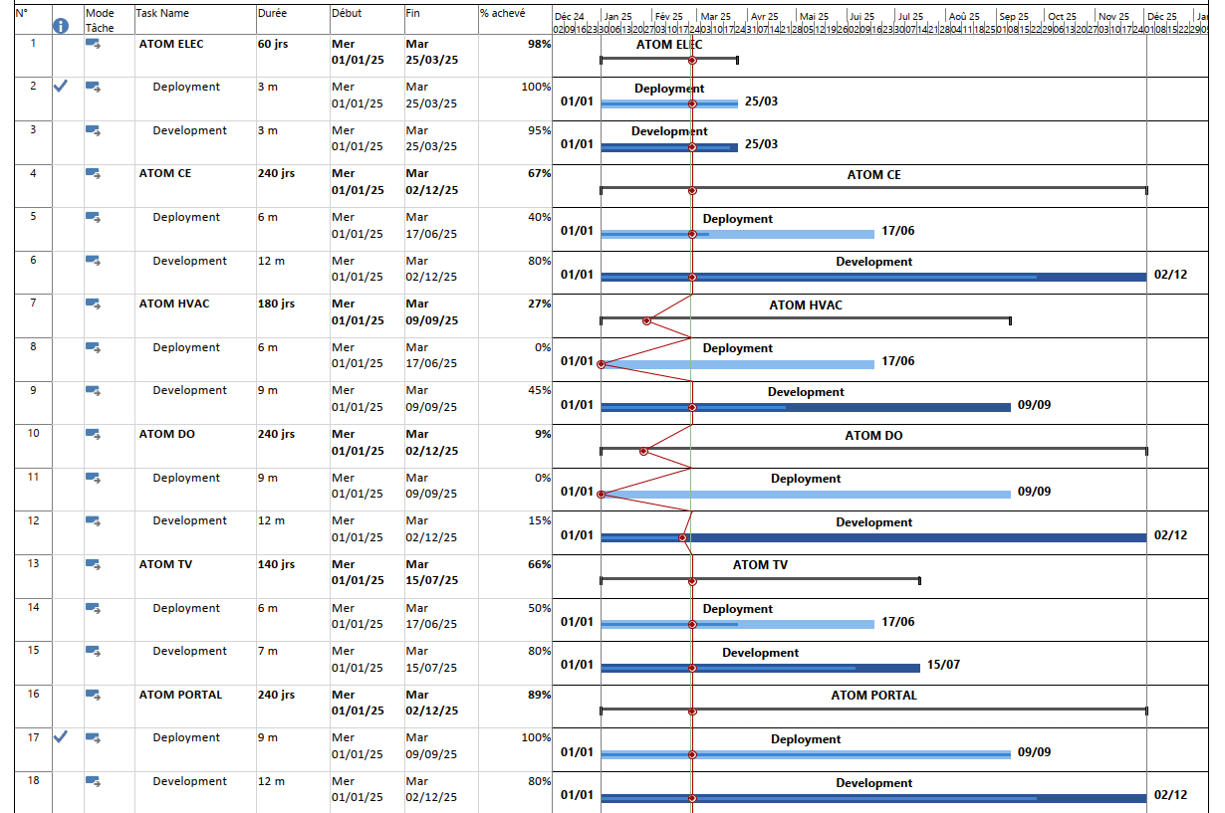
DEVELOPPEMENT
IMPLEMENTATION
PLANNING 2025
ASC #1
ASC #2
ASC #3
ASC #4
Communication : Séminaire technique SCE
Restructure of SAM-IN team Q1 2025
+ Priorities IT Frame Contract
ATOM
Notes:
BANDE PLENARY PLANNING

Slide 11

ATOM – ON LINE DEMO
ATOM

Slide 12


CHALLENGES AND DECISIONS
What functionality is not already established in to the process? SAM FS/ ATOM Underground
ATOM Technical Seminar / June- Format → Videos – feedback
ATOM TV - What are the limits in terms of confidentiality?
- IRPs Info – To validate
            - Photos of current projects
            - Dashboard summary of ongoing maintenance
ATOM TV - Where is the main screen located? → Visible location: 2nd floor next to the water cooler
ATOM

Slide 13
Thank you for your attention!
Optimisation and standardisation of work processes
Camille Sortambosc – Project Leader

