Slide 1





Muon Collider News
D. Schulte
On behalf of the International Muon Collider Collaboration
MuCol Governing Board, March 2025
Funded by the European Union (EU). Views and opinions expressed are however those of the author(s) only and do not necessarily reflect those of the EU or European Research Executive Agency (REA). Neither the EU nor the REA can be held responsible for them.

Slide 2
News
Today we focus on the EU reporting, but a few news
Tania will replace Michela
We had a review by LDG
Provided submissions to ESPPU
  Still improve our long document and plans
We developed an R&D plan
MuCol and IMCC Annual meeting at DESY: https://indico.desy.de/event/45968/overview
IMCC is growing in the US, e.g.
  SLAC/Stanford will build RF test stand, funding for study of demonstrator at FNAL, detector efforts in the US get additional funding
  More interest in Europe and Japan
Are searching a new leader for the Publication and Speakers Committee

Slide 3
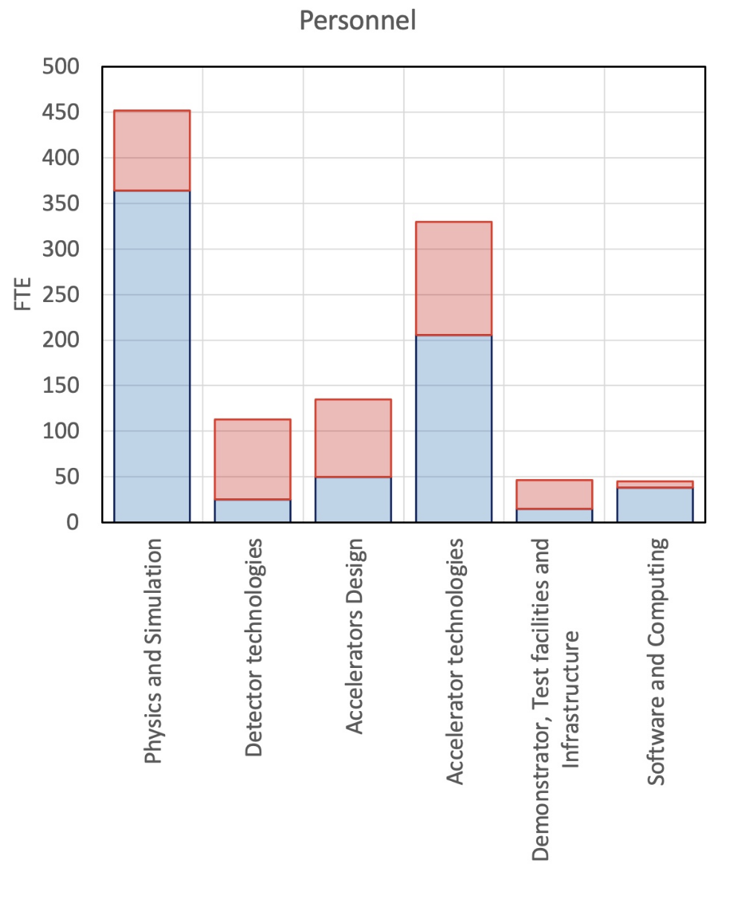
LDG Review
Presented
Progress of work
Proposed workplan
LDG appreciated our progress and the proposed R&D plan
Recommend review of R&D plan
However, LDG cannot do it on a short timescale
Will have our own review at Annual meeting
MuCol is an important part of the LDG Roadmap implementation (O(40%))

Slide 4
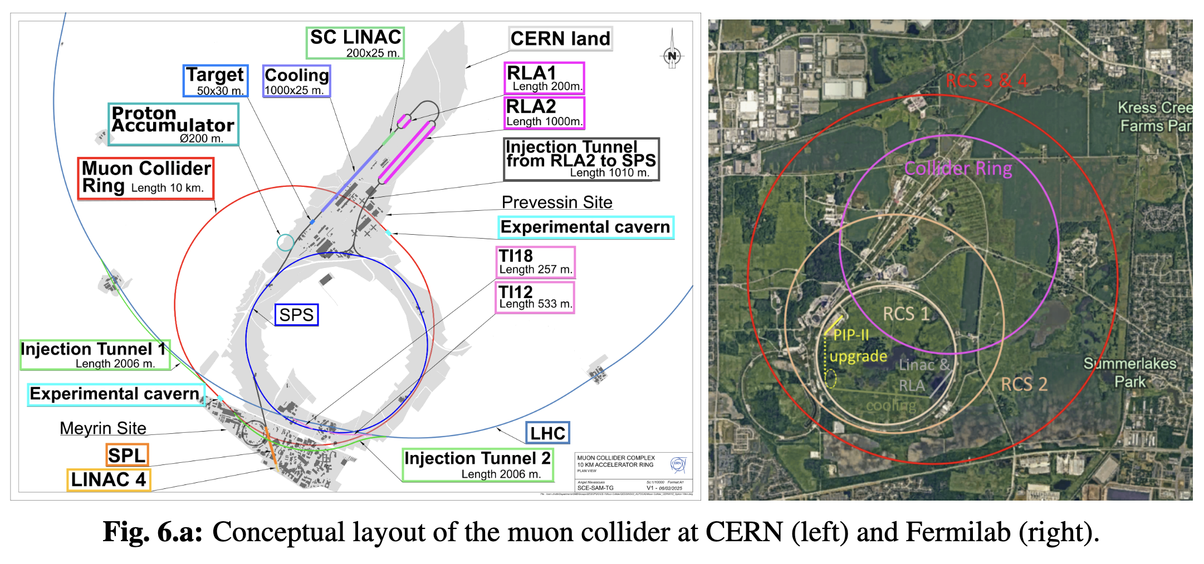
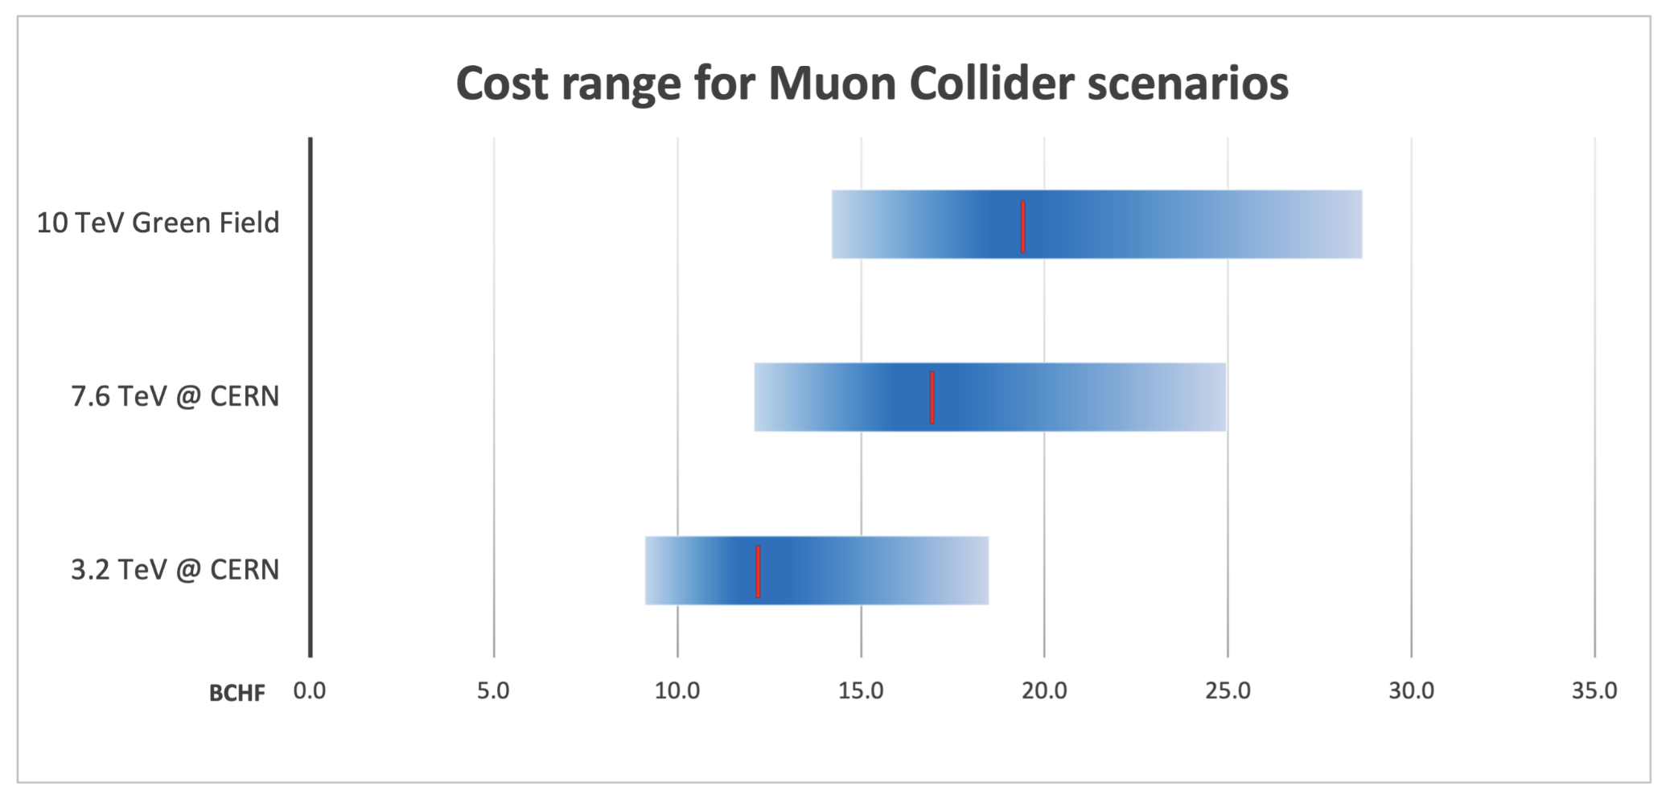
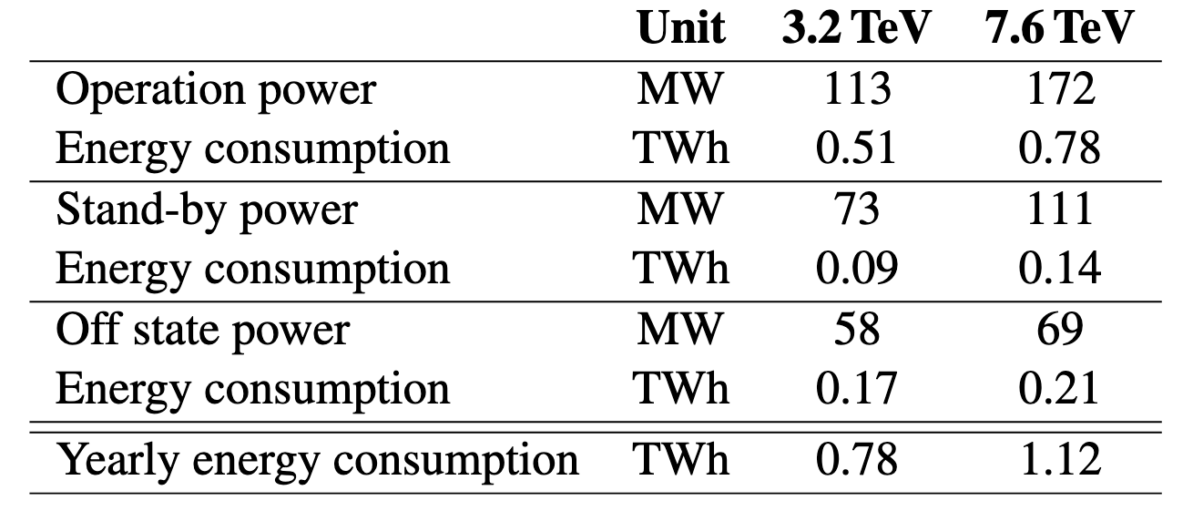
ESPPU Submission
Three documents prepared and submitted:
Ten page summary
Addendum to the summary to answer the questions of the ESPPU
Long document describing the muon collider O(400 pages)
Please find the documents here:
https://indico.cern.ch/event/1439855/contributions/6461618/

Slide 5
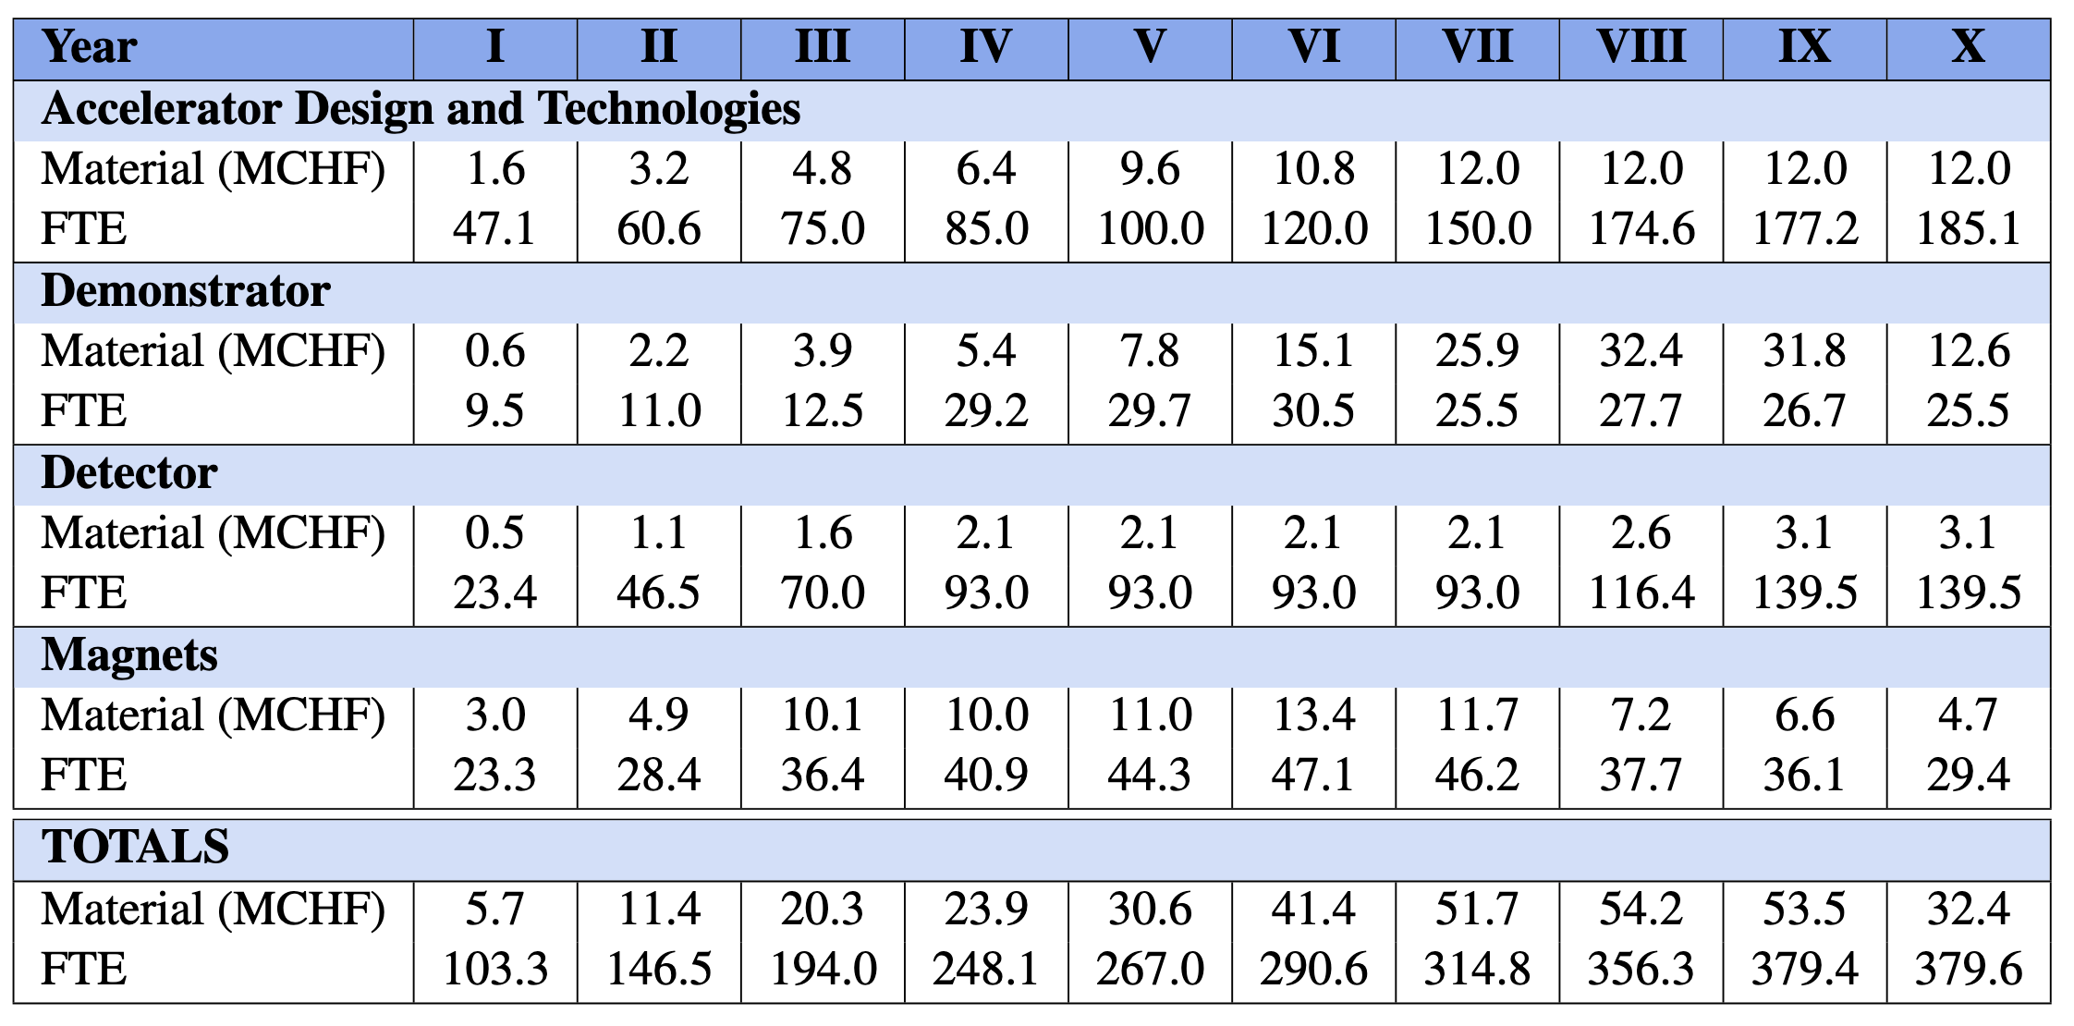
R&D Plan
Total volume
Material O(300 MCHF) for the machine, O(20 MCHF) for the detector
Personnel O(1800 FTEy) machine, O(900 FTEy) detector
Technically limited schedule: 10 years

Slide 6
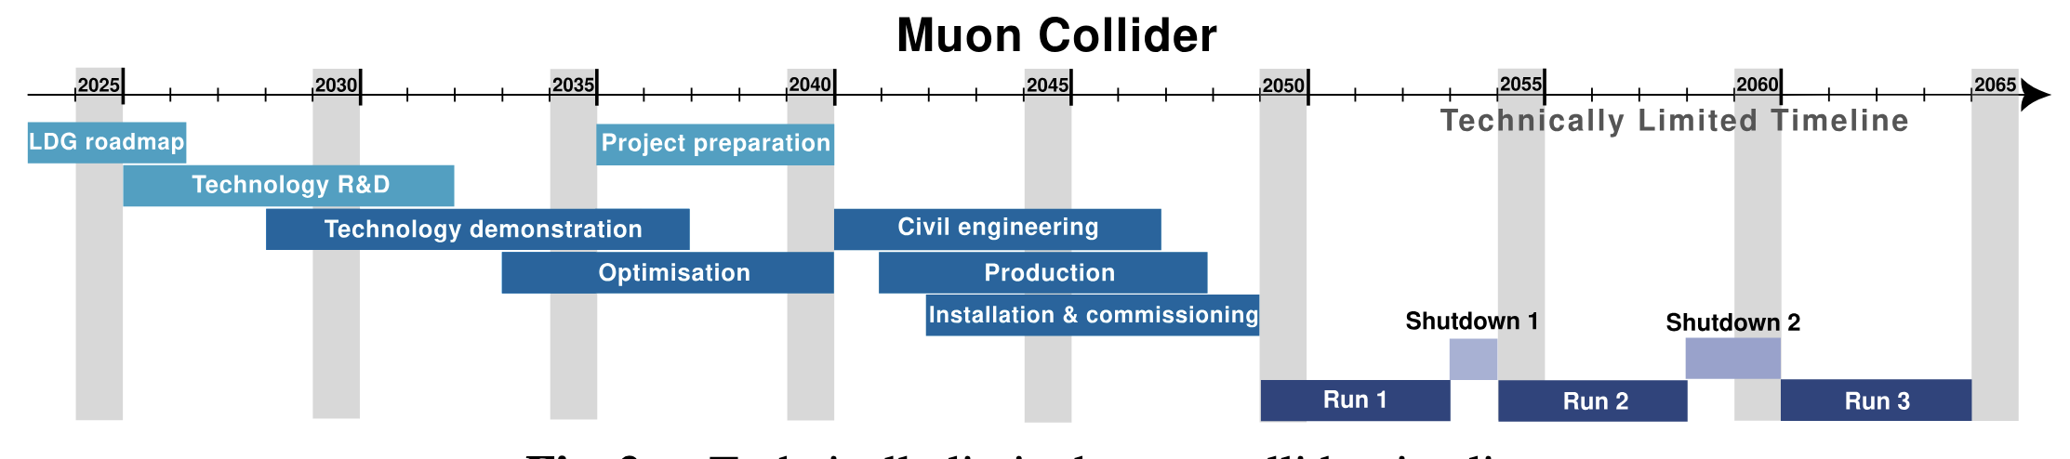
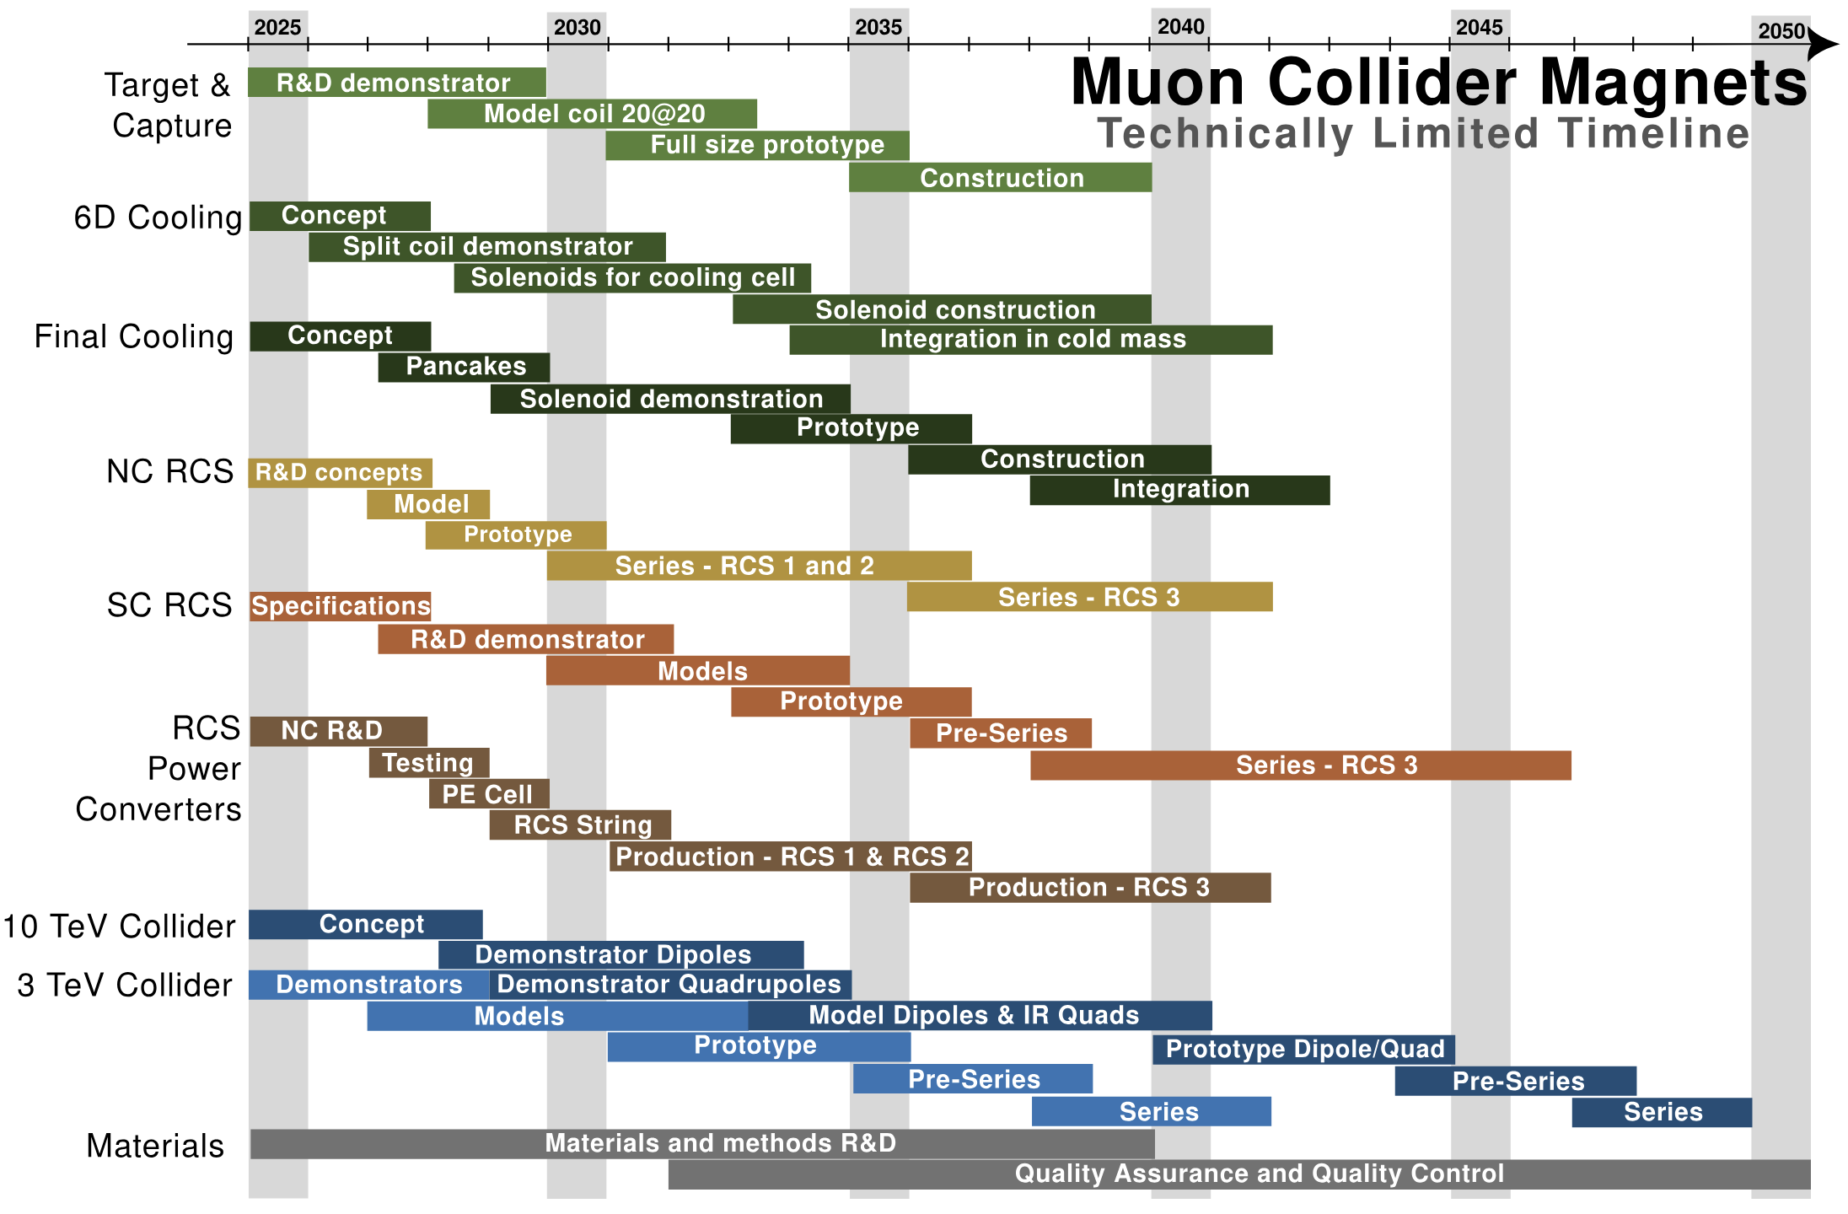
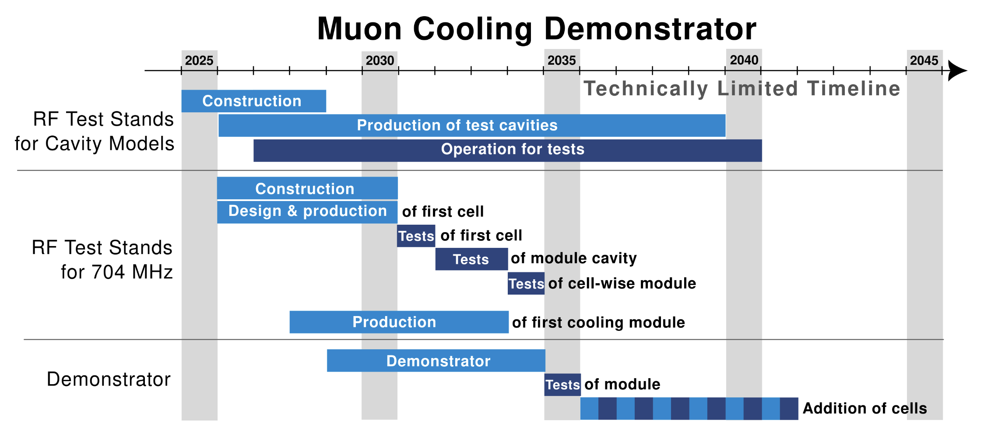
R&D Timelines

