Slide 1



Observation of string breaking on a (2+1)D Rydberg quantum simulator
T. V. Zache
University of Innsbruck & IQOQI Austrian Academy of Sciences
CERN workshop “Real-time and out-of-equilibrium dynamics in the quantum HEP era”
Geneva, 26th May 2025

Slide 2
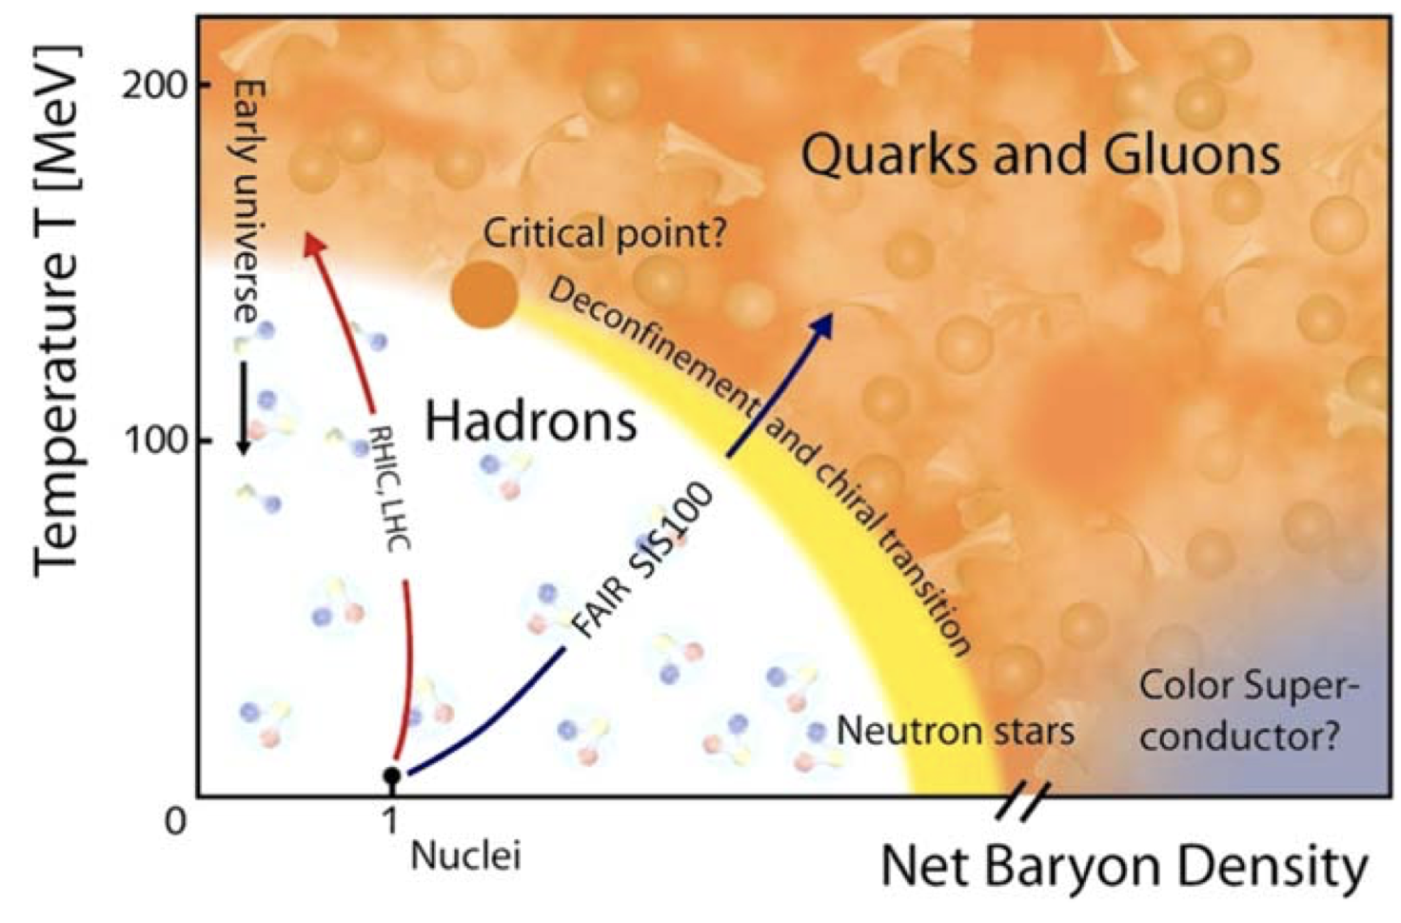
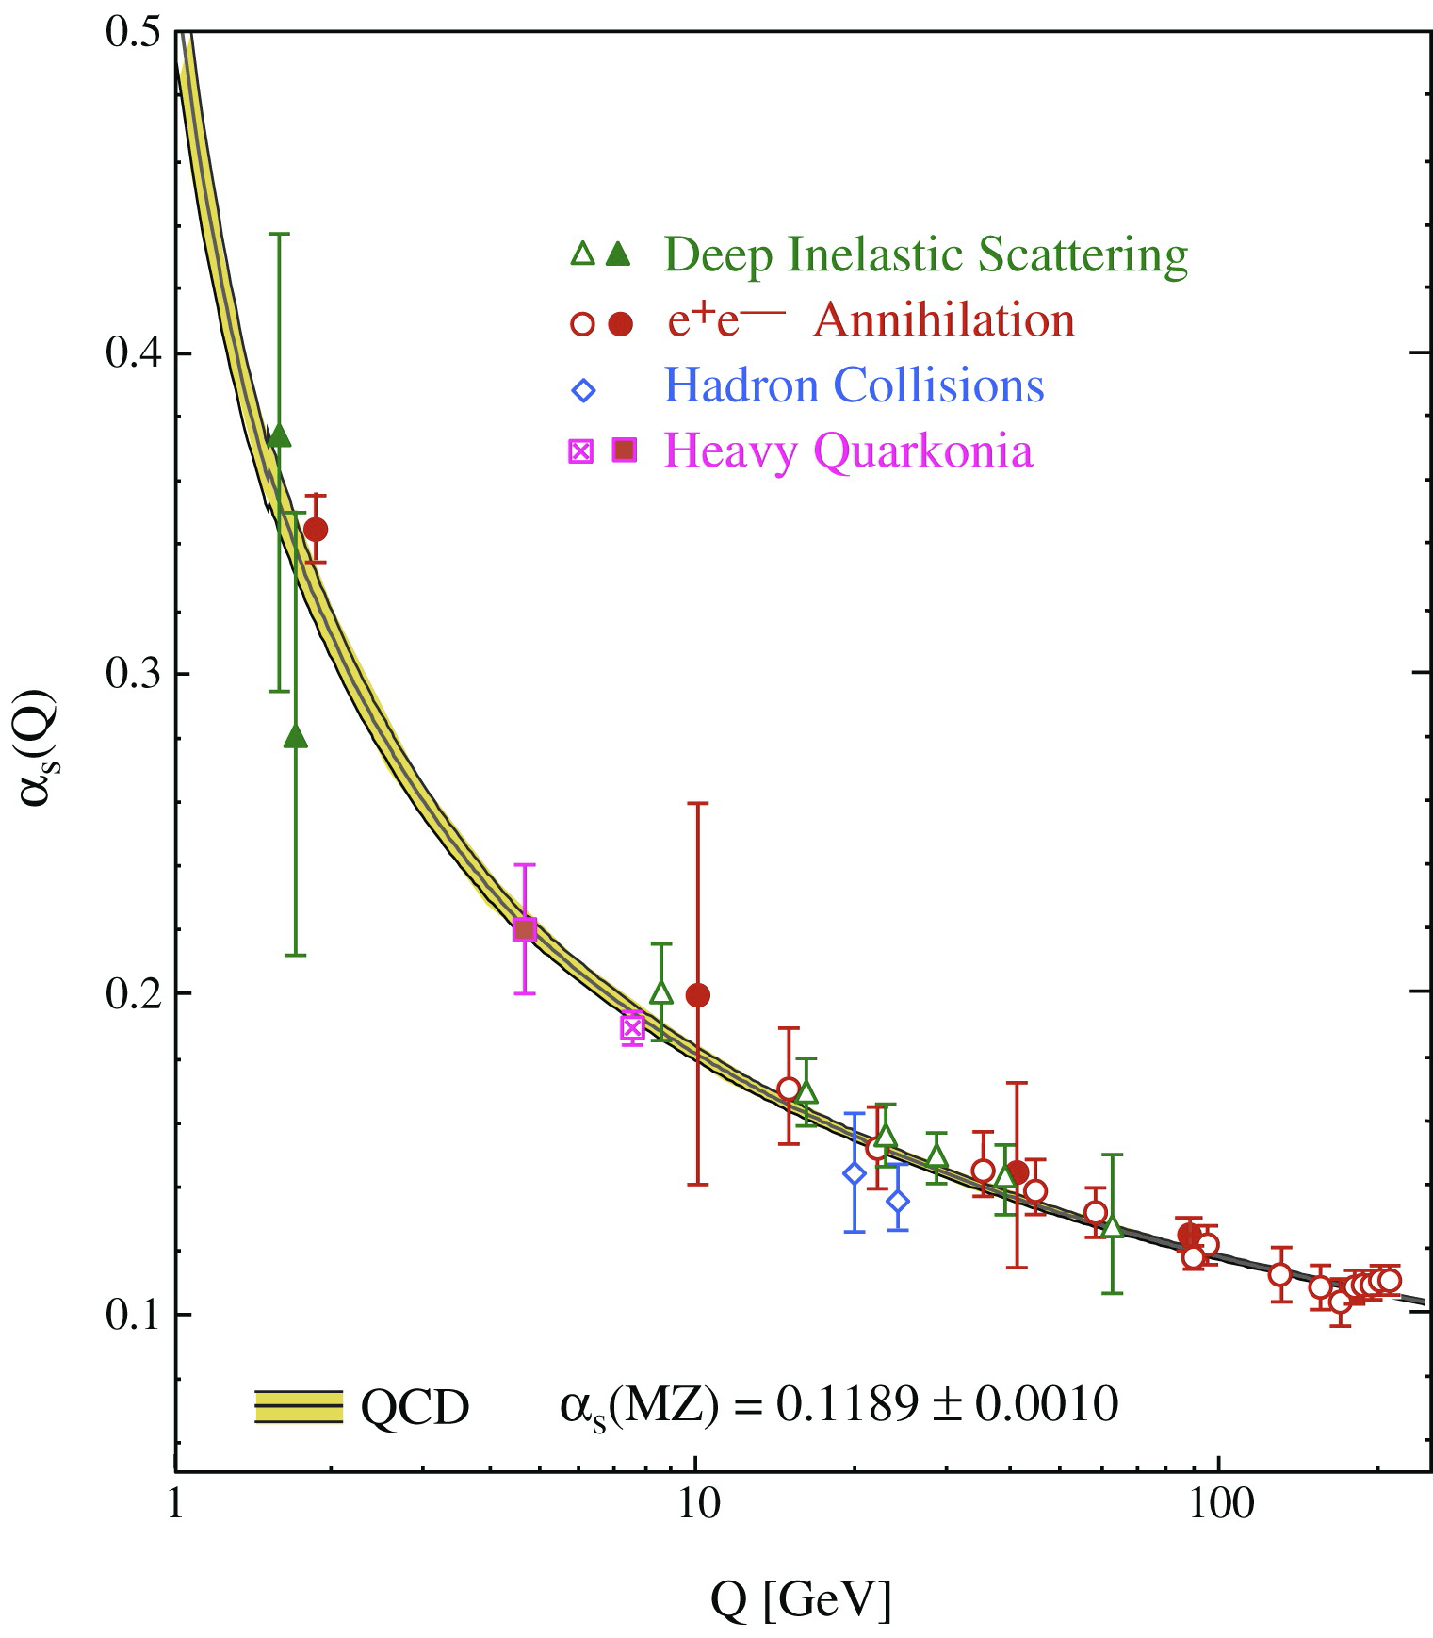
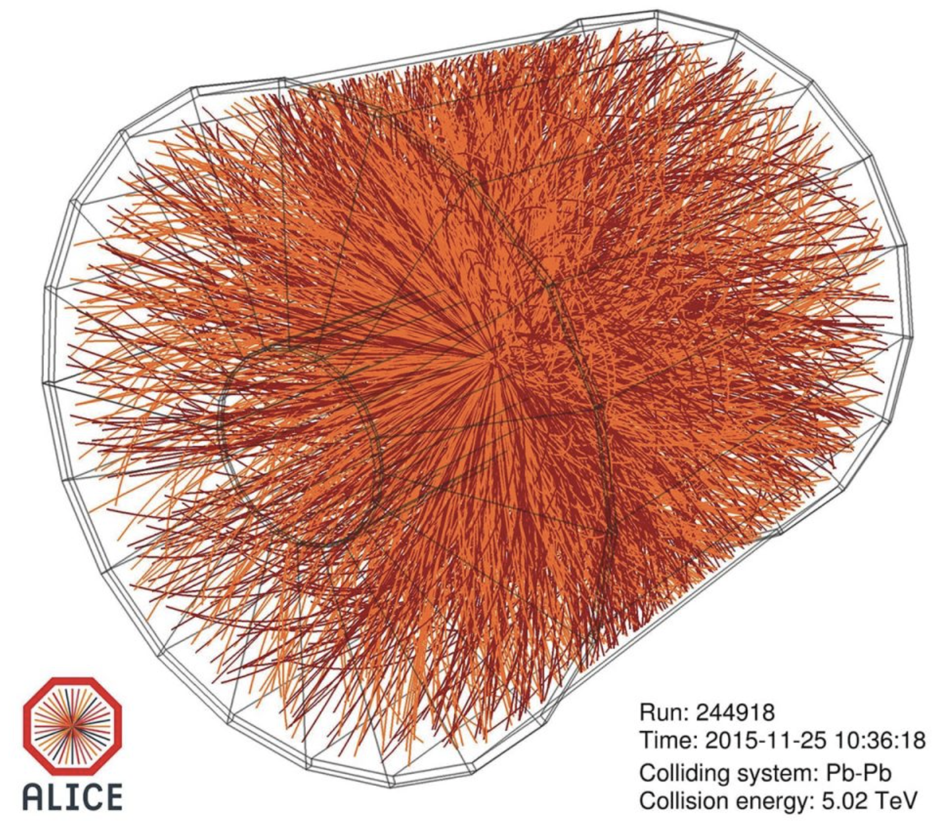
Motivation: quantum simulation of gauge theories
Particle physics: quantum chromodynamics (QCD)
Experiments: particle colliders
asymptotic freedom & confinement!
Bethke. Prog. in. Part. and Nucl. Phys. 58 (2007)
Durante et al., Physica Scripta, 94(3), 033001 (2019)
Condensed matter & quantum info: topological order, quantum error correction, ..
Computational “sign problem”:
Real-time dynamics
Finite baryon density
Kitaev, Annals of physics, 303(1), 2 (2003)
Troyer & Wiese, Physical review letters, 94(17), 170201 (2005)
Büchler et al, Physical review letters, 95(4), 040402 (2005)
Byrnes & Yamamoto, Physical Review A, 73(2), 022328 (2006)
… Martinez et al., Nature, 534(7608), 516-519 (2016) …
Klco et al., Reports on Progress in Physics, 85(6), 064301 (2022)
Di Meglio, arXiv:2307.03236 (2023)
…

Slide 3
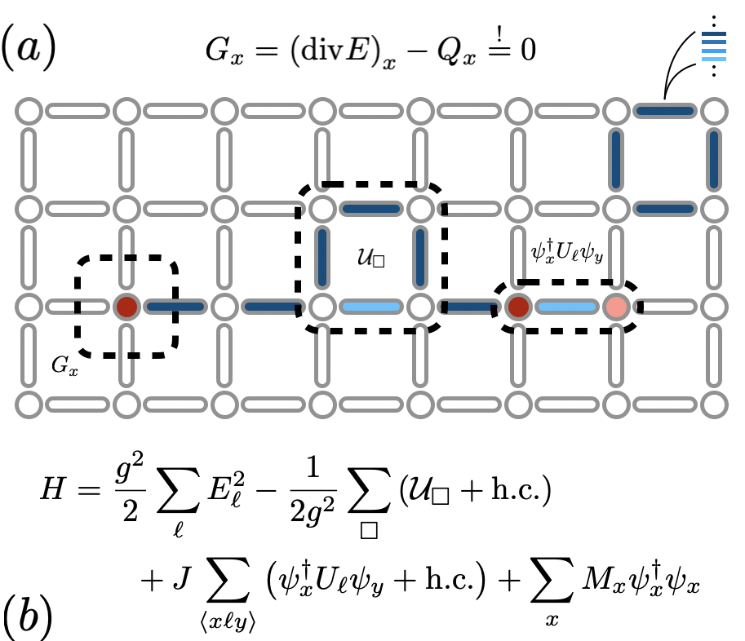
The challenges of quantum simulating LGTs
gauge invariance: constrained many-body system
Physics in 2D / 3D: plaquette interactions
Truncate large local Hilbert spaces!
How to treat fermionic matter?
eventually: continuum field theory limit
Kogut & Susskind, Physical Review D, 11(2), 395 (1975)

Slide 4
The challenges of quantum simulating LGTs
gauge invariance
Physics in 2D
gauge invariance: constrained many-body system
Physics in 2D / 3D: plaquette interactions
Truncate large local Hilbert spaces!
How to treat fermionic matter?
eventually: continuum field theory limit
Kogut & Susskind, Physical Review D, 11(2), 395 (1975)

Slide 5
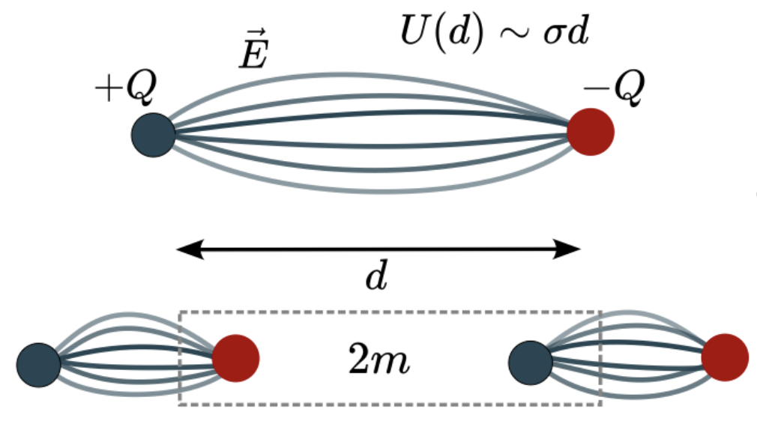
Can we explore characteristic LGT phenomena on quantum simulators today?
Superconducting qubits, digital, 2D:
Cochran et al., arXiv:2409.17142 (2024)
Trapped-ions, analog, 1D:
De, Lerose, Luo, Surace, Schuckert, Bennewitz, Ware, Morong, Collins, Davoudi, Gorshkov, Katz, Monroe, arXiv:2410.13815 (2024)
Rydberg tweezer array, analog, 2D:
Gonzalez-Cuadra, Hamdan, TVZ, Braverman, Kornjaca, Lukin, Cantu, Liu, Wang, Keesling, Lukin, Zoller & Bylinskii, arXiv:2410.16558 (2024)
Trapped ions, digital, 2D:
Crippa, Jansen & Rinaldi, arXiv: 2411.05628 (2024)
Superconducting qubits, digital, 1D:
Ciavarella, arXiv:2411.05915 (2024)
Cold atoms in optical lattice, analog, 1D:
Liu, Zhang, Zhu, He, Yuan & Pan, arXiv:2411.15443 (2024)
…
Confinement & string-breaking

Slide 6

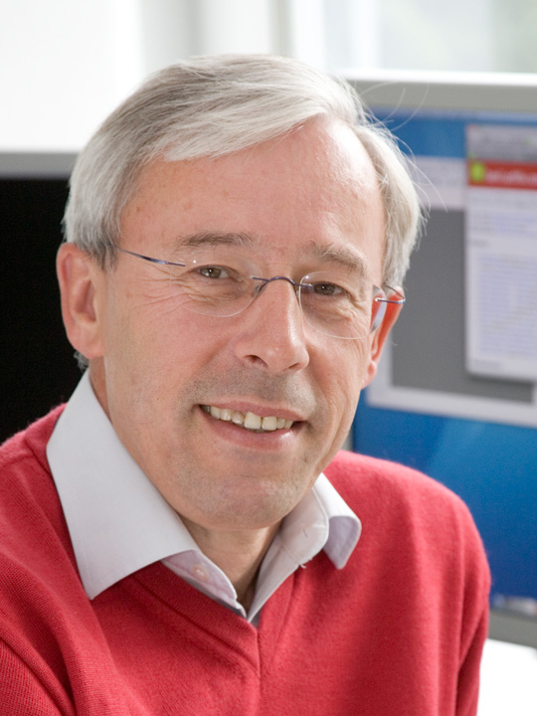

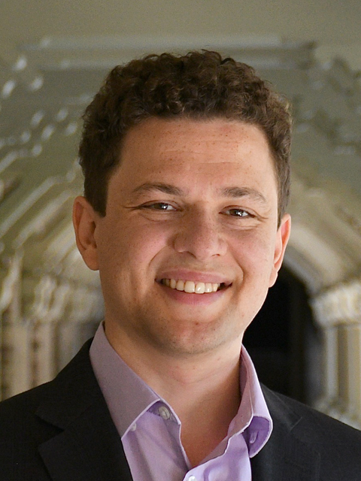







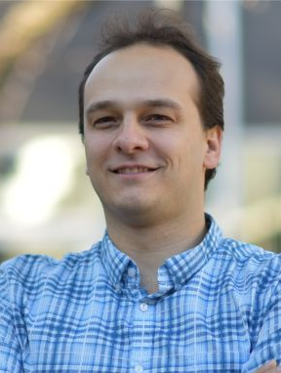
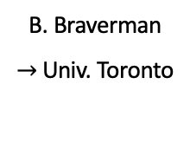
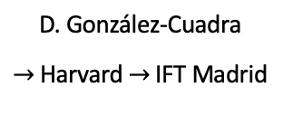
String breaking on a Rydberg quantum simulator
IQOQI / Univ. Innsbruck:
QuEra + Harvard:
D. González-Cuadra
$→$ Harvard $→$ IFT Madrid
P. Zoller
M. Hamdan
B. Braverman
$→$ Univ. Toronto
M. Kornjaca
A. Lukin
S. H. Cantu
arXiv:2410.16558
(accepted in Nature)
F. Liu
S.-T. Wang
A. Keesling
M. D. Lukin
A. Bylinskii

Slide 7
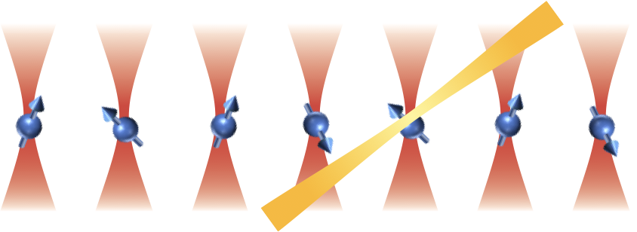
Rydberg atom arrays
blockade = Gauss’ law!
Hamiltonian:
Strong VdW interaction by coupling to Rydberg states:
Rydberg blockade:
Jaksch et al., Physical Review Letters 85, 2208 (2000)
Weimer, Müller, Lesanovsky, Zoller & Büchler, Nature Physics, 6(5), 382 (2010)
Browaeys & Lahaye, Nature Physics, 16(2), 132 (2020)
Surace et al., Physical Review X, 10, 021041 (2020)
Wurtz et al., arXiv:2306.11727 (2023)
Bluvstein et al., Nature, 626, 58 (2024)
Muniz et al., arXiv:2411.11708 (2024)
…
Neutral atoms trapped in tweezer array

Slide 8
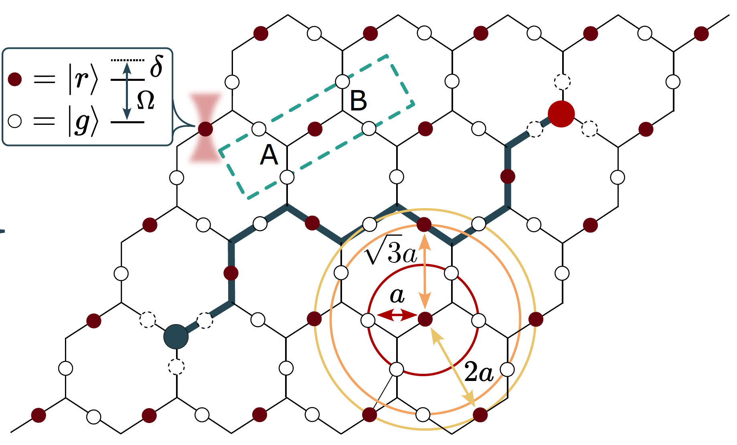
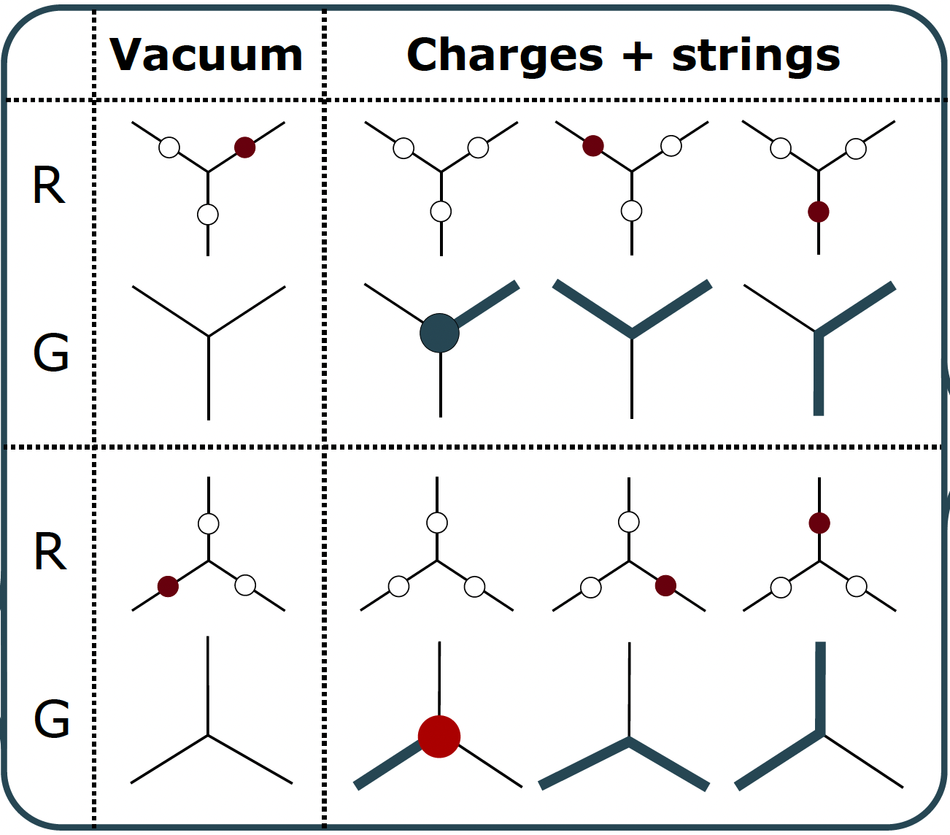
Analog 2D U(1) QLM with a Rydberg atom array
Honeycomb / Kagome lattice geometry:
Gauss’ law & mapping:
Gonzalez-Cuadra, Hamdan, TVZ, Braverman, Kornjaca, Lukin, Cantu, Liu, Wang, Keesling, Lukin, Zoller & Bylinskii, arXiv:2410.16558 (2024)
See also: Samajdar et al., Proceedings of the National Academy of Sciences, 118, e2015785118 (2021)
Review of quantum link models (QLMs):
Wiese, Philosophical Transactions of the Royal Society A, 380, 20210068 (2022)

Slide 9
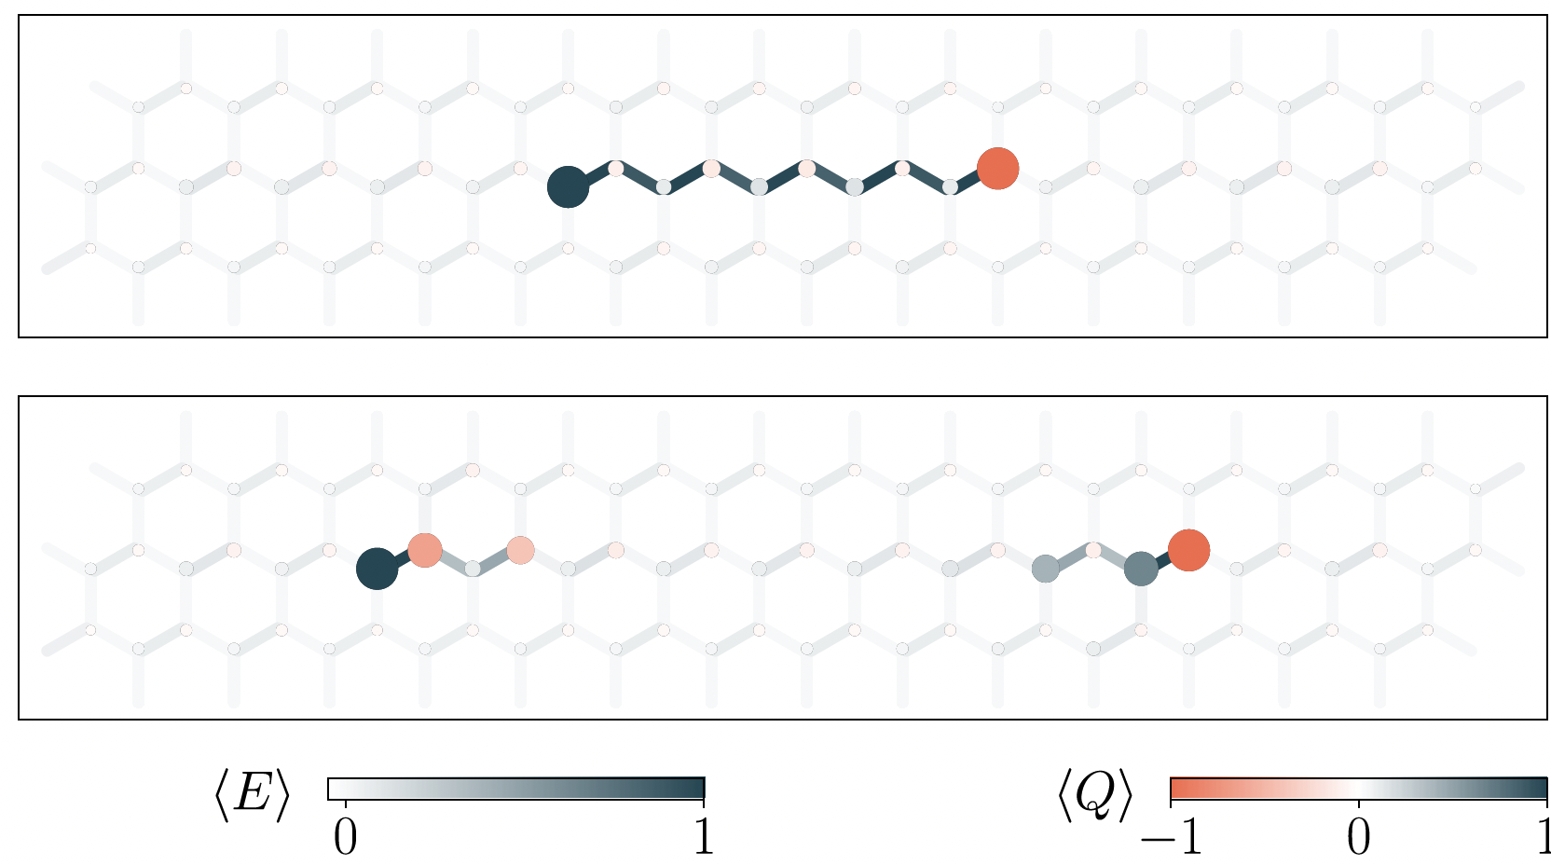
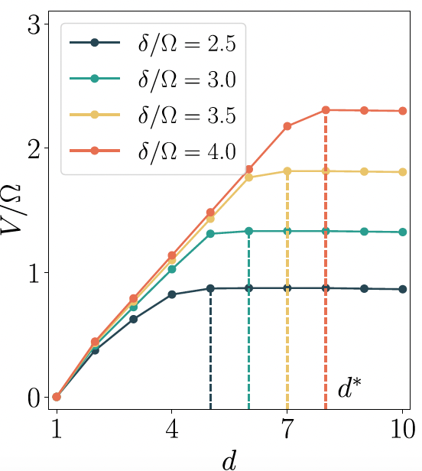
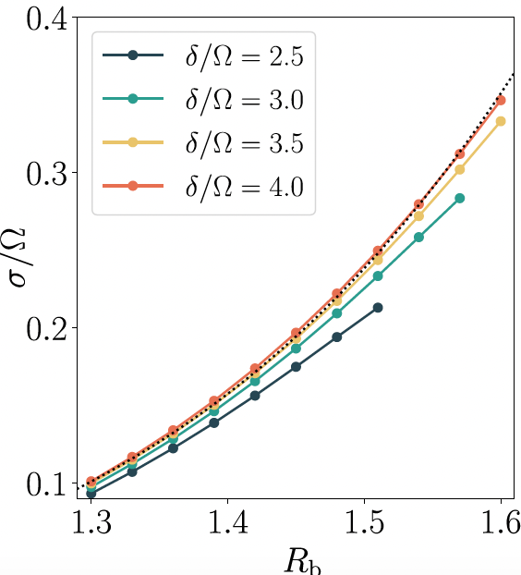
Theory expectations: confinement + string breaking
matter-gauge interaction
mass
electric energy
Potential
String tension
Ground state with static charges, DMRG results:

Slide 10
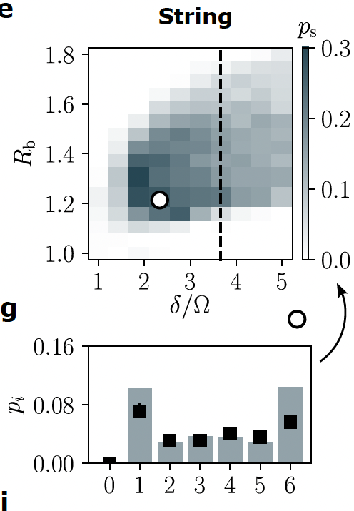
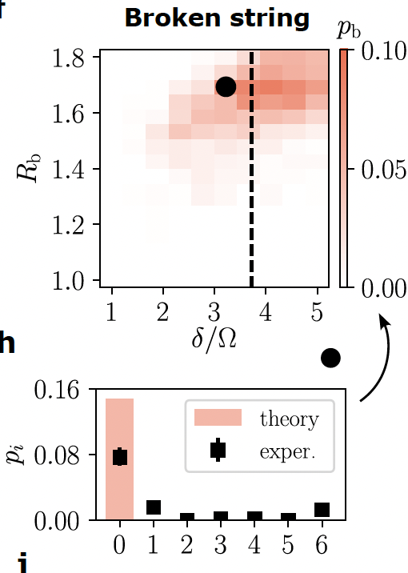
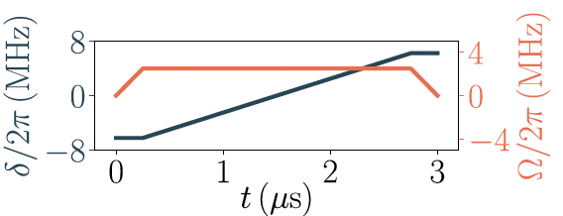
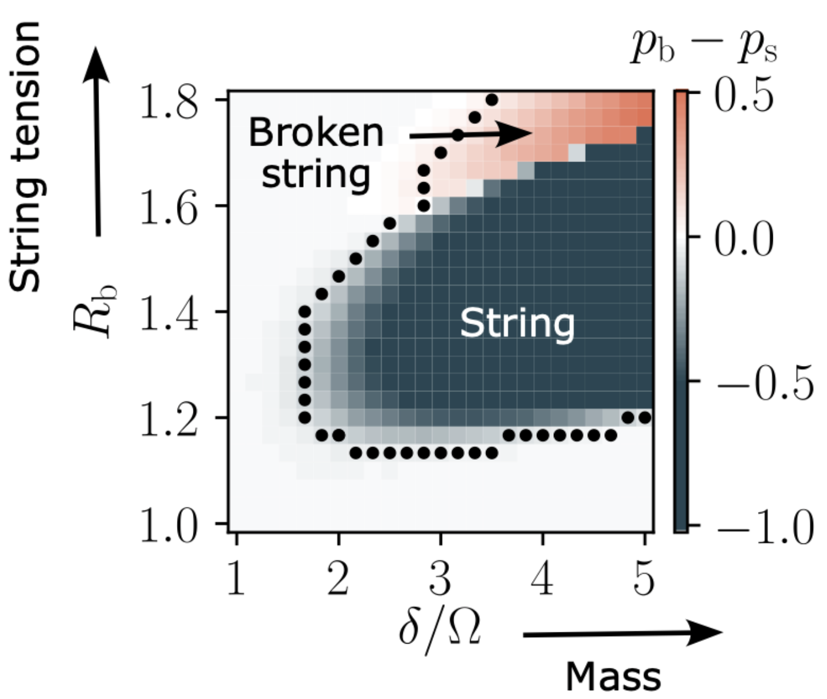
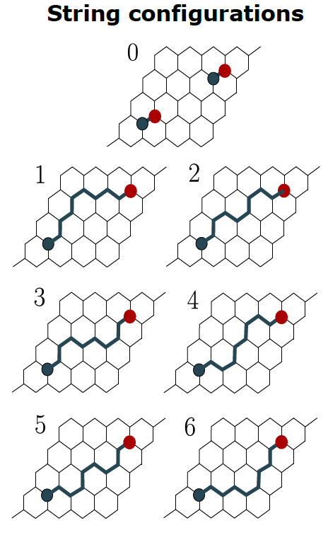
Experimental results: ground state peparation
Adiabatic state preparation on “Aquila” (QuEra)
Theory

Slide 11
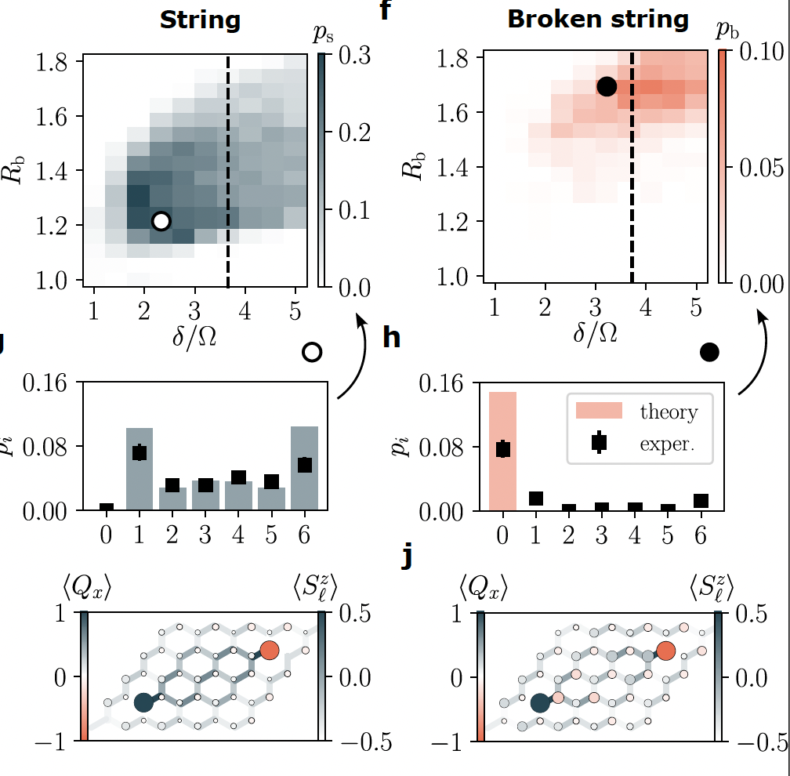
Experimental results: ground state peparation
Adiabatic state preparation on “Aquila” (QuEra)
Theory

Slide 12
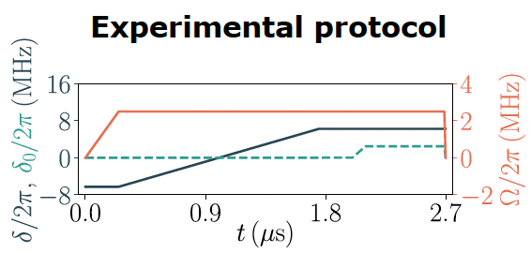
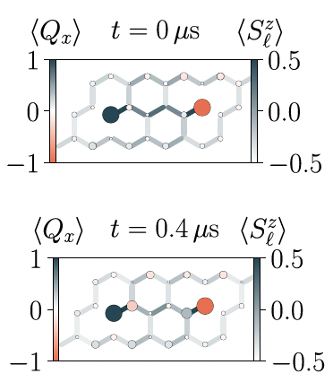
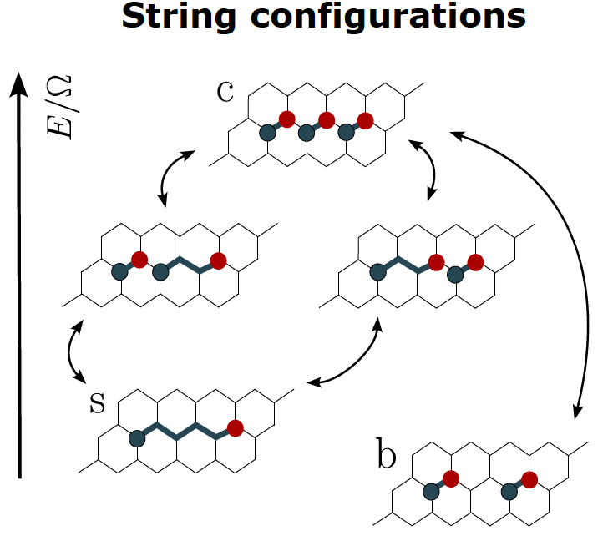
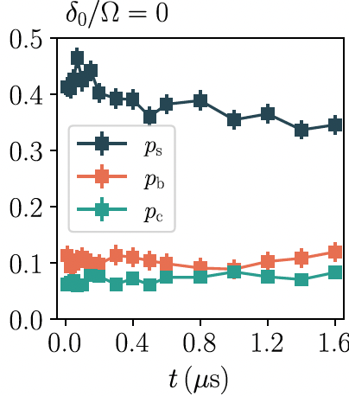
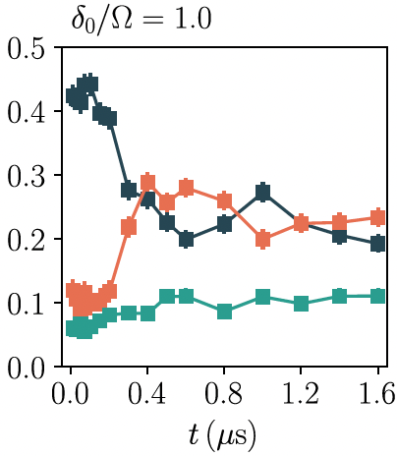
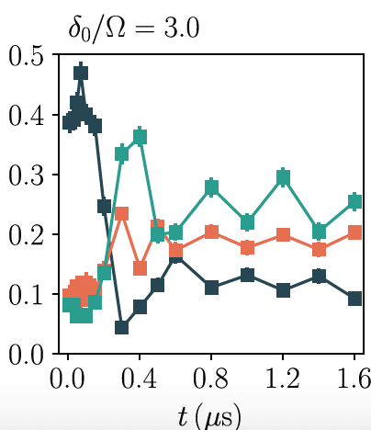
Experimental results: dynamics of a string
Adiabatic state prep. + local detuning quench
no quench
String breaking!
intermediate state

Slide 13
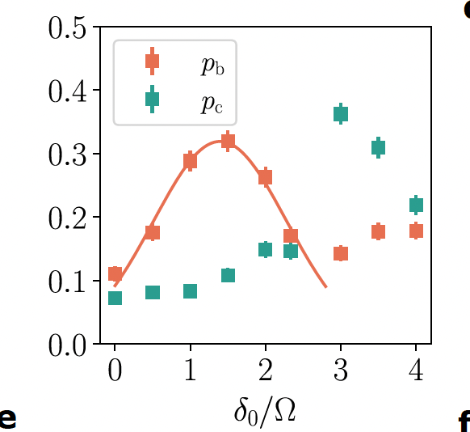
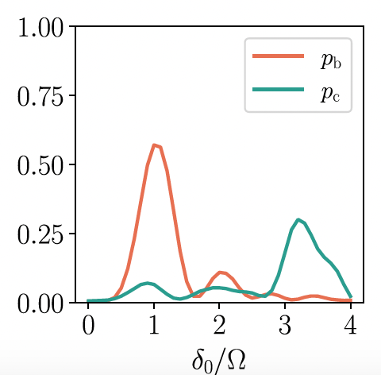
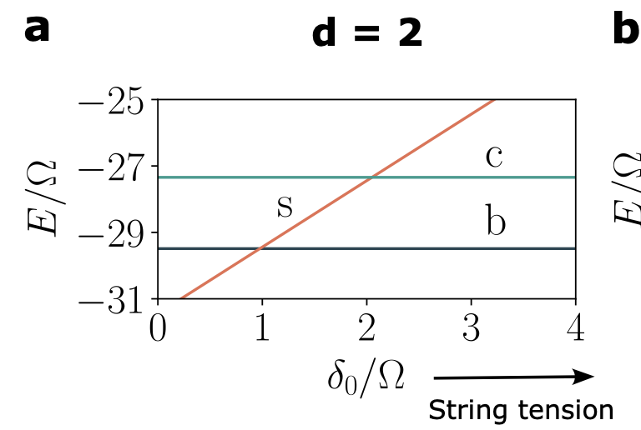
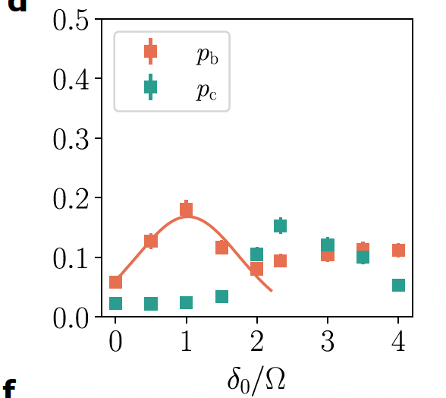
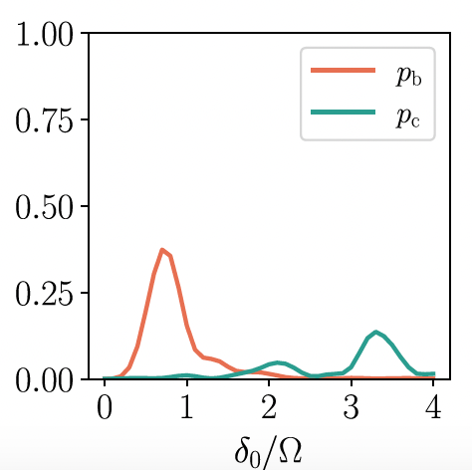
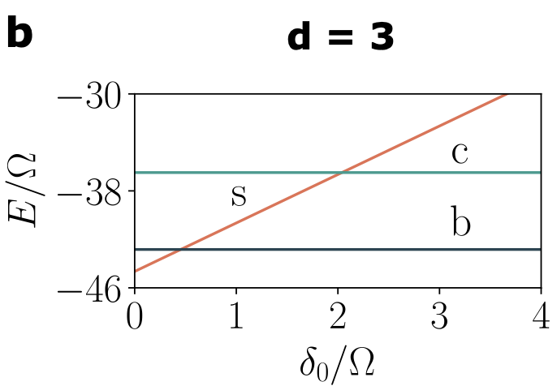
Experimental results: resonance of string-breaking
Theoretical energy levels
Experiment
Simulation

Slide 14
Gonzalez-Cuadra, Hamdan, TVZ, Braverman, Kornjaca, Lukin, Cantu, Liu, Wang, Keesling, Lukin, Zoller & Bylinskii, arXiv:2410.16558 (2024)
Summary
Analog quantum simulator for 2D U(1) QLM with Rydberg atom array
Ground state “Phase diagram” of (un)broken strings
Real-time dynamics of resonant string-breaking
.. include plaquette interactions?!
Feldmeier et al., arXiv:2408.02733 (2024)
Outlook: more realistic models (non-abelian gauge groups, large local Hilbert spaces) on qudit computers?
TVZ, González-Cuadra & Zoller, Quantum, 7, 1140 (2023)

Slide 15




Thanks for listening!
I’m looking for team members:
open PostDoc + PhD positions
https://www.mcqst.de/support/job-offers/phd-and-postdoctoral-positions-quantum-simulation-theory.html

