Slide 1
Pattern recognition demo
FPGA - LabVIEW
Adriaan Rijllart
CERN & ANGARA Technology
Notes:
Welcome to the NI myRIO Design Real Systems, Fast Hands On

Slide 2
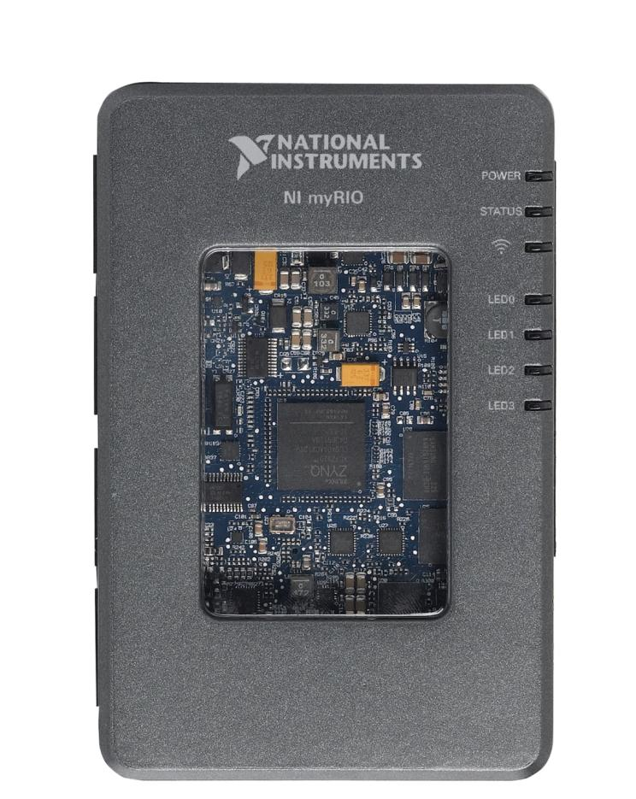
NI myRIO Product Overview: Front View
XILINX Zynq SoC
Small Size, Low Power
667 MHz Dual-Core ARM Cortex-A9 Processor
Artix-7 FPGA, 28k logic cells
16 DMA Channels
92 Billion calculations per second
Notes:
The first thing that you will notice is the Xilinx Zynq chip right in the middle of the myRIO window. National Instruments is very excited to be partnering with Xilinx to bring this cutting edge technology to students. Let’s take a closer look at this chip.

Slide 3

What is Zynq?
Traditional Implementation
Analogue Input
FPGA
Processor
Analogue Output
AXI Bus
PCI Bus
Digital I/O
Custom I/O
Single System on Chip
Notes:
To appreciate what Zynq has to offer, let’s take a look at how the industry has traditionally implemented processors and FPGAs on embedded devices.
Traditionally the processor and FPGA have been two separate, desperate chips… connected with a generic computing bus
<animate>
NI has been working closely with technology leaders like Xilinx and ARM to help bring a new category of system on chip to market… the new Zynq all programmable SOC.
Zynq is revolutionary because it combines both a powerful dual-core processor and the power efficient 7 Series FPGA… and puts then onto a single chip

Slide 4






Pattern recognition demo
“Finding a needle in a haystack”
+5 V
Random data generated
Potentiometer
GND
FPGA
LEDs showing counter value
(8 bits)

Slide 5




Pattern recognition demo
“Finding a needle in a haystack”
FPGA
+5 V
2 random values summed
Potentiometer
GND
If match
pot value
LEDs showing counter value
(8 bits)
01001010
8-bit counter

Slide 6
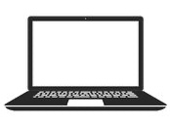
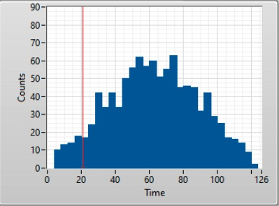
Pattern recognition demo (2)
Data flow FPGA -> ARM -> PC
FPGA
FIFO
CPU
PC
analog
1
2
digital

Slide 7
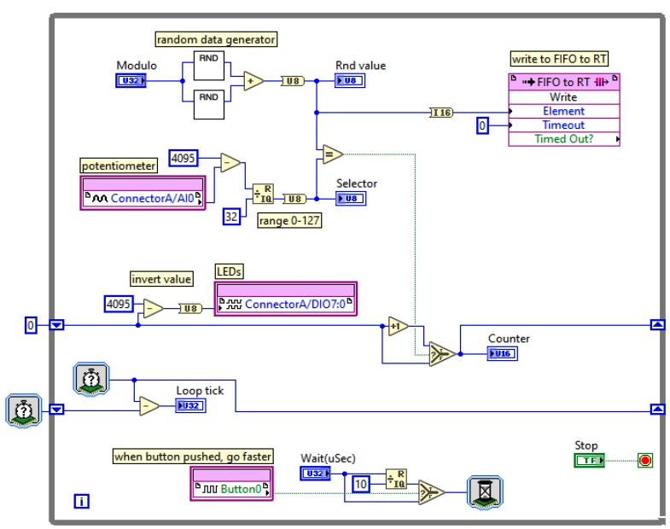
FPGA filling the FIFO
FIFO
Generate
data
I/O

Slide 8
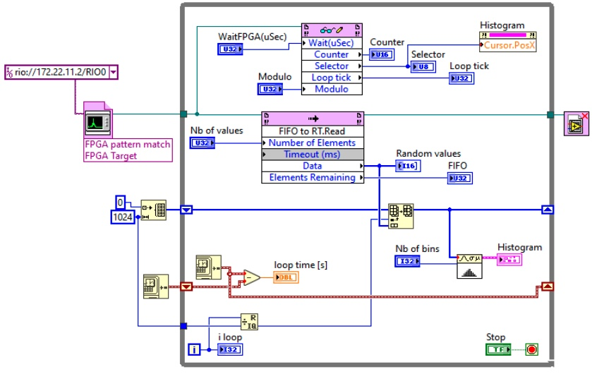
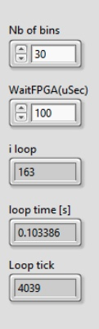
CPU reading FIFO
FIFO
ARM running Linux RT
Read parameters
Fill histogram

Slide 9
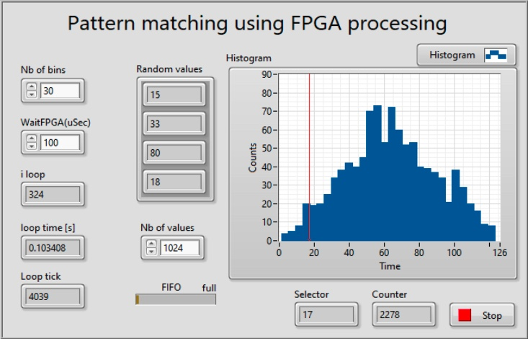
Display on PC

Slide 10
Backpressure from ARM processor
FPGA
FIFO
CPU
PC
analog
1
2
digital
backpressure
If CPU is too slow to empty FIFO
FIFO will fill up
When FIFO full, data will be lost

Slide 11
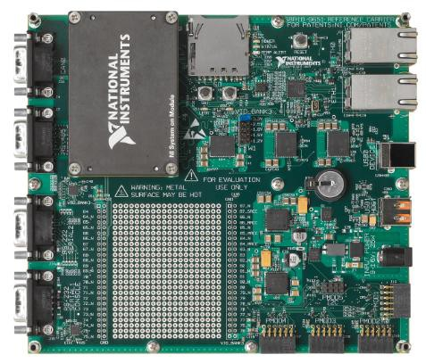
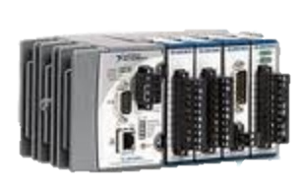
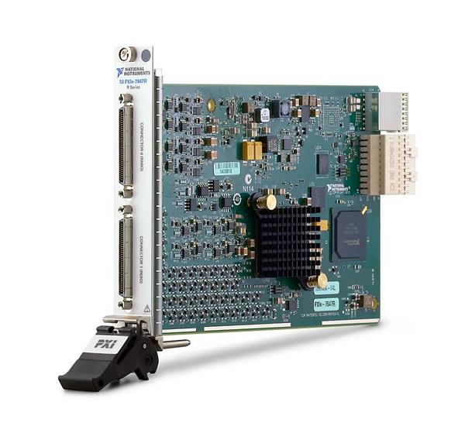
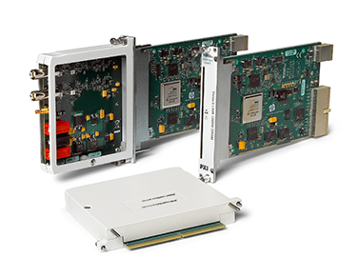
From small to big FPGA systems
myRIO
sbRIO
cRIO
PXIe R-series boards
PXIe FlexRIO boards

Slide 12
X-band cavity test FlexRIO system
PXIe FlexRIO boards

