Slide 1
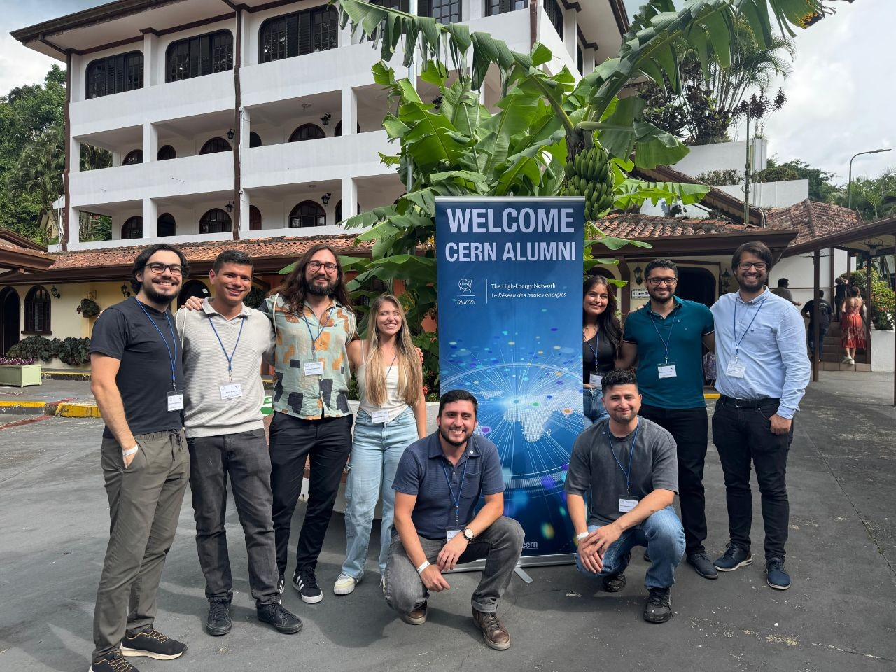
Progress Report Dec 2024- May 2025
14th CERN Alumni Advisory Board meeting
6 June 2025
IR-DS-AR-04

Slide 2
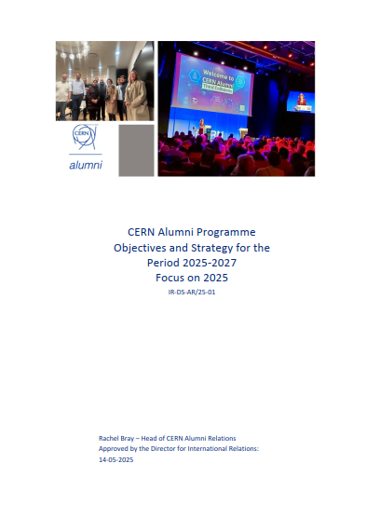
Agenda
              Reminder: Goals Alumni Programme
              Status of the Network
              Objectives and Strategy
                CAN doers (Badges)

Slide 3
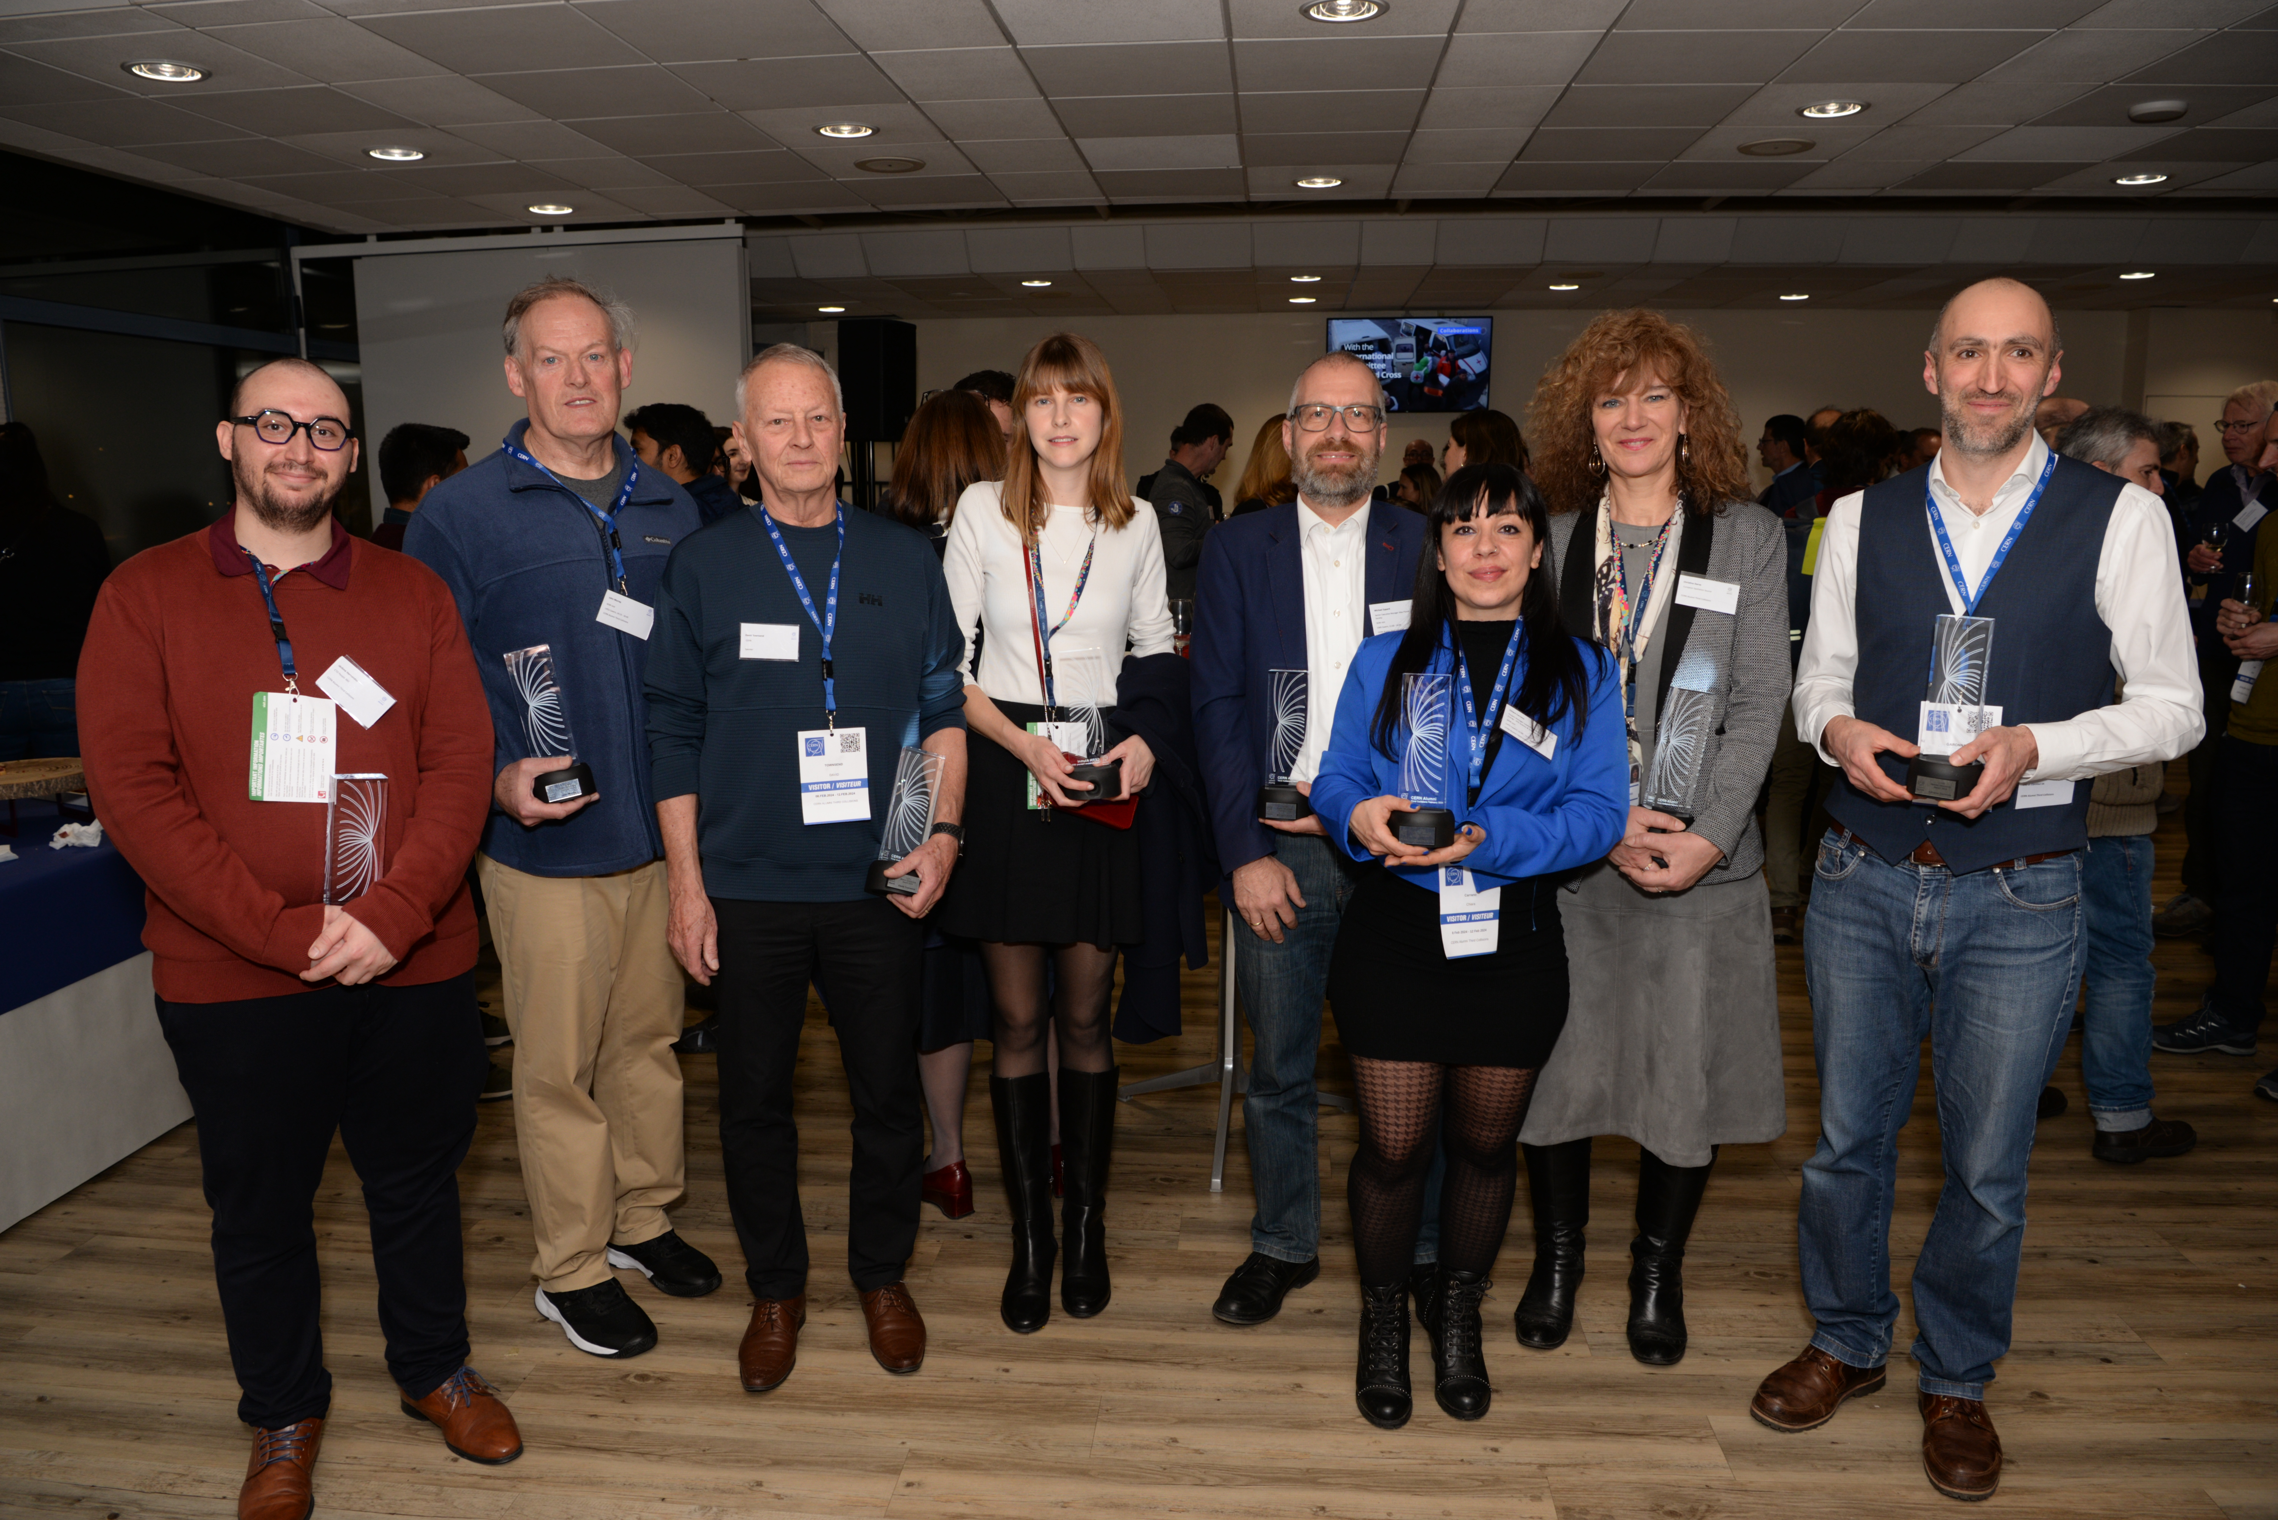
Goals of the CERN Alumni Programme:
Demonstrate impact
Stay connected
Network of ambassadors
Support early careers
Launched June 2017
>10,900
active members

Slide 4

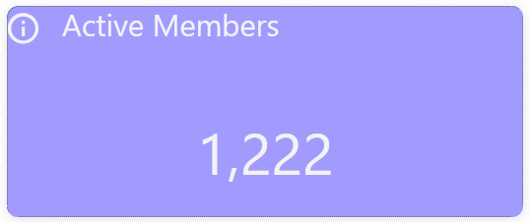
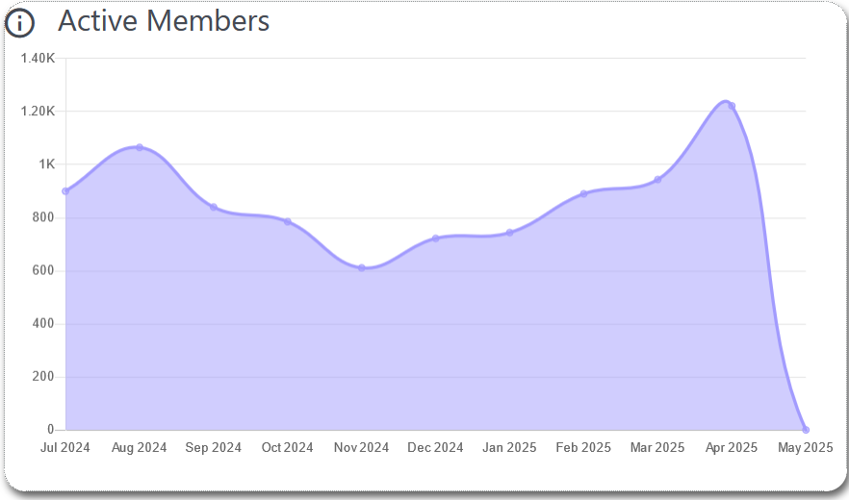

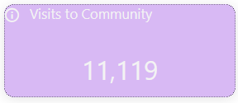
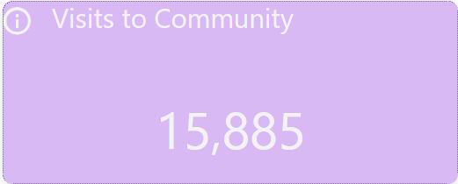
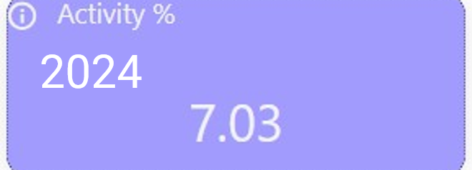
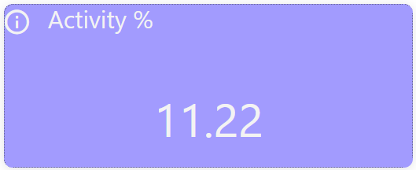
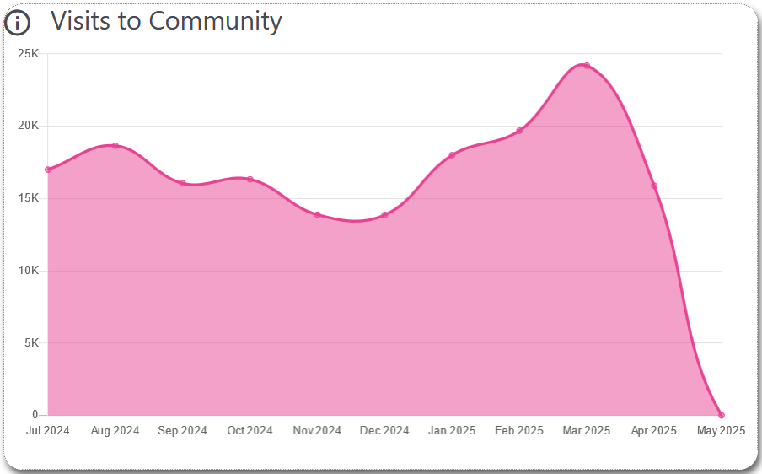
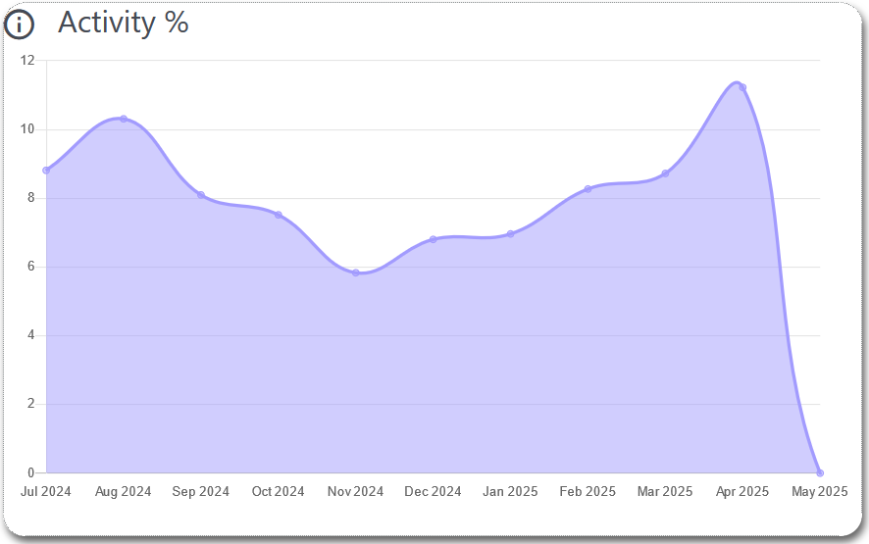
Status of the network*
2024
2025
*
2024
Number | May 2024 | May 2025
Alumni | 7,221 | 8,263
Members of Personnel | 2,438 | 2,593
Friends | 78 | 87
Totals | 9,737 | 10,943
*
*
2024
2025
2024
2025
8 members requested to leave the Network between 05/23 and 05/24
(20 between 05/23 & 05/24)
* End April ‘25

Slide 5
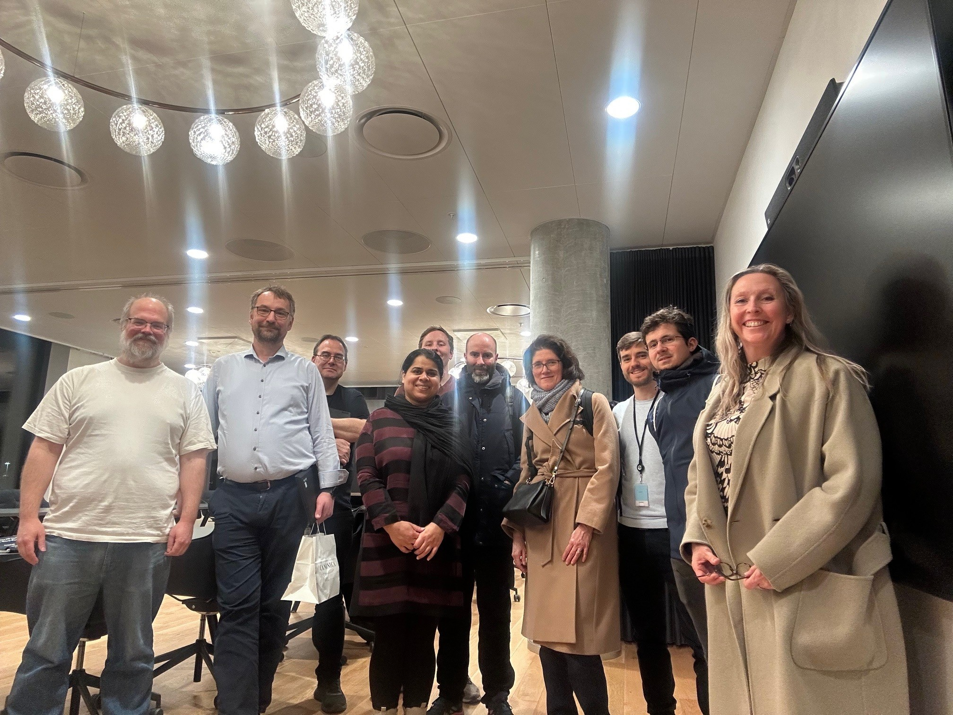
Activities Dec 2024 – May 2025
2024
2024
Events:
Virtual Company Showrooms: 3
Moving Out of Academia to Data Science & Analytics (2nd edition): 1
News from the Lab | Introduction and Status Report on the HL-LHC Project: 1
Group meet-ups: 11
Soon-to-be alumni networking events: 2
Jobs:
Opportunities posted: 123
Groups:
Costa Rica
Estonia
Mentoring:
mentor | mentee relationships: 13
Content:
News postings: 130
Live feed posts: 111
Journeys:
Onboarding - 45% completion
Mentoring - 12% completion
2024
2024
Copenhagen Group meet-up Feb 2025

Slide 6
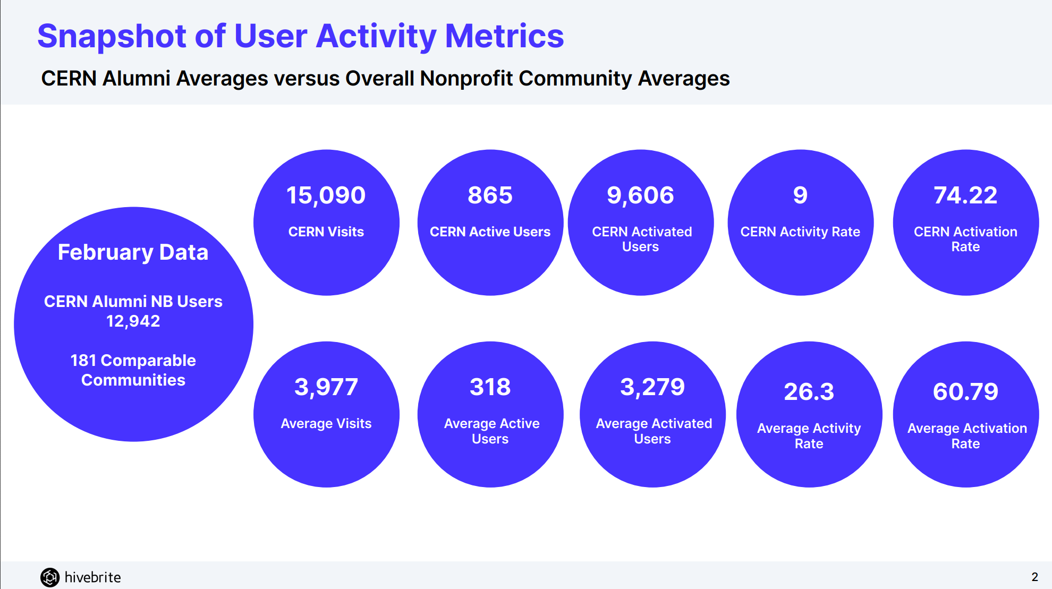
Status of the network ** UPDATE**

Slide 7
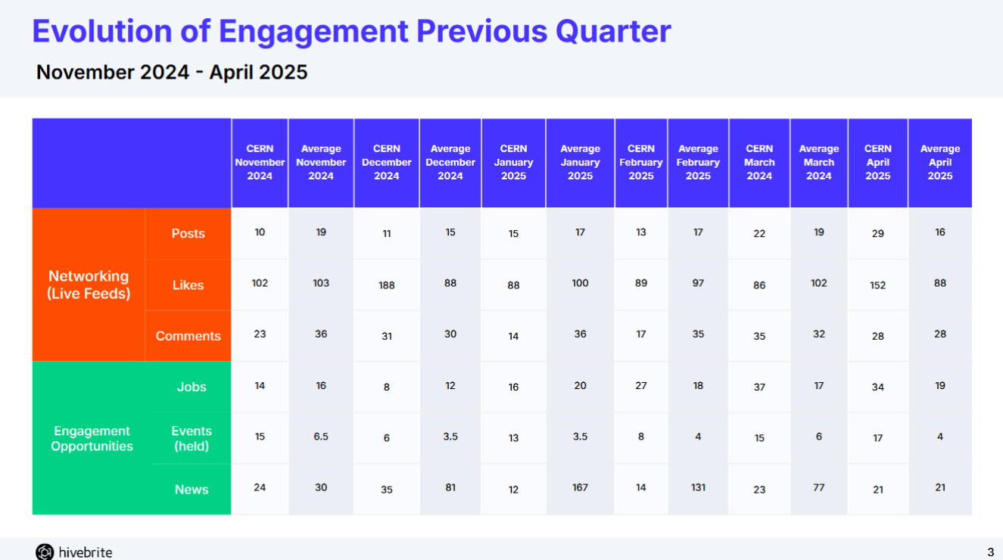

Slide 8

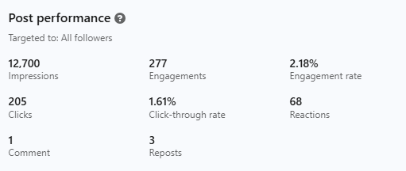




Status of the network
LinkedIn:
  Group: retired
  Page: 3,751 followers (2, 644)
Facebook: 7,363 members (6, 940)
Instagram: 4,855 followers (4,207)
Retired

Slide 9

Strategy & Objectives (2025)
This Photo by Unknown Author is licensed under CC BY-SA

Slide 10









Develop a network of ambassadors
Alumni data quality
Awareness raising (internal and external)
Early-career support
Enhance member experience
Increase member engagement, empowerment and interactions
Events & Content
Leverage the CAAB
Permanent objectives

Slide 11
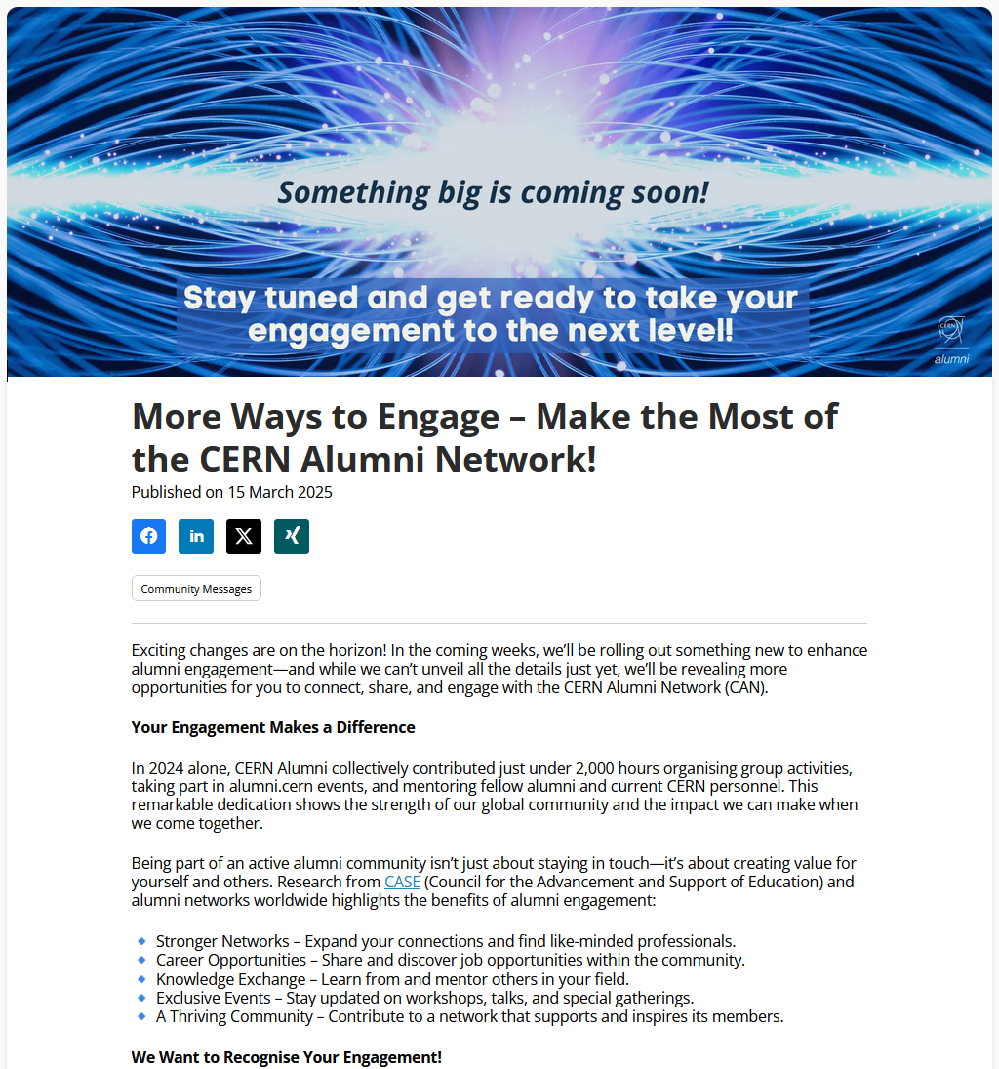
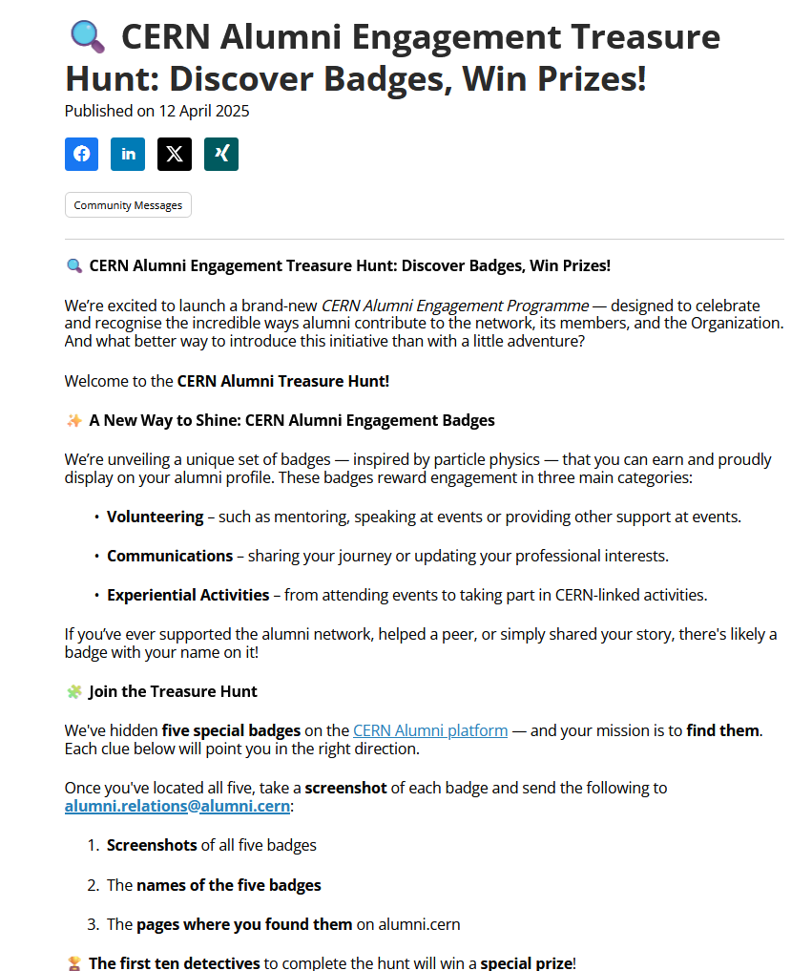
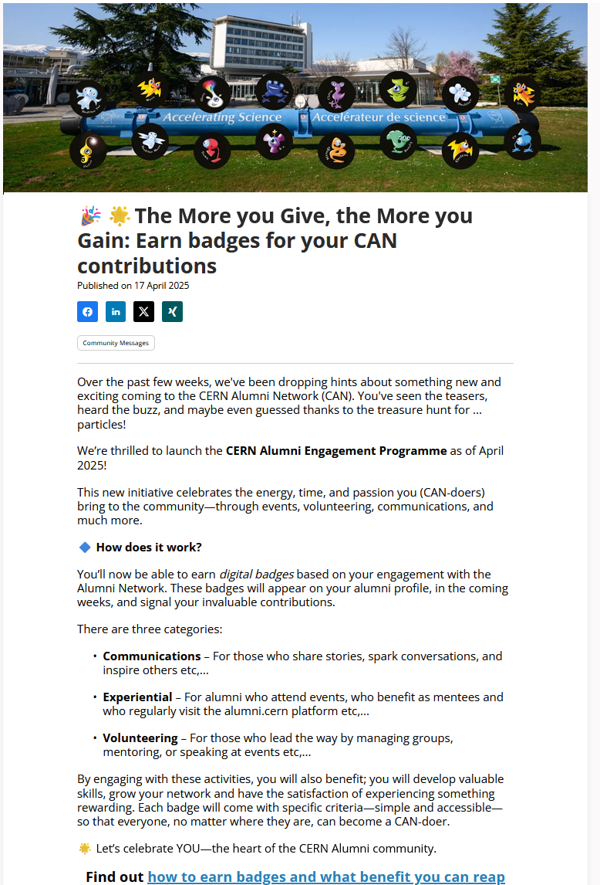
1. Develop a network of ambassadors

Slide 12
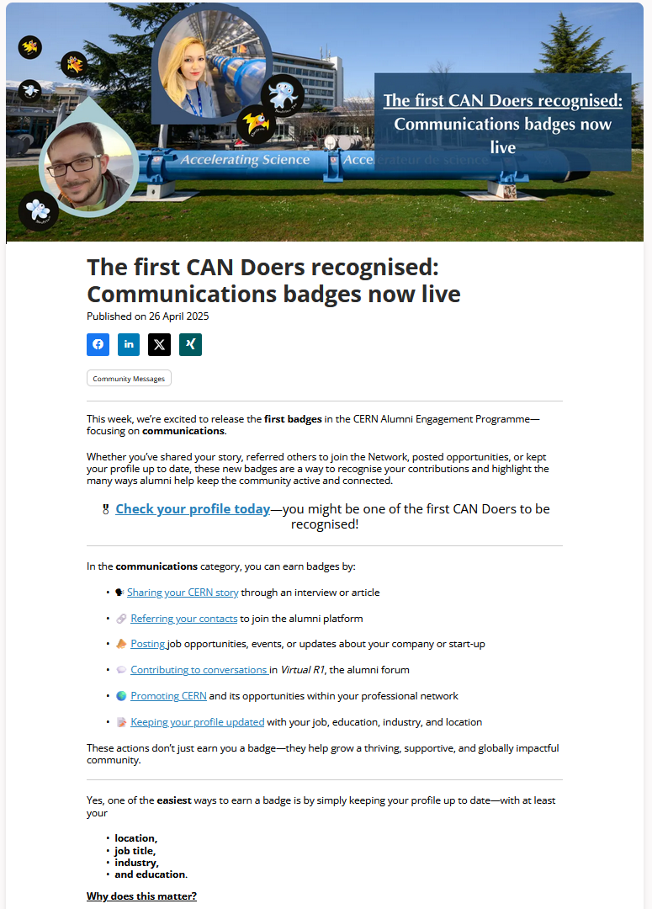
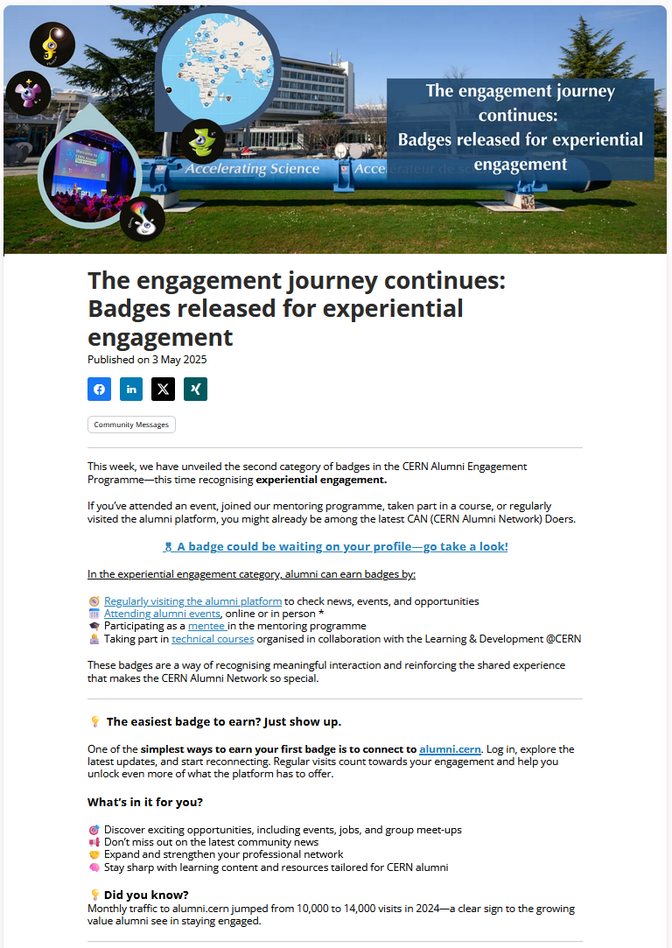
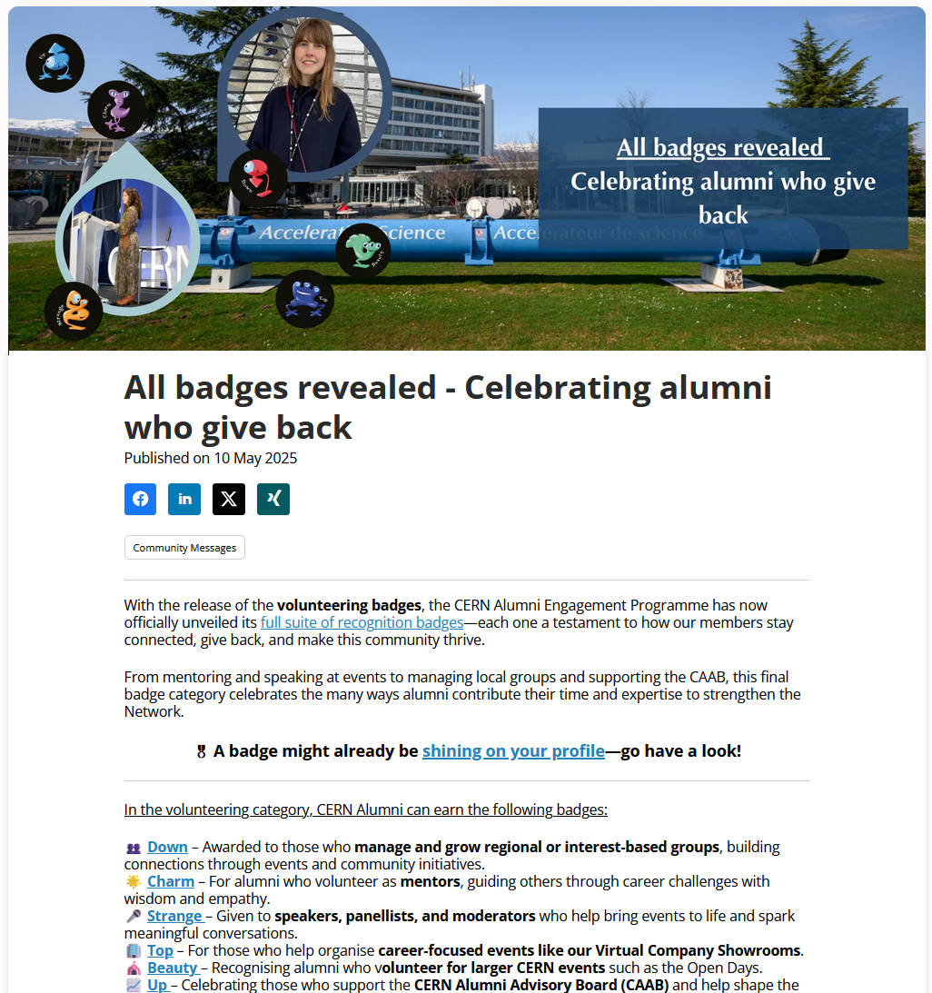
1. Develop a network of ambassadors

Slide 13
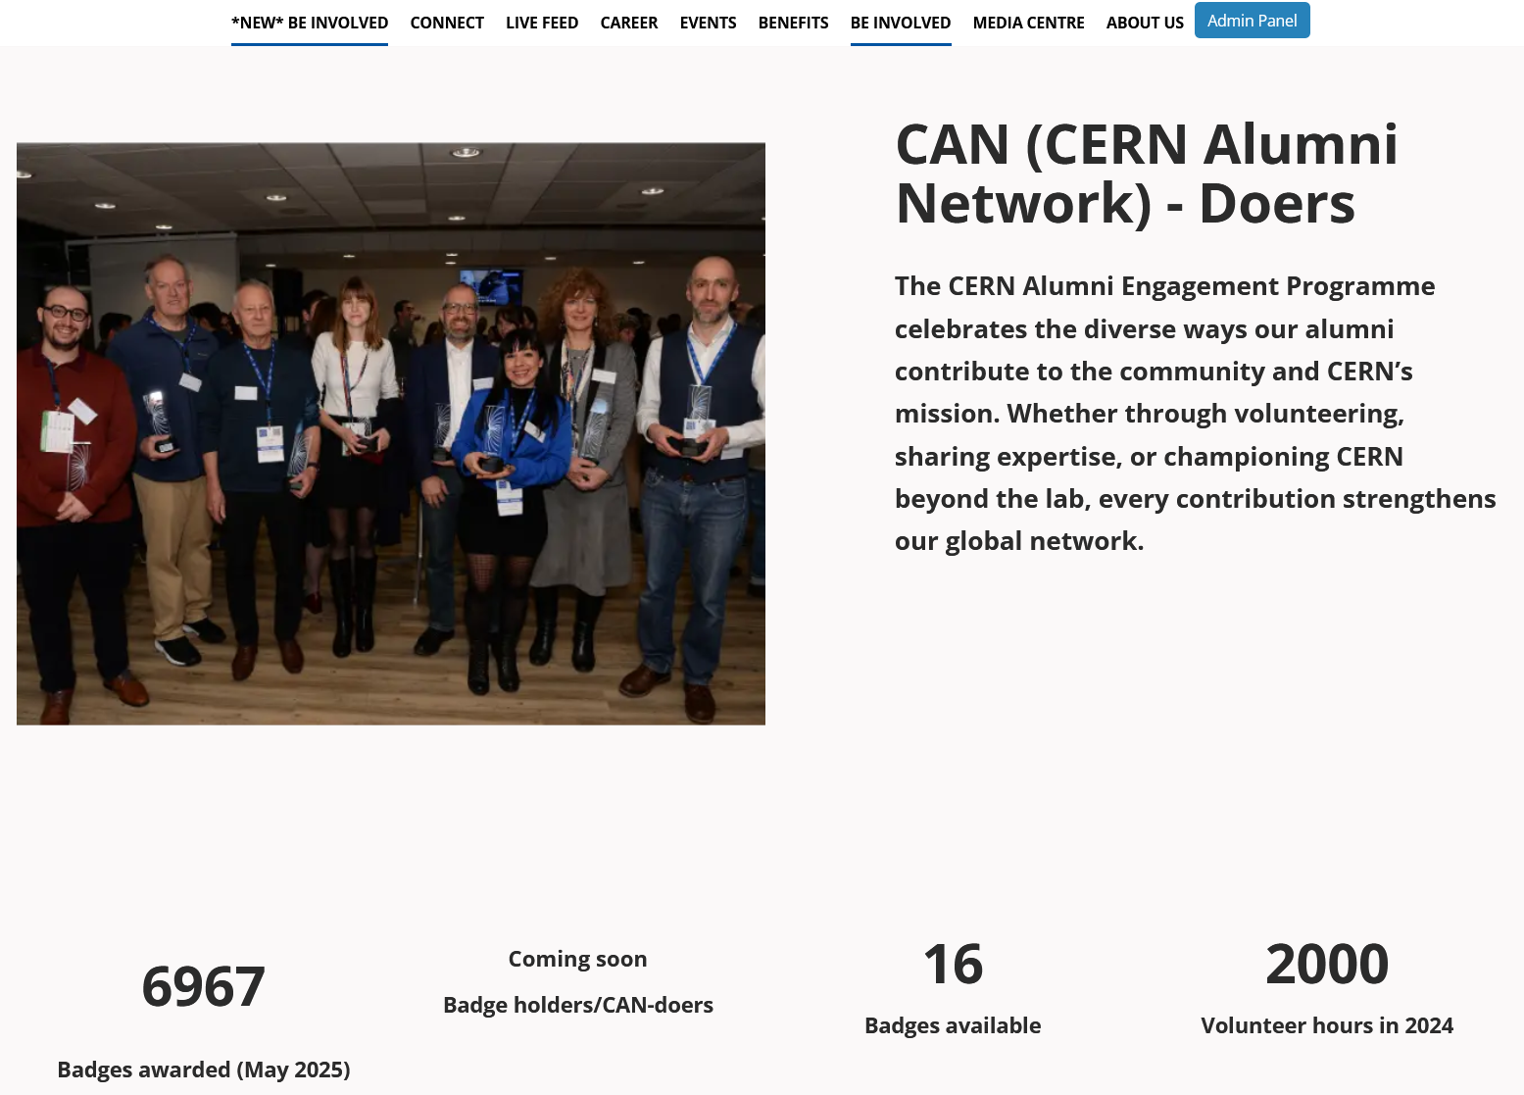
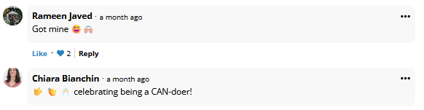


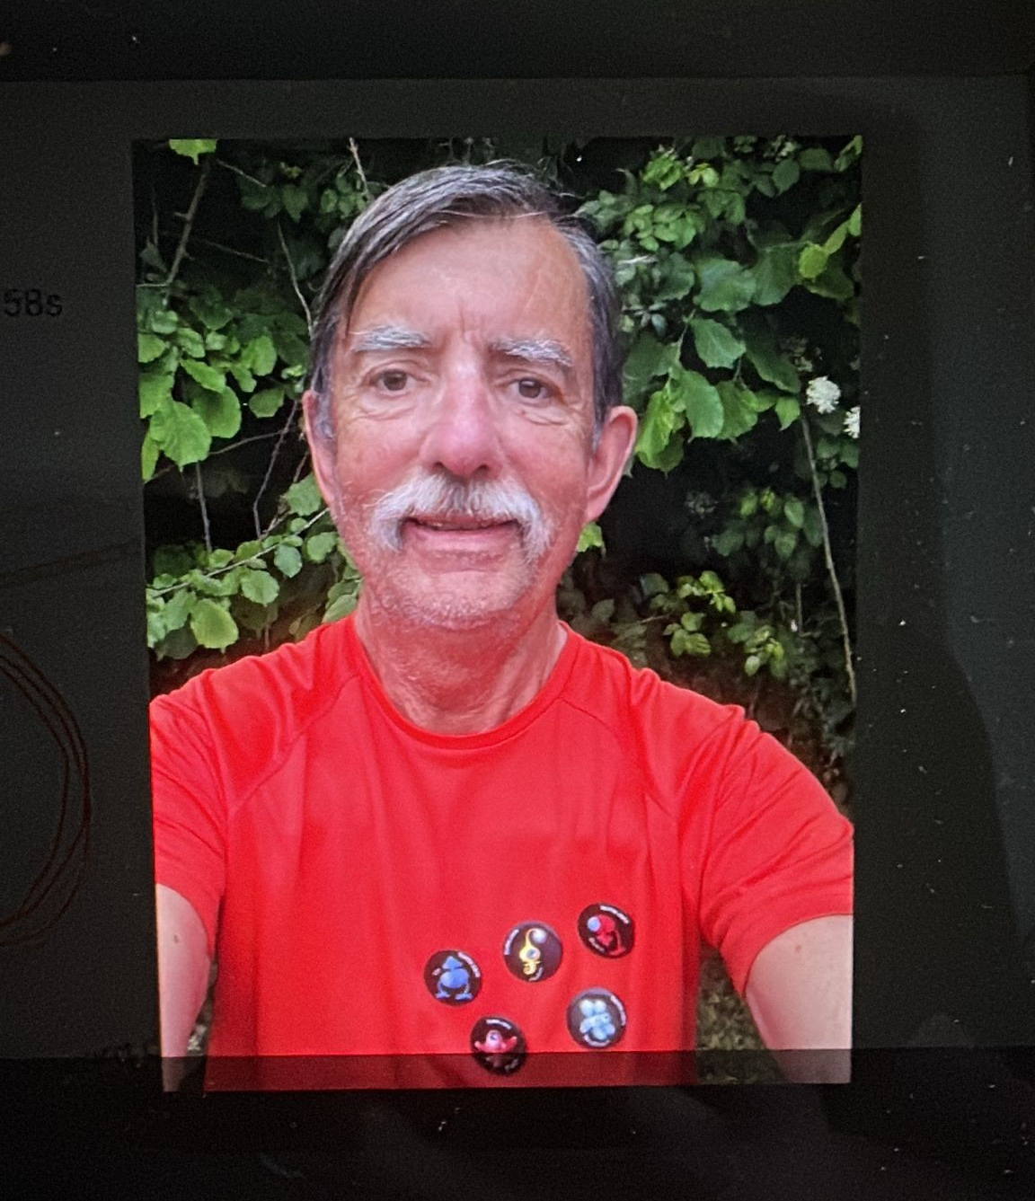
1. Develop a network of ambassadors
2025

Slide 14






1. Develop a network of ambassadors
Badges – in total 6967
COMMUNICATIONS – 1857 badges
Electron - For alumni who keep their CERN Alumni profile updated, ensuring accurate professional and networking information.
1123 badges
Muon - Awarded to those who advocate for CERN’s mission of fundamental research as well as promoting CERN opportunities in their professional circles.
36 badges
Tau - Given to alumni who initiate or contribute to discussions in the CERN Alumni forum, fostering meaningful exchanges.
107 badges
Neutrino - For alumni who share job opportunities, career events, or start-ups on alumni.cern, contributing to a dynamic and resourceful community.
268 badges
Neutrino Muon - Given to alumni who invite former colleagues and friends to join the CERN Alumni Network and guide them on their alumni journey.
50 badges
Neutrino Tau - For alumni who share their CERN journey through interviews or articles, inspiring others in the community.
273 badges
2025

Slide 15




1. Develop a network of ambassadors
EXPERIENTIAL = 4606 badges
Z°- For alumni who stay engaged by regularly visiting alumni.cern, accessing content, and updating their profile, benefiting fully from what alumni.cern has to offer.
3863 badges
Photon - Given to alumni who enhance their skills through Learn@CERN courses and share feedback with the community.
18 badges
W⁺ - Given to alumni who engage in the CERN Alumni mentoring programme as mentees, set goals, and collaborate with a mentor for professional growth.
28 badges
Gluon - Recognising alumni who attend CERN Alumni events to connect, learn, and share feedback for continuous improvement.
700 badges
2025

Slide 16

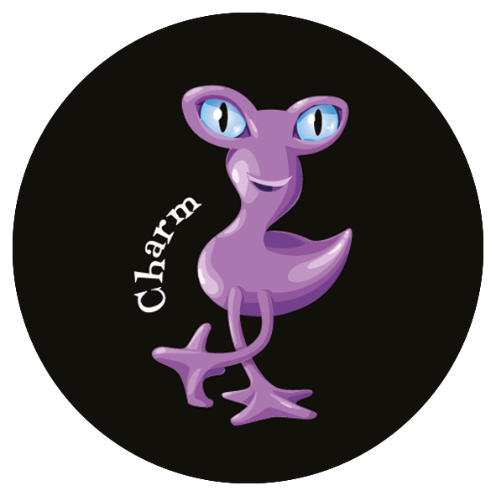




1. Develop a network of ambassadors
VOLUNTEER – 504 badges
Down - Recognising those who actively manage and grow regional or interest-based groups, fostering connections through events, discussions, and networking.
84 badges
Charm - For alumni who support others by sharing their experience as mentors and guiding mentees through their professional development.
47 badges
Strange - Given to alumni who share their expertise as speakers, panellists, or moderators at CERN Alumni events.
249 badges
Top - For alumni who collaborate with the Office for Alumni Relations to organise career events like the Virtual Company Showroom.
53 badges
Beauty - For alumni who respond to volunteer calls and contribute to CERN events, including Open Days.
48 badges
Up - Recognising alumni who engage with and support the CERN Alumni Advisory Board (CAAB).
23 badges
2025

Slide 17
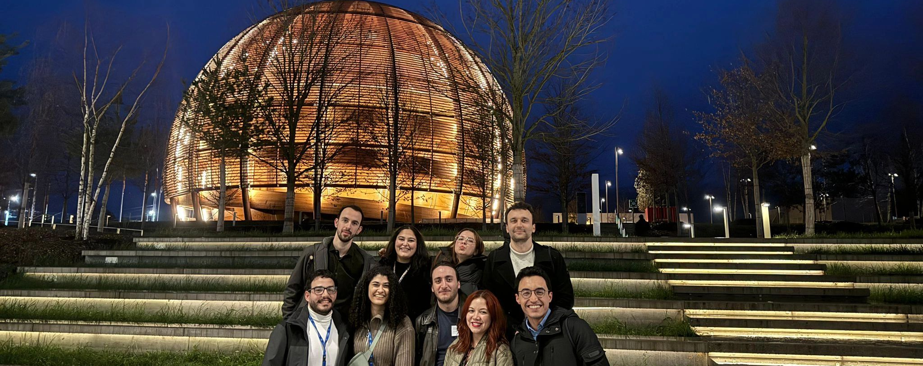
Questions & Discussion

Slide 18
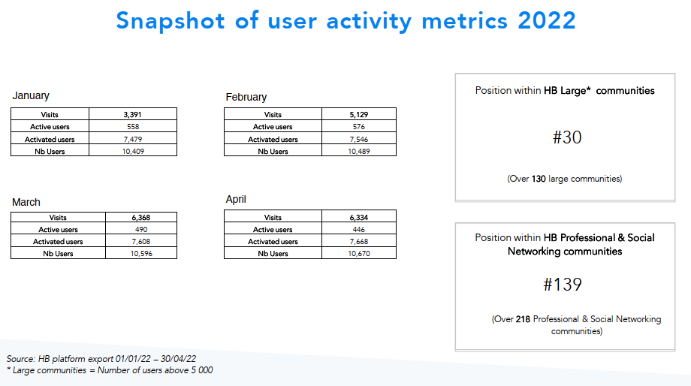
Status of the network
Number | May 2022 | 31 May 2023
Alumni | 5,602 | 6,392
Members of Personnel | 2,018 | 2,285
Friends | 71 | 75
Totals | 7,691 | 8,752

