Slide 1

CERN Alumni Survey

Slide 2

CERN Alumni Survey
Surveying alumni is a vital tool for understanding the needs and preferences of this important constituency, improving their experience, and ultimately strengthening the institution's connection to its alumni network.

Slide 3
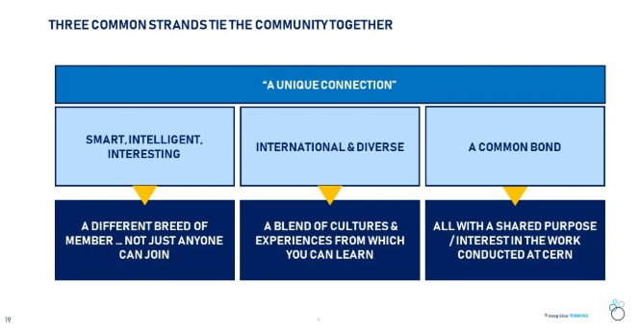
CERN Alumni Survey 2020
4336 alumni contacted
20% response rate

Slide 4
KEEPING IN TOUCH WITH CERN IS THE MAIN DRIVER FOR INITIALLY JOINING THE ALUMNI NETWORK BUT WORTH ALSO NOTING IMPORTANCE OF PROFESSIONAL DEVELOPMENT
CAREER DEVELOPMENT AN IMPORTANT PART OF THE ALUMNI NETWORK PROPOSITION
BASE: ALL RESPONDENTS (N=875)
4

Slide 5
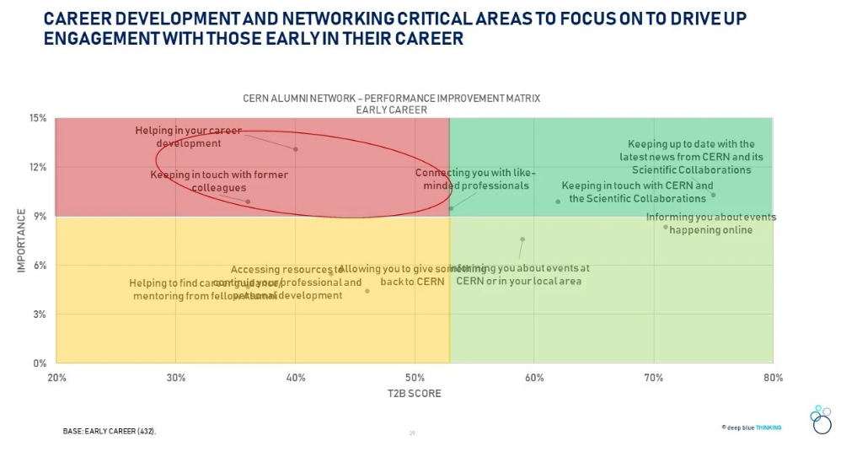
BASE: ALL RESPONDENTS (N=875)
5

Slide 6
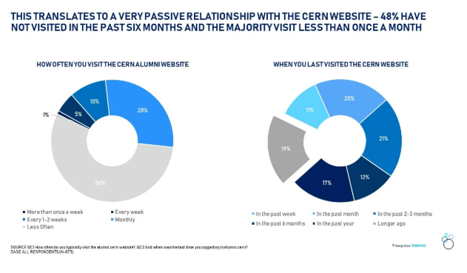
2020 Survey Indicated a Need to Improve the alumni.cern Platform
BASE: ALL RESPONDENTS (N=875)
6

Slide 7
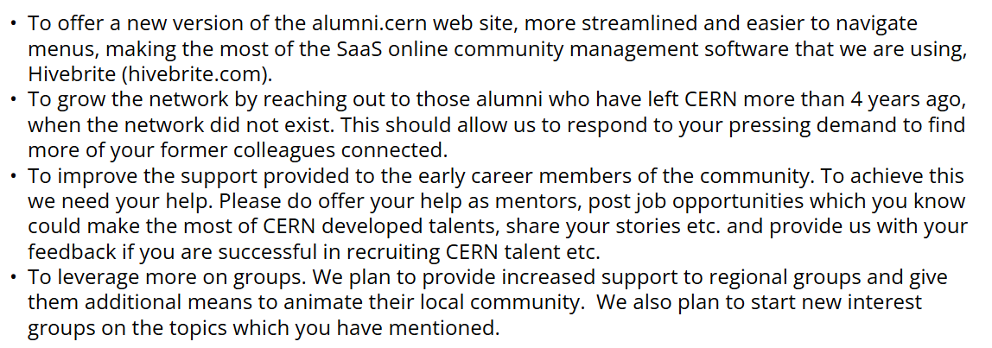
Post-Survey Strategy

Slide 8
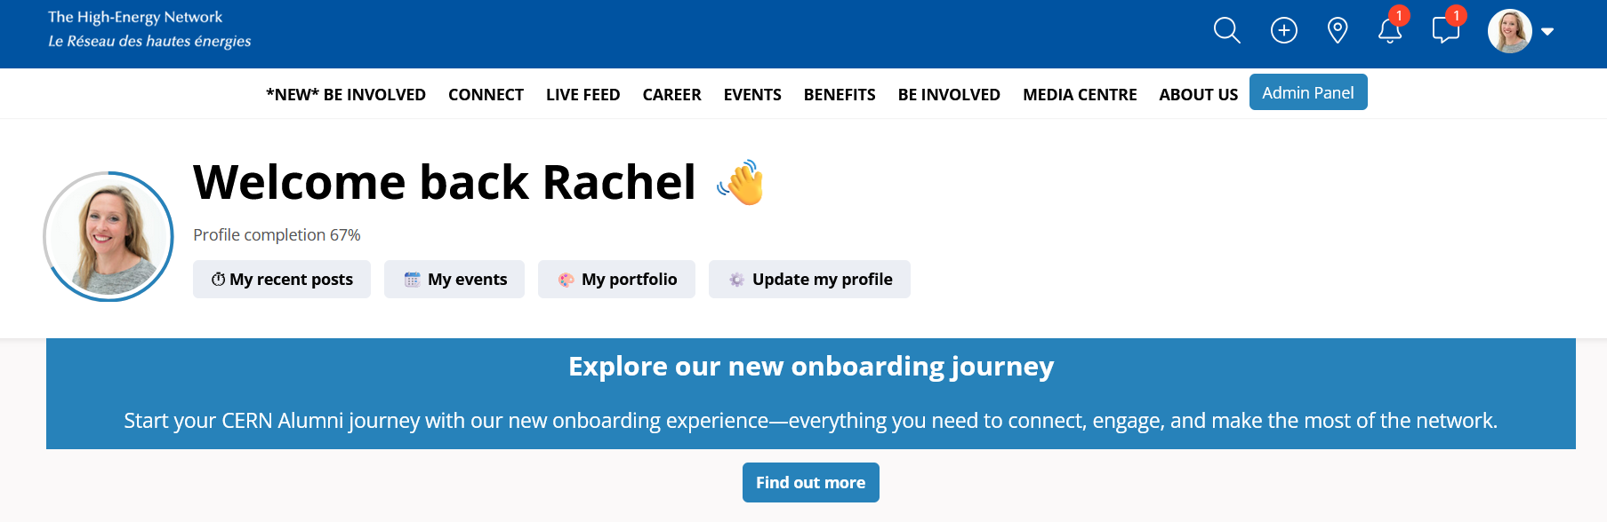
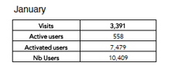
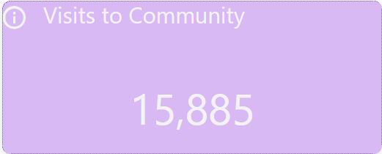
Improvements to alumni.cern Platform
2022
2025

Slide 9
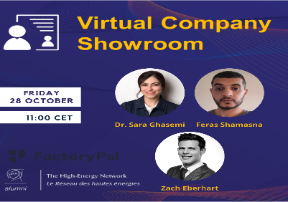
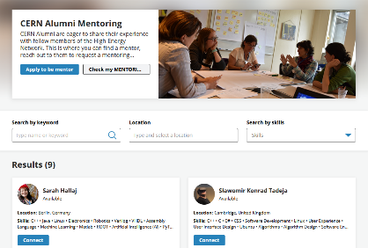

Actions taken for early careers

Slide 10
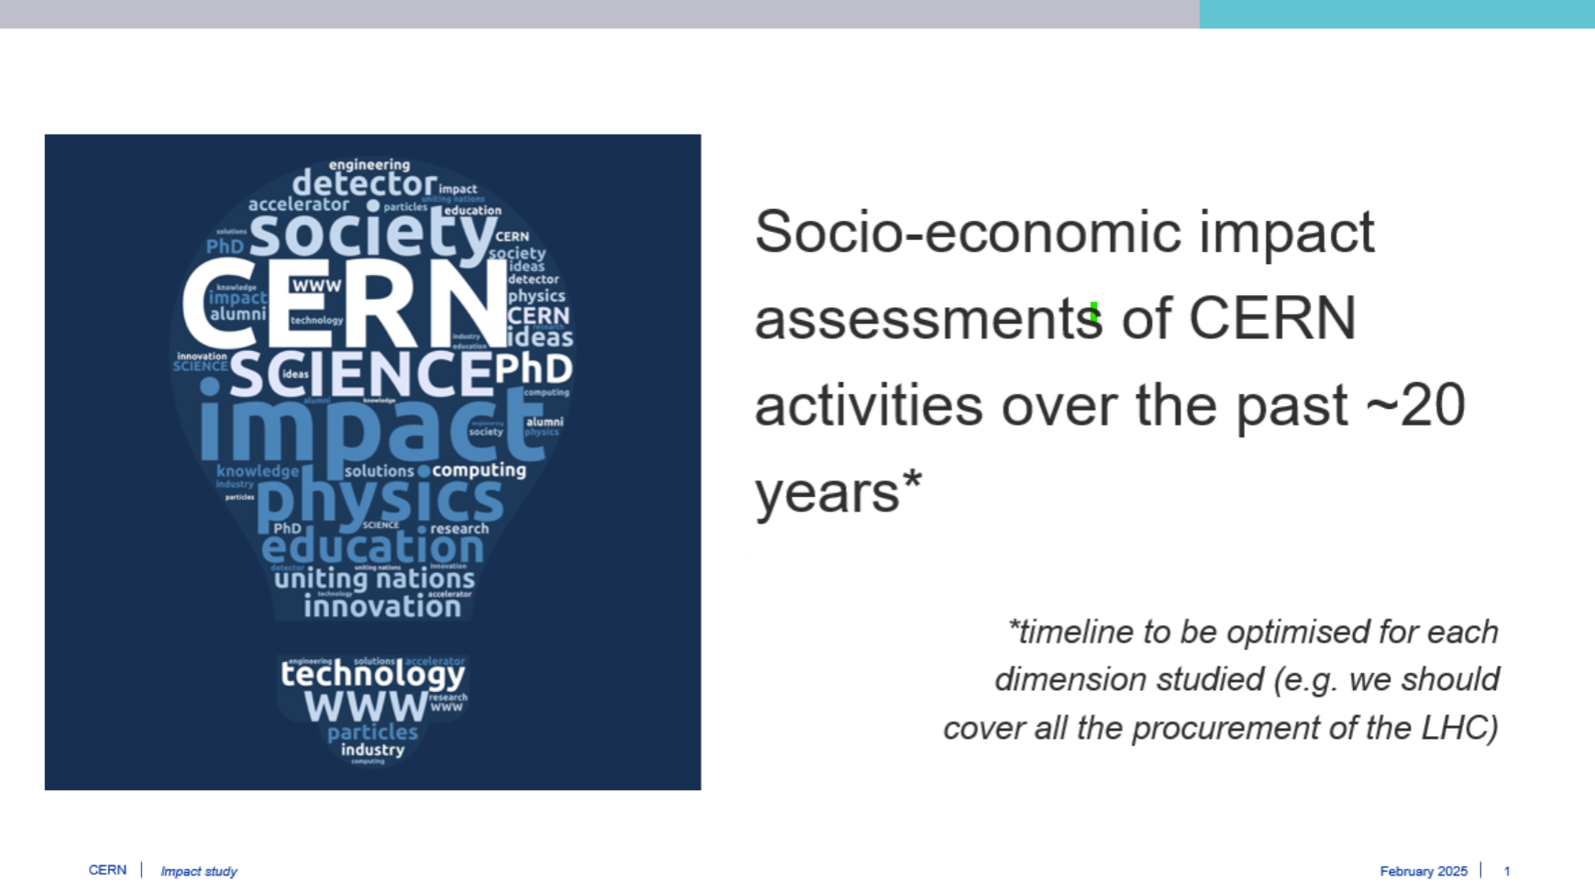
Alumni Survey 2025
Re-visit the questions:
  What problems can the alumni network solve for you? UVP & USP
  What do our members like & dislike?
  Where can we improve?
Questions for the CERN Socio-Economic Impact Study

Slide 11
Alumni Survey 2025
Joining the alumni network
  How and why.
Overall experience of being a member
  Value, net promoter score, areas for improvement, rating of benefits, frequency of visits.
alumni.cern platform experience (web and app).
Communications
  Channels, content.
Groups
  Membership and level of involvement.
Events
  Awareness, participation, rating.
Benefits
  Existing and suggestions.

Slide 12
Alumni Survey 2025 – Socio-Economic Impact study
To what extent have your experiences and interactions with CERN been helpful in advancing your career?
To what extent have you mobilised knowledge and skills acquired at CERN in other professional roles,
Could you give a concrete example of how knowledge and skills that you have acquired through CERN have been deployed in other settings, outside of CERN
Are there other skills or capabilities that you acquired through CERN which have proved beneficial to your career beyond CERN?
Additional wage premia questions
  Salary expectations compared with someone who doesn’t have CERN experience
  current approximate gross annual salary?

Slide 13
Alumni Survey 2025 – Schedule
 | 19/5 | 26/5 | 2/6 | 9/6 | 16/6 | 23/6 | 30/6 | 7/7 | 14/7 | 21/7 | 28/7 | 4/8 | 11/8 | 18/8 | 25/8 | 1/9 | 8/9 | 15/9 | 22/9
Project Go Ahead
KO Call
Questionnaire Design
Data Shared with Deep Blue
Scripting & Testing
Unique Links Shared with CERN
Outbound Invite
Reminder Mailing 1
Reminder Mailing 2
Survey Close & Data Processing
Analysis
Topline Data
QUANT DEBRIEF
Qual recruitment
Fieldwork
Analysis
FINAL DEBRIEF – QUAL & QUANT

Slide 14
Alumni Survey 2025 – Questions?

Slide 15

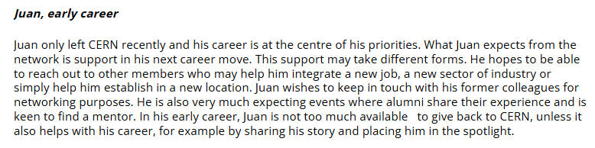
3 personas: Juan

Slide 16

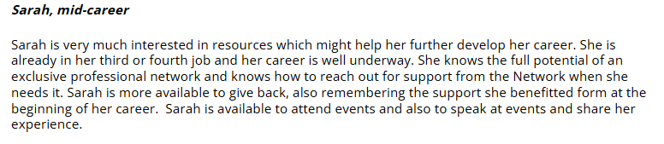
3 personas: Sarah

Slide 17

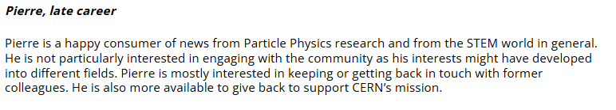
3 personas: Pierre

