Slide 1
Shaping PRISMAP +
T. Stora – CERN - PRISMAP coordination

Slide 2
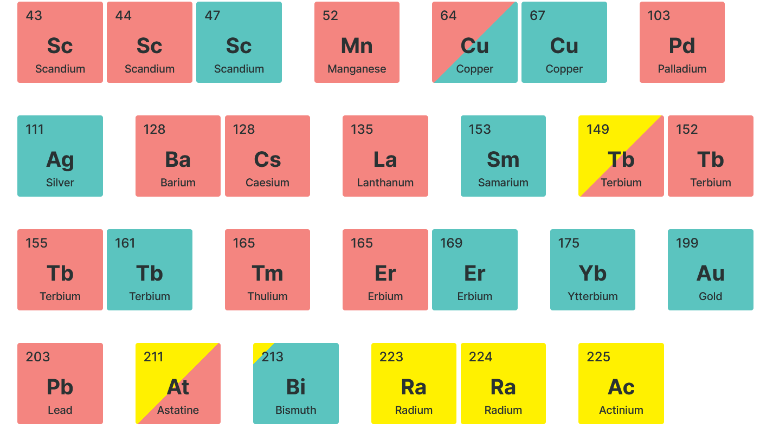

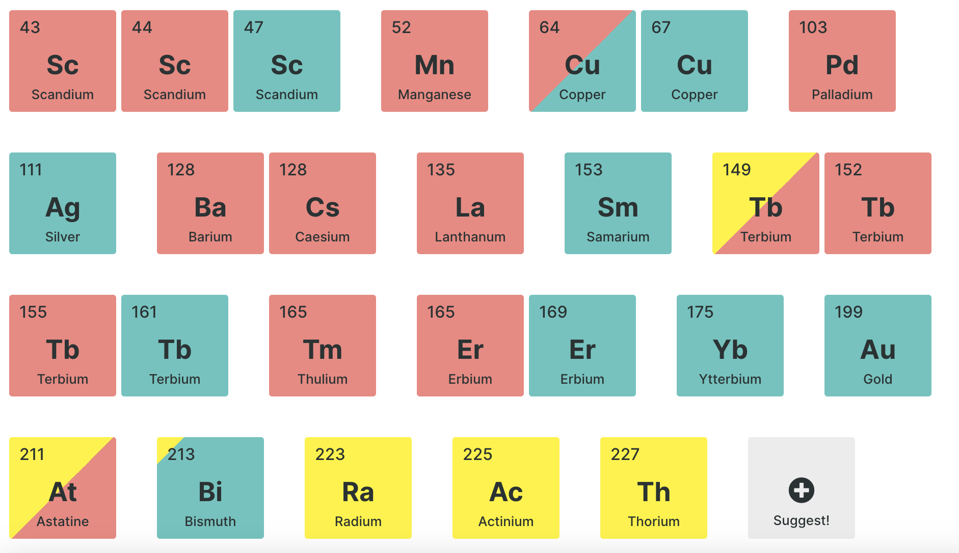
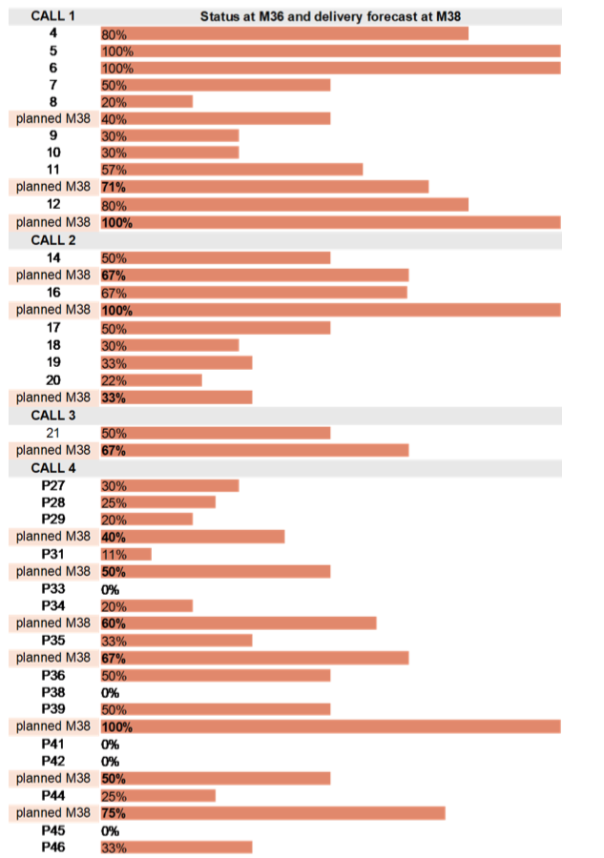
PRISMAP after 3 years (aka KPI’s)
Alphas
PET
Beta
Augers
(pure or not)
SPECT
This project has received funding from the European Union’s Horizon 2020 research and innovation programme under grant agreement No 101008571 (PRISMAP).
2021 → Dec 2025* (4,5 years)
4(+1) calls
32(+14) projects
  https://www.prismap.eu/access/user-projects/
>60 deliveries
15(21) different radionuclides
total of 28 radionuclides available (with >4 newly offered wrt day 1)
Suggest and Helpdesk in place https://www.prismap.eu/access/helpdesk/
>10 projects completed
2 projects published, ~ 10 at international conferences
1 “TROP” presentation highlighted at EANM’24 congress
2 projects moving into clinical settings
2 Emerging facilities in EU will join in PRISMAP +
PRISMAP(+) - EB– Mar 2025 T. Stora - CERN

Slide 3
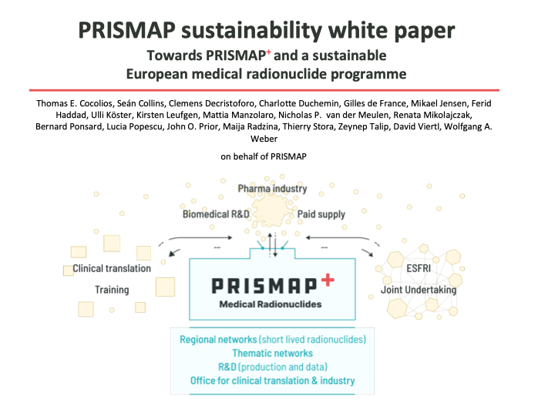
Long(er) term developments in PRISMAP, into PRISMAP +
2 projects aim at performing clinical trials
(first-in-human and phase-1/pilot )
P4 Towards 161Tb-PSMA cell targeting treatment of prostate cancer biochemical recurrence: Comparison with 177Lu-PSMA | Tb-161 | Dr. M. Kirienko | Italy
P31 203/212Pb-mcp-D-PSMA for an improved tumor therapy: Preclinical evaluation, automatisation and translation to clinical application | Pb-212/Pb- 203 | Dr. M. Pretze | Germany
https://zenodo.org/records/11448842
2 meetings on PRISMAP +:
- Consortium meeting (Mol (BE) 2-4 Apr 2025)
- Workshop (Oslo (NO) , 12-15 May 2025)
HORIZON-INFRA-2025-01 : INFRASERV - Research infrastructures services to support health research - Opening: 06 May 2025 -Deadline: 18 Sep 2025
Good news !: CH is back as fully associated country
PRISMAP(+) - EB– Mar 2025 T. Stora - CERN

Slide 4


Last news from the EU
The European Economic and Social Committee issued an opinion in Spring 2024 about Europe’s Beating Cancer Plan, the SAMIRA Action Plan, and in particular the European Radioisotope Valley Initiative (ERVI)
The Council of the European Union has taken up that opinion to recommend the ERVI programme and the consolidation of PRISMAP into a next phase (PRISMAP +, ?).
https://www.consilium.europa.eu/en/press/press-releases/2024/06/17/radioisotopes-for-medical-use-council-approves-conclusions/
ERVI : last 20 March : steering board meeting
PRISMAP(+) - EB– Mar 2025 T. Stora - CERN

Slide 5
ERVI specifics 20 March
The PRISMAP project is a notable success in the area of engaging the radioisotope R&D community through enabling the supply of rare isotopes to researchers. Its continuation for a new four-year period is underway, supported through a collaborative research project funded by the Horizon Europe Programme.
Project #4. R&D on new and innovative radioisotopes: Since 2021, the PRISMAP project, funded by the H2020 Programme, has successfully provided small amounts of radionuclides for medical research. There is broad agreement that this R&D should continue with enhanced support (expected PRISMAP+ project to be funded under Horizon Europe Programme). Additionally, a more ambitious R&D&I programme on medical isotopes is needed, guided by a common strategic document (i.e. Strategic Research and Innovation Agenda (SRIA)). This programme should build on existing initiatives, in particular ongoing collaborative projects (PRISMAP, SECURE, EU-CONVERSION) and various projects funded through the Innovative Health Initiative and other EC programmes. To ensure synergies in funding ERVI-related R&D&I initiative, increased coordination among stakeholders in the phase of strategic programming is required.
Brief relevance assessment: Similarly, PRISMAP project representatives are actively engaged in the ERVI Steering Group. The desire to build on PRISMAP’s efforts has been expressed, and a follow-up initiative has been presented. Further discussions are anticipated to explore the potential expansion of the project’s scope to include new activities and/or to enhance synergies with other initiatives planned under Strand 2.
the IPCEI format could also be explored (Important Projects of Common European Interest)
ERIC framework
Establishing a European Partnership
International Non-Profit Association (INPA)

Slide 6
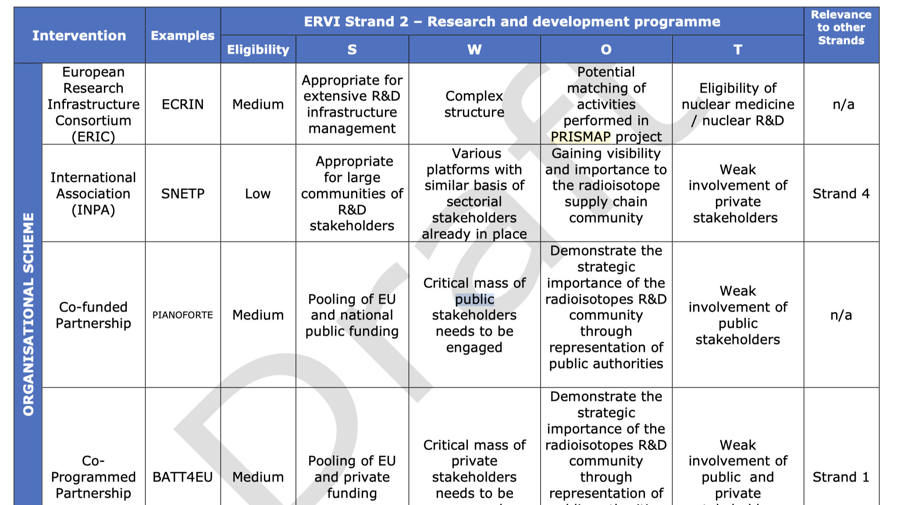
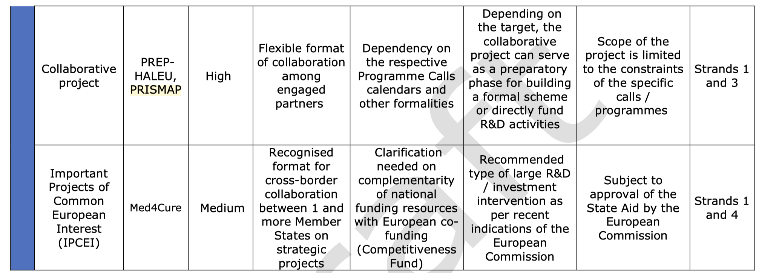
PRISMAP(+) - EB– Mar 2025 T. Stora - CERN

Slide 7
Planning for the targeted call
HORIZON-INFRA-2025-01 : INFRASERV - Research infrastructures services to support health research :
Opening: 06 May 2025
Deadline: 18 Sep 2025
Recruitment of Sciprom for preparation of the proposal by MEDICIS collab. – ASAP
Invitation to take part in the “Writing team” (proposal):
T. Cocolios, C. Decristoforo, F. Haddad, , U. Koester, K. Leufgen, J. Prior/V. Garibotto or delegate, T. Stora (support EU office/Charlotte)
Comm : regular reports to consortium meeting
Build upon Nantes meeting, latest developments (lessons learned, EANM, ERICs(EuroBioImaging), emerging facilities, TRIUMF, CNL, PANTERA, CERN decision(s), industry, etc), White paper
PRISMAP(+) - EB– Mar 2025 T. Stora - CERN

Slide 8
PRISMAP + targetted call
Draft work program (as received 07/2024)
HORIZON-INFRA-2025-01-SERV-01: Research infrastructure services to enable R&I addressing main challenges and EU priorities related to the health domain
Preamble : EU supported transnational access to research infrastructures has radically transformed the availability of state-of-the-art facilities for researchers, reinforcing Europe’s strong research performance. Horizon Europe marked a shift towards new types of transnational access grants, awarded to consortia of diverse types of facilities providing access to broad portfolios of installations and scientific services relevant for a large research domain or in support of societal challenge and EU priorities.
Given the specific nature of this topic, access provision activities must be included in the proposal. Please read carefully the provisions under the section “Specific features for Research Infrastructures” of this work programme part before preparing your application.
In case of a distributed Research Infrastructure, a signed declaration from the legal representative confirming which node(s) will represent the research infrastructure is an alternative to the member that holds the statutory seat (e.g. ERIC) being a beneficiary.

Slide 9
legal entities established in Australia, Brazil, Canada, Chile, India, Japan, Mexico, New Zealand, Republic of Korea, Singapore, Switzerland, and USA, which provide, under the grant, access to their research infrastructures to researchers from Member States and Associated Countries, are exceptionally eligible for funding from the Union under this topic.
NB : (PSI, CHUV, HUG, Bern, EPFL…) (CNL, TRIUMF) are eligible; NPL also
The Joint Research Centre (JRC) may participate as member of the consortium selected for funding.
best research infrastructure services
curiosity-driven and challenge-driven access,

Slide 10
The extent to which the access activities (trans-national and/or virtual access) will offer access to the state-of-the-art infrastructures of European interest in the field, high quality services, and will enable users to conduct excellent research.
The extent to which the project will contribute to facilitating and integrating the access procedures, to improve the services the infrastructures provide and to further develop their on-line services.
------------------------------------------------
.

Slide 11
Access to novel radionuclides and facilities
Build on the work carried out by the PRISMAP project in establishing a network of world-leading European facilities, including nuclear reactors, accelerators and radiochemical laboratories, offering a broad catalogue of radionuclides for medical research. The network must offer researchers access to radionuclides and to the complementary biomedical facilities
The network must offer services for:
the production and delivery of high purity radionuclides;
associated research in biomedical facilities;
supporting translational research and preclinical research techniques, either self-service or fully performed as a service.
Development towards the upscaling of the production
New purification methods
Proof-of-concept investigations showing the development of new treatments from test bench to patient care.
monitor and engage with other initiatives supporting the EU SAMIRA

Slide 12
quote at GRC on radiopharmaceuticals last summer:
“We wish we would have a similar progrAMME IN THE USA”

Slide 13
PRISMAP(+) - EB– Mar 2025 T. Stora - CERN

Slide 14
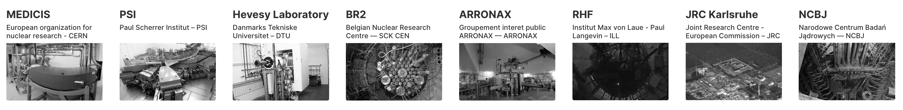
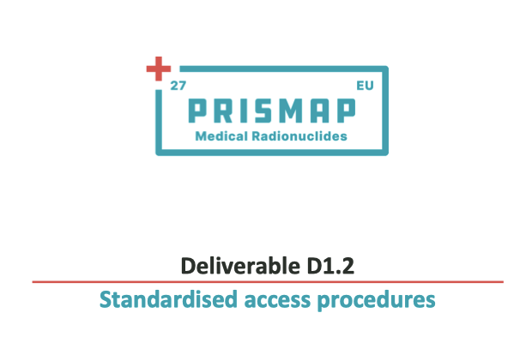
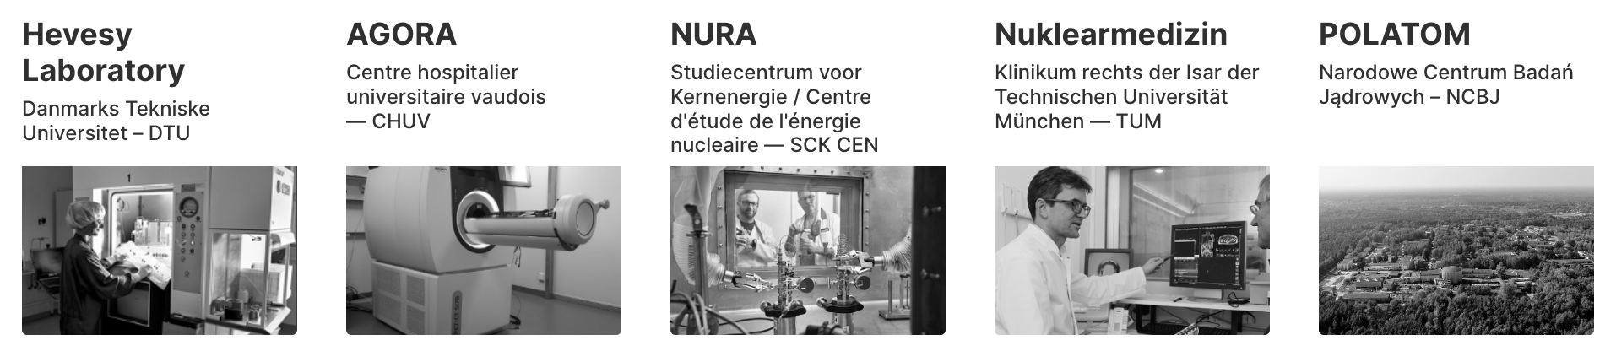
Create a common entry port and web interface for the starting research community
PRISMAP Community still in its infancy...

