Slide 1
ERVI Roadmap and PRISMAP + inclusion
Report from ERVI Steering Group participation
Mikael Jensen at PRISMAP + session end of CM8 @ SCK

Slide 2
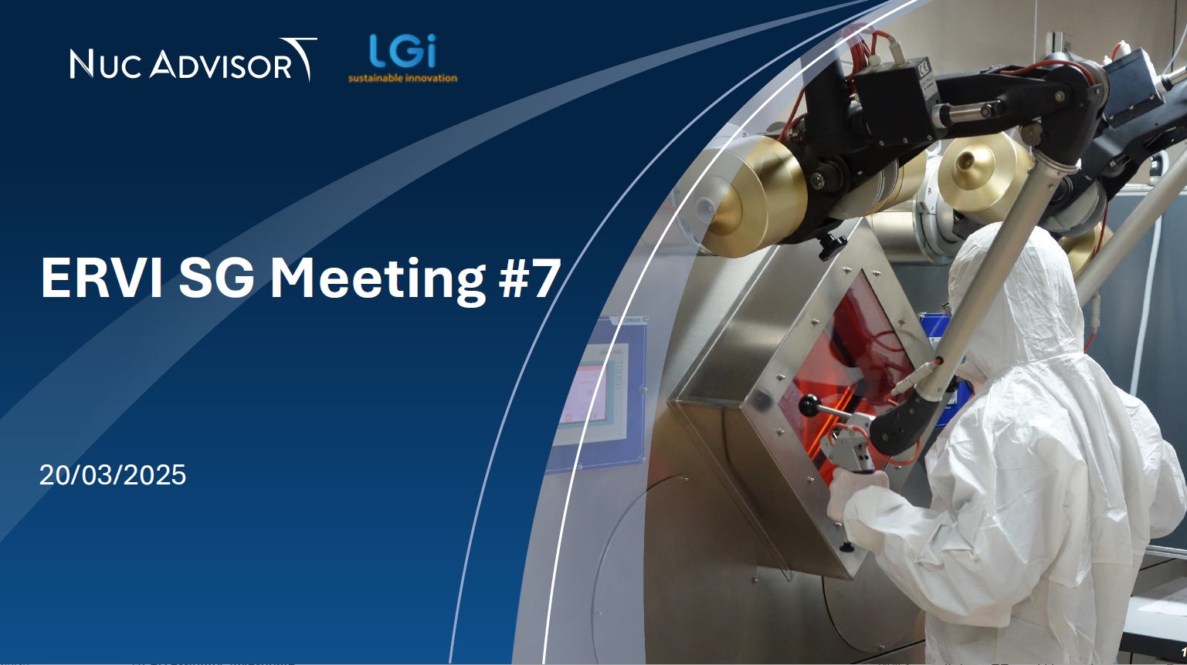
What is ERVI?

Slide 3
ERVI = European Radioisotope Valley Initiative
Goes together with SAMIRA – a European Action Plan – to secure the supply of medical radioisotopes
Both having large INDUSTRY involvement

Slide 4
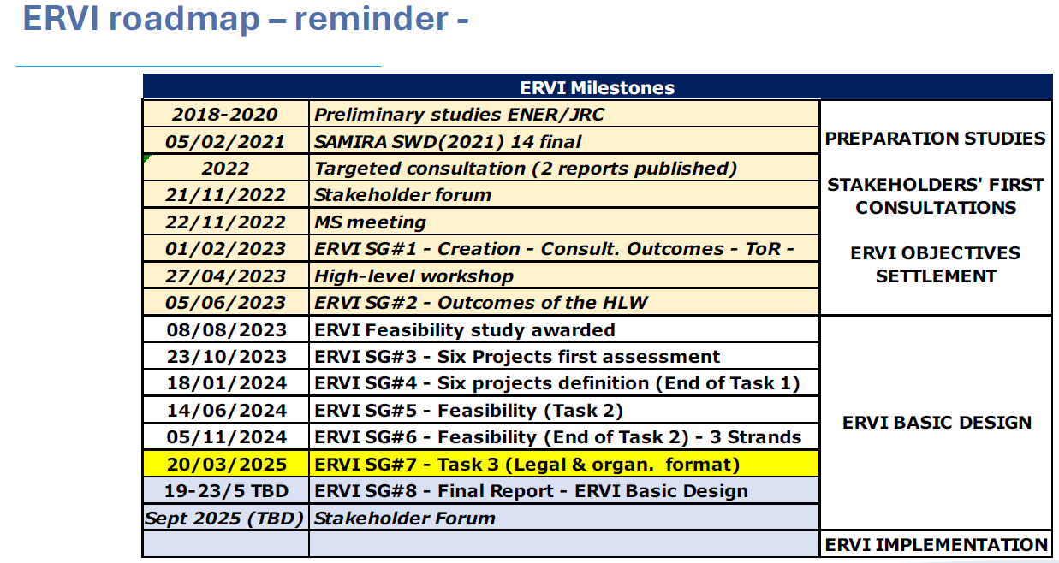

Slide 5
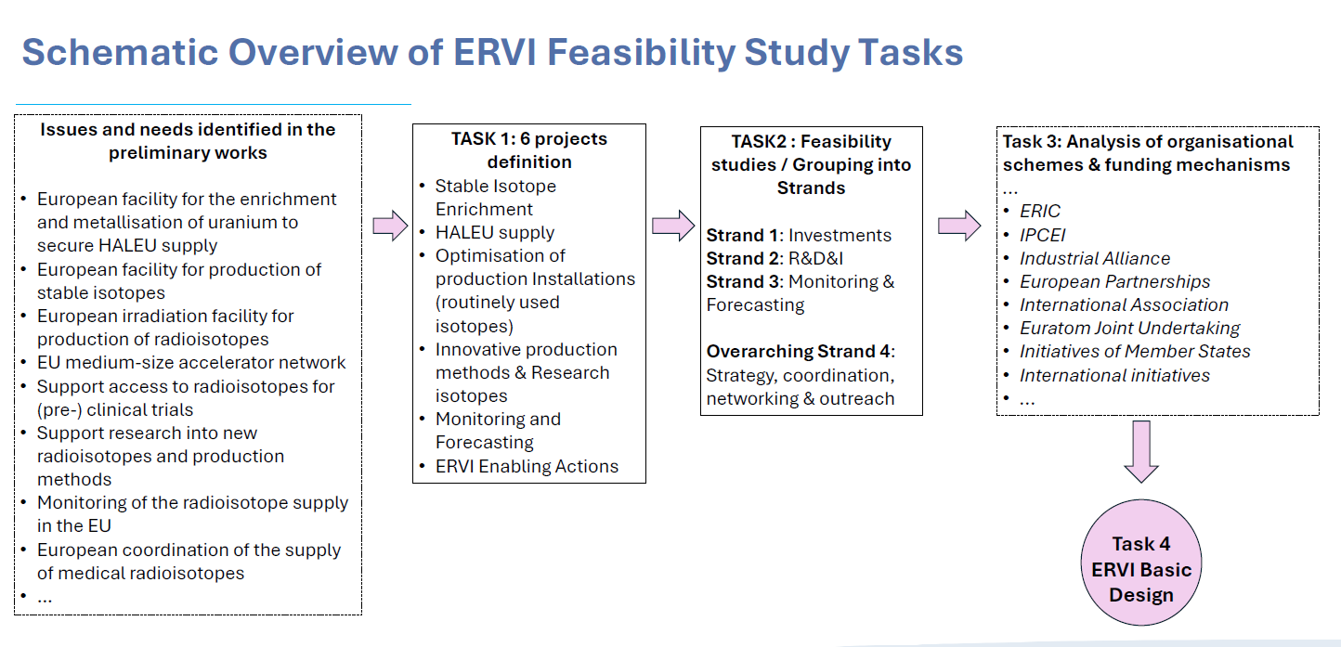

Slide 6
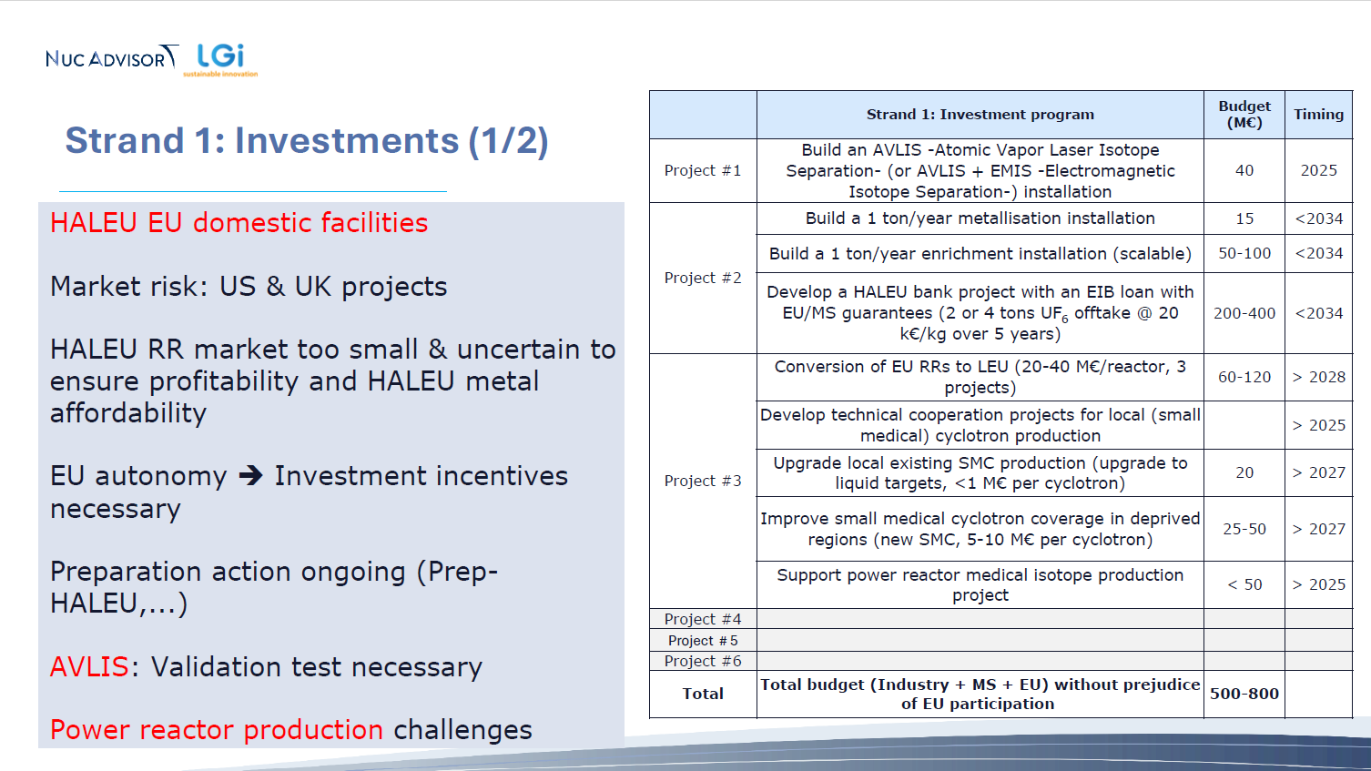

Slide 7
Interlude:
PRISMAP+ and all of us may benefit from the ”stable isotopes enrichment” initiatives
ORANO and URENCO are part of ERVI / SAMIRA …..
But EUROPEAN large scale electromagnetic separation
is far away ….

Slide 8
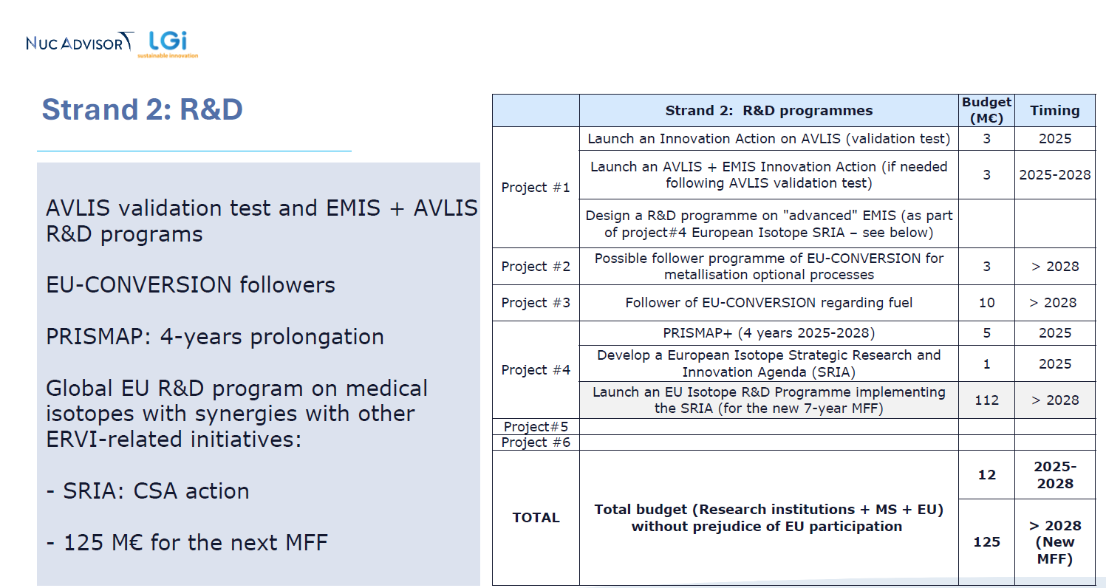

Slide 9
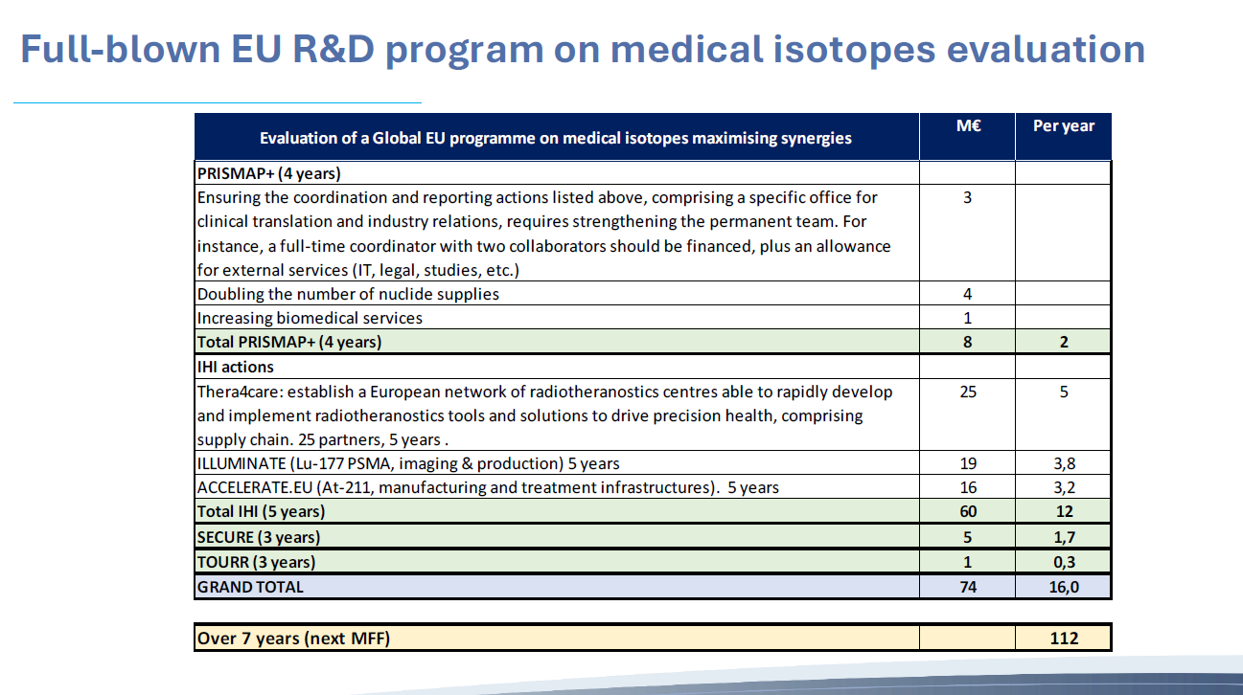
?
>2028
?

Slide 10
PRISMAP + funding - from EU DG Energy
5 M Euro ? From late 2025 ?
Mind the gap
INFRASERV01 call opens 6 May
Training not part
PRISMAP is universally recognised as a success …
“clear appetite of R&D ERVI’s SG members for a more ambitious R&D
program to achieve synergies with other MS and EC initiatives”
BUT ” a lack of drive of stakeholders to invest “ (Public versus private money)

Slide 11
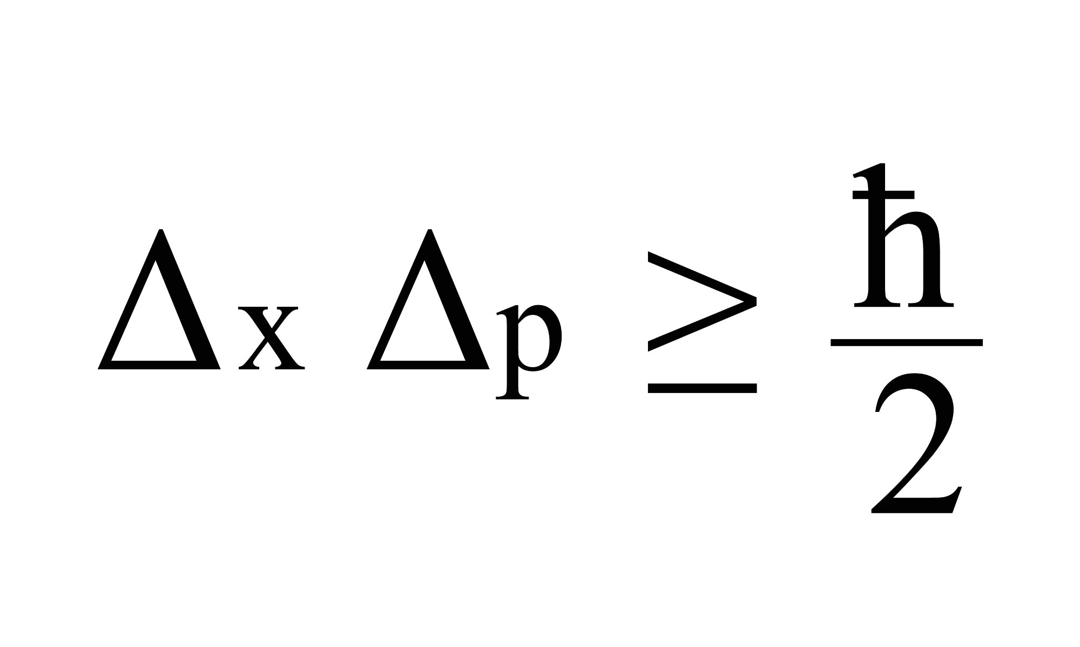
ERVI ”uncertainties”…..
“Political backing remains to be reinforced
- Commitment on foreign dependencies for source materials
- Recognition of radioisotopes as a critical part of a high level of healthcare
- Commitment to maintaining and strengthening Europe’s autonomy
ERVI’s legal, organisational and funding formats, must address these political issues”
TIME is running …. ( slipping ?)

