Slide 1
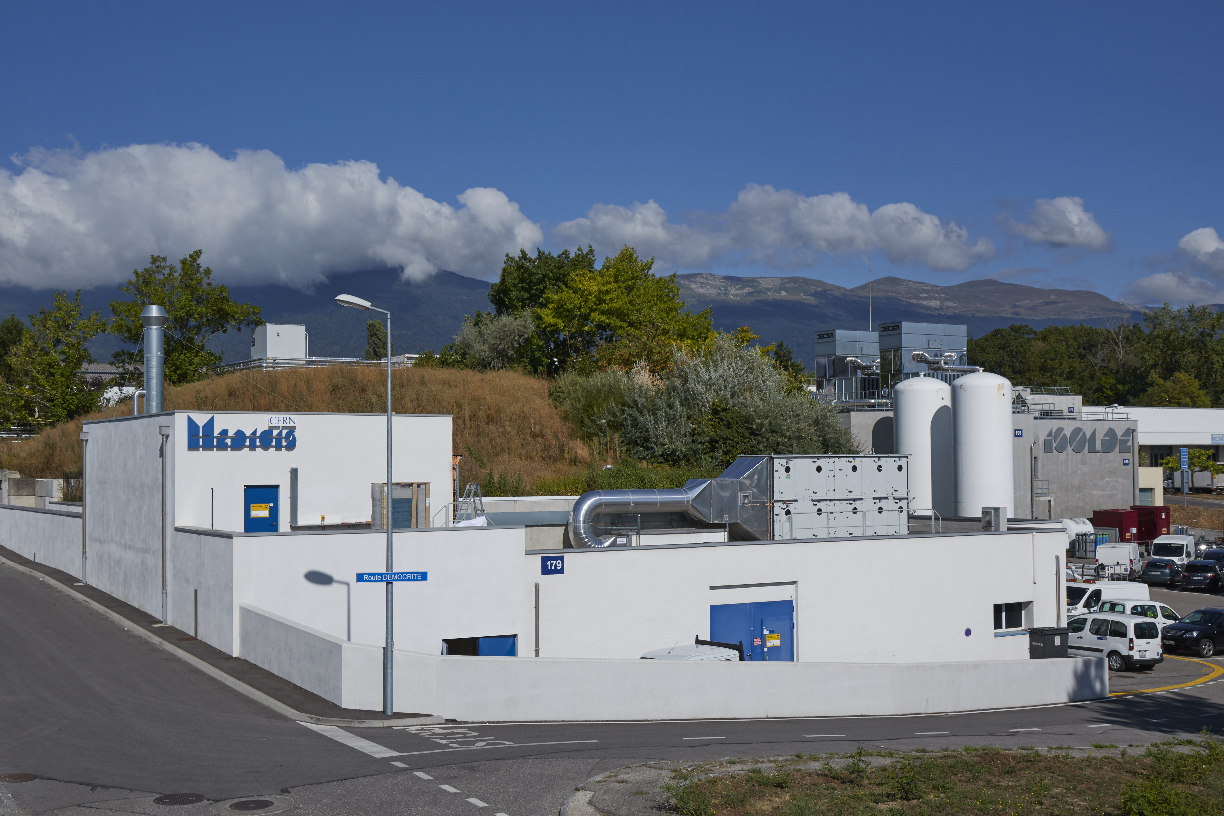
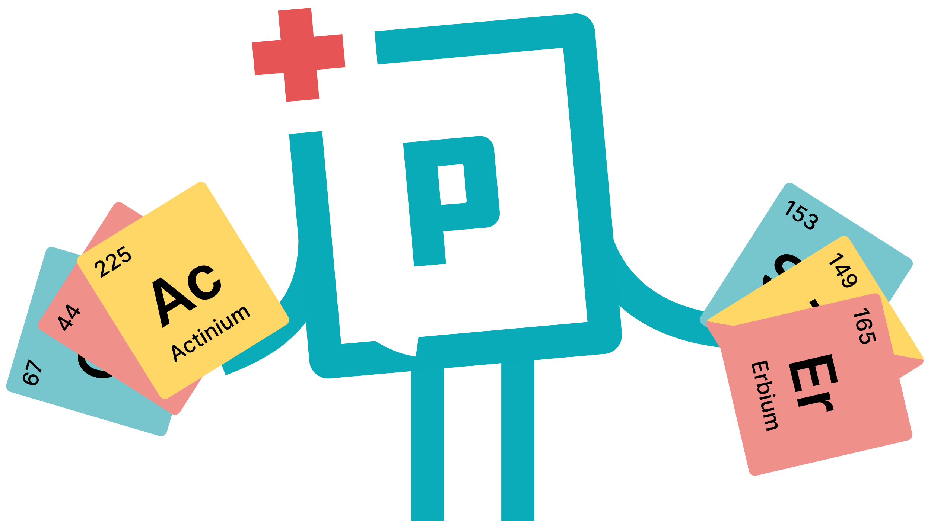
InnoMedRad
An MSCA DN
Prof. Thomas Elias Cocolios
KU Leuven Institute for Nuclear and Radiation Physics
In the margin of the PRISMAP CM8, April 2025, Mol

Slide 2
Rational
Novel medical radionuclides require particular training that is not currently available through standard education.
Novel medical radionuclides are on the rise (PRISMAP!!)
All stakeholders have identified the need for dedicated training (see PRISMAP, ERVI, Accelerate.EU)
The INFRA call where PRISMAP+ will be submitted EXCLUDES the possible to include such training.
➔ Those are all the ingredients to motivate the creation of a Marie Skłodowska Curie Action, Doctoral Network.

Slide 3
Scientific project
Targeted Alpha Therapy
  High promise for therapeutic potency
  Very close to clinic yet requiring some careful investigation
  Working with alpha-emitting radionuclides is beyond the state of the art
Auger Electron Therapy
  Great promise for therapeutic potency
  Requires particular attention to targeting
  Many gaps in the scientific knowledge
Novel nuclear medicine pathways
  There are many more things to explore or develop in nuclear medicine
  De-risking high-risk ideas is essential to open the way to new solutions

Slide 4
1- Targeted Alpha Therapy
GANIL (FR): Radiobiology with alpha emitters
Academic partner: Caen Université
Secondment: TBD
IBA (BE): Chemistry of ²¹¹At
Academic partner: TBD (UCLouvain? KU Leuven?)
Secondment: Erasmus MC for clinical flow integration
Nuclide Tx (UK): novel radiopharmaceutical with ²¹¹At
Academic partner: King College London (student fee?)
Secondment: Nantes for pre-clinical research
CERN: high-throughput, non-laser ion source
Academic partner: TBD (Leuven?)
Secondment: IBA ?
KU Leuven (BE): 3-fold collections at MEDICIS (^{223,224,225}Ra / ^{225,226,227}Ac)
Secondment: CERN & TBD

Slide 5
2- Auger Electron Therapy
ARRONAX (FR): Production of ⁷¹Ge
Academic partner: Subatech
Secondment: somewhere to look into Ge coordination chemistry
PSI (CH): Production of another Auger electron emitter?
Academic partner: ETH Zurich or Bern
Secondment: TBD
IST (PT): Mitochondria targetting radiopharmaceutical development
Secondment: KU Leuven & more?
KU Leuven (BE): Nanobody-based radiopharmaceutical development
Secondment: IST & more
Collaboration with Sanofi Ablynx
NPL (UK): Automated chemical synthesis for Auger emitters
Academic partner: University of Surrey (student fee?)
Secondment: TBD

Slide 6
3- Novel nuclear medicine pathways
Innsbruck (AT): Novel targetting strategy
Secondment: TBD
Vienna (AT): Nobel metals in nuclear medicine
Secondment: TBD
BioEmTech (GR): high-energy gamma-ray imaging
Academic partner: Athens?
Secondment: TBD
Nantes Université (FR): Radiobiology
Secondment: SCK CEN
JGU Mainz (DE): ¹⁹⁴Os/Ir generator
Secondment: TBD

Slide 7
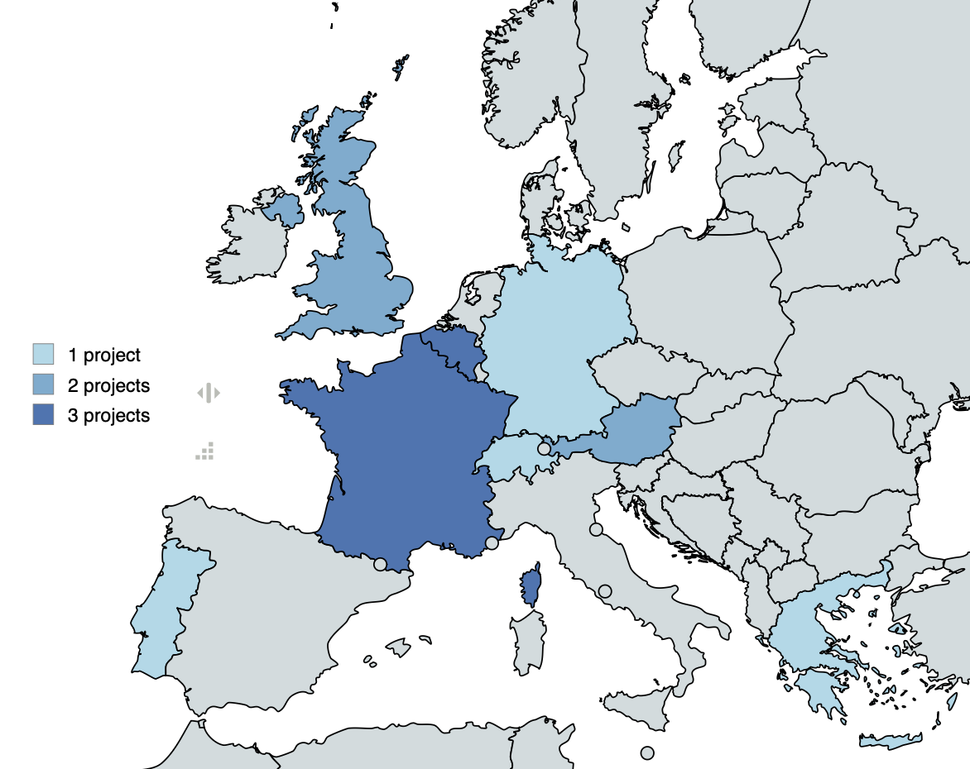
Consortium
4 companies
4 laboratories
6 universities
No more than 3 projects per country

Slide 8
Training
I propose to recreate the trainings that were proposed in PRISMAP, structured around the interest of the network:
Translational training at SCK CEN → As a partner (SCK CEN Academy has expressed interest)
Radiolanthanide school DTU/PSI → To be discussed with DTU
Radiopharmaceutical school IST
Radionuclide production school Leuven
Medical school Riga → To be discussed
ISI Nuc Med Nantes

Slide 9


Alignment with PRISMAP+
Substantial overlap with the PRISMAP+ consortium.
Mix of radionuclides on the portfolio and of developments that can lead to additions to the portfolio.
Possibility to synergise with the PRISMAP+ Joint Research Activities to maximise impact.
Synergies in the project structure (use of SCIPROM infrastructure like member section, GoTo Meeting, ...)
Proposed combined dissemination strategy: same website, matching visual identity, …

Slide 10
Preparation
Submission deadline 25 Nov: after PRISMAP+, just after CM9.
Full draft ready shortly after the PRISMAP+ submission in September for finalising in time.
Writing in parallel with PRISMAP+ to ensure a good match between the two proposals.
Suggest to employ SCIPROM for enabling (use of their platform) and follow up of the proposal preparation.
KU Leuven can cover 50% of that cost. Will ask the consortium to cover the remaining part == 3.33% per project (should be ~ € 500 each).

