Slide 1


Belgian and UGent contributions in the CMS detector upgrade
Frank Hartmann – CMS Upgrade Coordinator
You want to do fundamental science?
You want to have the perfect place to educate students in and international edge-technology environment?
The CMS upgrade is your toy!

Slide 2
~200 vertices
~10’000 tracks per collision
40 MHz
➔ 0.5 THz of tracks

Slide 3
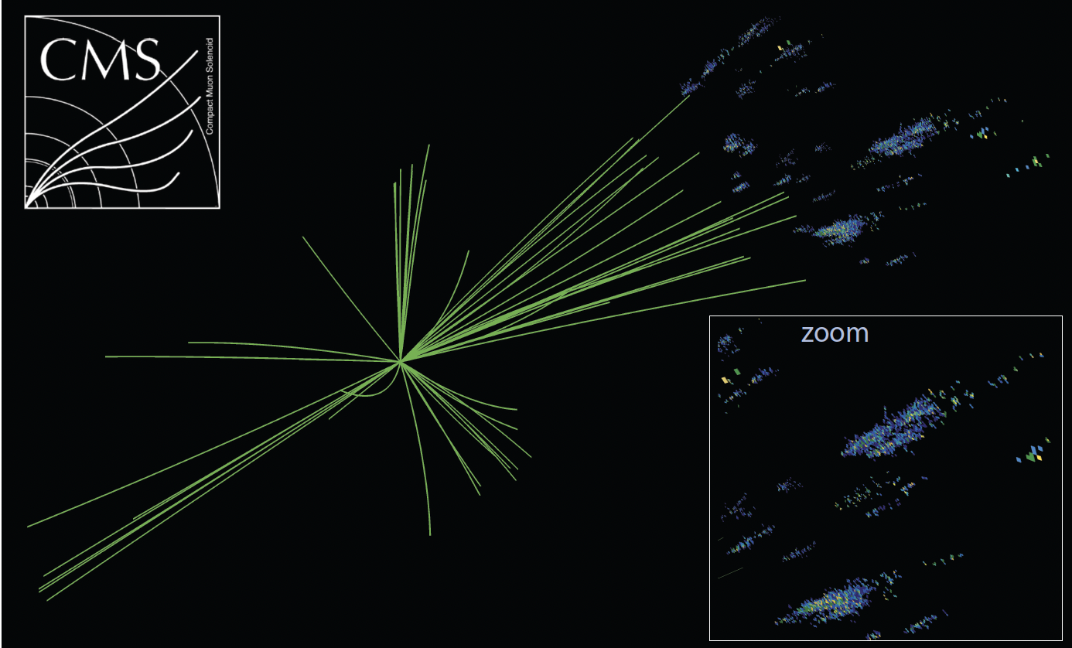
High granularity allows particle flow
already at Level-1 trigger

Slide 4
Same trigger event today
TRACKER
CAL
'to be clear this is excellent for the physics in the current environment'

Slide 5
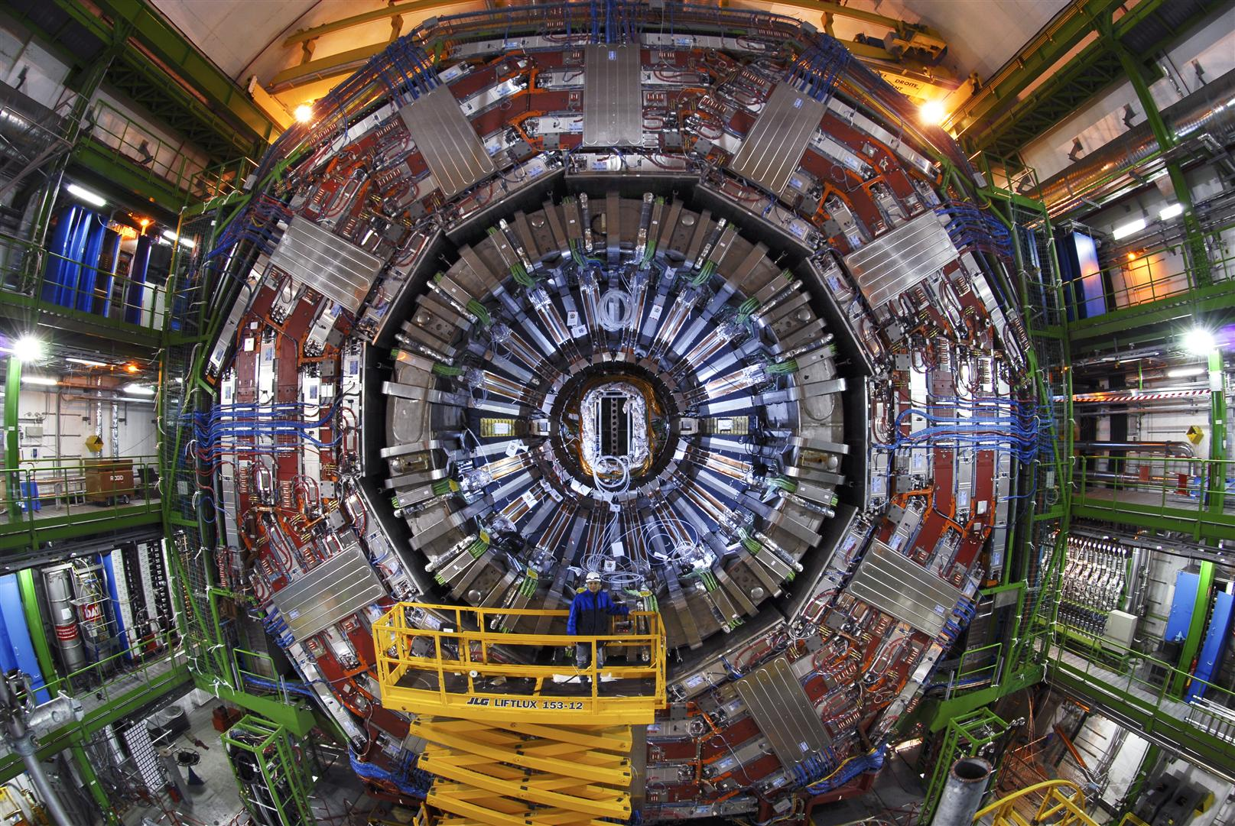

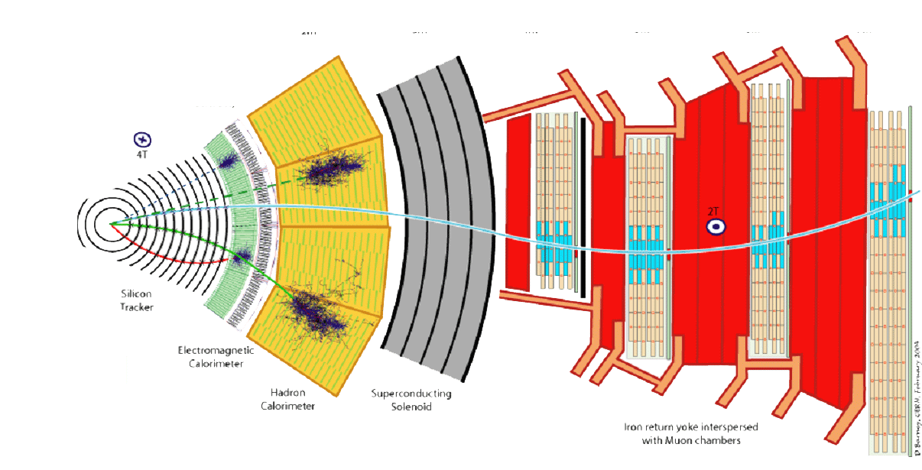
And real life in CMS
Notes:
Mind to explain the magnet

Slide 6

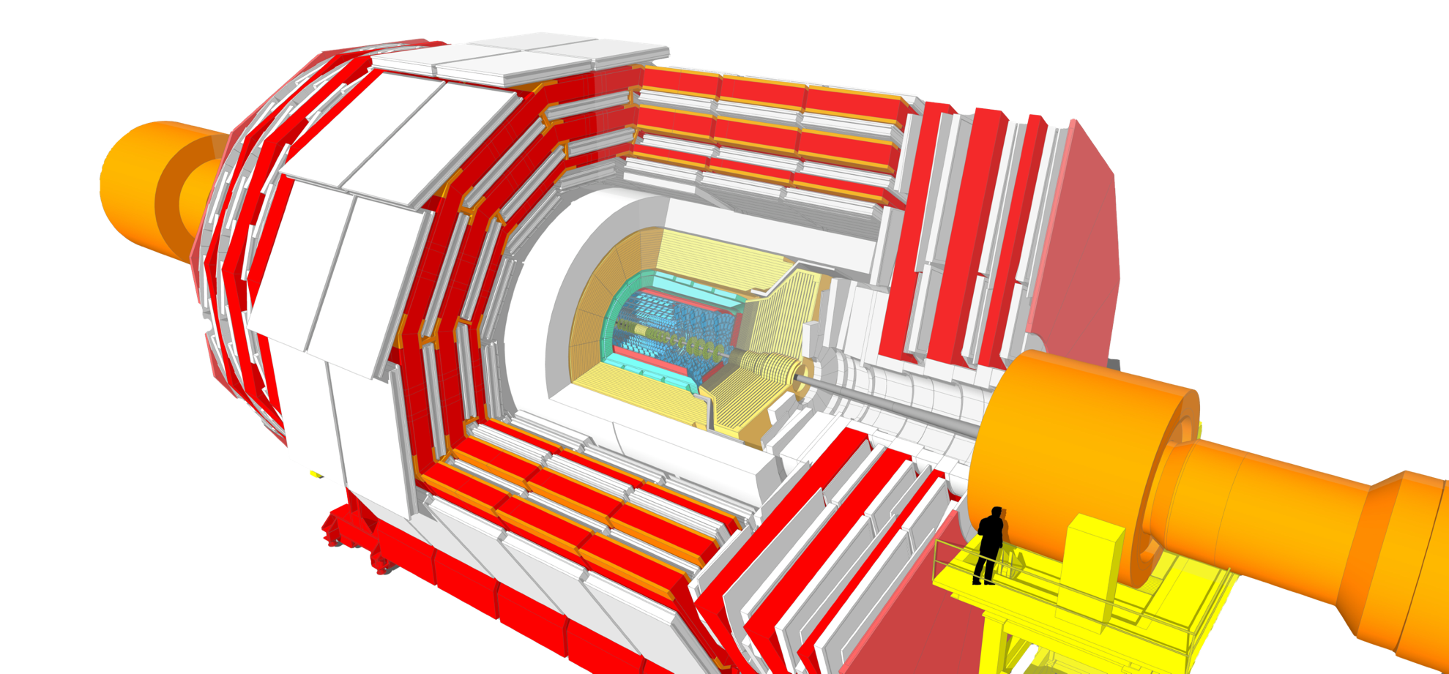





Our Future Unprecedented Beauty - A Bold Upgrade
Replace 100% electronics
  Increase bandwidth
New Tracker (incl. trigger)
New high granularity endcap CALO
  Extend Tracker & Muon in forward direction
Add Timing Detector (mitigate pile-up)
  Add timing in Muon and calorimeter
L1-Trigger
https://cds.cern.ch/record/2714892
Tracks in L1-Trigger at 40 MHz
Particle Flow selection
750 kHz L1 output
40 MHz data scouting
Barrel Calorimeters
https://cds.cern.ch/record/2283187
ECAL single crystal granularity at L1 trigger
with precise timing for e/γ at 30 GeV
ECAL and HCAL new Back-End boards
Calorimeter Endcap
https://cds.cern.ch/record/2293646
3D showers and precise timing
Si, Scint+SiPM in Pb/W-SS
Muon systems
https://cds.cern.ch/record/2283189
DT & CSC new FE/BE readout
RPC back-end electronics
New GEM/RPC 1.6 < η < 2.4
Extended coverage to η ≃ 3
DAQ & High-Level Trigger
https://cds.cern.ch/record/2759072
Full optical readout
Heterogenous architecture
60 TB/s event network
7.5 kHz HLT output
Tracker
https://cds.cern.ch/record/2272264
Si-Strip and Pixels increased granularity
Design for tracking in L1-Trigger
Extended coverage to η ≃ 3.8
Beam Radiation Instr. and Luminosity
http://cds.cern.ch/record/2759074
Beam abort & timing
Beam-induced background
Bunch-by-bunch luminosity:
1% offline, 2% online
Neutron and mixed-field radiation monitors
MIP Timing Detector
https://cds.cern.ch/record/2667167
Precision timing with:
Barrel layer: Crystals + SiPMs
Endcap layer:
Low Gain Avalanche Diodes
Mitigate by
Rate – new electronics
Occupancy – high granula
Rad tolerance (SI)
Notes:
Replace 100% electronics
Increase bandwidth
New Tracker (incl. trigger)
New high granularity endcap CALO
Extend Tracker & Muon in forward direction
Add Timing Detector (mitigate pile-up)
Add timing in Muon and calorimeter

Slide 7
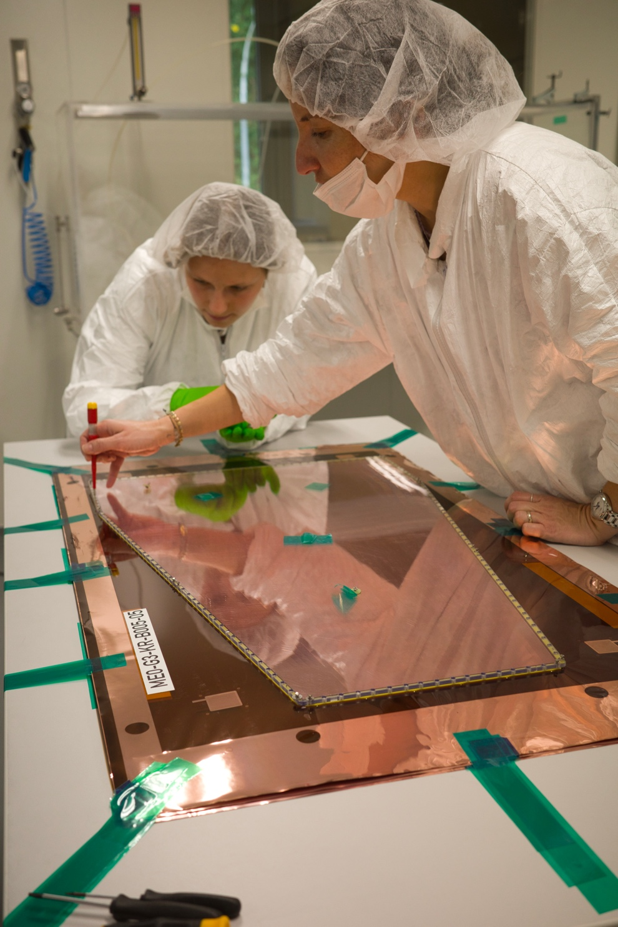
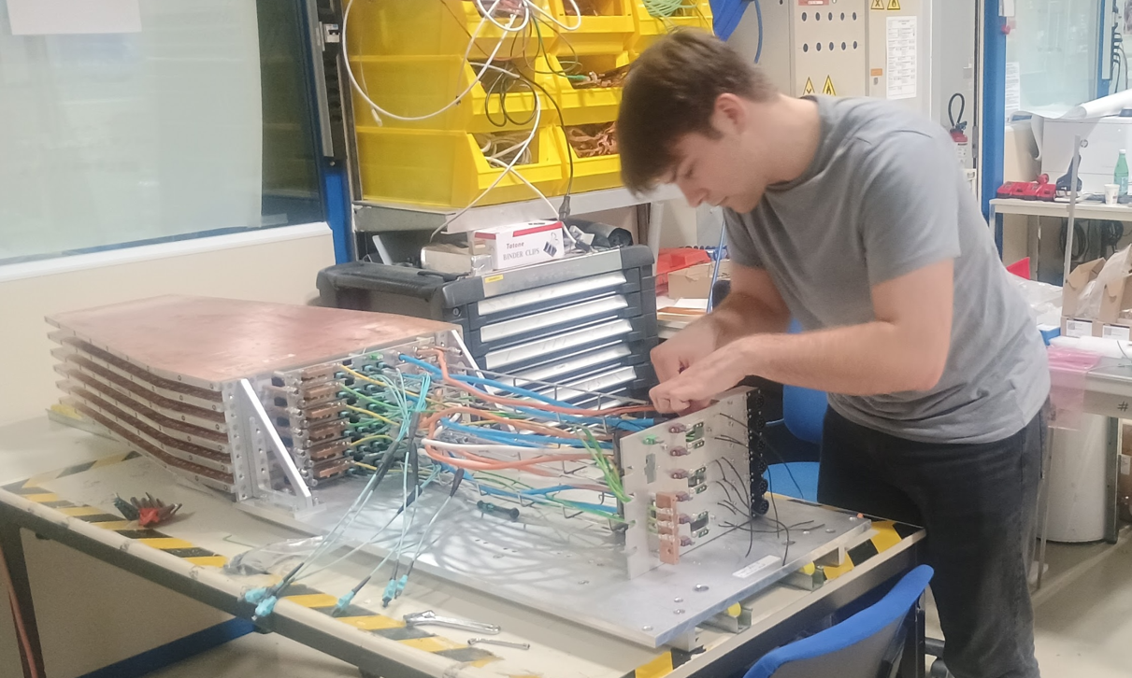
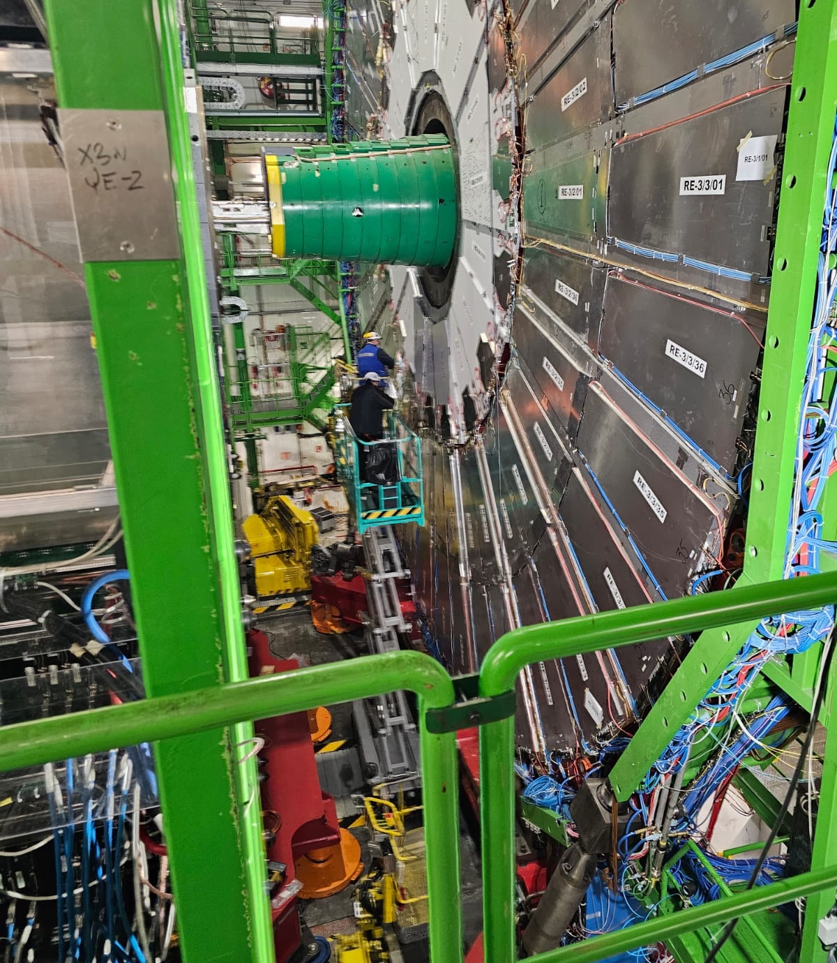
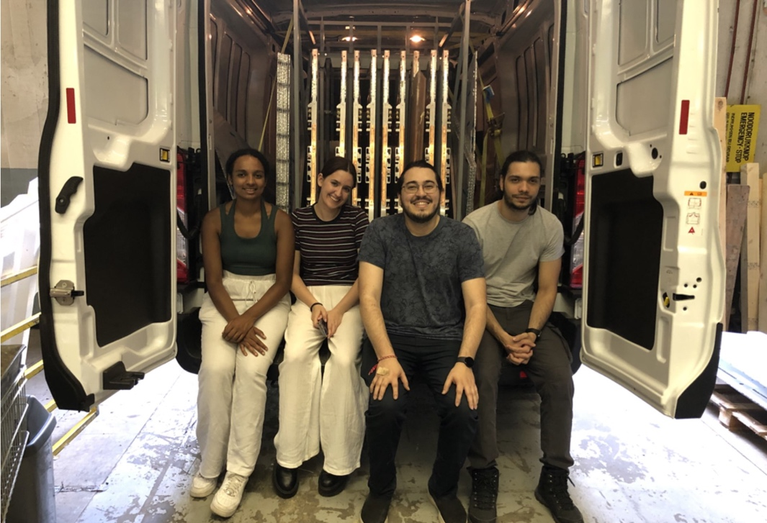
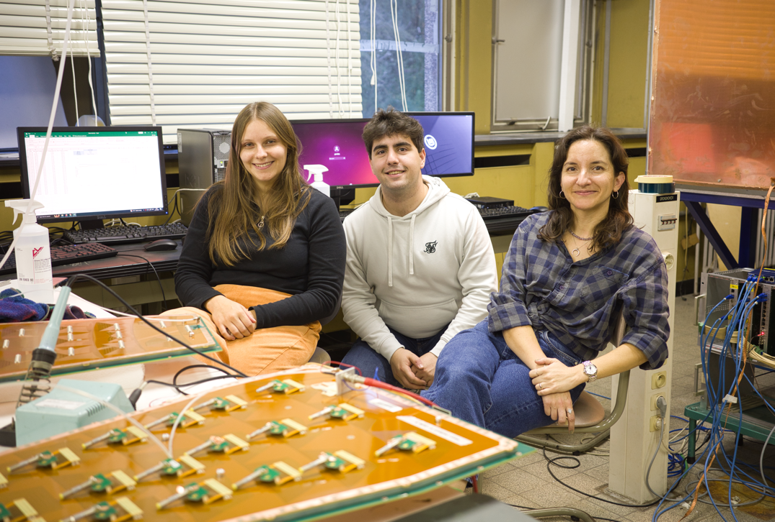
Muon Detectors
2nd 6-layer tripple GEM stack
RPCs from Gent – main site
20 RE3/1 and RE4/1 chambers
Building GEMs in Gent – delicate work
RPCs just installed
Gent involved in BOTH Muon detector extension – RPC & GEM
Master students testing GEMs in Gent

Slide 8
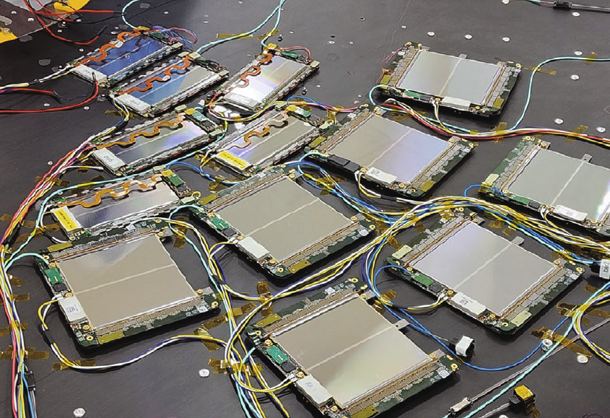
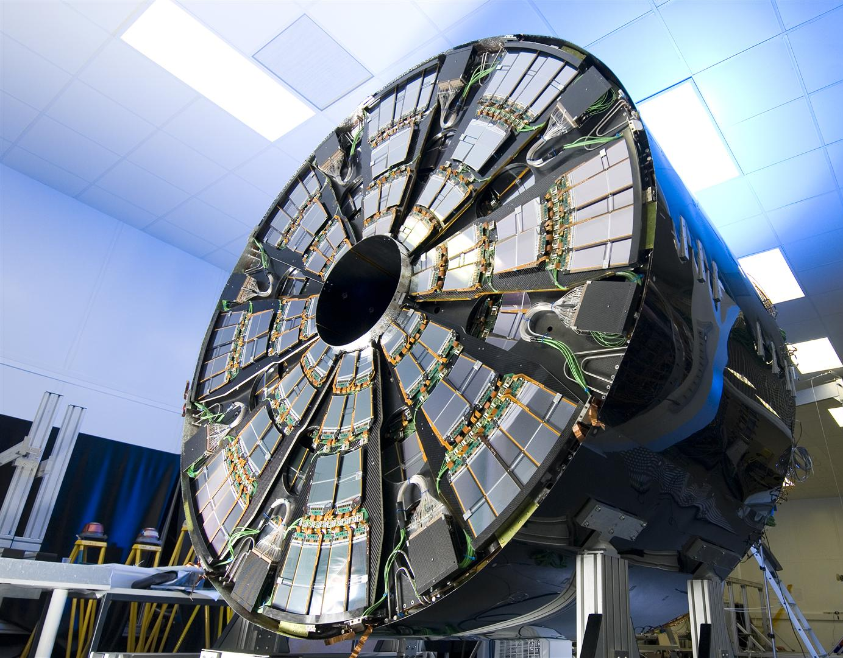
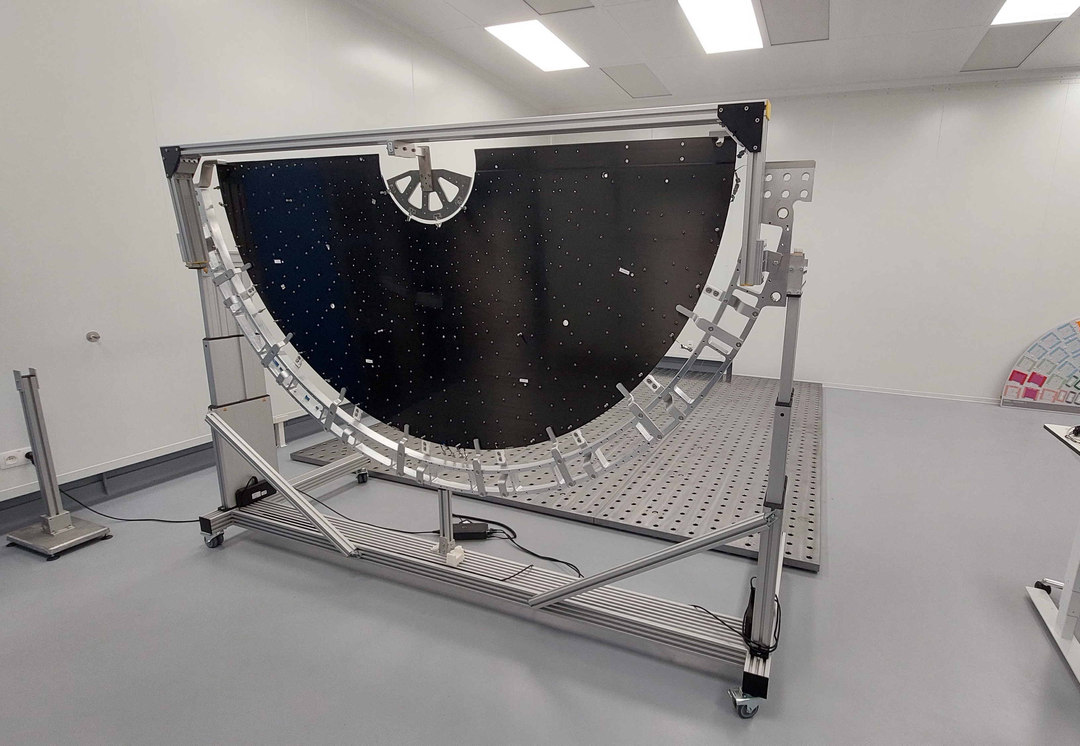
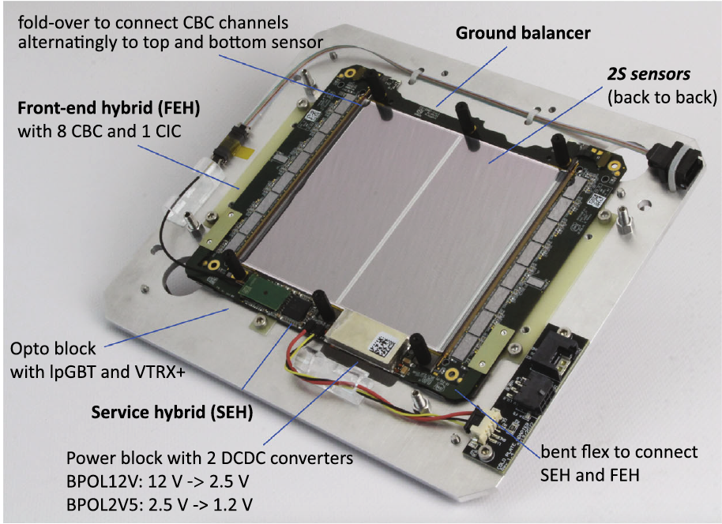





CMS Tracker
-200m² of silicon
Today
Tracker, today the most complex system
Tracker, tomorrow even more complex
Huge and complex job, need hands at Brussels and Louvain from all of Belgium and probably beyond
~10M Euro contribution through Hercules funding
FWO/FNRS
To be built for tomorrow at Louvain
1 endcap = 5 double disks = 20 of these
Most complex module – ever
2000/14000 to be built on Brussels -NOW

Slide 9
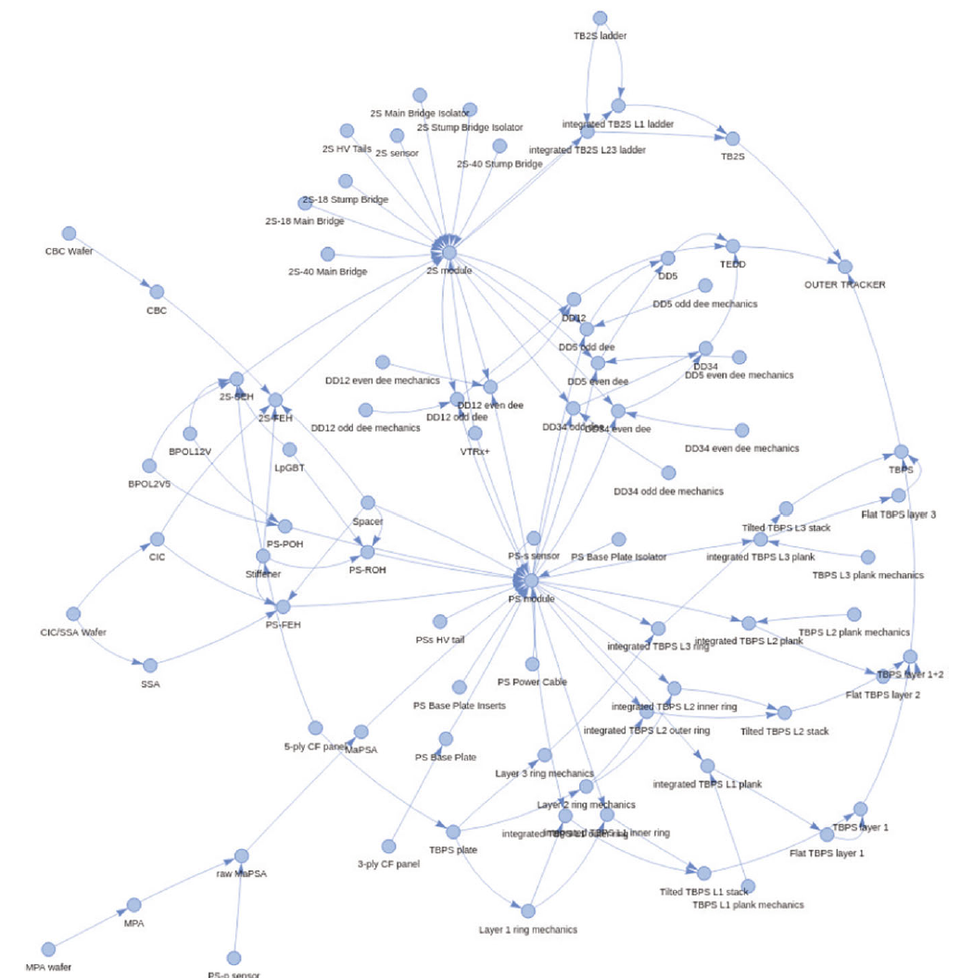
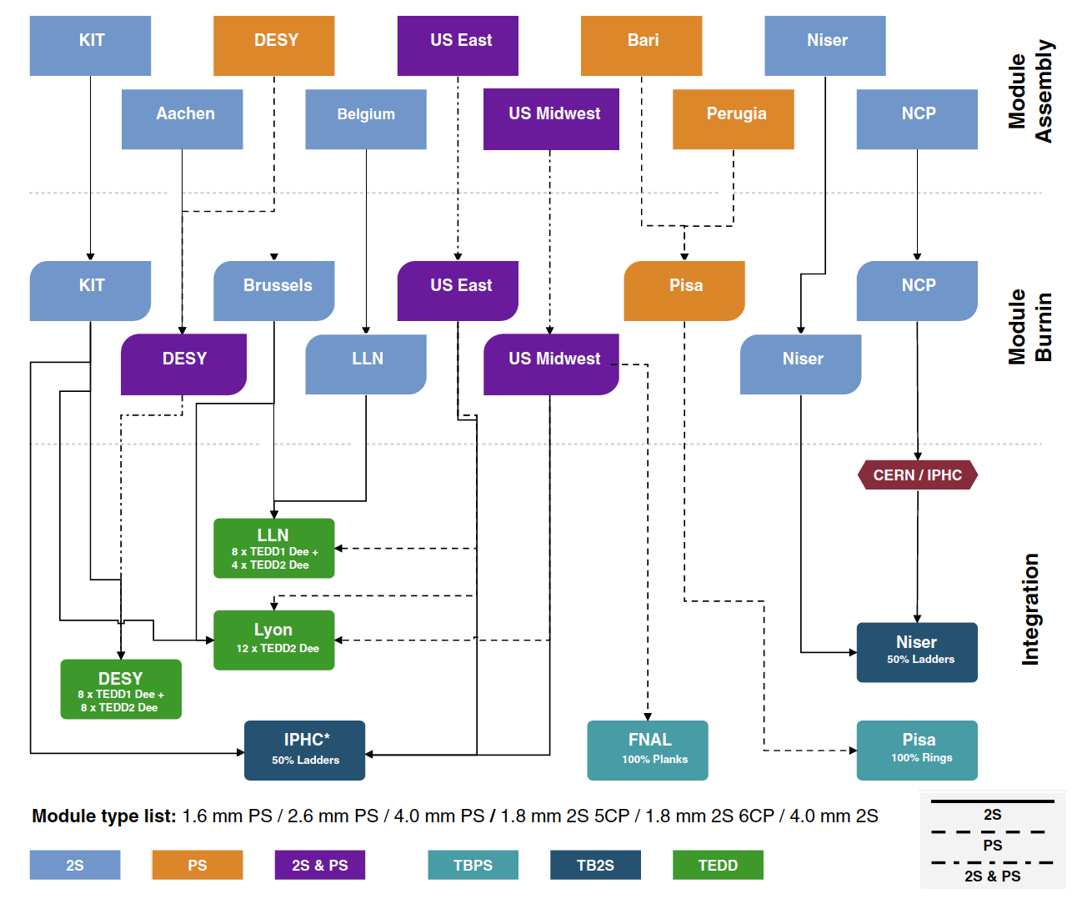
Tracker Logistics
Brussels
Belgium: 2000 modules and integrating them is a Herculean task

Slide 10
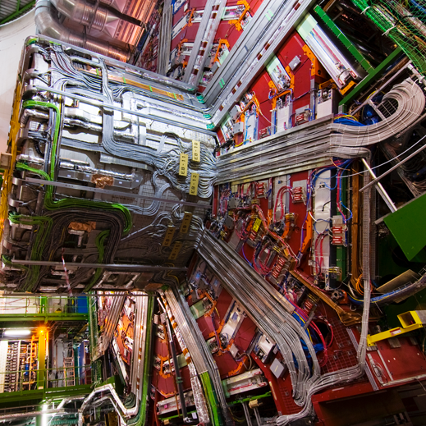
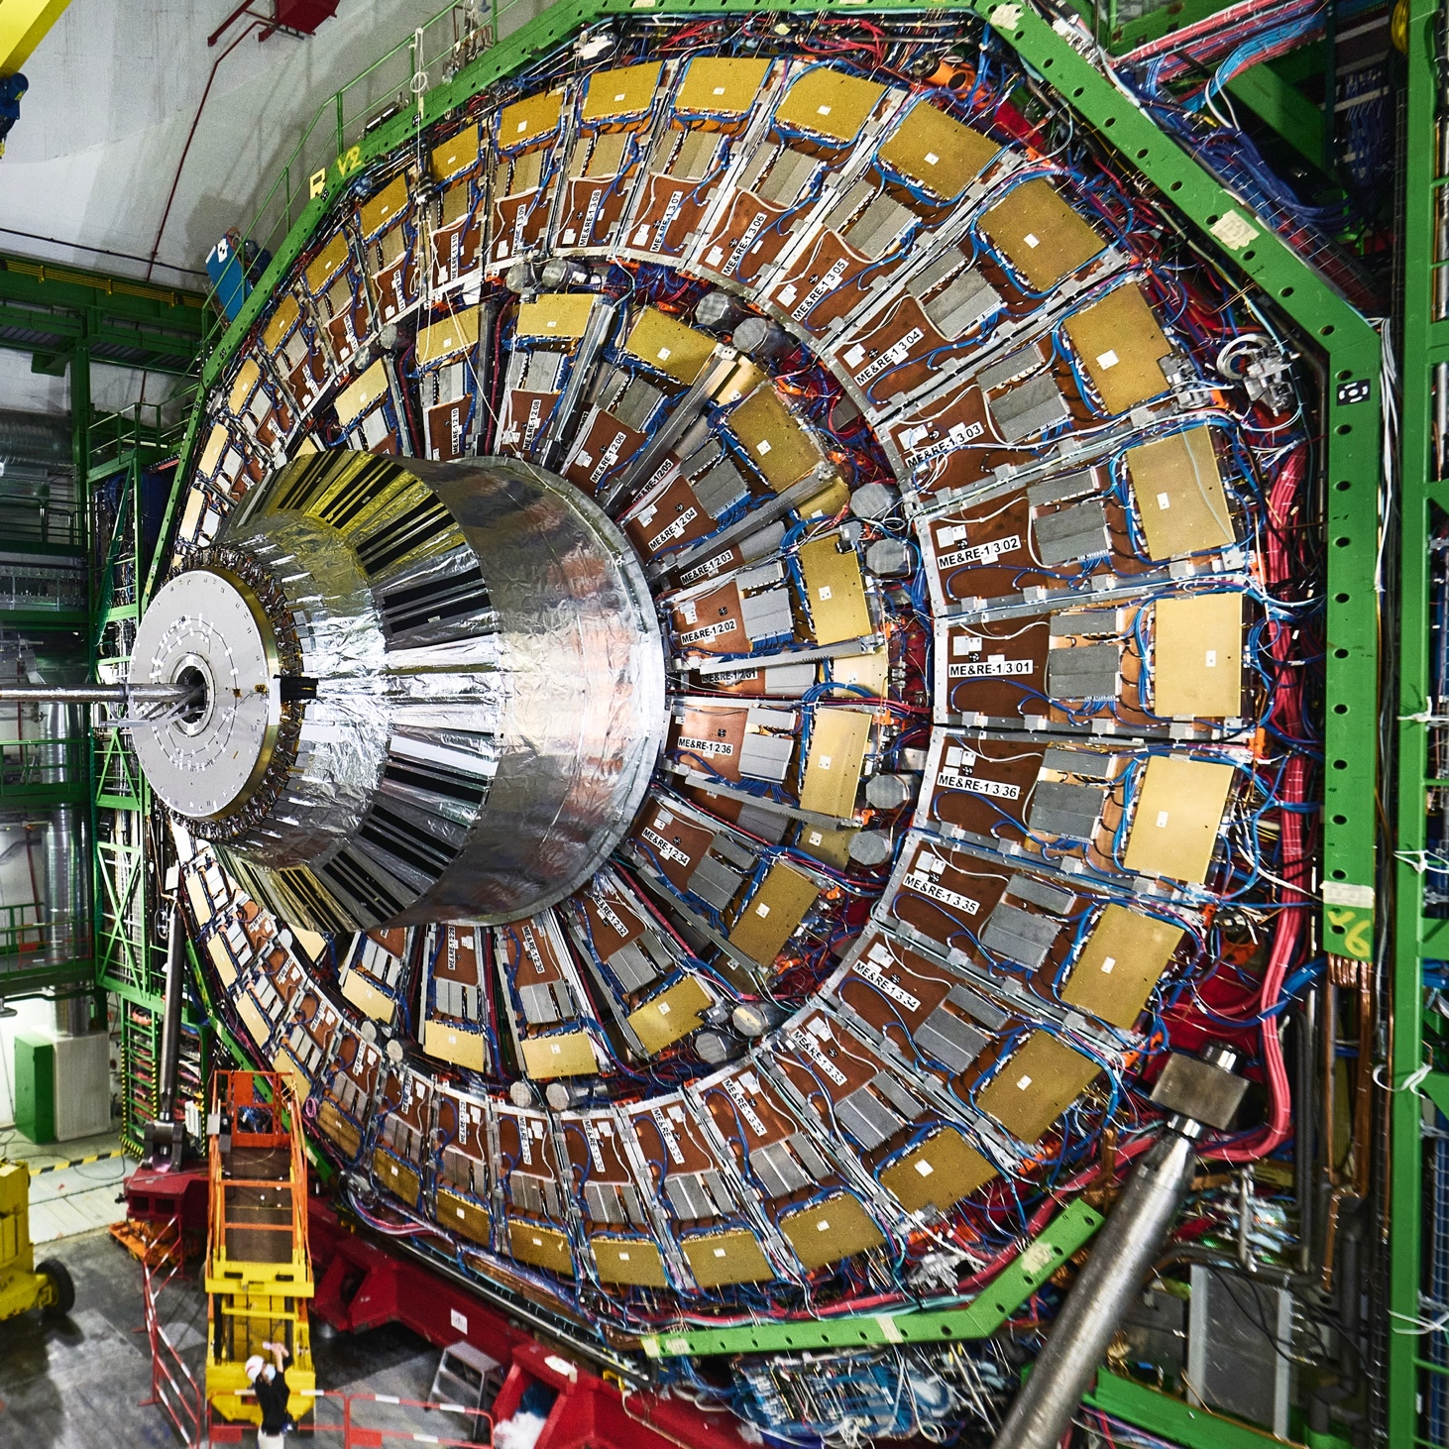
During the next long shutdown 2026-2030:
Installation and Commissioning of completely novel detectors
…and operate them afterwards
Tracker
goes here
Muon GEM
goes here
Ample opportunities to get first hand experience to build
and commission the most complex scientific instrument in the world
Last time was the best, most fun, most challenging time of my life!

Slide 11
backup

Slide 12
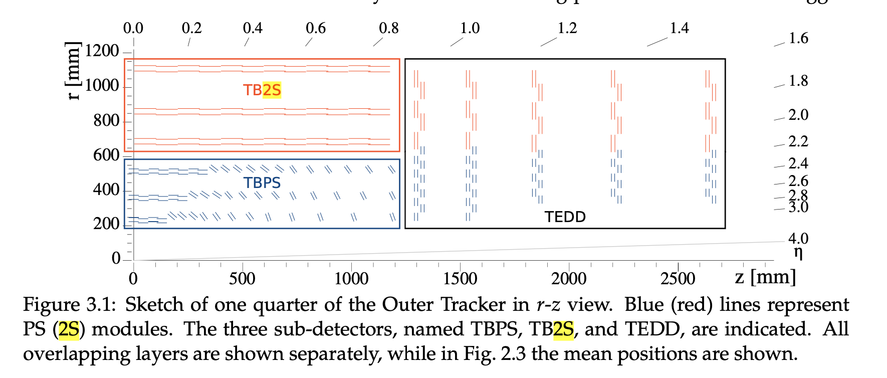
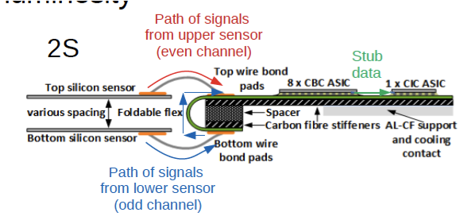
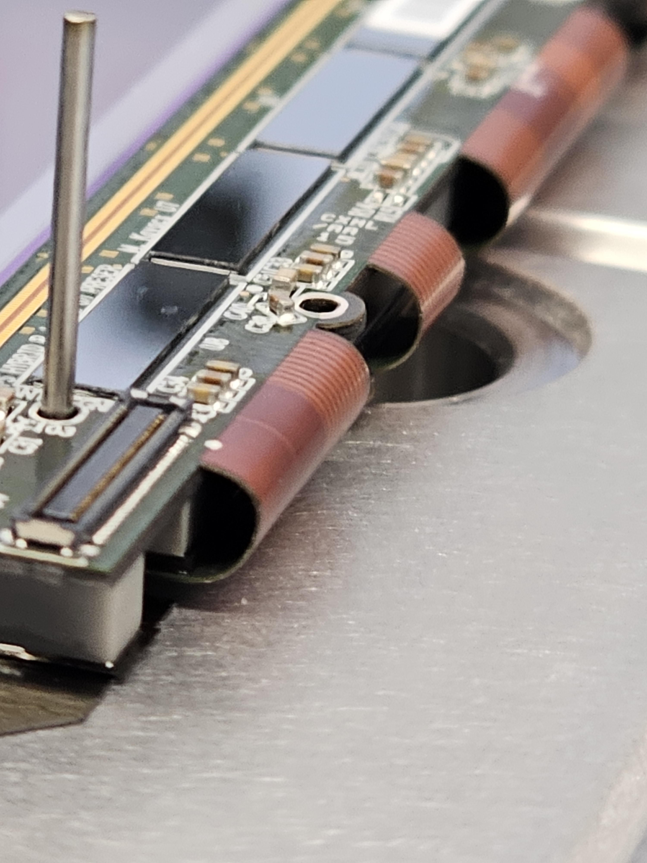
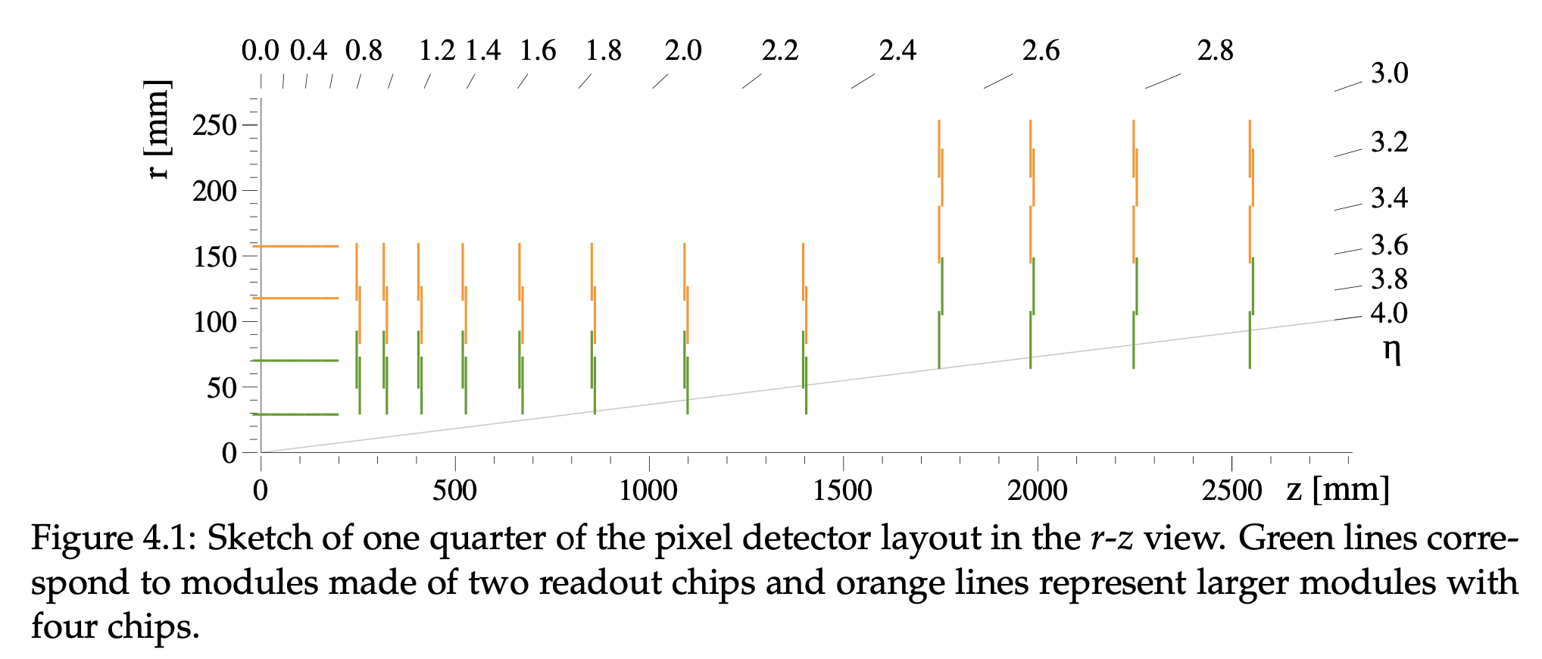
Tracker
Outer Tracker design driven by ability to provide tracks at 40 MHz to L1-trigger (p_{T}>2GeV)
  World’s first
Tilted modules in three OT layers
  Saves cost and material
Inner Tracker (pixel) extend coverage to η ≃ 3.8
Trigger
Collisions here
For simplicity only rectagular modules
p_{T} transverse momentum
CERN-LHCC-2017-009 CMS-TDR-17-001
Notes:
Outer Tracker design driven by ability to provide tracks at 40 MHz to L1-trigger
Tilted modules in three OT 3 layers
Inner Tracker (pixel) extend coverage to η ≃ 3.8
Number of channelsNotes/Comments
OT. 198 104 064 10 736 640 long strips, 15 581 184 short strips, 171 786 240 macro pixels
IT. 1 924 134 912

Slide 13
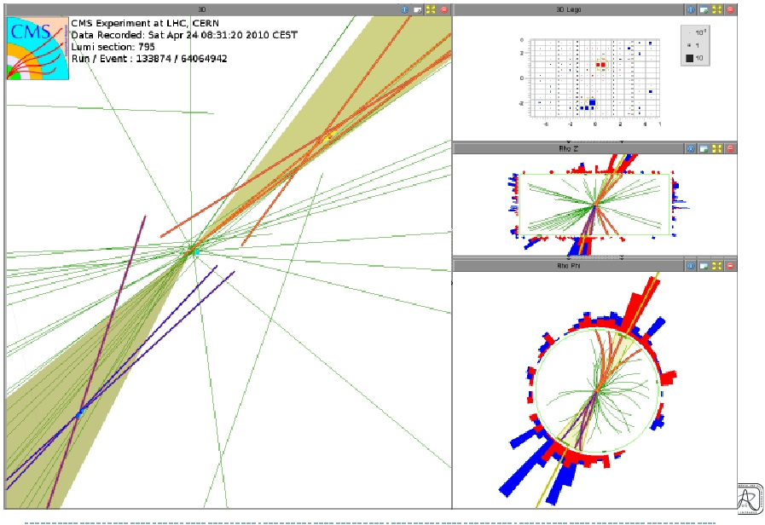
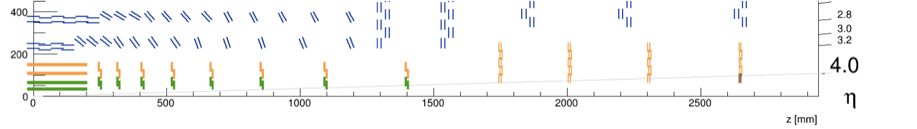
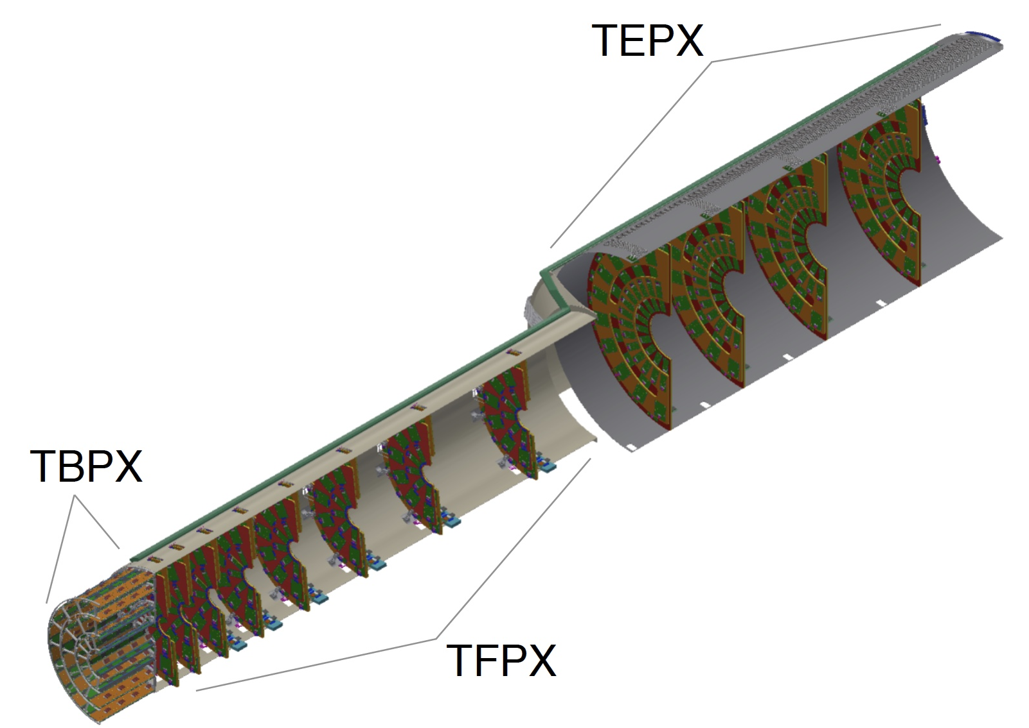
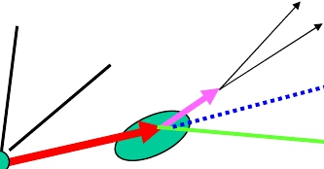
We extend into the forward region
Half-shells permit installation/extraction with beam pipe in place – BIG advantage as it allows maintenance/repairs
  Low radius helps excellent b-tagging
  Coverage up to η=4
  4000 modules = 2 billion pixels
  Surface: 4.9 m² (today 1.75 m²)
  Pixels: 25x100 μm² (today 100x150 μm²)
    mandatory with high pile-up
  Hit rate: 3 GHz/cm²
NB.: Pixel chip development:
24 institutes – 8+ years of work
K
π
ν
D0
∝
VBF
b-tagging
PU mitigation
B
Primary Vertex
Secondary Vertex
Today
Pixel at small radius(r~3cm) and small Pixels (25x100μm²)
– excellent b-tagging
Phase-2

Slide 14
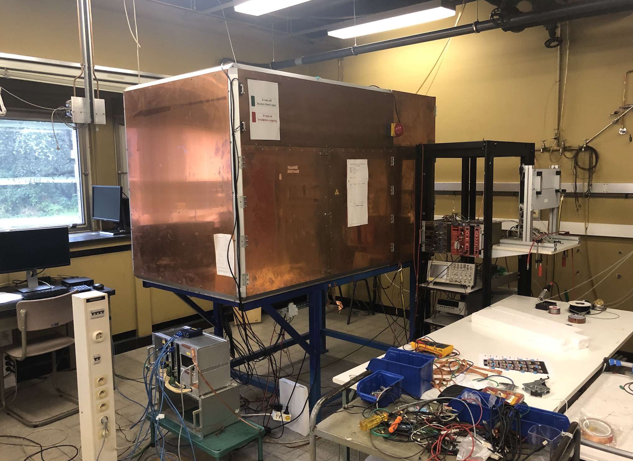
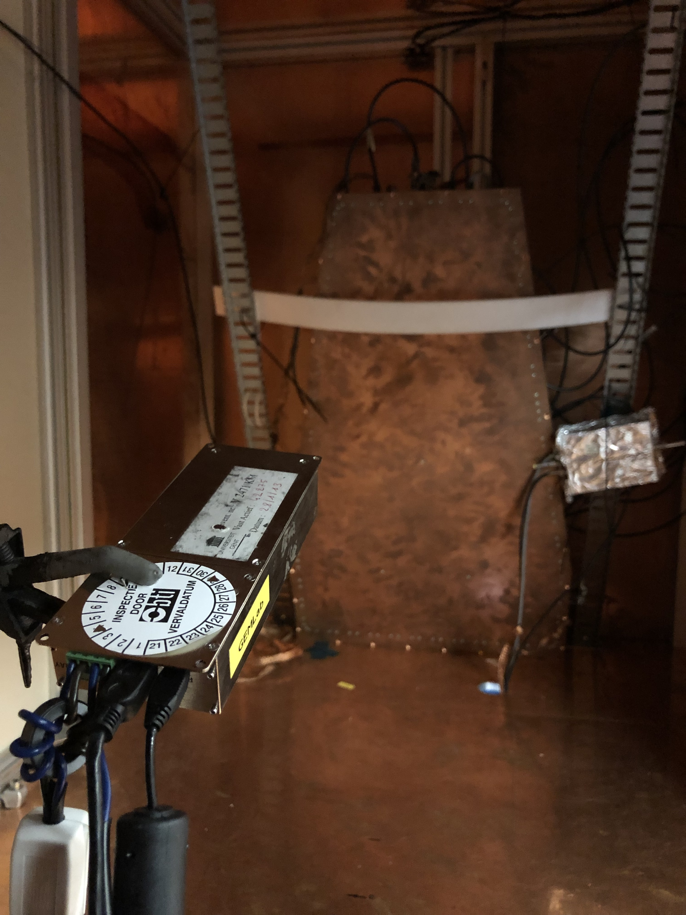
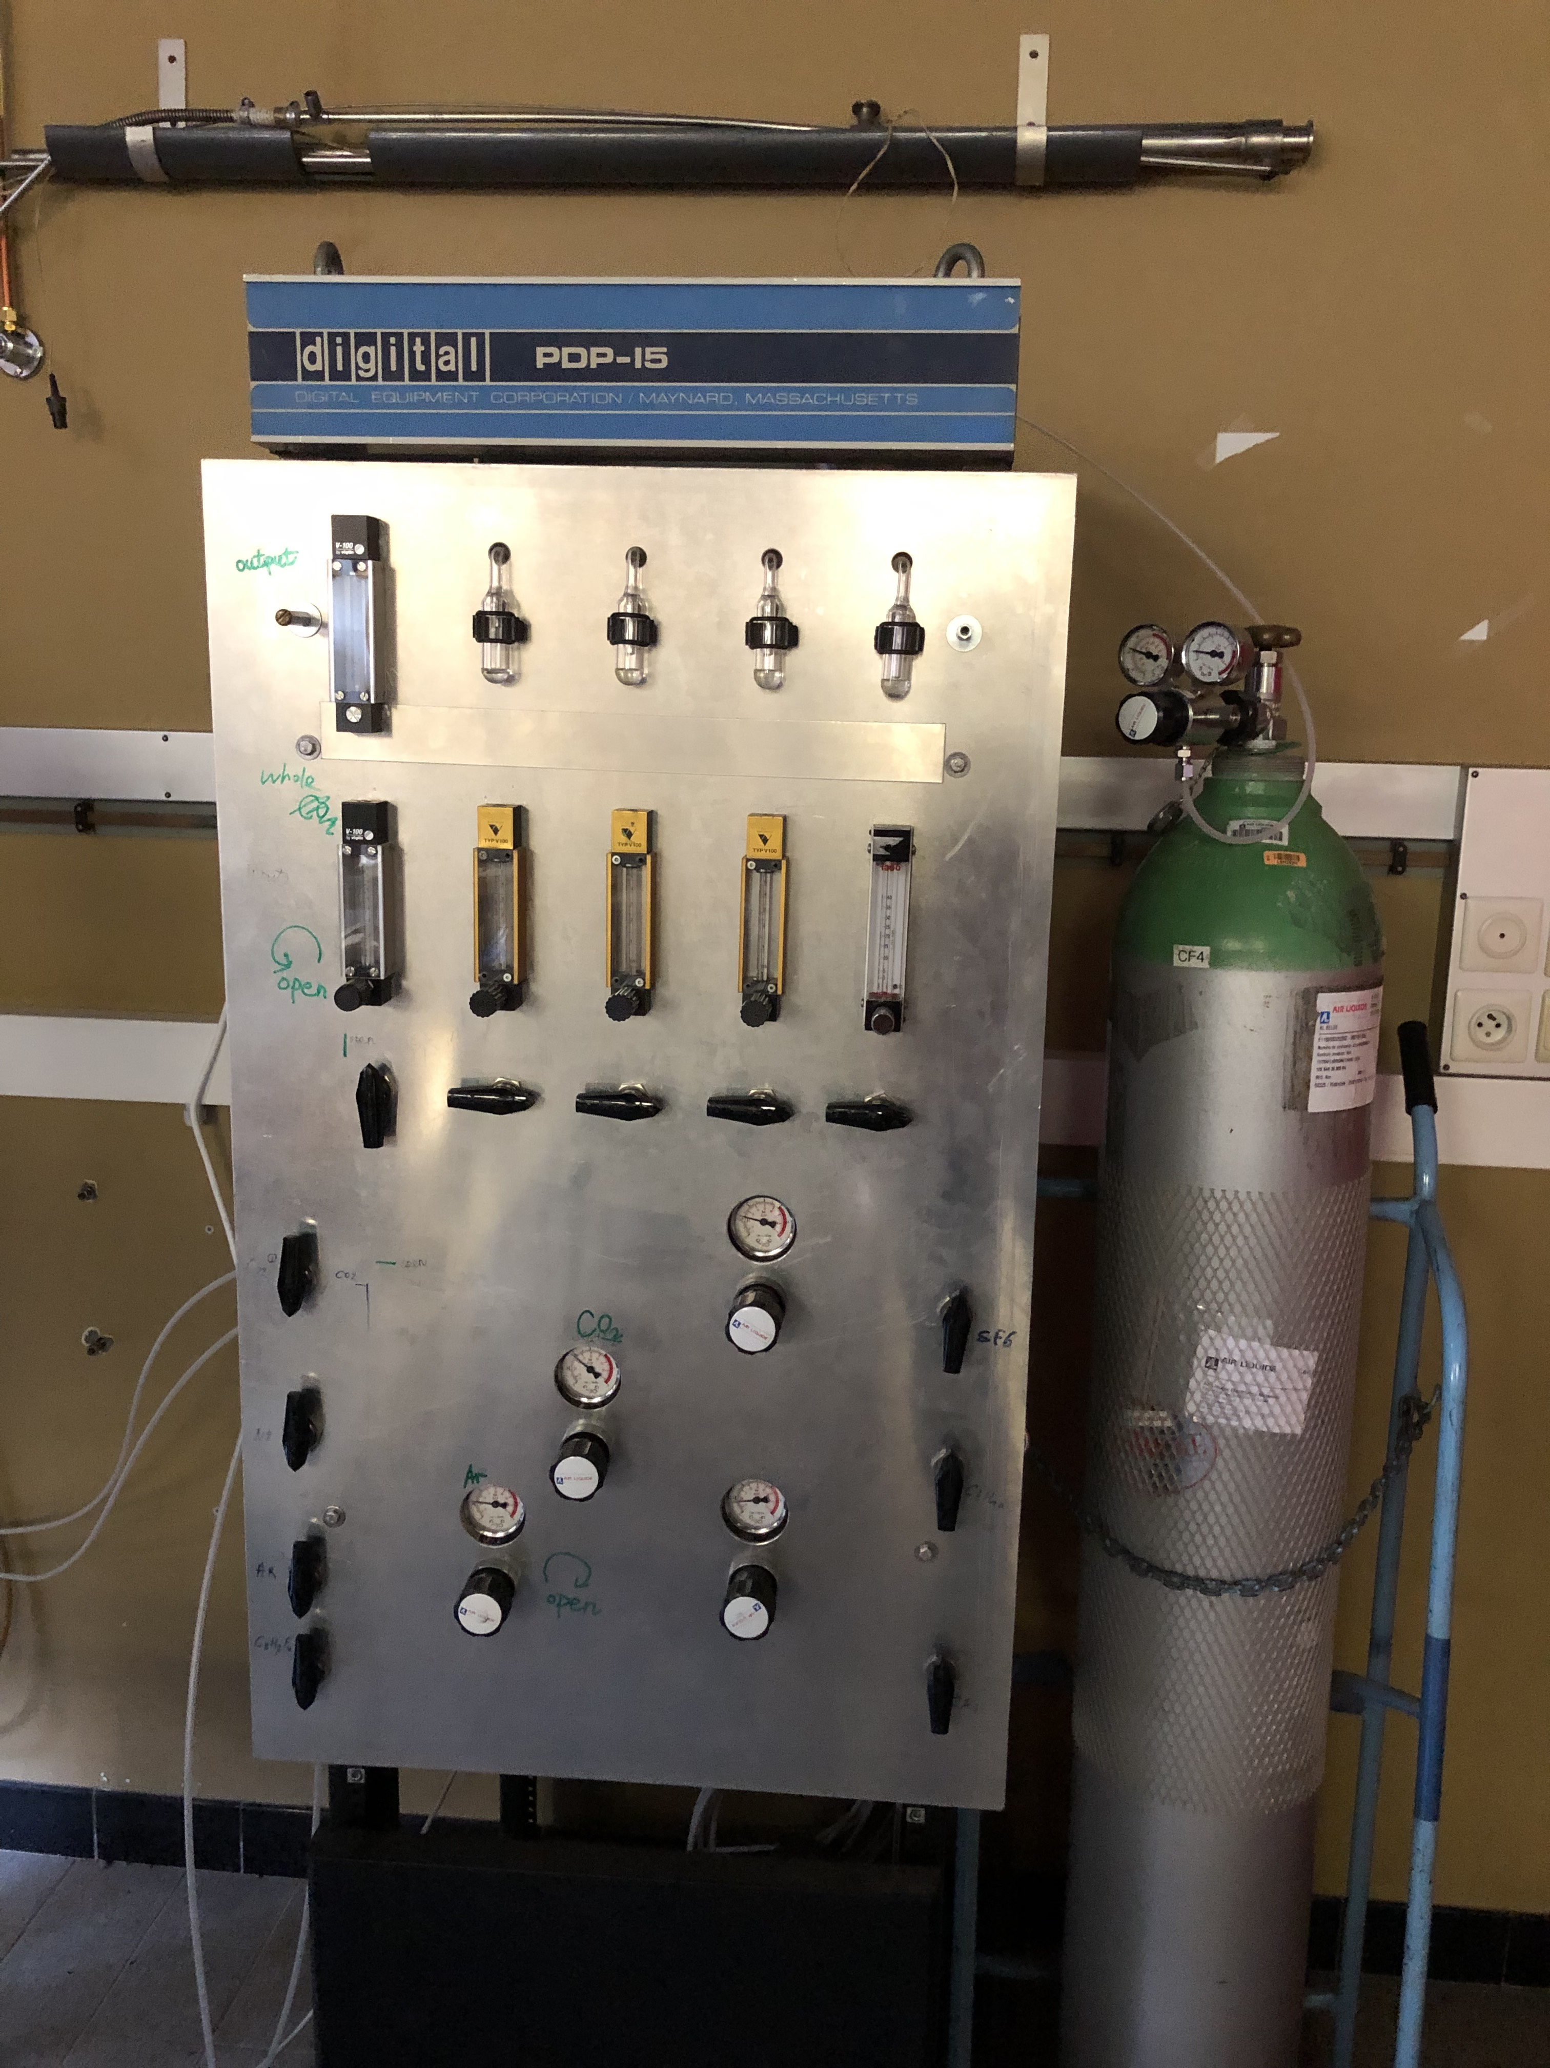
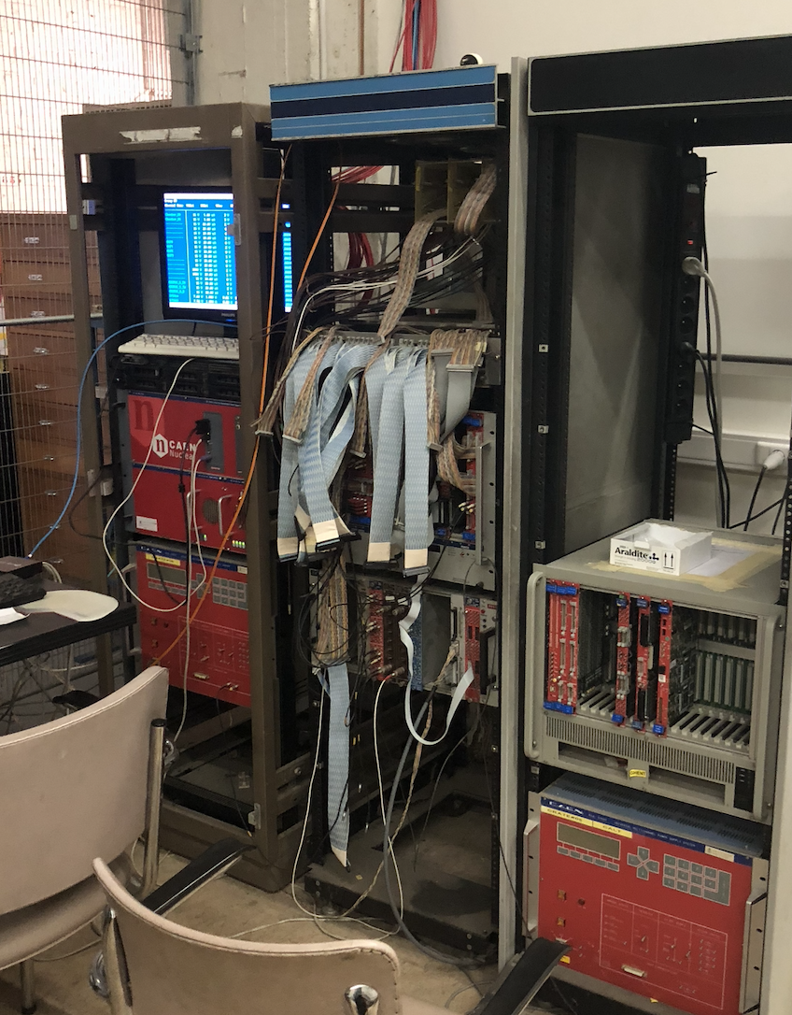
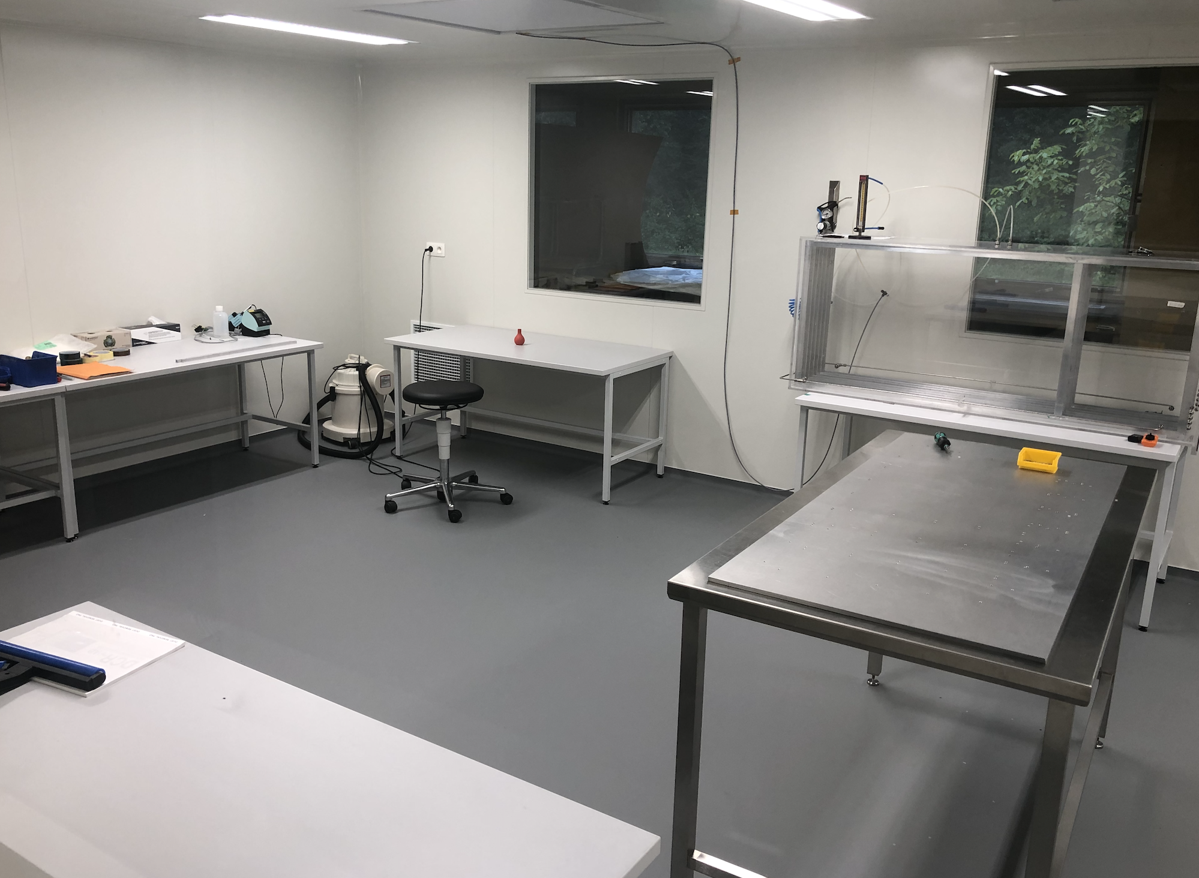
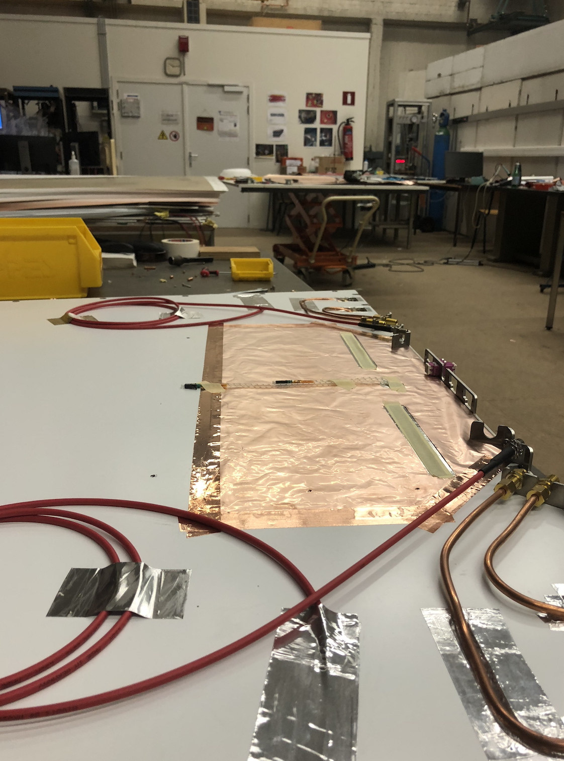
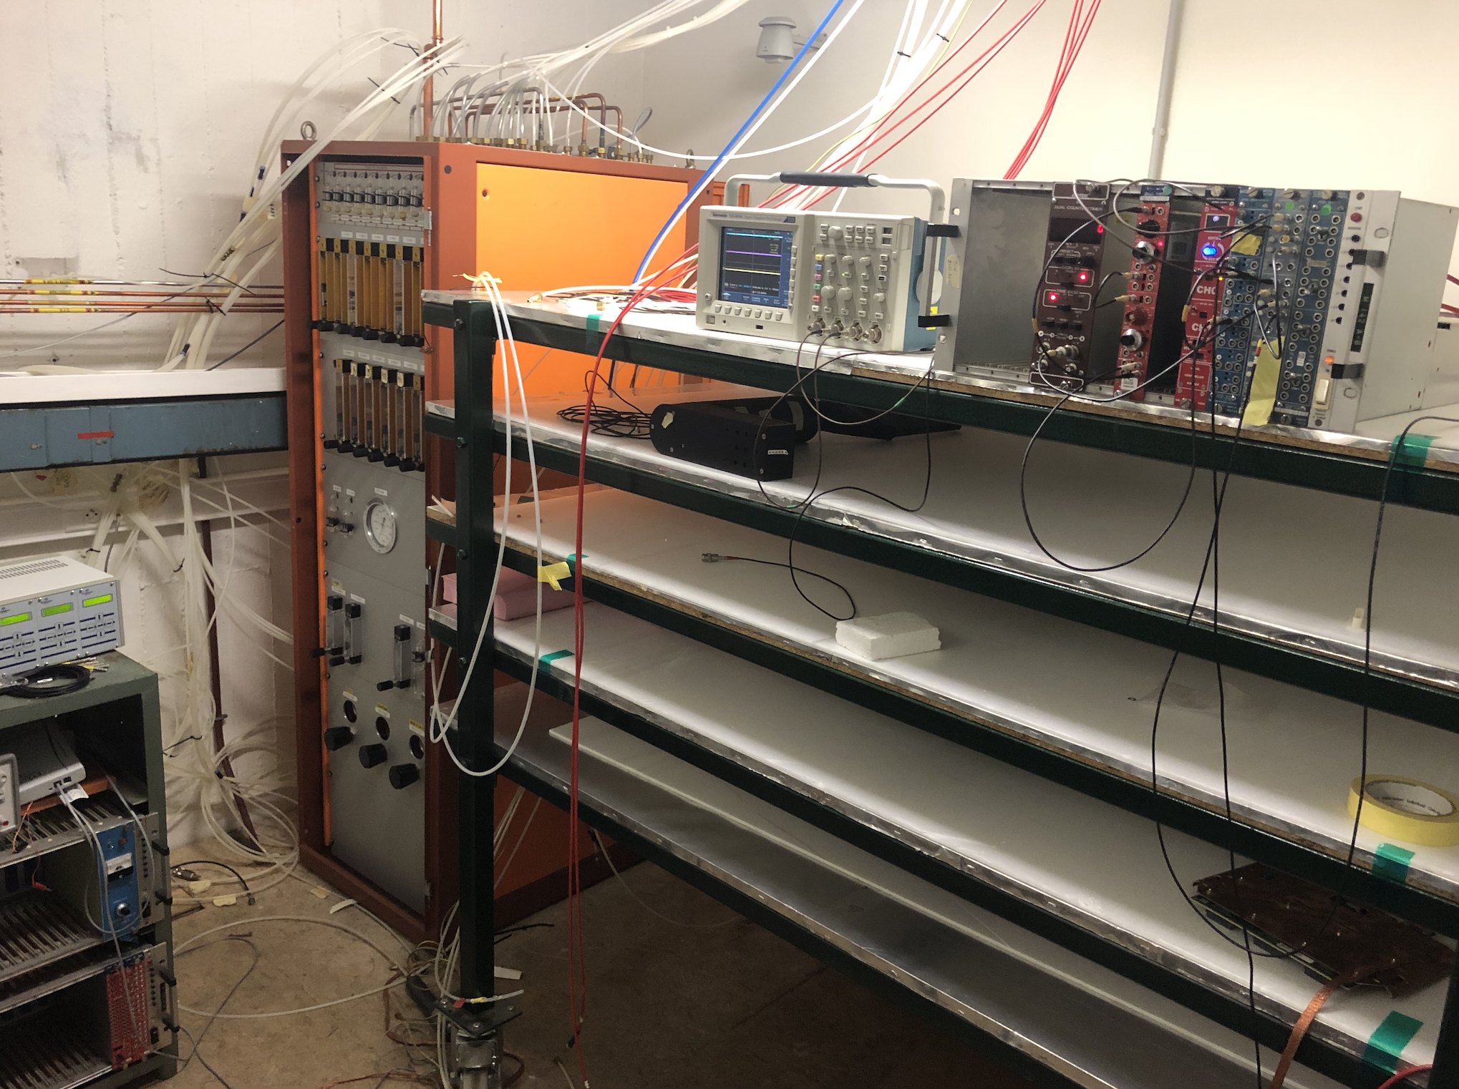
Infrastructure at UGent
X-ray irradiation box
X-ray gun
Gas system and electronics
GEM clean room
Assembly hall
Cosmic stand

