Slide 1
«STCF ECAL & PID»
“Yunlong Zhang”
University of Science and Technology of China
5/3/2025

Slide 2
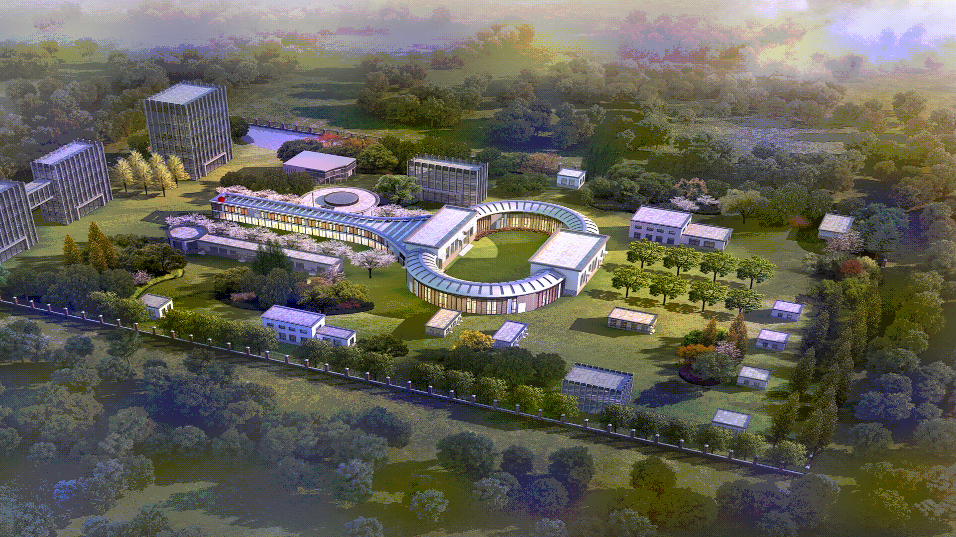
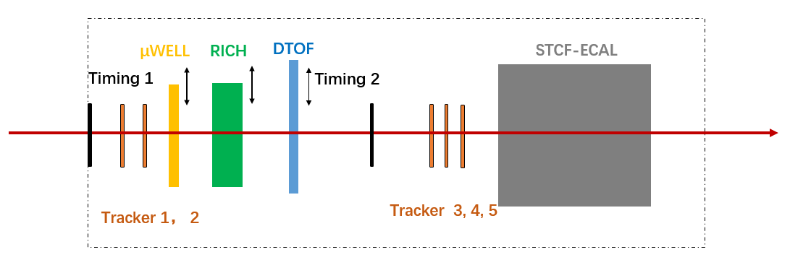
Schematic of the installation
Super Tau-Charm Facility (STCF)
  Next generation high luminosity e+/e- collider
  E_{cm}≈2 – 7 GeV, luminosity ~0.5×10³⁵ cm⁻²s⁻¹ at 4 GeV
We wish to test the Tracker, PID, ECAL, DAQ, and Trigger systems this time
“Schematic of the experiment”
Beam
Total length : “8” m
Total width : “2” m

Slide 3
Beam Condition
Please enter all the beams condition required.
If multiple beam time with different beam condition, please detail the run number under the corresponding column.
Particle | Polarity | Energy (0.1 to 15 GeV/c (T09) | High purity | Intensity | Beam size (Ømm) | Run number (if applicable
Muon | Positive | 10 | No | Several kHz | Several mm
pi, p | Positive | 3 – 5 | No | Several kHz | Several mm
Positron | Positive | 0.3 – 5 | Yes | Several kHz | Several mm

Slide 4
Services needed
Tables
  Fix table : YES (3-5)
  Moving table : YES (1)
  Purpose for the moving table: Scanning
  Size (1 m x 1 m) and weight (~ 100 kg) of setup on the table for the PID detetcor
GAS : YES (Ar+CO2, dry N2)
High Voltage : YES (2000 V for PMT and gas detectors)
  We will take our HV power
Instrumentation :
  Wire Chamber : YES
  Cherenkov signal : NO
  Scintillator signal : YES
Infrastructure
  Electronics rack in zone : YES/NO (1)
  Any other : (detail)
We want low-energy e+/- (0.3 GeV?), perhaps we need to remove the upstream material?

Slide 5
Contact during the run
Contact :
“Yunlong Zhang” + “ylzhang@ustc.edu.cn”
“Zhongtao Shen” + “henzt@ustc.edu.cn”

