Slide 1
Water Cherenkov Test Experiment (WCTE)
M. Hartz, A. Konaka

Slide 2
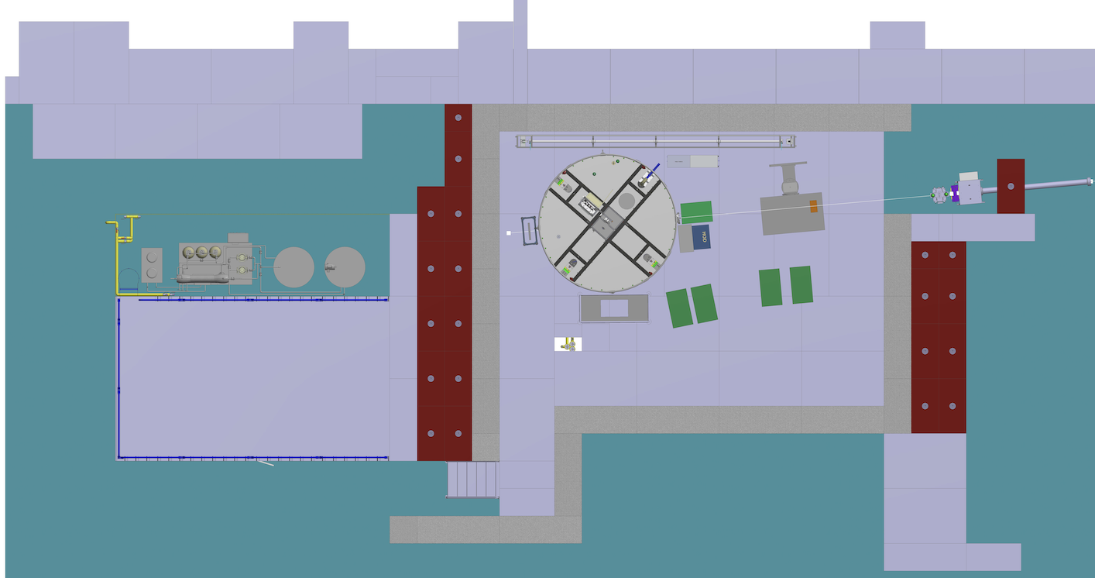
Schematic of the installation
The WCTE detector is placed at the downstream end of the T9 area. Beam monitors are installed on blocks and tables upstream of the WCTE detector and water monitor system is installed along the wall. The water purification system is installed in the downstream staging area
Water Monitor System
Water System
Beam
WCTE
Beam Monitors
Total length : 10 m
Total width : 6 m
Height of beam : 1.35 m

Slide 3
Beam Condition
Runs 1 & 2 should be the configuration that maximized the pion and muon composition. Run 4 will be used to create the tagged gamma beam.
Particle | Polarity | Energy (0.1 to 15 GeV/c (T09) | High purity | Intensity | Beam size (Ømm) | Run number (if applicable
Pions/Muons Enhanced | Positive | 0.2 to 1.2 GeV/c | Not possible (mostly positron) | As high as possible | As small as possible | 1
Pions/Muons Enhanced | Negative | 0.2 to 1.2 GeV/c | Not possible | As high as possible | As small as possible | 2
Pions/Muons/Positrons | Positive | 0.7 GeV/c | No | As high as possible | As small as possible | 3
Positron | Positive | 0.2 to 1.0 GeV/c | Yes | As high as possible | As small as possible | 4

Slide 4
Services needed
Tables
  Fix table : YES – 1 table for beam monitors (using shielding block), and 3 tables for computers and equipment staging
  Moving table : YES, 1 DESY table and one table with vertical motion
  Purpose for the moving table: To move beam monitors into and out of the beam
  Equipment filling the DESY table takes up 2 m x 1 m and weights ~100 kg
GAS : NO
High Voltage : YES, but we use our own power supply to generate high voltage for photomultiplier tubes.
Instrumentation :
  Wire Chamber : NO
  Cherenkov signal : NO
  Scintillator signal : NO
Infrastructure
  Electronics rack in zone : YES, 4 racks
  Scaffolding to access the top of the WCTE detector and shielding blocks for the tagged gamma configuration

Slide 5
Contact during the run
Contact :
Mark Hartz + mhartz@triumf.ca + 69577
Lauren Anthony + l.anthony@imperial.ac.uk + 61836
Stefania Bordoni (EXSO) + Stefania.Bordoni@cern.ch + 160961

