Slide 1

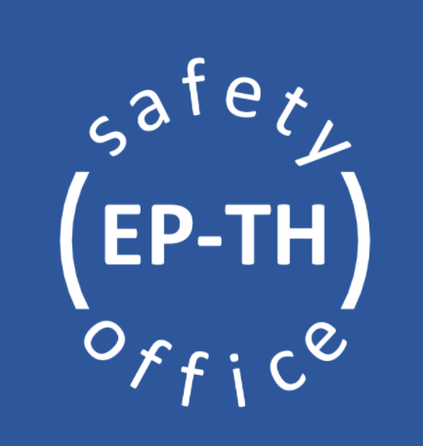
Safety for
EP Temporary Experiments in East Hall – B.157

Slide 2

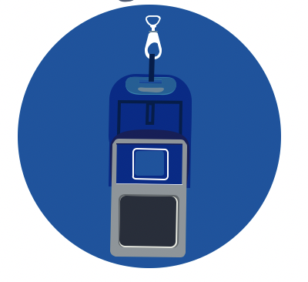
General Safety in East Hall
Necessary PPE (Personal Protective Equipment) to enter the building are: helmet, safety shoes and personal dosimeter
The experimental areas T09 and T10 are equipped with safety installations, including fire extinguishers at the entry of the areas and AUG in the areas (General Emergency). Please, take some time to familiarise yourself with their position!
Any accidents or incidents shall be declared via: https://edh.cern.ch/Document/General/IncidentDeclaration
Additional PPE might be required, depending on the activities to be performed.

Slide 3
B.157 : 1 Assembly Point, located on the Salève Side
Please familiarise yourself with its location.
Jura Side
In case of evacuation alarm, leave immediately the building and go to the assembly point!
EHN1
Salève Side
Satigny Side

Slide 4
Early Safety Instructions for Temporary Experiments
The information contained in EP Safety Office web pages shall be considered as early as possible in the design of the experiment to facilitate the safety validation process. You will find details about:
  List of materials allowed and forbidden at CERN;
  Instructions and recommendations to be followed for specific hazards and risks brought by the experiment to CERN;
  Best safety practices for installation and operations of detectors at CERN;
  Safety contacts for any additional questions.
This process should start no later than 1 week prior to the installation of your experiment at CERN. If your experiment introduces hazards or risk implications (including but not limited to the use of flammable gas, mechanical equipment, cryogenics or lasers), the EP Safety Office must be contacted as early as possible, in advance of the submission of your ISIEC.

Slide 5
ISIEC Form & Safety Clearance process
Before operations, every set-up must undergo this safety process!
Go on the website: https://ep-th-safety.web.cern.ch/isiec-safety-clearance (you must login to access the ISIEC form)
Submit the ISIEC (Initial Safety Information for Experiments at CERN) form with the details related to your experiment (description, hazards, etc.) at least one week before the operation. The ISIEC is mandatory for all setups.
You will receive a confirmation email and you will be contacted by the EP Safety Office to organise the inspection visit on site (once the installation of the set-up is completed!)
After the inspection, the remarks (if any) will be communicated to you. If no major remarks are present, you will receive the Safety Clearance form via email. If present, minor remarks will be listed in this form. Make sure they are all resolved before taking beam!
The Safety Clearance is valid for 3 weeks, please contact the EP Safety Office if you extend your beam time.
Remind to request access for T09 (0157-R-F30) or T10 (0157-R-C21) control room in ADAMS.

Slide 6
Safety contacts
In case of any safety related questions, different safety actors are available :
TSO – Territorial Safety Officer
Contact: aboubakr.ebn.rahmoun@cern.ch
DSO – Department Safety Officer
Contact: ep-th-safety@cern.ch

Slide 7

Thank you for your attention!

