Slide 1
Radiation Protection guidelines for the East Area
J-F. Gruber
05/03/2025
EDMS 2866156

Slide 2
Main Contacts
Angelito Herve (RP Officer) 163168
Arnaud Devienne (RP responsible and physicist) 162330
General RP for Meyrin : 72504
RP piquet outside working hour : 74848

Slide 3
Traceability of material in beam area
Every material used on a beamline has to be traced in TREC and controlled by RP (http://trec.cern.ch/)
Every material with unknown history leaving a radiologically classified building should be controlled by RP
Identify the material on TREC/EAM (traceability stickers)
Deposit the material in the Buffer Area, if possible. Otherwise, call the RP Officer
TREC will create the EDH for the transport if you choose the option
The location of radioactive material has to be updated on TREC

Slide 4
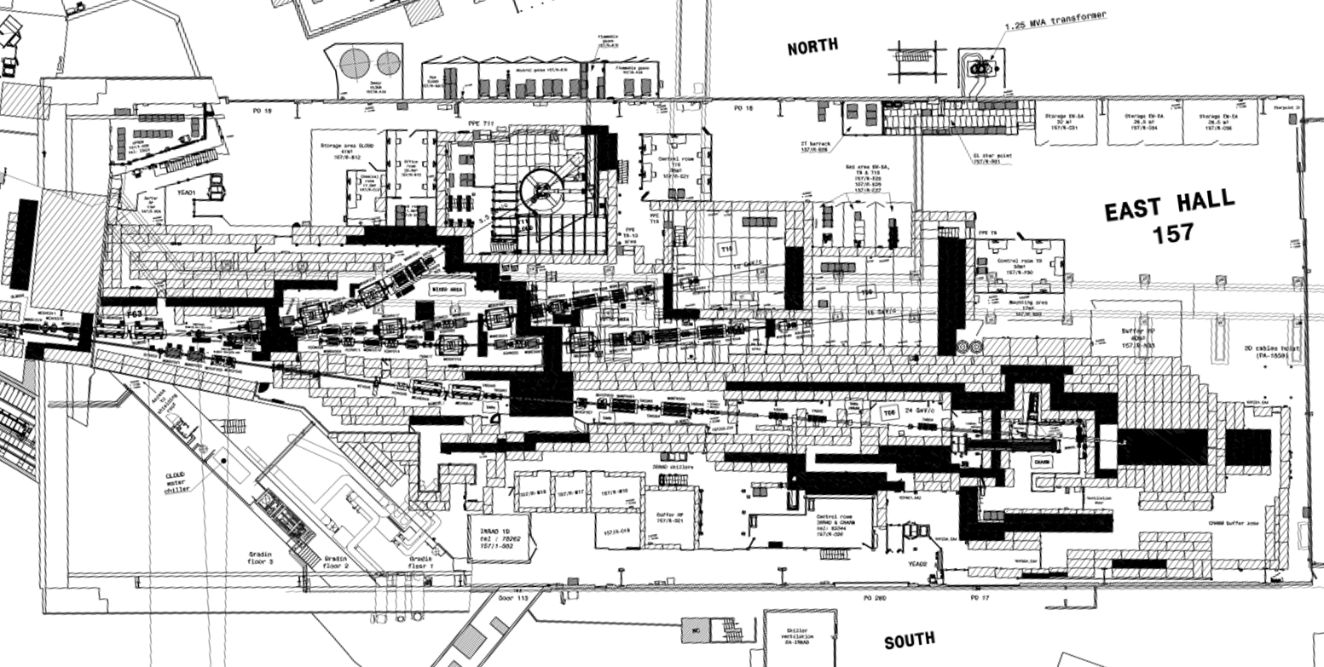
Layout of the East Area (EA)
Secondary Beam lines (T9, T10 and T11)
  2 Buffer Area available
CHARM/IRRAD
  1 Buffer Area available
All the building is minimum a Supervised Area
  Do no eat or smoke
  Drinks allowed only in control rooms
  Wear your dosimeter

Slide 5
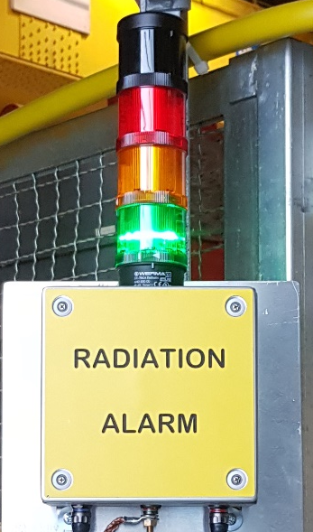
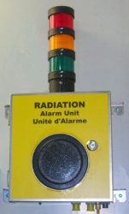
Radiation alarm displays
Flashing RED light + Audible ALARM
→ Leave the concerned area calmly
Flashing ORANGE light + WARNING SOUND
→ Limit your stay in the concerned area
Continuous green light = NORMAL situation
(low radiation levels, system OK)
You can always call the CCC (76677) or RP (72504) to get more information about the alarm

Slide 6
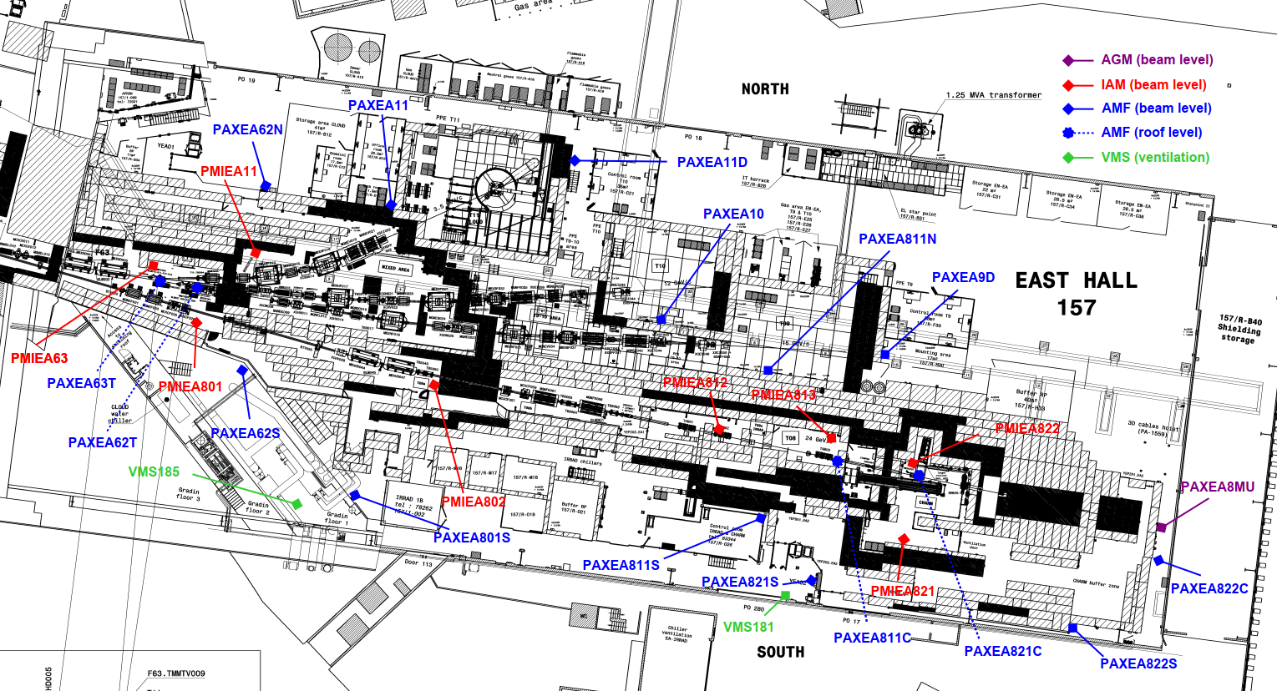
Radiation monitoring system at EA

Slide 7
Possible sources of EA radiation alarms
Beam transport, steering and accidental beam losses
  Primary beam impacting on T9 and TN targets (Target Area)
  Primary beam along T8-IRRAD/CHARM beam line
  Secondary beams along T9, T10 and T11-CLOUD beam lines

Slide 8
Reminders
The TREC/EAM code follows the equipment part until the end of his life
Record your request in TREC
Indicate a responsible person who is at CERN and available to sign in EDH
Sign your EDH and wait EDH fully approved before leaving
Only RP vacuum cleaner are allowed in Supervised and controlled area
In case of urgency, contact the RPO
For specific cases, contact the RPO

Slide 9
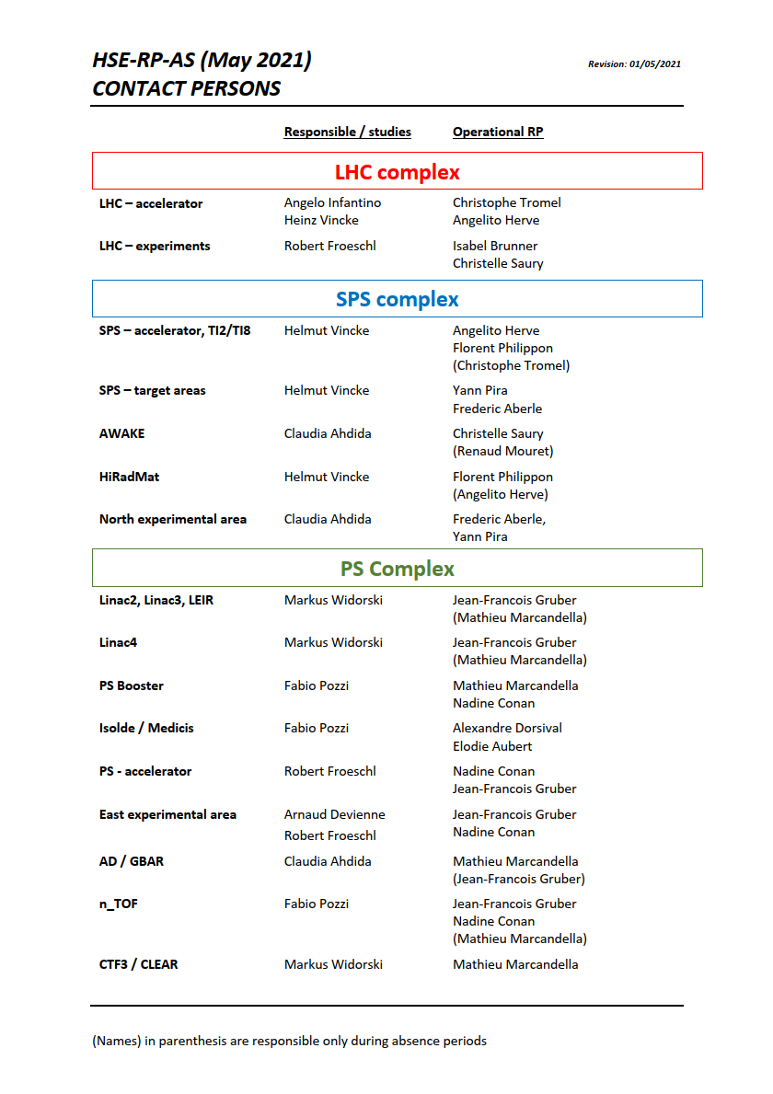
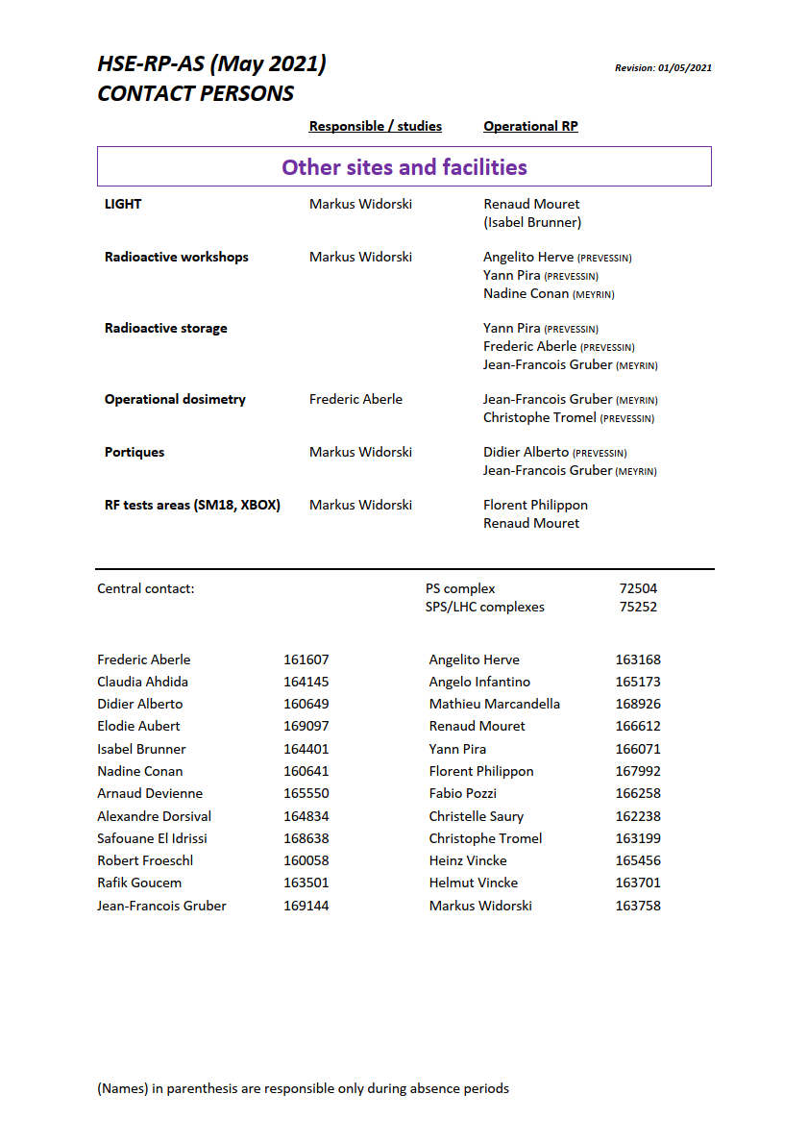
All RP Contacts
RP contact available at: RP-AS-Contacts-LastUpdate.pdf
Do not hesitate to contact the RPO of the concerned area
Meyrin: +41227672504
Prévessin: +41227675252

Slide 10
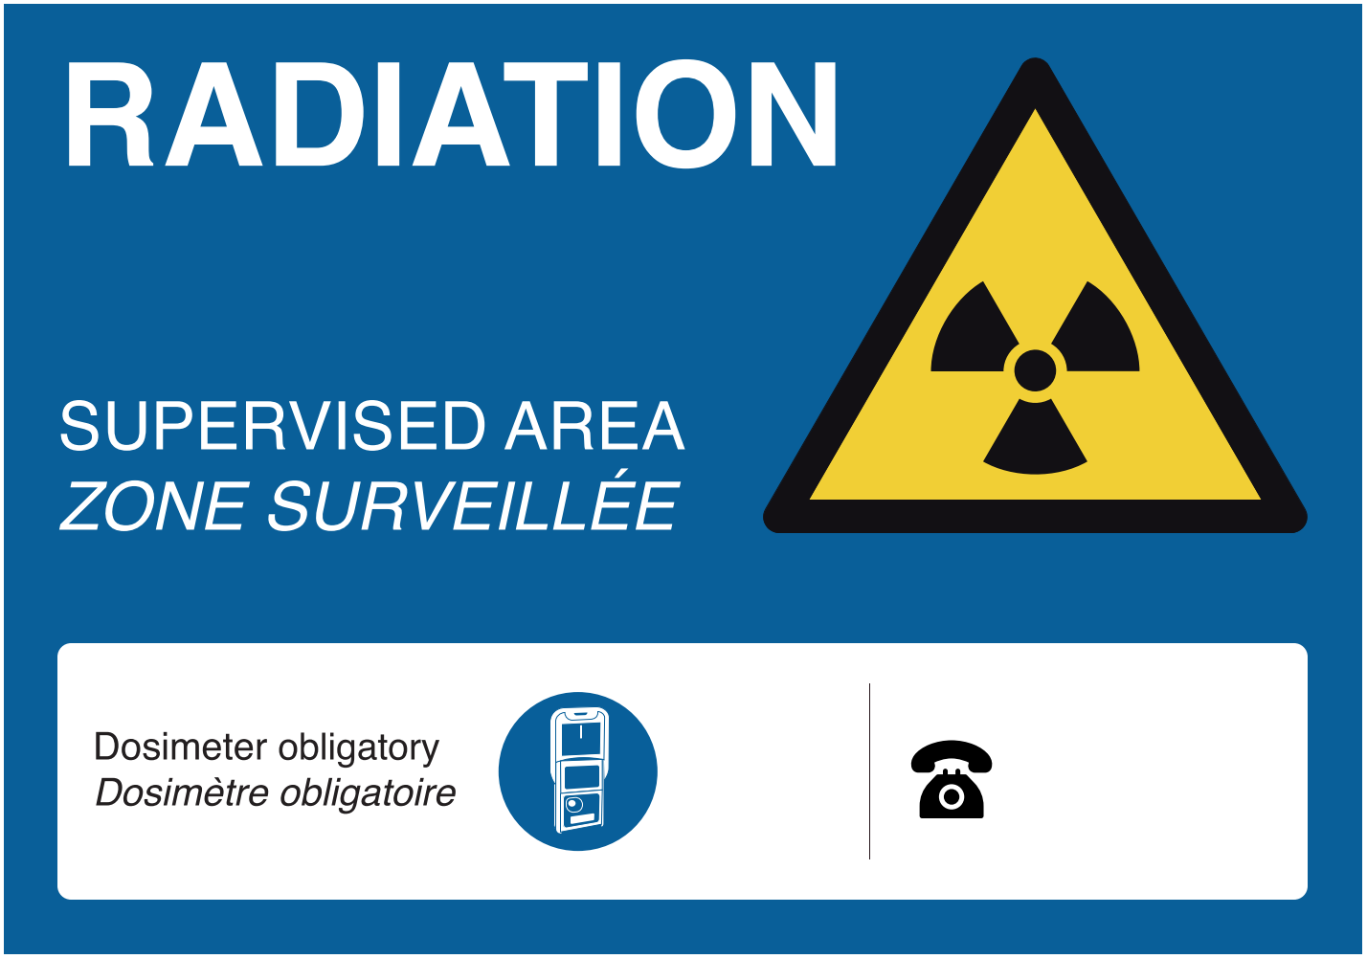
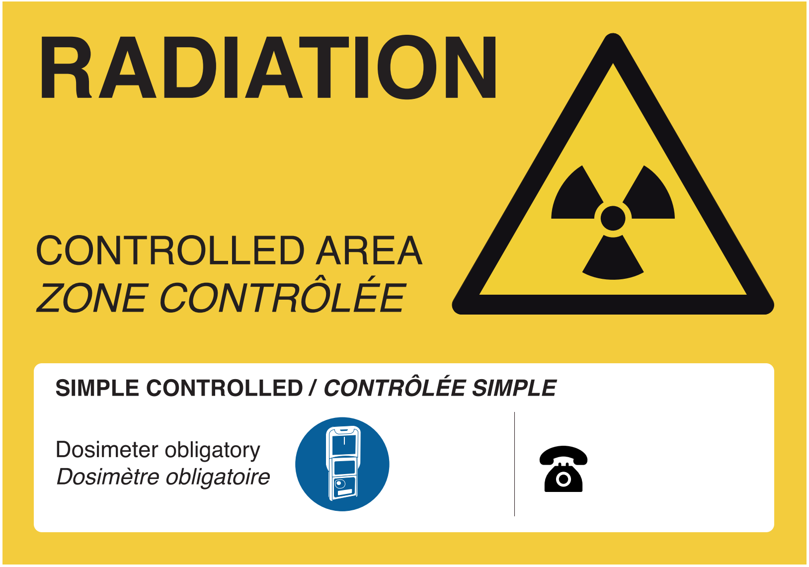
Radiation Areas at CERN
Areas with risks due to ionizing radiation are classified as "Radiation Areas". Radiation Areas at CERN are clearly marked with yellow panels. Corresponding to the risk level, Radiation Areas are subdivided into:
"Supervised Radiation Areas“
(<15 μSv/h - low risks)
"Controlled Radiation Areas“
(elevated risks)
East Area is generally a Supervised Radiation Area due to prompt radiation levels

Slide 11


Radiation at CERN
Accelerator in operation:
The interaction beam-matter generates stray radiaton
Accelerator stopped:
The interaction beam-matter has made the matter radioactive (activation)
Stray radiation
Residual radioactivity (resulting)
Stable matter
Radioactive matter
Beam
Stray radiation
No Beam

Slide 12

Ionising radiation in/around the accelerators
Experimental hall:
Accelerator in operation
Primary beam
Secondary beam
Beam tunnel:
Experimental area:

Slide 13

Ionising radiation in/around the accelerators
Experimental hall
Accelerator in shut down
Radioactive accelerator
Beam tunnel:
Experimental area:

