Slide 1
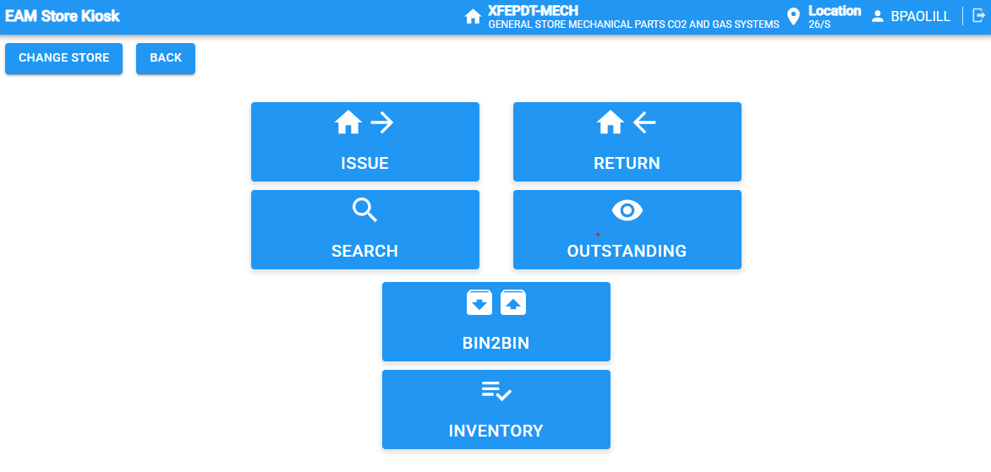
EAM Store Kiosk
To better menage the spare parts we can use the Kiosk interface to:
Keep track of parts in stock.
Create department-specific inventory lists.
Automatically purchase equipment when necessary.

Slide 2
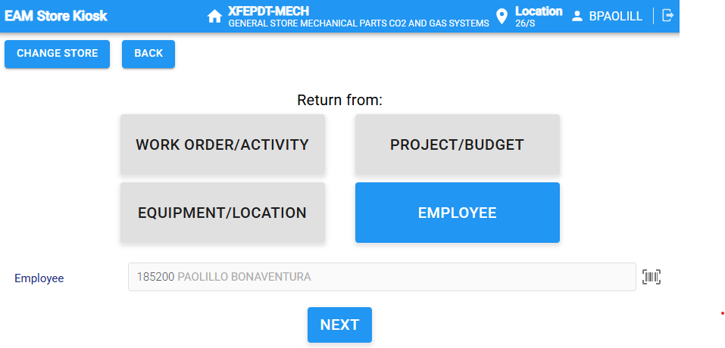
Replenish parts in store
To replenish the parts in the store:
Select RETURN
Select EMPLOYEE to register who added the parts (by default => logged user)

Slide 3
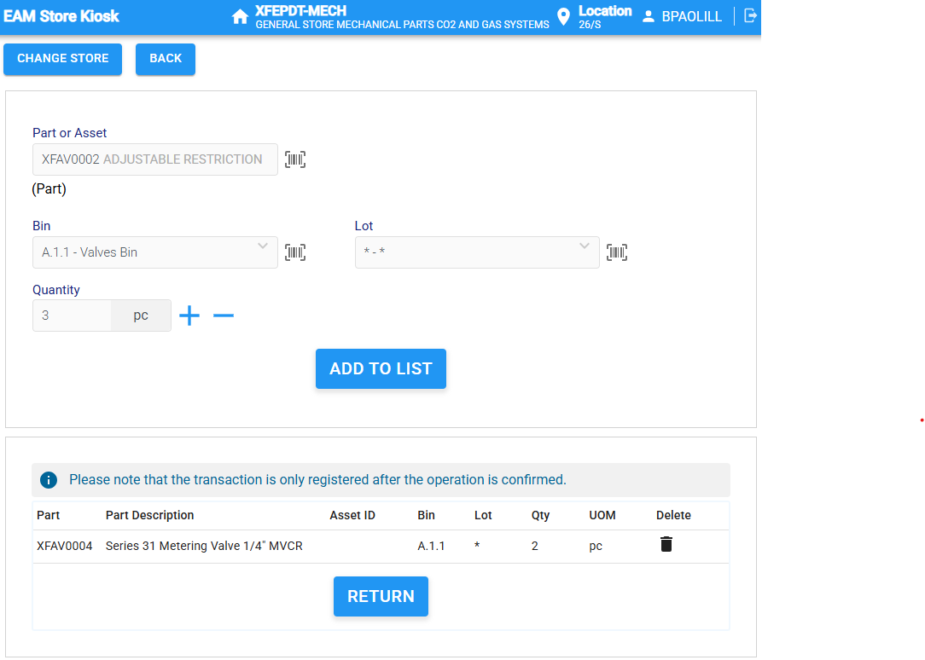
Replenish parts in store
Scan or type the part code.
Specify the quantity and the bins to which they are added.
Click ADD TO LIST
Once all of the parts have been added to the list, press RETURN to confirm the transaction

Slide 4
Issue assets from store
To remove the parts from the store:
Select ISSUE to remove assets from the store
Select EMPLOYEE to register who added the parts (by default => logged user)

Slide 5
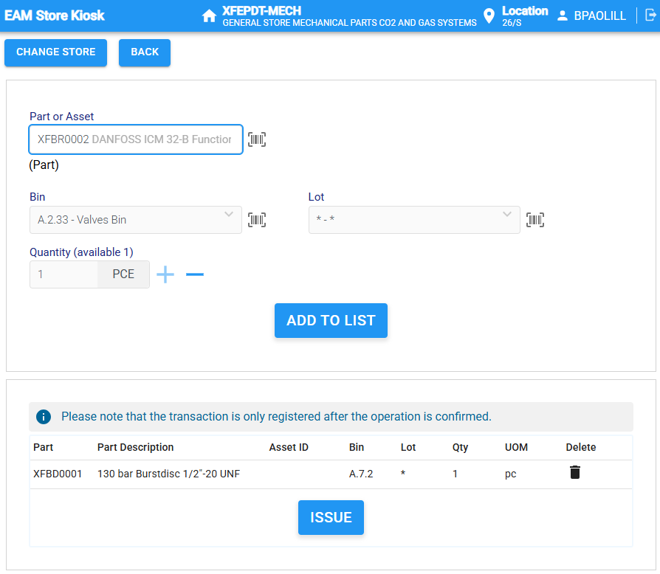
Issue assets from store
Scan or type the part code.
Specify the quantity and the bins to which they are added.
Click ADD TO LIST
Once all of the parts have been added to the list, press ISSUE to confirm the transaction

Slide 6
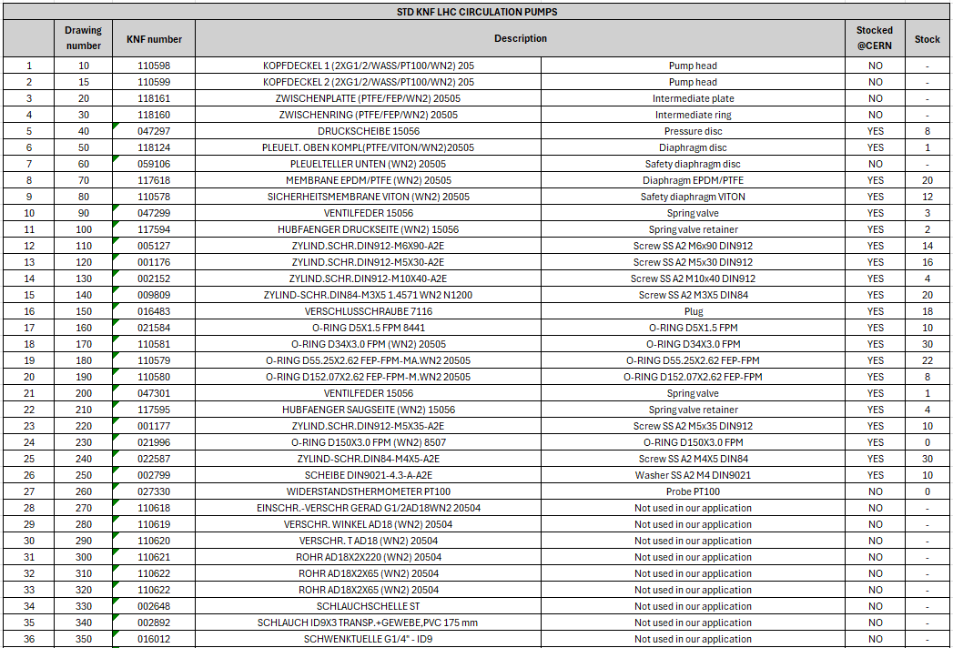
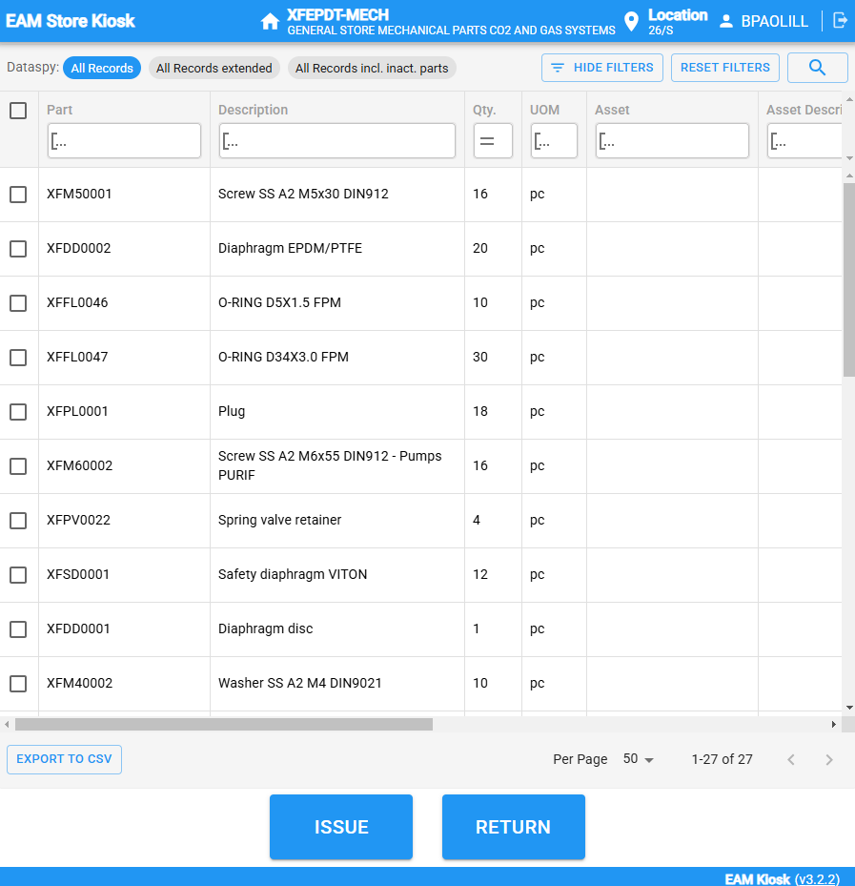
Kiosk
We created a spare part invetory on kiosk
I will keep it update

Slide 7
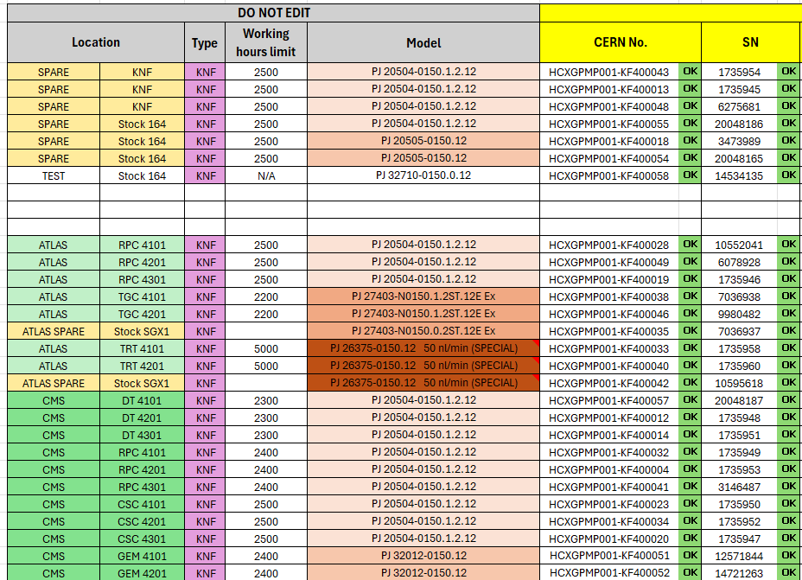
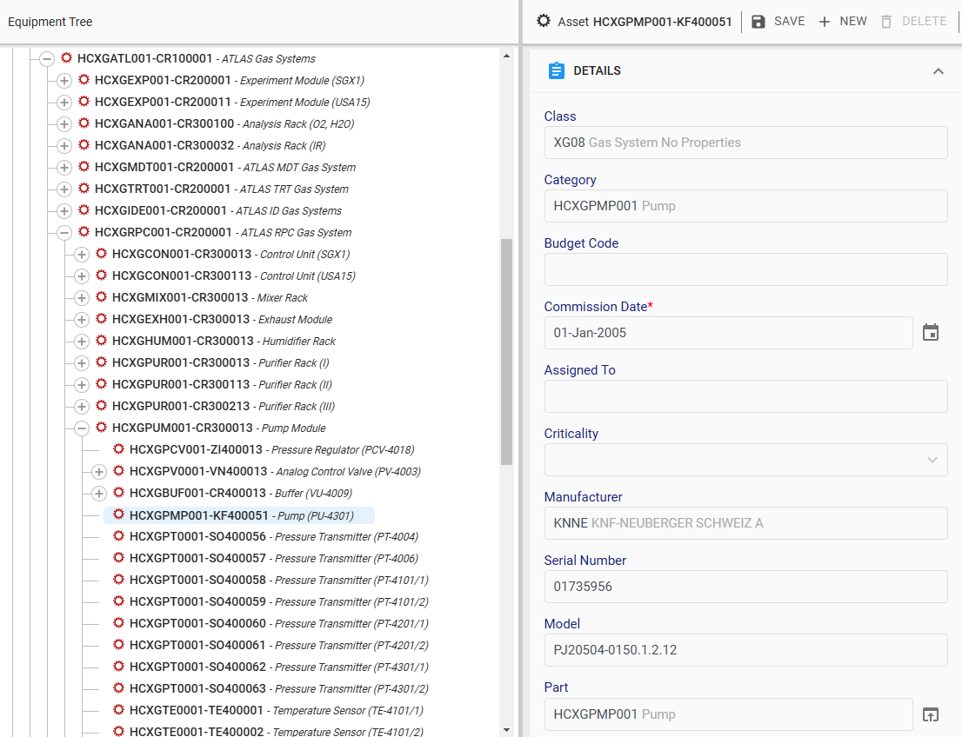
The pump are already on InforEAM:
The Infor and the Excel file are updated regularely.

Slide 8
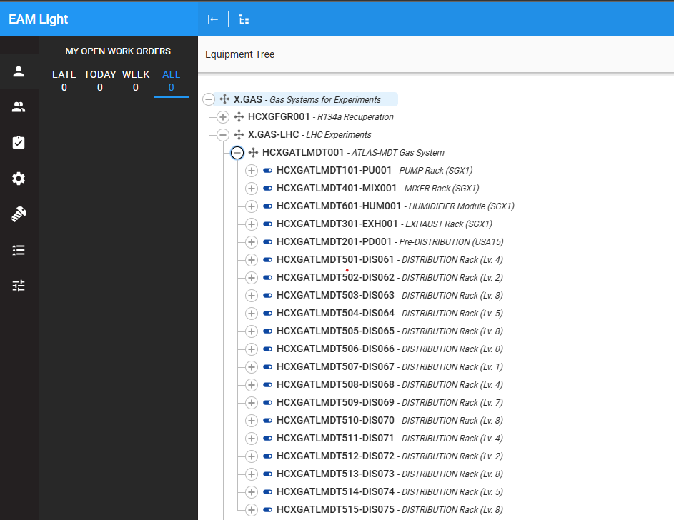
ATLAS System InforEAM
We changed the configuration of ATLAS System in InforEAM to better follow the logic of the P&ID drawings.
Now the Code used for the single Equipment reflect the code of the P&ID.

Slide 9
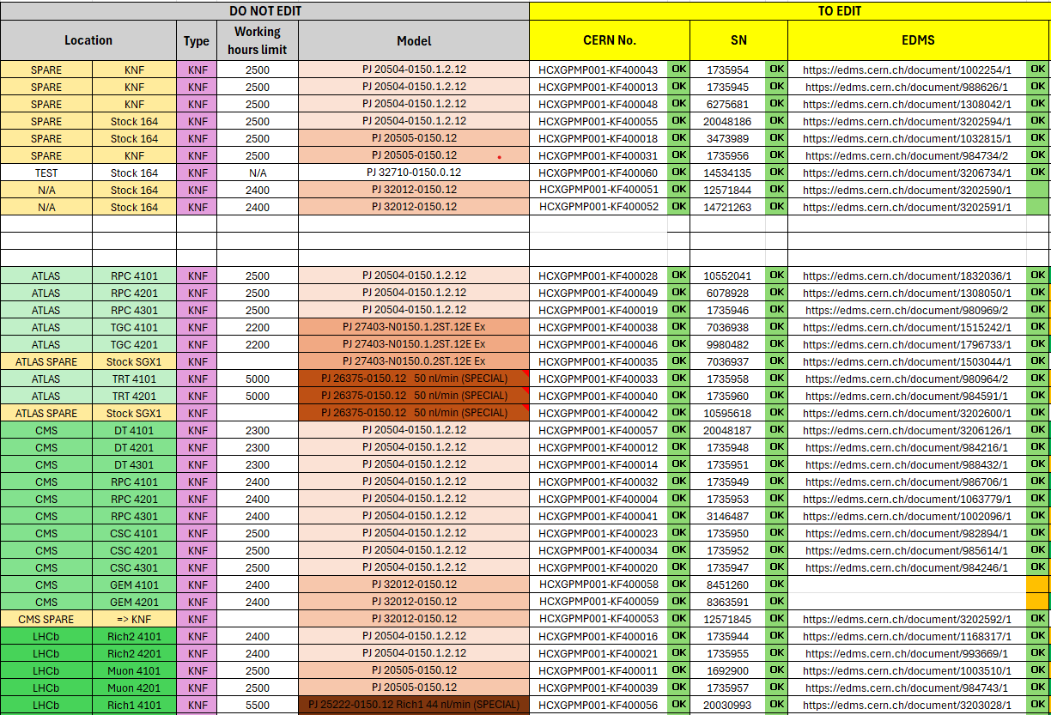
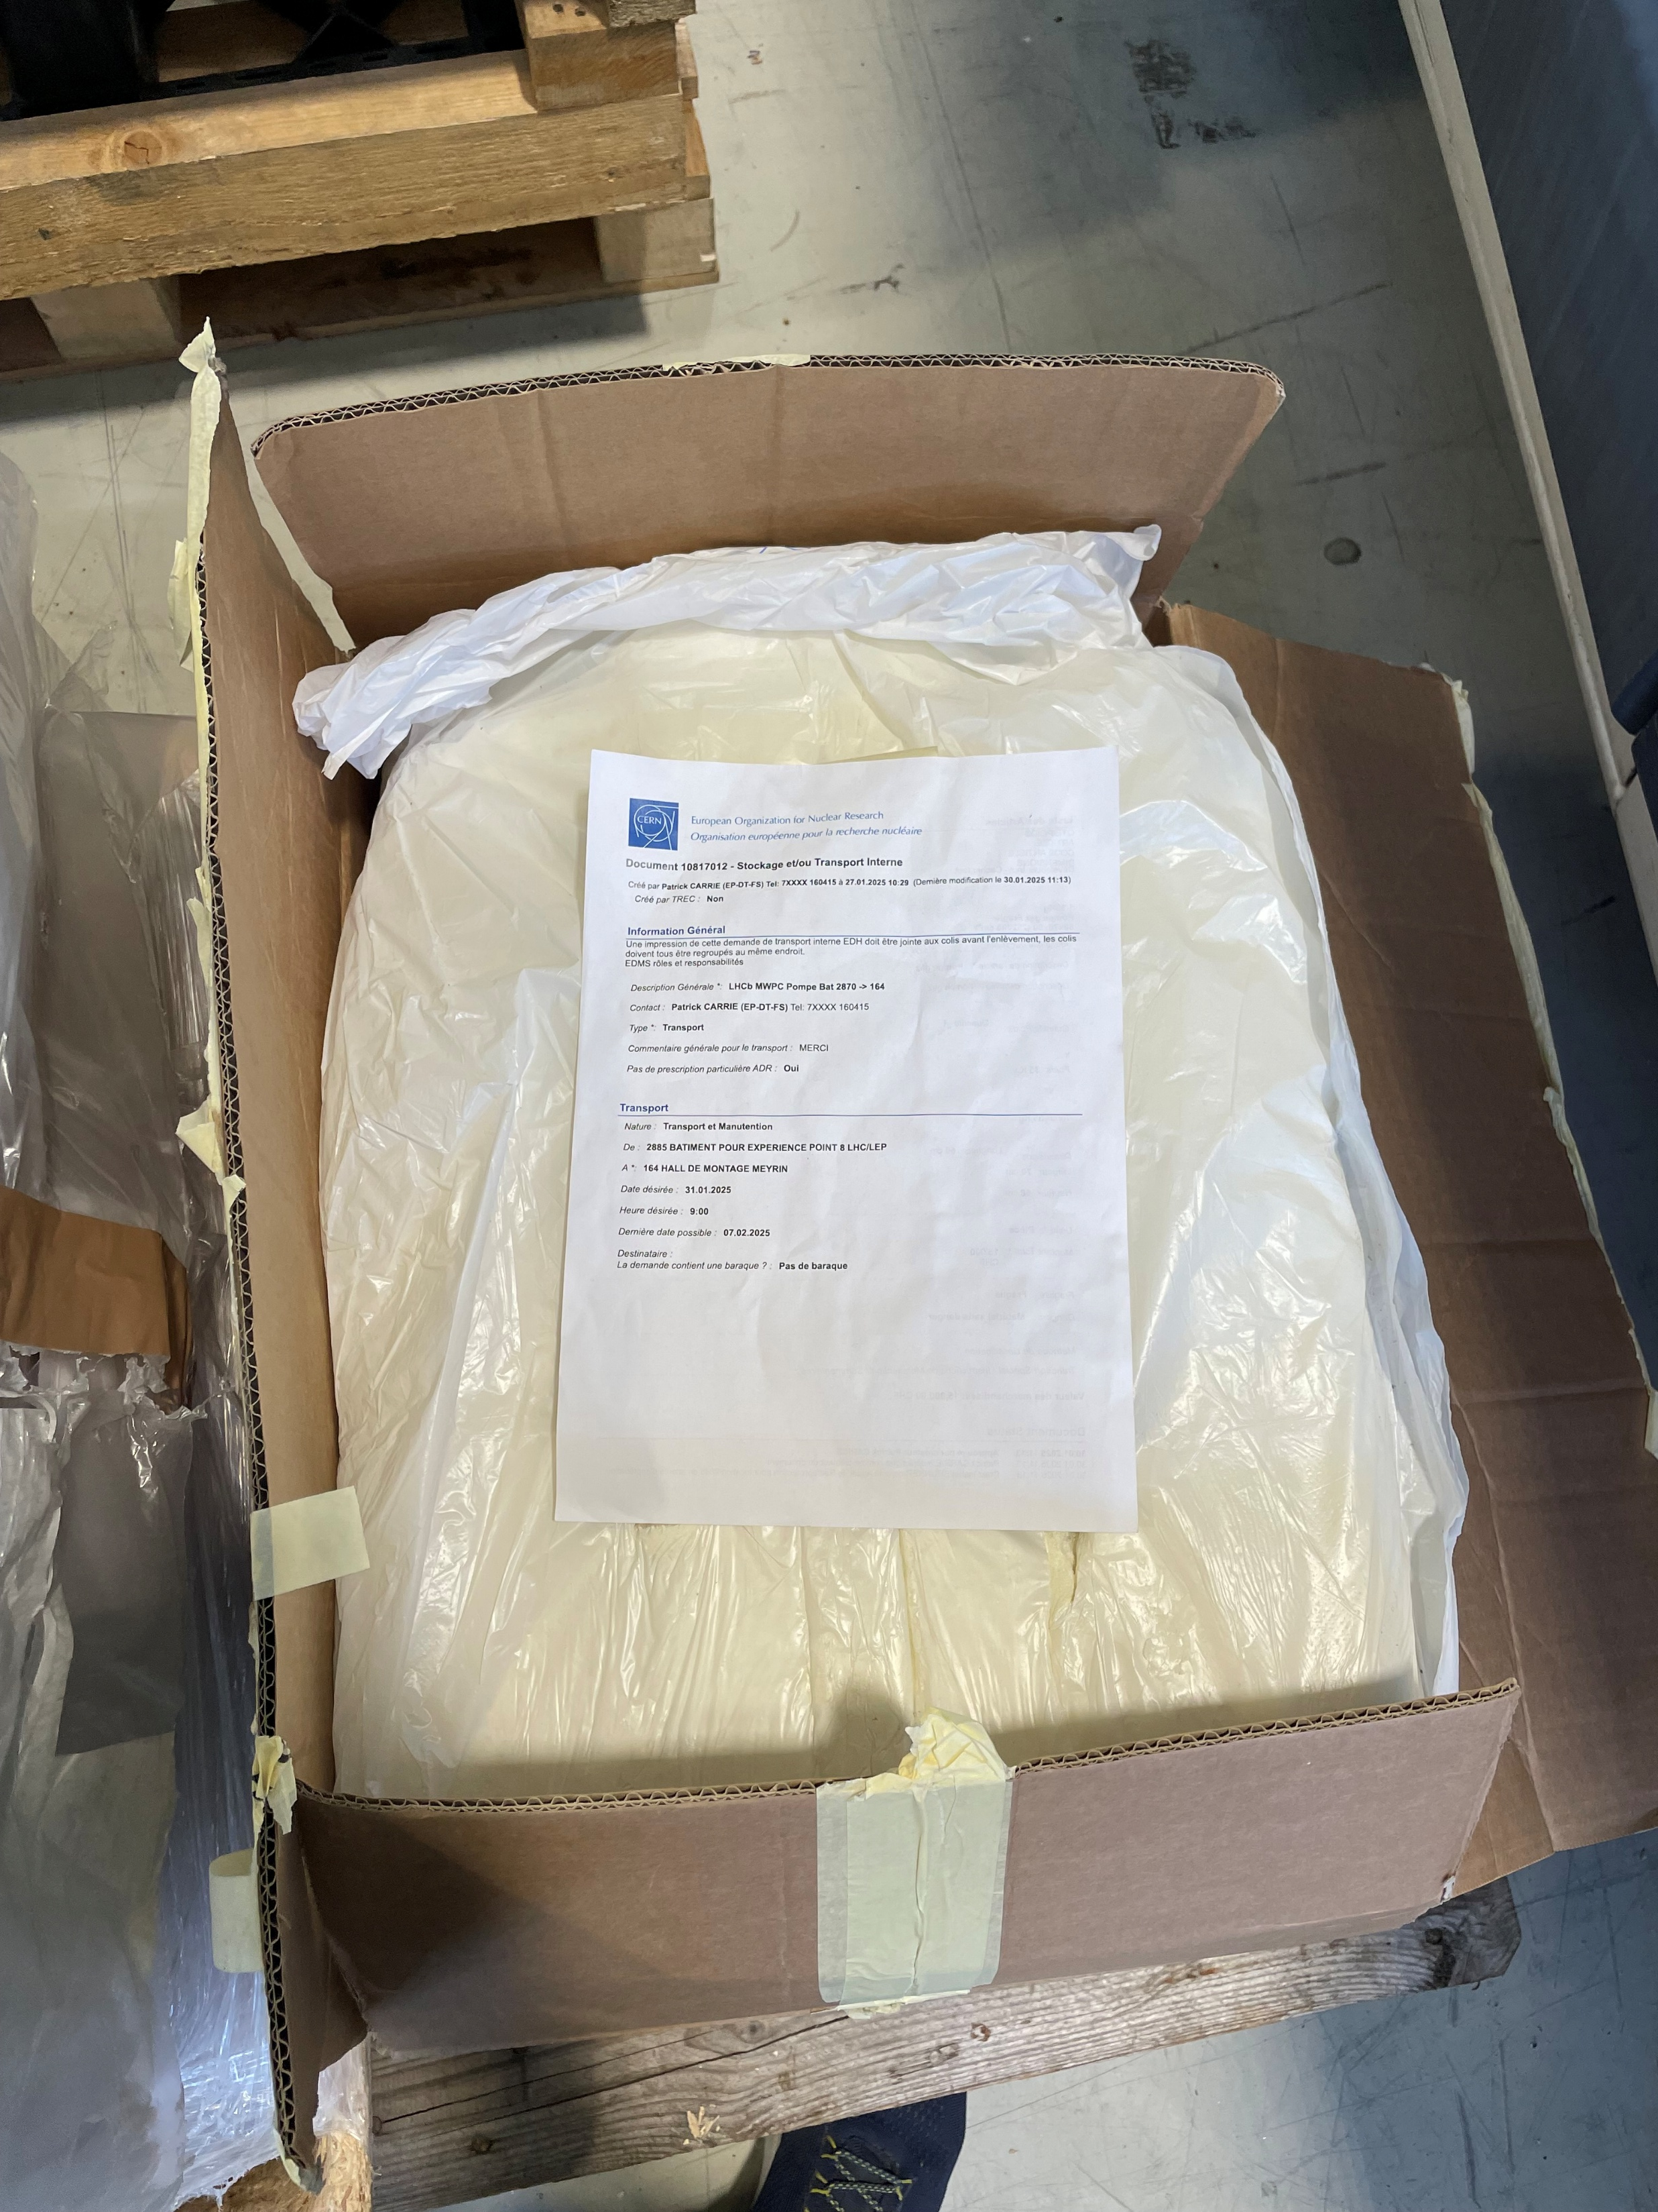
Pump SN: 3473989 sent to KNF for general mantenance.

Slide 10
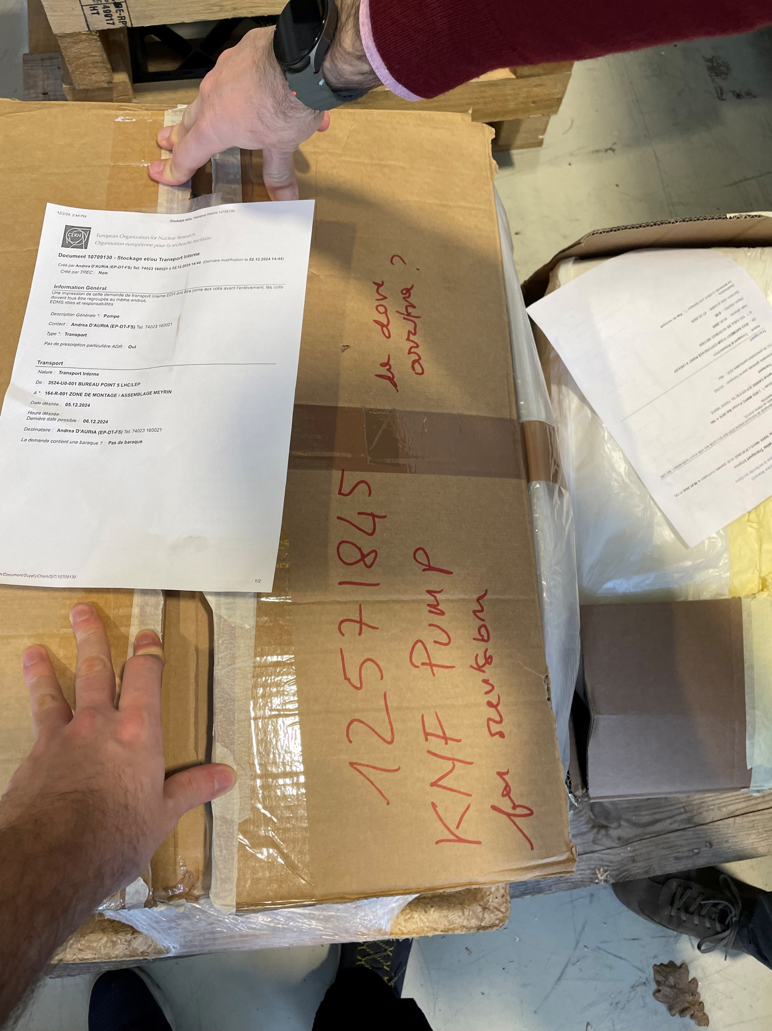
SN:12571845
Pump SN:12571845 sent to KNF for general mantenance.

Slide 11
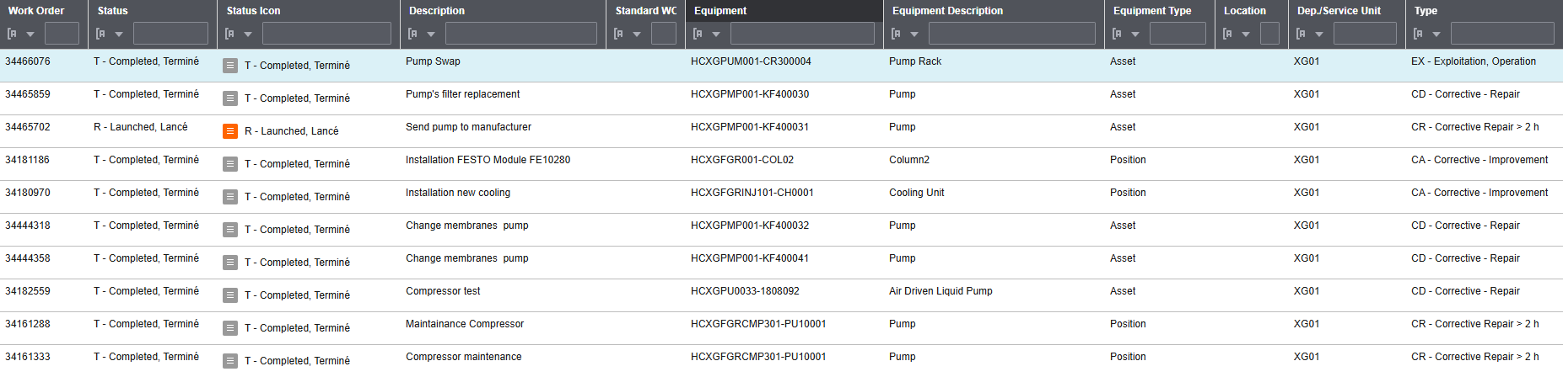
Work order
We are loading the Work Order for the pump, based from the eLog.

Slide 12
eLogs and Work order
To better understand the eLog, and have a better track of data in the future,please include in the eLog the following:
The P&ID code of the pump e.g. pump PU4201 (no pump 1)
The Seria numeber of the pump
The last hour reading for the pump that goes under mantenance.
Thank you.

Slide 13
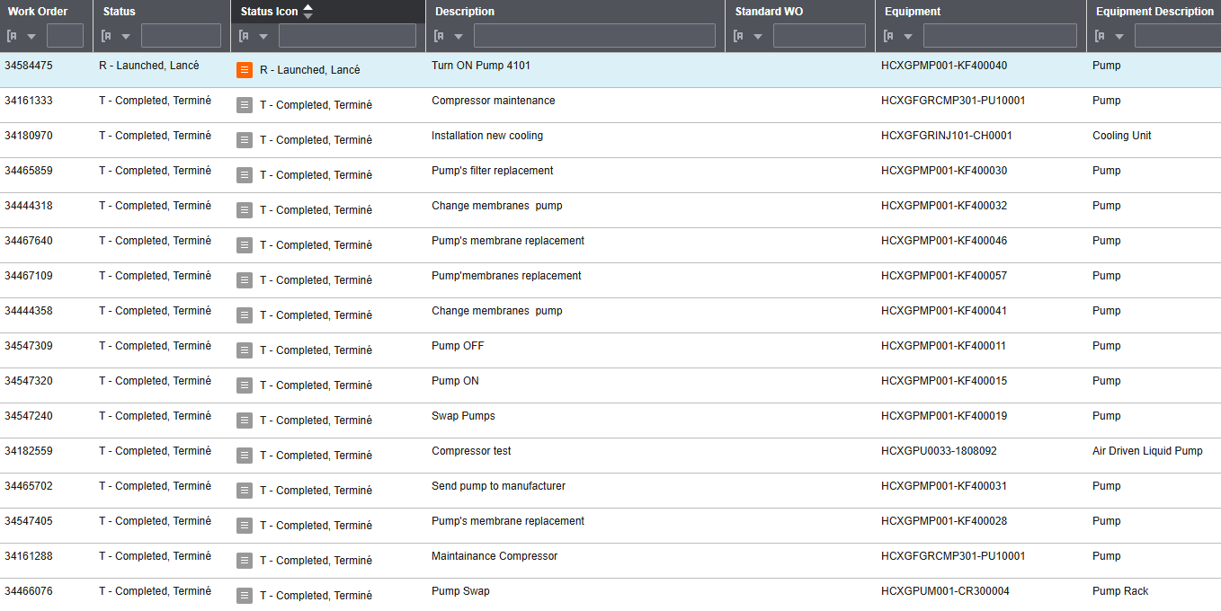
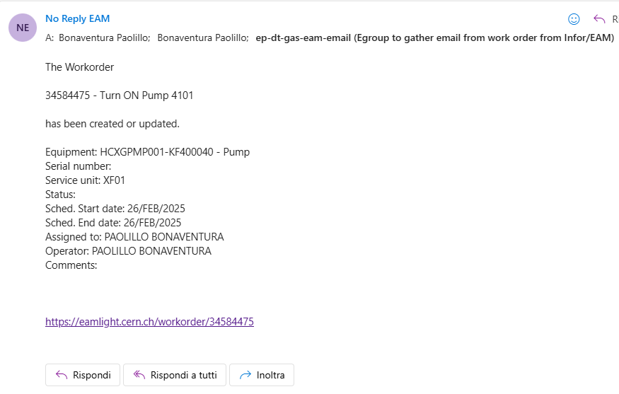
Work order
For every Work order made, you will be notify by an email with the information needed.
We are tested the system. It will send an email no more then 60 min from the creation of the work order

Slide 14
Work order
The mail will be sent to:
The operator specified in the Work order.
Everyone who is subscribed to the e-group created.

Slide 15
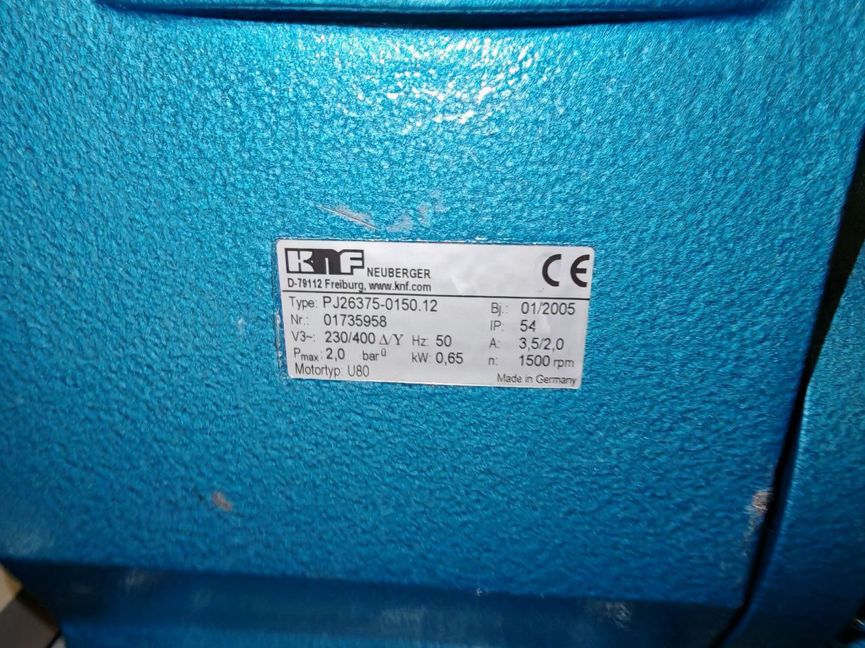
Pump Maintenance
ATLAS TRT pump PU4102:
To be send to KNF for general maintenance

