Slide 1
Survey Integration Accessories
Dirk MERGELKUHL, Solomon KAMUGASA (BE-GM-ESA)
26.02.2025

Slide 2
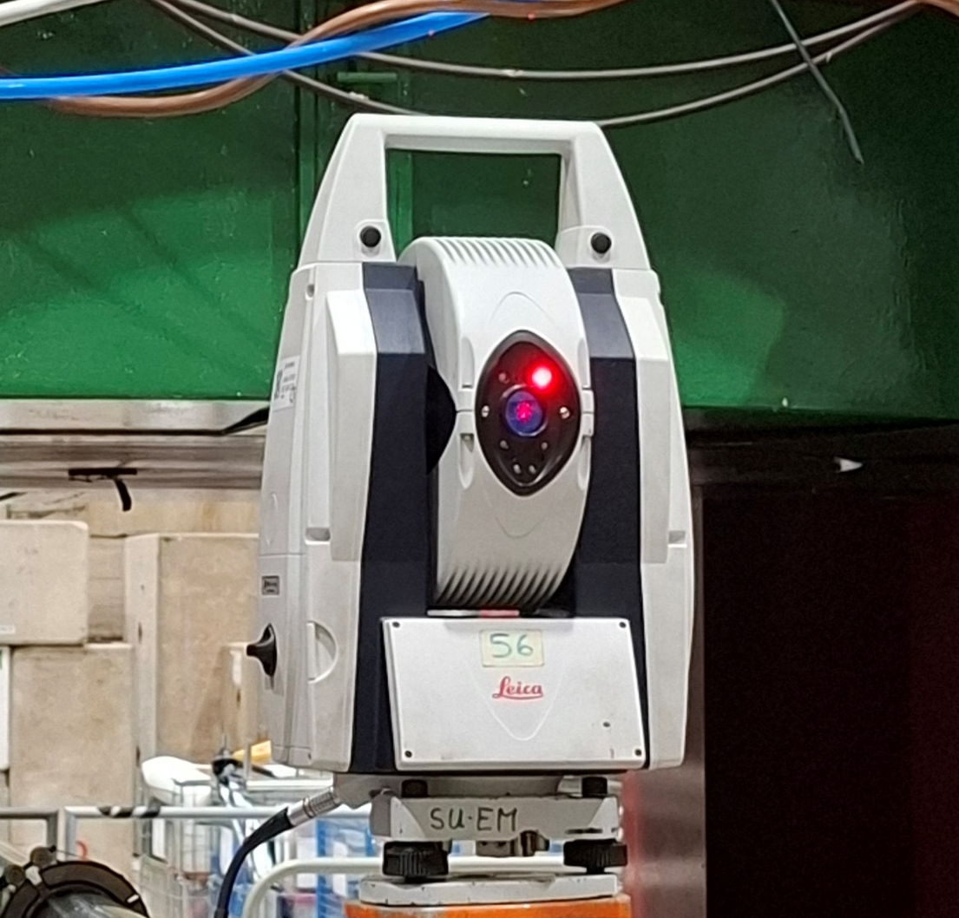
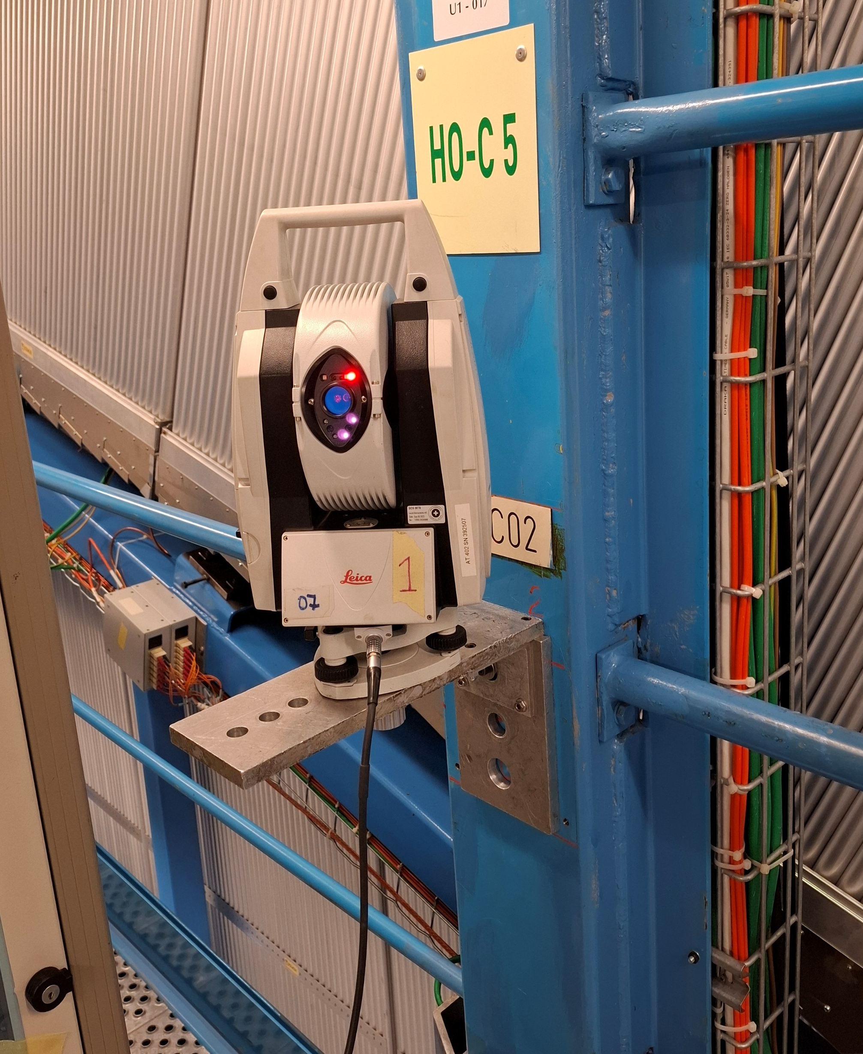
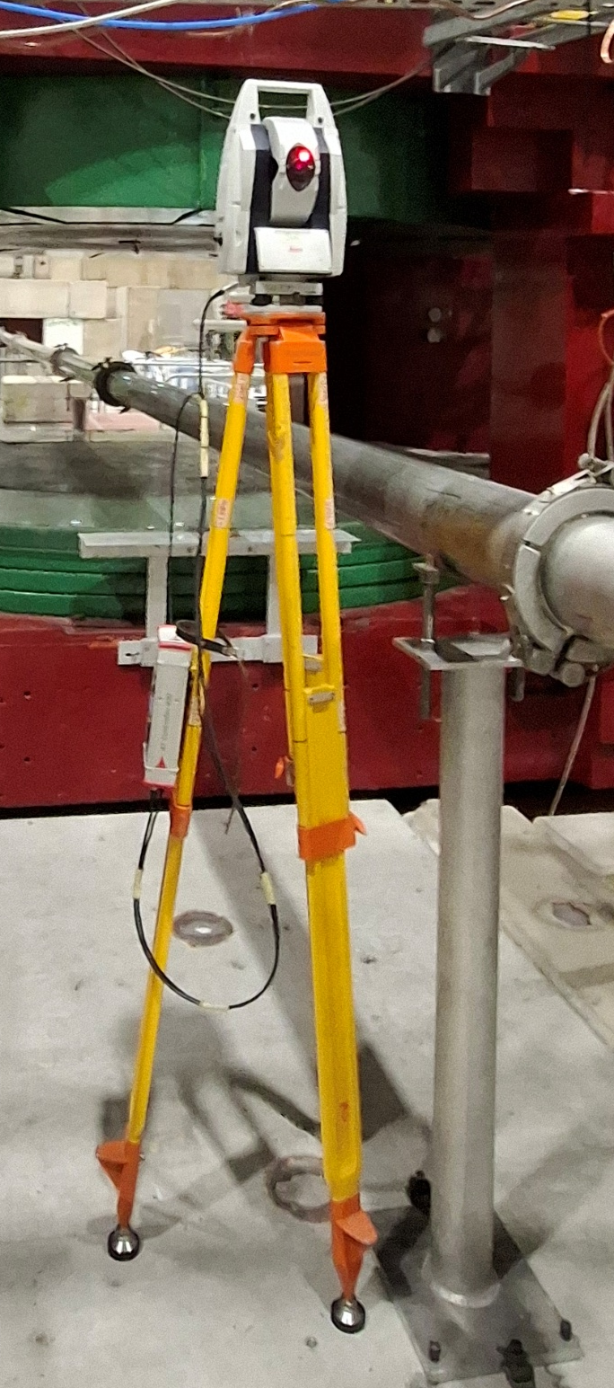
Laser Tracker

Slide 3
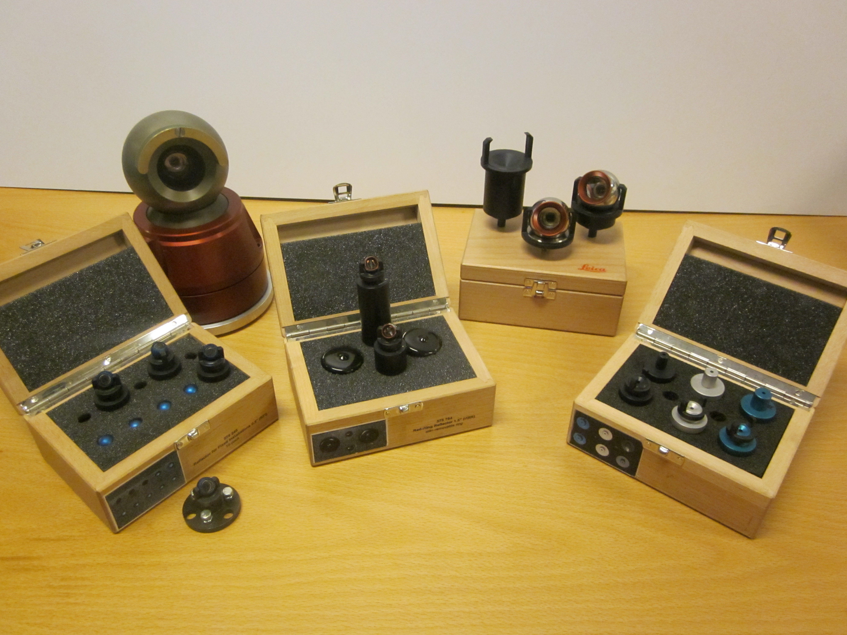
Survey Targets & Supports

Slide 4
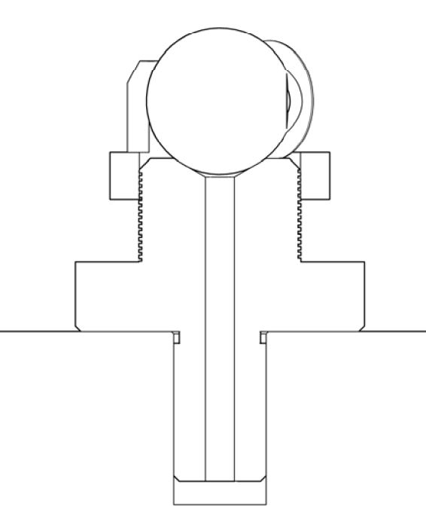
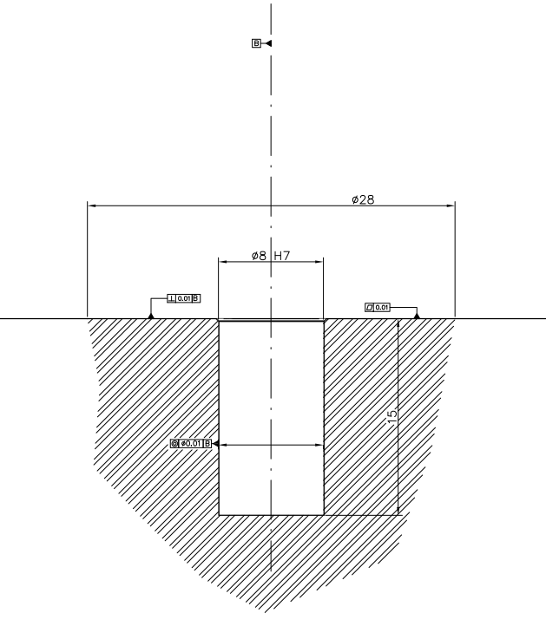
Survey Target Integration

Slide 5
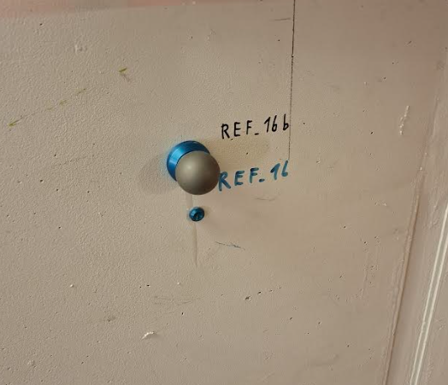
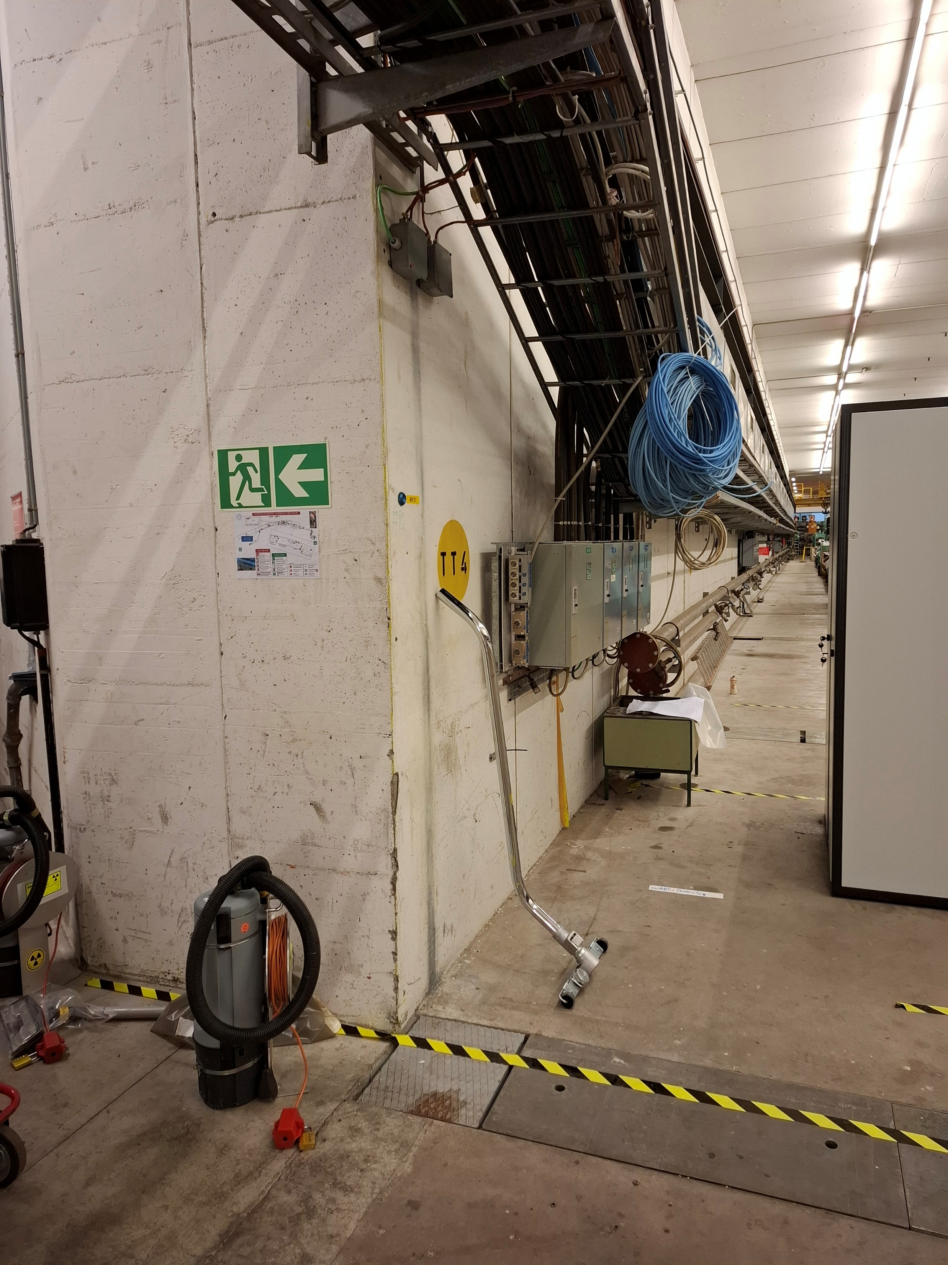
0.5 & 1.5 Inch Target Mounting

Slide 6
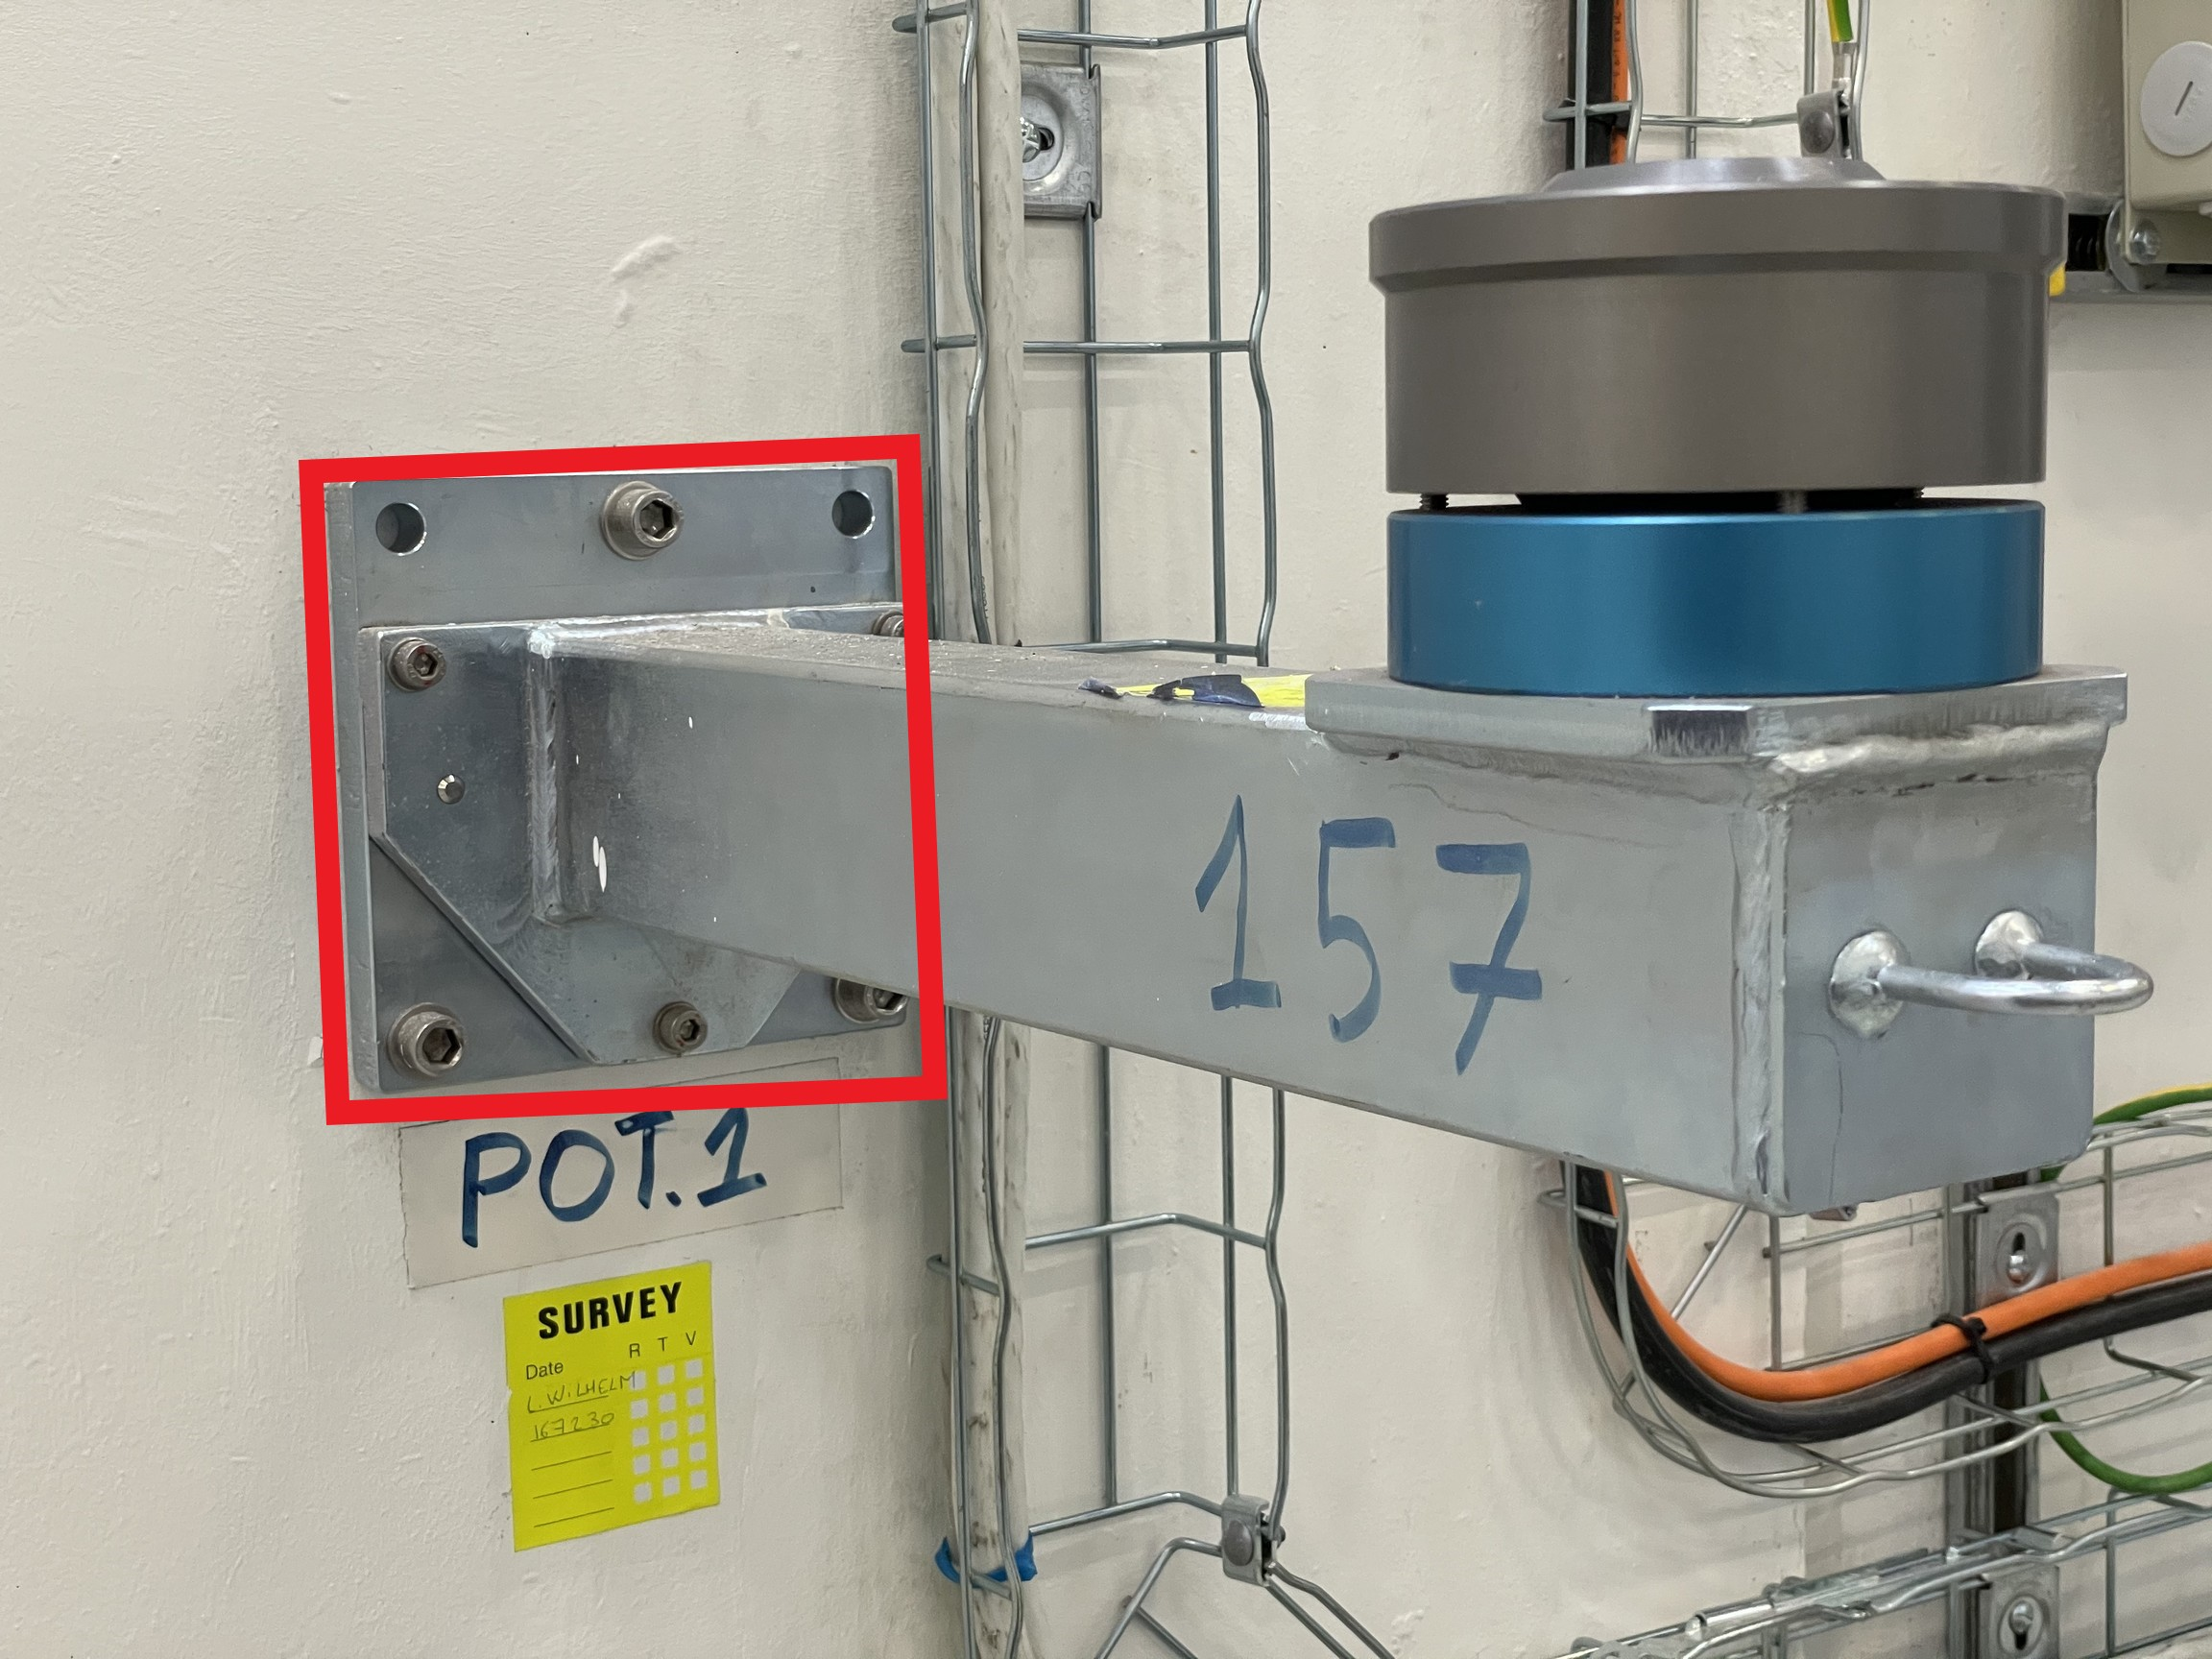
3.5 Inch Target/ Laser Tracker Bracket

Slide 7
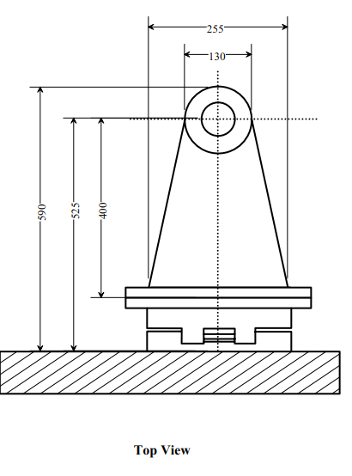
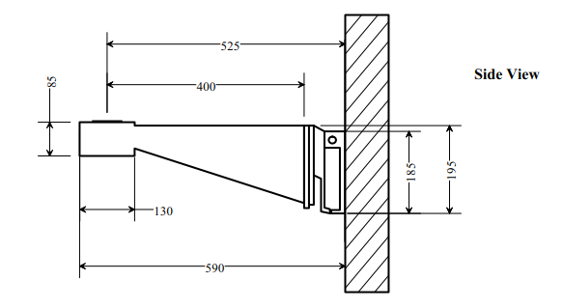
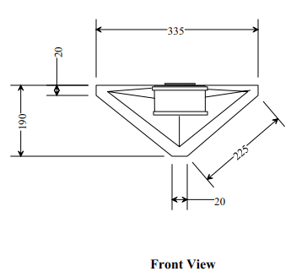
3.5 Inch Target/ Laser Tracker Bracket

Slide 8
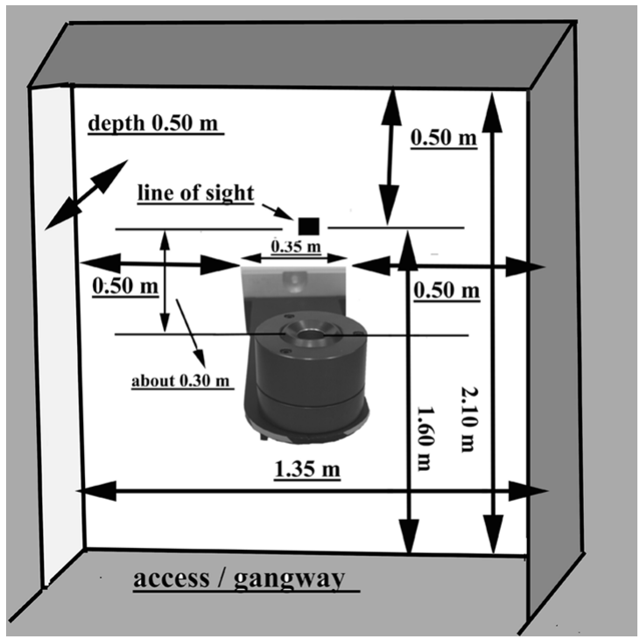
Bracket Envelope

Slide 9
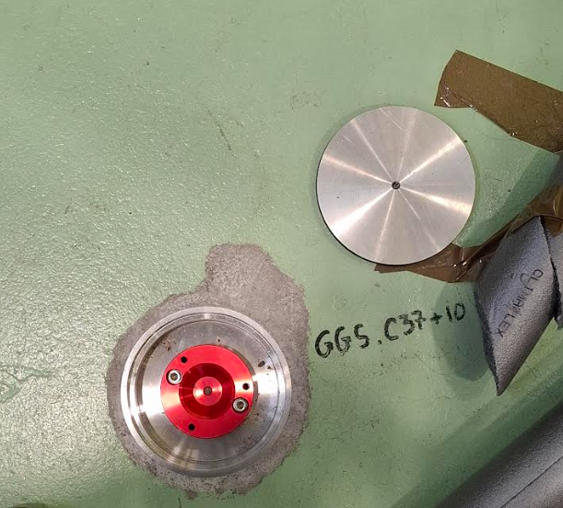
Floor Mounted Nests

