Slide 1
3D Modelling of HTS Magnets using Equivalent Circuits
TE-MPE-PE Section Meeting
Leon Teichröb – University of Stuttgart
19.03.2025

Slide 2

A quick reintroduction…
Technical student in the STEAM team for one year
Under the supervision of Tim Mulder
My task:
Find the protection limitations and failure modes
of large HTS magnets

Slide 3
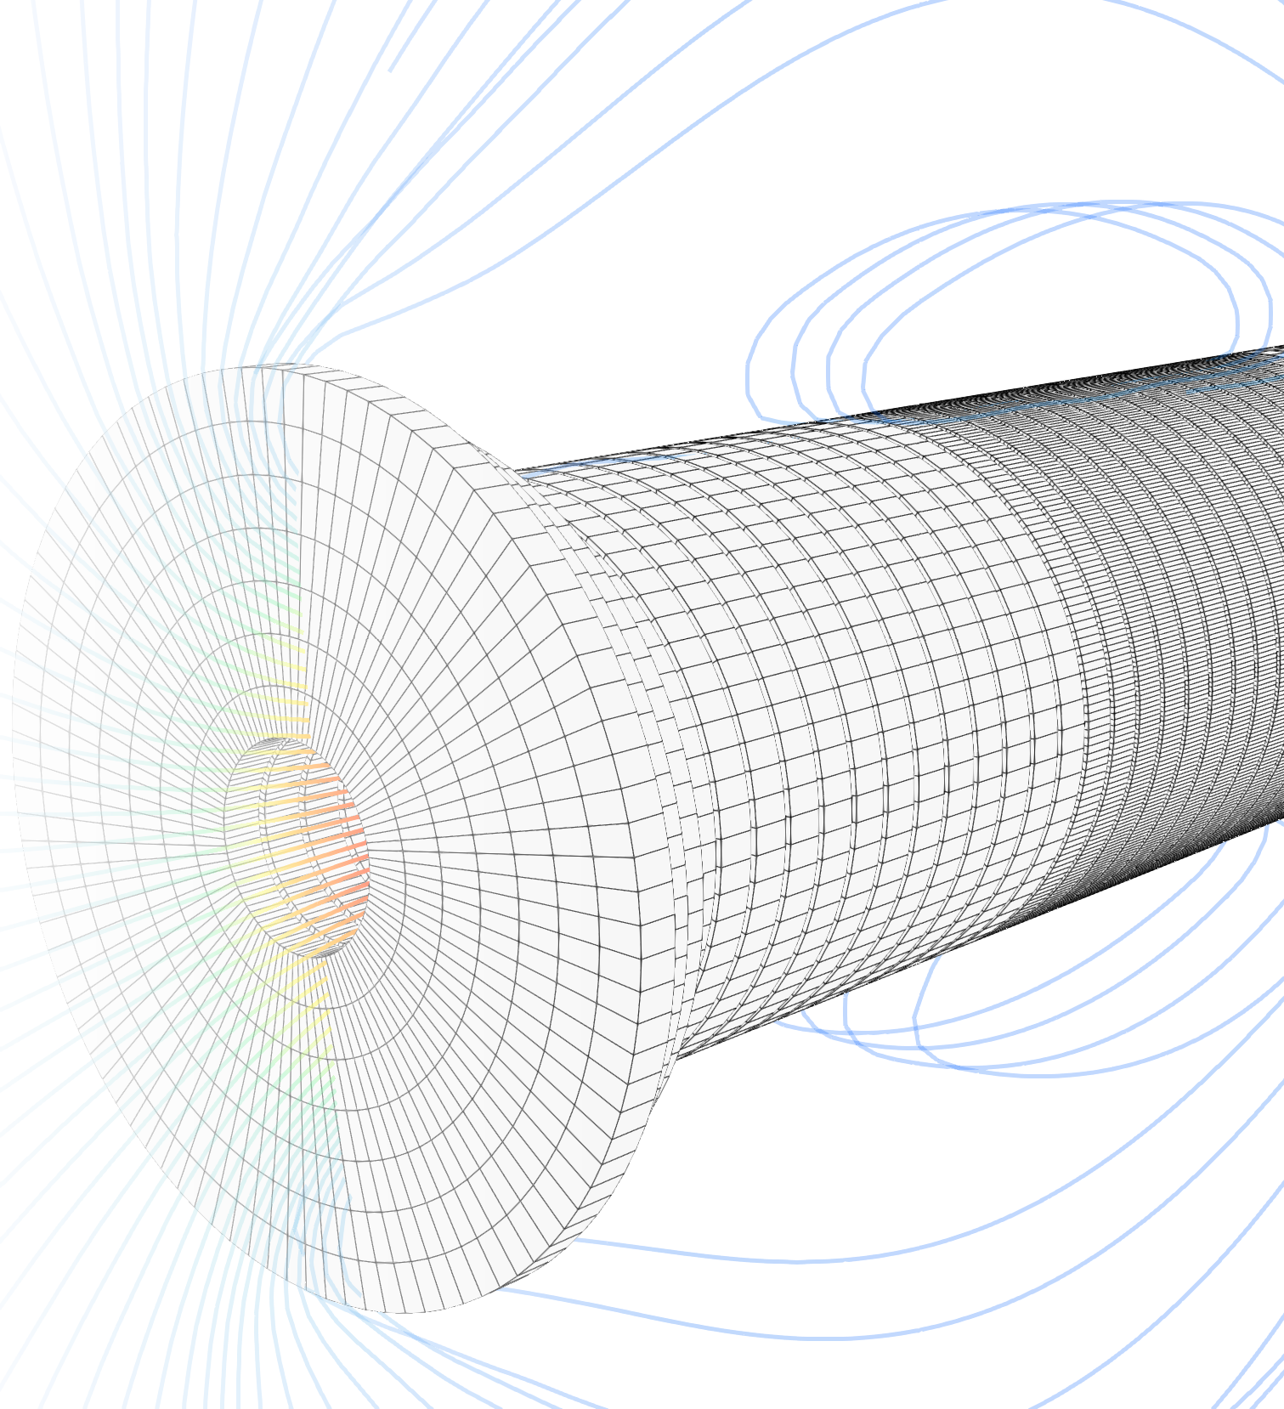
Agenda
Goals and Motivation
HETS
  The Idea of NICQS and HETS
  Design Overview
  Geometry Representation
  Homogenization
  Circuit Solver
Results
Other Contributions
The Future

Slide 4
Goals
Evaluate non-insulated magnet concepts
  Muon Collider: 40T Cooling Magnet
  HFM: HTS racetrack coils
Generally, pave the way for new magnet designs
→ Reduce size
→ Increase attainable field
→ Improve stability

Slide 5
Boundary Conditions
Limited simulation capability for NI HTS magnets
Conclusion:
Extension of the NICQS solver to 3D
Large geometries to expensive to simulate
NICQS* giving interesting results, but asymmetry is essential!
* NICQS is the 2D, non-insulated HTS-magnet simulator written by Tim Mulder

Slide 6
An elegant adaptation of NICQS was not possible…

Slide 7
An elegant adaptation of NICQS was not possible…
Moving to 3D:
Required a more sophisticated geometry data model
Invalidated the circuit model
Necessitated a new software architecture

Slide 8
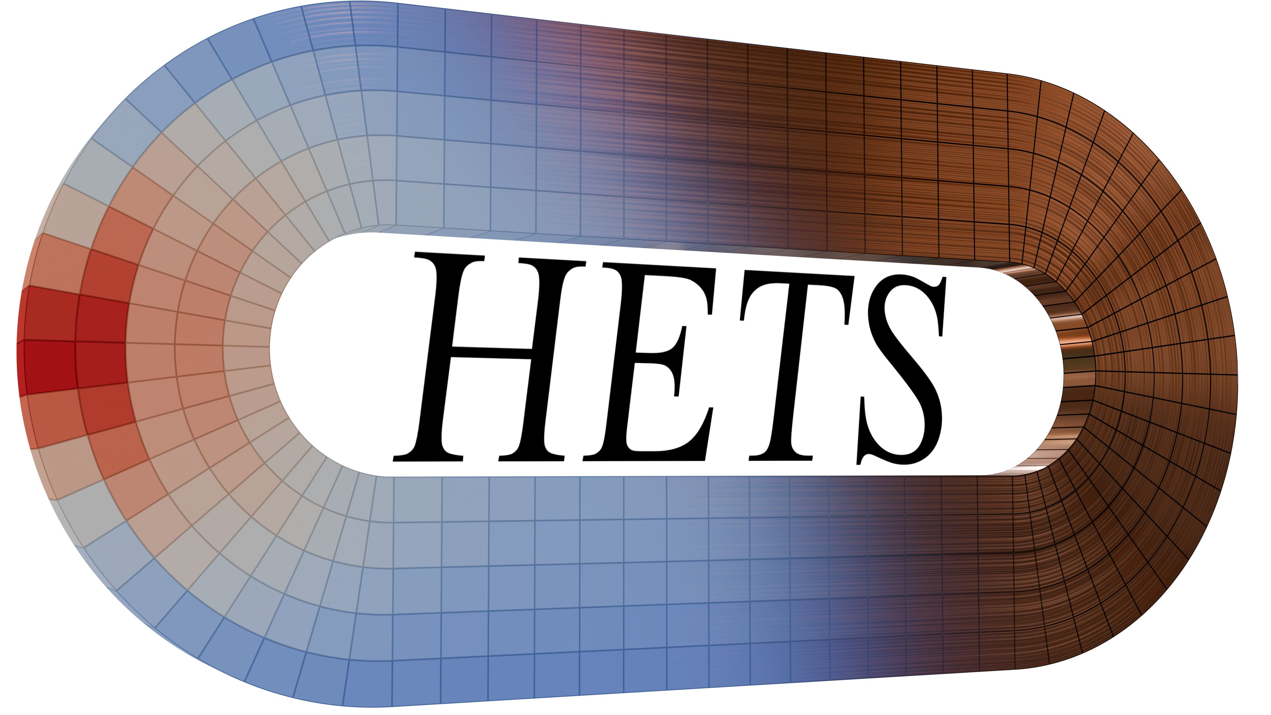
Homogenized Electrothermal Transients of Superconductors
https://gitlab.cern.ch/steam/hets
Notes:
And so HETS was born

Slide 9
The Design of HETS

Slide 10

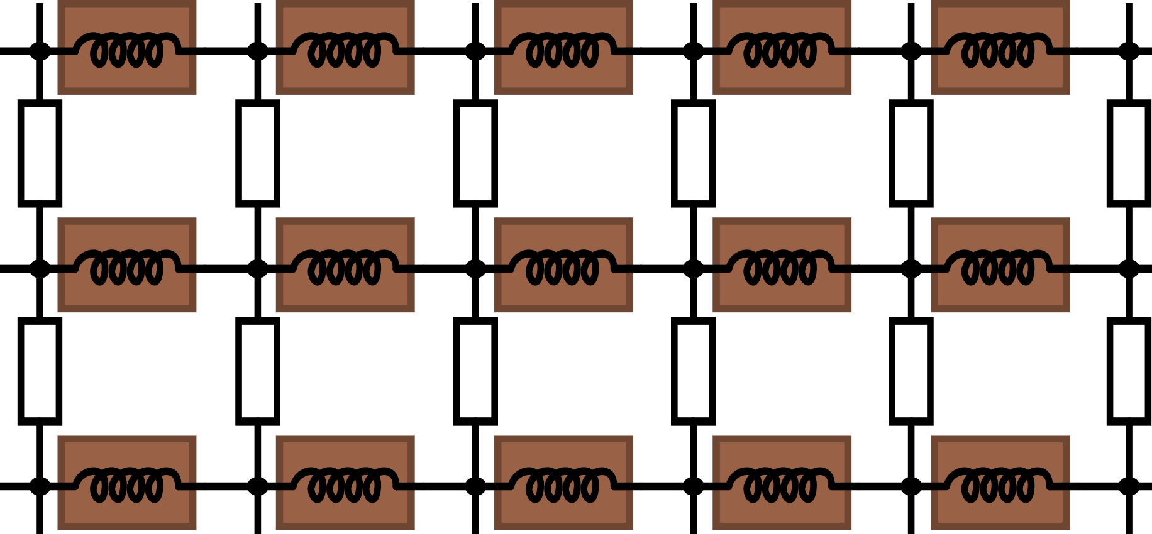
1. The Idea of NICQS and HETS
Both NICQS and HETS use an equivalent circuit representation of the geometry
Current Flow
Radial Current

Slide 11
1. The Idea of NICQS and HETS
Both NICQS and HETS use an equivalent circuit representation of the geometry
  Not a Finite Element or Boundary Element method
  Like PEEC method
Lump conductors together, reducing element count
Direct magnetic field calculation
No meshing of free space

Slide 12
2. Design Overview
HETS
Imports
Pre-processor
Solver
Post-processor
YAML File
YAML File
YAML File
Artifacts
…
CAD Files
Solution
VTKs
Plots
CSVs
Paraview
Multi-Part Simulations
Plots
Notes:
HETS is driven by YAML simulation definition files

Slide 13
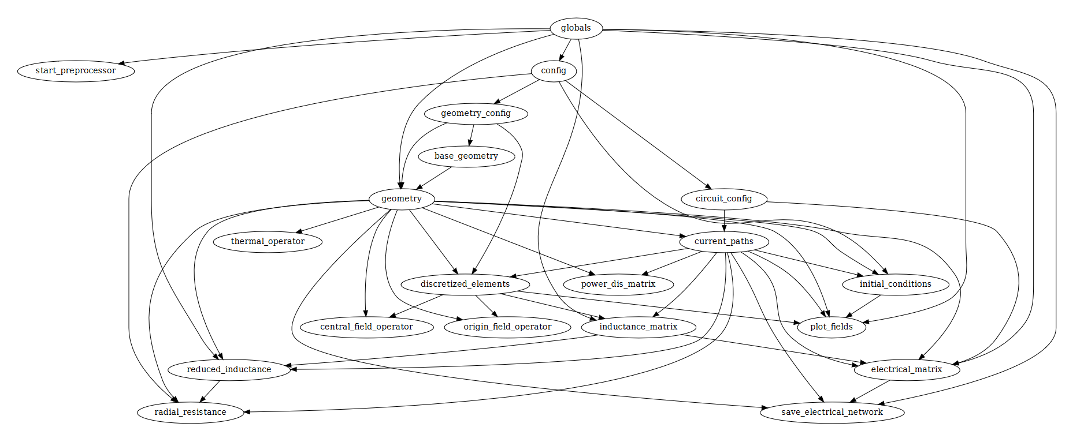
2. Design Overview
Written in pure Python
  But still fast?
Speed-ups via
  Numba (highly recommended!)
  Julia (DifferentialEquations.jl)
  Numpy, Pytorch, etc.
  Lookup tables
Clearly structured processing steps. A Directed Acyclic Graph (DAG) drives the execution of the preprocessor.
A part of the HETS execution graph

Slide 14
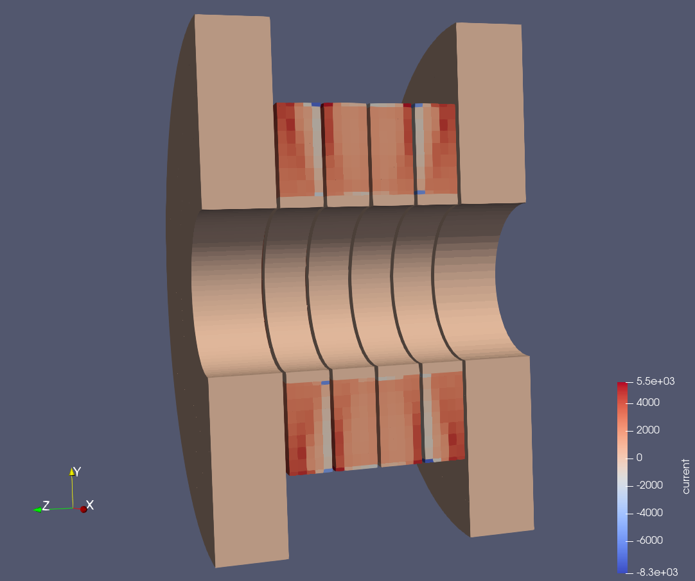
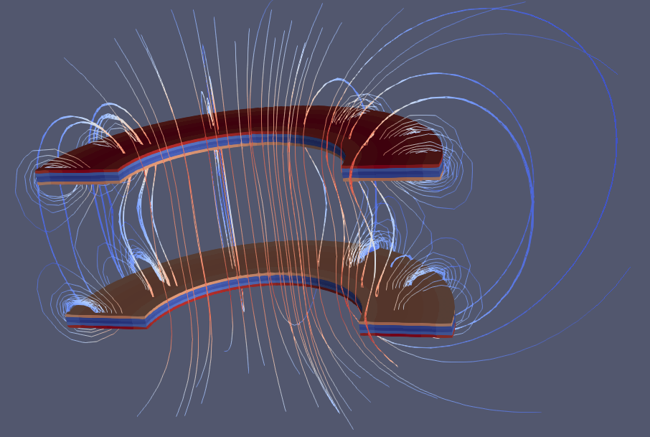
2. Design Overview
HETS models:
  Thermals
  B-Field
  Voltage and Current
  Radial Current
  Screening Currents
  Inductive Coupling
  T- and B-dependent materials
  External circuitry

Slide 15
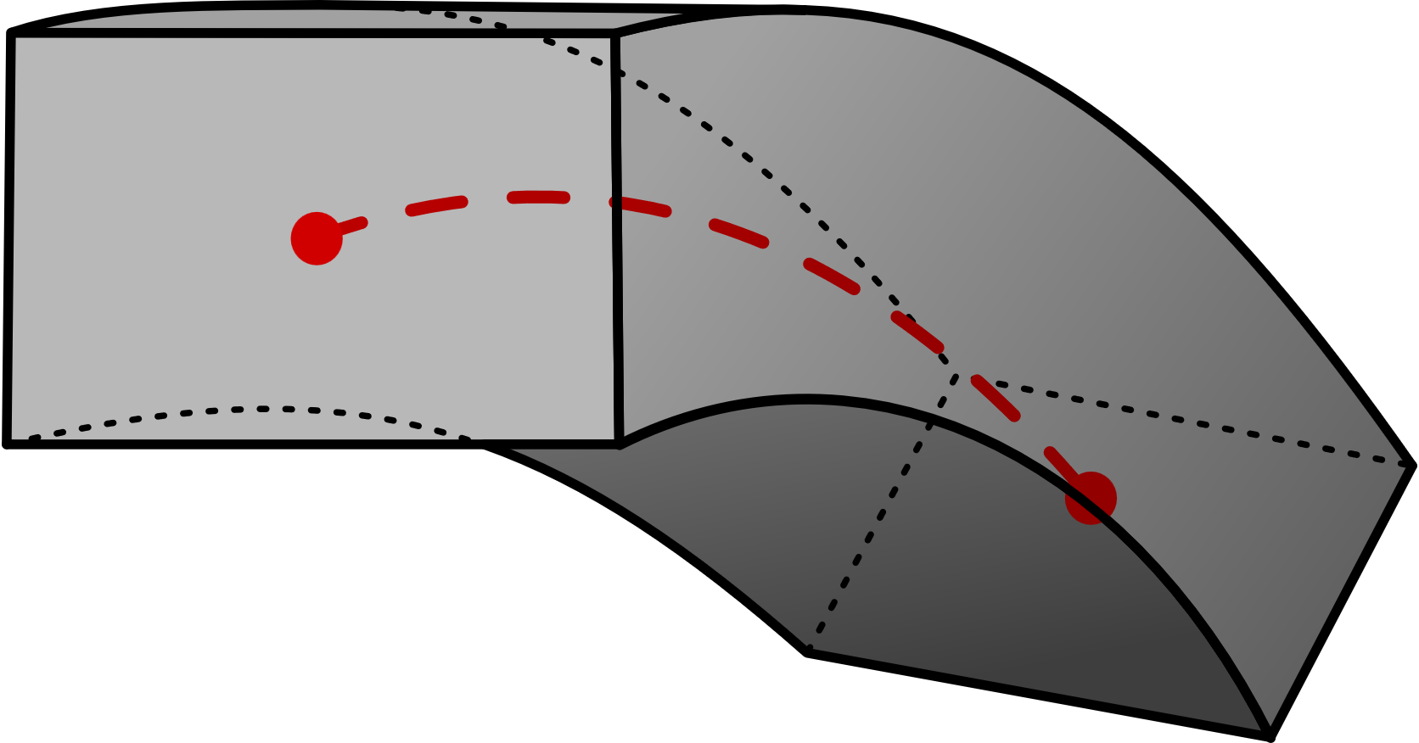
3. Geometry Representation
The homogenization method demands a specific kind of element
  Hexahedral mesh approximates geometry inaccurately
  High order elements incompatible
A swept section with
arbitrary path is used
  Lines
  Splines
  Spirals
Very accurate for many NI-HTS
geometries
Illustration of HETS geometry element
Notes:
Electrical nodes at the ends. Each element is modelled as an electrical component with two terminals.

Slide 16
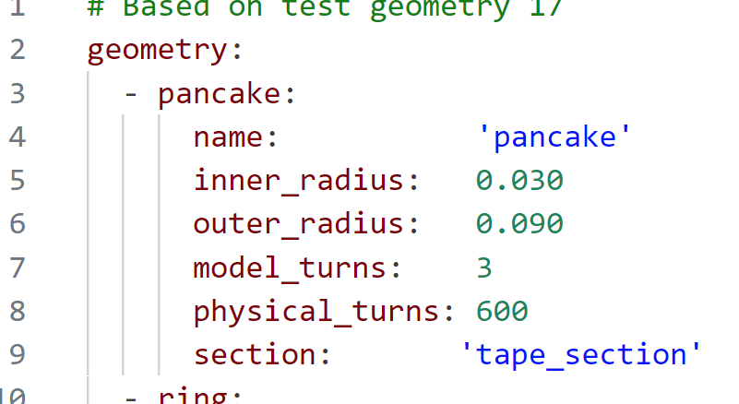
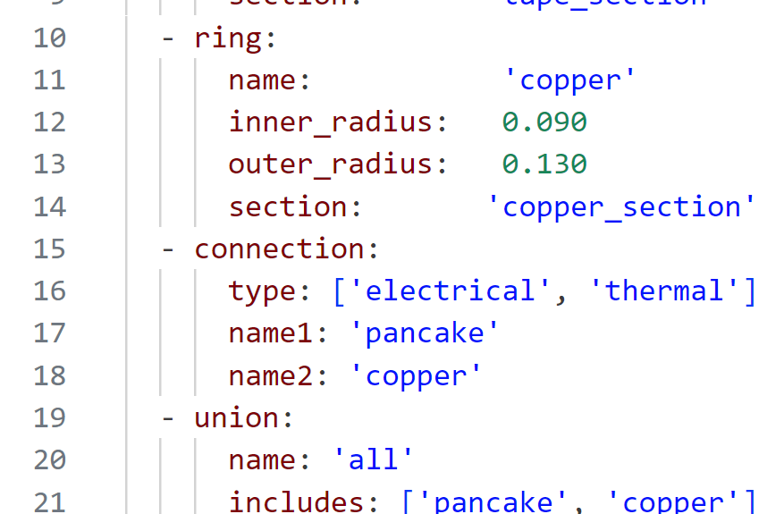
3. Geometry Representation
Currently the geometry is described in YAML format
Perhaps CAD import in the future

Slide 17
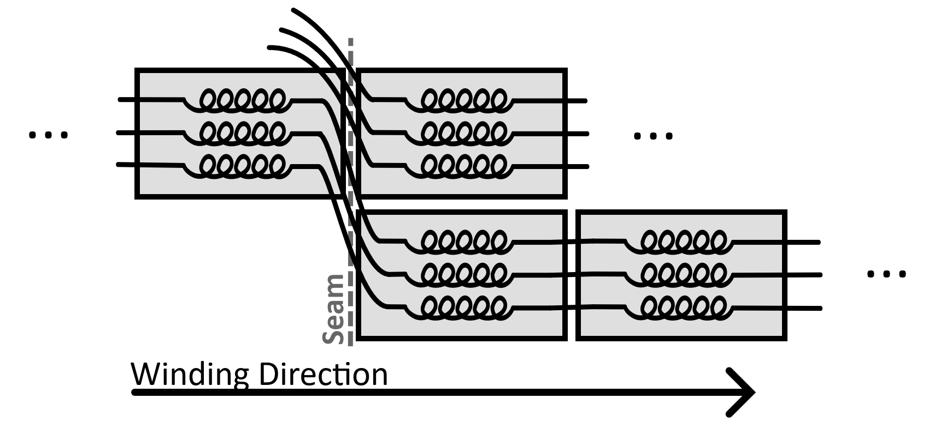
4. Homogenization
Electrically the model in NICQS is a spiral, like the real geometry
This model breaks down when lumping + asymmetry are permitted
We are actually modelling parallel tapes
Notes:
KCL is violated in 3D and it can be demonstrated that it is a very fundamental issue.

Slide 18
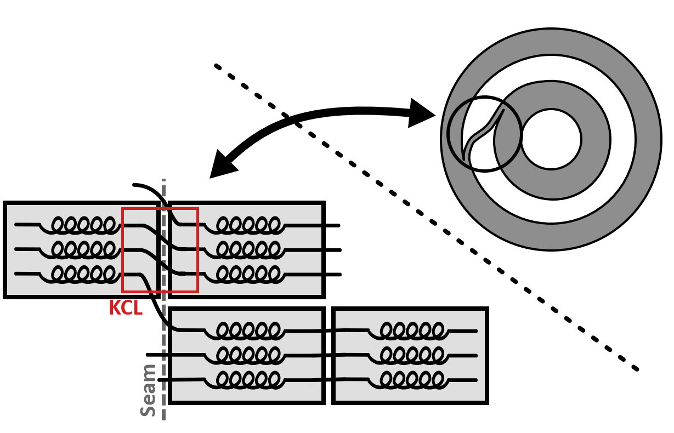
4. Homogenization – New Technique
An exact solution to the current flowing azimuthally and radially at a selected bridging point is established under more accurate assumptions
As more conductors are lumped,
only a small fraction passes into
the next layer
Modelled as a generic circuit
component with four terminals
  “Bridges”

Slide 19
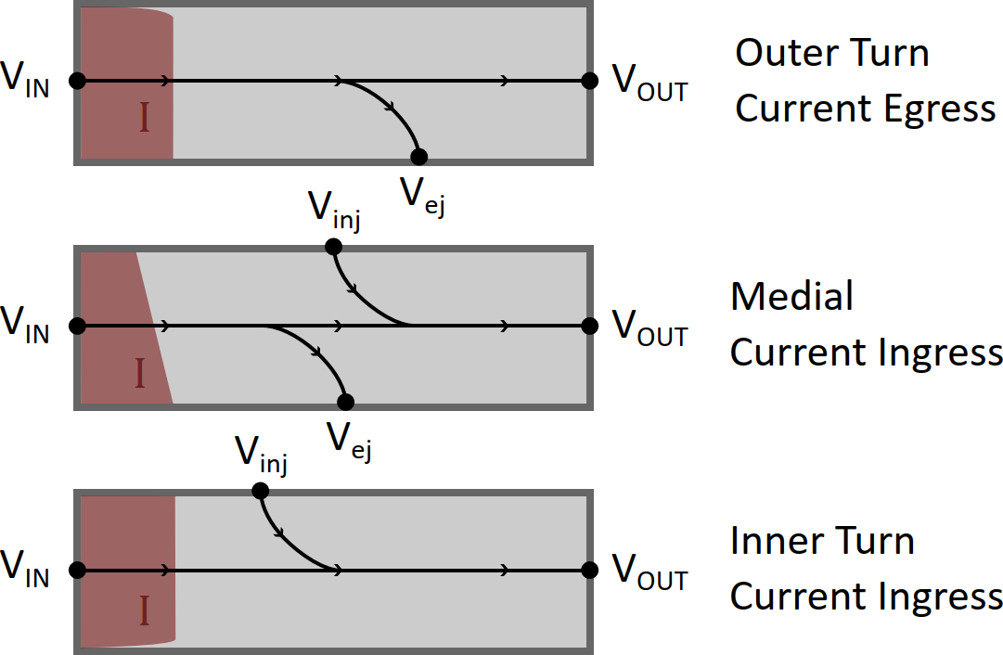
4. Homogenization – New Technique
Multiple bridge-types are employed
that model the exact distribution
of current in the tape stack
The new technique is…
  Proven to fulfill KCL
  Proven to fulfill conservation of energy
  Exactly accurate in common cases
  (like slow ramping)
  Still works with a single current per
  element and a single voltage per node

Slide 20
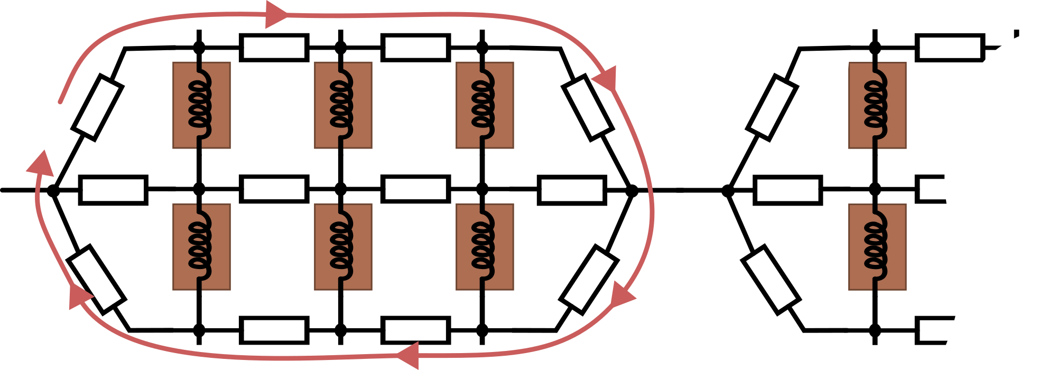


5. Circuit Solver
In NICQS, the circuit was represented by an ODE
Thus, we were solving for $dI/dt$
  This does not work for resistor loops which exist in 3D
$$\dot{I}= ???$$

Slide 21
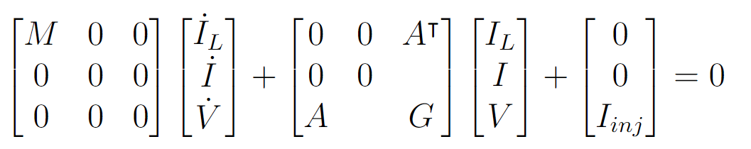
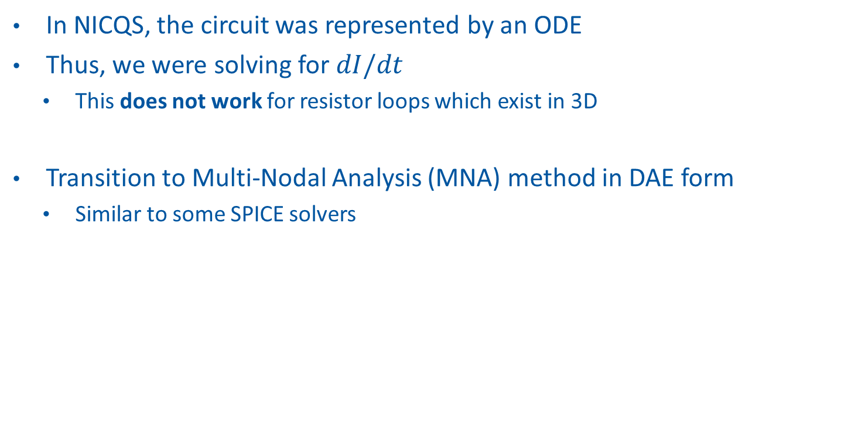

5. Circuit Solver
In NICQS, the circuit was represented by an ODE
Thus, we were solving for $dI/dt$
  This does not work for resistor loops which exist in 3D
Transition to Multi-Nodal Analysis (MNA) method in DAE form
  Similar to some SPICE solvers
$\dot{I}$ and $\dot{V}$ do not appear in the equation!

Slide 22
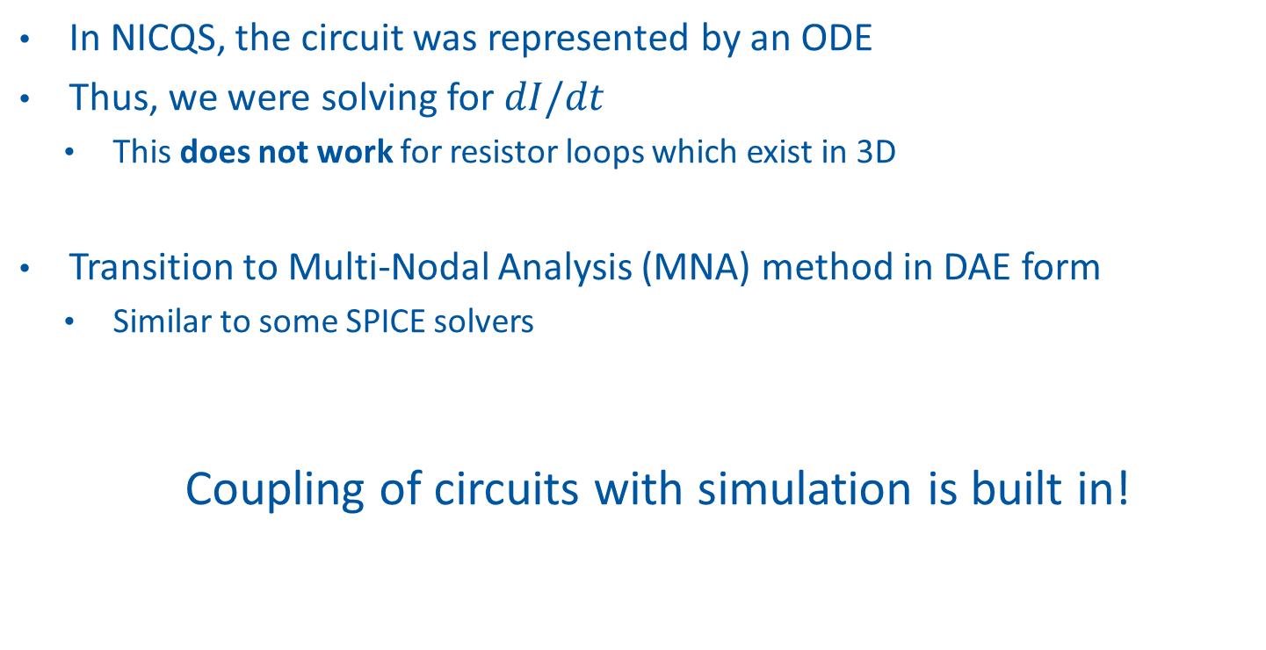
5. Circuit Solver
In NICQS, the circuit was represented by an ODE
Thus, we were solving for $dI/dt$
  This does not work for resistor loops which exist in 3D
Transition to Multi-Nodal Analysis (MNA) method in DAE form
  Similar to some SPICE solvers
  Coupling of circuits with simulation is built in!

Slide 23
What else…
Gitlab CI Pipeline for unit tests, system tests, coverage, etc.
A complete User Guide
Full Linux and Windows compatibility
Multithreaded + CUDA acceleration
Local resolution control

Slide 24
Results

Slide 25
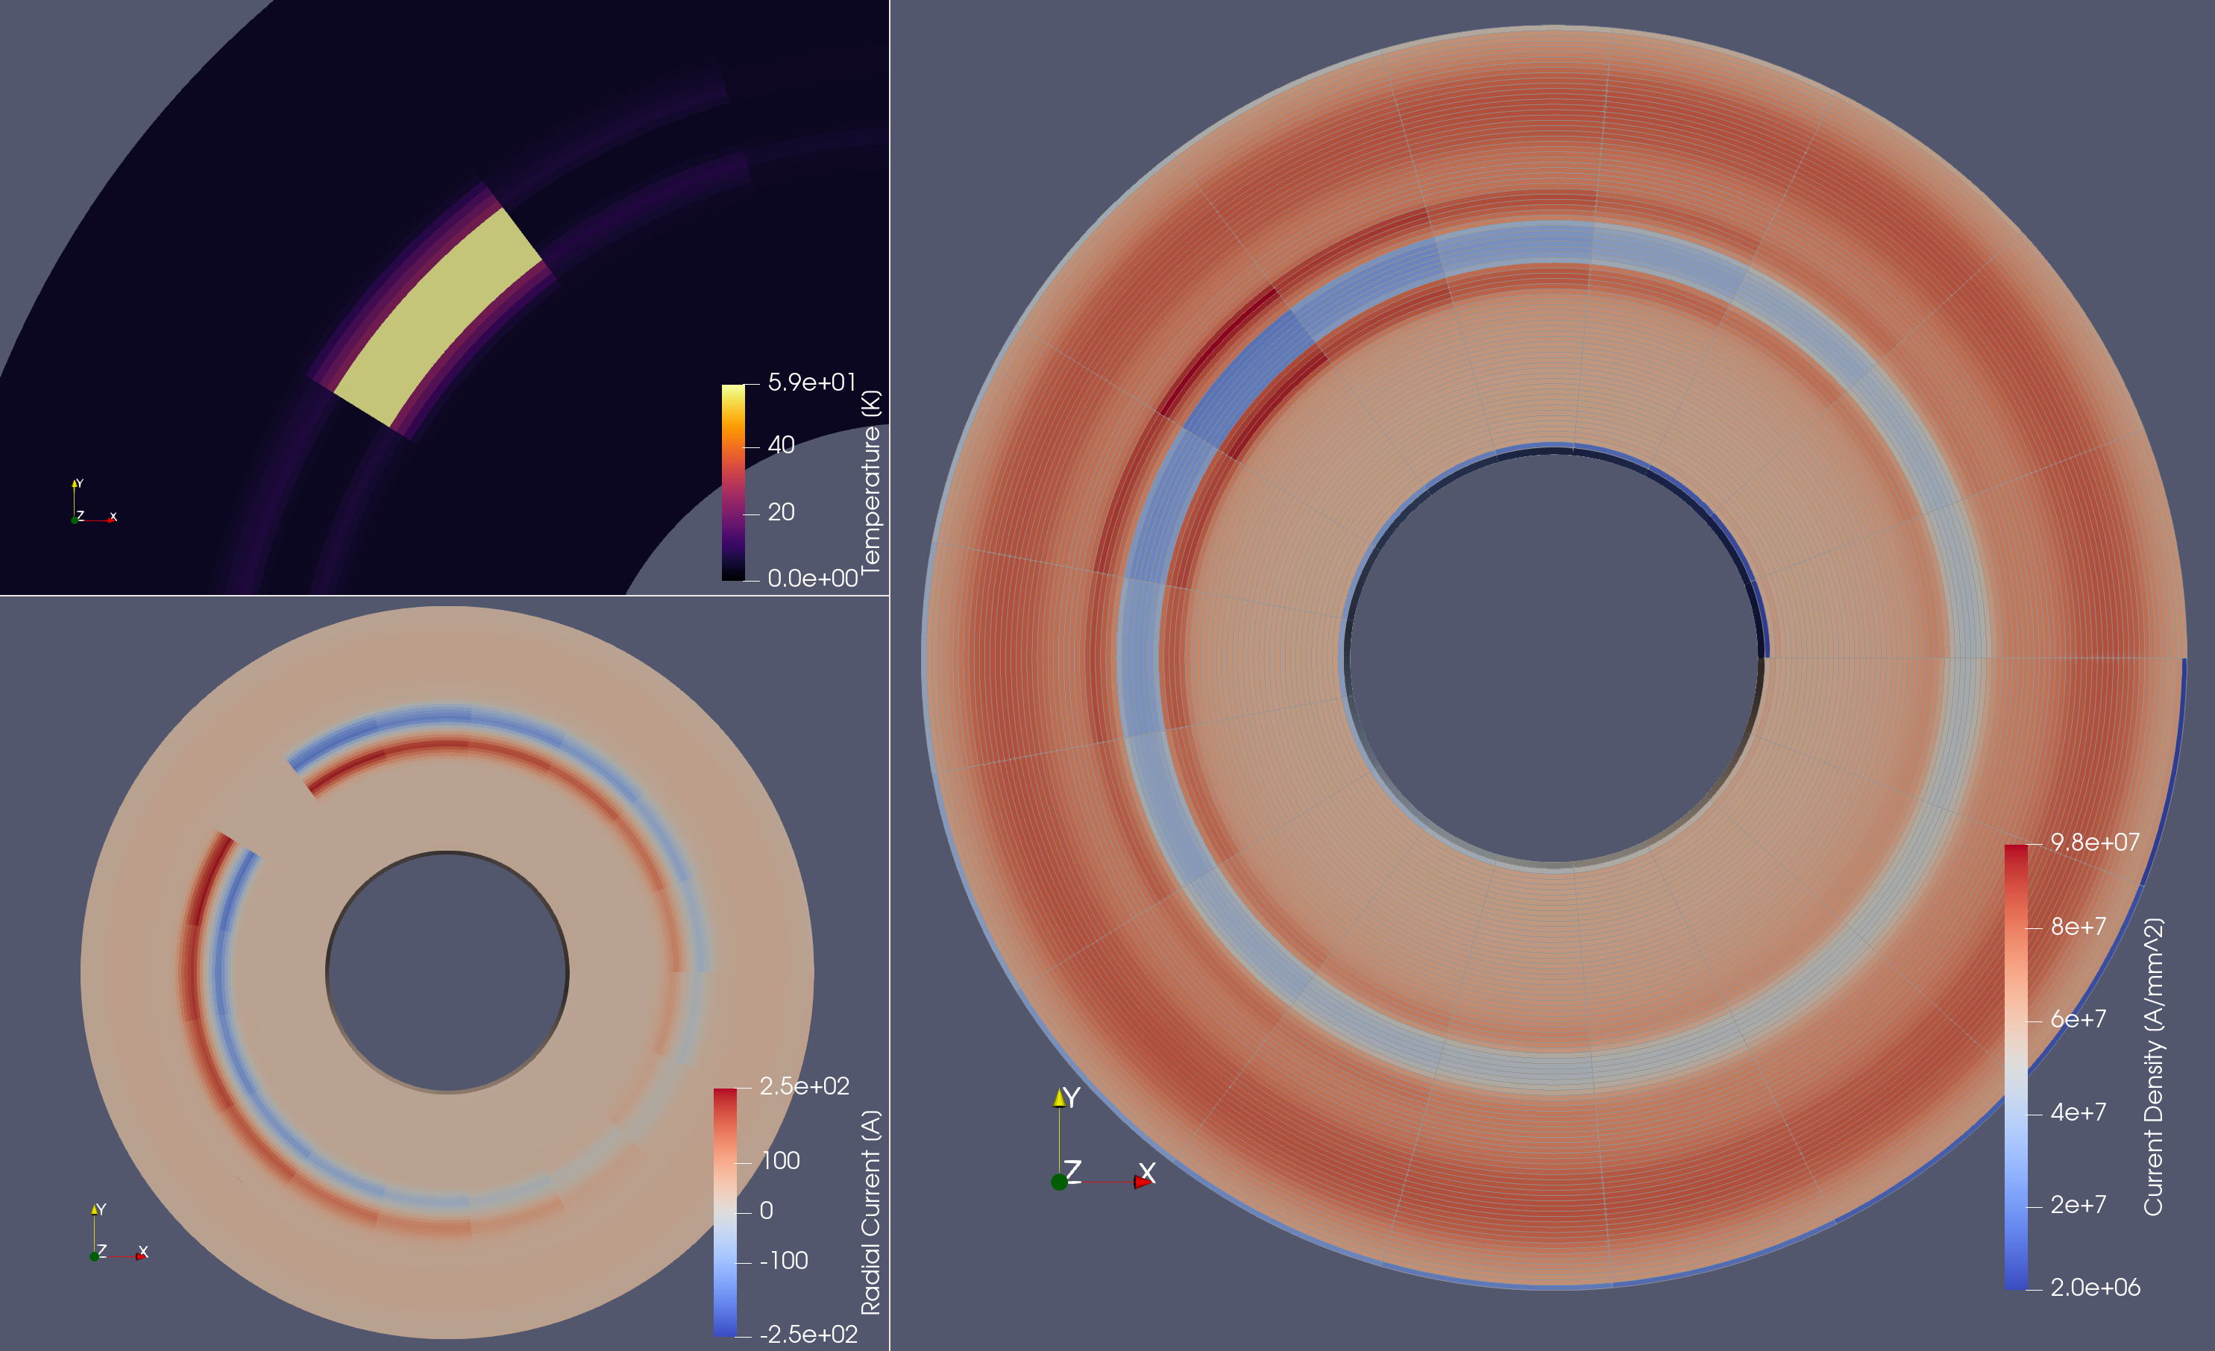
Example: Low Energy-Density Quench in Pancake Coil
Notes:
I do not have exact data for this one.

Slide 26
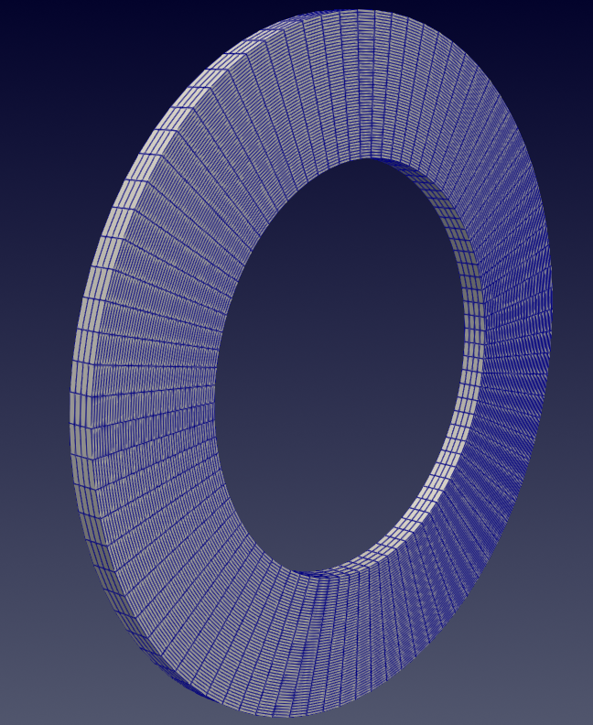
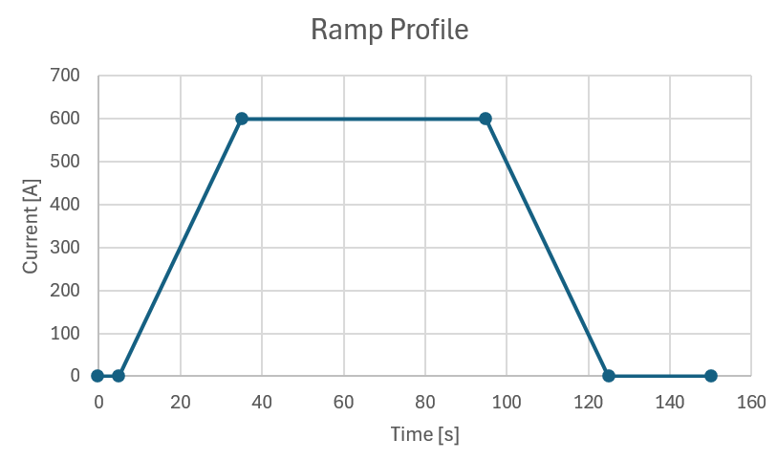
Solver Comparison Benchmark
Ramp of simple pancake coil
Comparison of HETS, NICQS, COMSOL, FiQuS
3cm ID, 5cm OD
250 turns
Resolution
  16 azimuthal elements
  50 radial elements
  4 screening current divisions

Slide 27
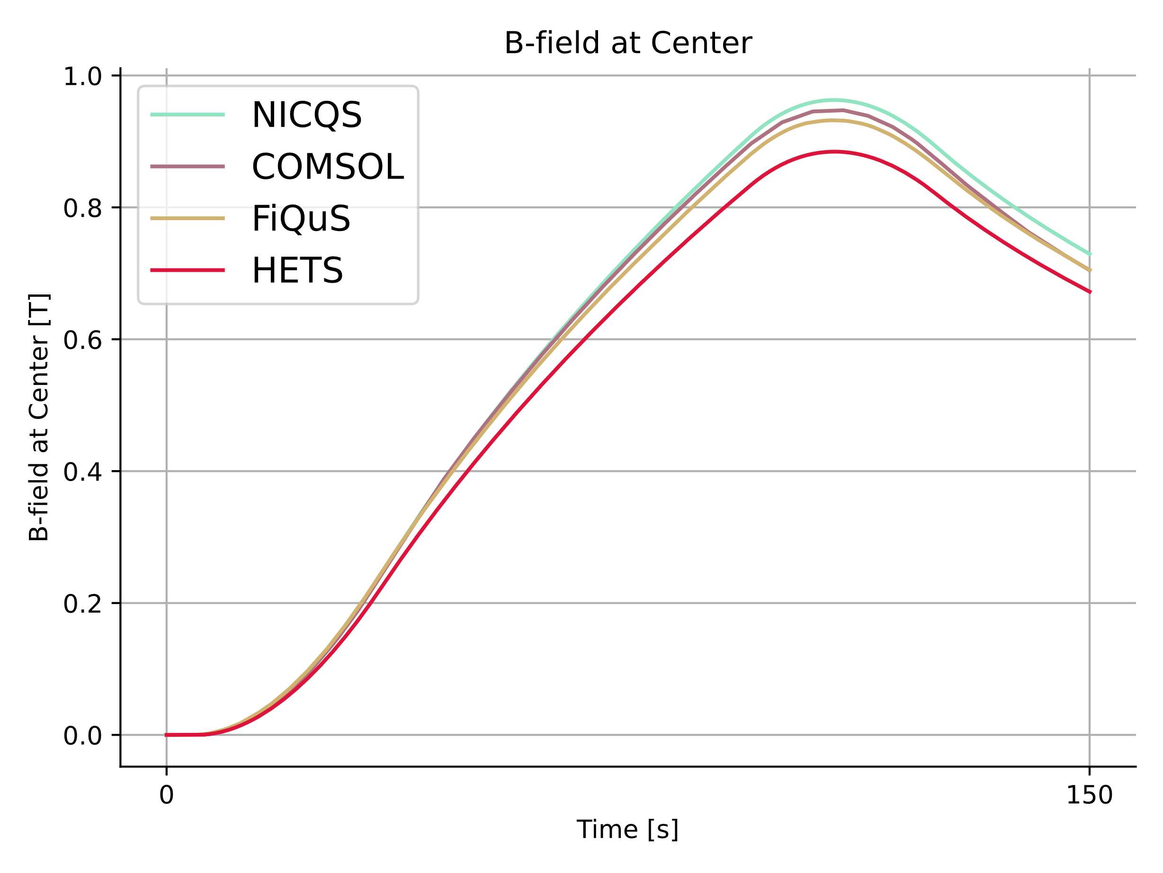
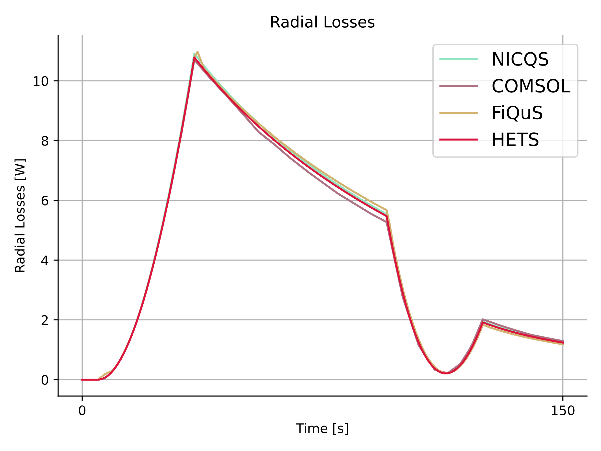
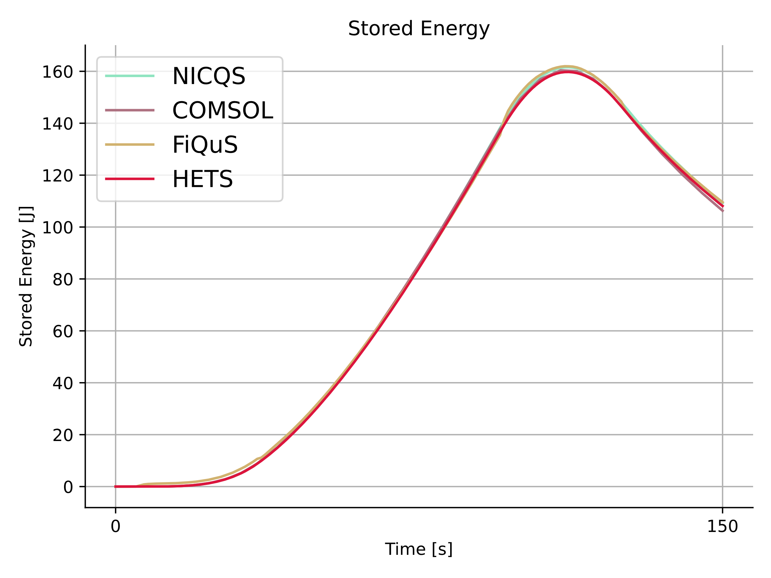
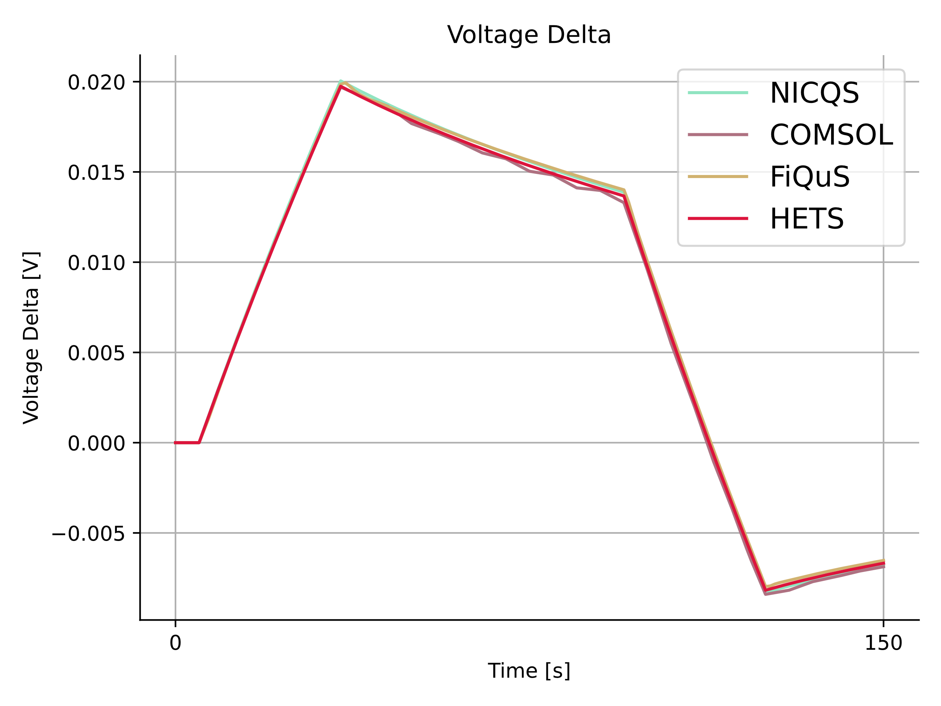
Solver Comparison Benchmark
Notes:
We compared the results of a ramp of a non-insulated pancake coil
- Good agreement

Slide 28
Solver Comparison Benchmark
Quantity | Average Error | Maximum Error
Elements | 3200
B-Field | 6.9% | 8.6%
Voltage Delta | 0.8% | 1.3%
Stored Energy | 0.9% | 2.5%
Radial Losses | 0.5% | 2.4%
Quantity | Average Error | Maximum Error
Elements | 280
B-Field | 8.2% | 11.7%
Voltage Delta | 0.6% | 2.6%
Stored Energy | 1.3% | 3.8%
Radial Losses | 0.6% | 2.2%
Notes:
We compared the results of a ramp of a non-insulated pancake coil
Good agreement
Using coarse elements, the result is practically the same!

Slide 29
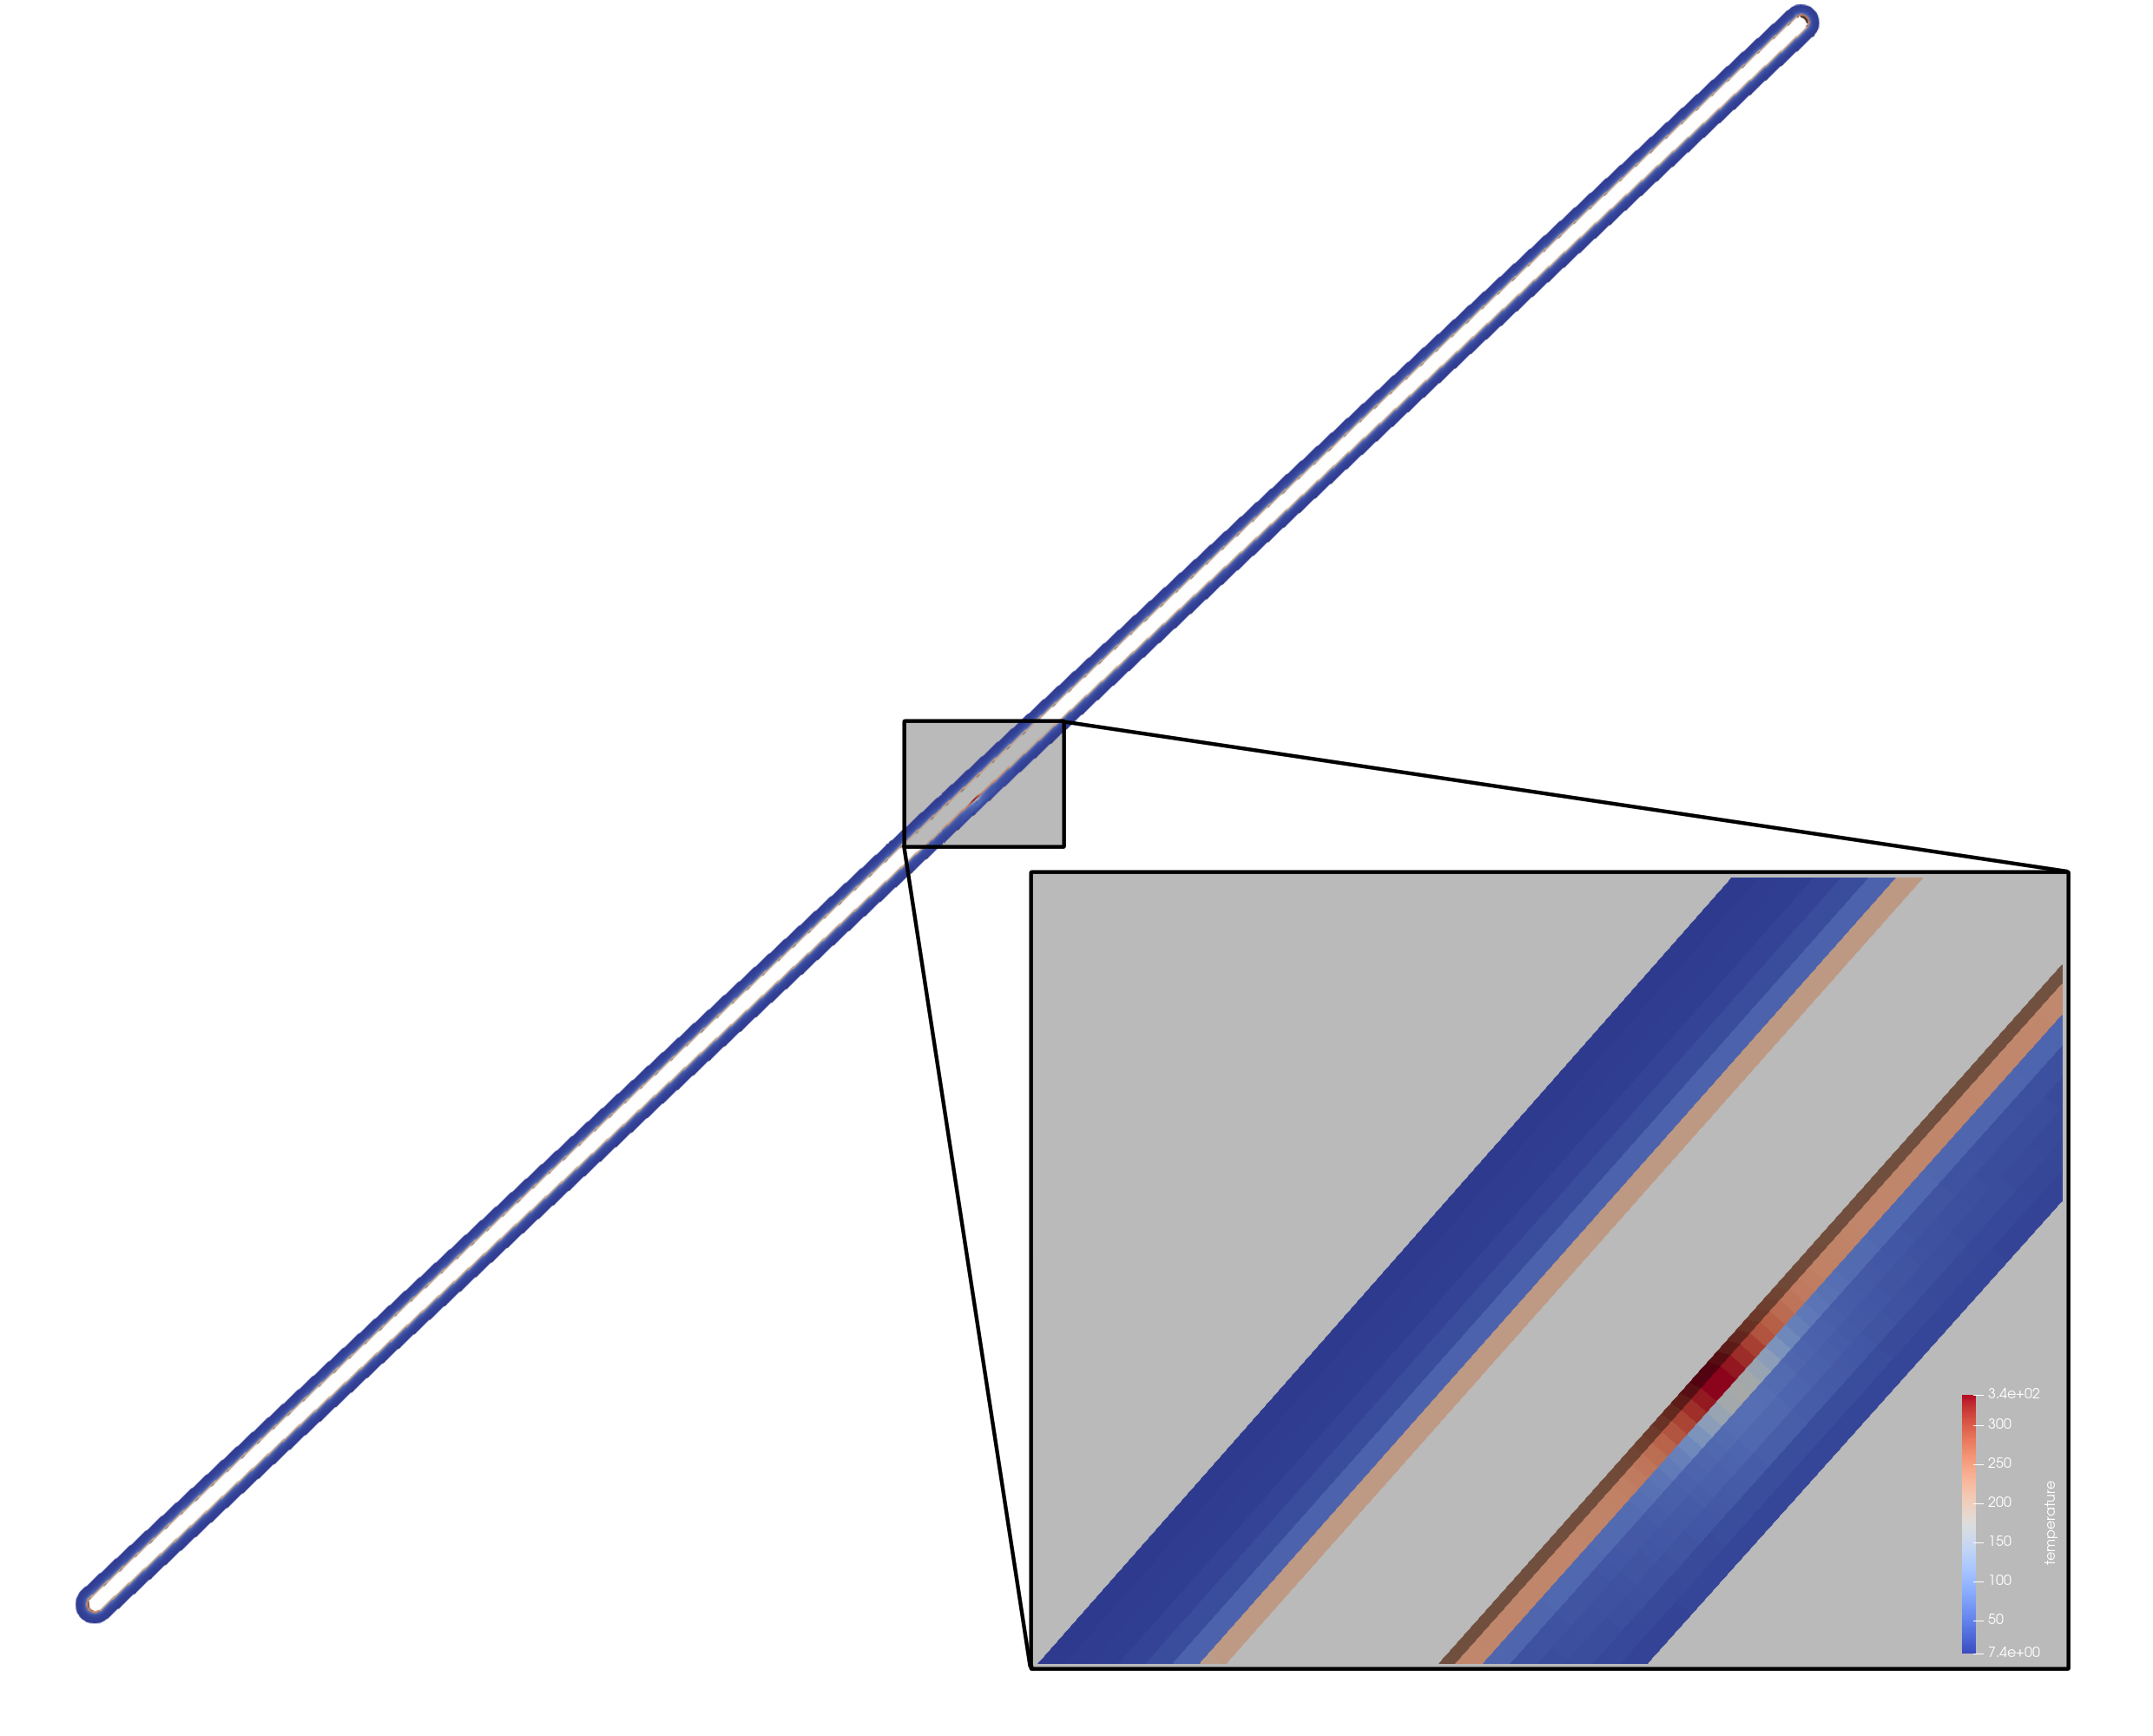
Example: Racetrack Quenches
Elements | 1344
Inner Width | 30mm
Outer Width | 80mm
Turns | 80
Energy Density | 17.3 kJ/kg
Current | 10.000A
15 Meters

Slide 30
Example: Racetrack Quenches
Elements | 1344
Inner Width | 30mm
Outer Width | 80mm
Turns | 80
Energy Density | 17.3 kJ/kg
Current | 10.000A
15 Meters
HETS operates at great scales
Solves in 90-100s!

Slide 31
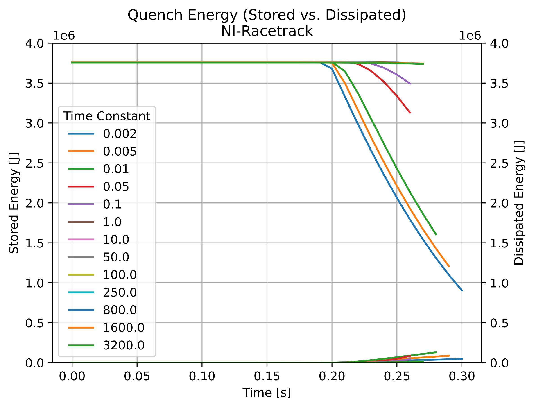
Example: Racetrack Quenches
There is no time constant that would protect this magnet
Not enough of the racetrack is quenched
  Not enough energy is dissipated
Energy Extraction Region
Insufficient Dissipation!
Notes:
For low time constants, ramping down of the PSU behaves like an energy extraction system and high voltages are induced.
For high time constants the magnet does not dissipate energy autonomously.
Both do not work.

Slide 32
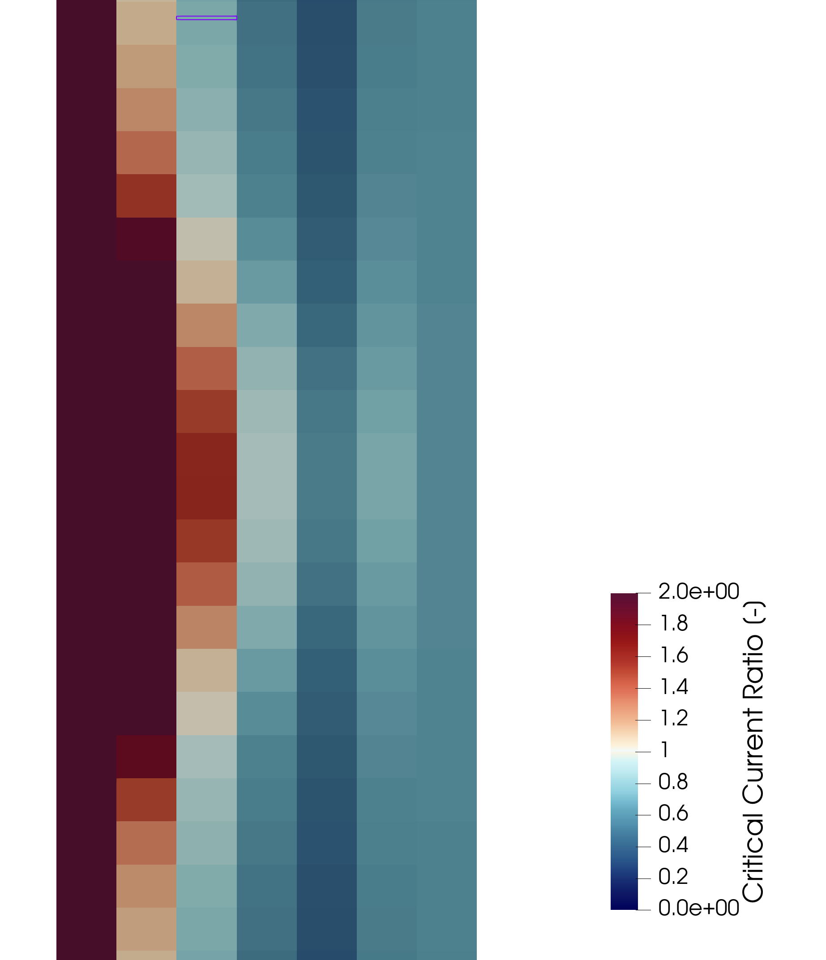
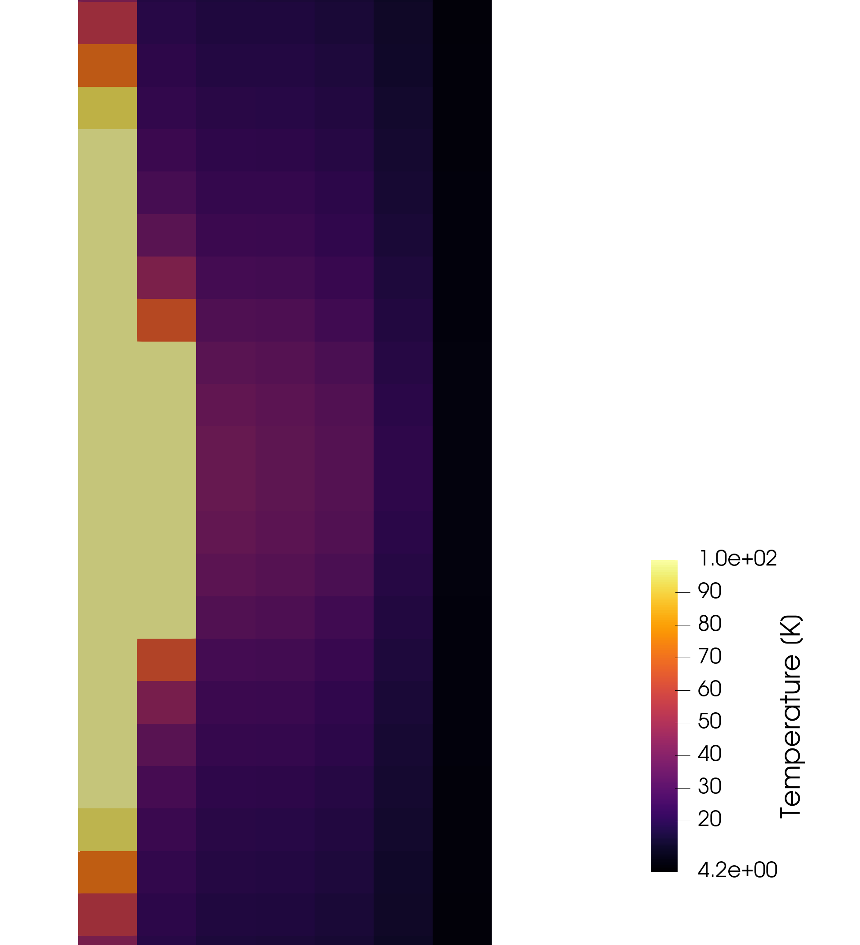
Example: Racetrack Quenches
Far below quench threshold!
Current

Slide 33
Other contributions

Slide 34
STEAM Material Library
Refactored, cleaned out legacy files
Added multiplatform support for Windows and Linux
Numerous fixes
Worked on STEAM material library pipeline
  Automatic release builds
  Automatic PyPI deployment
Transition to CMake for compilation
…

Slide 35
The Future

Slide 36
The Future
Validation!
  Against real measurements and other solvers
  For more interesting cases
Then: Apply to more real problems
  Capacitor discharge protection?
  Protection parameter study
Matrix-free methods…
Iron-effects…
CAD import…
Thermal transfer models…

Slide 37
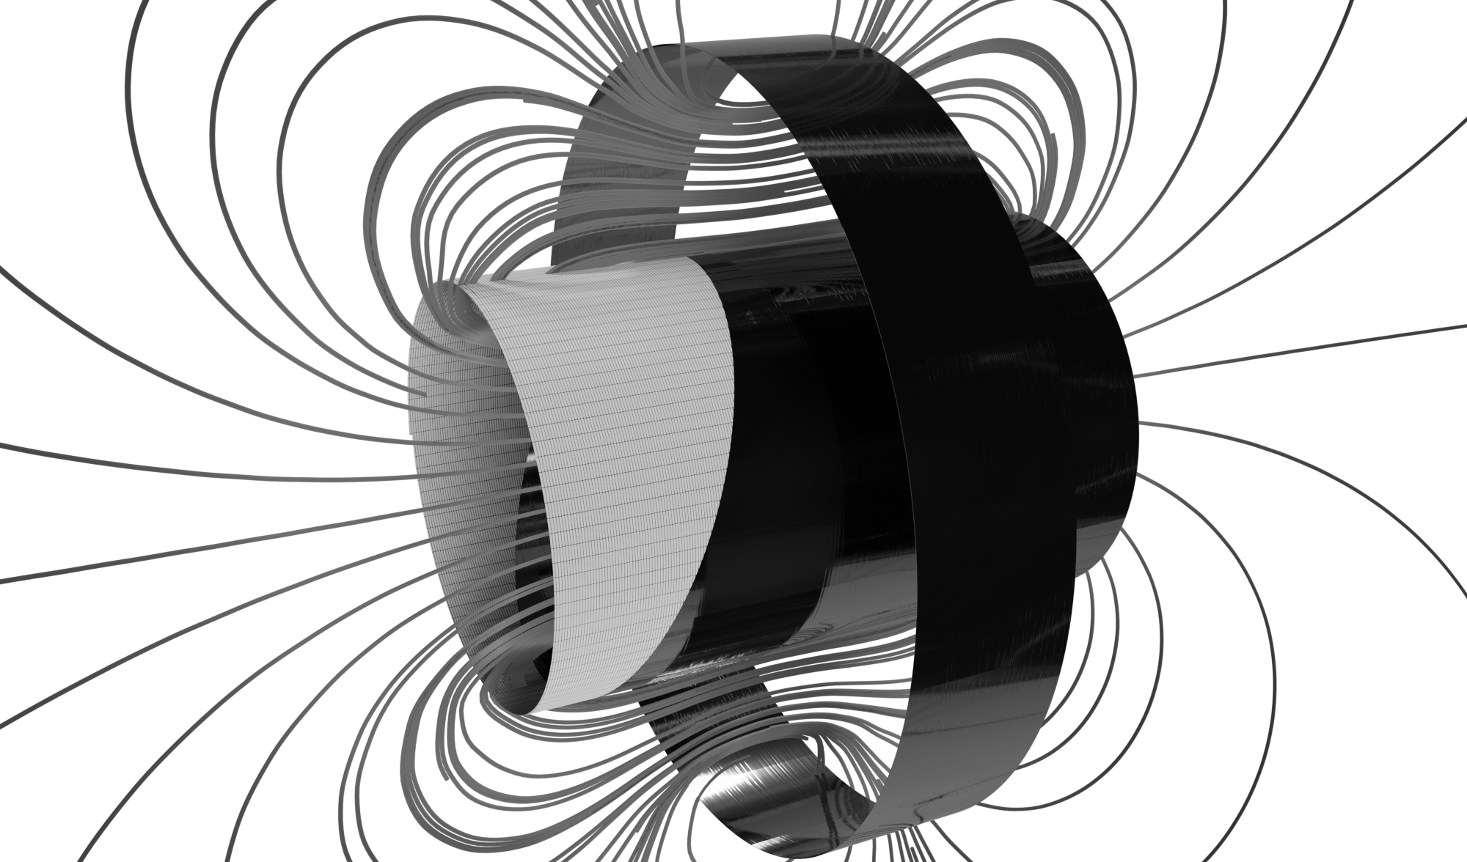
Questions?
Leon Teichröb
University of Stuttgart
leon.teichroeb@{cern.ch, protonmail.com}

Slide 38

Poster Art 🚀

Slide 39
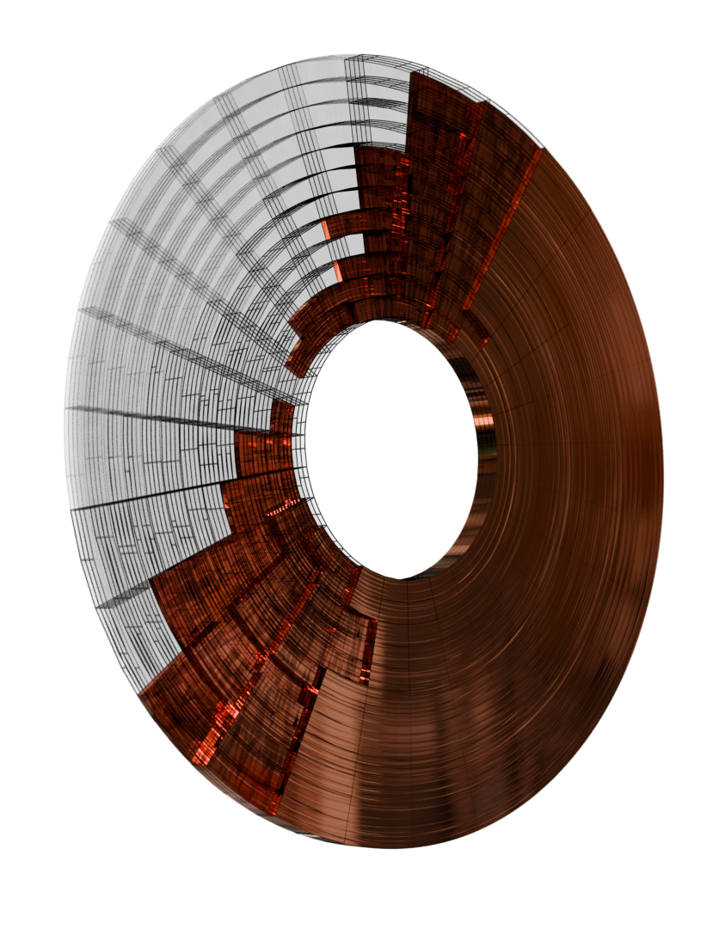
Poster Art 🚀

Slide 40
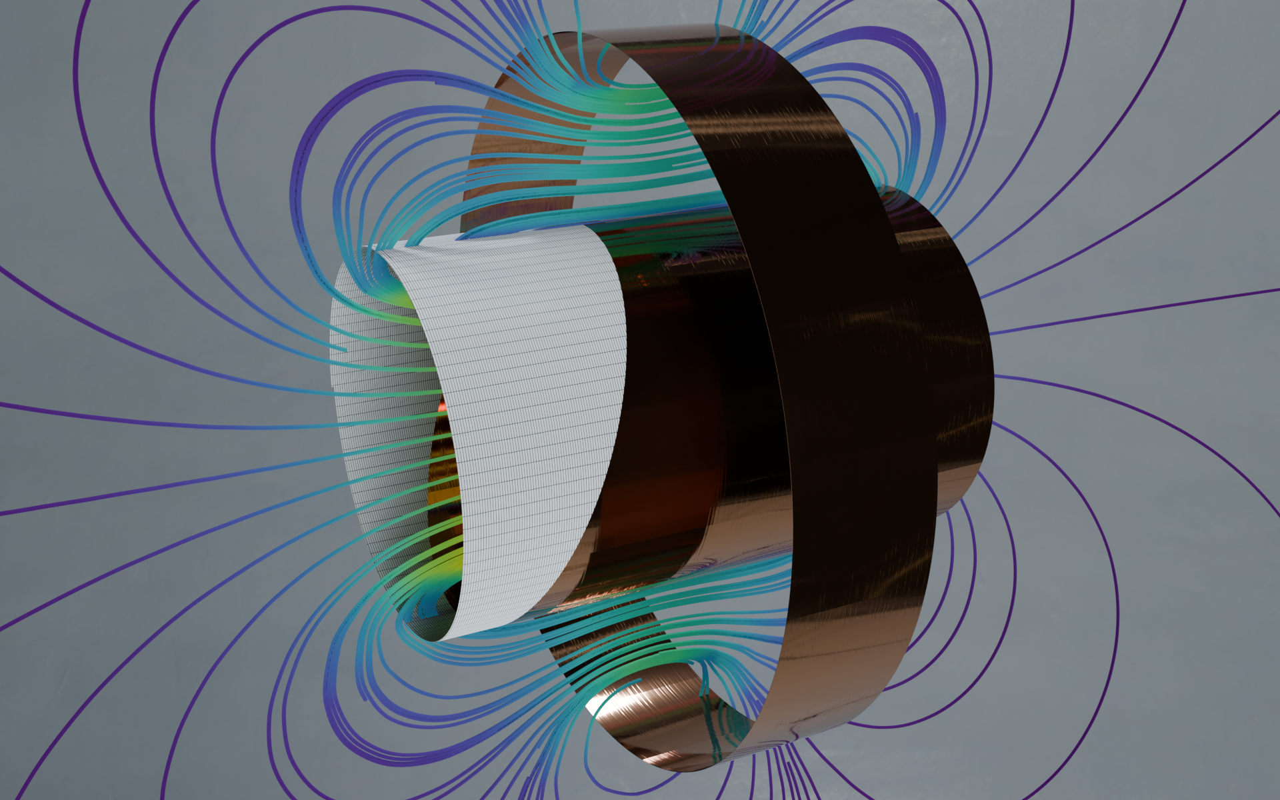
Poster Art 🚀

Slide 41
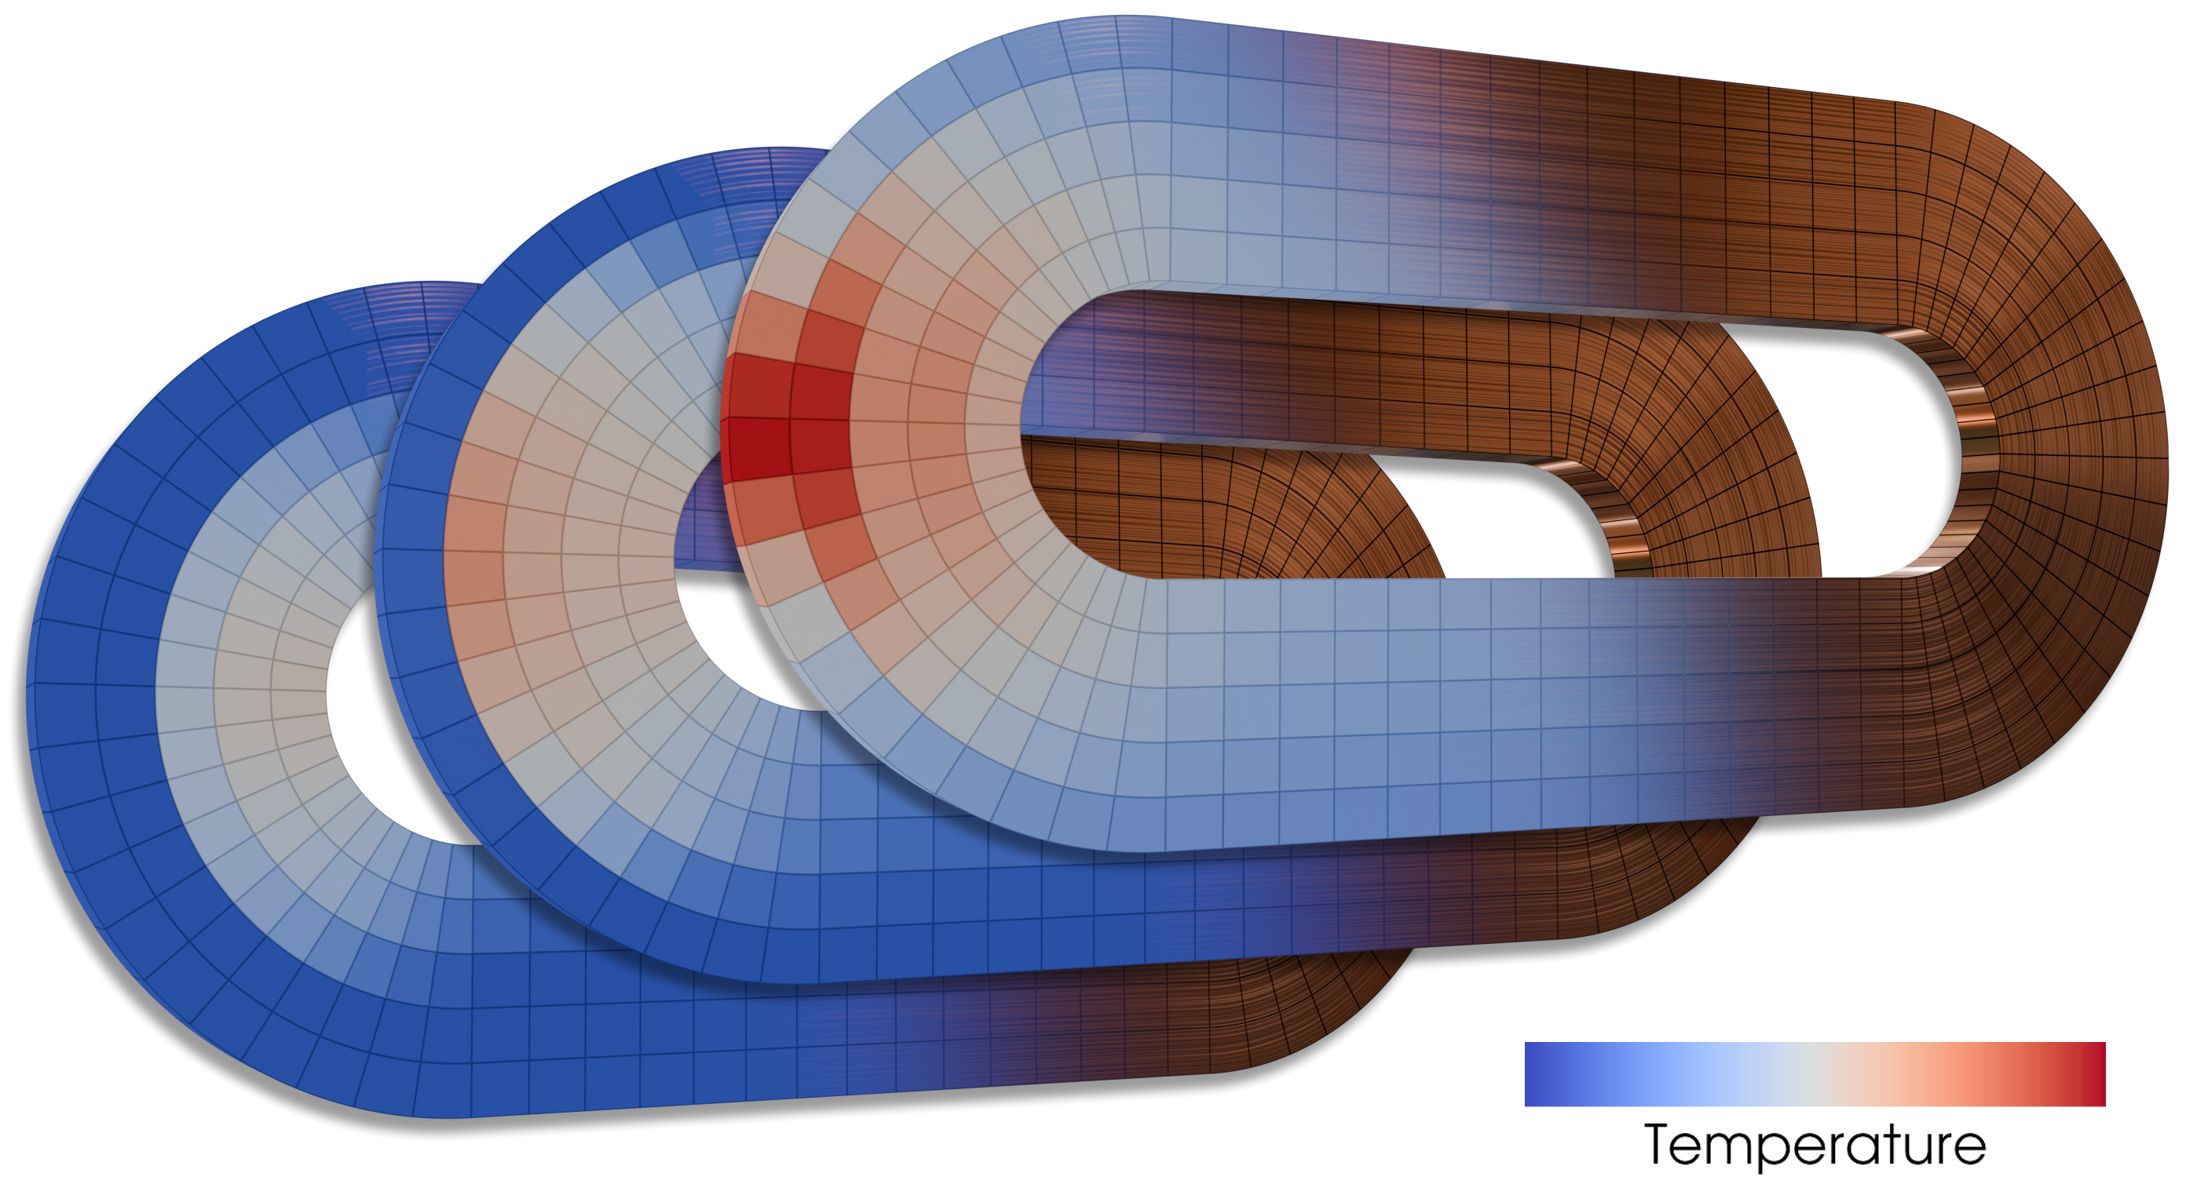
Poster Art 🚀

