Slide 1
Bond
Engineering design update
N.Peray
04/03/2025

Slide 2
Cross section update
Coil design details
Winding
Reaction
Splicing
Impregnation

Slide 3
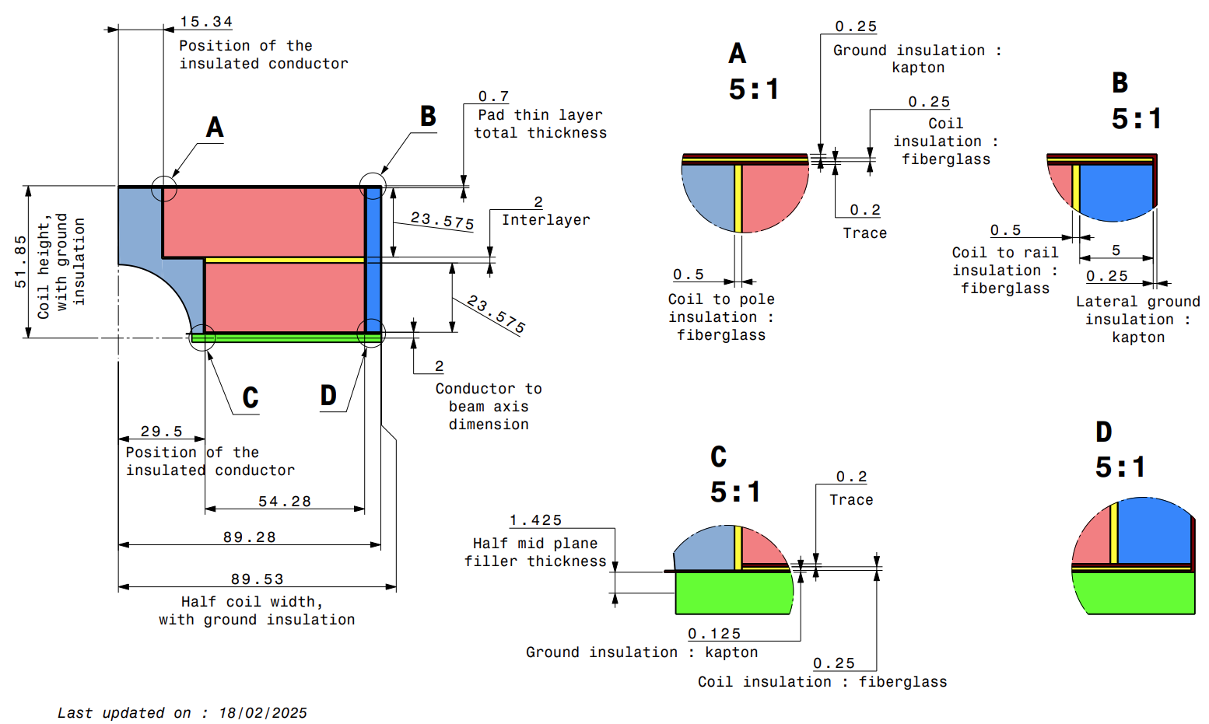
Coil cross section with the 40x1.1 cable
- Insulated cable to component = 2x0.25mm S2 glass
- Ground insulation : 2x0.125mm Kapton
- Interlayer material under investigation
- Midplane stack to be defined
https://plm.cern.ch/p/CAD/number:ST2412841_02

Slide 4
Cross section update
Coil design details
Winding
Reaction
Impregnation

Slide 5
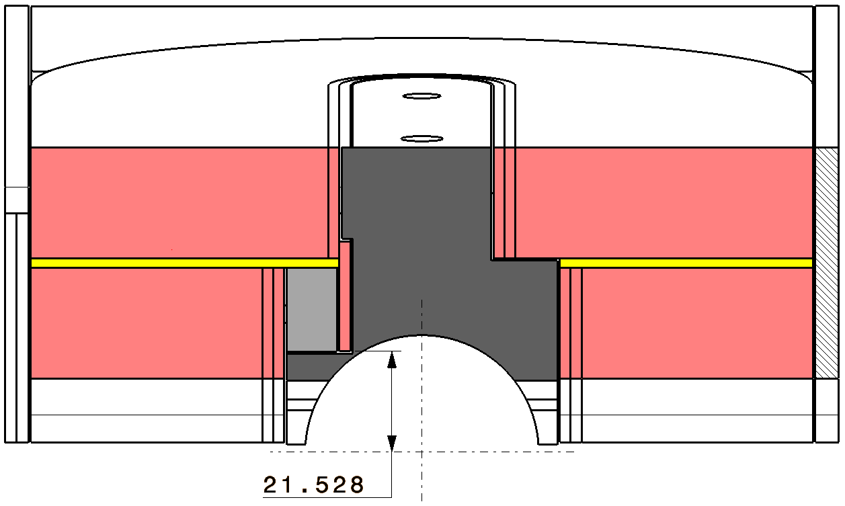
Coil design details : Layer jump
Layer jump design parameters :
Hard way bending radius = 750mm
Distance between the lowest point of the layer jump and the beam axis ≥ 21.5mm
Straight section after the layer jump (before the easy way bend) ≈ 20mm
Distance between first cable in the head and the beam axis ≥ 25mm
Design parameters
Link between practical and functional dimensions
Practical dimensions

Slide 6
Coil design details : Splice configuration
NbTi
Nb3Sn
Lead stabilizer
Cu
Splice cover
Cu

Slide 7
Cross section update
Coil design details
Winding
Reaction
Splicing
Impregnation

Slide 8
First 6 turns of the lower layer

Slide 9
Lower layer winding

Slide 10
Upper layer winding
Interlayer is not displayed here

Slide 11
Cross section update
Coil design details
Winding
Reaction
Splicing
Impregnation

Slide 12
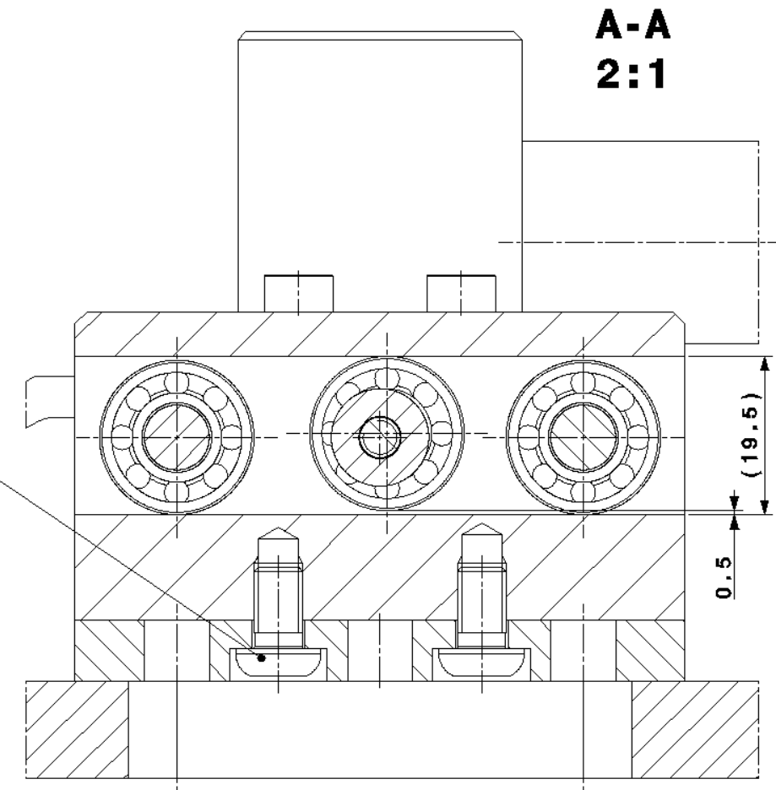
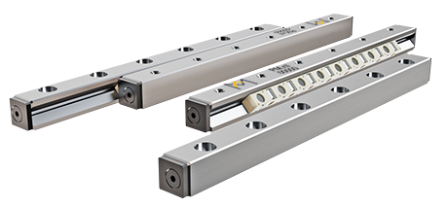
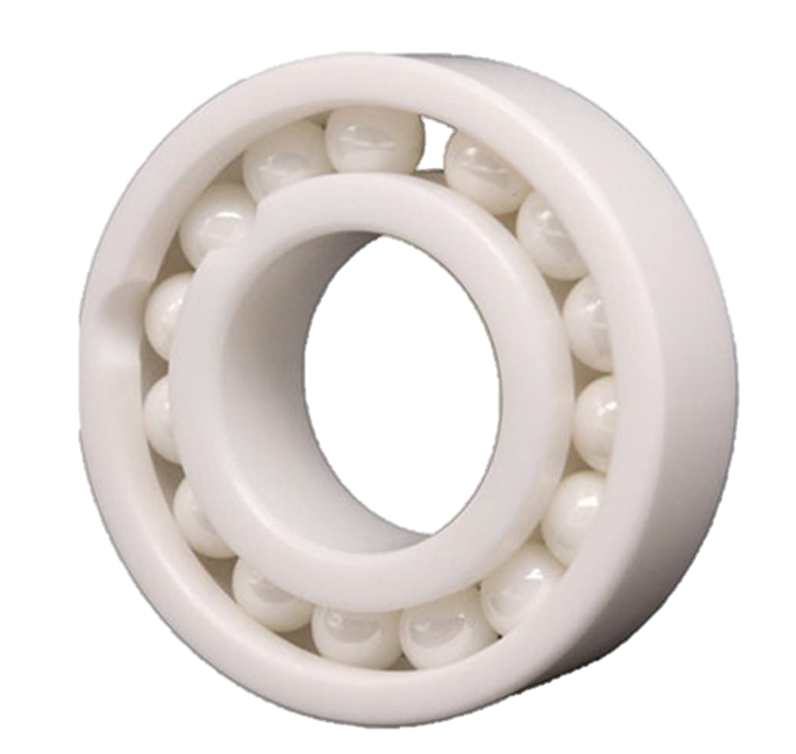
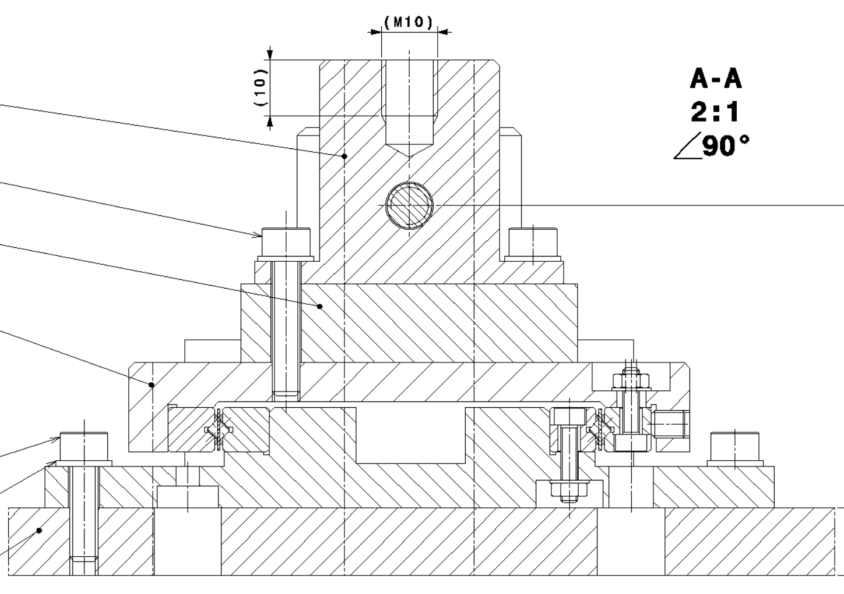
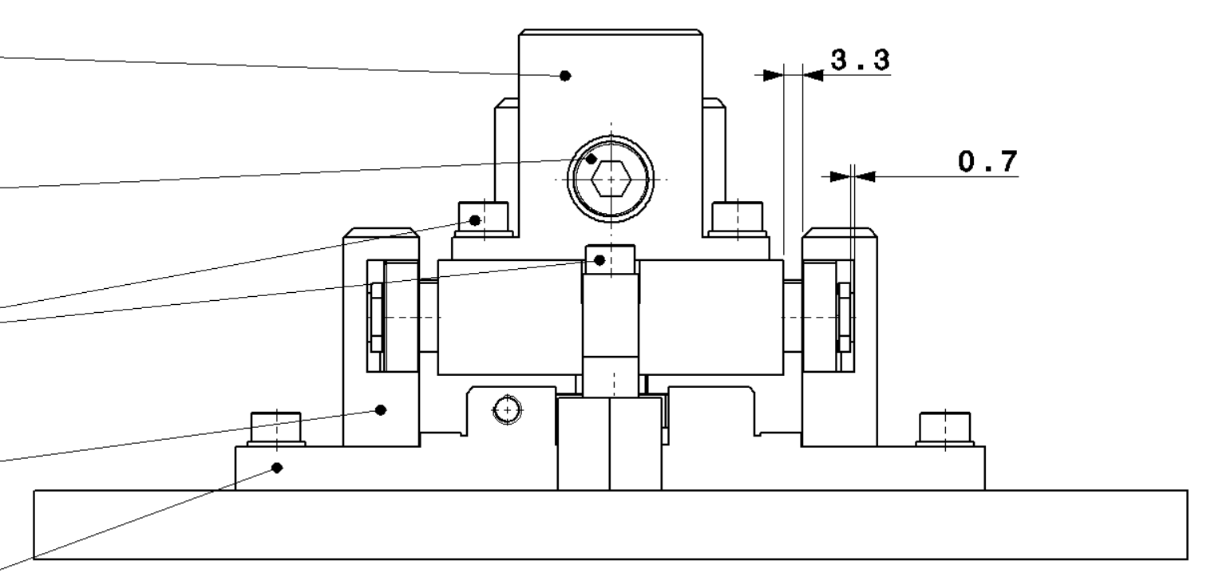
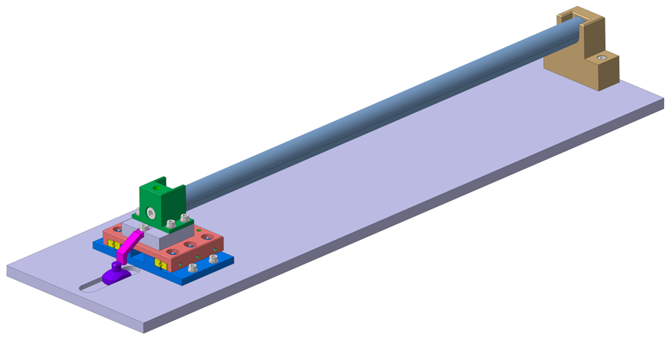
Reaction mold
To avoid unwanted stress due to different thermal expansion , we plan to let the heads move freely parallel to the beam axis.
Two options are under investigation :
Circular cearamic bearing
Linear ceramique bearing
Circular bearing
(Si₃N₄)
Linear bearing
(ZrO₂ rails/Si₃N₄ rollers)
Reaction mold
Guiding table
Mock-up test setup designed by B. Pellet & N. Lusa

Slide 13
Reaction mold
2 layers of mica are placed at each component interfaces

Slide 14
Cross section update
Coil design details
Winding
Reaction
Splicing
Impregnation

Slide 15
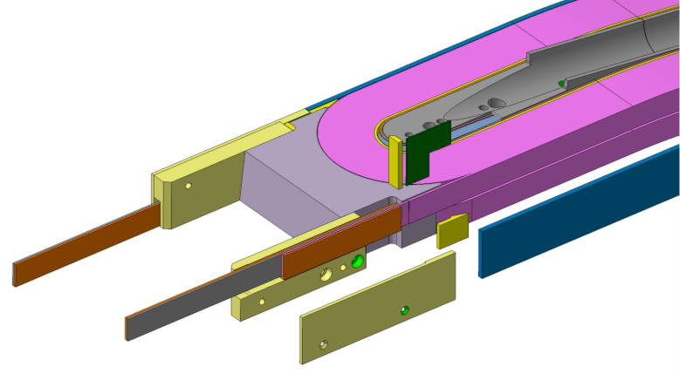
Splicing

Slide 16
Cross section update
Coil design details
Winding
Reaction
Splicing
Impregnation

Slide 17
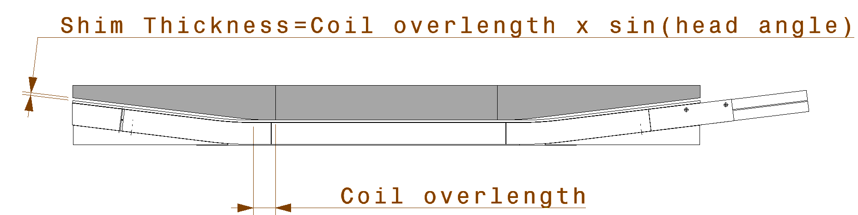
Impregnation mold
To obtain a uniform stress at each interface, coils geometry should be the closest to perfection possible.
Due to the behavior of the cable and the tooling during reaction, the position of the cable in the head cannot be fully guarantied.
Meaning that distance between cables and the pad in the head can vary and need to be filled for the final assembly.
Coil overlenght | Total shim thickness*
mm | mm
1 | 0.12
2 | 0.24
3 | 0.37
4 | 0.49
5 | 0.61
6 | 0.73
7 | 0.85
8 | 0.97
9 | 1.10
10 | 1.22
11 | 1.34
12 | 1.46
13 | 1.58
14 | 1.71
15 | 1.83
16 | 1.95
17 | 2.07
18 | 2.19
19 | 2.32
20 | 2.44
*Shim thickness to be split in two if equally spread at each end

Slide 18
Impregnation mold
Option 1 : Filling the gaps before impregnation
Fiber glass or EP GC/GM
Seal web

Slide 19
Impregnation mold
Option 2 : Adaptative mold
The gaps between the coil and the pad will need to be shimmed after impregnation
Custom spacer
Similar in some point to the technic used on TFD

Slide 20
Impregnation mold
Option 3 : Impregnated pad
Machined after reaction to fit the coil overlength
Final pad
ESC Coil* or any filler
*If ESC coil, it needs to be fitted to the coil shape/overlength

Slide 21
Impregnation mold
Option 4 : Simple box mold with adaptative filler
Filler are tailored to fit the overlength of the coil. This, to avoid extra layer of impregnated material.
The pad, used in the mechanical structure, will be tailored the same way to fit the coil.
Tailored filler

Slide 22
Thanks for your attention

