Slide 1
Swedish Teacher Program 2025
Lectures 1 to 3

Slide 2
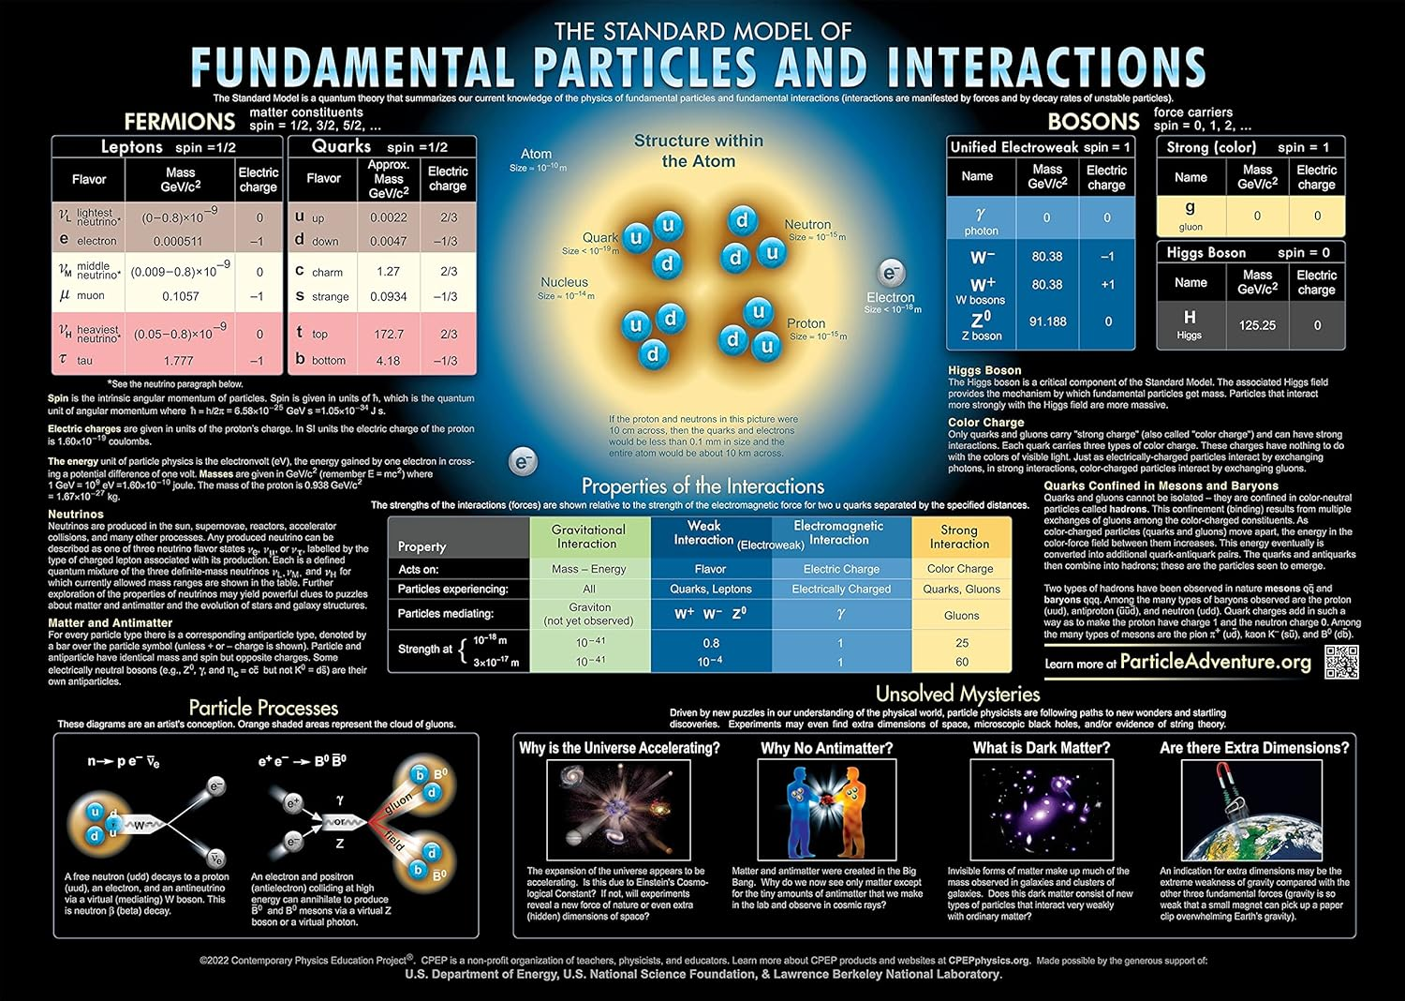
Beyond the Standard Model

Slide 3
Lecture 1
Particles and Interactions
Glimpses on the Standard Model
Quarks and Particle spectroscopy
b
Notes:
Glimpses on….

Slide 4
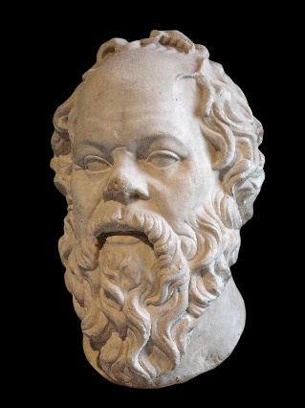
Socrate, (470-399 B.c.) (Plato, Apology )
By Sting, CC BY-SA 2.5, https://commons.wikimedia.org/w/index.php?curid=96296061
So di non sapere – Wikipedia
«So di non sapere»
(consapevolezza della propria ingnoranza)
https://en.wikipedia.org/wiki/Socrates
Socrates, aware of his own leak of knowledge, professes his own ignorance...
So that, I can only do much less, share with you my deep ignorance!! ☺
b
Notes:
Credits to Socrate!!

Slide 5

Introduction 1
Particle Physics is the study of elementary particles and interactions of the “subnuclear world”
ELEMENTARY or FUNDAMENTAL ??
b

Slide 6
Introduction 1
Summary difference
Elementary = indivisible (by current theory: SM).
Fundamental = basic building blocks (relative to the model or discipline)
All elementary particles are fundamental, but not all fundamental particles are elementary (e.g., in chemistry, protons and neutrons are treated as fundamental, but they’re not elementary in particle physics).
b

Slide 7
Introduction 2
Elementary particles (by AI)
Definition (modern physics): Particles that are not made up of anything smaller, according to our best theories. "Elementary" is a theoretical classification
Examples in the Standard Model: Quarks, leptons (like the electron and neutrino), gauge bosons (like the photon, gluon, W and Z bosons), and the Higgs boson.
protons and neutrons are composite (made of quarks).
b

Slide 8
Introduction 3
Fundamental particles (by AI)
Definition (broader, sometimes less strict): Particles that form the basic building blocks of matter and forces in a given physical framework.
Usage:
In particle physics, "fundamental" often means the same as "elementary."
In chemistry, "fundamental particles" may refer to protons, neutrons, and electrons—even though physics tells us protons and neutrons are composite (made of quarks).
Key point: "Fundamental" is more contextual—it’s about what level of description you’re working at.
b

Slide 9
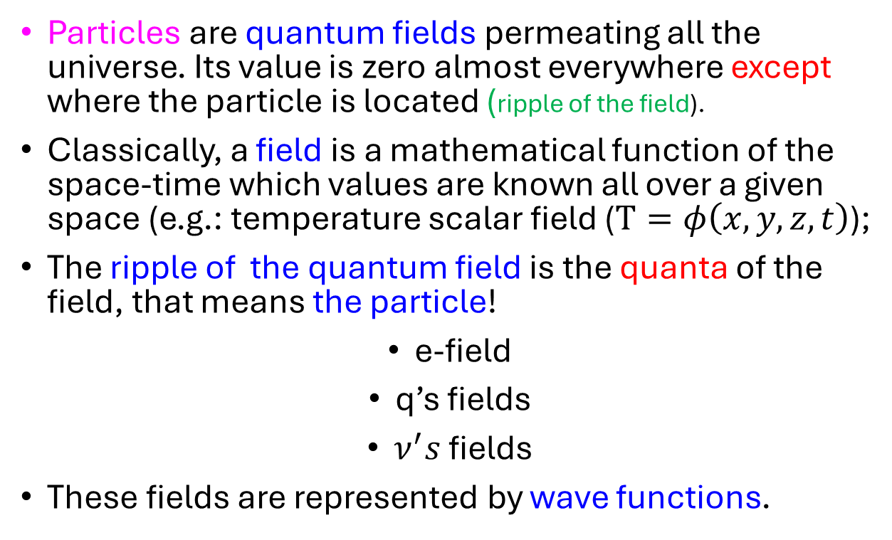
Particles
Particles are quantum fields permeating all the universe. Its value is zero almost everywhere except where the particle is located (ripple of the field).
Classically, a field is a mathematical function of the space-time which values are known all over a given space (e.g.: temperature scalar field ($T=φ\left(x,y,z,t\right)$);
The ripple of the quantum field is the quanta of the field, that means the particle!
e-field
q’s fields
$ν^{′}s$ fields
These fields are represented by wave functions.
b

Slide 10



Metaphors of interactions:
Interaction: exchange of energy and momentum between particles, or the possibility of creation/annihilation of particles;
particles
particles
Repulsive force
Vector Bosons
Attractive force
b
Notes:
(2) forces.

Slide 11
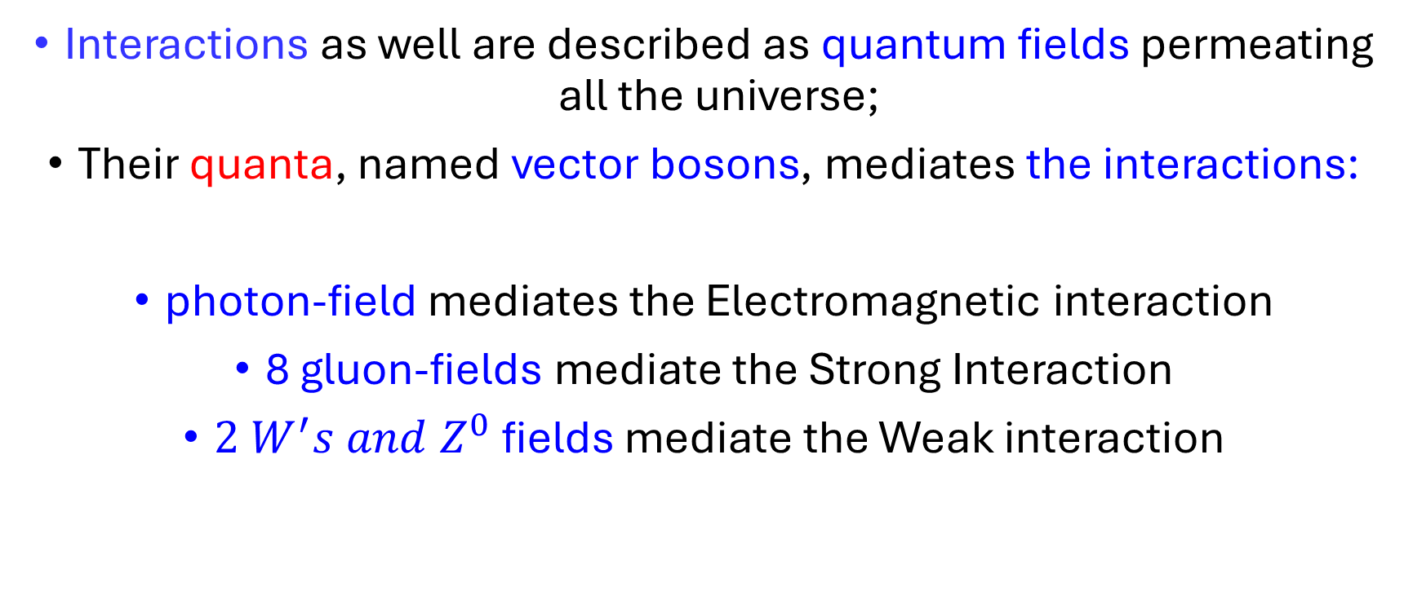
Interactions
Interactions as well are described as quantum fields permeating all the universe;
Their quanta, named vector bosons, mediates the interactions:
photon-field mediates the Electromagnetic interaction
8 gluon-fields mediate the Strong Interaction
${2 W}^{′}s and Z^{0}$ fields mediate the Weak interaction
b

Slide 12
Fundamental Interactions
b

Slide 13
Charges of Interactions
Electromagnetic Interaction (EM): electric charge;
Weak Interaction (WI): e, μ and τ flavor (weak Isospin (T), weak Hypercharge (Y_{w}) and Chirality );
Strong interaction (SI): Color Charge (see below)
b

Slide 14
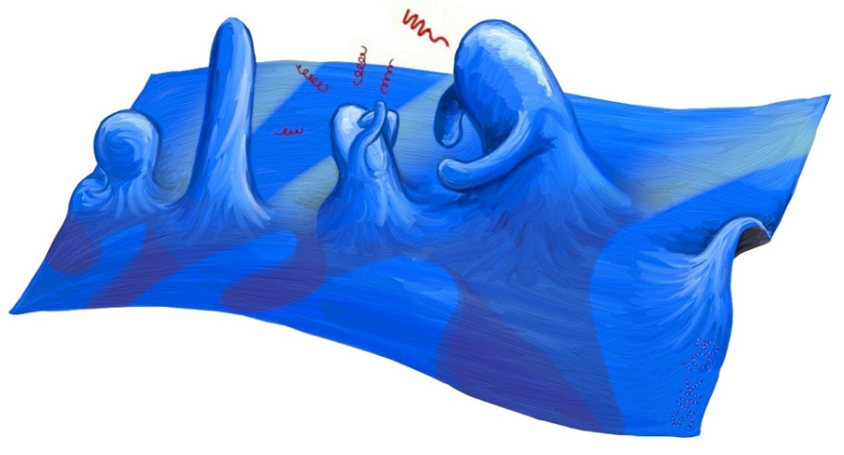
Pictorial view of a quantum field !
Credits: David Tong image
b
Notes:
https://www.google.com/url?sa=i&url=https%3A%2F%2Fwww.discovery.com%2Fscience%2FEmpty-Space-Quantum-Researchers-Have-Direct-Evidence&psig=AOvVaw1Ch3dY4QpHiqSJCxx0hj_-&ust=1697727683879000&source=images&cd=vfe&opi=89978449&ved=0CA8QjRxqGAoTCNiOvtju_4EDFQAAAAAdAAAAABCdAQ

Slide 15
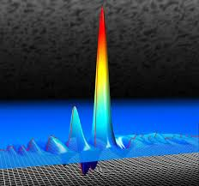
QM for quantum fields
…just to figure out the ripple…
Particle and Field: in 1924, L. de Broglie proposed that a particle with energy E and momentum p, has an associated matter field with frequency ν = E/h and wavelength λ = h/p.
Wave-particle duality!
Heisenberg’s uncertainty principle
ΔEΔt ≥ h and ΔxΔp ≥ h
https://www.google.com/... See the note
Quantum Mechanics!!
- Quantized values of Energy and angular momentum
-interaction radiation-matter via the photon;
-………..
b
Notes:
https://www.google.com/url?sa=i&url=https%3A%2F%2Fwww.discovery.com%2Fscience%2FEmpty-Space-Quantum-Researchers-Have-Direct-Evidence&psig=AOvVaw1Ch3dY4QpHiqSJCxx0hj_-&ust=1697727683879000&source=images&cd=vfe&opi=89978449&ved=0CA8QjRxqGAoTCNiOvtju_4EDFQAAAAAdAAAAABCdAQ

Slide 16
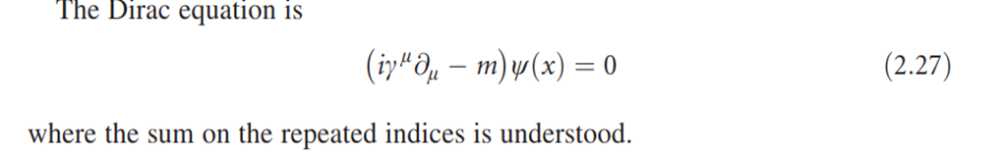
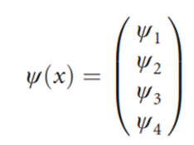

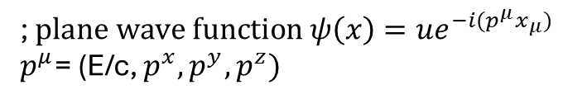
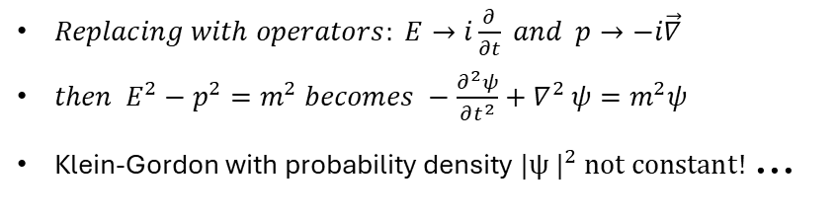
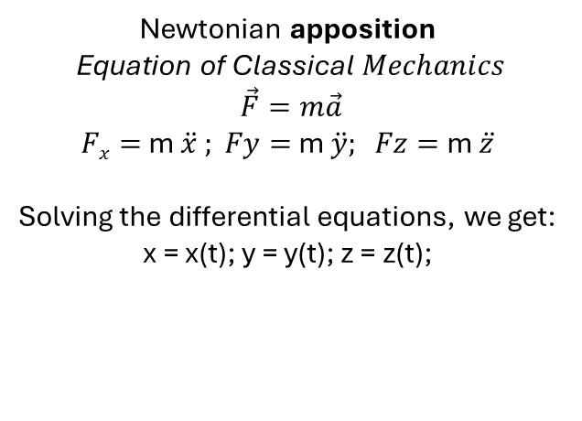
QM: the Relativistic wave equation
Newtonian apposition
Equation of Classical$Mechanics$
$$\vec{F}=m\vec{a}$$
$Fx=$ m $\ddot{x} ; Fy=$ m $\ddot{y}; Fz=$ m $\ddot{z}$
Solving the differential equations, we get:
x = x(t); y = y(t); z = z(t);
Quantum Mechanics by the Correspondence Principle
$Replacing with operators: E→i\frac{∂}{∂t} and p→−i\vec{∇}$
$then E^{2}−p^{2}=m^{2} becomes −\frac{∂^{2}ψ}{∂t^{2}}+∇^{2}$ $ψ=m^{2}ψ$
Klein-Gordon with probability density $|{ψ |}^{2} not constant!$ …
The (2.27) contains first order, time partial derivative. Its solutions have the probability density$|{ψ |}^{2}$ conserved.
; $plane wave function ψ\left(x\right)=ue^{−i(p^{μ}x_{μ})}$
$p^{μ}$= (E/c, $p^{x},p^{y},p^{z})$
b

Slide 17

Glimpses on the Standard Model
THE STANDARD MODEL OF PARTICLE PHYSICS (SM)
-It is a mathematical framework for a unified description of three interactions:
The Electromagnetic interaction (EI),
The Weak Interaction (WI)(particle decay, radioactivity),
Electroweak (EI+WI) Interaction (EWI)
The Strong Interaction (SI) (interaction binding quarks),
plus the Higgs field (providing the mass to the particles).
-The SM is based on Relativistic Quantum Field Theory.
b

Slide 18

Glimpse on Quantum Field Theory
QFT = QM+ quantum Fields = Quantum Field Theory
QM = Quantum Mechanics, incorporating the Special Relativity, predicts the existence of the anti-matter: Dirac equation;
Quantum Fields = mathematical functions describing particles and interactions.
b

Slide 19
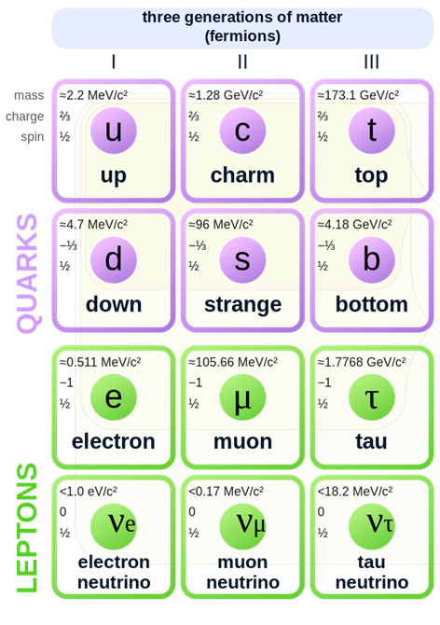
Keystones of the Standard Model
Matter fields (aka fermions)
- Corresponding 6 anti-matter families exist!
3 Anti-quarks families;
3 Anti-leptons families.
- A total of 24 fundamental fermions, exists.
b

Slide 20
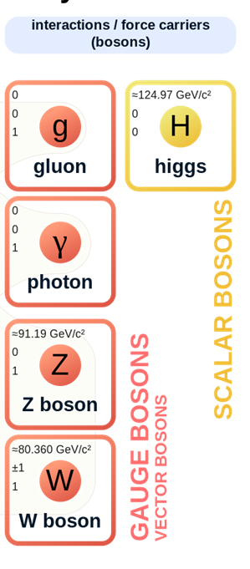
Keystones of the Standard Model
Interaction fields (aka vector bosons)
mass
charge
spin
b

Slide 21
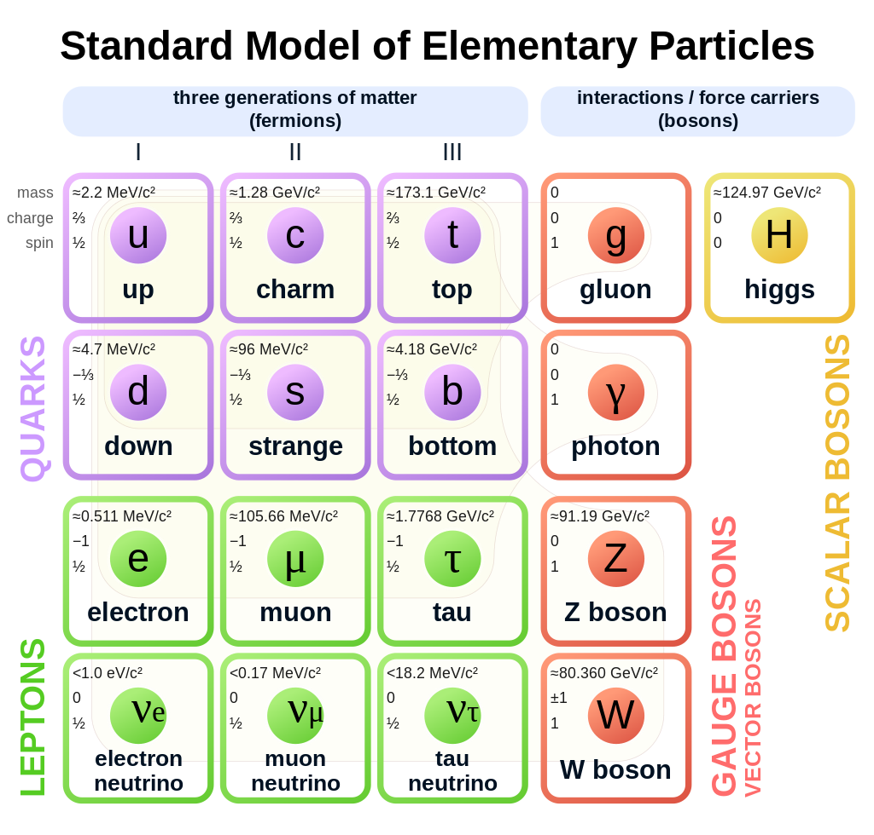

Keystones of the Standard Model
b

Slide 22
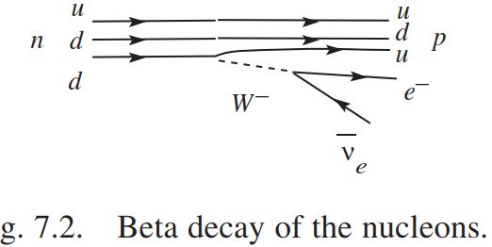
Feynman diagrams for the Weak, Electro-weak interaction
The diagrams are useful to calculate the interaction probability in one vertex
Weak interaction: n decay
W couples to:
upper and lower members of a fermion generation.
Electro-weak interaction
Z couples to:
Matter and antimatter versions of a fermion.
e-
Z
°
e+
e+
e-
Time
b

Slide 23
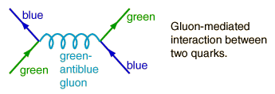
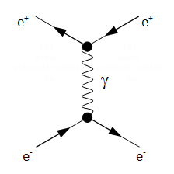
Feynman diagrams for
the Strong and EM interactions
Strong interaction
Time
Electromagnetic interaction
Time
b

Slide 24
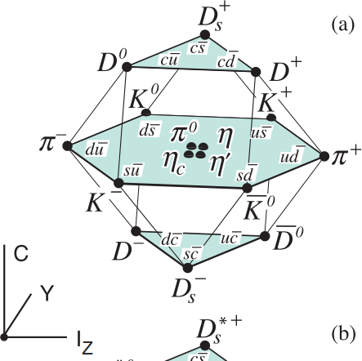
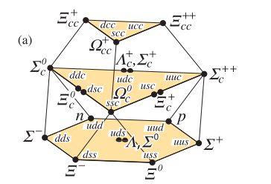
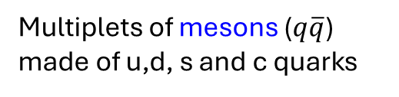
Mesons and Baryons spectroscopy: static quark content
=B+S
Multiplets of mesons ($q\overline{q}$) made of u,d, s and c quarks
Multiplets of barions made of u,d, s and c quarks
b

Slide 25

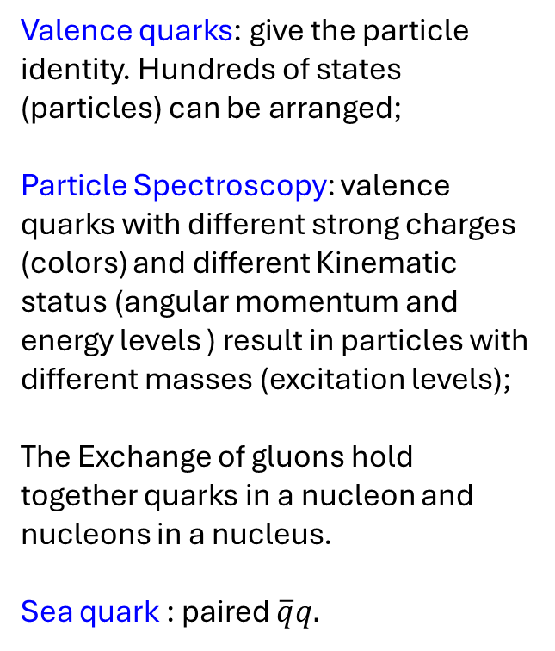
Valence quarks: give the particle identity. Hundreds of states (particles) can be arranged;
Particle Spectroscopy: valence quarks with different strong charges (colors) and different Kinematic status (angular momentum and energy levels ) result in particles with different masses (excitation levels);
The Exchange of gluons hold together quarks in a nucleon and nucleons in a nucleus.
Sea quark : paired $\overline{q}q.$
b

Slide 26
Summary
Particles and Interactions are quantum fields;
The particle-wave duality results in the Heisenberg incertitude principle. Energy quantization and more → Quantum Mechanics;
The QM incorporate the SR and predicts the existence of the anti-matter (Dirac equation);
The Quantum Field Theory (QFT) describes interactions between particle fields by means of mediator fields;
The Standard Model: is a mathematical framework providing a unified description of the three interactions; plus, the Higgs field. The SM is a QFT;
Particle spectroscopy: by the valence quarks (quarks and anti-quarks), hundreds of particles (states) can be built.
b

Slide 27

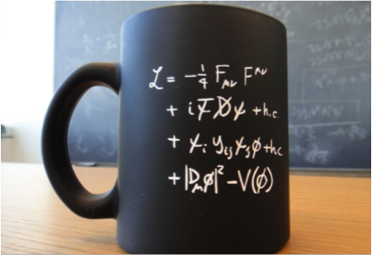
Lecture 2
Overview of the SM
Classical and SM Lagrangian
Symmetry, invariance and conservation laws
Higgs field and experimental results
Credits to:
C. Grosjean and D. Tong : https://indico.cern.ch/event/1254879/timetable/
b
Notes:
Digress a bit with philosophy

Slide 28
Overview of the Standard Model
Elementary
b

Slide 29

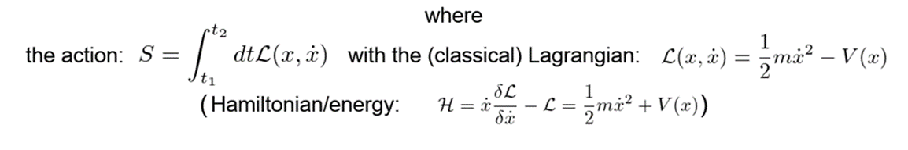
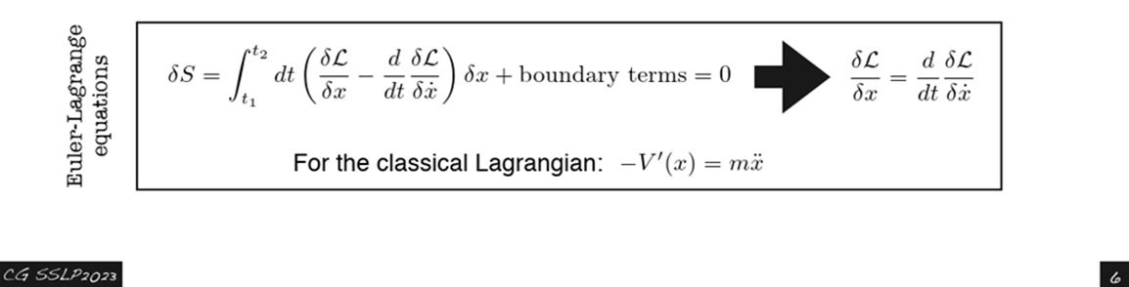
Lagrangian in the classical Mechanics
Potential term
Kinetic term
b

Slide 30
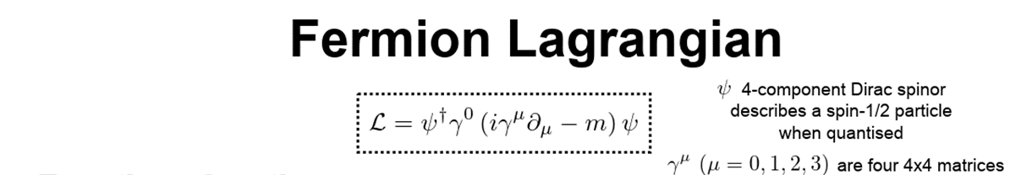
Lagrangian for particle physics
Kinetic term
b
Notes:
REM: dL=0?… example of Shoreline!

Slide 31

Lagrangian of the SM
Kinetic term of all gauge bosons fields
(W’s, Zº, photon and gluons)
Kinetic term of fermion fields
(quarks and leptons)
Interaction with H field giving mass to
the q’s and leptons
kinetic term for Higgs boson and H potential
!!
b
Notes:
kinetic term for Higgs boson and H potential that enter that minimum different from 0 that break SU(2) x(U1) in U(1)

Slide 32
Invariance of the physics laws
The laws of nature should be invariant under certain transformations since “nature does not know” how we observe it!
For example, the physics laws should be invariant in any inertial reference frame ☺ (Special Relativity)
Abandon the anthropocentric view and move towards a more abstract mathematical view, universally valid!
b
Notes:
That means the physics laws have to have the same space-time structure (covariance) in all the reference systems connected via the Lorentz transformations,

Slide 33
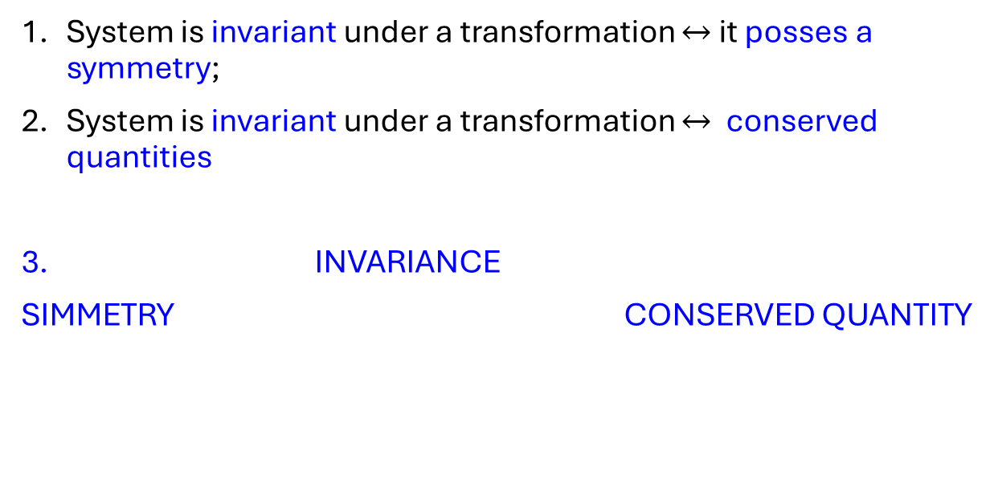
Symmetry, invariance and conservation laws
System is invariant under a transformation $↔$ it posses a symmetry;
System is invariant under a transformation $↔$ conserved quantities
INVARIANCE
SIMMETRY CONSERVED QUANTITY
(A.E. Nother Theorem)
(A.E. Nother Theorem)
b
Notes:
Example: norm invariance of four-vectors
1) The fundamental space-time symmetry requires the equations of the evolution of a physical system or its Lagrangian, to be invariant (covariant) under the transformation of the Poincaré group (Lorentz plus rotation transforms)
2) Conservation law: The Noethern theorem establishes that the invariance(/covariance) of the of the equations of motion under continuous transformations with n parameters, implies the existence of n conserved quantities,

Slide 34
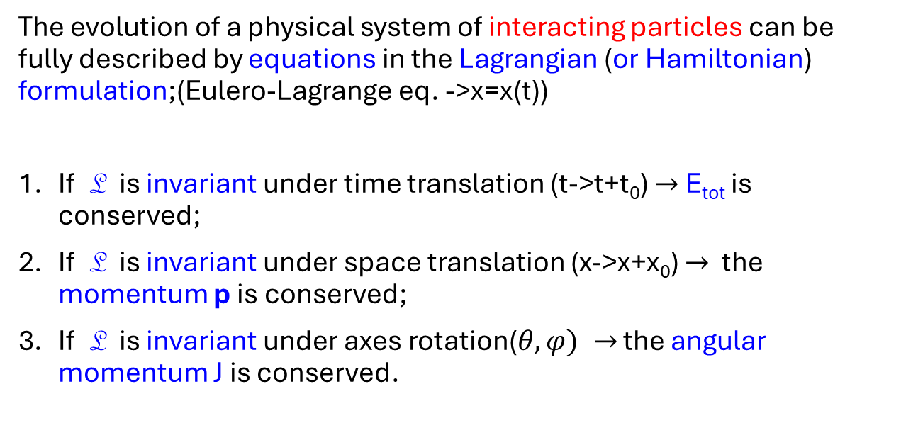
Classical invariance and conservation laws
The evolution of a physical system of interacting particles can be fully described by equations in the Lagrangian (or Hamiltonian) formulation;(Eulero-Lagrange eq. ->x=x(t))
If L is invariant under time translation (t->t+t₀) $→$ E_{tot} is conserved;
If L is invariant under space translation (x->x+x₀) $→$ the momentum p is conserved;
If L is invariant under axes rotation($θ,φ) →$ the angular momentum J is conserved.
b

Slide 35
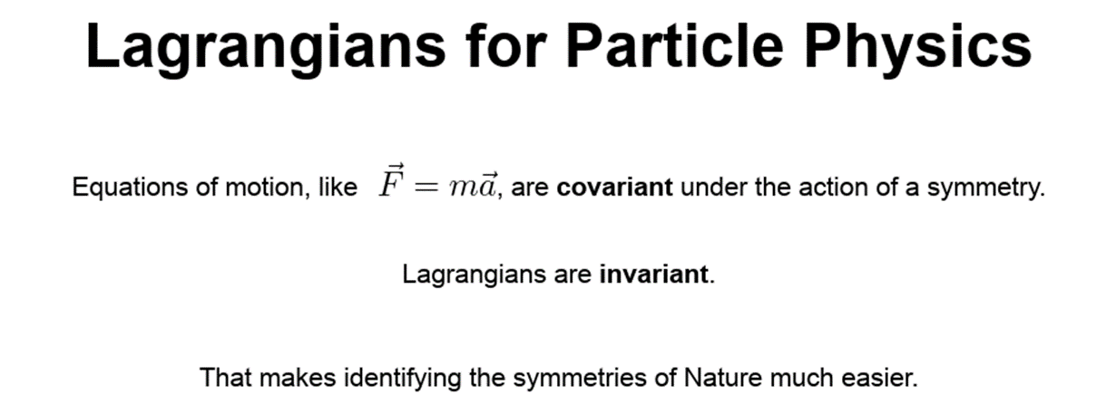
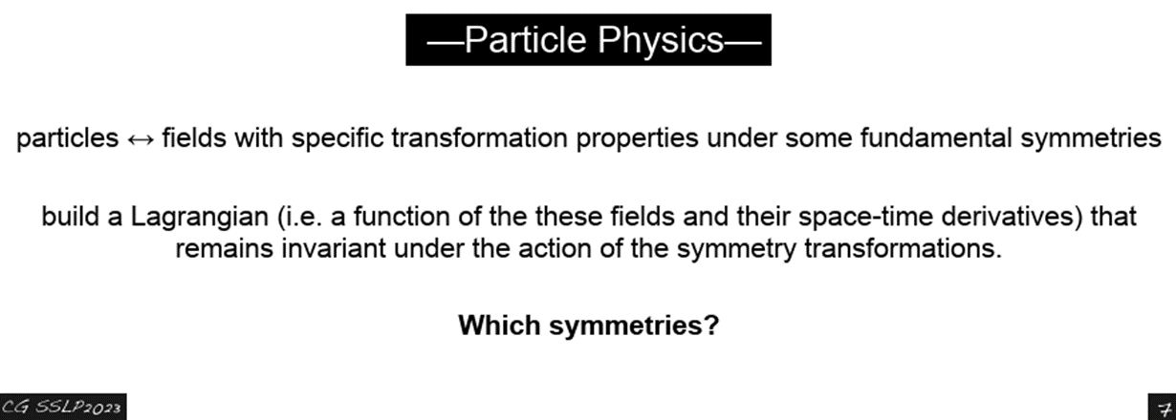

(Under the Transformation of Galileo between two reference systems) gdc
1) L must be invariant under the Special Relativity space-time transform (Lorentz invariant)
2) L must be invariant under (local)transformations of the particle fields and of the potentials (gauge invariant…->charge conservation)
b

Slide 36
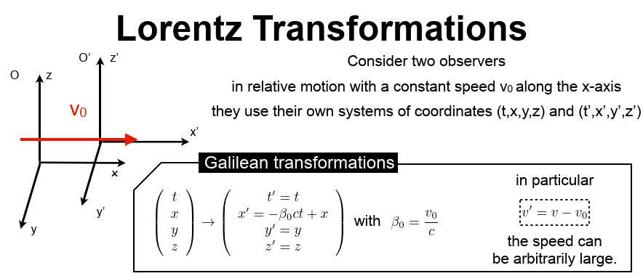
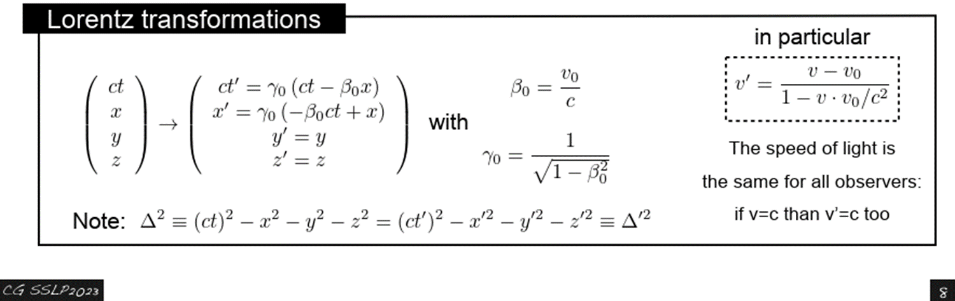
Galilean and
b

Slide 37
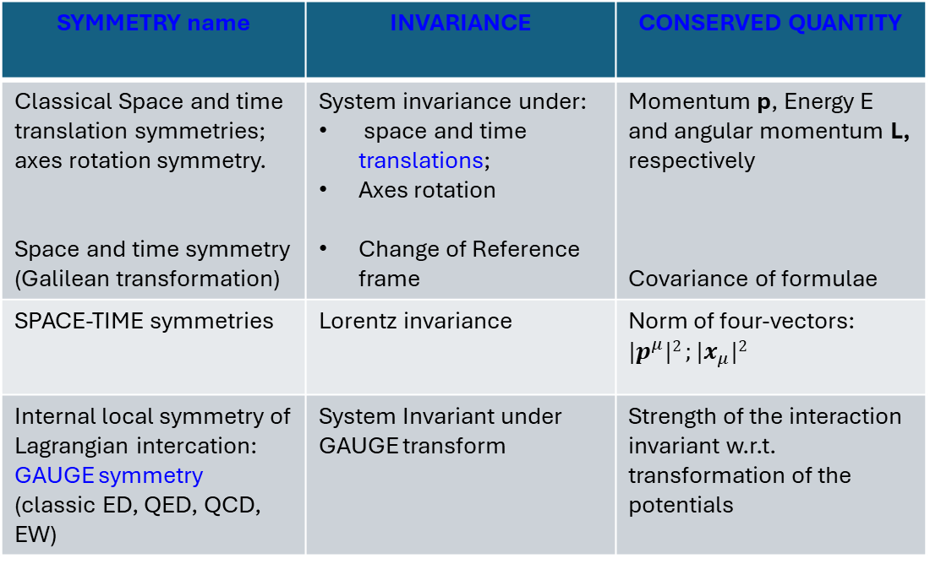
Summary on Simmetries
SYMMETRY name | INVARIANCE | CONSERVED QUANTITY
Classical Space and time translation symmetries; axes rotation symmetry. Space and time symmetry (Galilean transformation) | System invariance under: space and time translations; Axes rotation Change of Reference frame | Momentum p, Energy E and angular momentum L, respectively Covariance of formulae
SPACE-TIME symmetries | Lorentz invariance | Norm of four-vectors: ${|p}^{μ}|2 ;|x_{μ}|2$
Internal local symmetry of Lagrangian intercation: GAUGE symmetry (classic ED, QED, QCD, EW) | System Invariant under GAUGE transform | Strength of the interaction invariant w.r.t. transformation of the potentials
b

Slide 38
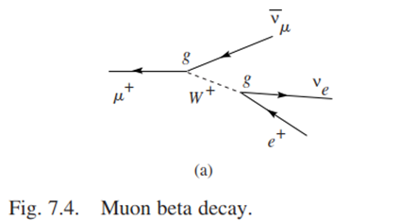
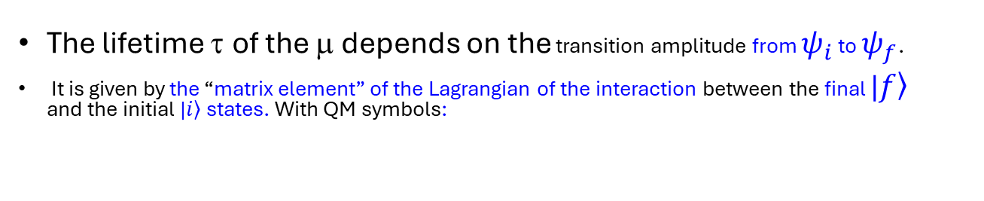



The SM elements
Feynman diagram of the muon beta decay
$$ψ_{i}$$
$$ψ_{f}$$
The lifetime τ of the μ depends on the transition amplitude from $ψ_{i}$ to $ψ_{f}$.
It is given by the “matrix element” of the Lagrangian of the interaction between the final |$\left.f\right\rangle$ and the initial |$\left.i\right\rangle$ states. With QM symbols:
$M_{fi}= \left\langle ψ_{f} | L_{int} | ψ_{i}\right\rangle$
$${{\left|M_{fi}\right|}^{2}→τ}_{μ}={10}^{−6}s that is the experimental value!$$
Any disagreement SM-experiments, leads to the SM corrections
b

Slide 39
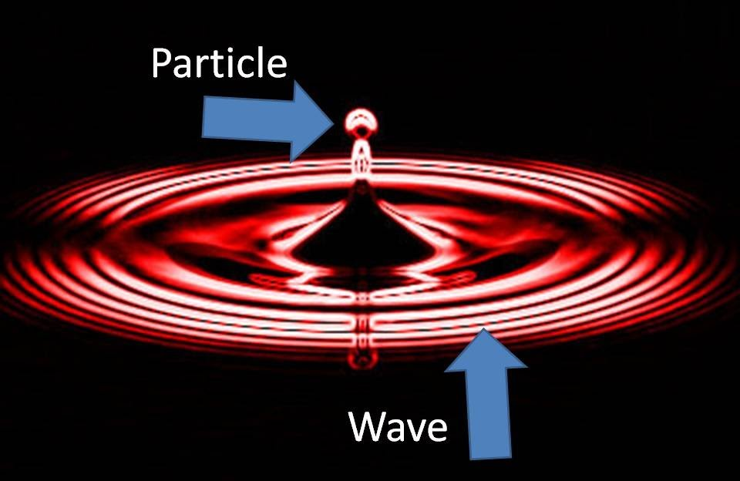
Observation of the Higgs boson
Two protons interacting in the LHC excite the Higgs field that manifests itself with the emission of the boson with a mass of 126 GeV.
b

Slide 40
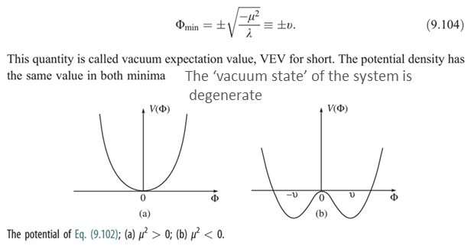
The Higgs mechanism
The Higgs mechanism was proposed (1960) to provide mass to the weak gauge bosons W± and Z°, the interaction carriers, without destroying the gauge invariance of the EW Lagrangian!
this was to unify the Weak and EM interactions in a gauge QFT (Electroweak interaction);
After about 50 years, The Higgs boson was observed at the LHC and presented on the 4th July 2012 at CERN;
The Higgs field fills the Universe with a nonzero value and provides mass to the fundamental particles as leptons, quarks and of course the bosons the force carriers;
~ 10⁻¹² s after the Big-Bang
b

Slide 41
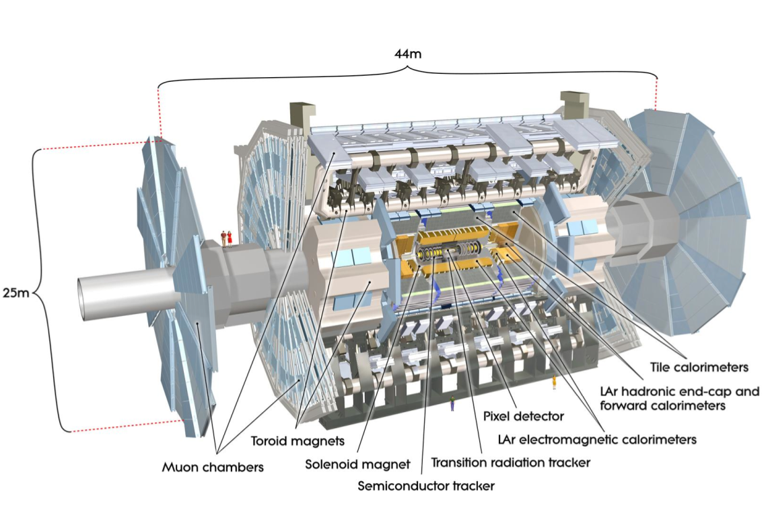
The “giant” of LHC: ATLAS
b
41

Slide 42
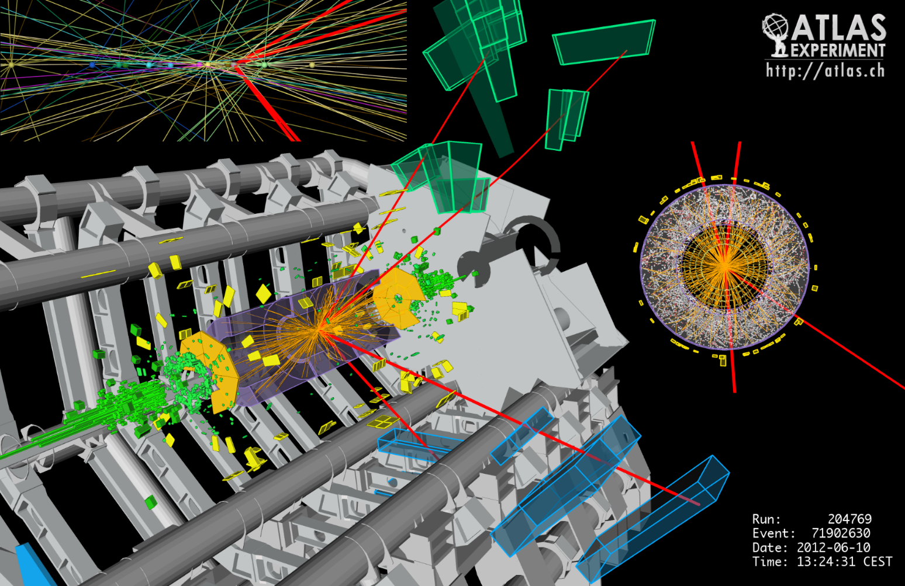
H→Z⁰Z⁰→4 leptons
b

Slide 43
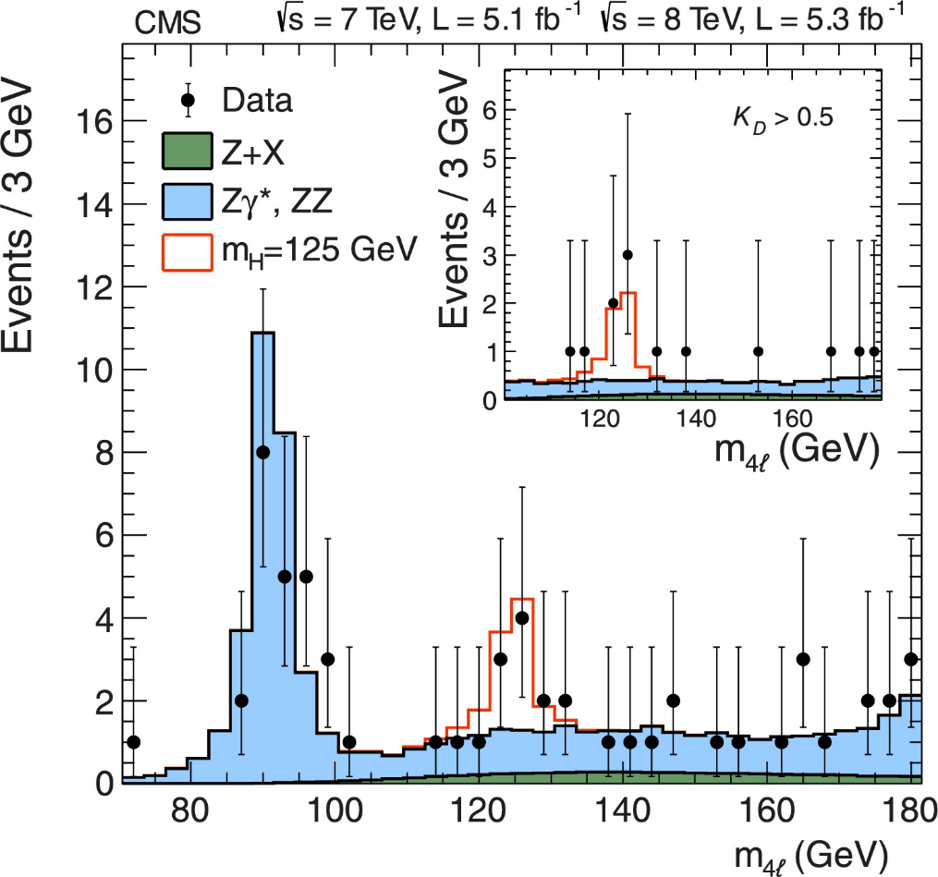
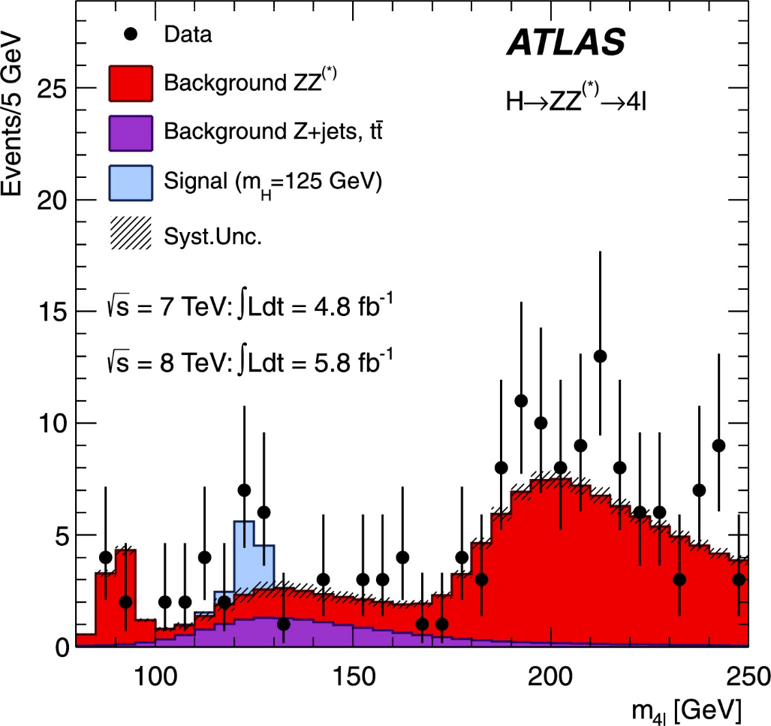
Invariant mass plot H→ZZ→4 leptons
b

Slide 44
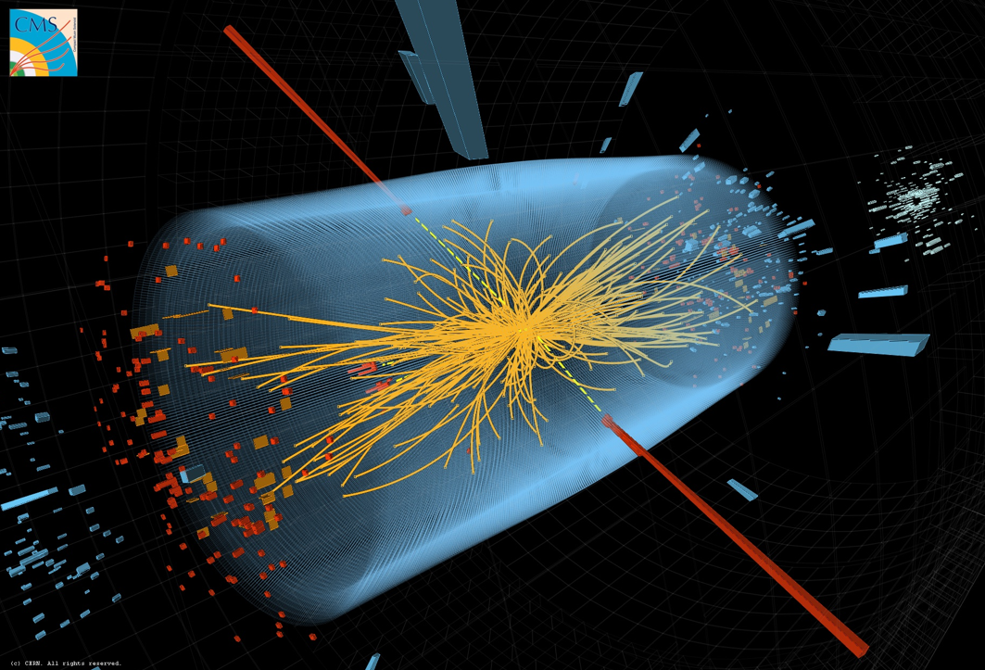
H→γγ
b

Slide 45
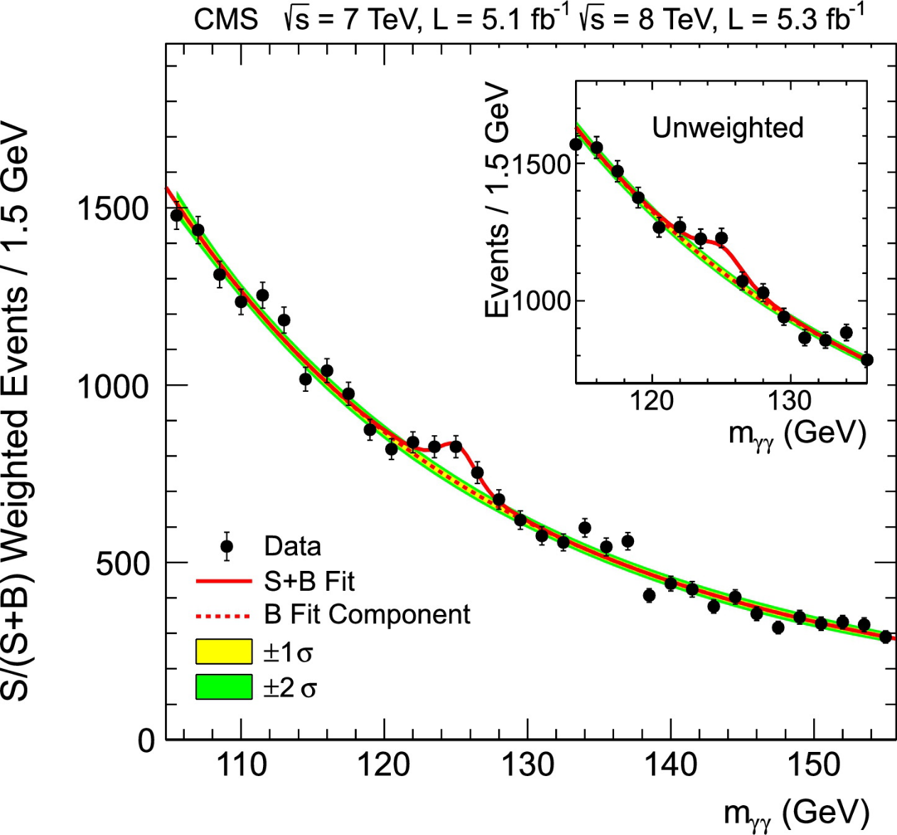
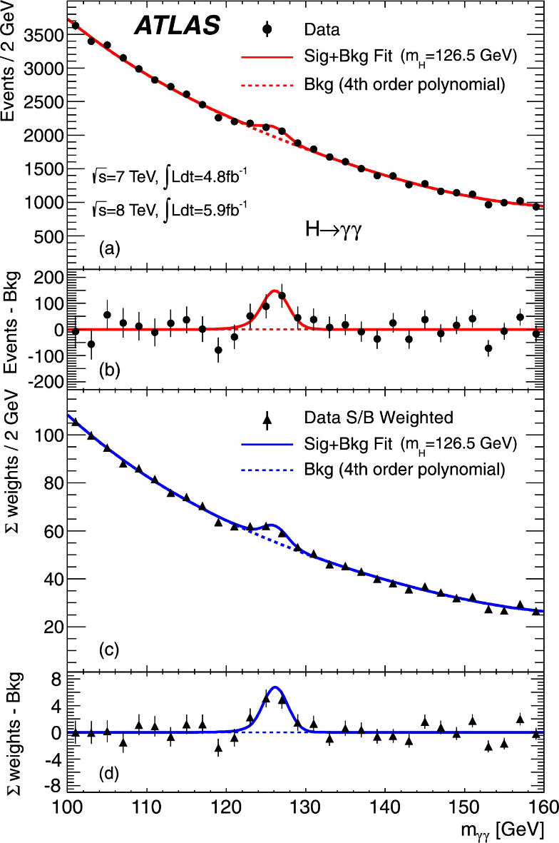
H→γγ
b

Slide 46
Summary
From the classical Lagrangian to the particle physics Lagrangian;
Invariance, conserved quantities and symmetries;
Elements of SM: Feynman diagrams and the computation of the muon life-time;
The Higgs boson and the experimental results
b

Slide 47
Lecture 3
Beyond the SM
Limits of the SM
Grand unified theories (GUT) (speculative)
Theories of Everything (ToE) (speculative)
b

Slide 48
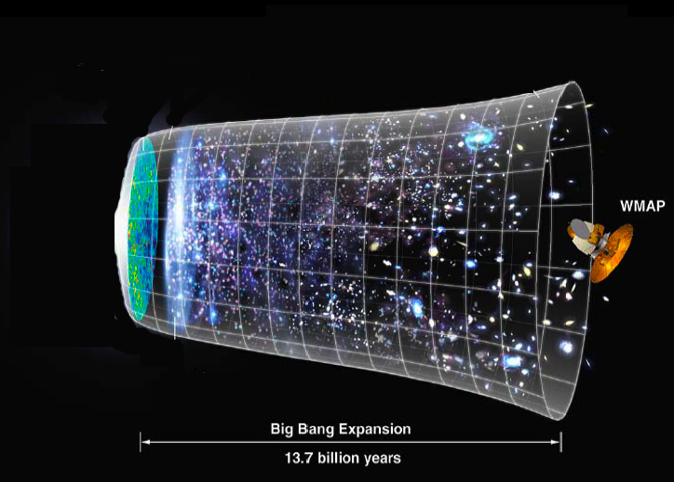
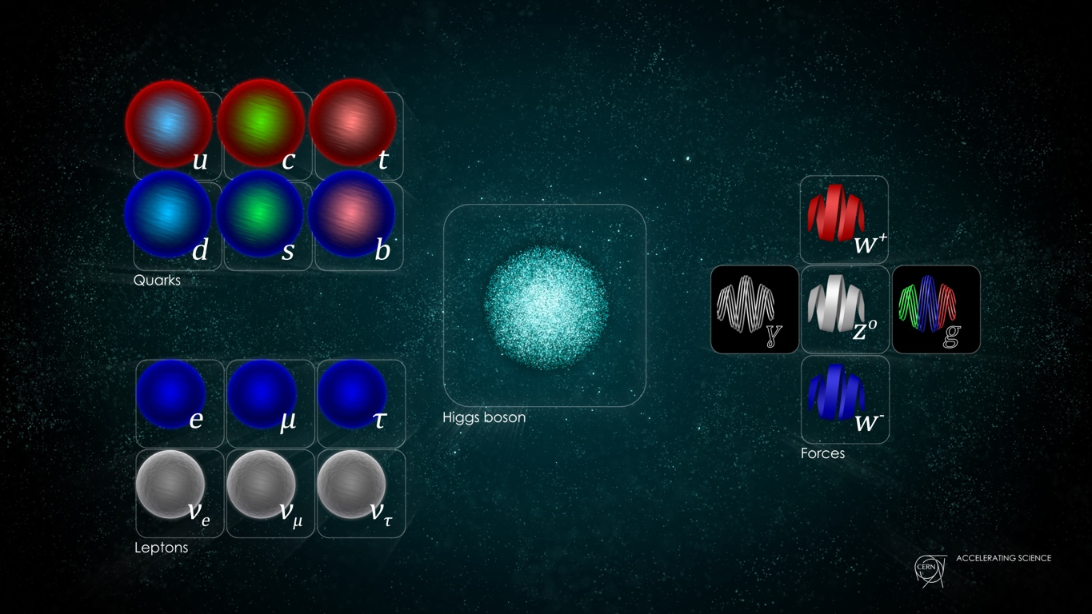
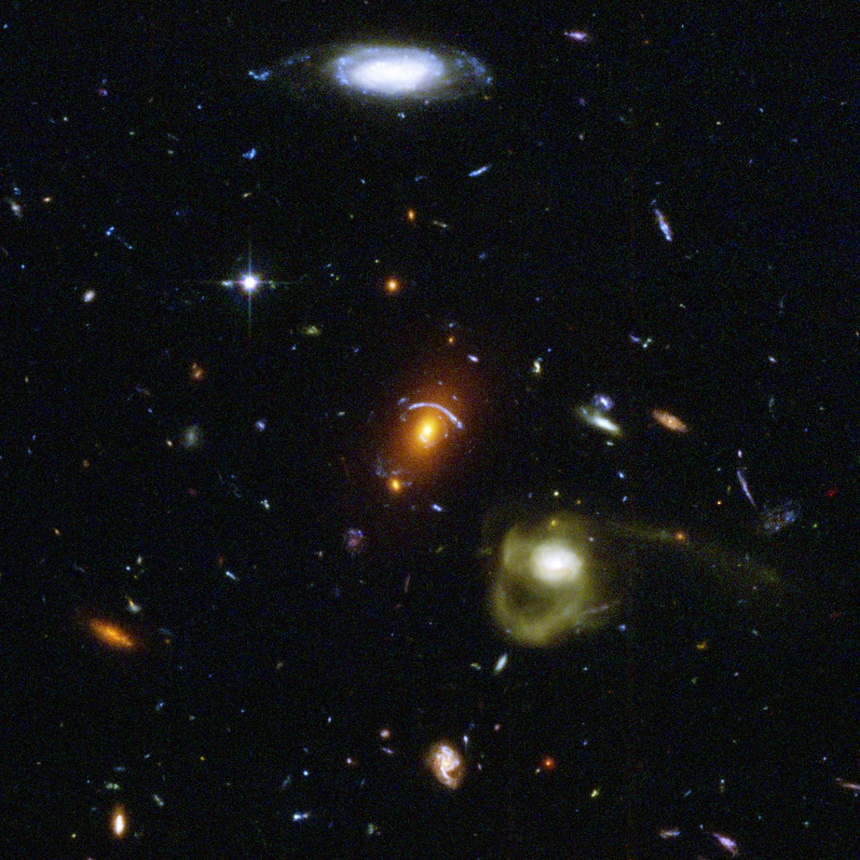
Standard Model
General Relativity
Universe ?
+
=
Wilkinson Microwave Anisotropy Probe
+
=
Actually, not yet !
Acceleration of the Universe expansion: dark energy;
dark matter.
b
Notes:
Quantum field theory depends on particle fields embedded in the flat space-time of special relativity.
General relativity models gravity as a curvature within space-time that changes as a gravitational mass moves. Historically, the most obvious way of combining the two (such as treating gravity as simply another particle field) ran quickly into what is known as the renormalization problem.

Slide 49
What the SM doesn’t explain
Dark matter: galaxy rotate too fast! It exists some extra matter not visible. It accounts for 23% of the total mass-energy. Which type of matter?
Dark energy: the universe expansion is accelerating therefore there is injection of energy. 73 % of total energy is dark. What is its origin?
We are in the 0.4% of the observable 4% mass-energy!
SM doesn’t incorporate the neutrino oscillation (then neutrino mass);
Origin of mass (hierarchy problem);
matter-antimatter asymmetry.
b

Slide 50
Acceleration of the Universe’s expansion (by AI)
✅ In short: The acceleration of the Universe’s expansion is directly linked to the cosmological constant because Λ contributes a form of energy with strong negative pressure, which counteracts gravitational deceleration and drives cosmic acceleration.
b

Slide 51

Acceleration of the Universe’s expansion (by AI)
1. Einstein’s cosmological constant (Λ)
Introduced by Einstein in his field equations as an extra term:
Physically, Λ behaves like a form of energy density of empty space — vacuum energy.
It has negative pressure, which is crucial for acceleration.
b

Slide 52

Acceleration of the Universe’s expansion (by AI)
2. Expansion dynamics
In cosmology, the expansion of the Universe is described by the Friedmann equations (derived from Einstein’s equations under assumptions of homogeneity and isotropy). The acceleration equation is:
where:
a(t) = scale factor (describes expansion),
ρ = energy density of matter and radiation,
p = pressure,
Λ = cosmological constant.
b

Slide 53

Acceleration of the Universe’s expansion (by AI)
3. How acceleration happens
Ordinary matter and radiation: Their pressure is ≥ 0, so the term −(ρ+3p/c² ) contributes to deceleration.
Cosmological constant: Equivalent to a vacuum energy density ρ_{Λ}​ with pressure
Plugging this in: the negative pressure makes the term in brackets very negative, so the overall effect of Λ is repulsive gravity, causing acceleration.
b

Slide 54
Acceleration of the Universe’s expansion (by AI)
4. Interpretation
A positive Λ acts like a uniform energy density filling space, pushing space itself to expand faster.
Observations (supernovae, CMB, galaxy clustering) show the Universe’s expansion is accelerating — consistent with Λ>0.
In modern cosmology, this effect is usually attributed to dark energy, often modelled simply as Einstein’s cosmological constant.
b

Slide 55
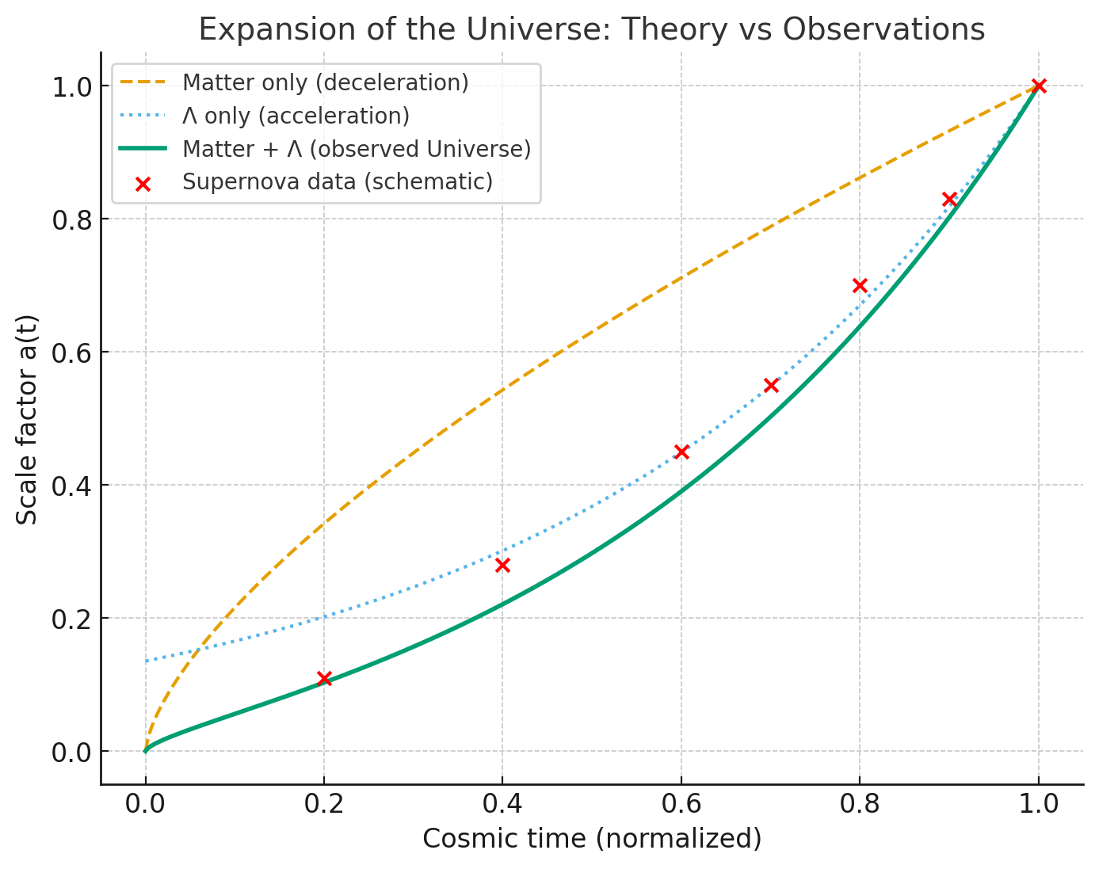
Acceleration of the Universe’s expansion (by AI)
🔴 Red points represent schematic observational data from distant Type Ia supernovae, which act as “standard candles.” They clearly fall along the Matter + Λ curve, showing the transition from past deceleration (matter-dominated) to present acceleration (Λ-dominated).
b

Slide 56

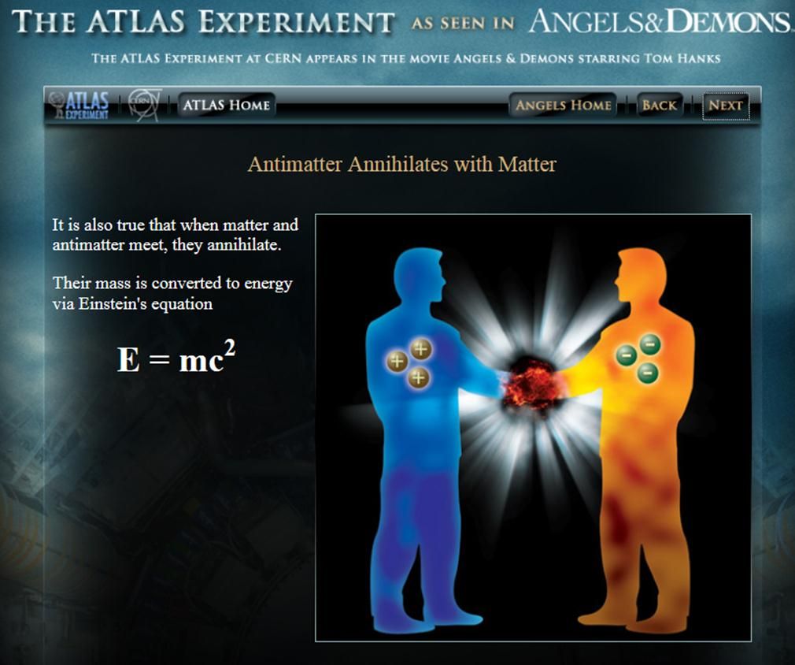
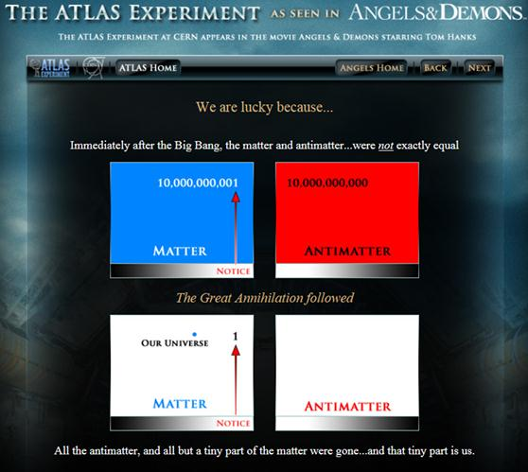
10⁻¹⁰ Matter-animatter asymmetry
LHCb (http://lhcb-public.web.cern.ch/lhcb-public/Welcome.html#EW2013) is dedicated to deeply investigate matter/antimatter asymmetry via decay of Beauty-particles (beauty-quark in) since weak interactions of matter differ subtly from those of antimatter. This may explain why the matter survived right after the Big-Bang.
ATLAS and CMS as well contribute on this topic
b
Notes:
LHCb is an experiment set up to explore what happened after the Big Bang that allowed matter to survive and build the Universe we inhabit today

Slide 57
Matter-animatter asymmetry (by AI)
1. Why did this happen? (Baryogenesis)
Physicists think the answer lies in processes collectively called baryogenesis — mechanisms in the early Universe that created a slight imbalance between matter and antimatter.
For baryogenesis to work, three conditions (called Sakharov conditions) must be satisfied:
Baryon number violation
Some reactions must allow baryons (like protons and neutrons) not to be conserved.
C and CP violation
C (charge conjugation) symmetry: physics looks the same if we swap matter ↔ antimatter.
P (parity) symmetry: physics looks the same in a mirror.
Together, CP symmetry means matter and antimatter behave exactly the same.
Experiments (like in kaons and B-mesons) show CP is not exact — matter and antimatter have tiny behavioral differences.
Departure from thermal equilibrium
In the rapidly cooling early Universe, conditions weren’t perfectly balanced, which allowed asymmetry to “freeze in.”
b

Slide 58
Matter-animatter asymmetry (by AI)
2. Status today
We don’t yet know the full mechanism. The Standard Model allows some CP violation, but probably not enough to explain the observed matter–antimatter imbalance.
Many theories go beyond the Standard Model (like leptogenesis, where neutrino asymmetries generate baryon asymmetry) to explain it.
Experiments (like studying neutrino oscillations, CP violation in mesons, and searching for proton decay) are probing this mystery.
✅ In short: No antimatter “survived” because in the early Universe there was a tiny imbalance — slightly more matter than antimatter. Almost everything annihilated, but that small excess of matter remained, and became all the structures we see today.
b

Slide 59
Beyond the Standard Model
GUT (Grand Unified Theory): ElectroWeak and Strong Interaction unified in a common theory. So far, they are described within the same mathematical scheme (SM), but not in a “unified physics”. EW it is.
TOE (Theory Of Everything)= GUT + General Relativity (GR)!
So far GR is not yet a quantum theory of the interaction (QFT), it is “analytical description of space geometry” in presence of masses/(energy)
GUT and TOE, a scientific challenge …and maybe a romantic dream,
for a unified description of the Universe
b

Slide 60
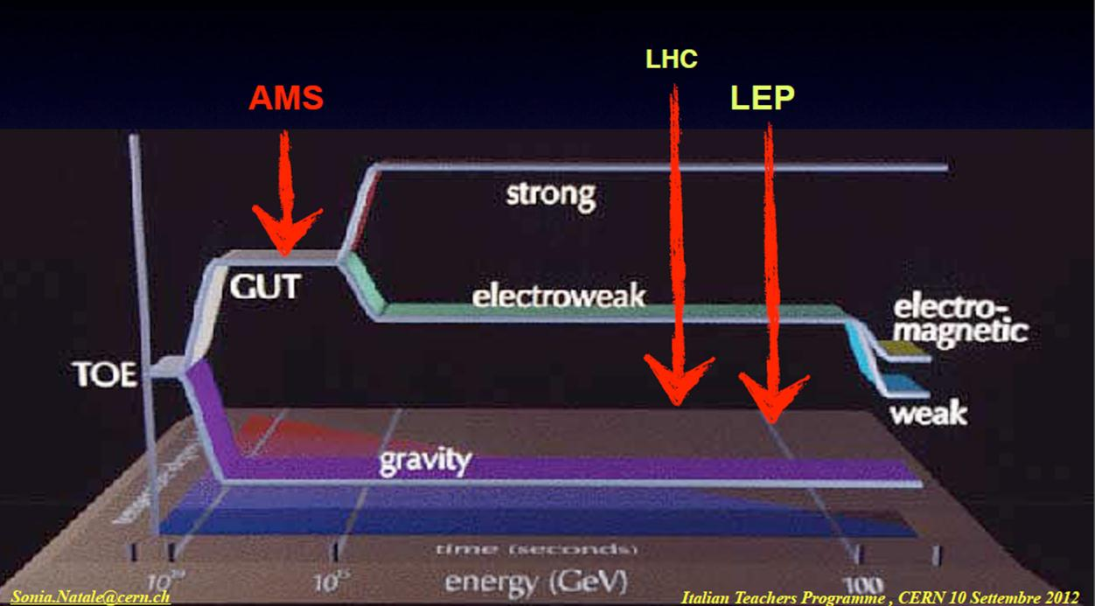
Energy scale for GUT and ToE
SM energy range
Candidates
Supersymmetry,
String theory,
M-theory
Supergavity
10¹⁹
10¹⁵
BigBang
today
t
b

Slide 61
Theory of Everything
Theory with the objective to unify a GUT (EW+SI) with gravity described as QFT!
Candidates:
Composite models
Supersymmetry (SUSY)
Kaluza-Klein theories
String models
M-theories
b

Slide 62
(1) Composite structure
Electrons and quarks are assumed as composite structure;
So far no evidence from the cross section trend that assumes the fermions as point-like objects!!
b

Slide 63

(2) SUPERSYMMETRY (SUSY)
SUSY can include the Gravity as QFT;
A connection between fermion fields (spin 1/2) and boson fields (spin 1, force carriers particles) exists;
We know that fermions (quarks and leptons) interact through the exchange of gauge bosons (gluons, photon, W± and Z°);
“SUPERSYMMETRY” predicts a complete symmetry between particles of matter and Interaction carriers :
Spin ½ (fermions) | Spin 0, Spin 1 (bosons)
electron | selectron (S=0)
quark | squark (S=0)
photino | photon (S=1)
gluino | gluon (S=1)
gaugino (Wino, Zino) | W, Z (S=1)
b

Slide 64

SUSY at one glance
b

Slide 65

Evolution of the interactions
Forces “run” with energy ….. and don’t agree at high energy
SUSY can modify their evolution to join up → unification @ 10¹⁴ GeV
SUSY could explain the cosmological matter-antimatter asymmetry;
Lightest supersymmetric particle = dark matter ;
Unfortunately, so far, no evidence of supersymmetric particles neither in ATLAS nor in CMS search!!
b
Notes:
We talked about this yesterday. MYSTERY.

Slide 66
Supersymmetric BEH bosons
If the supersymmetry exist then 5 Higgs bosons should exist (three neutral and two electrically charged)
In this case the BEH boson discovered at LHC, could be one out of the three neutral;
No such SUSY partner has been observed so far. So, if they exist, they must have a mass > 1 TeV (energy explored at LHC);
b

Slide 67
(3) Kaluza-Klein theories
(1920-1926) The idea was to add a fifth space dimension to the space-time of the General Relativity(GR);
The fifth dimension is curled-up and has no effect on usual physics;
It is possible to define a field with components that in the four dimensions satisfy the field equation of the GR and with the other components which satisfy the Maxwell’s relations;
Electromagnetism and GR are connected but not as QFT!!
The success of the Electroweak unification has revived the interest on this theory and an integer number of dimensions have been added: work in progress.
b

Slide 68


(4)String theory as ToE ?
Superstrings in 9+1 dimentional space?
The elementary entities are little strings vibrating in a 9+1 dimensional space, revealing its structure at l ~10⁻³⁵ m (Planck length );
The SM particles: would be described via different vibration modes, open/closed strings
Quantum Gravity: graviton-like particle is contained in the Superstring model
b
Notes:
Which string?
String theory is conceptually complex, with a fascinating but very difficult mathematical structure. This has so far prevented researchers from deriving concrete predictions from the theory for comparison with experimental results. Not only does string theory involve the complex study of the geometry of extra dimensions, but the way the structure of the dimensions are chosen appears arbitrary and can lead to different outcomes.
For instance, there seem to be many possible ways to curl up the extra dimensions, by choosing different shapes and sizes. This leads to many alternative versions of the theory. In certain cases, the sizes of the extra dimensions are very small and it will be difficult to obtain direct evidence for them. In others, the sizes are far larger and could be observed at new accelerators such as CERN’s Large Hadron Collider.
Underlying string theory is the radical idea that fundamental particles are not really like points or dots, but rather small loops of vibrating strings

Slide 69
(4)String theory as ToE ?
Superstrings in 9+1 dimentional space?
With superstring in 10 dimension, the unification of SM and Gravity (GR) is then possible!!
But, why 6 space dimensions disappeared? How did they disappear?
Is there a unique way to go from 10 to 4 dimensions where we live?
With superstrings, Axions, Magnetic monopoles, Majorana neutrinos, Dyons (MM with e charge), weakly interacting massive particles (WIMPS) can be proposed,…unfortunately, so far, no experimental observations!! ☹
b
Notes:
Which string?
String theory is conceptually complex, with a fascinating but very difficult mathematical structure. This has so far prevented researchers from deriving concrete predictions from the theory for comparison with experimental results. Not only does string theory involve the complex study of the geometry of extra dimensions, but the way the structure of the dimensions are chosen appears arbitrary and can lead to different outcomes.
For instance, there seem to be many possible ways to curl up the extra dimensions, by choosing different shapes and sizes. This leads to many alternative versions of the theory. In certain cases, the sizes of the extra dimensions are very small and it will be difficult to obtain direct evidence for them. In others, the sizes are far larger and could be observed at new accelerators such as CERN’s Large Hadron Collider.
Underlying string theory is the radical idea that fundamental particles are not really like points or dots, but rather small loops of vibrating strings

Slide 70

(5) M-theory as ToE ?
M-theory*): p-brane in 11 dimension for the unification of SM+Gravity in a Theory of Everithing (ToE)
A p-brane is a physical object that generalizes the notion of a point particle to higher dimensions. For example, a point particle can be viewed as a brane of dimension zero, while a string can be viewed as a brane of dimension one.
Branes are dynamical objects which can propagate through spacetime according to the rules of quantum mechanics. They have mass and can have other attributes such as charge. A p-brane sweeps out a (p+1)-dimensional volume in spacetime called its worldvolume. Physicists often study fields analogous to the electromagnetic field which live on the worldvolume of a brane.
This image of the en:Calabi–Yau manifold appeared on the cover of the November 2007 issue of en:Scientific American.
*) http://en.wikipedia.org/wiki/M-theory
b
Notes:
The fundamentl constituent of the particle physics evolve from point-like objects to 9 dimension string till 11 dimension p-brane !

Slide 71

Beyond SM: Scientific program at LHC 2015 -...
b

Slide 72

ATLAS and CMS on SUSY and extra dimensions
ATLAS and CMS
are investigating about the origin of mass, extra dimensions of space, microscopic black holes, and evidence for dark matter candidates in the Universe..
Supersymmetry
Events with substantial missing energy with high-energy electrons or muons will be indications for the production and decay of super-partners
b
Notes:
Other event signatures are possible. For example, if the LSP is the super-partner of the graviton, pairs of high-energy gamma rays or pairs of electrons or muons can result. Gamma rays can also be emitted in the decay chains if the LSP is the super-partner of the Higgs boson and the second lightest supersymmetric particle is the super-partner of the photon. By studying the types and characteristics of missing-energy events, physicists will be able to discern the properties of the super-partners that are being produced including their masses, and determine which super-partner is the LSP.
To really show that supersymmetry has been discovered and to determine the complete theory of supersymmetry chosen by nature, physicists will need to see a variety of signals, measure detailed information about each of them, and collect high statistics to assure accuracy.

Slide 73

ATLAS and CMS probing Extra dimensions for gravity
ATLAS Experiment may see evidence that extra dimensions exist via collision events in which a graviton particle disappears into other dimensions. ATLAS would detect a large imbalance of energy in the event.
CMS: This is why the detector must be as “hermetic” as possible.
b
Notes:
We can only experience and therefore visualize the world in three space dimensions, even though it might well have more. An indication for extra dimensions may be the extreme weakness of gravity compared with the other three fundamental forces (gravity is so weak that a common refrigerator magnet can pick up a paper clip overwhelming the gravity of the entire Earth). This weakness may be due to gravity's force field spreading into other dimensions.
The ATLAS Experiment may see evidence that extra dimensions exist via collision events in which a graviton particle disappears into other dimensions. ATLAS would detect a large imbalance of energy in the event.
CMS: Two of the most fundamental laws of physics are that momentum and energy “are conserved”. In other words, the total momentum and energy before a collision is equal to the total momentum and energy after. So if we add these up in all the observed particles emerging from a collision (in the case of CMS we do this is the sideways “transverse” direction) and it does not equal the amount in the original particles, there must be a missing particle that carried away the momentum and energy: a lost piece leaving a hole in the jigsaw.
This is why the detector must be as “hermetic” as possible, that is, it must be able to catch, to the extent possible, every particle emerging from the collisions, so we can deduce that particles have genuinely disappeared, and have not just been missed by the detector.

Slide 74


ALICE probing the quark-gluon plasma
Two relativistic lead-ion collision in the laboratory frame
The long term goal of the ALICE experiment is to provide a precise characterization of the high-density (10¹¹ kg/cm³), high-temperature (5 10 ¹² K )phase of strongly interacting matter;
To achieve this goal, high-statistics precision measurement are required. The general upgrade strategy for the ALICE detector is conceived to deal with this challenge with expected Pb-Pb interaction rates of up to 50 kHz during future operation of LHC
b
Notes:
The long term goal of the ALICE experiment is to provide a precise characterization of the high-density, high-temperature phase of strongly interacting matter. To achieve this goal, high-statistics precision measurement are required. The general upgrade strategy for the ALICE detector is conceived to deal with this challenge with expected Pb-Pb interaction rates of up to 50 kHz
Confinement
No quark has ever been observed in isolation: the quarks, as well as the gluons, seem to be bound permanently together and confined inside composite particles, such as protons and neutrons. This is known as confinement. The exact mechanism that causes it remains unknown.
Generation of mass
Protons and neutrons are known to be made of three quarks, but by adding together the masses of the three quarks one gets... only about 1% of the proton or neutron mass. Where does the remaining 99% come from?
Is the mechanism that confines quarks inside protons and neutrons also responsible for the generation of most of the mass of ordinary matter?
A detailed investigation of the properties of strongly interacting matter at high temperature, are the principal aims of the ALICE scientific program.

Slide 75
Summary
The SM doesn’t account for dark matter, dark energy,....... And as input it requires several parameters. Nevertheless it accounts for many experimental observations!
Theories beyond standard model try to unify Gravity and the particle world:
GUT
Supersymmetry
Kaluza-klaine
String and M theories
Anyway so far no experimental evidence of predicted new particles;
But, 2015 confirmation of the gravitational waves!! Data useful to study the graviton properties!
A long way to go! Young and smart students required!
b

