Slide 1
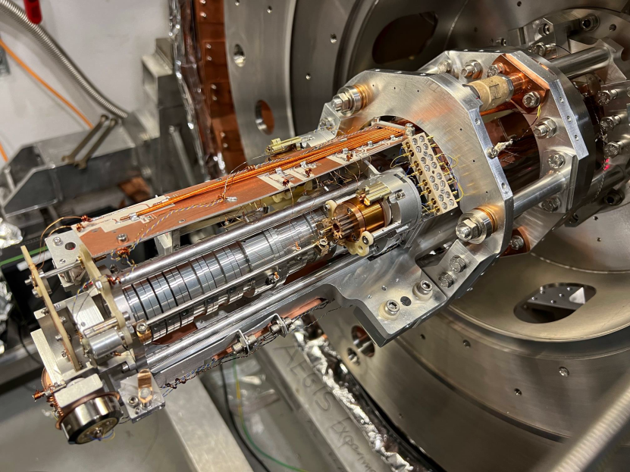

Cold antimatter physics at CERN
Dr. Fredrik Parnefjord Gustafsson

Slide 2
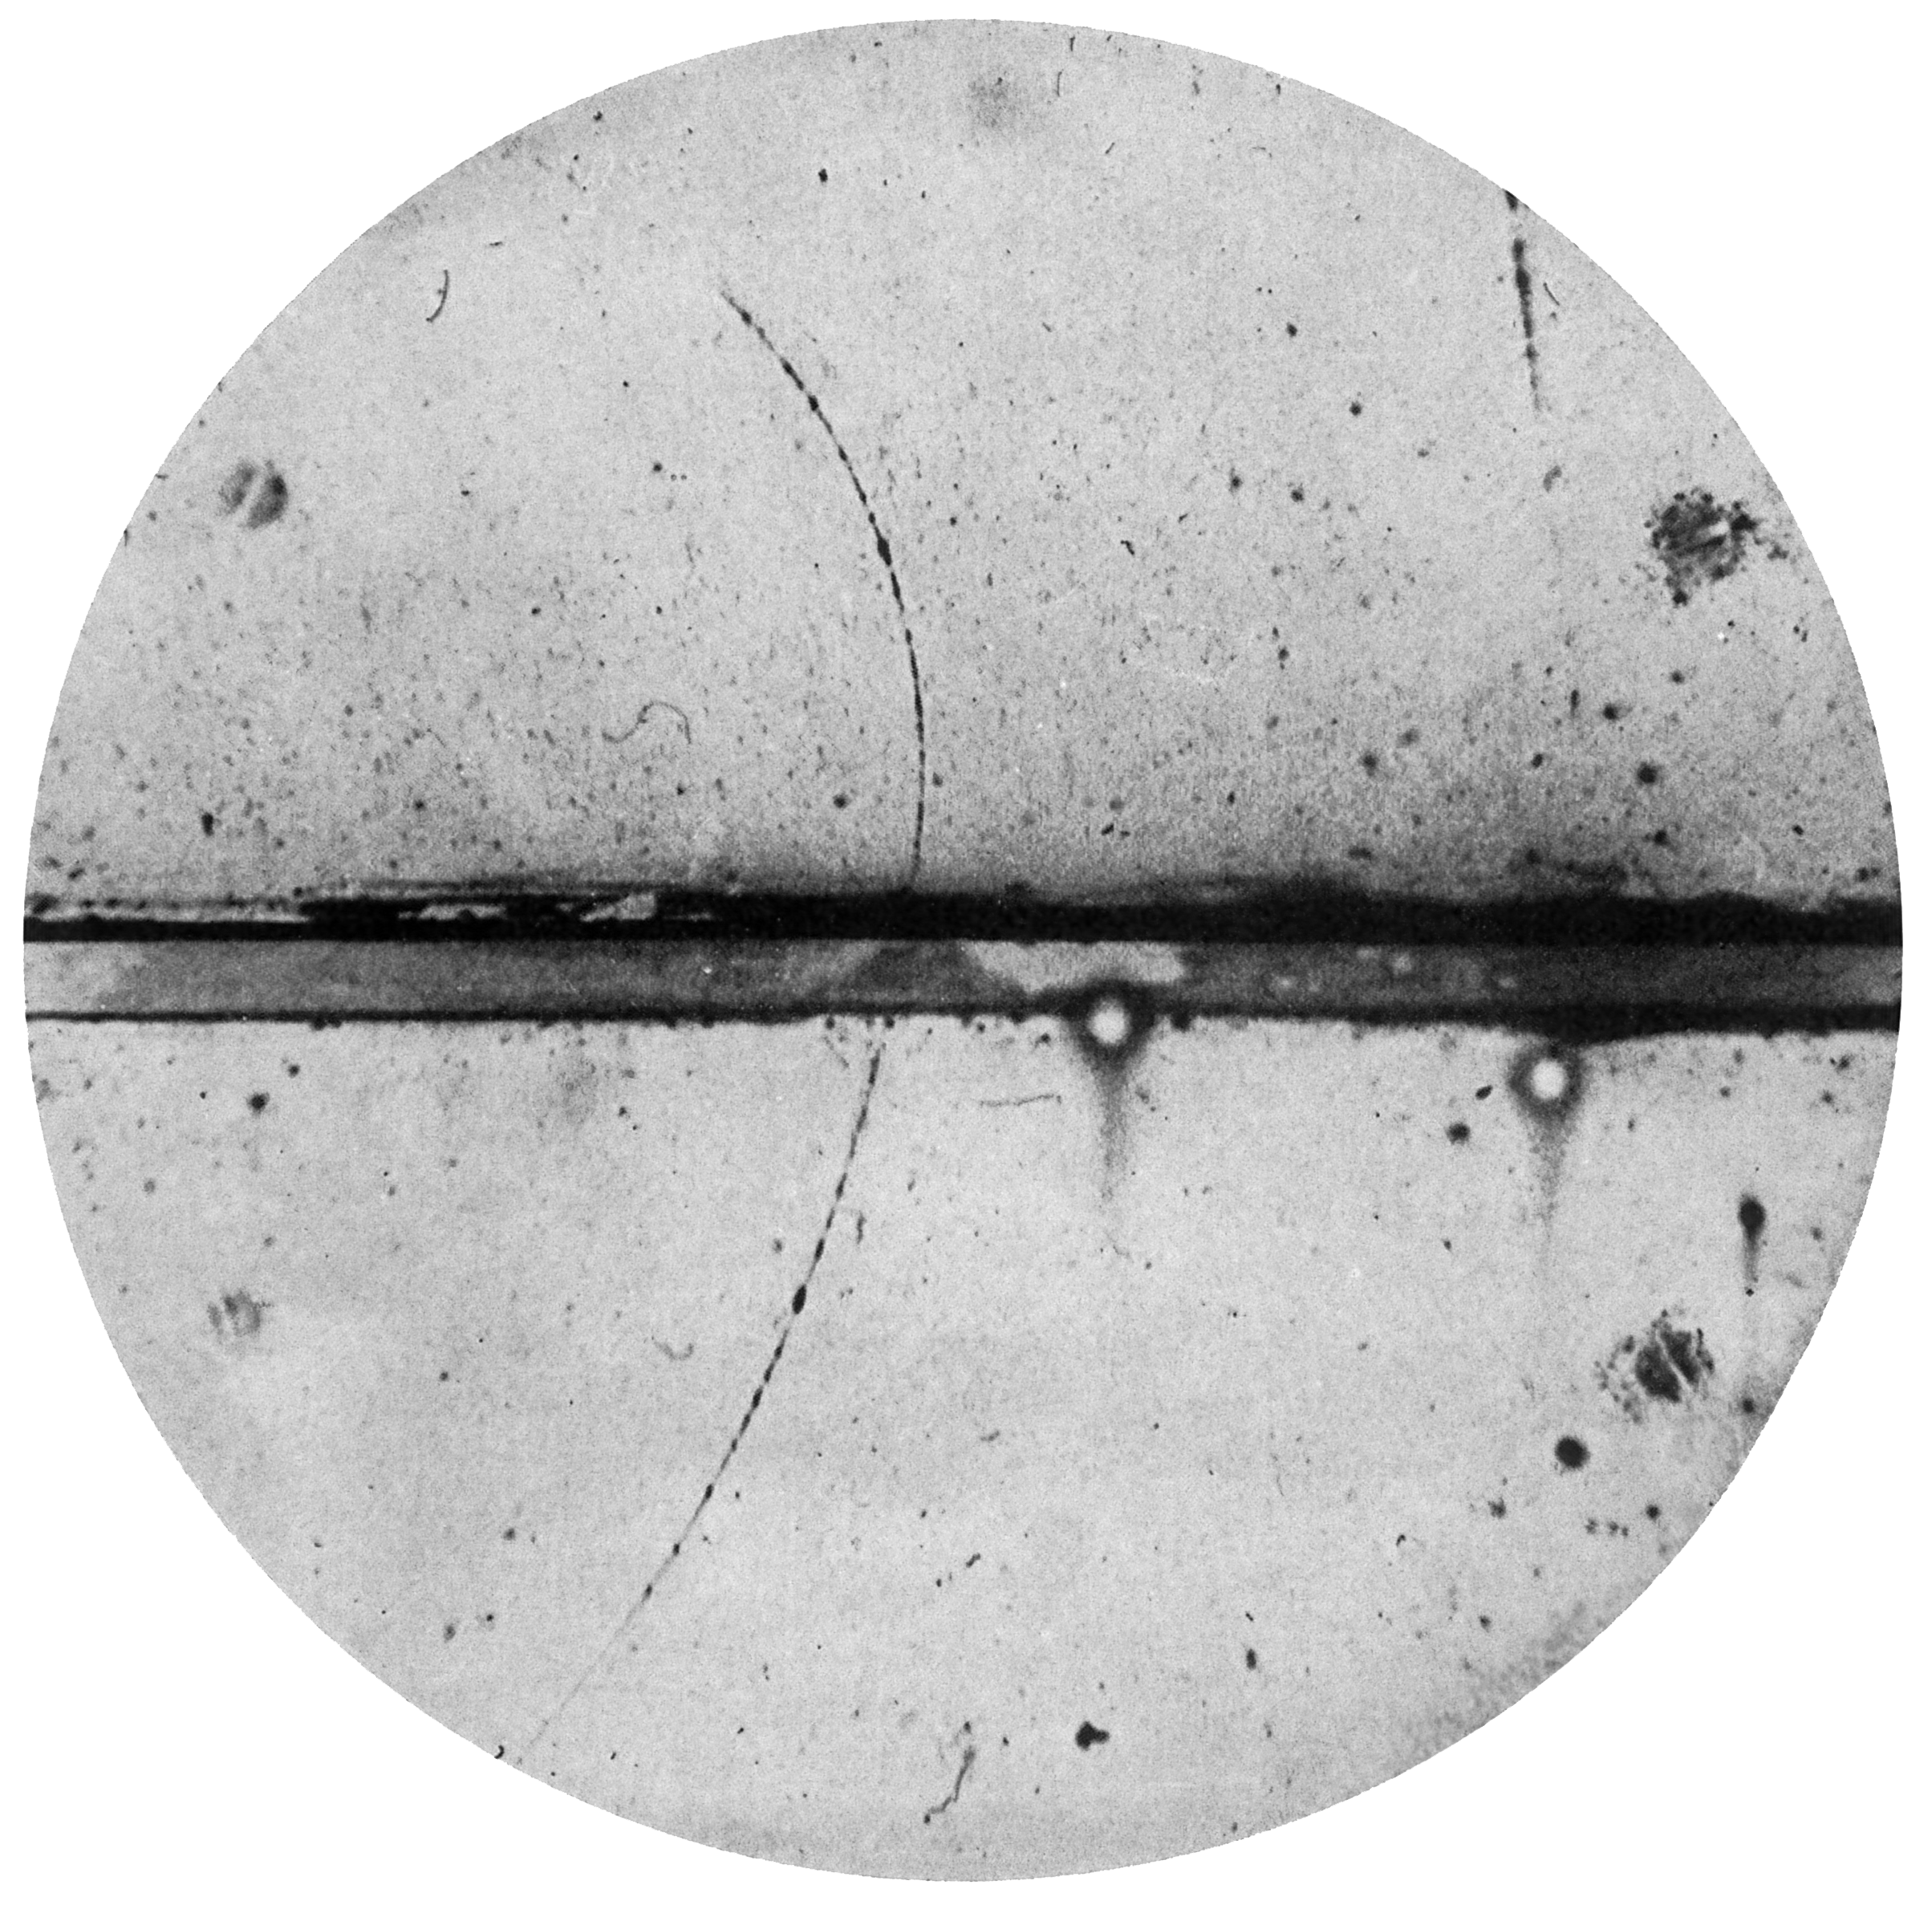
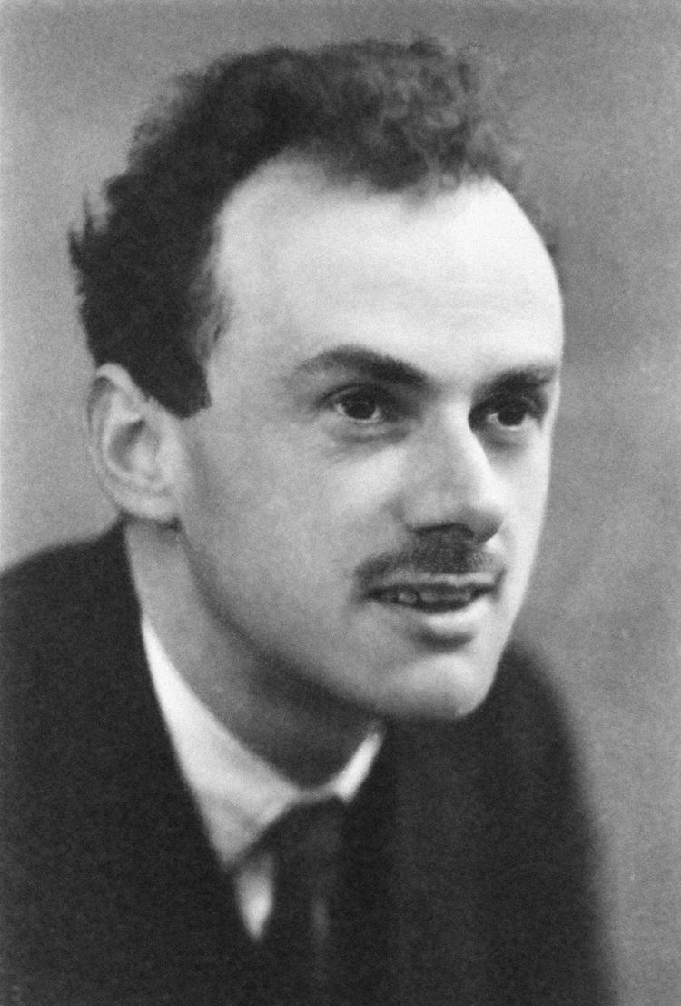
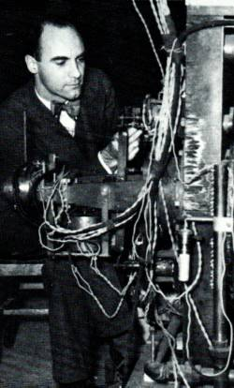
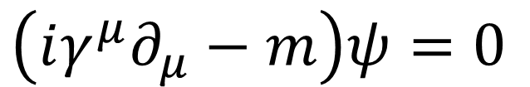
What is antimatter?
(Anti-electron/positron)
+
Quantum mechanics
Theory of special relativity
(Physics of the very small things)
(Physics of very fast things)
e⁺
$$\left(iγ^{μ}∂_{μ}−m\right)ψ=0$$
Two valid solutions:
Matter
Theory confirmed!
Antimatter?
Positron discovery
Awarded Carl David Anderson the Nobel Prize in 1936
Notes:
Emphasize that this was a surprise at the time – Dirac's theory predicted something new, and experiment confirmed it.

Slide 3
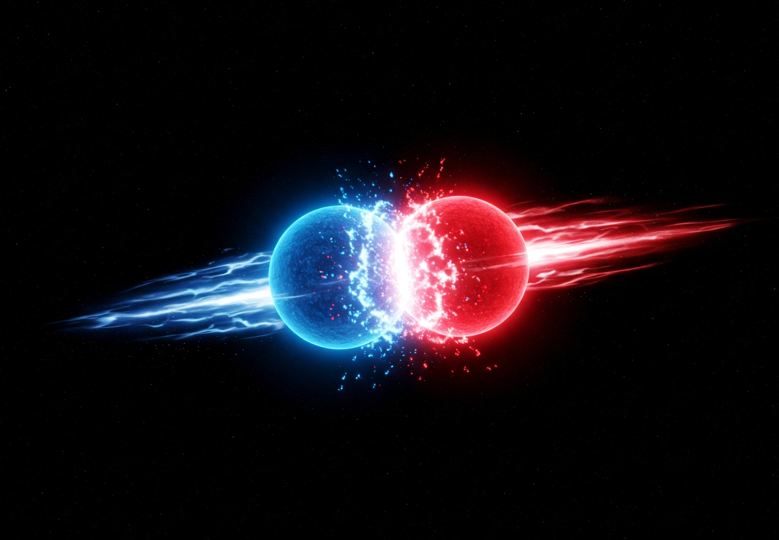



Annihilation av antimateria
Annihilation
Matter
Antimatter
$$e^{+}$$
$$e^{−}$$
$$E=mc^{2}$$

Slide 4
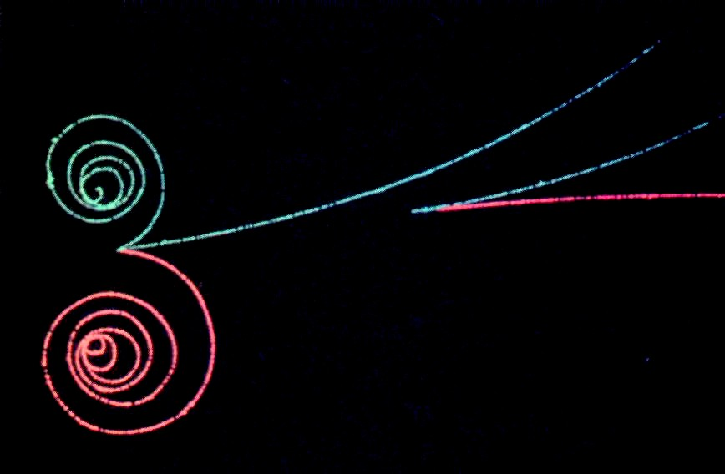
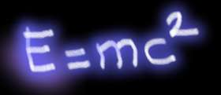



Skapelse av antimateria från energi
Creation of matter/antimatter
$$e^{−}$$
Energi
$$e^{+}$$
$$E=mc^{2}$$

Slide 5
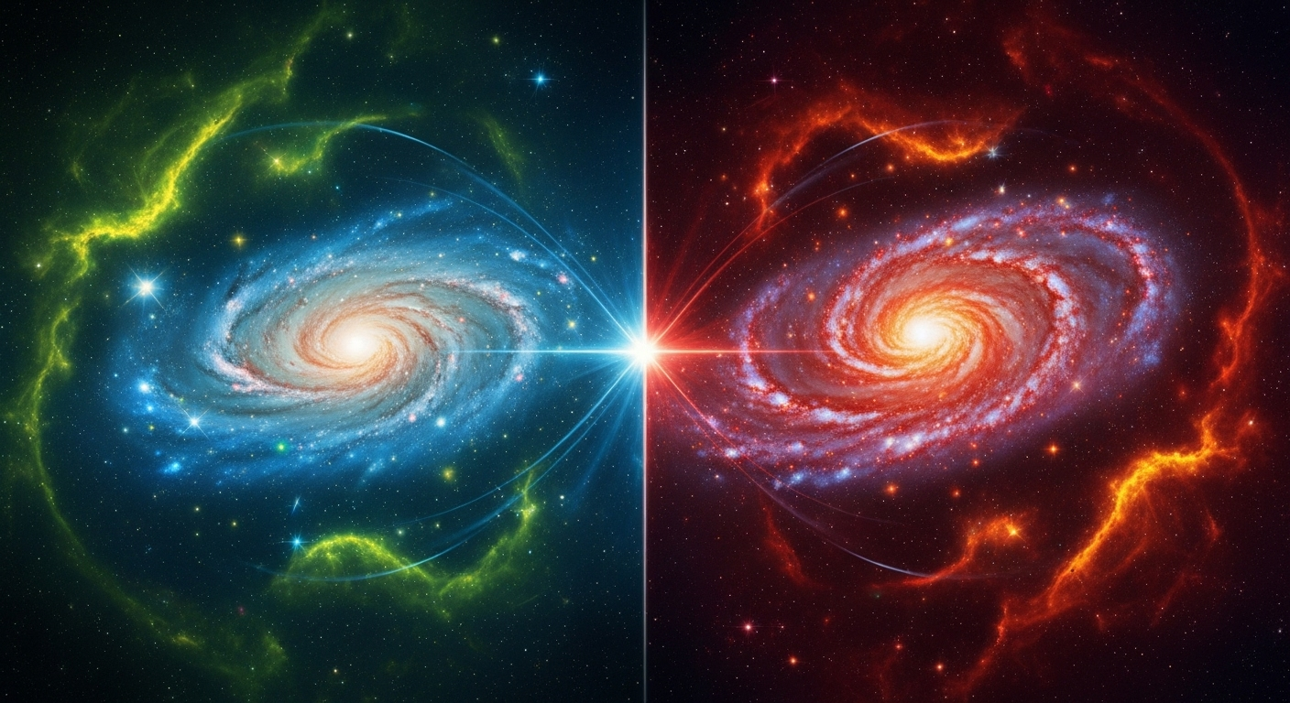
What happened to all antimatter?
Matter
Antimatter?

Slide 6
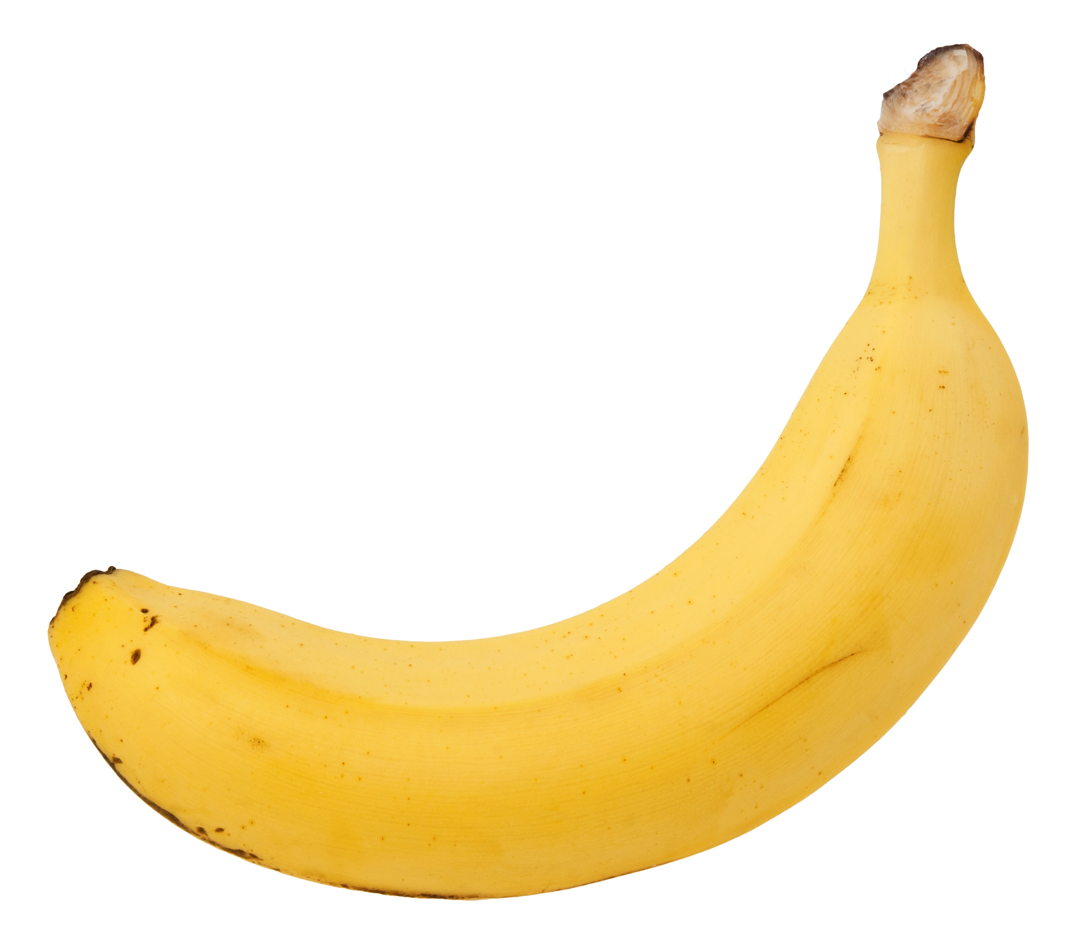
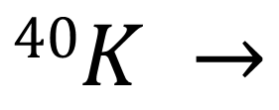
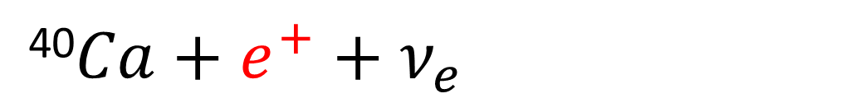
Where can we find antimatter?
Roughly 0.5 gram potassium inside a banana, with 50$μ$g potassium-40
Positron
$$40K →$$
⁴⁰$Ca+e^{+}+ν_{e}$
One banana generates roughly one positron per hour.

Slide 7
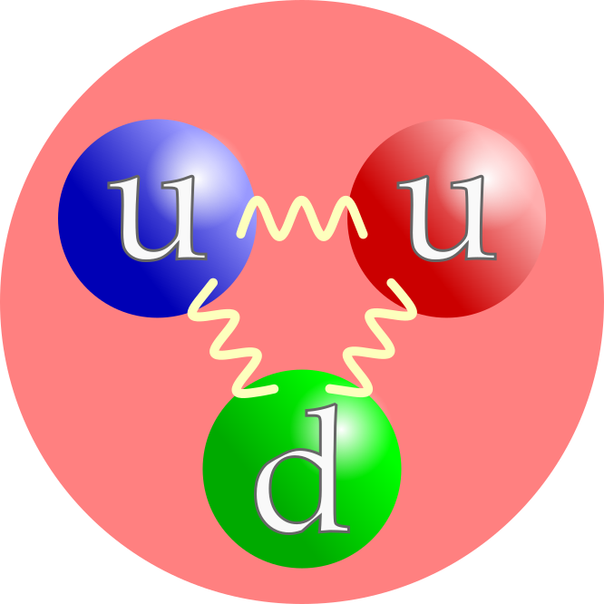
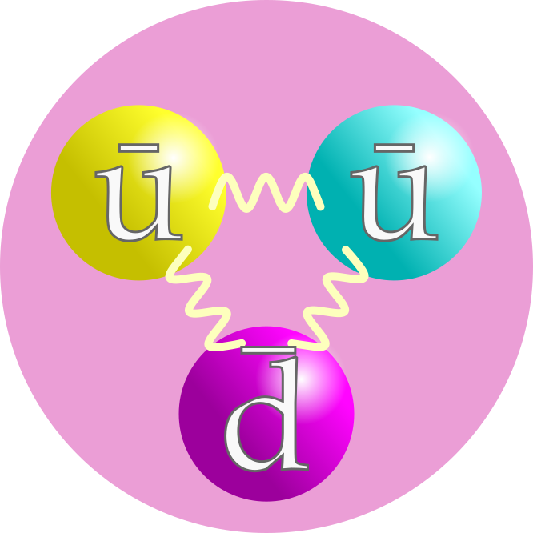
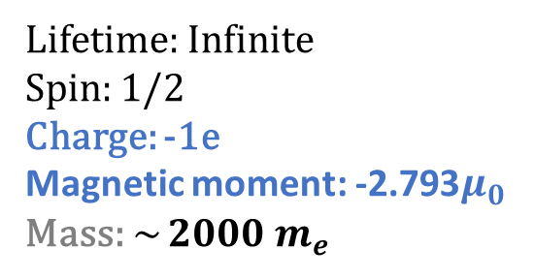
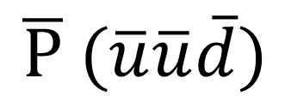
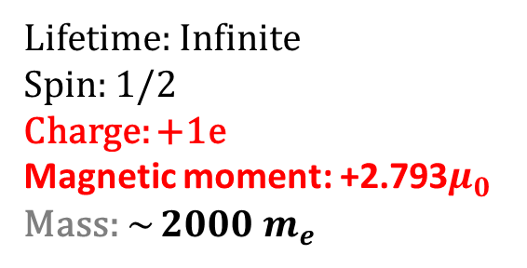


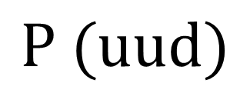

Proton and the antiproton
$$P (uud)$$
$$\overline{P} (\overline{u}\overline{u}\overline{d})$$
Annihilation
$$π$$
$$π$$
$$π$$
Lifetime: Infinite
Spin: 1/2
Charge: +1e
Magnetic moment: +$\text{2.793}μ_{0}$
Mass: ~ $2000 m_{e}$
Lifetime: Infinite
Spin: 1/2
Charge: -1e
Magnetic moment: -$\text{2.793}μ_{0}$
Mass: ~ $2000 m_{e}$
Notes:
Antimatter counterpart of the proton
Exotic particle with infinite lifetime!
Antiproton is a stable negatively charged hadron 1836x heavier than the electron.

Slide 8
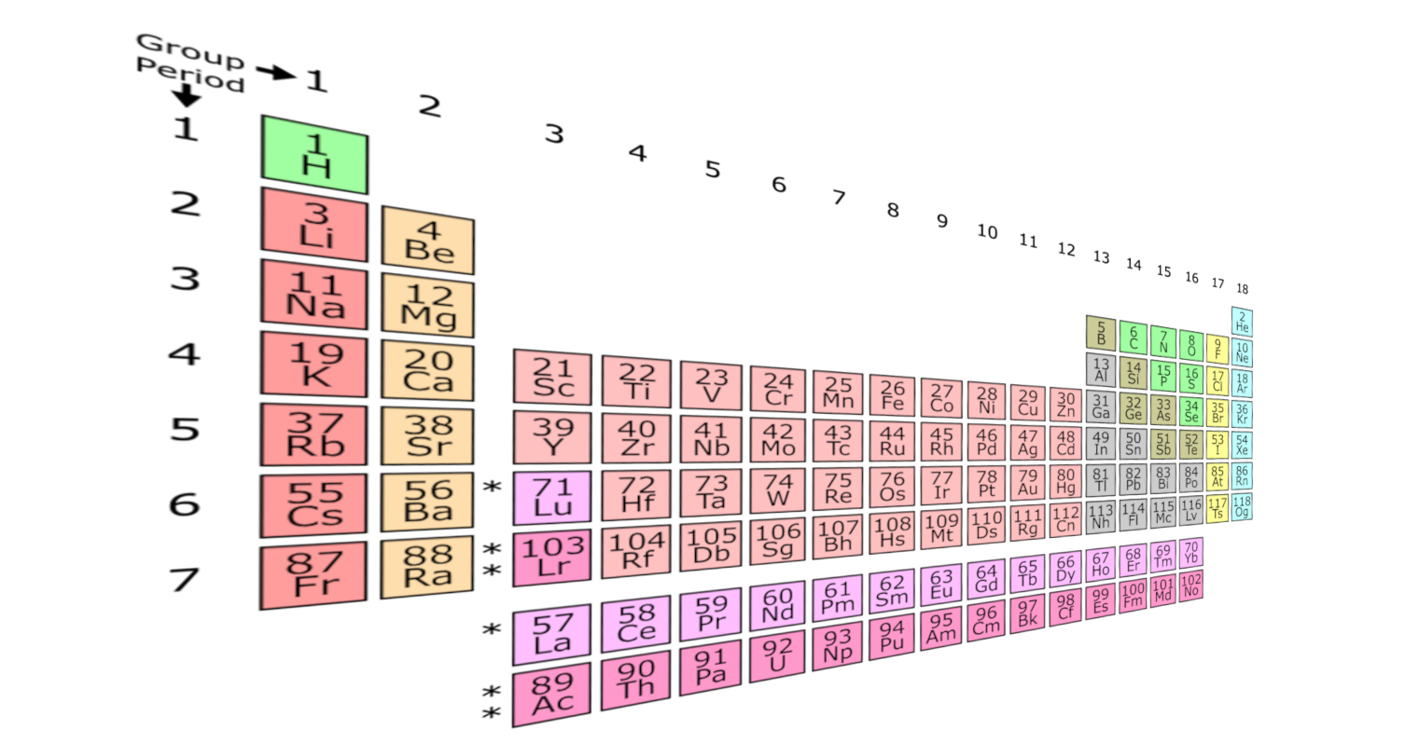
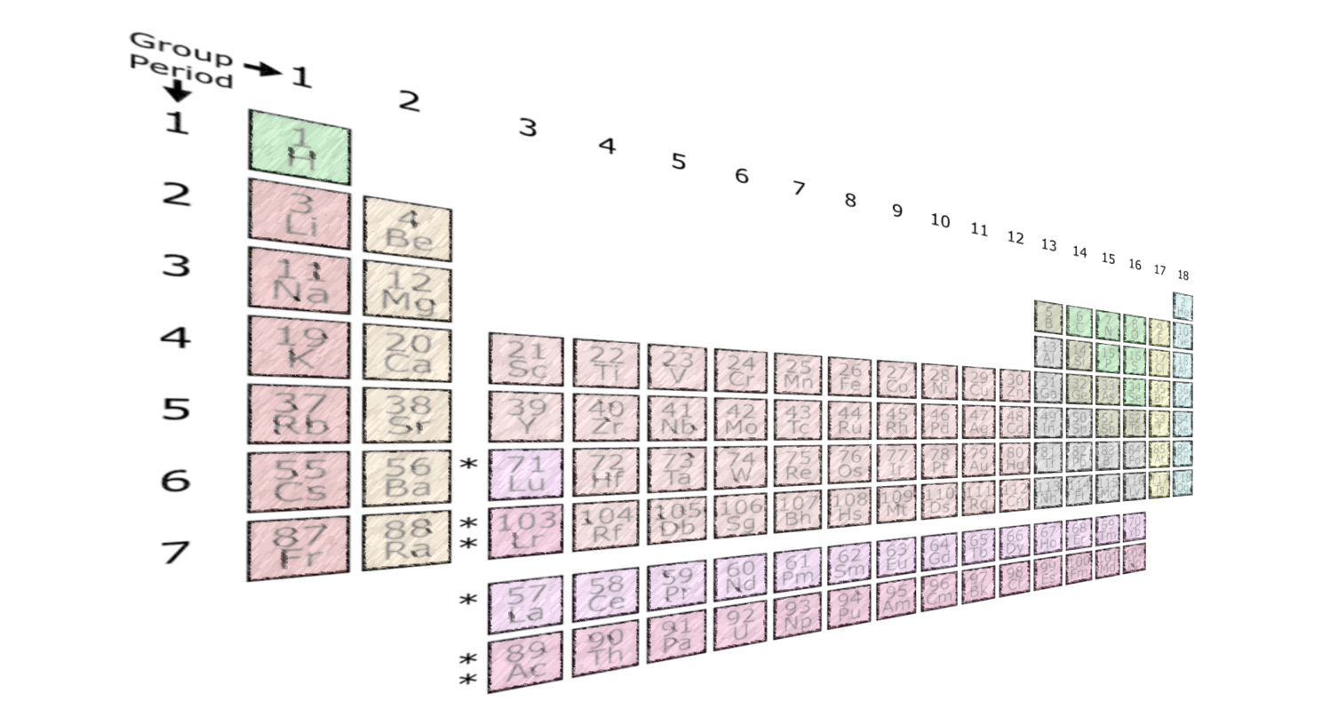
For every matter particle there is an equivalent antimatter particle…
Elements in our universe
Anti- elements in our universe?

Slide 9


How do we study the difference between matter and antimatter?
Hydrogen
Anti-hydrogen
$$e^{−}$$
$$e^{+}$$
Proton
Antiproton
+
-
Any observed difference would indicate a violation against a fundamental symmetry….
For accurate studies we need cold antimatter…
9
Notes:
So far no difference has been found yet: Same masses, lifetimes, g-factors, |charge|,... The hydrogen atom is the best understood physical system.
A neutral system is excellent for testing gravity.
Any observed difference between the properties of $H$and $\overline{H}$would reveal a broken fundamental symmetry in our universe.

Slide 10
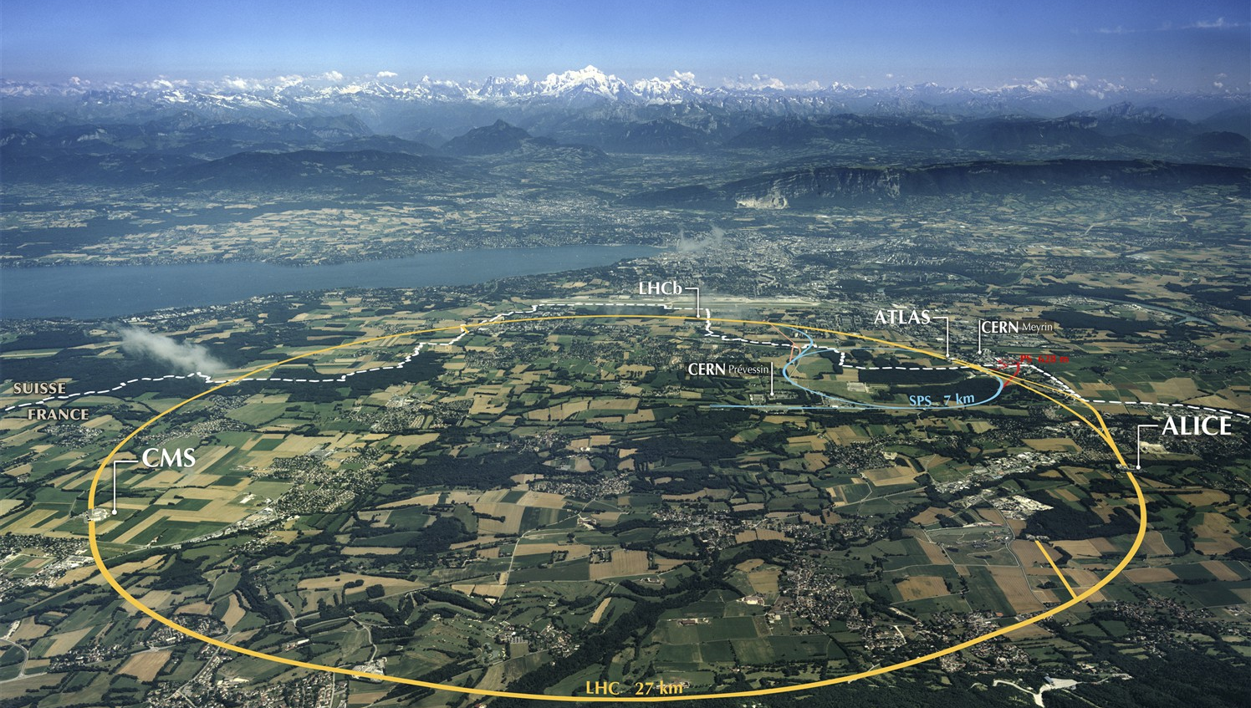


Geneva
CERN
(Conseil Européen pour la Recherche Nucléaire)
Notes:
Startade år 1954
24 medlemsländer
Mer än 20000 personal (2500 CERN)
>100 Pågående experiment

Slide 11
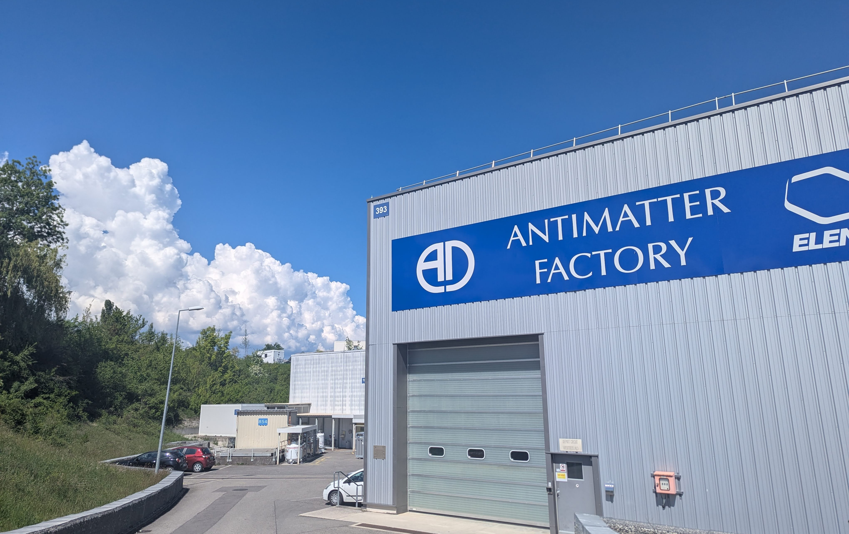
Today at CERNs antimatter factory
11

Slide 12
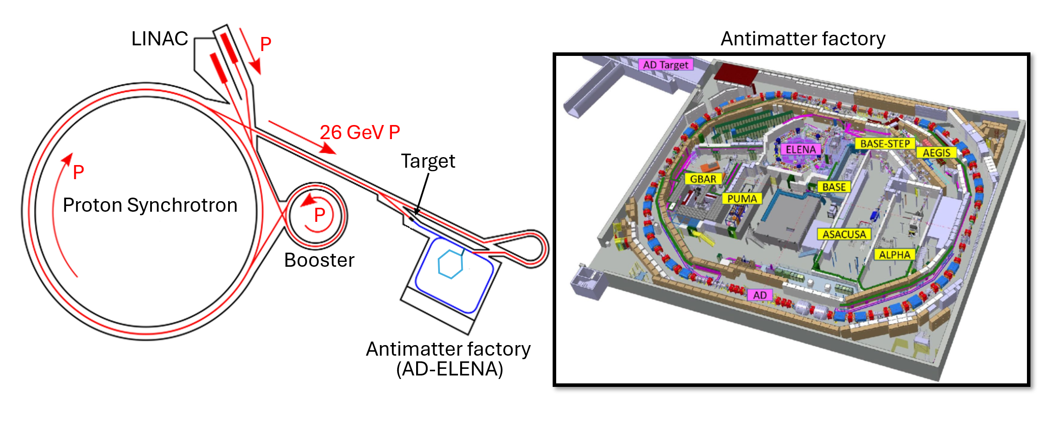
The Antiproton Decelerator (AD) at CERN
Notes:
PS accelerate 26 GeV protons into a Iridium target
ASACUSA is based in the antiproton decelerator hall at CERN
The AD is located here in the CERN acc complex off the PS
AD delivered 10 million at 5.3 MeV every 100s
In the work presented here for antihydrogen I will be talking about antiprotons from the AD
ELENA – Extra Low Energy Antiproton Ring
ELENA delivers 4 bunches about 7-8 million at 100 keV
RFQD decelerated about 30% of those to 115 keV
Cusp experiment is that concerned with measuring the GS-HFS located at the end of long beamline
Also have PbarHe which is in the same area
AD delivers 10 million antiprotons at 5.3 MeV every 100s
Antiprotons are then further decelerated by ELENA which deliver 4 bunches with 7-8 million antiprotons at 100 keV to experiments at AD.
Precision measurements of antiprotons and antihydrogen are now routinely performed here.
Precision measurments are performed at each experiment for BSM searches
CPT symmetry
Weak equivalence principle

Slide 13
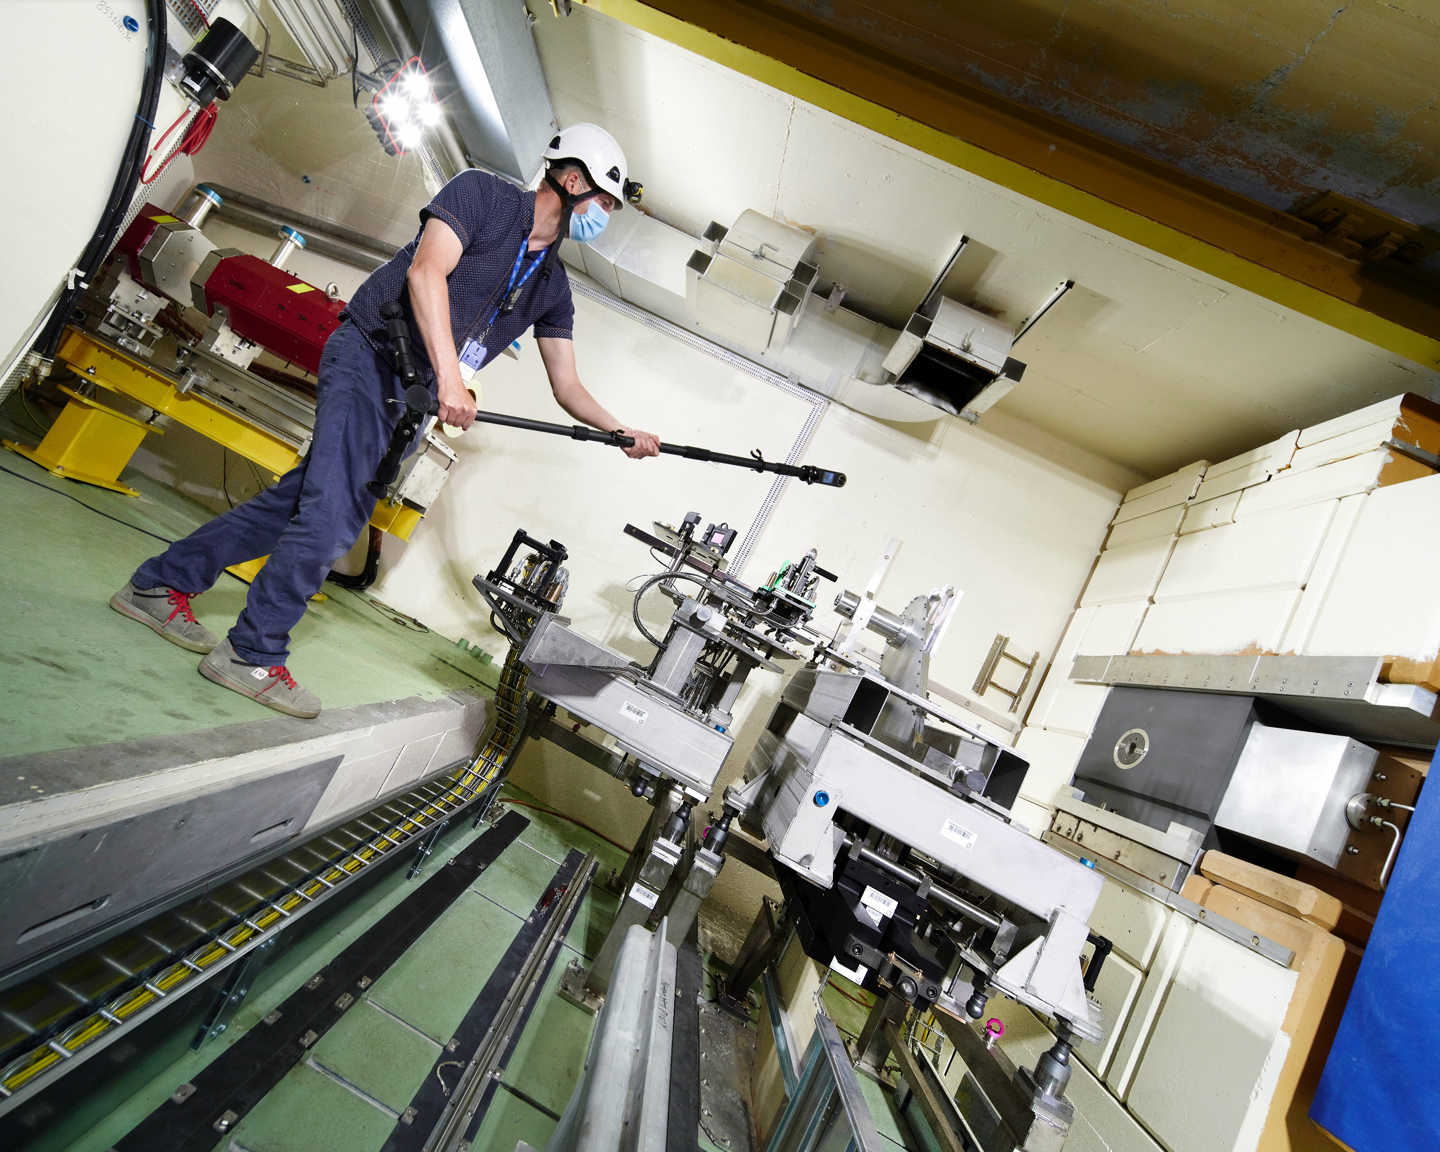
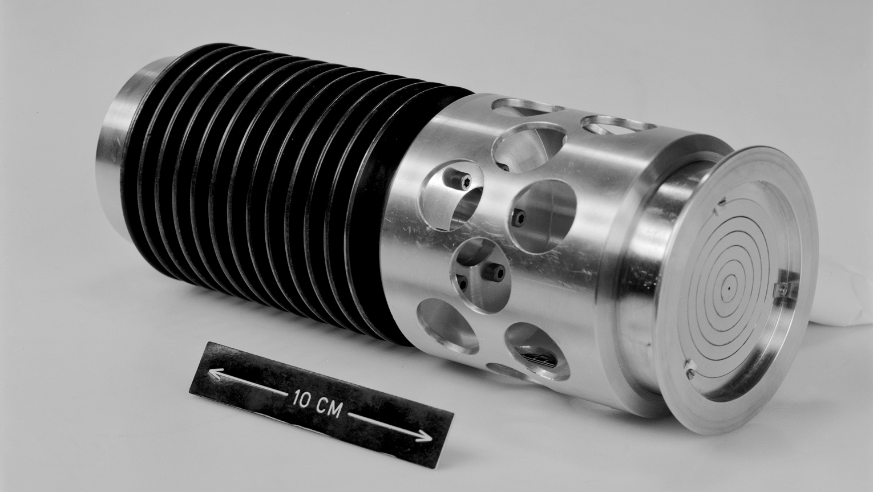

Slide 14
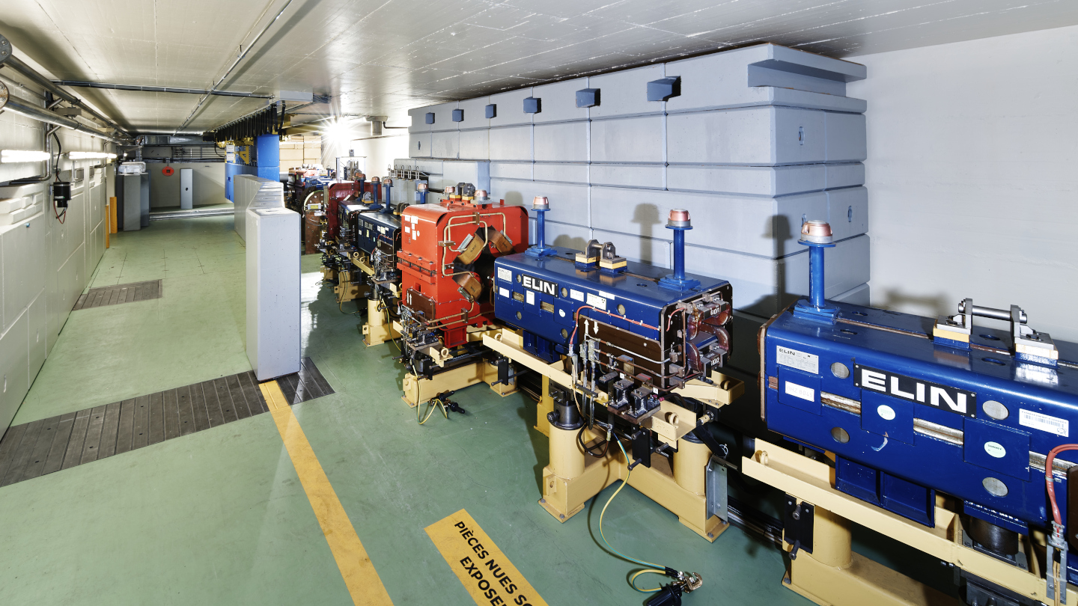

Slide 15
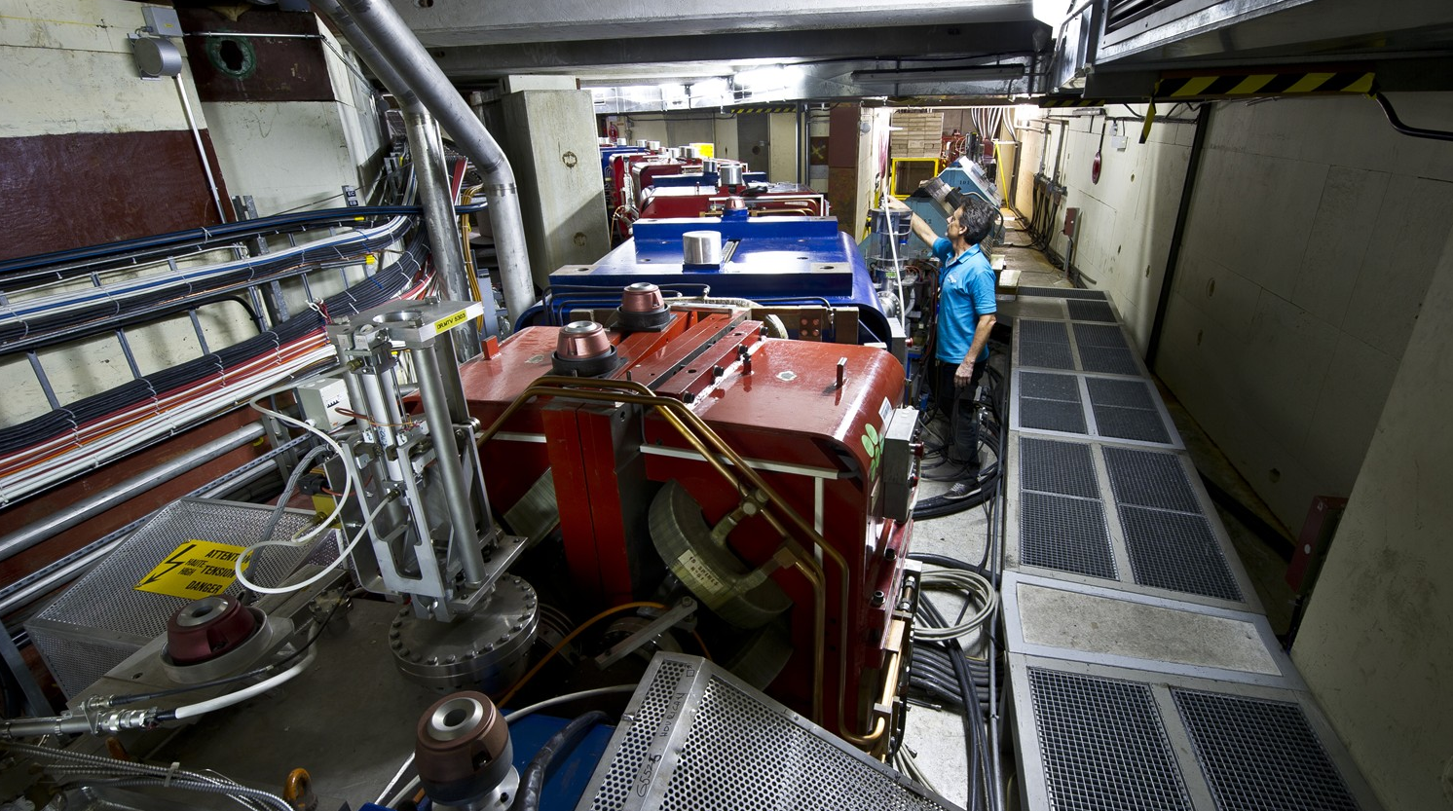

Slide 16
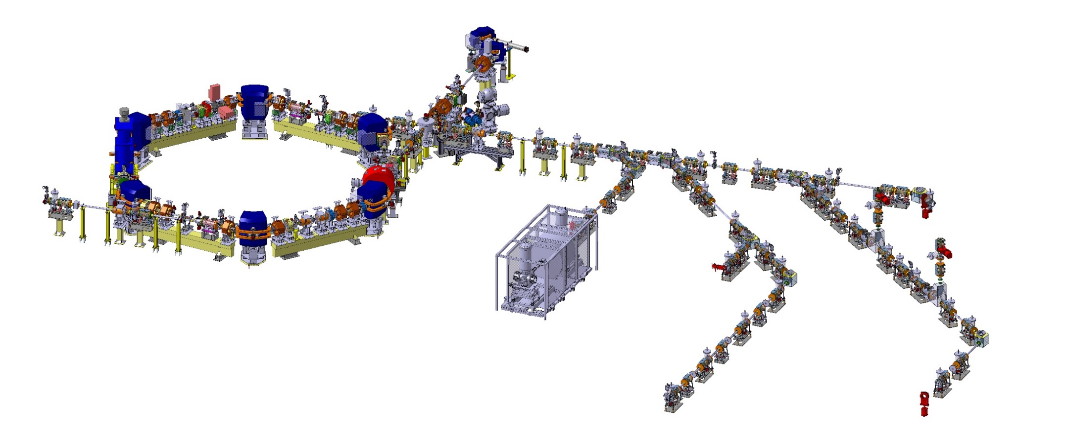


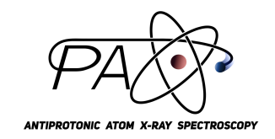




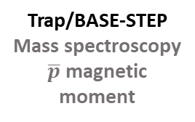
Experiments at the antimatter factory
Antiprotons @ 0.1 MeV
ELENA
Antiprotons @1 MeV
Antiprotons for experiments
ALPHA ASACUSA AEGIS BASE GBAR PUMA pAX
Beam
Antihydrogen
spectroscopy
Laser spectroscopy of antiprotonic atoms
Beam
Pulsed production
of antihydrogen
Gravity
Positronium
Antiprotonic atoms
Trap
Antihydrogen studies
Laser spectroscopy
and gravity
Trap/BASE-STEP
Mass spectroscopy
$\overline{p}$ magnetic moment
Trap
Antimatter gravity
Lamb-shift
Portable trap
Antiprotonic atoms
Meson charge capture from annihilations in trap
Cyclotron trap
Antiprotonic atoms
X-ray spectroscopy on target

Slide 17
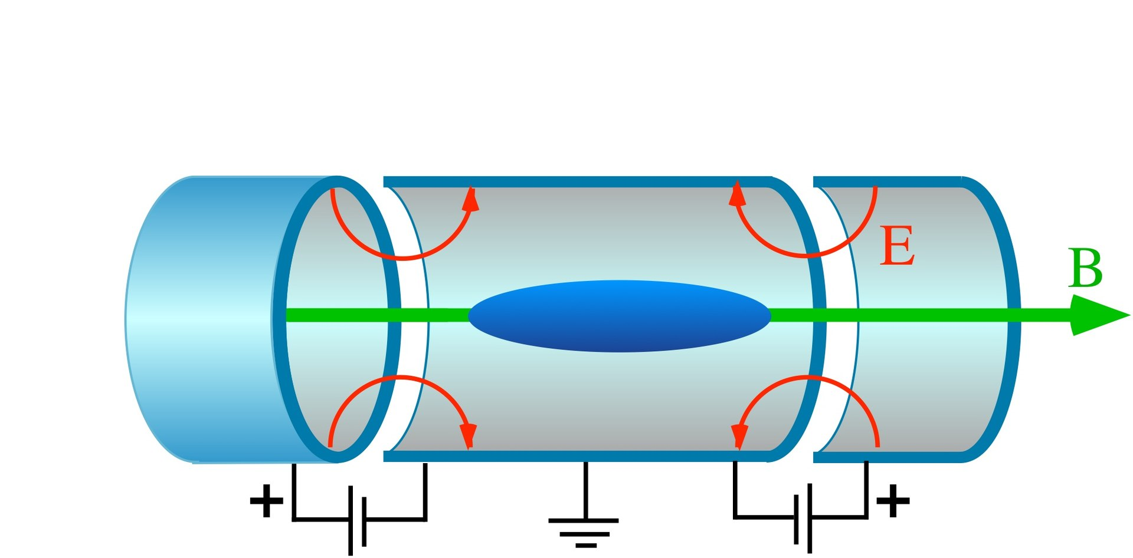



Trapping and cooling antiprotons
Penning-Malmberg trap
100 keV
$$\overline{p}$$
10 keV
$$\overline{p}$$
Degrador or drift tube
$$\overline{p}$$
Notes:
4-8 million antiprotons are sent from ELENA to each experiment every 2 minutes.
Antiprotons can be cooled sympathetically using co-trapped electrons to <100K.

Slide 18
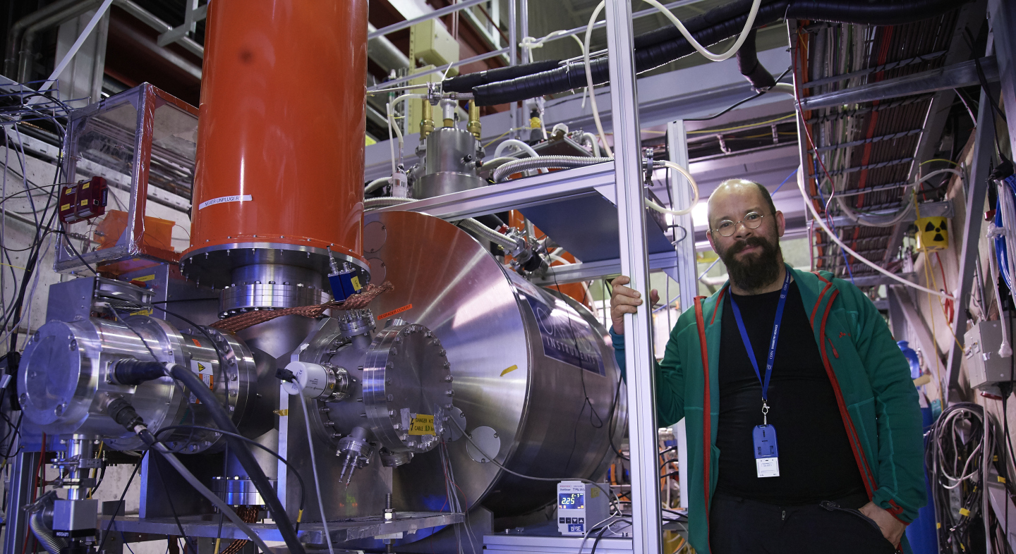
(Baryon Antibaryon Symmetry Experiment)

Slide 19
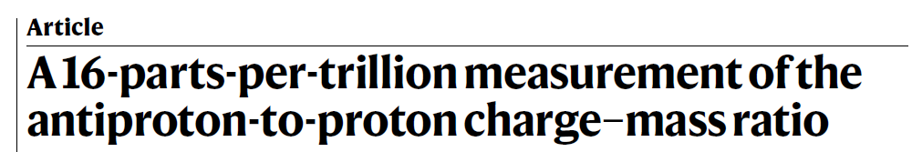
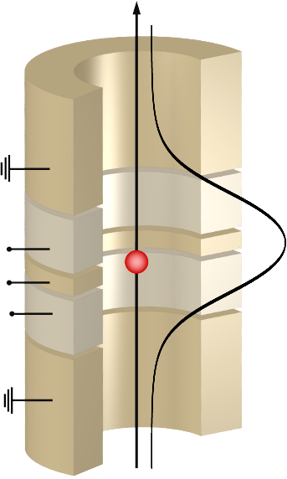
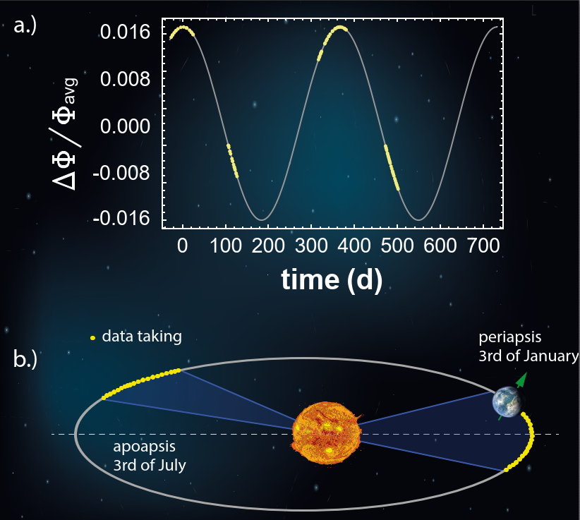
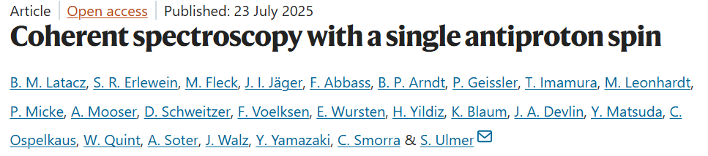
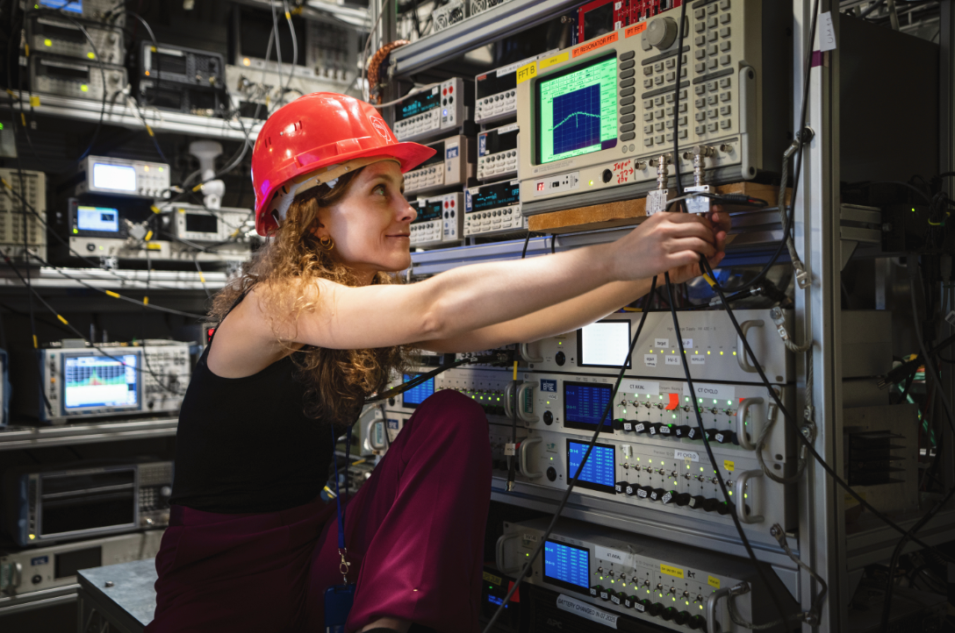
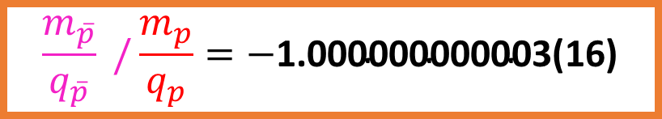

The BASE experiment
$$\frac{m_{\overline{p}}}{q_{\overline{p}}} /\frac{m_{p}}{q_{p}}=−\text{1.000000000003(16)}$$
Nature 601 53-57 (2022)
$$\overline{p}$$
Nature 644, 64–68 (2025)

Slide 20
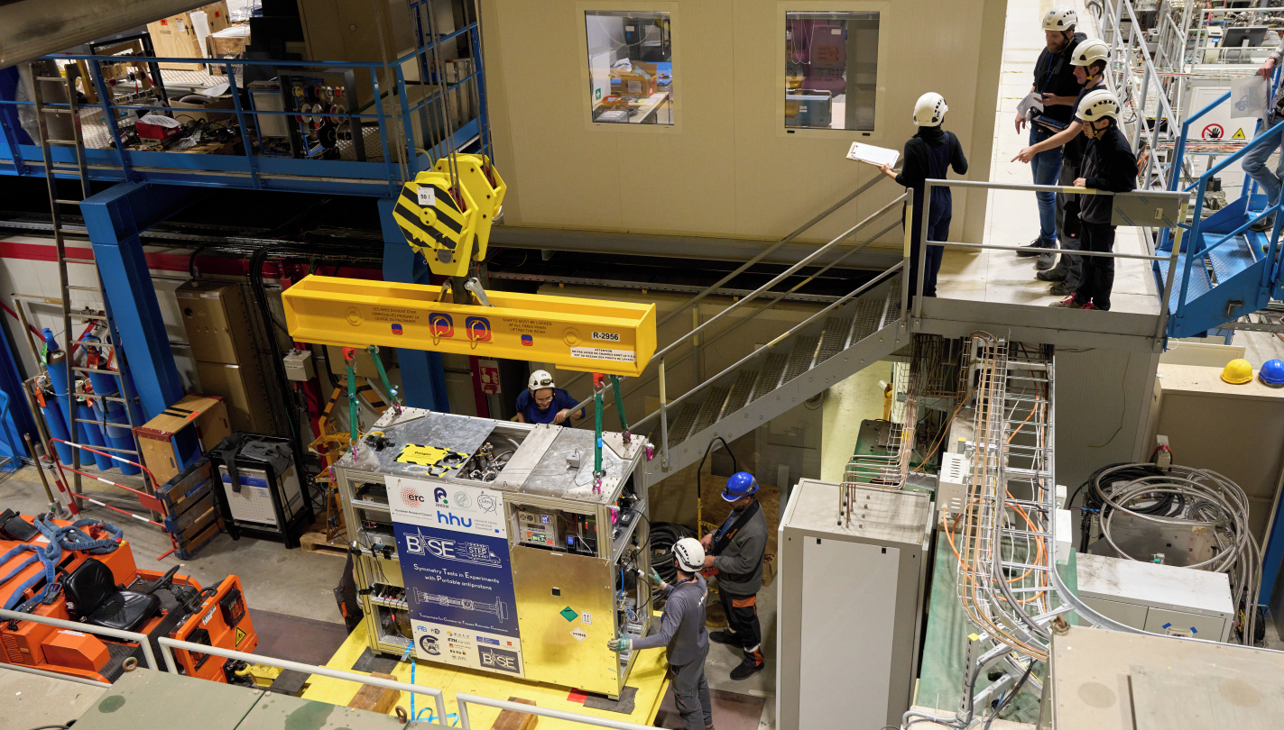
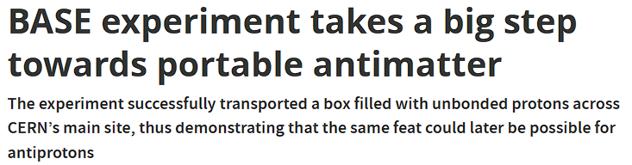

Nature 641, 871–875 (2025)

Slide 21
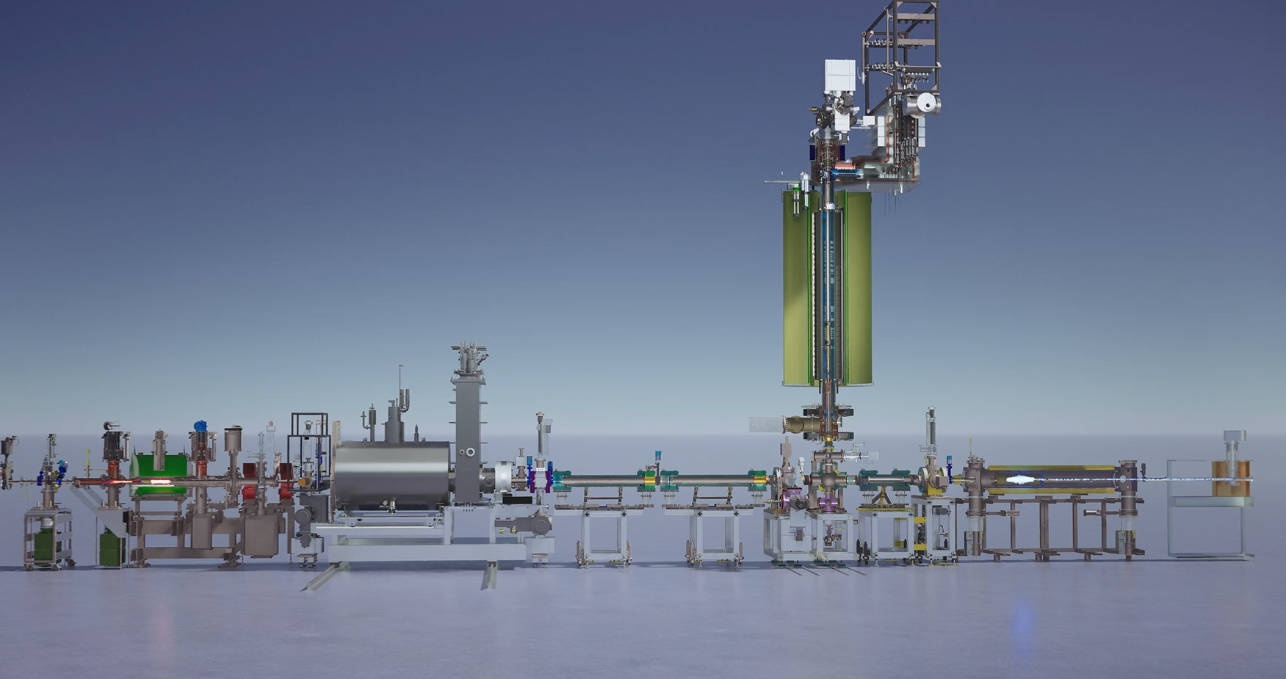
The ALPHA experiment
ALPHA-g
ALPHA-2
5m
Positron
source
Antiproton catching
Positron accumulation

Slide 22
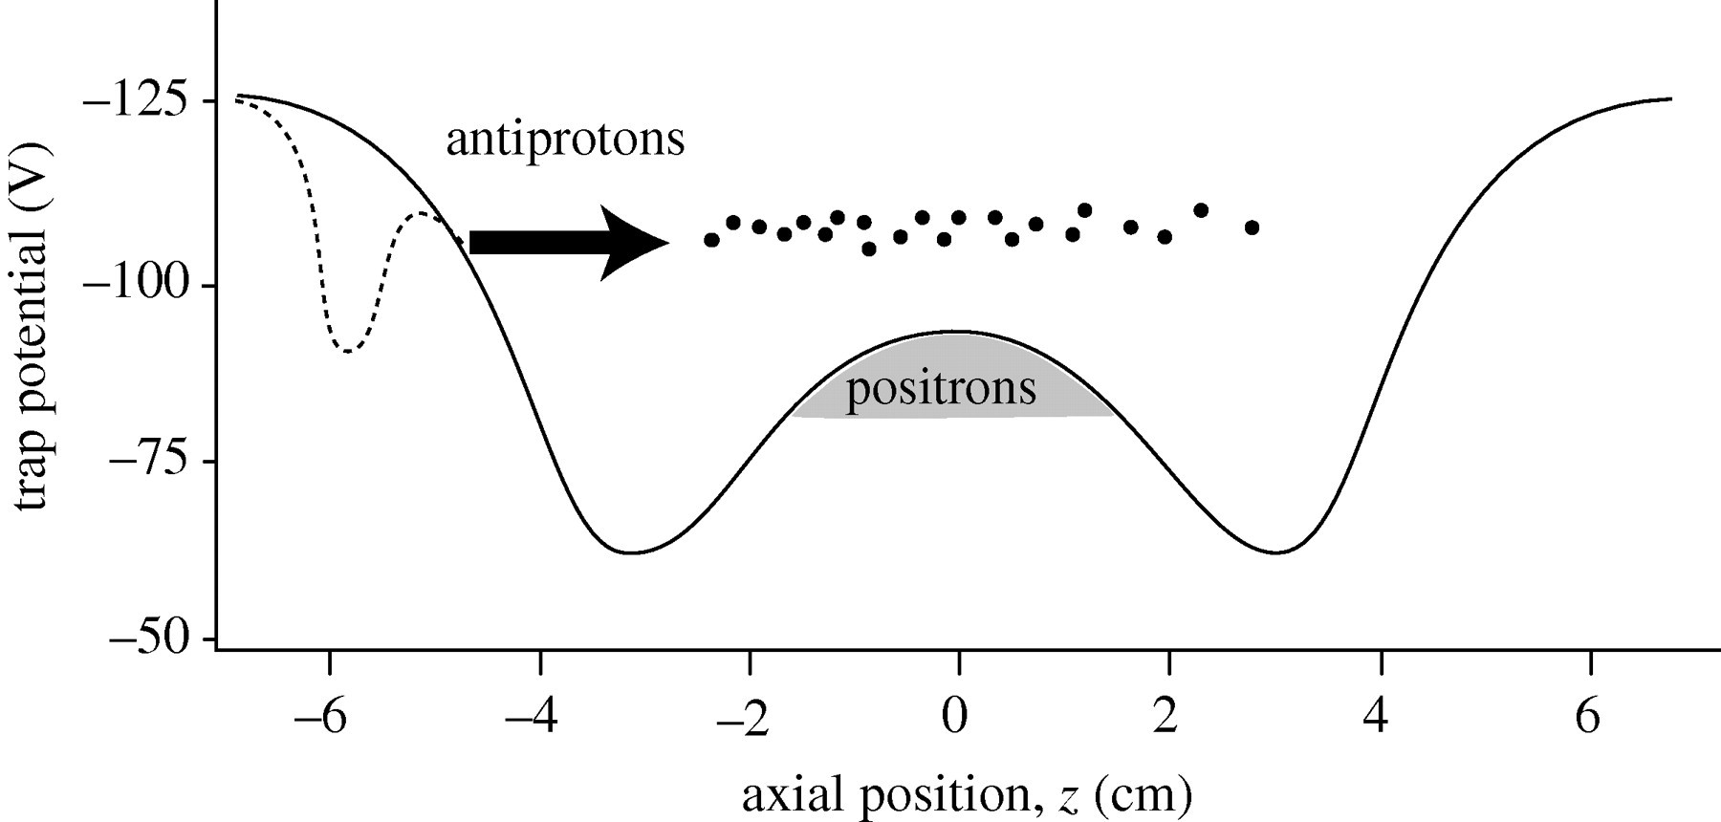
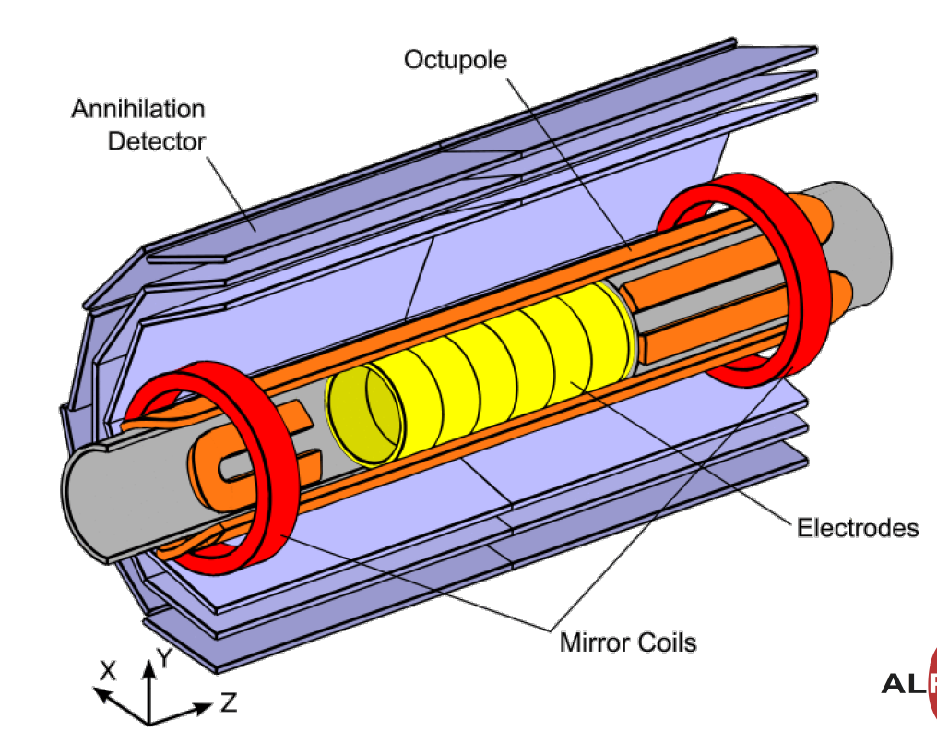
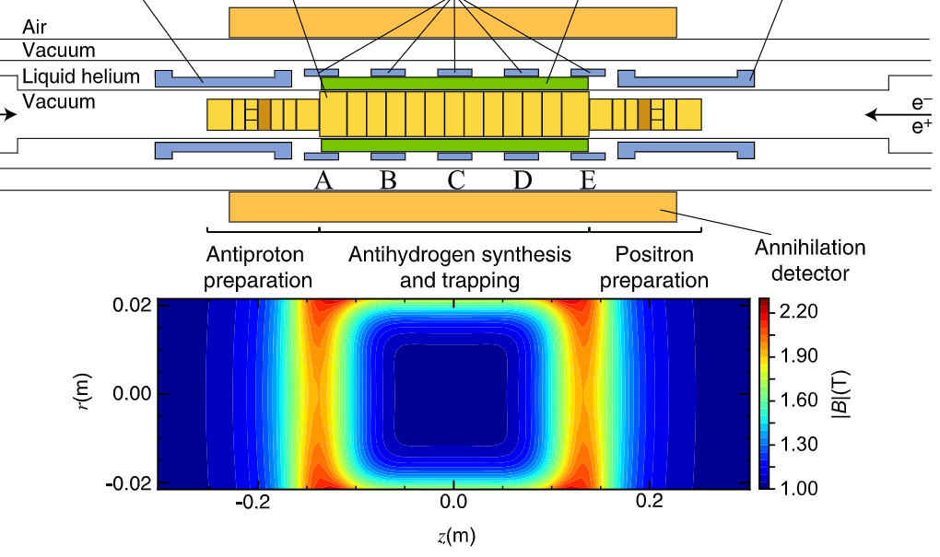
A Penning-Malmberg trap for charged particles
ALPHA-2
Antihydrogen Laser Physics Apparatus
And a magnetic trap for neutral atoms...

Slide 23
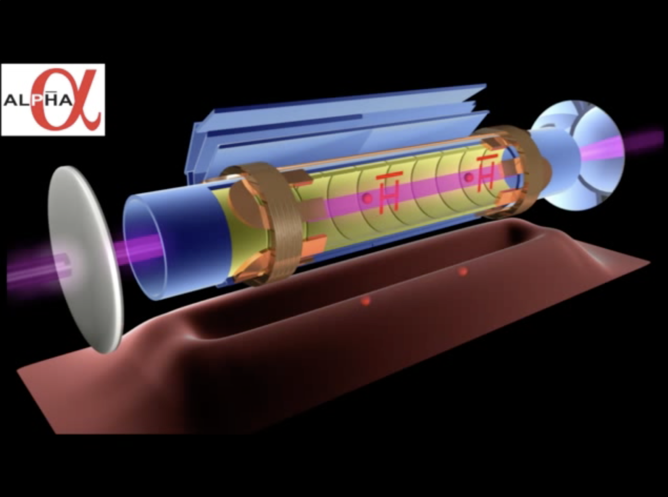
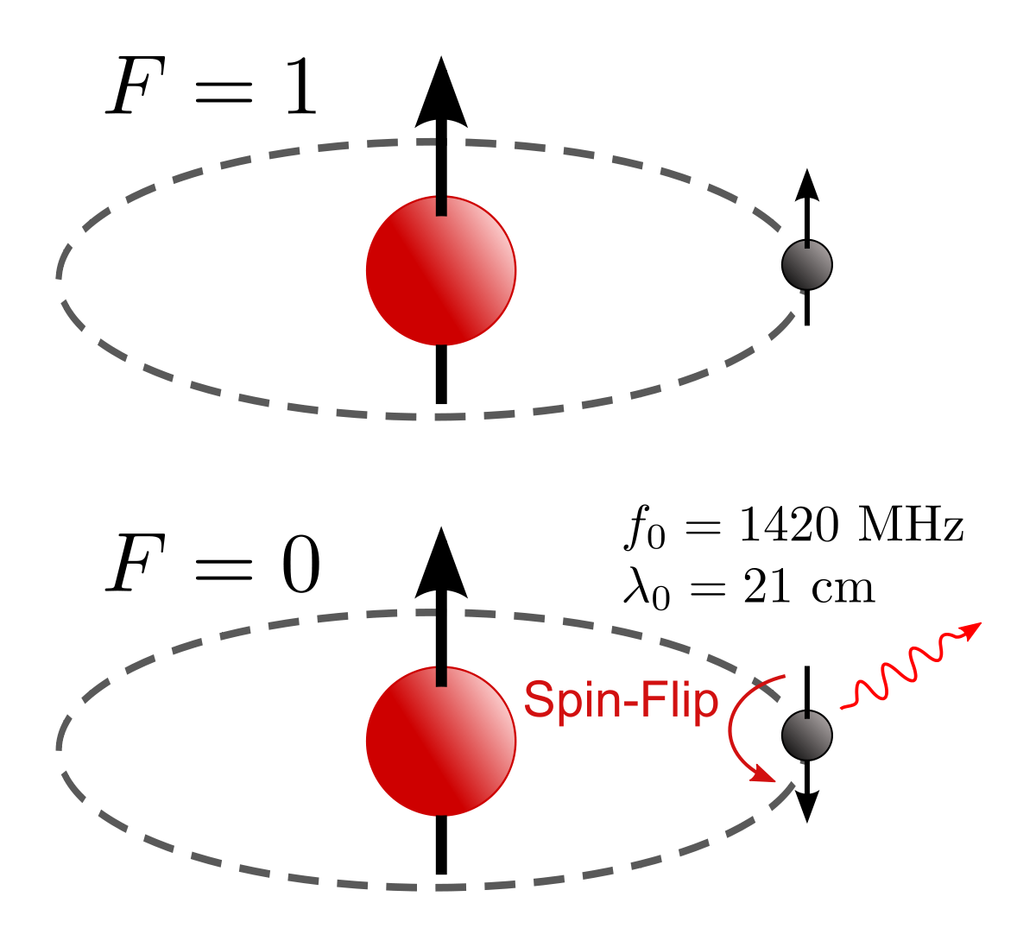


Spectroscopy of (anti-)hydrogen
First Trapping of Antihydrogen Atoms
Nature 468, 673–676 (2010)
First Laser Spectroscopic Measurement
Nature 541, 506–510 (2017)
Measurement of the Hyperfine Splitting
Nature 548, 66–69 (2017)
Observation of the Lyman-alpha Transition
Nature 561, 211–215 (2018)
First Laser Cooling of Antimatter
Nature 592, 35–42 (2021)
Hyperfine structure of 2p state
Nature Physics 21, 201–207 (2025)
Example GS HFS:
ASACUSA …
ν_{HFS} ($\overline{H}$)= 1,420.4(5) MHz
ν_{HFS} ($H$)= 1,420.4057513768(1) MHz
Notes:
Lot of information in this plot – measurements and planned measurements! Not theory.
It’s a comparison of several tests of CPT symmetry
Focuses on measurements of masses and frequencies (easy conversion)
The right edge of each bar shows the value, the length of the bar is the relative precision, and the left most point the absolute sensitivity.
Existing measurements are shown in blue, planned measurements are shown in orange and what is potentially measurable in the case of the hyperfine structure and lamb shift as shown in the light yellow.
The hyperfine transition has a potential for one of the highest precision comparisons with this matter counterpart and hence high sensitivity too CPT violation
Focusing on antihydrogen – we have the lyman-alpha (n=1-n=2), lamb shift (2S->2P) and the Hyperfine structure.
To date measurements have all been performed by the ALPHA collaboration in their magnetic trap
1S-2S isn’t a pure test as it should be compared at like B field
1S-2S from electromagnetic interaction, HFS from interaction of the magnetic moments of positron and antiproton

Slide 24

Anomolous antimatter gravity?
Could a difference in the influence of gravity explain the antimatter/matter assymmetry we see?
?

Slide 25



ALPHA-g measurement of gravity
$$a_{\overline{g}}\text{ = (0,75 ± 0,13 (}\text{stat}\text{. + }\text{syst}\text{.) ± }\text{0,16 (}\text{simulation}\text{)}\text{) }\text{• }\text{g} \text{where} \text{g}\text{ = 9,81 }\text{m}\text{/}\text{s}\text{2}$$

Slide 26










AEgIS: Antimatter Experiment: gravity, Interferometry and Spectroscopy
Charge-Exchange reaction
Objectives:
<1% precision measurement of $\overline{g}$ in a field free environment
Study of matter-antimatter bound systems (positron/antiproton)
$${Ps}^{∗}+ \overline{p}→ {\overline{H}}^{∗} + e^{−}$$
$$e^{+}$$
$$e^{−}$$
Mirror
$$e^{+}$$
Trapped antiprotons
Silicon target
$${Ps}^{∗}$$
Laser excitation of positronium
$${\overline{H}}^{∗}$$

Slide 27





The AEGIS experiment
3.5 m
$$e^{+}$$
100 keV
Antiprotons ($\overline{p}$ )
from ELENA
Antihydrogen beam
Laser access

Slide 28



The AEGIS experiment

Slide 29




The antiprotonic atom
Typical atom:
$\sim$10 000 fm
$$\overline{P}$$
$$e^{−}$$
Bohr radius $∝\frac{m_{e}}{m_{p}}$
Anti-protonic atom:
1-10 fm
<50 fm
1/2000
Nucleus

Slide 30



Antiprotonic atoms – Extreme physics!
F.P Gustafsson et al., Phys. Rev. C 112, 015207
Electric field: ~10²⁰ V/m
Magnetic field: ~10⁸ T
$$\overline{p}$$

Slide 31



Portable trap for antiprotons
The PUMA experiment - Probing the neutron skin using antiprotonic atoms

Slide 32







Antimatter systems studied so far..
In the near future...
Anti-deuteron
Anti-Hydrogen atom
Anti-neutron
Anti-electron
Anti-proton
+
$$\overline{n}$$
$$\overline{n}$$
$$e^{+}$$
$$\overline{p}$$
$$\overline{p}$$
-
Anti-anion
Anti-molecules
Positronium
Antiprotonic atoms
+
+
$$e^{+}$$
-
-
-
-
$$e^{−}$$
+
+
Anti-elements
Search for fundamental symmetry violations
Test of the weak equivalence principle (gravity)
Benchmarking extreme field QED
Short-ranged strong interaction studies
Probe for nuclear ‘surface’ structure

Slide 33



p-
He
e-
Thank you for your attention

Slide 34



Antiproton QUBIT?
Notes:
Here’s a concise bullet-point summary suitable for a PPT slide based on the paper:
First demonstration of coherent quantum transition spectroscopy on a single antiproton spin.
Achieved Rabi oscillations and spin coherence times > 50 s.
Implemented multi-trap technique with cryogenic Penning-trap system at CERN’s AD/ELENA.
Spin inversion > 80% in time-series; > 70% in resonance scans.
Transition linewidth 16× narrower than previous antiproton measurements.
Enables potential 10× improvement in proton/antiproton magnetic moment tests.
Paves way for stringent CPT invariance tests and antimatter–dark matter coupling searches.
Here’s a simplified PPT version:
First coherent spectroscopy of a single antiproton spin
Observed Rabi oscillations, spin coherence > 50 s
Spin inversion > 80%, linewidth 16× narrower than before
Achieved with multi-trap Penning-trap system at CERN
Enables much more precise proton/antiproton magnetic moment tests
Advances CPT symmetry and antimatter research

Slide 35


Slide 36



Antiprotonic atom laser spectroscopy
Typical lifetime $\sim$ns (4 us for $\overline{p}$He, n=38)
The ASACUSA experiment
p-
He
e-
Notes:
The antiproton will decay through transitions, emitting auger electrons, followed by radiative emission of x-ray photons.
Energy levels shifted by strong interaction (benchmark for QCD)
Nuclear resonances resulting from antiproton decay.
Annihilation occur once the wavefunction overlap the with the nucleus.

Slide 38


AEgIS gravity module
Timing
scintillators
Back view
The Optical PHoton and ANtimatter IMager (OPHANIM)
60 CMOS sensors, 30.8 cm² coverage, 0.8 um pixels
World-record-breaking pixel count: 3.84 Gpx ¹

Slide 39


Slide 40

Tool for studying the skin of the nucleus
Neutron-halo
n
$$\overline{p}$$
n

Slide 41






The BASE experiment
High precision mass spectroscopy
High precision magnetic moment measurements
A 16-parts-per-trillion measurement of the antiproton-to-proton charge–mass ratio
1.5 p.p.b. Measurement of antiproton magnetic moment.
Nature 601.7891 (2022): 53-57.
Nature 550, 371-374 (2017)

