Slide 1
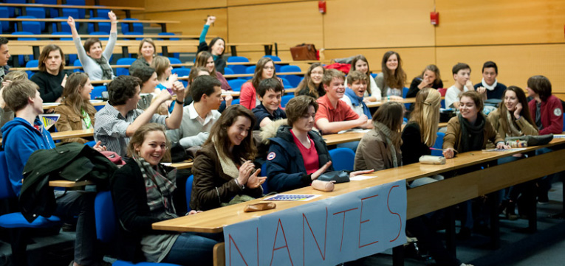


INTERNATIONAL MASTERCLASSES
HANDS ON PARTICLE PHYSICS
Nantes

Slide 2
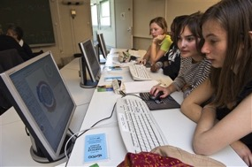
A day of immersion in particle physics for 16-18 year old pupils
Typical day of International Masterclasses
Morning : introductory lectures on
Particle physics (elementary particles, forces, Standard Model and beyond)
Detectors – accelerators – experimental methods
Visit of laboratory / experimental site / discussion with scientists and graduate students
Lunch – usually offered by the Host Institute
Afternoon : students analyse data from an LHC
experiment and do a physics measurement
They work in groups of 2 per computer;
analysis is visual in most cases
At the end of the day : Video Conference
moderated by two physicists at CERN and connecting up to 5 institutes
presentation / merging/ discussion of results, answering questions, quiz

Slide 3
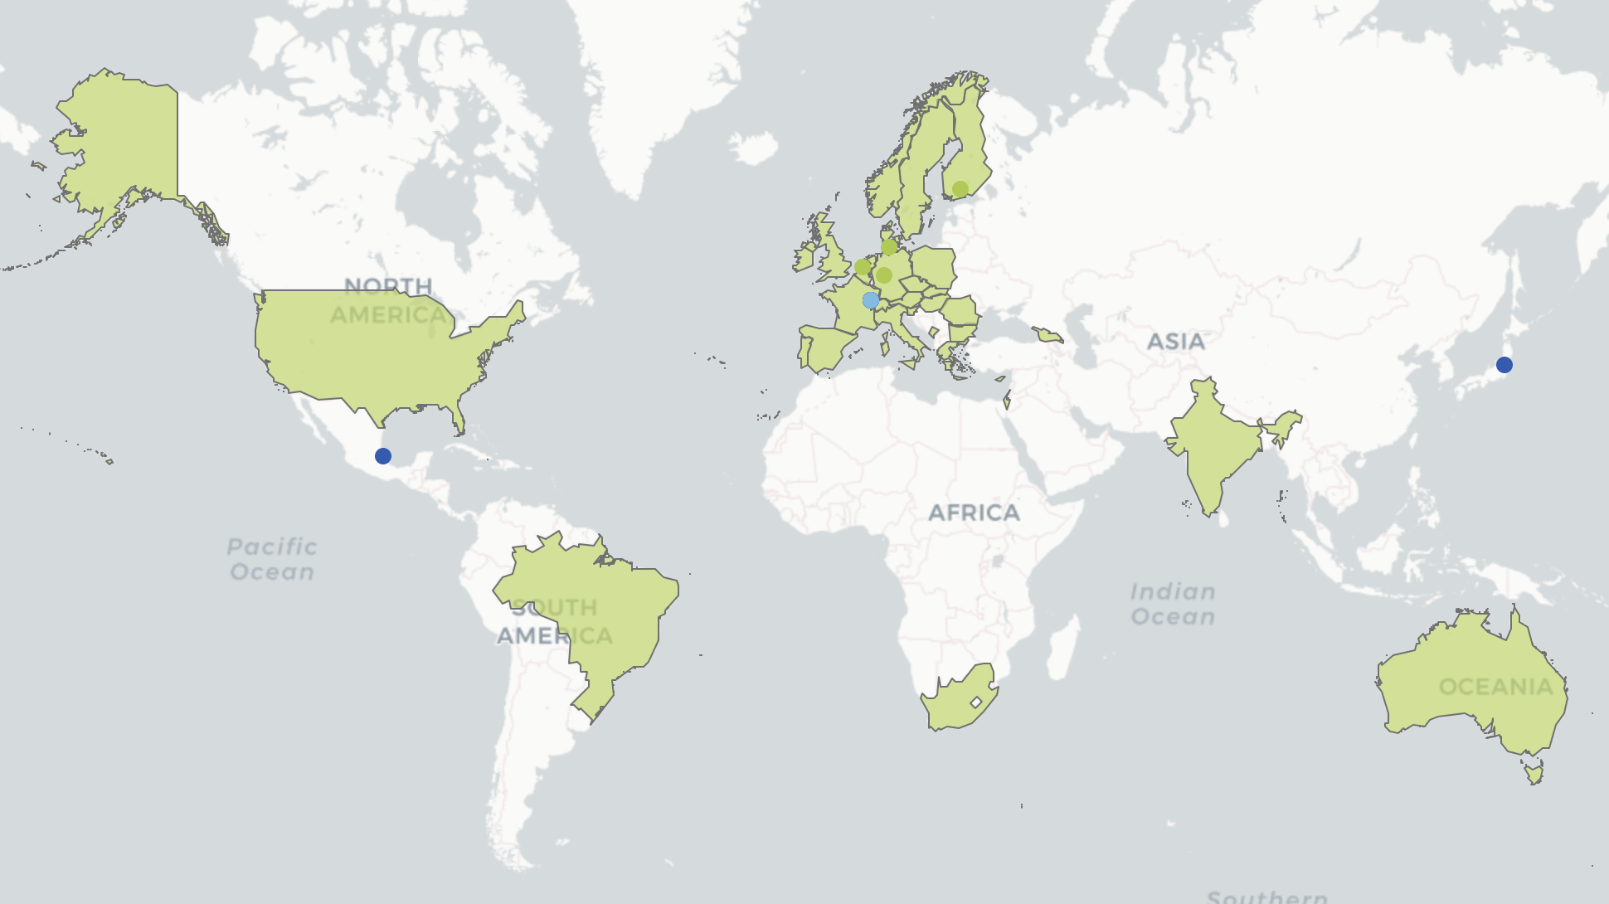
IPPOG : INTERNATIONAL PARTICLE PHYSICS OUTREACH GROUP
Network of scientists + communicators to promote and coordinate outreach + educational activities (in particle physics). Share experiences, resources and best practices
EPPOG established in 1997 (CERN Council/ECFA)
IPPOG Collaboration: 42 members (34 countries, CERN, 7 int. collaborations: ALICE, ATLAS, CMS, LHCb, Belle II, HAWC+Auger) + two associate members (DESY, GSI)
https://ippog.org
IPPOG meets twice a year (Spring, Autumn)
Flagship activity: International Particle Physics Masterclasses
https://physicsmasterclasses.org
Global cosmics, https://ippog.org/global-cosmic-rays-portal
Resource database https://ippog.org/ippog-resource-database

Slide 4
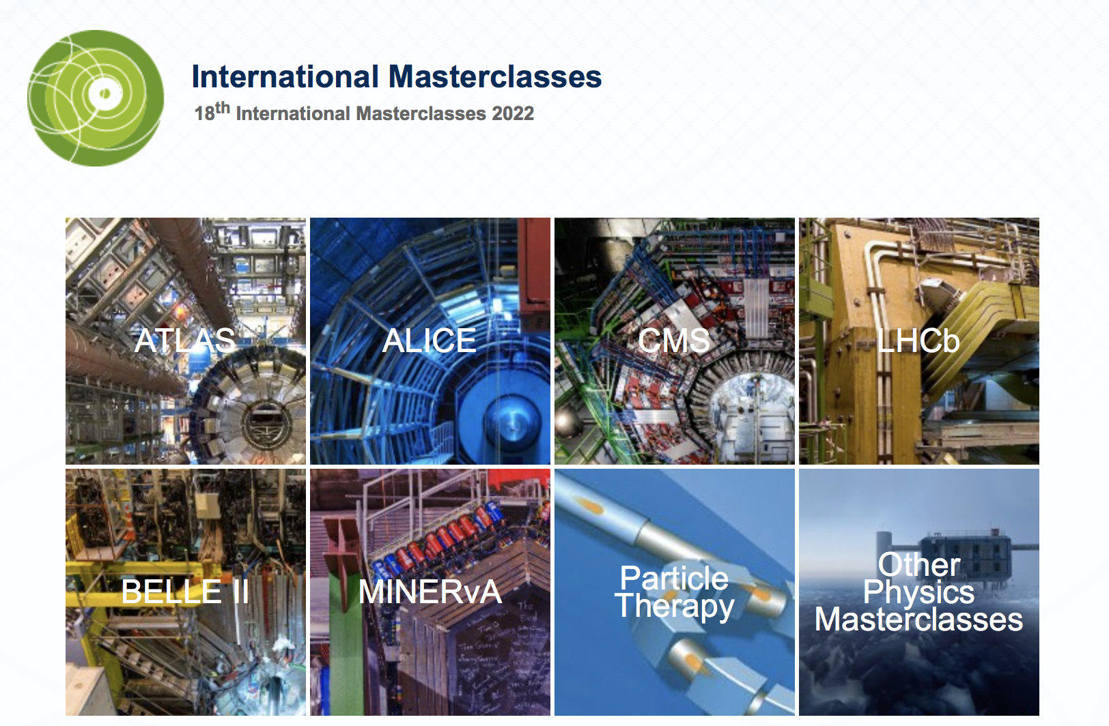
A bit of history and present status
1996: Started in UK
2005: Adopted by EPPOG (European Particle Physics Outreach Group) for all Europe
Use data from LEP (the Large Electron Positron collider, CERN, 1989-2000)
OPAL Identifying Particles
DELPHI Hands on CERN
Z0 decays / calculation of branching ratios
2006: U.S. joined program
2010: preparing to move to LHC-based Masterclasses
2011: Start using data from LHC
ALICE Looking for strange particles , Nuclear modification factor R_{AA}
ATLAS W+W- (MINERVA), Z0 (HYPATIA)
CMS J/Ψ, Z
LHCb Measurement of the Dº lifetime
More exercises added, nowadays
Central organisation
TU Dresden (Uta Bilow)
Quarknet (Ken Cecire)

Slide 5
Statistics International Masterclasses
2005
2006
2007
2008
2009
2010
2011
2012
2013
2014
2015
2016
2017
2018
18
countries
52
58
institutes
225
72
masterclasses
307
3k
students
14k
12
video conferences
82

Slide 6
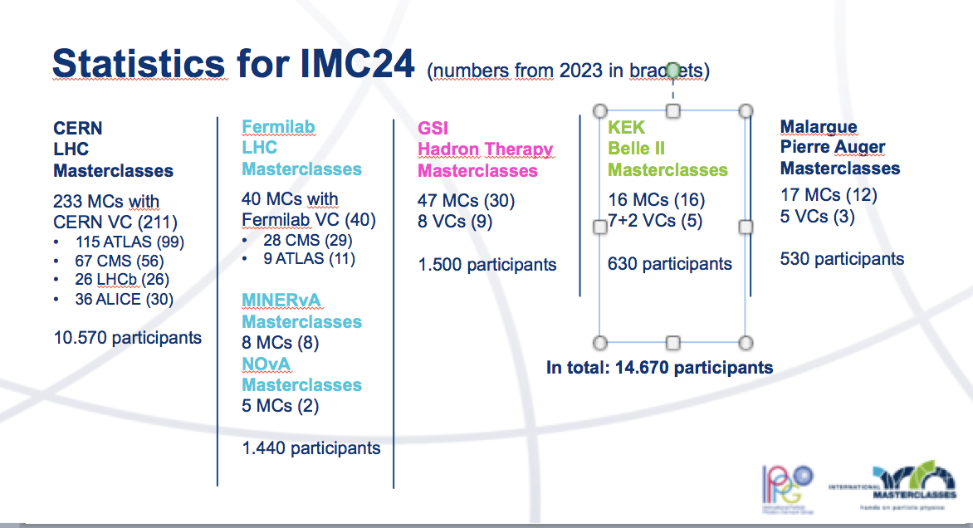

Slide 7
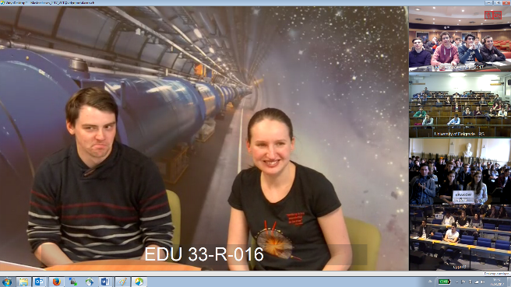
Video Conference
Presentation of the moderators
Welcome of the participating institutes
General questions from the participating institutes
Presentation of the results of the measurements by institutes
Merging of results by moderators
Comments, discussion, more questions
Quiz
Often it is the highlights of the day
General appreciation of the International Masterclasses very positive
New countries join every year

Slide 8
Some information
International Masterclasses are typically announced in October
In 2026 18 February – 1st April
11 February : International day of Women and Girls in Science : special masterclasses for girls
Limiting factors :
Computer rooms available at Institutes
Number of institutes per video conference (maximum 5)
In Sweden : Masterclasses in Uppsala – Lund (?) – Stockholm
LHC World Wide Data Day launched in 2016
https://quarknet.org/content/world-wide-data-day
This year : 20 November 2024

