Slide 1



Beamline for Schools
A physics competition for high-school students
Welcome to CERN and DESY!

Slide 2
What will we do in the next hour?
Science Gateway brief introduction
Where are we today?
Visit some exhibitions (20 min)
Live laboratory experiment (20 min)
Q&A session (20 min)
Website: https://cern.ch/bl4s
Beamline for Schools | Science Gateway Virtual Visit

Slide 3
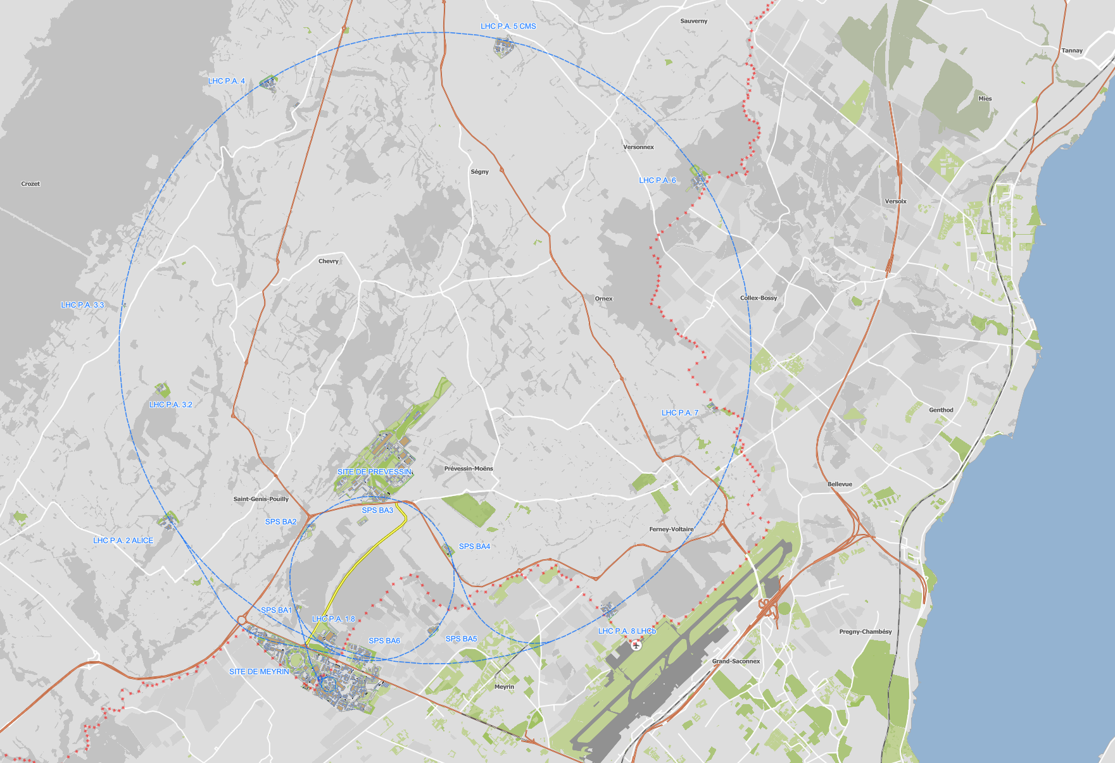
Where are we today?
Beamline for Schools | Science Gateway Virtual Visit

Slide 4
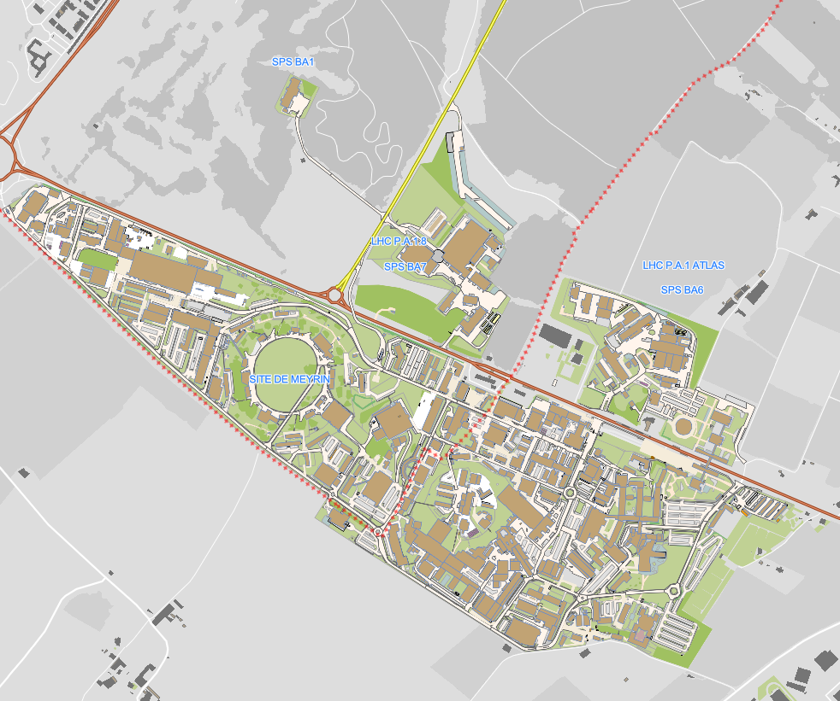
Science Gateway
Beamline for Schools | Science Gateway Virtual Visit

Slide 5
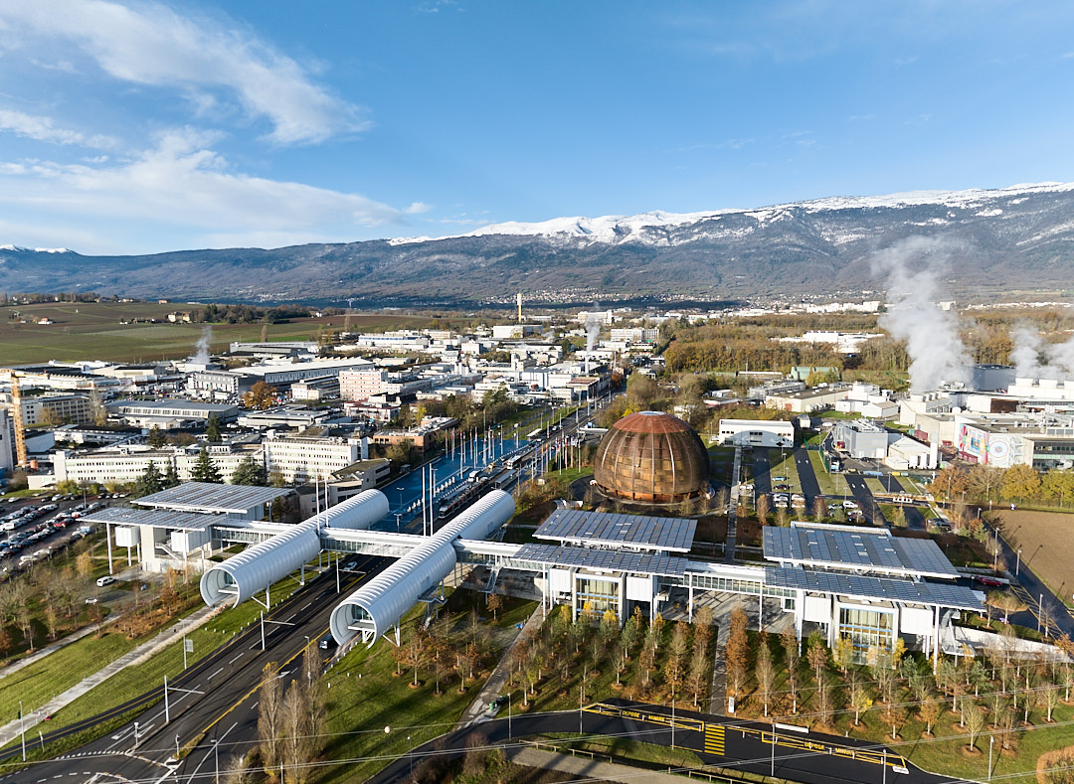
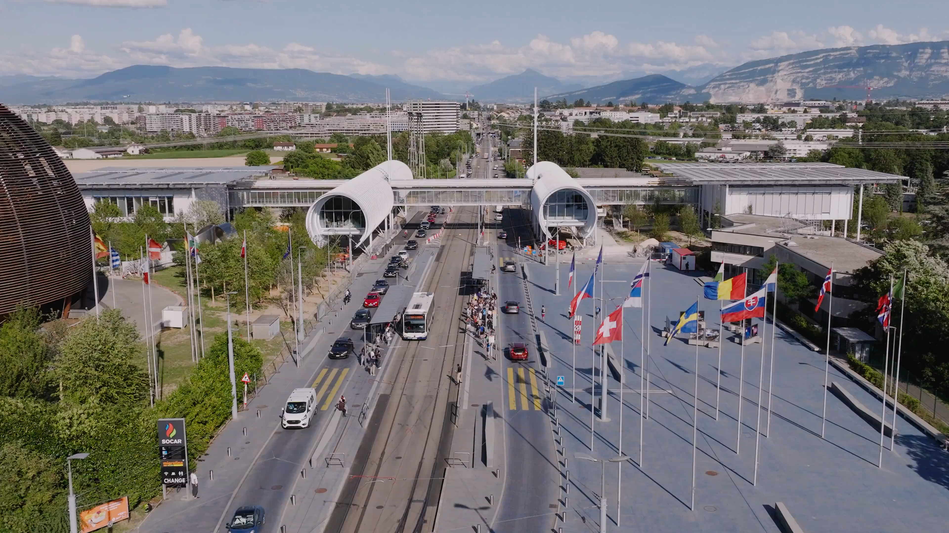
Sneak a peek into Science Gateway
Beamline for Schools | Science Gateway Virtual Visit

