Slide 1

Beam Diagnostics for BDF
Kick-off Introduction
L. Nevay, F. Velotti, M. Fraser, R. Jacobsson, R. Ximenes
7th March 2025

Slide 2
Introduction
Today we will discuss the beam instrumentation needed before the BDF target / SHiP in TCC8 (only)
The only beam here will be the “SFTSHIP” high-intensity beam
Will introduce:
  nominal beam parameters
  measurement requirements
    from the experiment, SHiP
    from the target complex
    from the beamline
  failure scenarios
  background implications

Slide 3
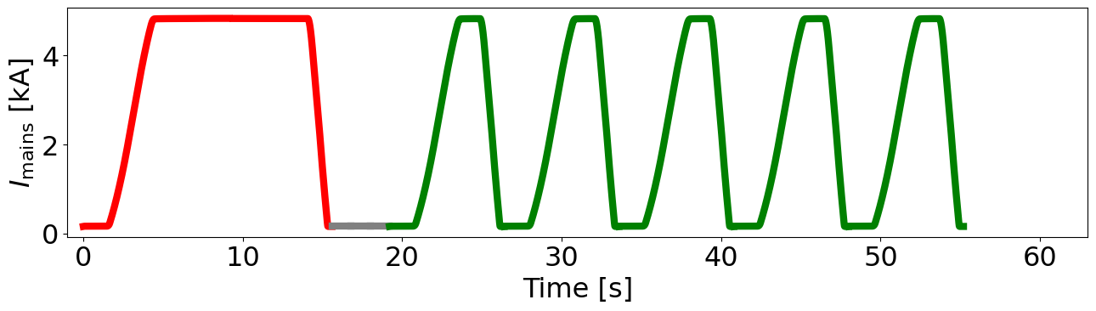
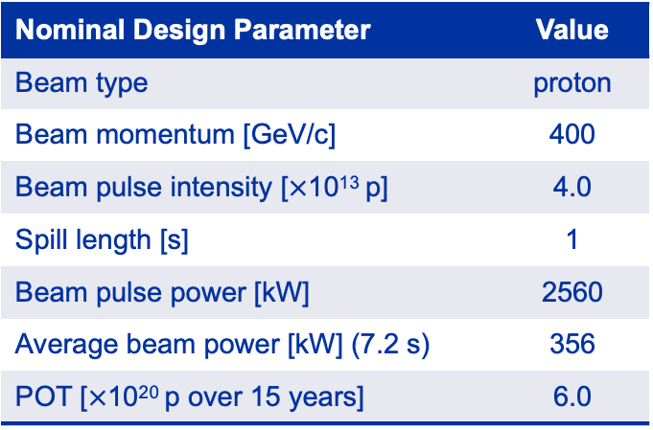
Beam Delivery and Supercycle Composition
Nominal Design Parameter | Value
Beam type | proton
Beam momentum [GeV/c] | 400
Beam pulse intensity [$×$10¹³ p] | 4.0
Spill length [s] | 1
Beam pulse power [kW] | 2560
Average beam power [kW] (7.2 s) | 356
POT [$×$10²⁰ p over 15 years] | 6.0
Nominal 4 x 10¹³ protons / spill in a 1.2 s spill to BDF/SHiP
SFTPRO
SFTSHiP
15.6 s
7.2 s
to rest of North Area
to TCC8 / ECN3

Slide 4
Nominal Beam Parameters
= to be confirmed
Range | Duration | Intensity | Size | Position
Minimum | 1.0 s | 5 x 10¹¹ p / spill | σ = 5 mm | 0 mm on axis
Nominal | 1.0 s | 4 x 10¹³ p / spill | σ = 8 mm | 50 mm circular sweep radius at 4 Hz
Maximum | 9.6s | 4.2 x 10¹³ p / spill | σ = 16 mm | 50 mm circular sweep radius at 4 Hz
Nominally, the beam will be Gaussian in profile
10 m exclusion zone (TBC)
dilution system
TCC8
σ ~ 1 mm
4Hz
σ ~ 8 mm
50 mm
~ 100 m
end of beamline
BDF front face

Slide 5
Interlocking Considerations
A single full-intensity shot with σ = 8 mm with no sweeping will break the target
  we must ensure the sweeping is going correctly during the spill
  the maximum intensity without sweeping is 2 x 10¹² protons in 1s
The current of most transfer line magnets will be monitored
  this includes the ramp across the spill to compensate for the shift in momentum
We would like an independent method of verifying beam sweep
  e.g. independent field probe in dilution magnets or simple beam loss related trigger (using BLM system)
Such a method must provide a quick interlock e.g. << 50 ms response
  therefore, we want to avoid high-level software-based solutions for this
Must be reliable (for availability) on a long time-scale

Slide 6
Experiment Background Considerations
We should minimise the material in the beam if possible
Any material in the beam will ultimately create a very small fraction of losses that will create a very low fraction of muons
We are about to study how muons off-axis will be guided by the SHiP muon shield
  i.e. does the shield ‘capture’ back muons off axis into the experiment
Nominally, muons very close to the axis should be ok…
So, being relatively close to the target is preferable than being at the exit of the dilution system (if possible)
Once we have the studies from the muon shield we can say if any locations are bad or if there is no problem at all

Slide 7
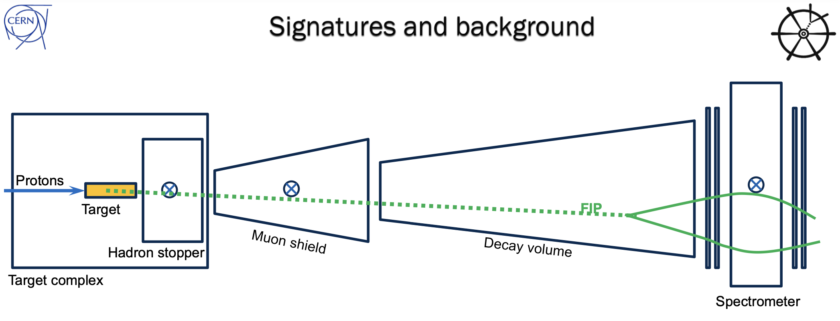
Possible Background Route
Muon passes through BDF (>20m concrete / iron → over 30 GeV)
Perhaps captured by muon shield
R. Jacobsson

Slide 8
Measurement Requirements
preliminary
 | From SHiP | From the Target | From the Beamline
Intensity | < 3% error (abs.) each spill |  | < 5% error each spill
when? | after spill | after spill | after spill
Beam Size / Profile | < 20% error | < 10% error | < 10% error
when? | after spill | after spill | after spill
Beam Position / Sweep | points during sweep? | < 5 mm error radial | < 5 mm error radial
when? | after spill | each 50 ms (max.) | each 50 ms (max.)
Preliminary - let’s discuss here
= to be confirmed

Slide 9
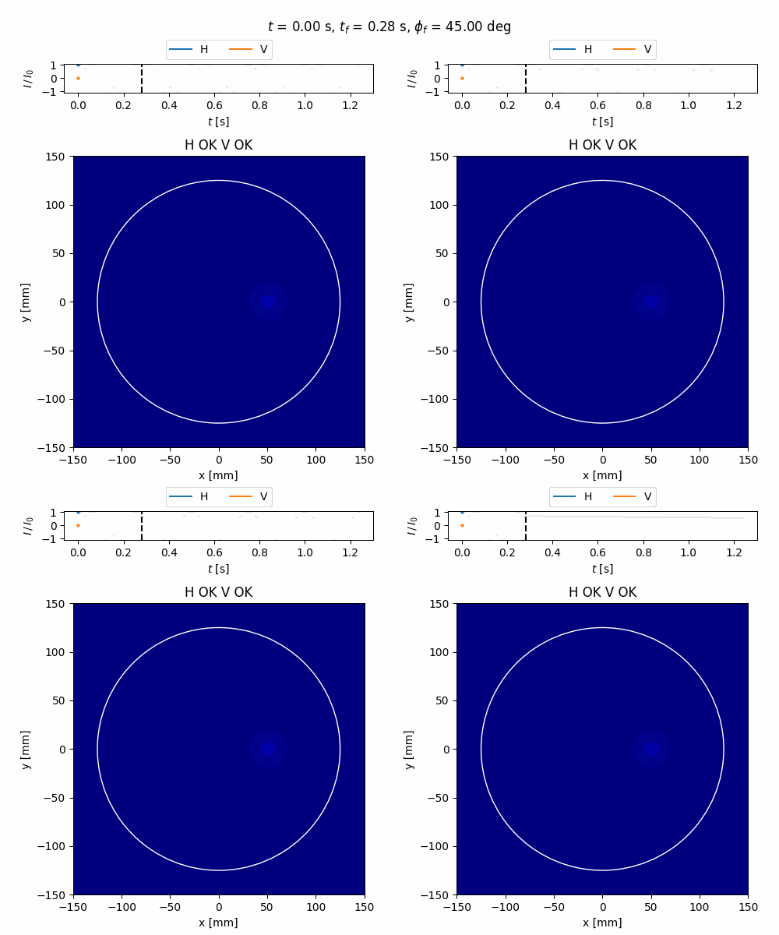
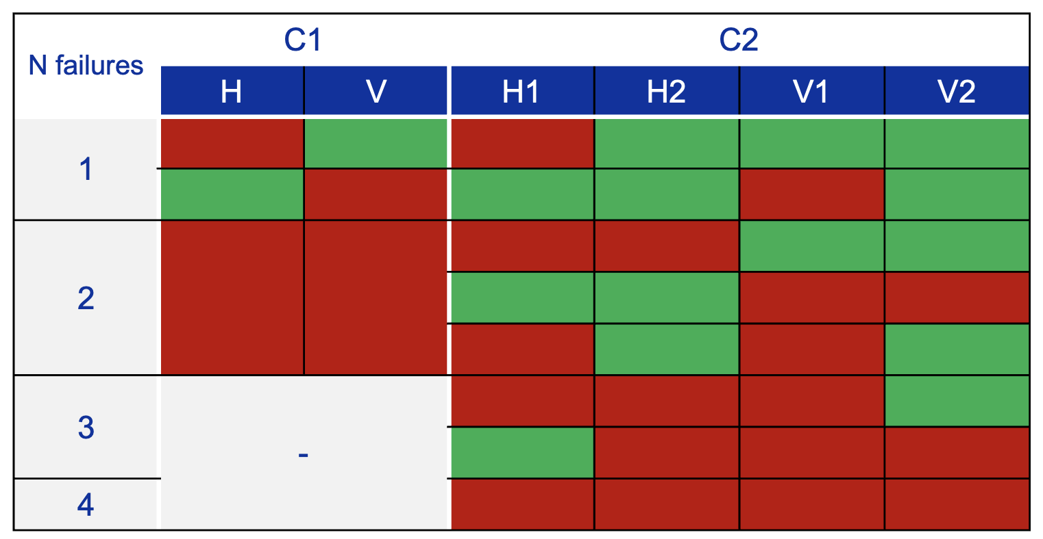
Nominal and Accident Scenarios
Magnets along the beamline can fail
  change in beam position and size as the field drops
Beam loss monitors will be placed on each quadrupole to cut the beam quickly if losses high
A crucial failure mode will be that of the dilution system magnets and power supplies
1 magnet per plane
2 magnets per plane
Patterns on target vary depending on the magnet and exact time of failure
A failure may not result in the beam ‘falling’ to the axis

Slide 10
Actions & Timeline
The goal is a design for instrumentation upstream of BDF that satisfies these requirements
This instrumentation should be online by 2031 for beam commissioning
BDF TDR is due in Spring 2026 - all should be specified and valid by then
Need to propose concepts to satisfy these requirements
Will require iteration with beam delivery (sweep) / target / interlocking
Matthew → will finish document on experimental requirements

Slide 12
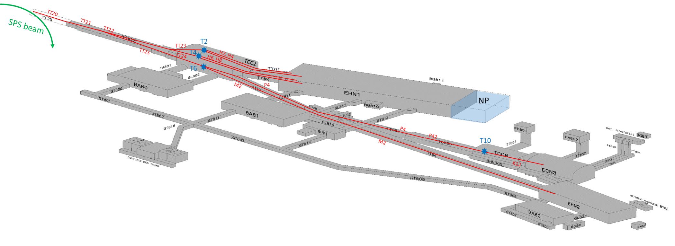
Tunnel Names
TCC2
TT83
TDC8
TT85
TCC8
ECN3

