Slide 1
Clogging Issue of Heat Exchangers
INDICO 1520926
Okba BOUCHELOUCHE / Frederic FERRAND
March 26th, 2025

Slide 2
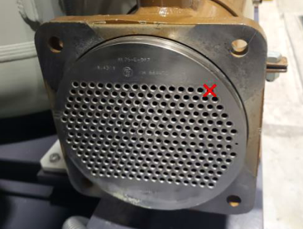
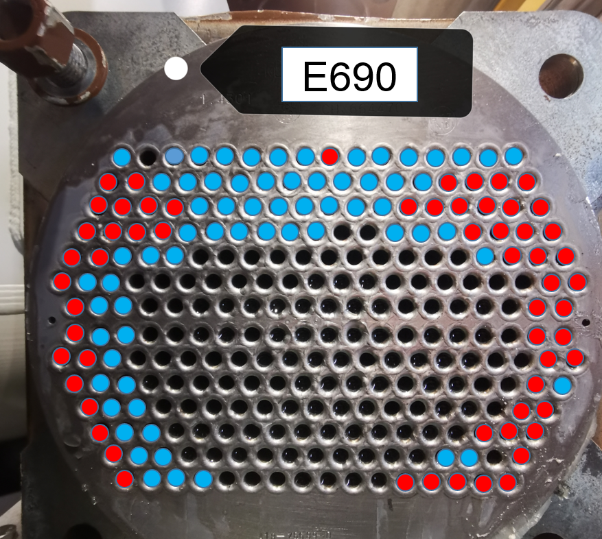
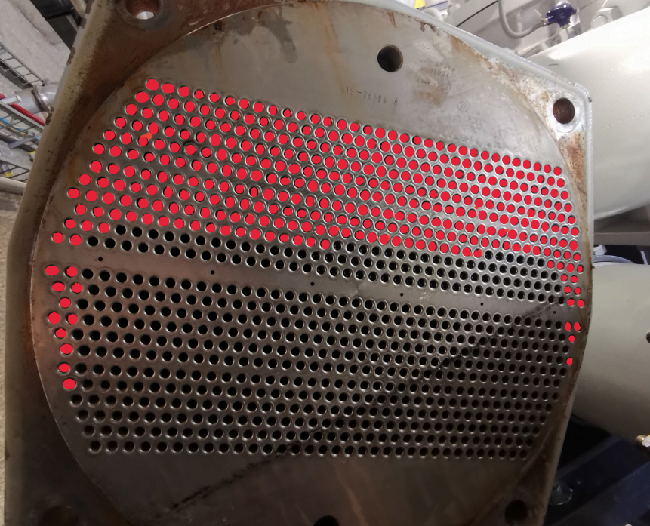
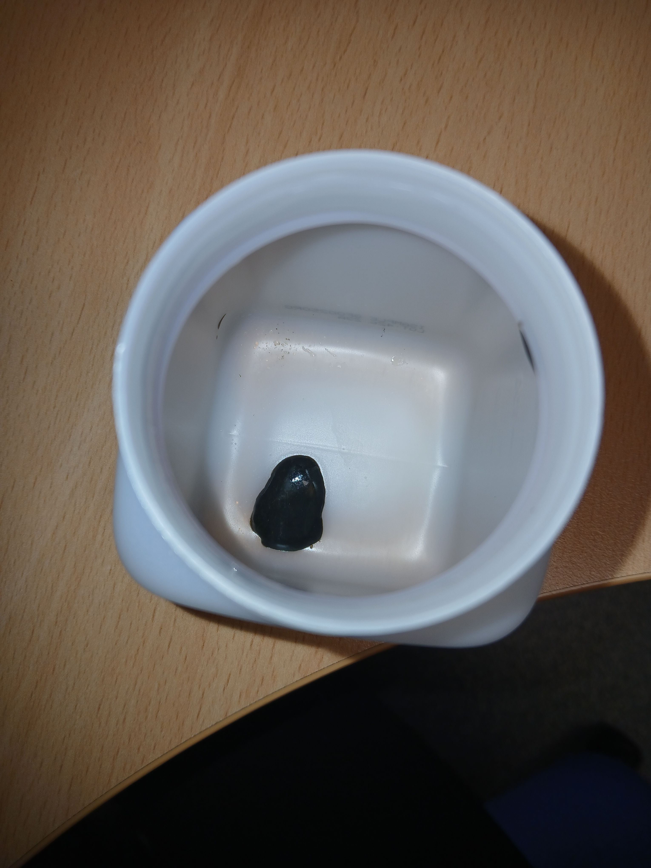
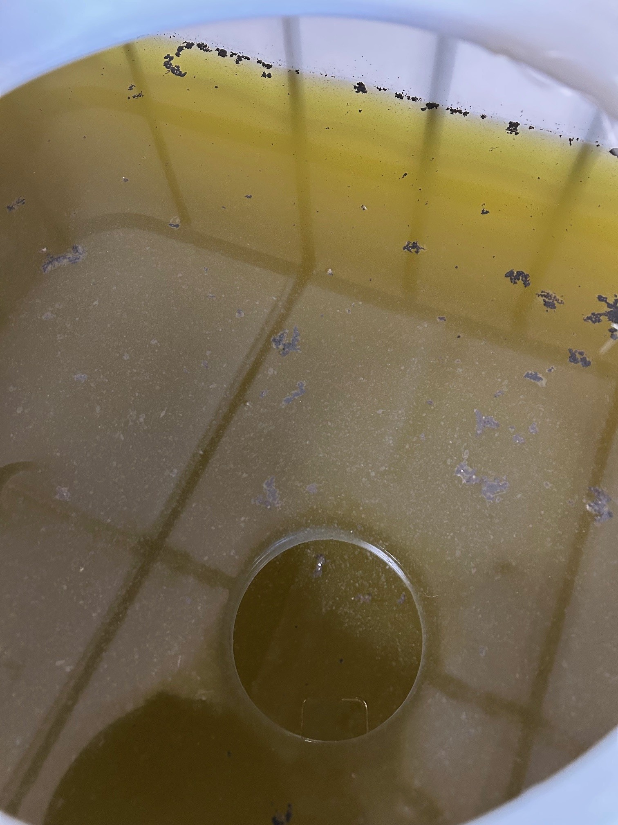
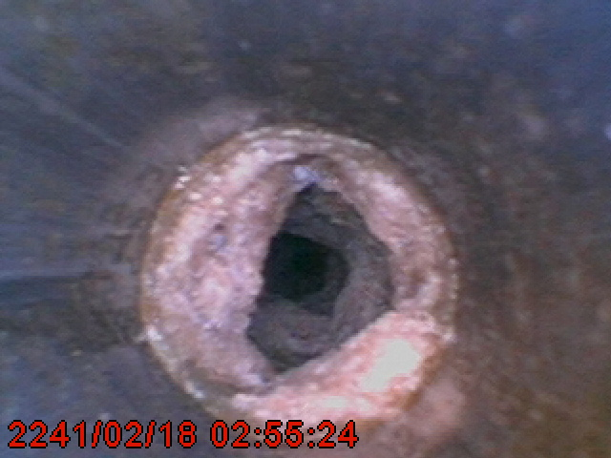
SM18 – LINDE B
Three cleanings in one year
First Cleaning : January 2024 (HP Cleaning)
Second Cleaning : July 2024 (HP Cleaning)
6 months later
Nearly all the tubes have been unclogged
Third Cleaning : January 2025 (New chemical cleaning process)
Mapping of fully and partially blocked tubes before cleaning
Before the chemical cleaning : Tubes that had remained clogged after the second HP cleaning were no longer blocked
Several tubes could not be unclogged due to the very solid compound and the limitations of the cleaning process for such small tubes
After the chemical cleaning : Black residue and traces of hydrocarbons were found on the surface of the retention tank
→ Analysis In Progress
→ Analysis results : Calcium phosphate (Product used by EN-CV for water treatment)
Place for your logo

Slide 3
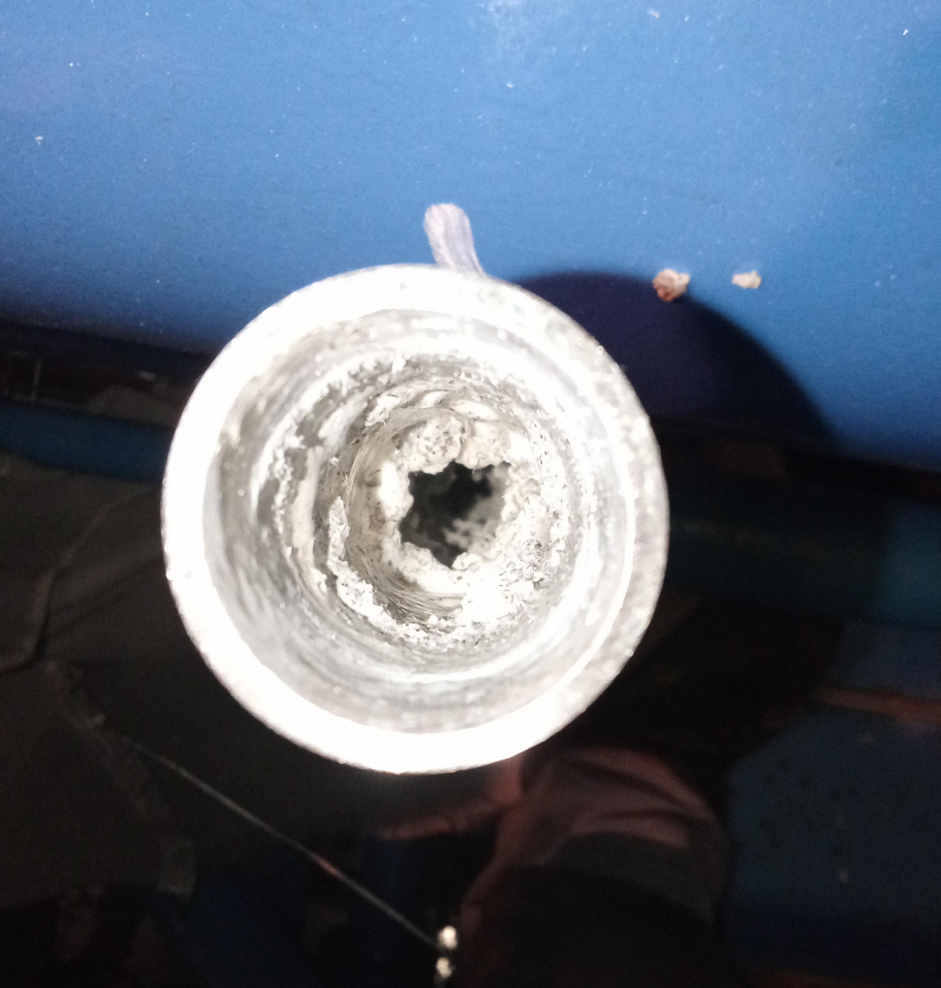
HIE ISOLDE
Gearbox cooling water heat exchanger
QSC1H-198-E120
Limescale buildup
Chemical cleaning during the last Shutdown in February 2025

Slide 4
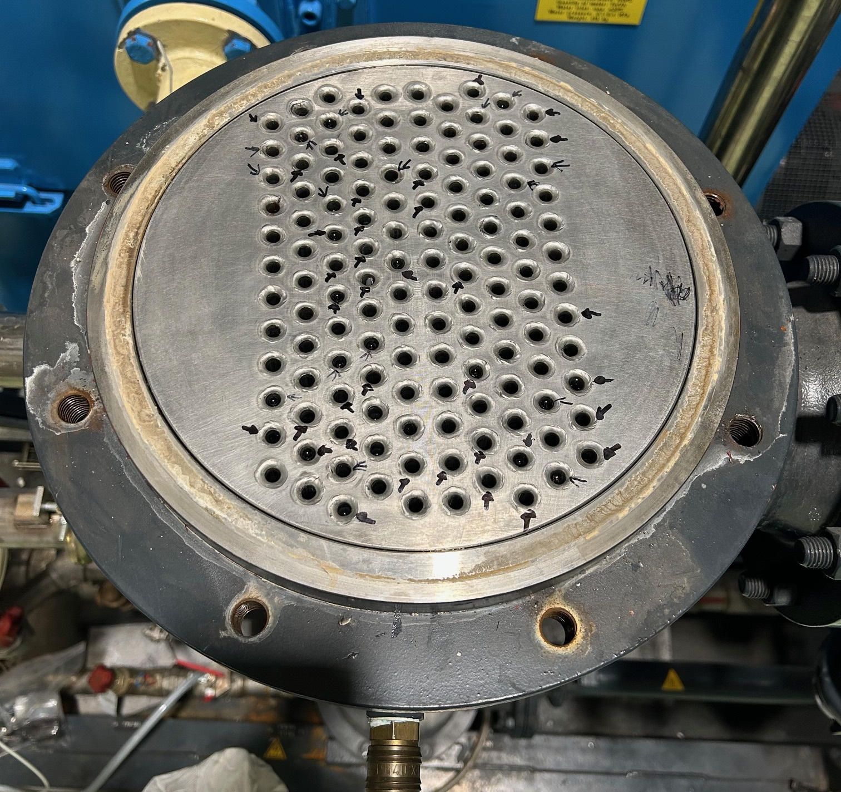
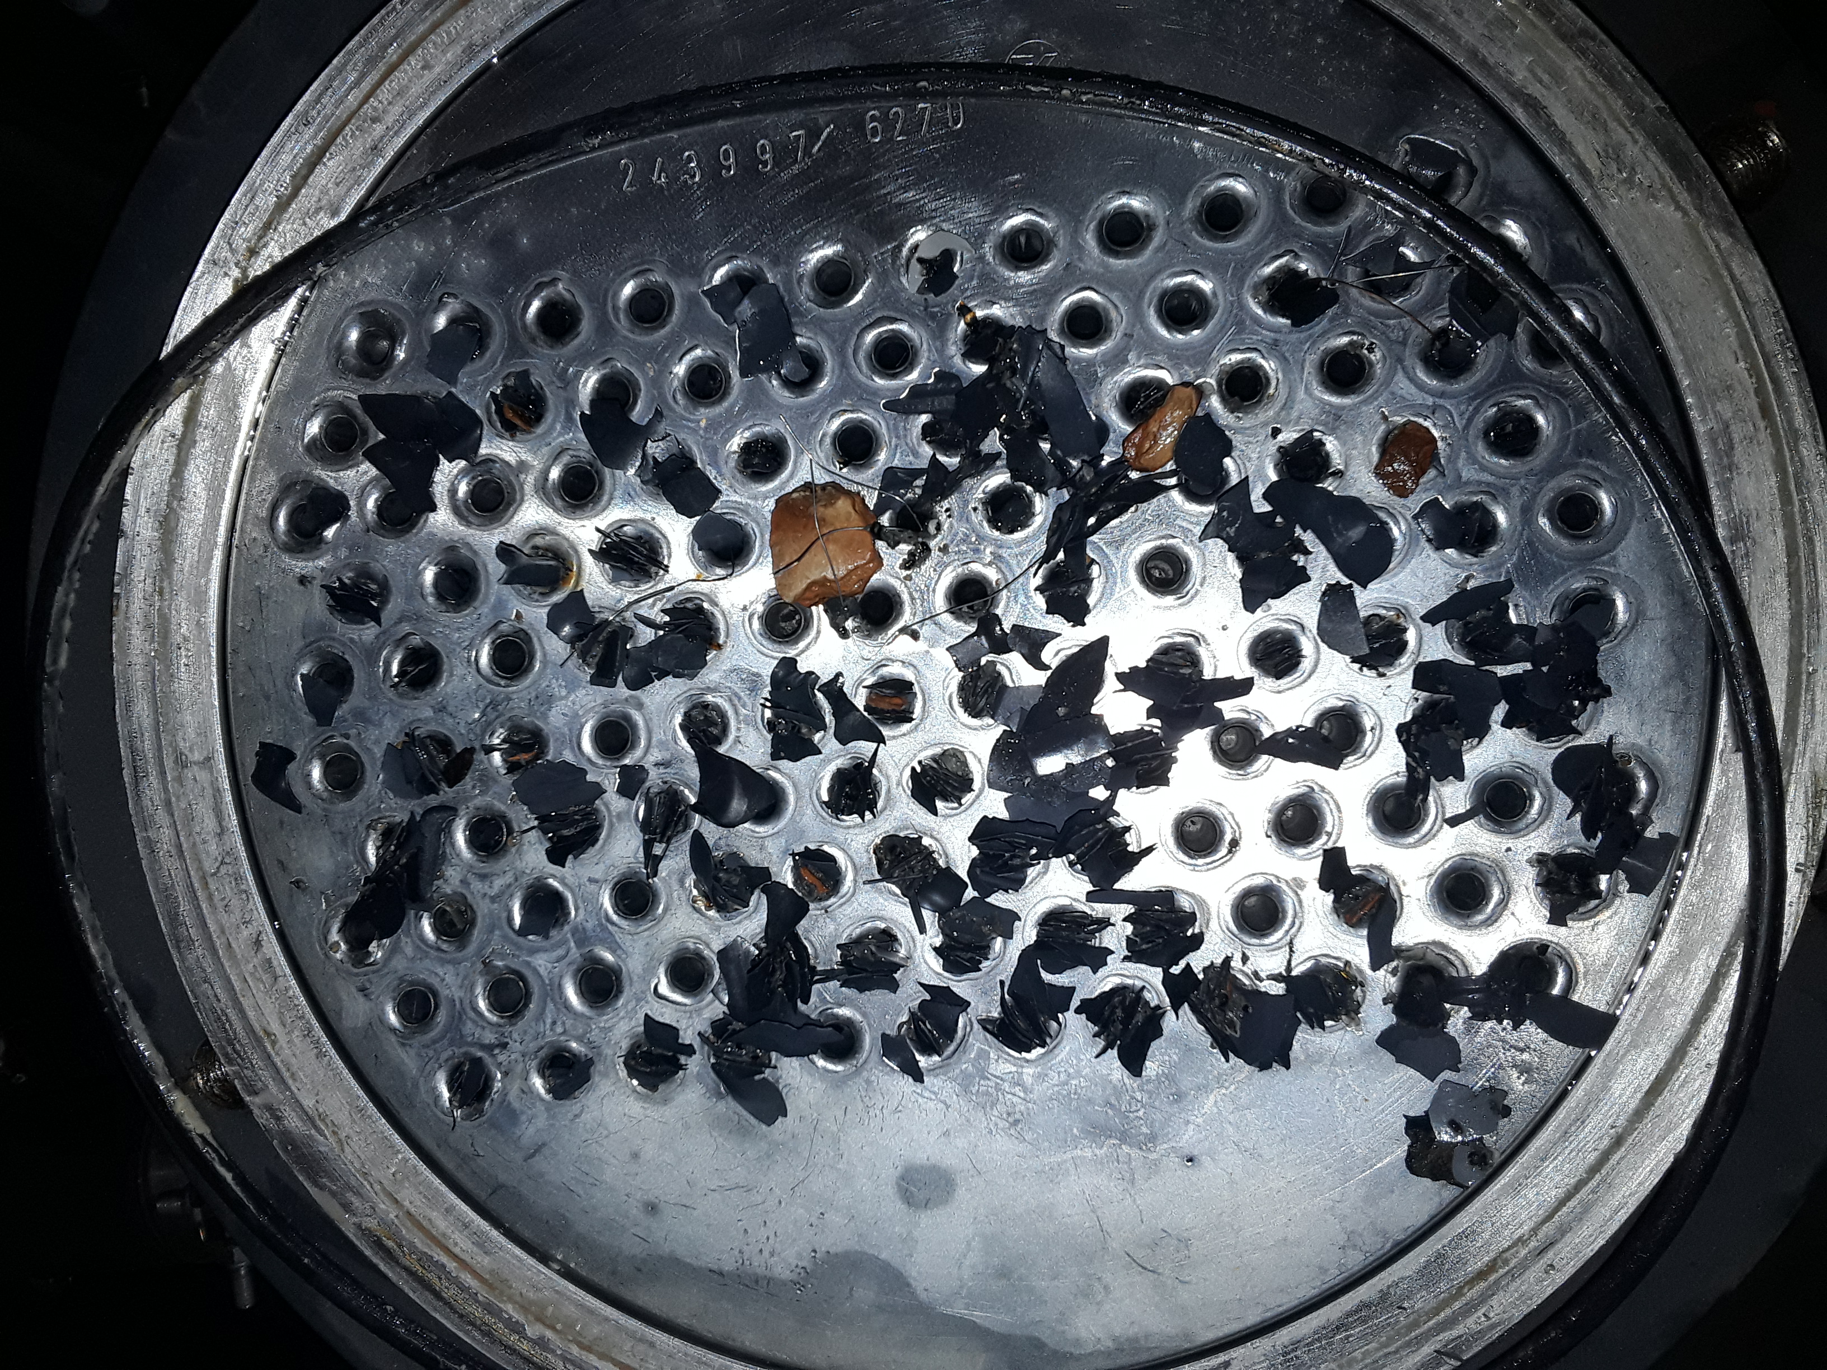
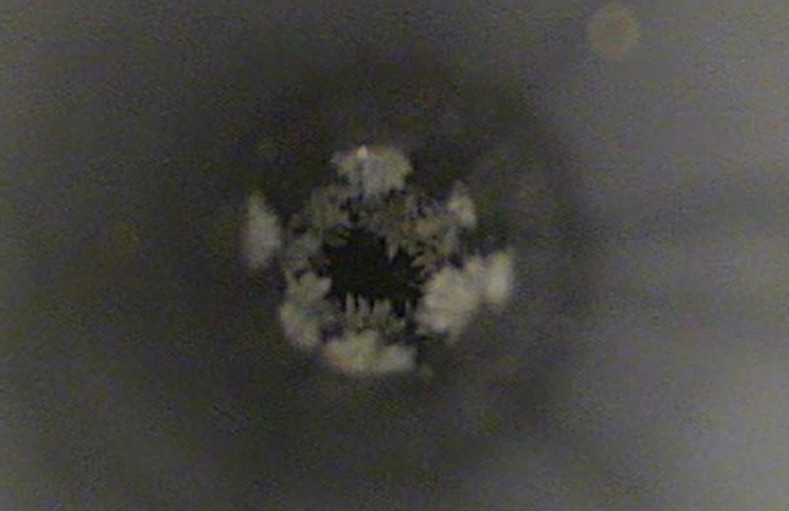
P18 - P6
P18 QSCCB – Exchanger 1E610
P6 QSCCA - Exchanger 1E610
30% of tubes clogged randomly distributed
Deposit composed mainly of calcium (Veolia analysis)
Rod-based tube cleaning + Standard Chemical Cleaning + Televisual Inspection

Slide 5
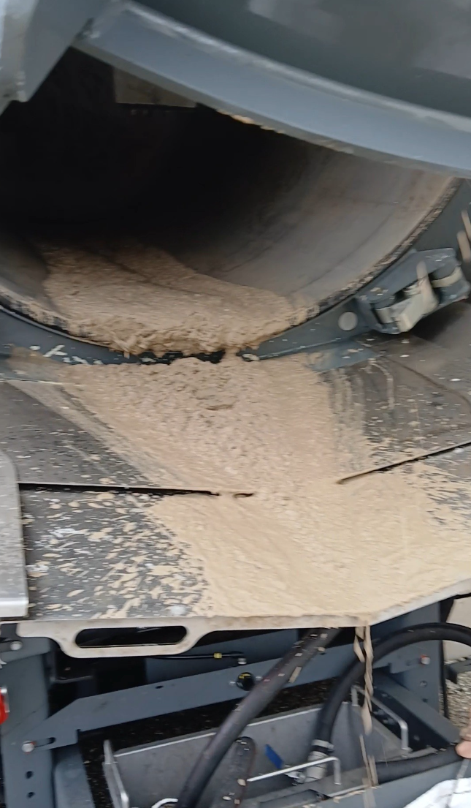
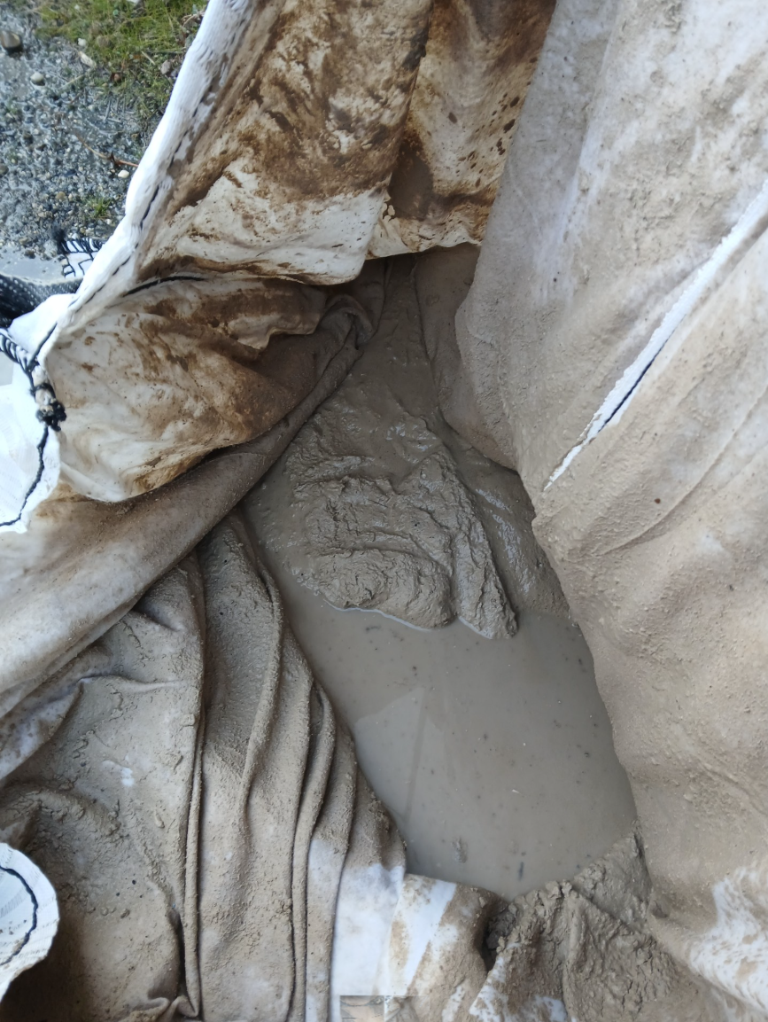
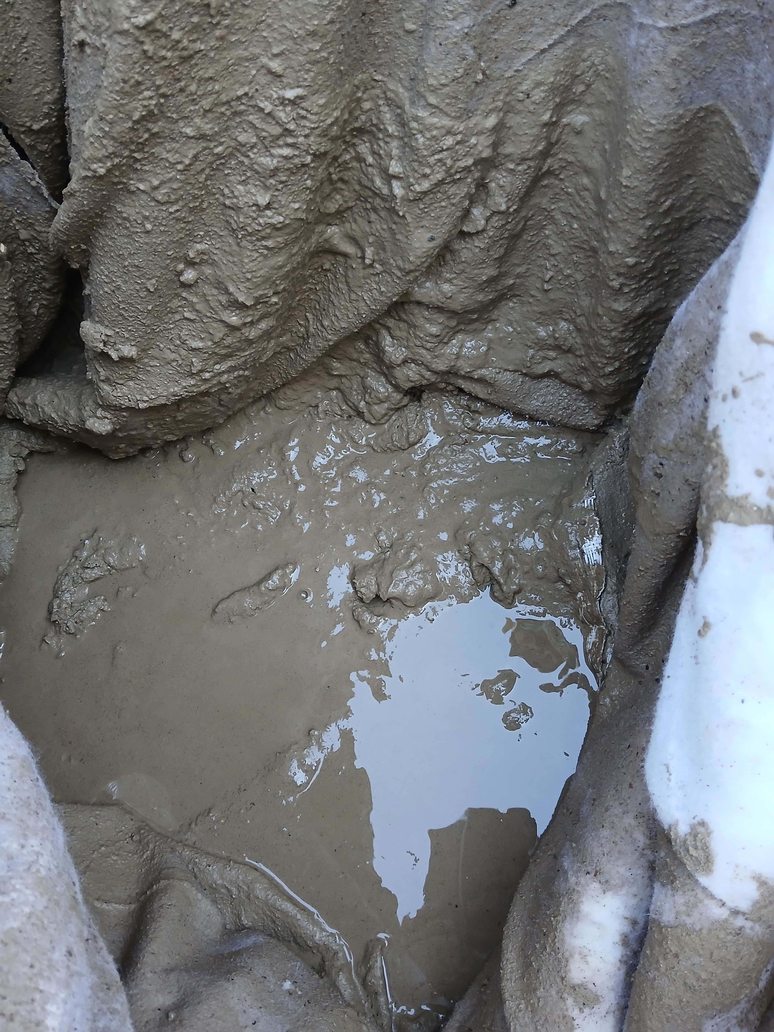
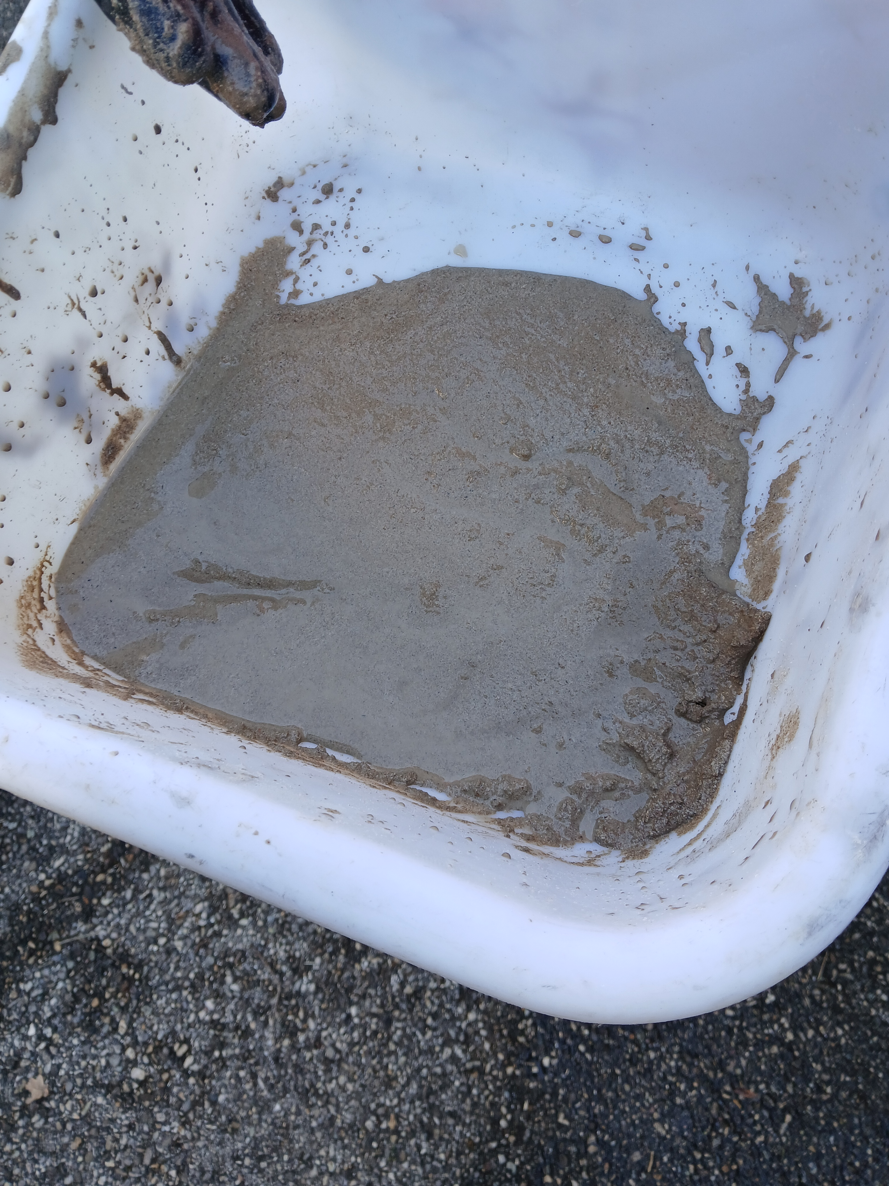
P2 - P8 – High Pressure Cleaning Exchangers YETS 24/25
P2 QSCA – Exchanger 7E660
P8 QSCA – Exchanger 1E130
Mud / sand
Mud / sand found on the last 5 lines of tubes and on the periphery

Slide 6
Points to discuss
What are the levers at our disposal to resolve these issues effectively?

