Slide 1
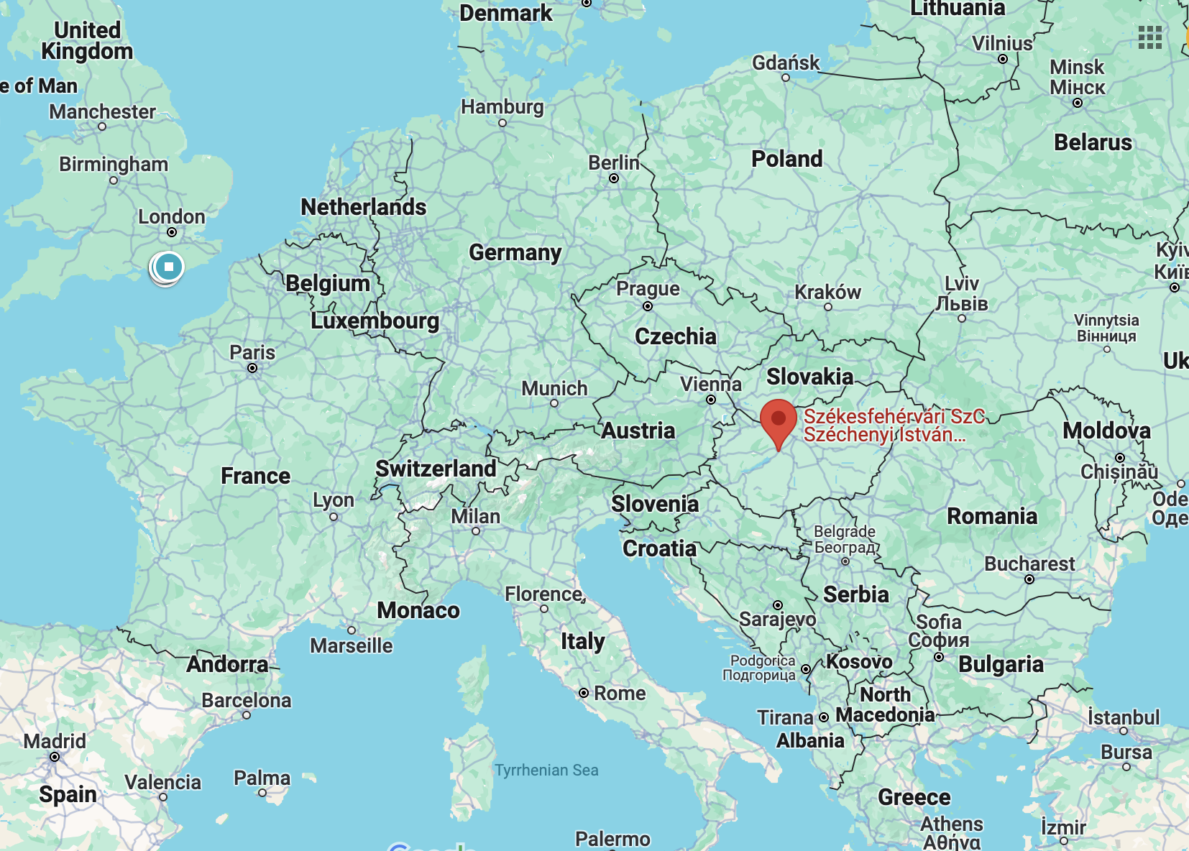
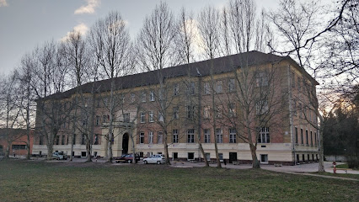
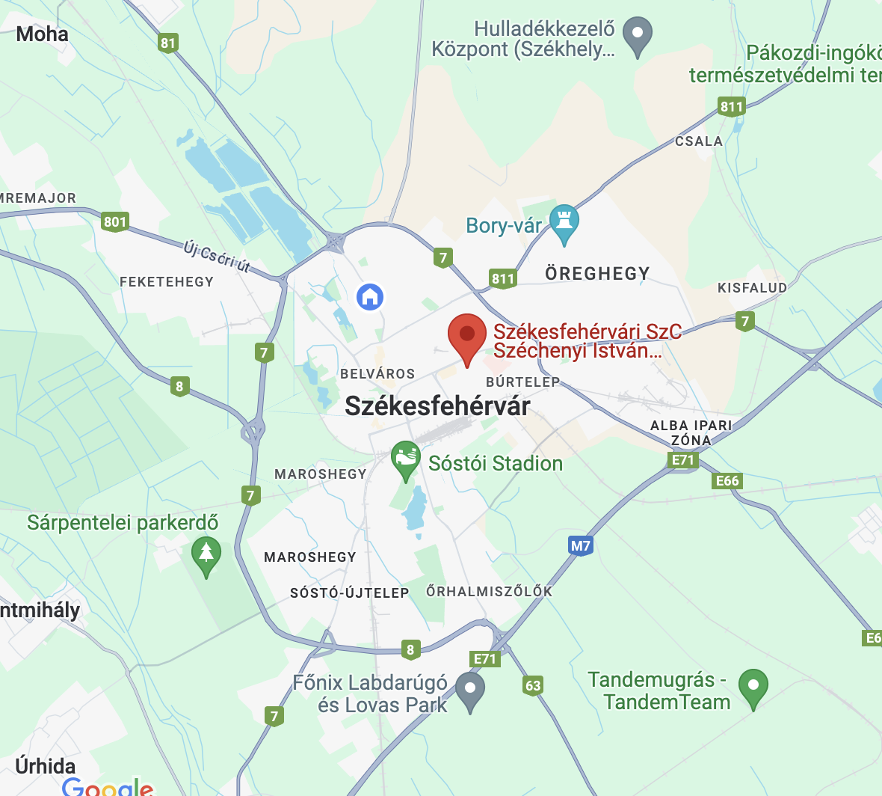
Széchenyi István Mechanical Technical School
Székesfehérvár
HUNGARY

Slide 2
Table of contents
    History
    About the school
    Education
    Classes
    School life

Slide 3
History
                The first school year started in 1939
                The main building was damaged in World War II
                1945-1947: functioned as a hospital
                Lots of name changes, named after Széchenyi István since 1990
                2023: 18th place in the top 100 best
                vocational-technical schools in Hungary

Slide 4
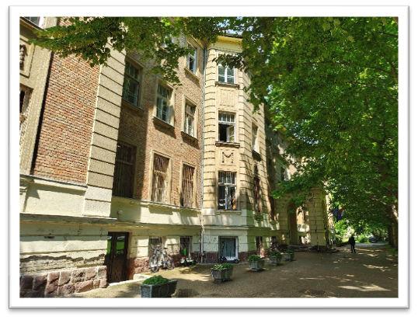
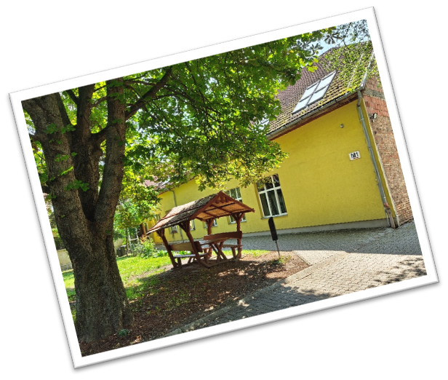
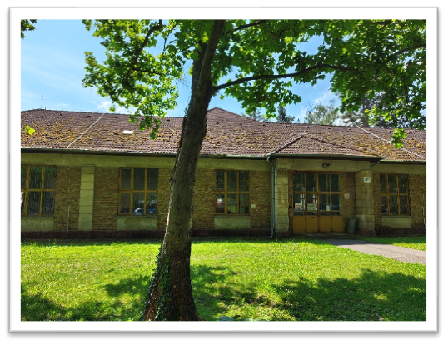
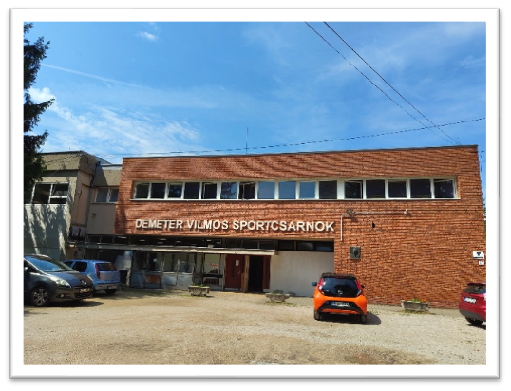
About the school
  Number of teachers: 100
  Number of students: 1100
  Buildings
  Main building (I)
  Gymasium (Sports Hall)
  Workshop (M1)

Slide 5
Education
Vocations/Specializations:
  Mechanical engineering
  Specialised machine and vehicle manufacturing
  Electronics and electro-technology
  IT and Telecommunication
  Bilingual IT and Telecommunication

Slide 6
Education
5 years (from grade 9 to 13)
2 years of basic vocational
education
Sectoral
preliminary
exam
3 years of specific
vocational education
  Grade 12: 3 school leaving exams (Hungarian Language and Literature, History, Mathematics)
  Grade 13: 2 school leaving exams (Vocational subject and Foreign Language
  Students receive a high school diploma and a vocational certificate

Slide 7
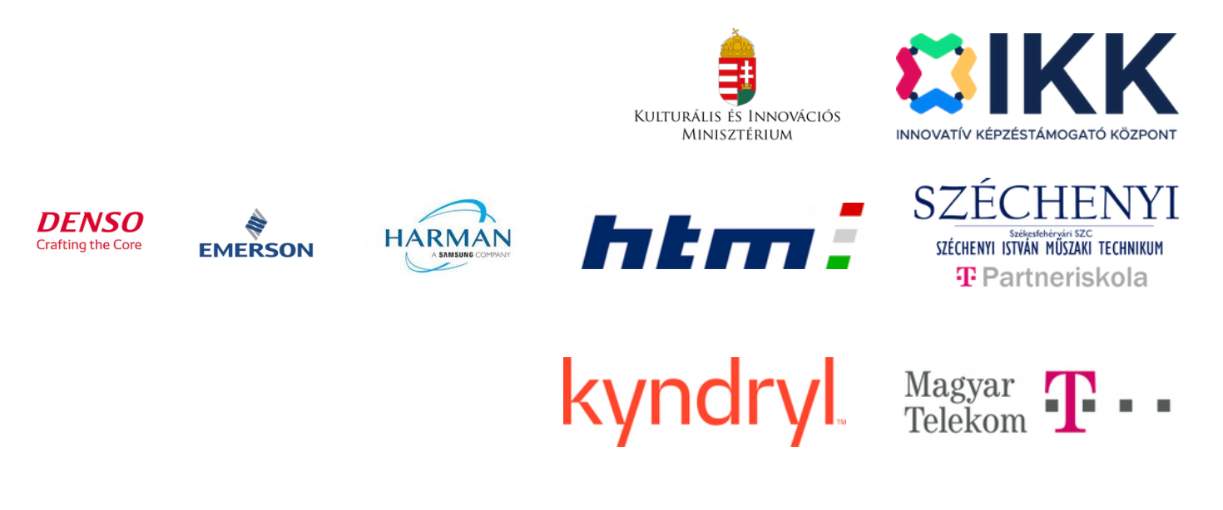
Dual education
from grade 11 students can take part in dual education
learning vocational subjects at partner companies
work contract with salary or scholarship
Our partners:

Slide 8
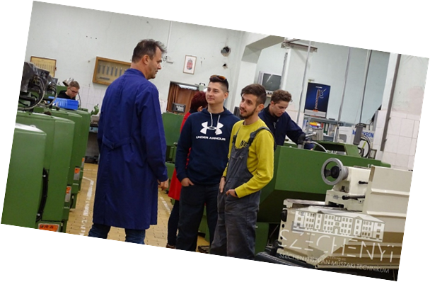
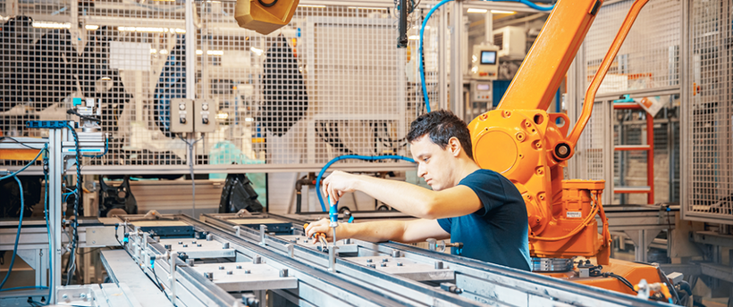
Classes (size:32-36 students)
1. Mechanical engineering (1 class )
  CAD-CAM
  CNC manufacturing
2. Specialised machine and vehicle manufacturing
(1 class )- building, operating
and maintaining
mechatronic equipment

Slide 9
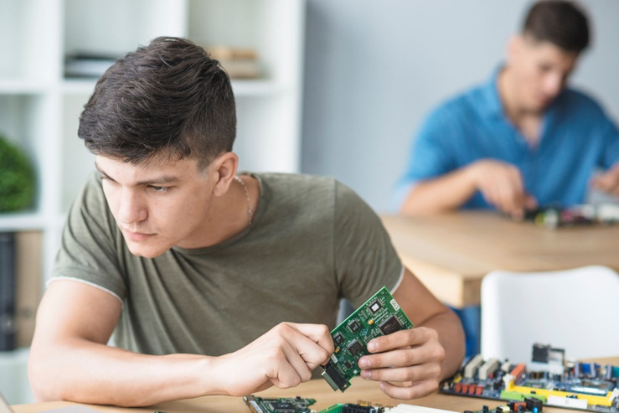
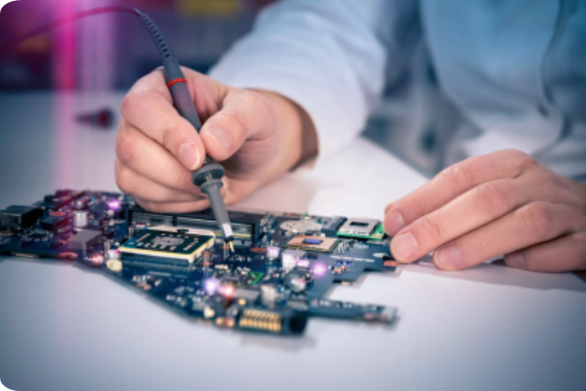
Classes (size:32-36 students)
3. Electronics and electro-technology(1 class)
2 possible fields from year 11:
- Electronics technician - operating, configuring and maintaining equipment
        - Industrial IT technician//Automation technician
        IT-related parts of robotics and automation
        PLC systems

Slide 10


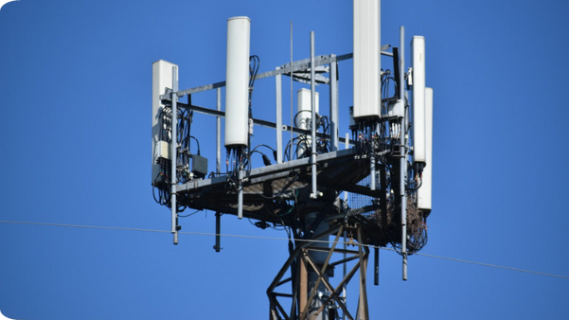
Classes (size:32-36 students)
4. IT and telecommunication (2 classes)
3 possible fields from year 11:
Software developer and tester
  Programming, software installation, testing and maintenance
  Developing desktop applications
IT systems - and application - operator technician
  Network planning, installation and maintenance
  Hardware maintenance
Telecommunications technician
  Broadcasting

Slide 11
Classes (size: 36-40 students)
5. Bilingual IT and telecommunication (1 class)
1 possible field from year 11:
Software developer and tester
  1+5 years of education
  First-year subjects: Digital culture, Mathematics, Physical Education and English language
  Students have 18 English lessons a week
  They can choose a second foreign language from the second year (German, Russian or Spanish)
  History, IT, Technical Chemistry PE lessons are held in English
  They receive a C1 Language certificate when they
  finish school

Slide 12
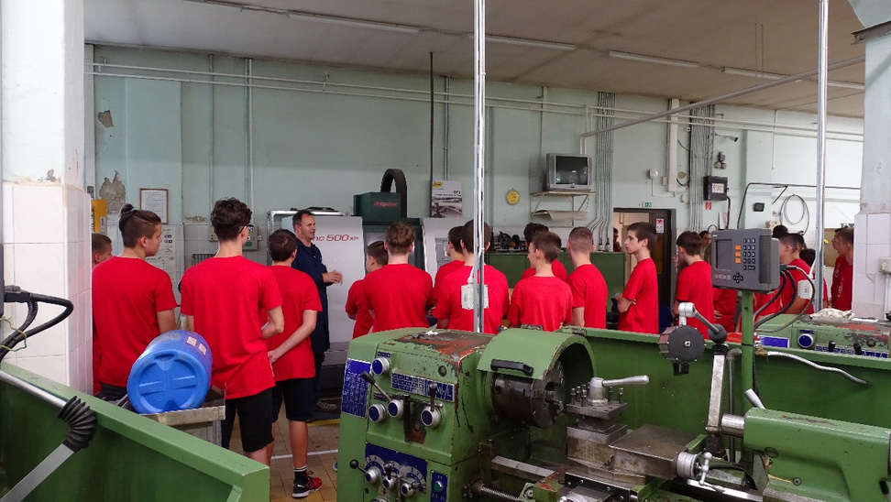
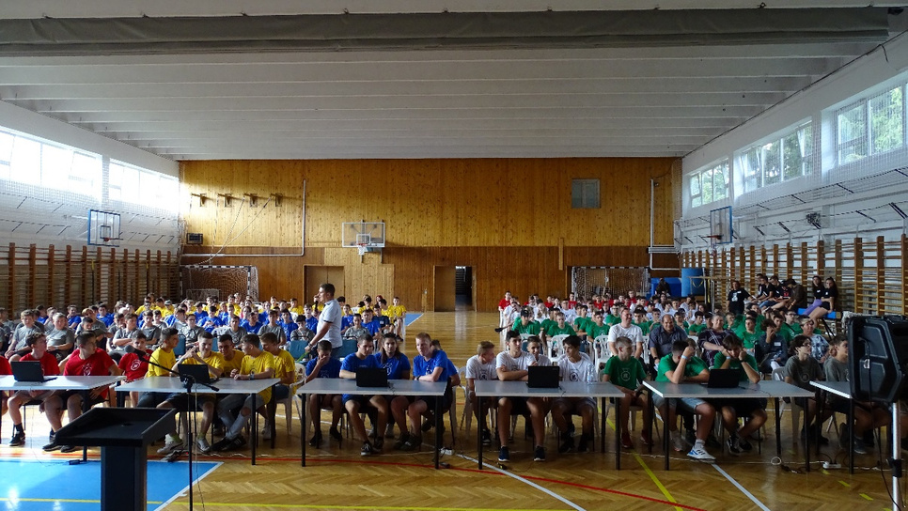
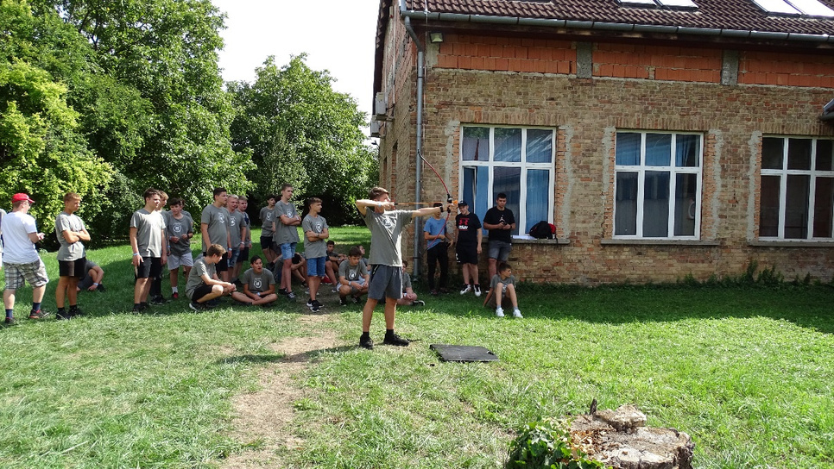
School life
Freshmen’s day

Slide 13
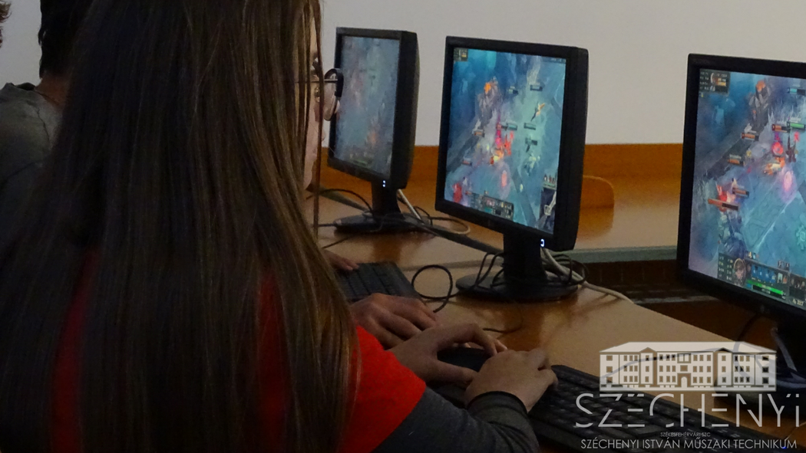
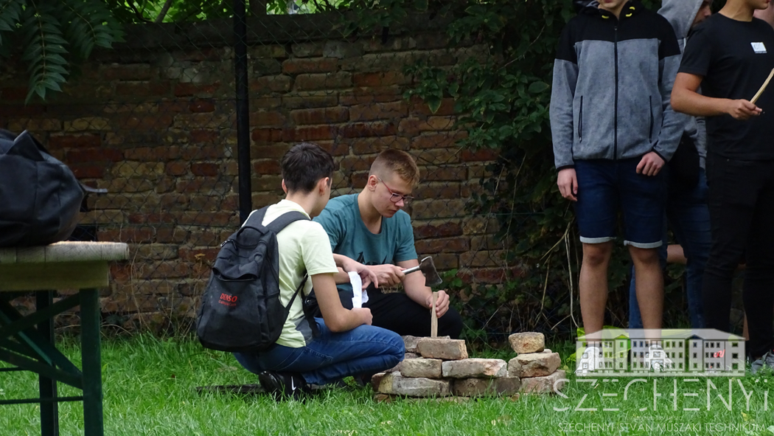
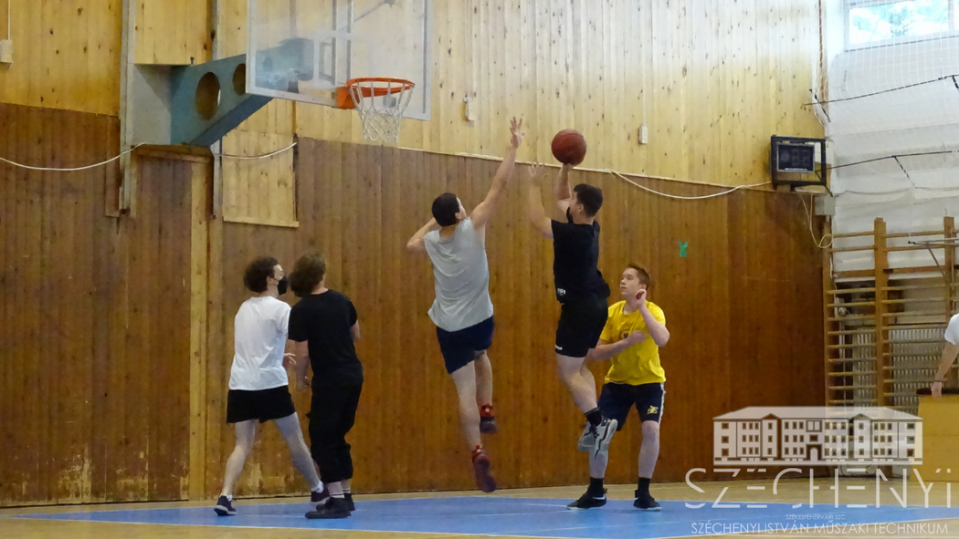
School life
Student government’s day

Slide 14
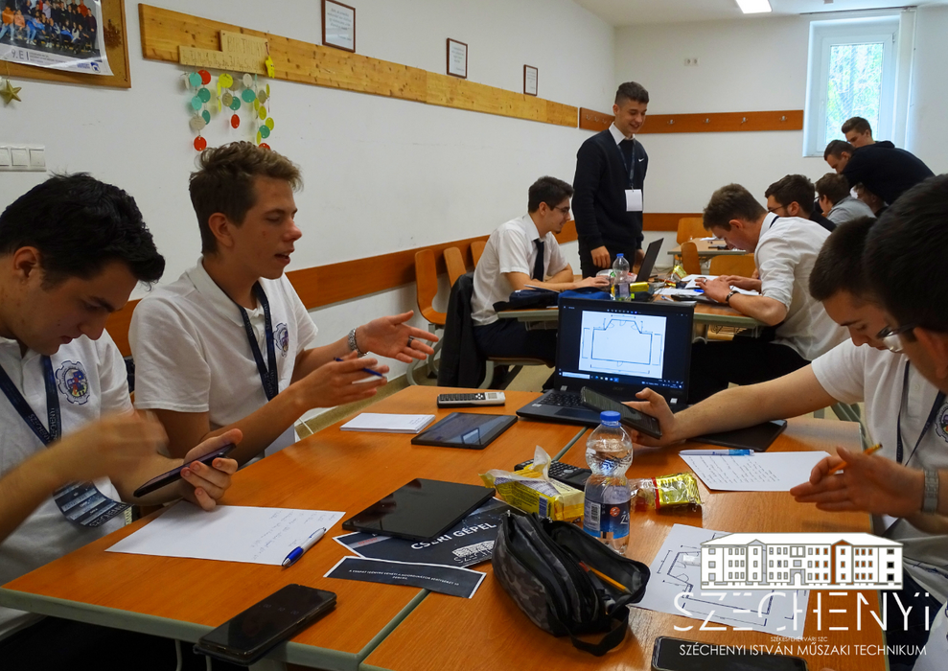
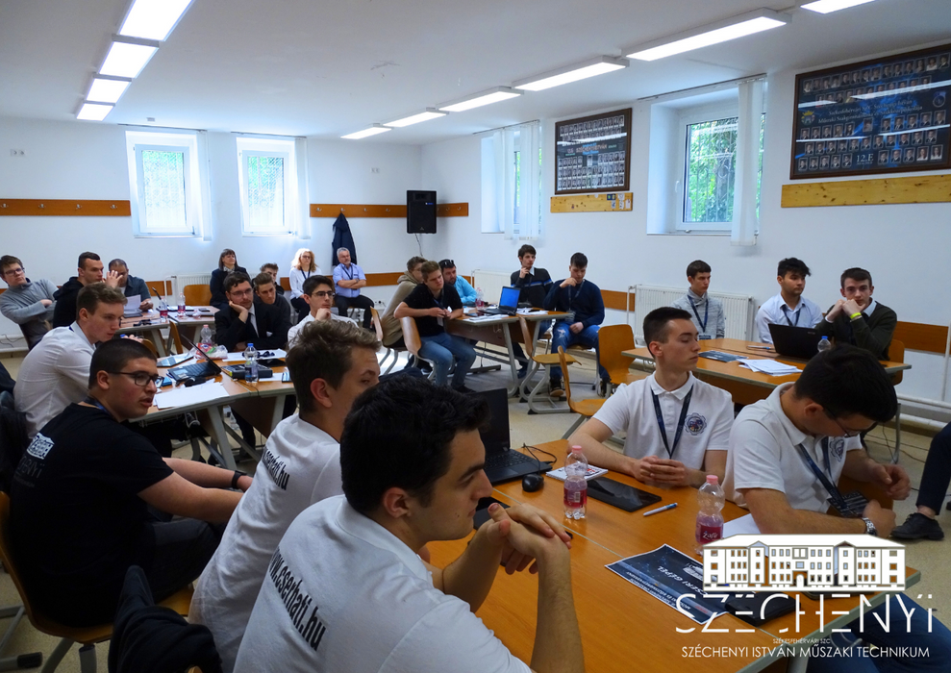
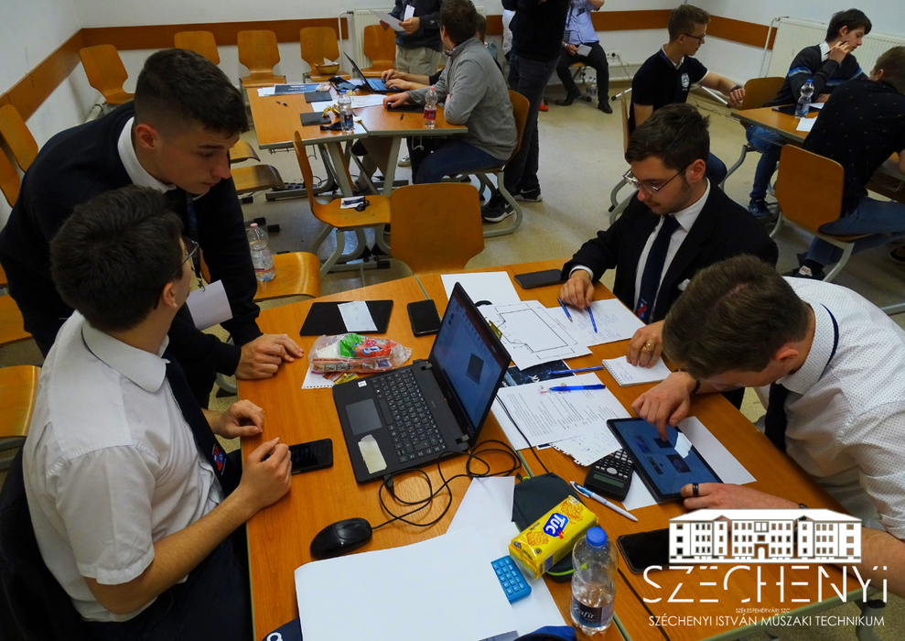
School life
Széchenyi competition

Slide 15
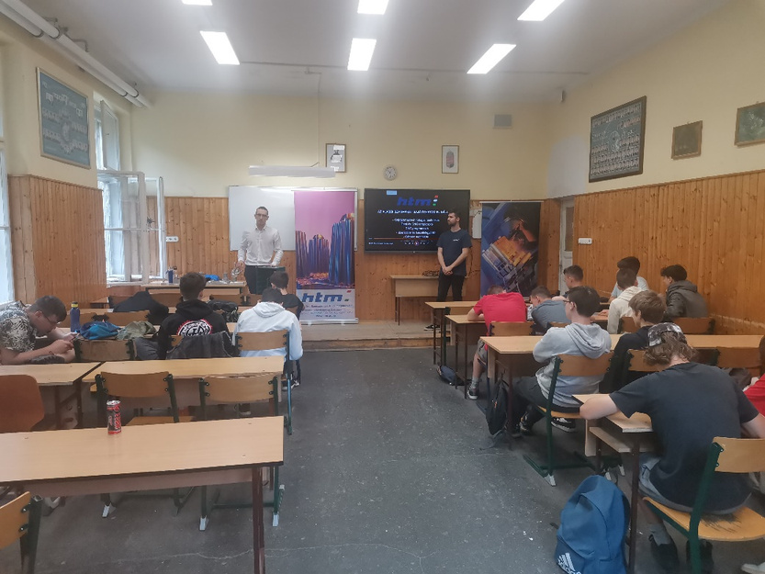
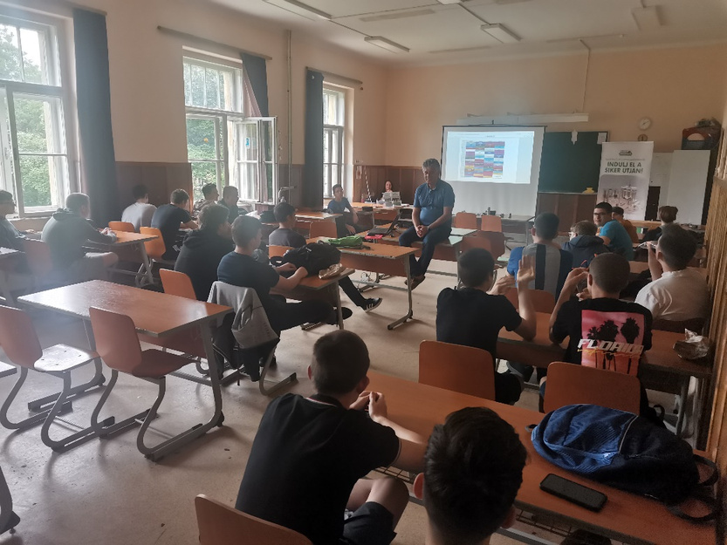
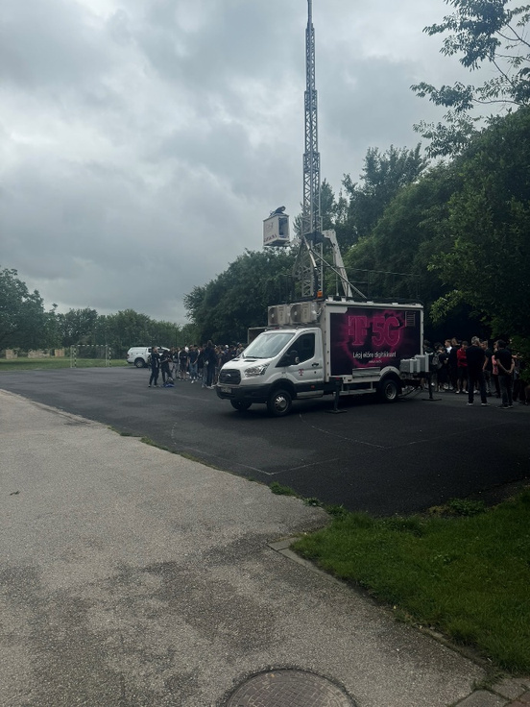
School life
Dual partners’ Roadshow

Slide 16
Thank you for your attention!
Sources:
School website: https://szek-szechenyi.www.intezmeny.edir.hu/
www.freepik.com
Google maps

