Slide 1
LMF Infrastructure for HFM WP3.3
TE-MSC-LMF
Starting February 2025

Slide 2
Introduction
The logic for the needed infrastructure follows our MQXF case (bladder and key, with the particularities of a block coil):
Coil manufacturing infrastructure
  Winding
  Reaction heat treatment
  Impregnation
Magnet assembly
  Coilpack preparation
    For short models we machine the rails. To be discussed!
  Structure assembly
  Coilpack insertion
  Magnet centering & loading (incl. axial)

Slide 3
Outline
Meeting 1 (03/03/2025) – Coil winding

Slide 4
Meeting 1 – Coil winding
First is to check the status of the blue winding machine
  Is it operational?
  If not, what’s the main issue?
  Who to work on this: Jerome & Seb
Second, it would be interesting to think on what we need for an easy winding test
  FRESCAII pictures can be found in \\eosproject-smb\eos\project\w\wp33-5m-long-block-coil\6_Infrastructure\FRESCAII_Experience
  The test should start giving us more information on what we need (as an intervention in the winding machine)
We’re advancing with the design of the winding/reaction/impregnation tooling for BOND (927). Very important to follow and later modify to our needs.

Slide 5
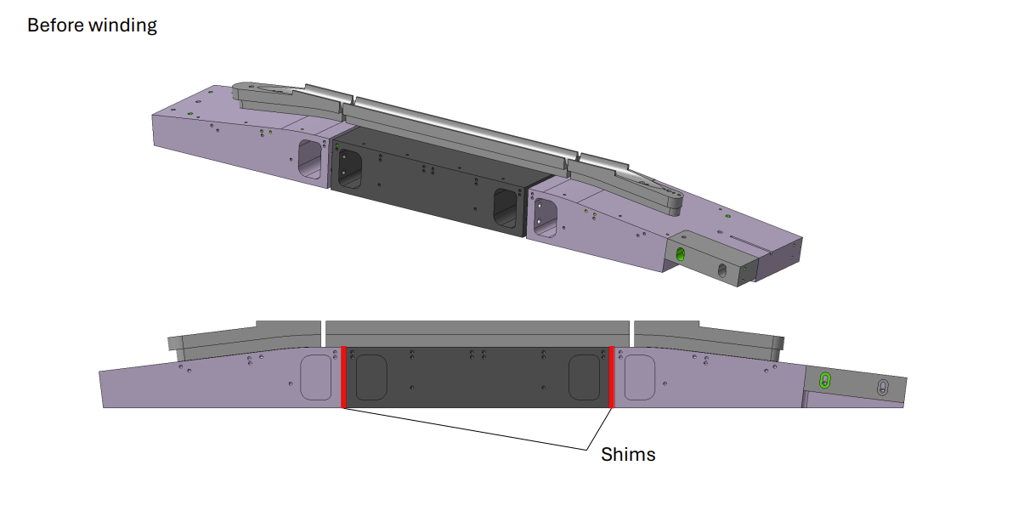
Meeting 1 – Coil winding

Slide 6
Meeting 1
Andres and Hans are going to Hannover for a technical exposition with some of our providers
  We should all think if there is something interesting from which we could profit

Slide 7
Action items
Jerome & Seb
  Check the winding machine and see if we can operate it
  Consider blocking the rotation axis used for cos(theta) coils
Jose
  Provide the winding tension used for BOND – 25 kg
N. Lusa and Benjamin Pellet
  Benjamin has already designed a quick 3D for winding test in the blue machine
  Parts will be printed in the 3D printing machine at B.180
All – Quick discussion next week to check where we are

Slide 8
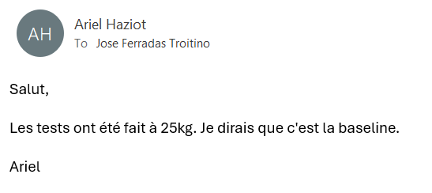
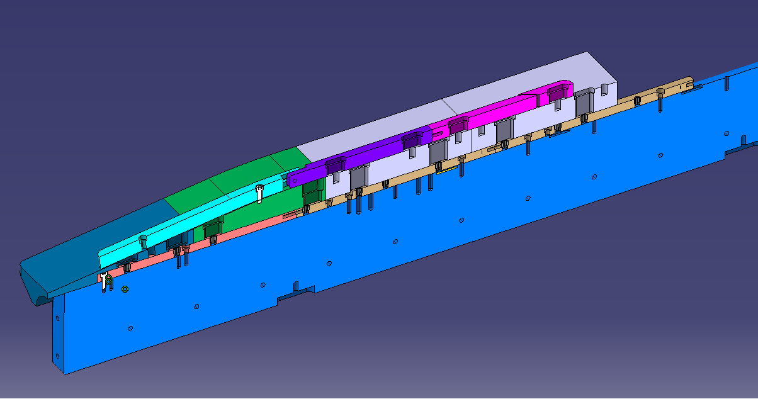
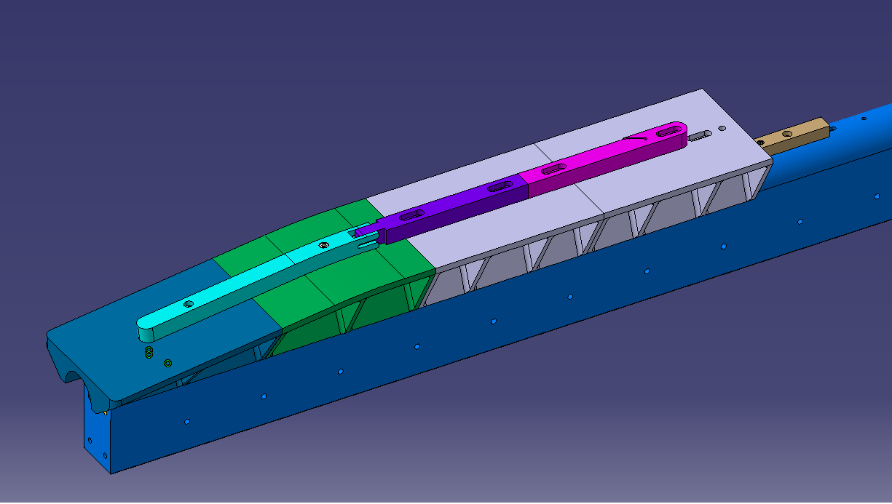
Action items

