Slide 1
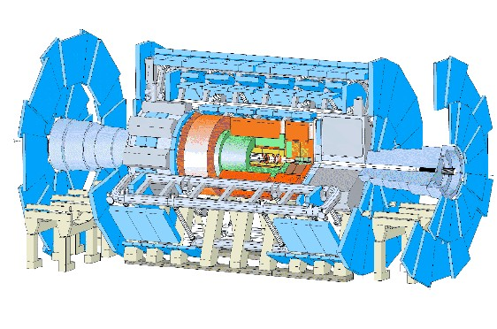
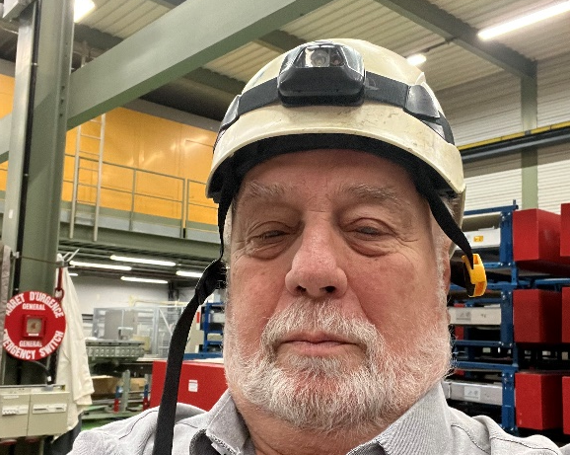
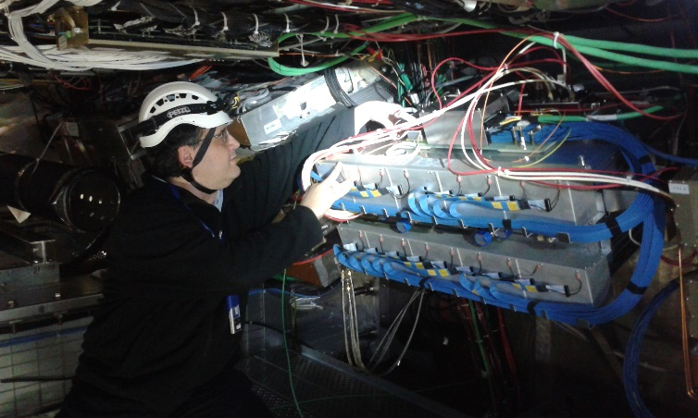
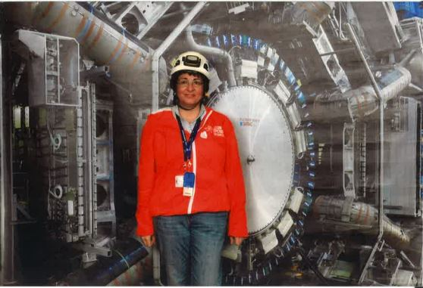
Καλώς ήρθατε στο CERN!
Δρ. Χρυσόστομος Βαλδεράνης Δρ. Ραχήλ Μαρία Αβραμίδου Δημήτρης Δαμιανόγλου

Slide 2

ATLAS Virtual Visits
EYETS 2023-2024: 15 VV (November 2023 - February 2024).
430 Greek schools and 13000 participants.
EYETS 2024-2025: 17 VV (January 2025 - March 2025).
640 schools with 25000 participants from Schools all over Greece, Cyprus, 1 school from Germany (Bielefeld) and 1 school from Congo (Kinshasa).
Many requests from kindergartens, primary schools and school of special education, asking for equal opportunities: Diversity, Inclusion and Equity principles respected.
Many requests from Schools of Second Chance in Detention Centers.

Slide 3
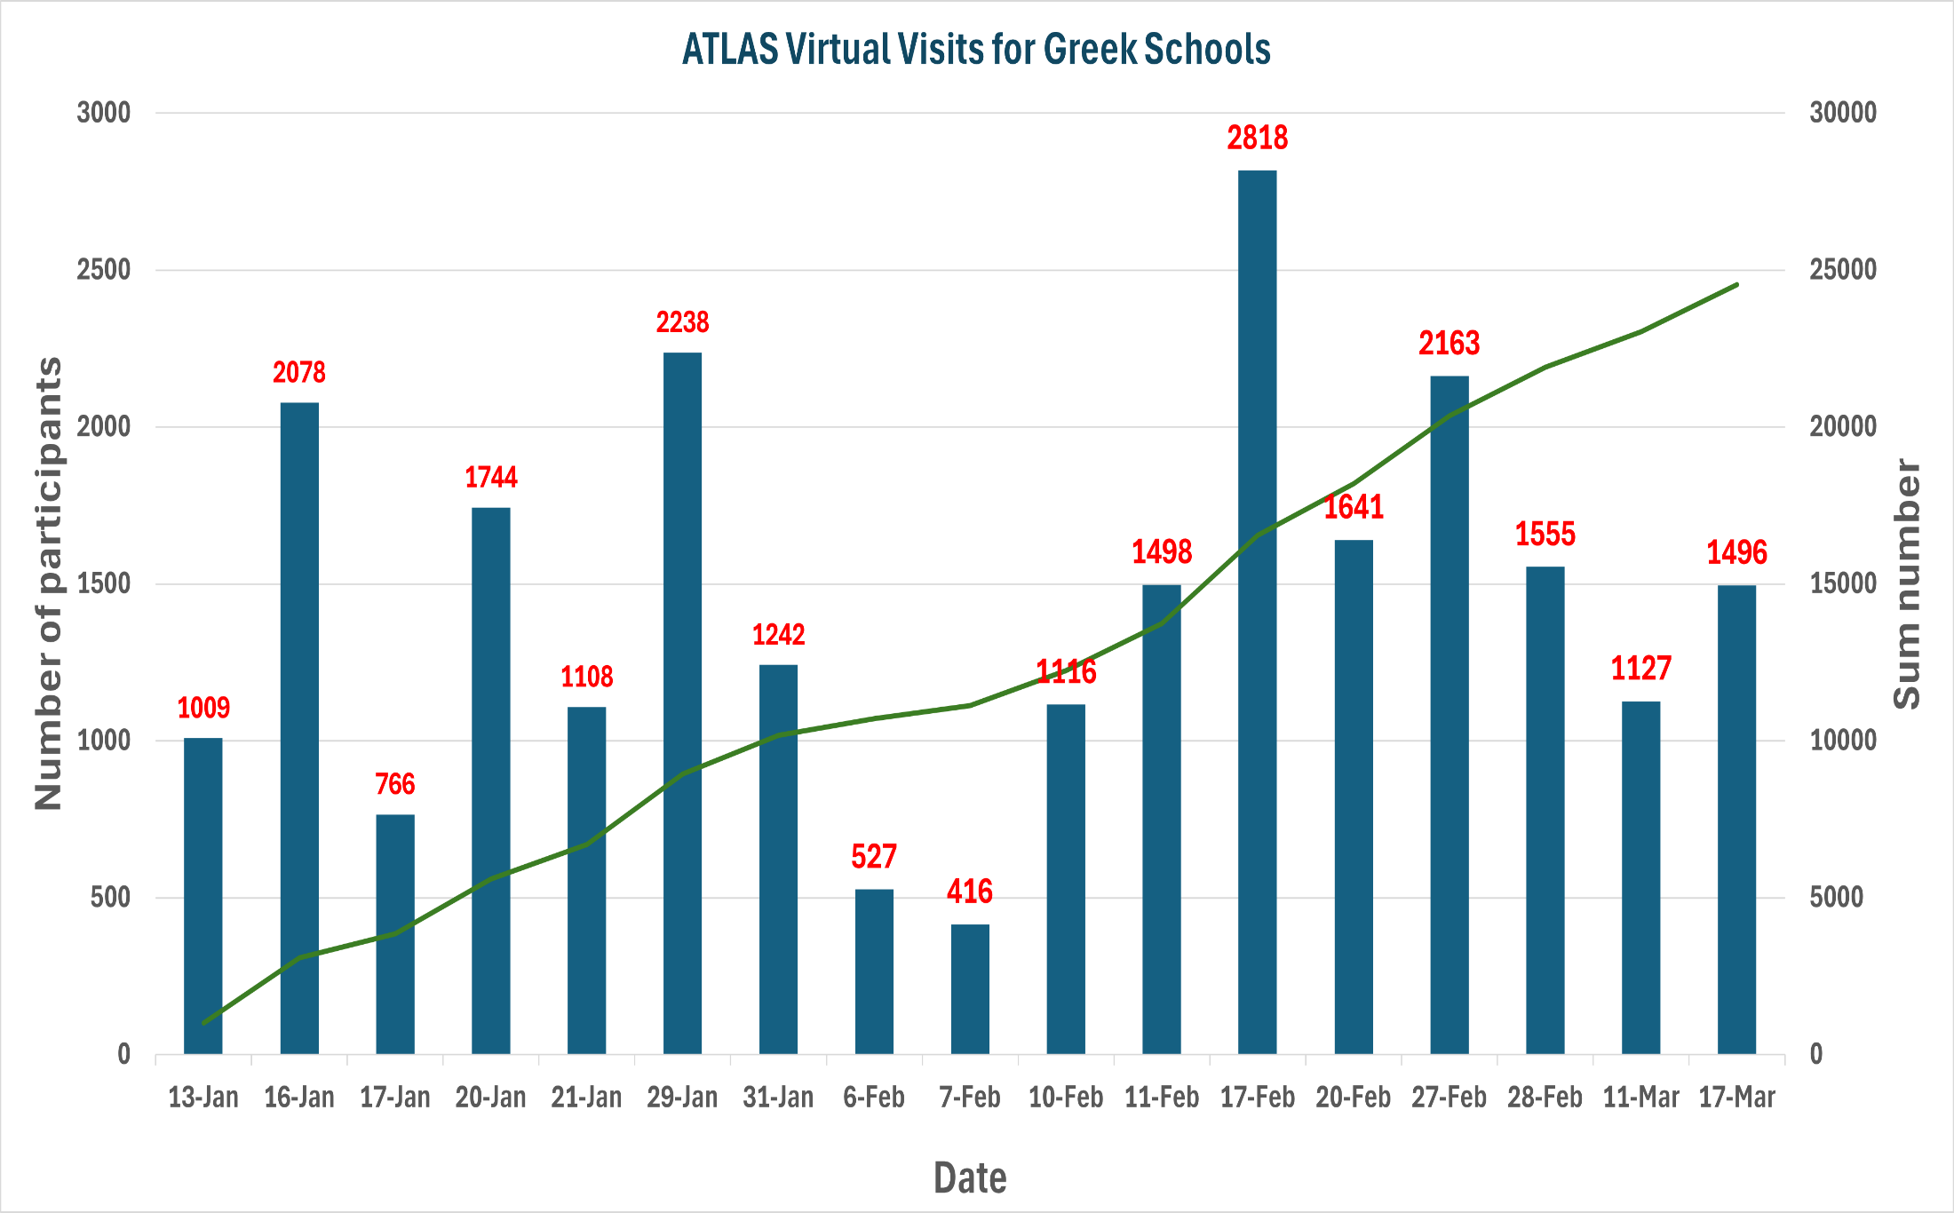
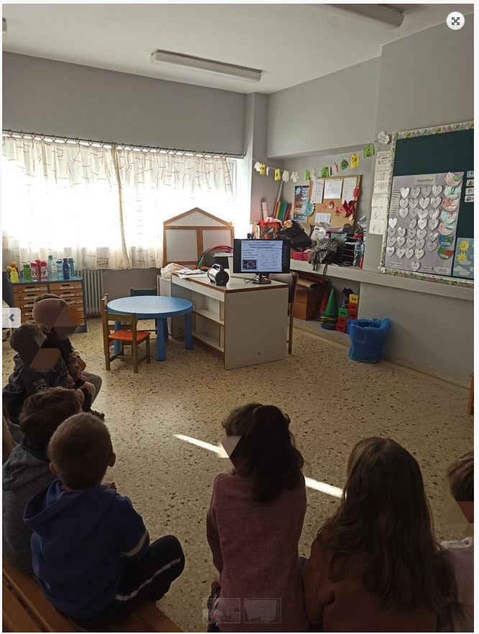
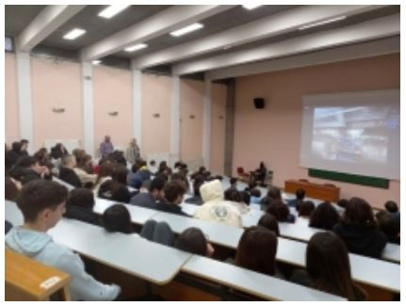
ATLAS Virtual Visits
“ATLAS a playground for Scientists”

Slide 4
Motivation
“On the occasion of the educational visit of our school's kindergarten teachers to CERN, a project with related activities was implemented. Our preschoolers were excited and constantly asked us if they could visit CERN themselves!! It is an excellent opportunity to tour, even virtually!!” Greek-British Kindergarten, Athens.
“Our small primary school in Myrtia, Heraklion, is excited to apply for a virtual visit to the ATLAS experiment at CERN. As a school committed to fostering curiosity and scientific thinking, we believe this experience will inspire our students and introduce them to the fascinating world of particle physics. Given our rural location, opportunities for direct engagement with cutting-edge research are limited, making this virtual visit an invaluable educational experience. We would be grateful for the chance to connect with CERN scientists, learn about the mysteries of the universe, and encourage our students to dream big in science.” Primary School of Myrtia, Heraklion, Crete.
“Our kindergarten is thrilled to participate in the virtual tour of the ATLAS experiment at CERN's LHC! As part of our learning journey, we explore topics like space, astronauts, and the mysteries of the universe! This experience will give our young students a unique glimpse into the world of science, helping them develop curiosity and excitement about how scientists study the tiniest building blocks of the universe. Through this visit, we hope to inspire their imagination and introduce them to the wonders of discovery and exploration! Thank you all for this opportunity! : )” 2nd Kindergarten, Megalopoli Arkadias.

Slide 5
Motivation
“It will be a once in a lifetime opportunity for our students to visit the faculties of CERN virtually.” Arsakeio Lyceum of Thessaloniki.
“Rizomata is a village up in the mountains and the students don't have many opportunities to experience such visit. some of the students don't even have travelled away from their village or the nearest town Veria.” High School of Rizomata.
“General Lyceum of Soufli is a school near the boarder, our students don't have the opportunity to visit a university or a research center very often. Visiting CERN will be such an experience for them and will improve their relation with physics science.” GEL, Soufli, Evros.
“It is a great chance for students of a quite difficult island to approach such as Ikaria, to virtually visit the modern facilities of CERN by using technology, and to verify in practice the value and the application of the experimental and scientific method in practice like ATLAS project. “ High School Evdilou, Ikaria.
“It would be a great opportunity for students of a small, rural high- school to visit CERN, which they otherwise couldn't, mostly due to financial reasons.
It also offers them a glimpse into a world that they would rarely -if at all- access on their own, even though they are constantly on the internet.
A glimpse at ATLAS will be a scientific eyeopener for both students and faculty that will attend the guided tour”. High School, Zitsa, Ioannina.

Slide 6
Comments
“EXCELLENT PRESENTATION AND TOUR!!! THE CHILDREN WERE EXCITED!!!”, GEL, Schimatari, Viotia.
"Excellent presentation, understandable, impressive in the depths of the atlas detector. Thank you!“ 4th GEL Aigaleo.
“The presentation was very nice and interesting. It was very understandable and contained a lot of important information that we will need in the future. We would definitely like to attend such a presentation again.” 9th High School of Kalamaria, Thessaloniki.
“Amazing Experience. Bravo to everyone. Incredible what is happening at CERN. These were the comments of the students and I think that is what counts. Thank you for the unforgettable experience. Amazing sound and image. Bravo to all of you. Do it again next year.” 3rd High School of Ioannina.
“Watching the ATLAS experiment offered our students a unique opportunity to understand how fundamental research in particle physics shapes our understanding of the universe. The presentation was extremely structured and tailored to the needs of the student audience, making complex concepts more accessible and understandable. Our participation in this process was not only an educational experience, but also a source of inspiration for our students, encouraging them to seek more information about high-energy physics and the world of scientific research. We warmly thank the CERN team for this invaluable experience!” GEL Pelopiou, Ancient Olympia.

Slide 7
Comments
“It was an experience! Better than in person.” 1st GEL of Nafplio Argolida.
Excellent tour. Very understandable and informative for children. Thank you very much.” 1st High School of Pylaia, Thessaloniki.
“Amazing experience. Our students were thrilled. Very well organized and structured presentation-tour. Congratulations!!! You managed to keep our interest undiminished until the end. It was a very beautiful journey into the world of CERN.... Thank you very much for the opportunity you gave us!!!” Greek School, Kinshasa, Congo.
"The presentation was excellent! Our students were thrilled with the information in the projection, the tour of CERN and the training it provides in its facilities. The day before the presentation, we watched the video you had sent us. Our only remark is that we found it a little difficult because it was in English. Thank you very much! Good luck with your work!"
2nd High School of Chaidari, Athens.
‘We would like to thank you very much for the excellent online tour you provided to our school of the ATLAS experiment. This experience was unique and impressive for all of us, as we were given the opportunity to get in touch with the fascinating world of particle physics and cutting-edge technology. Your presentation was very informative and inspiring, and your willingness to answer our questions made the experience even more interesting. We hope to have the opportunity to collaborate again in the future and continue to learn from your great work.” High School of Thera, Santorini.

Slide 8
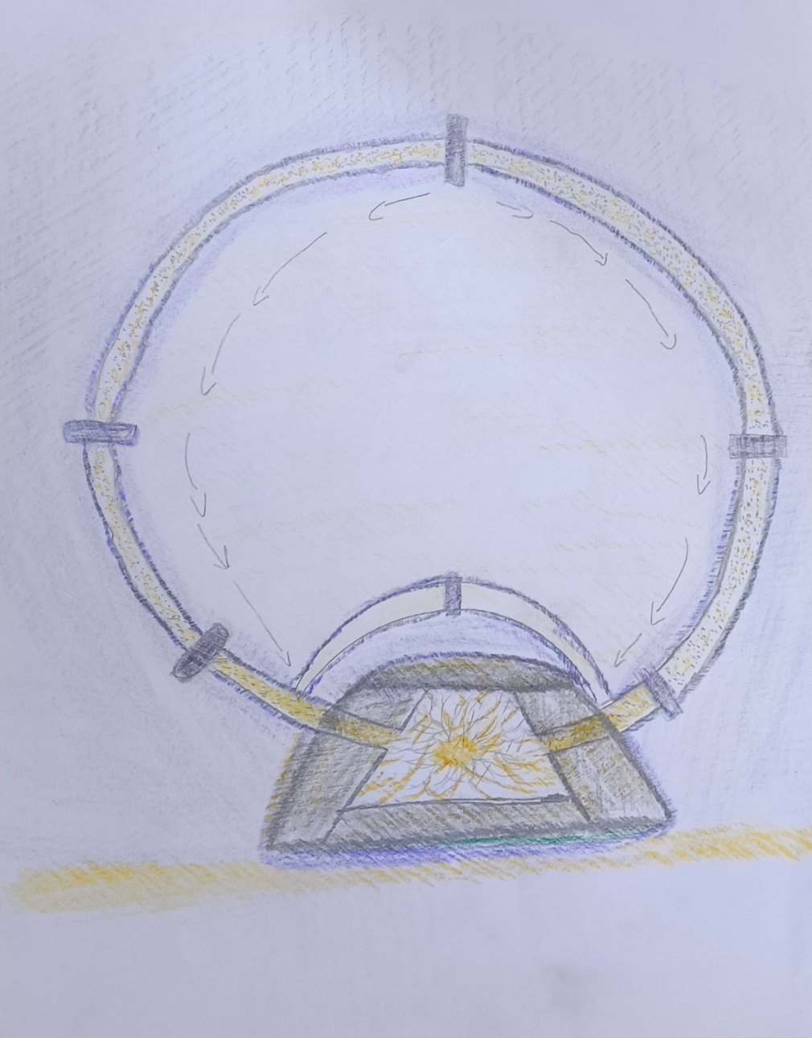
Schools of Second Chance in Detention Centers-Motivation
“Extremely interesting and rare opportunity for our imprisoned students to learn about cern and science” (SSC of Nigrita)
“To inform our students that there is a partnership of the international community for a common scientific purpose.
To make them realize that there are things outside their microcosm.
To give them a window into the world as incarceration takes a toll on them” (5th Primary School, SSC of Amfissa).
8th Primary School of Kos

Slide 9
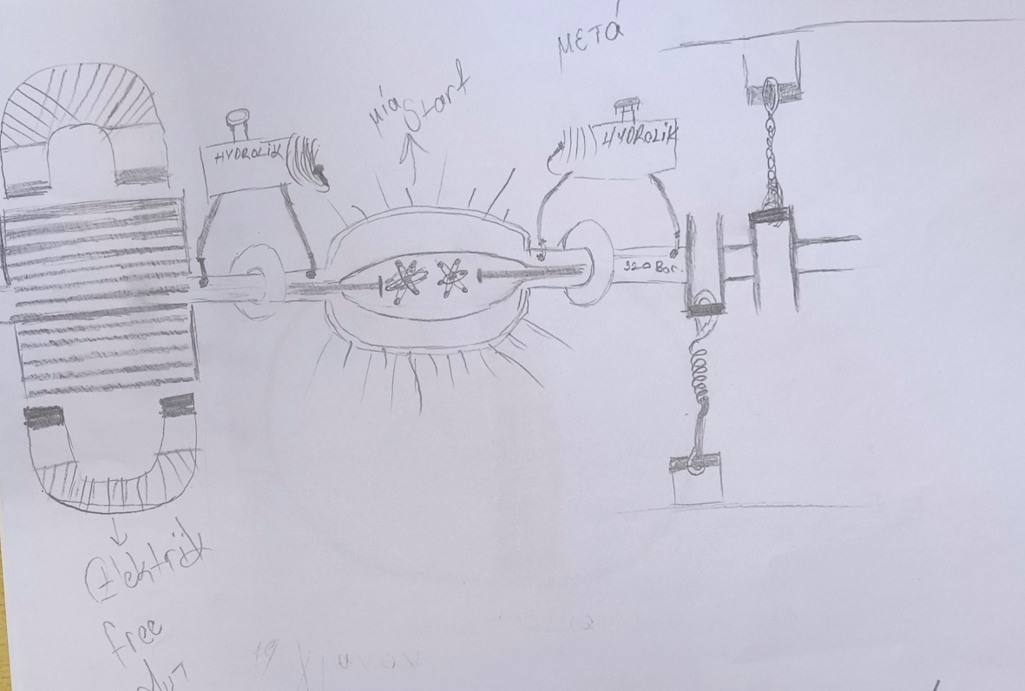
Schools of Second Chance in Detention Centers- Comments
“The trainees responded with great interest to the virtual tour and wished for a renewal of the meeting. The tour was appropriate in terms of duration, understandable and with a popular language. The trainees showed even greater interest in the question and answer section. Could we think of a way where there would be more interaction?” 2nd SSC of Korydallos
8th Primary School of Kos
"The tour was interesting and the presentation understandable. We enjoyed it very much and the speakers were excellent. It was impressive what we saw and what we learned in just one hour. Thank you for answering all the questions. It would be interesting if it is possible to meet again and see an experiment live sometime.” (8th Primary School of Kos).

Slide 10
Summary
Teachers found it very valuable experience, asked for the VV to be repeated every year.
Some teachers asked the VV to become part of their teaching program.
Very successful also for younger ages (kindergartens and primary schools), far beyond our expectations.
The VV touched students of all ages, even the youngest ones.
Many requests for more similar initiatives.

