Slide 1
MADX / BDSIM benchmarking
Aleksandr Gorn, Francesco Maria Velotti, Matthew Alexander Fraser (SY-ABT-BTP)
Laurie Nevay, Fabian Metzger (BE-EA-LE)
06.03.2025

Slide 2
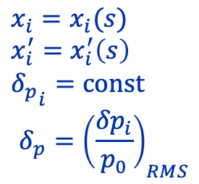

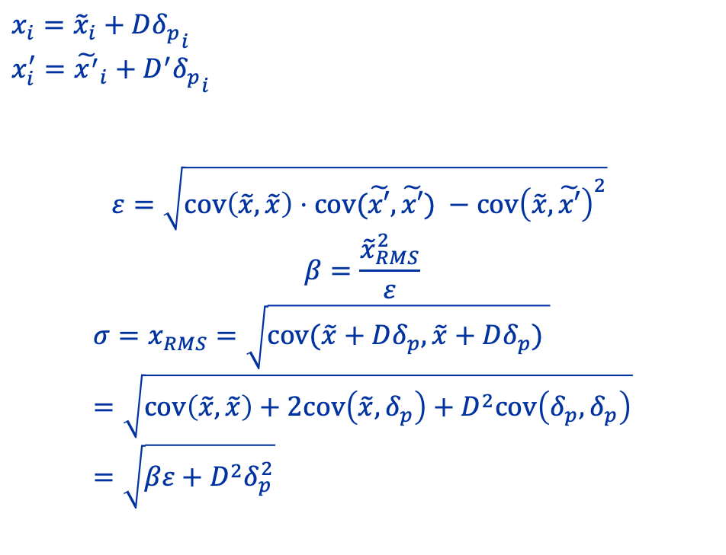
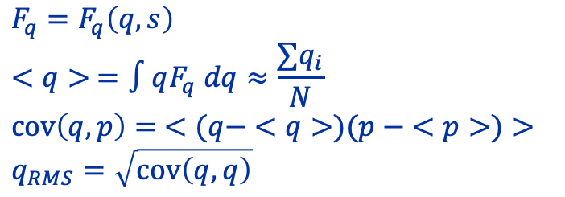
Calculation of optics parameters from a particle distribution
$$F_{q}=F_{q}\left(q, s\right)$$
$$<q> =∫qF_{q} dq≈\frac{∑q_{i}}{N}$$
$$cov\left(q, p\right)= <(q− <q>)(p − <p>)>$$
$$q_{RMS}=\sqrt{cov\left(q, q\right)}$$
$D=\frac{cov\left(x,δ_{p}\right)}{δ_{p}^{2}}$ , $cov(\tilde{x}, δ_{p}) =0$
$D′=\frac{cov\left(x^{′},δ_{p}\right)}{δ_{p}^{2}}$, $cov(\tilde{x′}, δ_{p})=0$
$$x_{i}={\tilde{x}}_{i}+D{δ_{p}}_{i}$$
$$x_{i}^{′}={\tilde{x^{′}}}_{i}+D^{′}{δ_{p}}_{i}$$
$$ε=\sqrt{cov\left(\tilde{x},\tilde{x}\right)⋅cov(\tilde{x′},\tilde{x′}) −cov{\left(\tilde{x},\tilde{x′}\right)}^{2}}$$
$$β=\frac{{\tilde{x}}_{RMS}^{2}}{ε}$$
$$σ=x_{RMS}=\sqrt{cov(\tilde{x}+Dδ_{p},\tilde{x}+Dδ_{p}) }=\sqrt{cov\left(\tilde{x},\tilde{x}\right)+2cov\left(\tilde{x},δ_{p}\right)+D^{2}cov\left(δ_{p},δ_{p}\right)}=\sqrt{βε+D^{2}δ_{p}^{2}}$$
$$x_{i}=x_{i}(s)$$
$$x_{i}^{′}=x_{i}^{′}\left(s\right)$$
$${δ_{p}}_{i}=const$$
$$δ_{p}={\left(\frac{{δp}_{i}}{p_{0}}\right)}_{RMS}$$

Slide 3
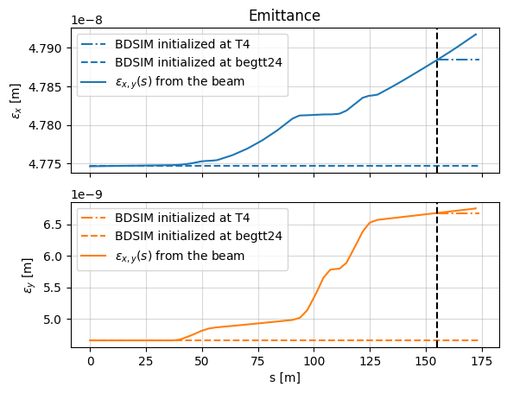
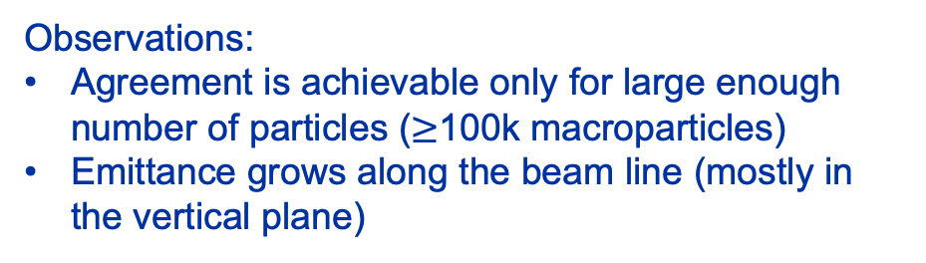
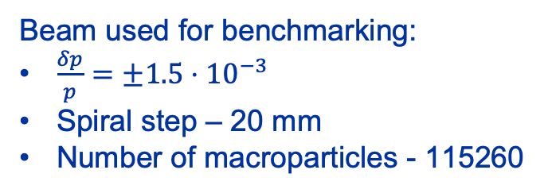
Benchmarking with BDSIM
Beam used for benchmarking:
$\frac{δp}{p}=±1.5⋅{10}^{−3}$
Spiral step – 20 mm
Number of macroparticles - 115260
Observations:
Agreement is achievable only for large enough number of particles ($≥$100k macroparticles)
Emittance grows along the beam line (mostly in the vertical plane)

Slide 4
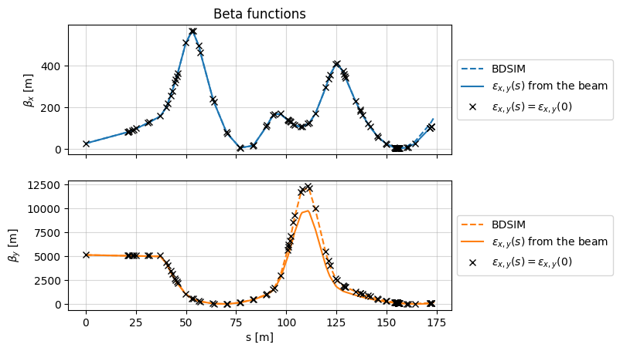
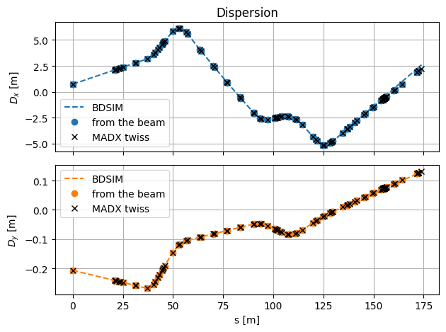
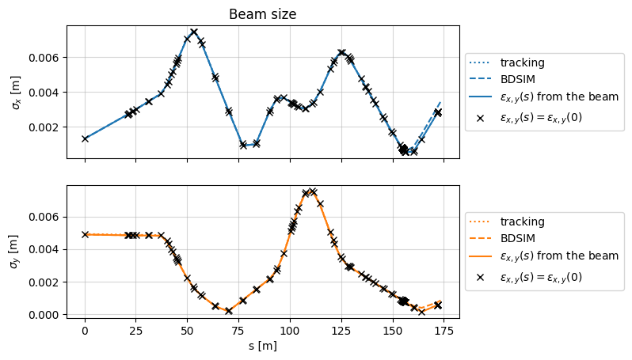
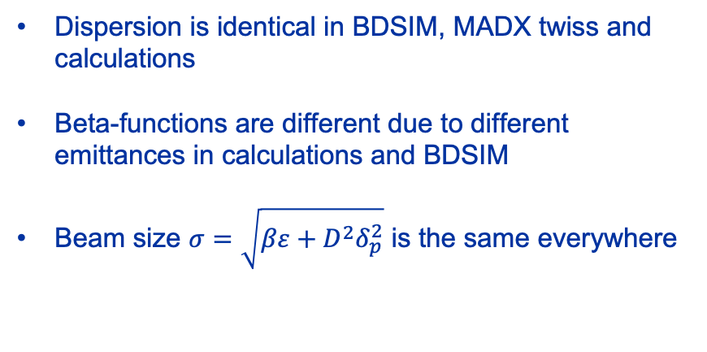
Benchmarking with BDSIM
Dispersion is identical in BDSIM, MADX twiss and calculations
Beta-functions are different due to different emittances in calculations and BDSIM
Beam size $σ=\sqrt{βε+D^{2}δ_{p}^{2}}$ is the same everywhere

Slide 5
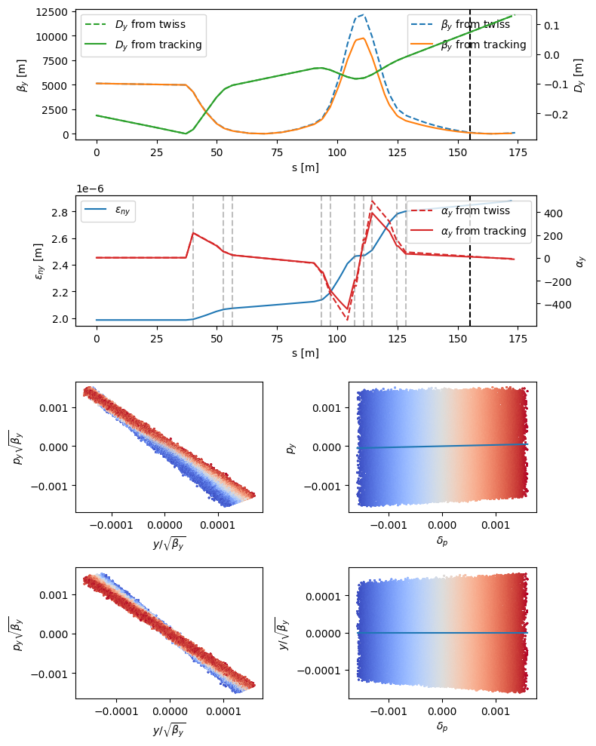

Benchmarking with BDSIM
At T4:
Before the correction
Dispersion correction:
$${\tilde{x}}_{i}=x_{i}−D{δ_{p}}_{i}$$
$${\tilde{x^{′}}}_{i}=x_{i}^{′}−D^{′}{δ_{p}}_{i}$$
After the correction
Dashed gray lines are the quads. Emittance starts to grow in TT24 immediately after the first quadrupole.
Beta and alpha functions are different in MADX twiss and tracking because of this growth.
Color stands for the momentum. Lower momentum particles are focused more comparing to high momentum ones, which is purely chromatic aberration.

Slide 6
Summary
We should be careful with emittance definition and calculation in our codes since the results may differ significantly depending on our approach.
Dispersion calculation from the beam distribution gives the correct answer for large enough number of macroparticles in the beam (> 100k)
Twiss functions depend on the way you calculate the emittance, but the beam size will be correct due to correct dispersion.
Emittance growth in caused by chromatic aberration at strongly powered quads.

Slide 7
Thanks for your attention!

Slide 8
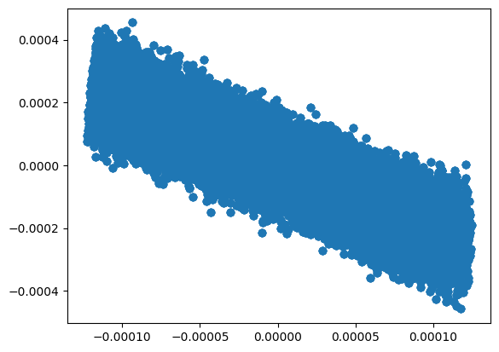
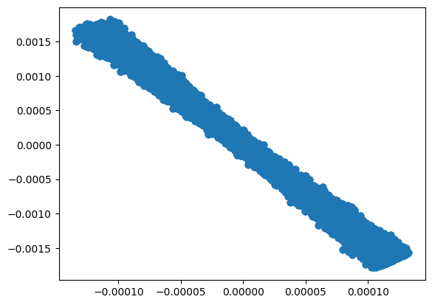
Summary
Normalized phase space V plane BEGTT24
Normalized phase space V plane T4 CENTER

