Slide 1
CERN Workshop upgrade
Rui De Oliveira
KOBE
WG6

Slide 2
  Equipment upgrade
  New building
  Micromegas in industry

Slide 3
WG6: TE/MPE/EM Workshop upgrade
Last year, agreement was reached with CERN management to purchase the subset of machines necessary to carry out R&D on large size GEM
(2m x 0.5 m) & Micromegas (2m x 1m) and the associated large size
read-out boards in the current CERN TE/MPE/ME facility.
GEM market call for order received ready
survey tender
  1 continuous polyimide etcher x x x x 11/2011
  1 Cu electro-etch line x x x x x
  1 stripping line x x x x x
Micromegas
  1 large laminator x x x x x
  1 large Cu etcher x x x 01/2012
  1 large UV exposure unit x x x x 09/2011
  1 large resist developer x x x 01/2012
  1 large resist stripper x x x 01/2012
  1 large oven x x x x x
  1 large dryer x x x x x
3

Slide 4
On top of introducing new machines we have to:
    -redefine all the process parameter related to the new equipments
    -Build some prototypes of the # detectors
    -Hire a technical engineer for 2 years (AIDA Funds) (in progress)

Slide 5
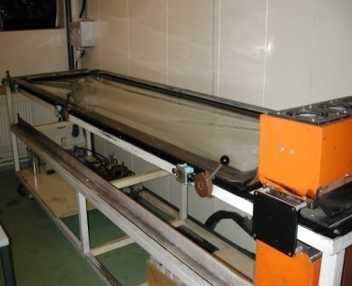
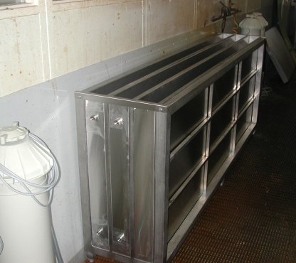
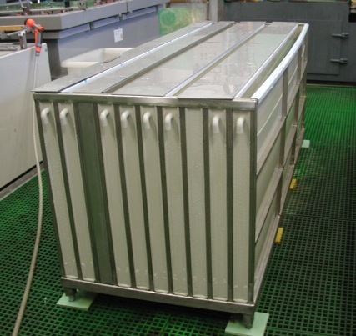
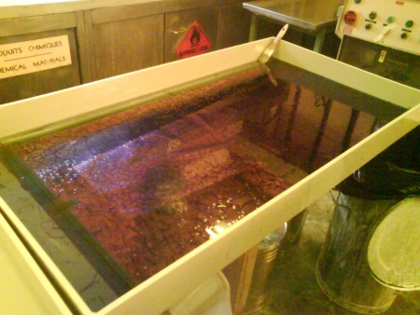
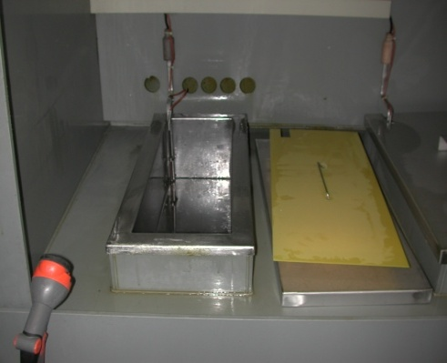
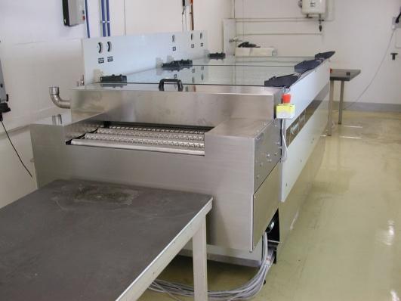
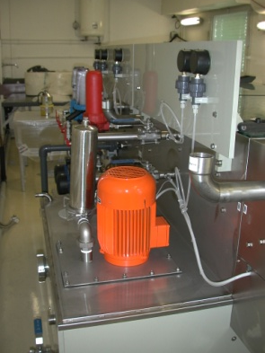
Machine investment for GEM production
UV exposure unit
moving from 2m x 0.6m → 2.2m x 1.4m
30 years old equipment replacement
TECHNIGRAPH (DE)
Not yet Installed
Already delivered
GEM alcohol resist stripping
1m x 0.6m → 2.2m x 0.6m
GEM electro etch
1m x 0.6m→ 2.2m x 0.6m
10 baths compacted
LECOULTRE (CH)
GEM polyimide etch
moving from 1m x 0.6m → ?
10→ 30 GEM/day
roll to roll compatible
no tooling needed
WISE (IT)

Slide 6
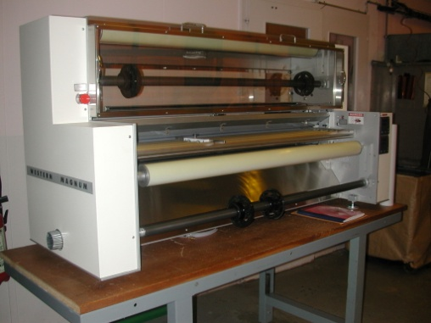
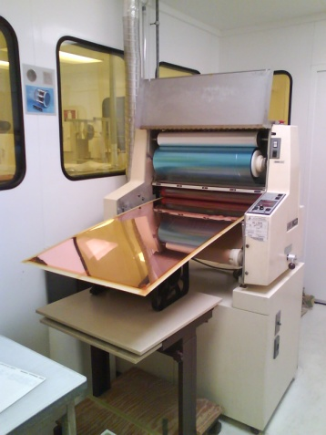
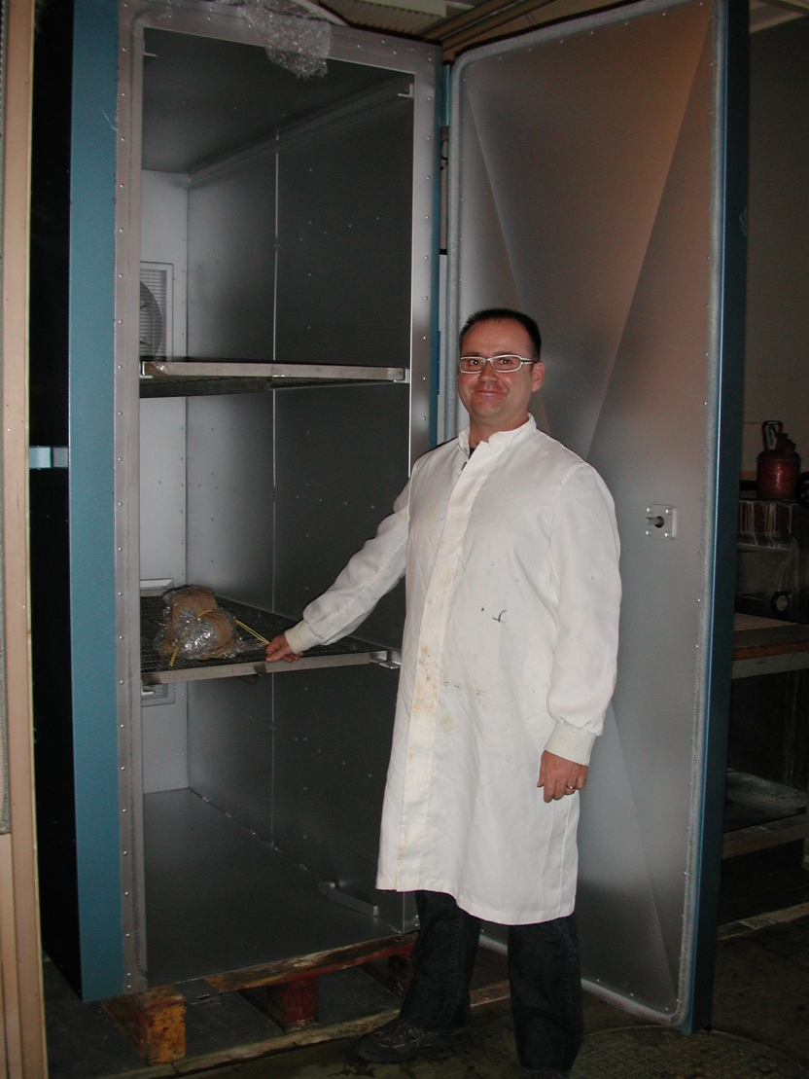
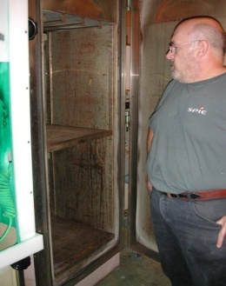
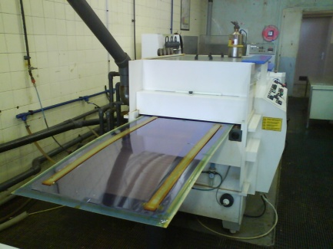
Machine investment for Micromegas production
Laminator (resist and coverlay)
0.6m width → 1.4m
WESTERN MAGNUM (US)
Ovens (cure the coverlay)
1.5m x 0.6m → 2.2m x 1.4m
JLS (UK)
Resist developer
Resist stripper
Copper etcher
0.6m width → 1.2m
WISE (IT)
Not yet delivered
ordered

Slide 7
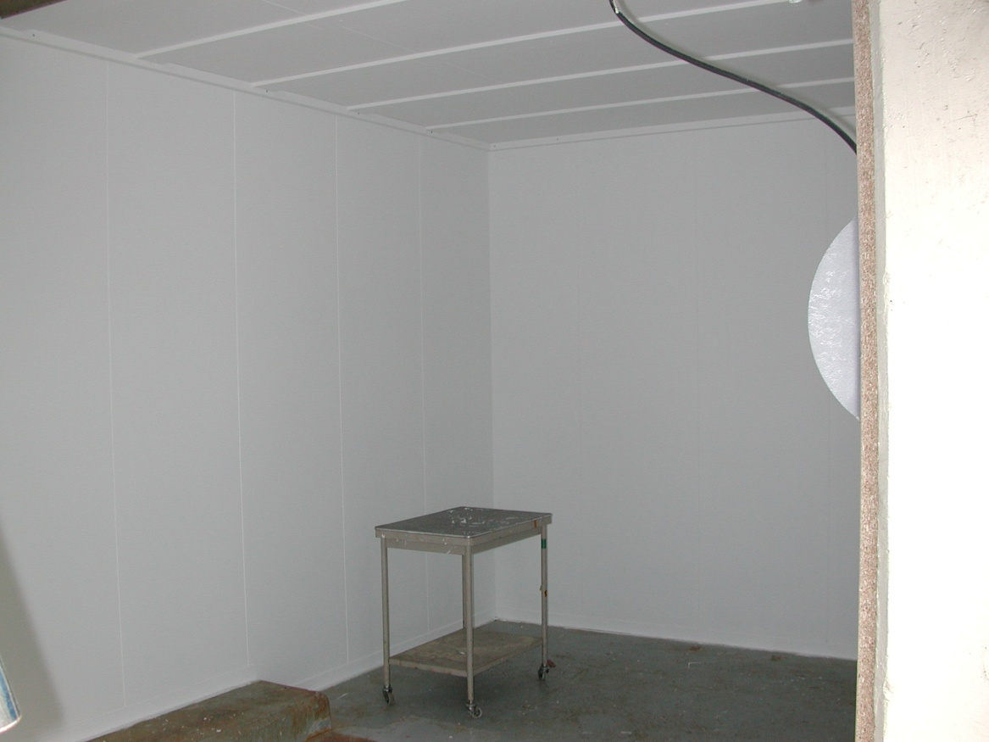
UV exposure unit
Room is prepared
Electricity is ready
Air renewal is OK
Move the machine to it’s final place to be done soon

Slide 8
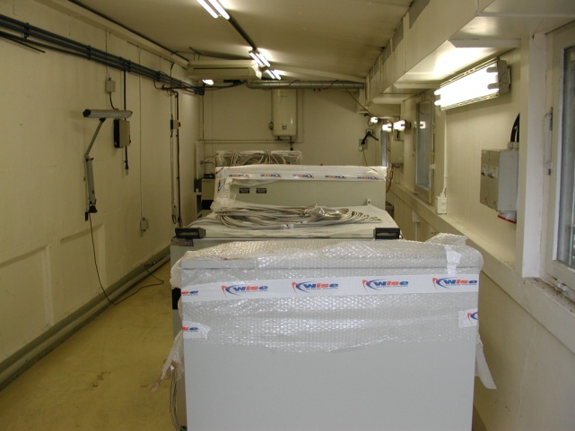
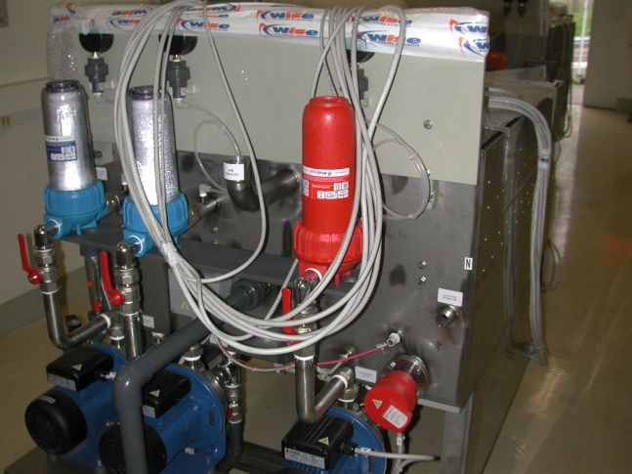
GEM polyimide etching machine
Machine assembly is done
Power connection OK
Air exhaust missing
Chemical connection missing

Slide 9
Resistive deposition equipment
This process was not existing when we ask for the subset of machines
Different techniques are envisaged:
  Paste filling + polishing (no size limitation)
  Screen printing (80cm x80cm)
  Spray deposition (no equipment at CERN)
In the coming month we are going to study the best solution for mass production.
PCB
PCB
PCB
PCB
PCB

Slide 10
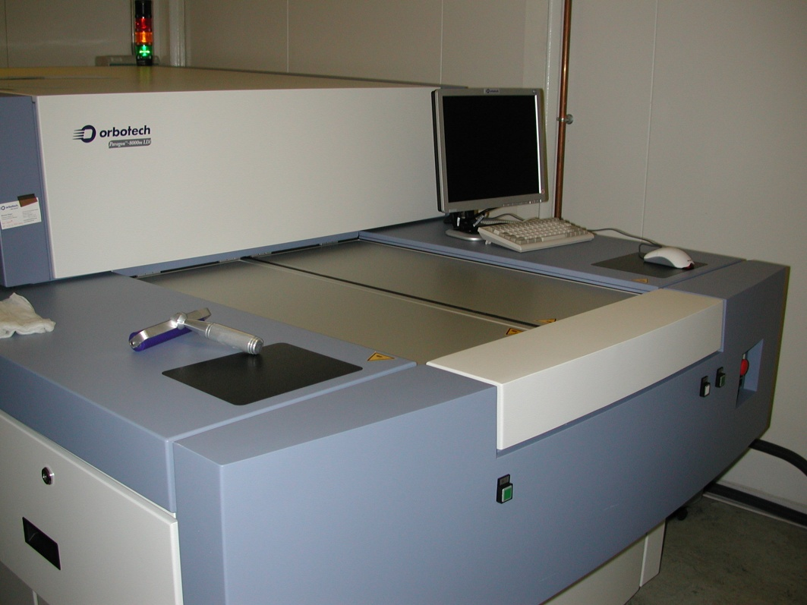
Machine investment for MPGD production
LDI (laser direct imaging) replacing films or masks
LDI is fully operational since
since 3 months
Single side GEM
Special readouts
Repetitive work
High alignment accuracy
  MHSP (large size?)
  COBRA and THCOBRA

Slide 11
  Equipment upgrade
  New building
  Micromegas in industry

Slide 12
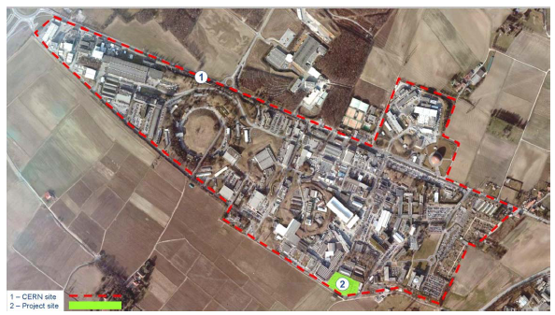
New Building 107

Slide 13
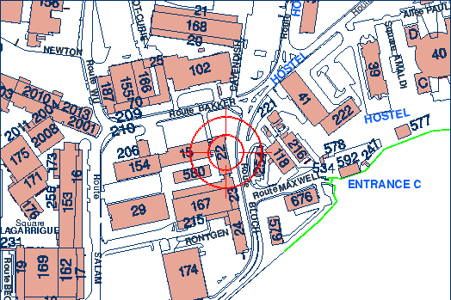
Water treatment plant
Present location
new location

Slide 14
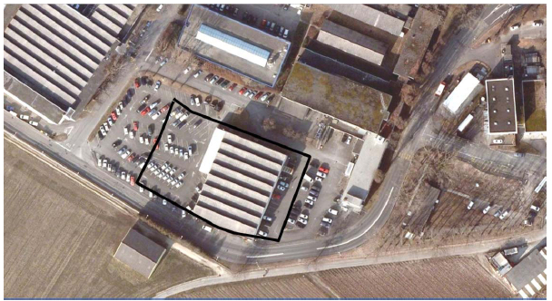
New Building 107

Slide 15
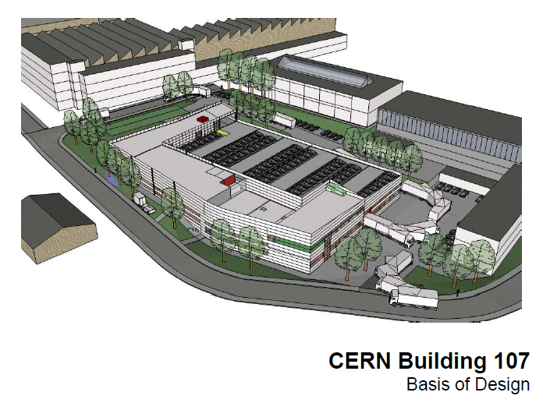
New Building 107

Slide 16
New building 107
    The Consultant company designing the building have been selected
    The design is completed
    The market survey for construction should be launch soon
    The final design will be done with the consultant and constructor
    The construction should start beginning of 2012
    The construction should end October 2013
    40 square meter room reserved for MPGD assembly
    All the machines for large size detectors production are in the layout
    Area 900 m2 → 1400m2 with optimized layout
    Most of the baths will be replaced by compact machines
    Rooms are reserved for new processes (laser and plasma)

Slide 17
  Equipment upgrade
  New building
  Micromegas in industry

Slide 18
Micromegas with company Eltos (IT)
    July the 4th we have got a meeting with the CEO of ELTOS at CERN
    Why Micromegas with Eltos?
      This company has won a CERN market survey for the production of PCBs out of 80 European companies.
      They have already made components for MPGD detectors ( THGEMs).
      They are really interested by this project.
      They have the knowledge to stretch the meshes.
      They do not reject the idea to build large detectors.
    Decisions taken in collaboration with RD51 leaders during this meeting:
      1/ send the files to build a 10 x 10 std Bulk (done)
      2/ build the read-out PCB (in progress)
      3/ bulk this PCB with CERN help (visit to be scheduled for September 2011)
      4/ stop point for radiation test at CERN
      5/ technology transfer of resistive strips (November 2011)
      6/ production of a protected device (December 2011)

Slide 19


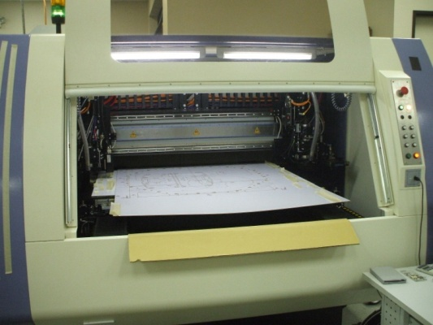
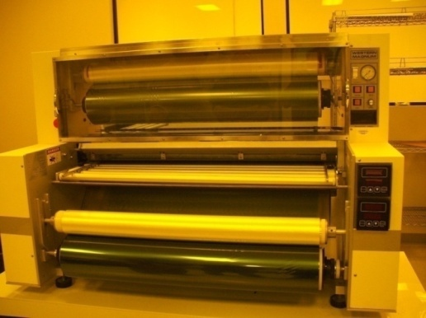
Micromegas/
TRIANGLE LABS
Visited 3/06/2009 in Nevada with Brookhaven lab Atlas Team
-Their equipment is compatible with the production of 2m x 1m Bulk
-They are going to increase their PCB capability up to 1.4 m x 2m (new laminator)
-Print and etch and also Plated through holes
-12 persons
AOI for read out ?
Project followed by Vienetos Polychronacos (BNL).
2 m x 1m milling machine
1 meter laminator

Slide 20
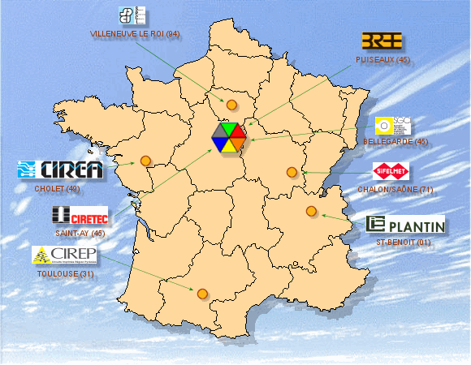
CIREA
First contact for large size large volume productions in2008
CIRE Group
8 companies in France
Possibility to make large boards up to 2mx 0.6m
They have already produced some small BULKS
Project followed by SACLAY

Slide 21
Thank you

