Slide 1
Front End IC for the ATLAS Muon Upgrade, A Status Report
V. Polychronakos, BNL
Kobe, September, 2011

Slide 2
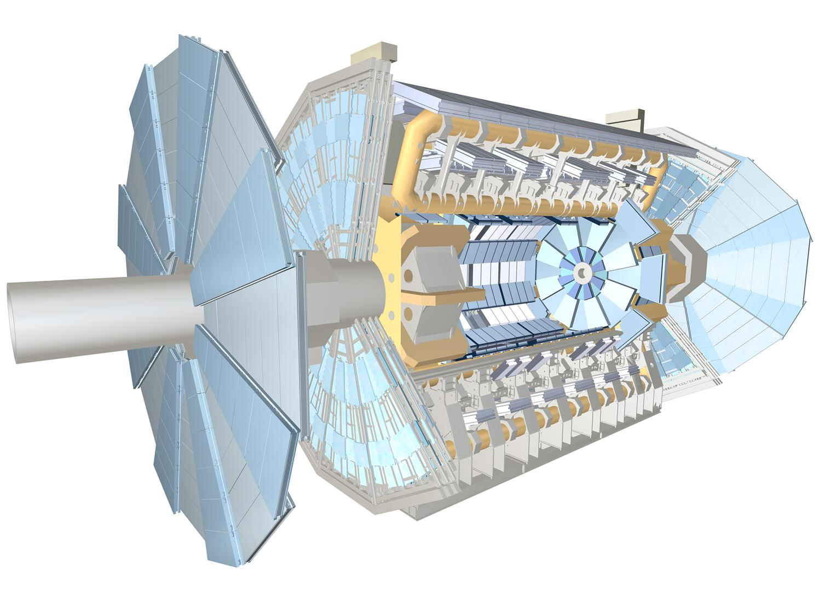
The ATLAS Muon Spectrometer
Drift tubes (3cm Φ)
Precision Measmnt
In both Barrel, Endcap
RPC Barrel Trigger
CSC Forward Inner layer
Precision Measurement
Thin gap chambers Endcap Trigger

Slide 3
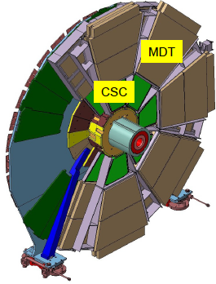
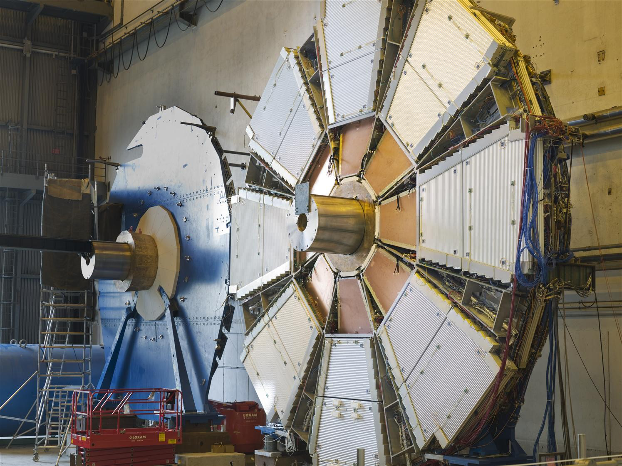
The Present “Small Wheels” (9m Diameter)
Need New Detectors that participate in the Level1 Trigger by providing a vector
with ~1 mrad resolution
Need to handle considerably higher rates at L = 5x10e34

Slide 4
Three reasons for the New Small Wheels
(in order of increasing importance)
Complete Original Scope in CSC Area, add more layers. Alll detectors in SW expected to be at their Rate Limit
  Very weak, doubt it could convince Reviewers
Improve Pt resolution to sharpen thresholds
  Requires 1 mrad pointing resolution for a ~20% gain which quickly disappears if resolution ~1.5-2 mrad
Eliminate Fakes in Pt>20 GeV Triggers
  Serious issue, Higher Luminosity Physics MUST use Pt thresholds 20-25 GeV. Currently over 90% of high Pt triggers are fake

Slide 5
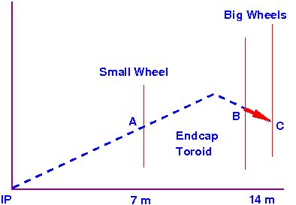
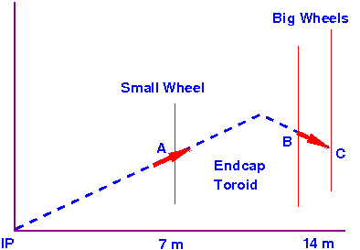
The Problem with High pT Triggers
Current Endcap Trigger
Only a vector BC at the Big Wheels is measured
Momentum defined by implicit assumption that track originated at IP
Random background tracks can easily fake this
ProposedTrigger
Provide vector A at Small Wheel
Powerful constraint for real tracks
With pointing resolution of 1 mrad it will also improve pT resolution
Currently 96% of High pT triggers have no track associated with them

Slide 6
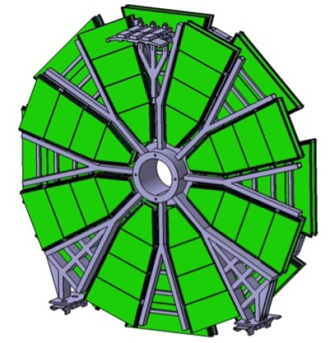
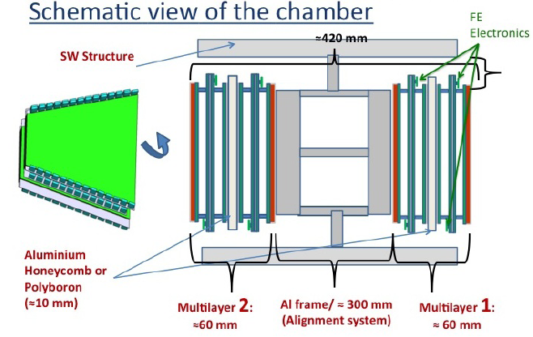
A tentative Layout of the New Small Wheels and a sketch of an 8-layer Chamber built of 2 4-layer multilayers separated by an instrumented Al spacer for monitoring in-plane alignment

Slide 7
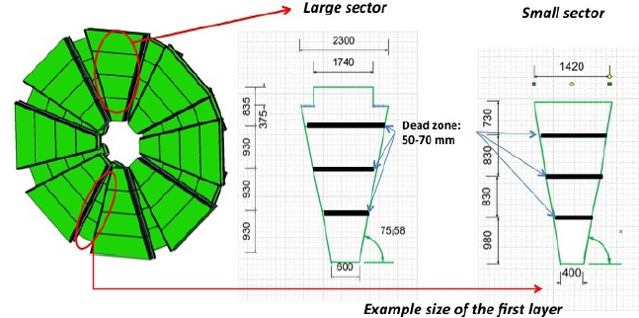
A possible segmentation of Large and Small Sectors

Slide 8
The Electronics Challenge
The Small (~0.5 mm FWHM) charge footprint of the μMegas Detectors results in excellent position and double track resolution
Results in a very large number of channels (order 10⁶)
Two Functions of the Readout:
  Provide Precision measurement of charge and time at Trigger Level 1 accept
  Provide in real time vector with ~1 mrad resolution to assist Trigger Level 1
First task relatively easy to accomplish by highly multiplexed, data driven system
Custom front end ASIC being under development

Slide 9
Block Diagram of the IC being designed
To SRS
64 channels
adj. polarity, adj. gain (0.11 to 2 pC), adj. peaking time (25-200 ns)
derandomizing peak detection (10-bit) and time detection (1.5 ns)
real-time event peak trigger and address
integrated threshold with trimming, sub-threshold neighbor acquisition
integrated pulse generator and calibration circuits
analog monitor, channel mask, temperature sensor
continuous measurement and readout, derandomizing FIFO
few mW per channel, chip-to-chip (neighbor) communication, LVDS interface
Readout at L1 Accept
No Problem
Zero-suppressed, already digitized, much of DAQ already on Front End IC

Slide 10
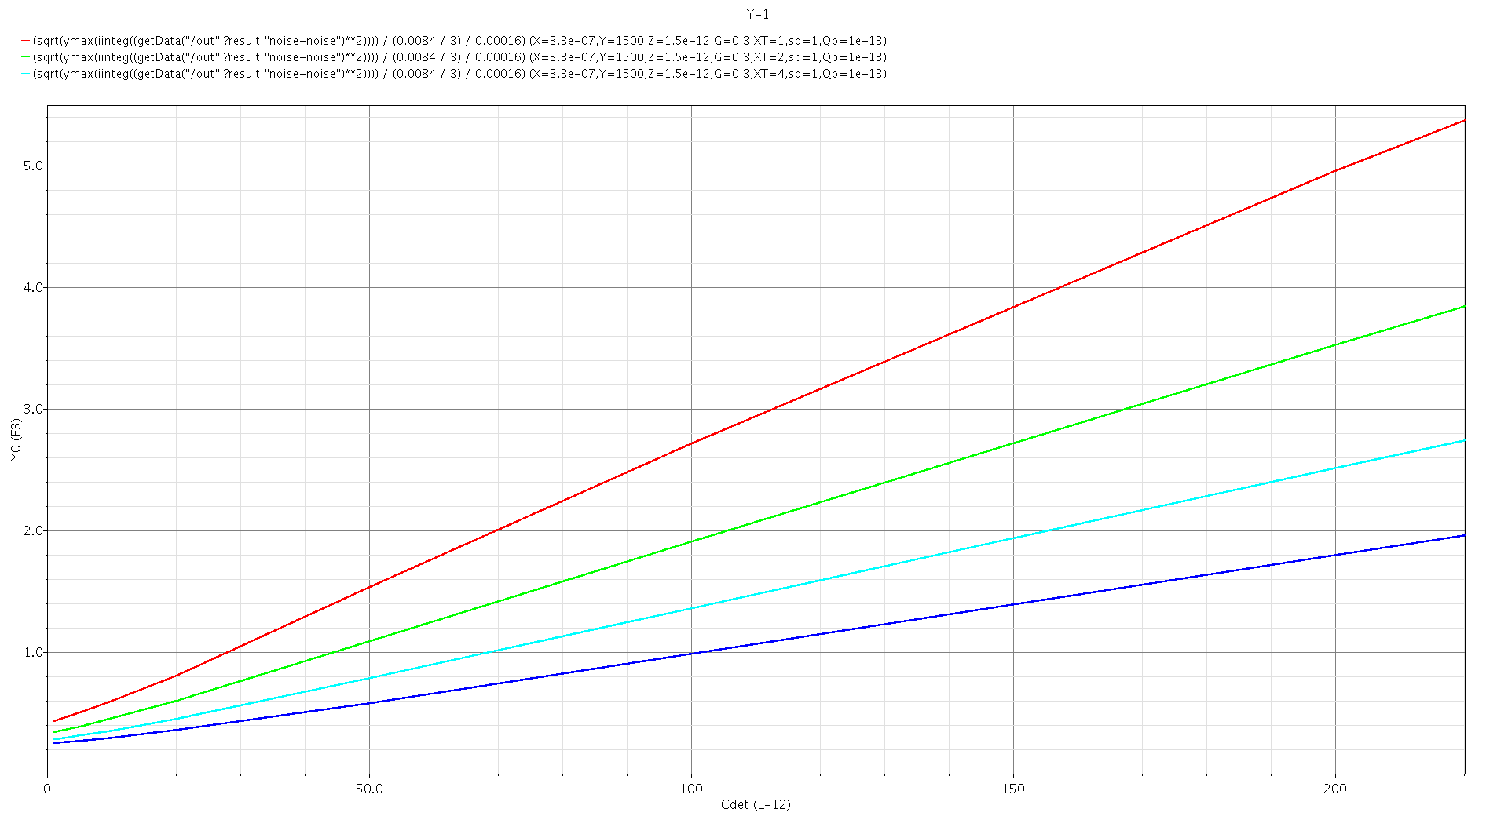
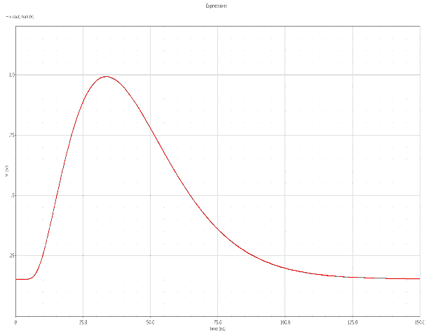
VMM1 IC SPICE Simulation performance
Analog section:
transistor-level simulations
power ≈ 4 mW
Charge Resolution
5k
Q_{max} = 330 fC
Pulse Response
1.2
Q_{in} = 300 fC
ENC (e⁻)
peaktime 25ns
Amplitude [V]
50ns
100ns
200ns
0
0
150
time [ns]
0
0
C_{IN} [pF]
200

Slide 11
BUT, How about Trigger?
Need to process in Parallel at 40 MHz
How can we take advantage of the 0.5 mm strip pitch?
Assume that we use ONLY one hit (the strip with the first arriving signal above a set threshold) from each 64-channel chip at each bunch crossing
This way:
We have a trigger system with granularity of 3.2 cm (64 channels x 0.5 mm) BUT
With spatial resolution ~ 0.5 mm
We now have to deal with ~30,000 channels and not 2 million

Slide 12
But are we paying a price for this? i.e. efficiency loss?
Consider worst case at η= 2.4:
Rate r = 10 kHz/cm², strip length l = 50 cm, strip width w = 0.5 mm
Occupancy/BC = rlwt = 6.25x10⁻⁴
 | Probability per Front End IC [%]
 | Probability per Chip per Bunch Crossing | Probability per Chip per 3 Bunch Crossings | Probability per Chip per 5 Bunch Crossings
# Hits
0 | 96.1 | 88.7 | 81.9
1 | 3.8 | 10.6 | 16.5
>=2 | 0.1 | 0.6 | 1.6

Slide 13
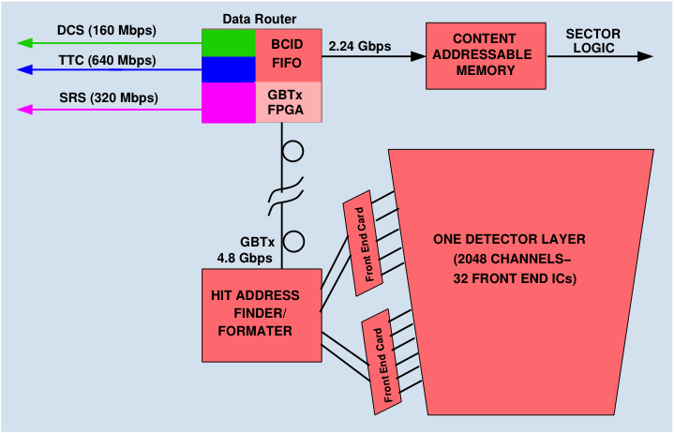
Trigger/DAQ Block Diagram
GBTx Gigabit Tranceiver
Chipset being developed at CERN, will combine
Data, TTC, DCS on a single fiber

Slide 14
Timing Diagram
Fine Time to next BC
40 MHz BC clock convenient for LHC but any clock can be used to related hit with trigger accept

Slide 15
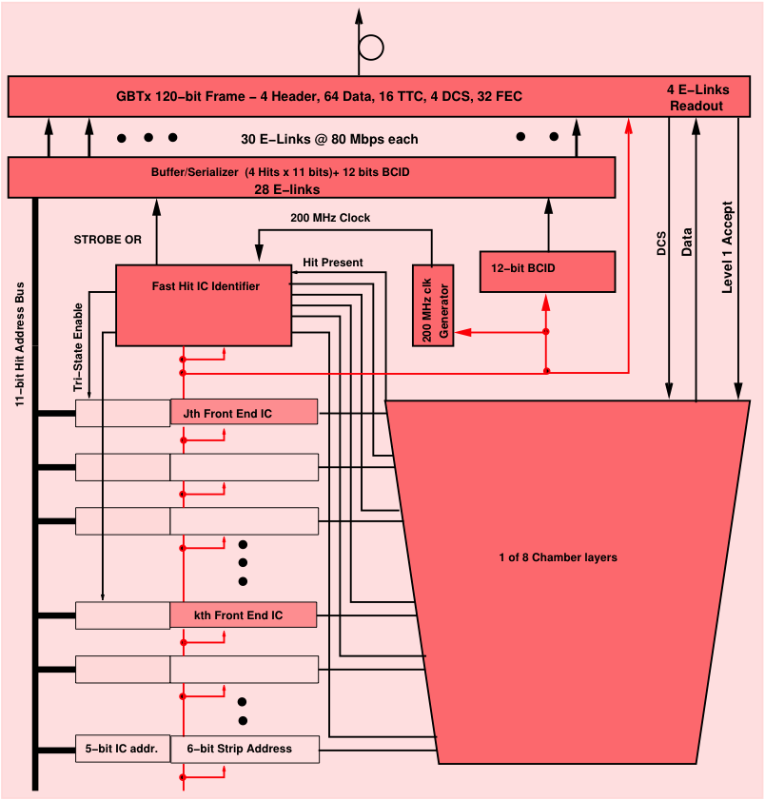
On-Detector Card
6 bit prompt strip address
5 bit IC address per plane
Up to 4 hits per plane transferred in 2 BC
A Custom Digital IC the likely implementation

Slide 16
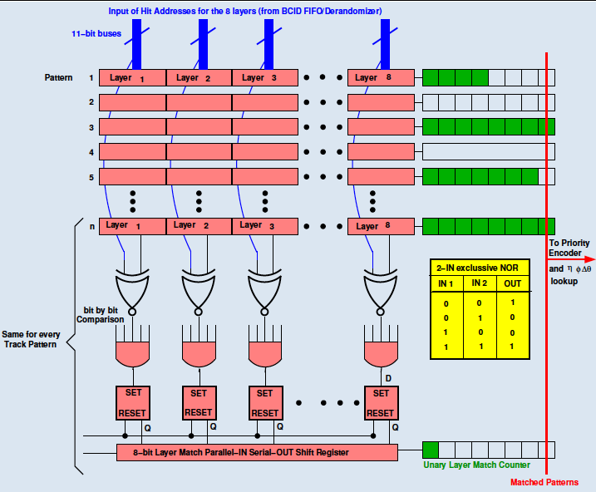

Slide 17
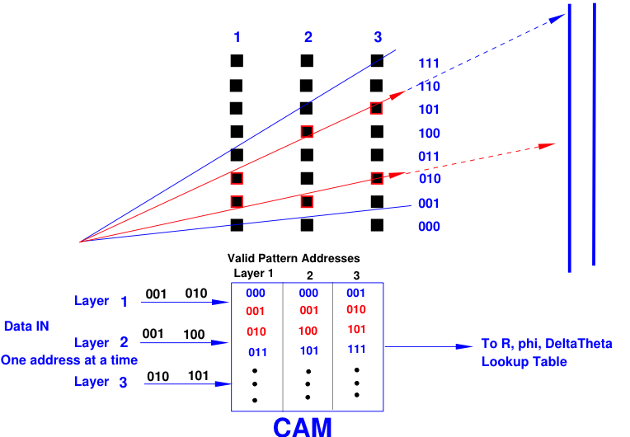
An Example

Slide 18
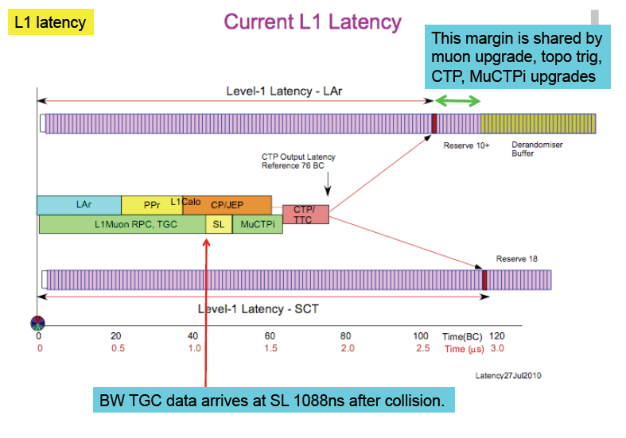

Slide 19
Time Required (BC)
Muon TOF 1
Detector Response (drift time) 1
Front End Response (peaking time) 2 -- 3
Front End to GBTx 2
To USA15 (80 m fiber) 15
GBTx FPGA to CAM (up to 5 addresses per BCID) 1 – 2
CAM Read (160 MHz clock) 2 – 3
To Sector Logic 1 – 5*
Total 25 – 32
* Assumes that existing sector logic clocked @ 40 MHz

Slide 20
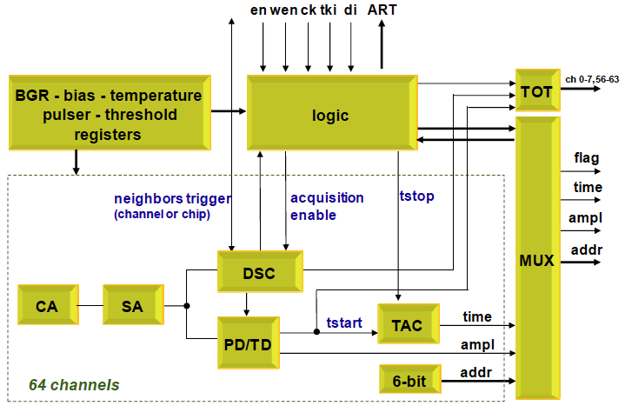
First Version of the front End IC
No ADC, no Buffers and no
Redundant Logic

Slide 21
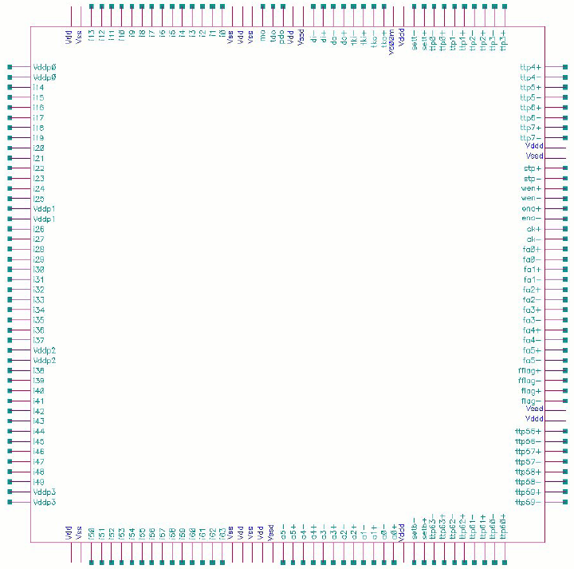
Layout of the Prototype ASIC
IBM 132 nm, 1.2
Packaging QFN176
Combines Mmegas and TGC Trigger Functions
Saving in Prototype costs (~120 k$ for 40 chips)
Production would be separate

Slide 22
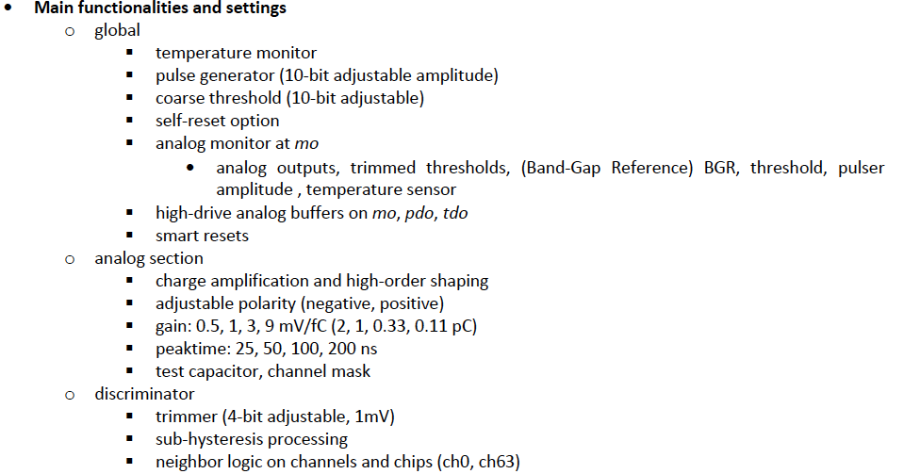

Slide 23
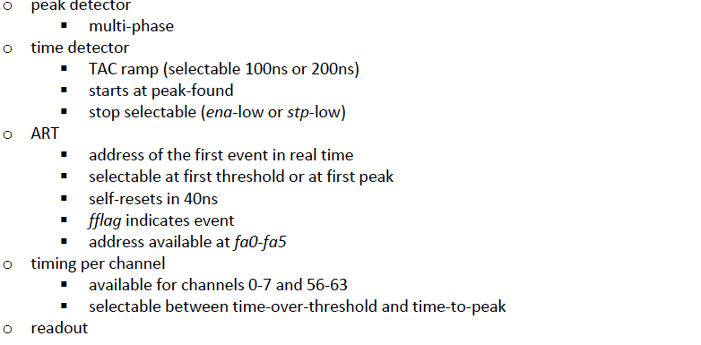
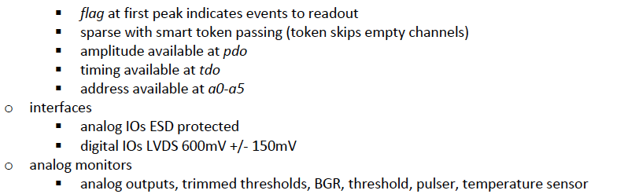

Slide 24
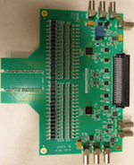
Further Front End Card Development for prototype and future on-detector readout(U.Az)
Integration of BNL ASICs into
  Development of so-called “C-card” for
    BNL “LEGS TPC” ASIC
    BNL new “MM TPC” ASIC
Development of “small format” front-end card for CSC size Micromegas
Development of complete front-end system for CSC size Micromegas
Scalable Readout System
SRS
Common Readout System developed for use by the RD51 collaboration for beam tests at CERN but not only
C-card (green module)
Front-end card

Slide 25
Summary
Design of first prototype finished
Has all Basic Functionality for both mMegas and TGC
Layout to be done over the next month or two
To be submitted for fabrication with MOSIS in November 2011
Note: the first prototype won't implement the ADCs and the SEU circuitry.
Work on front end boards started, to be tested early next year
A second submission in about one year from now
Preproduction and production to follow, estimate end of 2013 beginning 2014
Schedule consistent with the overall Small Wheel schedule

