Slide 1
The Economics of Big Science
Introduction
Last update: 16 March 2025
INDICO: https://indico.cern.ch/category/19634/

Slide 2
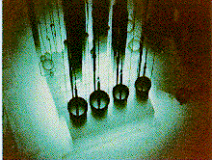
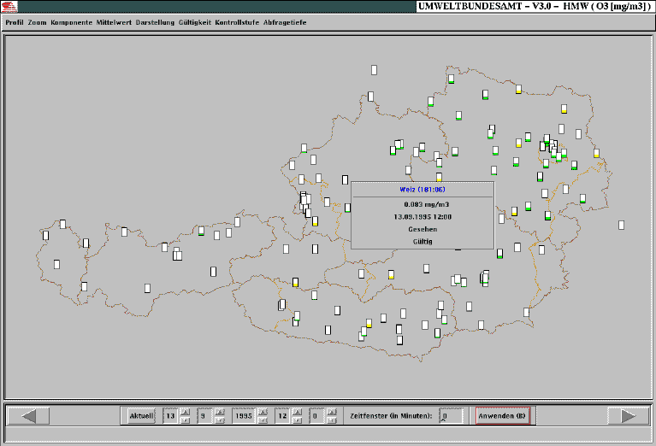
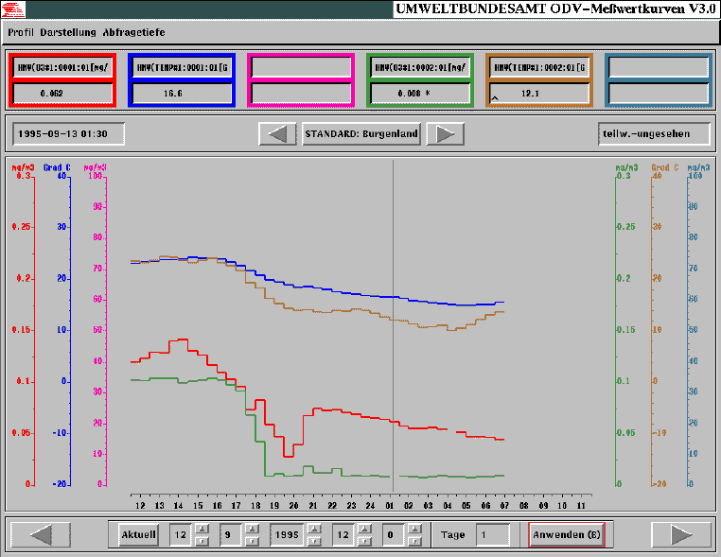
1991 – 1996: Austrian Research Centre Seibersdorf
Research Reactor: radionuclide management
Resarch on active real-time database management systems and
distributed shared memory

Slide 3
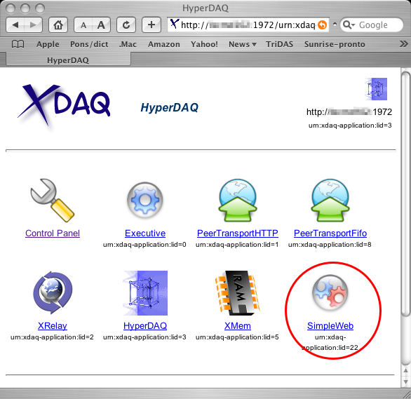
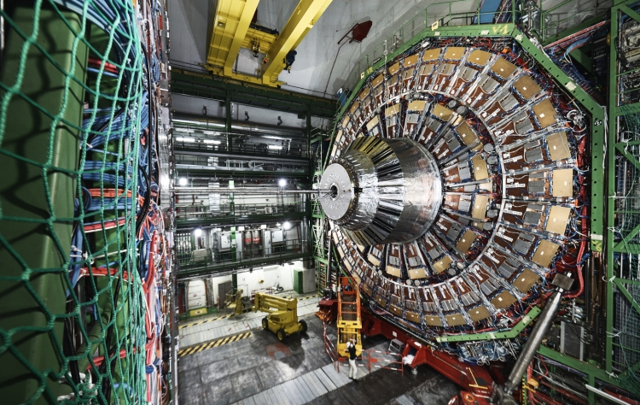
1996 - 2009: CERN, CMS experiment @ LHC
Development of the on-line data acquisition system, based on a hardware-agnostic, re-configurable and Web enabled executive.
In uninterrupted operation since 2006, aving passed 4+ computing and networking technology generations.

Slide 4
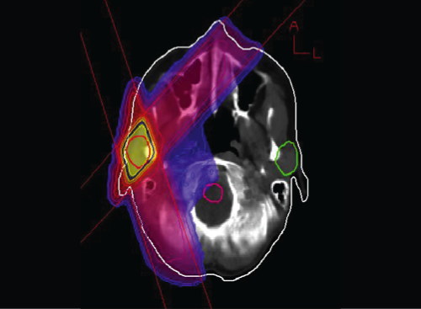
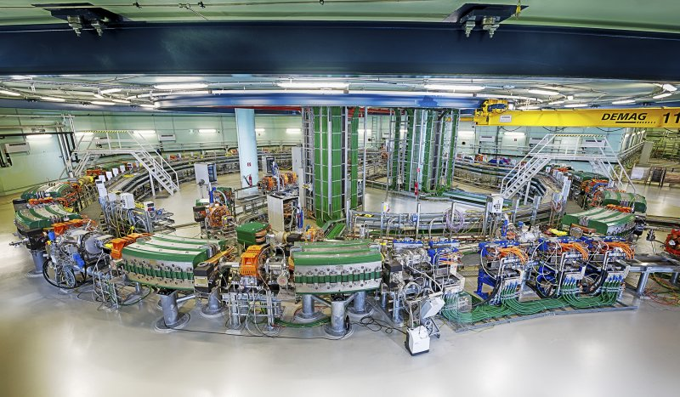
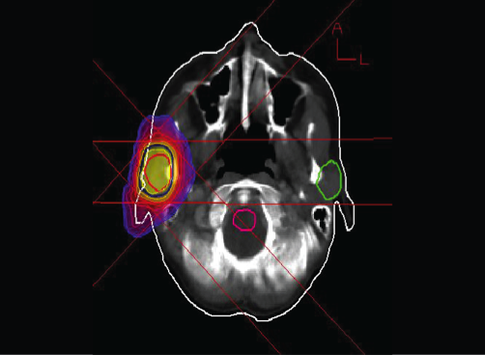
2008 - 2014: CERN, MedAustron
Re-configurable, light-ion synchrotron for cancer treatment in Austria, designed at CERN.

Slide 5
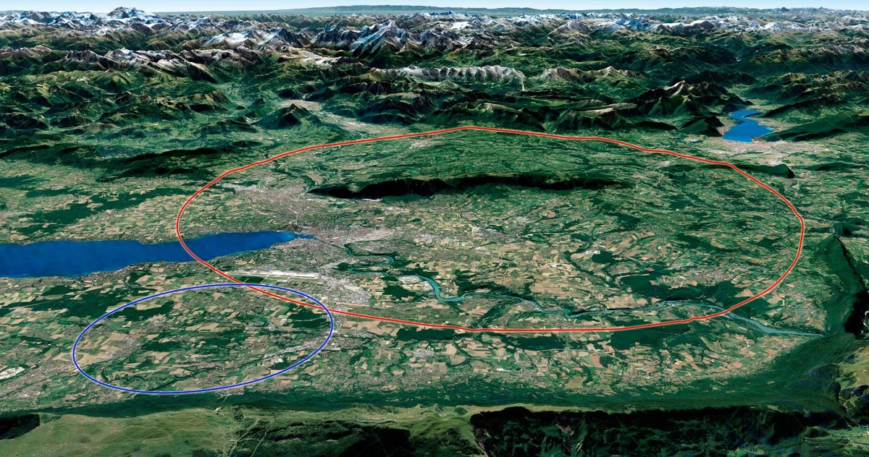
2014 – now: CERN, Future Circular Collider
91 km long, circular particle collider infrastructure, 2 phases until the end of the 21st century

