Slide 1
The Economics of
Big Science
Part 2
INDICO: https://indico.cern.ch/category/19634/

Slide 2
Outline
(Lifecycle Analysis)
Time preference and social discounting
Project lifecycle and project planning
Theory of Change
Costs of research infrastructures
Cost Benefit Analysis techniques
Public good value
Caveats
(Economic linkages - IO Tables)
(Multi Criteria Analysis / Decision Making)

Slide 3
Lifecycle Assessment

Slide 4
What is Lifecycle Assessment?
A methodical approach to quantify the environmental impact of a system, product or organisation.
ISO 14040 suite (“Environmental management, LCA principles and framework”) and ISO 14044 “requirements and guidelines” in particular) defines the process of four steps:
Goal and scope definition
Life Cycle Inventory (LCI)
Life Cycle Impact Assessment (LCIA)
Life Cycle Interpretation
LCA always requires a goal and scope definition!

Slide 5
General goals
Goals depend on the phase of the project under consideration.
LCA is useful in all phases for different purposes:
Concept - informed decision making, environmental authorisation process, establish requirements and constraints for eco-design
Design – eco-design, optimise the performance
Costruction – monitor against requirements, continuous improvement
Operation – monitor against requirements, reporting, continuous improvement
Retirement – assure sustainable disposal

Slide 6
Goals for Research Infrastructures & Big Science
Support the development of a scenarios that can be compared.
Support the development of a well balanced scenario.
Identify key environmental impact drivers.
Support the decision making process.
Obtain an authorisation to construct and operate.
Obtain a “social license” to operate.
Foster cooperation among RIs and science projects to continuously improve their environmental performance.
Support the development of a sustainable procurement and construction process.
Support the continuous optimisation of the infrastructure design and thus catalyse the Open Innovation process.
Monitor operation performance w.r.t. science produced & socio-economic impacts generated.
Assure the eco-responsible decommissioning.

Slide 7
Total costs
Total life-cycle-costs
Costs
Total Lifecycle Cost model taken from Reliability Engineering applies to all project lifecycle cost/performance relations.
As it can be applied to availability it can be applied to environmental impacts.
The earlier an analysis is carried out, the earlier choices can inform the design and balance capex and opex for a given performance goal, may it be availability, environmental impact or another goal.
Minimal
costs
Investment costs
+
Operation costs
Down time costs
A_{opt}
Availability
Example: As availability increases costs due to down times decrease. However, to achieve high availability, higher CAPEX and OPEX are required. There exists an optimal location for the total lifecycle costs where availability and cost are acceptable (note this is not necessarily where the two curves cross).

Slide 8
Total costs
Total life-cycle-costs
Costs
Total Lifecycle Cost model taken from Reliability Engineering applies to all project lifecycle cost/performance relations.
As it can be applied to availability it can be applied to environmental impacts.
The earlier an analysis is carried out, the earlier choices can inform the design and balance capex and opex for a given performance goal, may it be availability, environmental impact or another goal.
Minimal
costs
Investment costs
+
Operation costs
Costs due environmental impacts
A_{opt}
Environmental performance
Example: As the environmental performance increases, also the costs for the environment and the society decrease.
However, to achieve high availability, higher CAPEX and OPEX are required. There exists an optimal location for the total lifecycle costs where availability and cost are acceptable (note this is not necessarily where the two curves cross).

Slide 9
Relation between costs and impacts
Impact prevention Impact generation
Opportunity for action Necessary actions
Influence on impact avoidance / mitigation
Cost per impact
Concept,
Design, development
Purchasing
Manufacture
construction
Use and
retirement
100.00
10.00
0.10
1.00
Concept
phase
Design,
product development
Planning,
purchasing
Production
Product utilization
Concept - Design
Production - construction
Operation - decommissioning

Slide 10
Relation between costs and impacts
The earlier in the project you are, the more lever you have on potential impacts, the lower the costs to keep impacts low.
Costs of impacts increase exponentially with the lifecycle phases.
Recommendation:
Integrate lifecycle thinking in all your daily work and integrate
financial/economic aspects
Societal aspects
Ecological/biosphere aspects
as early as possible where your degrees of freedom are still high.

Slide 11
Prerequisite to start an LCA
Identification and documentation of
functional units
  project, system, subsystem
system boundary
  Lifecycle phases concerned, process, system, subsystem, geographical extent (local, regional, global)
methodology
  Impact categories considered, assumptions on input data, LCA databases, calculations

Slide 12
Specific example for particle accelerator project
Identification and documentation of
functional units
  Civil structures, injector, collider, electrical subsystem, cooling system, cryogenic refrigeration system, radiofrequency acceleration system, operation
system boundary
  Construction, manufacturing, operation phases, upgrades, maintenance phases, decommissioning
  Procurement of materials and systems
  Transport, installation perimeters
methodology
  Definition of key performance indicators:
  Greenhouse gas emission (CO2(eq)), water consumption, land consumption, air pollution
  Generic databases, Environmental Product Declarations
  Fixed assumptions for transport or a procurement scenario with variable distances and transport means
  Location- or market based CO2 footprint of Scope 2 emissions (energy)

Slide 13
Key Performance Indicators (KPI)
KPIs are required to determine the total lifecycle cost and to measure particular LCA determined performances against the project performance.
Example:
Total greenhouse gas production vs. what the science community obtains from the project.
CAUTION!
Science KPIs cannot be used like conventional production or societal service KPIs, since they do not directly contribute to the economy or society!
To avoid bias and “marketing”, it is discouraged to merge science KPIs with LCA performance KPIs, e.g. “The carbon footprint per Higgs boson produced”.
KPIs are always to be reported in absolute terms and separately.

Slide 14
Interludium: KPIs of science projects
Science projects are very different from conventional industrial projects.
They produce knowledge and not goods.
Sometimes they offer services (e.g. a spallation source, a synchrotron light source)
It is important to report the science KPI of a planned or operational science project, e.g.:
Total integrated luminosity delivered (per IP, in total), collision energy levels, number of beam hours that a light source can deliver, average beam intensity of a light source, number of measurement slots that can be offered to users, number of users that a facility can satisfy, number of years that a facility can operate at least, number of science fields that can be served, number of countries from which clients can be accepted, …
NOTE: KPIs are different for different types of research & science infrastructrures!
Examples:
ESRF: https://www.esfri.eu/sites/default/files/05_ESFRI_WORKSHOP_19-20NOV2018_J.SUSINI_ESRF.pdf
ESFRI: https://repository.oceanbestpractices.org/bitstream/handle/11329/2304/ESFRI_WG_Monitoring_Report.pdf?sequence=1&isAllowed=y
A particle collider (FCC-ee): https://www.sciencedirect.com/science/article/pii/S0168900220302990

Slide 15
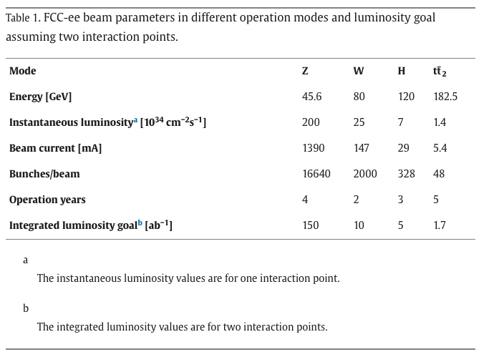
Example of collider KPI
FCC-ee in https://www.sciencedirect.com/science/article/pii/S0168900220302990

Slide 16
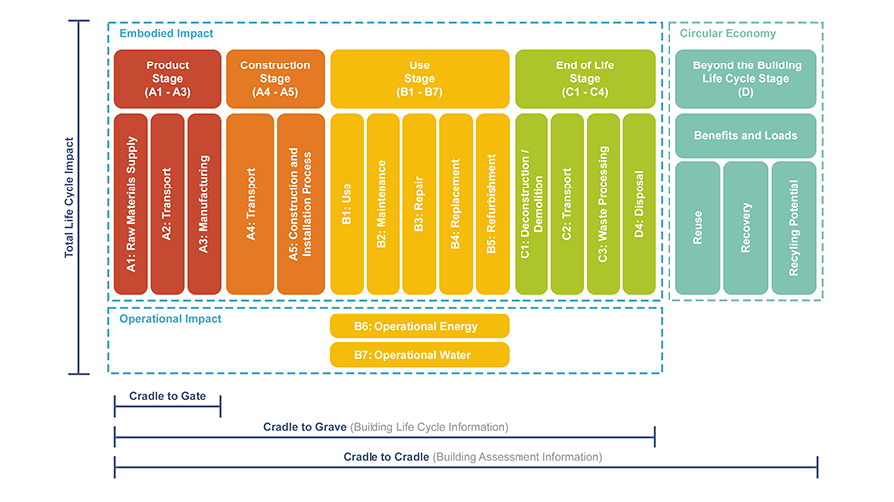
Phases in an ISO based LCA
According to EN 15978 and D. Overbey online (https://www.buildingenclosureonline.com/blogs/14-the-be-blog/post/ 89547-lca-stages-matter-when-tracking-embodied-carbon )

Slide 18
Depending on available knowledge and data, combinations of lifecycle phases can be assessed.
As long as it is justified and documented which phases are concerned the approach is valid.
Benefits and re-use potentials (D) should be considered from the beginning on!

Slide 19
Accounting of effects in long-lasting projects
Research infrastructructures and science projects are typically characterised by long time scales:
15 years planning and design
10-15 years construction
15-20 years first operation phase
10 years upgrade
25 years second operation phase
…
Therefore, accounting of environmental impacts is important.
Time accounting is regulated in the EN 17472 standard on the “Sustainability of construction works”.

Slide 20
EN 17472: “Sustainability of construction works”
Evaluations are for a selected Reference Study Period (RSP) that can be different than the duration of lifetime of the object under evaluation.
General: construction and demolition linked impacts are independent of the evaluation period. For econmic indicators (e.g. residual value) a discounting factor must be applied.
RSP 1: study and lifetime are the same. The entire footprint is accounted for the result.
RSP 2: study period is shorter than lifetime of object. Impacts of modules B1-B8 and benefits in D are reduced by a factor (RSP / lifetime), i.e. only account what is studied). Construction linked impacts are fully accounted. Deconstruction is fully accounted. Disposal is reduced by (RSP / lifetime).
RSP 3: study period is longer than the lifetime of the object. A scenario for the extension of the lifetime can be developed and considered up to the evaluation lifetime or beyond. Then the impact accounting rules of RSP 1 or RSP 2 are applied.

Slide 21
Accounting factors
Evaluation period = lifetime
Evaluation period < lifetime

Slide 22
Specific example: FCC-ee + FCC-hh
One infrastructure can host subsequently two particle colliders:
2035 – 2045: construction of infrastructure and first collider (FCC-ee)
2050 – 2065: operation of FCC-ee
2065 – 2075: decommissioning of FCC-ee and installation of FCC-hh
2075 – 2100: Operation of FCC-hh
2100+: Decommissioning of FCC-hh at some point, then undefined
Scope of impact assessments

Slide 23
Types of emissions: Scope 1, 2, 3
The “Scope” emissions are a complementary way to look certain environmental impacts, i.e. the emissions. One must be careful not to confuse them with all other emissions, not to double count.
Scope emissions are particularly important when reporting impacts of organisation during operation.
Scope 1:
Emissions from sources under the direct control of an organisation.
Example: burning fuel for a manufacturing process.
Scope 2:
Emissions from procured energy
Example: electricity purchased via the grid.
Scope 3:
All other indirect emissions as a consequence of an organisation’s activities from sources outside the direct control of the organisation.
Examples: emissions embodied in all goods and services purchased, i.e. also those that are needed for the construction of a new research infrastructure.

Slide 24
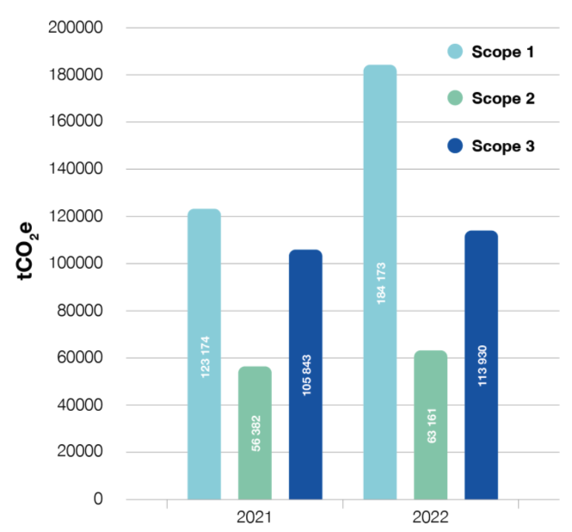
Scope emission examples from CERN
https://hse.cern/environment-report-2021-2022/emissions
Scope 1:
Principally gases that are needed to cool & to operate the particle detectors (PFCs, HFCs, SF6).
Scope 2:
Electricity purchased from the French power grid, mainly from EDF’s nuclear park.
Reporting using the “location-based” principle, i.e. the average CO2 footprint of the French grid, not the actual carbon footprint of nuclear power.
ADEME Base Empreinte©:
Scope 3:
Procurement, own business travel, personnel commutes, catering, waste treatment & water purification.

Slide 25
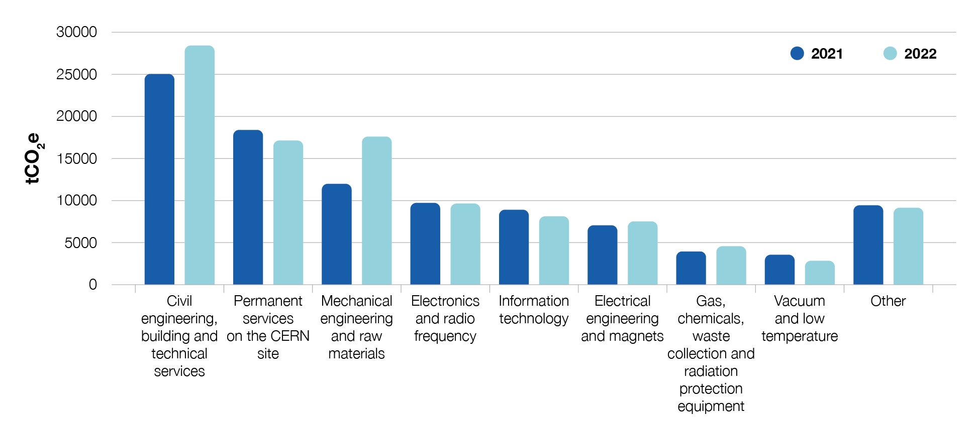
Part of procurement induced Scope 3 @ CERN
Represents > 90% of Scope 3 and > 30% of all emissions.
Induced by 471 MChf (2021) and 462 MChf (2022) purchases of goods, services and supplies. Total in the order of 100’000 tCO2(eq).
Determined using an extended multi-regional input output table model (EXIOBASE 3 + Climatiq procurement endpoint model). ISO/EN 20400 Sustainable Procurement Guidance is a powerful lever to improve.

Slide 26
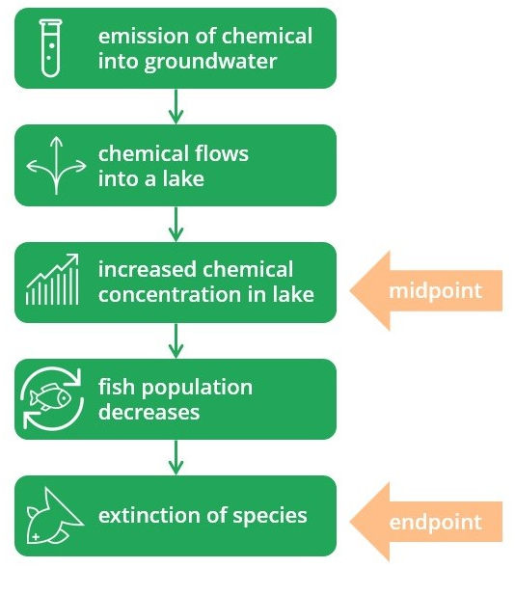
Quantifying impacts
Once input data are gathered, conversion factors for products and services are applied to convert the products and services into environmental indicators.
There exist
Midpoint categories and
  Reports a potential impact earlier along the entire cause-effect chain, before the impact to the environment is reached.
  Midpoints capture effects on many different endpoints.
  Permits identifying the relative contributions of a project, identify levers for improvement and compare projects.
  Suitable for technical practitioners, since domain knowledge is required.
Endpoint categories
  Reports the potential environmental impact at the end of the cause-effect chain.
  Suitable for lay-people
  Affected by high uncertainties, gaps, assumption, geolocalisation.

Slide 27
Reporting methodologies
ReCiPe 2016
  RIVM and Radboud University
  Most-widely used by scientists and domain experts
International Life Cycle Data (ILCD) 2011
  European Joint Research Centre (JRC) and European Direcctorate for Environment of the EC
  Adopted core impact iundicators of EN 15804+A2
  Integrates with ReCiPe
CML-IA
IMPACT 2002+

Slide 28
ReCiPe 2016

Slide 31
Assessment – Quantification of inventory
Requires the availability of environmental data for the goods and services that are entered in the inventory (see lalso https://iopscience.iop.org/article/10.1088/1755-1315/588/4/042051/pdf) and https://nexus.openlca.org/databases
Ecoinvent: generalised, standardised and averaged data at international level
INIES (France): generalised and averaged data for France
KBOB (Switzerland): generalised and averaged data for Switzerland
IBU (Germany)
Ökobaudat
BauEPD (Austria)
Environmental Product Declarations according to EN15804+A2 (EPD): product and location specific
Fiches de Déclaration Environnementale et Sanitaire (FDES, France): product and location specific

Slide 32
Environmental Production Declearions (EPDs)
Standardized (EN 15804+A2), third-party verified documents that transparently present credible information about a product’s impact on the environment.
Is a so-called type III environmental declaration that is compliant with the ISO 14025 standard.
EPDs are based on the information from a Life Cycle Assessment (LCA) for that particular product.
Limited validity of 5 years
Administered and supervised by undepoendent agencies called EPD Program Operators (POs)
Comprises 2 sets of documents:
Underlying, comprehensive LCA (not public)
Third party verified.
Third party certified, oublic EPD sheet with LCA results
Sensitive information that may impact the commercial activity (e.g. processes or particular raw materials or ingredients) are not disclosed.

Slide 33
Indicators that the EPDs include according to ILCD
See also https://www.environdec.com/resources/indicators
1. Climate change (kg CO₂ eq.)
2. Ozone depletion (kg CFC-11 eq.)
3. Photochemical ozone formation, human health (kg NMVOC eq.)
4. Particulate matter / respiratory inorganics (kg PM_{2.5} eq.)
5. Ionising radiation, human health (kBq ²³⁵U eq. to air)
6. Acidification (mol H⁺ eq.)
7. Eutrophication: terrestrial (mol N eq.), freshwater (kg P eq.), marine (kg N eq.)

Slide 34
Indicators that the EPDs include according to ILCD
8. Human toxicity: cancer and non-cancer effects (CTU_{h})
Comparative Toxic Unit for human expresses the estimated increase in morbidity in the total human population per unit mass of a chemcical emitted (disease cases per kg emitted).
9. Freshwater ecotoxicity (CTU_{e})
Comparative Toxic Unit for the ecosystem (CTUe), an estimate of the Potentially Affected Fraction of species (PAF) integrated over time and volume, per unit mass of a chemical emitted. [CTUe per kg emitted] = [PAF × m3 × day per kg emitted]
10. Land use (kg C deficit)
Change of soil organic carbon in kg, depending on the soil quality before and after the transformation.
11. Resource depletion: water (m³ water eq.), mineral, fossil and renewables (kg Sb eq.)

Slide 35
EPD Example: FDES, France, concrete
Environmental effects indicated
Per functional unit (FU)
For each lifecycle phase of the product
Attention: product units differ!
Unit for this product: 1 m² wall with a thickness of 20 cm, called UF (unite fonctionelle).
1 UF of this product corresponds to 457,6 kg.
Typically carbon footprint is given in kg per tonne (1000 kg) of the product.
Hence, the results must be multiplied by 2.18 to compare to other products.

Slide 36
EPD Example: FDES, France, concrete C25/30

Slide 37
EPD Example: FDES, France, concrete

Slide 38
EPD Example: FDES, France, concrete
1 Watt = 1 Joule/sec
1 MJ = 1 MWs =
0.000277 MWh = 0.28 kWh

Slide 39
EPD Example: FDES, France, concrete

Slide 40
EPD Example: FDES, France, concrete

Slide 41
EPD Example: FDES, France, concrete

Slide 42
EPD Example: FDES, France, concrete total effects
Production of carbon footprint of 1 kg this specific, low carbon, recycled concrete:
46.9 kg CO₂(eq) per functional unit = 46.9 * 2.18 = 102.24 kg CO₂(eq)/tonne.

Slide 43
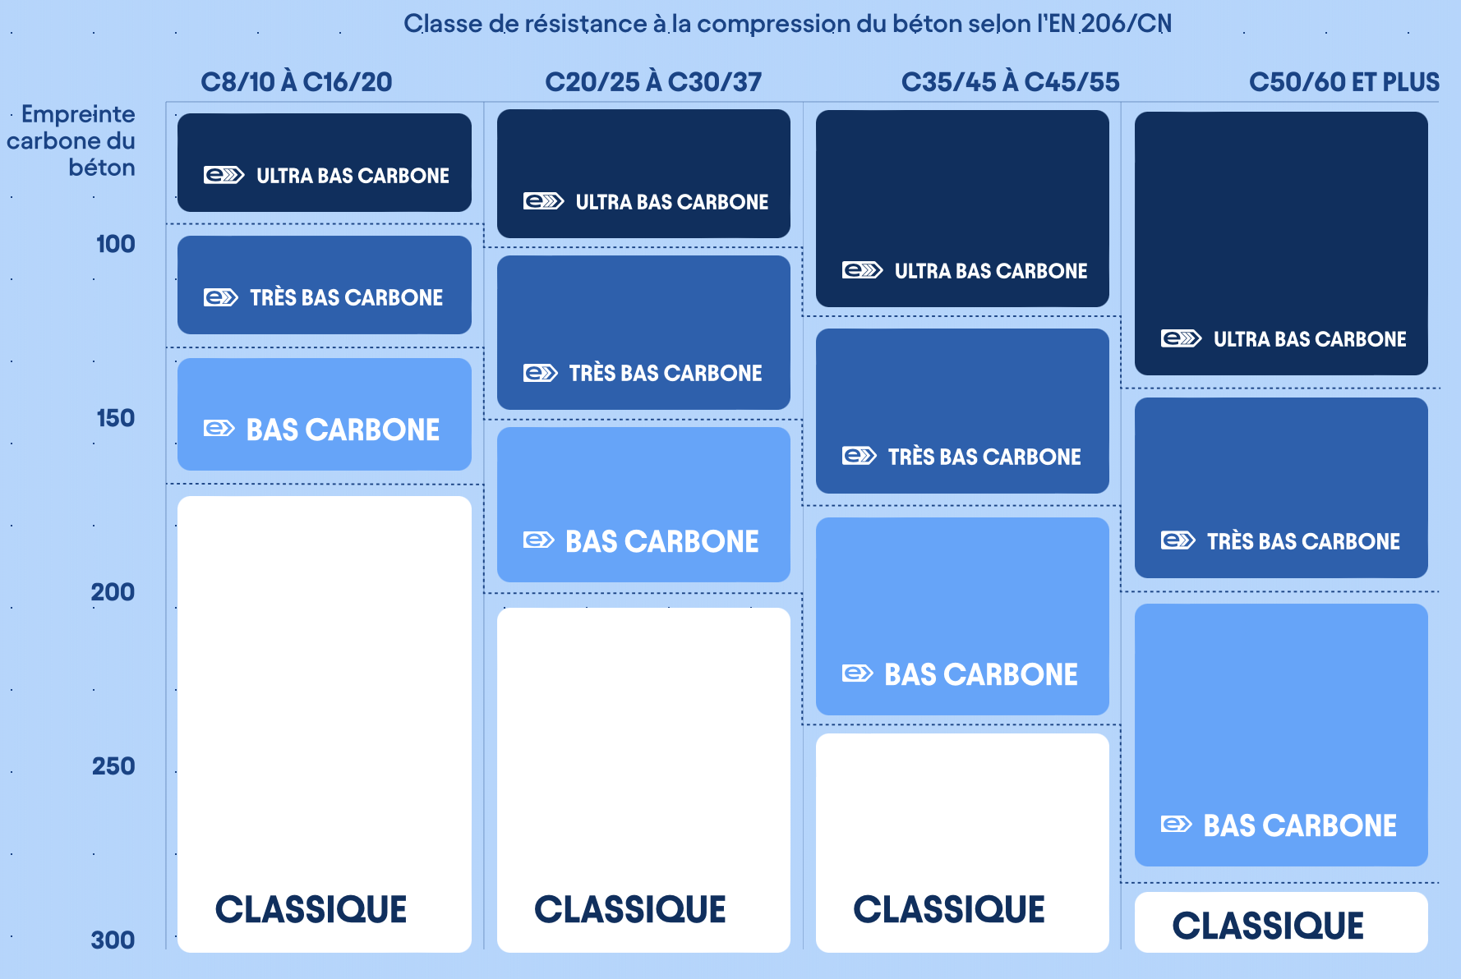
Typical carbon footprint of concrete today (2025)
Standard concrete using Portland cement (CEM I) has a carbon footprint of
C40/C50 goal: < 150 gCO₂e/kg
Replace reinforcement bars with fibres
Use recucled rebar
Foster local production with modular, re-usable plants

Slide 44
Software solutions
SimaPro: Commercial, comprehensive, needs expert knowledge
OpenLCA:
offline software free, comprehensive, needs expert knowledge
For a fee an online service exists suitable for non-experts
OneClick LCA: Commercial web based, easy to use, limited in terms of reporting
Excel: Need to craft your own

Slide 45
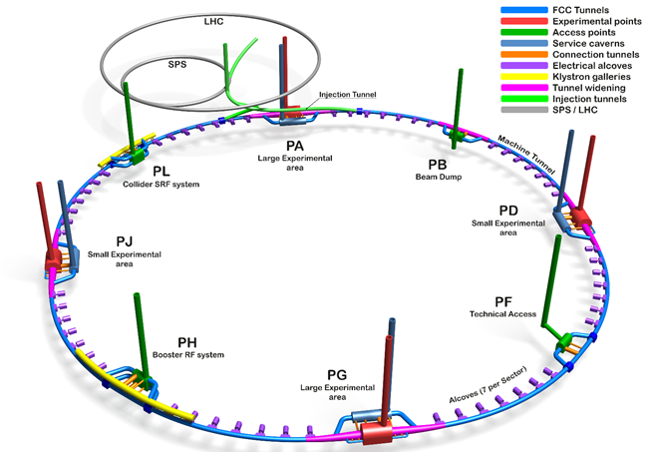
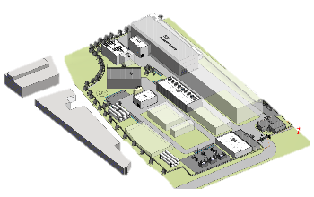
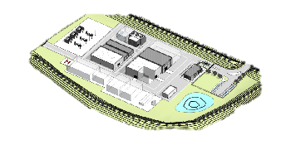
Specific example: Construction footprint of FCC

Slide 46
KPIs selected
EPD based on EN 15804+A2 | Reported in OneClickLCA
Climate Change Total | X
Climate Change Fossil | X
Climate Change Biogenic Removals and Emissions | X
Climate Change Land Use and Land Use Change | X
Ozone Depletion | Data from EPDs included manually In reporting
Acidification
Eutrophication Aquatic Freshwater
Eutrophication Fresh Marine
Eutrophication Terrestrial
Photochemical Ozone Formation
Abiotic Depletion- Minerals and Metals
Fossil Fuels
Water Use
Particulate Matter Emissions
Ionizing Radiation, Human Health
Eco-Toxicity
Human Toxicity, Cancer Effects
Human Toxicity, Non-Cancer Effects
Land Use Related Impacts/Soil Quality

Slide 47
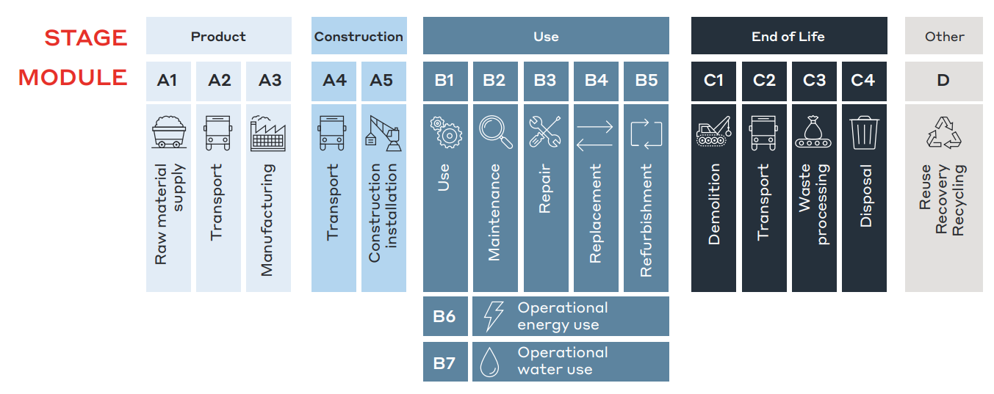
Specific example: Construction footprint of FCC
Concerns only the civil constructions of underground and
surface and the immediately linked general technical services.
Stage ”Product”, modules A1-A3 and stage “Construction”, modules A4 and A5.
Benefits of procured products as reported in their EPDs (“D”) are used.
End of life was not considered, since the infrastructures are not considered to be decommissioned and disposed (tunnel remains). De-commissioning data of technical services could in principle be obtained and added.

Slide 48
Use of generic and specific product data

Slide 49
Use of generic and specific product data

Slide 50
Typical input data for LCI
Description | Point Mapping | Total
 | kg
Acier d'armature | Reinforc. Steel | 103 974 813
Acier | Int. Str. Steelw. | 16 525 476
Fibre d'acier | Steel Fibre | 7 719 276
 | m
Polyéthylène haute densité, épaisseur supposée de 5 mm | Dimple Sheet | 101 676
acier, diamètre de 25 mm | Rockbolts | 400 739
 | m²
Polyéthylène haute densité, épaisseur supposée de 5 mm | Dimple Sheet | 482 579
Protection passive projeté | Passive Prot. | 845 172
Polyéthylène haute densité, épaisseur supposée de 3 mm | Waterproofing | 801 484

Slide 51
Typical input data for LCI
Description |  | Total
 | m³
Coulis cimentaire | Annulus Grout | 160 000
coulis de remblayage | Backfill Grout | 48 465
Béton coulé | Cast Insitu C. | 421 098
Paroi en béton moulé et en acier, densité des barres d'armature 130 kg/m3, béton 40 Mpa | D-Wall C. | 42 964
Béton | Filter Material | 111 942
Traitement d'injection | G. Treatment | 50 932
Béton coulé sur place, 30 Mpa et densité des barres d'armature 80 kg/m3 | Internal Str. C. | 53 920
Béton coulé sur place, barres d'armature de 55 kg/m3 et béton de 20 Mpa | Invert Insitu C. | 649 057
Béton préfabriqué, densité des armatures 80 kg/m3. Béton 30 Mpa | Invert Precast C. | 99 978
Excavation | Limestone | 141 175
Excavation | Molasse | 6 185 911
Excavation | Moraine | 179 808
Béton préfabriqué, densité des armatures 80 kg/m3, béton 50 Mpa | Pre-Cast C. | 451 635
Béton projeté | Shotcrete | 189 110

Slide 52
Intermediary results: by phases
LULUC = Land Use Land Use Change takes into account additional greenhouse gas emissions and bonds (CO2, CO and CH4) through biosphere alteration.
Stage | Global Warming Potential fossil-A2 tCO2e | Global Warming Potential, LULUC tCO2e
A1-A3 | 898 670 | 338
A4-full | 70 294 | 2
A5 | 62 485 | 91
B4-B5 | 1 | 0
B6 | 280 | 0
C1-C4 | 23 251 | 7
D | -303 632 | -141

Slide 53
Intermediary results: by resource
No. | Ressource | Impacts du berceau à la porte (A1-A3) | % d’émissions (A1-A3)
1. | Ready-mix concrete, normal strength, generic, C35/45 (5000/6500 PSI) with CEM I, 0% recycled binders (340 kg/m3; 21.2 lbs/ft3 total cement) | 410 103 tonnes CO₂e | 47.2 %
2. | Ready-mix concrete, normal-strength, generic, C40/50 (5800/7300 PSI), 0% recycled binders in cement (400 kg/m3 / 24.97 lbs/ft3) | 204 521 tonnes CO₂e | 23.5 %
3. | Reinforcement steel (rebar), generic, 60% recycled content, A615 | 126 979 tonnes CO₂e | 14.6 %
4. | Steel sheets, generic, 0% recycled content (only virgin materials), S235, S275 and S355 | 62 137 tonnes CO₂e | 7.1 %
5. | Ready-mix concrete, low-strength, generic, C12/15 (1700/2200 PSI), 0% recycled binders in cement (220 kg/m3 / 13.73 lbs/ft3) | 33 975 tonnes CO₂e | 3.9 %

Slide 54
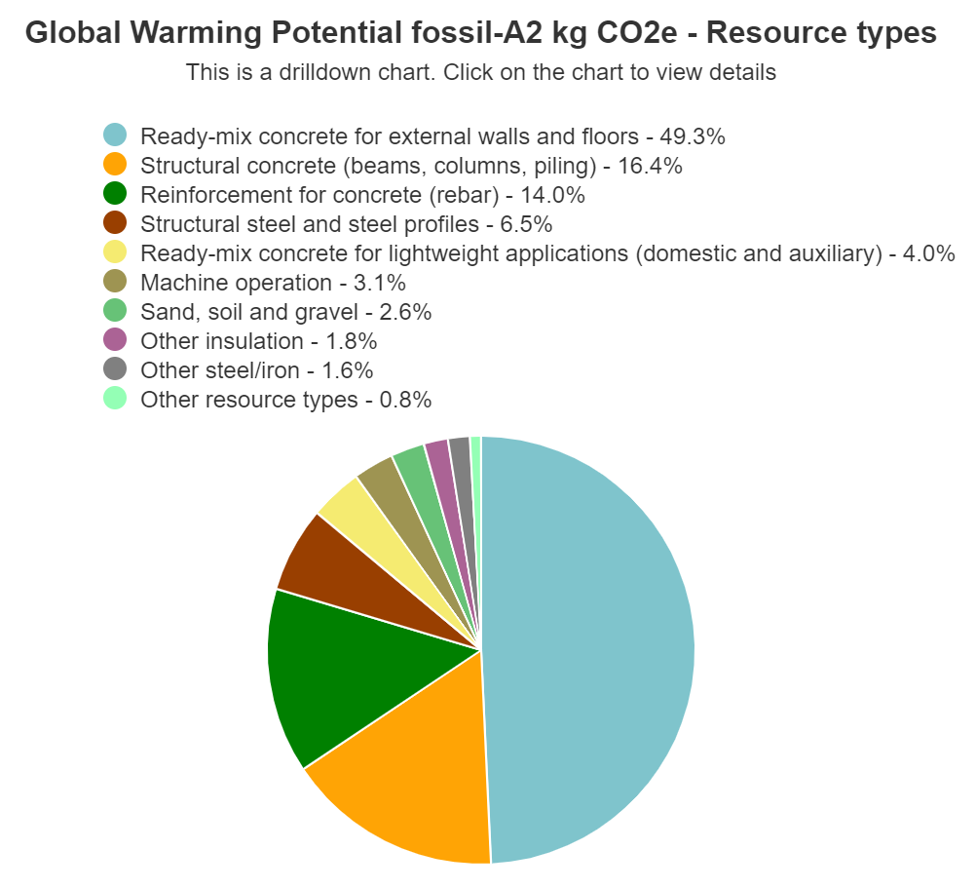
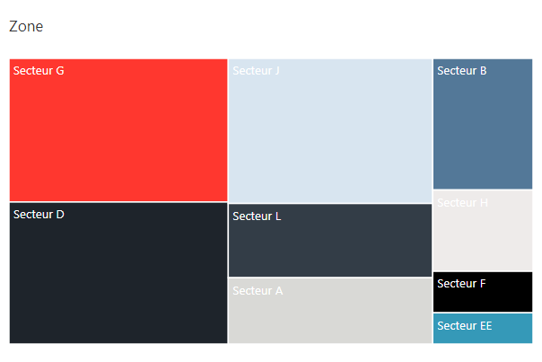
Intermediary results: by location

Slide 55
The intermediary results permit developing design and procurement optimisation scenarios
Benchmark | Emission CO2 | Substitute for improvement | Emission CO2 | Reduction
Steel sheets, generic, 0% recycled content, S235, S275 and S355 | 3.91 kgCO2e/kg | Steel sheets, generic, 100% recycled content, S235, S275 and S355 | 0.87 kgCO2e/kg | 77%
Steel fibre for concrete reinforcement, 0% recycled content (One Click LCA) | 2.09 kgCO2e/kg | Steel fibre for concrete reinforcement, 100% recycled content (One Click LCA) | 0.51 kgCO2e/kg | 75%
Reinforcement steel (rebar), generic, 60% recycled content (only virgin materials), A615 | 1.41 kgCO2e/kg | Reinforcement steel (rebar), generic, 100% recycled content, A615 | 0.42 kgCO2e/kg | 70%
Ready-mix concrete, normal strength, generic, C35/45 (5000/6500 PSI) with CEM I, 0% recycled binders (340 kg/m3; 21.2 lbs/ft3 total cement) | 327.02 kgCO2e/m³ | Ready-mix concrete, normal strength, generic, C35/45 (5000/6500 PSI) with CEM III/A, 60% GGBS content (340 kg/m³; 21.2 lbs/ft³ total cement) | 170.36 kgCO2e/m³ | 48%
Ready-mix concrete, low-strength, generic, C12/15 (1700/2200 PSI), 0% recycled binders in cement (220 kg/m3 / 13.73 lbs/ft3) | 217.91 kgCO2e/m³ | Ready-mix concrete, low-strength, generic, C12/15 (1700/2200 PSI), 40% recycled binders in cement (220 kg/m³ / 13.73 lbs/ft³) | 149.41 kgCO2e/m³ | 31%
Ready-mix concrete, normal-strength, generic, C40/50 (5800/7300 PSI), 0% recycled binders in cement | 384 kgCO2e/m³ | Ready-mix concrete, normal-strength, generic, C40/50 (5800/7300 PSI) with CEM III/B, 75% GGBS content in cement | 173.00 kgCO2e/m³ | 39%

Slide 56
Result of subsurface optimisation
Adjustments to designs and specific choide of materials, products, processes, local sourcing

Slide 57
Optimisation
Empreinte CO₂ | Calcul initial | Optimisation | Réduction
Souterraine | 999 778 tCO₂(eq) | 477 388 tCO₂(eq) | 52%
4 sites techniques | 54 800 tCO₂(eq) | 17 600 tCO₂(eq) | 68%
4 sites d'expériences | 114 800 tCO₂(eq) | 31 200 tCO₂(eq) | 73%
Total | 1 169 378 tCO₂(eq) | 526 188 tCO₂(eq) | 55%
Impact drivers:
Pre-fabricated concrete (49%), concrete (23%) and re-inforced steel (14%).

Slide 58
Improvement of other indicators (subsurface)
Subsurface initial | Valeur
Potentiel d’appauvrissement de la couche d’ozone stratosphérique | 40.4 kg CFC 11 eq
Potentiel d’acidification | 2 020 tonnes SO₂ eq
Potentiel d’eutrophisation - eau douce | 143 tonnes (PO₄)³⁻ eq
Potentiel d’eutrophisation - marine | 5 tonnes N
Potentiel d’eutrophisation - terrestre | 5.7 x 10⁶ mol N
Subsurface reference (improved) | Valeur
Potentiel d’appauvrissement de la couche d’ozone stratosphérique | 19.3 kg CFC 11 eq
Potentiel d’acidification | 929 tonnes SO₂ eq
Potentiel d’eutrophisation - eau douce | 96 tonnes (PO₄)³⁻ eq
Potentiel d’eutrophisation - marine | 12 tonnes N
Potentiel d’eutrophisation - terrestre | 2.1 x 10⁶ mol N
Overall scenario improvement resulted in an increase of marine eutrophisation due to the selection of re-used steel reinforcement bars (rebar).
The choice to keep the improvement is justified in the presence of the significant overall reduction of the GWP.
Shows that priorities, goals, weights are very important and that a too simplified approach can be misleading.

Slide 59
Recommendations as results of assessment
Establish technical requirements for the structural subsurface and surface elements that capture the strict minimum needs to fulfil the scientific research programme.
Develop an eco-design with carbon reduction in mind that meets the established requirements.
Structural modification by reducing the inner line thickness of subsurface structures by 5 cm, leading to a reduction of 16% for precast concrete and rebar steel.
Material substitution, considering low-impact materials wherever possible in agreement with established requirements.
Construction process optimization to minimize emissions (e.g. local production).
Reuse of excavated materials, for instance in the concrete production.

Slide 60
Science project vs. conventional linear project
Comparison of the footprint for the linear parts
Metro (U5 Berlin) requires more effort due to expected use pattern, degredation, exposure to adverse environmental conditions, limitations in terms of materials, procurement, product choice.

Slide 61
Use of LCA for overall sustainability assessment
The output of an LCA needs to be reported in units of time over the evaluation period, e.g. the impacts per yuear.
The time-unit based data needs to be monetised, i.e. the quantified potential environmental impacts need to be converted into monetary terms.
The monetary equivalent needs to be time adjusted and discounted over the evaluation period.
The individual values need to be integrated into the calculation of a Net Present Value of the entire project to contribute on the “cost” side as “nega.tive environmental externalities”
Monetisation and an example thereof will be covered later, once the principles of time preference, discounting and fundamental Cost-Benefit-Analysis methods are introduced.
ISO EN ISO 14007 and 14008 provide the necessary guidance.

Slide 62
Environmental
Performance Reporting for organisations and projects

Slide 63
Project environmental KPI
EC Regulation No. 1221/2009, a voluntary tool, supported by independent verifiers, e.g. TÜV SÜD
An overall project environmental reporting goes beyond the reporting of an LCA assessment. The European Union Eco-Management and Audit Scheme (EMAS) defines a few easy to manage KPIs that help to communicate environmental project performance.
Complyting with ISO/EN 14001 provides compliance with EMAS.

Slide 64
Global Reporting Initiative (GRI) and ESRS
Suitable for large organisations. Integrates UN SDGs. Integrates with European Sustainability Reporting Standards (ESRS) that become ever more important.
E.g. CERN adopted GRI several years ago.
ESRS covered topics
GRI and ESRS are comprehensive and require the engagement of domain-specific consultants or dedicated companies.

Slide 65
Time Preference and
Social Discounting

Slide 66
Time preference
The concept of valuation of
receiving a good at an earlier date
compared with receiving it at a later date.
Mathematically, time preference is captured in a “discount function”.
Discounting is the process of determining the present value of a future amount.
Accounts for the time value of money,
i.e. a unit of money today is worth more than in the future
The higher the time preference, the preference of receiving something now rather than later, i.e. the valuation of receiving a good rather earlier than later,
the higher the discount placed on returns (benefits) receivable and costs payable in the future.

Slide 67
Time preference
The concept of valuation of
receiving a good at an earlier date
compared with receiving it at a later date.
Mathematically, time preference is captured in a “discount function”.
Discounting is the process of determining the present value of a future amount.
Accounts for the time value of money,
i.e. a unit of money today is worth more than in the future
The higher the time preference, the preference of receiving something now rather than later, i.e. the valuation of receiving a good rather earlier than later,
the higher the discount placed on returns (benefits) receivable and costs payable in the future.

Slide 68
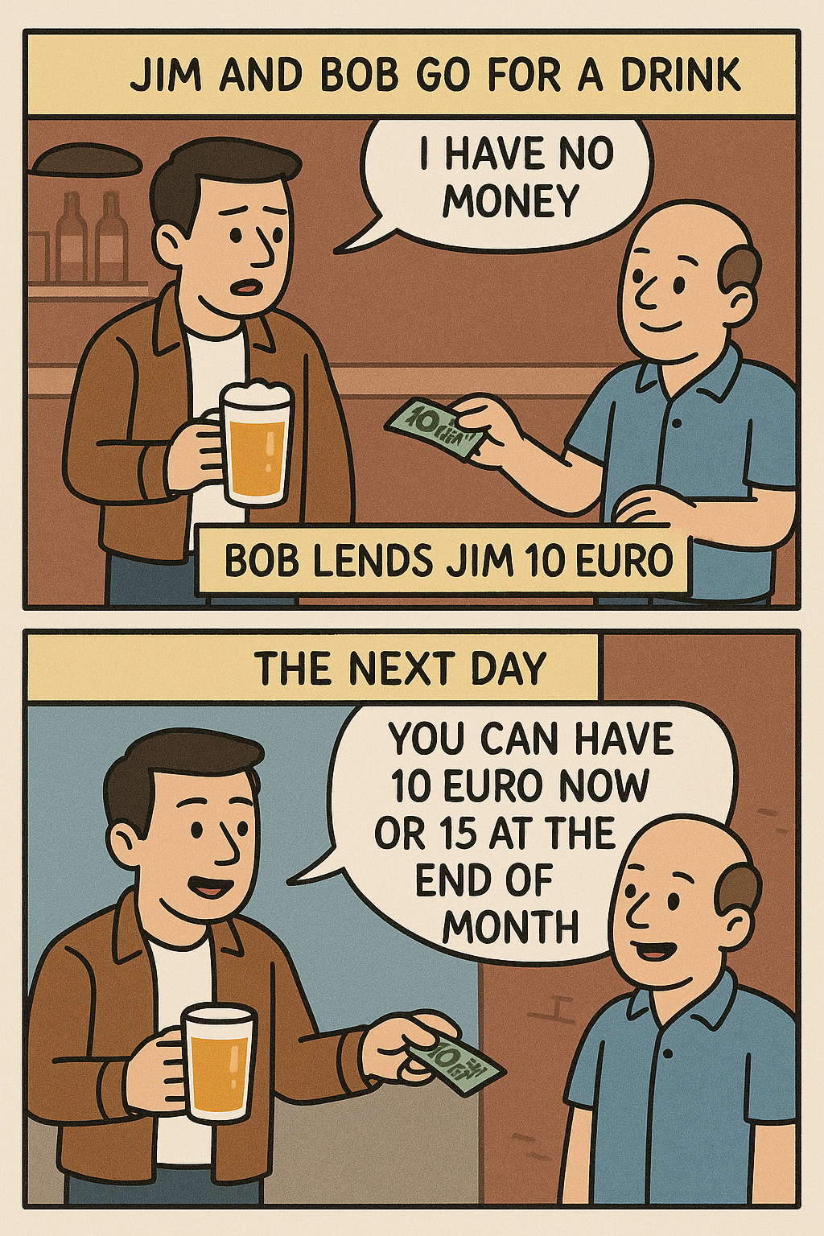
Example (from Wikipedia)
Jim and Bob go for a drink.
Jim has no money. Bob lends Jim 10 euro.
The next day Jim says to Bob:
“You can have 10 euro now or 15 at the end of the month when I get paid.”

Slide 69
Discuss
How do you feel about getting things now or later?
What would influence your choice?

Slide 70
Example (from Wikipedia)
Bob’s time preference depends on
the trust in Jim (risk),
whether he needs money now or
if he thinks he can wait or
if he prefers to have 15 euro later rather than 10 euro now.
Present and expected needs, present and expected income (financial situation), present and expected social, environmental and economic situation affec time preference.

Slide 71
Estimating the discount rate
Depends on the actual choice:
“Would you rather have 100 euro today or 110 euro in a month?”.
If I choose 100 euro now:
I believe that the 110 euro in a month have less value to me than 100 euro now.
Therefore, the discount rate is at least 10%, so that the 110 euro in one month
is less worth than 100 euro to me (110 euro – 10% = 99 euro).
If I choose 110 euro in a month:
I believe that the value in a month is greater to me than the 100 euro now.
I believe it would be at least corresponding to 101 euro.
Therefore, the discount rate must be less than 10% (e.g. 110 euro – 9% = 100.1 euro).
However, I do not know exactly the discount rate at this point, since I do not yet know the risks associated with not being able to enjoy the 110 euro (e.g. inflation, death).

Slide 72
Discounting to compare costs and benefits
Discounting is needed to be able to compare costs and benefits.
They bring cost and benefit values to the same point in time.
Only discounted figures can be compared.
Social discounting is therefore a key concept in Cost Benefit Analysis and
the determination of the Net Present Value of a project.
Now
Benefits
NPV = B-C
Time
Costs

Slide 73
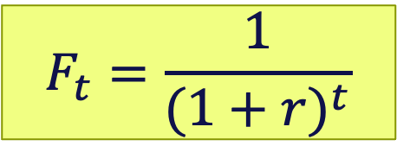
Discounting factor
A numerical factor to convert a monetary value in the future to a ‘present value’ so that money flows (benefits and costs) can be compared over time.
The function reflects the present value of a unit of consumption or benefit occurring
t years in the future.
As t increases, the discount factor decreases, meaning that future benefits are valued less today.
In other terms, it helps to express the ‘present value’ of one euro received or spent in a year t.
The process of ‘discounting’ is used to compare monetary flows or net social effects at a given point in time, usually when the decisions about investments have to be made.
The formula for the discount factor F using a constant rate r in a future year t is:
$$F_{t}=\frac{1}{{(1+r)}^{t}}$$

Slide 74

Discounting function
Several different discounting functions exist: exponential, hyperbolic, quasi hyperbolic.
Today, the best practice in socio-economic analysis is to use an exponential discounting function.
𝜌 is the social-discount rate selected for the specific analysis.
k is the year in the future for which the discount factor is to be applied during subsequent assessment.

Slide 75
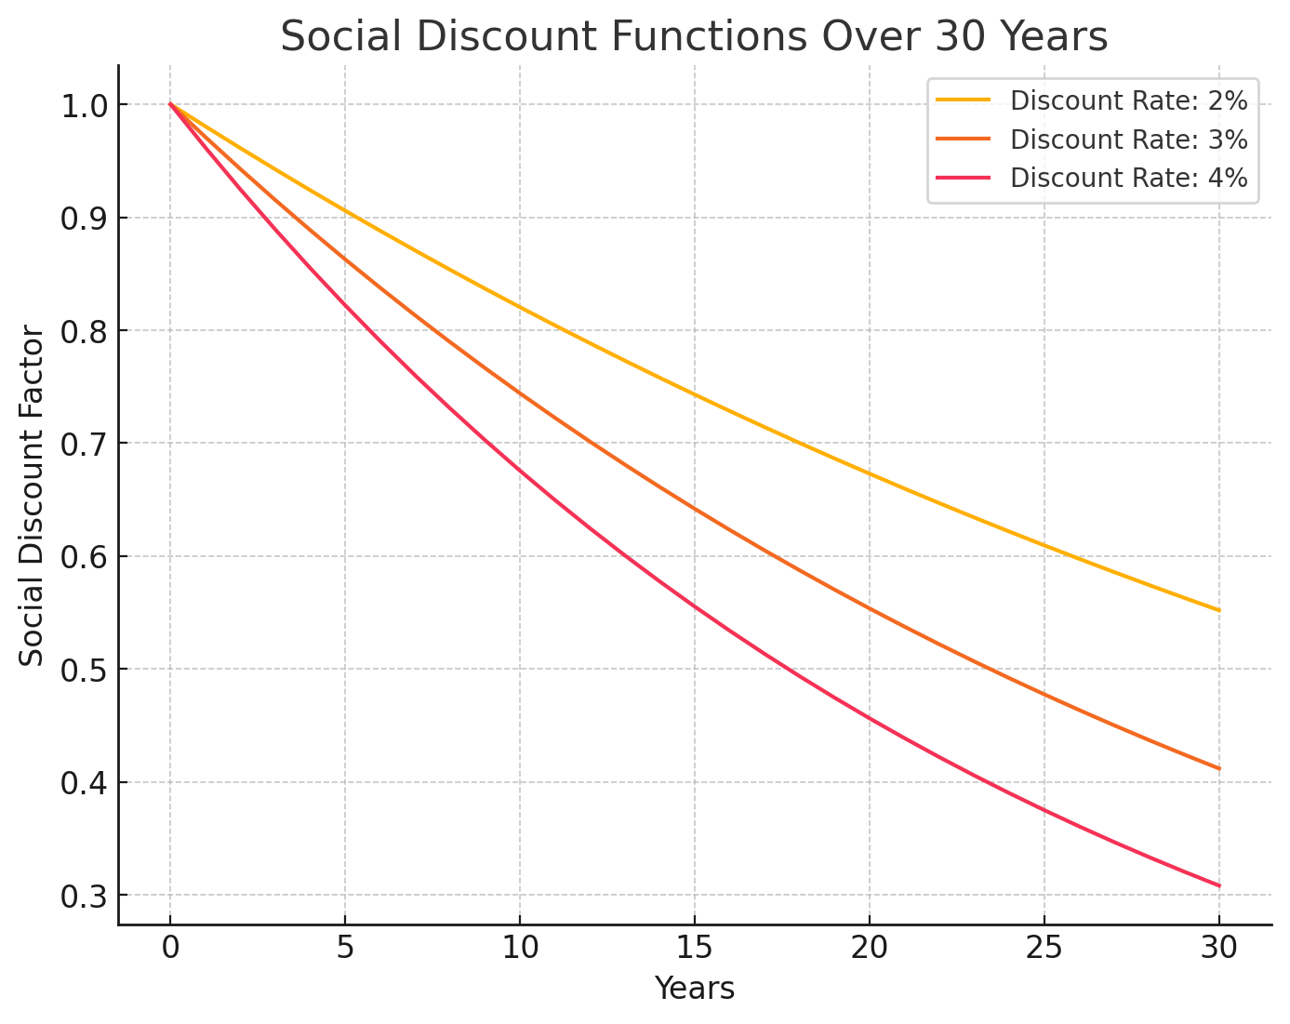
Discounting function

Slide 76
Discount rates
A proper discount rate should represent the opportunity cost of what else a society could accomplish with those same funds.
This can for instance mean investing the money in the private sector.
The expected yield determines if this would be the next best alternative for using that money. In this case, the expected yield would be the social discount rate.
The most common formula to determine the SDR is
the one of Frank Ramsey.
Ramsey, F. P. (1928). A Mathematical Theory of Saving. The Economic Journal, 38(152), 543–559.
https://doi.org/10.2307/2224098

Slide 77

Ramsey’s SDR:
$$r=ρ+ηg$$
r = Social Discount Rate
ρ = Pure rate of time preference (how much we discount the future simply because it is in the future)
η = Elasticity of marginal utility of consumption (EMUC, captures inequality aversion)
= measurement of the utility as a change in demand for a good or service
in relation to a change in its price.
0 corresponds to risk neutrality, OECD 20 is 1.4
g = growth rate of per capita consumption
Discount rates vary a lot between different countries,
depend on the project appraisal time span of the project,
Depend on the type of project itself and various additional parameters.
In developed countries the span is typically between 2.5% and 8%.
In developing nations it is typically higher, between 8% and 15%.
The UK HM Treasury fixes the social discount rate for the public sector at 3.5%.
The French SGPI recommends a value between 3 and 3.5%.
The EU recommended SDR for policy analysis is 3% for the period 2021-2027.

Slide 78
Example for elasticity of marginal utility
Tells us how much the utility changes as the consumption changes:
Elasticity =
relative change in demand in %
divided by
relative change in income or price in %
Example:
If income increases by 10%, but consumption only increases by 5%,
then the elasticity of marginal utility (consumption of an additional unit)
with respect to the income would be 5%/10% = 0.5.

Slide 79
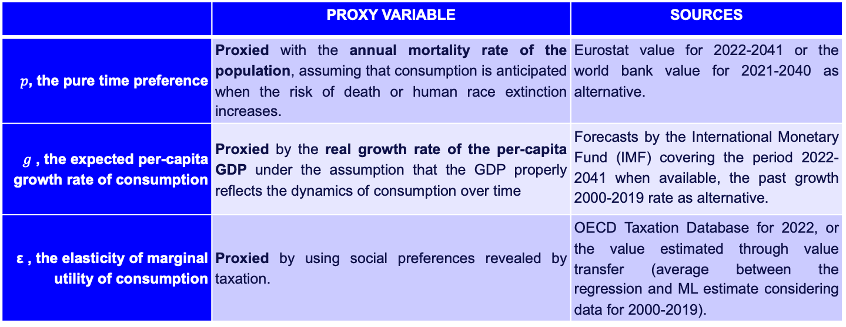
Social Rate of Time Preference (SRTP)
Typical average value in 2025 based on weighted values in the CERN member states: 2.8%
$SDR=SRTP= p + ε∗ g$
 | Proxy Variable | Sources
$p$, the pure time preference | Proxied with the annual mortality rate of the population, assuming that consumption is anticipated when the risk of death or human race extinction increases. | Eurostat value for 2022-2041 or the world bank value for 2021-2040 as alternative.
$g$ , the expected per-capita growth rate of consumption | Proxied by the real growth rate of the per-capita GDP under the assumption that the GDP properly reflects the dynamics of consumption over time | Forecasts by the International Monetary Fund (IMF) covering the period 2022-2041 when available, the past growth 2000-2019 rate as alternative.
ε , the elasticity of marginal utility of consumption | Proxied by using social preferences revealed by taxation. | OECD Taxation Database for 2022, or the value estimated through value transfer (average between the regression and ML estimate considering data for 2000-2019).

Slide 80
Project Lifecycle

Slide 81
Project management/lifecycle standards

Slide 82
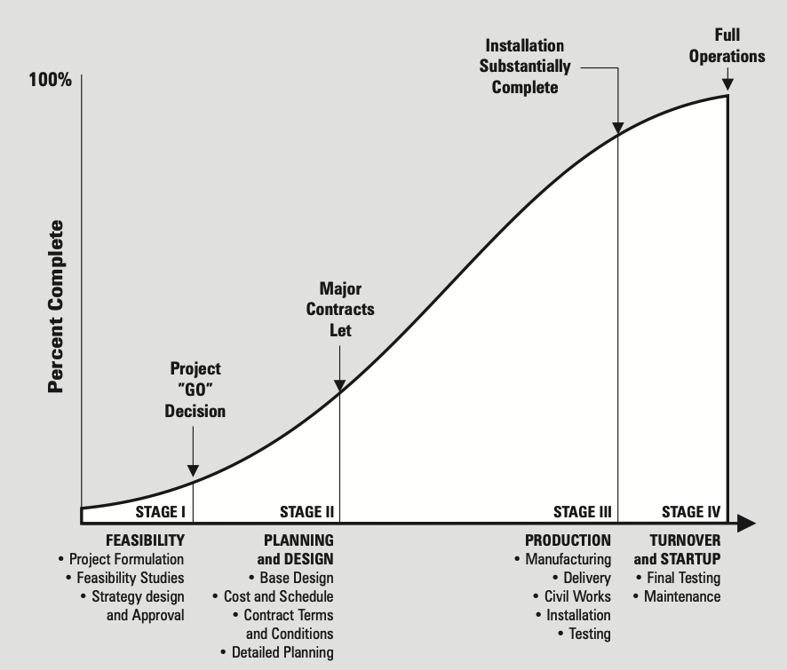
PMI Institute Book of Knowledge
Organisations performing project divide them into phases to be able to manage them. Collectively the project phases are known as the “project life cycle”.
Morris (P. W.G. Morris, 1981, Managing Project Interfaces: Key Points for Project Success, Project Management Handbook, 2nd ed. Englewood Cliffs, N.J., Prentice Hall)

Slide 83
IBM/Rational Unified Process

Slide 84
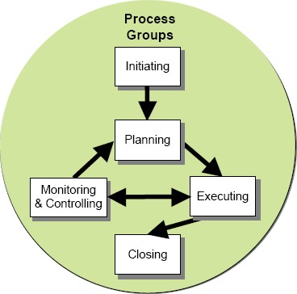
ISO 21500:2021 Guidance on Project Management
Initiation
Planning
Execution
Monitoring and Controlling
Closure
Note: also covered by ISO 10006
Additional considerations:
Stakeholder management
Risk management
Quality management

Slide 85
Durations of science projects: JWST
1996: Next Generation Space Telescope initiated
2003: 825 million USD awarded to TRW Inc.
2007: Technology review
2011: Cancellation attempt survived
2013: Mid range infrared installed
2014: Near Infrared Camera installed
2015: Contract for launcher foreseen 2018 signed
2016: Hexagonal mirror assembled
2017: Construction complete, anomalies detected
2018: Launch postponed
2021: Launch vehicle not ready
12/2021: Liftoff
01/2022: Orbit reached
07/2022: Commissioning complete
> Operation
~ 25 years until operation

Slide 86
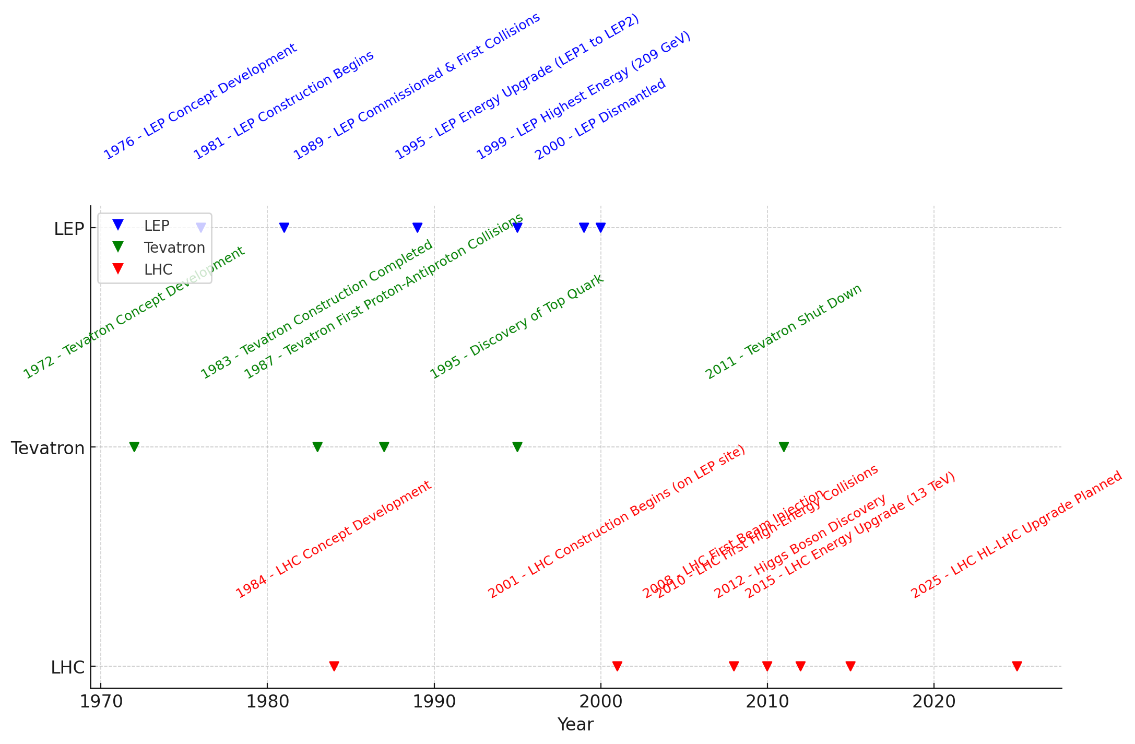
Durations of particle collider projects: 10 – 30+ years
13 years
11 years
15 years
24 years
24 years
32 years (until 2040)

Slide 87
Challenges with a long-term research project
Details of project segments are known with different detail levels at different times.
Different project owners for different project segments.
Requirements and constraints are different in different countries.
Different time scales for authorisation processes.
CE construction start
Machine installation
Operation start
Example
Future Circular Collider:
Level of knowledge
about project segments
over the years.

Slide 88
Theory of Change

Slide 89
Theory of Change appropach
Permits in a systematic way to identify relevant impact pathways with causality links for further qualitative and quantitative assessment.
Permits defining indicators for the impact assessments.
It leads to the possibility on how one can design for impact generation.
Helps creating “impact stories” as you identify and analyse them.
Specific qualitative and quantitative methods to evaluate and assess the impacts need to follow!

Slide 90
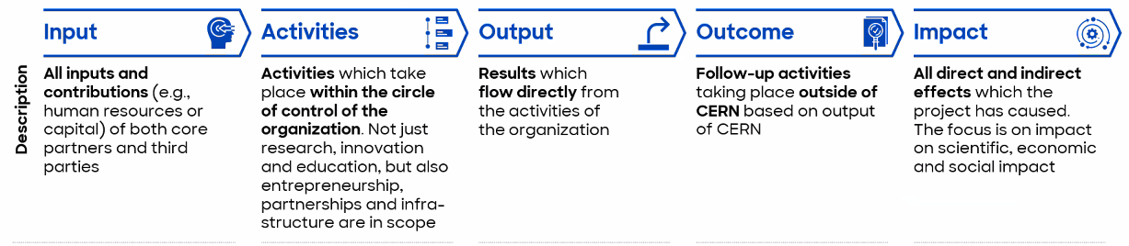
TOC EXAMPLE: Impact of science tourism
Creation of a new research project with visit opportunities conceived from the onset.
Public funding
Provided land
More scientists
Support staff
New infrastructures
Partnerships with local tourism bodies and private companies
New visit contents, points, programmes & extended visit time creates opportunities for visitors and raises the curiosity.
Construction of new research instrument
Construction of new visit facilities
Development of new tourism attractions around the research facility (e.g. leisure activities, cultural activities, exhibitions, tours)
Establishment of collaborations with local companies and culture organisations
Additional inflow of tourists leads to more people spending time more money in the region.
More visitors
More events
More capacity
More media coverage
More offers for tourists around the RI
Short- and medium term changes:
Local restaurants, hotels,
transport and retailers
experience increased
demand.
Increased demand in local businesses (restoration, gift shots, retail, accomodation, leisure activities, museums, transport)
More demand for further activities not directly concerning the RI in the wider area
Long-term, systemic changes as result of outcomes:
Job cfreation in tourism, retail, hospitality, restoration, retail, culture
Diversification of local economy
Shift to higher quality tourism offers

Slide 91
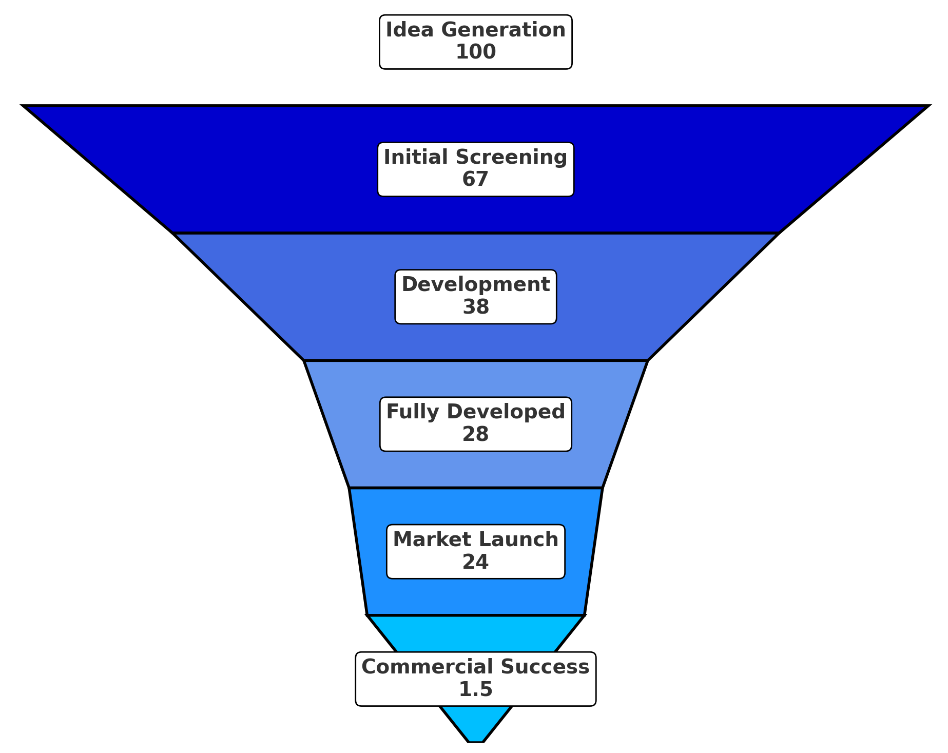
Entrepreneurship funnel
Only less than 5% of ideas make it into a product, or about 95% of product developments fail.
The key factors are:
Market demand
Technical and financial feasibility
Competition
Execution design, marketing , distribution
Regulatory and legal constraints
Cooper, R. G. (2019). The drivers of success in new-product development. Industrial Marketing Management, 76, 36–47. https://doi.org/10.1016/j.indmarman.2018.07.005​.

Slide 92
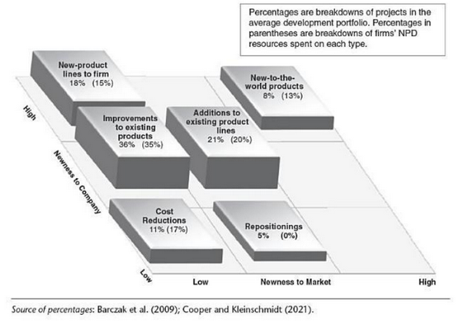
What is the success pattern of innovation?

Slide 93
Costs associated with
Research Infrastructures

Slide 94
Classications of cost: many different views
Investment costs + operating costs
By nature:
Direct: e.g. wages, subsistence allwances, materials, travels, events, direct project related consumables and supplies, project-related services
Indirect: e.g. Overheads, rent, debts, vehicles, compensations, taxes, insurances, land, transport and consumables, non-project related consumables and supplies and services and computing.
By behaviour:
Fixed: indirect costs that do not change with the service provided, e.g. lease, rent, utilities
Variable: e.g. electricity, water, working gases, service related transport and consumables
(Sunk: all historical costs incurred, unrecoverable and not making a difference in the current decision)
(Opportunity: benefits of an alternative given up in favour of another decision = difference in return between two chosen investments)

Slide 95


Example: CERN financial statements
https://cds.cern.ch/record/2908196/files/English.pdf
According to International Public Sector Accounting (IPSAS).
Materials: CE, electronics, chemicals, health, safety, environment, IT, low temperature, magnets, measuring, raw materials, office supplies, detectors, radiation equipment, transport, handling, vacuum, energy, water, services, repairs, temporary labour, associated members of personnel, others (communication, consultants, insurance, overheads, training, visits, conferences).
Personnel: remuneration, benefits, instrances
Financial: interests, exchange loss
Depreciation
The different views on cost classifications and accounting standards complicate the socio-economic assessment and appraisal processes of research facilities and infrastructures.
Each case is specific and not one size fits all.
https://www.ipsasb.org/publications/2024-handbook-international-public-sector-accounting-pronouncements
https://www.iasplus.com/en/publications/public-sector/ipsas-in-your-pocket-july-2024

Slide 96
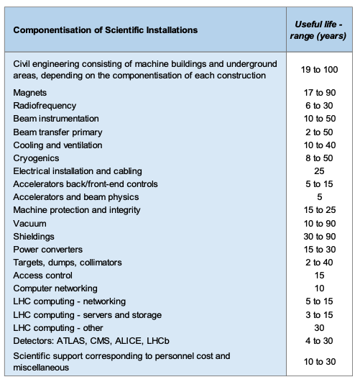
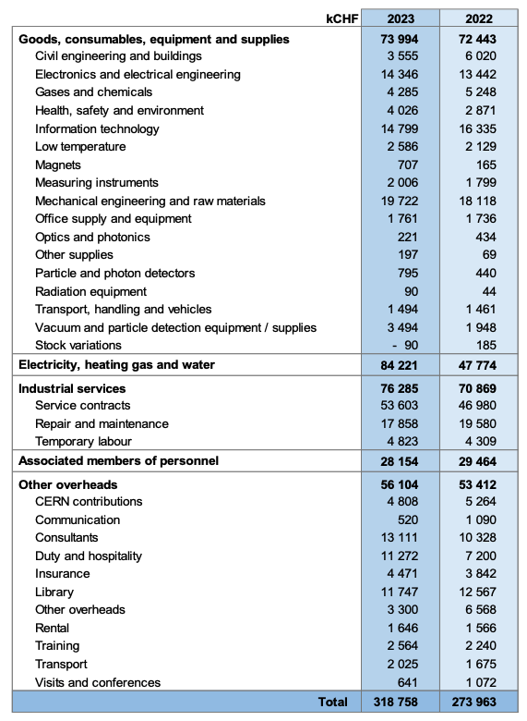
It is challenging in an organisation to attribute expenses to a specific project or programme. In particular for personnel

Slide 97
Science project costs and negative externalities
The Future Circular Collider example

Slide 98
Scope of FCC-ee costs and negative externalities
Costs:
Construction of infrastructure, technical infrastructures, particle accelerators and detectors
Costs of personnel in an international collaboration (full costs)
Cost and impacts of operation
Cost and impact of accelerator and detector dismantling and de-commissioning
Residual value: can be a benefit or not
Exemplary negative externalities:
Loss of land,
Reduction of habitat and biodiversity
Loss of income from agricultural activity due to construction of the land
Environmental impacts such as for instance the effect on global warming

Slide 99
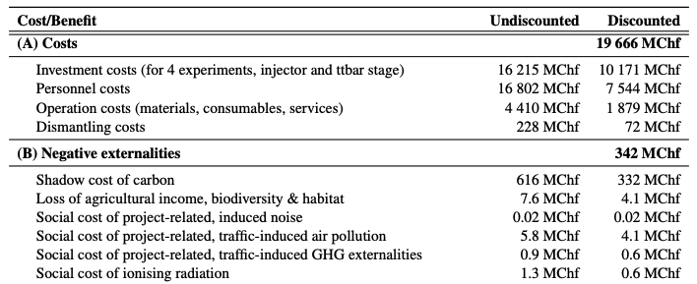
Example for cost and negative externalities volumes

Slide 100
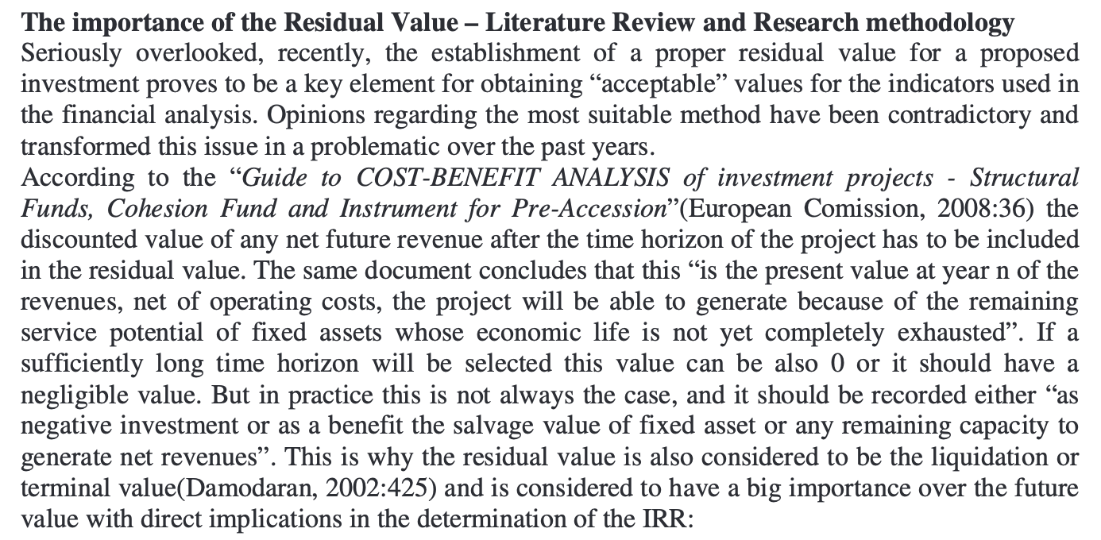
The importance of residual asset value for RIs
https://www.researchgate.net/publication/227462871_DETERMINATION_OF_RESIDUAL_VALUE_
WITHIN_THE_COST_BENEFIT_ANALYSIS_FOR_THE_PROJECTS_FINANCED_BY_THE_
EUROPEAN_UNION

Slide 101
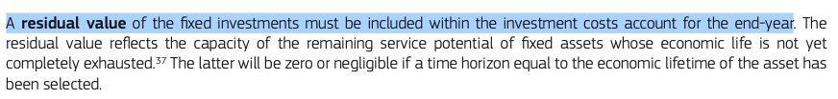
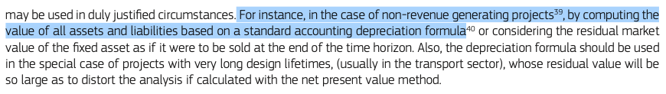
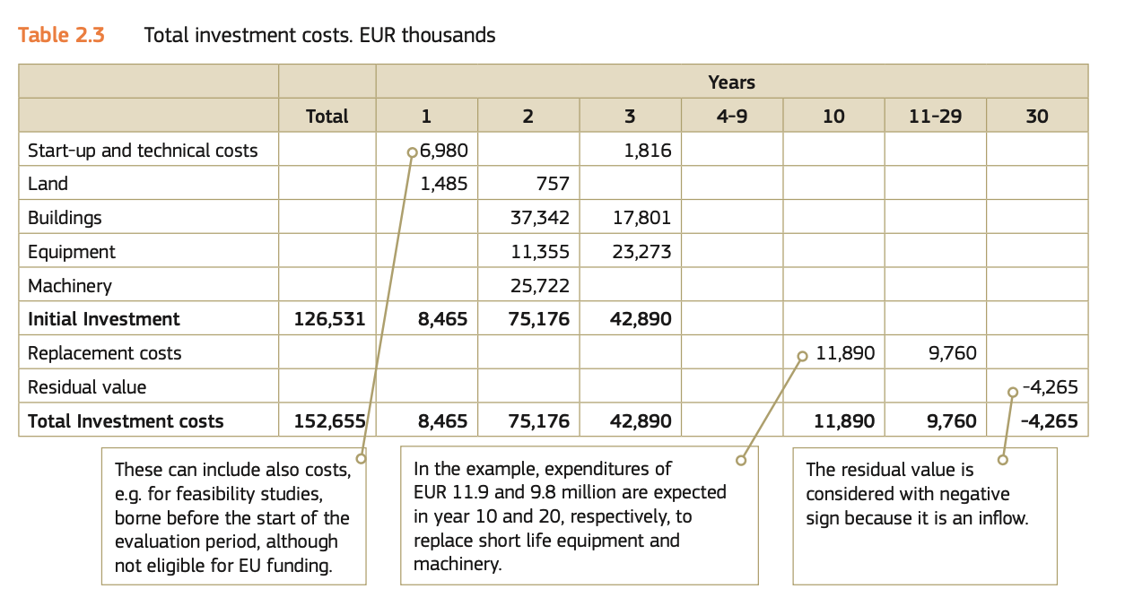
Example on how to present residual asset value
From the EC guide to CBA, p. 45

Slide 102
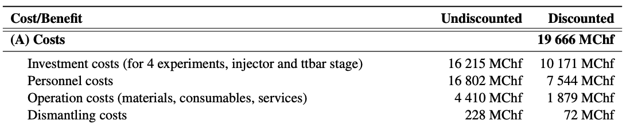
Example: residual value of FCC-ee
Case 1: Second collider will be built after first one
The residual value of the civil structures is the discounted value of the construction costs in the year in which the new collider is foreseen to be installed.
The residual value of the accelerators and detectors is estimated based on today’s scrap metal market value and then discounted to the year of decommissioning.
Case 2: Only the first collider is built
The residual value of the civil structures is zero.
The residual value of the accelerators and detectors is estimated based on today’s scrap metal market value and then discounted to the year of decommissioning.
24% of CAPEX

Slide 103
Cost Benefit Analysis
Techniques for socio-economic assessment

Slide 104
Net Present Value (NPV)
Gives an indication if at the end of the observation period the project can be
sustainable or not from a socio-economic perspective.
Note: It does not inform about the financial sustainability.
NPV is the discounted sum of all future benefits less
the discounted sum of all future costs
over the entire appraisal period.
To estimate the NPV, realistic estimates are required of the benefit and costs streams over the appraisal period.
Typically 30 years are a practical time limit for project appraisal.
Knowledge of the times at which various elements come into play are needed.

Slide 105

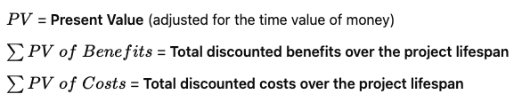
Benefit / Cost Ratio (BCR)
BCR is the ratio of the discounted sum of all future benefits and costs.
The BCR is a value for money measure,
indicating how much net benefit would be obtained in return for each unit of investment cost.
Pearce and Nash (1981) provide examples:
Pearce, D. W., & Nash, C. A. (1981). The social appraisal of projects: A text in cost-benefit analysis. Macmillan Education UK., https://archive.org/details/socialappraisalo0000pear_a9v9 (Account needed)

Slide 106
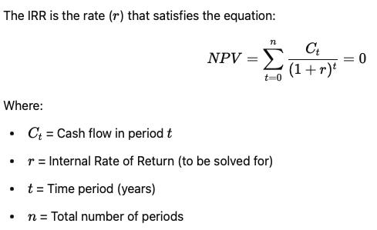
Internal Rate of Return (IRR)
IRR reports the average rate of return on
investment costs over the appraisal period.
It can be compared with the test to see
which SDR would lead to a BCR break even,
i.e. the SDR that leads to a zero NPV
at the end of the appraisal period.
The IRR is then the discount rate that would bring
the net present value (NPV) of the entire project
over the observation period to a zero value.
If the IRR is higher than the assumed SDR, it means
that the cost of the project is lower than the social cost
or the cost to obtain the funds.
Generally, an investment can be considered sustainable from a socio-economic perspective if the BCR is positive and if the IRR is greater than the cost of obtaining the required capital. NOTE: decisions cannot be based on this alone!

Slide 107
Project sustainability criteria

Slide 108


Determining the NPV
Net
Present
Value
Benefits
Residual value
Value of positive externalities
CAPEX
OPEX
Value of negative externalities
=
-
Benefits
Costs
Note: Each cost and each benefit must be discounted before being summed:

Slide 109
Tpy NPV calculation example
Consider 2 project scenario options, A and B.
Both have initial investments of 100, but they have different benefits over time.
The SDR rate determines the choice of a scenario.
 |  | Option A |  |  | Option B
Time | Type | Value | 1% SDR | 5% SDR | Value | 1% SDR | 5% SDR
1 | Cost | -100 | -99.01 | -95.24 | -100 | -99.01 | -95.24
2 | Benefit | 10 | 9.80 | 9.07 | 30 | 49.01 | 45.35
3 | Benefit | 20 | 19.41 | 17.28 | 60 | 58.24 | 51.83
4 | Benefit | 30 | 28.83 | 24.68 | 50 | 48.05 | 41.14
5 | Benefit | 40 | 38.06 | 31.34 | 50 | 47.57 | 39.18
6 | Benefit | 50 | 47.10 | 37.31 | 20 | 18.84 | 14.92
7 | Benefit | 60 | 55.96 | 42.64 | 20 | 18.65 | 14.21
8 | Benefit | 70 | 64.64 | 47.38 | 20 | 18.47 | 13.54
NPV: |  |  | 164.80 | 114.46 |  | 159.83 | 124.93

Slide 110
Guidelines and toolbox
EC Better regulation: guidelines and toolbox:
https://commission.europa.eu/law/law-making-process/planning-and-proposing-law/better-regulation/better-regulation-guidelines-and-toolbox_en

Slide 111
Monetising costs and benefits
Four principal approaches
Contingent valuation,
Travel cost method,
Hedonic pricing,
Cost-based approaches
  Shadow project approach (compare to a similar project implemented)
  Market price
  Avoided cost
  Replacement cost
Only contingent valuation is universally applicable.
Stated preference
(Contingent means “dependent on something else”)
Revealed preference

Slide 112
EN Norms for environmental externalities
ISO EN 14007 and 14008
Monetary valuation of environmental impacts and related environmental aspects.
Permits integrating analysed environmental impacts in a project appraisal process.
Permits comparing different environmental issues and challenges.
Comprises use and non-use values and value of human health.
Use value: real or potential consumption of resources with or without market prizes
Non-use value: value independent of whether it is used or not in the future such as
Existence value: value given by individuals to know that the good continues to exist.
Altruist value: value given by individuals that the good exists and others can profit from it.
Bequest or Leg(acy) value: value given by individuals that the good continues to exist and that future individuals yet to be born will be able to profit from it.
The standard describes all the methods also presented thereafter and provides further sub-methods in more detailed fashion, e.g. temporal and spatial value transfer method.

Slide 113
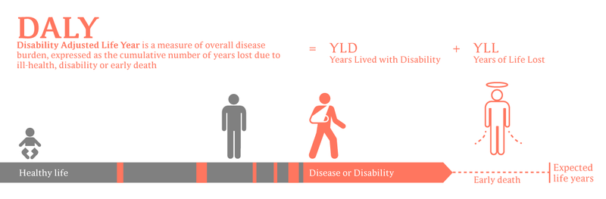
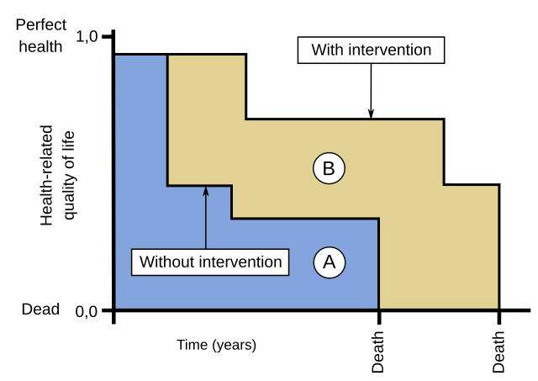
Examples for topics covered by 14007/14008
Impacts on ecosystem services: Productivity of cultures, kg/ha/year
Biodiversity: Endangered species / species on red list, species X inventory of concerned zone
Abiotic resources: Use of primary minerals or water, kg or m³/year consumed or for the activity
Human health: DALY (Disability-adjusted life years = number of lost years due to ill-health, disability or early death) or QUALY (Quality adjusted life year = 1 year in perfect health) per product or activity
Constructed environment: Surface in m² per product consumed per year or activity.

Slide 114
Contingent valuation
Revealing the preferences of people contingent, i.e. “under condition” of a hypothetical scenario.
The meaning is that the value depends on a hypothetical or conditional scenario.
Typically revelaed by a question: “How much would you be willing to pay to …”
Examples: protect something, discover something, understant something.
Estimate the value of non-market goods and services based on preference theory.
Preference theory states that a good or service which contributes to human welfare has economic value.
Individuals are asked what they would pay for a good or a service in a hypothetical market situation, i.e. to pay for something that is actually free.
The approach elicits ‘valuations’ in terms of ‘bids’.
The bids eventually approach the actual value for people by revealing their preferences.
Respondents express what they would be “Willing to Pay” if a market existed for the good or service.
The monetised value can be close to the value if a market value existed.
This works also for intangible goods and services.
Altenatively also the “Willingness To Accept a compensation” (WTA) can be used.

Slide 115
Contingent valuation
Revealing the preferences of people contingent, i.e. “under condition” of a hypothetical scenario
Approach is the ideal process to quantify the scientific research output such as data.
It works by developing a questionnaire with a bidding scheme that comprises ideally two hypothetical scenarios: with and without the output.
The questionnaire would be created in such a way to arrive at a coefficient depicting the probability to which scientific research output would contribute to a researcher’s work or to the development of the economy or welfare increase.
A survey of such kind can also use the resulting coefficient to transform it into a willingness to pay to benefit from research or be designed to yield directly a WTP.
Much care must be taken when designing the survey so to avoid biases, administer it to cohorts that represent the target groups properly, to identify the underlying motivating variables and to eliminate responses that are incoherent.
The US National Oceanic and Atmospheric Administration (NOAA) has developed proper guidelines in 1993: https://repository.library.noaa.gov/view/noaa/60900

Slide 116
Travel Cost Method
Typically for common and public goods: e.g. national parks, heritage sites, clean water
Values a good based on a surrogate market (markets used “in place”):
At least the cost of the journey to the desintation comprising:
Transport
Time spent
Any related fees
Requires:
Inventory of elements included (time, fuel, wear, frares, accomodation, food, spending, …)
Description of how the values have been determined
Attribution to site in case of multiple-visits
Resolution of multiple purposes for the trip
Model for the total value determination
The travel cost function
ISO EN 14008

Slide 117
Hedonic pricing
American labor economist Sherwin Rosen first presented a theory of hedonic pricing in 1974, in a paper titled “Hedonic Pricing and Implicit Markets: Product Differentiation in Pure Competition.”
(https://neconomides.stern.nyu.edu/networks/phdcourse/Rosen_Hedonic_prices.pdf)
The term “hedonic” originated in the 17th century and is an
adjective meaning “of, relating to, or characterized by pleasure” or hedonism.
The approach is encountered in the value determination of e.g.:
Housing
Noise nuissances
Odor nuissances

Slide 118
Hedonic pricing concept (1/2)
Step 1: Estimate relationship between the price of an asset (the dependent variable) and all of its characteristics (independent variables). E.g. the price of a house can be summarised using a hedonic price function P = f(location, type, size, view, neighbourhood*).
*e.g.: connectivity, schooling, infrastructures, crime.
The change in a house price resulting from the marginal change in one of the characteristics is called the hedonic price. It can be interpreted as the additional cost of purchasing a house that is marginally ‘better’ in terms of a particular characteristic.
Usually the price function has a multiplicative functional form. This means that as a characteristic improves the house price increases but at a decreasing rate:
P_{H} = β₀ (LOC β₁) (TYPE β₂) (SIZE β₃) (VIEW β₄) (NEIGH β₅)
β are called the “elasticities”.
The socio-economic benefit of a change induced by a project can be valued by the expected increase in the real estate prices of buildings in the neighbourhood due to the changed (improved or worsened) urban functions (β₅).

Slide 119
Hedonic pricing concept (2/2)
Step 2: Estimate the value of the change of the neighbourhood elasticity β₅ as house prices change with the changed neighbourhood.
The hedonic price of a particular characteristic is the slope of this equation with respect to that particular characteristic:
P_{NEIGH} = (β₅ * P_{H})/NEIGH
The hedonic price of house neighbourhood depends on the value of β₅, the price of the house P_{H}, and the neighbourhood. The hedonic price of a characteristic can be interpreted as the willingness to pay of households for a marginal increase in that particular characteristic.
The differences of house prizes depending of the estimated neighbourhood hedonic price in zones without the project and with the project is the socio-economic impact (positive or negative).

Slide 120
Challenges associated to hedonic pricing
1) Require prior knowledge of the potential positive and negative externalities they may face having purchased a house. For example, they should know the quality of the neighbourhood and the effect on their lives. Limited accessibility to knowledge and is not always the case.
2) Measurement validity: the quality of the measures used in the independent variables is important. If proxy measures are used, for example for the build quality of a house, this could result in an inaccurate coefficient being generated in the regression analyses.
3) Market limitations: the model requires a database of houses with the entire variety of variables available. However, in reality the market is limited, and the choices are constrained in any case.
4) Multicollinearity: it may be the case that houses with good views are only in good neighbourhoods and houses with poor views are only in areas with bad neighbourhoods. In this case it would be impossible to separate out view and neighbourhood accurately.
5) Price changes: the model assumes that market prices adjust immediately to changes in attributes. In reality there is a lag and it also depends on the market activity (rate of sales).

Slide 121
Shadow cost / project approach
Estimated value placed on intangible costs in a project
Value assigned to an abstract or intangible commodity not traded in a marketplace.
If there is a distortion of the real cost w.r.t. the market prize, e.g. if the market if government controlled (e.g. carbon tax, cost of labour).
It is a proxy value for the good or service.
Typically for an externality, where somebody outside the project is affected, societal impacts, real exonomic price given to goods and services to compensate for distortions and to reflect the project’s opportunity costs and benefits more accuratly.
Example: shadow cost of carbon emissions:
Set the cost of 1 tCO2(eq) emitted such the society can with the value abate this extra ton in elsewhere. Carbon shadow cost guidelines differ. The EIB uses one that permits to achieve the Paris Agreement limitation of global warming goals.
EIB Project Carbon Footprint Methodologies, 2013: https://www.eib.org/attachments/lucalli/eib_project_carbon_footprint_methodologies_2023_en.pdf
The Economic Appraisal of Investment Pojects at the EIB, 2023:

Slide 122
Examples for Cost and Benefits Estimations for a scientific research infrastructrure

Slide 123
Benefits

Slide 124
Model building
Example:
Number of users,
Number of publications,
Investment/operation expenses
Value of a comparable product
Opportunity value per unit,
Time value per unit
Financial effect per unit
Set of input parameters
All benefit estimates rely on a repeatable building block, the benefit model.
A set of key parameters that determine the benefit generation
The concept of “incremental benefit” with respect to a counterfactual scenario
Benefit generation per year
Discounting of benefit per year
Sum of the discounted benefits for each year
Important to account for uncertainity:
Minimum, average, max values
Distributions
Benefit
Model
Example:
A formula B = func( input_{1..n} )
Benefit in
each year
Example:
B_{discounted}(t) = B_{undiscounted}(t) * DF(t)

Slide 125
Value of training

Slide 126
The value of training
Example groups of people that can profit from a “salary premium”:
Undergraduate students
Doctoral students
Postdoctoral researchers
Apprentices
Highly-qualified professionals in a situation of “temporary labour” and ”limited duration contracts”.
The effect can only be estimated for persons that stay between a minimum time and a maximum period and up to a certain age at which still “ordinary hiring conditions” apply that can be compared to control groups (e.g. < 30 years old).
Persons, in particular in their early career phase, acquire skills and competencies in Big Science projects that make them more valuable than peers without that experience.
The incremental benefit can be estimated by comparing the lifetime salary of persons who participated in science projects to an equivalent set of persons who did not (control group).
Effects lead to better job opporunities and thus a “premium” on their future salaries. This “marginal” increase is the net benefit.
The effect is visible after a “minimum enagement” in the scientific research project.

Slide 127
What is needed
Assumption on the life active working period are needed. They differ substantially between countries. Official retirement ages are not the “effective” retirement ages.
Effects need to be calculated from the first person entering the research project until the last person leaving the scientific research project.
The lifetime salaries for each “capita” needs to be added and discounted for each year using distributions of the job category after their leave and the active working life and the salary distribution in the countries in which the people are likely to end up working.
Careful: different countries have different additional labour costs and insurance schemes. Therefore it is needed to make a choice between net and gross salary evolution.
Database of different people groups in the research infrastructure.
Entry ages, exit ages of individuals to be able to estimate the average stay per group.
Country distribution of people in the RI, since national salaries and job migration effects are relevant.
Distribution of job markets into which persons leave after their activity at the RI.
Long-term salary tracking of control persons.
Control lifetime salary evolution can be estimated using commercial salary databases (e.g. glassdoor or public administration salary tables)

Slide 128

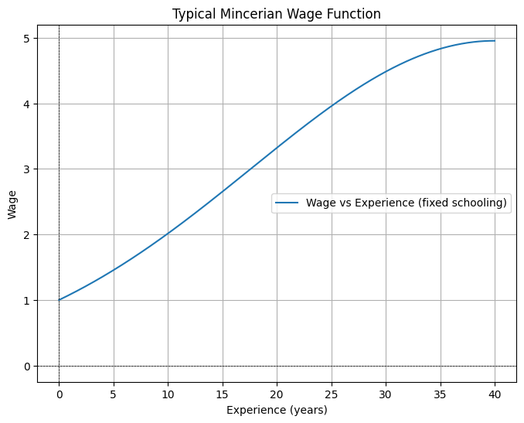
Minzerian wage model after Jacob Mincer
Explains wage as a function of schooling.
Higher education = higher wages
More experience = higher wages, but at decreasing rate captured by the X²
ln(W): natural logarithm of the wage
β₀: earnings without education and experience
S: years of schooling (education, training)
β₁: % increase in salary for each additional year of schooling
X: years of work eXperience
β₂: initial increase of salary with work experience
X²: square of work eXperience to account for diminishing returns to experience
β₃: diminishing returns to experience
e: error term to account for unobserved factors.
ln_wage = a + b * schooling + c * experience +
d * experience**2
wage = np.exp(ln_wage)

Slide 129
Points to remember
The Mincer model describes the
typical wage to be expected for a person in a certain socio-economic context.
The major contributions to the wage level have been determined to be
  Schooling
  Relevant work experience
  Too “long” work experience can also have a negative effect on the wage
The Mincer model is not a lifetime salary evolution function S(t) = …

Slide 130
Lifetime salary evolution
Lifetime salary evolution on the actual labour market matches a simplified logarithmic function based on J. Mincer (but different!) that depends on the amount of active working years and the activity sector.
Wage(t) = A + B * ln(t)
A is the entry point salary, indicated at
t=1 where ln(1) = 0.
Note that ln(0) is undefined.
The higher B, the steeper the curve,
the faster the wage increases.

Slide 131
Lifetime salary premium of LHC participants
Only observed undergraduate, doctoral and post-doctoral researchers.
Only considered at scientists and engineers.
People spend between 1 and 5 years,
avergage = 3.78 years.
Stays below 1 year have no relevant effect.
Legal and effective retirement ages vary
a lot between countries.
The age at which persons enter the labour market
varies, but can for persons at university level be
constrained: 25 – 32 years.
Total working life varies between 37 and 40 years
with a highest probability of 37.5 years
Active work life in years after training
for persons at university level

Slide 132
Results
Analysis permitted to show that a salary premium exists for persons who participate in large-scale, scientific research projects at CERN.
Premium depends on the number of years of service at CERN:
3% (range: 2% to 4%) per year of work in a CERN project.
6% (range 2% to 10%) on average for the average number of 3.78 years at CERN.

Slide 133
Salary premium effect during active work life

Slide 134
Self-declared benefits
Attention: potential bias
Self-declared benefits are not necessarily the only ones linked to the actual salary premium.
The underlying causality is hidden from the persons who actually benefit from the premium.
People in the early career stage consistently tend to assign high value to technical, engineering, scientific skills and tend to value less other skills.
However, industrial partners consistently value language, creativity, analysis, software, teamwork, management as the relevant skills.

Slide 135
Example on how to sum benefits (SalaryPremiumExample.xlsx)
Project year | Persons entering labout market | Active work life when moving from research project to the labour market
 |  | 1 | 2 | 3 | 4 | 5 | 6 | 7 | 8 | 9 | 10 | 11 | 12 | 13 | 14 | 15 | Undiscounted Incremental benefit
2040 | 1 | 1'653 € | 2'543 € | 3'063 € | 3'433 € | 3'719 € | 3'953 € | 4'151 € | 4'323 € | 4'474 € | 4'609 € |  |  |  |  |  | 35'919 €
2041 | 2 |  | 3'305 € | 5'085 € | 6'126 € | 6'865 € | 7'438 € | 7'906 € | 8'302 € | 8'645 € | 8'947 € | 9'218 € |  |  |  |  | 71'838 €
2042 | 3 |  |  | 4'958 € | 7'628 € | 9'189 € | 10'298 € | 11'157 € | 11'859 € | 12'453 € | 12'968 € | 13'421 € | 13'827 € |  |  |  | 107'757 €
2043 | 3 |  |  |  | 4'958 € | 7'628 € | 9'189 € | 10'298 € | 11'157 € | 11'859 € | 12'453 € | 12'968 € | 13'421 € | 13'827 € |  |  | 107'757 €
2044 | 2 |  |  |  |  | 3'305 € | 5'085 € | 6'126 € | 6'865 € | 7'438 € | 7'906 € | 8'302 € | 8'645 € | 8'947 € | 9'218 € |  | 71'838 €
2045 | 1 |  |  |  |  |  | 1'653 € | 2'543 € | 3'063 € | 3'433 € | 3'719 € | 3'953 € | 4'151 € | 4'323 € | 4'474 € | 4'609 € | 35'919 €
Undiscounted benefit per year |  | 1'653 € | 5'848 € | 13'106 € | 22'144 € | 30'706 € | 37'616 € | 42'181 € | 45'569 € | 48'302 € | 50'603 € | 47'862 € | 40'044 € | 27'097 € | 13'692 € | 4'609 € | 431'030 € | Total undiscounted benefit
Discount rate | 0.03
Today | 2025 | Discounting year with respect to 'today'
Discount start year | 2040 | 15 | 16 | 17 | 18 | 19 | 20 | 21 | 22 | 23 | 24 | 25 | 26 | 27 | 28 | 29
Discount factor |  | 0.64 | 0.62 | 0.61 | 0.59 | 0.57 | 0.55 | 0.54 | 0.52 | 0.51 | 0.49 | 0.48 | 0.46 | 0.45 | 0.44 | 0.42 | Discounted incremental benefit
Discounted benefit per year |  | 1'061 € | 3'644 € | 7'929 € | 13'007 € | 17'511 € | 20'827 € | 22'674 € | 23'782 € | 24'474 € | 24'893 € | 22'859 € | 18'568 € | 12'199 € | 5'984 € | 1'956 € | 221'369 € | Total discounted benefit
Every year a number of projecct participants leaves and enters the job market.
Here, the incremental benefit in terms of annual salary premium is shown over 15 years after entering the labour market for a time frame of 10 years per person entering the labour market.
Example provides the discounted value of benefits accumulated between 2040 and 2055 projected to the year 2040, viewed in the year 2025.

Slide 136
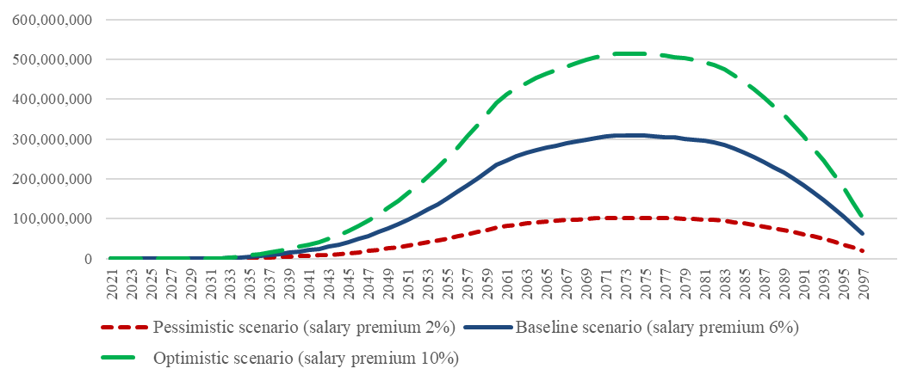
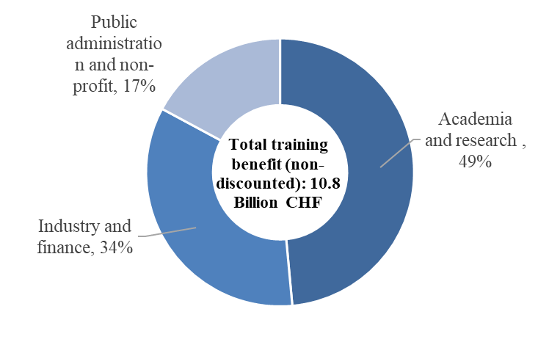
Estimated lifetime salary for FCC-ee
Undiscounted 11 billion total benefit.
Present value of 7 billion is the sum of all discounted salary premium effects (increments with respect to the counterfactual, i.e. peers in the control group) until the year 2097, when the last person who was active in the project retires.

Slide 137
Interesting open research questions
Training effects for non-scientists and engineers:
Environmental technologies
Finance and administration
Communications
Law, economics
Training effects for
Apprentices
Temporary labour
Regularly employed limited duration workers
Training effects due to brain gain/drain:
Premium compared to not leaving the country of origin
Premium of persons returning to their country of oreigin
What is the true causality between lifetime salary premium effects and the activity in a scientific research project? This is still not understood.
See: The Human Capital Accumulation at Research Infrastructures: Reexamining Wage Returns to Training, Models, Interpretation, and Magnitude
Erica Delugas, Francesco Giffoni, Emanuela Sirtori, Johannes Gutleber, https://arxiv.org/abs/2502.07419

Slide 138
Industrial spillovers

Slide 139
Industrial spillovers
Research infrastructure projects require supplies and services that can go beyond commercial-off-the-shelf technological intensity.
A supplier can enjoy a tangible economic benefit due to its involvement in the RI project.
The benefit leads to an EBIT effect after the work for the RI (typically about 5 years).
The effect lasts for a limited period of time (typically 5 to 15 years).
The effect can be observed for a fraction of the supplies and services.
The effect has a different scale depending on the technological intensity.
EBITDA effect on supplier through
causally related followup contracts
Total contract volume
High-tech fraction
Time

Slide 140
Duration of the spillover effect
Technological Learning and Capabilities (5–15 years)
Companies that develop new technologies or manufacturing techniques for CERN often retain and further develop these capabilities for over a decade.
Some suppliers use this expertise to enter new high-tech markets
(e.g., medical imaging, aerospace, or energy sectors).
Reputation and Market Expansion (10+ years)
Being a CERN supplier enhances a company’s reputation,
leading to long-term business opportunities.
Some companies report sustained increases in their customer base
for more than a decade after working with CERN.
Networking and Collaboration (10–15 years)
Participation in CERN projects leads to long-term R&D collaborations with other firms, universities, and research institutions, leading to further innovation.

Slide 141
Duration of the spillover effect
Human Capital Development (Indefinite Impact)
Engineers and technicians trained on CERN projects bring advanced knowledge back to their companies, improving long-term innovation capacity.
Knowledge transfer effects can persist even after employees move to other firms.
Case studies and evidence
60% of suppliers reported significant long-term benefits with 10+ years effects
OECD report on Big Science and Innovation 2017 noted that firms supplying major scientific facilities like CERN often experience technological spillovers lasting 15 years or more.

Slide 142
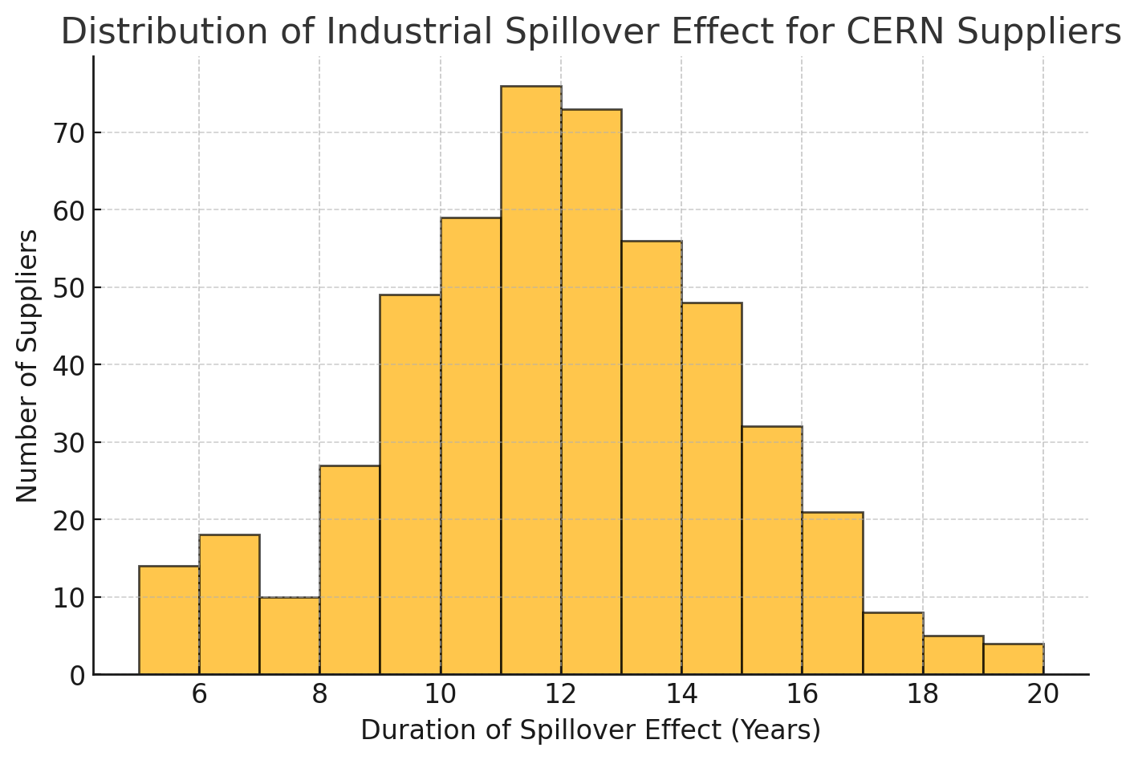
Duration of the spillover effect
import numpy as np
import matplotlib.pyplot as plt
# Create a random distribution with constraints
# Mean 12 years, Std Dev 3 years
spillover_durations = np.random.normal
(loc=12, scale=3, size=500)
# Constrain between 5 and 20 years
spillover_durations = np.clip
(spillover_durations, 5, 20)
# Plot histogram
plt.figure(figsize=(8, 5))
plt.hist(
spillover_durations,
bins=15, edgecolor='black’,
alpha=0.7)
plt.xlabel("Duration of Spillover Effect (Years)")
plt.ylabel("Number of Suppliers")
plt.title("Distribution of Industrial Spillover Effect")
plt.grid(axis='y', linestyle='--', alpha=0.6)
plt.show()
Massimo Florio & Francesco Giffoni & Anna Giunta & Emanuela Sirtori, 2018. "Big science, learning, and innovation: evidence from CERN procurement," Industrial and Corporate Change, Oxford University Press and the Associazione ICC, vol. 27(5), pages 915-936. https://doi.org/10.1093/icc/dty029
Giunta, A., Bastianin, A., Castelnovo, P., & Florio, M. (2021). Big science and innovation: Gestation lag from procurement to patents for CERN suppliers. The Journal of Technology Transfer, 46(2), 297–322. DOI: 10.1007/s10961-021-09854-5, https://link.springer.com/article/10.1007/s10961-021-09854-5
OECD (2017). The Impacts of Large Research Infrastructures on Economic Innovation and Society. OECD Report
Autio, E., Hameri, A.-P., & Vuola, O. (2004). “A framework of industrial knowledge spillovers in big-science centers.” Research Policy, 33(1), 107–126.
Castelnovo, P., & Dal Molin, M. (2020). “The learning mechanisms through public procurement for innovation: The case of government-funded basic research organizations.” R&D Management, 50(1), 67-83.
Florio, M., Pancotti, C., & Sirtori, E. (2016). “Cost–benefit analysis of applied research infrastructure: The case of CERN.” Technological Forecasting and Social Change, 112, 38–53.

Slide 143
Technological intensity level
1) Very likely to be off-the-shelf products with low technological intensity.
2) Off-the-shelf products with an average technological intensity.
3) Mostly off-the-shelf products, requiring limited design and engineering work according to detailed specifications.
4) Products requiring project-related customisation and adaptation with
a moderate to high design and engineering activity.
5) Products requiring scratch developments and CERN/supplier
co-developments or significant adaptation of an existing product
or service for the project.
No effect
Low
Moderate
High
Sales Utility Multiplier for high-tech science projects
is typically between 1 (Low) and 3.15 (High)

Slide 144
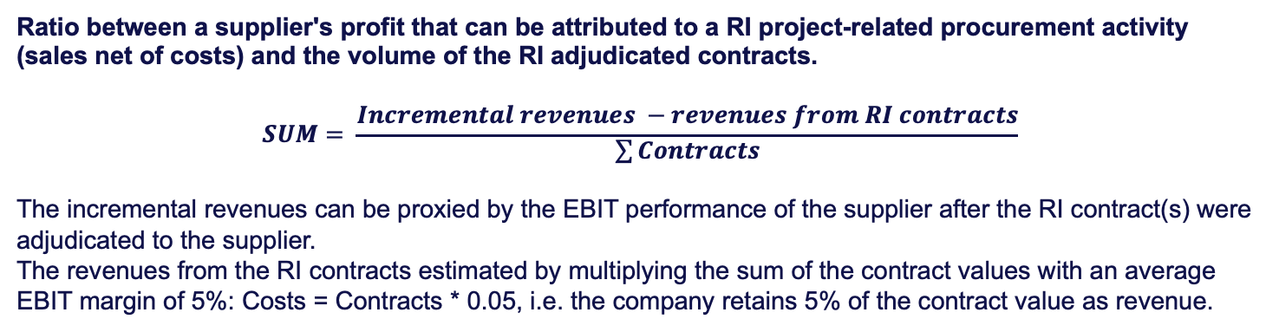
Sales Utility Multiplier
Ratio between a supplier's profit that can be attributed to a RI project-related procurement activity (sales net of costs) and the volume of the RI adjudicated contracts.
$$SUM= \frac{Incremental revenues −revenues from RI contracts}{\sum{Contracts}}$$
The incremental revenues can be proxied by the EBIT performance of the supplier after the RI contract(s) were adjudicated to the supplier.
The revenues from the RI contracts estimated by multiplying the sum of the contract values with an average EBIT margin of 5%: Costs = Contracts * 0.05, i.e. the company retains 5% of the contract value as revenue.
A list of Sales Utility Multipliers in the US that is regularly updated can be found online:
https://pages.stern.nyu.edu/~adamodar/New_Home_Page/datafile/psdata.html
and
https://pages.stern.nyu.edu/~adamodar/New_Home_Page/data.html

Slide 145
How to
Determine for each contract fraction the intensity scale.
Multiply the fraction of the contract fraction value with the sales-utility multiplier corresponding to the technological intensity level (= undiscounted benefit).
Stretch the undiscounted benefit over a likely time period after a gap between the contract assignment by sampling from a histogram for the effect duration over time.
Discount the benefits.
Sum the discounted benefits to obtain the present value of the total benefit.

Slide 146
Example: Accelerator radiofrequency system
Total investment value: 580’000’000 Chf
Duration of production: 6 years, starting in 2038 (completion 2044)
Intensity level | Fraction oncerned | Value | SU Multiplier | Undiscounted benefit | Rationale
5 | 0.4 | 232 MChf | 3.06 | 709.92 MChf | Competitiveness increase due to thin film coating and complex geometry production.
4 | 0.2 | 116 MChf | 1.96 | 226.36 MChf | New markets due to higher efficiency, increased quality, lower production costs.
2 | 0.2 | 116 MChf | 1.0 | 116.00 MChf | Gain of reputation and reference case leads to further contracts in industry sectors.
1 | 0.2 | 116 MChf | 0.0 | 0.00 MChf | Off the shelf metal production and system installation.
 | 1.0 (Sum) | 580 MChf | n/a | 1’052.28 Chf

Slide 147
Calculation (see IndustrialSpilloverExample.xlsx)
 |  |  | Start of contract |  |  |  | Begin effect |  | End of contract |  |  |  |  | End effect
 | Sum | 2025 | 2038 | 2039 | 2040 | 2041 | 2042 | 2043 | 2044 | 2045 | 2046 | 2047 | 2048 | 2049 | 2050 | 2051 | 2052 | 2053 | 2054 | 2055 | 2056
Total contract volume | 580.00 |  | 48.33 | 96.67 | 96.67 | 96.67 | 96.67 | 96.67 | 48.33
Contract fraction TIL 5 (0.4) | 232.00 |  | 19.33 | 38.67 | 38.67 | 38.67 | 38.67 | 38.67 | 19.33
Contract fraction TIL 4 (0.2) | 116.00 |  | 9.67 | 19.33 | 19.33 | 19.33 | 19.33 | 19.33 | 9.67
Contract fraction TIL 2 (0.2) | 116.00 |  | 9.67 | 19.33 | 19.33 | 19.33 | 19.33 | 19.33 | 9.67
Contract fraction TIL 1 (0.2) | 116.00 |  | 9.67 | 19.33 | 19.33 | 19.33 | 19.33 | 19.33 | 9.67
Spillover effect TIL 5 | 709.92 |  |  |  |  |  | 12.78 | 21.30 | 36.92 | 48.27 | 68.15 | 72.41 | 86.61 | 105.07 | 83.77 | 75.25 | 44.02 | 32.66 | 8.52 | 5.68 | 8.52
Spillover effect TIL 4 | 226.35 |  |  |  |  | 4.07 | 6.79 | 11.77 | 15.39 | 21.73 | 23.09 | 27.62 | 33.50 | 26.71 | 23.99 | 14.03 | 10.41 | 2.72 | 1.81 | 2.72
Spillover effect TIL 2 | 116.01 |  |  |  | 2.09 | 3.48 | 6.03 | 7.89 | 11.14 | 11.83 | 14.15 | 17.17 | 13.69 | 12.30 | 7.19 | 5.34 | 1.39 | 0.93 | 1.39
Undiscounted benefit (MChf) | 1052.28 | 0.00 | 0.00 | 0.00 | 2.09 | 7.55 | 25.60 | 40.96 | 63.45 | 81.83 | 105.39 | 117.20 | 133.80 | 144.08 | 114.95 | 94.62 | 55.82 | 36.31 | 11.72 | 8.40 | 8.52
Discount time |  | 0 | 13 | 14 | 15 | 16 | 17 | 18 | 19 | 20 | 21 | 22 | 23 | 24 | 25 | 26 | 27 | 28 | 29 | 30 | 31
Discount factor |  | 1.00 | 0.70 | 0.68 | 0.66 | 0.64 | 0.63 | 0.61 | 0.59 | 0.58 | 0.56 | 0.54 | 0.53 | 0.52 | 0.50 | 0.49 | 0.47 | 0.46 | 0.45 | 0.44 | 0.42
Discounted benefit (MChf) | 559.39 | 0.00 | 0.00 | 0.00 | 1.38 | 4.85 | 16.01 | 24.91 | 37.54 | 47.11 | 59.01 | 63.84 | 70.89 | 74.26 | 57.63 | 46.15 | 26.48 | 16.76 | 5.26 | 3.67 | 3.62
The spillover effects are calculated by multpliying the fraction of the contract volume with a utility multiplier,
e.g. Undiscounted spillover technological intensity level 5 = total ontract volume * TIL 5 fraction * multiplier TIL 5 = 580 * 0.4 * 3.06 = 709.92
The discounted spillover in each each year the undiscounted spillover is multiplied with the discount factor.
All discounted spillovers are summed up.

Slide 149
Challenges
Determining the sales utility mulitpliers
  Requires actual companies that received contracts
  Requires interviews with companies (ORBIS and book value insufficient for analysis)
  Large companies invoice in different locations than where contract is performed
  Requires control companies that supply exactly the same goods and services
  Requires counterfactual scenario
Determining the start and duration of the spillover effects
  See above: interviews with companies are needed
Determining the fractions of contract volumes with technological intensities > 1
  Requires in-depth, excellent technical understanding of the work to be done
  Need to avoid bias of interviewed ”domain experts” who are not necessarily experienced in industrial procurement or who have a stake in the project
Determining the procurement scenario
  Requires either access to past procurement databases or very good insight & knowledge

Slide 150
Possible approaches for counterfactual scenarios
Classical
  Build a set of companies based on the procurement codes
  (NACE if you have)
  Compare past performance of control companies with companies who have received an RI procurement contract.
Novel
  Build a “synthetic” company that exhibits exactly the same characteristics as the one who receives the contract and model its future behaviour based on known market demand.

Slide 151
Value of
Onsite tourism

Slide 152

The value of on-site tourism
Research infrastructures can be destinations of high-quality tourism throughout the entire year.
The visit to the Research Infrastructure can justify further visits to explore the region.
For example, CERN welcomes today almost 400’000 visitors.
The NY Times rated Geneva as global tourism destination number 10, mainly due to CERN.

Slide 153
Monetising the value of tourism
The conventional approach is the “Travel Cost Method” that captures the value in terms of “opportunity cost” and “leasure time value”. This approach is incomplete and does not fully account for the tangible economic surplus.
A comprehensive analysis of the visitor spending via a survey is required over at least 4 seasons.
Key elements:
Reason for visit: (1) RI or (2) region. This is important for demonstrating the causality.
Motivation for RI visit: (1) the specific project or (2) a past project or (3) general interes or other reasons. This is important for demonstrating the causality.
Case: Motiviation CERN
Account the full visit value
Case: Motivation region
Account only local travel time
Account only the CERN visit time
Account only spending related to CERN
Full spending during visit.
Full duration of visit including additional sites visited.

Slide 154






Survey example

Slide 155



Survey example

Slide 156

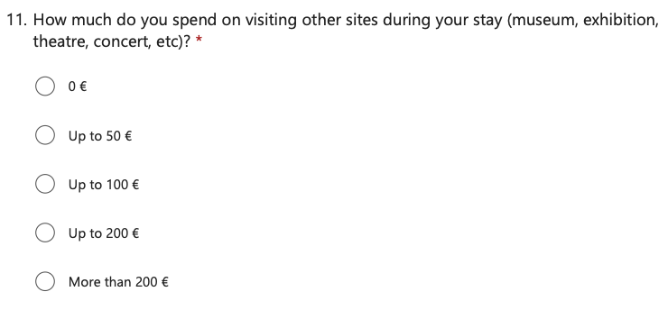

Survey example

Slide 157

Survey example

Slide 158
Hints for successful questionnaires
Make it as short as possible (but as long as needed).
Ask only what you need to know.
Avoid open ended questions as much as possible.
Administer the surveys electronically.
Localise the language!
Have the questionnaire reviewed by a panel of economists.
Keep a database of responses.
Foresee an evolution of the questionnaire (configuration management, versioning).
Administer the survey with a hostess/guidance to avoid the need for cleaning as much as possible and to get trustworthy responses.
Reward people who are interviewed, e.g. with a ”goodie”.
Any investment upfront to assure that your data quality is good will help later.
Bad quality data cannot be repaired!

Slide 159
Motivation for visit: CERN or region?
MOTIVATION | IndividuaL | GROUP | Total
CERN motivated | 1,164 | 540 | 1,704
Region motivated | 1,173 | 209 | 1,382
Total | 2,337 | 749 | 3,086

Slide 160
Value of leisure time
Value of time (CHF/hour, 2021) | Source
9.36 | Handbook on the external costs of transport – January 2019
13.96 | Pelletier, M. C., Heagney, E., & Kovač, M. (2021). Valuing recreational services: A review of methods with application to New South Wales National Parks. Ecosystem Services, 50, 101315.
14.40 | Meunier, D., & Quinet, E. (2015). Value of time estimations in cost benefit analysis: the French experience. Transportation Research Procedia, 8, 62-71.
16.56 | Lugano, G., Cornet, Y., UNIZA, R. P., Bernardino, J., Waris, H., & Milakis, D. (2018). D2. 2–Mobility and Travel Time Report.
16.28 | Boiteux M. (2000) “Choix des investissements and prise en compte des nuisances”,
7.30 - 16.28 | Legal basis socio-economic impact studies France
18.65 | Wardman, M., Chintakayala, V. P. K., & de Jong, G. (2016). Values of travel time in Europe: Review and meta-analysis. Transportation Research Part A: Policy and Practice, 94, 93-111.
Summary
7.3 | Minimum
14.1 | Average
18.7 | Maximum

Slide 161
Hybrid approach
Travel cost method
Travel cost to CERN depending on distance and travel modality based on survey to visitors
Time spent for travelling
Time spent at CERN
Eocnomic impact: local spending
Accomodation
Foods and drinks
Souvenirs
Visits to other sites (museums, concerts)

Slide 162
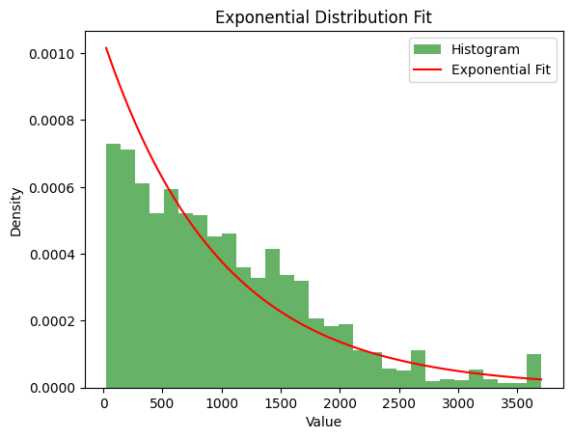
Results of the survey at CERN 2024/2025
75% are individual visitors and 25% come in groups.
Some outliers above 3’500 euro per stay.
Average spending (travel cost and local spending) is abour 1’000 euro per total visit period.
Local spendings: about 200 euro per day and person.
Average duration of stay is 3 to 4 days (3.75) days.
Travel time value is between 8 and 20 Chf per hour (Average 15.5 Chf).
Main challenge:
Cleaning of the data due to not trustworthy results and conflicting responses.

Slide 163
Approach
Have spending distributions per visitor type, e.g. individual and groups.
Obtain up to date leasure time values for different people in Europe (NOT working time value!)
Ask visitors their travel costs or use travel cost databases.
Sample the estimated forecast number of annual visitors from the existing distributions.
Use the fraction that is causally attributable to the project only!
Sum up the benefits in each year (undiscounted).
Discount the benefits in each year and sum them up.

Slide 164
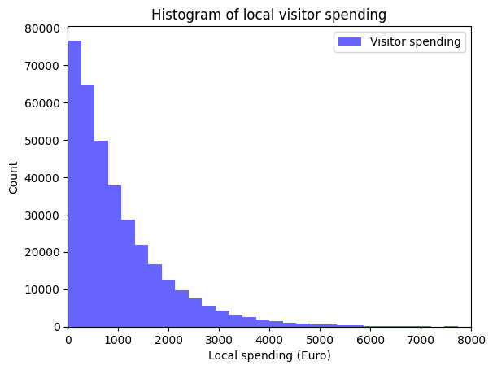
Results of the survey at CERN 2024/2025
Based on the revealed local spending distribution the annual local spending generated by about 350’000 visitors at cern is about 360 million euro (358’161’807) euro.
Note:
This is not the benefit for a specific future research project. It is the overall economic benefit of visitors to CERN!
To reveal the incremental benefit of a project, a counterfactual scenario needs to be defined and only the difference must be reported.
350’000 entries samples from histogram to the left

Slide 165
Counterfactual

Slide 166
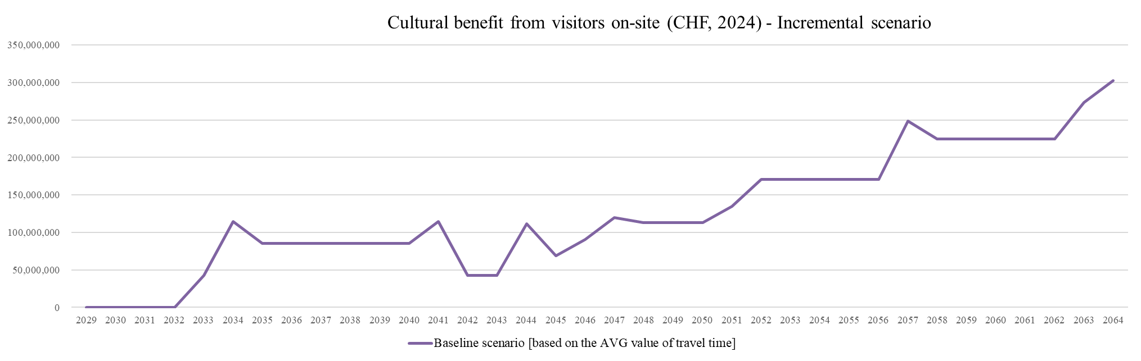
Result: 4 billion non discounted, 2 billion discounted

Slide 167
Calculation example based on local spending
VisitorExample.xlsx
 |  |  | Construction phase
Year | Sum | 2025 | 2033 | 2034 | 2035 | 2036 | 2037 | 2038 | 2039 | 2040 | 2041 | 2042 | 2043 | 2044 | 2045 | 2046 | 2047
(A) Project scenario individual visitors | 7'000'000 | 0 | 250000 | 250000 | 250000 | 250000 | 250000 | 250000 | 250000 | 250000 | 250000 | 250000 | 250000 | 250000 | 250000 | 250000 | 250000
(B) Project scenario group visitors | 2'230'000 | 0 | 120000 | 120000 | 120000 | 120000 | 120000 | 120000 | 120000 | 120000 | 140000 | 140000 | 140000 | 50000 | 50000 | 50000 | 50000
(A) Counterfactual individual visitors | 5'401'000 | 0 | 250000 | 250000 | 250000 | 250000 | 250000 | 250000 | 250000 | 250000 | 250000 | 250000 | 250000 | 240000 | 230000 | 220000 | 210000
(B) Counteractual group visitors | 1'700'000 | 0 | 85000 | 85000 | 85000 | 85000 | 85000 | 85000 | 85000 | 85000 | 100000 | 100000 | 100000 | 50000 | 50000 | 50000 | 50000
(A-C) Incremental individual visitors | 1'599'000 | 0 | 0 | 0 | 0 | 0 | 0 | 0 | 0 | 0 | 0 | 0 | 0 | 10000 | 20000 | 30000 | 40000
(B-D) Incremental group visitors | 530'000 | 0 | 35000 | 35000 | 35000 | 35000 | 35000 | 35000 | 35000 | 35000 | 40000 | 40000 | 40000 | 0 | 0 | 0 | 0
Value of incremental individual visitors | 554'853'000 | 0 | 0 | 0 | 0 | 0 | 0 | 0 | 0 | 0 | 0 | 0 | 0 | 3470000 | 6940000 | 10410000 | 13880000
Value of incremental group visitors | 583'000'000 | 0 | 38500000 | 38500000 | 38500000 | 38500000 | 38500000 | 38500000 | 38500000 | 38500000 | 44000000 | 44000000 | 44000000 | 0 | 0 | 0 | 0
Total visitor value | 1'137'853'000 | 0 | 38500000 | 38500000 | 38500000 | 38500000 | 38500000 | 38500000 | 38500000 | 38500000 | 44000000 | 44000000 | 44000000 | 3470000 | 6940000 | 10410000 | 13880000
Discount year |  | 0 | 8 | 9 | 10 | 11 | 12 | 13 | 14 | 15 | 16 | 17 | 18 | 19 | 20 | 21 | 22
Discount factor |  | 1.00 | 0.80 | 0.78 | 0.76 | 0.74 | 0.72 | 0.70 | 0.68 | 0.66 | 0.64 | 0.63 | 0.61 | 0.59 | 0.58 | 0.56 | 0.54
Discounted value | 617'503'490 | 0 | 30868520 | 30027743 | 29209867 | 28414267 | 27640338 | 26887488 | 26155144 | 25442747 | 28285433 | 27515013 | 26765577 | 2053337 | 3994819 | 5829017 | 7560333
SDR | 0.028
Base year | 2025
Economic impact of individual visitor/stay | 347 | Chf
Economic impact of group visitor/stay | 1'100 | Chf
Mutiple estimation approaches possible:
Visitors without project, visitors with the project, difference between the two values
> Permits also calculating NPV of counterfactual case.
Immediately the incremental (positive or negative) number of visitors in the project case

Slide 168
Value of
Open Software

Slide 169
The value of open software and data
There exists not one single economic model to estimate the value of open software and data.
The “demand” or “market existence” question is complicated, since the demand or market may not even exist before the software becomes available.
Examples:
GNU
World Wide Web
Linux
Indico

Slide 170
Case of Open Repository: Invenio SW / Zenodo
NPV = ∑^{T} _{t = 0}Discounted Benefit i – ∑^{T} _{t = 0}Discounted Cost i
  Cost of the virtual repository: Costs related to the development and maintenance of the repository.
  Benefits of the repository: Three variables have been identified as having a socio-economic impact benefit measuring the benefits of open access.
    Data storage: Data storage includes all files stored in the free virtual repository.
    The measurement of the benefit of this feature is determined by establishing a price based on market values from Dryad, a commercial repository (datadryad.org).
    Downloads: This variable makes measures the benefit of access to information due to downloads made by users of the documents hosted in the repository.
    Online usage: This variable estimates the monetary value of the time spent by unique visitors to the website. The value of web usage is based on Piwik's observations. Piwik is a free and open-source web analytics application used by Zenodo for its metrics. The value of time was calculated, based in the average salaries per minute for researchers in EU countries.

Slide 171
MODEL ASSUMPTIONS
Timeline | 2021 – 2057 2021 as a base year
General increase of the timeline | The variables used in the study increase until 2040 and then remain constant.
Social Discount Rate | 2%
Currency | Fixed at 1 € = 1.07 CHF
Value of time | 0.30 €/min extracted from the Eurostat database.
Virtual value of a single download | 7 € established based on comparable comercial platforms (e.g. IEEE Xplore) and a public good value survey

Slide 172
Infrastructure costs
Conditioned by the present economic situation of development in an existing research infrastructure.
Costs increase in the period 2023 - 2027 according to the inflation rate estimates made by the International Monetary Fund.
In the period 2028 - 2040 the costs increase by 4% according to the average inflation values in the European Union.
Leads to infrastructure cost 2028-2057 of 12.9 MCHF discounted.

Slide 173
Estimated benefits
Data Storage
Market price based (Dryad):
  < 50 GB or 50 GB per document upload = 111.72 €
  > 50 GB = 46.55 € per +10 GB
10% annual increase in documents under 50GB in size until 2040, then constant until 2057.
3% annual increase in documents over 50GB in size until 2040, then constant until 2057.
These assumptions yield a total discounted benefit of 1,3 billin CHF for 29 years observation period.
Online usage
Value of time: 0,30 €/min.
Total time spent by visitor (min) → Average time of 4 min.
% Annual increase in visitors until 2040, where it will remain constant until 2057 → 10 %
Total benefit discounted in CHF → 1.4 billion CHF for 29 years observation period.
Downloads
Average value of a download of 1 information record (paper, data, software): 7 €.
Given the impossibility of computing unique downloads per document, it was decided to consider only one download per document stored in the repository.
Total benefit discounted in CHF → 82 MCHF for 29 years observation period.

Slide 174
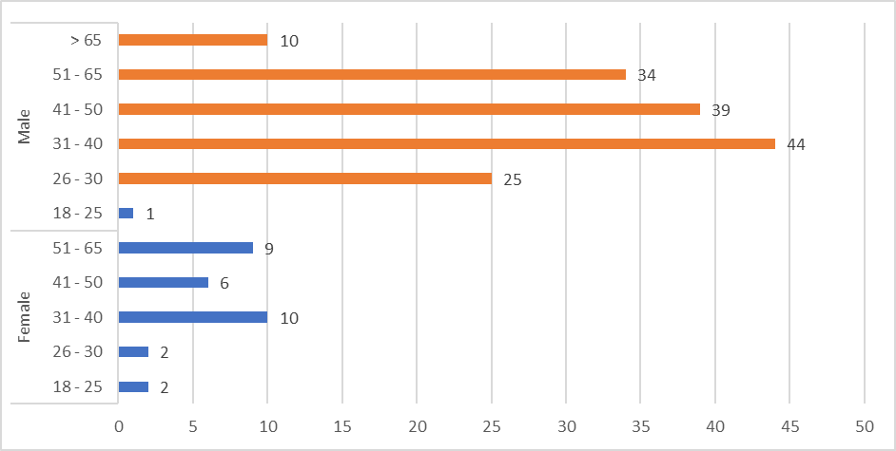
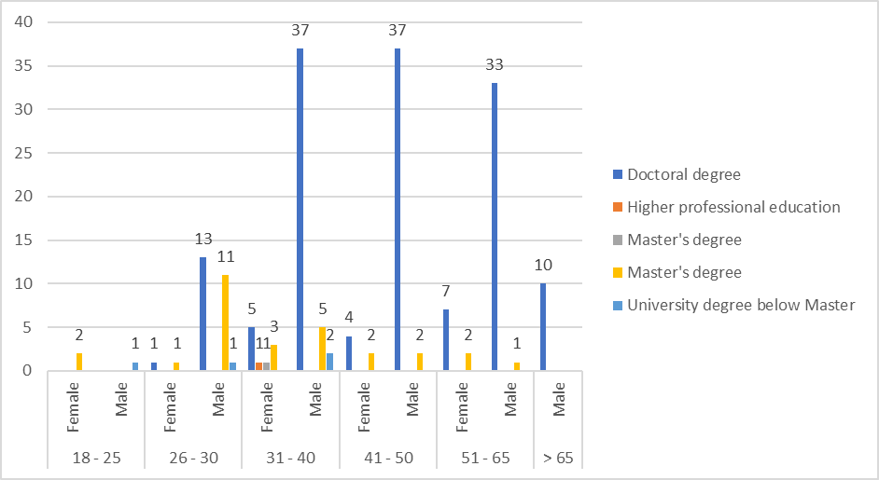
Second approach: WTP survey with 182 respondants
Age range of the respondents by gender
Highest level of education in function of gender and age range
Current occupational status in function of type of firm/organisation and gender

Slide 175
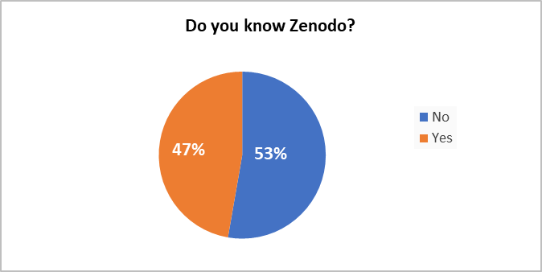
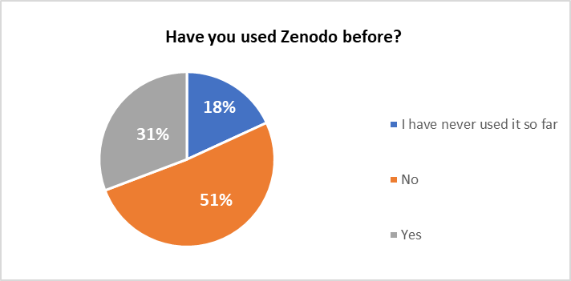
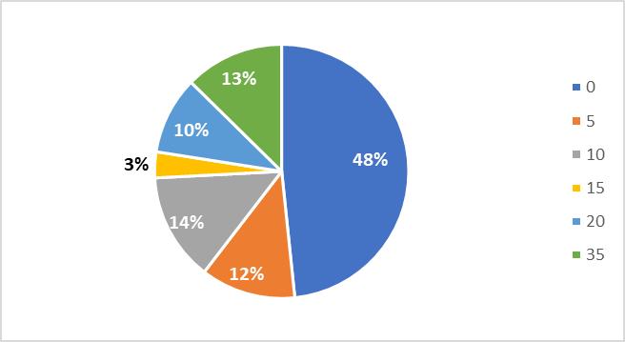
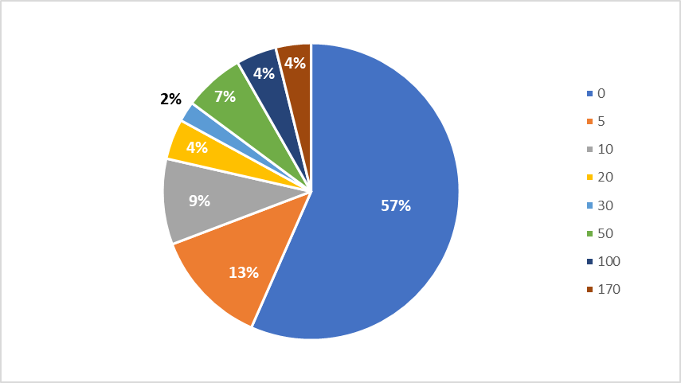
WTP survey
WTP levels per year to have unlimited data storage in Zenodo for scientific information
WTP levels per year in order to obtain unlimited access to Zenodo scientific information

Slide 176
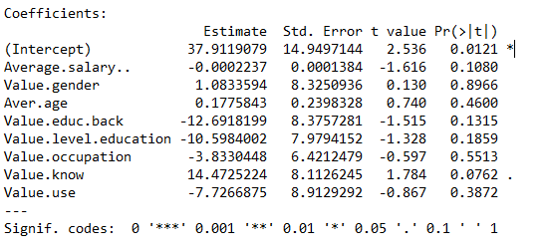


Regression analysis considering diff. variables
WTP Downloads = 17,34€
WTP Storage = 8,87€
WTP total = 26,21€
Only variable that influences is the platform awareness variable. WTP is not influenced by education, age, …
Not sufficient to use the model, though.
The sample size is small and is not representative of the target population of the repository.

Slide 177
Case of collaborative software: Indico
Tool allows to manage conferences, workshops, and meetings.
  Example for a collaborative tool in a global RI setup.
  Serves as a fact-based baseline for estimating the value of a future, similar service.
Designed, implemented, maintained, and operated by CERN.
Free and accessible to anyone who wants to install it in their infrastructure.

Slide 178
Potential value
Qualitative
Easy organization of events including all the needs you may require: room reservation; program management; registration, e-payment, badge creation; submission of materials; surveys, etc.
Enterprise content archiving system. One place to store all your events and integrate in your working life.
Quantitative
Based on a choice experiment method conducted through a survey distributed in different countries.

Slide 179
Contingent valuation
2’100 valid respondents from 5 different countries:
  Italy, Spain, Germany, the United Kingdom and the United States of America.
  In each country, 350 people were surveyed.
Target audience → employees over 18 years of age in private sector companies with more than 50 computers who are users of the conference, workshop, and meeting management software.
Survey serves as a representative source of information for Indico’s target population.
Quantification estimates were obtained in different currencies. Results were converted to euro.
Exchange rate November 11, 2022
1 $ → 0.97 €
1 £ → 1.14 €

Slide 180
Respondants use comparable tools

Slide 181
Goal: elucidate the market value
Two types of questions were asked in relation to the Willingness To Pay (WTP) as a proxy for the market value, after showing a presentation on the Indico tool, explaining its features and how it works:

Slide 182
When respondents were asked to justify their response, most were responding
that keeping events and documents safe is a fair price.
This response is repeated in several different ways throughout the study.
Response value ranges | Rationale for the answer
51 € - 150 € | Good service.
151€ - 250 € | I like that it is organized and professional.
251 € - 500 € | The platform is very good. I like high-quality services like this. Because it helps me at work.
501 € - 750 € | Very good platform.
751 € - 900 € | Effort matters. Because it is elite.
> 900 € | High-quality platform. According to the description, it is a full options service with very excellent features, therefore I choose this price range.

Slide 183

Regression model
The model shows how the choice decision of Willingness to Pay is influenced by the variables age, salary, and whether the user is a moderator/creator of events and a participant.
Variables that do not influence the prize range choice are not taken into account.
The regression model reports a Willingness To Pay per single event of 405.53 €.

Slide 184
Alternative approach: choice experiment
Survey approach designed to elicit consumer preferences based on hypothetical markets.
The choice experiment has been formulated as follows:
  Respondents were informed that the Indico tool has basic features:
  names of speakers and participants with their contact details, material to be used at the event, detailed agenda with time indications, links to videoconferences, invitations to speakers and participants, and management of access to the event.
  The attributes respondents were asked about in the choice:
    Price per event: (A) 250 €, (B) 475 €, (C) 750 €
    Registration form and room reservation
    Abstract submissions and publications review
    Customizing the event page
  6 different sets of questions were created with four options each. Three options where the existence or non-existence of the three attributes were mixed according to the price attribute and a fourth option in case the respondent did not agree with the three previous options.

Slide 185

Conditional Logistic Regression model
Conditional logistic regression is an extension of logistic regression that allows one to consider stratification and matching. The dependent variable is binary (yes/no). Its main field of application is observational studies and in particular epidemiology.
The results show that all variables are significant and therefore important in the choice.
The price coefficient is negative, as expected, for the calculation of the “Marginal Willingness to Pay” (MWTP). Means that as the price increases, the probability of choosing the good decreases.
The price should be negative to reflect the trade-off between the price and the positively valued attribute. A positive price coefficient will give a negative MWTP.

Slide 186
Results
MWTP
Abstract submissions and publications review | 307.38
Registration form and room reservation | 361.59
Customizing the event page | 209.60
Average WTP | 292.86
The results reflect that:
  Respondents are willing to pay additional 307 € to add the feature “Abstract and publications review" to their events.
  The feature they would be least willing to pay for is "Customizing the event page“, and the feature they would be most willing to pay for is "Registration form and room reservation".
  Respondents would be willing to pay
  additional 293 € for each individual feature added to the basic event management functionality.

Slide 187
Considerations
We consider that, with the exception of the United Nations using the tool in 90 % of the cases for conferences, Indico is mostly used for lecture or meeting type events.
Eliminating the category of “Abstract submission and publication review”, which is more commonly used at conferences,
the WTP reported by the survey is 571.19 € per event.

Slide 188
Deployment of Indico outside physics
Year | WWU Münster | SISSA | SKAO | Maths CNRS | EGO | United Nations | ESA | UU | CTA | STFC | RIKEN | FUSENET | EGI | INAF | IHEP | Sum events per year
2006 |  |  |  |  |  |  |  |  |  |  |  |  |  |  | 21 | 21
2007 |  |  |  |  |  |  |  |  |  |  |  |  |  |  | 135 | 135
2008 |  |  |  |  |  |  |  |  |  |  | 59 |  |  |  | 286 | 345
2009 |  |  |  |  |  |  |  |  |  |  | 75 |  |  |  | 379 | 454
2010 |  |  | 27 |  |  |  |  |  | 19 |  | 206 |  | 211 |  | 388 | 851
2011 |  |  | 43 |  |  |  |  |  | 65 |  | 268 |  | 442 |  | 519 | 1,337
2012 |  |  | 11 |  |  |  | 7 |  | 121 |  | 310 |  | 415 |  | 493 | 1,357
2013 |  |  | 27 | 241 |  |  | 11 | 53 | 192 |  | 345 |  | 540 |  | 410 | 1,819
2014 |  |  | 33 | 280 |  |  | 17 | 78 | 235 |  | 338 |  | 384 | 31 | 672 | 2,068
2015 |  | 2 | 31 | 264 |  | 1,973 | 32 | 86 | 204 |  | 359 |  | 348 | 125 | 679 | 4,103
2016 |  | 2 | 50 | 673 |  | 3,910 | 36 | 89 | 221 |  | 261 |  | 335 | 145 | 925 | 6,647
2017 |  | 11 | 35 | 869 |  | 4,354 | 38 | 123 | 372 |  | 218 |  | 333 | 69 | 844 | 7,266
2018 |  | 7 | 30 | 855 | 7 | 4,636 | 36 | 105 | 392 | 17 | 252 |  | 603 | 127 | 1,268 | 8,335
2019 | 30 | 7 | 54 | 924 | 28 | 5,083 | 44 | 113 | 376 | 81 | 306 | 1 | 571 | 194 | 1,652 | 9,464
2020 | 144 | 10 | 53 | 731 | 58 | 2,486 | 29 | 122 | 541 | 104 | 289 | 4 | 485 | 315 | 1,899 | 7,270
2021 | 517 | 4 | 48 | 744 | 154 | 1,807 | 31 | 152 | 596 | 186 | 343 | 10 | 324 | 459 | 2,325 | 7,700
2022 | 571 | 13 | 53 | 1,289 | 170 | 3,270 | 34 | 232 | 683 | 196 | 331 | 8 | 245 | 420 | 2,431 | 9,946

Slide 189
Quantified socio-economic benefit potential
Values have been calculated using the following assumptions:
  The increase of events in the time period 2028 - 2040 is assumed to be 20 % per year, considering 2014 – 2022 as a reference period.
  The increase of events in the time period 2041 - 2057 is assumed to be 5 % per year, considering that the platform’s user community will eventually stabilize.
DISCOUNTED VALUE | NON – DISCOUNTED VALUE
3.1 billion CHF for a time period of 29 years | 5.3 billion CHF for a time period of 29 years

Slide 190
Other benefits

Slide 191
Value of scientific products
Scientific products are the main output of research infrastructures:
Peer reviewed journal articles
Books and book chapters
Workshop and conference proceedings
Conference posters
Preprints
Self-published technical reports
Web pages
Publicly available presentations
Open research data
Important products, but difficult to analyse:
Presentation, lectures, courses
Capturing the potential benefits from this impact pathway is one of the most challenging tasks.
Challenges include:
Building an inventory
Attributing the production to the project
Attributing the authorship
Forecasting the production
Monetising the products

Slide 192
Production or demand based monetising?
Demand based
Credible approach reflecting reality
Requires statistics on purchases
Requires read count estimates
Requires costs of purchases
With shift from paper to on-line it became more challenging:
  Missing count of printed or purchased articles
  Intransparent costing due to open access publications
  Absence of defendable economic value
Production based
Easier to estimate than demand based
Difficult to assign authorship contribution in large collaborative work
Difficult to assign time contribution of authors
Difficult to assess how many consumers exist
Requires total cost of salary statistics

Slide 193
Hybrid approach
Establish an inventory of all products using different tools:
Scopus, Clarivate Web of Science
Search in preprint servers ArXiv, Inspire, Zenodo
IEEE, Springer, Elsevier and other publisher digital libraries
Search in Researchgate
Crawl the web
Establish tiers to capture consumption based on citations:
T0 = products produced by the project
T1 = products that cite T0 (consumers of T0)
T2 = products that cite T1 (consumers of T1)
Estimate the production values of T0, T1, T2
Since T1 cite T0, at least it can be assumed that at least one author of T1 read the T0 product.
The production time is a proxy to the consumption time value.
Francesco Giffoni, Louis Colnot, Emanuela Sirtori, The Link Between Large Scientific Collaboration and Productivity. Rethinking How to Estimate the Monetary Value of Publications,
https://doi.org/10.5281/zenodo.14141946, https://arxiv.org/abs/2411.10278

Slide 194
Some recommendations for future projects to help accounting and quanitifying science impacts
Create a DOI for each individual scientific project and make sure that authors include the DOI of the project in each publication. This eases creating an inventory of the tier 0 publications!
Recommend the use of proper keywords in all scientific products (not only articles) to help building an inventory.
Build a database of authors for which you can search,
e.g. CERN manages so called “Grey Books” for each scientific collaboration.
Foster the publication of articles in platforms that count the downloads,
the citations to help building a tracking of the publications.
Include the large “informal publication” sector consisting of presentations,
university lectures and courses, workshops and self-publications that become ever more important.

Slide 195
Example: FCC scientific articles production
Step 1: Estimate the production of T0 articles
This can be done based on previous, comparable particle collider projects, considering the new science programme. There are 2 parameters: 1) shape and 2) volume
Shape: Can be derived from the science programme.
Volume: Can to be based on a scaling of publications of known scientific collaborations and # scientists.
Note: it is easier to determine those numbers in smaller collaborations and those that have a more rigorous publishing policy.

Slide 196
Example: FCC scientific articles production
Step 2a: Estimate the citation of T1 articles based on citations of T0 articles
This can be done based on a scientometric analysis of previous, comparable particle collider projects
to obtain the ratios of T1/T0 and T2/T1.
 |  | LHC scientific products
Description | Ratios of products and citations | Construction 1993-2007 | Operation 2008-2021 | Average for the period 1993-2021
Number of T1 papers that a T0 induces | T1/T0 | 0.6 | 2.0 | 1.3
Number of T2 papers that a T0 induces | T2/T0 | 1.5 | 6.0 | 3.7
Number of times a T0 is referenced | R0/T0 | 1.3 | 11.6 | 6.3
Number of times a T1 is referenced | R1/T0 | 2.8 | 36.5 | 19.1

Slide 197
Example: FCC scientific articles production
Step 2b: Based on the ratios, the production of T1 and T2 can be estimated over time.

Slide 198
Example: FCC scientific articles production
Step 3: Estimating the value of T0 products.
Approach:
Based on the “marginal production cost”, i.e. the cost to produce 1 additional paper
  Comprises only variable costs (labour), but not fixed costs (overheads, assets)
  measured by the annual gross salaries of the persons on the author list and
  an assumption of their contribution.
Complemented with an influence factor
  based on consumption indicated by the references of that article.
Plus some publication costs (~ 310 euro in 2024)
Typical time spent on research relevant for publication from Nature’s 2016 Jobs Survey
(https://www.chemistryworld.com/careers/time-after-time-how-academic-researchers-spend-their-working-life/2500016.article)
  Percentage of time spent on the project:
    100% for students and post-doctoral researchers
    Down to an avberage of 22% for senior scientists due to engagement in multiple research projects
  Overall 55% for a researcher (rest is administration, data management, teaching, grant applications, discussions)

Slide 199

Example: FCC scientific articles production
Cost_{Total} = Cost_{Research} + Cost_{Publication}
$${Cost}_{Research}= \sum{\frac{{Salary}_{Researcher} × {Engagement}_{Researcher}}{{Productivity}_{Researcher}}} × N_{Coauthors}$$
Or simpler:
$${Cost}_{Research}=\frac{{Avg(Salary}_{Researchers}) × Avg({Engagement}_{Researchers})}{{Avg(Productivity}_{Researchers})} × N_{Coauthors}$$
Salary = annual gross salary
Engagement = percentage engaged in the project (100%, 55% * 22% = 12%)
Productivity = Amount of papers on which an author typicaly appears, i.e. contribution diminishes by 1/P_{r}.
Initially 6, ranging to 18-32 when experiments operate
N_{Coauthors} = total number of researchers involved in that publication.
Average unit production cost is between 126’300 to 131’400 CHF with a median of 18’700 CHF.
For CERN collaborations, 80% are produced by less than 8 authors.
Value of a citation: Based on hourly gross salary to read and cite: approximately 3 hours per citation.

Slide 200
Typical number of authors in PP and HEP

Slide 201
Example: FCC scientific articles production
 | Total discounted | Total UNdiscounted | Share
P0 scientific products | 2,542,936,009 | 5,831,401,438 | 90.4%
P1 scientific products (total) | 117,359,181 | 288,833,542 | 4.2%
P2 scientific products | 12,400,551 | 31,831,373 | 0.4%
(Q0) P1 citations | 23,522,523 | 57,822,586 | 0.8%
(Q1) P2 citations | 117,021,158 | 296,701,799 | 4.2%
Total | 2,813,239,421 | 6,506,590,739 | 100.0%

Slide 202
Positive externalities

Slide 203
Examples for positive externalities
Benefits enjoyed by third parties as result of the research infrastructure or scientific project construction and operation activities.
Examples:
Improved local and regional infrastructures
  Roads
  Railways accesses
  Telecommunications
  Electricity
Economy
  Indirect and induced jobs
Environmental benefits
  Creation of greenspaces, habitats
  Preservation of habitats and biodiersity
  Creation of leisure facilities
  Supply of excess heat
  Water treatment
  Treated waste water
  Excess water for release
Social benefits
  Housing
  Public transport
  Fire-fighting/emergency services, health services
  Schools
  Apprenticeships
  Continued training

Slide 204
Value of waste heat supply
2 pathways of benefit creation
Economic value of heat through avoidance of energy consumption costs
Avoidance of fossile energy
Quanitification needed
demand within a perimeter (e.g. 5 km) per unit time (year, month, week)
supply potential on a point per unit time (year, month, week)
Stability of supply
Identify existing DH networks or need for new creation
Temperature ranges and need for priming to higher temperatures need to be analysed
(55 degrees low temperature heating, 70 degrees conventional heating, 90 degrees for food processing applications)
Seasonality is a major factor to be considered

Slide 205
Typical energy costs
 | Cost of the Service (S) | Cost of the energy (E) | Price for the supply of waste heat paid by the final consumer (P) | Cost of the Service (S) | Cost of the energy (E) | Price for the supply of waste heat paid by the final consumer (P)
 | EUR/MWh | EUR/MWh | EUR/MWh | CHF/MWh | CHF/MWh | CHF/MWh
Gas* | 25.7 | 103.4 | 129.1 | 24.5 | 98.5 | 123.0
Electricity* | 129.3 | 219.5 | 219.5 | 123.1 | 209.1 | 209.1
CERN waste heat | 108.0 | 2.0 | 110.0 | 102.9 | 1.9 | 104.8
*Values change based on economic boundary conditions. Consequently the avoided costs change as well.
 | Avoided cost | Avoided cost
 | (EUR/MWh) | (CHF/MWh)
CERN waste heat vs. gas | 19 | 18
CERN waste heat vs. electricity | 109 | 104
CERN waste heat vs. mix (gas and electricity) | 64 | 61

Slide 206
Carbon footprint avoidance potential
Heat source | CO₂e footprint | Weight in the energy mix (%) | Weighted CO₂e footprint
 | gCO₂e/kWh |  | gCO₂e/kWh
Electricity | 147 | 0.36 | 52.92
Gas | 227 | 0.34 | 77.18
Oil | 324 | 0.16 | 51.84
Wood (renewable) | 30 | 0.11 | 3.3
Heat pump | 49 | 0.03 | 1.47
Geothermal | 10 - 25 | - | -
TOTAL |  | 1.00 | 186.71
Waste heat |  |  | 5 – 25*
Avoidance potential per kWh supplied and consumed: |  |  | 162 - 182
Source: CERN based on ADEME values, Carbone 4 and Pays de Gex Agglomeration.
*Depending on energy source and mix: nuclear, renewables.
To consider that over time the carbon footprint of electricity decreases and that conventional heat sources are in any case replacing fossil energy sources with a footprint fo 5 to 25 gCO₂/kWh.

Slide 207
Calculation example waste heat

Slide 208
Costs

Slide 209
Shadow cost of carbon

Slide 210
The shadow cost of carbon
Shadow cost of carbon is the estimated cost of impact to the society when emitting
1 additional metric ton of CO₂.
The value is not a true project cost that enters in the financial cash-flow tables.
It is a decision-making, policy analysis value.
Many converstion factors exist at international scale to monetise one ton of emitted CO₂.
Shadow cost values can be
Internal, e.g. Microsoft
Market-based, e.g. EU emissions trading system (ETS)
Marginal, e.g. the next best alternative to cutting the CO₂ such as investing in a measure to compensate it.
Most credible and reliable estimate today is the one of the European Investment Bank (EIB).
Based on estimated investments needed to meet the Paris Agreement global warming limitation goal (below 2 degrees Celsius) and climate change damage estimates to be paid.

Slide 211
The shadow cost of carbon
Greenhouse gas emissions (GHG) related to a project can be estimated and converted into a carbon dioxide emission equivalent : CO₂(eq).
GHG emission estimates is done via a
Lifecycle Analysis (LCA).
Conversion factors for different GHG exist.
Ideally the entire lifecycle of a project is considered, but this is challenging.
Which phases are considered must be indicated.
The considered Scope of the emissions must be considered.
Scope 1
- Direct emissions created by the project
Scope 2
- Emissions related to energy purchases
Scope 3
- All other emissions (procured goods and services)

Slide 212
Example of GHG to CO₂(eq) conversion
GHG | Symbol | GWP (100 yr)
Carbon dioxide | CO2 | 1
Methane | CH4 | 27-29.8
Nitrous Oxide | N2O | 273
Sulfur Heaxfluoride | SF6 | 25’200
Perfluorocarbons | PFCs | 7’000 – 12’500
Conversion factors are mulitpliers, e.g.:
10 metric tons of CH4
= 10 x 28
= 280 metric trons of CO₂(eq)
Source: IPCC, 100 year global warming potential

Slide 213

Adjusting time value of money
Costs are frequently not indicating in the current year, but in monetary values of earlier years.
The value of money needs to be adjusted!
Time adjustment can be done with the GDP deflator.
Is an economic metric that measures the level of prices of all new, domestically produced, final goods and services in an economy over a specific period.
Reflects changes in price levels.
Used to convert nominal GDP into real GDP, effectively removing the effects of inflation.
$$GDP Deflator=\left(\frac{Nominal GDP}{Real GDP}\right)× 100$$
Nominal GDP is the value of all final goods and services in a country measured in current prices (includes inflation).
Real GDP (in a year in the past) is the value of all final goods and services adjusted for inflation, in a base year.

Slide 214
GDP Inflator in Europe
GDP Deflator (2016 base) | 2016 | 2017 | 2018 | 2019 | 2020 | 2021 | 2022 | 2023
EU - 27 countries (from 2020) | 100.0 | 101.6 | 103.4 | 104.9 | 105.6 | 108.7 | 118.7 | 126.3
France | 100.0 | 101.2 | 103.3 | 104.7 | 105.2 | 107.4 | 113.7 | 120.2
Switzerland | 100.0 | 100.6 | 101.5 | 101.9 | 101.1 | 101.6 | 104.3 | 106.7
The GDP inflator can be obtained from the World Bank:
https://data.worldbank.org/indicator/NY.GDP.DEFL.KD.ZG?locations=FR
There’s a 1 to 2 year lag, hence the GDP deflator cannot be obtained for the current year.
The factor to bring the 2016 shadow cost of carbon for electricity bought in France to today
would be 120.2/100 = 1.202.

Slide 215


Slide 216
Carbon footprint of Scope 2 energy
Location based:
Use the average grid emission factor for the region where electricity is consumed.
Reflects the physical mix of energy generation sources available in that geographical area.
Obtained from national official sources or national grid operators.
Example France:
ADEME Base Empreinte database
Regulatory compliance requirement!
Does NOT reflect renewable energy purchases!
Market based:
Accounts for emissions based on specific energy contracts and certificates a company purchases, such as:
Renewable Energy Certificates in the U.S.
Guarantees of Origin in Europe.
Power Purchase Agreements (PPAs) with renewable energy suppliers.
Obtain the values from power suppliers and official databased, e.g. in France the ADEME Base Empreinte.
Voluntary reporting!
Reflects renewable energy purchases!

Slide 217
Example for carbon footprint of electricity in France
Location based:
Market prized:
Ademe carbon intensity | gCO₂/kWh | Year
France (Ademe) | 52.0 | 2023
Germany (UBA) | 380.0 | 2023
Italy (ISPRA) | 257.2 | 2022
Switzerland (OFEV) | 54.7 | 2018
Switzerland (OFEV, RES) | 15.7 | 2018
Ademe carbon intensity | gCO₂/kWh | Percent
nuclear power plant | 3.7 | 0.1
coal-fired power plant | 1060.0 | 0
fuel-fired power plant | 730.0 | 0
gaz-fired power plant | 418.0 | 0
offshore wind turbine | 15.6 | 0.35
wind turbine on land | 14.1 | 0.35
hydraulic | 6.0 | 0.1
Photovoltaic | 55.0 | 0.1
Weightet carbon intensity | 16.87 | 1.00
IEA, Emissions Factors 2023, IEA, Paris https://www.iea.org/data-and-statistics/data-product/emissions-factors-2023, Licence: Terms of Use for Non-CC Material
gCO₂/kWH = kgCO₂/MWh = tCO₂/GWh

Slide 218
Monetising the GHG emissions
LCA of GHG emissions
Convert to GHG emissions to CO₂(eq) in each year
For Scope 2 energy consumption, estimate the consumed Wh per year
Select a (a) location based and a (b) market based carbon intensity of energy
Multiply the Scope 2 energy consumption in each each with the (a) location based and the (b) market based carbon intensity of energy in each year > this gives you 2 scenarios!
Take a shadow cost of carbon table
Bring the monetary values to the base year
Multiply the monetary value with the CO₂(eq)
Discount the yearly values
Sum the discounted values up
Put them on the cost side of the CBA when calculating the Net Present Value and Benefit Cost Ratio of a project

Slide 219
Example with GHG emissions from LCA
interpolated
ShadowCostOfCarbon.xlsx
Year | Sum | 2025 | 2033 | 2034 | 2035 | 2036 | 2037 | 2038 | 2039 | 2040
Shadow cost of carbon EIB 2016 prize (Euro) | 11'920 | 165 | 334 | 262 | 390 | 417 | 444 | 471 | 498 | 525
Shadow cost of carbon EIB 2023 prize (Euro) | 14'304 | 198 | 400.8 | 314.4 | 468 | 500.4 | 532.8 | 565.2 | 597.6 | 630
tCO2(eq) emitted | 526'671 | 0 | 30000 | 35000 | 45000 | 55000 | 55000 | 55000 | 55000 | 55000
Undiscounted shadow prize of carbon (Euro) | 299'030'566 | 0 | 12024000 | 11004000 | 21060000 | 27522000 | 29304000 | 31086000 | 32868000 | 34650000
Discount year |  | 0 | 8 | 9 | 10 | 11 | 12 | 13 | 14 | 15
Discount factor |  | 1.00 | 0.80 | 0.78 | 0.76 | 0.74 | 0.72 | 0.70 | 0.68 | 0.66
Discounted value (euro) | 204'227'191 | 0 | 9640599 | 8582475 | 15978176 | 20312142 | 21038246 | 21709726 | 22329020 | 22898472
SDR | 0.028
Base year | 2025
GDP Deflator 2023 (2023) | 1.20
Shadow cost of carbon values after 2050 can either be
set to 0 or
be kept at the 250 level or
decrease according to a decarbonization policy
The choice needs to be accompanied by a rationale and be explained.
Also, different scenarios can be presented (pessimistic case, intermediate, optimistic case)

Slide 220
Public Good Value

Slide 221
Motivation
The public good value refers to the total worth or benefit that society derives from a public good — something that is non-rivalrous (one person using it doesn’t reduce its availability to others) and non-excludable (no one can be easily excluded from using it).
Assess the public’s awareness and attitude towards a particular scientific research activity.
Understand what influences the non-use value that people associate to the research
Existence value: value given by individuals to know that the good continues to exist.
Altruist value: value given by individuals that the good exists and others can profit from it.
Bequest or Leg(acy) value
Understand better if the public investments foreseen or already engaged are justified in the eyes of the public.

Slide 222
Approach: Willingess to financially participate survey
Requires a representative sample of the population in the country for a
“stated preference survey” to understand the value of an item does not have a market price.
  Contingent valuation (pay yes or no, with our without payment ladder)
  Discrete choice experiment (different scenarios with difference prices)
  Bidding game (increase or decrease price iteratively)
Requires the design of a survey

Slide 223
Points for survey design
Follow the NOAA guidelines
  Original paper 1993: https://repository.library.noaa.gov/view/noaa/60900
  https://www.jstor.org/stable/1244369
  https://coast.noaa.gov/data/digitalcoast/pdf/econguide-stated-preference.pdf
Be pecific (for a project or programme)
Indicate a specific time frame (e.g. within the next 10 years for a time period of 10 years)
Present a counterfactual example in a choice experiment
Realistic payment scenarios (e.g. based on existing tax contributions and donations)
Ask bid before and after explaining the project and its context
Avoid bias
Include ”no payment” option
Include justification for the provided payment value or no payment
Administer anonymously (neither knowing who asks nor who is asked)
Have analysis done independently by quality assured partner

Slide 224
Bias and how to deal with it
WPT are sensitive to different bias:
Hypothetical: people tend to overstate their bids, since they are not real
Strategic: people may understate bid to avoid having eventually to pay
Starting point: Initial numbers can anchor responses (too high, too low).
Embedding effects: scope/frame may be misunderstood
Cheap talk scripts:
Ask to sign a declaration of honour to help contributing to a work that costs actual money and that there is no right/wrong answer, but the results depend on honest declaration and that the asked persons act on behalf of other persons who are not asked.
Foresee certainty scales in the questionnaire.
Make sure to ask necessary background data about the respondent
To better understand yes/no, develop a logit model based on factors that may influence a yes or no decision, e.g. income, education, political government model, gender, … > need to ask those data.

Slide 225
Sampling strategy (https://zenodo.org/records/7766949)
Preliminary desk work
Identify target population
Determine size of sample
(1000 – 2000 to get within 3% range of uncertainty)
Interview types (face-to-face, CAWI, CAPI)
Survey setup
Questionnaire development with experts & panel
In local language!
With support materials (video, presentation)
Pilot survey
Permits adjustements
Deployment
Must include quality management
Data cleaning
Descriptive statistics

Slide 226
Example question
Particle accelerator research, including the Large Hadron Collider (LHC) at CERN, has established a theoretical representation of the Universe. However, the research highlights phenomena that cannot be explained by this theory. CERN Member States, including the United Kingdom, are financing this research.
All British people over the age of 18 pay on average about 3 Pounds per year to CERN through taxes.
Scenario A
CERN Member States decides to invest in a new particle accelerator in the next decade. It will make discoveries on phenomena that cannot be explained today. This new accelerator will be operated for at least twenty-five years.
Scenario B
CERN Member States decide not to invest in a new particle accelerator. The research activity with the existing accelerator, the LHC, will gradually decrease over the next twenty years. The possibility of finding answers on unexplained phenomena will remain limited.

Slide 227
How to justify non payment
Answer this question only if you answered the previous question: "I would not participate financially". What are the main reasons you would not participate financially? Choose at most two options. [FOR THE SCRIPTER: RANDOMIZE ANSWER ORDER]
I prefer that my tax contribution is used for other uses Currently, I cannot afford this expense I do not understand the purpose of CERN's scientific research. Therefore, I do not want to contribute I am against government-funded programs I am against international organizations I think my taxes contribution should be used to fund research activities in other fields Only people who directly benefit from CERN research activities should pay for it I think my money should be used to fund research activities in my own country Other reasons (specify):

Slide 228

Bidding scheme
General rule: the selection of bids in CV questions should be the result of pretesting, empirical research and literature review (Johnston et al. 2017).
Initial
bid
BS by Florio and Giffoni (2020 - FR)
Value | Value in US $
Questionnaire version | Initial Bid | Lower Bid | Upper Bid
A | 3 | 2 | 5
B | 5 | 3 | 10
C | 10 | 5 | 30
D | 30 | 10 | 50
E | 50 | 30 | 100
No
Yes
Lower
bid
Upper
bid
No
Yes
No
Yes
x 2: with and without telling how much
tax contributions are paid per year
Max
?
Max
?
Max
?
Max
?
+/- wrt the initial value (%) | Value in US $
Questionnaire version | Initial Bid | Lower Bid | Upper Bid
A | 3 | -33% | +67%
B | 5 | -40% | +100%
C | 10 | -50% | +200%
D | 30 | -67% | +67%
E | 50 | -40% | +100%
Justify 0
Justify stated amount > 0
Distance lowest – highest bid: 4900% [=(100-2)/2]

Slide 229


Results - Awareness
Awareness of CERN per country

Slide 230
Public Good Value of future collider project
~70% (Japan) - 30% (Poland) do not want to pay.
  Main reason: insufficient means
  Second reason: no interest in publicy funded scientific research (e.g. Japan).
In CERN Member States the stated value is always larger than what a person pays via taxes per year to CERN.
Model: Dependency on GDP and awareness identified.
Generalised model permits forecasting of non surveyed countries

Slide 231
Public Good Value of future collider project
Country | Percent WTP > 0 | Mean CHF (WTP > 0) | Median CHF (WTP > 0) | Tax CHF contribution tataxpayer/year | Population (Millions)
Switzerland | 76 | 67 | 50 | 6 | 6
UK | 77 | 39 | 19 | 4 | 48
Italy | 76 | 38 | 22 | 2 | 43
Germany | 69 | 29 | 22 | 3 | 61
Israel | 68 | 23 | 15 | 3 | 5
France | 52 | 28 | 11 | 3 | 47
Poland | 77 | 12 | 10 | 1 | 28
USA | 73 | 61 | 48 | n/a | 237
Japan | 29 | 35 | 18 | n/a | 84

Slide 232


Model based forecast
$${\hat{WTP}}_{c}=α+β_{1}GDP_{c}+β_{2}Awareness of CERN$$
$$PublicGoodValue=Population × WTP\left(>0) × WTP(Annual\right)$$

Slide 233
Results of model forecast
Country | Undiscounted public good value (MCHF) | Discounted public good value (MCH) | Adult population (million persons)
CERN member states | 165 550 | 109 746 | 380.3
States in pre-stage to membership | 1 586 | 1 051 | 3.2
CERN associated countries | 44 268 | 29 336 | 226.9
CERN observer countries | 268 600 | 178 048 | 320.9
Subtotal | 480 004 | 318 181 | 931.3
Discounted value
318 billion CHF over 30 years
= ~ 10.6 billion CHF per year
Compared to an operation budget of 1.4 billion CHF pear year

Slide 234
Caveats

Slide 235
Choice of the counterfactual scenario
Realistic, plausible in case of non-project
Comparable cost
Consistent with project context
  Geographic, temporal, institutional
Avoid do-nothing unless justified
  business as usual continuation
Consult different stakeholders
Same level of detail as project
Rationalise and document

Slide 236
Opportunity cost
What is the next best alternative to the project?
Opportunity cost represents the potential benefits that are forgone when choosing one alternative over another,
highlighting the value of the next best option not pursued.
Opportunity cost of a project is
the value of benefits that would have occurred
in the counterfactual case
When you decide to invest in project A
you give up the potential benefits of project B
Hence the potential net benefits of project B is the opportunity cost
Net Benefit = (Benefits_{A}​ − Costs_{A}​)− (Benefits_{B}​ − Costs_{B}​)
Opportunity cost

Slide 237
Data availability & quality
Financial accounting in science and research organisations may be different from accounting in private or other public organisations. In particular, in-kind contributions are to be considered.
Research organisations cannot be easily asked to record data due to organisational, structural, budget and personnel limitations.
Collaborative and distributed facilities are even more subject to limitations that monolithic ones.
It is risky to base forecasts on past gathered data, since those will for sure evolve and may not be representative (e.g. visitors, patents, personnel movement, publications).
Effects can be highly technology dependent and technology evolution is very fast (e.g. online presence, social-media, computer networks, open libraries, publications)
Only few research infrastructures and scientific organisations in carry out systemmatic accounting of data items that are needed for socio-economic studies. If they do, data may only be available for limited periods of time.
It can be challenging to find a single or a few relevant contacts for data. It can take months to understand the internal structure of a research organisation.
Data are often inconsistent (e.g. if accounted by different departments) and without indication of the quality (coverage, dates, source, errors).
Data are not always available in computer readable formats, in particular historic data in case any archives exist.
Demand can be very challenging to determine.

Slide 238
Data availability and quality - recommendation
Establish a list of required data early.
Put quality requirements, limiations and also flexibilities on the data you need.
Make a gap analysis and adjust your project accordingly.
Do not engage in primary data collection if you do not have the budget, personnel and time.
Identify a data provisioning responsible in the organisation you work with.
Assign a data quality officer to be sure that all data are properly gathered, annotated with meta data, and data quality is assessed.
Record & use reliable sources and references.
Invest effort to understand well the market demand for goods and services.
Invest effort to understand opportunity cost, since it is a credible proxy for impacts (the “next best alternative forgone”).
Establish a data management plan for gathering, acquiring, accounting and managing data for the study project. Foresee that this data management plan is extensible in case the study continues.
Accept that data are incomplete and of heterogeneous quality. They may not be under your control. A lot of valuable analysis can be done with it as long as incomplemeteness and heterogeneity are clearly documented and the uncertainties associated are taken into consideration.

Slide 239
Uncertainties on inputs and outputs
Socio-economic context related:
General variability of the economic evolution (e.g. Social Discount Rate).
Evolution of legal and regulatory frameworks (e.g. shadow cost of carbon, taxes, costs of resources and commodities).
Evolution of general economic indicators (GDP, inflation, interest rates, unemployment, markets such as evolving offer and demand of commodities)
Environmental evolution
Project related:
Incomplete knowledge about the analysed costs and benefits, the economic linkages indirect, direct and induced.
Incomplete information about causality relationships.
Degree of detail of the analysed project (e.g. depending on the development stage).
Quality of the underlying input data.
Evolution of project or study scenarios.
Alternatives within the analysed scenario.

Slide 240
Completeness of costs and benefits
Costs and benefits can never be exhaustively accounted for scientific resarch projects,
neither ex-ante nor ex-post.
Different national accounting schemes are the first and easiest source of incompleteness
to cite when it comes to Big science
and collaborative science.
Costs can be direct (e.g. personnel, materials), indirect (e.g. overheads, fees, cost of capital)
and linked to externalities
(e.g. environmental impacts).
Attribution and causality are further challenges.
U.S. Department of Defense. (2002, February 12). DoD News Briefing - Secretary Rumsfeld and Gen. Myers. Retrieved from https://archive.defense.gov/Transcripts/Transcript.aspx?TranscriptID=2636

Slide 241


Multiple accounting and consistency
Common good value:
Quantified by WTP
“How much is it worth to you
to fund research
with an FCC per year?”
Value-added and job creation:
Quantified by
Input-Output Tables
Indirect – direct – induced jobs
Double counting
Tripple counting
Missing counting
Base year
Currency
Value assumptions
Methods
Observation period
Geographical extent
… and much more
Incremental benefit estimates:
Measured by tourist spending + leasure time value

Slide 242
Specific example: restoration
Local spending on food is captured in the benefit of on-site visitors and accounts it fully as an economic benefit.
Induced effects of local spendings are covered in an IO Table based analysis of economic value-added and creation of jobs. It captures a “wider” economic benefit based on the local spending.
The WTP estimate captures also what a local visit is worth to a potential visitors.
Depending on the definition of a counterfactual scenario:
If a counterfactual scenario does not include a possibility for on-site visitor spending with value-added effects, indirect and induced value-added can be included in the calculation of the Net Present Value.
If a counterfactual scenario also foresees on-site visitors, only the difference between the two scenarios must be foreseen. This requires then also 2 IO table based value-added analysis.
The WTP should in none of the two cases be summed into the NPV calculation. It is a complementary view on the project value.
Caution: Attempts for full socio-economic impact coverage can quickly get out of control in terms of (a) knowledge, (b) required time, (c) personnel and budget resources.
It is important to set an ddocument a scope and inform about the limitations of the assessment.

Slide 243
There exists no single and absolute truth!
Depending on assumptions, models and input data, the socio-economic impact estimate will be different.
This holds for ex-ante and for ex-post evaluations.
Example: the value of scientific publications depends on the time value of researchers assumed, the depth and breath of the scientometric analysis and the assumptions about how scientists and engineers spend their working times.
Example: Cost of carbon depends on the power purchasing agreements that will eventually be concluded and the actuall certificates of origin as well as the regulatory and national accounting in place. It will never be the exact value and cost incurred.
Example: environmental externalities depend a lot of the model used to evaluate them and how ultimately affected individuals value the impacts.
Economic linkage analysis reports on tangible economic effects, but does notinform about societal incremental benefits and externalities.
Recommendation:
Make assumption, models used, input data always explicit and clear.
Inform about the limitations fo the analysis.
Provide complementary analysis that is not summed up (e.g. CBA methods, IO tables, WTP) and augment them with qualitative reporting.

Slide 244
Economic Linkages
IO Tables

Slide 245
Multi-Criteria
Analysis & Decision Making

