Slide 1
Component test
H4iirrad
25th August 2011
G. Spiezia, P. Peronnard, S. Danzeca (EN/STI/ECE)

Slide 2
Outline
  Component description
  Goal of the test
  Radiation conditions and dosimetry
  Results
  Conclusions

Slide 3
Components under test
DUT | Type-Tec | Voltage | Input | Gain
MAX410 | OpAmp-Bip | +/-5 V | +/-1,GND | 2
OPA2227 | OpAmp | +/-5 V | +/-1,GND | 2
TL072 | OpAmp | +/-5 V | +/-1,GND | 2
TL431 | Voltage Ref | +5 V | -
TL432 | Voltage Ref | +5 V | -
INA141 | DiffAmp | +/-5 V | 120 mV | 10
LM4041 | Voltage Ref | +5 V | -
MAX6341 | Voltage Ref (ADC) | +10 V | -
  3 parts for each DUT

Slide 4
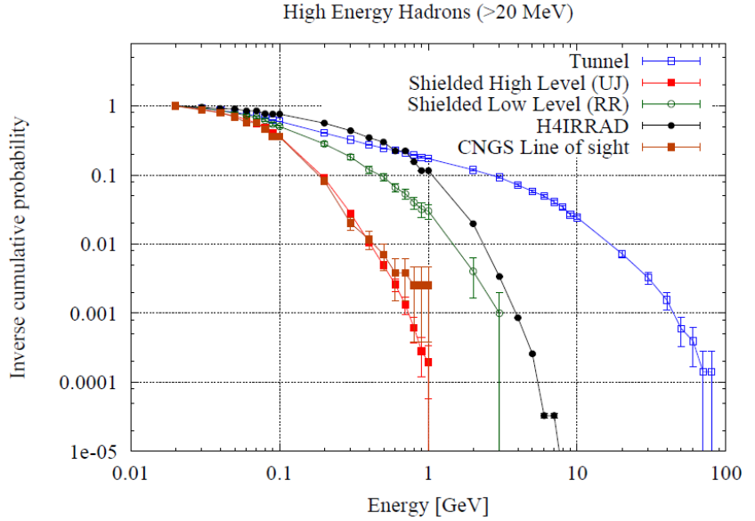
Motivation
  Devices already tested at PSI
    p+ beam, 230 MeV, Dose rate 250-300 Gy/h
  Test in a mixed field (LHC-like environment) at low dose rate to compare the results
  Verify destructive events in this environment
K. Roeed (2011)

Slide 5
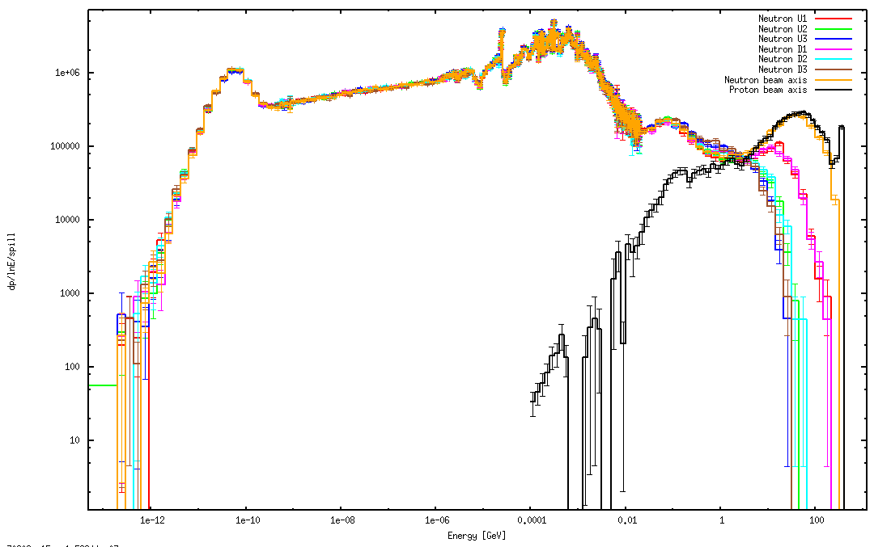
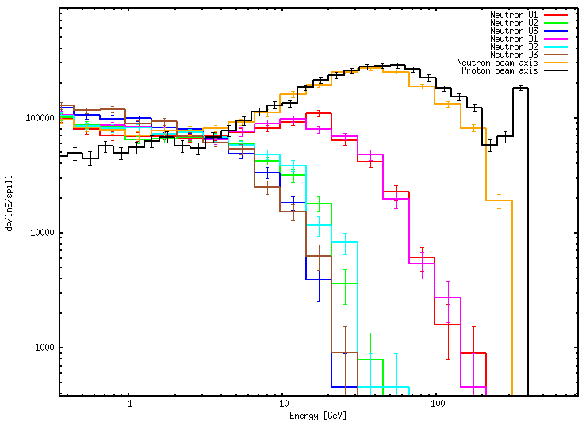
H4IRRAD – Beam conditions
  H4IRRAD Internal location
  Mixed field and high energy hadrons
±5 cm
±10 cm
@ M. Calviani

Slide 6
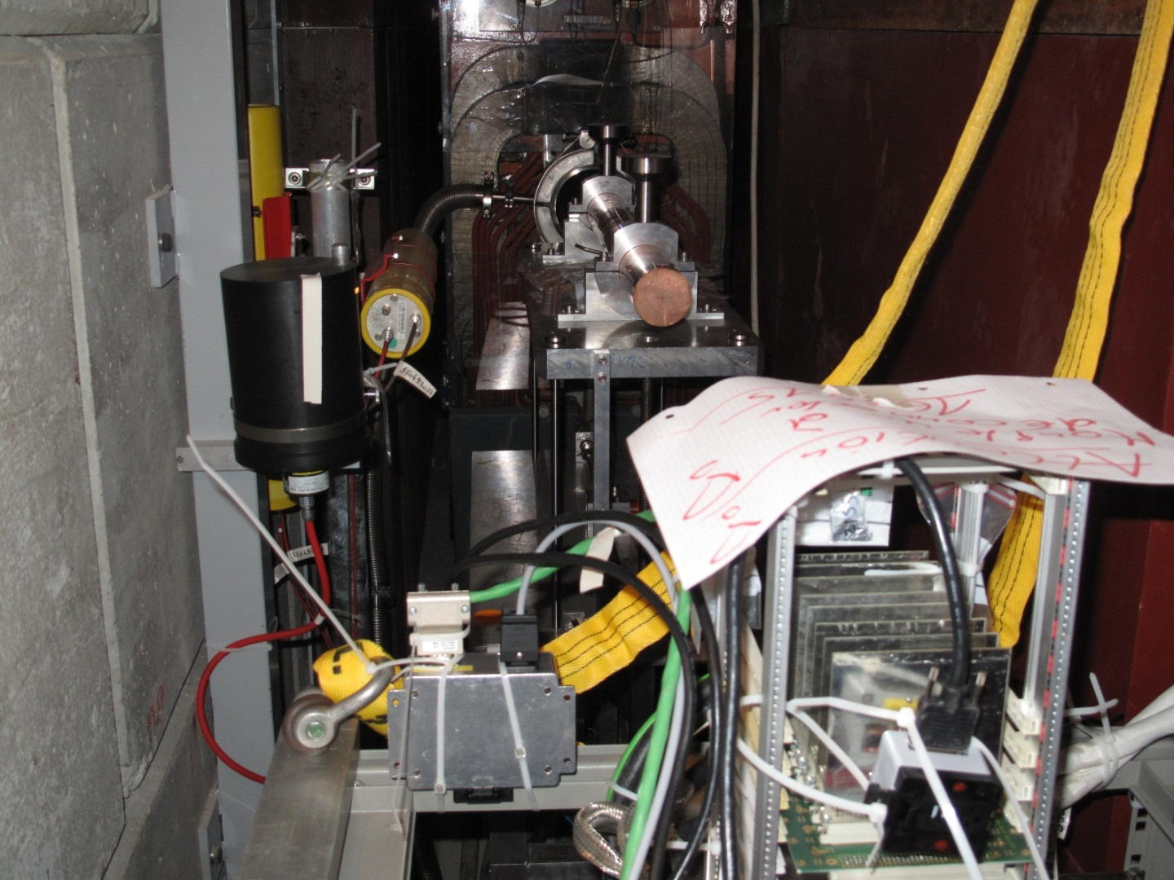
H4IRRAD – Beam conditions
  H4IRRAD Internal location
BLMs
target
PMI
Top of internal rack with component test
Deported radmon

Slide 7
H4IRRAD – Beam conditions
  H4IRRAD Internal location
    1.2e9 pot per cycle
    Cycle ~ 45 s
    Bunch length 5 s
    TID/Pot ~ 3e-12 [Gy/pot]
    TID per cycle ~ 3.6 mGy
    TID during extraction (5s)=2.6Gy/h
    Average Dose rate (3.6 mGy over 45 sec) = 0.3 Gy/h
    Recommended dose rate to evaluate ELDR

Slide 8
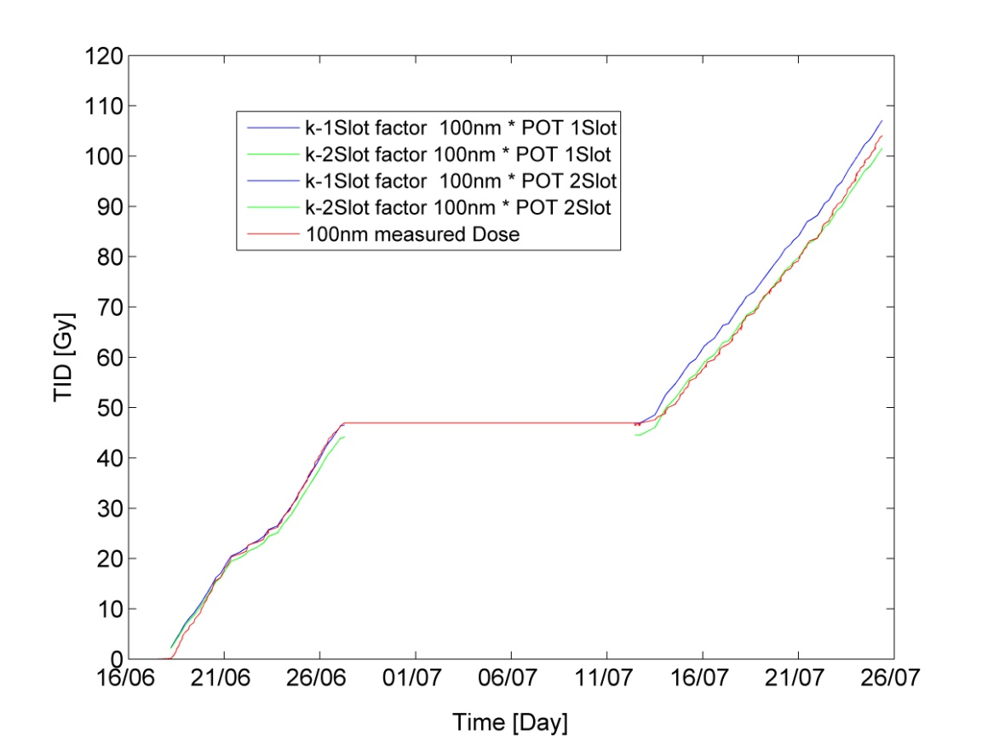
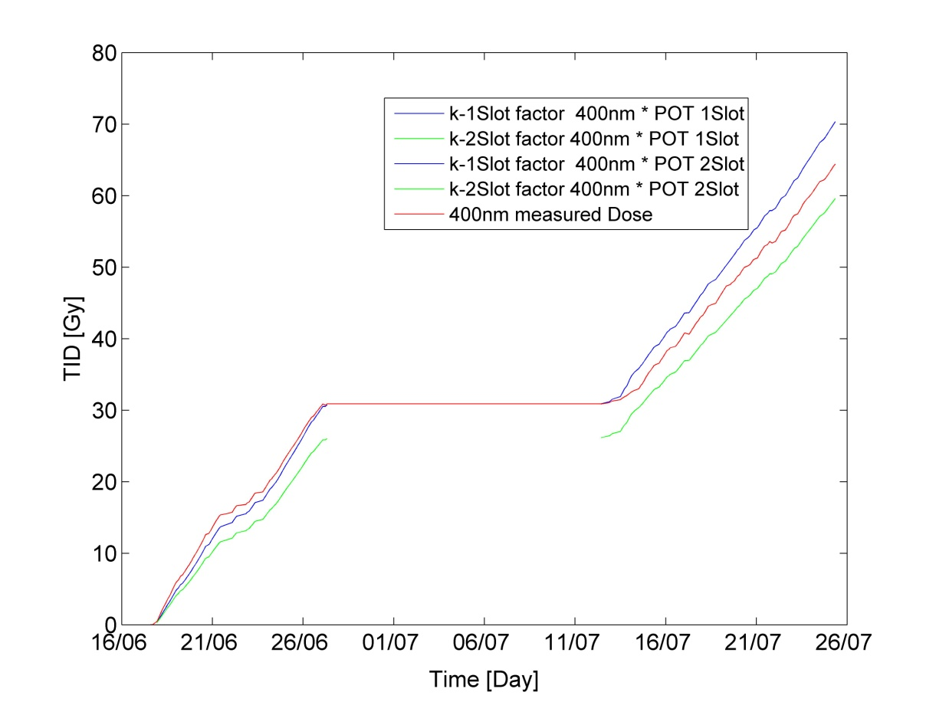
H4IRRAD – Dosimetry for TID
  FLUKA calculation (TID in air)
    High gradient on the target line
  Radfets on the RADMON (2 oxide Thickness)
400 nm
100 nm

Slide 9
H4IRRAD – Dosimetry for TID
  FLUKA calculation (TID in air)
    High gradient on the target line
    Score position to be reviewed
  Radfets on the RADMON (2 oxide Thickness)
 | FLUKA [Gy Air ]±50% | 400nm | 100nm | TID ±50%
19/06-27/06 | 70 | 30 | 46
19/06-25/07 | 160 | 70 | 100 | 100±50
19/06-21/07 | 130 | 60 | 85 | 85±40
Acquisition not running after 21st July.
Uncertainty could improve if
400nm (low) response is understood; it seems to be systematic
Target score is improved and TID in SI is considered (20% difference)
→In this condition:100nm and FLUKA calculation are in agreement within 20 %

Slide 10
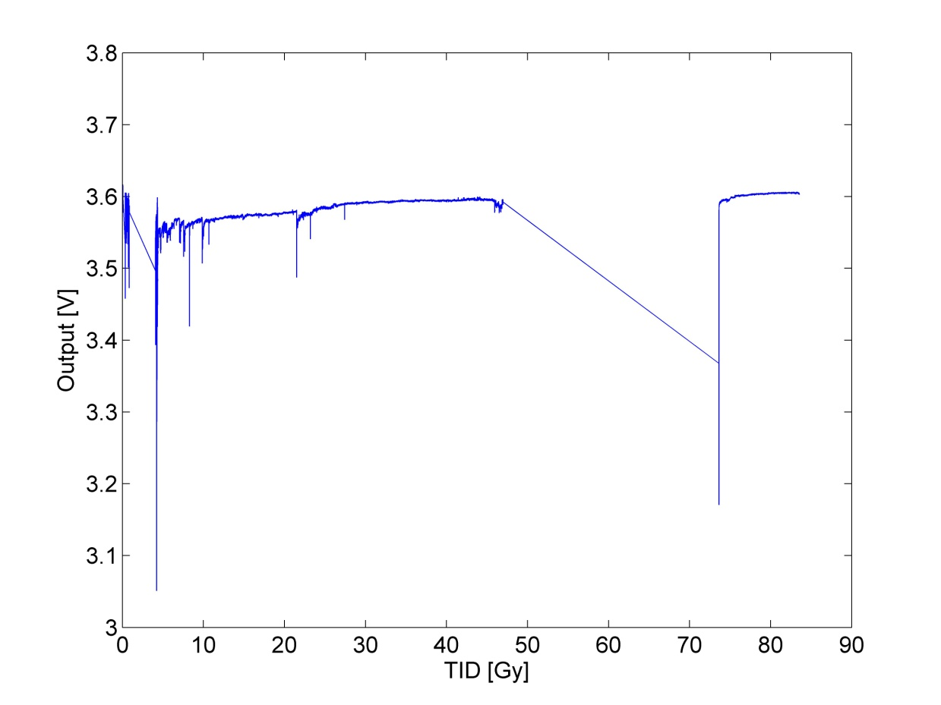
Results
  Same acquisition system as PSI but
    Some signals were noisy.
    Power Supply interruption due to spikes on the current consumption (not related to radiation)
spikes
TL431 (typical signal)
Power up

Slide 11
Results
DUT | Type-Technology | PSI, p+, >250Gy/h * | H4IRRAD 0.3 Gy/h * | Comment
MAX410 | OpAmp-Bip | 100 Gy-ok | 85-ok
OPA2227 | OpAmp | 200 Gy -ok | 85-ok
TL072 | OpAmp | 200 Gy-ok | -
TL431 | Voltage Ref | 200 Gy-ok | 85 – ok
TL432 | Voltage Ref | 200 Gy-ok | 85 - ok
LM4041 | Voltage Ref | 200 Gy-Ok | 85 – ok
INA141 | DiffAmp | 130Gy-Out of spec | 85 - ok | Limit of spec
MAX6341 | Voltage Ref (ADC) | 25 Gy-Out of spec | 25 Gy-Out of spec. | 3 mV drift over 100 Gy
* Max TID without failure or TID at which measurements are out of spec

Slide 12
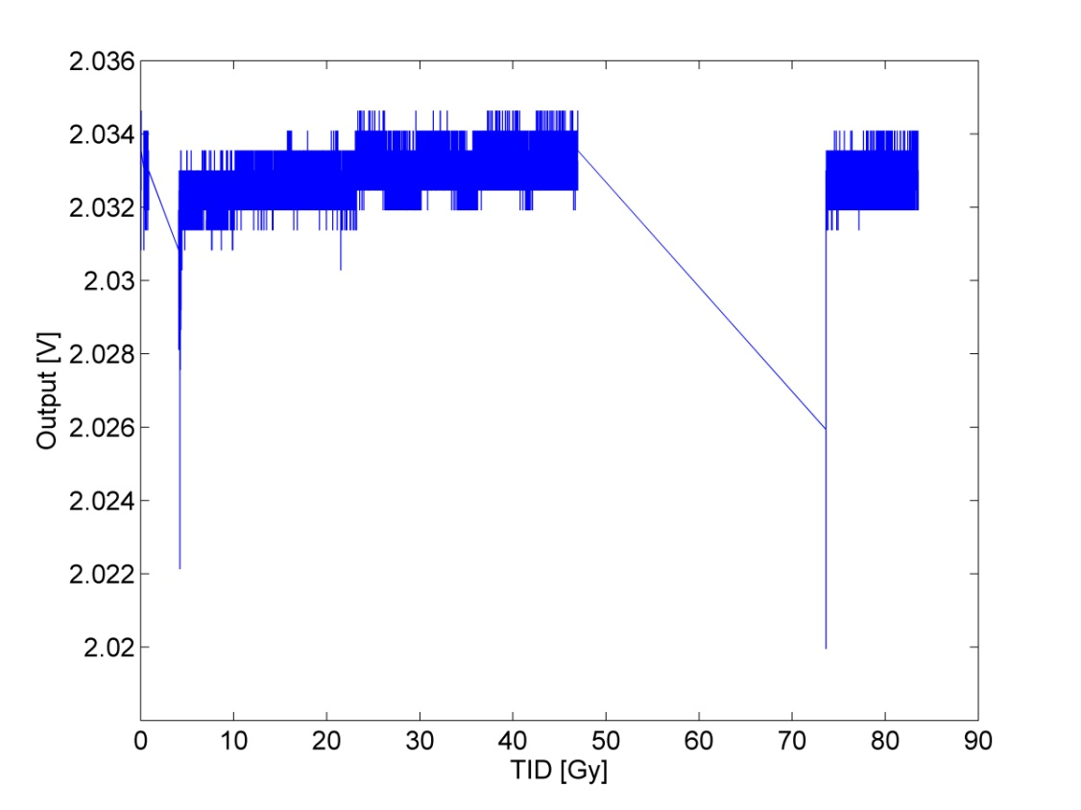
Results – Max410
  PSI
    250 Gy/h
    230 MeV p+
    100 Gy (2 runs of 50 Gy)
  H4IRRAD
    3 Gy/h(per extraction)
    0.3Gy/h (average)
  Within specification

Slide 13
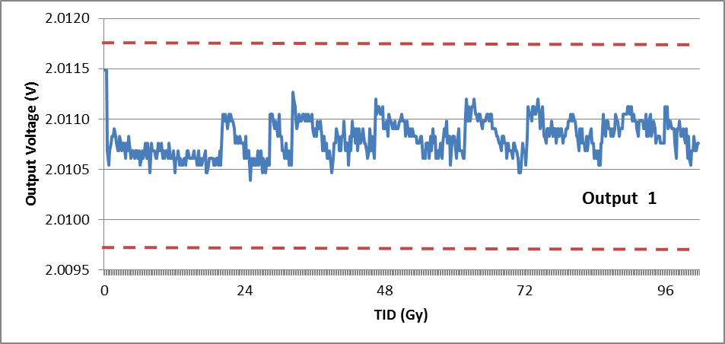
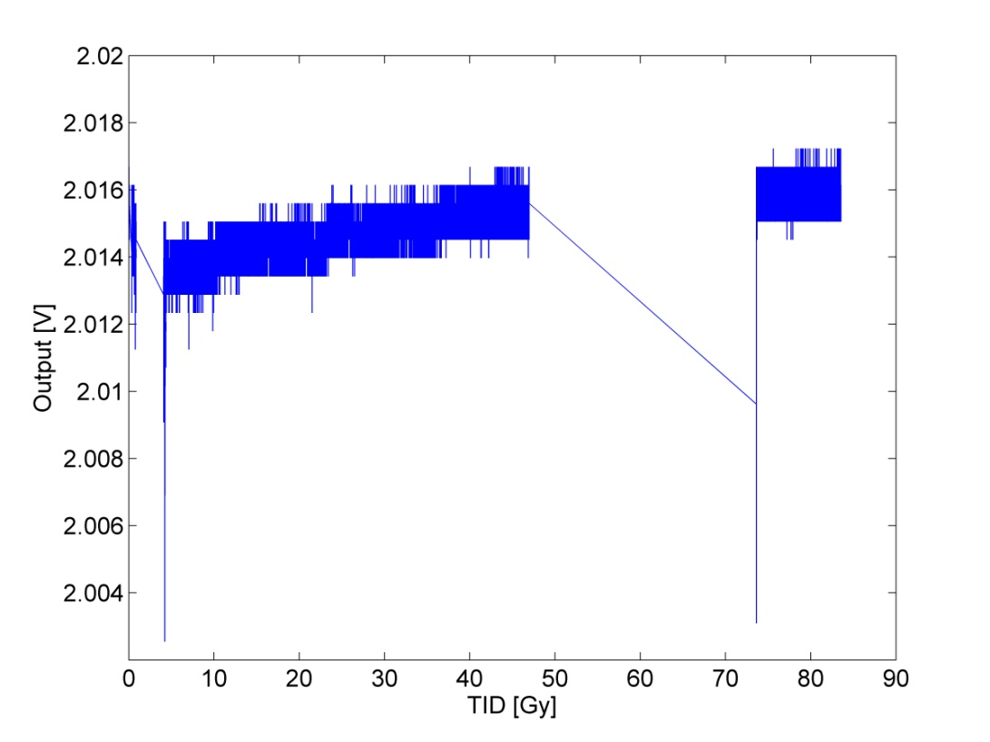
Results – OPA2227
  PSI
    290 Gy/h
    230 MeV p+
    200 Gy (2 runs of 100 Gy)
  H4IRRAD
    3 Gy/h(per extraction)
    0.3Gy/h (average)
  Within specification

Slide 14
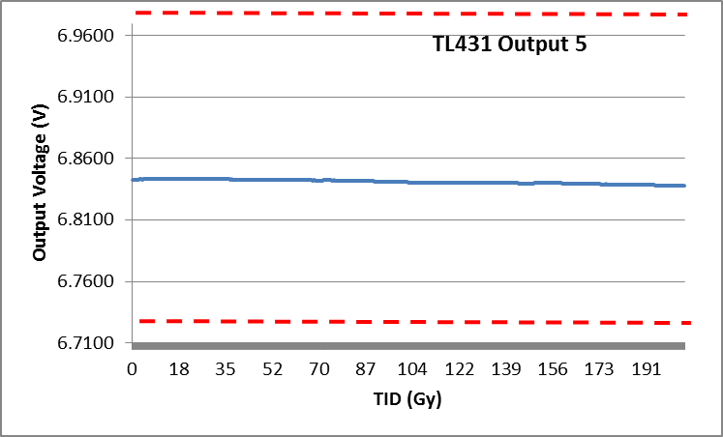
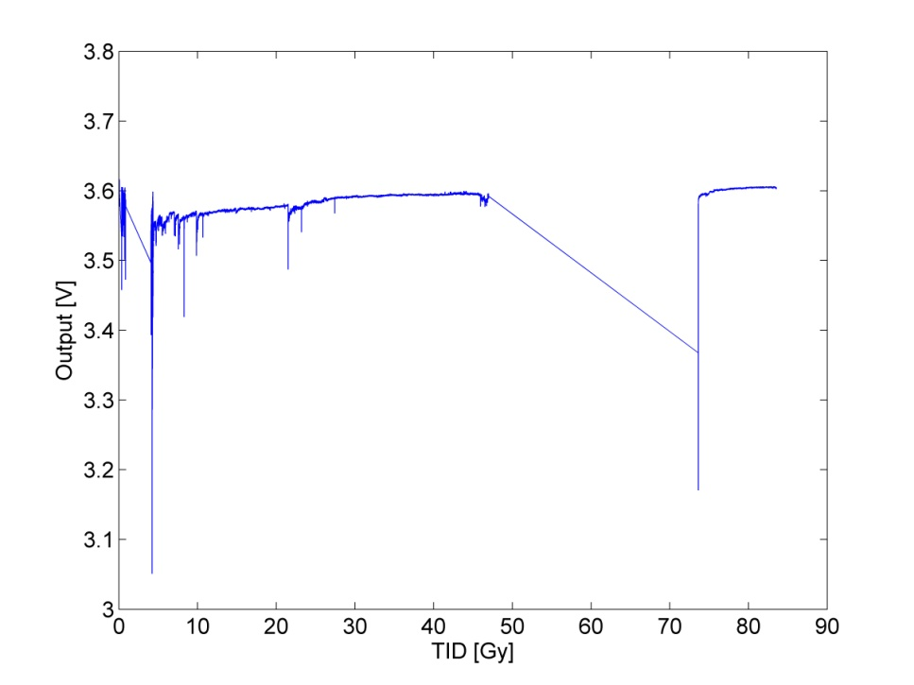
Results – TL431
  PSI
    290 Gy/h
    230 MeV p+
  H4IRRAD
    3 Gy/h(per extraction)
    0.3Gy/h (average)
  Within specification

Slide 15
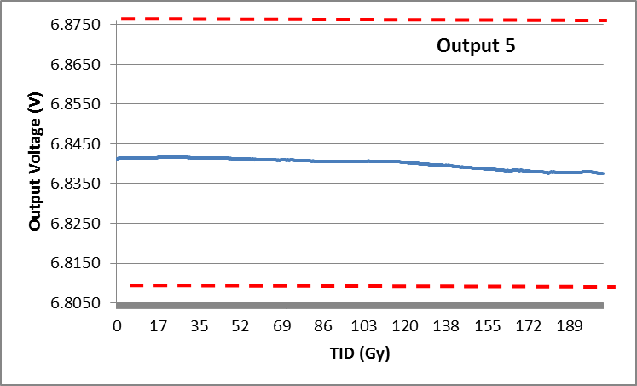
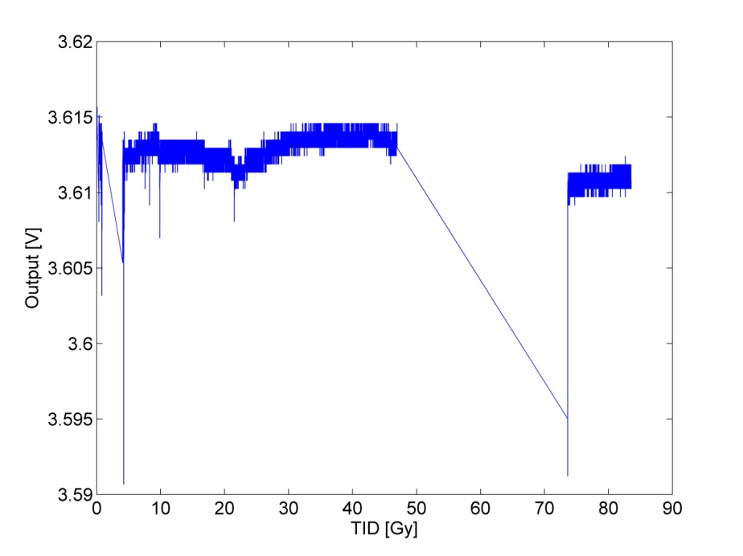
Results – TL432
  PSI
    290 Gy/h
    230 MeV p+
  H4IRRAD
    3 Gy/h(per extraction)
    0.3Gy/h (average)
  Within specification

Slide 16
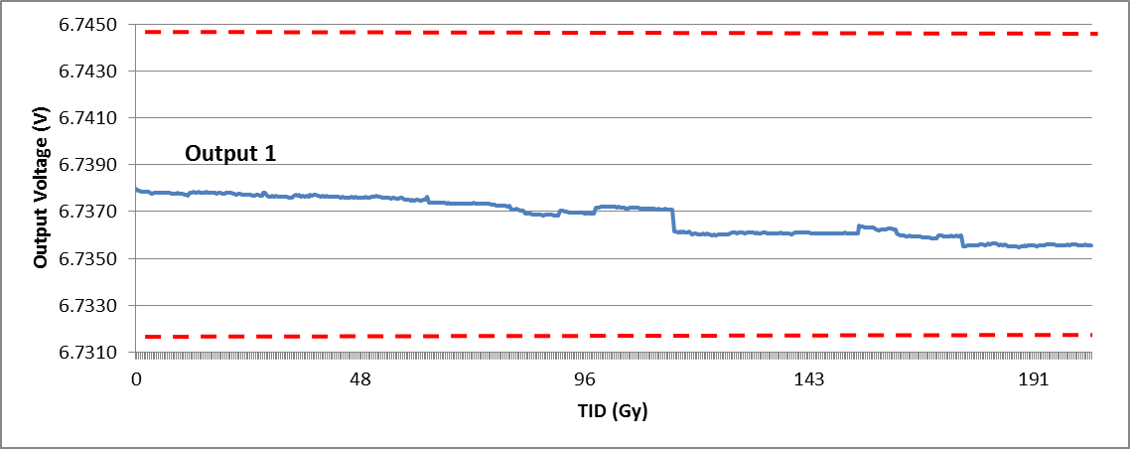
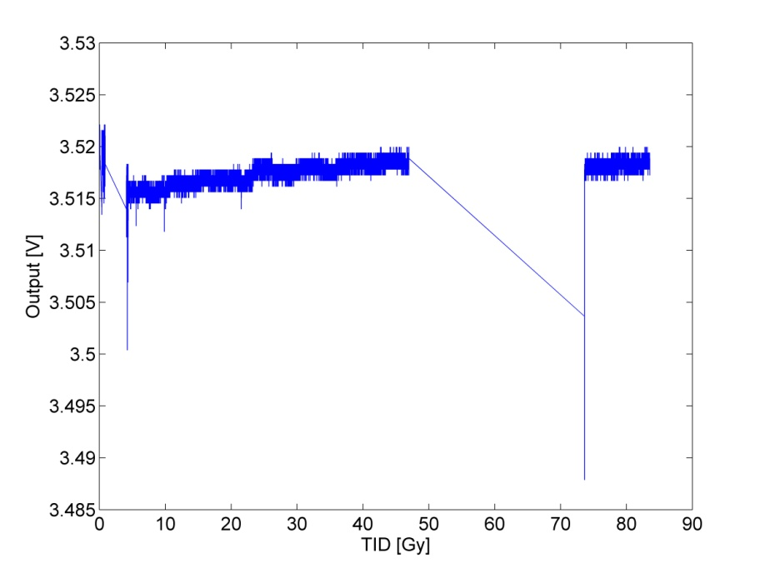
Results – LM4041
  PSI
    290 Gy/h
    230 MeV p+
  H4IRRAD
    3 Gy/h(per extraction)
    0.3Gy/h (average)
  Within specification

Slide 17
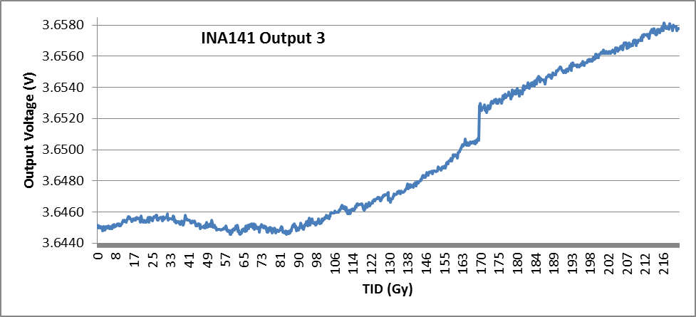
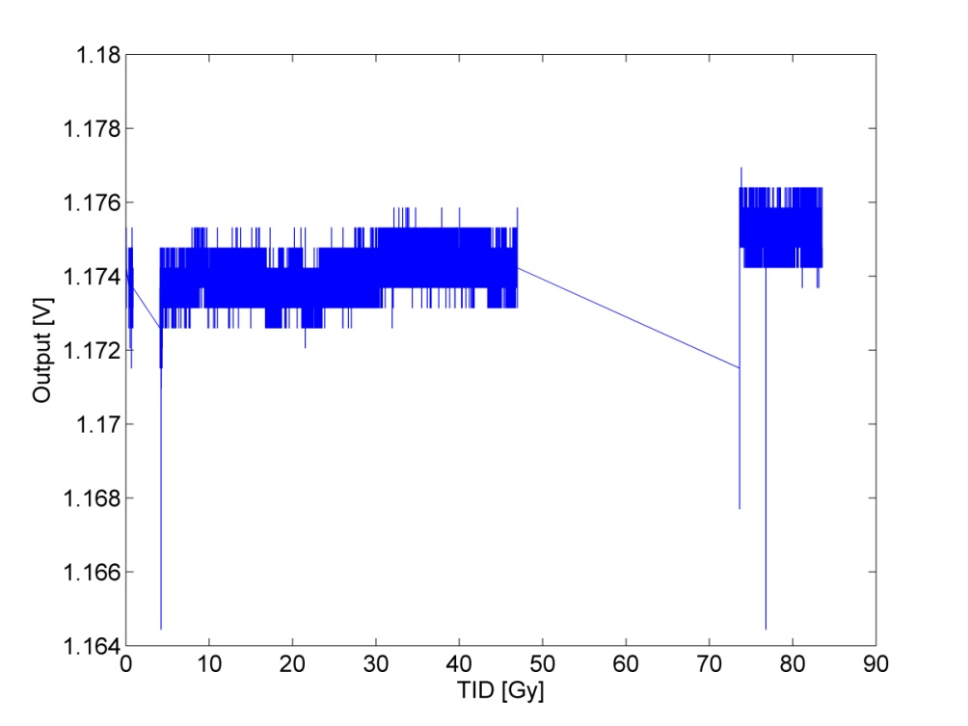
Results – INA141
  PSI
    290 Gy/h
    230 MeV p+
    130 Gy out of specification
  H4IRRAD
    3 Gy/h(per extraction)
    0.3Gy/h (average)
  1 case within specification; 2 cases at the boarder of spec.

Slide 18
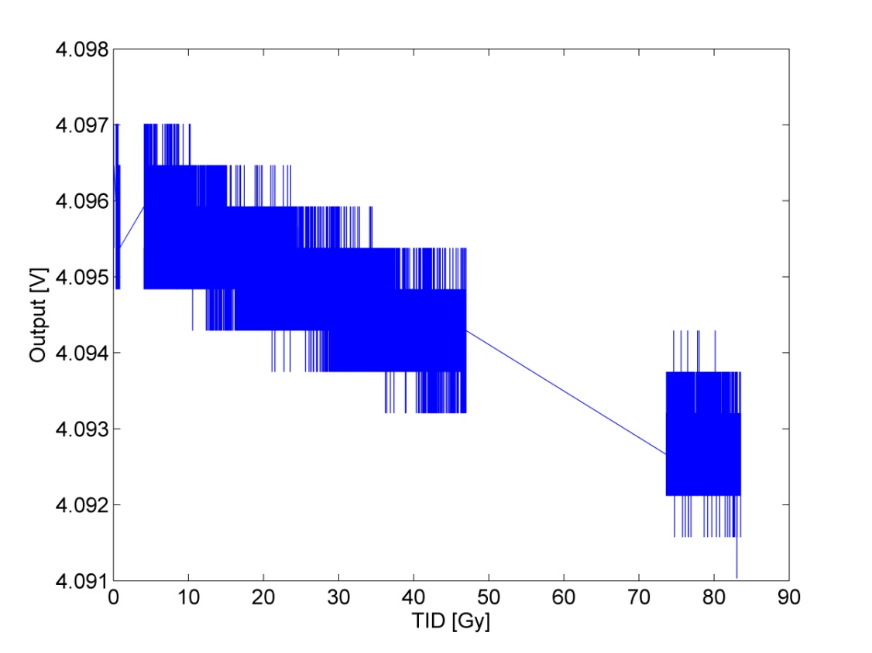
Results – Max6341
  PSI
    250 Gy/h
    230 MeV p+
  H4IRRAD
    3 Gy/h(per extraction)
    0.3Gy/h (average)
  0.02% Accuracy
  3mV drift in both cases

Slide 19
Results
DUT | Type-Technology | PSI, p+, >250Gy/h * | H4IRRAD 0.3 Gy/h * | Comment
MAX410 | OpAmp-Bip | 100 Gy-ok | 85-ok
OPA2227 | OpAmp | 200 Gy -ok | 85-ok
TL072 | OpAmp | 200 Gy-ok | -
TL431 | Voltage Ref | 200 Gy-ok | 85 – ok
TL432 | Voltage Ref | 200 Gy-ok | 85 - ok
LM4041 | Voltage Ref | 200 Gy-Ok | 85 – ok
INA141 | DiffAmp | 130Gy-Out of spec | 85 - ok | Limit of spec
MAX6341 | Voltage Ref (ADC) | 25 Gy-Out of spec | 25 Gy-Out of spec. | 3 mV drift over 100 Gy
* Max TID without failure or TID at which measurements are out of spec

Slide 20
Conclusions
  No destructive events were observed
  Comparison PSI-H4IRRAD has to take into account the uncertainty on the TID
  H4IRRAD test (low dose rate and mixed field) tends to confirm the PSI results (high dose rate)
    No significant increase of DUT degradation up to 80 Gy for most of the devices
    MAX6341 and INA141 are out of spec at 25 and 85 Gy respectively

Slide 21
How to explain
  Dosimetry is wrong? No ...
    >50 Gy (more conservative case)
    Good agreement 100nm Radfet and FLUKA
  Device technology
    ELDR has little effect on CMOS technology and affects more Bipolar components
    But few (no) information on technology
  H4IRRAD spectrum
    Spectrum in the target line is dominated by high energy hadrons (Needed to verify destructive events)
    Dose enhancement effect seems to appear mainly in case of Co60 irradiation
    Microelectronics may degrade less in a Hadron environment with respect to pure gamma irradiation
    Open point: depending on the technology, the Hadron energy (literature focused on proton), and the percentage composition of our spectrum

